Slide 1
On Monolithic and Microservice deployment of Network Functions
2020/06/02
陳靖
joesph60261@gmail.com
2019 IEEE Conference on Network Softwarization
Impact factor:none

Slide 2
Outline
Author
Abstract
Introduction
Performance of Network Functions
Experiment Setup
Results
Related Work
Conclusions
References

Slide 3
Author
Sachin Sharma , National College of Ireland
Navdeep Uniyal , University of Bristol, U.K.
Besmir Tola , University of Bristol, U.K.
Yuming Jiang, NTNU, Norway

Slide 4
ABSTRACT

Slide 5
Abstract
Network Function Virtualization (NFV) has recently attracted telecom operators to migrate network functionalities from expensive bespoke hardware systems to virtualized IT infrastructures where they are deployed as software components.
Scalability, up-gradation, fault tolerance and simplified testing are important challenges in the field of NFV.
Notes:
NFV技術吸引了電信營運商把network function從昂貴 訂製的硬體設備轉移到虛擬化的IT設備,以軟體方式佈署
Scalability(擴展性), up-gradation(升級), fault tolerance(容錯)以及 simplified testing (簡單測試)對於NFV來說都是重要的議題

Slide 6
Abstract
In order to overcome these challenges, there is significant interest from research communities to scale or decompose network functions using the monolithic and microservice approach.
In this paper, we compare the performance of both approaches using an analytic model and implementing test-bed experiments.
Notes:
為了克服以上挑戰,學術界研究scale或是decompose network functions以monolithic 和 microservice 方式
這篇論文作者以分析模型和實驗比較兩種方法的性能

Slide 7
Abstract
In addition, we calculate the number of instances of monoliths or microservices in which a network function could be scaled or decomposed in order to get the maximum or required performance.Single and multiple CPU core scenarios are considered.
Experimentation is performed by using an open source network function, SNORT and running monoliths and microservices of SNORT as Docker containers on bare metal machines.
Notes:
作者還計算scale或decompse後的monoliths 或 microservices instances的數量以求得最佳或所需的效能,作者也考慮single或multiple cpu的情況
實驗透過開源的network function—SNORT(一套開放原始碼的網路入侵預防軟體與網路入侵檢測軟體)當作network function,以monoliths 和 microservices 形式執行,跑在docker容器, bare metal 機器上
,

Slide 8
Abstract
The experimental results compare the performance of monolith and microservice approaches and are used to estimate the validity of the analytic model.
The results also show the effectiveness of our approach in finding the number of instances (monoliths or microservices) required to maximize performance.
Notes:
實驗結果比較monolith and microservice兩種方法的效能,並且使用分析模型來驗證。
結果顯示作者的方法找到instances的數量來達到最大化效能是有用的

Slide 9
INTRODUCTION

Slide 10
Introduction
In recent years, monolithic and microservice approaches for deploying applications have been successfully implemented in the field of cloud computing [1].
In the case of the monolithic approach, an application is deployed as a single software package that offers tens or hundreds of services.
[1] J. Thnes, “Microservices,” IEEE Software, vol. 32(1), pp. 116-116, 2015
Notes:
reference[1]中提到,以monolithic and microservice 佈署應用程式是非常成功的在雲端計算領域中
以monolithic方法為例,應用程式佈署方式是以單一軟體package形式來提供數以百計的services

Slide 11
Introduction
However, in the microservice approach, an application is decomposed into a set of independently deployed smaller sucomponents (i.e., microservices) in which each sub-component does a small and simple task, and communicates through well-defined, light weight mechanisms.
Notes:
在microservice方法中,應用程式分解成一群相互獨立,可佈署的小sucomponent(也就是microservices),每個subcomponent執行負擔輕 簡單的工作,以定義好的輕量化機制來互相通信

Slide 12
microservice approach advantages
Many cloud computing companies, such as Netflix and Amazon, have been deploying their applications using the microservice approach. For these companies, the microservice approach offers following main advantages [2]:
Scalability :The various components of an application have diverse performance footprints. Thus, some components might be more resource intense than others. In comparison to the monolithic approach, the microservice approach provides an efficient way of scaling up only resource intense components.
Notes:
許多雲端技術公司像是網飛 亞馬遜,已經使用microservice方式佈署應用程式,對於這些公司來說, microservice方式擁有幾項優點
第一:Scalability
一個應用程式中的不同components有不同的資源使用情況,因此,有些components相比其他components需要更多資源
對於資源需求較多的components來說,相比monolithic方法, microservice方法提供一種有效的scaling up

Slide 13
microservice approach advantages
2. Up-gradation: Since small applications can be upgraded independently in short time, upgrading microservices is a lot easier and less disruptive (e.g., in terms of downtime) than upgrading an entire monolithic application.
Notes:
2.升級:因為小型應用程式在短時間內可以各自升級,因此升級microservices相比monolithic application而言,更簡單 更少的修復成本(下線時間)

Slide 14
microservice approach advantages
3. Simplified development :
The microservice approach fosters software re-usability in building different applications. It is easier to re-use smaller code fragments (i.e., microservices) than a large code base (e.g., monoliths).
They can even be written in different programming languages. Evidently this simplifies the software development process, especially for the big code-development teams.
Notes:
3.簡易的佈署:
Microservice方法中,建構不同的應用程式可以重複使用不同軟體。也就是可以簡單得重複使用較少的程式碼(microservices)來寫程式,相比較多的程式碼 (monoliths)
軟體可用不同得程式語言撰寫
以上簡化了軟體的佈署過程,尤其是對於大型軟體開發團隊來說

Slide 15
microservice approach advantages
4. Simplified testing: Since the feature set of a microservice is much less compared to a monolithic application, it is easier to test and debug service components. Testing the overall service, however, might be more complex though.
Notes:
4. 簡化了測試:因為microservice的功能比monolithic較少,這使得測試和偵錯service components更簡單。
但是測試整個service可能會比較複雜

Slide 16
microservice approach advantages
5.Fault tolerance: When a critical failure (e.g., a segmentation fault) happens in a monolithic application, the whole application goes down.
In case of microservices, however, only a small subset may be affected if a failure happens to a single or a subset of microservices.
Notes:
5.容錯能力:
當monolithic application發生重大的錯誤(像是segmentation fault),整個application無法運作
而microservices中,只有一小部分的功能錯誤,只影響一部份的microservices

Slide 17
microservice approach overheads
In addition to aforementioned advantages, a microservice approach might introduce the following overheads compared to the monolithic approach:
Notes:
除了上述的優點, microservice方法相比monolithic方法,也有一些負擔,接下來一一介紹

Slide 18
microservice approach overheads
Decomposition overhead: The microservice approach requires an application to be decomposed. Today, this is usually considered more complex and introduces additional efforts as compared to the monolithic approach.
In the monolithic approach, these additional overheads are not there, as an application is not required to be decomposed
Notes:
Decomposition overhead(分解開銷)
micorservice方法需要分解應用程式,相比monolithic方法, micorservice方法較複雜且需要額外的開銷成本。
monolithic方法中這些額外的開銷不存在,因為應用程式不用分解

Slide 19
microservice approach overheads
2. Orchestration overhead: Orchestrating (i.e., coordinating, deploying, configuring, and managing) a set of microservices that constitute the overall service, may result in a larger overhead compared to orchestrating a single monolithic application as the number of managed entities is increased.
Notes:
2. Orchestration overhead(協調工作的開銷):
Orchestrating(包括協調,佈署,配置和管理)一群microservices,構成完整的service,管理的元件數量增加時,microservices方法需要較多的開銷相比orchestrating單一monolithic application

Slide 20
microservice approach overheads
3.Communication overhead: Since microservices are loosely coupled and possibly distributed over a large set of physical or virtual hosts, they need to communicate over well defined APIs and protocols. Evidently, this increases communication costs.
Notes:
3. Communication overhead(通訊開銷):
因為microservices耦合性低且分布在大型的實體或虛擬主機上,這需要定義好的API或是協定來進行通訊
很明顯的這會增加Communication overhead

Slide 21
microservice approach overheads
4. Integration testing overhead: Since the communication patterns and protocols are more complex (e.g. due to asynchronous communication), integration tests might become cumbersome. This introduces a significant testing overhead and calls for a strict automated testing
Notes:
4. Integration testing overhead(整合測試開銷):
複雜的通訊模式和協定(像是非同步通訊),整合測試較為繁瑣
這帶來大量的測試成本和需要較嚴苛的自動化測試

Slide 22
Introduction
Today, microservices are mostly considered in the context of traditional software systems, such as web and cloud applications. Recently, however, this approach has also raised significant attention in the field of Network Function Virtualization (NFV) [3].
[3] Steven Van Rossem et. al., “NFV Service Dynamicity with a DevOps
approach: Insights from a Use-case Realization”, IFIP/IEEE International Symposium on Integrated Network Management (IM), pp. 674-
679, 2017
Notes:
microservices常被應用在傳統的軟體開發上,像是網頁或是雲端應用程式
最近NFV領域中,也開始引入microservices的概念

Slide 23
Introduction
In NFV, network functions, such as load balancer, intrusion detection, and network address translation, which usually run on specialized, proprietary hardware, are implemented as software components on top of custom-off-the-shelf cloud infrastructure [4].
Notes:
一些network functions像是load blancer ,intrusion detectioin和NAT經常運行在特殊的硬體,透過NFV技術把上述的network function實作成軟體,運行在現有的雲端設備上

Slide 24
Introduction
In this paper, we define microservice as a decomposed component of a network function and define monothith as a virtual network function that is run as a single instance. We deploy network functions using the monolithic and microservice approach and compare the performance of both monoliths and microservice version of network functions using a simple analytic model and experimental results.
Notes:
作者定義microservice,把network function分解成各個component
定義monothith,一個虛擬的network function 為一個完整的instance
作者以上述兩種方式佈署network function,並且以簡單的分析模型和實驗結果比較兩種方式的性能

Slide 25
Introduction
An M/M/1 queuing model is considered in order to estimate the performance using an analytic model. Without loss of generality while maintaining low complexity, we make use of an M/M/1 model and verify the suitability of this model through experimental results.
Notes:
為了使用分析模型來分析性能,作者採用一個M/M/1 queuing model.
在不複雜的情況下,作者使用M/M/1 queuing model和透過實驗證明該model適合用來分析

Slide 26
Introduction
We first provide the mathematical formulations for the performance (in form of average delay) of the monolithic and microservice version of network functions.
We then calculate the number of instances of monoliths and microservices required to get maximum performance. We also experimentally calculate the performance using an open source network function, SNORT [5] and running monoliths and microservices as Docker containers on bare metal machines.
Notes:
首先作者用數學公式證明monolithic和microservices的network functions的性能(平均延遲)
然後計算monolithic和microservices所需的instances以求得最大的效能
作者使用開源的network function—SNORT作為實驗的benchmark,以monolithic和microservices兩種方式運行在docker容器 bare metal 機器上

Slide 27
Introduction
The experimental results compare the performance of monolith and microservice approaches and verify the mathematical formulations. In addition, the experimental results verify the value of the number of instances for scaling or decomposition, given by the analytic model, with respect to experimental results.
Notes:
實驗結果比較monolithic和microservices兩種方法的性能也驗證數學公式
除此之外,還驗證分析模型對於scaling 或 decomposition的instances數量與實驗結果呈正相關

Slide 28
Introduction
Section 2:Related Work
Section 3:Experiment Setup
Section 4:Results
Section 5:Related Work
Section 6:Conclusions
Notes:
第二章:network function性能的數學公式
第三章:實驗設置
第四章:實驗結果
第五章:文獻回顧
第六章:結論

Slide 29
PERFORMANCE OF NETWORK FUNCTIONS

Slide 30
Performance of Network Functions
Single CPU n-monoliths scaling
Dedicated CPU n-monoliths scaling
Single CPU n-microservices case
Dedicated CPU n-microservices case
Notes:
四種不同佈署NF的方式
簡單分類:
Single CPU : NF都在某一個CPU上執行
Dedicated CPU : 一個NF只跑在特定CPU(不同NF在不同CPU上執行)

Slide 31
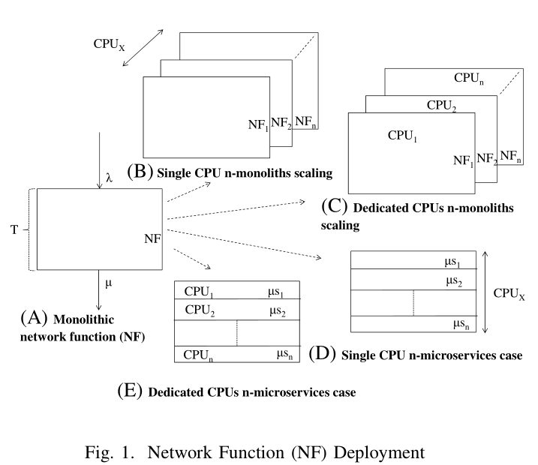
Fig 1

Slide 32
Performance of Network Functions
We use queuing theory to model a network service, where an NF is modeled as a queuing system and its serving capacity is represented by the computational resources, i.e., CPU, used by the NF.
We use an M/M/1 queuing system to model an NF, as we assume that the NF is a single threaded function and run on one server. Our aim is to use a rather simple model but capable of providing us useful performance evaluation so that we find good parameters to take into account when scaling or decomposing a network function.
Notes:
作者用排隊理論來設計network service model,在queuing system中NF使用CPU當作計算資源
作者使用M/M/1 queuing system 當作model,假設NF為single thread的function而且只在一個server 上跑。
作者目標為以簡單但可行的model用來評估性能,為了找到scaling 或 decomposing a network function時最佳的參數

Slide 33
Considered network function
2.A

Slide 34

2.A : Considered Network Functions
λ : Incoming traffic rate
µ : service rate
T : average service time per packet
I : average idle time per packet
t : the service time if there is no idle time
Note that if idle time is greater than 0, the CPU allocated to the NF will not be utilized fully. Hence, CPU utilization will always be less than 100%.
$$\text{µ}=\frac{1}{T}$$
T = t + I
Notes:
作者假設traffic arrives是Poisson process,exponential distribution (指數分布)
Traffic rate 代表單位時間內含有多少個封包
Service rate代表單位時間內NF處裡多少個封包
T包含I

Slide 35

2.A : Considered Network Functions
D :average delay per packet

Slide 36
Network functions deployment
2.B
Notes:
介紹四種NF佈署方式

Slide 37
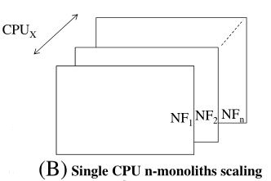
2.B : Network Functions Deployment
Single CPU n-monoliths scaling :
Notes:
圖1B中,NFs擴張成N個不同的NF instances(NF 1 NF2 NF3…),由一個CPU處理所有的instances

Slide 38
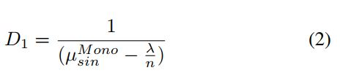
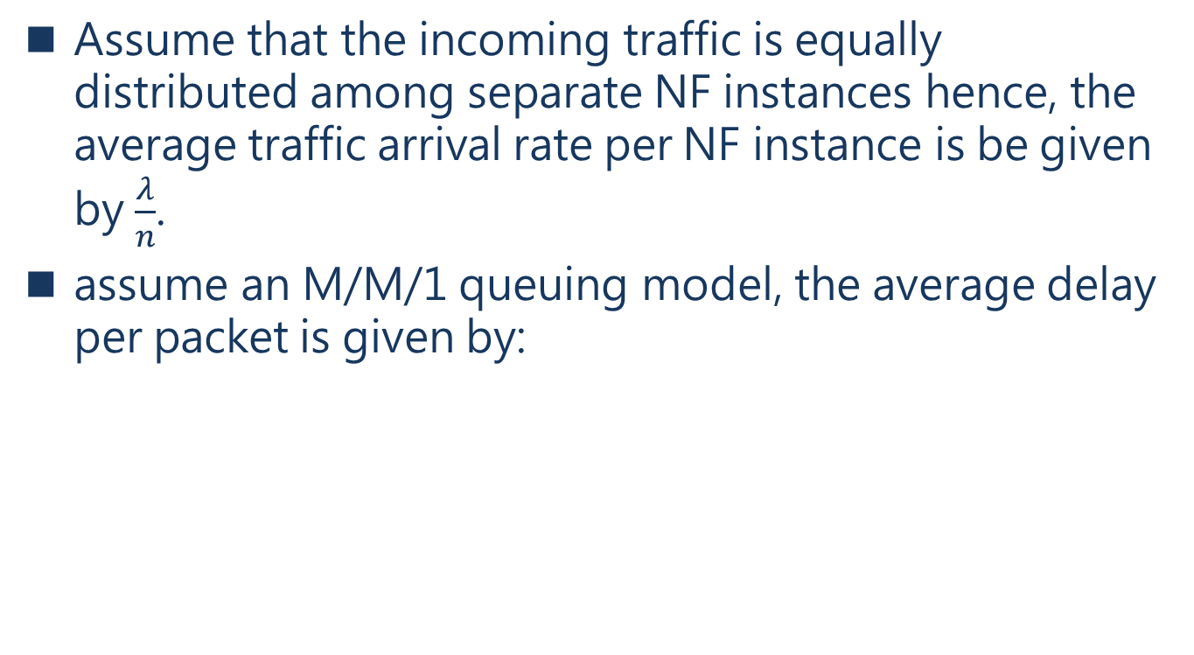
Single CPU n-monoliths scaling
Assume that the incoming traffic is equally distributed among separate NF instances hence, the average traffic arrival rate per NF instance is be given by $\frac{λ}{n}$.
assume an M/M/1 queuing model, the average delay per packet is given by:
Notes:
假設流進的流量可以平均的分配到不同的NF instances,所以每個NF instance的平均arrival rate都是 λ除以N

Slide 39

Single CPU n-monoliths scaling
For the case in which there is no idle time and also no overhead due to this scaled version of monoliths, the average delay of a packet will be equal to the delay D given insubsection II-A.
Notes:
Eq 1 和Eq 2的delay 相同 產生等式,就可求得eq 3

Slide 40
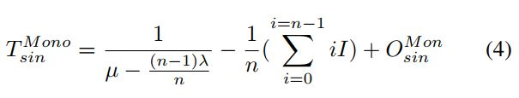
Single CPU n-monoliths scaling
For the case in which there is idle time or also overheads (e.g., due to traffic distribution among NF instances and context switching), the average delay per packet will be different than the delay given in subsection II-A.
For simplicity, we assume that each NF_{i} has an equal average idle time of I per packet. Let O_{sin}^{Mon} denote the average time spent due to traffic distribution among different NF instances and context switching.
Hence, when an NF is idle, another NF can utilize the CPU.
Notes:
假設Nf_{i}有相同的平均idle時間 I 每個封包, O_{sin}^{Mon}代表流量分配到不同NF instance和context switching所花的平均時間

Slide 41
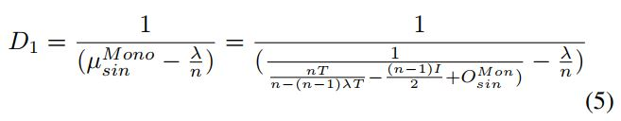
Single CPU n-monoliths scaling
the average service rate (µ^{Mon}_{sin} ) is given by the inverse of the average service time 1/T_{sin}^{Mono}.
Notes:
平均service rate µ^{Mon}_{sin}為平均service time的倒數,因此平均的service delay per packet可以表示成 eq 5

Slide 42
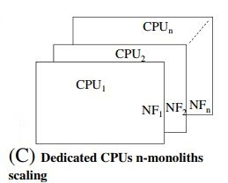
Single CPU n-monoliths scaling
2. Dedicated CPUs n-monoliths scaling :
Notes:
圖1C中,NF擴展成N個不同的NF instances,每個NF分配到一個專用的CPU(CPU1 , CPU2, CPU3 …)上運行

Slide 43

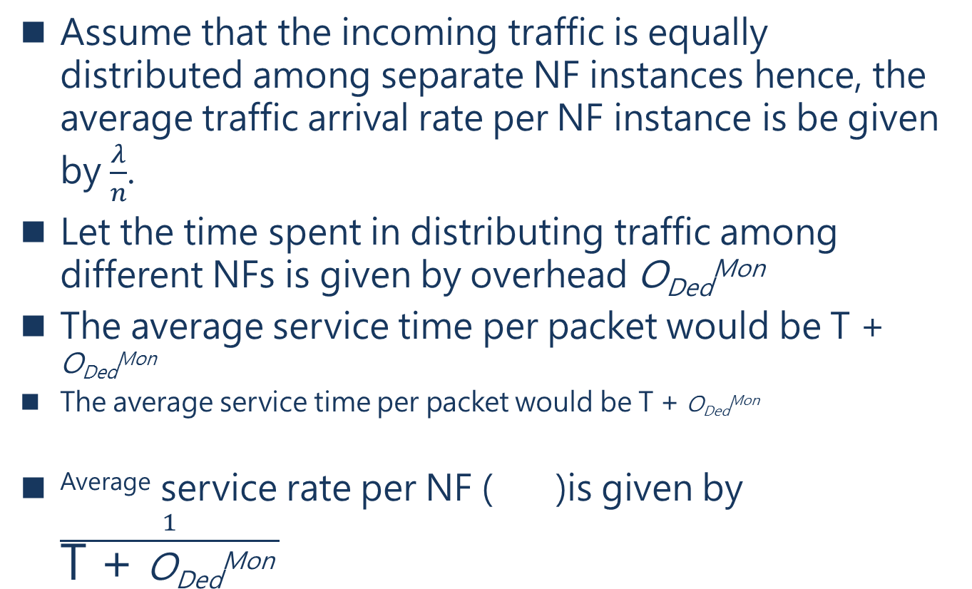
Single CPU n-monoliths scaling
Assume that the incoming traffic is equally distributed among separate NF instances hence, the average traffic arrival rate per NF instance is be given by $\frac{λ}{n}$.
Let the time spent in distributing traffic among different NFs is given by overhead O_{Ded}^{Mon}
The average service time per packet would be T + O_{Ded}^{Mon}
The average service time per packet would be T + O_{Ded}^{Mon}
^{Average} service rate per NF ( )is given by $\frac{1}{\text{T}\text{ + }\text{O}\text{Ded}\text{Mon} }$
Notes:
O ded mon : 分配traffic到不同NF所花的時間

Slide 44
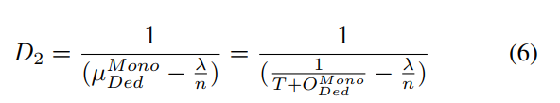
Single CPU n-monoliths scaling
Notes:
Average delay為D2

Slide 45
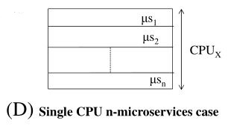
Single CPU n-microservices case
3. Single CPU n-microservices case :
Notes:
NF分解成N個microservices(µs1 µs2 µs3…),而所有N個microservices都由某個CPU處理

Slide 46
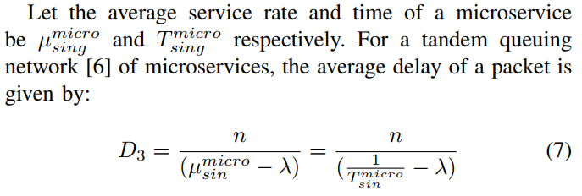
Single CPU n-microservices case
Notes:
假設平均service rate µ 和T分別表示如上
對於一個串聯的queuing network而言,average delay of a packet可表示成eq 7

Slide 47
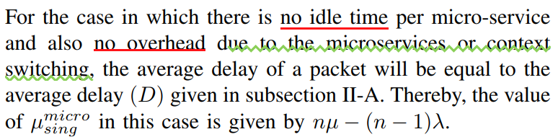
Single CPU n-microservices case
Notes:
在沒有idle time和overhead的情況下,average delay if a packet (eq 7)公式等於eq 1,透過計算後可以得到µ micro sing = nµ - (n - 1)λ

Slide 48
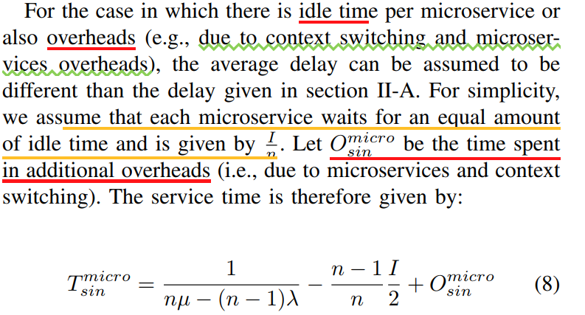
Single CPU n-microservices case
Notes:
若考慮idle time 和overhead的情況下,average service per paclet如eq 8表示

Slide 49
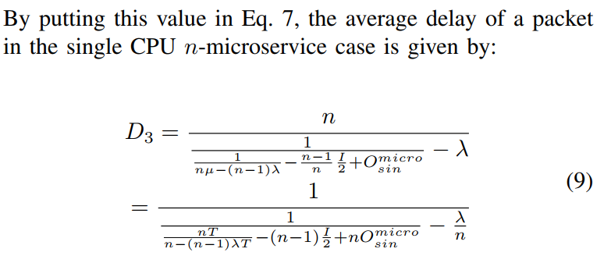
Single CPU n-microservices case
Notes:
把T待入eq 7 就可以得到average delay of a packeet如eq 9表示

Slide 50
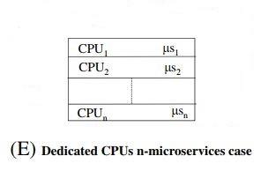
Dedicated CPU n-microservices case
4. Dedicated CPU n-microservices case :
Notes:
圖1E中,一個NF分解成N個microservices(µs1 µs2),每個microservice分配到特定的CPU(CPU1 CPU2 …)

Slide 51
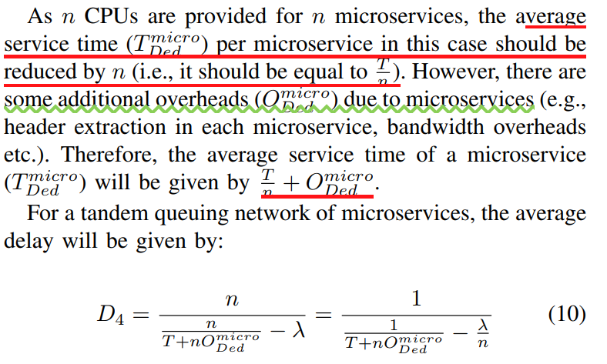
Dedicated CPU n-microservices case
Notes:
每個microservice的Average service time t 應該除以N
需要考慮額外的overhead
Average delay如eq 10所示

Slide 52
Number of instances of monoliths or microservices
2.C
Notes:
介紹四種NF佈署方式

Slide 53
Number of instances of monoliths or microservices
In this subsection, we calculate the value of n for all the above four cases so that we can achieve maximum or required performance (in form of delay).
For the single CPU cases, we can achieve performance gain without increasing the number of resources (i.e., due to idle time we discussed above). In order to achieve the maximum performance in these cases, the average delay given by Eq. 5 and Eq. 9 should be minimum.
Notes:
在這小節中,作者計算上述4種情況的N值,以求得最大化的效能(延遲)
在single cpu情況中,可以在不增加資源數量的情況下提升效能(因為idle time)
為了達到最大化的效能,公式5和公式9的平均延遲可以求到最小值

Slide 54
Number of instances of monoliths or microservices
However, for the dedicated CPU cases, we need to dedicate additional resources in order to gain more performance.
Hence, in these cases, the minimum number of resources could be selected, so that we can achieve the required performance (i.e., there is no need to achieve minimum performance in these cases)
Notes:
對於dedicated CPU情況來說,需要投入額外的資源來增加更多的效能
在這個情況中,需要選一個最小的資源數量已達到所需的效能,意即不需要求最大的效能

Slide 55
Number of instances of monoliths or microservices
In this paper, we use a graph based method to find the minimum or required value of the average delay. In this method, if all the values except n and D; D1; D2; D3; D4 in Eq. 5, Eq. 6, Eq. 9 and Eq. 10 are known, the graph is plotted where y axis is represented by the average delay and x-axis is represented by the number of instances of monoliths or microservices (n).
The value of x is chosen from the graph
that represents the minimum or required value of the average delay. This value gives the number of instances in which a network function should be scaled or decomposed in order to achieve minimum or required performance.
Notes:
這篇論文中,作者以圖表展示求到的最小化或所需的平均延遲
在公式5 6 9 10中,除了n和delay (D1~D4)
圖表的Y軸表示平均延遲
圖表的X軸表示monoliths or microservices 的instances 數量
圖表選出的X值代表最少或所需的平均延遲的值,也代表在instances數量為N時,NF應該scale或是decomposed以達到最小或所需的效能

Slide 56
EXPERIMENT SETUP
3
Notes:
介紹四種NF佈署方式

Slide 57
Experiment Setup
In an NFV architecture, when deploying VNFs through a microservice approach, the VNFs can typically be function based or rule based. It would be easier to decompose a large and complex (in terms of functionality) VNFs (e.g., Virtual EPC and IMS) based on functions.
However, if a VNF (e.g.,forwarder) is small in terms of functionality, it would much easier to decompose such VNFs into rule based. There are several VNFs which are rule based such as forwarder, routers or IDS, and the rule based creation of microservices is a perfect example of simplicity and easy way to decompose network functions using a black box approach.
Notes:
NFV架構中用microservice方式佈署VNF,可以分成function based 或是rule based兩類
這樣一來可以分解功能較多且複雜的VNF(像是virtual EPC或是IMS)依function based方式
但是如果一個VNF(像是forwarder)的功能較少,依rule based分解VNF比較容易
多種VNF屬於rule based ,例如forwarder,router或IDS
基於rule based創立的microservices是最簡單且完美的方法,利用black box方法去分解NF

Slide 58
Experiment Setup
In this paper, we perform the experimentation based on rule based decomposition.
We used the Intrusion Detection System - SNORT – as a network function [5] and deployed it in four ways discussed
in section II.
Notes:
本篇論文用rule based分解NF
以一種開源入侵檢測系統 SNORT作為NF,佈署成四種方式來實驗

Slide 59
Experiment Setup
SNORT contains the number of rules combining signature,protocol and anomaly inspection methods to detect a malicious activity.
We have added 200 such rules in a single SNORT NF, which is deployed on a single Docker container.
Packets are forwarded according to the Poisson distribution.
Each packet has 1000 bytes size and is matched against each rule in the SNORT and if a malicious activity is present, it is written in an alert file.
Notes:
Snort是一套開放原始碼的網路入侵預防軟體與網路入侵檢測軟體。Snort使用了以偵測簽章與通訊協定的偵測方法
一個SNORT NF中還有200種rules,佈署在一個docker 容器中
封包傳遞方式以Poisson distribution分布
每個封包大小為1000bytes,與SNORT中的規則相對應,若有惡意的行為,就會寫在警告檔案裡

Slide 60
Experiment Setup
Therefore, if malicious activities are reported by many rules, SNORT writes many alerts in the file for a single packet, taking long time in input/output operations. Hence, it increases the idle time of the SNORT NF.
We randomly generated traffic producing different malicious activities and calculated the idle time by having 200 such rules in SNORT.
We ran 50 different experiments (with different traffic characteristics) and calculated the average idle time.
The average idle time (I) in our experiments was 0.248 ms.
Notes:
若有發現多個惡意活動(根據rules),SNORT會在檔案中寫入某個封包的多個警告,需要花較長的IO時間,增加了SNORT NF的idle time
作者製造出不同的惡意活動的封包,以200個rules間隔求得SNORT NF的idle time
作者跑了50個不同的實驗(每個都有不同的流量特性),求出平均idle time,為0.248ms

Slide 61
Experiment Setup
In case of the single and dedicated CPU n-monoliths scaling case, n instances of the SNORT NF are deployed on a machine and traffic is equally divided among all the instances using a load balancer.
Here, each instance and load balancer are run on a separate Docker container.
In the single CPU n monolith case, all the n instances and load balancer are dedicated on a single CPU. However, in the dedicated CPU n-monoliths scaling case, each instance is given a dedicated CPU core.
Notes:
每個SNORT NF的instances都分配有load blancer平均的分配流量給每個NF
每個instance和load balancer都運行在docker容器上
在single CPU n monolith case,instances和load balancer都跑在單一個CPU
在dedicated CPU n-monoliths 每個instance跑在各自特定的CPU上

Slide 62
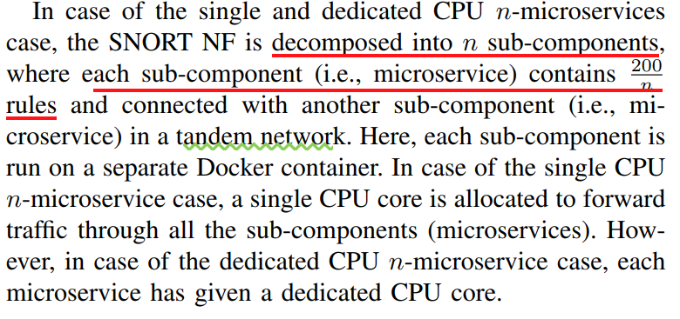
Experiment Setup
Notes:
在single and dedicated CPU n-microservices case 中,NF分成N個sub-components ,每個sub-components 包含 200/n個,彼此間互聯
在single CPU n-microservice case 中,只有一個CPU來forward所有的流量到sub-components
在dedicated CPU n-microservices case 中,每個microservice都跑在某個特定的cpu上

Slide 63
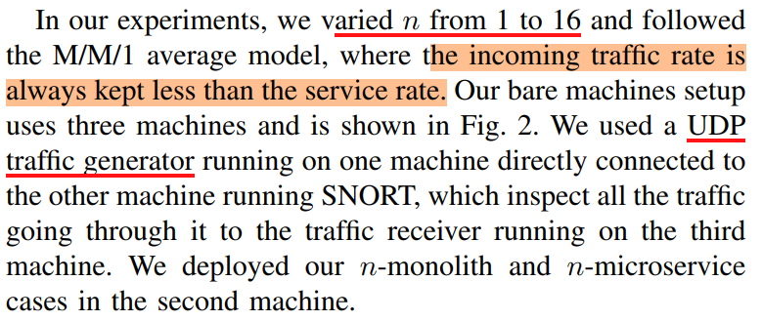
Experiment Setup
Notes:
N設置為1到16
流入的traffic rate永遠比service rate還少
第一台機器(traffic generator)負責產生UDP封包流量,傳到第二台機器,執行SNORT負責檢測封包,最後傳到第三台機器(traffic reciever)

Slide 64
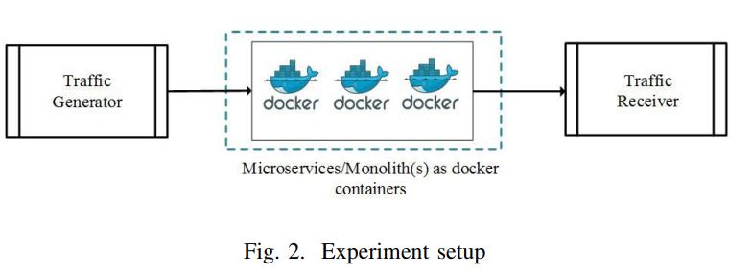
Fig 2

Slide 65
Experiment Setup
Machine specs:
OS:Ubuntu 16.04
CPU:Intel Xeon E5-2640 v4 2.4G 16cores
RAM : 125G

Slide 66
Experiment Setup
For our experiments we have pinned the Docker containers to single or multiple CPU cores as per the case scenarios discussed in Section II.
Each machine in the setup has a direct connection to each other using 10Gbps link.
The traffic rate λ for the experiment is 0.97 per ms, considering no packet loss due to network link congestion.
Notes:
每個docker容器根據 single或是dedicated情況,分配在固定的CPU或是多個CPU上運行
每台機器中間有條10Gbps的網路線連接
實驗的traffic rate為0.97 per ms,不考慮網路阻塞所造成的packet loss

Slide 67
Experiment Setup
This choice of parameters is according to the M/M/1 queuing model with a stable queuing system where the incoming traffic rate (λ) should be less than service rate.
The choice of the arrival rate is to exploit the dedicated processing capacity, yet having a stable queue by not exceeding the allocated service time, given by the processing capacity.
Notes:
參數的挑選是根據穩定的MM1排隊模型,流入的traffic rate(λ) 應該小於service rate
根據model的處理能力,選一個合適的參數,並且在一定的service time處理traffic

Slide 68
results
4
Notes:
介紹四種NF佈署方式

Slide 69
4.A Analytical results
We already know the value of λ and I through our emulation scenario (described in the previous section).
The value of T is calculated from Eq. 1 by putting the value of λ and the average delay observed by running the experiment (mentioned in the previous section) on a single SNORT NF.
So, we now calculate the value of overheads for different values of n. We then calculate the value of the average delay.

Slide 70
Overheads
Overheads in case of the single CPU n-monolithic case are traffic distribution overheads and context switching overheads.
However, overheads in case of the single
CPU n-microservice case are context switching overheads and
microservices overheads (such as header translation at each
microservices, communication overheads etc.).

Slide 71
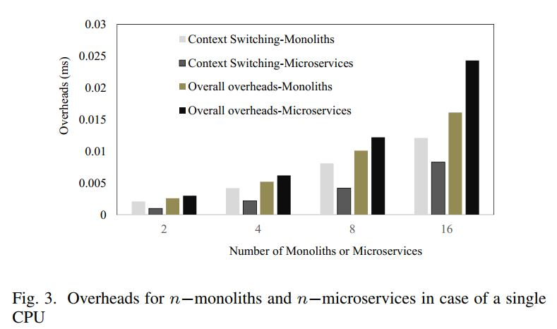
Fig 3
Notes:
圖3中可以看出, single CPU n-monolithic case 比single CPU n-microservices 有較多的context switching overheads
因為monolithic function較為龐大,在context switching時需要傳較多的狀態變數

Slide 72
Overheads
Traffic distribution and microservice overheads are multiple of the number of instances of monoliths or microservices.
In addition, the traffic distribution overhead is smaller than the microservice overhead.
This is because in traffic distribution, the overheads are just due to redirecting traffic to a particular instances, however, in microservice overheads, the overheads are due to many factors such as header translation at each instance, bandwidth overheads etc.
Notes:
Traffic distribution和 microservice overheads隨著instances的數量增加呈現倍數成長
Traffic distribution overhead比microservice overheads還小的原因是raffic distribution 只有redirect traffic到特定的instances,而microservice overheads包含其他因素像是header translation bandwidth overheads

Slide 73
Overheads
In our experiments, the traffic distribution overhead is about 0.0005 ms for two monoliths (i.e., for n = 2) and the microservice overhead is about 0.002 ms for two microservices (i.e., for n = 2).
Hence, for a high value of n, these overheads are the overheads when n equal to 2 and multiplied with n/2.
The overall overheads are then calculated by adding this value with the context switching overheads. The overall overheads are also shown in Fig. 3.
Notes:
實驗結果(沒有列出圖表)表示,兩個monoliths的traffic distribution overheads大約為0.0005m,兩個microservices的traffic distribution overheads大約為0.0002ms
隨著N越大,overheads呈倍數關係
圖3中的overall overheads包含context switching overheads

Slide 74
Overheads
In case of the dedicated CPU n- monolithic case, there are only traffic distribution overheads and in case of the dedicated CPU n- microservice case, there are are only microservices overheads. These overheads are shown in Fig. 4
Notes:
圖4表示dedicated CPU n- monolithic case中,

Slide 75
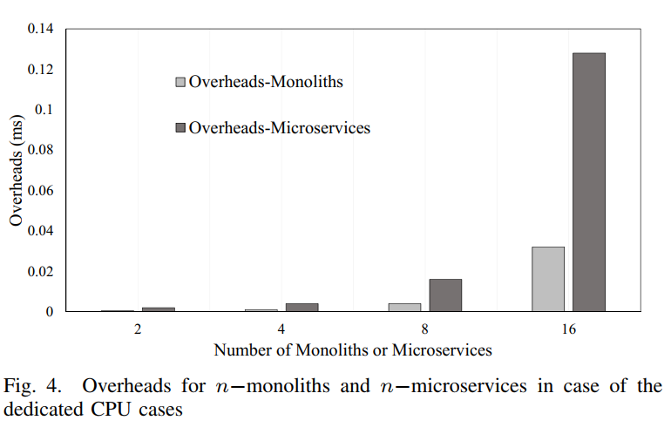
Fig 4

Slide 76
Average Delay Caculations
If overheads in case of the single CPU n-monoliths (O_{sin}^{Mon}) and microservice case (nO_{sin}^{micro}), the average delay given by Eq. 5 and Eq.9 are equal.
Therefore, we depict only a single line in Fig. 5 for both of these cases of the single CPU.
In addition, if overheads
in case of the dedicated CPU n-monoliths (O_{Ded}^{Mon}) and n-microservice cases (nO_{Ded}^{micro}) are equal, the average delay given by Eq. 6 and Eq. 10 are equal.
In our mathematical results, we calculate the average delay for the overheads value 0, 0.005, 0.01, 0.015 and 0.02 ms using Eq. 5 and Eq. 10.
Notes:
照著英文念就好

Slide 77
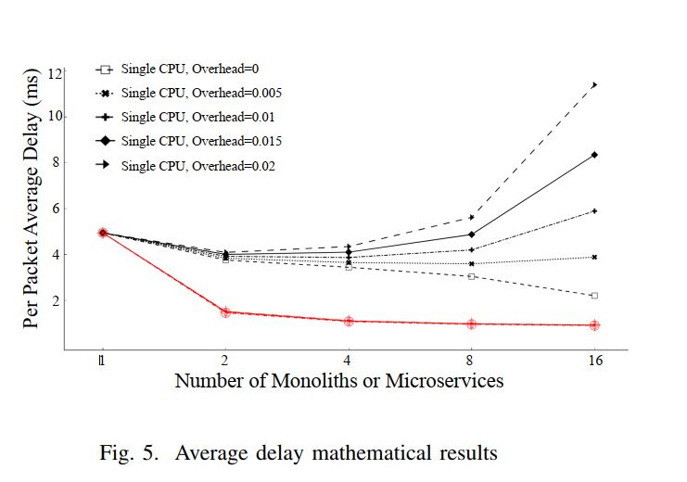
Fig 5
Notes:
圖5表示利用章節2的數學公式算出的average delay

Slide 78
Average Delay Caculations
Fig. 5 shows that if the overhead is 0 ms, the average delay decreases in case of the single CPU when we increase n (i.e, the number of instances) from 1 to 16.
This is because if the number of instances (monoliths or microservices) increases, the total idle time of the CPU (in case of a single CPU) will decrease. This is due to the fact that when one instance is idle, the other instance can take the CPU.
Notes:
隨著instances的數量增加,total cpu 的idle time會減少(因為所有instances只在一個cpu上執行,cpu busy idle時間少),一旦某個instance idle,其他instance馬上搶走cpu使用

Slide 79
Average Delay Caculations
For the dedicated CPU case, as we have dedicated CPU per instance, we always get short average delay when we increase the number of instances from 1 to 16.
However, this short delay is in the cost of dedicated CPUs.

Slide 80
Average Delay Caculations
Note that in real scenarios, the overhead value varies as we increase the number of instances (i.e., n).
Therefore, in order to choose the best value of n we need to calculate the average delay at different overhead values (can be calculated using the
description given in previous subsection) and have to choose the n which gives the shortest or acceptable average delay .
Notes:
在真實情況中,overhead會隨著instance增加而上升
因此為了找出最佳的N值符合最短且可接受的平均延遲,作者計算不同overhead下的平均延遲。

Slide 81
Average Delay Caculations
We found that the single CPU n-monolithic
and n-microservice case give the shortest average delay at n = 4.
Therefore, in these cases, we should decompose or
scale a network function into 4 instances to get the maximum performance.
In case of the dedicated CPU n-monolithic and
n-microservice case, we found the shortest average delay at n = 16.
In fact, when n = 4; n = 8, and n = 16, the average delay is quiet close to each other .

Slide 82
4.B Experimental Results
We emulated all the four cases we described before and depict the average delay and CPU utilization results .
The average delay is calculated as the mean value of the time difference when a packet is received by the receiver and the packet is sent by the sender.
The CPU utilization is calculated at the middle node where all the monoliths or microservices are deployed.
Notes:
Average delay: 封包在receiver和sender之間的時間差,求得平均值
CPU使用率:第二台機器求得

Slide 83
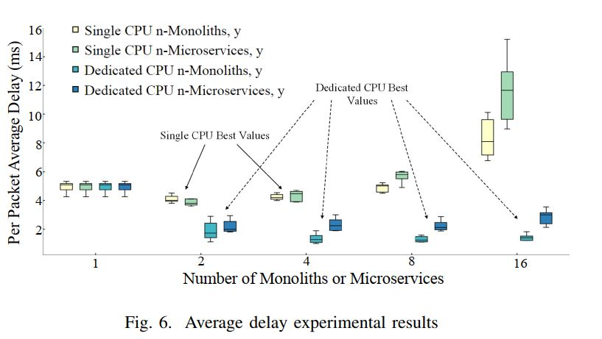
Fig 6
Notes:
在single CPU情況中,SNORT NF為2或4個instances擁有最低的平均延遲(monoliths和microservices都是)
在dedicated CPU情況中, SNORT NF為2,4,8或16個都有最低的延遲(monoliths和microservices都是)

Slide 84
Average Delay Experimental Results
The above results are in line with mathematical results(see the previous subsection).
The difference is only that the experimental results also show the best value of the average delay at n=2.
Note that in our experiments, the best value of n are same for the monolithic and microservice cases.
However, as the overheads are different for monolithic and microservice cases for any n value, there may be cases in which the best value of n are different for monolithic and microservice cases.
Notes:
前3段英文直接翻就好
但是在monolithic 和 microservice cases 的overheads都不同,因此monolithic 和 microservice cases 的最佳n值可能會不同

Slide 85
Average Delay Experimental Results
The experimental results verify that performance of both scaled and microservice version of the SNORT NF in the dedicated CPU case is better than that of the single CPU case. This is obvious because additional CPUs are allocated in case of the dedicated CPU cases.
Notes:
英文直接翻就好

Slide 86
Average Delay Experimental Results
We also see in Fig. 6 that the average delay in the dedicated CPU case for scaled monoliths is less than that of the delay observed in the decomposed microservices case for all values of n (i.e., from 2 to 16).
This is because observed overheads (i.e., traffic distribution overheads) in case of scaled monoliths in the dedicated case are lesser than the microservice overheads in the dedicated case.
Notes:
在dedicated CPU case中,scale monoliths的delay比microservices還少
這是因為scale monoliths所觀察到的overheads比起microservice overheads 還少

Slide 87
CPU Utilization
We can infer that the average CPU utilization in the single CPU cases increases on increasing the number of instances.
While scaling monoliths on a single CPU, the CPU utilization increases almost linearly from 34% to nearly 60% when the number of instances is increased from 1 to 16.
On the other hand, the CPU utilization in the single CPU microservices case is higher than the single CPU monoliths case due to additional microservice overheads (discussed in Section 3).
Notes:
第三段
在single CPU n-microservice case 中,只有一個CPU來forward所有的流量到sub-components
在dedicated CPU n-microservices case 中,每個microservice都跑在某個特定的cpu上

Slide 88
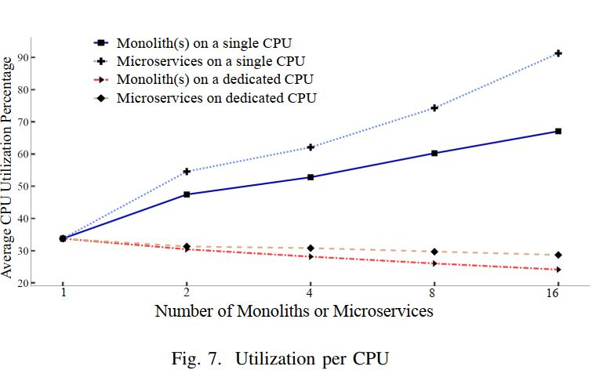
Fig 7

Slide 89
CPU Utilization
In case a dedicated CPU is available for each instance, the average utilization per CPU tends to decrease from 34% to nearly 20% in case of the decomposed microservices as well as scaled monoliths cases.
This is because the traffic load per CPU is decreased by dedicating a separate CPU to each instance.
Notes:
在dedicated CPU情況中,microservice的使用率最低(與monoliths情況差不多),因為traffice分配到每個instance,而每個instances分配到不同的CPU上

Slide 90
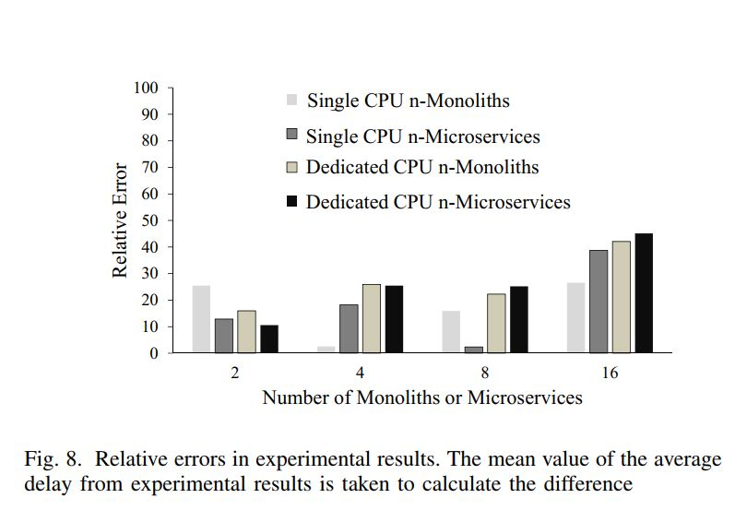
Fig 8
Notes:
圖8表示四種實驗情況的relative error

Slide 91
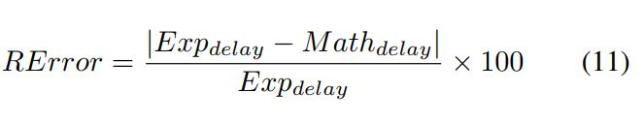
Relative error
Notes:
Exp delay:實驗結果的平均延遲,取多次平均
Math delay:數學公式求得的平均延遲

Slide 92
Comparison between Mathematical and Experimental Results
Although the M/M/1 queuing model is rather simple and gives an approximation for the average delay, Fig. 8 shows that the relative error in experimental results is between 2%-48%.
We notice that on average, the smaller the number of
instances the smaller is the relative error with values confined within 25%.
Note that finding the best analytic model is out of the scope of this work as we make use of a simple model just for gaining preliminary insights into the best configuration.
Notes:
尽管M/M/1排队模型相当简单，也求出了平均时延的近似值，但从图8可以看出，实验结果的相对误差在2%-48%之间。
從圖8觀察出,instances越少誤差越小
本篇論文不是找出最佳的分析模型,作者用一個簡單的模型只是為了開始研究最佳化的配置

Slide 93
Comparison between Mathematical and Experimental Results
Finding a more suitable model that generalizes a VNF and achieves even lower relative errors is left for future work where one possible way could be by using a queuing network instead of a single-queue single-server system.
However, instead of analyzing the network function through a queuing network analyzer (QNA), as in [26], we could use more robust mathematical tools like the robust queuing network analyzer (RQNA) proposed in [28] which is shown to outperform the QNA in terms of relative errors for both heavy- and light-tail
traffic distributions.
Notes:
未來再來找適合的model(較小的relative error)來配置VNF
然而，我们可以使用更稳健的数学工具，如[28]中提出的robust queuing network analyzer （RQNA），而不是像[26]那样通过queuing network analyzer (QNA)来分析网络功能
RQNA相比QNA在輕或是重網路負載有較低的relative error

Slide 94
Related works
5
Notes:
介紹四種NF佈署方式

Slide 95
Related work
There are many CAPex and OPex related advantages for operators to switch from Physical Network Functions to Virtual Network Functions.
However, the major difference between the two approaches is based on the performance gains and loss. Most studies [4] [7] show that the choice should be subjective as in most cases physical devices perform better than the Virtual Network Functions.
To enable the better migration, scaling and failure recovery of VNFs, there has been some tools and architectures proposed [8] which advocate decoupling of states from the network functions to achieve the aforementioned benefits.
Notes:
對於operator來說從實體NF轉換到虛擬NF可以減少成本支出
但是兩種方法的主要差別在性能差距, [4] [7]研究指出實體NF比起虛擬NF性能較佳
[8]提出一些工具和架構,為了实现VNF的更好的迁移、扩展和故障恢复,主張把state和網路功能分開

Slide 96
Related work
Recently, there has been a surge in technologies like zerocopy [7], SR-IOV and DPDK [9] which allows VNFs to perform better on the commodity hardware with specialized NICs and dataplane technologies [10].
Also, there has been various tools and architectures proposed for better VNF placement, development and chaining to achieve the desired performance [12].
With these technologies, there is a high scope of improvement in performance of the VNFs running as VMs on the commodity hardware.
Notes:
最近有些新的技術, 像是zerocopy [7], SR-IOV and DPDK [9]可以讓VNF在商用硬體搭配特殊的網卡和dataplane技術,擁有較佳的表現
[12]提出各種工具和架構,提供較好的VNF分配佈署和串聯,達到預期的效能
有了這些技術,在VM上運行的VNF提升不少的效能

Slide 97
Related work
Microservice architecture has gained popularity in recent time across all the software domains as a new and emerging software architecture.
Microservice architecture is thought to be one of the major driver in enabling cloud-native devops [13], [14].
The existing software architectures like SOA (Service Oriented Architecture) is being compared with the microservices architecture to create a case for the large scale adoption [11].
Notes:
Microservice 架構最近在各種領域開始流行起來,
該架構被認為是促使雲端敏節開發的主要推力
[11]比較現有的架構(像是Service Oriented Architecture)與microservices架構,在建立

Slide 98
Related work
Efforts are being made through studies to create an architecture which can be easily adopted by the industry [15] [11].
The introduction of containers creates an interesting case for experimenting the architecture in the networking domain.
There has been platforms like openNetVM [24] developed, which advocates the use of containers for running VNFs combined with the technologies like DPDK.
Recent study [25] shows that the performance of containers can be further improved, which provide a valid case to experiment with the microservice architecture for the VNF deployment

Slide 99
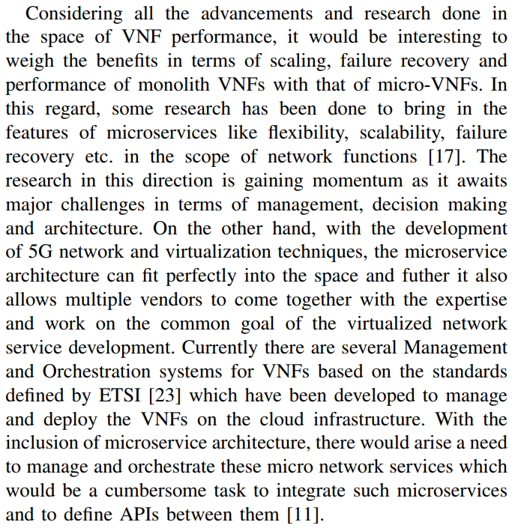
Related work
Notes:
大意:利用VNF搭配microservices,可以發展5g

Slide 100
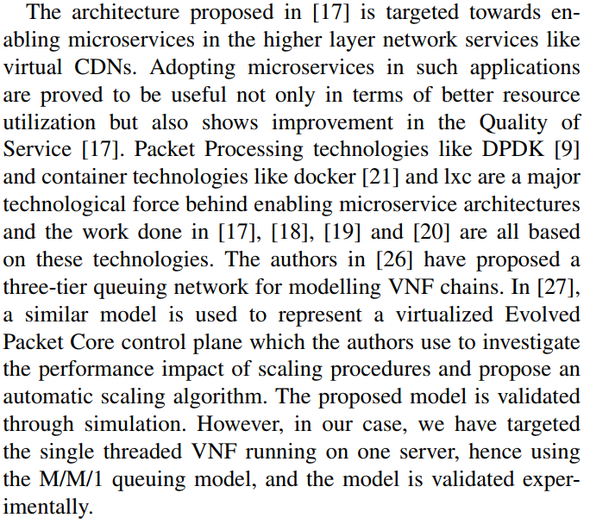
Related work
Notes:
VNF在不同種類網路環境(CDN docker 3-tier queuing network EPC)中的研究

Slide 101
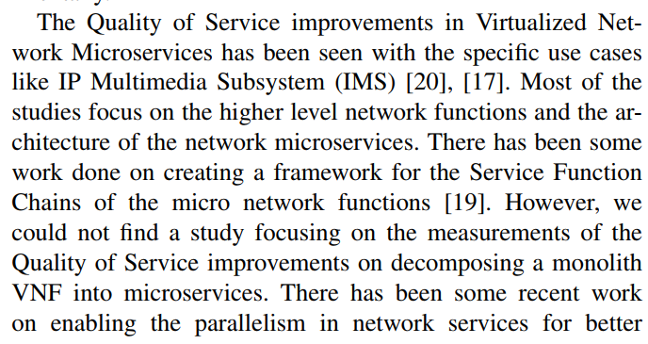

Related work
Notes:
大意:NF搭配QoS在IMS和SFC的研究

Slide 102
conclusions
6
Notes:
介紹四種NF佈署方式

Slide 103
Conclusion
In this paper we focus on deploying virtual network functions using the monolithic and microservice approaches. We compared the performance of both the approaches using the mathematical and experimental results.
We also calculated the number of instances in which a network function could be scaled or decomposed in both the approaches.
Our results showed that scaling using the monolithic approach can result into more performance compared to the decomposition using the microservice approach (due to low overheads in the monolithic approach).
Notes:
這篇論文討論佈署VNF以monolithic 和 microservice ,用數學式子和實驗結果比較兩者的效能
作者也求出NF應該scale或是decompose的instances數量
結果顯示用monolithic方法相比microservice方法有較佳的效能,因為monolithic方法有較低的overhead

Slide 104
Conclusion
In addition, we showed that by dedicating a CPU for each instance in the monolithic and microservice
approach, we can get more performance.
However, this performance gain is at the cost of additional CPUs.
Therefore, we showed that the monolithic and microservice approach can utilize resources (e.g., CPU) fully by just increasing the number of instances and thereby, performance can also increase without investing more on resources (e.g, CPU).
Notes:
除此之外,每個instance使用特定的CPU可以獲得較好的效能
不過效能增加來自使用額外的CPU支援
只要增加instances的數量,就可以充分利用資源(CPU),因此可以在不增加資源(CPU)(這邊講的意思是購置額外的CPU前提是CPU使用率未滿的情況)的情況下提升性能

Slide 105
Conclusion
The results also showed the effectiveness of our method to calculate the number of instances in order to achieve maximum or required performance.
In this paper, microservices are connected through a tandem network.
However, in future work microservices connected in a mesh network will be considered.
Notes:
求得最佳instance數量也可以達到最佳或是所需的效能
這篇論文中的microservice以串連而成網路
未來考慮mesh(網狀)網路情況

Slide 106
My opinions
Microservice是設計趨勢,但這篇論文以實驗證明monolith的overhead較低,在效能上比microservice叫好
網路的性能指標大多用delay當標準

Slide 107
References
J. Thnes, “Microservices,” IEEE Software, vol. 32(1), pp. 116-116, 2015
N. Dragoni, S. Giallorenzo, A. L. Lafuente, M. Mazzara, F. Montesi, R.
Mustafin, L. Safina, “Microservices: yesterday, today, and tomorrow”,
arXiv:1606.04036v2, 2017
Steven Van Rossem et. al., “NFV Service Dynamicity with a DevOps
approach: Insights from a Use-case Realization”, IFIP/IEEE International Symposium on Integrated Network Management (IM), pp. 674-679, 2017
B. Han, V. Gopalakrishnan, L. Ji and S. Lee, “Network function
virtualization: Challenges and opportunities for innovations”, IEEE
Communications Magazine, Vol. 53(2), pp. 90-97, 2015
SNORT software and documentation: https://www.snort.org/
Kishor S. Trivedi, “Probability and Statistics with Reliability, Queuing,
and Computer Science Applications”, 2nd Edition, Wiley, 2001
A. Panda, et. al., “NetBricks: Taking the V out of NFV”, 12th USENIX
Conference on Operating Systems Design and Implementation (OSDI),
pp. 203-216, 2016
A. Panda, et. al., “NetBricks: Taking the V out of NFV”, 12th USENIX
Conference on Operating Systems Design and Implementation (OSDI),
pp. 203-216, 2016

Slide 108
References
9. Intel DPDK https://dpdk.org
10. J. Hwang, K. K. Ramakrishnan and T. Wood, ”NetVM: High Performance and Flexible Networking Using Virtualization on Commodity
Platforms,” in IEEE Transactions on Network and Service Management,
vol. 12, no. 1, pp. 34-47, March 2015
11. Cerny, Tomas and Donahoo, Michael J. and Trnka, Michal, ”‘Contextual Understanding of Microservice Architecture: Current and Future
Directions”’, SIGAPP Appl. Comput. Rev., pp. 29–45, 2018
12. Cerny, Tomas and Donahoo, Michael J. and Trnka, Michal, ”‘Contextual Understanding of Microservice Architecture: Current and Future
Directions”’, SIGAPP Appl. Comput. Rev., pp. 29–45, 2018
13. Cerny, Tomas and Donahoo, Michael J. and Trnka, Michal, ”‘Contextual Understanding of Microservice Architecture: Current and Future
Directions”’, SIGAPP Appl. Comput. Rev., pp. 29–45, 2018
14. J. Kim et al., “Service provider DevOps for large scale modern network services,” 2015 IFIP/IEEE International Symposium on Integrated
Network Management (IM), pp. 1391-1397, 2015

Slide 109
References
15.P. D. Francesco and I. Malavolta and P. Lago, ”Research on Architecting
Microservices: Trends, Focus, and Potential for Industrial Adoption,”
IEEE International Conference on Software Architecture (ICSA), 2017
16. M. P. Martinez et. al., ”‘Multivendor Deployment Integration for Future
Mobile Networks”’, SOFSEM 2018: Theory and Practice of Computer
Science, pp. 351–364, 2018
17. Narjes Tahghigh Jahromi, Roch H. Glitho, Adel Larabi and Richard
Brunner, ”‘An NFV and Microservice Based Architecture for On-thefly Component Provisioning in Content Delivery Networks”’, 15th IEEE
Annual Consumer Communications & Networking Conference (CCNC),
pp. 1–7, 2018
18. D. H. Luong, H. T. Thieu, A. Outtagarts and B. Mongazon-Cazavet,
”Telecom microservices orchestration,” 2017 IEEE Conference on Network Softwarization (NetSoft), Bologna, 2017, pp. 1-2.
19. R. Kawashima and H. Matsuo, ”vNFChain: A VM-Dedicated Fast
Service Chaining Framework for Micro-VNFs,” 2016 Fifth European
Workshop on Software-Defined Networks (EWSDN), The Hague, 2016,
pp. 13-18

Slide 110
References
20. A. Boubendir, E. Bertin and N. Simoni, ”A VNF-as-a-service design
through micro-services disassembling the IMS,” 2017 20th Conference
on Innovations in Clouds, Internet and Networks (ICIN), Paris, 2017,
pp. 203-210.
21. Dirk Merkel, ”‘Docker: lightweight Linux containers for consistent
development and deployment,”’ Linux Journal 2014, 239, pages.
22. Chen Sun, Jun Bi, Zhilong Zheng, Heng Yu, and Hongxin Hu. 2017.
NFP: Enabling Network Function Parallelism in NFV. In Proceedings
of the Conference of the ACM Special Interest Group on Data Communication (SIGCOMM ’17). ACM, pp. 43-56.
23. ETSI NFV ISG. GS NFV-MAN 001 V1.1.1 network function virtualisation (NFV); management and orchestration, Dec. 2014.
24. W. Zhang, G. Liu, W. Zhang, N. Shah, P. Lopreiato, G. Todeschi,
K.K. Ramakrishnan, and T. Wood. 2016. OpenNetVM: A Platform
for High Performance Network Service Chains. In Proceedings of the
2016 workshop on Hot topics in Middleboxes and Network Function
Virtualization (HotMIddlebox ’16). ACM, New York, NY, USA, 26-31.

Slide 111
References
25. Y. Zhao et. al., ” Performance of Container Networking Technologies”.
In Proceedings of the Workshop on Hot Topics in Container Networking
and Networked Systems (HotConNet ’17). ACM, New York, NY, USA,1-6.
26. J. Prados-Garzon et. al., ” Analytical modeling for Virtualized Network
Functions” 2017 IEEE International Conference on Communications
Workshops (ICC Workshops) 2017
27. J. Prados-Garzon and A. Laghrissi and M. Bagaa and T. Taleb. ” A Queuing based dynamic Auto Scaling Algorithm for the LTE EPC Control
Plane” 2018 IEEE Global Communications Conference (GLOBECOM
2018), Abu Dhabi, UAE. 2018.
28. C. Bandi, D. Bertsimas and N. Youssef, (2015). ”Robust queueing
theory”. Operations Research, 63(3), 676-700, INFORMS.

