Slide 1
Exploring Microservices as the Architecture of Choice for Network Function Virtualization Platforms
Hassan Hawilo , Manar Jammal, and Abdallah Shami
IEEE Network • March/April 2019
Impact factor: 8.808
Notes:
探索微服務 對於網路功能虛擬化平臺 作為體系結構的選擇

Slide 2
OUTLINE
Abstract
Introduction
Microservices Architecture
Microservices and NFV: A Match Made with Modularity Cloud9
Microservices NFV and Mobile Edge Computing
Challenges of NFV Implementing Microservices
Conclusion
References

Slide 3
Abstract
NFV is an emerging key technology that overcomes many challenges facing network service providers.
Integrating NFV with MEC and cloud environments requires an architecture that enables efficient implementations and deployments of NFV entities.
This article envisions microservices architecture as the solution of choice for building NFV platforms that are hosted in a dynamic environment ranging from MEC to cloud environments.
Notes:
NFV是一種新興的關鍵技術，它克服了網路服務提供商面臨的許多挑戰
將NFV與MEC和雲環境整合在一起，需要一個能夠有效實現和部署NFV實體的架構。
本文將microservices架構設想為構建NFV平臺的首選解決方案，這些平臺託管(host in)在從MEC到雲環境的動態環境中。

Slide 4
This article addresses the major challenges and requirements of the microservices architecture to fully-exploit the potential of its adoption in NFV. It also proposes potential solutions that alleviate these issues.
The article also discusses the need for agile and modular NFV entities along with MEC to realize various applications.
To this end, the article discusses explicitly a novel NFV microservices entities scheduler optimization model. The proposed scheduler aims at minimizing network delays while taking into consideration various functional and non-functional constraints.
Notes:
本文討論了微服務體系結構的主要挑戰和需求，以充分利用其在NFV中的應用潛力。它還提出了緩解這些問題的潛在解決方案。
本文還討論了敏捷和模組化NFV實體以及MEC實現各種應用的需求。
為此，本文明確討論了一種新的NFV微服務實體調度優化模型。該調度器的目標是在考慮各種功能和非功能約束的同時最小化網路延遲。

Slide 5
Introduction
Network service providers (NSPs) are certainly facing challenges in satisfying the rapid increase in network connectivity demands while maintaining the required quality of service (QoS).
NSPs have projected the need for a programmable automated infrastructure that drives real-time, flexible, and user-application-centric network connectivity services.
However, the dependency of the current network on an extravagant proprietary complicated infrastructure prevents the NSP from realizing automated programmable networks without overwhelming their capital and operating expenditure (CAPEX and OPEX) budgets.
Notes:
網路服務提供商（nsp）在滿足快速增長的網路連線性需求的同時保持所需的服務品質（QoS）無疑面臨著挑戰。
NSPs預計需要一個可程式設計的自動化基礎設施，以驅動即時、靈活和以使用者應用程式為中心的網路連接服務。
然而，當前網路對昂貴的專有複雜基礎設施的依賴性，使得NSP無法實現自動化可程式設計網路，而不會超出其資本和運營支出預算。

Slide 6
A major milestone was reached when a group of NSPs under the European Telecommunications Standards Institute (ETSI) introduced network function virtualization (NFV).
NFV is the technology that migrates the networking functions from the proprietary hardware to virtual network functions (VNFs).
NFV utilizes various IT virtualization techniques based on commodity hardware (computing resources, storage, and networking) to consolidate network function applications.
Notes:
歐洲電信標準協會（ETSI）下屬的一組nsp引入了網路功能虛擬化（NFV），這是一個重要的里程碑。
NFV是將網路功能從專有硬體遷移到虛擬網路功能（VNFs）的技術。
NFV利用基於商用硬體（計算資源，存儲和網絡）的各種IT虛擬化技術來合併網絡功能應用程式。

Slide 7
In that context, a powerful companion technology to NFV is software-de-fined networking (SDN), the technology that introduces real-time network programmability.
With the effective integration between these two paradigms, NSPs can expect major improvements in component modularity and implementation agility.
Notes:
在這種情況下，軟件定義網絡（SDN）是NFV的強大輔助技術，它引入了real-time網絡可編程性。
通過這兩個範式之間的有效整合，NSP可以期待組件模塊化和實現敏捷性的重大改進。

Slide 8
In the ETSI definition of the basic architecture standards for the VNFs, each VNF consists of one or more virtual network function components (VNFCs) [1].
VNFCs implement various functionalities that provide the service defined by the VNF descriptor (VNFD).
The VNFCs implementation freedom drives the innovation and evolution of the VNF services and provides the capability of flexible management and orchestration of the VNFCs lifecycle based on functional and non-functional constraints.
Notes:
在VNF基本架構標準的ETSI定義中，每個VNF由一個或多個虛擬網路功能元件（vnfc）組成[1]。
vnfc實現各種功能，這些功能提供由VNF描述符(descriptor)（VNFD）定義的服務。
VNFCs的實現自由推動了vnfs服務的創新和發展，並提供了基於功能和非功能限制的VNFCs生命週期的靈活管理和協調能力。

Slide 9
NFV is expected to complement mobile edge computing (MEC) technology to provide accelerated content delivery and better application responsiveness, such as intelligent edge data caching, to enhance the quality of user experience (QoE).
MEC has been introduced by ETSI as a technology that enables the deployment of services and applications in the edge network to achieve the closest proximity to the end user [2].
Notes:
NFV有望對移動邊緣計算(mobile edge computing)（MEC）技術進行補充，以提供更快的內容交付和更好的應用回應能力，例如智慧邊緣資料緩存，以提高用戶體驗品質（QoE）。
MEC是ETSI引入的一種技術，它可以在邊緣網路中部署服務和應用程式，從而實現與最終使用者最接近的目的[2]。

Slide 10
this article envisions microservices architecture, the emerging implementation of service-oriented software architecture (SOA), as the solution of choice for developing a VNF.
Microservices architecture allows the VNFs services to be more flexible in the hosting environment where the virtualized functionalities can adopt various manageability scopes to meet functional and non-functional constraints.
Notes:
本文設想將微服務架構，一種服務導向的軟件架構（SOA）的新興實現，作為開發VNF的首選解決方案。
微服務體系結構允許VNFs服務在hosting環境中更加靈活，虛擬化功能可以採用各種可管理性範圍來滿足功能和非功能限制(約束)。

Slide 11
This article discusses the adoption of microservices architecture in NFV and provides a guideline to design a placement scheduler for the VNFCs. The main contributions of this work can be summarized as follows:
Define the major challenges of adopting microservices within NFV platforms.
Define the requirements for microservices architecture to fully-exploit the potential of its adoption in NFV.
Notes:
本文討論了在NFV中採用microservices體系結構，並為vnfc的佈局調度器的設計提供了指導方針。這項工作的主要貢獻概括如下：
1.定義在NFV平臺中採用微服務的主要挑戰。
2.定義微服務體系結構的需求，以充分利用其在NFV中採用的潛力。

Slide 12
Propose potential solutions that alleviate the challenges of adopting microservices within NFV platforms.
Discuss explicitly a novel optimization model for the NFV microservices entities' scheduler. The model aims at minimizing the computational paths network delays while taking into consideration various functional and non-functional constraints.
Notes:
3.提出潛在的解決方案，以減輕在NFV平臺中採用微服務的挑戰。
4.明確討論了一種新的NFV微服務實體調度優化模型。該模型在考慮各種功能和非功能約束的情況下，以最小化計算路徑網路延遲為目標。

Slide 13
Microservices Architecture
Cloud computing accompanied with virtualization is introduced as an infrastructure foundation to meet the rapid and increasing demands of computing resources with minimal CAPEX and OPEX investments.
Adopting cloud computing services in an application development requires remodeling the application architecture to exploit the benefits of cloud services, such as scaling on-demand.
Notes:
伴隨著虛擬化的雲計算被引入作為基礎設施的基礎，以CAPEX(資本支出)和OPEX(營運支出)投資最小 滿足計算資源的快速和日益增長的需求。
在應用程式開發中採用雲計算服務需要重構應用程式架構，以利用雲服務的好處，例如按需伸縮。

Slide 14
Traditionally, web-based applications are developed using a monolithic architecture.
However, the change in the application nature and the increase in the complexity and demand of the provided services introduce various challenges to monolithic applications.
The tightly coupled codebase is typically a result of the monolithic application, which imposes high-risk associated with any code change or addition of new features.
Moreover, the monolithic application does not support component reusability, which hinders the scalability of an individual component.
Notes:
傳統上，基於web的應用程式是使用單片體系結構開發的。
然而，應用程式性質的變化以及所提供服務的複雜性和需求的增加給單片應用程式帶來了各種挑戰。
緊密耦合的代碼庫通常是單片應用程式的結果，這會帶來與任何代碼更改或添加新功能相關的高風險。
此外，單片應用程式不支援元件的再使用性，這阻礙了單個組件的可伸縮性。

Slide 15
Microservices architecture has evolved to mitigate monolithic architecture challenges by introducing distributed systems with lightweight components.
Each component performs a specific workload in an independent manner.
Components are defined as microservices in this architecture.
Notes:
微服務體系結構通過引入具有輕量級元件的分散式系統來緩解單一體系結構的挑戰。
每個元件以獨立的方式執行特定的工作負載。
在這個架構中，元件被定義為微服務。

Slide 16
Microservices and NFV: A Match Made with Modularity Cloud9
Leading ICT equipment vendors have rushed to build and release various proof-of-concepts designs and prototypes of VNFs running on COTS computing resources.
However, these prototypes are based on traditional network function development and monolithic stack development that can only scale vertically and are limited to the computing performance of the underlying bare-metal servers [3].
Since networking functions' applications thrive on the power of computing resources, NSPs are faced with the challenge of re-engineering VNFs to enable horizontal scaling.
Notes:
領先的資訊通信技術設備供應商已經爭先恐後地開發和發佈各種概念驗證設計和基於COTS(“商用现成品或技术”或”商用货架产品”)計算資源的VNFs原型。
然而，這些原型都是基於傳統的網路功能開發和單片堆疊開發，這些開發只能垂直擴展，並且受限於底層裸機伺服器的計算性能[3]。
由於網路功能的應用依賴于計算資源的能力，nsp面臨著重新設計vnf以實現水平擴展的挑戰。

Slide 17
Microservices architecture is considered the best-fit architecture to help NFV achieve its goals.
Defining VNFCs as microservices provides the following advantages:
VNFC Bounded Context: Each VNFC performs a limited set of functionalities, which results in a small code base limiting the scope of bugs. Furthermore, the standalone nature of microservices facilitates direct testing of functionalities in isolation with respect to the VNF provided service.
Notes:
微服務架構被認為是説明NFV實現其目標的最佳架構。將vnfs定義為微服務具有以下優點：
VNFC bounded context：每個VNFC都執行有限的功能集，這會導致代碼庫很小，從而限制了bug的範圍。 此外，微服務的獨立性質有助於相對於VNF提供的服務進行隔離的功能的直接測試。

Slide 18
VNFC Modularity: This means gradual transitions to updated versions of VNFCs. The newer versions of VNFCs can be deployed simultaneously with the old ones. The VNFCs that depend on the old versions can be gradually modified to interact with the updated VNFCs, which is known as rolling upgrade. With this approach, NFV can adopt VNFCs' continuous integration and can greatly ease VNF software maintenance.
VNF Innovation and Evolution: By exploiting the independency characteristic, new NFV micros-ervices can be easily introduced to the production services without disrupting their operations.
Notes:
VNFC模組化：這意味著逐漸過渡到vnfs的更新版本。新版本的vnfs可以與舊版本同時部署。依賴於舊版本的vnfs可以逐步修改以與更新的vnfc交互，這就是所謂的輪流升級。通過這種方法，NFV可以採用vnfc的連續整合，大大簡化了vnfs軟體的維護。
VNF創新與發展：通過利用獨立特性，新的NFV微服務可以很容易地引入到生產服務中，而不會中斷它們的操作。

Slide 19
VNF Flexibility and Scalability: VNF building blocks, VNFCs, can be scaled up or down independently according to the service demand.
VNFC Interoperability: With microservices architecture, VNFCs can be deployed in a heterogeneous manner. Various VNFCs provided by different vendors or developed using different programming languages and frameworks can still be interconnected as long as they implement the right communication interfaces.
Notes:
VNF靈活性和可擴展性：VNF構建block，vnfc，可以根據業務需求獨立地放大或縮小。
VNFC互通性：使用microservices架構，vnfs可以以異構(不同)方式部署。不同供應商提供的或使用不同程式設計語言和框架開發的各種vnfc，只要它們實現了正確的通信介面，它們仍然可以相互連接。

Slide 20
Microservices NFV and Mobile Edge Computing
Designing high bandwidth networks with negligible latency is the intent of the service providers to serve many emerging applications.
Implementing such broadband mobile networks requires efficient utilization of the assigned spectrum for wireless communication and the distribution net- work infrastructure.
It also requires placing the data-hosting application servers in closest proximity to the end-users to achieve negligible latency.
Notes:
設計具有可忽略延遲的高頻寬網路是服務提供者為許多新興應用服務的目的。
實現這種寬頻移動網路需要有效地利用分配給無線通訊的頻譜和分散式網路基礎設施。
它還需要將託管資料的應用伺服器放置在離最終用戶最近的位置，以實現可忽略的延遲。

Slide 21
With spectrum being the scarce resource, mobile network service providers are tending to deploy heterogeneous networks where macro and micro base station cells coexist with small base-station cells (pico-cells and femto-cells).
Heterogeneous networks enhance spectrum utilization to achieve higher data rates for the end-users (user equipment).
Notes:
隨著頻譜資源的稀缺性，移動網路服務提供商傾向於部署異構網路，其中macro、micro base station與小型base station（pico和femto）共存。
異構網路提高頻譜利用率，為最終使用者（使用者設備）實現更高的資料速率。

Slide 22
Mobile edge computing (MEC) is introduced to minimize the latency of serving data through hosting the application servers with the closest proximity to the end-users, especially data caching servers.
the existence of applications and data caching servers in mobile edge networks is essential to offload the data traffic from the core network and minimize networking latency while serving the maximum number of users with high bitrates.
Given the evolution at the level of base stations, D2D, and storage technology, deploying the application and caching servers at macro, micro, pico and femto base stations become feasible.
Notes:
移動邊緣計算（MEC）是通過託管與終端使用者最接近的應用伺服器（尤其是資料緩存伺服器）來最小化服務資料的延遲。
移動邊緣網絡中存在應用程序和數據緩存服務器 對於從核心網絡上分擔數據流量並最小化網絡延遲，同時為最大數量用戶提供高bit rate服務至關重要。
考虑到base station、D2D和存储技术的发展，在macro、mirco、pico和femto基站部署应用服务器和缓存服务器变得可行。

Slide 23
However, flexible, agile, and automated network entities should exist side by side with the MEC entities to achieve the desired application and data caching schemes for the above designs.
Implementing NFV and SDN networking micro-services entities at the network edges offloads the networking orchestration traffic from the core network and enables elastic network federations that can be self-sustained while providing high bandwidth connectivity with negligible latency for the end-users.
The centralized core networking entities can then synchronize and orchestrate the network federations' inter-traffic.
Notes:
然而，靈活、敏捷和自動化的網路實體應該與MEC實體並肩存在，以實現上述設計所需的應用程式和資料緩存方案。
在網絡邊緣實施NFV和SDN網絡微服務實體可減輕核心網絡的網絡編排流量的負擔，並實現可自我維持的彈性網絡聯盟，同時為最終用戶提供高帶寬連接且延遲可忽略不計。
然後，集中式核心網絡實體可以同步和協調網絡聯盟之間的內部流量。

Slide 24
Challenges of NFV Implementing Microservices
To ensure a wider adoption of NFV by the ICT industry, NFV should overcome the challenges introduced by the softwarization of network functions and the development architecture.
Prime challenges include the following issues. Table 1 summarizes this section.
Notes:
為確保資訊和通信技術行業更廣泛地採用網路虛擬化，網路虛擬化應克服網路功能和開發架構的軟體化帶來的挑戰。

Slide 25
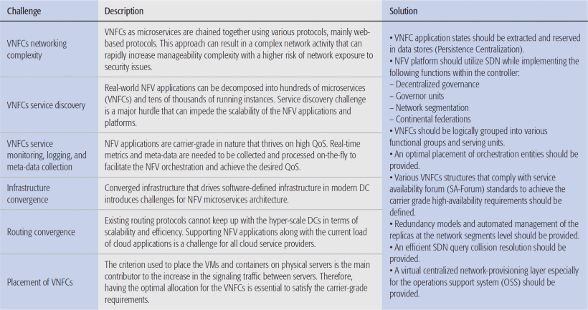

Slide 26
VNFC Networking Complexity
NFV microservices architecture is based on the creation of (as many as needed) small independent VNFCs that are chained together using various web-based protocols.
This approach can result in complex network activities that are difficult to manage and rapidly impose a negative effect on network manageability.
Network chaining complexity is a challenge that NFV-microservices should overcome through intelligent networking management, possibly with SDN integration [7].
Notes:
VNFC網路複雜性
NFV微服務體系結構是基於（根據需要）創建小型獨立vnfs，這些vnfs使用各種基於web的協定連結在一起。
這種方法會導致複雜的網路活動難以管理，並迅速對網路的可管理性產生負面影響。
網路連結的複雜性是NFV microservices應該通過智慧型網路管理（可能是SDN集成）來克服的挑戰[7]。

Slide 27
VNFC Service Discovery
Despite the benefits that microservices architecture introduces to NFV, VNFC management and development are still intricate challenges.
Service discovery of VNFCs is a major hurdle that impedes the scalability of the NFV application and platforms.
As VNFCs scale on-demand in a cloud environment, a real-time automated service discovery mechanism should be developed to create dynamic service chains to permit the dynamic scaling of VNFs.
Notes:
VNFC服務發現
儘管微服務體系結構為NFV帶來了好處，但VNFC的管理和開發仍然是一個複雜的挑戰。
vnfc的服務發現是阻礙NFV應用程式和平臺可伸縮性的一個主要障礙。
隨著VNFs在雲環境中按需要擴展，需要開發一種即時自動服務發現機制來創建動態服務鏈，以允許VNFs的動態擴展。

Slide 28
VNFC Service Monitoring, Logging, and Meta-Data Collection
Typical NFV applications are carrier-grade in nature, and they thrive on high QoS.
Real-time metrics and meta-data should be collected and processed on-the-fly to facilitate the NFV service entities (VNFs and VNFCs) orchestrations that achieve the desired QoS.
The orchestration and management entities in the NFV platform require clear visibility of the collected system metrics data to perform versus VNFC health checks.
Notes:
VNFC服務監視、日誌記錄和中繼資料收集
典型的NFV應用本質上是電信級的，它們依靠高QoS發展。
Real-time指標和meta-data應實時收集和處理，以促進實現所需QoS的NFV服務實體（VNF和VNFC）編排。
NFV平台中的編排和管理實體需要清楚地了解所收集的系統指標數據，以執行VNFC健康檢查。

Slide 29
Further analysis of VNFC health checks can craft the NFV provided service topology, but any variation in the performance metrics across various VNFCs or NFV infrastructure (NFVI) resources hinders this capability.
Notes:
對VNFC運行狀況檢查的進一步分析可以構建NFV提供的服務拓撲，但是跨各種VNFC或NFV基礎結構（NFVI）資源的性能指標的任何變化都會阻礙此功能。

Slide 30
VNFC Security
These security challenges are exacerbated due to the extensive usage of various communication channels between all the VNFCs that create more roads for data hijacks and interception while in transit.
Implementing all the security measures on hyper-scale microservices intensifies the security challenges.
Notes:
VNFC安全
由於所有VNFC之間廣泛使用各種通信通道，從而在傳輸過程中為數據劫持和攔截創造了更多的道路，因此這些安全挑戰更加嚴重。
在超大規模微服務上實施各種安全措施，加劇了安全挑戰。

Slide 31
Infrastructure Convergence
Convergence of infrastructure is a promising approach currently being utilized in modern DCs to allow ICT service providers to scale their infrastructure with efficient resource utilization [10].
However, this kind of computing infrastructure is not flawless.
Some of the challenges that should be addressed in software-defined infrastructure to enable NFV microservices
Notes:
基础设施融合
基礎設施的融合是當前在現代DC中正在使用的一種有前途的方法，以允許ICT(資訊和通信技術)服務提供商以有效的資源利用來擴展其基礎設施[10]。
然而，這種計算基礎設施並不是完美無缺的。在支援NFV微服務架構的軟體定義基礎架構中，應該解決的一些挑戰如下。

Slide 32
Computing Resources Convergence
Various standards, communication types, file system protocols, and interface buses are used to connect hosts over COTS networking equipment.
With this limitation of network control exposure, users cannot optimize VNFCs to the best performance.
Notes:
各種標準，通信類型，文件系統協議和接口總線用於通過COTS(商用現貨軟體)網絡設備連接主機。
由於受到網絡控制風險的限制，用戶無法優化VNFC以獲得最佳性能。

Slide 33
Networking Resources Convergence
Converged infrastructure combines all kinds of traffics into a unified infrastructure without any segregated network. This approach of unified network infrastructure imposes risks on high priority traffics.
Applying QoS and traffic separation through various networking bearers occurs through network adapters and switch partitioning.
Although this approach is a solution, it introduces various manageability and traffic processing challenges, especially in a virtualized environment.
DC infrastructure orchestrators should integrate and expose various network-con-trolling functionalities to maintain the desired QoS and assure interoperability of VNFCs.
Notes:
融合的基礎架構將各種流量組合到一個統一的基礎架構中，而無需任何隔離的網絡。這種統一網路基礎設施的方法給高優先順序業務帶來了風險。
各種網路載體發生的QoS和流量分離是透過網路介面卡和交換機區分
儘管這種方法是一種解決方案，但它會帶來各種可管理性和流量處理挑戰，特別是在虛擬化環境中。
DC基礎結構協調者應整合並公開各種網絡控制功能，以維持所需的QoS並確保VNFC的互操作性。

Slide 34
Routing Convergence
Multiple distinct architecture choices can be used when designing a data center. Each aims at minimizing the resources required to suit the needs of cloud service providers.
Supporting NFV applications along with the current load of cloud applications is a challenge for all cloud service providers. They should take a step back and decide on the conflict resolution techniques to be used.
In addition, the adoption of microservices architecture with NFV applications requires new approaches at the levels of network hardware and software infrastructure specification.
Notes:
在設計資料中心時，可以使用多種不同的體系結構選擇。每種方法都旨在最小化所需資源，以滿足雲服務提供者的需求。
對所有雲服務提供者來說，支援NFV應用程式以及當前的雲應用程式負載都是一個挑戰。他們應該退後一步，決定採用何種衝突解決技術。
此外，在NFV應用中採用微服務體系結構需要在網路硬體和軟體基礎設施規範級別上採用新的方法。

Slide 35
The increase in the number of virtualized applications using virtual machines (VMs) and containers has imposed challenges to the current routing protocols.
VMs and containers are entities added and dropped out on the fly to meet the cloud application dynamic workloads. These VMs and containers are mobile; they can migrate from one serving node to another in real time [12]. With these properties, VMs and containers highly rely on network traffic mobility and low-latency.
Common routing protocols are yet to be proven to serve efficiently this kind of workload.
Notes:
使用vm和container的虛擬化 應用程式數量的增加 給當前的路由式通訊協定帶來了挑戰。
vm和容器是動態添加和刪除的實體，以滿足雲應用程式的動態工作負載。這些vm和容器是可移動的；它們可以即時地從一個服務節點遷移到另一個服務節點[12]。
有了這些特性，vm和容器高度依賴於網路流量的移動性和低脆弱性。
常用的路由式通訊協定還沒有被證明能有效地服務於這種工作負載。

Slide 36
Adding NFV applications to the existing cloud workload can disrupt the underlying network because NFV adds hyper-scale overlay networks served by VNFCs.
It is a challenge for the SDN controller.
A first step would be deploying distributed SDN controllers to handle multiple network federation routing convergence, but this area requires further investigation to converge on implementation techniques.
Notes:
將NFV應用程式添加到現有的雲工作負載中可能會中斷底層網路，因為NFV增加了vnfc服務的超大規模覆蓋網路。
這對SDN控制器是一個挑戰。
第一步是部署分散式SDN控制器來處理多個網路聯合路由的收斂，但是這一領域需要進一步的研究來融合實現技術。

Slide 37
Inter-connecting and Intra-Connecting VNFCs
In a virtualized environment, various inter-connection and intra-connection approaches can be held, as illustrated in Fig. 1:
Notes:
在虛擬化環境中，可以保持各種互連和互連方法，如圖1所示：

Slide 38
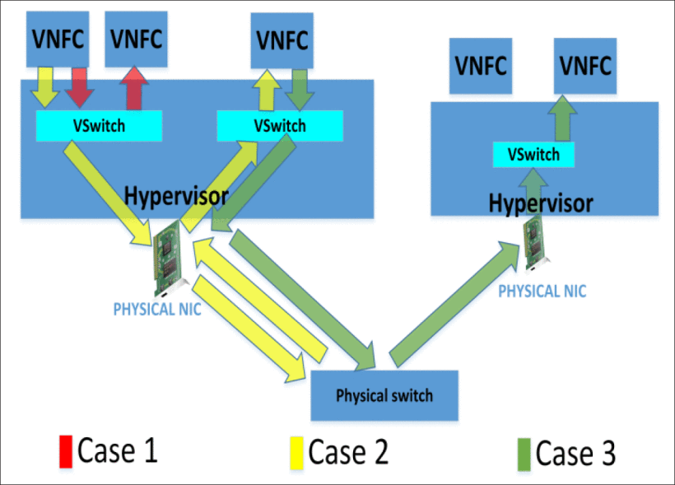
Notes:
兩個VNF位於同一物理伺服器和同一虛擬交換機（vSwitch）上。
兩個vnf位於同一個物理伺服器上，但位於不同的vSwitch上。
兩個vnf位於不同的物理伺服器上。

Slide 39
VNFCs establish virtual connections through the virtual network interface controllers (vNICs), which can introduce various hop spanning trees.
Optimized traffic routing and VNFC placements should be used to monitor and minimize network traffic latency.
Single-root input/ output (I/O) virtualization (SR-IOV) compliant NICs are considered a solution to eliminate intermediate virtual network hops, but they can hinder the VNFCs' mobility in a virtualized environment.
Notes:
vnfc通過虛擬網路介面控制器（vnic）建立虛擬連接，vnic可以引入各種hop spanning tree。
優化的流量路由和VNFC放置來監視和最小化網路流量延遲。
與單root輸入/輸出（I/O）虛擬化（SR-IOV）相容的NIC被認為是消除中間虛擬網路hops的解決方案，但它們會阻礙虛擬環境中VNFC的移動性。

Slide 40
Placement of VNFCs
The criterion used to place VMs and containers on physical servers is the main contributor to the increase in signaling traffic between servers.
VM and container allocation is one of the main factors that affect carrier-grade application requirements such as QoS, reliability, and high availability.
Therefore, having the optimal (or as close to optimal as possible) allocation of VNFCs is an indispensable step to satisfy QoS requirements.
Notes:
VNFC的安置
用於在物理伺服器上放置vm和容器的標準是伺服器間信令流量增加的主要原因。
虛擬機器和容器分配是影響運營商級應用需求（如QoS、可靠性和高可用性）的主要因素之一。
因此，對vnfcs進行最優（或盡可能接近最優）分配是滿足QoS需求必不可少的一步。

Slide 41
ETSI has defined a basic framework architecture that does not have a VNFC placement management entity [1].
VNFC placement directly affects the service chains' routing decisions.
This can have a critical impact on the service level agreements (SLAs) in which the cloud service providers guarantee computing resource performance and availability.
However, existing SLAs do not guarantee carrier-grade application performance with five nines (99.999 percent) of service availability, which is a critical requirement for virtualized carrier network functions.
Therefore, the cloud tenants should orchestrate the VNFC deployment and management in order to achieve the desired QoS.
Notes:
ETSI已經定義了一個基本的框架架構，它沒有VNFC放置管理實體[1]。
VNFC佈局直接影響服務鏈的路由決策。
這會對服務級別協定（sla）產生重大影響，在sla中，雲服務提供者保證計算資源的性能和可用性。
但是，現有的SLA不能以五分之九（99.999％）的服務可用性來保證運營商級應用程序的性能，這是虛擬化運營商網絡功能的關鍵要求。
因此，雲租戶應該協調VNFC的部署和管理，以實現期望的QoS。

Slide 42
VNFC placement and management are more complex compared to current cloud applications.
VNFCs are networking function services that overlay networks and process networking packets in real time.
Therefore, any potential error or service degradation can escalate issues at various levels of the substrate and overlay networks and can disrupt any dependent services.
Notes:
與當前的雲應用程式相比，VNFC的放置和管理更加複雜。
vnfcs是一種網路功能服務，它覆蓋網路並即時處理網路資料包。
因此，任何潛在的錯誤或服務降級都可能升級substrate(基板)和overlay network(覆蓋網絡)各個級別的問題，並可能中斷任何相關服務。

Slide 43
Having schedulers agnostic of NFV application intricacies may result in inefficient VNFC place ments.
Considering this, service chained VNFCs can for the same reason be scheduled on hosts where delay constraints are violated.
This placement can hinder NFV application services from scaling and offloading traffics between VNFCs.
The NFV-aware scheduler would optimally be defined as a management entity within the cloud orchestration platforms to ensure that the NFV services can serve a dynamic workload while satisfying all carrier-grade requirements.
Notes:
使調度程序與NFV應用程序無關，可能會導致VNFC放置效率低下。
考慮到這一點，出於相同的原因，可以在違反延遲限制的主機上調度服務鍊式VNFC。
這種放置方式可能會阻止NFV應用程序服務擴展和卸載VNFC之間的流量。
可以將NFV-aware調度程序最佳地定義為雲編排平台內的管理實體，以確保NFV服務可以在滿足所有運營商級要求的同時提供動態工作負載。

Slide 44
VNFC Placement Modeling
As for the VNFC instances, they are executed within VMs and containers that are mapped to the physical servers by the cloud orchestrator.
As mentioned in previous sections, NFV applications typically provide their services through various chained VNFs, which are defined as several VNFCs.
These chains determine the dependency relations between the VNFCs.
The service computational path is restricted by the delay tolerance constraints, which determine the maximum allowed latency between VNFC instances at which this path outage is declared.
Notes:
VNFC布局建模
對於VNFC實例，它們在vm和容器中執行，這些vm和容器由雲編排器映射到物理伺服器。
如前幾節所述，NFV應用程式通常通過各種連結的vnf提供服務，這些vnf被定義為多個vnfcs。
這些鏈決定了vnfs之間的依賴關係。
服務計算路徑受到延遲容忍約束的限制，延遲容忍約束決定了宣佈路徑中斷的VNFC實例之間的最大允許延遲。

Slide 45
Maintaining the maximum number of computational paths requires optimal NFV-aware scheduling models and algorithms. Therefore, the following constraints should be satisfied.
Notes:
保持計算路徑的最大數量需要最優的NFV感知調度模型和演算法。因此，應滿足以下約束條件。

Slide 46
Resources Capacity Constraints: Used to Eliminate Servers that DO Not Satisfy the Resources Demands of VNFC
Network Delay Constraints: These constraints discard the servers that violate the delay tolerance between VNFCs.
Availability Constraints: These constraints select the servers that satisfy the following:
  Affinity constraint: Defines the set of VNFCs that can reside on the same hosting server.
  Anti-affinity constraint: Defines the set of VNFCs that should reside on different servers. Usually, these VNFCs can tolerate higher outage than the co-located VNFCs.
Notes:
資源容量約束：用於消除不滿足VNFC資源需求的伺服器
網路延遲約束: 這些約束會丟棄違反vnfcs之間延遲容限的伺服器。
可用性限制: 這些約束選擇滿足以下條件的伺服器：
親和約束:定義可以駐留在同一個宿主要伺服器上的一組vnfcs。
反親和約束:定義應該駐留在不同伺服器上的一組vnfcs。通常，這些vnfcs比同一位置的vnfcs能夠承受更高的中斷。

Slide 47
Redundancy Constraints: These constraints define the number of redundant VNFCs and their redundancy model type. The redundancy models are highly correlated with the cloud environment metrics, such as spin-up time of a VM or container.
Anchors Constraints: VNFC anchors are defined by the functional dependencies that exist between the VNFC microservices. Dependencies may introduce network hierarchy limitations between the VNFC and its anchors.
Notes:
冗餘約束: 這些約束定義了冗餘vnfcs的數量及其冗餘模型類型。冗餘模型與雲環境指標高度相關，例如虛擬機器或容器的啟動時間。
定位約束: VNFC定位由VNFC微服務之間存在的功能依賴關係定義。依賴關係可能會在VNFC及其定位點之間引入網路層次結構限制。

Slide 48
Orbital Area Constraints: The orbital area is defined by the region where the VNFC can be placed. This area is bounded by the VNFC anchors' constraints associated with the service chain. A VNFC can have multiple peers and dependents in a service chain. Therefore, the orbital areas and distances must be carefully calculated to enable further elastic scalability of the NFV service.
Notes:
軌道面積約束
軌道面積由可放置VNFC的區域確定。
該區域受與服務鏈相關聯的VNFC定位的約束所限制。
VNFC可以在一個服務鏈中有多個對等方和依賴項。
因此，必須仔細計算軌道面積和距離，以使NFV服務進一步具有彈性伸縮性。

Slide 49
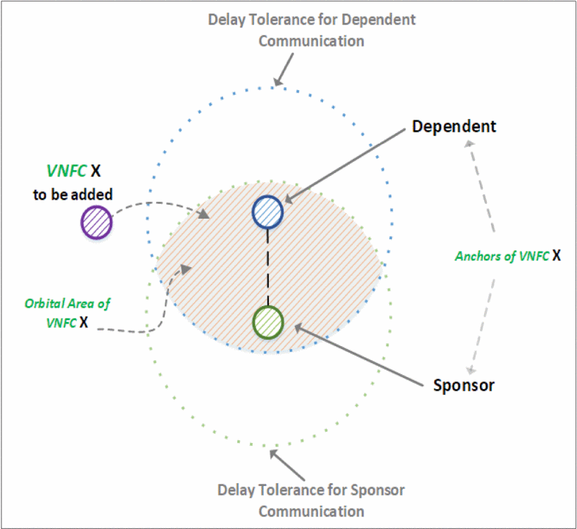
Figure 2 illustrates the conceptualization of the VNFCs' anchors in relation to the VNFC orbital area.
Notes:
圖2說明了與VNFC軌道面積相關的VNFC定位點的概念。

Slide 50
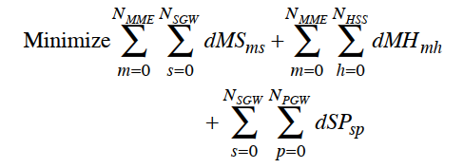
VNFC PLacement Simulation
The NFV-aware scheduler should generate optimal placements of VNFCs to pave the way for a carrier grade NFV service.
For this purpose, a mixed-integer linear programming (MILP) model is formulated based on the aforementioned constraints and with the following objective function:
Notes:
NFV感知調度器應該生成VNFC的最佳佈局，為運營商級NFV服務鋪平道路。
為此，基於上述約束條件和以下目標函數，建立了一個混合整數線性規劃（MILP）模型：

Slide 51
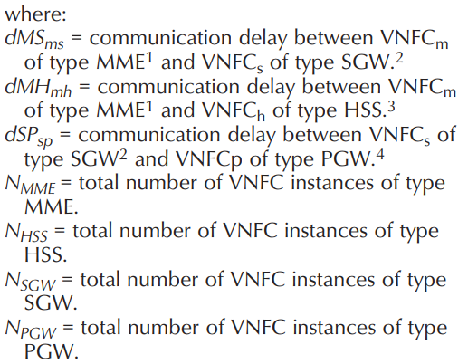
Notes:
通信延遲在MME型VNFC和SGW型VNFC之間
通信延遲在MME型VNFC和HSS型VNFC之間
通信延遲在SGW型VNFC和PGW型VNFC之間
MME型VNFC instance的數量
HSS型VNFC instance的數量
SGW型VNFC instance的數量
PGW型VNFC instance的數量

Slide 52
Virtualized evolved packet core (vEPC) is used as a use case in the simulation.
Table 2 summarizes the input data of the model. Given the available computing processing power and the computational complexity of the MILP model, the dataset is defined to generate the simulation results within a reasonable time.
The delay tolerances between entities are based on data center network latency measurements as defined in [16].
Notes:
虛擬化演進包核心（vEPC）被用作模擬中的一個用例。
表2總結了模型的輸入資料。
考慮到MILP模型可用的計算處理能力和計算複雜度，定義資料集以在合理的時間內生成模擬結果。
實體之間的延遲容忍基於[16]中定義的資料中心網路延遲測量。

Slide 53
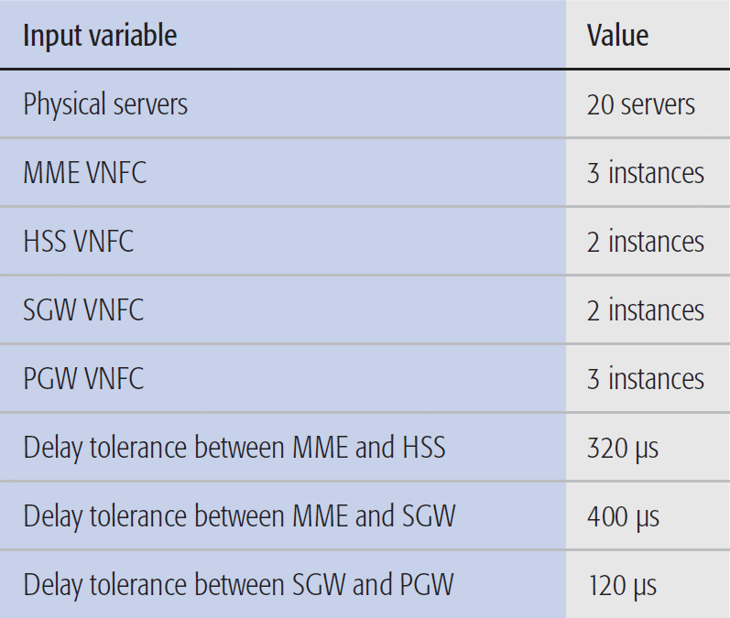

Slide 54
The MILP model is implemented using the IBM ILOG CPLEX optimization studio, and the greedy algorithm is implemented using Java.
A virtual machine with 12 vCPU cores and 64 GB of memory is used to run the simulation environment. We have compared the NFV-aware scheduler with a greedy algorithm.
The corresponding results are shown in Fig. 3 and Table 3.
Notes:
利用IBM-studio語言實現了貪婪演算法，並用Java語言實現了優化。
使用一個具有12個vCPU核和64gb記憶體的虛擬機器來運行模擬環境。
我們比較了NFV-aware調度器和貪婪演算法。相應的結果如圖3和表3所示。

Slide 55
The MILP model generates the optimal placements that satisfy all the aforementioned constraints while minimizing network delays.
These placements maximize the number of available computational paths that represent the VNFC service chains. This objective is achieved by placing the VNFC instances on the hosts with minimum connection delays, which provides valid connections for the computational paths.
Increasing the number of computational paths can be quantified by the number of participating members in a functional group of a VNFC instance. The higher the number of participating members in a functional group, the better it becomes.
Notes:
MILP模型生成滿足上述所有限制(約束)條件的最優佈局，同時最小化網路延遲。
這些位置最大化了代表VNFC服務鏈的可用計算路徑的數量。這個目標是通過將VNFC實例放置在具有最小連接延遲的主機上來實現的，這為計算路徑提供了有效的連接。
增加計算路徑的數量可以通過VNFC實例的功能組中的參與成員的數量來量化。一個functional group參與成員越多，它就越好。

Slide 56
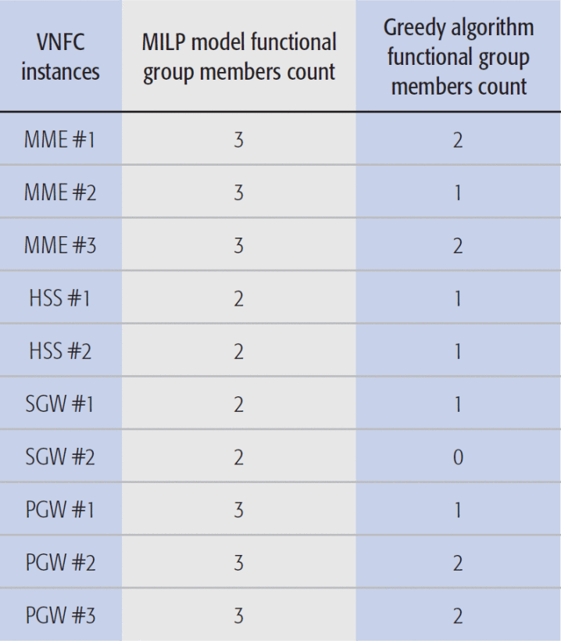
Notes:
表3顯示了從MILP模型和貪婪演算法放置生成的功能組成員的計數。
與貪婪演算法相比，MILP模型實現了更高的功能組成員數。
與貪婪演算法相比，使用MILP模型佈局演算法的NFV服務可以獲得更好的性能和可用性。
從性能的角度來看，MILP模型允許功能組在較高的VNFC成員之間卸載流量；但是貪婪演算法不是這樣。
從可用性的角度來看，與貪婪演算法相比，MILP模型為功能組提供了更好的可用性，因為MILP模型具有更高的成員數；這些成員充當冗余元件，可以在VNFC實例發生故障時接管工作負載。

Slide 57
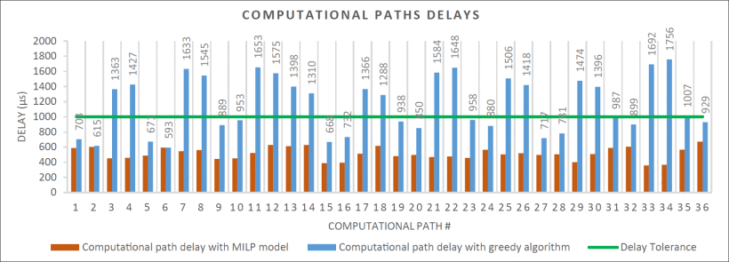
Notes:
除了使用所提出的MILP模型增加VNFCs功能組成員的數量之外，結果表明，與圖3所示的貪婪演算法相比，計算路徑的延遲被最小化。
最小化VNFC計算路徑的延遲對於VNFC管理實體至關重要。延遲容忍度和計算路徑延遲之間的差異允許管理實體在系統上應用各種策略。這些策略根據網路服務提供商的意圖而變化，例如基於綠色或高級安全的分析策略。

Slide 58
Conclusion
The leading ICT service providers, equipment vendors, and academic researchers should be aware of NFV's challenges and explore new approaches to overcome them.
This article discussed the possibility of adopting microservices architecture in NFV to enable hyper-scaling services.
To this end, various challenges were identified and discussed. Anticipated solutions for these issues were provided as well.
The proposed scheduler was evaluated in terms of an MILP model to show the potential advantages of optimized VNFC placement in a virtualized environment.
Notes:
領先的ICT服務提供者、設備供應商和學術研究人員應該意識到NFV的挑戰，並探索新的方法來克服這些挑戰。
本文討論了在NFV中採用microservices架構來實現超規模服務的可能性。
為此，確定並討論了各種挑戰。還提出了這些問題的預期解決辦法。
通過MILP模型對所提出的調度器進行了評估，以顯示在虛擬化環境中優化VNFC佈局的潛在優勢。

Slide 59
References
[1] ETSI, “Network Functions Virtualisation (NFV); Virtualisation
Technologies; Report on the Application of Different Virtualisation Technologies in the NFV Framework,” ETSI GS
NFV-EVE 004 version 1.1.1, 2016.
[2] ETSI, “Mobile-Edge Computing — Introductory Technical
White Paper,” Solutions Reference Architecture, 2014.
[3] Intel, “Evolved Packet Core (EPC) for Communications Service Providers,” Issue 1, white paper, 2016.

Slide 60
[4] Ericsson, “Ericsson Mobility Report,” https://www.ericsson.
com/assets/local/mobility-report/documents/2017 /ericsson-mobility-report-june-2017.pdf, Report, 2017.
[5] Netflix, “First NetflixOSS Meetup,” http://techblog.netflix.
com/2013/02/first-netflixoss-meetup.html , Feb. 2017.
[6] Twitter, “The infrastructure behind Twitter: efficiency and
optimization,” https://blog.twitter.com/2016/the-infrastructure-behind-twitter-efficiency-and-optimization, February
2017.

Slide 61
[7] Heavy Reading, “Service Chaining in Carrier Networks,”
White Paper, 2015.
[8] Digital Ocean, “One-Click Install Apps,” https://www.digitalocean.com /community/tags/one-click-install-apps?type=tutorials, Feb. 2017.
[9] T. Yarygina and A. H. Bagge, “Overcoming Security Challenges in Microservice Architectures,” Proc. IEEE Symposium
on Service-Oriented System Engineering (SOSE), Bamberg,
2018, pp. 11–20.

Slide 62
[10] Cisco and NetApp, “Converged vs. Hyper-converged Infrastructures: Understanding the impact on your organization,” white Paper, 2016.
[11] NUTANIX, “The Secret to Google’s Datacenter and
Why it Matters to Every Enterprise,” https://www.nutanix. com/2014/02/20/the-secret-to-googles-datacenter-andwhy-it-matters-to-every-enterprise/, Feb. 2017.
[12] M. Jammal et al., “Mitigating the Risk of Cloud Services
Downtime Using Live Migration and High Availability-Aware Placement,” Proc. IEEE Int’l.Conf. Cloud Computing Technology and Science (CloudCom), Dec. 2016, pp.578-583.

Slide 63
[13] Sandvine, “2016 Global Internet Phenomena: Latin America and North America,” Report, 2016.
[14] CNBC, “Apple: services back after major outage,” http:// www.cnbc.com/ 20 15/03/11/some-apple-services-suffering-outages.html, February 2017.
[15] ETSI, “Digital cellular telecommunications system; Universal Mobile Telecommunications System (UMTS); LTE; Network architecture,” 3GPP TS 23.002 version 11.6.0, Release 11, 2013.

Slide 64
[16] C. Guo et al., “Pingmesh: A Large-Scale System for Data Center Network Latency Measurement and Analysis,” Proc. ACM Conf. Special Interest Group on Data Communication, Aug. 2015, pp. 139-152.

