Slide 1
Implementation of Service Function Chaining Control Plane through OpenFlow
Gianluca Davoli, Walter Cerroni, Chiara Contoli, Francesco Foresta, Franco Callegati
IEEE Conference on Network Function Virtualization and Software Defined Networks (NFV-SDN)
Notes:
探索微服務 對於網路功能虛擬化平臺 作為體系結構的選擇

Slide 2
OUTLINE
Abstract
Introduction
Service Function Chaining Architecture
Openflow-Based NSH Control Plane
Experimental Validation
Conclusion
References

Slide 3
Abstract
This papers describes a proof-of-concept implementation of the Service Function Chaining Control Plane, exploiting the IETF Network Service Header approach.
The proposed implementation combines the OpenFlow protocol to control and configure the network nodes and the NSH method to adapt the service requirements to the transport technology.
The manuscript shows that the result of this combination is a very general architecture that may be used to implement any sort of Service Function Chain with great flexibility.
Notes:
本文描述了一個SFC控制平面概念證明的實現方法 透過使用IETF網路服務header方法。
該實現結合了OpenFlow協定來控制和配置網路節點，並採用NSH方法來適應傳輸技術的服務需求。
論文表明，這種組合的結果是一個非常通用的架構，可以用來實現任何種類的服務功能鏈，具有很大的靈活性。

Slide 4
Introduction
The expression(表達式) Service Function Chaining (SFC) is generally used to describe the deployment of composite services that are obtained from a concatenation, i.e., a chain, of one or more basic services.
Virtualized Network Functions (VNFs) and the Network Function Virtualization (NFV) paradigm [1] are attracting the interest of operators because they promise a decoupling of the logical functionalities from the underlying hardware, with potential significant reductions in CAPEX and OPEX.
At the same time, the deployment of SFCs can make use of Software Defined Networking (SDN) principles for efficient and flexible control and management purposes [2].
Notes:
服務函數鏈（SFC）一詞 通常用於描述一種組合服務部署，其服務從串接獲得 ，如chain由一個或多個基本服務組成。(換句話說，SFC基本上是packe或flow必須通過的一系列服務功能。)
虛擬化網路功能（VNFs）和網路功能虛擬化（NFV）範式[1]正吸引著運營商的興趣，因為它們承諾將邏輯功能與底層硬體分離，並可能顯著降低資本支出和運營成本。
同時，SFCs的部署可以利用軟體定義的網路（SDN）原理來實現高效和靈活的控制和管理目的[2]。

Slide 5
SFC makes use of a service-specific overlay that creates the required service topology.
Therefore SFC inherently defines a Service Plane, that is an intermediate plane between Application and Control Planes.
The Service Plane includes all the processes that allow the infrastructure to provide services to users and maintains state on those services, relying on Control and Management Plane functions to suitably program the Data Plane.
Notes:
SFC使用特定於服務的覆蓋來創建所需的服務拓撲。
因此，SFC固有地定義了一個服務平面，即應用程式和控制平面之間的中間平面。
服務平面包括所有程式，其允許基礎設施向使用者提供服務並維護這些服務的狀態，其程式依賴於控制和管理平面功能對資料平面進行適當的程式設計。

Slide 6
A very important problem in the implementation of the SFC Orchestrator arises when the chain spans several network domains with non homogeneous forwarding technologies.
One option being considered by IETF is the so-called Network Service Header (NSH) [7], which intends to provide a flexible, dynamic, and transport-independent SFC solution for the data plane.
The NSH draft(草案) focuses on data plane aspects only, and very little has been said about a possible SFC control plane solution.
Notes:
在SFC協調器的實現中，當鏈跨多個具有異構轉發技術的網路域時，會出現一個非常重要的問題。
IETF正在考慮的一個選項是所謂的網路服務報頭（NSH）[7]，它旨在為資料平面提供靈活、動態和獨立於傳輸的SFC解決方案。
NSH草案只關注資料平面方面，對SFC可能的控制平面解決方案幾乎沒有提及。

Slide 7
In this paper we propose a possible implementation of a NSH-aware control plane inspired by the concepts discussed in [8].
Our approach is based on the use of SDN-like technology inside NSH nodes and on the adoption of the OpenFlow protocol for the communication between the SFC Control Plane and the Service Plane components.
Notes:
在本論文中，我們根據[8]中討論的概念，提出了一種NSH-aware控制平面的可能實現方案。
我們的方法基於在NSH節點內使用類似SDN的技術，以及採用OpenFlow協議為了SFC控制平面和服務平面組件之間通信的。

Slide 8
Service Function Chaining Architecture
The SFC architecture introduces some important concepts that we briefly mention here [6].
The Service Function Path (SFP) is a specification of the path to be followed by packets assigned to a certain SFC.
On the other hand, the SFC encapsulation (SFC-En) always provides SFP identification and can optionally provide further information.
Notes:
SFC體系結構引入了一些重要的概念，我們在此處簡要介紹了這些概念[6]。 服務功能路徑（SFP）是分配給特定SFC的數據包所遵循的路徑規範。
另一方面，SFC encapsulation（SFC-En）總是提供SFP identification，並且可以選擇提供進一步的信息(MPLS、NSH)。

Slide 9
The main components of the SFC Service Plane are:
SFC Classifiers (SFC-Cl), which classify the incoming traffic based on predefined policies, in order for the flow to be steered through the required set of network service functions; the main task for the SFC-Cl is to add the SFC-En, which is then removed by the last node in the SFP, or by a SFC-aware function that consumes the packet;
Notes:
SFC分類器（SFC-CI），它根據預定義的策略對傳入的業務進行分類，以便使flow通過所需的一組網路服務功能；
SFC-CI的主要任務是添加SFC-En，SFC-En由SFP中的最後一個節點刪除或由SFC-aware功能消耗packet；

Slide 10
Service Functions (SF), which are the basic elements of a chain, and are responsible for a specific treatment of received packets; they can act at different levels of the protocol stack, and they can be implemented either as virtual elements hosted by a server, or as physical equipment with specialized hardware; a SF can be either SFC-aware (i.e., able to act on SFC-encapsulated packets) or SFC-unaware (i.e., it must receive only packets without SFC encapsulation);
Service Function Forwarders (SFF), which are responsible for forwarding traffic to one or more connected SFs according to information carried in the SFC-En; they can also terminate the SFP;
Notes:
服務功能（SF），它們是chain的基本元素，負責對接收到的packet進行特定的處理；
它們可以不同級別的protocol stack上工作，而且可以被實現在服務器託管的虛擬元素，也可被實現在具有專用硬件的物理設備；
SF可以是SFC-aware的（即能夠對SFC封裝的包起作用）或者SFC-aware的（即它必須只接收沒有SFC封裝的包）；
服務功能轉發器（SFF），它們負責根據SFC-En中攜帶的資訊將業務轉發給一個或多個連接的SFs；它們還可以終止SFP；

Slide 11
SFC Proxies (SFC-Pr), which remove and insert SFC-En on behalf of SFC-unaware SFs, before and after their action, respectively.
Notes:
SFC proxies（SFC-Pr），其分別代表SFC-aware的SF在之前和之後，刪除和插入SFC-En。

Slide 12
The reference architecture of the SFC Control Plane (SFC-CP) described in [8] defines the following interfaces to communicate with Data Plane components:
interface C1, between SFC-CP and SFC-Cl, used to manage SFC classification rules in classifiers;
interface C2, between SFC-CP and SFF, used for exchanging required information for SFC forwarding decision-making, collect state information on SFPs, etc.;
Notes:
[8]中描述的SFC control plane（SFC-CP）的參考體系結構，定義了以下的接口與數據平面組件進行通信：
SFC-CP和SFC-CI之間的接口C1，用於管理分類器中的SFC分類規則；
SFC-CP和SFF之間的接口C2，用於交換SFC轉發決策所需的信息，收集有關SFP的狀態信息等；

Slide 13
interface C3, between SFC-CP and SFC-aware SF, used, for example, to collect output information resulting from the processing of packets in the SF;
interface C4, between SFC-CP and SFC Proxies, used to communicate SFC instructions and to retrieve state information.
Notes:
SFC-CP和SFC-aware的SF之間的接口C3，例如，用於收集輸出信息，其由SF中的數據包處理產生的；
SFC-CP和SFC Proxies之間的接口C4，用於傳達SFC指令和查看狀態信息。

Slide 14
The SFC Architecture can be implemented by making use of NSH, which defines a Service Plane protocol, specific for the creation of dynamic SFCs.
The two most important fields in the NSH header are the Service Path Identifier (SPI) and the Service Index (SI).
The SPI is a 24-bit integer number assigned to packets by the first SFC-C1 in the SFP, and all nodes taking part in that SFP must use the same SPI consistently.
Notes:
SFC架構可以通過使用NSH來實現，NSH定義了一個服務平面協定，專門用於創建動態SFC。
NSH报头中最重要的两个字段是Service Path Identifier（SPI）和Service Index （SI）。
SPI是由SFP中的第一個SFC-CI分配給分組的24位元整數，參與該SFP的所有節點必須一致地使用相同的SPI。

Slide 15
The SI, an 8-bit integer number, is used to identify the location within the SFP. The SI must be set by the initial SFC-C1 either to its maximum value (i.e., 255) or to a value related to the length of the SFP, and it must be decremented by one unit by all SFC-aware SFs and SFC Proxies the packet traverses in the SFP.
Notes:
SI是一個8位整數，用於標識SFP中的位置。
SI必須由初始SFC-CI將SI設置為最大值（即255）或與SFP長度相關的值，並且當數據包在SFP中穿越，所有SFC-aware的SF和SFC proxies必須將其減1。

Slide 16
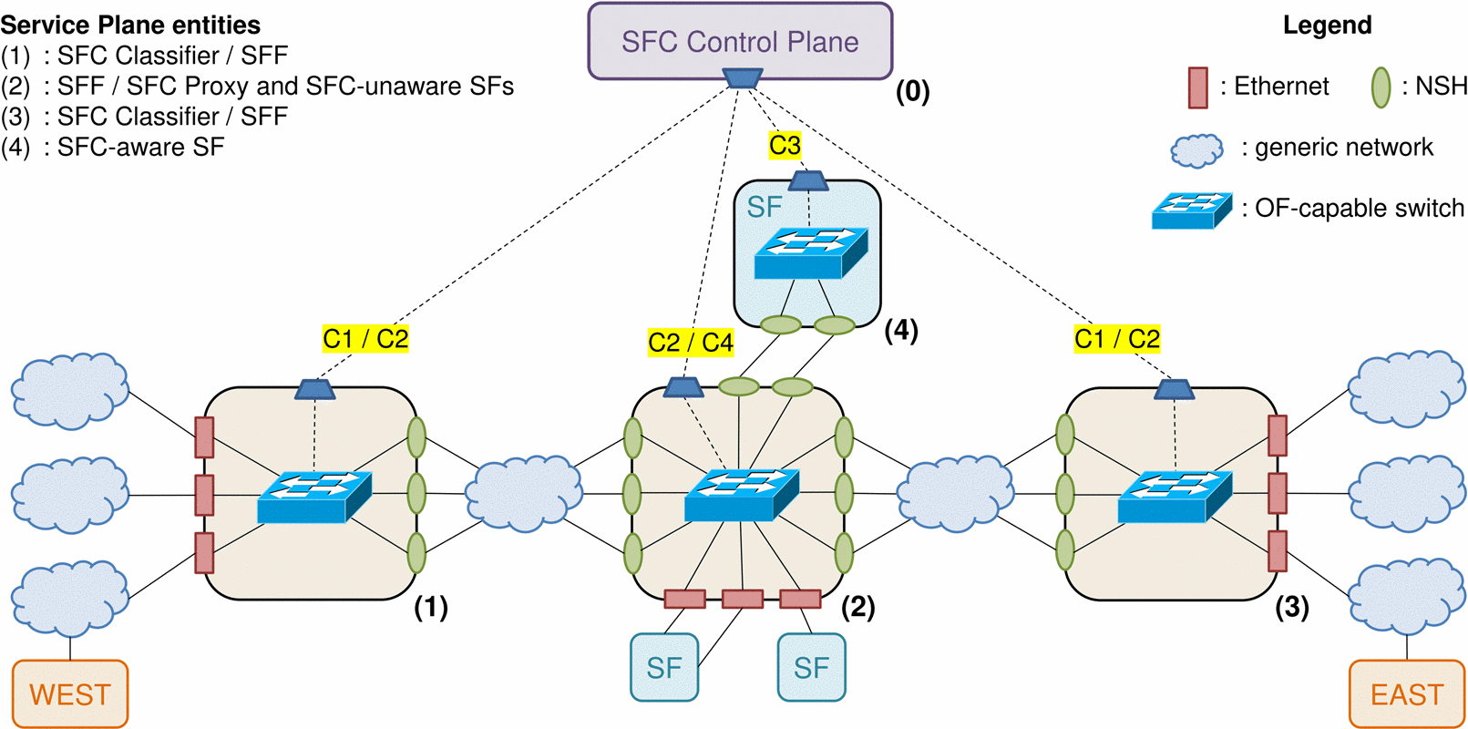
Openflow-Based NSH Control Plane
Notes:
它由一個SFC-CP實體、一對SFC-CIs、一個中間節點作為SFF和作為SFC Pr對SFC-aware SFs的執行轉發、一個SFC-aware的SF和兩個SFC-aware的SF組成。

Slide 17
In our reference implementation we assume that each Service Plane entity is built around an OpenFlow-capable switch (OF-S).
Then, all SFC entities are interconnected by means of a tunneling technology (e.g., VXLAN) through an underlying network infrastructure, controlled by one or multiple network operators through a generic control plane paradigm.
The network infrastructure can use either SDN or non-SDN control, but this does not matter because the proposed SFC-CP is separate from the network control plane.
Notes:
在我們的參考實現中，我們假設每個服務平面實體都是圍繞具有OpenFlow功能的交換機（OF-S）構建的。
然後，所有SFC實體通過隧道技術（例如VXLAN）通過基礎網絡基礎結構互連，並由一個或多個網絡運營商通過通用控制平面範例進行控制。
網絡基礎結構可以使用SDN或非SDN控制，但這無關緊要，因為提出的SFC-CP與網絡控制平面是分開的

Slide 18
Mapping a SFP to the transport network requires to define a relationship between a given position in the SFP (i.e., a SPI/SI pair) and a certain next-hop in the underlying network.
While the former information belongs to the Service Plane, the latter depends on the network's topology and technology, as it must point to an existing location in the underlying network, typically expressed as an address (e.g., IP or MAC).
This paper introduces a mapping strategy that, to the best of our knowledge, has not been proposed yet. It is a rather straightforward idea: mapping the SFP-to-transport relationship onto the ports of the employed OF-S.
Notes:
將SFP映射到傳輸網絡需要定義SFP中的給定位置（即SPI / SI對）與基礎網絡中的特定下一跳(目的地)之間的關係。
前者信息屬於服務平面，而後者則取決於網絡的拓撲和技術，因為它必須指向基礎網絡中的現有位置，通常表示為地址（例如IP或MAC）。
就我們所知，本文介紹了一種尚未提出的映射策略。 這是一個相當簡單的想法：將SFP-to-transport的關係映射到所用OF-S的端口上。

Slide 19
In our implementation, each NSH interface, corresponding to a specific SPI/SI pair, is bridged to a port on the node's internal OF-S.
The working principle of the proposed implementation is the following: through the association of SPI/SI pairs to ports on a OF-S, it is possible to have the node acting as a NSH Service Plane component while controlling it through the OpenFlow protocol from an SDN Controller
Notes:
在我們的實現中，每個NSH接口(對應於特定的SPI / SI對）都橋接到節點內部OF-S上的端口。
提議的實現的工作原理如下：通過將SPI / SI對與OF-S上的端口相關聯，可以使該節點充當NSH服務平面組件，同時通過在SDN控制器上的OpenFlow協議來控制該節點

Slide 20
The NSH mapping tables are therefore implemented in the form of flow tables inside the OF-S.
As an example, assume port N of the OF-S is bridged to interface nshM of the node.
Instructing the switch to send traffic out of port N will result in the node sending NSH-encapsulated traffic out of interface nshM with the corresponding SPI/SI values.
Notes:
因此，NSH映射表以of-S內部的flow table的形式實現。例如，假設of-S的port N橋接到節點的interface nshM。
指示 交換機將traffic從port N發送出去 將導致(代表) 從interface nshM發送NSH封裝的traffic同時有著相對應的SPI/SI值

Slide 22
With reference to Fig. 1, the entities are mapped to the nodes in the following way:
Node (0) hosts the SFC-Co.
Node (1) is responsible for adding the NSH tag to packets coming from WEST hosts and forwarding NSH-encapsulated packets to the first SFF in the SFP: in this role, it acts as SFC-Cl. Additionally, this node is also responsible for removing the NSH tag from packets assigned to a SFP which ends at Node (1), such as packets destined to WEST hosts, thus acting as SFF. Following this approach, the SFC classification is as expressive as OpenFlow matching is.
Notes:
節點（0）承載SFC-Co。
節點（1）負責將NSH標記添加到來自西部主機的資料包，並將NSH封裝的資料包轉發到SFP中的第一個SFF：在此角色中，它充當SFC-Cl。此外，該節點還負責從分配給SFP的資料包中刪除NSH標記，該SFP結束於節點（1），例如發送到西部主機的資料包，因此充當SFF。按照這種方法，SFC分類就像OpenFlow匹配 。

Slide 23
Node (2) is responsible for handling the NSH encapsulation on behalf of SFC-unaware SFs, as well as for forwarding the NSH-encapsulated packets to the following SF or SFF in the SFP. In those two tasks, Node (2) acts as SFC-Pr and SFF, respectively.
Node (3), similarly to Node 1, acts both as SFC-Cl and SFF for the traffic exchanged with EAST hosts.
Node (4) acts as a SFC-aware SF, as it is able to receive NSH-encapsulated packets from the SFF and process them, before sending them back to the SFF after updating the SI.
Notes:
節點（2）負責代表SFC-unaware SFs的SFs處理NSH封裝，以及將NSH封裝的包轉發到SFP中的以下SF或SFF。在這兩個任務中，節點（2）分別充當SFC-Pr和SFF。
與節點1類似，節點（3）同時充當與EAST主機交換的流量的SFC CI和SFF。
節點（4）充當SFC-aware SF，因為它能夠從SFF接收NSH封裝的包並對其進行處理，然後在更新SI之後將其發送回SFF。

Slide 24
Experimental Validation
Test Bed Setup:
As a proof of concept, we developed a test bed to implement the proposed solution, based on the reference scenario illustrated in Fig. 1.
The test bed comprises a total of five Virtual Machines (VMs) and the interconnecting virtual networks.
All of the involved VMs run Ubuntu 14.04 LTS. One of them hosts an instance of the ONOS SDN Controller [10], while the remaining four VMs implement NSH-capable nodes.

Slide 25
On each NSH node we installed and enabled the open-source NSH kernel module [11].
We assigned a SPI/SI pair to each NSH interface, and mapped each of them to a transport-level next-hop (i.e., an IP address), instructing the node to use VXLAN as encapsulation protocol to obtain the overlay topology.
This is equivalent to adding an entry in the NSH-to-transport mapping table specifying that all traffic addressed to the endpoint with that SPI/SI should be encapsulated in VXLAN packets and sent to the specified remote IP address.
Similarly each NSH interface was made aware of the inbound SPI/SI values it is meant to receive.
Notes:
在每個NSH節點上，我們安裝並啟用了開源NSH內核模組[11]。
我們為每個NSH interface分配了一個SPI/SI對，並將它們對應到一個傳輸級下一跳(目的地)（即IP位址），指示該節點使用VXLAN作為封裝協定來獲得覆蓋拓撲。
這相當於在NSH-to-transport映射表中添加一個entry，指定所有traffic定址到endpoint所會有的SPI/SI都應該被封裝進VXLAN的packet和送到指定的遠端IP address。
類似地，每個NSH interface都知道它要接收的入站SPI/SI值。

Slide 26
The transport network infrastructure will be traversed by as many VXLAN tunnels as the number of SPI/SI pairs defined.
Each packet sent out by the VMs over one of their NSH interfaces will be intercepted by the NSH kernel module and encapsulated in a NSH/VXLAN packet, obtaining the SPI/SI pair assigned to the NSH interface.
Similarly, when a packet is received on one of the NSH interfaces, the kernel module will intercept it and remove the NSH/VXLAN encapsulation, before handling the packet to the traditional IP forwarding module of the VM.
Notes:
VXLAN隧道將遍歷(經過所有)傳輸網絡基礎結構，其數量與定義的SPI / SI對的數量相同。
發送的每個數據包 透過VM的其NSH interface之一 將被NSH kernel模塊攔截，並封裝在NSH / VXLAN數據包中，從而獲得分配給NSH interface的SPI / SI對。
類似地，當在其中一個NSH interface上接收到資料包時，內核模組將截獲該資料包並刪除NSH/VXLAN封裝，然後將該資料包處理到VM的傳統IP轉發模組。

Slide 27
We implemented the full set-up depicted in Figure 1. As SFC-unaware SFs, we deployed a Deep Packet Inspector (DPI) and a Traffic Controller (TC), the latter configured with two Layer-2 interfaces (inbound and outbound). The SFC-aware SF is an Integrity Checker (IC). The WEST hosts represent users wishing to communicate with the EAST hosts with different priorities and the following service policies:
Traffic coming from user WEST1 should be first checked by the DPI and then copied in the IC;
Traffic coming from user WEST2 should be first checked by the DPI and then limited in bandwidth by TC.
Notes:
我们实现了图1所示的完整设置。
由于SFC-unaware的SFs，我们部署了一个Deep Packet Inspector（DPI）和一个traffic controller（TC），后者配置了两个第2层interface（入站和出站）。
SFC-aware的SF是一个完整性检查器（IC）。
East主机代表希望与west主机进行通信的用户，具有不同的优先级和以下服务策略：
来自用户WEST1的流量应首先由DPI检查，然后复制到IC中；
来自用户WEST2的流量应首先由DPI检查，然后由TC限制带宽。

Slide 28
Therefore, three possible SFCs are needed with their respective SFPs:
SFCl, from any WEST user to the destination EAST user, duplicating the traffic towards the DPI;
SFC2, from a high-priority WEST user to the destination EAST user, passing through the IC;
SFC3, from a low-priority WEST user to the destination EAST user, passing through TC for bandwidth limitation.
Notes:
因此，需要三個可能的SFC及其各自的SFP：
SFCl，從任何西部用戶到目的地東部用戶，複製朝向DPI的流量；
SFC2，從高優先順序的西部用戶到目的地東部用戶，通過IC；
SFC3，從低優先順序西部用戶到目的地東部用戶，通過TC進行頻寬限制。

Slide 29
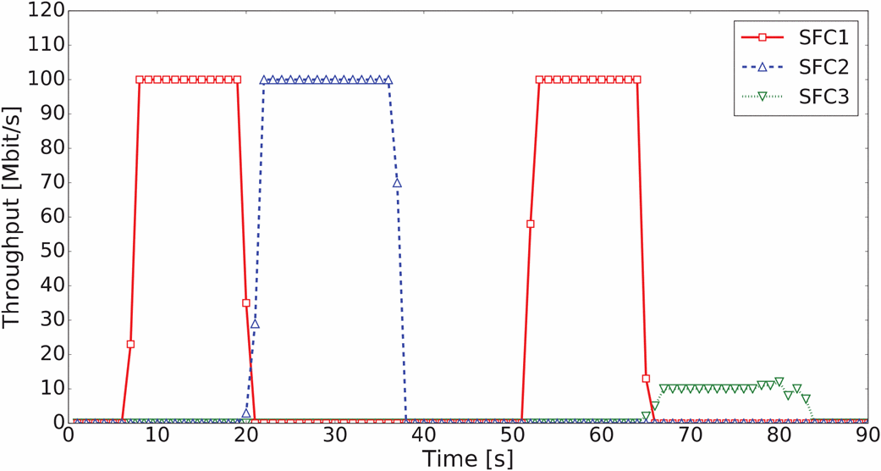
Proof-of-Concept Validation
Notes:
Orchestrator主動將流程規則安裝在相關SFC實體的OF-S內部，以便應用鏈SFC1。然後，它等待任何西部用戶開始向目的地東部用戶發送流量。當流啟動時，編排器啟動DPI，並在一小段時間後從中檢索資訊。如果檢查的流量包含來自WEST1的資料，則腳本安裝應用SFC2的規則，否則，如果流量包含來自WEST2的資料，則腳本安裝應用SFC3的規則。應該注意的是，交通流被引導到不同的SFP而不阻止它們，從而實現動態SFC。
在應用不同的sfc時，在節點（2）內的OF-S處測得的西向東輸送量如圖2所示。首先，SFC1應用於從WEST1（從t=8s到t=20s）的交通，然後在檢查後應用SFC2（從t=21s到t=38s）。隨後，從WEST2出發的交通需遵守SFC 1（從t=53s到t=65s），然後在檢查後，使用帶成形的SFC3（從t=66s到t=84s）。這一結果證明了動態SFC在實驗臺上的正確實現。

Slide 30
Conclusion
The SFC Control Plane solution proposed in this paper is based on the SDN paradigm.
In particular, assuming SFC entities that are built around an OpenFlow-capable switch we can take advantage of SDN's inherent dynamicity and programmability also in the Service Plane, while keeping it independent of the underlying network infrastructure.
We validated our approach on a test bed emulating multiple SFC entities interconnected by non-SDN networks under dynamic chaining scenarios.
Notes:
本文提出的SFC控制平面解決方案基於SDN範例。 尤其是，假設圍繞支持OpenFlow的交換機構建的SFC實體，我們還可以在服務平面中利用SDN固有的動態性和可編程性，同時使其不依賴於底層網絡基礎結構。
我們驗證了我們的方法在試驗臺上模擬多個SFC實體的，這些實體在動態連結場景下由非SDN網路互連。

Slide 31
References
[1] “Network Functions Virtualisation (NFV); Architectural Framework,” The European Telecommunications Standards Institute (ETSI), October 2013. [Online]. Available: http://www.etsi.org/technologies-clusters/ technologies/nfv
[2] F. Callegati, W. Cerroni, C. Contoli, R. Cardone, M. Nocentini, and A. Manzalini, “SDN for dynamic NFV deployment,” IEEE Communications Magazine, vol. 54, no. 10, pp. 89–95, October 2016.

Slide 32
[3] A. M. Medhat, G. A. Carella, M. Pauls, M. Monachesi, M. Corici, and T. Magedanz, “Resilient orchestration of Service Functions Chains in a NFV environment,” in 2016 IEEE Conference on Network Function Virtualization and Software Defined Networks (NFV-SDN), Nov 2016, pp. 7–12.
[4] M. T. Beck, J. F. Botero, and K. Samelin, “Resilient allocation of Service Function Chains,” in 2016 IEEE Conference on Network Function Virtualization and Software Defined Networks (NFV-SDN), Nov 2016, pp. 128–133.

Slide 33
[5] T. Soenen, S. Sahhaf, W. Tavernier, P. Skldstrm, D. Colle, and M. Pickavet, “A model to select the right infrastructure abstraction for Service Function Chaining,” in 2016 IEEE Conference on Network Function Virtualization and Software Defined Networks (NFV-SDN), Nov 2016, pp. 233–239.
[6] J. M. Halpern and C. Pignataro, “Service Function Chaining (SFC) Architecture,” RFC 7665, Oct. 2015. [Online]. Available: https://rfc-editor.org/rfc/rfc7665.txt

Slide 34
[7] P. Quinn and U. Elzur, “Network Service Header,” Internet Engineering Task Force, Internet-Draft draft-ietf-sfc-nsh-12, Feb. 2017, work in Progress. [Online]. Available: https://datatracker.ietf.org/doc/html/draft-ietf-sfc-nsh-12
[8] M. Boucadair, “Service Function Chaining (SFC) Control Plane Components,” Internet Engineering Task Force, Internet-Draft draftietf-sfc-control-plane-08, 2016, work in Progress. [Online]. Available: https://datatracker.ietf.org/doc/html/draft-ietf-sfc-control-plane-08

Slide 35
[9] T. Nadeau and P. Quinn, “Problem Statement for Service Function Chaining,” RFC 7498, Apr. 2015. [Online]. Available: https://rfc-editor. org/rfc/rfc7498.txt
[10] ONOS: Open Network Operating System. [Online]. Available: http://onosproject.org
[11] Network Service Header Linux kernel module implementation. [Online]. Available: https://github.com/upa/nshkmod

