Slide 1
An Auto Scaling System for API Gateway Based on Kubernetes
Meina Song,Chengcheng Zhang, E Haihong
School of Computer Science, Beijing University of Posts and Telecommunications, Beijing, China
Date of Conference: 23-25 Nov. 2018
Impact factor:X
Notes:
作者利用kubernetes 設計一個auto scaling的系統
能讓API gateway 達到auto scaling
三位作者是來自北京大學
日期是2018年 11月

Slide 2
OUTLINE
Absract
Introduction
The Design of API Gateway
The Design of Auto Scaling System Based on Kubernetes and Prometheus
Experiment and Results
Conclusion

Slide 3
Absract
The micro-service approach is a new term in software architecture patterns which is gaining popularity due to its flexibility, granular approach and loosely coupled services [1].
In this paper, first, we present an API Gateway System as the entrance to backend services.
It can effectively decrease the amount of remote calls between applications and backend services, and simplify the complexity of internal services calling each other.
[1] V Singh and S K. Peddoju, "Container-based microservice architecture for cloud applications[C]", Computing Communication and Automation (ICCCA) 2017 International Conference, pp. 847-852, 2017.
Notes:
微服務方法是軟體架構模式中的一個新形式，由於其靈活性，粒度方法和鬆散耦合的服務而日益熱門[1]。
在這篇paper中,作者介紹了API gateway 作為後端服務的一個入口
它可以有效率的減少應用程式和後端服務之間的遠端呼叫
並且簡化內部服務互相呼叫的複雜度

Slide 4
Absract
Secondly this paper designs an auto scaling system for API Gateway System based on Kubernetes and Prometheus which can dynamically adjust the number of application instances according to its own load.
It can improve the utilization of system resources while ensuring the high availability and quality of the applications service.
Notes:
第二,這篇paper基於 k8s和 Prometheus設計了一個 可以供API gateway auto scaling的系統
它可以根據它的負載 動態的調整應用程式 instances的數量
它可以增進系統資源的利用,同時確保服務的高可用性和服務的品質
Prometheus 是一套open source的 系統監控警報框架,最主要就是週期性的收集系統指標資料
它的專案是由 SoundCloud 的工程師(前 Google 工程師)建立

Slide 5
Introduction
The micro-service is a new term in software architecture patterns which divides the complex system into a set of small independent services.
Each of the services is running independently in its own process which performs a specific task [2]–[3].
Services can communicate with each other by a number of lightweight mechanisms such as HTTP, RPC and so on [4].
[2] D Namiot and M. Sneps-Sneppe, "On Micro-services Architecture[J]", International Journal of Open Information Technologies, vol. 2, no. 9, pp. 24-27, 2014.
[3] Z. Xiao, I. Wijegunaratne and X. Qiang, "Reflections on SOA and Microservices", 2016 4th International Conference on Enterprise Systems (ES), pp. 60-67, 2016.
[4] Uckelmann Dieter, Mark Harrison and Florian Michahelles, "An architectural approach towards the future internet of things" in Architecting the internet of things, Berlin Heidelberg:Springer, pp. 1-24, 2011.
Notes:
微服務是一種新的軟體架構模式, 它把複雜的系統劃分為一組小型獨立的服務
每個服務獨立執行在它自己的process 並且能完成特定的任務
微服務可以藉由許多輕量化的機制彼此溝通, 像是 HTTP ,RPC 等等

Slide 6
Introduction
In traditional communication pattern,applications directly call the backend services.
However, a request for an application may call various backend services.
The masses of remote calls could cause the delays and impact on customer experience.
With the development of business, the backend service may need to be further divided into a set of small independent services. The direct communication pattern could result in much modification in all applications to adapt services' changes.
Notes:
在傳統的溝通模式下, 應用程式是直接的呼叫後端服務
然而, 一個應用程式的request 可能呼叫多個後端服務
大量的遠端呼叫可能導致延遲並影響用戶的體驗
隨著商業的發展, 可能需要將後端服務劃分為一組小型獨立的服務
直接通信的這種模式可能導致 為了要適應後端服務改變, 應用程式需要大量的進行修改

Slide 7
Introduction
By using API Gateway System as the middle layer between the applications and backend services [6]–[7], it can hide some limitations and details for applications.
For example the changes of backend service are invisible to the applications.
[6] Q Zhang, H Chu, M Li et al., "A unified API gateway for high availability clusters[C]", Mechatronic Sciences Electric Engineering and Computer (MEC) Proceedings 2013 International Conference, pp. 2321-2325, 2013.
[7] C Y Fan and S P. Ma, "Migrating Monolithic Mobile Application to
Microservice Architecture: An Experiment Report[C]", AI & Mobile Services (AIMS) 2017 IEEE International Conference, pp. 109-112, 2017.
Notes:
藉由使用API gateway系統當作應用程式和後端服務的中間層,它可以隱藏
應用程式一些限制和細節
例如, 後端服務的改變對於應用程式來講是無形的,不受影響的

Slide 8
Introduction
But since the API Gateway System is the only entrance to backend services, and it's breaking down can lead to all services unavailable.
So high availability of API Gateway services must be guaranteed.
Notes:
但是由於API gateway 是後端服務的唯一入口,
因此它的崩潰會導致整個服務不可使用
所以 必須確保API gateway是高可用性的

Slide 9
Introduction
API Gateway
  we present an API Gateway System which can effectively decrease the amount of remote calls and enable the changes of backend services invisible to applications.
Auto Scaling System
  we designed an Auto Scaling System for API Gateway. It can dynamically adjust the number of instances of API Gateway according to its workload, which can improve the utilization of system resources while ensuing the high availability and quality of the API Gateway's service.
Notes:
這篇paper的主要貢獻
他們介紹一個了API gateway系統 , 它可以有效的減少遠端呼叫的次數,並且
後端服務的更改對應用程式來說是無形的
他們對API Gateway 設計一個 auto scaling系統, 它可以根據API gateway的工作負載
動態的調整 API gateway的數量, 從而可以確保 API Gateway有高可用性和高品質的
並且提高系統資源的利用

Slide 10
The Design of API Gateway
Communications in Micro-Service Architecture
The Design of API Gateway System
Notes:
A．會先介紹微服務的架構溝通
B. API gateway系統的設計

Slide 11
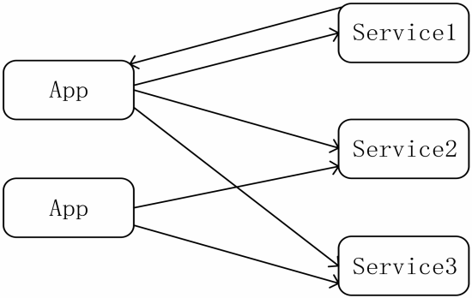
A. Communications in Micro-Service Architecture
Fig. 1. communication directly.
Notes:
在微服務架構中，基本的通訊模式由兩部分組成：應用程序和後端服務，後端服務執行特定功能
應用程式是用戶, 可以呼叫後端服務，例如mobile application 和Web 服務 client端。

Slide 12
A. Communications in Micro-Service Architecture
We built an API gateway using node JS and consul [8] as the middle layer between the application and backend services which allows users to invoke the services required without the need for any knowledge pertaining to the structure of the system[7].
Notes:
作者他們使用 Node JS 和 Consul 建置 API gateway API gateway作為應用程式和後端服務的中間層
它可以讓用戶 使用後端服務時, 無需有任何系統架構的相關知識

Slide 13
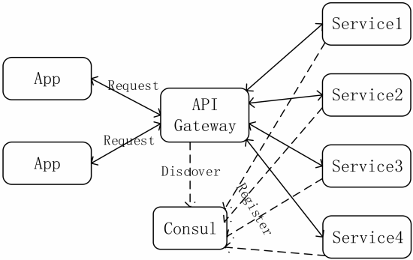
A. Communications in Micro-Service Architecture
Fig. 2. communication by API gateway.
Notes:
在這種通訊模式中，應用程式和後端服務僅需要分別與API gateway通訊。
後端服務啟動時將在consul 註冊服務address。
API gateway 接收應用程式 request 並在consul中 進行service Discovery
然後路由到 後端服務，最後將結果返回給應用程式。

Slide 14
B. The Design of API Gateway System
The API Gateway System has three subsystems: Core subsystem, monitor subsystem and admin subsystem. The architecture of API Gateway system is shown in Fig 3.

Slide 15
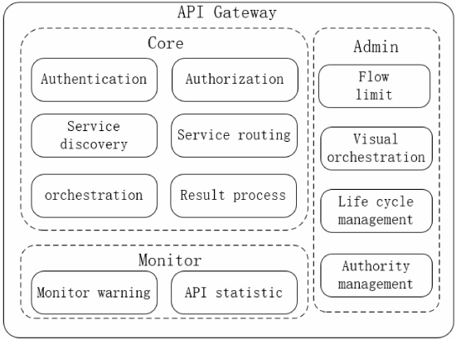
The Design of API Gateway System
Fig. 3. the architecture of API Gateway.
Notes:
在Core 子系統部分
有用戶身份驗證，授權，service discovery，service 編排，service routing和 result processing
它是API gateway 的核心功能
它的處理是在收到請求時，首先對請求進行身份驗證，然後從Consul發現服務，
最後將請求路由到後端服務。最後，核心子系統根據應用程式的類型 處理結果。
在monitor 子系統中
它的主要職責是監視 core subsystem 的運行狀況和性能,
例如 API response time 和 正在呼叫的服務 數量等等
在 ADMIN 子系統
它主要是關於core subsystem的控制和配置

Slide 16
The Design of Auto Scaling System Based on Kubernetes and Prometheus
In the micro-service architecture, The API Gateway System is the only entrance to backend services, when a large amount of requests invokes API Gateway service concurrently, it could cause the API Gateway service blocking or even breaking down.
If API Gateway service breaks down, it makes all services unavailable. To resolve this problem, we use Kubernetes and Promethues to build an auto scaling system to dynamically scale API Gateway System.
Notes:
在微服務架構中，API Gateway是到後端服務的唯一入口，
當大量request同時使用API gateway服務時，可能會導致API gateway 阻塞甚至崩潰。
如果API gateway服務發生故障，它將使所有服務不可用。
為了解決這個問題，作者使用Kubernetes和Promethues構建了一個
Auto scaling system來動態擴展API gateway。

Slide 17
A.Kubernetes and Promethues
Kubernetes is an open source cluster manager for Docker containers [10]. It provides management of containerized clusters based on the CAAS (Container as a service) level.
Notes:
Kubernetes是 一個開源的 Docker容器的叢集管理
它提供了 (容器即服務)等級 的 容器化叢集的管理
Kubernetes 的架構如下一張圖4

Slide 18
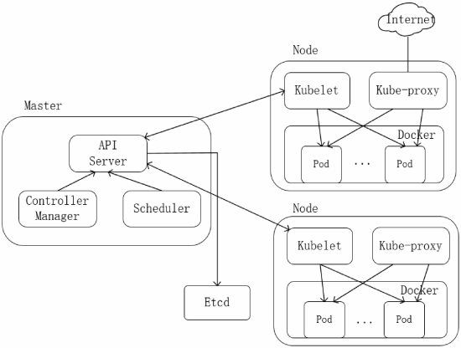
A.Kubernetes and Promethues
Fig. 4. the architecture of Kubernetes.
Notes:
在 k8s的叢集中 , Pod 是可以執行和管理的
基本部屬單元 , 每個Pod內也可以監視各服務的狀態
Master node
它作為控制節點, 它負責 container在叢集中的管理和排列
所有的 K8s 操作都是透過 API Server
API Server是所有k8s服務的入口,
當 API Server 收到資源管理需求時，
會交由 scheduler 進行調度，分配最適合的 Node 來執行 Container。
Controller負責所有的控制功能，我在網路上查得
有像是 node controller ,, service controller等等幾種不同的
controller , 這些文章中沒有提到
etcd 是一個分散式資料庫系統，
由於 Master Node 可以由多個節點組成，
好讓某個節點發生故障的時候可以有其他 Master Node
接手管理 Container，因次透過 etcd 會隨時同步每一個 Master Node 的資料。
Node
是工作節點, 負責實際contaoner的運行
Kubelet負責 管理叢集中容器的生命週期, maser node 可以透過
Kubelet 管理容器
Kube-proxy 在叢集內提供 service discovery 和 load balancing
kube-proxy 提供給 kubelet 進行 API Server 連線

Slide 19
A.Kubernetes and Promethues
In Kubernetes clusters, Pod is the basic deployment unit that can be both operated and managed. It is also native support for monitoring the state of services within pod.
Master
  as the control node, it is responsible for the of containers arrangement and management in cluster.
  The API server is the entrance to all services
  the Scheduler is responsible for scheduling the application to the node for deployment which based on the state of the cluster.
Notes:
在 k8s的叢集中 , Pod 是可以執行和管理的
基本部屬單元 , 每個Pod內也可以監視各服務的狀態
Master node
它作為控制節點, 它負責 container在叢集中的管理和排列
API Server是所有服務的入口, Scheduler負責根據將應用程式
調度到要部屬的node
Controller 負責將依據應用程式的狀態進行管理
Node
是工作節點, 負責實際container的運行
Kubelet負責 管理叢集中容器的生命週期, maser node 可以透過
Kubelet 管理容器
Kube-proxy 在叢集內提供 service discovery 和 load balancing

Slide 20
A.Kubernetes and Promethues
  The Controller manages the state of the application in the cluster as the desired state that we set.
Node
  Node is the working node and responsible for actually running the containers.
  The Kubelet manages the lifecycle of containers in the cluster, as well as Volume and network management.
  The Master node manages the containers through Kubelet. Kube-proxy provides service discovery and load balancing within the cluster.
Notes:
在 k8s的叢集中 , Pod 是可以執行和管理的
基本部屬單元 , 每個Pod內也可以監視各服務的狀態
Master node
它作為控制節點, 它負責 container在叢集中的管理和排列
API Server是所有服務的入口, Scheduler負責根據將應用程式
調度到要部屬的node
Controller 負責將依據應用程式的狀態進行管理
Node
是工作節點, 負責實際container的運行
Kubelet負責 管理叢集中容器的生命週期, maser node 可以透過
Kubelet 管理容器
Kube-proxy 在叢集內提供 service discovery 和 load balancing

Slide 21
A.Kubernetes and Promethues
Prometheus
  Prometheus is an open source monitoring alarm system by SoundCloud [11].
  It uses pull model and HTTP protocol to collect data indicators.
  Prometheus supports the monitoring of containers and it can be easily deployed to Kubrnetes cluster as a monitor system.
Notes:
Prometheus是SoundCloud的開源的系統監視警報框架[11]。
它使用pull model 和HTTP協議來收集數據指標。
Prometheus支援 容器的監視，它可以輕鬆地將其作為監視系統部署到Kubrnetes集群。

Slide 22
B.The Design of Auto Scaling System Based on Kubernetes and Prometheus
The Auto scaling system can dynamically adjust the number of application instances according the workload of application.
It can ensure the high availability of the application and improve the utilization of the system resources.
Notes:
Auto scaling 系統可以根據應用程式的工作負載動態
的調整 應用程式instance的數量
它可以確保應用程式的高可用性並且增進系統資源的效能
它的模型如下一張圖5

Slide 23
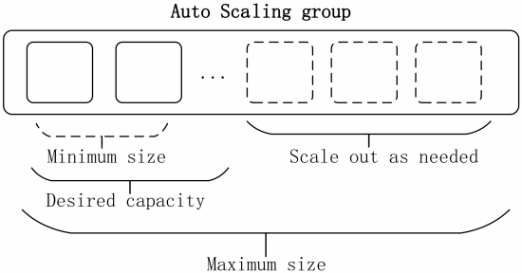
B.The Design of Auto Scaling System Based on Kubernetes and Prometheus
Fig. 5. the auto scaling model.
Notes:
API gateway instance的最小和最大數量可以藉由系統參數指定
當API gateway的工作負載量是低的時候, 可以僅部屬最少量的 API gateway instance
隨著 工作負載的增加, 它可能超過當前的 instance的工作負載閥值
Auto scaling system會根據需求去scale out 已平衡這些工作負載
同時，系統為每個API gateway instance設置預期狀態並監視它們的即時狀態。
當其中一個API gateway instance 異常退出或發生故障時，auto scaling system
將自動分配一個新instances，並將工作負載從不可用的instance 移至新的 instance，
以確保API 服務的連續性和可用性。
基於Kubernetes和Prometheus的Auto Scaling系統的架構如下一張圖表示。

Slide 24
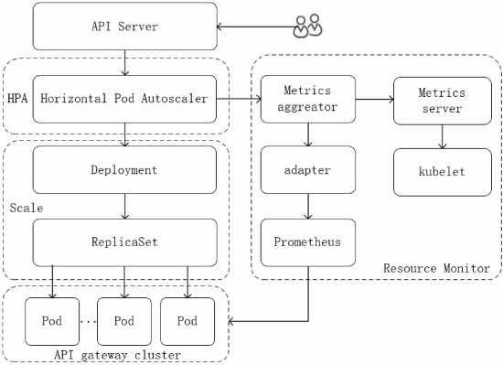
The Design of Auto Scaling System Based on Kubernetes and Prometheus
Fig. 6. the architecture of Auto Scaling System.
Notes:
架構主要包含四個部分
API Gateway cluster, Resource monitoring, HPA, Scale.
API gateway cluster
API gateway 定義並公開監視指標 並提供HTTP interface 供
Pormetheus週期性的收集資料
Resource Metric Monitoring
主要透過 API gateway 提供的 HTTP interface收集客戶數據
Adapter 負責 從 Prometheus檢索 客戶監視資料
並為 metric aggregator 處理特定data
Metric aggregator 將 Prometheus 和 Kubelet 收集的資料整合
給 使用HPA
HPA—
它會週期性的從 metric aggregator 獲取監控的數據 並且,和threshold進行比較
並根據 auto scaling 演算法計算需要調整的 instance數量
Scale—
它根據HPA的計算 負責調整API gateway instances的實際數量
Auto scaling 步驟
User 透過API Server設置HPA , 設置需要參考的資源和配額利用率,
並設置最大和最小的api gateway instance的 threshold
HPA週期性的從 aggregator 獲取 Prometheme和 kubelet 收集來的指標資料
使用 monitor資料計算目標instance數 和threshold比較
目標instances數量不能超過步驟1設置的最大和最小閥值
如果超過 會被強制為最大instance數
反之, 將會被expanded為計算出的數量

Slide 25
The Design of Auto Scaling System Based on Kubernetes and Prometheus
API Gateway Cluster
  API Gateway defines and exposes custom monitoring metrics and provides a HTTP interface for Prometheus to collect data periodically.
Resource Metric Monitoring
  It is mainly responsible for getting customer monitoring data from the HTTP interface provided by the API Gateway.
  The Adapter is responsible for retrieving customer monitoring data from Prometheus and processing and specification of the data for Metric aggregator calls.
  The metric aggregator combines the data collected by Prometheus and Kubelet for HPA call.
Notes:
API gateway cluster
API gateway 定義並公開監視指標 並提供HTTP interface 供
Pormetheus週期性的收集資料
Resource Metric Monitoring
主要透過 API gateway 提供的 HTTP interface收集客戶數據
Adapter 負責 從 Prometheus檢索 客戶監視資料
並為 metric aggregator 處理特定data
Metric aggregator 將 Prometheus 和 Kubelet 收集的資料整合
給 使用HPA
HPA—
它會週期性的從 metric aggregator 獲取監控的數據 並且,和threshold進行比較
並根據 auto scaling 演算法計算需要調整的 instance數量

Slide 26
The Design of Auto Scaling System Based on Kubernetes and Prometheus
HPA
  it gets the monitoring metric data from Metrics Aggregator periodically and compared it with the threshold and calculates the number of instances that need to be adjusted according to the auto scaling algorithm.
Scale
  it is responsible for adjusting the actual number instances of API Gateway according to the number calculated by HPA.
Notes:
HPA—
它會週期性的從 metric aggregator 獲取監控的數據 並且,和threshold進行比較
並根據 auto scaling 演算法計算需要調整的 instance數量
Scale—
它根據HPA的計算 負責調整API gateway instances的實際數量

Slide 27
The Design of Auto Scaling System Based on Kubernetes and Prometheus
The Auto Scaling System step is as follows:
  The user creates the HPA through API Server, sets the quota utilization rate of the resource that needs reference and sets the maximum and minimum threshold of the number of API Gateway instances.
  HPA gets the monitoring metric data collected by Prometheme and kubelet from Metric aggregator periodically.
  Calculate the number of target instances by using the monitoring data compared with the threshold.
Notes:
步驟如下:
User 透過API Server設置HPA , 設置需要參考的資源和配額利用率,
並設置最大和最小的api gateway instance的 threshold
HPA週期性的從 aggregator 獲取 Prometheme和 kubelet 收集來的指標資料
使用 monitor資料計算目標instance數 和threshold比較

Slide 28
The Design of Auto Scaling System Based on Kubernetes and Prometheus
  4. The target number of instances cannot exceed the maximum and minimum threshold that set in step 1. If it exceeds, it will be forced to the maximum number of instances, If not, it is expanded to the calculated number of instances.
  5. Repeat steps 2 to 4.
Notes:
目標instances數量不能超過步驟1設置的最大和最小閥值
如果超過 會被強制為最大instance數
反之, 將會被expanded為計算出的數量

Slide 29
Expriment and Results
  five physical machines
  set up the Kuberneter cluster with one master node and five working nodes in centos system.
  One master node and one working node is installed in the same physics machine.
  Kubernetes version : 1.9.6
    64GB memory
    24 cores
  Docker version : 1.13.1
Notes:
5個實體機
設置 k8s叢集 1 master node 5個 working node
系統是 centos system
1 master node 和 1 working node 在同一台實體機

Slide 30
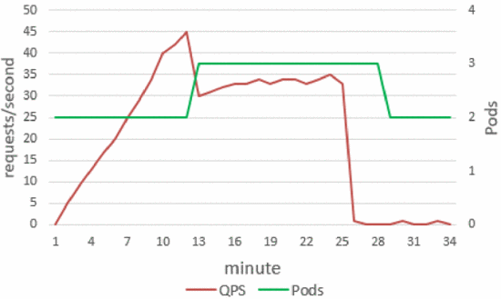
Expriment and Results
Fig. 7. QPS and the number of Pods .
Notes:
QPS (query per second)
並使用兩個監控指標CPU和QPS的使用率來測試
創建了API Gateway的HPA
實驗時間為35分鐘。然後，我們使用測試程序來模擬用戶請求，首先從零逐漸增加請求，保持請求線性增長，
當API Gateway的請求負載在大約12分鐘內達到45 QPS時，它開始scale out，並創建了一個instances。
擴展後，API gateway 服務的負載下降，然後開始緩慢增長，並最終穩定在34 QPS左右。
當我們停止測試程序時，它開始scale in，並將實例數從三個更改為兩個。

Slide 31
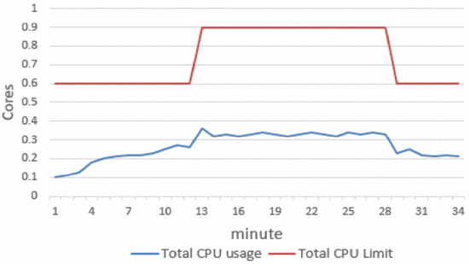
Expriment and Results
Fig. 8. The usage of CPU.
Notes:
圖8是CPU 使用率和cpu 限制

Slide 32
Conclusion
we have present an API Gateway System as the entry point for the applications and backend service in micro-service architecture.
We designed an Auto Scaling System based on Kubernetes and Prometheus for the API Gateway System.
we tested the Auto Scaling System with the test program.
Notes:
作者提出了一個API gateway系統作為微服務體系架構中應用程序和後端服務的入口點。
他們設計了基於Kubernetes和Prometheus的Auto Scaling系統，用於API gateway系統。
然後，作者使用測試程序測試了Auto Scaling系統。

Slide 33
Conclusion
after using the API Gateway mechanism, it can decrease the number of remote calls and simplify the complexity for backend services calling each other.
The applications and backend services only need to communicate with API Gateway.
we can dynamically replace or modify the backend services which is invisible to the applications.
Notes:
使用API​​ gateway機制後，它可以減少遠端呼叫的次數，並簡化後端服務之間相互呼叫的複雜性。
應用程序和後端服務僅需與API gateway通訊，
我們可以動態替換或修改服務 並對於應用程式來說是無形的。

Slide 34
Conclusion
the Auto Scaling System can dynamically adjust the number of the service instances according to the load of API Gateway.
When it load exceeds the specified threshold, more instances are created dynamically to balance the workload.
It can improve the utilization of system resources while ensuing the high availability and quality of service of the API Gateway.
Notes:
Auto Scaling系統可以根據API gateway 的負載動態調整service instances的數量。
當負載較低時，它使用最少的實例數來平衡工作負載。當負載超過指定的閾值時，將動態創建更多實例以平衡工作負載。
它可以確保API gateway的高可用性和服務質量的同時提高系統資源的利用率。

Slide 35
心得
作者藉由K8s和prometheus設計了一個auto scaling
系統 可以動態調整api gateway的instances數量,
不僅充分利用k8s的功能,並能監測工作負載狀況進行調整,使API Gateway在微服務架構中能達到更好的資源利用。

Slide 36
Reference
[1] Singh V, Peddoju S K. Container-based microservice architectu re for cloud applications[C]IIComputin g, Communication and Automation (ICCCA), 2017 International Conference on. IEEE, 2017: 847-852 .
[2] Namiot D, Sneps -Sneppe M. On Micro-services Architecture[J]. International Journal of Open Information Technologies, 2014, 2(9) :2427.
[3] Z. Xia o, 1. Wijegunaratne and X. Qiang, "Reflections on SOA and Microservices," 2016 4th International Conference on Enterprise Systems (ES), Melbourne , Australi a, 2016, pp. 60-67
[4] Uckelmann, Dieter, Mark Harri son, and Florian Michahelles. "An architectural approach towards the futu re intemet of things .“ Architecting the internet of things. Springer Berlin Heide lberg, 2011. 1-24.
[5] David son T J, Kelley M T. Method and system for implementin g remote procedure calls in a distr ibuted compu ter system[J]. 1994 .

Slide 37
Reference
[6] Zhang Q, Chu H, Li M, et al. A unified API gateway for high availability clusters[C]/lMech atron ic Sciences, Electric Engineerin g and Computer (MEC), Proceedings 2013 International Conference on. IEEE, 2013 : 2321-2325.
[7] Fan C Y, Ma S P. Migratin g Monolithic Mobile Application to Microservice Architecture: An Experiment Report[C]IIAI & Mobile Services (AIM S), 2017 IEEE International Conf erence on. IEEE, 2017: 109-112 .
[8] Al-Ayyoub M, Jararweh Y, Daraghmeh M, et al. Multi-agent based dynamic resource provisioning and monitoring for cloud computing systems infrastructure[J ]. Cluster Computing, 2015, 18(2):9 19-932.
[9] Consul. [Online]. Available: https ://github.comlhashicorp/consul
[10]Bernstein D. Containers and Cloud: From LXC to Docker to Kubemetes[J] . IEEE Cloud Computin g, 2015,1 (3):81-84.
[11]Promethes. [Online]. Available: https://github.com/prometheus/prometheus

