Slide 1
Kubernetes as an Availability Manager for Microservice Applications
Leila Abdollahi Vayghan , Mohamed Aymen Saied , Ferhat Khendek
Engineering and Computer Science Concordia University
Montreal, Canada
Maria Toeroe
Ericsson Inc.
Montreal, Canada
Notes:
Kubernetes作為微服務應用程序的可用性管理器
Leila Abdollahi Vayghan，Mohamed Aymen Saied，Ferhat Khendek
康考迪亞大學工程與計算機科學系
加拿大蒙特利爾
瑪麗亞·特羅（Maria Toeroe）
愛立信公司
加拿大蒙特利爾

Slide 2
OUTLINE
Abstract
Introduction
Architectures for deploying microservice based applications with kubernetes
Settings, failure scenarios and metrics
Experiments, results and analysis
Lessons learned and threats to validity
Related work
Conclusion and future work
Notes:
摘要
介紹
使用kubernetes部署基於微服務的應用程序的架構
設置，故障場景和指標
實驗，結果和分析
經驗教訓和對有效性的威脅
相關工作
結論與未來工作

Slide 3
Abstract
In this paper, we investigate more architectures and conduct more experiments to evaluate the availability that Kubernetes delivers for its managed microservices.
We present different architectures for public and private clouds.
We evaluate the availability achievable through the healing capability of Kubernetes.
We investigate the impact of adding redundancy on the availability of microservice based applications.
Notes:
在本文中，我們將研究更多的體系結構並進行更多的實驗，以評估Kubernetes為其託管的微服務提供的可用性。
我們為公共雲和私有云提供了不同的體系結構。
我們評估通過Kubernetes的恢復能力可實現的可用性。
我們研究了添加冗餘對基於微服務的應用程序可用性的影響。

Slide 4
Abstract
We conduct experiments under the default configuration of Kubernetes as well as under its most responsive one.
We also perform a comparative evaluation with the Availability Management Framework (AMF), which is a proven solution as a middleware service for managing high-availability.
Notes:
我們在Kubernetes的默認配置以及響應速度最快的配置下進行實驗。
我們還使用可用性管理框架（AMF）進行了比較評估，該框架是作為用於管理高可用性的中間件服務的成熟解決方案。

Slide 5
Introduction
Microservices address the drawbacks of monolithic applications. They are small and can restart faster at the time of upgrade or failure recovery.
Microservices are loosely coupled, and failure of one microservice will not affect other microservices of the system.
Docker [6] is the leading container platform that packages code and dependencies together and ships them as a container image.
Notes:
微服務解決了單片應用程序的弊端。 它們很小，在升級或故障恢復時可以更快地重新啟動。
微服務是鬆散耦合的，一個微服務的故障不會影響系統的其他微服務。
Docker [6]是領先的容器平台，它將代碼和依賴項打包在一起，並將它們作為容器映像發送。

Slide 6
Introduction
Since containers are isolated, they are not aware of each other.
Thus, there is a need for an orchestration platform to manage the deployment of containers.
Kubernetes provides healing for its managed microservice based applications [7].
The healing capability of Kubernetes consists of restarting the failed containers and replacing or rescheduling containers when their hosts fail.
Notes:
由於容器是隔離的，因此它們彼此之間不知道。
因此，需要業務流程平台來管理容器的部署。
Kubernetes為其基於託管微服務的應用程序提供修復[7]。
Kubernetes的修復能力包括重新啟動發生故障的容器以及在其主機發生故障時更換或重新安排容器的時間。

Slide 7
Introduction
As a follow up to [11] for an initial setup in a private cloud and the default Kubernetes configuration for healing, we have investigated other architectures, configurations, and conducted a series of experiments with Kubernetes and measured the outage times for different failure scenarios.
The goal was to answer the following research questions (RQ):
[11] L. A. Vayghan, M. A. Saied, M. Toeroe, and F. Khendek, “Deploying Microservice Based Applications with Kubernetes: Experiments and Lessons Learned,” in 2018 IEEE 11th International Conference on Cloud Computing (CLOUD), 2018, pp. 970–973.
Notes:
作為[11]的私有云初始設置和用於修復的默認Kubernetes配置的後續措施，我們研究了其他架構，配置，並使用Kubernetes進行了一系列實驗，並測量了不同故障場景的中斷時間。
目的是回答以下研究問題（RQ）：

Slide 8
Introduction
• RQ1: What is the level of availability that Kubernetes can support for its managed microservices solely through its healing features?
• RQ2: What is the impact of adding redundancy on the availability achievable with Kubernetes?
• RQ3: What is the availability achievable with Kubernetes under its most responsive configuration?
• RQ4: How does the availability achievable with Kubernetes compare to existing solutions?
Notes:
•RQ1：Kubernetes可以僅通過其修復功能支持其託管微服務的可用性級別是什麼？(這個可用性級別應該是說可以到達什麼樣的程度)
•RQ2：添加冗餘對使用Kubernetes可獲得的可用性有什麼影響？
•RQ3：Kubernetes在其響應速度最快的配置下可以實現什麼可用性？
•RQ4：與現有解決方案相比，Kubernetes可獲得的可用性如何？

Slide 9
Introduction
To better position and characterize the obtained results we opted for a comparison with an existing solution for availability management, the Availability Management Framework (AMF) [12], a proven middleware service for high availability (HA) management.
Notes:
為了更好地定位和表徵獲得的結果，我們選擇與現有的可用性管理解決方案進行比較，可用性管理框架（AMF）[12]，這是一種經過驗證的高可用性（HA）管理中間件服務。

Slide 10
Architectures for deploying microservice based applications with kubernetes
Kubernetes Architectural Components
Deploying Containerized Applications in a Kubernetes Cluster Running in a Public Cloud
Deploying Containerized Applications in a Kubernetes Cluster Running in a Private Cloud
Notes:
Kubernete架構組件
在公有雲中運行的Kubernetes集群中部署容器化應用
在私有雲中運行的Kubernetes集群中部署容器化應用

Slide 11
Architectures for deploying microservice based applications with kubernetes
A. Kubernetes Architectural Components
The nodes in a Kubernetes cluster can be either virtual or physical machines.
The master node hosts a collection of processes to maintain the desired state of the cluster.
The most important process running on every node is called Kubelet [7].
Notes:
A. Kubernete架構組件
Kubernetes集群中的节点可以是虚拟机，也可以是物理机。
主节点承载着一个进程的集合，以维持集群的期望状态。
每个节点上运行的最重要的进程叫做Kubelet[7]。

Slide 12
Architectures for deploying microservice based applications with kubernetes
A. Kubernetes Architectural Components
Kubelet runs the containers assigned to its node via Docker, periodically performs health checks on them, and reports to the master their statuses as well as the status of the node maintain the desired state of the cluster.
The smallest and simplest unit that Kubernetes deploys and manages is called a pod [7].
A pod is a collection of one or more containers and provides shared storage and network for its containers.
Notes:
Kubelet通过Docker运行分配到其节点上的容器，定期对它们进行健康检查，并向主控报告它们的状态以及节点的状态。
Kubernetes部署和管理的最小和最簡單的單元稱為Pod [7]。
容器是一個或多個容器的集合，並為其容器提供共享的存儲和網絡。

Slide 13
Architectures for deploying microservice based applications with kubernetes
A. Kubernetes Architectural Components
Containers in a pod share its IP address and port space.
A pod also has the specifications of how to run its containers.
In practice, microservices are containerized and deployed on a Kubernetes cluster as pods.
Notes:
容器中的容器共享其IP地址和端口空間。
所有這些信息在pod模板中進行了描述。
在實踐中，微服務被容器化並作為Pod部署在Kubernetes集群上。
Specifications : 規格

Slide 14
Architectures for deploying microservice based applications with kubernetes
A. Kubernetes Architectural Components
There are different types of controllers in Kubernetes and each of them is suitable for a specific purpose.
For example, DaemonSet controllers run a copy of a pod on all nodes, Job controllers create a number of pods and make sure they successfully terminate, and StatefulSet controllers are used to manage stateful applications.
In this paper, we focus on the deployment controller used for deploying stateless applications.
Notes:
Kubernetes中有不同類型的控制器，每種控制器都適合特定的用途。
例如，DaemonSet控制器在所有節點上運行Pod的副本，Job控制器創建多個Pod並確保它們成功終止，並且StatefulSet控制器用於管理有狀態的應用程序。
在本文中，我們重點介紹用於部署無狀態應用程序。
DaemonSet : 不像 Deployment 一個Pod 會散佈在不同 Pod ，DaemonSet 在每個 Node上都只有一個 Container在運作 ，常用來部署一些記錄Log、監控或者其他系統管理應用。典型的應用包括：
-> 記錄 Log ，比如 fluentd,logstash等
-> 系統狀態監視，比如 Prometheus Node Exporter，collectd，New Relic agent，Ganglia gmond 等
-> 系統儲存以及運行，比如 kube-proxy, kube-dns, glusterd, ceph
Job :
->它可以創建一個或多個 Pod 來指定 Pod 的數量，並可以監控它是否成功地運行或終止
->我們可以根據 Pod 的狀態來給 Job 設置重置的方式及重試的次數
-> 我們還可以根據依賴關係，保證上一個任務運行完成之後再運行下一個任務；同時還可以控制任務的並行度，根據並行度來確保 Pod 運行過程中的並行次數和總體完成大小。
StatefulSet :
在與有狀態的應用及分佈式系統一起使用，statefulset 中的每個pod 擁有一個唯一的身份標識，並且所有pod 名都是按照{0..N-1} 的順序進行編號。
-> 創建、擴容和縮容都是會依照順序

Slide 15
Architectures for deploying microservice based applications with kubernetes
A. Kubernetes Architectural Components
Kubernetes provides an abstraction called service [7], which defines a logical set of pods as its endpoints and a policy by which to access them.
A service groups pods based on their labels and not based on their IP addresses, and so it hides the changes of IP addresses of pods from the client.
Besides Kubelet, the other important process running on all nodes is called Kube-Proxy [7].
Notes:
Kubernetes提供了一種稱為service的抽象[7]，它定義了一個邏輯Pod集作為其端點，並定義了一個訪問它們的策略。
服務根據其標籤而不是根據其IP地址對Pod進行分組，因此它向客戶端隱藏了Pod的IP地址更改。
除了Kubelet，在所有節點上運行的另一個重要進程稱為Kube-Proxy [7]。

Slide 16
Architectures for deploying microservice based applications with kubernetes
A. Kubernetes Architectural Components
Kube-Proxy watches the master for information about the services created in the cluster and their endpoints.
It updates the iptables of the node and adds rules to forward the requests for a service to its endpoints.
Kubernetes’ services can be of different types.
The default type is called “Cluster IP”. Services of this type are accessible only from within the cluster.
Notes:
Kube-Proxy監視主服務器，以獲取有關在群集中創建的服務及其端點的信息
它更新節點的iptables並添加規則以將對服務的請求轉發到其端點。
Kubernetes的服務可以是不同的類型。
默認類型稱為“群集IP”。只能從群集內部訪問這種類型的服務。

Slide 17
Architectures for deploying microservice based applications with kubernetes
A. Kubernetes Architectural Components
The “Node Port” type of service is built on top of a Cluster IP service and exposes the service on the same port of each node of the cluster.
Lastly, a “Load Balancer” type of service is exposed externally only when the cluster is running in a public cloud.
Kubernetes provides another way, called ingress, to access services from outside of the cluster [7].
Notes:
“節點端口”類型的服務建立在Cluster IP service的頂部，並在群集的每個節點的相同端口上公開該服務。
最後，僅當群集在公共雲中運行時，才在外部公開“負載平衡器”類型的服務
Kubernetes提供了另一種稱為ingress的方式，可以從集群外部訪問服務[7]。。

Slide 18
Architectures for deploying microservice based applications with kubernetes
A. Kubernetes Architectural Components
An ingress is a collection of rules for inbound connections to reach certain services in the cluster that are defined as backends for the ingress.
Notes:
ingress是入站連接到達群集中某些服務的規則的集合，這些服務定義為入口的後端。
Certain : 某些

Slide 19
Architectures for deploying microservice based applications with kubernetes
B. Deploying Containerized Applications in a Kubernetes Cluster Running in a Public Cloud
We will discuss two ways to expose services in Kubernetes clusters running in a public cloud.
    Service of Type Load Balancer
    Ingress
Notes:
B. 在公共雲中運行的Kubernetes集群中部署容器化的應用程序

Slide 20
Architectures for deploying microservice based applications with kubernetes
B. Deploying Containerized Applications in a Kubernetes Cluster Running in a Public Cloud
1. Service of Type Load Balancer:
In addition to a cluster IP, services of type Load Balancer have an external IP address that is automatically set to the cloud provider’s load balancer IP address.
Using this external IP address, which is public, it is possible to access the pods from outside of the cluster.
Notes:
除群集IP外，Load Balancer類型的服務還具有外部自動設置為雲提供商的負載平衡器IP地址的IP地址。
使用公共的此外部IP地址，可以從群集外部訪問Pod。

Slide 21
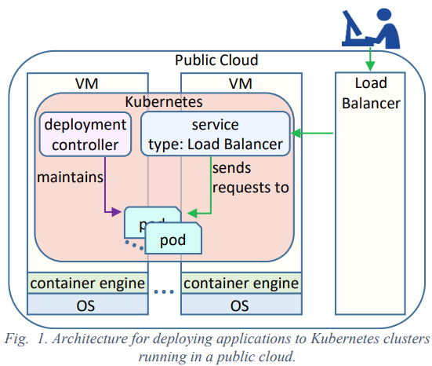
Architectures for deploying microservice based applications with kubernetes
B. Deploying Containerized Applications in a Kubernetes Cluster Running in a Public Cloud
1. Service of Type Load Balancer:

Slide 22
Architectures for deploying microservice based applications with kubernetes
B. Deploying Containerized Applications in a Kubernetes Cluster Running in a Public Cloud
2. Ingress
There could be more than one service that need to be exposed externally and with the previous method, one load balancer is needed for each service.
On the other hand, Kubernetes’ ingress resource can have multiple services as backends and minimize the number of load balancers [7].
In a Kubernetes cluster running in a public cloud, an ingress controller is deployed and exposed by a service of type Load Balancer [7].
Notes:
可能需要在外部公開多個服務，而使用先前的方法，每個服務都需要一個負載平衡器。
另一方面，Kubernetes的ingress資源可以將多個服務作為後端，並最大程度地減少負載均衡器的數量[7]。
在公共雲中運行的Kubernetes集群中，ingress控制器由負載均衡器[7]類型的服務部署和公開。
第一點 : LoadBalancer type 只有在公有雲的時候才會使用，每當service要暴露出去時就會使用這個type，會與public cloud 的 LoadBalance 溝通獲取一個實體IP，每暴露一個就會噴錢

Slide 23
Architectures for deploying microservice based applications with kubernetes
C. Deploying Containerized Applications in a Kubernetes Cluster Running in a Private Cloud
Below, we will discuss two ways of exposing applications deployed in a Kubernetes cluster running in a private cloud.
  External Load Balancer
  Ingress
Notes:
C. 在私有雲中運行的Kubernetes集群中部署容器化的應用程序

Slide 24
Architectures for deploying microservice based applications with kubernetes
C. Deploying Containerized Applications in a Kubernetes Cluster Running in a Private Cloud
1. External Load Balancer
Fig. 2 depicts the architecture for exposing the service using an external load balancer.
Since it is not a good practice to expect the users to connect to the nodes directly, an external load balancer is used, which distributes the requests between the nodes and delivers them to the port on which the Node Port service is exposed.
The downside of this architecture is that for each service in the cluster that needs to be exposed externally, we will need one external load balancer.
Notes:
圖2描述了使用外部負載平衡器公開服務的體系結構。
由於不是期望用戶直接連接到節點的好習慣，因此使用外部負載平衡器，該負載平衡器在節點之間分配請求並將請求傳遞到暴露節點端口服務的端口。
這種體系結構的缺點是，對於群集中需要對外公開的每個服務，我們將需要一個外部負載平衡器。

Slide 25
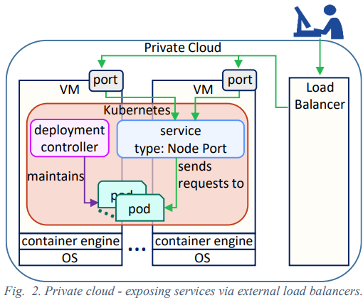
Architectures for deploying microservice based applications with kubernetes
C. Deploying Containerized Applications in a Kubernetes Cluster Running in a Private Cloud
1. External Load Balancer

Slide 26
Architectures for deploying microservice based applications with kubernetes
C. Deploying Containerized Applications in a Kubernetes Cluster Running in a Private Cloud
2. Ingress
In this case, a service of type Cluster IP is created to redirect requests to the pods and will be used as the backend of the Ingress resource.
Also, an ingress controller is needed in the cluster in order to redirect the incoming requests to the ingress resource, which later will be redirected to the appropriate backend service.
(Figure 3)We create a service of type Node Port to expose the ingress controller pod to outside of the cluster.
Since it is possible to define multiple services as backends for the ingress resource, this method is more practical than the previous case in which we needed to use a load balancer for each individual service that needs to be exposed.
Notes:
在這種情況下，將創建類型為Cluster IP的服務以將請求重定向到Pod，並將其用作ingress資源的後端。
同樣，集群中需要一個ingress controller，以便將傳入請求重定向到入口資源，該ingress resource隨後將被重定向到適當的後端服務。
圖3 我們創建類型為Node Port的服務，以將入口控制器Pod暴露給集群之外。
由於可以將多個服務定義為ingress資源的後端，因此該方法比之前的情況更為實用，在前面的情況中，我們需要為需要公開的每個服務使用負載均衡器。

Slide 27
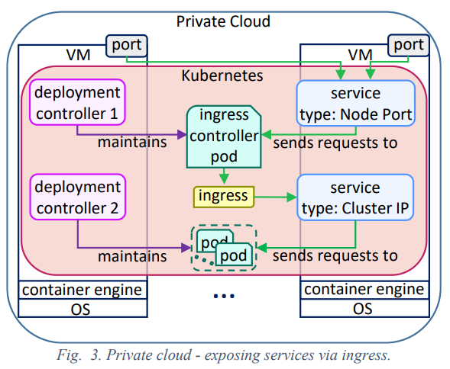
Architectures for deploying microservice based applications with kubernetes
C. Deploying Containerized Applications in a Kubernetes Cluster Running in a Private Cloud
2. Ingress

Slide 28
Architectures for deploying microservice based applications with kubernetes
C. Deploying Containerized Applications in a Kubernetes Cluster Running in a Private Cloud
Even though Kubernetes can run in both private and public clouds, one may notice that it is better tailored for public clouds than it is for private ones.
For a Kubernetes cluster running in a public cloud, the application is automatically exposed to the outside world through a service of type Load Balancer because it can use the cloud provider’s load balancer.
Also, using the ingress resource for redirecting requests to multiple services is less challenging.
Notes:
儘管Kubernetes既可以在私有云中也可以在公共雲中運行，但人們可能會注意到，它比私有云更適合於公共雲。
對於在公共雲中運行的Kubernetes集群，該應用程序會通過負載均衡器類型的服務自動向外界公開，因為它可以使用雲提供商的負載均衡器。
同樣，使用入口資源將請求重定向到多個服務的挑戰也較小。

Slide 29
Architectures for deploying microservice based applications with kubernetes
C. Deploying Containerized Applications in a Kubernetes Cluster Running in a Private Cloud
On the other hand, in a private cloud, exposing the application to the outside world is challenging and requires more efforts.
One needs to either tackle the complexity of adapting an ingress controller to expose services or use an external load balancer for each service that needs to be exposed which will not be practical for large and complex microservice based applications composed of many microservices.
Notes:
另一方面，在私有云中，將應用程序暴露給外部世界具有挑戰性，需要更多的努力。
需要解決使ingress controller適應公開服務的複雜性，或者為需要公開的每個服務使用外部負載平衡器，這對於由許多微服務組成的大型，複雜的基於微服務的應用程序將是不切實際的。

Slide 30
Settings, failure scenarios and metrics
We set a Kubernetes cluster in a private cloud (Fig. 3).
three VMs running on OpenStack cloud.
Ubuntu 16.04
Kubernetes 1.8.2
Docker 17.09
The application deployed is VideoLan Client (VLC) [17].
Notes:
我們在私有云中設置了Kubernetes集群（圖3）。

Slide 31
Settings, failure scenarios and metrics
Kubernetes offers three levels of health check and repair action for managing the availability of the deployed microservices.
At the application level : The container is restarted
At the pod level : Reacts according to the defined restart policy
At the node level : If the node hosting a pod fails, the pod is rescheduled into another healthy node.
With respect to these levels of health check, we defined three sets of failure scenarios.
In the first set, the application failure is caused by the VLC container process failure.
In the second set, it is due to pod container process failure.
In the third set it is caused by the node failure.
Notes:
Kubernetes提供了三個級別的運行狀況檢查和修復操作，用於管理已部署的微服務的可用性。
在應用程序級別：容器已重新啟動
在pod級別：根據定義的重新啟動策略做出反應
在節點級別：把pod轉到健康的node上
關於這些健康檢查級別，我們定義了三組故障方案。
在第一組中，應用程序故障是由VLC容器進程故障引起的。
在第二組中，這是由於容器容器處理失敗所致。
在第三組中，它是由節點故障引起的。

Slide 32
Settings, failure scenarios and metrics
For each set, we experimented with different redundancy models [18] and with both default and most responsive configuration of Kubernetes.
Each scenario has been repeated 10 times and the average of the measurements are shown in Table I through Table V.
The metrics we use to evaluate Kubernetes from availability perspective are defined below. In Fig. 4 we summarize the relations between these metrics.
Notes:
我們都嘗試了不同的冗餘模型[18]以及Kubernetes的默認配置和響應速度最快的配置。
每個場景已重複10次，測量的平均值顯示在表I至表V中。
下面定義了用於從可用性角度評估Kubernetes的指標。在圖4中，我們總結了這些指標之間的關係。

Slide 33
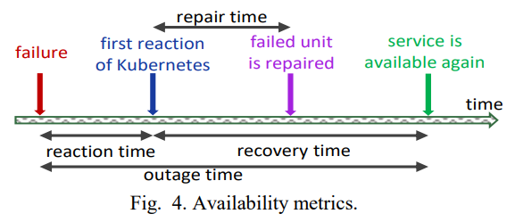
Settings, failure scenarios and metrics
Reaction Time: The time between the failure event we introduce and the first reaction of Kubernetes that reflects the failure event was detected.
Repair Time: The time between the first reaction of Kubernetes and the repair of the failed pod.
Recovery Time: The time between the first reaction of Kubernetes and when the service is available again.
Outage Time: The duration in which the service was not available. It represents the sum of the reaction time and the recovery time as shown in Fig. 4.
Notes:
反應時間：檢測到我們引入的故障事件與Kubernetes的第一反應之間的時間，該反應反映了故障事件。
修復時間：從Kubernetes的第一個反應到修復出現故障的Pod的時間。
恢復時間：從Kubernetes的第一個反應到服務再次可用之間的時間。
中斷時間：服務不可用的持續時間。它代表了反應時間和恢復時間的總和，如圖4所示。

Slide 34
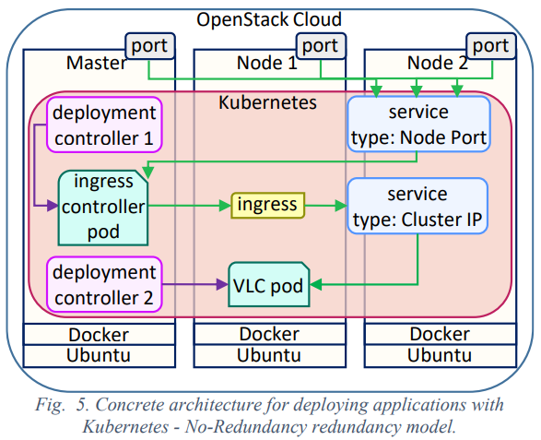
Experiments, results and analysis
A. Evaluating the Repair Actions with Default Configuration of Kubernetes for Supporting Availability (RQ1)
Fig. 5 shows the architecture for these experiments. The redundancy model in this case is No-Redundancy [18] and therefore, the number of pods in the deployment controller specification is only one.
Notes:
實驗，結果和分析
使用Kubernetes的默認配置評估修復措施以支持可用性（RQ1）
圖5顯示了這些實驗的架構。 在這種情況下，冗餘模型為No-Redundancy [18]，因此，部署控制器規範中的Pod數量僅為一個。

Slide 35
Experiments, results and analysis
A. Evaluating the Repair Actions with Default Configuration of Kubernetes for Supporting Availability (RQ1)
1) Experiments (Service Outage due to VLC Container Process Failure:)
When the VLC container crashes, the Kubelet detects the crash and brings the pod to a state where it will not receive new requests.At this time, that is the reaction time, the pod is removed from the endpoints list.
Later, the Kubelet restarts the VLC container and the video willstart from the beginning of the file. This time marks the repair time.
Recovery time is when the pod is in the endpoints list again and is ready to receive requests.
Notes:
作者對上面講的三種中斷服務的情況做了實驗 container 、 Pod 、 Node
實驗 (由於VLC容器處理失敗而導致的服務中斷：)
當VLC容器崩潰時，Kubelet會檢測到崩潰，並將Pod置於不會接收新請求的狀態。這時，即reaction time，已將Pod從端點列表中刪除。
稍後，Kubelet將重新啟動VLC容器，並且視頻將從文件的開頭開始。 該時間標誌著repair time。
Recovery time是pod再次位於端點列表中並準備接收請求時。

Slide 36
Experiments, results and analysis
A. Evaluating the Repair Actions with Default Configuration of Kubernetes for Supporting Availability (RQ1)
1) Experiments (Service Outage due to Pod Container Process Failure:)
When the pod container process is killed, the Kubelet detects that the pod container is no longer present and this marks the reaction time.
When the new pod is created and its VLC container is started, the video will start streaming from the beginning of the file and we consider the pod as repaired.
After, the Kubelet will add the new pod to the endpoints list and it will be ready to receive new requests, this marks the recovery time.
Notes:
由於Pod處理失敗而導致的服務中斷：
當Pod進程終止時，Kubelet會檢測到Pod不再存在，這標誌著反應時間。
創建新的Pod並啟動其VLC容器後，視頻將從文件開頭開始流式傳輸，我們認為Pod已修復。
之後，Kubelet將新的Pod添加到端點列表中，並準備接收新的請求，這標誌著恢復時間。

Slide 37
Experiments, results and analysis
A. Evaluating the Repair Actions with Default Configuration of Kubernetes for Supporting Availability (RQ1)
1) Experiments (Service Outage due to Node Failure:)
The Kubelet is responsible to report the status of the node to the master, and it is the node controller of the master who detects the failure of the node.
When a node hosting a pod fails, it stops sending status updates to the master and the master will mark the node as not ready after the fourth missed status update. This time is the reaction time.
When the node is marked as not ready, the VLC pod on the node is scheduled for termination and after it is completely terminated a new one will be created. The repair time is when the new VLC pod is started and streaming the video.
Recovery time is when the pod is added to the endpoints list of the service
Notes:
Kubelet負責將節點的狀態報告給主節點，而由主節點的節點控制器檢測節點的故障。
承載Pod的節點發生故障時，它將停止向主節點發送狀態更新，並且在第四次丟失狀態更新後，主節點會將節點標記為未就緒。這個時間就是反應時間。
當節點標記為未就緒時，將計劃終止該節點上的VLC Pod，並在其完全終止之後將創建一個新的VLC Pod。 reapair時間是啟動新的VLC Pod並傳輸視頻時。
恢復時間是將Pod添加到服務的端點列表時的時間

Slide 38
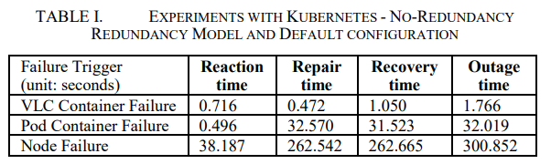
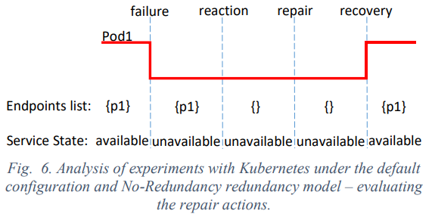
Experiments, results and analysis
A. Evaluating the Repair Actions with Default Configuration of Kubernetes for Supporting Availability (RQ1)
2) Results and Analysis
Notes:
可能因為上一張的第三點，所以node failure的repair time 靠北久，因為要等之前有問題的node裡面的pod被幹掉才能建新的

Slide 39
Experiments, results and analysis
A. Evaluating the Repair Actions with Default Configuration of Kubernetes for Supporting Availability (RQ1)
2) Results and Analysis
In the case of node failure, removing the IP of Pod1 from the endpoints list, as a reaction from the node controller of the master was measured as 38.187 seconds.
The reason is that with the default configuration of Kubernetes, the master takes at least 30 seconds to detect a node failure.
Because the Kubelet updates the node status every 10 seconds and the master allows for four missed status updates before marking the node as not ready.
Notes:
在節點發生故障的情況下，從主機列表中刪除Pod1的IP（作為主服務器的節點控制器的響應）的時間為38.187秒。
原因是使用Kubernetes的默認配置，主節點至少需要30秒才能檢測到節點故障。
因為Kubelet每10秒更新一次節點狀態，而主節點允許在標記節點未準備好之前進行四次錯過狀態更新。

Slide 40
Experiments, results and analysis
A. Evaluating the Repair Actions with Default Configuration of Kubernetes for Supporting Availability (RQ1)
2) Results and Analysis
As observed in Table I, the repair time of the VLC container or the pod container failure scenarios differ significantly (0.472 seconds for the former and 32.570 seconds for the latter).
The reason is that in the case of pod container failure, a graceful termination signal is sent to the VLC container and Docker waits 30 seconds for it to terminate.
The repair process will not start unless the VLC container is terminated.
Notes:
如表I所示，VLC容器的維修時間或吊艙容器故障情況存在顯著差異（前者為0.472秒，後者為32.570秒）。
原因是在Pod容器發生故障的情況下，正常終止信號會發送到VLC容器，而Docker等待30秒才能終止。
除非終止VLC容器，否則修復過程將不會開始。

Slide 41
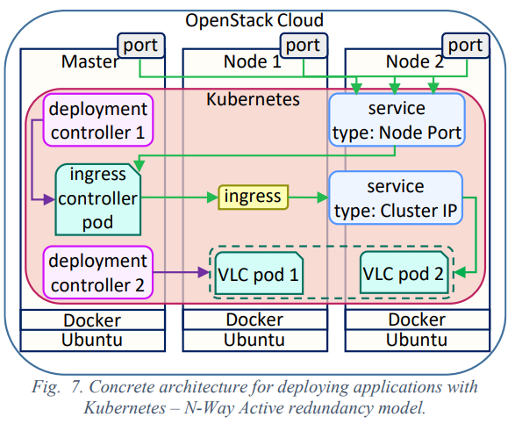
Experiments, results and analysis
B. Evaluating the Impact of Redundancy on the Availability Support by Kubernetes (RQ2)
To investigate the impact redundancy may have on the availability support by Kubernetes, we consider the architecture in Fig. 7 where the number of pod replicas that the deployment controller maintains is increased to two.
In this architecture, we have a N-Way Active redundancy model [18].
Notes:
B . 評估冗餘對Kubernetes（RQ2）可用性支持的影響
為了研究冗餘對Kubernetes可用性支持的影響，我們考慮圖7中的架構，其中部署控制器維護的Pod副本的數量增加到兩個。
在這種架構中，我們有一個N-Way Active冗餘模型[18]。

Slide 42
Experiments, results and analysis
B. Evaluating the Impact of Redundancy on the Availability Support by Kubernetes (RQ2)
1) Experiements (Service Outage due to the VLC Container Process Failure:)
In this scenario, similar to the No-Redundancy redundancy model, the reaction time is when the Kubelet detects the VLC container has crashed and removes the pod from the endpoints list.
By just removing the unhealthy Pod1 from endpoints list, the service is recovered.
This is because another healthy pod is still on the endpoints list and ready to serve the requests.
Therefore, the reaction time for this scenario is the same as the recovery time.
The repair time is when the Kubelet has restarted the crashed VLC container and the video has started streaming again.
Notes:
在這種情況下，類似於“無冗餘”冗餘模型，反應時間是指Kubelet檢測到VLC容器崩潰並從端點列表中刪除Pod的時間。
通過僅從端點列表中刪除不正常的Pod1，即可恢復該服務。
這是因為另一個運行狀況良好的Pod仍在端點列表上，並準備服務請求。
因此，此方案的reaction時間與recovery時間相同。(應該是end point 相同)
repair時間是Kubelet重新啟動已崩潰的VLC容器並且視頻再次開始流式傳輸時。

Slide 43
Experiments, results and analysis
B. Evaluating the Impact of Redundancy on the Availability Support by Kubernetes (RQ2)
1) Experiements (Service Outage due to Pod Container Process Failure:)
Similarly to the previous scenarios, the recovery time is when the unhealthy pod is removed from the endpoints list.
The repair time is when a new pod is created and its VLC container is started and streaming the video
Notes:
與以前的方案類似，恢復時間是從端點列表中刪除不健康的容器時。
修復時間是在創建新的pod並啟動其VLC容器並流式傳輸視頻時

Slide 44
Experiments, results and analysis
B. Evaluating the Impact of Redundancy on the Availability Support by Kubernetes (RQ2)
1) Experiements (Service Outage due to Node Failure:)
The reaction time in this scenario is the same as for the No-Redundancy redundancy model architecture
The recovery time is when the IP of Pod1 is removed from the endpoints list.
The repair time is when Pod1 is terminated and another one is created.
Notes:
在這種情況下，反應時間與無冗餘冗餘模型體系結構的反應時間相同。
恢復時間是從端點列表中刪除Pod1的IP時的時間。
修復時間是Pod1終止並創建另一個時。

Slide 45
Experiments, results and analysis
B. Evaluating the Impact of Redundancy on the Availability Support by Kubernetes (RQ2)
2) Results and Analysis
As shown in Table II, the measured outage time in the experiments with a N-Way Active redundancy model is significantly lower than for the No-Redundancy redundancy model.
The reason is that with the N-Way Active redundancy model, the recovery does not depend on the repair of the faulty unit and the service is recovered as soon as Kubernetes detects the failure.
The results show that the repair actions and the healing capability of Kubernetes are not sufficient for supporting availability and adding redundancy can significantly decrease the downtime
Notes:
如表II所示，在使用N-Way Active冗餘模型進行的實驗中，測得的中斷時間顯著低於“ No-Redundancy”冗餘模型。
原因是使用N-Way Active冗餘模型時，恢復不取決於故障單元的維修，並且只要Kubernetes檢測到故障，就可以恢復服務。
結果表明，Kubernetes的修復操作和恢復能力不足以支持可用性，而增加冗餘可以大大減少停機時間

Slide 46
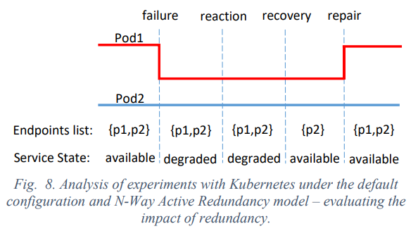
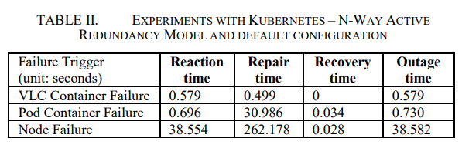
Experiments, results and analysis
B. Evaluating the Impact of Redundancy on the Availability Support by Kubernetes (RQ2)
2) Results and Analysis
Notes:
VLC Container Failure reaction 跟 recovery在同一時間被mark 沒說明why
原因是使用N-Way Active冗餘模型時，恢復不取決於故障單元的維修，並且只要Kubernetes檢測到故障，就可以恢復服務。
結果表明，Kubernetes的修復操作和恢復能力不足以支持可用性，而增加冗餘可以大大減少停機時間

Slide 47
Experiments, results and analysis
C. Evaluating the Repair Actions with Most Responsive Configuration of Kubernetes for Supporting Availability (RQ3)
One aspect affecting the service outage is the graceful termination signal sent to the application container in the scenario of pod container failure.
For the node failure scenarios, the frequency of node status posting by Kubelet to the master and the number of allowed missed status updates before marking a node as unhealthy are the main aspects that affect the service outage.
Notes:
使用Kubernetes響應速度最快的配置評估修復措施以支持可用性（RQ3）
影響服務中斷的一個方面是在Pod容器發生故障的情況下，正常終止信號發送到應用程序容器。
對於節點故障情形，在將節點標記為不正常之前，Kubelet將節點狀態發佈到主節點的頻率以及允許的丟失狀態更新的次數是影響服務中斷的主要方面。

Slide 48
Experiments, results and analysis
C. Evaluating the Repair Actions with Most Responsive Configuration of Kubernetes for Supporting Availability (RQ3)
1) Experiements (Reconfiguring the Graceful Termination Period of Pods:)
As it was mentioned, when a pod container process fails, a graceful termination signal is sent to Docker to terminate the application container which delays the repair of the pod for 30 seconds.
In the No-Redundancy redundancy model, this grace period affects the recovery time, because a new pod will not be created unless the failed one completely terminates.
To reduce this grace period, we updated the pod template and set the grace period to zero.
We repeated the experiments for the pod container failure scenario and evaluated the impact of this change on service outage.
Notes:
1) 實驗（重新配置Pod的最佳終止期：）
如前所述，當Pod容器進程失敗時，會向Docker發送一個正常的終止信號以終止應用程序容器，這將Pod的修復延遲了30秒。
在No-Redundancy冗餘模型中，此寬限期會影響恢復時間，因為除非有故障的Pod完全終止，否則不會創建新的Pod。
為了減少此寬限期，我們更新了Pod模板，並將寬限期設置為零。
我們針對容器發生故障的情況重複了實驗，並評估了此更改對服務中斷的影響。

Slide 49
Experiments, results and analysis
C. Evaluating the Repair Actions with Most Responsive Configuration of Kubernetes for Supporting Availability (RQ3)
1) Experiements (Reconfiguring Node Failure Handling Parameters:)
To have the most responsive Kubernetes configuration, we reconfigured the Kubelet of each node to post the node’s status every second to the master.
The node controller of the master was also reconfigured to read the updated statuses every second and only allow one missed status update for each node.
Notes:
1 ) 重新配置節點故障處理參數
為了擁有最敏感的Kubernetes配置，我們重新配置了每個節點的Kubelet，以每秒將節點的狀態發佈到主節點。
還對主節點的節點控制器進行了重新配置，使其每秒讀取更新的狀態，並且僅允許每個節點一次丟失狀態更新。

Slide 50
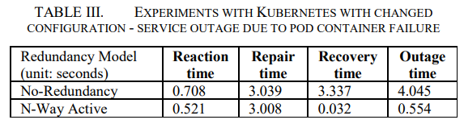
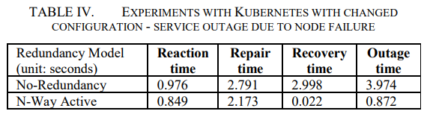
Experiments, results and analysis
C. Evaluating the Repair Actions with Most Responsive Configuration of Kubernetes for Supporting Availability (RQ3)
2) Results and Analysis
(In Table III) We observed that with the new configuration, when the pod container crashes, the time Docker gives to the application container before forcefully killing it is reduced to 2 seconds.
(In Table IV) With the new configuration, the master allows only one missed status update and since each node updates its status every second, the reaction time is reduced to almost one second.
Notes:
2)結果與分析
我們觀察到，通過新配置，當pod容器崩潰時，Docker在強行殺死它之前給應用程序容器的時間減少到2秒。
在表IV中，我們觀察到所有測量指標的顯著變化。使用新配置，主服務器僅允許一次丟失狀態更新，並且由於每個節點每秒都會更新其狀態，因此反應時間減少到將近一秒鐘。

Slide 51
Experiments, results and analysis
C. Evaluating the Repair Actions with Most Responsive Configuration of Kubernetes for Supporting Availability (RQ3)
2) Results and Analysis
The repair time also is decreased from 260 seconds to around 2.5 seconds, as the master will wait only one second before starting a new pod on a healthy node
Notes:
修復時間也從260秒減少到2.5秒左右，因為主服務器將僅等待一秒鐘，然後在運行正常的節點上啟動新的Pod。

Slide 52
Experiments, results and analysis
D. Comparing Kubernetes with Existing Solutions for Availability Management (RQ4)
AMF [12] is a standard middleware service for managing the availability of components based applications.
It has been implemented, with other middleware services, in the OpenSAF middleware [19], a proven solution for availability management.
We considered the following failure scenarios, VLC process failure, VM failure and physical host failure, corresponding to VLC container failure, pod container failure and node failure, respectively.
In the experiments with OpenSAF we used a No-redundancy redundancy model with two VLC applications, one active and the other one as a spare to be instantiated and take over in case of failure of the active.
Notes:
D.比較Kubernetes與現有的可用性管理解決方案（RQ4）
(Availability Management Framework) AMF [12]是用於管理基於組件的應用程序可用性的標準中間件服務。
它已與其他中間件服務一起在OpenSAF中間件[19]中實現，這是一種經過驗證的可用性管理解決方案。
我們考慮了以下故障場景：VLC進程故障，VM故障和物理主機故障，分別對應於VLC容器故障，pod容器故障和節點故障。
在使用OpenSAF進行的實驗中，我們使用了具有兩個VLC應用程序的無冗餘冗餘模型，其中一個處於活動狀態，另一個處於備用狀態，可以實例化並在活動發生故障時接管。

Slide 53
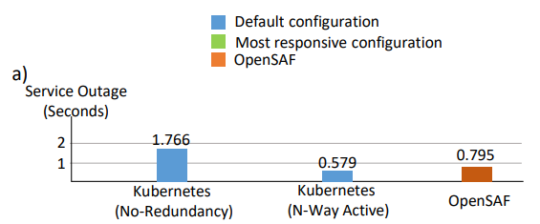
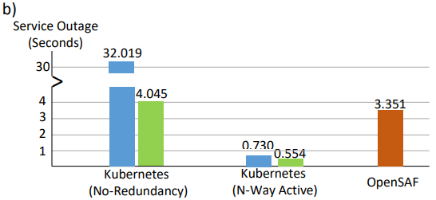
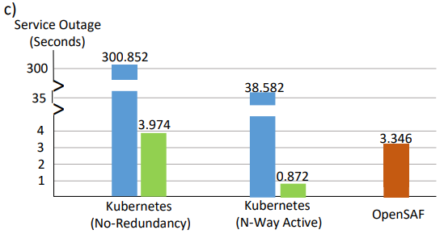
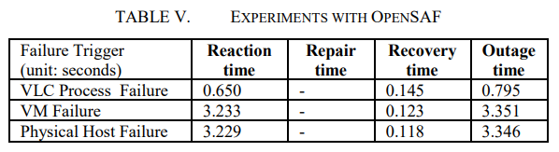

Experiments, results and analysis
D. Comparing Kubernetes with Existing Solutions for Availability Management (RQ4)
The results of the experiments with OpenSAF and the comparison with Kubernetes are shown in Table V and Fig. 9, respectively.
Container
Pod
Node
Notes:
表V和圖9分別顯示了OpenSAF的實驗結果和Kubernetes的比較結果。
在C(node failure)中，N-Way Active of K8s 比起 OpenSAF還要高很多，因為是使用默認配置造成反應時間(reaction time)過長，更換配置後No-Redundancy of K8s (綠色)就跟OpenSAF差不多了

Slide 54
Lessons learned and threats to validity
A. Lessons Learned
Kubernetes provides availability through its repair actions.
However, these are not sufficient for supporting highly availability.
For example, for the node failure scenario, the outage time is about 5 minutes, which is equivalent to the amount of downtime allowed in a one-year period for a highly available system.
Even after adding redundancy, we observed that the default configuration of Kubernetes still resulted in a significant service outage in the case of node failure.
Notes:
經驗教訓和對有效性的威脅
A 經驗教訓
Kubernetes通過其修復措施提供可用性。
但是，這些不足以支持高可用性。
例如，對於節點故障情形，中斷時間約為5分鐘，這相當於高可用性系統在一年時間內允許的停機時間。
即使添加了冗餘，我們也發現，在節點故障的情況下，Kubernetes的默認配置仍然導致大量服務中斷。

Slide 55
Lessons learned and threats to validity
A. Lessons Learned
Although the default configuration can be changed, Kubernetes is most commonly used under its default configuration and figuring out how to reconfigure Kubernetes’ reaction to node failure while avoiding network overhead and false positive reports can be complicated and requires a great effort.
Notes:
經驗教訓和對有效性的威脅
A 經驗教訓
儘管可以更改默認配置，但Kubernetes的默認配置還是最常用的方法，弄清楚如何重新配置​​Kubernetes對節點故障的反應，同時避免網絡開銷和誤報，這可能很複雜，需要付出很大的努力。

Slide 56
Lessons learned and threats to validity
B. Threats to Validity
Internal Validity:
The following internal threats can affect the validity of our results.
First, all experiments were conducted in a small cluster consisting of only a master and two worker nodes.
Kubernetes may behave differently in larger clusters which may impact the availability measurements presented in our experiments.
Second, the availability measurements may also vary depending on the application’s complexity and the collocated applications managed by Kubernetes.
Notes:
經驗教訓和對有效性的威脅
B. 有效性威脅
1)內部有效性
以下內部威脅可能會影響我們結果的有效性。
首先，所有實驗都是在只有一個主節點和兩個工作節點的小型集群中進行的。
Kubernetes在較大的集群中的行為可能有所不同，這可能會影響我們的實驗中提供的可用性度量。
其次，可用性度量也可能因應用程序的複雜性和Kubernetes管理的並置應用程序而異。
Behave : 表現

Slide 57
Lessons learned and threats to validity
B. Threats to Validity
2) External Validity:
Before generalizing the results, one has to consider other types of applications even though the conducted experiments and the analysis give some indications about the availability of the applications deployed with Kurbernetes
Notes:
經驗教訓和對有效性的威脅
B. 有效性威脅
2)外部有效性
在對結果進行概括之前，即使進行的實驗和分析給出了一些有關使用Kurbernetes部署的應用程序可用性的指示，也必須考慮其他類型的應用程序。

Slide 58
Lessons learned and threats to validity
B. Threats to Validity
3) Construct Validity:
Indeed, we rely on the timestamps reported in Kubernetes and Docker logs. However, we used NTP to synchronize the time between the nodes.
Other strategies can be used and may be more meticulous, for instance, container instrumentation.
Notes:
經驗教訓和對有效性的威脅
B. 有效性威脅
3)構建有效性
實際上，我們依賴於Kubernetes和Docker日誌中報告的時間戳。
但是，我們使用NTP來同步節點之間的時間。 可以使用其他策略，並且可能更加細緻，例如，容器儀表。

Slide 59
Related work
Dragoni et al. in their work [3] propose the definition of a microservice as a small and independent process that interacts by messaging.
They define the microservice based architecture as a distributed application composed of microservices and discuss the impact of microservices on the quality attributes of the application.
Along with performance and maintainability, they specifically discuss availability as a quality attribute which is impacted by the microservice based architecture.
Notes:
Dragoni等。在他們的工作中[3]提出了將微服務定義為通過消息進行交互的小型獨立過程。
他們將基於微服務的體系結構定義為由微服務組成的分佈式應用程序，並討論了微服務對應用程序質量屬性的影響。
除了性能和可維護性之外，他們還專門討論了可用性，將其作為一種質量屬性，這會受到基於微服務的體系結構的影響。

Slide 60
Related work
Emam et al. in [21] found that as the size of a service increases, it becomes more fault-prone.
Since microservices are small in size, in theory, they are less fault-prone.
However, Dragoni et al. argue that at integration, the system will become more fault-prone because of the complexity of launching an increasing number of microservices.
Notes:
Emam等。在[21]中發現，隨著服務規模的增加，它變得更加容易出錯。
由於微服務的大小很小，因此從理論上講，它們不太容易出現故障。
但是，Dragoni等。他認為，由於啟動越來越多的微服務的複雜性，在集成時，該系統將更容易出現故障。

Slide 61
Related work
Khazaei et al. in [22] propose a microservice platform for the cloud by using a Docker technology that provisions containers based on the requests of microservice users.
One of the key differences between this platform and Kubernetes is that this platform has the ability to ask for more VMs from the infrastructure when needed while Kubernetes does not.
Notes:
Khazaei等。 [22]中的人通過使用Docker技術為雲提出了一個微服務平台，該技術基於微服務用戶的需求來配置容器。
該平台與Kubernetes之間的主要區別之一是，該平台能夠在需要時從基礎架構中請求更多VM，而Kubernetes則無法。

Slide 62
Related work
Kang et al. in [23] propose a microservice based architecture and use containers to operate and manage the cloud infrastructure services.
In their architecture, each container is monitored by a sidekick container and in case of failure, recovery actions are taken.
They performed some experiments and concluded that recovering from container failure is faster than recovering from VM failure.
Notes:
Kang等。 [23]中提出了一種基於微服務的架構，並使用容器來操作和管理雲基礎架構服務。
在其體系結構中，每個容器都由同伴容器監視，並且在發生故障的情況下，將採取恢復措施。
他們進行了一些實驗，得出結論：從容器故障中恢復比從VM故障中恢復更快。

Slide 63
Related work
Netto et al. in [24] believe that Kubernetes improves the availability of stateless applications but faces problems when it comes to stateful applications.
They integrated a coordination service with Kubernetes to offer automatic state replication.
In their architecture, all replicas of a pod execute the incomingrequests while only one, which has received the request from the client, will respond.
This way, the state is replicated. They evaluated some metrics such as latency and they concluded that the latency increases with the number of pod replicas.
Notes:
Netto等。 [24]中的人相信Kubernetes可以提高無狀態應用程序的可用性，但是在涉及有狀態應用程序時會遇到問題。
他們將協調服務與Kubernetes集成在一起以提供自動狀態復制。
在其體系結構中，pod的所有副本都執行傳入的請求，而只有一個已接收到來自客戶端的請求的副本將響應。 (應該是由一個固定的pod來回應 此狀態會記錄在pod中??)
這樣，狀態被複製。他們評估了諸如延遲等指標，並得出結論說，延遲會隨著Pod副本數量的增加而增加。
Integrated : 集成

Slide 64
Conclusion and future work
Through our investigations, we learned that although it is not stated in Kubernetes’ documentation [15], Kubernetes is more tailored for public clouds than for private clouds.
We analyzed the results of our experiments and found that the repair actions of Kubernetes are not sufficient for providing availability, especially high availability.
We will also consider, the case of multiple masters and failure from the master side, as well as Kubernetes behavior in case of network partitioning.
Notes:
結論與未來工作
過我們的調查，我們了解到，儘管Kubernetes的文檔中沒有對此進行說明[15]，但Kubernetes更適合於公共雲而不是私有云。
我們分析了我們的實驗結果發現，Kubernetes的修復措施不足以提供可用性，尤其是高可用性。
(future work)我們還將考慮多個主機的情況以及主機方面的故障，以及網絡分區情況下的Kubernetes行為。

Slide 65
References
[1] D. Jaramillo, D. V. Nguyen, and R. Smart, “Leveraging microservices architecture by using Docker technology,” in SoutheastCon 2016, 2016, pp. 1–5.
[2] “Microservices,” martinfowler.com. [Online]. Available: https://martinfowler.com/articles/microservices.html. [Accessed: 01-Oct2018].
[3] N. Dragoni et al., “Microservices: Yesterday, Today, and Tomorrow,” in Present and Ulterior Software Engineering, M. Mazzara and B. Meyer, Eds. Cham: Springer International Publishing, 2017, pp. 195–216.
[4] S. Newman, Building Microservices: Designing Fine-Grained Systems. O’Reilly Media, Inc., 2015. [5] M. Amaral, J. Polo, D. Carrera, I. Mohomed, M. Unuvar, and M. Steinder, “Performance Evaluation of Microservices Architectures Using Containers,” in 2015 IEEE 14th International Symposium on Network Computing and Applications, 2015, pp. 27–34.
[6] “Docker - Build, Ship, and Run Any App, Anywhere.” [Online]. Available: https://www.docker.com/. [Accessed: 01-Oct-2018].
[7] “Kubernetes,” Kubernetes. [Online]. Available: https://kubernetes.io/. [Accessed: 24-Jan-2018].

Slide 66
References
[8] M. Toeroe and F. Tam, Service Availability: Principles and Practice. John Wiley & Sons, 2012
[9] M. Nabi, M. Toeroe, and F. Khendek, “Availability in the cloud: State of the art,” Journal of Network and Computer Applications, vol. 60, pp. 54– 67, Jan. 2016.
[10] N. Dragoni, I. Lanese, S. T. Larsen, M. Mazzara, R. Mustafin, and L. Safina, “Microservices: How To Make Your Application Scale,” in Perspectives of System Informatics, 2018, pp. 95–104.
[11] L. A. Vayghan, M. A. Saied, M. Toeroe, and F. Khendek, “Deploying Microservice Based Applications with Kubernetes: Experiments and Lessons Learned,” in 2018 IEEE 11th International Conference on Cloud Computing (CLOUD), 2018, pp. 970–973.
[12] “SAI-AIS-AMF-B.04.01.AL.pdf.” .
[13] NGINX Ingress Controller for Kubernetes. Contribute to kubernetes/ingress-nginx development by creating an account on GitHub. Kubernetes, 2018.
[14] Andjelko Iharos, “HAProxy Ingress Controller for Kubernetes,” HAProxy Technologies, 12-Dec-2017.
[15] “Kubernetes Documentation,” Kubernetes. [Online]. Available: https://kubernetes.io/docs/home/. [Accessed: 23-Jan-2018].

Slide 67
References
[16] “ntp.org: Home of the Network Time Protocol.” [Online]. Available: http://www.ntp.org/. [Accessed: 12-Oct-2018].
[17] “VLC: Official site - Free multimedia solutions for all OS! - VideoLAN.” [Online]. Available: https://www.videolan.org/index.html. [Accessed: 12-Oct-2018].
[18] A. Kanso, M. Toeroe, and F. Khendek, “Comparing redundancy models for high availability middleware,” Computing, vol. 96, no. 10, pp. 975– 993, Oct. 2014.
[19] “OpenSAF Foundation - Welcome to OpenSAF.” [Online]. Available: http://opensaf.org/. [Accessed: 12-Oct-2018].
[20] “Integrating Open SAF High Availability Solution with Open Stack - IEEE Conference Publication.” [Online]. Available: https://ieeexplore.ieee.org/abstract/document/7196529. [Accessed: 12- Oct-2018].
[21] K. E. Emam, S. Benlarbi, N. Goel, W. Melo, H. Lounis, and S. N. Rai, “The optimal class size for object-oriented software,” IEEE Transactions on Software Engineering, vol. 28, no. 5, pp. 494–509, May 2002

Slide 68
References
[22] H. Khazaei, C. Barna, N. Beigi-Mohammadi, and M. Litoiu, “Efficiency Analysis of Provisioning Microservices,” in 2016 IEEE International Conference on Cloud Computing Technology and Science (CloudCom), 2016, pp. 261–268.
[23] “Container and Microservice Driven Design for Cloud Infrastructure DevOps - IEEE Conference Publication.” [Online]. Available: https://ieeexplore.ieee.org/abstract/document/7484185. [Accessed: 12- Oct-2018].
[24] H. V. Netto, L. C. Lung, M. Correia, A. F. Luiz, and L. M. Sá de Souza, “State machine replication in containers managed by Kubernetes,” Journal of Systems Architecture, vol. 73, pp. 53–59, Feb. 2017.

