Slide 1
AAAS: An Anonymous Authentication Scheme Based on Group Signature in VANETs
Yanji Jiang, Shaocheng Ge, Xueli Shen
Impact Factor:3.745
Published in: IEEE Access
Notes:
基於群簽名的匿名認證方案在VANETs中

Slide 2
OUTLINE
Abstract
Introduction
Preliminaries
The Proposed Schemes
Security Proof and Analysis
Performance Analysis
Conclusion

Slide 3
Abstract
As special ad-hoc networks, vehicular ad-hoc networks (VANETs) support vehicles to communicate with each other via opportunistic wireless links.
In order to protect privacy of drivers, vehicles registered in VANETs are required to authenticate and communicate with surrounding vehicles or roadside infrastructure anonymously.
However, due to high-speed driving and wireless environment, it is vital to propose a privacy protection scheme that is able to balance security and efficiency.
Notes:
作為特殊的自組織網絡，車輛自組織網絡（VANET）支持車輛通過機會性無線鏈路相互通訊。
為了保護駕駛員的隱私，需要在VANET中註冊的車輛以匿名方式與周圍的車輛或路邊基礎設施進行身份驗證和通信。
然而，由於高速駕駛和無線環境，提出一種能夠平衡安全性和效率的隱私保護方案至關重要。

Slide 4
Consequently, this paper proposes an anonymous authentication scheme in VANETs (AAAS).
Specifically, we add region trust authority (RTA) to provide more efficient anonymous authentication service for vehicles.
Subsequently, group signature mechanism is adopted to achieve anonymity and conditional privacy.
Moreover, security and performance analysis show that AAAS has higher security and efficiency.
Notes:
因此，本文提出了一種VANET（AAAS）中的匿名身份驗證方案。
具體來說，我們增加了區域信任機構 以為車輛提供更有效的匿名身份驗證服務。
隨後，採用組簽名機制來實現匿名和條件隱私。此外，安全性和性能分析表明，AAAS具有更高的安全性和效率。

Slide 5
Introduction
Generally, driving vehicles with OBU should inform surrounding vehicles and roadside infrastures of their position, direction and velocity [2].
Meanwhile, as collectors, vehicles can integrate and analyze received information, so as to avoid congested road and prevent accidents.
However, due to the wireless network communication environment, it’s easy for attackers to intercept, tamper and replay the transmitted messages, which gives a risk to security and reliability of VANETs [3].
According to [4], authentication is considered to be the most reliable mechanism to ensure the legitimacy of entities in VANETs.
Notes:
近年來，由於VANET為車輛提供穩定的通信服務，因此在ITS中得到了廣泛的關注。
通常，帶OBU的駕駛車輛應將其位置，方向和速度告知周圍的車輛和路邊基礎設施[2]。
同時，作為收集者，車輛可以對接收到的信息進行整合和分析，從而避免了擁擠的道路和事故的發生。
但是，由於無線網絡的通信環境，攻擊者很容易攔截，篡改和重播所傳輸的消息，這會給VANET的安全性和可靠性帶來風險[3]。
根據[4]，身份驗證被認為是確保VANET中實體合法性的最可靠機制。

Slide 6
Before data exchange, the legality of each sender’s identity must be verified, which can effectively prevent the security threat caused by adversaries attacks.
Since adversaries can collect safety information broadcast by vehicle, it is likely for adversaries to obtain trajectory of vehicle and violate the personal privacy of the driver over time [5].
Thus, vehicles have to broadcast security messages anonymously to prevent being tracked. Consequently, proposing a secure and efficient anonymous authentication and communication scheme has become an important factor in the rapid popularization of VANETs.
Notes:
在進行數據交換之前，必須驗證每個發件人身份的合法性，從而可以有效地防止對手攻擊造成的安全威脅。
由於對手可以收集車輛廣播的安全信息，因此隨著時間的推移，對手很可能獲得車輛的行駛軌跡並侵犯駕駛員的個人隱私[5]。
因此，車輛必須匿名廣播安全消息以防止被跟踪。因此，提出安全有效的匿名認證和通信方案已成為VANET快速普及的重要因素。

Slide 7
Recently, many anonymous authentication schemes have been proposed to ensure the security in vehicle to infrastructure (V2I) communication.
Symmetric cryptography, asymmetric cryptography, and group signature, are thought as main mechanisms to achieve anonymous authentication in VANETs.
In anonymous authentication scheme based on group signature, VANETs are composed of multiple groups, and each group manager is thought to be trustworthy. Generally, group members can generate signatures without revealing their real identity.
Notes:
最近，已經提出了許多匿名認證方案，以確保車輛到基礎設施（V2I）通信的安全性。
對稱密碼，非對稱密碼和組簽名被認為是在VANET中實現匿名身份驗證的主要機制。
在基於組簽名的匿名身份驗證方案中，VANET由多個組組成，每個組管理器都被認為是可信任的。通常，小組成員可以在不透露其真實身份的情況下生成簽名。

Slide 8
In [14], anonymous certificate is cancelled and RSUs are considered as group leaders to provide anonymous authentication service for vehicles, which is able to effectively improve the transmission and communication costs caused by certificate issuance and revocation.
However, [14] could not meet the security requirements of distributed resolution authority.
Since RSUs has already saved privacy information of vehicles, once a RSU compromises, each vehicle privacy is at risk of being exposed.
Notes:
在[14]中，取消了匿名證書，RSU被視為組領導者，為車輛提供匿名身份驗證服務，從而能夠有效地提高由證書頒發和吊銷 導致的傳輸和通訊成本。
但是，[14]無法滿足分散式解法機構的安全要求。
由於RSU已經保存了車輛的隱私信息，因此一旦RSU洩露，每個車輛的隱私都有暴露的危險。

Slide 9
Reference [15] proposes a secure vehicular network communication schemes (GIGS) through combining group signatures and identity-based signature.
GIGS adopts group signature and reduces vehicle information storage overhead. Apart from that, GIGS uses identity-based signature to release public key and certificate management pressure.
However, once there are illegal vehicles in the network, the scheme does not provide an effective mechanism for illegal vehicles revocation.
Notes:
參考文獻[15]通過組合組簽名和基於身份的簽名提出了一種安全的車載網絡通信方案（GIGS）。
GIGS採用群組簽名，減少了車輛信息存儲的開銷。除此之外，GIGS還使用基於身份的簽名來釋放公鑰和證書管理壓力。
但是，一旦網絡中存在違章車輛，該方案將無法為廢止違章車輛提供有效的機制。

Slide 10
[16] adds regional group manager to support vehicles update their identifies and group secret keys periodically. In credential revocation, which decreases TA revocation cost significantly.
Nevertheless, in anonymous authentication, a large number of point multiplication and bilinear pairing are executed, which makes the scheme inefficient.
Notes:
[16]添加了區域組管理器，以支持車輛定期更新其標識和組密鑰。在憑證吊銷中，這大大降低了TA吊銷成本。
然而，在匿名認證中，執行了大量的點乘法和雙線性配對，這使得該方案效率低下。

Slide 11
Ring signature, as a special group signature, is used in the scheme [17] for vehicle anonymous authentication.
In [17], vehicles can generate ring signature independently without the help of RSUs or TA. In addition, identities of all members can be changed quickly without consent or messaging.
However, the scheme does not mention how to disclose each illegal vehicle identity and trajectory, which is unable to solve the credential revocation of illegal vehicles.
Notes:
方案[17]中使用環簽名作為特殊的組簽名進行車輛匿名身份驗證。
在[17]中，車輛無需RSU或TA的幫助即可獨立生成環簽名。此外，所有成員的身份都可以快速更改，無需同意或發送消息。
但是，該計劃沒有提及如何披露每個非法車輛的身份和軌跡，這無法解決非法車輛的憑證撤銷問題。

Slide 12
Reference [18] adopts a batch group signature scheme to achieve effcient message signature verifcation and propose group session key (GSK)-based revocation strategy (GSSA) to achieve fast vehicle revocation check.
In terms of computation time cost, message delay and loss rate, GSSA is efficient. What is more, GSSA is able to resist to impersonation attacks, tracking attacks, sybil attacks, and replay attacks.
However, due to lack of challenge value in signature, GSSA does not recognize the trustworthiness of the sender’s message content, which causes vehicle could not verify the legal of the response from RSU.
Notes:
參考文獻[18]採用批處理組簽名方案來實現有效的消息簽名驗證，並提出基於組會話密鑰（GSK）的撤銷策略（GSSA）以實現快速的車輛撤銷檢查。
在計算時間成本，消息延遲和丟失率方面，GSSA是有效的。而且，GSSA能夠抵抗模擬攻擊，跟踪攻擊，sybil攻擊和重播攻擊。
但是，由於簽名中缺少挑戰值，GSSA無法識別發件人消息內容的可信度，這導致車輛無法驗證RSU回應的合法性。

Slide 13
To solve above problems, we propose an anonymous authentication scheme based on group signature in VANETs (AAAS). AAAS consists of four phases: system initialization, initial registration, initial V2I authentication, and handover V2I authentication. The main features of the proposed paper are as follows.
  AAAS adds region trust authority (RTA) as group manager to provide anonymous authentication and communication services for vehicles, which can effectively improve the computation and communication costs of TA and relieve the pressure of RSU with low computation and storage capacity.
Notes:
為了解決上述問題，我們提出了一種基於VANET（AAAS）中組簽名的匿名身份驗證方案。 AAAS分為四個階段：系統初始化，初始註冊，初始V2I身份驗證和切換V2I身份驗證。本文的主要特徵如下。
1.AAAS增加了區域信任機構（RTA）作為組管理員，為車輛提供匿名身份驗證和通信服務，從而可以有效地提高TA的計算和通信成本，並以低的計算和存儲容量緩解RSU的壓力。

Slide 14
  Pseudonym mechanism and group signature mechansim are integrated into the scheme to satisfy distrubuted resolution. Single authority cannot directly resolve the real identity, which effectively reduces the risk of vehicle privacy exposure once an authority is compromised.
  Security and performance analysis show that AAAS can maintain a balance between efficiency and security well.
Notes:
2.該方案集成了假名機制和組簽名機制，可以滿足分佈式解決方案。單一機構無法直接解決真實身份，一旦機構受到威脅，有效地降低了車輛隱私暴露的風險。
3.安全性和性能分析表明，AAAS可以很好地在效率和安全性之間保持平衡。

Slide 15
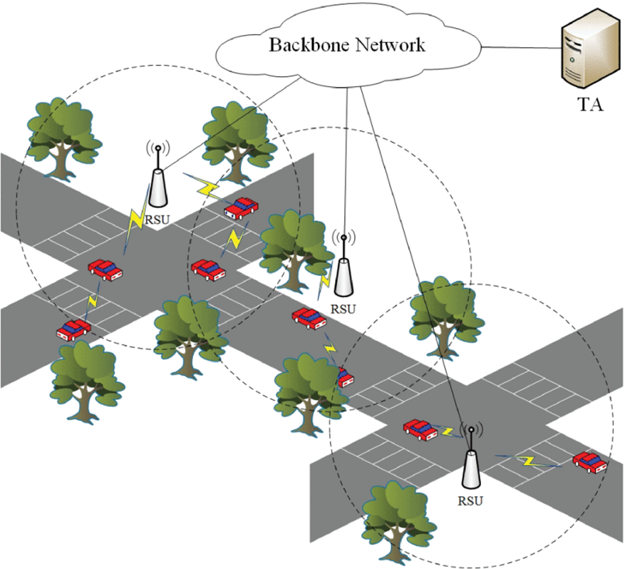
Preliminaries
VANETs
Notes:
作為智能交通系統（ITS）的重要組成部分，車輛自組織網絡（VANET）能夠使用無線通信技術來支持連續而穩定的網絡通信服務[19]。
如圖1所示，VANET由三個重要實體組成：信任授權（TA），路邊單元（RSU）和配備車載單元（OBU）的車輛[20]。
TA通常被視為信任第三方，VANET中的所有實體都信任TA。 TA的安全性和可靠性是在VANET中其他實體之間建立相互信任關係的基礎。
部署在道路兩側的RSU具有很高的存儲和計算能力。 RSU可以通過無線通信為車輛提供與安全有關的服務，與效率有關的服務以及與娛樂有關的服務。
安裝在車輛中的OBU可以支持與RSU或其他OBU進行信息交換以獲得所需的服務。

Slide 16
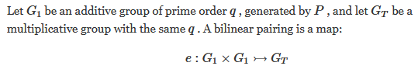
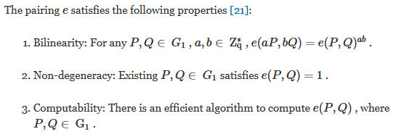
Bilinear Pairing
Notes:
令G1是q階的乘法循環群，其中q是大質數。雙線性配對(對稱) e：G1×G1滿足以下性質。
1、雙線性性：
對於任意a，b∈${ Z}_{q}^{∗}$和g1∈G1，有e(${g1}^{a}$, ${g1}^{b}$) = ${\text{e}\text{(}\text{g}\text{1,}\text{g}\text{1 )}}^{ab}$；
2、非退化性：
e(g1, g1) ≠ $1_{Gr}$（1Gr代表Gr群的單位元）；
3、可計算性：
存在有效的算法對任意的R，S∈G1，計算e(R, S)的值。

Slide 17
Identity-Based Group Signature
Group signature is considered as a special signature mechanism, in which authorized members can sign on behalf of the underlying group [22].
For a given group signature, any unauthorized entity can use group public key to verify whether the signature is legal, but it is impossible for any other verifier except for group manager to reveal the signer’s identity.
Consequently, group signature mechanism can be effectively used in anonymous authentication in VANETs [23].
Notes:
組簽名被認為是一種特殊的簽名機制，授權成員可以在其中代表基礎組進行簽名[22]。
對於給定的組簽名，任何未經授權的實體都可以使用組公鑰來驗證簽名是否合法，但是除組管理者之外，其他任何驗證者都無法透露簽名者的身份。
因此，組簽名機制可以有效地用於VANET的匿名身份驗證中[23]。

Slide 18
However, in traditional group signature schemes, any verifier has to determine the validity of the group public key certificate before verifying the group signature, which may influence the efficiency and stability of communication for high-speed vehicles.
In addition, due to limited computing and storage capacity of vehicles, the overhead of storing certificates for vehicles is also not negligible.
Consequently, identity-based group signature is adopted in the proposed scheme, where publicly group manager identifier can be used as the public group key component [24]. To reduce the burden of public key certificate management, verifier only needs to know the identity of the group manager to compute the group public key.
Notes:
但是，在傳統的組簽名方案中，任何驗證者都必須在驗證組簽名之前確定組公鑰證書的有效性，這可能會影響高速車輛通信的效率和穩定性。
此外，由於車輛的計算和存儲能力有限，因此存儲車輛證書的開銷也不容忽視。
因此，在提議的方案中採用了基於身份的組簽名，其中公共管理者標識符可以用作公共組密鑰組件[24]。為了減輕公鑰證書管理的負擔，驗證者只需知道組管理員的身份即可計算組公鑰。

Slide 19
The earliest identity-based group signature mechanism was proposed by Park et al. [25]. However, due to its high computation cost and low efficiency, it is difficult to be used in anonymous authentication in VANETs.
Han et al. proposed a novel identity-based group signature scheme [26], which makes a balance between the security and efficiency. In the proposed scheme, [26] is used in anonymous authentication and communication in VANETs. The details of the scheme are as follows.
Notes:
Park等人提出了最早的基於身份的組簽名機制[25]。
然而，由於其高昂的計算成本和低效率，因此難以在VANET中用於匿名身份驗證。
Han等提出了一種新穎的基於身份的組簽名方案[26]，該方案在安全性和效率之間取得了平衡。
在該方案中，[26]用於VANET中的匿名身份驗證和通信。該方案的細節如下。

Slide 20
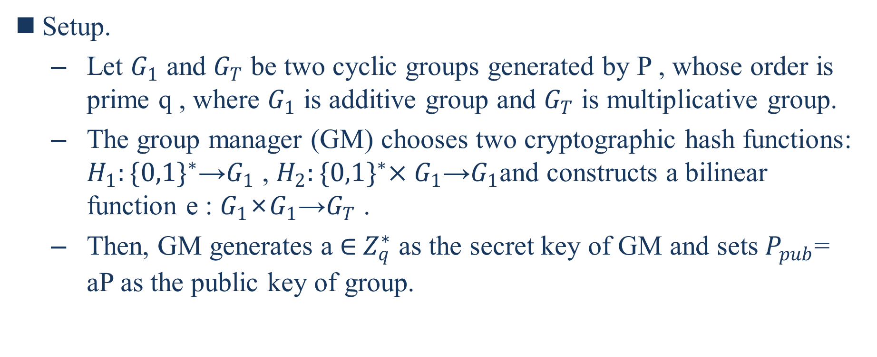
Setup.
      Let $G_{1}$ and $G_{T}$ be two cyclic groups generated by P , whose order is prime q , where $G_{1}$ is additive group and $G_{T}$ is multiplicative group.
      The group manager (GM) chooses two cryptographic hash functions: $H_{1}:{\{0,1\}}^{∗}$→$G_{1}$ , $H_{2}:{\{0,1\}}^{∗}×G_{1}$→$G_{1}$and constructs a bilinear function e : $G_{1}$×$G_{1}$→$G_{T}$ .
      Then, GM generates a ∈${ Z}_{q}^{∗}$ as the secret key of GM and sets $P_{pub}$= aP as the public key of group.
Notes:
設定
令$G_{1}$和$G_{T}$為P生成的兩個循環群，其順序為質數q，其中$G_{1}$為加法群，$G_{T}$為乘法群。
組管理器（GM）選擇兩個密碼hash函數：$H_{1}:{\{0,1\}}^{∗}$→$G_{1}$，$H_{2}:{\{0,1\}}^{∗}×G_{1}$→$G_{1}$並構造雙線性函數e：$G_{1}$×$G_{1}$→$G_{T}$。
(是任意大小的二進制位串的集合，例如任何數據可以表示為有序列的bits)
然後，GM生成a ∈${ Z}_{q}^{∗}$作為GM的私鑰，並將$P_{pub}$ = aP 設置為組的公鑰。

Slide 21
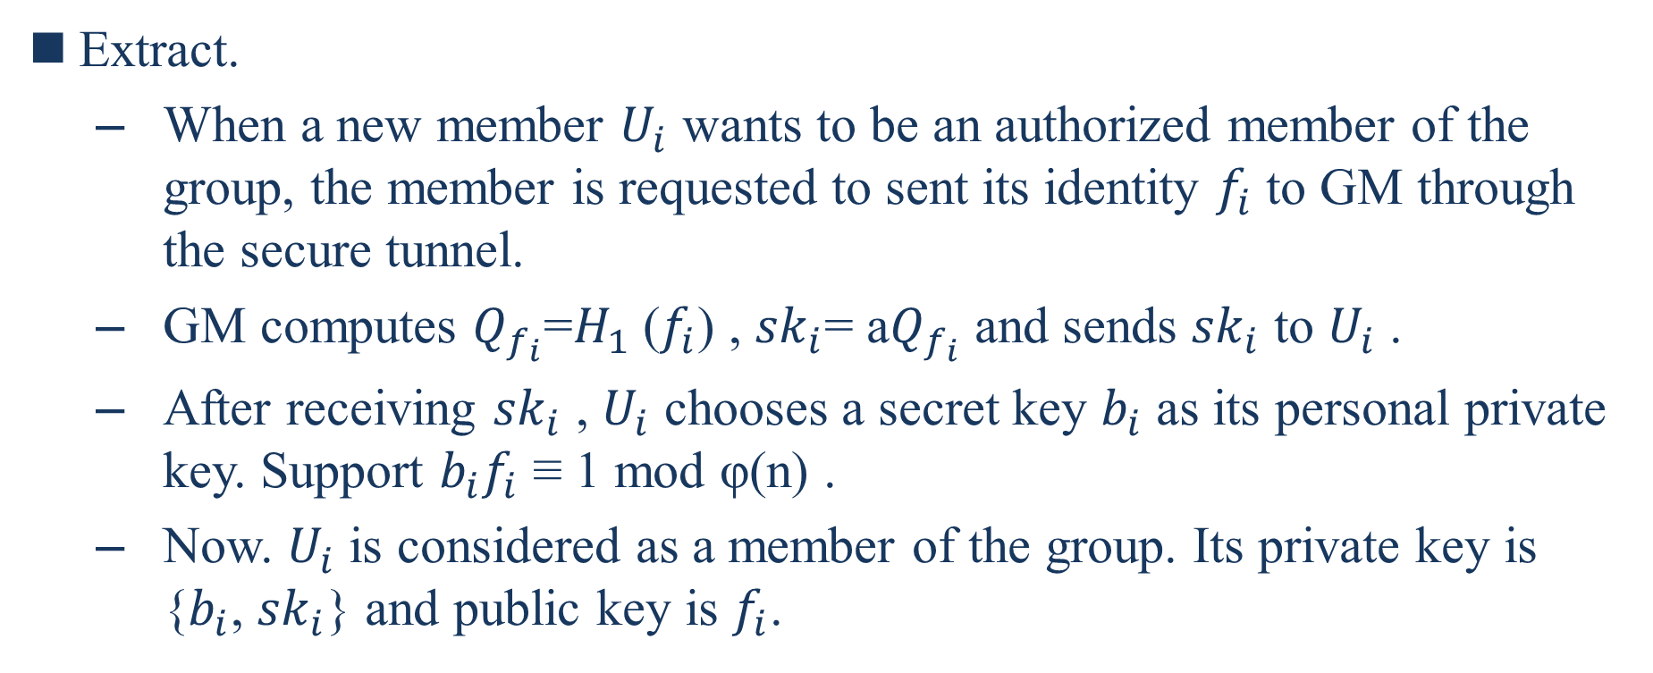
Extract.
      When a new member $U_{i}$ wants to be an authorized member of the group, the member is requested to sent its identity $f_{i}$ to GM through the secure tunnel.
      GM computes $Q_{f_{i}}$=$H_{1}$($f_{i}$) , ${sk}_{i}$= a$Q_{f_{i}}$ and sends ${sk}_{i}$ to $U_{i}$ .
      After receiving ${sk}_{i}$ , $U_{i}$ chooses a secret key $b_{i}$ as its personal private key. Support $b_{i}f_{i}$ ≡ 1 mod φ(n) .
      Now. $U_{i}$ is considered as a member of the group. Its private key is {$b_{i}$, ${sk}_{i}$} and public key is $f_{i}$.
Notes:
提取。
當新成員$U_{i}$要成為該組的授權成員時，要求該成員通過安全通道將其身份$f_{i}$發送給GM。
GM計算$Q_{f_{i}}$=$H_{1}$($f_{i}$), ${sk}_{i}$= a$Q_{f_{i}}$並將${sk}_{i}$發送給$U_{i}$。
在收到${sk}_{i}$後，$U_{i}$選擇一個秘密密鑰$b_{i}$作為其個人私鑰。支持$b_{i}f_{i}$≡1 mod φ(n)。
現在， $U_{i}$被視為該組的成員。它的私鑰是{bi，ski}，公鑰是fi。

Slide 22

Sign.
  For given a message M , signer chooses x ∈ ${ Z}_{q}^{∗}$and computes A= x P , B = $x^{−1}{sk}_{i}$ + $H_{2}$(m, A) $b_{i}$ .
  The group signature on message M is {A, B, $f_{i}$} .
Notes:
署名。
對於給定的消息M，簽署者選擇x ∈${ Z}_{q}^{∗}$併計算A = x P，B = $x^{−1}{sk}_{i}$ + $H_{2}$(m,A) $b_{i}$。
消息M上的組簽名為{A, B, $f_{i}$} 。

Slide 23
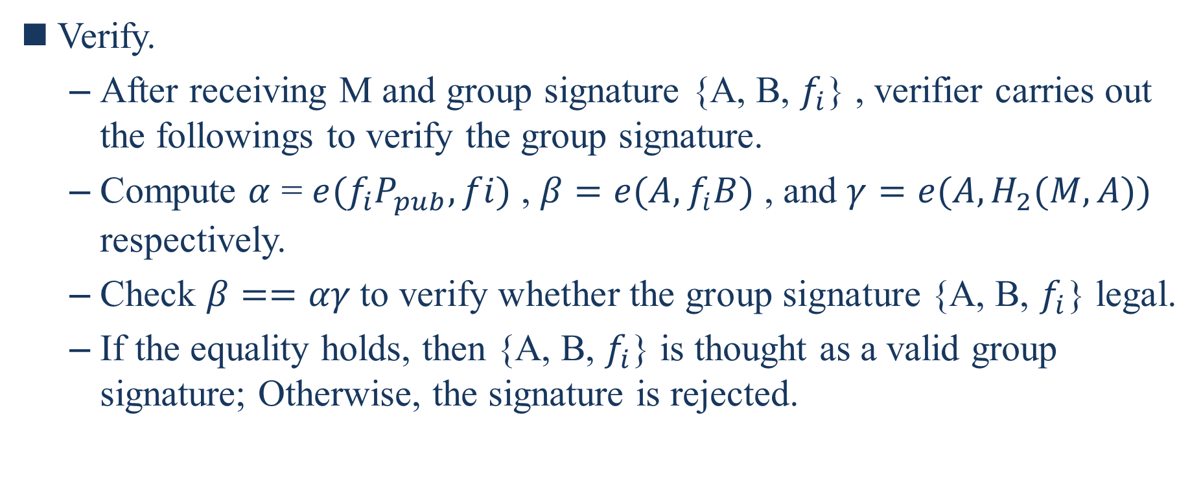
Verify.
  After receiving M and group signature {A, B, $f_{i}$} , verifier carries out the followings to verify the group signature.
  Compute $α$ = $e(f_{i}P_{pub},fi)$ , $β=e(A, f_{i}B)$ , and $γ=e(A,H_{2}(M,A))$ respectively.
  Check $β==αγ$to verify whether the group signature {A, B, $f_{i}$} legal.
  If the equality holds, then {A, B, $f_{i}$} is thought as a valid group signature; Otherwise, the signature is rejected.
Notes:
校驗。
驗證者收到M和組簽名{A, B, $f_{i}$}後，執行以下步驟來驗證組簽名。
分別計算$α$ = $e(f_{i}P_{pub},fi)$ , $β=e(A, f_{i}B)$和$γ=e(A,H_{2}(M,A))$ 。
檢查β==αγ以驗證組簽名{A, B, $f_{i}$}是否合法。
如果等式成立，則{A, B, $f_{i}$}被認為是有效的組簽名；否則，簽名將被拒絕。

Slide 24
The Proposed Schemes
In this section, AAAS network architecture, trust model, system initialization, initial registeration, V2I initial authentication, and V2I handover authentication are described.
We adopt identity based on signature mechanism (CC signatute [27]), Diffie-Hellman key exchange mechanism [28], and AES cipher mechanism [29] to support anonymous authenticaion and communication.
Notes:
在本節中，將描述AAAS網絡體系結構，信任模型，系統初始化，初始註冊，V2I初始認證和V2I切換認證。
我們採用基於身分簽名機制（CC簽名[27]），Diffie-Hellman密鑰交換機制[28]和AES密碼機制[29]來支持匿名身份驗證和通信。
Diffie-Hellman:它可以讓雙方在完全沒有對方任何預先資訊的條件下通過不安全信道建立起一個金鑰。這個金鑰可以在後續的通訊中作為對稱金鑰來加密通訊內容。
AES:最常見的對稱加密演算法

Slide 25
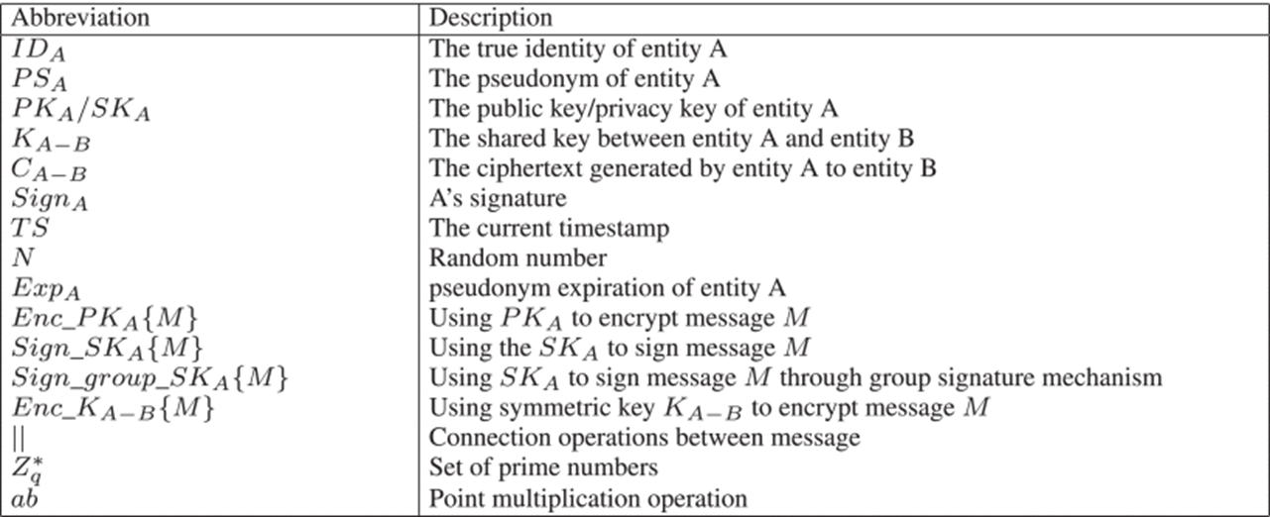
Before introducing AAAS, a few of relevant abbreviations and descriptions used frequently are illustrated in Table 1.
Notes:
缩写 說明
實體A的真實身份
A實體的假名
實體A的公開金鑰/私密金鑰
實體A和實體B之間的共用金鑰
由一個實體A到另一個實體B生成的密文
A的簽名
當前時間戳記
亂數
實體A的假名到期時間
使用pulic key A加密消息M
使用private key A對消息M簽名
利用private key A通過群簽名機制對消息M進行簽名
用對稱金鑰$K_{\text{A}\text{−}\text{B}}$加密消息M
消息之間的連接操作
素數集
點乘運算

Slide 26
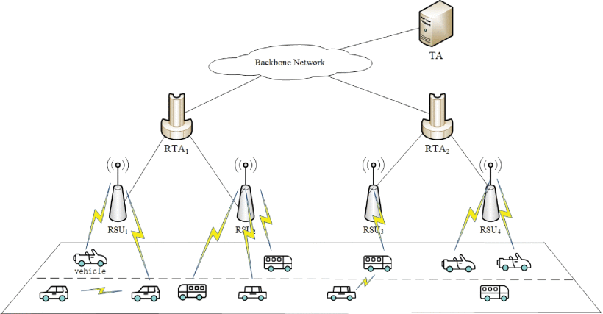
Network Architecture
Notes:
圖2顯示了所提出方案的網絡體系結構，其中包括四種類型的實體名稱：可信機構（TA），區域可信機構（RTA），RSU和車輛。
TA：作為受信任的第三方實體，TA生成系統參數，發布RTA的私鑰，併計算車輛的假名和私鑰。此外，TA亦會保留車輛的身分清單，並為非法車輛的吊銷提供服務。
RTA：為了減輕TA的計算和通信壓力，在AAAS網絡體系結構中，添加了RTA來管理每個區域中的所有RSU，並為車輛提供匿名身份驗證和通信服務。
RSU：RSU通常部署在道路的兩側，以通過無線通信為道路上的合法車輛提供相關的安全服務和娛樂服務。
車輛：為了獲得VANET提供的網絡服務，每輛配備OBU的車輛都可以與周圍的RSU和車輛交換信息，從而為駕駛員提供更好的駕駛體驗。

Slide 27
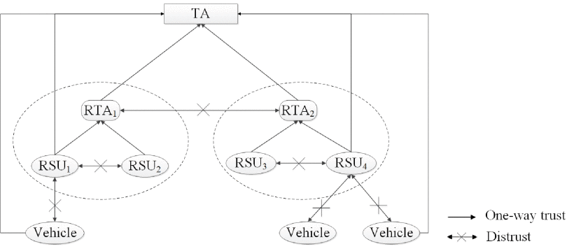
Trust Model
Notes:
圖3中描述了所提出方案的信任模型。
TA被VANET中的所有實體信任。其他實體需要提交真實身份才能申請註冊。保持TA的安全性和可靠性是在VANET中其他實體之間建立信任關係的基礎。
要求RTA向TA註冊以與TA建立信任關係。同時，分配區域中的所有RSU都信任RTA，但是RTA之間沒有信任關係。
RSU信任其區域內的TA和RTA，但不信任車輛。此外，RSU不信任其他RSU。
所有車輛都信任TA，但車輛不信任其他車輛和RSU。該方案的目的是匿名建立車輛與RSU之間的信任關係。

Slide 28
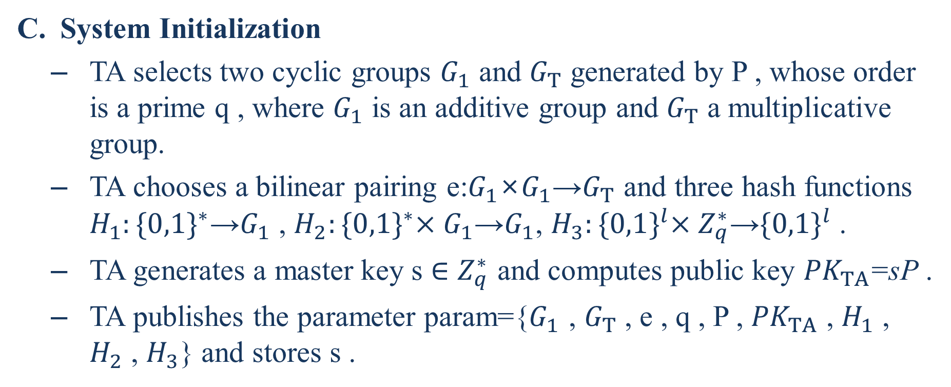
System Initialization
  TA selects two cyclic groups $G_{1}$ and $G_{T}$ generated by P , whose order is a prime q , where $G_{1}$ is an additive group and $G_{T}$ a multiplicative group.
  TA chooses a bilinear pairing e:$G_{1}$×$G_{1}$→$G_{T}$ and three hash functions $H_{1}:{\{0,1\}}^{∗}$→$G_{1}$ , $H_{2}:{\{0,1\}}^{∗}×G_{1}$→$G_{1}$, $H_{3}:{\{0,1\}}^{l}×{ Z}_{q}^{∗}$→${\{0,1\}}^{l}$ .
  TA generates a master key s ∈ $Z_{q}^{∗}$ and computes public key ${PK}_{TA}$=sP .
  TA publishes the parameter param={$G_{1}$ , $G_{T}$ , e , q , P , ${PK}_{TA}$ , $H_{1}$ , $H_{2}$ , $H_{3}$} and stores s .
Notes:
TA選擇由P生成的兩個循環群$G_{1}$和$G_{T}$，其順序為質數q，其中$G_{1}$為加法群，$G_{T}$為乘法群。
TA選擇雙線性配對e：$G_{1}$×$G_{1}$→$G_{T}$和三個哈希函數$H_{1}:{\{0,1\}}^{∗}$→$G_{1}$ , $H_{2}:{\{0,1\}}^{∗}×G_{1}$→$G_{1}$, $H_{3}:{\{0,1\}}^{l}×{ Z}_{q}^{∗}$→${\{0,1\}}^{l}$
TA生成一個主密鑰 s ∈ $Z_{q}^{∗}$ 併計算公共密鑰PKTA = sP。
TA發布參數param = { $G_{1}$ , $G_{T}$ , e , q , P , ${PK}_{TA}$ , $H_{1}$ , $H_{2}$ , $H_{3}$} 並存儲s。

Slide 29
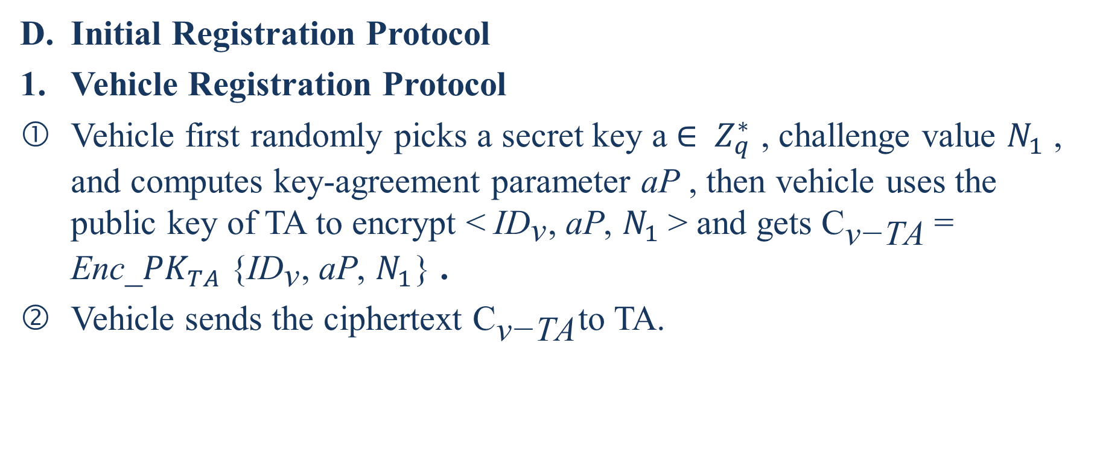
Initial Registration Protocol
Vehicle Registration Protocol
Vehicle first randomly picks a secret key a ∈ ${ Z}_{q}^{∗}$ , challenge value $N_{1}$ , and computes key-agreement parameter aP , then vehicle uses the public key of TA to encrypt <${\text{ID}}_{\text{v}}$, aP, $N_{1}$> and gets ${\text{C}}_{\text{v}\text{−}\text{TA}}$= ${\text{Enc}\text{_}PK}_{TA}${${\text{ID}}_{\text{v}}$, aP, $N_{1}$} .
Vehicle sends the ciphertext ${\text{C}}_{\text{v}\text{−}\text{TA}}$to TA.
Notes:
車輛首先隨機選擇一個秘密密鑰a ∈ ${ Z}_{q}^{∗}$，挑戰值$N_{1}$，併計算密鑰協商參數aP，然後車輛使用TA的公鑰對<${\text{ID}}_{\text{v}}$, aP, $N_{1}$>進行加密，並得到${\text{C}}_{\text{v}\text{−}\text{TA}}$= ${\text{Enc}\text{_}PK}_{TA}${${\text{ID}}_{\text{v}}$, aP, $N_{1}$} 。
車輛將密文${\text{C}}_{\text{v}\text{−}\text{TA}}$發送給TA。

Slide 30
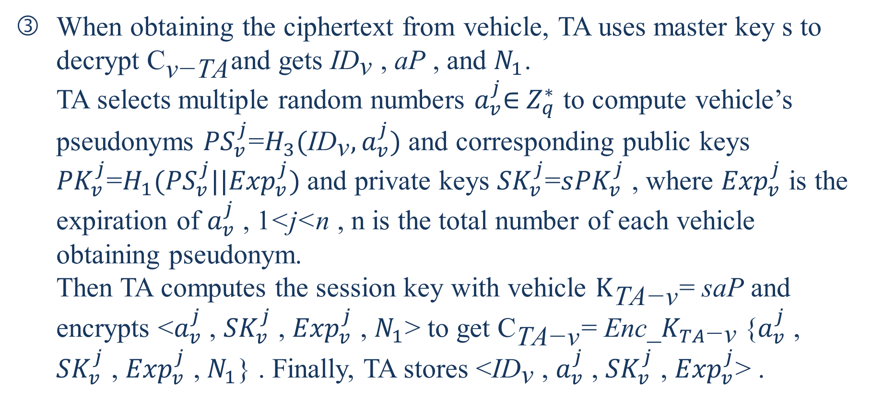
When obtaining the ciphertext from vehicle, TA uses master key s to decrypt ${\text{C}}_{\text{v}\text{−}\text{TA}}$and gets ${\text{ID}}_{\text{v}}$ , aP , and $N_{1}$.
TA selects multiple random numbers $a_{v}^{j}$∈${ Z}_{q}^{∗}$ to compute vehicle’s pseudonyms ${PS}_{v}^{j}$=$H_{3}({\text{ID}}_{\text{v}}, a_{v}^{j})$ and corresponding public keys ${PK}_{v}^{j}$=$H_{1}({PS}_{v}^{j}||{Exp}_{v}^{j})$and private keys ${SK}_{v}^{j}$=$s{PK}_{v}^{j}$ , where ${Exp}_{v}^{j}$ is the expiration of $a_{v}^{j}$ , 1<j<n , n is the total number of each vehicle obtaining pseudonym.
Then TA computes the session key with vehicle ${\text{K}}_{\text{TA}\text{−}\text{v}}$= saP and encrypts <$a_{v}^{j}$ , ${SK}_{v}^{j}$ , ${Exp}_{v}^{j}$ , $N_{1}$> to get ${\text{C}}_{\text{TA}\text{−}\text{v}}$= ${\text{Enc}\text{_}K}_{TA\text{−}\text{v}}${$a_{v}^{j}$ , ${SK}_{v}^{j}$ , ${Exp}_{v}^{j}$ , $N_{1}$} . Finally, TA stores <${\text{ID}}_{\text{v}}$ , $a_{v}^{j}$ , ${SK}_{v}^{j}$ , ${Exp}_{v}^{j}$> .
Notes:
當從車輛中獲得密文時，TA使用主密鑰s解密${\text{C}}_{\text{v}\text{−}\text{TA}}$並獲得${\text{ID}}_{\text{v}}$ , aP 和 $N_{1}$。
TA選擇多個隨機數$a_{v}^{j}$∈${ Z}_{q}^{∗}$來計算車輛的假名${PS}_{v}^{j}$=$H_{3}({\text{ID}}_{\text{v}}, a_{v}^{j})$以及相應的公鑰${PK}_{v}^{j}$=$H_{1}({PS}_{v}^{j}||{Exp}_{v}^{j})$和私鑰${SK}_{v}^{j}$=$s{PK}_{v}^{j}$，其中${Exp}_{v}^{j}$是$a_{v}^{j}$的到期時間，1<j<n，n是每個獲得假名的車輛的總數。
然後，TA用車輛${\text{K}}_{\text{TA}\text{−}\text{v}}$ = saP計算會話密鑰，並加密<$a_{v}^{j}$ , ${SK}_{v}^{j}$ , ${Exp}_{v}^{j}$ , $N_{1}$>以獲得${\text{C}}_{\text{TA}\text{−}\text{v}}$ = ${\text{Enc}\text{_}K}_{TA\text{−}\text{v}}${$a_{v}^{j}$ , ${SK}_{v}^{j}$ , ${Exp}_{v}^{j}$ , $N_{1}$} 。最後，TA存儲<${\text{ID}}_{\text{v}}$ , $a_{v}^{j}$ , ${SK}_{v}^{j}$ , ${Exp}_{v}^{j}$>。

Slide 31
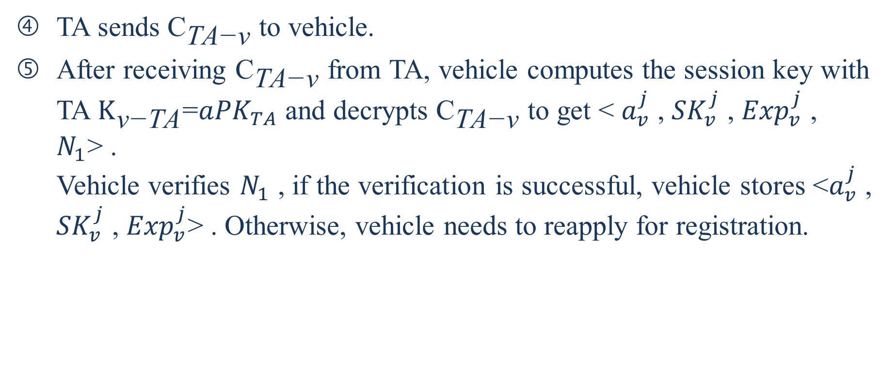
TA sends ${\text{C}}_{\text{TA}\text{−}\text{v}}$ to vehicle.
After receiving ${\text{C}}_{\text{TA}\text{−}\text{v}}$ from TA, vehicle computes the session key with TA $K_{\text{v}\text{−}\text{TA}}$=$a{PK}_{TA}$ and decrypts ${\text{C}}_{\text{TA}\text{−}\text{v}}$ to get < $a_{v}^{j}$ , ${SK}_{v}^{j}$ , ${Exp}_{v}^{j}$ , $N_{1}$> .
Vehicle verifies $N_{1}$ , if the verification is successful, vehicle stores <$a_{v}^{j}$ , ${SK}_{v}^{j}$ , ${Exp}_{v}^{j}$> . Otherwise, vehicle needs to reapply for registration.
Notes:
TA將${\text{C}}_{\text{TA}\text{−}\text{v}}$發送到車輛。
在從TA接收到${\text{C}}_{\text{TA}\text{−}\text{v}}$之後，車輛計算TA的會話密鑰$K_{\text{v}\text{−}\text{TA}}$=$a{PK}_{TA}$並解密${\text{C}}_{\text{TA}\text{−}\text{v}}$以獲得< $a_{v}^{j}$ , ${SK}_{v}^{j}$ , ${Exp}_{v}^{j}$ , $N_{1}$> 。車輛驗證$N_{1}$，如果驗證成功，則車輛存儲<$a_{v}^{j}$ , ${SK}_{v}^{j}$ , ${Exp}_{v}^{j}$> 。否則，車輛需要重新申請註冊。

Slide 32
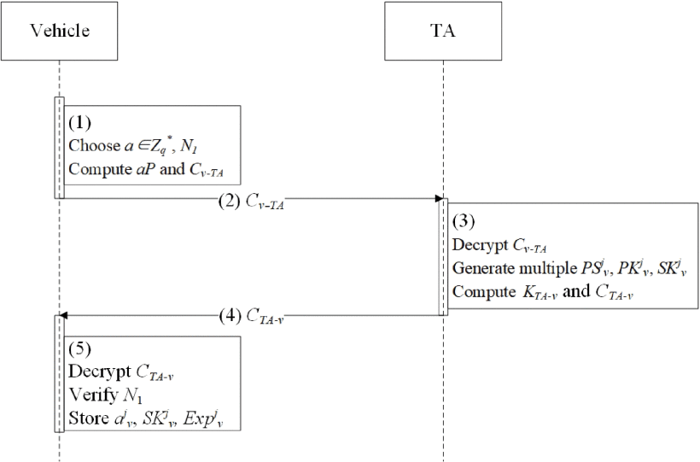

Slide 33
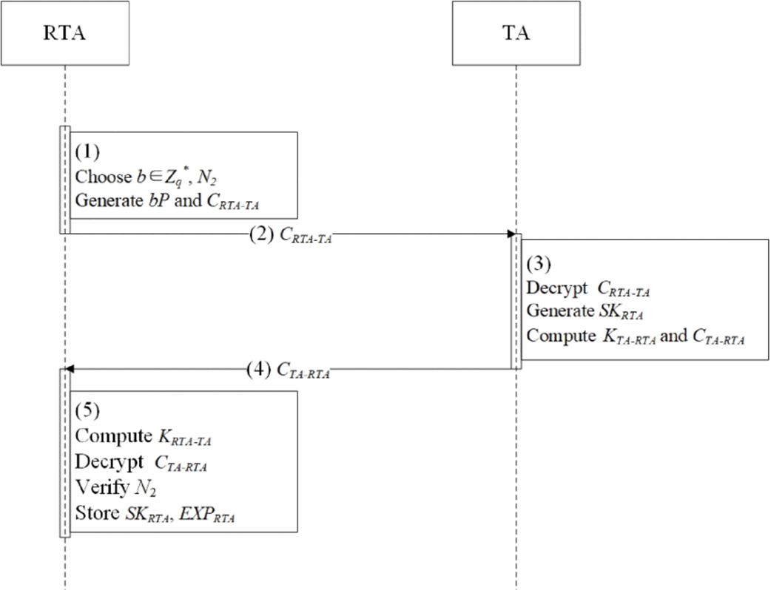
RTA Registration Protocol
Notes:
RTA選擇一個隨機數b ∈${ Z}_{q}^{∗}$ 作為其秘密密鑰，併計算密鑰協商參數 bP。然後，RTA計算密文${\text{C}}_{RTA\text{−}TA}$ = ${\text{Enc}\text{_}PK}_{TA}$ {${\text{ID}}_{RTA}$, aP, $N_{2}$} ，其中$N_{2}$是挑戰值。
RTA發送${\text{C}}_{RTA\text{−}TA}$到TA。
一旦接收到密文，TA首先解密${\text{C}}_{RTA\text{−}TA}$以獲得<${\text{ID}}_{RTA}$, aP, $N_{2}>$。 TA計算RTA的私鑰：${\text{SK}}_{RTA}$ = s${\text{PK}}_{RTA}$，其中${\text{PK}}_{RTA}$ = $H_{1}({\text{ID}}_{RTA}||{EXP}_{RTA})$是RTA的公鑰，${EXP}_{RTA}$是SKRTA的到期時間。
最後，TA計算與RTA會話密鑰 $K_{TA\text{−}RTA}$ = sbP，並加密<${\text{SK}}_{RTA}$，${EXP}_{RTA}$，$N_{2}$>以獲得${\text{C}}_{TA\text{−}RTA}$= ${\text{Enc}\text{_}K}_{TA−RTA}$ {${\text{SK}}_{RTA}$，${EXP}_{RTA}$，$N_{2}$}。
TA將${\text{C}}_{TA\text{−}RTA}$發送到RTA。
當從TA獲取密文時，RTA計算與TA會話密鑰 $K_{TA−RTA}$ = ${bPK}_{TA}$以加密${\text{C}}_{TA\text{−}RTA}$並獲取<${\text{SK}}_{RTA}$，${EXP}_{RTA}$，$N_{2}$>。 RTA確認$N_{2}$的有效性。如果無效，則RTA存儲${\text{SK}}_{RTA}$，${EXP}_{RTA}$。否則，RTA註冊失敗。

Slide 34
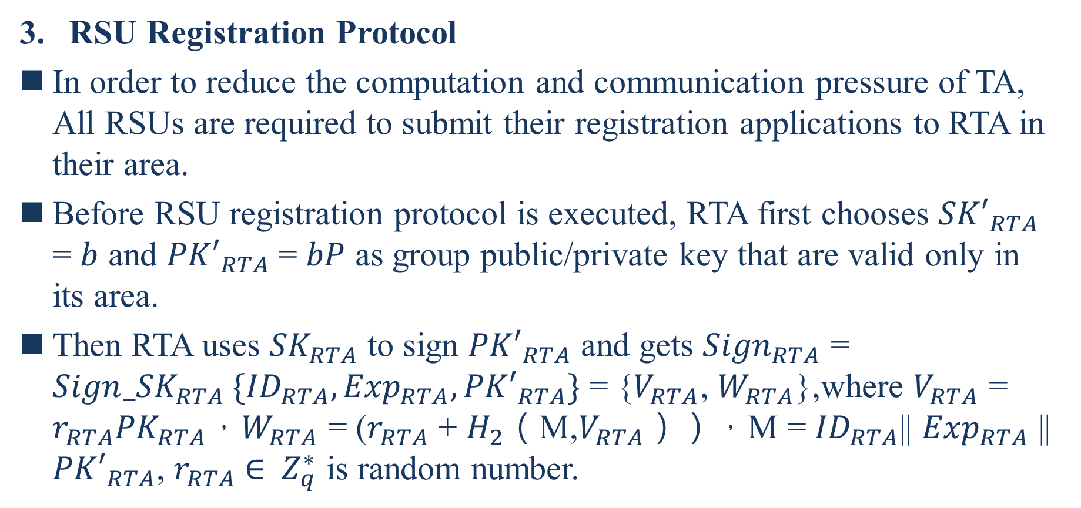
RSU Registration Protocol
In order to reduce the computation and communication pressure of TA, All RSUs are required to submit their registration applications to RTA in their area.
Before RSU registration protocol is executed, RTA first chooses ${SK′}_{RTA}$ = $b$ and ${PK′}_{RTA}$= $bP$ as group public/private key that are valid only in its area.
Then RTA uses ${SK}_{RTA}$ to sign ${PK′}_{RTA}$ and gets ${Sign}_{RTA}$ = ${Sign_SK}_{RTA} \{{ID}_{RTA},{Exp}_{RTA},{PK′}_{RTA}\}$ = {$V_{RTA}$, $W_{RTA}$},where $V_{RTA}$ = $r_{RTA}{PK}_{RTA}$，$W_{RTA}$ = ($r_{RTA}$ + $H_{2}$（M,$V_{RTA}$）），M = ${ID}_{RTA}$|| ${Exp}_{RTA}$ || ${PK′}_{RTA}$, $r_{RTA}$ ∈${ Z}_{q}^{∗}$ is random number.
Notes:
為了減輕TA的計算和通信壓力，所有RSU都必須向其區域內的RTA提交其註冊申請。在執行RSU註冊協議之前，RTA首先選擇${SK′}_{RTA}$ = $b$和${PK′}_{RTA}$= $bP$ 作為僅在其區域內有效的組公鑰/私鑰。然後RTA使用${SK}_{RTA}$簽名${PK′}_{RTA}$並獲得${Sign}_{RTA}$ = ${Sign_SK}_{RTA} \{{ID}_{RTA},{Exp}_{RTA},{PK′}_{RTA}\}$ = {$V_{RTA}$, $W_{RTA}$}，其中$V_{RTA}$ = $r_{RTA}{PK}_{RTA}$，$W_{RTA}$ = ($r_{RTA}$ + $H_{2}$（M,$V_{RTA}$）），M = ${ID}_{RTA}$|| ${Exp}_{RTA}$ || ${PK′}_{RTA}$，$r_{RTA}$ ∈${ Z}_{q}^{∗}$是隨機數。

Slide 35
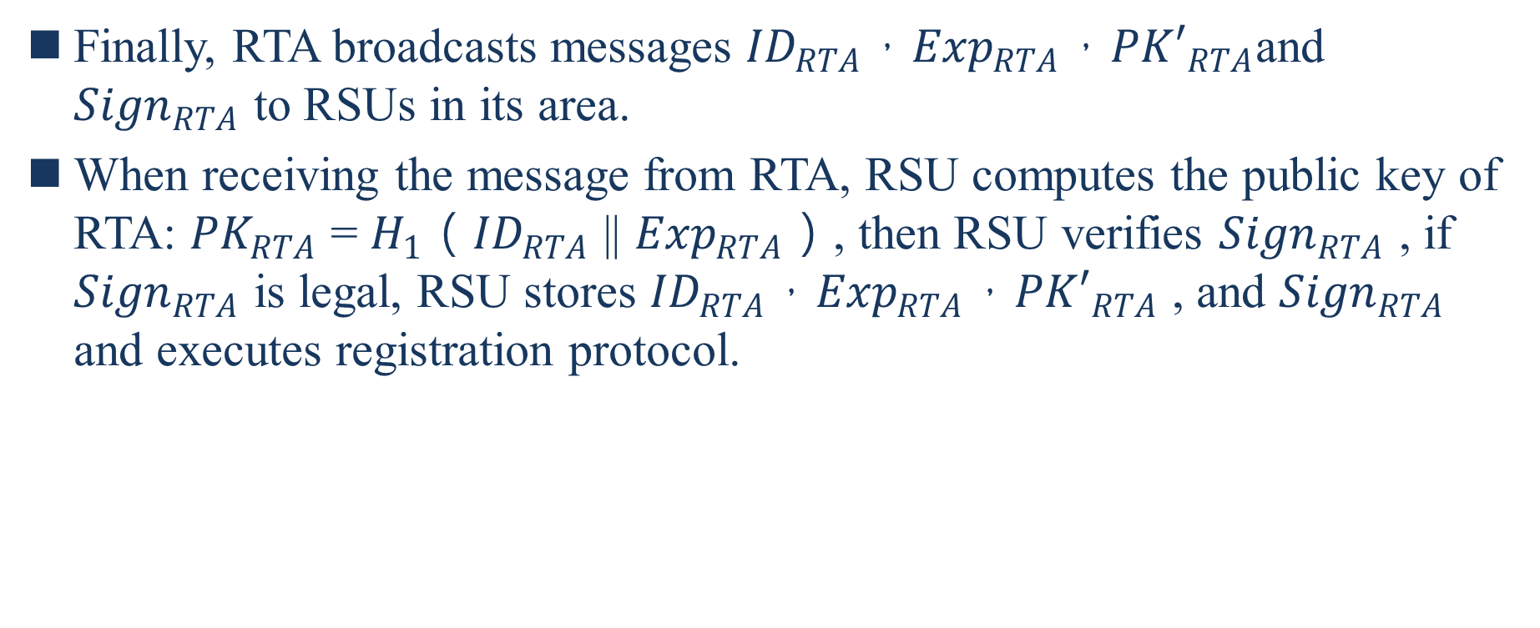
Finally, RTA broadcasts messages ${ID}_{RTA}$，${Exp}_{RTA}$，${PK′}_{RTA}$and ${Sign}_{RTA}$ to RSUs in its area.
When receiving the message from RTA, RSU computes the public key of RTA: ${PK}_{RTA}$ = $H_{1}$（${ID}_{RTA}$ || ${Exp}_{RTA}$）, then RSU verifies ${Sign}_{RTA}$ , if ${Sign}_{RTA}$ is legal, RSU stores ${ID}_{RTA}$，${Exp}_{RTA}$，${PK′}_{RTA}$ , and ${Sign}_{RTA}$ and executes registration protocol.
Notes:
最後，RTA向其區域內的RSU廣播消息${ID}_{RTA}$，${Exp}_{RTA}$，${PK′}_{RTA}$和${Sign}_{RTA}$。當從RTA接收消息時，RSU計算RTA的公鑰：${PK}_{RTA}$ = $H_{1}$（${ID}_{RTA}$ || ${Exp}_{RTA}$），然後RSU驗證${Sign}_{RTA}$，如果${Sign}_{RTA}$合法，則RSU存儲${ID}_{RTA}$，${Exp}_{RTA}$，${PK′}_{RTA}$和${Sign}_{RTA}$並執行註冊協議。圖6顯示了詳細信息。

Slide 36
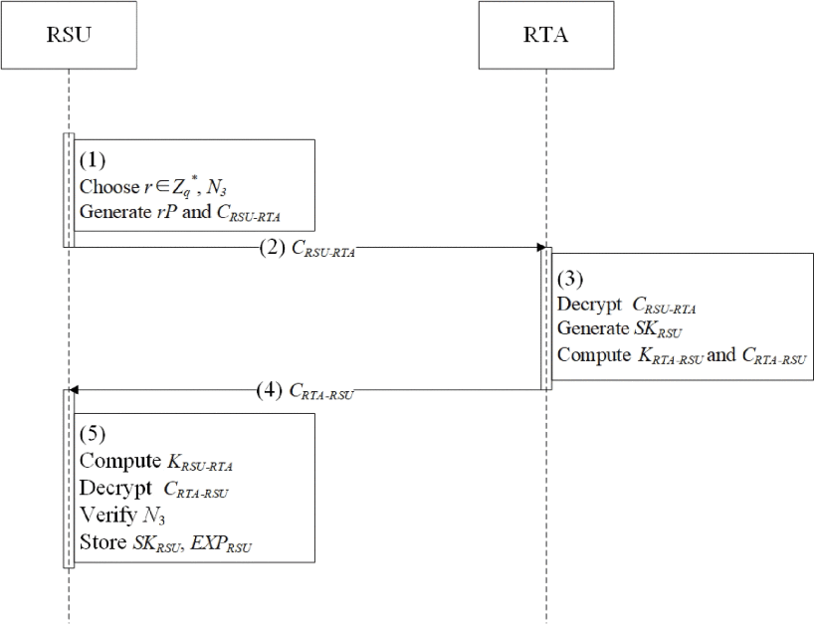
Notes:
每個RSU隨機生成一個秘密密鑰r ∈$Z_{q}^{∗}$，並使用RTA計算$rP$作為密鑰協商參數。之後，RSU生成密文$C_{RSU−RTA}$= ${Enc_PK′}_{RTA} \{{ID}_{RSU}，rP，N_{3}\}$，其中$N_{3}$是隨機數作為挑戰值。
RSU將$C_{RSU−RTA}$發送到RTA。
RTA解密$C_{RSU−RTA}$並獲取$<{ID}_{RSU}，rP，N_{3}>$。然後，RTA生成RSU的私鑰${SK}_{RSU}$=$b{PK}_{RSU}$，其中${PK}_{RSU}$ = $H_{1}$（${ID}_{RSU}$）。之後，RTA計算會話密鑰$K_{RTA−RSU}$= $brP$和$C_{RTA−RSU}$= ${Enc_K}_{RTA−RSU} \{{SK}_{RSU}，{Exp}_{RSU}，N_{3}+1\}$，其中${Exp}_{RSU}$是${SK}_{RSU}$的到期時間。
RTA將$C_{RTA−RSU}$發送到RSU。
RSU計算與RTA會話密鑰$K_{RTA−RSU}$= $b{PK′}_{RTA}$，並對$C_{RTA−RSU}$加密以獲得${SK}_{RSU}，{Exp}_{RSU}，N_{3}+1$。
如果$N_{3}+1$有效，則RSU存儲${SK}_{RSU}，{Exp}_{RSU}$。否則，要求RSU重新申請註冊。

Slide 37
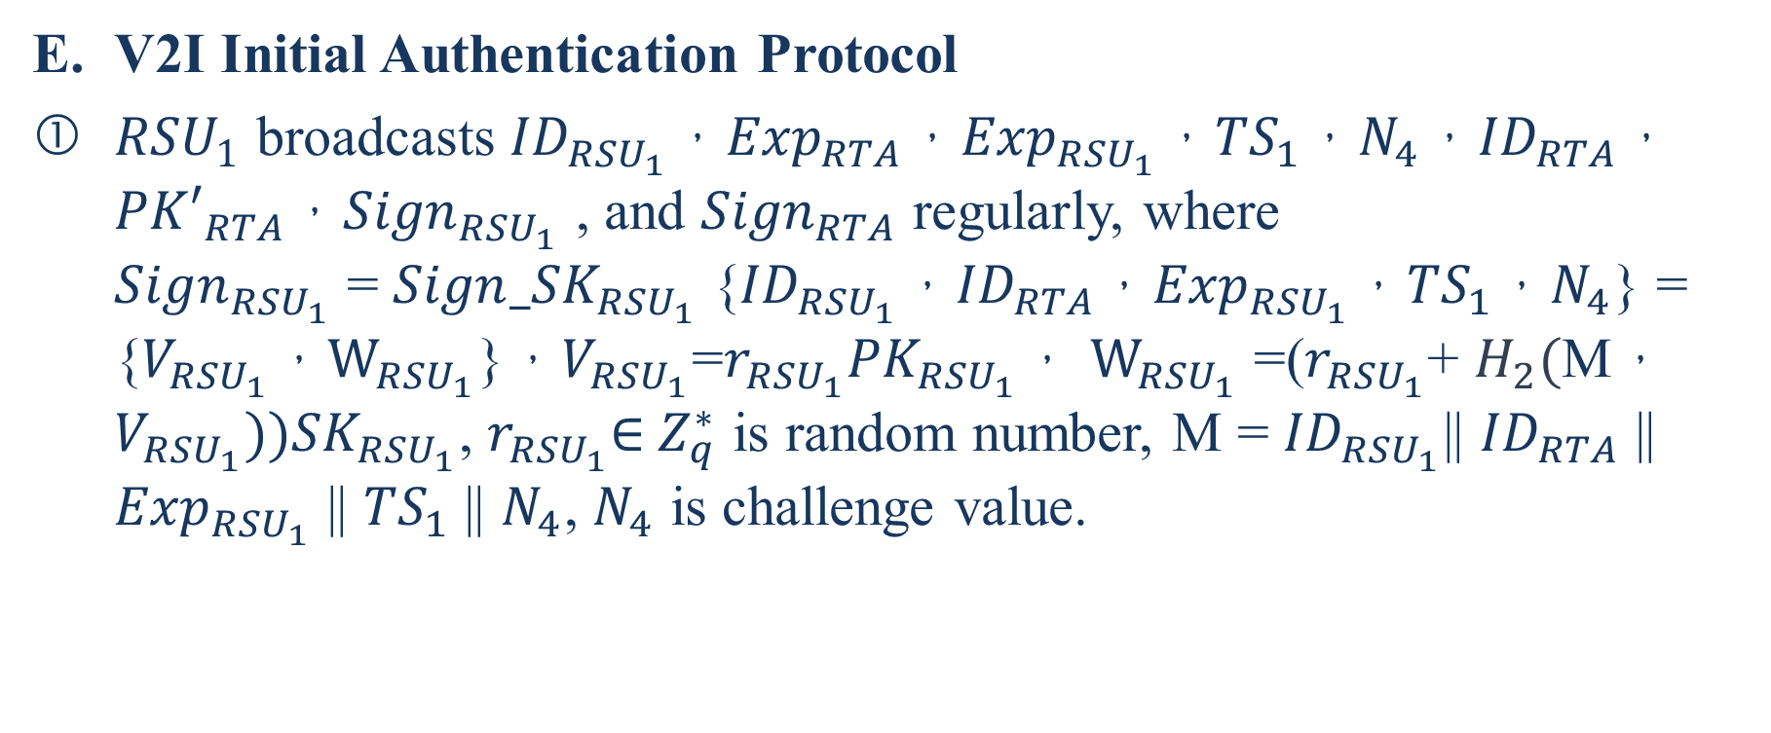
V2I Initial Authentication Protocol
${RSU}_{1}$ broadcasts ${ID}_{{RSU}_{1}}$，${Exp}_{RTA}$，${Exp}_{{RSU}_{1}}$，${TS}_{1}$，$N_{4}$，${ID}_{RTA}$，${PK′}_{RTA}$，${Sign}_{{RSU}_{1}}$ , and ${Sign}_{RTA}$ regularly, where
${Sign}_{{RSU}_{1}}$ = ${Sign_SK}_{{RSU}_{1}}$ {${ID}_{{RSU}_{1}}$，${ID}_{RTA}$，${Exp}_{{RSU}_{1}}$，${TS}_{1}$，$N_{4}$} = {$V_{{RSU}_{1}}，W_{{RSU}_{1}}$}，$V_{{RSU}_{1}}$=$r_{{RSU}_{1}}{PK}_{{RSU}_{1}}$， $W_{{RSU}_{1}}$ =($r_{{RSU}_{1}}$+ $H_{2}($M，$V_{{RSU}_{1}})){SK}_{{RSU}_{1}}$, $r_{{RSU}_{1}}$∈${ Z}_{q}^{∗}$ is random number, M = ${ID}_{{RSU}_{1}}$|| ${ID}_{RTA}$ || ${Exp}_{{RSU}_{1}}$ || ${TS}_{1}$ || $N_{4}$, $N_{4}$ is challenge value.
Notes:
${RSU}_{1}$定期廣播${ID}_{{RSU}_{1}}$，${Exp}_{RTA}$，${Exp}_{{RSU}_{1}}$，${TS}_{1}$，$N_{4}$，${ID}_{RTA}$，${PK′}_{RTA}$，${Sign}_{{RSU}_{1}}$和${Sign}_{RTA}$，其中${Sign}_{{RSU}_{1}}$ = ${Sign_SK}_{{RSU}_{1}}$ {${ID}_{{RSU}_{1}}$，${ID}_{RTA}$，${Exp}_{{RSU}_{1}}$，${TS}_{1}$，$N_{4}$} = {$V_{{RSU}_{1}}，W_{{RSU}_{1}}$}，$V_{{RSU}_{1}}$=$r_{{RSU}_{1}}{PK}_{{RSU}_{1}}$， $W_{{RSU}_{1}}$ =($r_{{RSU}_{1}}$+ $H_{2}($M，$V_{{RSU}_{1}})){SK}_{{RSU}_{1}}$，$r_{{RSU}_{1}}$∈${ Z}_{q}^{∗}$是隨機數，M = ${ID}_{{RSU}_{1}}$|| ${ID}_{RTA}$ || ${Exp}_{{RSU}_{1}}$ || ${TS}_{1}$ || $N_{4}$，$N_{4}$是質詢值。

Slide 38
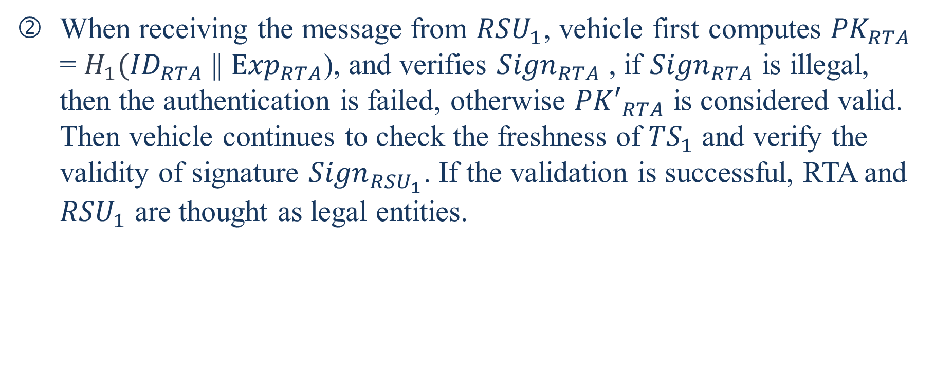
When receiving the message from ${RSU}_{1}$, vehicle first computes ${PK}_{RTA}$ = $H_{1}({ID}_{RTA}$ || ${Exp}_{RTA}$), and verifies ${Sign}_{RTA}$ , if ${Sign}_{RTA}$ is illegal, then the authentication is failed, otherwise ${PK′}_{RTA}$ is considered valid.
Then vehicle continues to check the freshness of ${TS}_{1}$ and verify the validity of signature ${Sign}_{{RSU}_{1}}$. If the validation is successful, RTA and ${RSU}_{1}$ are thought as legal entities.
Notes:
當從${RSU}_{1}$接收到消息時，車輛首先計算${PK}_{RTA}$ = $H_{1}({ID}_{RTA}$ || ${Exp}_{RTA}$)，並驗證${Sign}_{RTA}$，如果${Sign}_{RTA}$非法，則認證失敗，否則認為${PK′}_{RTA}$有效。然後，車輛繼續檢查${TS}_{1}$的新鮮度並驗證簽名${Sign}_{{RSU}_{1}}$的有效性。如果驗證成功，則將RTA和${RSU}_{1}$視為合法。

Slide 39
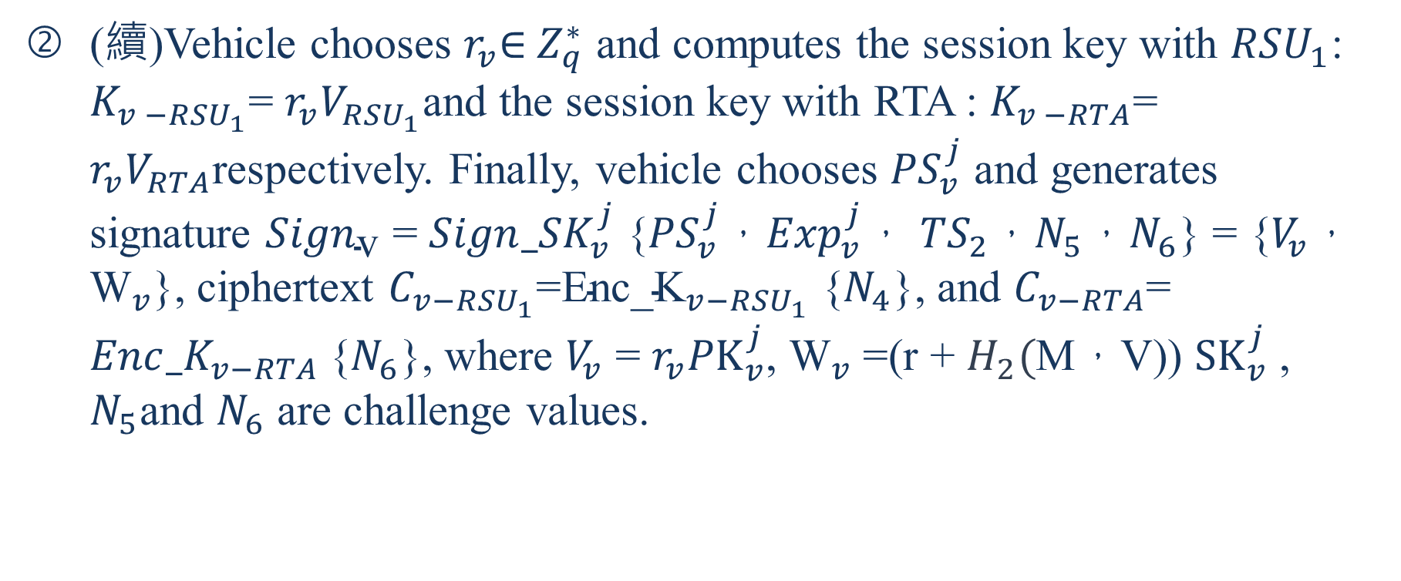
(續)Vehicle chooses $r_{v}$∈${ Z}_{q}^{∗}$ and computes the session key with ${RSU}_{1}$: $K_{v −{RSU}_{1}}$= $r_{v}V_{{RSU}_{1}}$and the session key with RTA : $K_{v −RTA}$= $r_{v}V_{RTA}$respectively. Finally, vehicle chooses ${PS}_{v}^{j}$ and generates signature ${Sign}_{\text{v}}$ = ${Sign_SK}_{v}^{j}$ {${PS}_{v}^{j}$，${Exp}_{v}^{j}$， ${TS}_{2}$，$N_{5}$，$N_{6}$} = {$V_{v}$，${\text{W}}_{v}$}, ciphertext $C_{v−{RSU}_{1}}$=${\text{Enc}\text{_}\text{K}}_{v−{RSU}_{1}}$ {$N_{4}$}, and $C_{v−RTA}$= ${Enc_K}_{v−RTA}${$N_{6}$}, where $V_{v}$ = $r_{v}{PK}_{v}^{j}$, ${\text{W}}_{v}$ =(r + $H_{2}($M，V)) ${SK}_{v}^{j}$ , $N_{5}$and $N_{6}$ are challenge values.
Notes:
車輛選擇$r_{v}$∈${ Z}_{q}^{∗}$並分別計算與${RSU}_{1}、\text{RTA}$會話密鑰，${RSU}_{1}$：$K_{v −{RSU}_{1}}$= $r_{v}V_{{RSU}_{1}}$和RTA：$K_{v −RTA}$= $r_{v}V_{RTA}$。最後，車輛選擇${PS}_{v}^{j}$並生成簽名${Sign}_{\text{v}}$ = ${Sign_SK}_{v}^{j}$ {${PS}_{v}^{j}$，${Exp}_{v}^{j}$， ${TS}_{2}$，$N_{5}$，$N_{6}$} = {$V_{v}$，${\text{W}}_{v}$}，密文$C_{v−{RSU}_{1}}$=${\text{Enc}\text{_}\text{K}}_{v−{RSU}_{1}}$ {$N_{4}$}，而$C_{v−RTA}$= ${Enc_K}_{v−RTA}${$N_{6}$}，其中$V_{v}$ = $r_{v}{PK}_{v}^{j}$，${\text{W}}_{v}$ =(r + $H_{2}($M，V)) ${SK}_{v}^{j}$，M = ${PS}_{v}^{j}$|| ${Exp}_{v}^{j}$ || ${TS}_{2}$ ||$N_{5}$ || $N_{6}$，$N_{5}$和$N_{6}$是挑戰值。

Slide 40
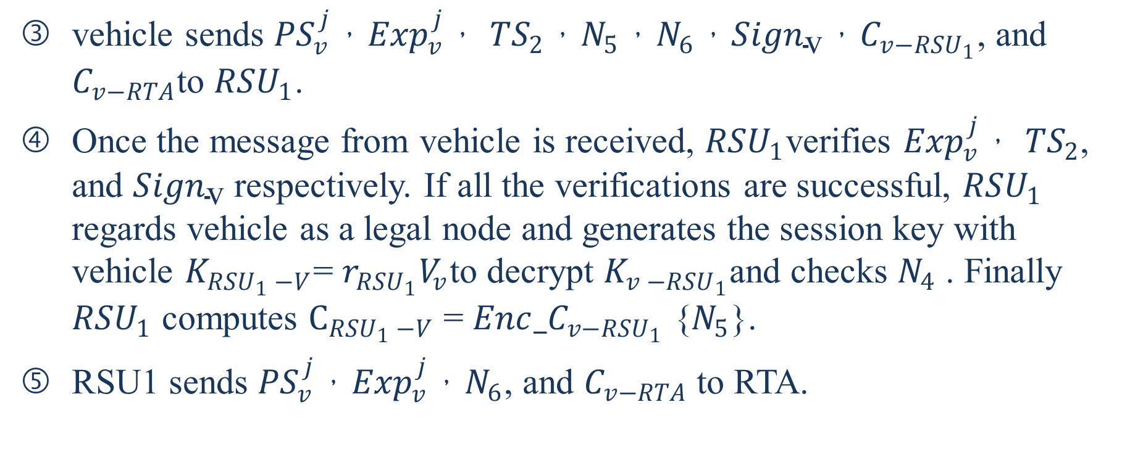
vehicle sends ${PS}_{v}^{j}$，${Exp}_{v}^{j}$， ${TS}_{2}$，$N_{5}$，$N_{6}$，${Sign}_{\text{v}}$，$C_{v−{RSU}_{1}}$, and $C_{v−RTA}$to ${RSU}_{1}$.
Once the message from vehicle is received, ${RSU}_{1}$verifies ${Exp}_{v}^{j}$， ${TS}_{2}$, and ${Sign}_{\text{v}}$ respectively. If all the verifications are successful, ${RSU}_{1}$ regards vehicle as a legal node and generates the session key with vehicle $K_{{RSU}_{1} −V}$= $r_{{RSU}_{1}}V_{v}$to decrypt $K_{v −{RSU}_{1}}$and checks $N_{4}$ . Finally ${RSU}_{1}$ computes $C_{{RSU}_{1} −V}$ = $Enc_C_{v−{RSU}_{1}}$ {$N_{5}$}.
RSU1 sends ${PS}_{v}^{j}$，${Exp}_{v}^{j}$，$N_{6}$, and $C_{v−RTA}$to RTA.
Notes:
車輛將${PS}_{v}^{j}$，${Exp}_{v}^{j}$， ${TS}_{2}$，$N_{5}$，$N_{6}$，${Sign}_{\text{v}}$，$C_{v−{RSU}_{1}}$和$C_{v−RTA}$發送到${RSU}_{1}$。
收到來自車輛的消息後，${RSU}_{1}$分別驗證${Exp}_{v}^{j}$， ${TS}_{2}$和${Sign}_{\text{v}}$。如果所有驗證均成功，則${RSU}_{1}$將車輛視為合法節點，並生成與車輛的會話密鑰$K_{{RSU}_{1} −V}$= $r_{{RSU}_{1}}V_{v}$以解密$K_{v −{RSU}_{1}}$並檢查$N_{4}$。最後，${RSU}_{1}$計算出$C_{{RSU}_{1} −V}$ = $Enc_C_{v−{RSU}_{1}}$ {$N_{5}$}。
RSU1將${PS}_{v}^{j}$，${Exp}_{v}^{j}$，$N_{6}$和$C_{v−RTA}$發送到RTA。

Slide 41
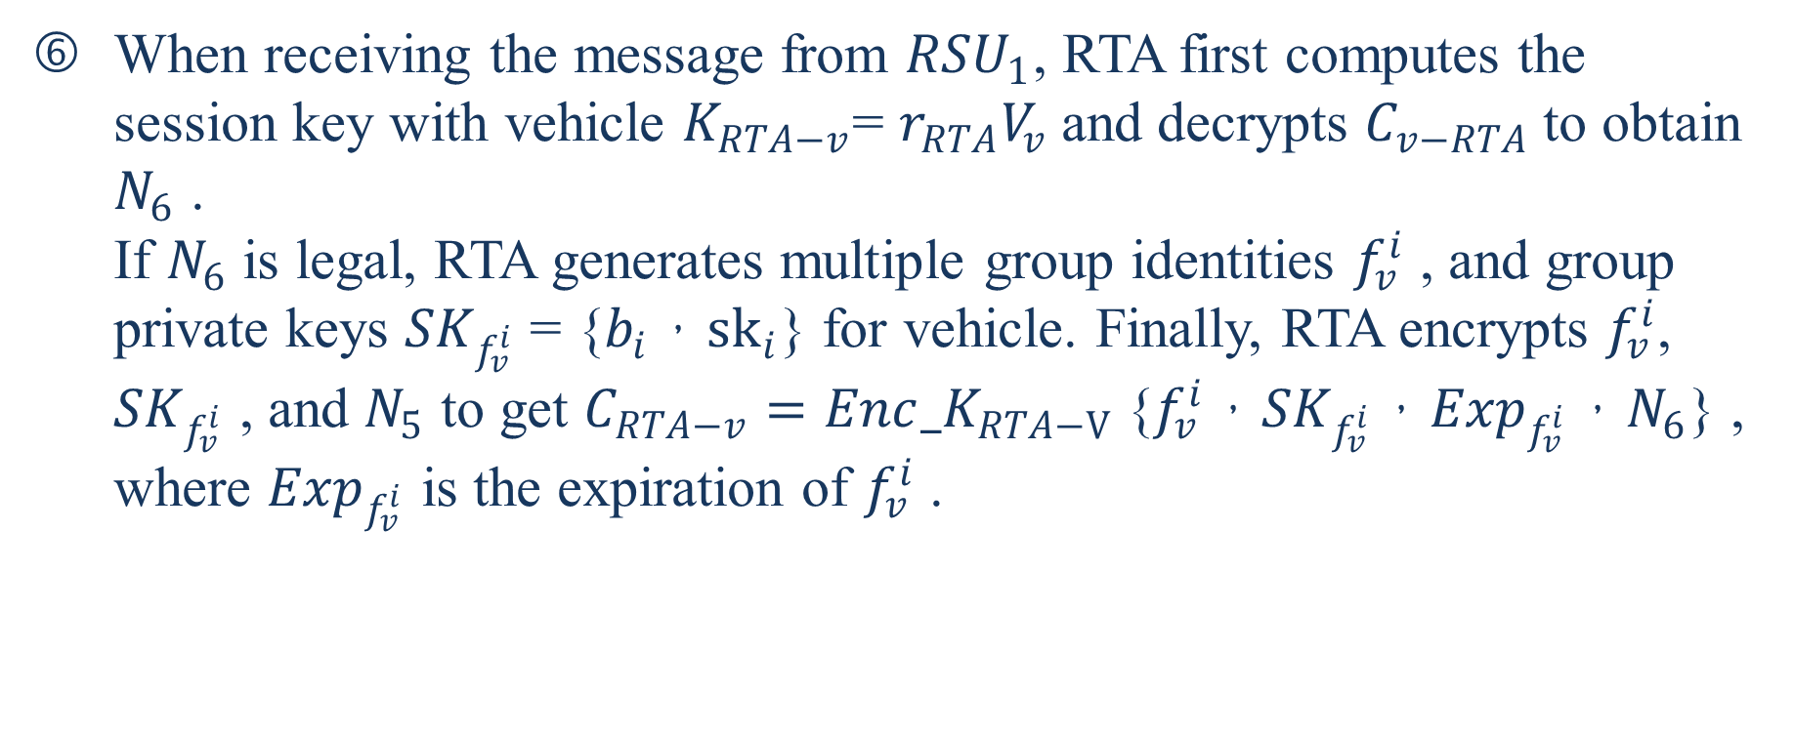
When receiving the message from ${RSU}_{1}$, RTA first computes the session key with vehicle $K_{RTA−v}$= $r_{RTA}V_{v}$and decrypts $C_{v−RTA}$to obtain $N_{6}$ .
If $N_{6}$ is legal, RTA generates multiple group identities $f_{v}^{i}$ , and group private keys ${SK}_{f_{v}^{i}}$ = {$b_{i}$，${sk}_{i}$} for vehicle. Finally, RTA encrypts $f_{v}^{i}$, ${SK}_{f_{v}^{i}}$ , and $N_{5}$ to get $C_{RTA−v}={Enc_K}_{RTA−V}${$f_{v}^{i}$，${SK}_{f_{v}^{i}}$，${Exp}_{f_{v}^{i}}$，$N_{6}$} , where ${Exp}_{f_{v}^{i}}$ is the expiration of $f_{v}^{i}$ .
Notes:
當從${RSU}_{1}$接收消息時，RTA首先計算與車輛$K_{RTA−v}$= $r_{RTA}V_{v}$的會話密鑰，然後解密$C_{v−RTA}$以獲得$N_{6}$。如果$N_{6}$合法，則RTA會生成多個組標識$f_{v}^{i}$，並為車輛設置組私鑰${SK}_{f_{v}^{i}}$ = {$b_{i}$，${sk}_{i}$}。最後，RTA加密$f_{v}^{i}$，${SK}_{f_{v}^{i}}$和$N_{5}$以獲得$C_{RTA−v}={Enc_K}_{RTA−V}${$f_{v}^{i}$，${SK}_{f_{v}^{i}}$，${Exp}_{f_{v}^{i}}$，$N_{6}$}，其中${Exp}_{f_{v}^{i}}$是$f_{v}^{i}$的到期時間。

Slide 42
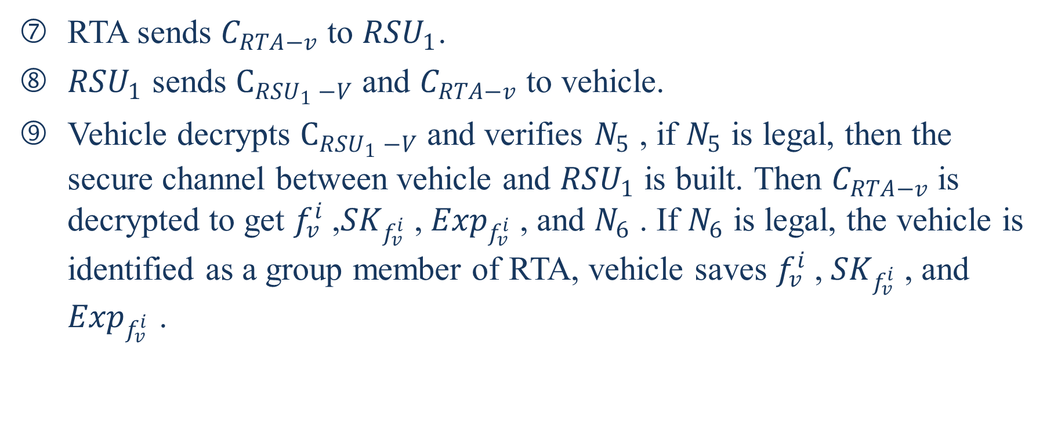
RTA sends $C_{RTA−v}$ to ${RSU}_{1}$.
${RSU}_{1}$ sends $C_{{RSU}_{1} −V}$ and $C_{RTA−v}$ to vehicle.
Vehicle decrypts $C_{{RSU}_{1} −V}$ and verifies $N_{5}$ , if $N_{5}$ is legal, then the secure channel between vehicle and ${RSU}_{1}$ is built. Then $C_{RTA−v}$is decrypted to get $f_{v}^{i} \text{,} {SK}_{f_{v}^{i}} \text{,} {Exp}_{f_{v}^{i}}$, and $N_{6}$ . If $N_{6}$ is legal, the vehicle is identified as a group member of RTA, vehicle saves $f_{v}^{i} \text{,} {SK}_{f_{v}^{i}}$ , and ${Exp}_{f_{v}^{i}}$ .
Notes:
RTA將$C_{RTA−v}$發送到${RSU}_{1}$。
${RSU}_{1}$將$C_{{RSU}_{1} −V}$和$C_{RTA−v}$發送到車輛。
車輛解密$C_{{RSU}_{1} −V}$並驗證$N_{5}$，如果$N_{5}$合法，則在車輛和${RSU}_{1}$之間建立安全通道。然後解密$C_{RTA−v}$以獲得$f_{v}^{i}$，${SK}_{f_{v}^{i}}$，${Exp}_{f_{v}^{i}}$，$N_{6}$。如果$N_{6}$合法，則將車輛標識為RTA的組成員，車輛保存$f_{v}^{i}$，${SK}_{f_{v}^{i}}$，${Exp}_{f_{v}^{i}}$。

Slide 43
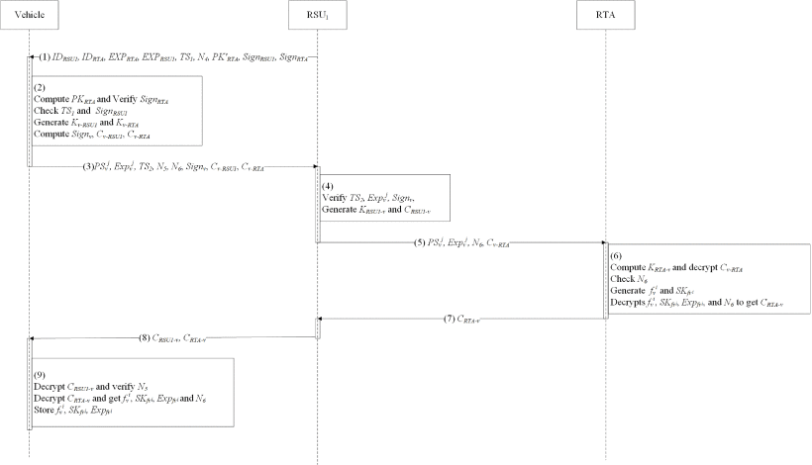

Slide 44
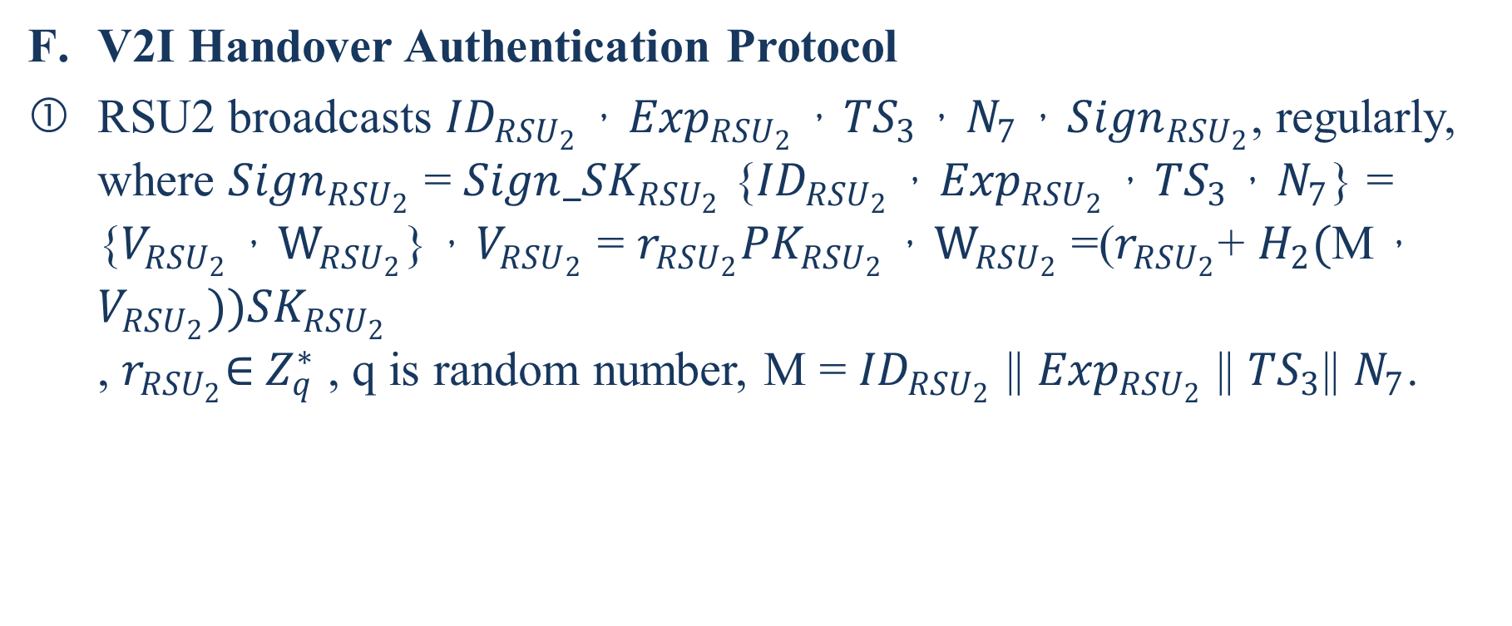
V2I Handover Authentication Protocol
RSU2 broadcasts ${ID}_{{RSU}_{2}}$，${Exp}_{{RSU}_{2}}$，${TS}_{3}$，$N_{7}$，${Sign}_{{RSU}_{2}}$, regularly, where ${Sign}_{{RSU}_{2}}$ = ${Sign_SK}_{{RSU}_{2}}${${ID}_{{RSU}_{2}}$，${Exp}_{{RSU}_{2}}$，${TS}_{3}$，$N_{7}$} = {$V_{{RSU}_{2}}，W_{{RSU}_{2}}$}，$V_{{RSU}_{2}}$ = $r_{{RSU}_{2}}{PK}_{{RSU}_{2}}$，$W_{{RSU}_{2}}$ =($r_{{RSU}_{2}}$+ $H_{2}($M，$V_{{RSU}_{2}})){SK}_{{RSU}_{2}}$
, $r_{{RSU}_{2}}$∈${ Z}_{q}^{∗}$ , q is random number, M = ${ID}_{{RSU}_{2}}$ || ${Exp}_{{RSU}_{2}}$ || ${TS}_{3}$|| $N_{7}$.
Notes:
${RSU}_{2}$定期廣播${ID}_{{RSU}_{2}}$，${Exp}_{{RSU}_{2}}$，${TS}_{3}$，$N_{7}$，${Sign}_{{RSU}_{2}}$，其中${Sign}_{{RSU}_{2}}$ = ${Sign_SK}_{{RSU}_{2}}${${ID}_{{RSU}_{2}}$，${Exp}_{{RSU}_{2}}$，${TS}_{3}$，$N_{7}$} = {$V_{{RSU}_{2}}，W_{{RSU}_{2}}$}，$V_{{RSU}_{2}}$ = $r_{{RSU}_{2}}{PK}_{{RSU}_{2}}$，$W_{{RSU}_{2}}$ =($r_{{RSU}_{2}}$+ $H_{2}($M，$V_{{RSU}_{2}})){SK}_{{RSU}_{2}}$
，$r_{{RSU}_{2}}$∈${ Z}_{q}^{∗}$，q是隨機數，M = ${ID}_{{RSU}_{2}}$ || ${Exp}_{{RSU}_{2}}$ || ${TS}_{3}$|| $N_{7}$。

Slide 45
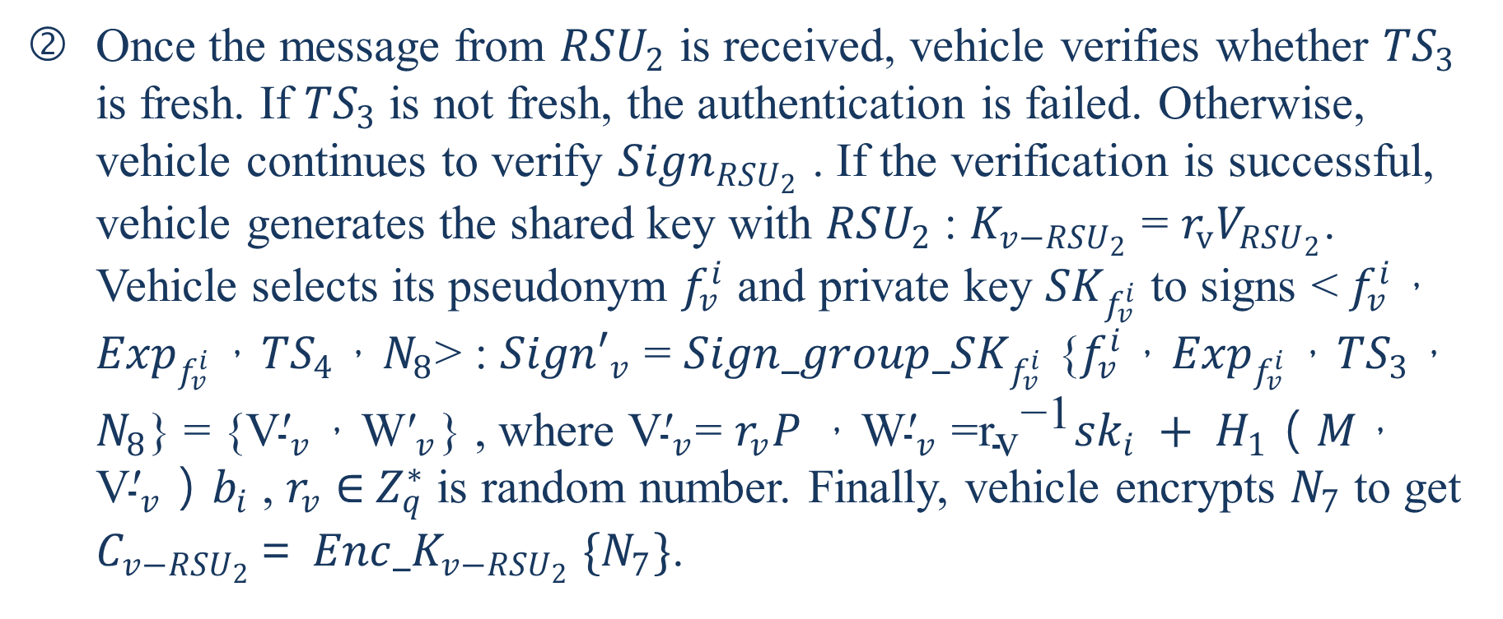
Once the message from ${RSU}_{2}$ is received, vehicle verifies whether ${TS}_{3}$ is fresh. If ${TS}_{3}$ is not fresh, the authentication is failed. Otherwise, vehicle continues to verify ${Sign}_{{RSU}_{2}}$ . If the verification is successful, vehicle generates the shared key with ${RSU}_{2}$: $K_{v−{RSU}_{2}}$ = $r_{v}V_{{RSU}_{2}}$. Vehicle selects its pseudonym $f_{v}^{i}$ and private key ${SK}_{f_{v}^{i}}$ to signs <$f_{v}^{i}$，${Exp}_{f_{v}^{i}}$，${TS}_{4}$，$N_{8}$> : ${Sign′}_{v}$ = ${Sign_group_SK}_{f_{v}^{i}}$ {$f_{v}^{i}$，${Exp}_{f_{v}^{i}}$，${TS}_{3}$，$N_{8}$} = {${\text{V}\text{′}}_{v}$，${\text{W}\text{′}}_{v}$} , where ${\text{V}\text{′}}_{v}$= $r_{v}P$，${\text{W}\text{′}}_{v}$ =${{\text{r}}_{\text{v}}}^{\text{−1}}{sk}_{i} + H_{1}（M，{\text{V}\text{′}}_{v}）b_{i}$ , $r_{v}$ ∈${ Z}_{q}^{∗}$ is random number. Finally, vehicle encrypts $N_{7}$ to get $C_{v−{RSU}_{2}}$＝ ${Enc_K}_{v−{RSU}_{2}} \{N_{7}\}$.
Notes:
接收到來自${RSU}_{2}$的消息後，車輛將驗證${TS}_{3}$是否新鮮。如果${TS}_{3}$不新鮮，則認證失敗。否則，車輛繼續驗證${Sign}_{{RSU}_{2}}$。如果驗證成功，則車輛用${RSU}_{2}$生成共享密鑰：$K_{v−{RSU}_{2}}$ = $r_{v}V_{{RSU}_{2}}$。車輛選擇其假名$f_{v}^{i}$和私鑰${SK}_{f_{v}^{i}}$來簽名<$f_{v}^{i}$，${Exp}_{f_{v}^{i}}$，${TS}_{4}$，$N_{8}$>：${Sign′}_{v}$ = ${Sign_group_SK}_{f_{v}^{i}}$ {$f_{v}^{i}$，${Exp}_{f_{v}^{i}}$，${TS}_{3}$，$N_{8}$} = {${\text{V}\text{′}}_{v}$，${\text{W}\text{′}}_{v}$}，其中${\text{V}\text{′}}_{v}$= $r_{v}P$，${\text{W}\text{′}}_{v}$ =${{\text{r}}_{\text{v}}}^{\text{−1}}{sk}_{i} + H_{1}（M，{\text{V}\text{′}}_{v}）b_{i}$，M = $f_{v}^{i}$ || ${Exp}_{f_{v}^{i}}$ || ${TS}_{4}$ || $N_{8}$，$r_{v}$∈${ Z}_{q}^{∗}$是隨機數。最後，車輛加密$N_{7}$以獲得$C_{v−{RSU}_{2}}$＝ ${Enc_K}_{v−{RSU}_{2}} \{N_{7}\}$。

Slide 46
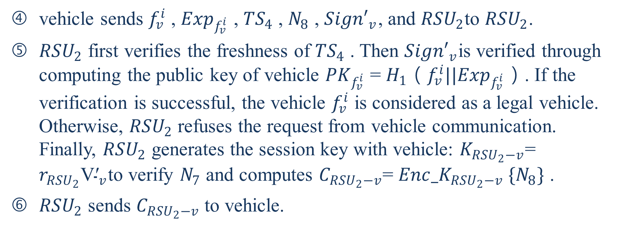
vehicle sends $f_{v}^{i}$ , ${Exp}_{f_{v}^{i}}$ , ${TS}_{4}$ , $N_{8}$ , ${Sign′}_{v}$, and ${RSU}_{2}$to ${RSU}_{2}$.
${RSU}_{2}$ first verifies the freshness of ${TS}_{4}$ . Then ${Sign′}_{v}$is verified through computing the public key of vehicle ${PK}_{f_{v}^{i}}$ = $H_{1}（f_{v}^{i}||{Exp}_{f_{v}^{i}}）$. If the verification is successful, the vehicle $f_{v}^{i}$ is considered as a legal vehicle. Otherwise, ${RSU}_{2}$ refuses the request from vehicle communication. Finally, ${RSU}_{2}$ generates the session key with vehicle: $K_{{RSU}_{2}−v}$= $r_{{RSU}_{2}}{\text{V}\text{′}}_{v}$to verify $N_{7}$ and computes $C_{{RSU}_{2}−v}$= ${Enc_K}_{{RSU}_{2}−v} \{N_{8}\}$ .
${RSU}_{2}$ sends $C_{{RSU}_{2}−v}$ to vehicle.
Notes:
車輛將$f_{v}^{i}$，${Exp}_{f_{v}^{i}}$，${TS}_{4}$，$N_{8}$，${Sign′}_{v}$和$C_{v−{RSU}_{2}}$發送到${RSU}_{2}$。
${RSU}_{2}$首先驗證${TS}_{4}$的新鮮度。然後通過計算車輛${PK}_{f_{v}^{i}}$ = $H_{1}（f_{v}^{i}||{Exp}_{f_{v}^{i}}）$的公鑰來驗證${Sign′}_{v}$。如果驗證成功，則車輛$f_{v}^{i}$被視為合法車輛。否則，${RSU}_{2}$拒絕來自車輛通信的請求。最後，${RSU}_{2}$生成與車輛的會話密鑰：$K_{{RSU}_{2}−v}$= $r_{{RSU}_{2}}{\text{V}\text{′}}_{v}$以驗證$N_{7}$，併計算$C_{{RSU}_{2}−v}$= ${Enc_K}_{{RSU}_{2}−v} \{N_{8}\}$。
${RSU}_{2}$將$C_{{RSU}_{2}−v}$發送到車輛。

Slide 47

vehicle uses $K_{v−{RSU}_{2}}$= $r_{v}V_{{RSU}_{2}}$to decrypt $C_{{RSU}_{2}−v}$ . If $N_{8}$ is legal, then the trust relationship is established between vehicle and ${RSU}_{2}$, otherwise, handover authentication fails.
Notes:
車輛使用$K_{v−{RSU}_{2}}$= $r_{v}V_{{RSU}_{2}}$解密$C_{{RSU}_{2}−v}$。如果$N_{8}$合法，則在車輛與${RSU}_{2}$之間建立信任關係，否則切換認證失敗

Slide 48
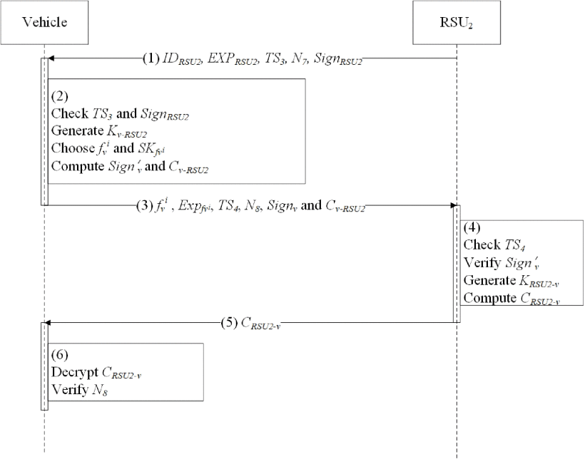

Slide 49
Security Proof and Analysis
SVO Logic
Among all proposed formal security analysis methods, SVO logic [31], as an important BAN-like logic, owns the advantages of BAN logic, GNY logic, and AT logic. Besides, SVO logic redefines some concepts in formal semantic and owns very simple inference rules or axioms.
Now, SVO logic has become a widely used formal analysis method. In most cases, since vehicles and RSUs perform V2I handover authentication protocol, formal security proof in AAAS handover authentication is provided in this section. Relevant notations and descriptions are given as Table 2.
Notes:
在所有提議的形式安全分析方法中，SVO邏輯[31]作為一種重要的類BAN邏輯，具有BAN邏輯，GNY邏輯和AT邏輯的優點。此外，SVO邏輯以形式語義重新定義了一些概念，並擁有非常簡單的推理規則或公理。
現在，SVO邏輯已成為一種廣泛使用的形式分析方法。在大多數情況下，由於車輛和RSU執行V2I切換認證協議，因此本節將提供AAAS切換認證中的正式安全證明。相關符號和說明如表2所示。

Slide 50
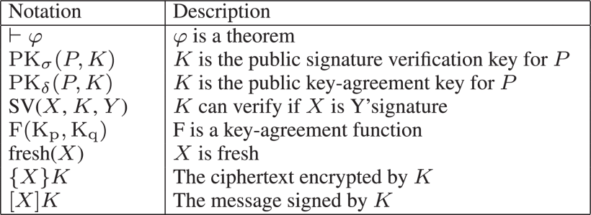
Notes:
符號 說明
$φ$是一個定理
K是P的公共簽名驗證金鑰
K是P的公開金鑰協議金鑰
K可以驗證X是否是Y的簽名
F是關鍵協議函數
X是新鮮的
用K加密的密文
由K簽名的消息

Slide 51

    Initial Rules
    SVO has two inference rules:
Notes:
SVO有兩個推理規則：
前件肯定(若P則Q;P為真Q也為真)：從φ和φ⊃ψ推斷ψ。
必要性：從⊢φ推論⊢P相信φ。

Slide 52
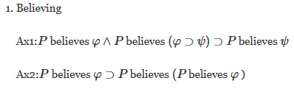
    SVO Axiom Schemata
    For any principal P , Q and formulae φ , ψ , the following axiom schemates are introduced.
Notes:
SVO公理綱要
對於任何原理P，Q和公式φ，ψ，引入以下公理模式。
一個原理相信所有邏輯(公式)上都源於他的所相信的。
實際上，原理可以說出他的所相信的。

Slide 53
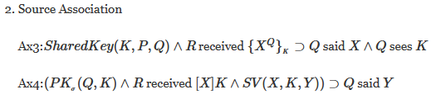

Notes:
使用密鑰來推斷消息發送者的所想講的。
(Ax4主體收到一個簽名消息，並且它知道簽名的驗證公鑰，則它能確認消息發送方的身分)
好的密鑰協商密鑰所產生的會話密鑰是好的。

Slide 54
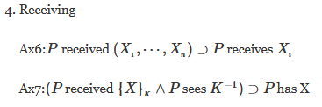
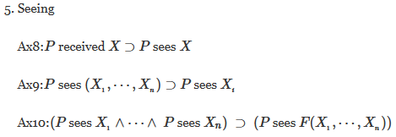
Notes:
主體使用有效密鑰接收連接好的 接收到的消息和解密
主體看到他收到的任何東西。
主體還可以看到他所看到的每條消息的所有組成部分，以及可以根據他所看到的內容進行計算的任何消息。

Slide 55
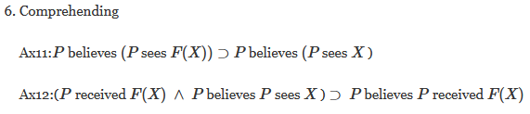
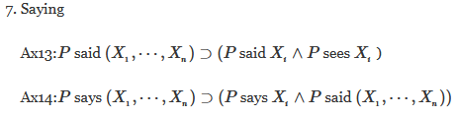
Notes:
如果一個主體理解了一條消息並看到了它的功能function（適當類型），那麼他就會明白他所看到的這是什麼。
主體說過連接消息也表示並看到該消息的連接。主體看到了他所說的。

Slide 56

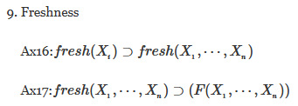

Notes:
這個公理實際上是說P對φ有仲裁權，當P說了φ，那應當把φ當作事實，即φ可信任
如果一個連接好的消息是新的，那麼一個連接是新的，並且該新消息的任何有效的一個函數F（包括加密和解密）是新的。
促進了資訊從（某個時候）被說出來變成在當前時代被說出來。(消息的新鮮性可以從“過去說過”進一步推知“當前說了”)

Slide 57


Notes:
共享密鑰對P和Q有好處，若且為若(iff:if and only if )它對Q和P有好處
一個主體有一把密鑰，若且為若(iff:if and only if )他看過密鑰

Slide 58
  Formal Description
  Goals
  In handover authentication protocol, the following SVO goals are given according to the security requirements of AAAS.
Notes:
在切換認證協議中，根據AAAS的安全要求給出了以下SVO目標。

Slide 59
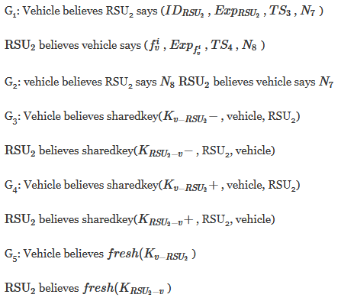

Slide 60
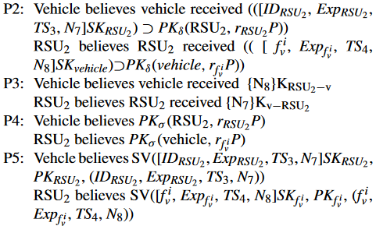

Notes:
Ax4主體收到一個簽名消息，並且它知道簽名的驗證公鑰，則它能確認消息發送方的身分

Slide 61


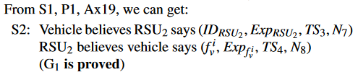

Slide 62
Further Security and Privacy Analysis
According to the security and privacy requirements of VANETs, we further analyze the security of the proposed scheme in the following aspects [30].
Notes:
進一步的安全和隱私分析
根據VANET的安全性和私密性要求，我們從以下幾個方面進一步分析所提出方案的安全性[30]。

Slide 63
Security Analysis
  Authentication
  In the proposed scheme, all vehicles are required to perform mutual authentication protocol before getting network services from surrounding vehicles and RSUs.
  Depending on the group signature mechanism and identity based on signature, vehicles and RSUs can confirm the legitimacy of their identities.
Notes:
在VANET中，身份驗證是檢查某些聲明（例如身份，特權和權限）的真實性和準確性的過程。
在提出的方案中，要求所有車輛在從周圍的車輛和RSU獲得網絡服務之前執行相互身份驗證協議。
根據組簽名機制和基於簽名的身份，車輛和RSU可以確認其身份的合法性。

Slide 64
  Besides, through Diffie-Hellman key exchange mechanism and challenge value, vehicles and RSUs can confirm that the information is transmitted correctly and a safe communication tunnel is built.
Notes:
此外，通過Diffie-Hellman密鑰交換機制和挑戰值，車輛和RSU可以確認信息是否正確傳輸，並建立了安全的通信隧道。

Slide 65
  Accountability
  In some scenarios, when some vehicles commit illegal acts, e. g. broadcasting a forged warning message, there exists the serious risk of unnecessary traffic jams and accidents.
  In this situation, law enforcement agencies needs to have capacity to accurately identify the real identity of illegal vehicles and hold them accountable. In addition, accountability means non-repudiation, that is, sender cannot repudiate the message that has been sent.
Notes:
問責制
在某些情況下，當某些車輛發生違法行為時，例如:廣播偽造的警告消息，存在不必要的交通堵塞和事故的嚴重風險。
在這種情況下，執法機構需要有能力準確識別非法車輛的真實身份並追究其責任。另外，問責制意味著不可否認性，即發件人無法否認已發送的消息。

Slide 66
  In the proposed scheme, each vehicle sends CC signature or group signature to prove the legitimacy of its identity.
  Receiver cannot know the true identity of sender, but once the vehicle has performed illegal acts, RTA and TA can resolve the real identity of the signer according to the content of the signature.
  Signer can not deny its signature, which meets accountability well.
Notes:
在提出的方案中，每輛車都發送CC簽名或組簽名以證明其身份的合法性。
接收者無法知道發送者的真實身份，但是一旦車輛執行了非法行為，RTA和TA就會根據簽名的內容來解析簽名者的真實身份。
簽名人不能否認其簽名，這很符合問責制。

Slide 67
  Restricted Credential Usage
  Usage of a legal credential is required to be limited by time and parallel use.
  In AAAS, as identity based signature is adopted, the identity of the vehicle is identified as a credential for authentication and accountability.
  In addition, since uncontrolled identity and signature of the vehicle may lead to abuse, and the attacker may use these credentials to launch a Sybil attack, AAAS adds expiration and timestamp into the signer’s public key and signatures respectively to control service time of credential and prevents the signature used as credentials from being reused.
Notes:
憑證使用限制
合法證書的使用必須受時間和並行使用的限制。在AAAS中，由於採用了基於身份的簽名，因此將車輛的身份標識為用於身份驗證和問責制的憑據。此外，由於車輛的不受控制的身份和簽名可能會導致濫用，並且攻擊者可能會使用這些憑據發起Sybil攻擊，因此AAAS分別將過期和時間戳記添加到簽名者的公鑰和簽名中，以控制憑據的服務時間並防止重用用作憑據的簽名。
Sybil攻擊(女巫攻擊):在Sybil攻擊中，攻擊者通過創建大量的假名身份來破壞網絡服務的信譽系統，並使用它們獲得不成比例的巨大影響力。如果攻擊者創建了足够的虛假身份（或Sybil身份），他們能以多數票擊退網絡上真實的節點。然後在這情況下，他們可以拒绝接收或傳輸區塊，從而有效地阻止其他用户進入網絡。

Slide 68
  Credential Revocation
  As vehicles may be sold or broken, and theirs OBU could be compromised, it is crucial to exclude malfunctioning or misbehaving vehicles from the VANETs.
  Consequently, law enforcement agencies must be able to revoke their pseudonyms.
  AAAS implements vehicle credential revocation through cooperation mechanism between RTA and TA.
Notes:
憑證撤銷
由於車輛可能被出售或損壞，其OBU可能會受到損害，因此至關重要的是，將故障或行為異常的車輛排除在VANET之外。
因此，執法機構必須能夠撤銷其假名。
AAAS通過RTA和TA之間的合作機制來實現車輛證書撤銷。

Slide 69
  When a vehicle is considered illegal, its signatures, pseudonyms and expirations are required to be sent to RTA.
  When receiving these messages, RTA is able to find pseudonym of illegal vehicles issued by TA.
  TA can reveal the true identity of illegal vehicle and distribute credential revocation List (CRL) to achieve credential revocation.
Notes:
當車輛被視為違法時，要求將其簽名，化名和有效期發送給RTA。
收到這些消息後，RTA可以找到TA發出的非法車輛的假名。
TA可以揭示非法車輛的真實身份，並分發證書吊銷列表（CRL）以實現證書吊銷。

Slide 70
Privacy Requirement
  Minimum Disclosure
  Minimal disclosure means that messages revealed by receivers should be kept to minimum in communication.
  In the mutual authentication of the proposed scheme, all messages sent need to be adaptive to authentication requirements and additional messages are not allowed to be added to authentication messages.
Notes:
最小程度的公開
最小程度的公開意味著接收方公開的消息在通信中應保持最少。
在提出的方案的相互認證中，所有發送的消息都必須適應認證要求，並且不允許將其他消息添加到認證消息中。

Slide 71
  Anonymity and Unlinkability
  It is the basis of protecting vehicle privacy to ensure vehicle communication anonymously.
  Based on the group signature mechanism, in AAAS, the verification of the vehicle’s identity is realized by verifying the identity issued by TA and RTA. Verifier only needs to determine that the verified vehicle is approved by TA or RTA, and do not need to know the real identity of vehicle.
  Besides, as attackers cannot obtain the real identity of the vehicle through monitored messages, anonymous communication can also meet the privacy requirements of unlinkability in VANETs.
Notes:
匿名和不可鏈接
保證車輛匿名通信是保護車輛隱私的基礎。
在AAAS中，基於組簽名機制，通過驗證TA和RTA發出的身份來驗證車輛的身份。驗證者僅需要確定經過驗證的車輛已獲TA或RTA批准，而無需知道車輛的真實身份。
此外，由於攻擊者無法通過監視的消息獲得車輛的真實身份，因此匿名通信還可以滿足VANET中不可鏈接性的隱私要求。
此外，TA和RTA發行的多個假名也為車輛定期更改假名提供了支持。

Slide 72
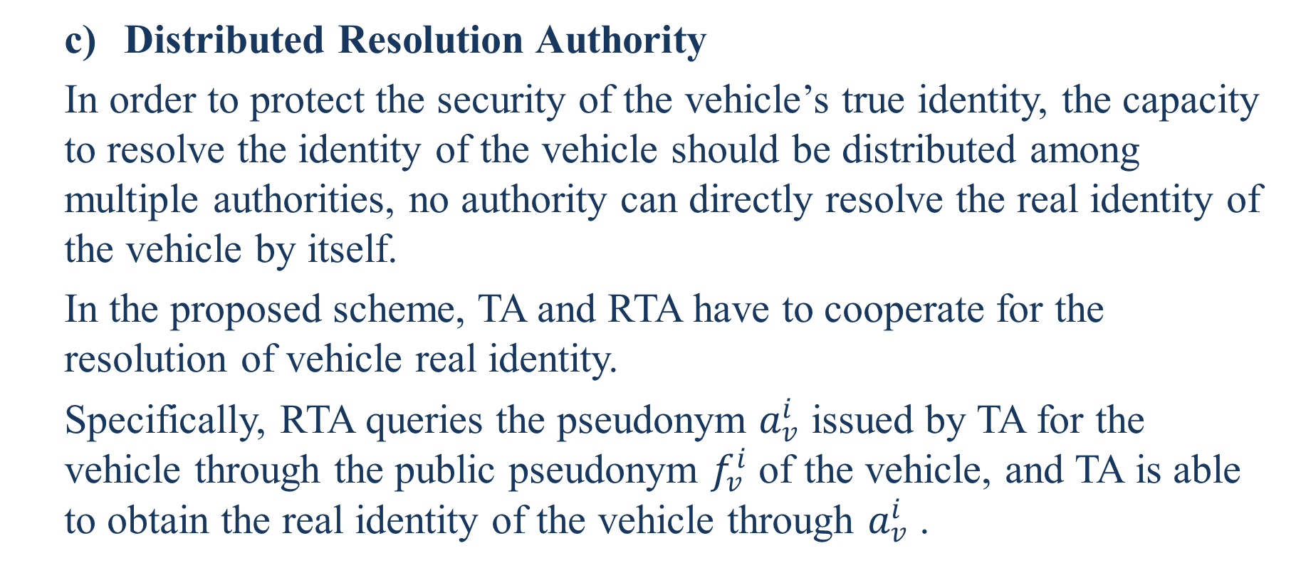
  Distributed Resolution Authority
  In order to protect the security of the vehicle’s true identity, the capacity to resolve the identity of the vehicle should be distributed among multiple authorities, no authority can directly resolve the real identity of the vehicle by itself.
  In the proposed scheme, TA and RTA have to cooperate for the resolution of vehicle real identity.
  Specifically, RTA queries the pseudonym $a_{v}^{i}$ issued by TA for the vehicle through the public pseudonym $f_{v}^{i}$ of the vehicle, and TA is able to obtain the real identity of the vehicle through $a_{v}^{i}$ .
Notes:
分佈式方案授權
為了保護車輛真實身份的安全，解析車輛身份的能力應在多個機構之間分配，任何機構都不能直接直接解決車輛真實身份。
在提出的方案中，TA和RTA必須合作以解決車輛真實身份。具體地，RTA查詢假名$a_{v}^{i}$由TA為車輛發出車輛的公共假名$f_{v}^{i}$，並且TA能夠通過$a_{v}^{i}$獲得車輛的真實身份。

Slide 73
  Perfect Forward Privacy
  In VANETs, the resolution of a vehicle credentials should not decrease unlinkability of other credentials of the vehicle.
  In AAAS, all broadcasted pseudonyms and certificates only indicate the legitimacy of their identity.
  More concretely, a Vehicle anonymous credential does not contain information about other credentials of the vehicle. Consequently, attackers can not obtain any information about other credentials of the vehicle.
Notes:
完善的轉發隱私
在VANET中，車輛憑證的解析不應降低車輛其他憑證的不可鏈接性。
在AAAS中，所有廣播的假名和證書僅表明其身份的合法性。
更具體地說，車輛匿名憑證不包含有關車輛其他憑證的信息。因此，攻擊者無法獲得有關車輛其他憑證的任何信息。

Slide 74
Performance Analysis
In this section, AAAS is compared with CPAS [12], EDKM [16], LIAP [13], and GSSA [18] in anonymous authentication. We give the details from 3 aspects: communication overhead, computation cost, and signaling cost.
Notes:
在本節中，將匿名認證中的AAAS與CPAS [12]，EDKM [16]，LIAP [13]和GSSA [18]進行比較。我們從3個方面給出詳細信息：通信開銷，計算成本和信令成本。

Slide 75
Computational Cost
Computational cost is defined as the total amount of computation in authentication protocol. In order to analyze and compare the computational costs of above schemes, we need to consider operations that consume a lot of computing resources.
As the processing time of bilinear pairing and point multiplication operation are thousands times of point addition operation or hash function, we ignore the cost of such low computation operations.
Notes:
計算成本定義為認證協議中的總計算量。為了分析和比較上述方案的計算成本，我們需要考慮消耗大量計​​算資源的操作。
由於雙線性配對和點乘法運算的處理時間是點加法運算或哈希函數的數千倍，因此我們忽略了這種低計算運算的成本。

Slide 76
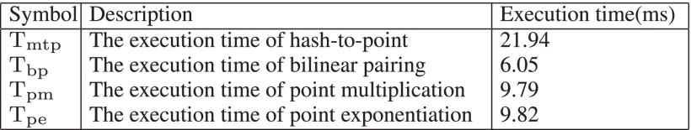
Notes:
符號 說明 執行時間（ms）
雜湊到點的執行時間 21.94
雙線性對稱的執行時間 6.05
點乘的執行時間 9.7
點指數運算的執行時間 9.82

Slide 77
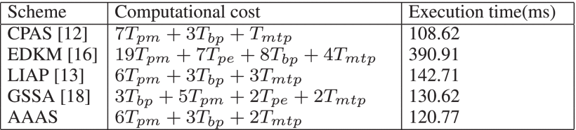
Notes:
7點乘法 3雙線性映射 1hash
19點乘法 7點指數 8雙線性映射 4hash
6點乘法 3雙線性映射 3hash
5點乘法 3雙線性映射 4點指數 2hash
6點乘法 3雙線性映射 2hash

Slide 78
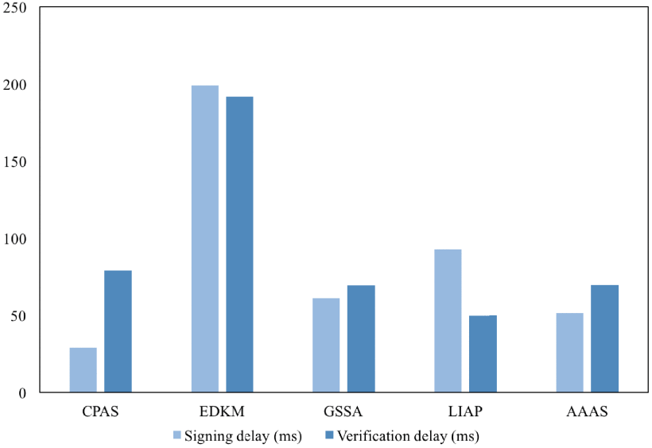
Notes:
從表4和圖9中，我們可以看到CPAS與AAAS相比具有較低的計算成本。
但是，CAPS不考慮如何建立會話密鑰，這對於確保車輛與RSU之間的安全通信至關重要。
此外，由於車輛的簽名不包含挑戰值，因此車輛難以確定RSU是否接收到車輛發送的消息。

Slide 79
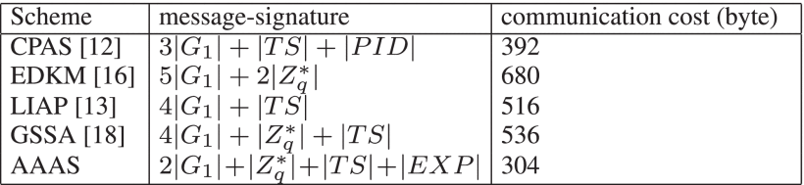
Communication Cost
Notes:
$G_{1}$ is 64*2 = 128 bytes
$G_{2}$ is 20*2 = 40 bytes
Hash $Z_{q}^{∗}$ 20 bytes
Expiration(到期) 4 bytes
Timestamp(時間標記) 4 bytes

Slide 80

Signaling Cost
In this section, we adopt fluid-flow model to evaluate signaling cost in authentication. We assume that subnets in VANETs are circular and of same size. Crossing rate(R) and signaling cost (SC) are defined as:

Slide 81
where ρ , v , L refer to vehicle density, vehicle average velocity, and perimeters of a subnet.
HL means authentication delay, which includes communication overhead and transmission delay.
According to [34], We sets L=100m , ρ=0.1∼0.01(1/m2) , v=0∼40(m/s) , the wireless bandwidth is 6 Mbps. The result is shown in Figure 10.
Notes:
ρ :車輛密度
V:車輛平均速度
L:子網的範圍
HL:認證延遲

Slide 82
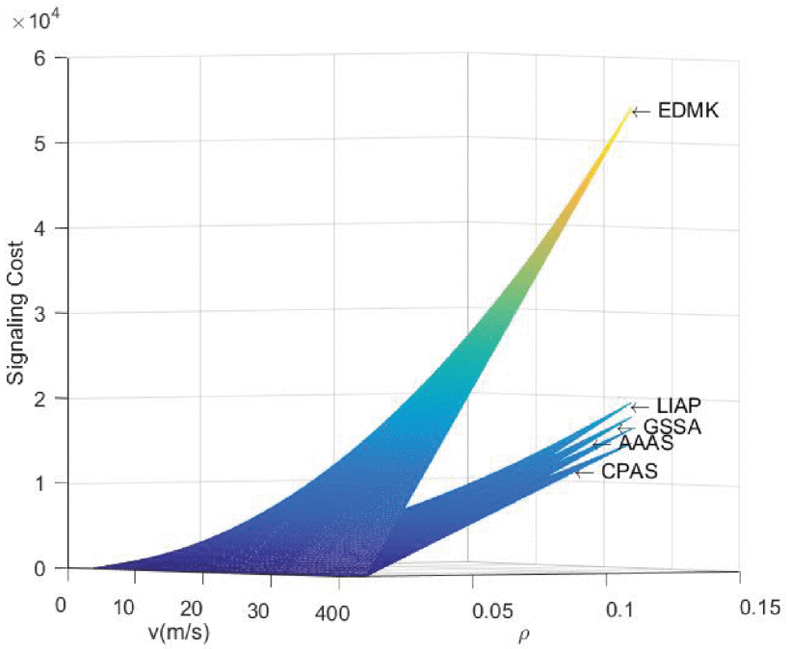
Notes:
AAAS和CPAS具有相似的信令成本，但是AAAS由於較低的通訊成本而具有更高的性能。

Slide 83
Conclusion
This paper proposes an anonymous authentication scheme based on group signature in VANETs.
Region trust authority as group manager is added to support vehicles to perform anonymous authentication as the group members.
Pseudonym mechanism and identity based on signature mechanism are adopted, which reduces the costs caused by the storage and verification of pseudonym certificates.
Moreover, security and performance analysis demonstrate that the proposed scheme is robust and efficient.
Notes:
本文提出了一種基於組簽名的VANET中的匿名認證方案。
添加了作為組管理員的區域信任機構，以支持車輛作為組成員執行匿名身份驗證。
採用了假名機制和基於簽名的身份識別機制，減少了假名證書的存儲和驗證所帶來的成本。
此外，安全性和性能分析表明，該方案是健壯和高效的。

Slide 84
In the future, we will propose a V2V authentication scheme based on AAAS, and simulate the proposed scheme to obtain more accurate performance results.
Notes:
將來，我們將提出一種基於AAAS的V2V認證方案，並對提出的方案進行仿真，以獲得更準確的性能結果。

Slide 85
References
C. N. E. Anagnostopoulos, I. E. Anagnostopoulos, V. Loumos, and E. Kayafas, ‘‘A license plate-recognition algorithm for intelligent trans-portation system applications,’’IEEE Trans. Intell. Transp. Syst., vol. 7,no. 3, pp. 377–392, Sep. 2006.
D. Rossi, R. Fracchia, and M. Meo, ‘‘VANETs: Why use beaconing atall?’’ in Proc. IEEE Int. Conf. Commun., Beijing, China, May 2008,pp. 2745–2751.
J. Feng, N. Liu, J. Cao, Y. Zhang, and G. Lu, ‘‘Securing traffic-related messages exchange against inside-and-outside collusive attack in vehicular networks,’’IEEE Internet Things J., vol. 6, no. 6, pp. 9979–9992,Dec. 2019.

Slide 86
T. Gao, X. Deng, Q. Li, M. Collotta, and I. You, ‘‘APPAS: A privacy-preserving authentication scheme based on pseudonym ring in VSNs,’’ IEEE Access, vol. 7, pp. 69936–69946, 2019.
A. Boualouache, S.-M. Senouci, and S. Moussaoui, ‘‘A survey on pseudonym changing strategies for vehicular ad-hoc networks,’’IEEECommun. Surveys Tuts., vol. 20, no. 1, pp. 770–790, 1st Quart., 2018.
J. Y. Choi, M. Jakobsson, and S. Wetzel, ‘‘Balancing auditability and privacy in vehicular networks,’’ in Proc. 1st ACM Int. Workshop Qual. Service Secur. Wireless Mobile Netw. (Q2SWinet), Oct. 2005, pp. 79–87.

Slide 87
C. Lyu, D. Gu, Y. Zeng, and P. Mohapatra, ‘‘PBA: Prediction-based authentication for vehicle-to-vehicle communications,’’IEEE Trans. Dependable Secure Comput., vol. 13, no. 1, pp. 71–83, Jan. 2016.
P. Vijayakumar, V. Chang, L. J. Deborah, B. Balusamy, and P. G. Shynu,‘‘Computationally efficient privacy preserving anonymous mutual and batch authentication schemes for vehicular ad hoc networks,’’Future Gener. Comput. Syst., vol. 78, pp. 943–955,Jan. 2018.
IEEE Standard for Wireless Access in Vehicular Environments–Security Services for Applications and Management Messages, IEEE Std 1609.2-2016 (Revision of IEEE Std 1609.2-2013), Mar. 2016, pp. 1–240

Slide 88
M. Azees, P. Vijayakumar, and L. J. Deboarh, ‘‘EAAP: Efficient anonymous authentication with conditional privacy-preserving scheme for vehic-ular ad hoc networks,’’IEEE Trans. Intell. Transp. Syst., vol. 18, no. 9,pp. 2467–2476, Sep. 2017.
T. Gao, Y. Li, N. Guo, and I. You, ‘‘An anonymous access authentication scheme for vehicular ad hoc networks under edge computing,’’Int. J.Distrib. Sensor Netw., vol. 14, no. 2, pp. 1–16, Feb. 2018.
K.-A. Shim, ‘‘CPAS: An efficient conditional privacy-preserving authentication scheme for vehicular sensor networks,’’IEEE Trans. Veh. Technol.,vol. 61, no. 4, pp. 1874–1883, May 2012.

Slide 89
S. Wang and N. Yao, ‘‘LIAP: A local identity-based anonymous message authentication protocol in VANETs,’’Comput. Commun., vol. 112,pp. 154–164, Nov. 2017.
L. Zhang, Q. Wu, A. Solanas, and J. Domingo-Ferrer, ‘‘A scalable robust authentication protocol for secure vehicular communications,’’IEEE Trans. Veh. Technol., vol. 59, no. 4, pp. 1606–1617, May 2010.
X. Lin, X. Sun, P.-H. Ho, and X. Shen, ‘‘GSIS: A secure and privacy-preserving protocol for vehicular communications,’’IEEE Trans. Veh.Technol., vol. 56, no. 6, pp. 3442–3456, Nov. 2007.

Slide 90
[16] Y. Sun, Z. Feng, Q. Hu, and J. Su, ‘‘An efficient distributed key management scheme for group-signature based anonymous authentication in VANET,’’Secur. Commun. Netw., vol. 5, no. 1, pp. 79–86, Jan. 2012.
B. K. Chaurasia and S. Verma, ‘‘Conditional privacy through ring signature in vehicular ad-hoc networks,’’ in Transactions on Computational Science XIII(Lecture Notes in Computer Science), vol. 6750. Berlin, Germany: Springer, 2011, pp. 147–156.
C. Zhang, X. Xue, L. Feng, X. Zeng, and J. Ma, ‘‘Group-signature and group session key combined safety message authentication protocol for VANETs,’’IEEE Access, vol. 7, pp. 178310–178320, 2019

Slide 91
J. Li, H. Lu, and M. Guizani, ‘‘ACPN: A novel authentication framework with conditional privacy-preservation and non-repudiation for VANETs,’’IEEE Trans. Parallel Distrib. Syst., vol. 26, no. 4, pp. 938–948, Apr. 2015.
IEEE Guide for Wireless Access in Vehicular Environments (WAVE) Architecture, IEEE Standard 1609.0-2019 (Revision of IEEE Std 1609.0-2013)-Redline, Apr. 2019, pp. 1–219.
D. Boneh and M. Franklin, ‘‘Identity-based encryption from the Weil pairing,’’ in Advances in Cryptology, vol. 32, no. 3. Philadelphia, PA, USA,Aug. 2001, pp. 213–229.

Slide 92
J. Y. Hwang, L. Chen, H. S. Cho, and D. Nyang, ‘‘Short dynamic group signature scheme supporting controllable linkability,’’IEEE Trans. Inf.Forensics Security, vol. 10, no. 6, pp. 1109–1124, Jun. 2015.
J. Shao, X. Lin, R. Lu, and C. Zuo, ‘‘A threshold anonymous authentication protocol for VANETs,’’IEEE Trans. Veh. Technol., vol. 65, no. 3,pp. 1711–1720, Mar. 2016.
S. Parvin, S. Han, Z. U. Rehman, A. Al Faruque, and F. K. Hussain,‘‘A new identity-based group signature scheme based on knapsack ECC,’’in Proc. 6th Int. Conf. Innov. Mobile Internet Services Ubiquitous Comput.,Palermo, Italy, Jul. 2012, pp. 73–80.

Slide 93
S. Park, S. Kim, and D. Won, ‘‘ID-based group signature,’’Electron. Lett.,vol. 33, no. 19, pp. 1616–1617, Sep. 1997.
S. Han, J. Wang, and W. Liu, ‘‘An efficient identity-based group signature scheme over elliptic curves,’’ in Universal Multiservice Networks(Lecture Notes in Computer Science), vol. 3262. Berlin, Germany: Springer, 2004.
J. C. Choon and J. H. Cheon, ‘‘An identity-based signature from gap Diffie-Hellman groups,’’ in Public Key Cryptography(Lecture Notes in Computer Science), vol. 2567. Berlin, Germany: Springer, 2003.

Slide 94
P. Bhattacharya, M. Debbabi, and H. Otrok, ‘‘Improving the Diffie-Hellman secure key exchange,’’ in Proc. Int. Conf. Wireless Netw., Commun. Mobile Comput., Maui, HI, USA, Jun. 2005, pp. 193–197.
Federal Information Processing Standards Publication (FIPS) 197.(Nov. 26, 2001).Specification for the Advanced Encryption Standard(AES). [Online]. Available: http://www.nist.gov/aes
J. Petit, F. Schaub, M. Feiri, and F. Kargl, ‘‘Pseudonym schemes in vehicular networks: A survey,’’IEEE Commun. Surveys Tuts., vol. 17, no. 1,pp. 228–255, 1st Quart., 2015.

Slide 95
P. F. Syverson and P. C. van Oorschot, ‘‘On unifying some cryptographic protocol logics,’’ in Proc. IEEE Comput. Soc. Symp. Res. Secur. Privacy,Washington, DC, USA, Mar. 1994, pp. 14–28.
X. Boyen and L. Martin,Identity-Based Cryptography Standard (IBCS)]1:Supersingular Curve Implementations of the BF and BB1 Cryptosystems,document RFC 5091, 2007.
C. Adams, P. Cain, D. Pinkas, and R. Zuccherato,Internet X.509 Public KeyInfrastructure Time-Stamp Protocol (TSP), document RFC 3161, 2001.

Slide 96
J.-H. Lee and J.-M. Bonnin, ‘‘HOTA: Handover optimized ticket-based authentication in network-based mobility management,’’Inf. Sci., vol. 230,pp. 64–77, May 2013.
A. De Caro and V. Iovino, ‘‘JPBC: Java pairing based cryptography,’’ in Proc. IEEE Symp. Comput. Commun. (ISCC), Kerkyra, Greece, Jun. 2011,pp. 850–855

