Slide 1
Optimization of Optical Aggregation Network for 5G URLLC Service
2021/02/04
陳靖
joesph60261@gmail.com
conference paper : 2019 IEEE Global Communications Conference (GLOBECOM)

Slide 2
Outline
Abstract
Introduction
Reference Network Architecture and Problem Formulation
Optimization Methodology For DPP and SPP in a URLLC Slice
Numerical Results and Comparisons
Conclusions

Slide 3
Authors
Name:Federico Tonini, Elisabetta Amato, Carla Raffaelli
DEI, University of Bologna -Bologna, Italy
f.tonini@unibo.it, e.amato@unibo.it,carla.raffaelli@unibo.it

Slide 4
ABSTRACT

Slide 5
Abstract
Optical aggregation network is a key subsystem to support high performance end-to-end services in 5G mobile networks. This paper presents a network design optimization methodology to implement ultra reliable low latency communications (URLLC) in a metro area.
Novel optimization algorithms based on Integer Linear Programming (ILP) are defined to solve dedicated (DPP) and shared (SPP) path protection problems, in the presence of single failure with the aim to minimize the number of active nodes, by adopting the functional splitting options defined by 3GPP.
Notes:
光纖聚合網路對於5G行動網路來說是個可以提供高性能的點對點服務的關鍵子系統
最新的優化演算法基於整數線性規劃(ILP),解決專用和共享的路徑保護問題,在單一錯誤的情況下透過3GPP可分割的功能選項,使運行中的節點數量最少

Slide 6
Abstract
The results prove the ability of the proposed algorithm to find optimal solutions which also minimize the number of high capacity node instances and the usage of bandwidth resources, especially when SPP is applied.
Notes:
結果證明了所提出的算法能夠找到最優解，同時也能最大限度地減少高容量節點實例的數量和頻寬資源的使用，尤其是在應用SPP時。

Slide 7
Introduction

Slide 8
Introduction
5G technology has nowadays entered the experimental phase in many countries [1], [2], [3].
[1] M. Shafi, A. F. Molisch, P. J. Smith, T. Haustein, P. Zhu, P. De Silva,F. Tufvesson, A. Benjebbour, and G. Wunder, “5G: A tutorial overviewof standards, trials, challenges, deployment, and practice,”IEEE Journalon Selected Areas in Communications, vol. 35, no. 6, 2017.
[2] A. Sgambelluri, M. Capitani, S. Fichera, K. Kondepu, A. Giorgetti, F. Gi-annone, B. Martini, F. Ubaldi, P. Iovanna, G. Landi, and L. Valcarenghi,“Experimental demonstration of a 5G network slice deployment exploit-ing edge or cloud data-centers,” in2019 Optical Fiber CommunicationsConference and Exhibition (OFC), March 2019, pp. 1–3.
[3] A. Farhadi-Beldachi, E. Huques-Satas, A. Tzanakaki, Y. Yan, R. Ne-jabati, and D. Simeonidou, “Experimental demonstration of 5G fron-thaul and backhaul convergence based on FPGA-based active opticaltransport,” in2018 European Conference on Optical Communication(ECOC), Sep. 2018, pp. 1–3.
Notes:
現在5G技術已經在許多國家進入實驗階段[1]、[2]、[3]。

Slide 9
Introduction
A few classes of services are envisioned(展望) to support use cases in different contexts which pose specific requirements on latency and bandwidth in the different segments of the end-to-end transport network [4], [5].
In particular, the Ultra Reliable Low Latency Communication(URLLC) class of service, as defined by the 3GPP initiative[4], is for sure one of the most critical one to be implemented, due to latency constraints down to 1 ms and the extremely high level of service reliability required.
[4] “Third Generation Partnership Project (3GPP) TR 38.801, v.14.”
[5] “GSM Association - Network slicing use case requirements,” 2018.
Notes:
一些服務類別應支持不同使用情況，這些使用情況提出一些對於在點對點網絡中不同段的延遲與頻寬的具體需求 [4]，[5]。
特別是3GPP [4]所定義的超可靠低延遲通信(URLLC)服務類別，由於延遲限制低至1毫秒，且要求極高的服務可靠性，因此被認為是最關鍵的服務之一。

Slide 10
Introduction
Use cases belonging to this service class can be identified in the automotive safety, Unmanned Aerial Vehicle control and smart health emergency interactive applications [5], just to mention a few of them.
Functional splits have been proposed for 5G to enhance the network efficiency and flexibility of the optical aggregation network segment [4] [6] giving rise to the fronthaul and midhaul sections in the optical aggregation network.
[5] “GSM Association - Network slicing use case requirements,” 2018.
[6] L. M. P. Larsen, A. Checko, and H. L. Christiansen, “A survey of the functional splits proposed for 5G mobile crosshaul networks,”IEEECommunications Surveys Tutorials, vol. 21, no. 1, pp. 146–172, 2019.
Notes:
提出幾個例子像是行車安全,無人飛行器和智慧健康與救護都是屬於urllc的服務範圍
為了提高光纖聚合網路的效率和靈活性，[4][6]提出了針對5G需求的功能拆解，主要探討光纖聚合網路中的前段和中段。

Slide 11
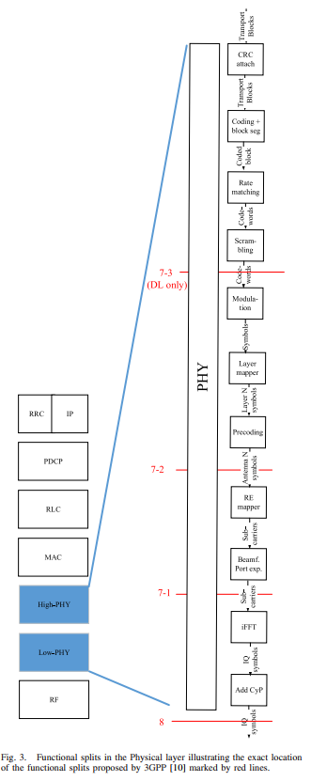
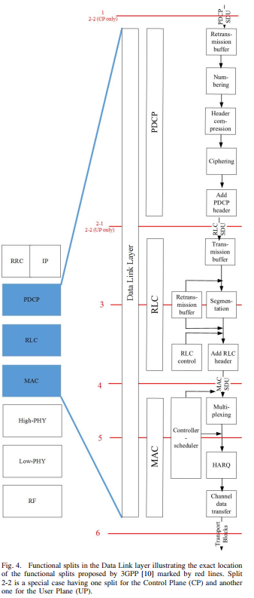
[6]

Slide 12
Introduction
This approach allows dynamic usage of resources based on statistical packet-based multiplexing of information, with consequent enhanced scalability.
Differently from the conventional C-RAN(Centralized radio access network) approach, anyway included among possible functional splits as option 8(ref [8]), centralization is relaxed by assuming some processing capability distributed in the nodes of the aggregation network, thus achieving more relaxed bandwidth and latency constraints with respect to C-RAN [6].
[6] L. M. P. Larsen, A. Checko, and H. L. Christiansen, “A survey of thefunctional splits proposed for 5G mobile crosshaul networks,”IEEECommunications Surveys Tutorials, vol. 21, no. 1, pp. 146–172, 2019.
Notes:
該方法是基於統計封包的資料多工化(把一些layer拆成多個layer),增加了擴展性(scalability)
與傳統的C-RAN(Centralized radio access network)方式不同的是，無論如何都包含在可能的功能拆分中，作為方案8，通過假設一些分佈在匯聚網絡節點中的處理能力來放鬆集中化，從而實現相對於C- RAN更寬鬆的頻寬和延遲限制[6]。

Slide 13
Introduction
The main problem is how to split the required functionalities into nodes in relation to the bandwidth available on the links and the processing capability in the nodes themselves, with the aim of achieving the full coverage of the packet-based metro area network.
Each node is associated a virtual function hotel that perform the associated functionalities in relation to the chosen split option.
Notes:
主文要解的大問題如何根據linkes上的頻寬和node的處理能力,把所需要的功能佈署在各nodes上,以實現全覆蓋(full coverage )的packet-based的都市網路。
每個節點都有virtual function的庫(hotel),根據決定的拆解方法執行與任務相關的功能

Slide 14
Introduction
In the specific case of URLLC, extremely tight requirements in terms of latency and reliability need to be met, while optimally associate functions to nodes.
To this end, ready-to-use additional backup resources need to be provided in case of link or hotel failure, able to meet the same quality of service of the primary ones. As a consequence, fast connectivity swap can be performed within the slice.
This approach is known in literature as resource protection and, according to previous classifications, different protection schemes can be applied for fast slice resiliency [7].
[7] D. M. M. Pioro,Routing, Flow, and Capacity Design in Communicationand Computer Networks. Morgan Kaufmann, 2004
Notes:
在Urllc的情況中需要滿足嚴格的延遲與可靠度要求,同時將功能優化關聯到節點上。
為此，在link或庫(hotel)發生故障時，需要提供隨時可用的額外備用資源，能夠滿足主資源相同的服務質量。因此，可以在slice內進行快速link切換。
這種方法在文獻中被稱為資源保留，根據以往的分類，可以採用不同的保留方案來實現快速slice彈性[7]。

Slide 15
Introduction
Protection schemes can be either dedicated path (DPP) or shared path (SPP).
In DPP, backup resources are dedicated and therefore cannot be shared with any other protection path.
Conversely, SPP allows sharing backup resources among protection paths. SPP mechanisms are expected to require less additional resources compared to DPP, but are usually more complicated to operate. At the best of our knowledge the problem of reliable slice embedding with functional split still needs investigation.
Notes:
保留機制可分成專用路徑(DPP)和共用路徑(SPP)
DPP方法中,備用資源是專用的,不與其他保留路徑共用
相反的,SPP允許共用備用路徑。與DPP相比,SPP方法需要更少的資源,但操作較複雜。根據作者所知,功能拆解的可靠切片嵌入問題仍然需要研究。

Slide 16
Introduction
Option 8 referred to conventional C-RAN was studied in [8]. [9] address the flexible functional placement problem with no specific reference to the latency and reliability constraints relevant to URLLC.
Anyway, a methodology to design the optical aggregation network while associating function splitting to nodes with URLLC is expected to greatly help the task of operators in the deployment of 5G network slicing.
Some evaluations on functional splitting in optical aggregation networks have been presented based on heuristics in [10] for DPP.
[10] B. M. Khorsandi, F. Tonini, E. Amato, and C. Raffaelli, “Dedicatedpath protection for reliable network slice embedding based on functionalsplitting,” in2019 International Conference of Transparent OpticalNetwork ICTON, 2019.
Notes:
方案8是ref [8]中所研究的傳統的C-RAN。
ref[9]解決了靈活的功能佈局問題，沒有特別提到與URLLC相關的延遲和可靠性限制。
無論如何，一種在設計光纖聚合網絡的同時,將功能分割與URLLC關聯到節點的方法，有望極大地幫助運營商完成5G網絡切片的部署工作。
至於DPP方法,在ref[10]中的啟發式方法，已經提出了一些有關光纖聚合網絡中功能拆分的評估方法。

Slide 17
Introduction
With reference to the above scenario, this paper proposes an optimization procedure based on Integer Linear Programming(ILP) to design resilient latency constrained end-to-end slicing with 5G functional splits for the URLLC service class.
The target is to minimize the number of nodes where virtual functions are activated, given a potential set of node locations.
Dedicated and shared path protection schemes, namely DPP and SPP, are proposed and related optimization procedures to minimize the physical network resources to be associated to URLLC network slice are described and applied to obtain evaluations of their effectiveness.
Notes:
針對上述情況，本文提出了一種基於整數線性規劃（ILP）的優化流程，以針對URLLC服務設計具有5G功能拆解的彈性延遲限制的點到點切片。
目標是在給定潛在的節點位置的集合，在這情況下，最大程度地減少啟動VNF的節點數量。
提出了專用的共享路徑保留方法，即DPP和SPP，並描述了相關的優化流程，以最小化要與URLLC網絡切片相關的物理網絡資源，並將其應用於評估其有效性。

Slide 18
Paper Organization
Section 2 : the reference network architecture and problem formulation are introduced.
Section 3:the optimization methodology for the design of URLLC slice using DPP and SPP with latency constraints to minimize the number of active hotels in the optical aggregation network
Section 4 : Several proposed solution processes contained in heuristics are developed to find an optimal solution.
Section 5 : results and comparison
Section 6 : the conclusions and main achievements
Notes:
第二章:參考的網路架構和問題列成公式
第三章:使用DPP和SPP並具有延遲限制的URLLC切片設計的優化方法，以最小化光纖聚合網絡中的活躍庫數量
第四章:開發了啟發式方法中包含的幾種建議的解決方法，以找到最佳解決方案。
第五章:結果與比較
第六章:結論與主要成就

Slide 19
Reference Network Architecture and Problem Formulation

Slide 20
REFERENCE NETWORK ARCHITECTURE
5G baseband functional splits have been investigated recently [6].
The functions composing the layers of the mobile network protocol stack can be split into multiple nodes and performed in sequence, forming a chain of functions.
Function chaining has been investigated before, where service end points are known and only end to end bandwidth and latency constraints are applied [11].
[6] L. M. P. Larsen, A. Checko, and H. L. Christiansen, “A survey of the functional splits proposed for 5G mobile crosshaul networks,”IEEE Communications Surveys Tutorials, vol. 21, no. 1, pp. 146–172, 2019.
[11] A. Hmaity, M. Savi, F. Musumeci, M. Tornatore, and A. Pattavina, “Protection strategies for virtual network functions placement and service chains provisioning,”Networks, vol. 70, no. 4, pp. 373–387. [Online].Available: https://onlinelibrary.wiley.com/doi/abs/10.1002/net.21782
Notes:
Ref 6 最近研究5G的baseband功能拆解
組成行動網路協定堆疊中的功能可以拆解到多個節點上並依順序執行,也就是組成功能鍊(function chain)
Ref 11研究了function chain中,探討對於服務終端之間的點對點頻寬和延遲限制

Slide 21
REFERENCE NETWORK ARCHITECTURE
However, when providing a service, the requirements of the baseband processing must be satisfied along with the one of the end to end service, usually performed in the cloud.
The bandwidth requirement to carry different functions of the protocol stack are shown in Table I for a sample antenna configuration [12].
An example of a possible end to end URLLC service slice is presented in Fig.1. The reliability required by this class of services implies the allocation of primary and backup path resources for each chain in the slice
Notes:
當提供一個服務時,在雲端執行的每個點對點服務必須滿足基頻(baseband)的處理需求
根據ref 12的無線示範環境,協議堆疊的不同功能所需的頻寬如表1所示
圖1所示,一個可能的點對點URLLC切片的範例

Slide 22
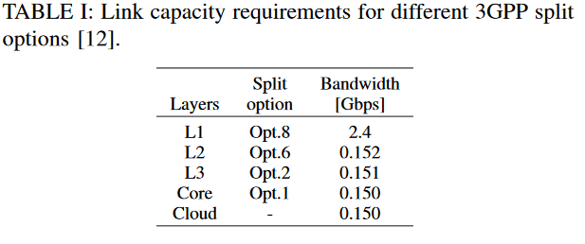
Table 1

Slide 23
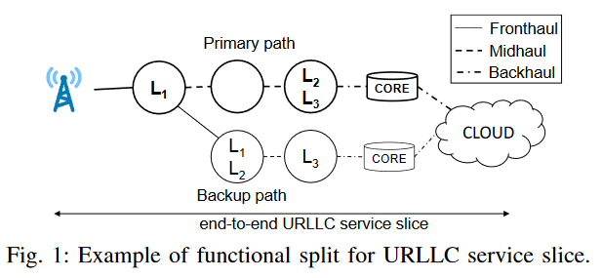
Fig 1

Slide 24
Problem Formulation
The formulation of the BBU hotel location problem with resiliency(彈性) is as follows:
Given: a set of nodes and related resources, which are candidates as hotels to host baseband, core and cloud functions, properly connected through a set of links.
To find: a suitable functions placement, such that the number of active nodes (i.e., nodes hosting any function)is reduced to a minimum while reliability against single link or hotel failure is provided.
Notes:
彈性基頻單元(BaseBand Unit，BBU)的庫(hotel)位置部屬問題以公式描述如下:
給定資訊: 一個節點的集合(Set)和相關資源,這些節點和資源可作為庫(hotel)的候選，用於承載基頻、核心和雲功能，並通過一組適當的鏈路(link)連接。
找出目標: 一個適合的功能配置,讓運行的節點的數量減至最少,也能同時滿足單一鏈路或庫故障時的可靠度

Slide 25
Problem Formulation
To ensure: that each antenna is connected to URLLC service through a set of properly ordered functions forming a chain running in active nodes, so that the maximum allowed distance between the antenna and the cloud is not exceeded, the maximum bandwidth available on each link is not exceeded, and the available computational resources in each node are not exceeded.
Notes:
確保(限制)條件:每個天線都連接一組正確排列的functions,最後連到URLLC服務,這些functions組成一個在活動節點(nodes)中運行的鏈路(links),而且排列結果需小於天線和雲端的最大距離,頻寬也小於每個links的最大頻寬,運算需求不能超過每個節點上提供的最大運算能力

Slide 26
Optimization Methodology For DPP and SPP in a URLLC Slice

Slide 27

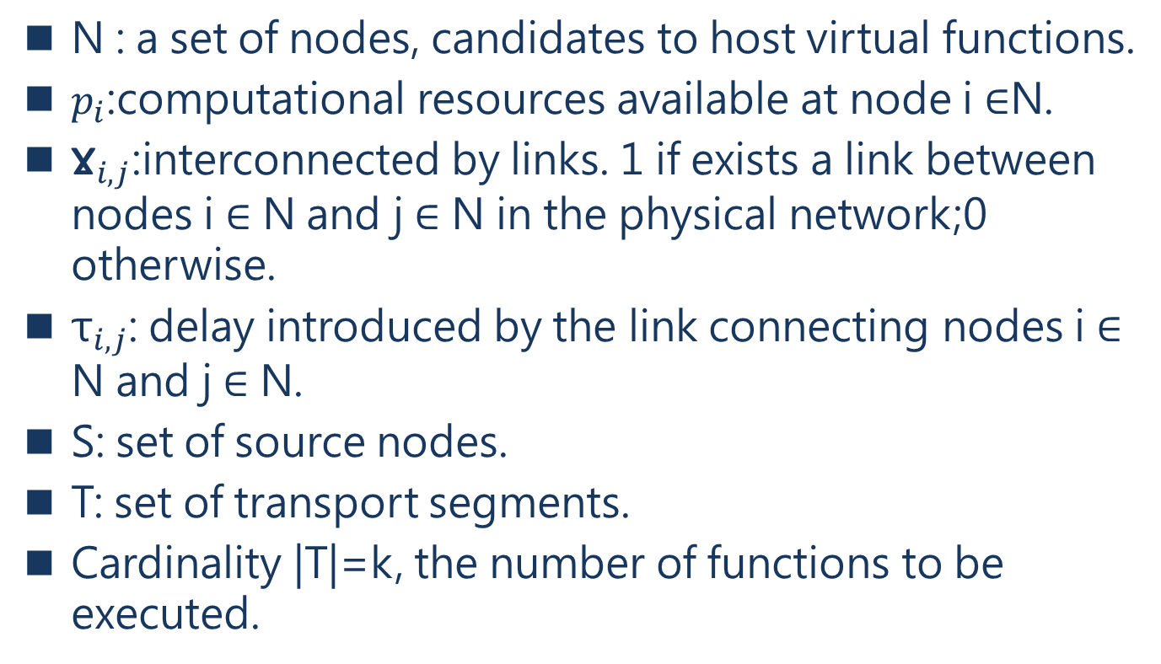
parameters
N : a set of nodes, candidates to host virtual functions.
$p_{i}$:computational resources available at node i ∈N.
${\text{Ɣ}}_{i,j}$:interconnected by links. 1 if exists a link between nodes i ∈ N and j ∈ N in the physical network;0 otherwise.
${\text{τ}}_{i,j}$: delay introduced by the link connecting nodes i ∈ N and j ∈ N.
S: set of source nodes.
T: set of transport segments.
Cardinality |T|=k, the number of functions to be executed.
Notes:
N : nodes的集合,可用來部屬VNF
Pi : node i可用的計算資源
Gamma i,j : 矩陣,表示實體網路中的節點i,j之間的是否有link,1代表有link,0代表沒有link
Tau i,j :矩陣,表示實體網路中的節點i,j之間的延遲
S : source nodes資源節點的集合
T : 傳輸小段的集合 , t1,… tq, … tk
T的基數 也就是等於k,代表可以執行functions的數量

Slide 28
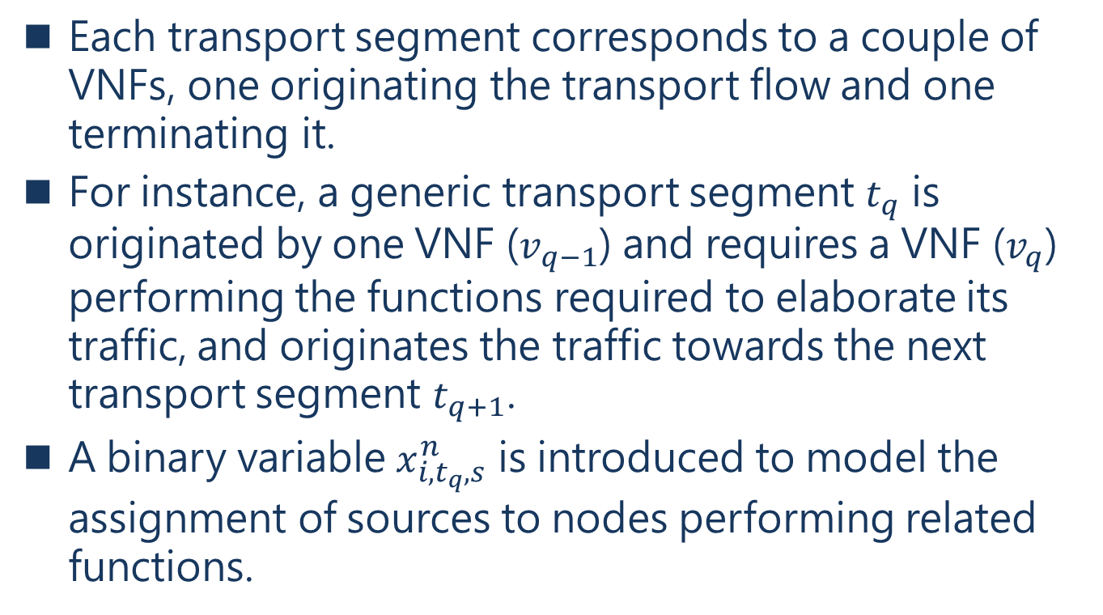
parameters
Each transport segment corresponds to a couple of VNFs, one originating the transport flow and one terminating it.
For instance, a generic transport segment $t_{q}$ is originated by one VNF ($v_{q−1}$) and requires a VNF ($v_{q}$) performing the functions required to elaborate its traffic, and originates the traffic towards the next transport segment $t_{q+1}$.
A binary variable $x_{i,t_{q},s}^{n}$ is introduced to model the assignment of sources to nodes performing related functions.
Notes:
每個傳輸小段 對應 幾個VNFs , 傳輸傳輸流有一個發起端和一個終止端
舉例,一個傳輸小段 $t_{q}$ 由一個VNF $v_{q−1}$發起,並需要一個VNF $v_{q}$ 用來執行所需要的functions,並向下一個傳輸小段$t_{q+1}$發起傳輸。
二元變數$x_{i,t_{q},s}^{n}$ ,用來表示把資源分配各執行相關功能的節點的情況

Slide 29
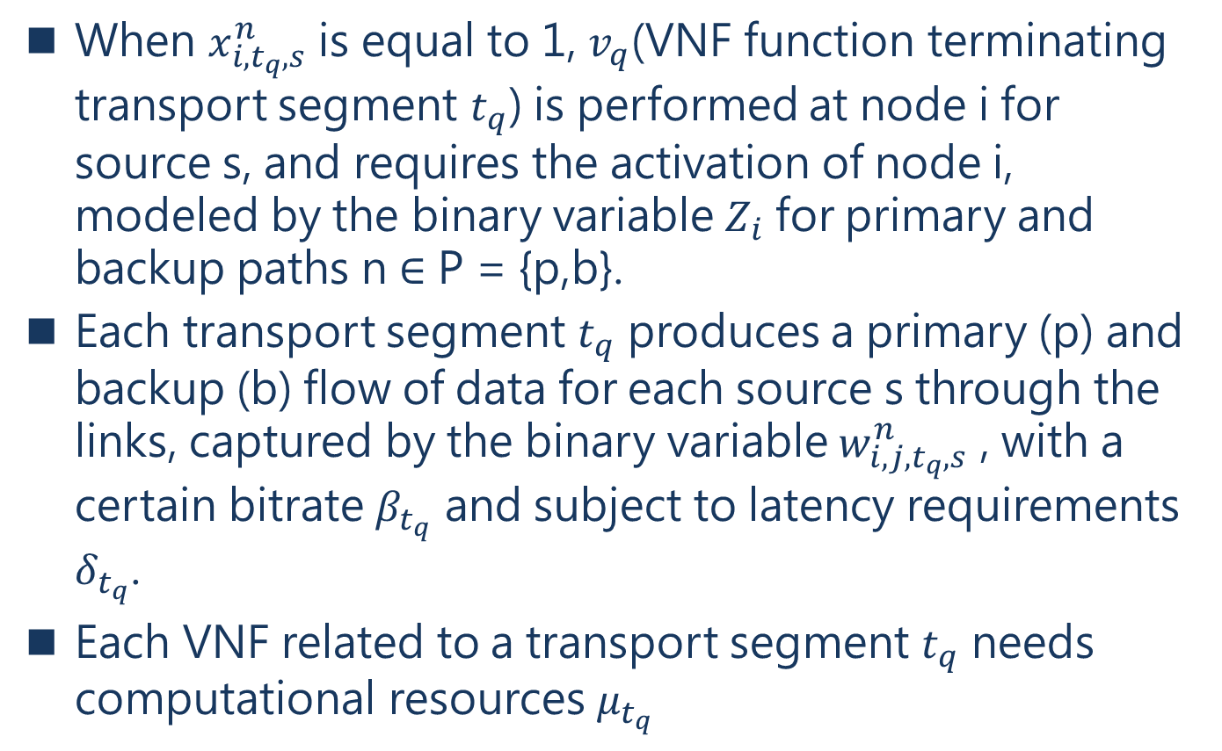
parameters
When $x_{i,t_{q},s}^{n}$ is equal to 1, $v_{q}$(VNF function terminating transport segment $t_{q}$) is performed at node i for source s, and requires the activation of node i, modeled by the binary variable $Z_{i}$ for primary and backup paths n ∈ P = {p,b}.
Each transport segment $t_{q}$ produces a primary (p) and backup (b) flow of data for each source s through the links, captured by the binary variable $w_{i,j,t_{q},s}^{n}$ , with a certain bitrate $β_{t_{q}}$ and subject to latency requirements $δ_{t_{q}}$.
Each VNF related to a transport segment $t_{q}$ needs computational resources $μ_{t_{q}}$
Notes:
當$x_{i,t_{q},s}^{n}$等於1時, VNF $v_{q}$(傳輸小段$t_{q}$被該VNF終止)執行中,在節點 i 上,從來源節點source s, 而需要啟動節點 i ,這個啟動節點狀態用二元變數$Z_{i}$表示,都可以表示主要路徑p和備用路徑b的情況
每個傳輸小段$t_{q}$,會 產生/乘載 一個主要資料流(primary flow of data) 備用資料流(backup flow of data),從來源s傳輸在每link上,用二元變數$w_{i,j,t_{q},s}^{n}$表示某條link的乘載狀態
二元變數$w_{i,j,t_{q},s}^{n}$ 等於1時 ,表示該條link乘載 節點i和節點j之間的資料流量,有傳輸小段$t_{q}$,該條路徑p從來源s出發 變數$β_{t_{q}}$表示傳輸小段$t_{q}$的頻寬需求
變數$δ_{t_{q}}$表示傳輸小段$t_{q}$的延遲需求
每個VNF都對應一個傳輸小段$t_{q}$,這些VNF需要計算資源$μ_{t_{q}}$
變數$μ_{t_{q}}$表示執行VNF結束傳輸小段$t_{q}$的任務的計算資源的容量

Slide 30
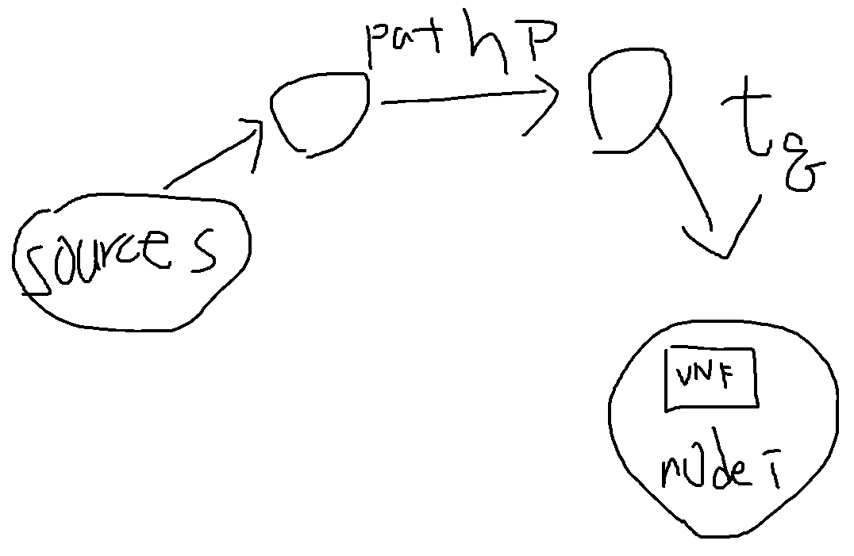

$$x_{i,t_{q},s}^{n}$$

Slide 31
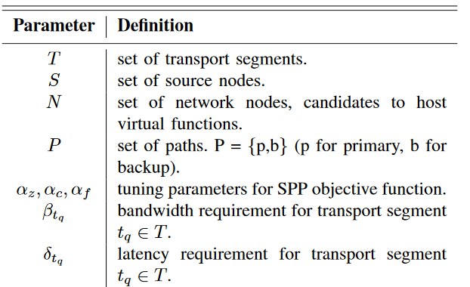
TABLE II: List of parameters

Slide 32
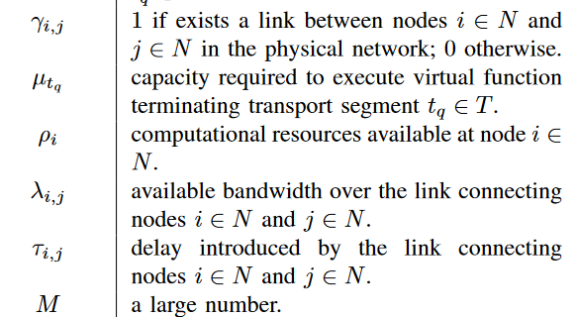
TABLE II: List of parameters

Slide 33
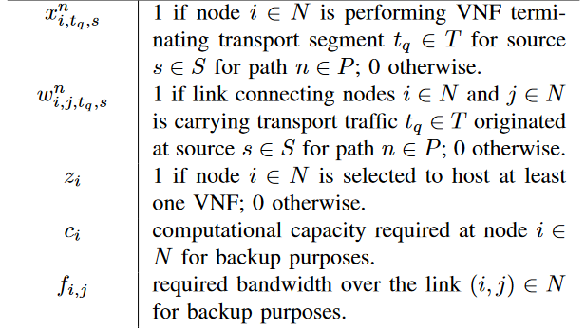
TABLE II: List of parameters

Slide 34
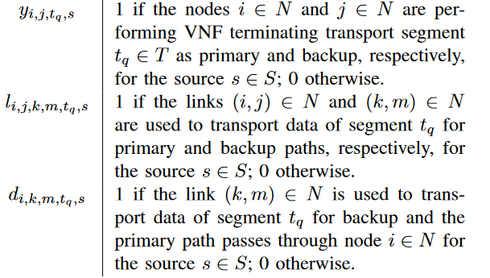
TABLE II: List of parameters

Slide 35
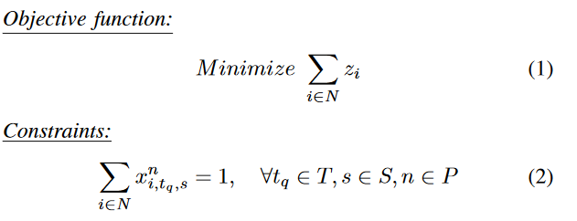
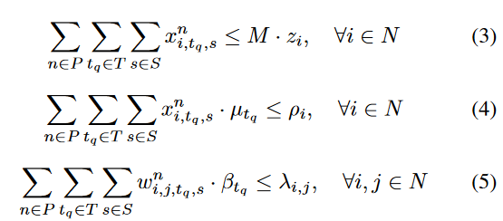
DPP model
Notes:
目標函式: 使運行VNF的節點數量最少
限制式:
2: 表示整個路徑上每個VNF和來源,都只有一個VNF負責運作
3: 表示選擇節點時,會先選擇正在運行的節點
4: 表示節點i的計算資源能夠提供從所有來源s和所有路徑要執行的VNF所需的計算資源(容量 capacity)
5: 表示節點i和節點j之間的link的可用頻寬 要大於 需求的頻寬大小

Slide 36

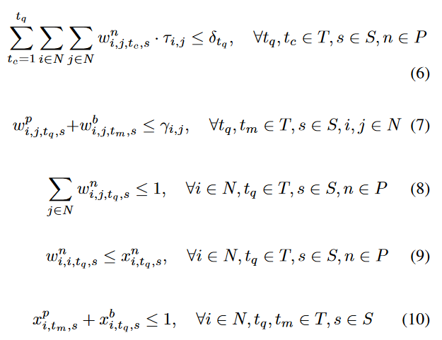
DPP model
Notes:
6: 表示所有節點i和節點之間的延遲必須小於傳輸小段$t_{q}$的延遲
7: 表示只能在物理拓撲路由中(選擇路徑),同時確保不同的路徑(主要路徑和備用路徑)使用的link是不同的 (因為DPP,只能專用路徑)
8: 表示限制了每個來源s 和 傳輸小段$t_{q}$ 的每個節點中傳出路徑的總和不能大於1。也就是說該條path在每個節點上只能有一條路徑不能有多條路徑
9: 禁止路徑發生迴圈的情況
10: 確保主要路徑和備用路徑所經過的節點是不同的

Slide 37
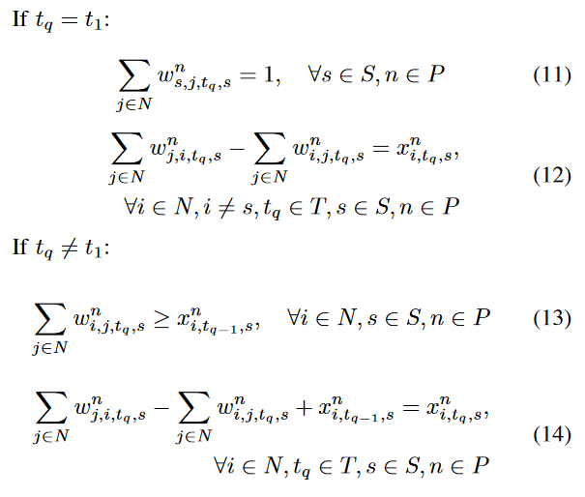
DPP model
Notes:
第一個傳輸小段的限制
11: 對於第一個傳輸小段t1 ,一定有且只有一個從來源s的傳出流
12: 表示傳輸小段t1 傳到下一個VNF是流量守恆的情況
其他的傳輸小段的限制
13: 確保每個節點i都有一個傳輸流,來連接傳輸小段t q-1
14: 每個傳輸小段需要保持流量守恆 (看原文描述怪怪的)

Slide 38
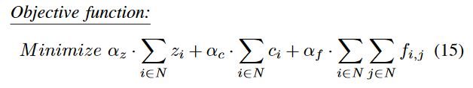

SPP model
In the SPP model, four additional variables have been introduced : $c_{i}$ and $f_{i,j}$ which allow the reduction of computational resources and bandwidth reserved for backup, and $y_{i,j,t_{q},s}$ and $l_{i,j,k,m,t_{q},s}$ to find the pairs of nodes and links of the primary and backup.
Notes:
在spp model中,添加四個的變數
變數$c_{i}$表示節點i可以減少的計算資源保存給備用路徑使用
變數$f_{i,j}$表示節點i和節點j可以減少的頻寬保存給備用路徑使用
目標函數(15): 使運作中的節點數量和備用計算資源和備用頻寬的量最少

Slide 39
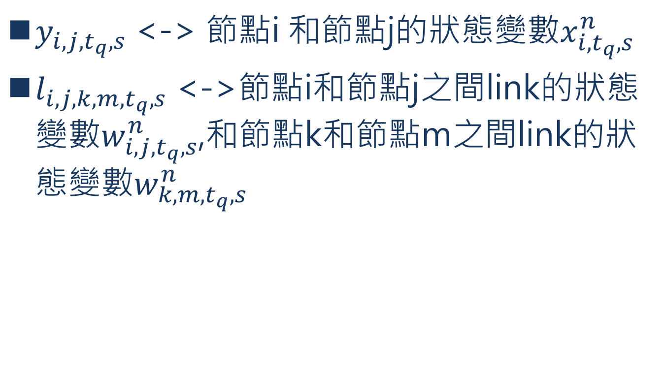
SPP model
$y_{i,j,t_{q},s}$ <-> 節點i 和節點j的狀態變數$x_{i,t_{q},s}^{n}$
$l_{i,j,k,m,t_{q},s}$ <->節點i和節點j之間link的狀態變數$w_{i,j,t_{q},s}^{n}$,和節點k和節點m之間link的狀態變數$w_{k,m,t_{q},s}^{n}$
Notes:
說明$:x_{i,t_{q},s}^{n}$ :表示兩個節點的node狀態
說明:$l_{i,j,k,m,t_{q},s}$ : 表示兩條不同link(主要和備用)的狀態

Slide 40
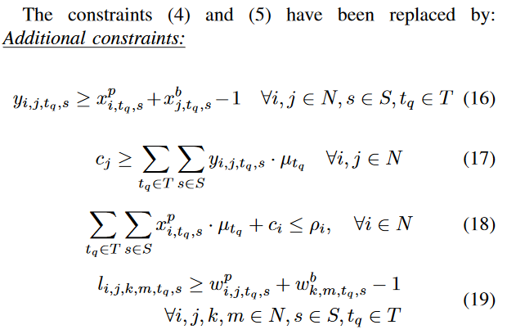
SPP model
Notes:
之前DPP的限制式 (4)和(5)替換成以下新增的限制式
(16)表示找到的主要路徑上的節點和備用路徑上的節點是執行不同的VNF
(17)表示備用節點j保留的容量可以滿足主要節點i中執行functions的容量,這是為了在在單一主要庫(節點)故障時還能保有可靠度
PS:(18)相比(4)添加了一個變數$c_{i}$
(18)表示節點i的的計算資源可以滿足所有來源所有路徑要執行的VNF的需求
PS:(19)與(16)相似
(19)表示找到的主要link(i,j)和備用link(k,m)乘載每個來源傳來的每個流量,簡單來說就是要找到主要Link和備用link來傳輸

Slide 41
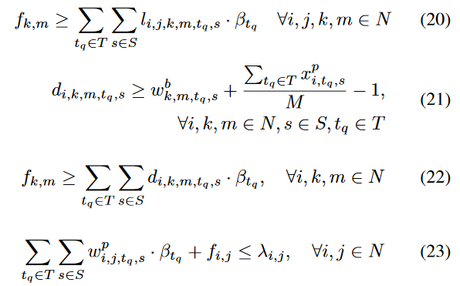
SPP model
Notes:
(20) 備用路徑保留的頻寬可以滿足傳輸小段tq的頻寬需求,這是為了在在單一主要link故障時還能保有可靠度
(21) 表示找到受到BBU庫故障的節點I,剛好與備用link(k,m)共用(不清楚意思)
(22) 表示在庫所在的節點i故障的情況下,計算 link(k,m)的頻寬需求須滿足傳輸小段tq的頻寬需求
(23) 表示每條link的頻寬需求不能超過該條link能提供的頻寬(原文:capacity容量)

Slide 42
Numerical Results and Comparisons
CH4

Slide 43
Numerical Results and Comparisons
In this section, the results obtained by running the two algorithms using the CPLEX commercial tool [13] are reported.
The DPP strategy is firstly evaluated referring to the 16 node networks represented in Fig 2
Each network node is connected to 10 antennas, collecting traffic from the radio section.
The available bandwidth on each link is set to 40Gbps (in each direction).
In addition, each node is equipped with processing units (PUs) according to traffic generated at each layer of the functional splitting as shown in Table I.
Notes:
兩個演算法都用CPLEX商用軟體分析其結果
DPP方法用16個節點網路如圖2的環境下去分析
每個網路節點有10個天線連結,從無線端(radio section)收集資料
每條link的可用頻寬為40Gbps(每個方向(雙工)都是40Gbps)
除此之外,每個節點都有處理單元(processing units ,PUs, 簡稱PU),
如表I所示，每個節點都根據在功能拆分的每一層生成的流量配備了處理單元。

Slide 44
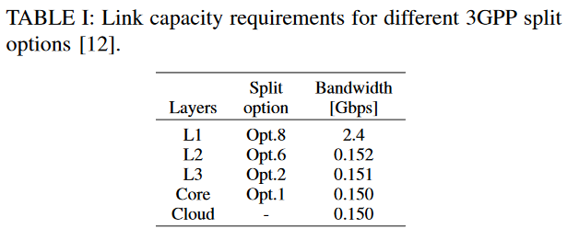
TABLE I
Notes:
PS : L1 L2 L3 都是屬於Baseband Unit的function(拆解出來的)

Slide 45
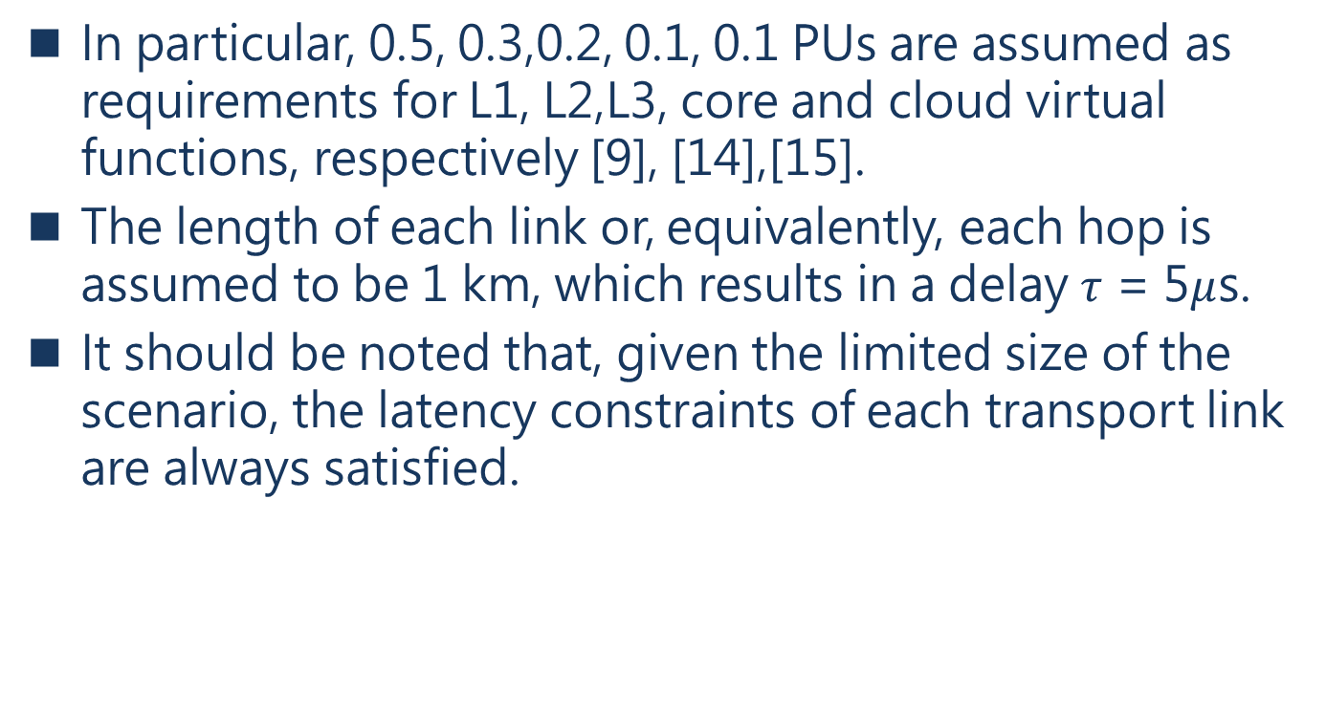
Numerical Results and Comparisons
In particular, 0.5, 0.3,0.2, 0.1, 0.1 PUs are assumed as requirements for L1, L2,L3, core and cloud virtual functions, respectively [9], [14],[15].
The length of each link or, equivalently, each hop is assumed to be 1 km, which results in a delay $τ$ = 5$μ$s.
It should be noted that, given the limited size of the scenario, the latency constraints of each transport link are always satisfied.
[9] D. Harutyunyan and R. Riggio, “Flex5G: Flexible functional split in 5GNetworks,”IEEE Transactions on Network and Service Management,vol. 15, no. 3, pp. 961–975, Sep. 2018.
[14] B. M. Khorsandi, D. Colle, W. Tavarnier, and C. Raffaelli, “Adaptivefunction chaining for efficient design of 5G xhaul,” in2019 InternationalConference on Optical Network Design and Modeling ONDM, 2019.
[15] H. Chang, B. Qiu, C. Chiu, J. Chen, F. J. Lin, D. de la Bastida, and B. P.Lin, “Performance evaluation of Open5GCore over KVM and Dockerby using Open5GMTC,” inNOMS 2018 - 2018 IEEE/IFIP NetworkOperations and Management Symposium, April 2018, pp. 1–6.
Notes:
根據ref [9] [14] [15]的文獻,L1,L2,L3,核心和雲端的virtual functions,各所需要0.5,0.3,0.2,0.1,0.1的PU資源
每個link的長度,也剛好是hop的意思,都是假定1公里,延遲$τ$都是5毫秒
要該注意的是，在給定限制情況下，須滿足每個傳輸link的延遲限制

Slide 46
Numerical Results and Comparisons
However, to satisfy the tight service requirements imposed by URLLC applications, all the nodes are allowed to host edge core and cloud functions.
The SPP approach is evaluated then, assuming a 6 node network, not to incur in out of memory exception due to the higher complexity of the SPP algorithm.
Notes:
為了滿足URLLC應用程式的嚴格的需求,每個節點都可以運行邊緣核心(edge core)和雲端的functions
而評估SPP方法,假設以6節點的網路,因為SPP作法的複雜性較高,為了避免記憶體不足而導致異常,故採用6節點的網路。

Slide 47
DPP evaluation
The two networks A and B used to evaluate the DPP algorithm are presented in Fig 2.
The two networks differ for the connectivity represented by a different number of links.
Notes:
評估DPP的情況 如圖2所示,兩個網路A和B用來評估DPP作法
兩個網路的連接性由不同數量的link表示

Slide 48
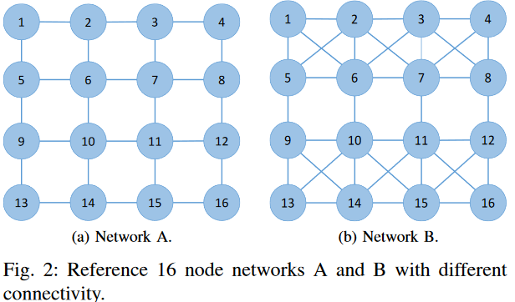
Fig 2

Slide 49
DPP evaluation
The case in which all the nodes candidate to host an hotel are equal to 25 PUs is referred to as balanced (bal).
The unbalanced (unbal)case, instead, has nodes 6,7,10,11 with infinite capacity in terms of PUs, thus emulating centralized data centers, while all the other nodes are equipped with 10 PUs.
The number of active nodes (i.e., nodes hosting baseband, core or cloud functions) obtained with the DPP model in the networks A and B in the balanced and unbalanced case under different hop constraints is reported in Fig. 3.
Notes:
平衡模式:每個節點都有一個庫(hotel),擁有25PU(的運算能力)
非平衡模式:節點6,7,10,11類似於集中式的資料中心,有無限的PU,其他的節點有10PU
如圖3中所示,在平衡和不平衡模式下，在網絡A和B中透過DPP方法,運作的運作節點（即運行基帶，核心或雲功能的節點）的數量。

Slide 50
DPP evaluation
The balanced case always requires the activation of all the nodes, as a consequence of the limitation of node resources, regardless the number of hops and network connectivity.
Conversely, the unbalanced case shows a reduction in the number of active nodes.
The effects of an increased network connectivity are evident, with only 8 active nodes required for both 2 and 4 hops.
看fig 3
Notes:
平衡模式中,因為受到節點資源的限制,會啟動所有的節點,與跳過節點的數量與網路連接無相關
而非平衡模式中,可以看到啟動節點的數量減少
網絡連接性增強的影響顯而易見，對於2 hop(跳過2個點部屬)和4hop，都需要8個活動節點。

Slide 51
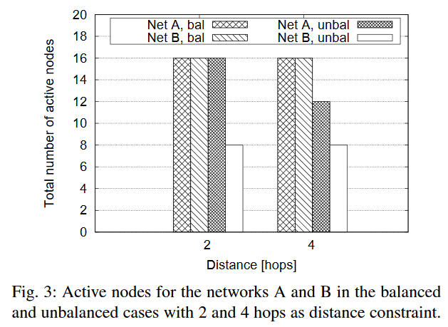
Fig 3

Slide 52
DPP evaluation(unbla)
The network A allows a reduction of 4 nodes when moving from 2 to 4 hops, thanks to high capacity nodes that perform multiple functions in few nodes, while in network B no additional node reduction is possible due to the limited resources over links connecting high capacity nodes.
Notes:
非平衡環境中
網絡A在從2 hops到 4 hops時允許減少4個節點，這歸功於高容量節點在少數節點中執行多種功能，而在網絡B中，由於連接高容量的links上的資源有限，無法減少節點(都還是4個active nodes)。
我的解釋:看圖3,網路A非平衡在2hops情況下有16個活動節點,在4hops情況下剩下12個活動節點。 而網路B非平衡在2hops和4hops的活動節點都是8個,因為連到高容量節點(6,7,10,11)的links的資源(延遲和頻寬)有限,只能要求更多的資源(節點)來運作(這邊怪怪的?),所以節點數量沒有減少。

Slide 53
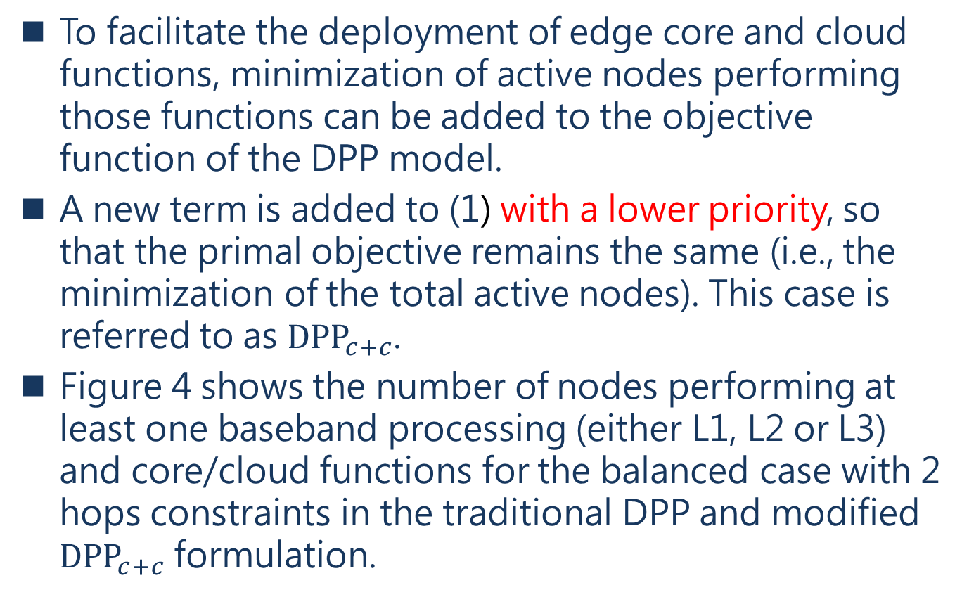
DPP evaluation
To facilitate the deployment of edge core and cloud functions, minimization of active nodes performing those functions can be added to the objective function of the DPP model.
A new term is added to (1) with a lower priority, so that the primal objective remains the same (i.e., the minimization of the total active nodes). This case is referred to as ${DPP}_{c+c}$.
Figure 4 shows the number of nodes performing at least one baseband processing (either L1, L2 or L3) and core/cloud functions for the balanced case with 2 hops constraints in the traditional DPP and modified ${DPP}_{c+c}$ formulation.
Notes:
為了促進邊緣核心和雲功能的部署，可以在DPP模型的目標函數中加入 執行這些functions的活動節點的數量最小化
目標函式(1)添加新的較低的權重,這樣一來,要解決的目標還是一樣的(解決目標:求得最少的活動節點數量),這個情況稱作${DPP}_{c+c}$
PS:這邊沒有寫怎麼在目標函式加入更低的權重
圖4顯示在傳統DPP方法和修改的${DPP}_{c+c}$方法中,具有2 hops限制的平衡模式下,至少有一個baseband執行（不論L1，L2或L3）和核心/雲功能的節點數量

Slide 54
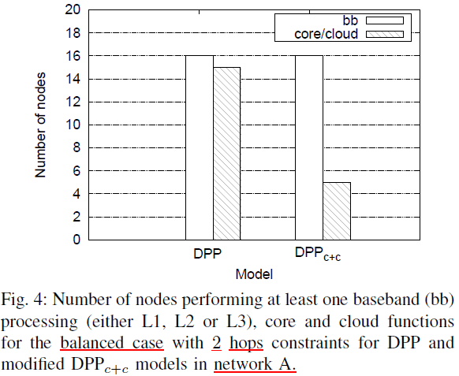
Fig 4

Slide 55
DPP evaluation
Figure 5 depicts the link usage of DPP in the network A, under 2 and 4 hop constraints, for both balanced and unbalanced cases.
In the figure the links are sorted in increasing order of usage for each curve. Depending on the specific curve, links show different usage, which indicates potential statistical multiplexing gain when multiple slices are embedded on the same network.
Some links exhibit a very low usage or even no usage, especially with 2 hop constraint. Many links needs 24 Gbps or slightly higher due to the capacity required for option 8 with 10 antennas (see Table I).
Notes:
圖5描述了在平衡和不平衡情況下，在2 和 4 hops限制下，網絡A中DPP的links使用情況。
在該圖中，link依照使用順序從高到低排序。根據實際的曲線，links顯示出不同的使用情況，這表示當在同一網絡(links)中承載多個切片時提昇了一些多路傳輸的使用(頻寬增加)。
某些Links在2 hops情況中表現出比較低的使用率甚至沒有使用,許多links需要24Gbps或是需要更多一點的資源(頻寬),以opt 8 10條天線(一條天線頻寬2.4Gbps)的情況下

Slide 56
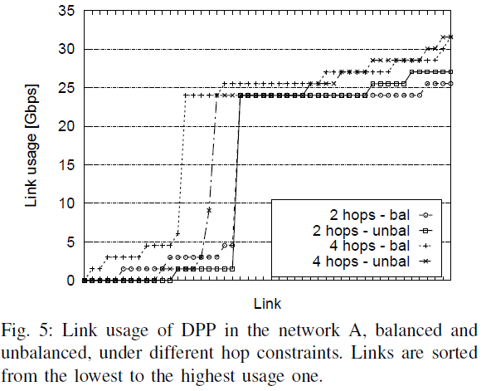
Fig 5
Notes:
PS:
看linke的使用頻寬,
2hops比4hops的使用頻寬還少
balance比unbalance的使用頻寬還少

Slide 57
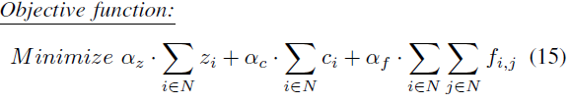
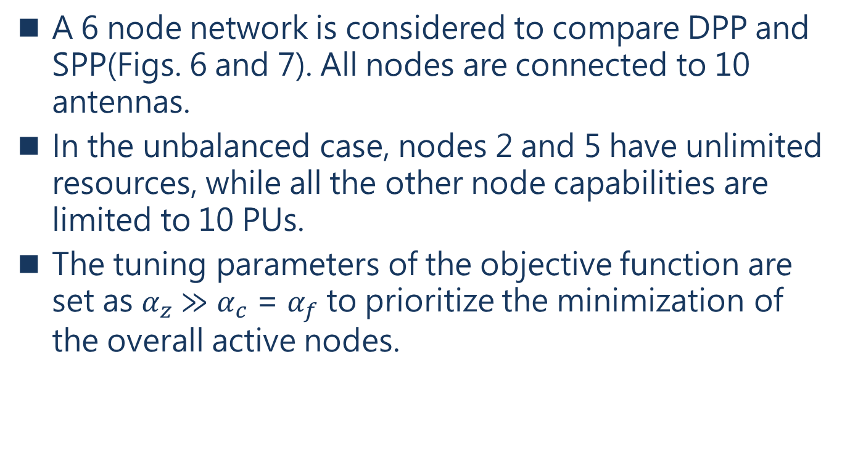
SPP evaluation
A 6 node network is considered to compare DPP and SPP(Figs. 6 and 7). All nodes are connected to 10 antennas.
In the unbalanced case, nodes 2 and 5 have unlimited resources, while all the other node capabilities are limited to 10 PUs.
The tuning parameters of the objective function are set as $α_{z}$ $≫$ $α_{c}$ = $α_{f}$ to prioritize the minimization of the overall active nodes.
Notes:
評估SPP的情況 一個6節點的網路拿來比較DPP和SPP(圖6和圖7),每個節點都有10個天線
非平衡模式下,節點2和節點5都有無限的資源,而其他的節點有10PU
目標函式的調整參數,設定成$α_{z}$ $≫$ $α_{c}$ = $α_{f}$,優化整體活動節點的最小數量

Slide 58
SPP evaluation
Table III reports the number of active nodes, capacity and node savings for the 6 node networks in the balanced and unbalanced cases under 2 and 3 hop constraints.
The SPP is capable of reducing the number of active nodes in the balanced case by 33.3%.
In addition, the SPP approach allows to share backup node resources among antennas assigned to different primary paths, leading up to 66.6% and 27.8% node capacity savings in the balanced and unbalanced cases, respectively.
Notes:
表3表示,在2 hops和3hops的限制下,在平衡和非平衡模式下的活動節點數量,節省的容量(link使用率)和節點比率
SPP在平衡模式下可以減少33趴的活動節點數量
除此之外,SPP方法允許不同的主要路徑透過無線傳輸(antennas)共用備用節點資源,在平衡模式可以節省66%的資源,在非平衡模式下節省27.8%的資源 PS:這裡講的資源是Links的使用情況(頻寬)

Slide 59
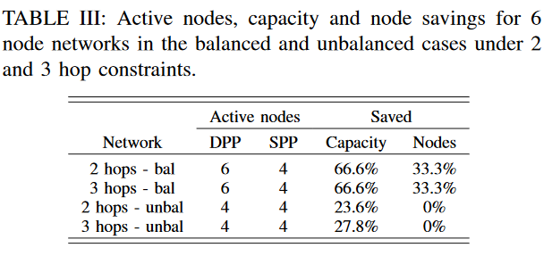
Table 3

Slide 60
SPP evaluation
The figures report the active nodes, that are the nodes performing primary and/or backup functions, eventually split in multiple nodes. The figures also report the link usage for both primary and backup (in underlined, red).
In the case of SPP, the number of active nodes is lower than in the DPP case, thanks to the sharing of the backup paths.
Notes:
這些圖顯示活動節點,也就是運行主要和備用functions的節點,最後拆解到多個節點上運行,這些圖還報告了主要和備用的Link的使用情況
在SSP方法中,活動節點的數量比DPP方法還少,這是因為可以共用備用路徑

Slide 61
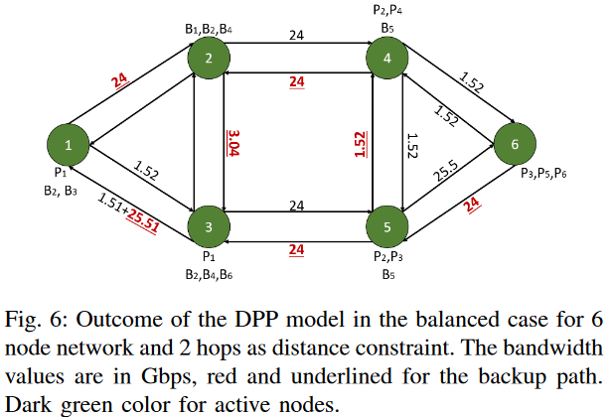
Fig 6

Slide 62
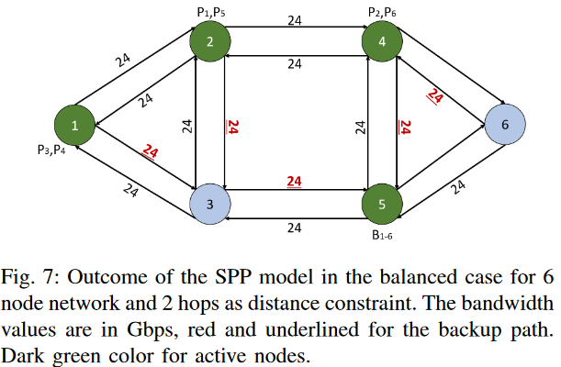
Fig 7

Slide 63
SPP evaluation
For instance, in the SPP case nodes 2, and 3 are able to reach node 5, for backup purposes, by sharing link 3-5.
In the DPP case instead, they cannot reach node 5 due to the dedicated resource allocation and limited bandwidth over the links, thus requiring to activate additional nodes.
Notes:
舉例,SPP方法中,節點2可以經過節點3到節點5,為了備用路徑的需求,因此共用節點3和5之間的Link
在DPP方法中,節點2不能經過節點3到節點5,因為該條link(3到5之間)是專用的,和有線的頻寬大小下,所以無法達到節點5,因此需要啟動其他節點

Slide 64
CONCLUSIONS
CH5

Slide 65
Conclusions
Optimization of functional split for URLLC service has been presented for DPP and SPP based on Integer Linear Programming.
Two different sets of constraints(也就是DPP和SPP) have been defined with the objective to minimize the number of active nodes in the optical aggregation networks.
The effectiveness of the algorithms has been shown also in terms of active nodes and bandwidth usage which is sensibly reduced with respect to the conventional centralized approach and allows statistical multiplexing gain for potential allocation of multiple slices.

Slide 66
Conclusions
The further saving related to SPP has been shown in comparison with DPP.
The SPP algorithm has some scalability limitations that, at this moment has reached optimization for a more limited size network with respect to DPP.
In any case the evaluations result suitable for most metro contexts.
Notes:
SPP算法具有一些可伸縮性限制，目前，對於DPP，此限制已達到針對大小更有限的網絡的優化。
無論如何，評估結果適用於大多數都市網路環境。

Slide 67
My opinions
1.本篇用ILP作為解資源分配的工具,日後作為理論分析可以用ILP進行理論分析。
2.未來規畫路徑可以使用本篇的方法:專用或是共用

Slide 68
Reference

Slide 69
References
[1] M. Shafi, A. F. Molisch, P. J. Smith, T. Haustein, P. Zhu, P. De Silva,F. Tufvesson, A. Benjebbour, and G. Wunder, “5G: A tutorial overview of standards, trials, challenges, deployment, and practice,” IEEE Journal on Selected Areas in Communications, vol. 35, no. 6, 2017.
[2] A. Sgambelluri, M. Capitani, S. Fichera, K. Kondepu, A. Giorgetti, F. Giannone, B. Martini, F. Ubaldi, P. Iovanna, G. Landi, and L. Valcarenghi, “Experimental demonstration of a 5G network slice deployment exploiting edge or cloud data-centers,” in 2019 Optical Fiber Communications Conference and Exhibition (OFC), March 2019, pp. 1–3.
[3] A. Farhadi-Beldachi, E. Huques-Satas, A. Tzanakaki, Y. Yan, R. Nejabati, and D. Simeonidou, “Experimental demonstration of 5G fronthaul and backhaul convergence based on FPGA-based active optical transport,” in 2018 European Conference on Optical Communication (ECOC), Sep. 2018, pp. 1–3.
[4] “Third Generation Partnership Project (3GPP) TR 38.801, v.14.”
[5] “GSM Association - Network slicing use case requirements,” 2018.
[6] L. M. P. Larsen, A. Checko, and H. L. Christiansen, “A survey of the functional splits proposed for 5G mobile crosshaul networks,” IEEE Communications Surveys Tutorials, vol. 21, no. 1, pp. 146–172, 2019.
[7] D. M. M. Pioro, Routing, Flow, and Capacity Design in Communication and Computer Networks. Morgan Kaufmann, 2004.
[8] B. M. Khorsandi, F. Tonini, and C. Raffaelli, “Design methodologies and algorithms for survivable C-RAN,” in 2018 International Conference on Optical Network Design and Modeling (ONDM), May 2018.

Slide 70
References
[9] D. Harutyunyan and R. Riggio, “Flex5G: Flexible functional split in 5G Networks,” IEEE Transactions on Network and Service Management, vol. 15, no. 3, pp. 961–975, Sep. 2018.
[10] B. M. Khorsandi, F. Tonini, E. Amato, and C. Raffaelli, “Dedicated path protection for reliable network slice embedding based on functional splitting,” in 2019 International Conference of Transparent Optical Network ICTON, 2019.
[11] A. Hmaity, M. Savi, F. Musumeci, M. Tornatore, and A. Pattavina, “Protection strategies for virtual network functions placement and service chains provisioning,” Networks, vol. 70, no. 4, pp. 373–387. [Online]. Available: https://onlinelibrary.wiley.com/doi/abs/10.1002/net.21782
[12] “Small Cell Forum - Functional splits and use cases,” 2016.
[13] IBM ILOG CPLEX Optimization Studio V12.6.3.
[14] B. M. Khorsandi, D. Colle, W. Tavarnier, and C. Raffaelli, “Adaptive function chaining for efficient design of 5G xhaul,” in 2019 International Conference on Optical Network Design and Modeling ONDM, 2019.
[15] H. Chang, B. Qiu, C. Chiu, J. Chen, F. J. Lin, D. de la Bastida, and B. P. Lin, “Performance evaluation of Open5GCore over KVM and Docker by using Open5GMTC,” in NOMS 2018 - 2018 IEEE/IFIP Network Operations and Management Symposium, April 2018, pp. 1–6.

