Slide 1
Efficient Pairing-Free Certificateless Authentication Scheme With Batch Verification for Vehicular Ad-Hoc Networks
N. B. Gayathri; Gowri Thumbur; P. Vasudeva Reddy; Muhammad Zia Ur Rahman
IEEE Access

Slide 2
OUTLINE
Abstract
Introduction
Syntax and Security Model
Proposed Scheme
Efficiancy Analysis
Conclusions

Slide 3
Abstract
The continuous progress of the wireless communication technology provides an intelligent and efficient transportation system through vehicular ad-hoc networks (VANETS) to mitigate traffic jams and road fatalities, which improves safety of passengers and traffic flow.
In order to improve computational efficiency and transmission overhead, in this paper, we present an efficient pairing-free certificateless authentication scheme with batch verification for VANETS.
Notes:
無線通信技術的不斷進步，通過車輛自組織網絡（VANETS）提供了一種智能，高效的交通系統，以減輕交通擁堵和道路事故，從而提高乘客和交通流量的安全性。
許多研究人員，汽車製造商和電信行業都在研究VANETS，以構建下一代運輸系統。在VANETS中，配備有無線設備的車輛與其他車輛和固定路邊單元（RSU）交換與交通有關的信息。 VANETS中車輛和RSU之間共享的信息必須安全。為了在VANETS中進行安全通信，提出了許多在不同設置下的加密方案，並且大多數方案在橢圓曲線上使用雙線性對。但是雙線性配對的計算非常昂貴。車輛發送的簽名/消息的驗證也增加了RSU的計算工作量。
為了提高計算效率和傳輸開銷，在本文中，我們提出了一種有效的免配對的無證書無認證身份驗證方案，用於批量驗證。

Slide 4
We designed the scheme in pairing-free environment which improves the communication and computational efficiency. The proposed scheme supports batch verification, which significantly reduces the computational workload on RSUs in VANETS.
The proposed scheme is proven secure in the random oracle model and meets the security requirements, such as authenticity, integrity, traceability, anonymity, and revocation. We compared our scheme with well-known existing schemes, and the efficiency analysis shows that the proposed scheme is more efficient.
Notes:
我們在無配對的環境中設計了該方案，從而提高了通信和計算效率。所提出的方案支持批量驗證，這大大減少了VANETS中RSU的計算工作量。所提出的方案在隨機預言機模型中被證明是安全的，並且滿足諸如真實性，完整性，可追溯性，匿名性和撤銷之類的安全性要求。通過將我們的方案與已知的現有方案進行比較，效率分析表明該方案更加有效。

Slide 5
Introduction
The advancements in wireless communication technology lead us to introduce the intelligent transportation system in metropolitan cities to manage the traffic caused by thousands of vehicles. These intelligent transportation systems are built using “Smart vehicles”, equipped with On Board Units (OBUs) and wireless communication devices. These OBUs have the ability to communicate with other OBUs on the vehicles and with the Road Side Units (RSUs), which are located on the road. With these units, two types of communications are possible: Vehicle to Vehicle (V2V) communications where OBUs communicate each other and Vehicle-to-Infrastructure (V2I) communication where OBUs communicate with RSUs.
Notes:
無線通信技術的進步使我們在大城市引入了智能交通系統，以管理由數千輛車輛引起的交通。這些智能交通系統是使用配備了車載單元（OBU）和無線通信設備的“智能車輛”構建的。這些OBU可以與車輛上的其他OBU和位於道路上的路側單元（RSU）通信。使用這些單元，可以進行兩種類型的通信：OBU之間相互通信的車輛到車輛（V2V）通信和OBU與RSU之間進行通信的車輛到基礎結構（V2I）通信。

Slide 6
These communications are depicted in Fig. 1. These communications will be monitored by a Trust Authority (TA).
The secure and trustful communications plays a crucial role in Vehicular ad-hoc networks (VANETS). Secure communications in VANETS enhances the traffic management, and mitigates traffic accidents, traffic jam, parking difficulty by providing safety related information (to other vehicles) such as traffic signal violation warning, curve speed warning, pedestrian cross warning, post crash notifications, current position of roads and intersections etc.
Notes:
這些通信如圖1所示。這些通信將由Trust Authority（TA）進行監視。
安全可靠的通信在車載自組織網絡（VANETS）中起著至關重要的作用。 VANETS中的安全通信通過提供（與其他車輛有關的）安全相關信息（如交通信號違規警告，彎道速度警告，行人交叉警告，撞車後通知，當前位置）來增強交通管理，並減輕交通事故，交通擁堵，停車困難。

Slide 7
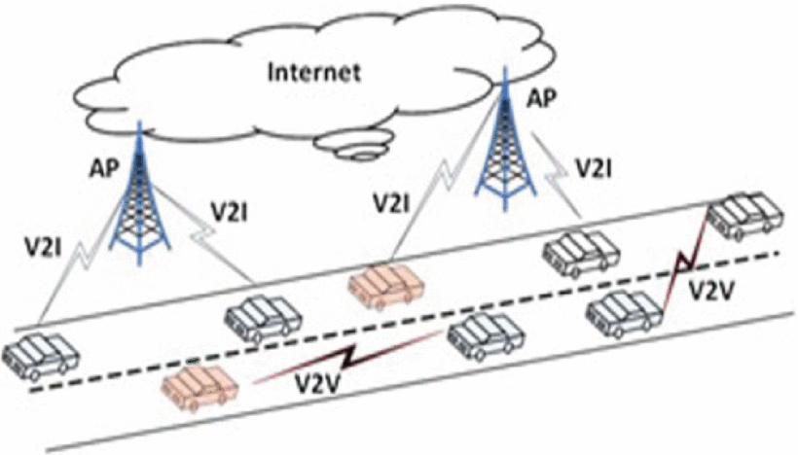

Slide 8
Hence the information shared in VANETS must be satisfied with several cryptographic security requirements such as authentication, integrity, privacy, non-repudiation, traceability, anonymity, of which authentication and privacy preservation are essential for effective security.
If the information shared in VANETS does not meet the cryptographic security standards then adversary may target these communications to various kinds of attacks such as eavesdropping, jamming, interference etc. and destroy the network. Hence, there is a need of cryptographic protection to provide secure communication among vehicles
Notes:
因此，在VANETS中共享的信息必須滿足多種密碼安全要求，例如身份驗證，完整性，隱私，不可否認性，可追溯性，匿名性，其中身份驗證和隱私保留對於有效的安全性至關重要。
如果在VANETS中共享的信息不符合密碼安全標準，則對手可能會將這些通信作為攻擊的目標，​​例如竊聽，干擾，干擾等，並破壞網絡。因此，需要密碼保護以提供車輛之間的安全通信。。

Slide 9
Digital signature on each message by OBU, before sending it to other vehicles or RSUs, ensures identity authentication, message integrity, entity-authentication, privacy, non-repudiation in VANETS.
Notes:
數字簽名是一種加密機制，可提供在VANETS中交換的消息的身份驗證和完整性。
OBU在將每條消息發送到其他車輛或RSU之前，對它們進行數字簽名，以確保身份驗證，消息完整性，實體身份驗證，隱私和VANETS中的不可否認性

Slide 10
A. Related Work
Many sophisticated security schemes have been proposed in the literature to ensure that all the information exchanged in VANET is authenticated. Some Public Key Infrastructure (PKI) authentication schemes [5], [6] for VANETS have been proposed. Though digital signature in conventional PKI provides integrity and authentication, the maintenance of certificates for vehicles public keys incurs huge computation and communication overhead.
Notes:
文獻中提出了許多複雜的安全方案，以確保對VANET中交換的所有信息進行身份驗證。已經提出了一些用於VANETS的公鑰基礎結構（PKI）認證方案[5]，[6]。儘管常規PKI中的數字簽名提供了完整性和認證性，但用於車輛公共密鑰的證書的維護會導致巨大的計算和通信開銷。

Slide 11
To overcome the difficulties in conventional PKI, many Identity-based (ID-based) authentication schemes have appeared in the literature [7]–[8][9][10][11][12][13][14][15][16][17][18][19][20][21]. In 2010, J. Sun et al. [7] presented an identity-based security system for user privacy in VANETS. Later, in 2011, C. Zhang et al. [8] proposed an identity based batch verification scheme with group testing for VANETS.
Though this ID-based system eliminates the difficulties in PKI, it suffers from inherent key escrow problem. To overcome the certificate management and key escrow problems, Al-Riyami [22] introduced the Certificateless (CLS) based mechanism in 2003.
Notes:
為了克服傳統PKI的困難，文獻[7] – [8] [9] [10] [11] [12] [13] [14] [ 15] [16] [17] [18] [19] [20] [21]。 2010年，J.Sun等人 [7]提出了一種基於身份的安全系統，用於VANETS中的用戶隱私。後來，在2011年，C.Zhang等人。 [8]提出了一種基於身份的批量驗證方案，並進行了VANETS的分組測試。
儘管此基於ID的系統消除了PKI的麻煩，但它仍然存在固有的密鑰託管問題。為了克服證書管理和密鑰託管問題，Al-Riyami [22]在2003年引入了基於無證書（CLS）的機制。

Slide 12
Advantages of certificateless based setting attracted the researchers to design various cryptographic schemes in this framework. Many CLS signatures have been evolved in literature for various applications [23]–[24][25][26]. However, one cannot adopt these signature schemes directly for authentication in VANETS due to various security requirements. To meet the security requirements in VANETS, very few CLS authentication schemes have appeared in literature [27]–[28][29][30][31]. All these schemes are using Aggregation procedure based on pairings.
Notes:
基於無證書設置的優點吸引了研究人員在此框架中設計各種加密方案。許多CLS簽名已在文獻中發展為各種應用[23] – [24] [25] [26]。但是，由於各種安全要求，不能直接在VANETS中採用這些簽名方案進行身份驗證。為了滿足VANETS中的安全性要求，很少的CLS認證方案出現在文獻[27] – [28] [29] [30] [31]中。
所有這些方案都使用基於配對的聚合過程。聚合是一種技術，其中所有有效簽名都可以由第三方進行聚合，並且可以驗證此聚合簽名。但是有時候，對於VANETS，需要在單個實例中驗證多個簽名，而不是對其進行匯總。批量驗證的概念到了。批量驗證是一個過程，可以一次驗證多個簽名，而不是一個個地驗證它們。

Slide 13
Aggregation is a technique where all the valid signatures can be aggregated by a third party and this aggregated signature can be verified.
But sometimes it is required to verify multiple signatures in a single instance rather than aggregating them, for VANETS. Here comes the concept of Batch verification. Batch verification is a process where multiple signatures can be verified at a time instead of verifying them one by one.
Notes:
所有這些方案都使用基於配對的聚合過程。聚合是一種技術，其中所有有效簽名都可以由第三方進行聚合，並且可以驗證此聚合簽名。但是有時候，對於VANETS，需要在單個實例中驗證多個簽名，而不是對其進行匯總。批量驗證的概念到了。批量驗證是一個過程，可以一次驗證多個簽名，而不是一個個地驗證它們。

Slide 14
B. Motivation
Moreover, all the above CLS signature schemes are designed using bilinear pairings over elliptic curves. The time consuming cryptographic operation is pairing operation and is more expensive than the evaluation of a scalar multiplication in elliptic curve. For example, ECC with 224 bit keys provides the same level of security as RSA with 2048 bit keys. Thus ECC has become popular since it provides higher security with smaller keys in size. This smaller key size improves the computational and communicational efficiency, storage capacity, bandwidth efficiency.
Notes:
此外，所有上述CLS簽名方案都是使用橢圓曲線上的雙線性配對設計的。費時的密碼運算是配對運算，比評估橢圓曲線中的標量乘法更昂貴。例如，具有224位密鑰的ECC提供與具有2048位密鑰的RSA相同級別的安全性。因此，ECC已變得流行，因為它以較小的密鑰提供更高的安全性。此較小的密鑰大小提高了計算和通信效率，存儲容量，帶寬效率。

Slide 15
Also, in V2I communications, RSUs need to verify large number of signatures that are generated by OBUs. But verifying these signatures sequentially requires lot of computational cost and time. In VANETS, for every 100-300 ms, hundreds of messages will be send to RSUs. To reduce the computational cost and time in verification process, Batch Verification technique is used to verify the signatures simultaneously instead of verifying each signature individually.
Notes:
同樣，在V2I通信中，RSU需要驗證OBU生成的大量簽名。但是順序地驗證這些簽名需要大量的計算成本和時間。在VANETS中，每100-300毫秒，將有數百條消息發送到RSU。為了減少驗證過程中的計算成本和時間，批量驗證技術用於同時驗證簽名，而不是單獨驗證每個簽名。

Slide 16
In these VANET based applications, the capacity of bandwidth and computational resources are limited. The evaluation of pairing operation by RSU requires large computing resources and time. For e.g. the evaluation of one pairing operation is 20 times with that of scalar multiplication. In this regard, to further improve the computational efficiency in VANET based applications, it is required to improve the efficiency by eliminating the pairing operations.
Notes:
在這些基於VANET的應用程序中，帶寬和計算資源的容量受到限制。 RSU對配對操作的評估需要大量的計算資源和時間。例如一個配對運算的評估是純量乘法的20倍。在這方面，為了進一步提高基於VANET的應用中的計算效率，需要通過消除配對操作來提高效率。這促使我們設計了一種用於VANETS的免費配對無證書認證方案。據我們所知，這是第一個為VANETS設計的免費配對無證書認證方案。

Slide 17
C. Our Contributions
We proposed a CLS based authentication scheme for secure communication in VANETS.
The construction of our CLS authentication scheme does not use any pairing operation over elliptic curves.
Our CLS authentication scheme is secure against Forgeability, Traceability, Anonymity and Revocation.
Notes:
我們提出了一種基於CLS的身份驗證方案，用於VANETS中的安全通信。
我們的CLS身份驗證方案的構造不對橢圓曲線使用任何配對操作。
我們的CLS身份驗證方案可防止偽造，可追溯性，匿名性和吊銷。

Slide 18
Compared with existing related schemes in the literature, our scheme improves the computational efficiency.
Our scheme uses batch verification technique to verify multiple signatures in a single instance, which significantly mitigates the computational workload on RSUs.
Notes:
與文獻中現有的相關方案相比，我們的方案提高了計算效率。
我們的方案使用批處理驗證技術在單個實例中驗證多個簽名，這大大減輕了RSU的計算工作量。

Slide 19
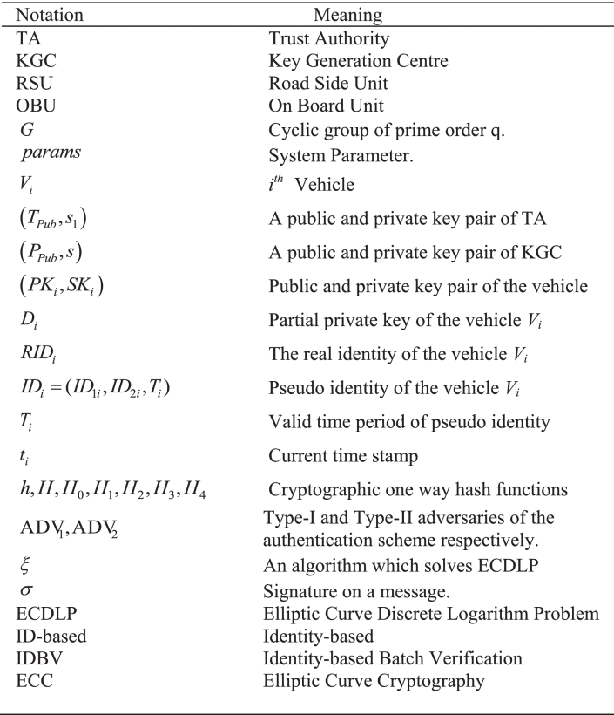
Syntax and Security Model

Slide 20
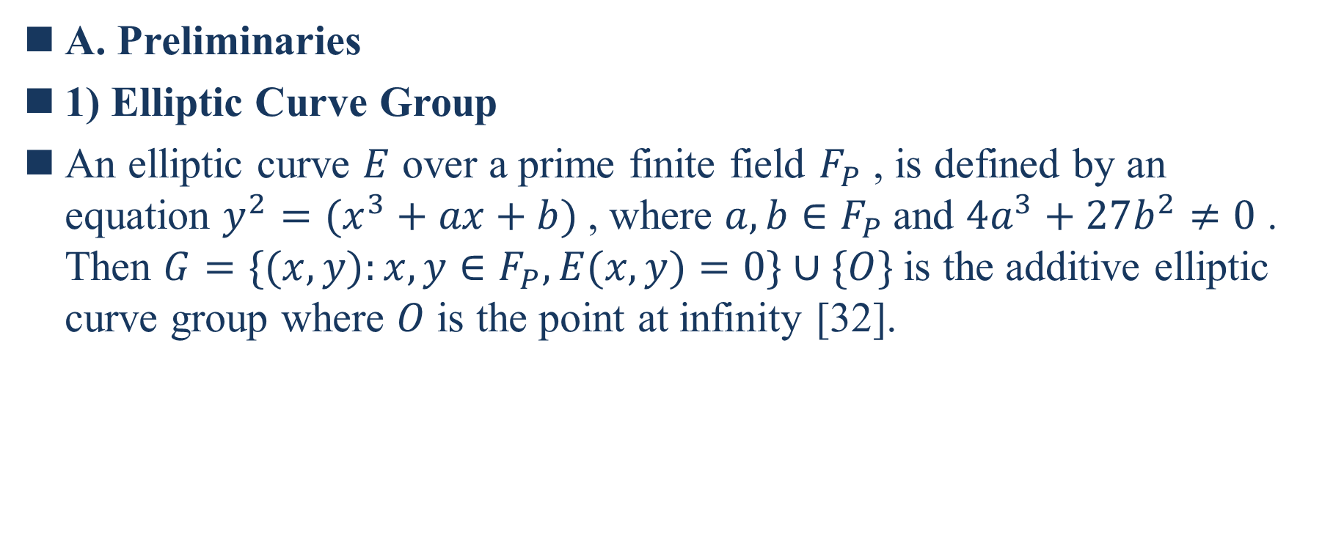
A. Preliminaries
1) Elliptic Curve Group
An elliptic curve $E$ over a prime finite field $F_{P}$ , is defined by an equation $y^{2}=(x^{3}+ax+b)$, where $a,b∈F_{P}$and $4a^{3}+27b^{2}≠0$ . Then $G=\{(x,y):x,y∈F_{P},E(x,y)=0\}∪\{O\}$is the additive elliptic curve group where $O$ is the point at infinity [32].
Notes:
質數有限域$F_{P}$上的橢圓曲線E由等式$y^{2}=(x^{3}+ax+b)$定義，其中$a,b∈F_{P}$和$4a^{3}+27b^{2}≠0$ 。
那麼$G=\{(x,y):x,y∈F_{P},E(x,y)=0\}∪\{O\}$是加法橢圓曲線群，其中O是無窮大點[32]。

Slide 21

2) Elliptic Curve Discrete Logarithm Problem (ECDLP)
Given $P,Q∈G$ , to find an integer $x∈Z_{q}^{∗}$ , such that $Q=xP$ . Computation of $x$ from $P$ and $Q$ is computationally hard by any polynomial-time bounded algorithm.
Notes:
給定$P,Q∈G$ ，找到整數$x∈Z_{q}^{∗}$，使得$Q=xP$ 。通過任何多項式時間有界算法，從P和Q計算x都是很困難的。

Slide 22
B. System Architecture
Our VANET structure consists of four entities: TA, Key Generation Centre (KGC), RSU and OBU.
  TA
  KGC: It is a trusted third party, generates partial private keys for vehicles. KGC and TA are always trusted and can never collude with each other.
  RSU
  OBU
Notes:
它是受信任的第三方，為車輛生成部分私鑰。 KGC和TA始終是受信任的，並且永遠不會相互勾結。

Slide 23
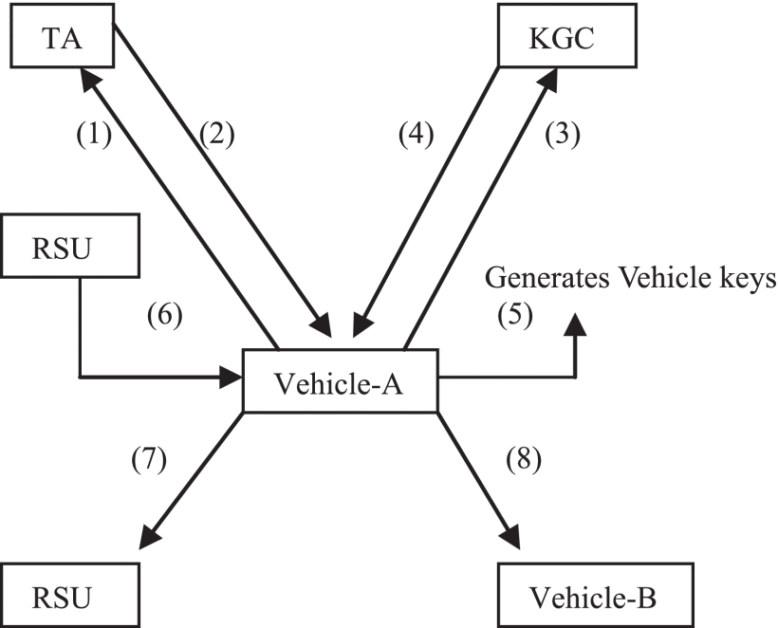
Notes:
Vehicle registration with TA.
通過TA進行車輛登記。
TA generates a Token and preloads in vehicles OBU.
TA生成token並預裝在車輛OBU中。
Vehicle requests for Partial private key.
車輛要求提供部分私鑰。
KGC generates Partial private key.
KGC生成部分私鑰。
Vehicle generates Public/Secret key pair.
車輛會生成公共/秘密密鑰對。
RSU generates pseudo identity after a request from vehicle.
RSU在車輛發出請求後生成偽身份。
Vehicle to Infrastructure (V2I) communication.
車輛到基礎設施（V2I）的通信。
Vehicle to Vehicle (V2V) communication.
車輛到車輛（V2V）通訊。

Slide 24
C. Scheme Framework
  SystemInitialization
  PartialKeyGen
  VehicleKeyGen
  PseudoIdentityGen
  SignatureGeneration
  SignatureVerification
  BatchVerification
Notes:
該算法由TA和KGC通過將安全性參數$n∈Z^{+}$作為輸入來執行。該算法生成主公用/秘密密鑰對，並將公用參數列表發佈為params。 TA還接受一些參數，真實身份作為輸入，併計算車輛票證令牌，並在令牌上生成簽名。
它由KGC執行，它將車輛token作為輸入併計算其部分私鑰。
車輛以TA生成的token和KGC生成的部分私鑰作為輸入，以生成車輛的公共/秘密密鑰對。
RSU執行此算法通過將車票Token作為輸入並輸出其假身份。
它由每個車輛執行，以消息$m∈{\{0,1\}}^{∗}$，公共/秘密密鑰對，車輛的部分私鑰及其偽身份作為輸入，並輸出簽名σ。
每輛車都執行單獨的驗證，每輛車都將系統參數params，偽身份，帶有當前時間戳的消息，簽名σ作為輸入，如果簽名有效，則輸出true，否則輸出false。
批量驗證是由RSU執行的，其過程類似於單個驗證。

Slide 25
D. Security Requirements
  MessageAuthentication : The message authenticity ensures that the received message is indeed transmitted by a vehicle which is claimed to done so.
  Integrity : It ensures that the message has not been modified or forged or dropped while it is communicated from the sender to the receiver.
  Non−repudiation : Authenticated vehicles could not deny messages after sending them to other vehicles in VANETS.
Notes:
Message的認證:消息的真實性確保了所接收的消息確實是由聲稱是通過車輛發送的。
完整性：確保消息在從發送者傳遞到接收者時未被修改，偽造或丟棄。
不可否認性：經過身份驗證的車輛在將消息發送到VANETS中的其他車輛後無法拒絕消息。

Slide 26
  Traceability : TA alone can identify the real identity of the sender by taking its pseudo identity and can identify the malicious messages that are sent by vehicles.
  Anonymity : Other vehicles and adversaries in VANET cannot identify the senders’ real identity either by analyzing multiple messages sent by the same vehicle or by its pseudo identity.
  Revocation : TA can terminate the communication when the vehicle is confirmed to be a malicious vehicle. Also TA updates the Revocation list by including the malicious vehicles and sends this list to KGC and RSU.
Notes:
可追溯性：僅TA就能通過獲取其偽身份來識別發送方的真實身份，並能夠識別車輛發送的惡意消息。
匿名性：VANET中的其他車輛和對手無法通過分析同一車輛發送的多條消息或其偽身份來識別發件人的真實身份。
撤消：當確認車輛為惡意車輛時，TA可以終止通信。 TA還通過添加惡意車輛來更新吊銷列表，並將此列表發送給KGC和RSU。

Slide 27
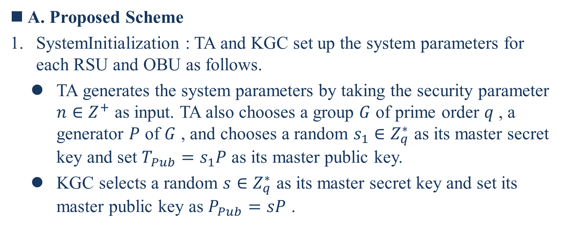
Proposed Scheme
A. Proposed Scheme
SystemInitialization : TA and KGC set up the system parameters for each RSU and OBU as follows.
  TA generates the system parameters by taking the security parameter $n∈Z^{+}$ as input. TA also chooses a group $G$ of prime order $q$ , a generator $P$ of $G$ , and chooses a random $s_{1}∈Z_{q}^{∗}$ as its master secret key and set $T_{Pub}=s_{1}P$ as its master public key.
  KGC selects a random $s∈Z_{q}^{∗}$ as its master secret key and set its master public key as $P_{Pub}=sP$ .

Slide 28
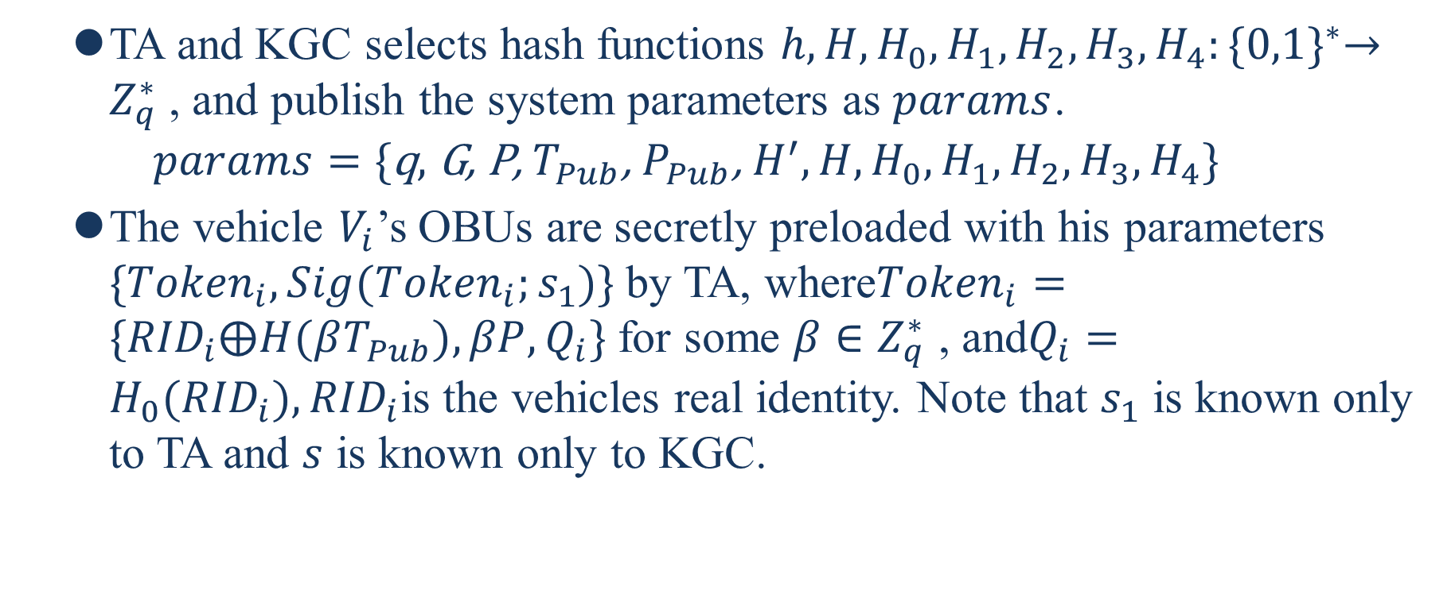
  TA and KGC selects hash functions $h,H,H_{0},H_{1},H_{2},H_{3},H_{4}:{\{0,1\}}^{∗}→Z_{q}^{∗}$, and publish the system parameters as $params$.
  $$params=\text{\{}\text{q}\text{, }\text{G}\text{, }\text{P}\text{, }T_{Pub}\text{,} P_{Pub}\text{,} H^{′},H,H_{0},H_{1},H_{2},H_{3},H_{4}\}$$
  The vehicle $V_{i}$’s OBUs are secretly preloaded with his parameters $\{{Token}_{i},Sig({Token}_{i};s_{1})\}$by TA, where${Token}_{i}=\{{RID}_{i}⨁H(βT_{Pub}),βP,Q_{i}\}$for some $β∈Z_{q}^{∗}$ , and$Q_{i}=H_{0}({RID}_{i}),{RID}_{i}$is the vehicles real identity. Note that $s_{1}$ is known only to TA and $s$ is known only to KGC.

Slide 29
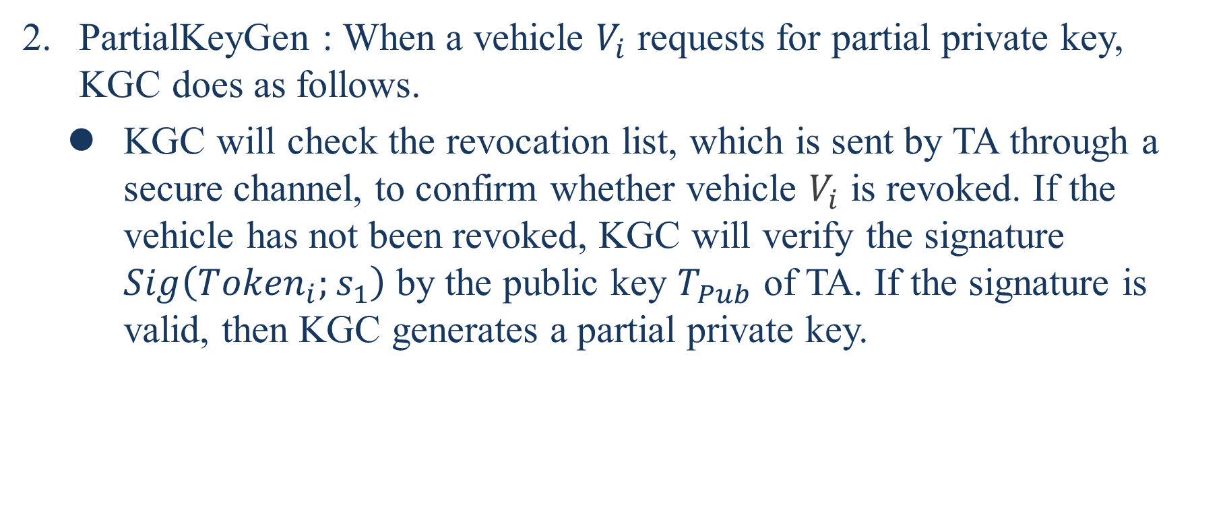
PartialKeyGen : When a vehicle $V_{i}$ requests for partial private key, KGC does as follows.
  KGC will check the revocation list, which is sent by TA through a secure channel, to confirm whether vehicle $V_{i}$ is revoked. If the vehicle has not been revoked, KGC will verify the signature $Sig\left({Token}_{i};s_{1}\right)$ by the public key $T_{Pub}$ of TA. If the signature is valid, then KGC generates a partial private key.

Slide 30
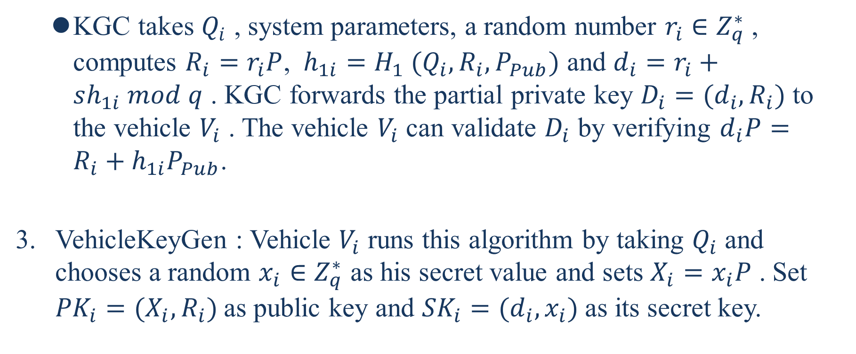
  KGC takes $Q_{i}$ , system parameters, a random number $r_{i}∈Z_{q}^{∗}$, computes $R_{i}=r_{i}P$, $h_{1i}=H_{1} (Q_{i}, R_{i},P_{Pub})$ and $d_{i}=r_{i}+sh_{1i} mod q$ . KGC forwards the partial private key $D_{i}=(d_{i},R_{i})$ to the vehicle $V_{i}$ . The vehicle $V_{i}$ can validate $D_{i}$ by verifying $d_{i}P=R_{i}+h_{1i}P_{Pub}$.
VehicleKeyGen : Vehicle $V_{i}$ runs this algorithm by taking $Q_{i}$ and chooses a random $x_{i}∈Z_{q}^{∗}$ as his secret value and sets $X_{i}=x_{i}P$ . Set ${PK}_{i}=(X_{i},R_{i})$as public key and ${SK}_{i}=(d_{i},x_{i})$as its secret key.

Slide 31
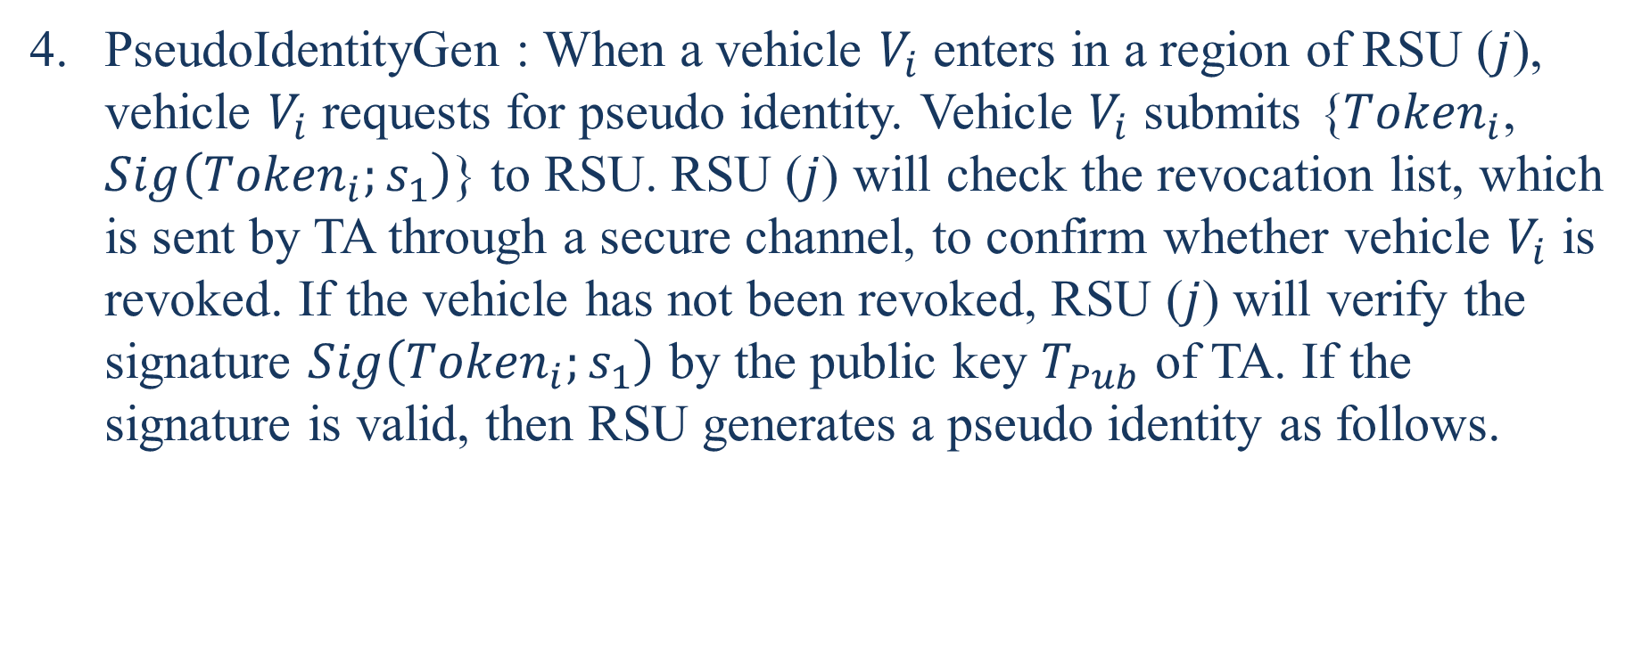
PseudoIdentityGen : When a vehicle $V_{i}$ enters in a region of RSU ($j$), vehicle $V_{i}$ requests for pseudo identity. Vehicle $V_{i}$ submits {${Token}_{i}$, $Sig\left({Token}_{i};s_{1}\right)$} to RSU. RSU ($j$) will check the revocation list, which is sent by TA through a secure channel, to confirm whether vehicle $V_{i}$ is revoked. If the vehicle has not been revoked, RSU ($j$) will verify the signature $Sig\left({Token}_{i};s_{1}\right)$ by the public key $T_{Pub}$ of TA. If the signature is valid, then RSU generates a pseudo identity as follows.

Slide 32
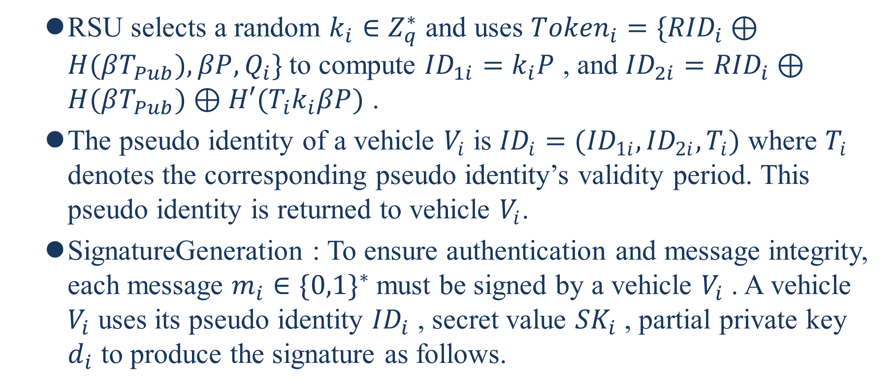
  RSU selects a random $k_{i}∈Z_{q}^{∗}$ and uses ${Token}_{i}=\{{RID}_{i}⊕H(βT_{Pub}),βP,Q_{i}\}$to compute ${ID}_{1i}=k_{i}P$ , and ${ID}_{2i}={RID}_{i}⊕H(βT_{Pub})⊕H′(T_{i}k_{i}βP)$ .
  The pseudo identity of a vehicle $V_{i}$ is ${ID}_{i}=({ID}_{1i},{ID}_{2i},T_{i})$ where $T_{i}$ denotes the corresponding pseudo identity’s validity period. This pseudo identity is returned to vehicle $V_{i}$.
  SignatureGeneration : To ensure authentication and message integrity, each message $m_{i}∈{\{0,1\}}^{∗}$must be signed by a vehicle $V_{i}$ . A vehicle $V_{i}$ uses its pseudo identity ${ID}_{i}$ , secret value ${SK}_{i}$ , partial private key $d_{i}$ to produce the signature as follows.

Slide 33
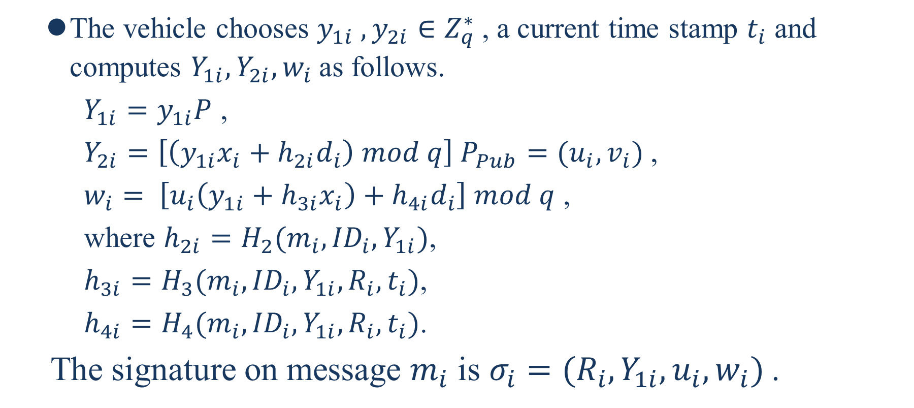
  The vehicle chooses $y_{1i} , y_{2i}∈Z_{q}^{∗}$, a current time stamp $t_{i}$ and computes $Y_{1i}, Y_{2i}, w_{i}$as follows.
    $Y_{1i}=y_{1i}P$ ,
    $Y_{2i}=\left[\left(y_{1i}x_{i}+h_{2i}d_{i}\right) mod q\right] P_{Pub}=(u_{i},v_{i})$,
    $w_{i}= \left[u_{i}\left(y_{1i}+h_{3i}x_{i}\right)+h_{4i}d_{i}\right] mod q$ ,
    where $h_{2i}=H_{2}(m_{i},{ID}_{i},Y_{1i})$,
    $h_{3i}=H_{3}(m_{i},{ID}_{i},Y_{1i},R_{i},t_{i})$,
    $h_{4i}=H_{4}(m_{i},{ID}_{i},Y_{1i},R_{i},t_{i})$.
  The signature on message $m_{i}$ is $σ_{i}=(R_{i},Y_{1i},u_{i},w_{i})$.

Slide 34
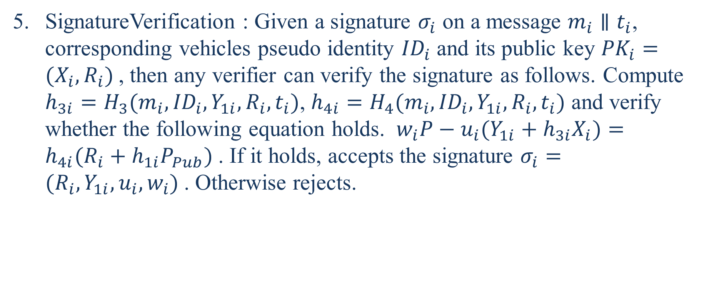
SignatureVerification : Given a signature $σ_{i}$ on a message $m_{i}∥t_{i}$, corresponding vehicles pseudo identity ${ID}_{i}$ and its public key ${PK}_{i}=(X_{i},R_{i})$, then any verifier can verify the signature as follows. Compute $h_{3i}=H_{3}(m_{i},{ID}_{i},Y_{1i},R_{i},t_{i})$, $h_{4i}=H_{4}(m_{i},{ID}_{i},Y_{1i},R_{i},t_{i})$ and verify whether the following equation holds. $w_{i}P−u_{i}(Y_{1i}+h_{3i}X_{i})=h_{4i}(R_{i}+h_{1i}P_{Pub})$. If it holds, accepts the signature $σ_{i}=(R_{i},Y_{1i},u_{i},w_{i})$. Otherwise rejects.

Slide 35
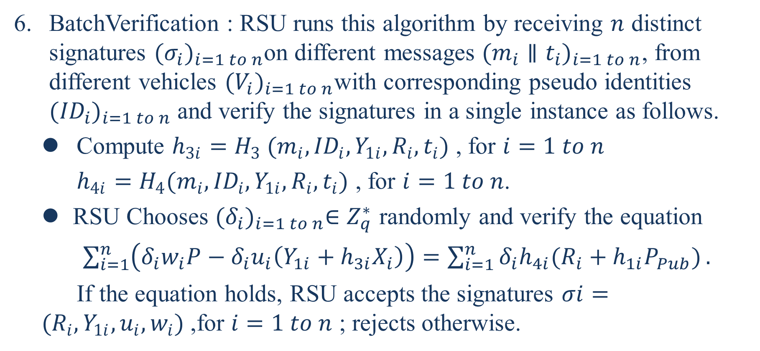
BatchVerification : RSU runs this algorithm by receiving $n$ distinct signatures ${(σ_{i})}_{i=1 to n}$on different messages ${(m_{i}∥t_{i})}_{i=1 to n}$, from different vehicles ${(V_{i})}_{i=1 to n}$with corresponding pseudo identities ${({ID}_{i})}_{i=1 to n}$ and verify the signatures in a single instance as follows.
  Compute $h_{3i}=H_{3} (m_{i},{ID}_{i},Y_{1i},R_{i},t_{i})$ , for $i=1 to n$
  $h_{4i}=H_{4}(m_{i},{ID}_{i},Y_{1i},R_{i},t_{i})$ , for $i=1 to n$.
  RSU Chooses ${(δ_{i})}_{i=1 to n}∈Z_{q}^{∗}$ randomly and verify the equation
  $\sum_{i=1}^{n}{\left(δ_{i}w_{i}P−δ_{i}u_{i}\left(Y_{1i}+h_{3i}X_{i}\right)\right)}=\sum_{i=1}^{n}{δ_{i}h_{4i}(R_{i}+h_{1i}P_{Pub})}.$
  If the equation holds, RSU accepts the signatures $σi=(R_{i},Y_{1i},u_{i},w_{i})$,for $i=1 to n$ ; rejects otherwise.

Slide 36
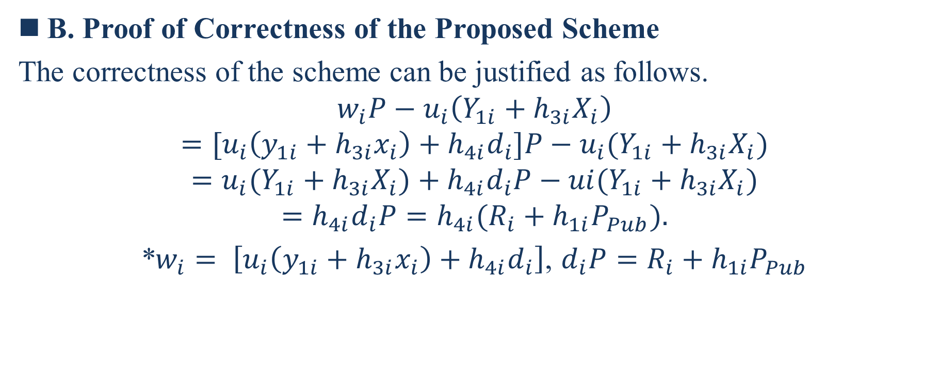
B. Proof of Correctness of the Proposed Scheme
The correctness of the scheme can be justified as follows.
$$w_{i}P−u_{i}\left(Y_{1i}+h_{3i}X_{i}\right)$$
$$=[u_{i}\left(y_{1i}+h_{3i}x_{i}\right)+h_{4i}d_{i}]P−u_{i}(Y_{1i}+h_{3i}X_{i})$$
$$=u_{i}(Y_{1i}+h_{3i}X_{i})+h_{4i}d_{i}P−ui(Y_{1i}+h_{3i}X_{i})$$
$$=h_{4i}d_{i}P=h_{4i}(R_{i}+h_{1i}P_{Pub}).$$
*$w_{i}= \left[u_{i}\left(y_{1i}+h_{3i}x_{i}\right)+h_{4i}d_{i}\right]$, $d_{i}P=R_{i}+h_{1i}P_{Pub}$

Slide 37
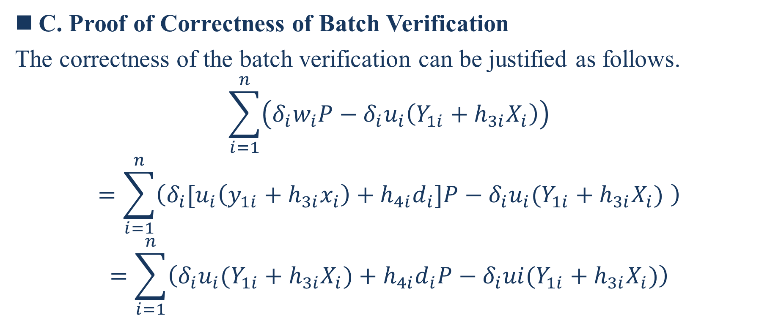
C. Proof of Correctness of Batch Verification
The correctness of the batch verification can be justified as follows.
$$\sum_{i=1}^{n}{\left(δ_{i}w_{i}P−δ_{i}u_{i}\left(Y_{1i}+h_{3i}X_{i}\right)\right)}$$
$$=\sum_{i=1}^{n}{\left(δ_{i}[u_{i}\left(y_{1i}+h_{3i}x_{i}\right)+h_{4i}d_{i}]P−δ_{i}u_{i}(Y_{1i}+h_{3i}X_{i}) \right)}$$
$$=\sum_{i=1}^{n}{\left({δ_{i}u}_{i}(Y_{1i}+h_{3i}X_{i})+h_{4i}d_{i}P−δ_{i}ui(Y_{1i}+h_{3i}X_{i})\right)}$$

Slide 38

$$=\sum_{i=1}^{n}{δ_{i}h_{4i}d_{i}P}$$
$$=\sum_{i=1}^{n}{δ_{i}h_{4i}(R_{i}+h_{1i}P_{Pub})}$$

Slide 39
D. Security Analysis
In the following, we present the security requirements such as authentication, integrity, and non-repudiation of our proposed scheme.
These security properties can be achieved through our CLS signature scheme. In the following Theorem 1, we prove the proposed CLS signature scheme is secure against Type I and Type II adversaries.
Theorem 1:
  In the ROM, the proposed CLS scheme is secure under the ECDLP assumption.
  The proof of Theorem 1 follows from lemma 1 and lemma 2.
Notes:
在下文中，我們提出了我們提出的方案的安全要求，例如身份驗證，完整性和不可否認性。
這些安全屬性可以通過我們的CLS簽名方案來實現。在下面的定理1中，我們證明了提出的CLS簽名方案對於I型和II型對手是安全的。

Slide 40
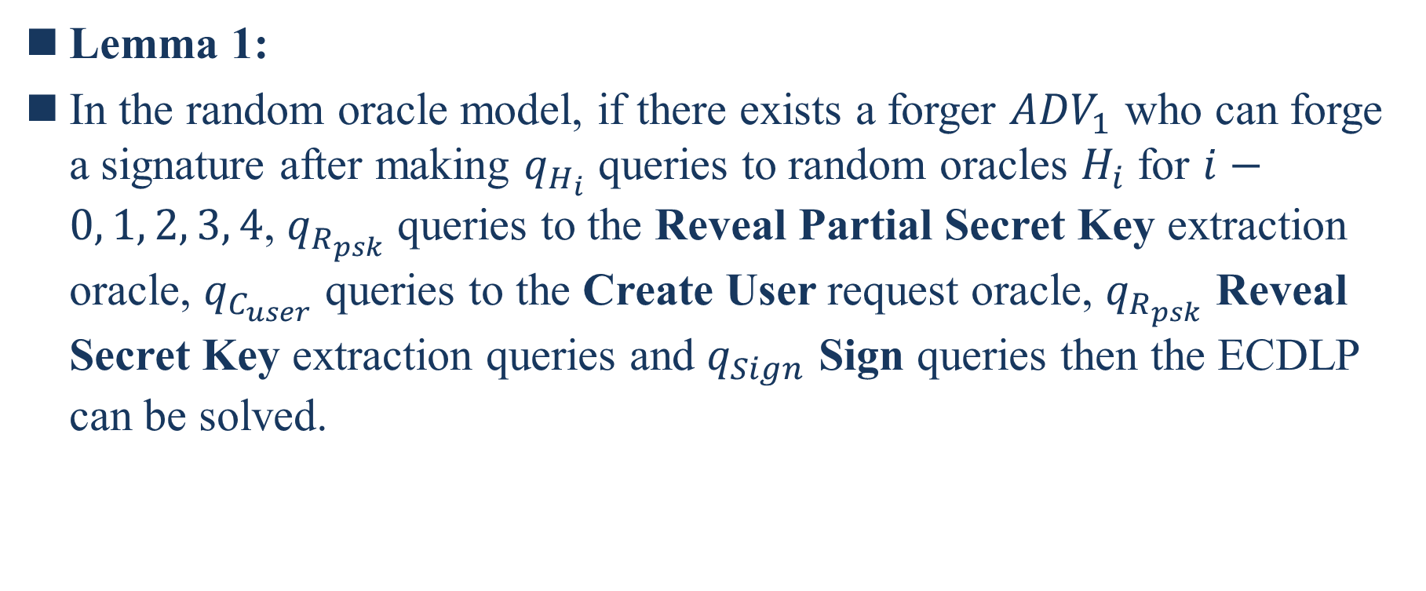
Lemma 1:
In the random oracle model, if there exists a forger ${ADV}_{1}$ who can forge a signature after making $q_{H_{i}}$ queries to random oracles $H_{i}$ for $i−0, 1, 2, 3, 4$, $q_{R_{psk}}$ queries to the Reveal Partial Secret Key extraction oracle, $q_{C_{user}}$ queries to the Create User request oracle, $q_{R_{psk}}$ Reveal Secret Key extraction queries and $q_{Sign}$ Sign queries then the ECDLP can be solved.
Notes:
引理1
Reveal Partial Secret Key:顯示部分秘密密鑰
Reveal Secret Key:顯示秘密密鑰

Slide 41
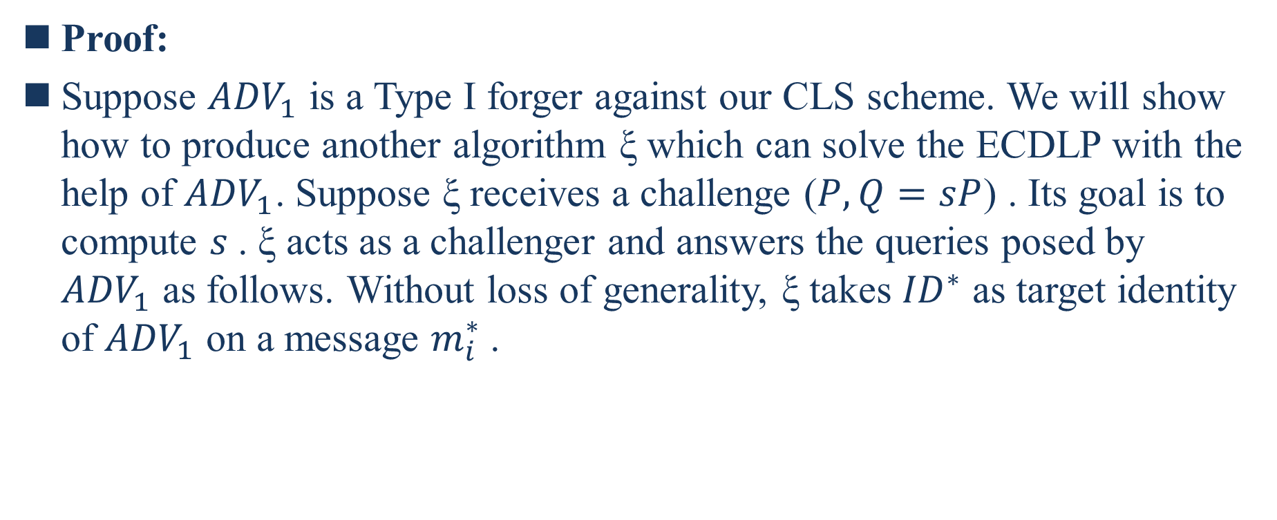
Proof:
Suppose ${ADV}_{1}$ is a Type I forger against our CLS scheme. We will show how to produce another algorithm ξ which can solve the ECDLP with the help of ${ADV}_{1}$. Suppose ξ receives a challenge ($P,Q=sP$) . Its goal is to compute $s$. ξ acts as a challenger and answers the queries posed by ${ADV}_{1}$ as follows. Without loss of generality, ξ takes ${ID}^{∗}$ as target identity of ${ADV}_{1}$ on a message $m_{i}^{∗}$.
Notes:
假設${ADV}_{1}$是針對我們的CLS方案的I型偽造者。我們將展示如何生成另一種算法ξ，該算法可以藉助${ADV}_{1}$解決ECDLP。假設ξ收到一個質詢（$P,Q=sP$）。其目標是計算$s$。 ξ充當挑戰者，並按如下方式回答${ADV}_{1}$提出的查詢。不失一般性，ξ將${ID}^{∗}$作為消息$m_{i}^{∗}$上${ADV}_{1}$的目標身份。
不失一般性:說明該個例能代表普遍情況，而非一種特例

Slide 42
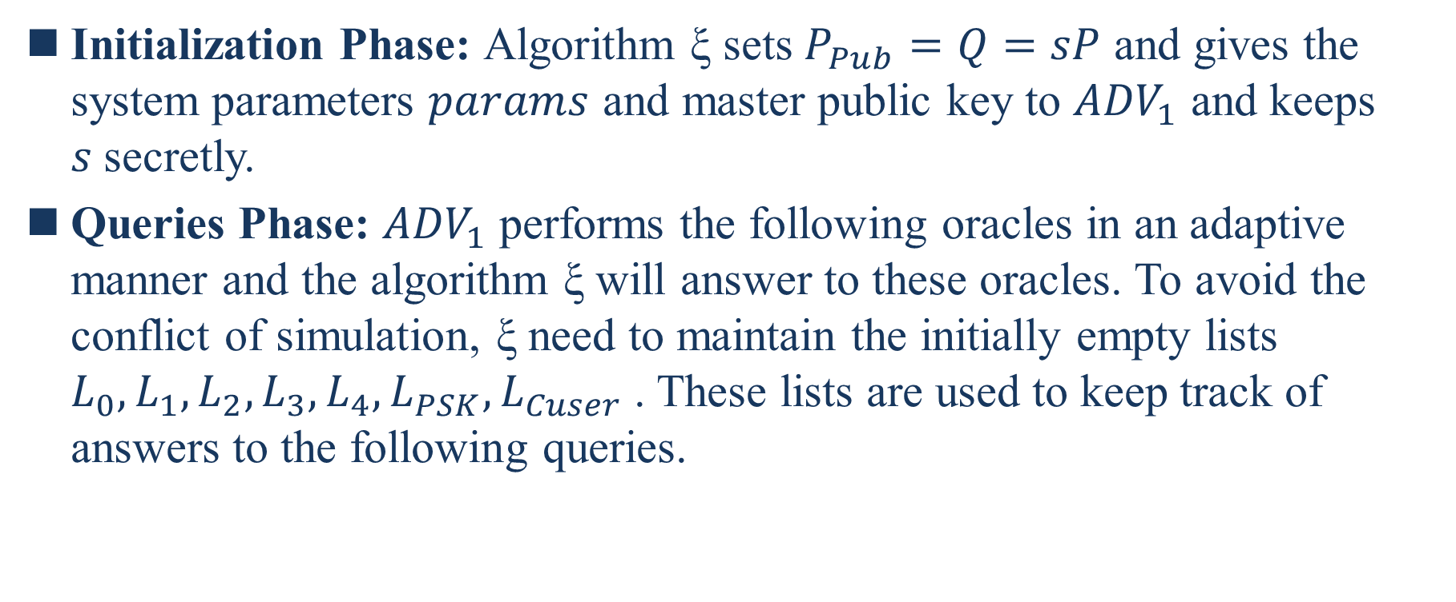
Initialization Phase: Algorithm ξ sets $P_{Pub}=Q=sP$ and gives the system parameters $params$ and master public key to ${ADV}_{1}$ and keeps $s$secretly.
Queries Phase: ${ADV}_{1}$ performs the following oracles in an adaptive manner and the algorithm ξ will answer to these oracles. To avoid the conflict of simulation, ξ need to maintain the initially empty lists $L_{0},L_{1},L_{2},L_{3},L_{4},L_{PSK},L_{Cuser}$. These lists are used to keep track of answers to the following queries.
Notes:
初始化階段:算法ξ設置$P_{Pub}=Q=sP$ ，並將系統參數$params$和主公鑰提供給ADV1，並秘密地保存s。
查詢階段：${ADV}_{1}$以自適應方式執行以下預言，算法ξ將對這些預言做出響應。為避免模擬衝突，ξ需要維護最初為空的列表$L_{0},L_{1},L_{2},L_{3},L_{4},L_{PSK},L_{Cuser}$。這些列表用於跟踪以下查詢的答案。

Slide 43
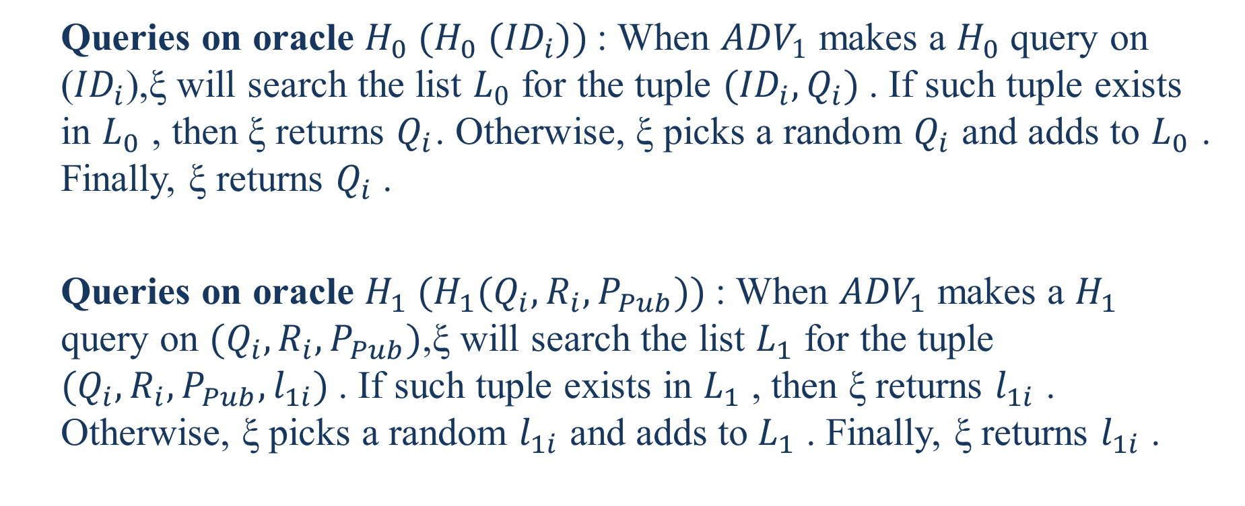
  Queries on oracle $H_{0} (H_{0} ({ID}_{i}))$: When ${ADV}_{1}$ makes a $H_{0}$ query on (${ID}_{i}$),ξ will search the list $L_{0}$ for the tuple $({ID}_{i},Q_{i})$. If such tuple exists in $L_{0}$ , then ξ returns $Q_{i}$. Otherwise, ξ picks a random $Q_{i}$ and adds to $L_{0}$ . Finally, ξ returns $Q_{i}$ .
  Queries on oracle $H_{1} (H_{1}(Q_{i},R_{i},P_{Pub}))$: When ${ADV}_{1}$ makes a $H_{1}$ query on $(Q_{i},R_{i},P_{Pub})$,ξ will search the list $L_{1}$ for the tuple $(Q_{i},R_{i},P_{Pub},l_{1i})$. If such tuple exists in $L_{1}$ , then ξ returns $l_{1i}$ . Otherwise, ξ picks a random $l_{1i}$ and adds to $L_{1}$ . Finally, ξ returns $l_{1i}$ .

Slide 44
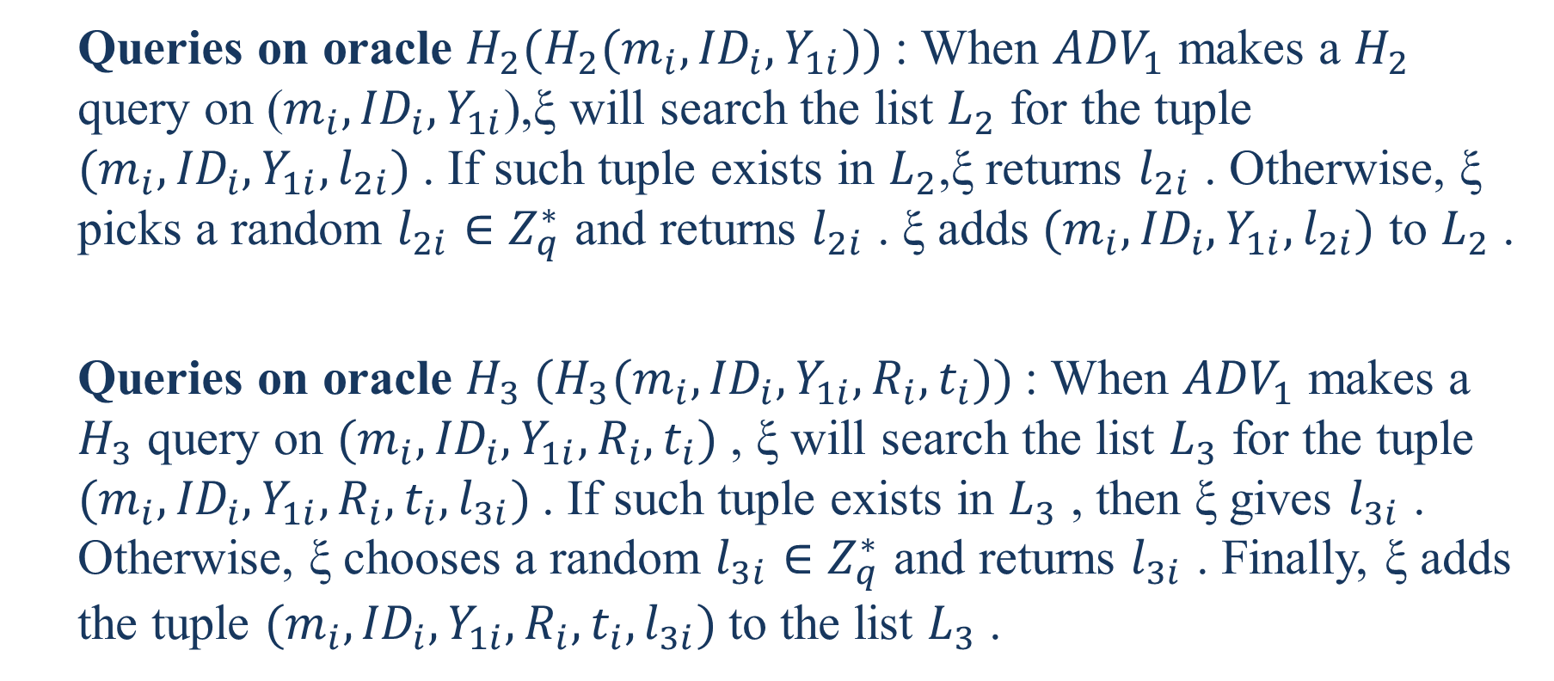
  Queries on oracle $H_{2}(H_{2}(m_{i},{ID}_{i},Y_{1i}))$: When ${ADV}_{1}$ makes a $H_{2}$ query on ($m_{i},{ID}_{i},Y_{1i}$),ξ will search the list $L_{2}$ for the tuple $(m_{i},{ID}_{i},Y_{1i},l_{2i})$. If such tuple exists in $L_{2}$,ξ returns $l_{2i}$ . Otherwise, ξ picks a random $l_{2i}∈Z_{q}^{∗}$ and returns $l_{2i}$ . ξ adds $(m_{i},{ID}_{i},Y_{1i},l_{2i})$ to $L_{2}$ .
  Queries on oracle $H_{3} (H_{3}(m_{i},{ID}_{i},Y_{1i},R_{i},t_{i}))$: When ${ADV}_{1}$ makes a $H_{3}$ query on $(m_{i},{ID}_{i},Y_{1i},R_{i},t_{i})$ , ξ will search the list $L_{3}$ for the tuple $(m_{i},{ID}_{i},Y_{1i},R_{i},t_{i},l_{3i})$. If such tuple exists in $L_{3}$ , then ξ gives $l_{3i}$ . Otherwise, ξ chooses a random $l_{3i}∈Z_{q}^{∗}$ and returns $l_{3i}$ . Finally, ξ adds the tuple $(m_{i},{ID}_{i},Y_{1i},R_{i},t_{i},l_{3i})$to the list $L_{3}$ .

Slide 45
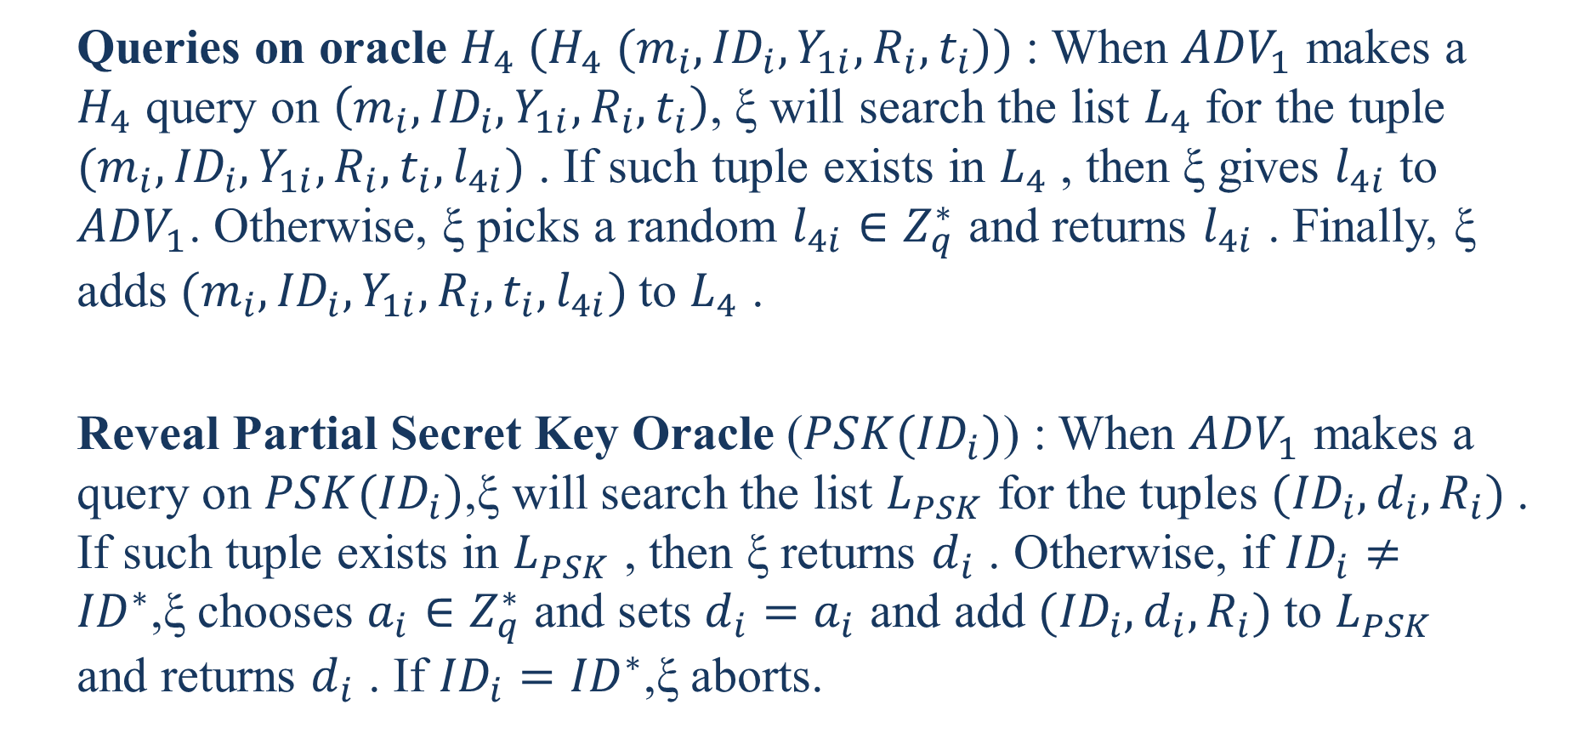
  Queries on oracle $H_{4} (H_{4} (m_{i},{ID}_{i},Y_{1i},R_{i},t_{i}))$ : When ${ADV}_{1}$ makes a $H_{4}$ query on $\left(m_{i},{ID}_{i},Y_{1i},R_{i},t_{i}\right)$, ξ will search the list $L_{4}$ for the tuple $(m_{i},{ID}_{i},Y_{1i},R_{i},t_{i},l_{4i})$ . If such tuple exists in $L_{4}$ , then ξ gives $l_{4i}$ to ${ADV}_{1}$. Otherwise, ξ picks a random $l_{4i}∈Z_{q}^{∗}$ and returns $l_{4i}$ . Finally, ξ adds $(m_{i},{ID}_{i},Y_{1i},R_{i},t_{i},l_{4i})$to $L_{4}$ .
  Reveal Partial Secret Key Oracle ($PSK({ID}_{i})$) : When ${ADV}_{1}$ makes a query on $PSK({ID}_{i})$,ξ will search the list $L_{PSK}$ for the tuples $({ID}_{i},d_{i},R_{i})$. If such tuple exists in $L_{PSK}$ , then ξ returns $d_{i}$ . Otherwise, if ${ID}_{i}≠{ID}^{∗}$,ξ chooses $a_{i}∈Z_{q}^{∗}$ and sets $d_{i}=a_{i}$ and add $({ID}_{i},d_{i},R_{i})$to $L_{PSK}$ and returns $d_{i}$ . If ${ID}_{i}={ID}^{∗}$,ξ aborts.

Slide 46
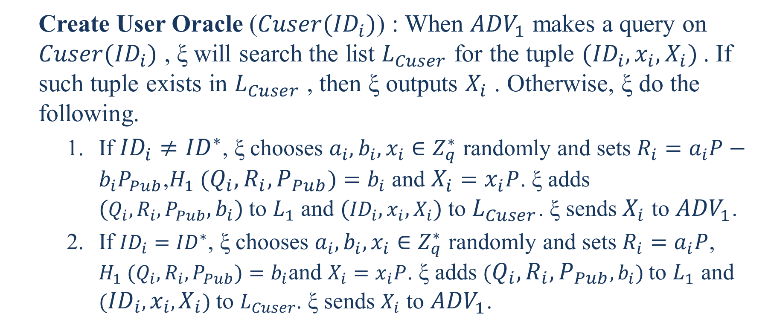
  Create User Oracle ($Cuser({ID}_{i})$) : When ${ADV}_{1}$ makes a query on $Cuser({ID}_{i})$ , ξ will search the list $L_{Cuser}$ for the tuple $({ID}_{i},x_{i}, X_{i})$. If such tuple exists in $L_{Cuser}$ , then ξ outputs $X_{i}$ . Otherwise, ξ do the following.
    If ${ID}_{i}≠{ID}^{∗}$, ξ chooses $a_{i},b_{i},x_{i}∈Z_{q}^{∗}$ randomly and sets $R_{i}=a_{i}P−b_{i}P_{Pub}$,$H_{1} (Q_{i},R_{i},P_{Pub})=b_{i}$ and $X_{i}=x_{i}P$. ξ adds $(Q_{i},R_{i},P_{Pub},b_{i})$to $L_{1}$ and $({ID}_{i},x_{i},X_{i})$to $L_{Cuser}$. ξ sends $X_{i}$ to ${ADV}_{1}$.
    If ${ID}_{i}={ID}^{∗}$, ξ chooses $a_{i},b_{i},x_{i}∈Z_{q}^{∗}$ randomly and sets $R_{i}=a_{i}P$, $H_{1} (Q_{i},R_{i},P_{Pub})=b_{i}$and $X_{i}=x_{i}P$. ξ adds $(Q_{i},R_{i},P_{Pub},b_{i})$to $L_{1}$ and $({ID}_{i},x_{i},X_{i})$to $L_{Cuser}$. ξ sends $X_{i}$ to ${ADV}_{1}$.

Slide 47
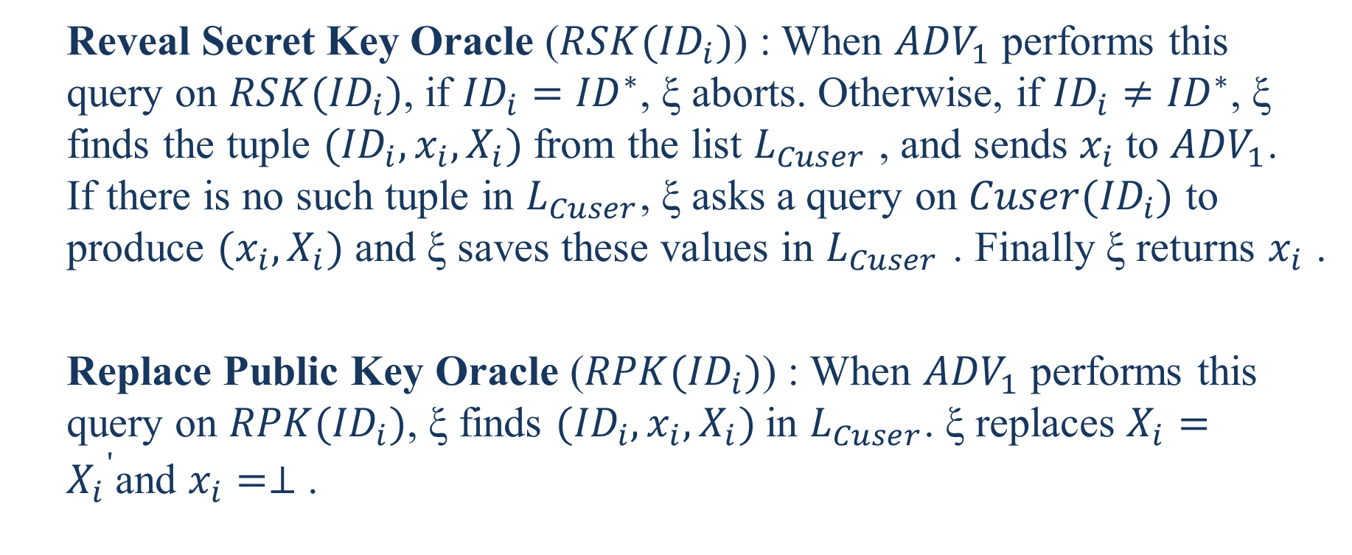
  Reveal Secret Key Oracle ($RSK({ID}_{i})$) : When ${ADV}_{1}$ performs this query on $RSK({ID}_{i})$, if ${ID}_{i}={ID}^{∗}$, ξ aborts. Otherwise, if ${ID}_{i}≠{ID}^{∗}$, ξ finds the tuple $({ID}_{i},x_{i},X_{i})$from the list $L_{Cuser}$ , and sends $x_{i}$ to ${ADV}_{1}$. If there is no such tuple in $L_{Cuser}$, ξ asks a query on $Cuser({ID}_{i})$ to produce $(x_{i},X_{i})$and ξ saves these values in $L_{Cuser}$ . Finally ξ returns $x_{i}$ .
  Replace Public Key Oracle ($RPK({ID}_{i})$) : When ${ADV}_{1}$ performs this query on $RPK({ID}_{i})$, ξ finds $({ID}_{i},x_{i},X_{i})$in $L_{Cuser}$. ξ replaces $X_{i}={X_{i}}^{'}$and $x_{i}=⊥$ .

Slide 48
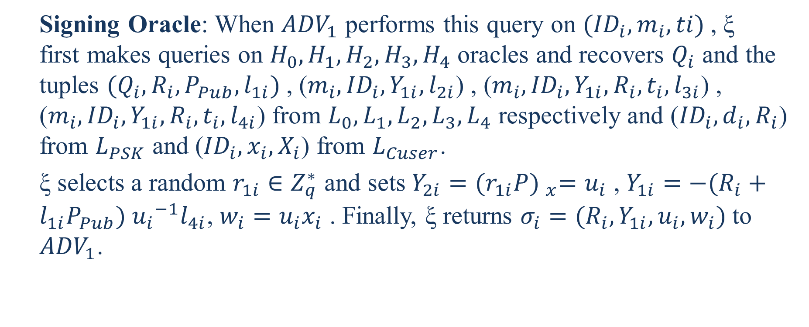
  Signing Oracle: When ${ADV}_{1}$ performs this query on $({ID}_{i},m_{i},ti)$, ξ first makes queries on $H_{0},H_{1},H_{2},H_{3},H_{4}$ oracles and recovers $Q_{i}$ and the tuples $(Q_{i},R_{i},P_{Pub},l_{1i})$, ($m_{i},{ID}_{i},Y_{1i},l_{2i}$) , ($m_{i},{ID}_{i},Y_{1i},R_{i},t_{i},l_{3i}$) , ($m_{i},{ID}_{i},Y_{1i},R_{i},t_{i},l_{4i}$) from $L_{0},L_{1},L_{2},L_{3},L_{4}$ respectively and (${ID}_{i},d_{i},R_{i}$) from $L_{PSK}$ and (${ID}_{i},x_{i}, X_{i}$) from $L_{Cuser}$.
  ξ selects a random $r_{1i}∈Z_{q}^{∗}$ and sets $Y_{2i}={(r_{1i}P) }_{x}=u_{i}$ , $Y_{1i}=−(R_{i}+l_{1i}P_{Pub}) {u_{i}}^{−1}l_{4i}$, $w_{i}=u_{i}x_{i}$ . Finally, ξ returns $σ_{i}=(R_{i},Y_{1i},u_{i},w_{i})$to ${ADV}_{1}$.
Notes:
當${ADV}_{1}$對$({ID}_{i},m_{i},ti)$執行此查詢時，ξ首先對$H_{0},H_{1},H_{2},H_{3},H_{4}$ oracle進行查詢並恢復$Q_{i}$和元組$(Q_{i},R_{i},P_{Pub},l_{1i})$, ($m_{i},{ID}_{i},Y_{1i},l_{2i}$) , ($m_{i},{ID}_{i},Y_{1i},R_{i},t_{i},l_{3i}$) , ($m_{i},{ID}_{i},Y_{1i},R_{i},t_{i},l_{4i}$)分別來自$L_{0},L_{1},L_{2},L_{3},L_{4}$和(${ID}_{i},d_{i},R_{i}$)從$L_{PSK}$中獲得和從$L_{Cuser}$中獲得(${ID}_{i},x_{i}, X_{i}$) .
ξ選擇一個隨機的$r_{1i}∈Z_{q}^{∗}$並設置$Y_{2i}={(r_{1i}P) }_{x}=u_{i}$，$Y_{1i}=−(R_{i}+l_{1i}P_{Pub}) {u_{i}}^{−1}l_{4i}$, $w_{i}=u_{i}x_{i}$。最後，ξ將$σ_{i}=(R_{i},Y_{1i},u_{i},w_{i})$返回給${ADV}_{1}$。

Slide 49
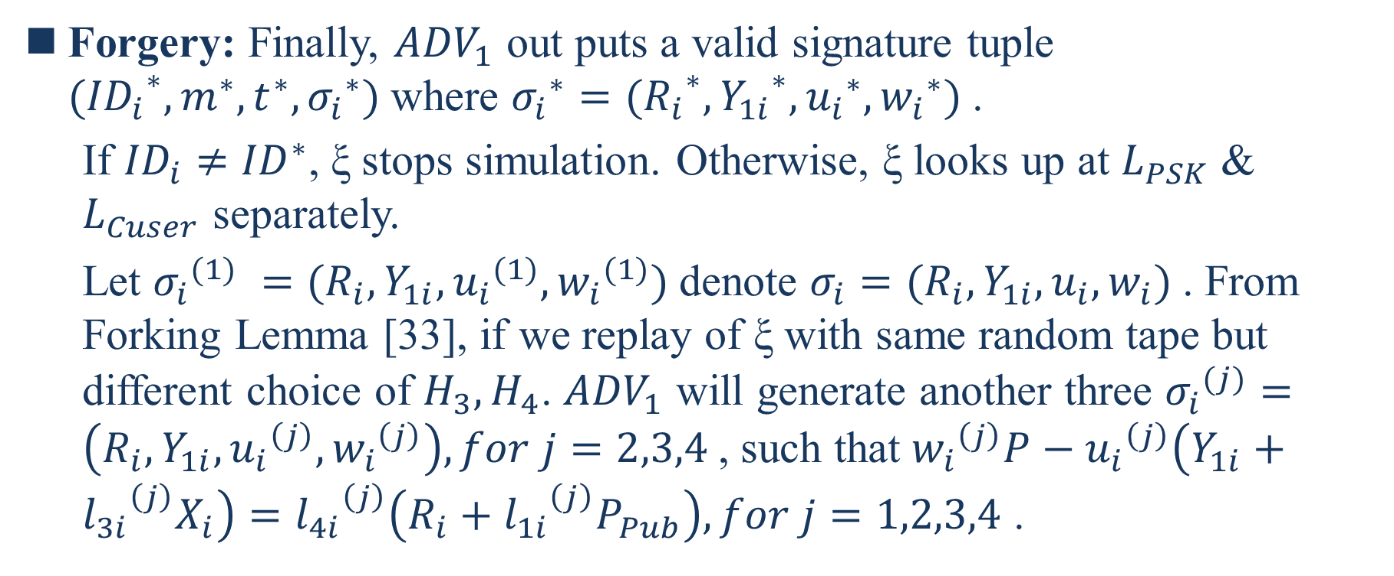
Forgery: Finally, ${ADV}_{1}$ out puts a valid signature tuple $({{ID}_{i}}^{∗},m^{∗},t^{∗},{σ_{i}}^{∗})$where ${σ_{i}}^{∗}=({R_{i}}^{∗}, {Y_{1i}}^{∗}, {u_{i}}^{∗}, {w_{i}}^{∗})$.
  If ${ID}_{i}≠{ID}^{∗}$, ξ stops simulation. Otherwise, ξ looks up at $L_{PSK}$ & $L_{Cuser}$ separately.
  Let ${σ_{i}}^{(1)} =(R_{i},Y_{1i}, {u_{i}}^{(1)}, {w_{i}}^{(1)})$denote $σ_{i}=(R_{i},Y_{1i},u_{i},w_{i})$. From Forking Lemma [33], if we replay of ξ with same random tape but different choice of $H_{3},H_{4}$. ${ADV}_{1}$ will generate another three ${σ_{i}}^{(j)}=\left(R_{i},Y_{1i},{u_{i}}^{\left(j\right)}, {w_{i}}^{\left(j\right)}\right),for j=2,3,4$, such that ${w_{i}}^{\left(j\right)}P−{u_{i}}^{\left(j\right)}\left(Y_{1i}+{l_{3i}}^{\left(j\right)}X_{i}\right)={l_{4i}}^{\left(j\right)}\left(R_{i}+{l_{1i}}^{\left(j\right)}P_{Pub}\right),for j=1,2,3,4$ .
Notes:
令${σ_{i}}^{(1)} =(R_{i},Y_{1i}, {u_{i}}^{(1)}, {w_{i}}^{(1)})$ 表示 $σ_{i}=(R_{i},Y_{1i},u_{i},w_{i})$。根據Forking Lemma [33]，如果我們用相同的隨機磁帶重播ξ，但是選擇不同的H3，H4(以相同的隨機方式選取不同的值)。${ADV}_{1}$則會生成另外三個${σ_{i}}^{(j)}=\left(R_{i},Y_{1i},{u_{i}}^{\left(j\right)}, {w_{i}}^{\left(j\right)}\right),for j=2,3,4$，使得${w_{i}}^{\left(j\right)}P−{u_{i}}^{\left(j\right)}\left(Y_{1i}+{l_{3i}}^{\left(j\right)}X_{i}\right)={l_{4i}}^{\left(j\right)}\left(R_{i}+{l_{1i}}^{\left(j\right)}P_{Pub}\right),for j=1,2,3,4$ 。
(磁帶是圖靈機的基本概念。隨機磁帶是上面帶有隨機bits的磁帶。)

Slide 50
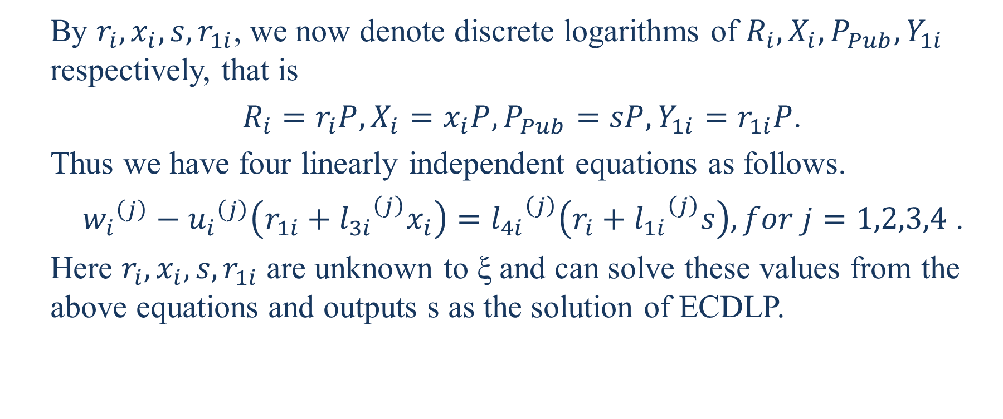
  By $r_{i},x_{i},s,r_{1i}$, we now denote discrete logarithms of $R_{i},X_{i},P_{Pub},Y_{1i}$ respectively, that is
  $R_{i}=r_{i}P,X_{i}=x_{i}P,P_{Pub}=sP,Y_{1i}=r_{1i}P$.
  Thus we have four linearly independent equations as follows.
  ${w_{i}}^{\left(j\right)}−{u_{i}}^{\left(j\right)}\left(r_{1i}+{l_{3i}}^{\left(j\right)}x_{i}\right)={l_{4i}}^{\left(j\right)}\left(r_{i}+{l_{1i}}^{\left(j\right)}s\right),for j=1,2,3,4$ .
  Here $r_{i},x_{i},s,r_{1i}$ are unknown to ξ and can solve these values from the above equations and outputs s as the solution of ECDLP.

Slide 51
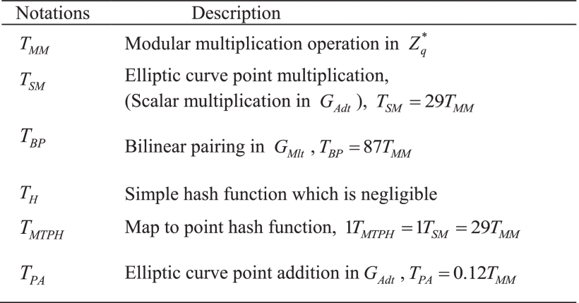
Efficiancy Analysis
A. Computation Costs
Notes:
$Z_{q}^{∗}$中的模乘運算
橢圓曲線點乘
雙線性配對
可忽略的簡單雜湊函數
映射到點哈希函數
橢圓曲線點加法

Slide 52
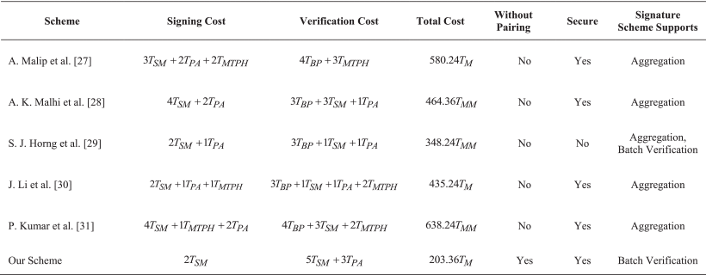

Slide 53
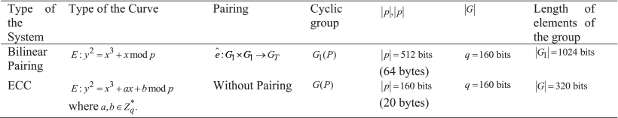
B. Transmission Overhead

Slide 54
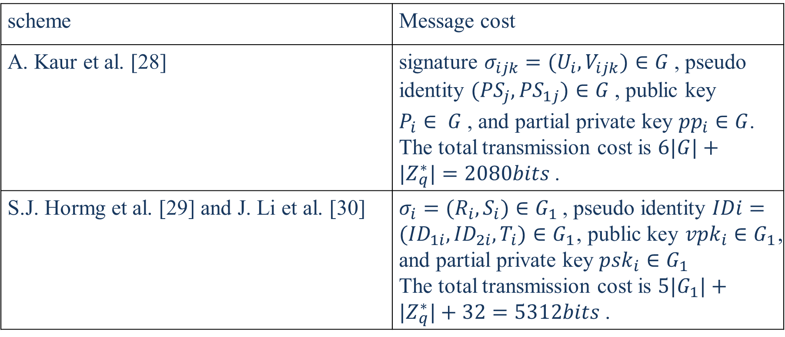
scheme | Message cost
A. Kaur et al. [28] | signature $σ_{ijk}=(U_{i},V_{ijk})∈G$, pseudo identity $({PS}_{j},{PS}_{1j})∈G$, public key $P_{i}∈ G$ , and partial private key ${pp}_{i}∈G$. The total transmission cost is $6|G|+|Z_{q}^{∗}|=2080bits$.
S.J. Hormg et al. [29] and J. Li et al. [30] | $σ_{i}=(R_{i},S_{i})∈G_{1}$, pseudo identity $IDi=({ID}_{1i},{ID}_{2i},T_{i})∈G_{1}$, public key ${vpk}_{i}∈G_{1}$, and partial private key ${psk}_{i}∈G_{1}$ The total transmission cost is $5|G_{1}|+|Z_{q}^{∗}|+32=5312bits$ .

Slide 55
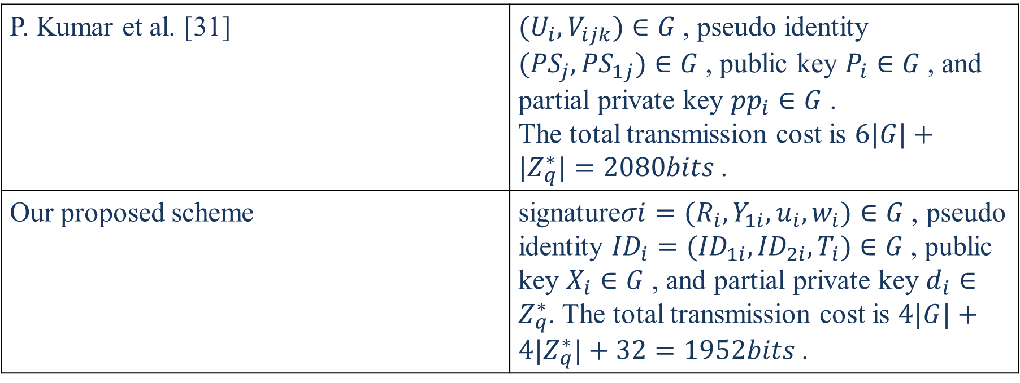
P. Kumar et al. [31] | $(U_{i},V_{ijk})∈G$, pseudo identity $({PS}_{j},{PS}_{1j})∈G$, public key $P_{i}∈G$ , and partial private key ${pp}_{i}∈G$ . The total transmission cost is $6|G|+|Z_{q}^{∗}|=2080bits$.
Our proposed scheme | signature$σi=(R_{i},Y_{1i},u_{i},w_{i})∈G$, pseudo identity ${ID}_{i}=({ID}_{1i},{ID}_{2i},T_{i})∈G$, public key $X_{i}∈G$ , and partial private key $d_{i}∈Z_{q}^{∗}$. The total transmission cost is $4|G|+4|Z_{q}^{∗}|+32=1952bits$.

Slide 56
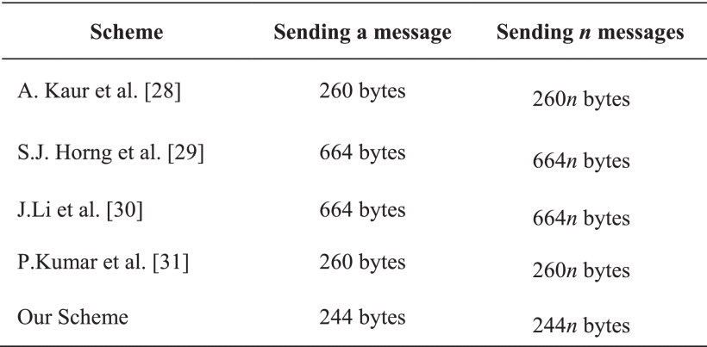

Slide 57
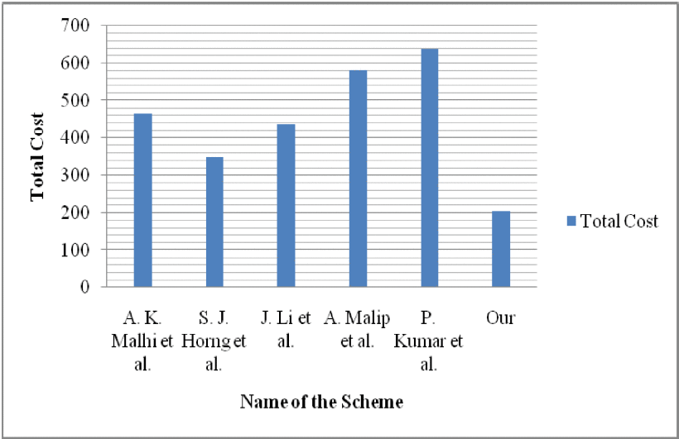

Slide 58
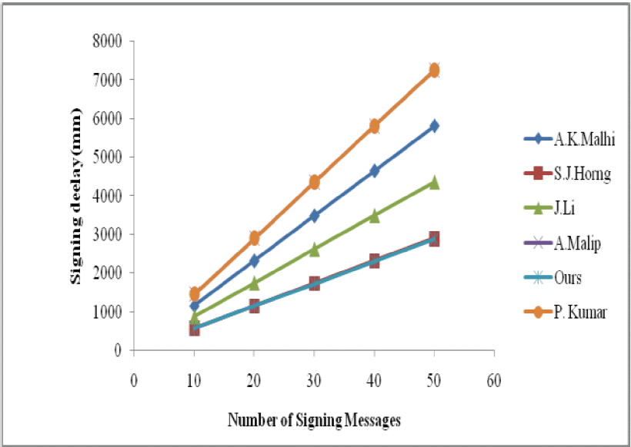

Slide 59
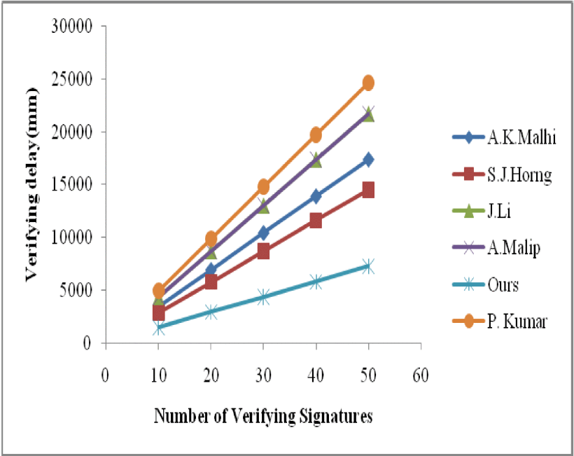

Slide 60
Conclusions
In this paper, we have presented an efficient certificateless authentication scheme supporting batch verification for VANETS. The proposed scheme is designed without using bilinear pairings over elliptic curves.
The proposed scheme is secure against authentication, integrity, privacy, non-repudiation, traceability, anonymity and revocation. Our scheme uses batch verification technique to verify multiple signatures in a single instance, which significantly mitigates the computational workload on RSUs.
The efficiency analysis shows that our authentication scheme is computationally more efficient than the well-known existing schemes. Thus, the proposed scheme can be applied in practice.
Notes:
在本文中，我們提出了一種有效的無證書身份驗證方案，該方案支持VANETS的批量驗證。設計的方案不使用橢圓曲線上的雙線性對。
所提出的方案在認證，完整性，私密性，不可否認性，可追溯性，匿名性和撤銷方面是安全的。我們的方案使用批處理驗證技術在單個實例中驗證多個簽名，這大大減輕了RSU的計算工作量。
效率分析表明，我們的認證方案在計算上比眾所周知的現有方案更有效。因此，所提出的方案可以在實踐中應用。

Slide 61
References
CHI I Hsu and YU Ching Tung, The benefits of PKI application and competitive advantage [J]. WSEAS Transactions on communications, 2008, 7(9): 758-767.
C. Ellison and B. Schneier, Ten risk of PKI: What you are not being told about public key infrastructure [J]. Computer Security Journal, 2000, 16(1): 1-7.
ADI Shamir, Identity–based cryptosystems and signature schemes [C]. Advances in Cryptology –Crypto’84, Berlin: Springer-Verlag, 1984: 47-53.

Slide 62
YW. Zhou, B. Yang and WZ. Zhang, Security analysis and improvement of certificateless signcryption scheme without bilinear pairing[J], CHINESE JOURNAL OF COMPUTER, 2016, 39(6), 1257-1266.
X. Wang, ZH. Qi and H. Huang, A certificateless signcryption scheme without bilinear pairing[J]. COMPUTER TECHNOLOGY AND DEVELOPMENT, 2017, 27(7): 106-110.

