Slide 1
AI for 5G: Research Directions and Paradigms
Xiaohu YOU, Chuan ZHANG, Xiaosi TAN, Shi JIN
National Mobile Communications Research Laboratory, Southeast University, Nanjing 210096, China;
Hequan WU
2Chinese Academy of Engineering, Beijing 100088, China

Slide 2
Abstract
The 5th wireless communication (5G) techniques not only fulfil the requirement of 1, 000 times increase of internet traffic in the next decade, but also offer the underlying technologies to the entire industry and ecology for internet of everything. Compared to the existing mobile communication techniques, 5G techniques are more-widely applicable and the corresponding system design is more complicated. The resurgence of artificial intelligence (AI) techniques offers as an alternative option, which is possibly superior over traditional ideas and performance.

Slide 3
Abstract
Typical and potential research directions to which AI can make promising contributions need to be identified, evaluated, and investigated. To this end, this overview paper first combs through several promising research directions of AI for 5G, based on the understanding of the 5G key techniques. Also, the paper devotes itself in providing design paradigms including 5G network optimization, optimal resource allocation, 5G physical layer unified acceleration, end-to-end physical layer joint optimization, and so on.

Slide 4
1 Introduction
The fifth generation mobile network (5G) applies the next generation of mobile telecommunication standards which targets at the needs of 2020 and beyond. It aims at providing a complete wireless communication system with diverse applications. Specifically,Specifically, 5G is going to be responsible for supporting three generic services, which are classified as enhanced mobile broadband (eMBB), massive machine-type communications (mMTC) and ultra-reliable and low-latency communications (URLLC) (also referred to as mission-critical communications).

Slide 5
1 Introduction
These applications suggest new performance criteria for latency, reliability, connection and capacity density, system spectral efficiency, energy efficiency and peak throughput that need to be addressed with the 5G technology. To meet these criteria, ongoing researches are conducted in many areas, mainly focused on key technologies including massive multiple-input multipleoutput (MIMO), new radio access technology (RAT), heterogeneous ultra-densification networks (UDN), channel coding and decoding (e.g. polar codes) and mmWave access [1].

Slide 6
1 Introduction
5G networks will inevitably be heterogeneous, with multiple modes and devices involved through one unified air interface tailored for specific applications. Hence, architectures as the dense Heterogeneous network are involved and 5G systems are going to be virtualised and implemented over cloud data centers. Network slicing will be a major feature of a 5G network, as will the use of a new air interface designed to dynamically optimize the allocation of network resources and utilize the spectrum efficiently.

Slide 7
1 Introduction
Compared to the current 4G networks, 5G NR:
(1) enhances the MIMO systems with the massive MIMO technology;
(2) makes completion to the time slot structure and resource block (RB) allocation of the orthogonal frequency-division multiplexing (OFDM), proposing a more flexible air interface;
(3) will introduce the non-orthogonal multiple access (NOMA) to support the Internet of Things (IoT) in the near future;
(4) follows the previous distributed antenna systems [6], splits the wireless functions into distributed units (DU) and central units (CU) and applies network virtualization and network slicing techniques based on cloud computing.

Slide 8
1 Introduction
Overall, 5G networks will tailor the provisioning mechanisms for more applications and services, hence is more challenging with the complicated configuration issues and evolving service requirements. Before 5G, researches of communication systems mainly aim at satisfactory data transmission rate and supportive mobility management. In the 5G era, the communication systems will gain the abilities to interact with the environment, and the targets are expanded to joint optimizations of ever-increasing numbers of key performance indicators (KPIs) including latency, reliability, connection density, user experience, etc [7].

Slide 9
1 Introduction
Meanwhile, new features like the dynamic air interface, virtualised network and network slicing introduce complicated system design and optimization requirements as long as challenges for network operation and maintenance. Fortunately, such problems falls into the field of artificial intelligence (AI) which provides brand new concepts and possibilities beyond traditional methods, hence has recently regained attention in the field of communications in both academia and industry.

Slide 10
1 Introduction
AI learning tasks are typically classified into two broad categories, supervised and unsupervised learning, depending on whether labels of the training data are available to the learning system. And another learning approach, reinforcement learning, is not exactly supervised neither unsupervised, hence can be listed in a new category.

Slide 11
1 Introduction
Supervised learning:
Sample data pairs of inputs and desired outputs are feed into the computer, and the goal is to learn a general function that relates the inputs to the outputs and further detects the unknown outputs of the future inputs. One typical example of supervised learning is illustrated in Figure 1, in which labeled data pairs are feed in a multi-layer deep neural network (DNN) to train the weights between the nodes in the DNN. The training is carried out offline, and after convergence, the trained DNN will be ready for recognition and inference of new inputs.

Slide 12
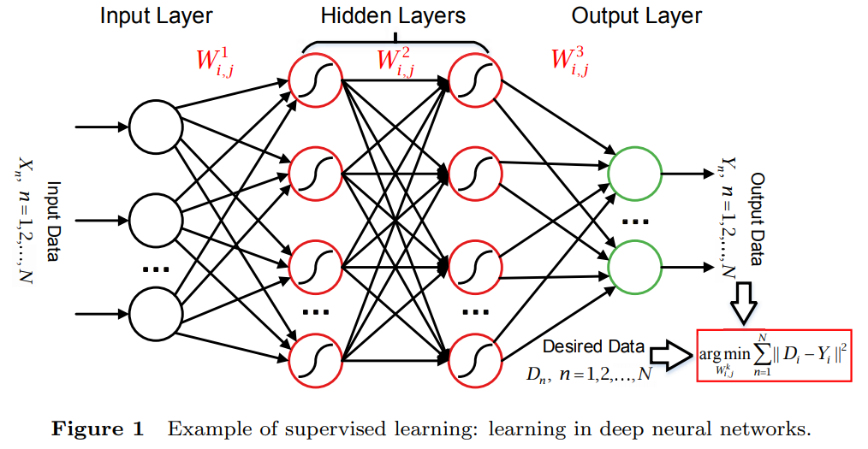
1 Introduction

Slide 13
1 Introduction
Unsupervised learning:
In unsupervised learning, no labels are given to the learning algorithm and structure in its input should be found on its own. Self-organizing map (SOM) is an example that is trained using unsupervised learning. In SOM, unlabeled data are feed in to a neural network to produce a low-dimensional (usually two-dimensional), discretized representation of the input space of the training samples, called a map (as illustrated in Figure 2) , and is therefore a method to do dimensionality reduction.

Slide 14
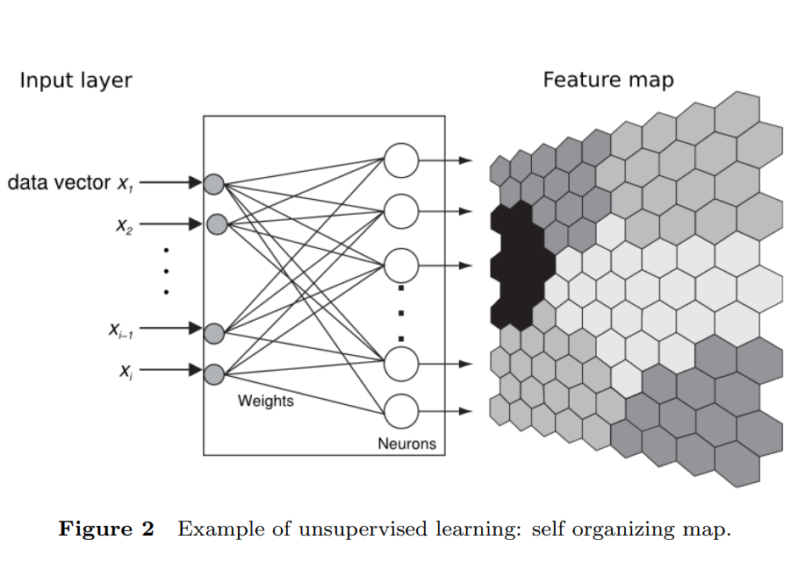
1 Introduction

Slide 15
1 Introduction
Reinforcement learning: This technique is based on alternative interaction between “Agent” and “Environment” and the process is illustrated in Figure 3. The “Agent” will perform certain action and as a result of this action his state will change which leads to either a reward or a penalty. The Agent will then decide the next action based on this result. By iterating through action and reward/penalty process, Agent learns the Environment.

Slide 16
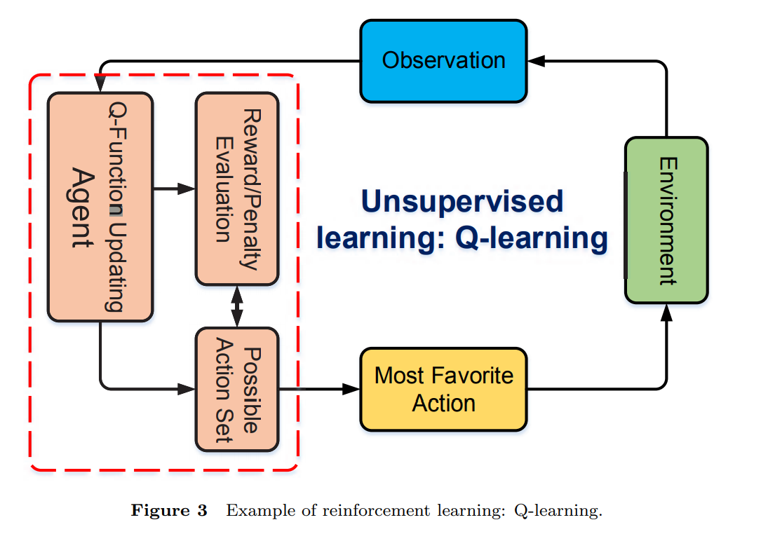
1 Introduction

Slide 17
1 Introduction
Backpropagation (BP): Backpropagation is a method used in ANN which is in the category of gradient descent [9]. It iteratively calculates gradient of the defined loss function with respect to the weights in the ANN to finally make the output of the ANN close to the known training label. Recently, BP is commonly used to train deep neural networks (DNN), a term referring to neural networks with more than one hidden layer. For example, convolutional neural network (CNN) is a class of feed-forward DNN, which has multiple hidden layers including convolutional layer, pooling layer, fully-connected layer and ReLU layer. CNN can be trained with the BP method efficiently, especially in the fields of image and voice recognition

Slide 18
1 Introduction
Q-learning: The Q-learning algorithm is also referred to as Bellman’s algorithm [13], which is a classical algorithm for the reinforcement learning. In this algorithm, a function (Q function) is defined to evaluate the actions of the “Agent” based on the current “Environment” and output the result in the form of award or penalty. At a certain step, all the possible actions of the “Agent” will be evaluated by the Q function, and the action with the maximum award in the current “Environment” will be selected as the next step and will be actually carried out.

Slide 19
2 Research directions for AI in 5G
As a universal intelligent problem-solving technique, AI can be broadly applied in the design, configuration and optimization for the 5G networks. Specifically, AI is relevant to three main technical problems in 5G:

Slide 20
2 Research directions for AI in 5G
Combinatorial optimization: One typical example of the combinatorial optimization problem in 5G NR is the network resource allocation. Given a resource-limited network, an optimized scheme should be figured out to allocate resources to different users who share the network such that the utilization of the resource achieves maximum efficiency. As the application of the HetNet architecture in 5G NR with features like network virtualization, network slicing and self-organizing networks (SON), the related network resource allocation problems are becoming more complicated, which requires more effective solutions.

Slide 21
2 Research directions for AI in 5G
• Detection: The design of the communication receiver is an example of the detection problem. An optimized receiver is able to recover the transmitted messages based on the received signals, achieving minimized detection error rate. Detection will be challenging in 5G within the massive MIMO framework

Slide 22
2 Research directions for AI in 5G
Estimation: The typical example is the channel estimation problem. 5G requires accurate estimation of the channel state information (CSI) to achieve communications in spatially correlated channels of massive MIMO. The popular approach is the so-called training sequence (or pilot sequence), where a known signal is transmitted and the CSI is estimated using the combined knowledge of the transmitted and received signal.

Slide 23
2 Research directions for AI in 5G
due to the limitations of both the communication systems and AI, some of the applications may be restricted. Firstly, after years of research and test, conventional methods have shown their abilities to handle the communication systems. A complete framework with conventional techniques have been formed, which is effective, mature and easy to implement for real world scenarios.

Slide 24
2 Research directions for AI in 5G
Secondly, the capacity of a communication system is constrained with certain upper bounds (e.g., the Shannon limit), and some of the well-designed methods can reach near-optimal performance suffering negligible loss with respect to the capacity bound. For example, in [24] a transmitter optimization method for MIMO is proposed based on an iterative water-filling algorithm, which closely achieves near-Shannon performance in the general jointly correlated MIMO channels.

Slide 25
2 Research directions for AI in 5G
This kind of methods will not be over-performed by even the mostadvanced AI technique. Moreover, there’re still obstacles to apply AI learning in real-world problems due to the convergence issues for training .Careful checks should be done to make sure the optimal performance can be “learned” with AI in every specific problem in the communication system. Finally, AI algorithms usually bring large computational complexity, which makes them not that competitive compared to conventional methods if the performance improvement is minor.

Slide 26
2 Research directions for AI in 5G
In this paper, we summarize the potential application directions for AI in 5G in four main categories: (1) Problems difficult to model; (2) Problems difficult to solve; (3) Uniform implementation; (4) Joint optimization and detection. In the following analysis and examples, we will see that for problems in (1) and (2), conventional methods are barely effective and AI techniques are expected to be promising; on the other hand, for (3) and (4), the potential of AI is problem-dependent compared to conventional methods, and careful investigation should be done to identify if AI is beneficial.

Slide 27
2 Research directions for AI in 5G
Problems difficult to model: The network optimization problems in communication systems is overall a kind of technical problem that is hard to model, which includes typical issues such as the network coverage, interference, neighboring cell selection and handover. Current solutions mostly depend on experience of the engineers. For 5G NR scenarios, these problems are more challenging due to the complicated network structures and large number of KPIs.

Slide 28
2 Research directions for AI in 5G
Applications of new features like massive MIMO beamforming [25] are associated with high-dimensional optimization parameters and the optimization problem itself is difficult to model. Also, 5G NR involves multiple KPIs including peak data rate, spectral efficiency, latency, connection density, quality of experience (QoE) and so on. These KPIs should be jointly optimized even if some of them contradicts with each other [7]. In these situations, an overall optimization model cannot be achieved with conventional methods and AI techniques are expected to be able to handle them.

Slide 29
2 Research directions for AI in 5G
Problems difficult to solve: Network resource allocation is a key issue in 5G NR [25, 26], which includes specific issues in inter-cell resource block allocation, orthogonal pilot resource allocation, beamforming resource allocation, massive MIMO user clustering and resource pool deployment in virtualized networks. The network resource allocation aims at maximizing the throughput of the network while balancing the service rate.

Slide 30
2 Research directions for AI in 5G
Its mostly a NP-hard combinatorial optimization problem, and the computational complexity to solve this kind of problem increases exponentially as the size of the systems. Traditional solutions use static partition of the network to cut down the computational cost for a suboptimal solution. Nowadays, with the assistance of modern computing technologies, AI will be an new effective solution for these problems.

Slide 31
2 Research directions for AI in 5G
Uniform implementation: Conventional methods are designed in a divide-and-conquer manner for some function blocks in 5G NR. For example, the physical layer in 5G NR consists of a series of signal processing blocks such as multiuser MIMO space-time processing, NOMA signal detection and encoding and decoding for LDPC or polar codes. Researchers have attempted to optimize the algorithms and implementations of each processing module and achieved success in practice.

Slide 32
2 Research directions for AI in 5G
However, the efficient and scalable implementation of the entire communication system is lacking, with guaranteed performance. It is noted that, AI techniques are supposed to be capable for handling each of the modules [15–23]. This inspires us to further develop a uniform AI-based implementation which works jointly for all the key modules in the 5G NR physical layer [27]. By unifying the modules with AI methods in both algorithm and hardware, the design, configuration and implementation of the physical layer communications will be simpler, faster, more economical and more efficient.

Slide 33
2 Research directions for AI in 5G
Joint optimization and detection: An intuitive idea for applying AI in 5G is to simply substitute the conventional modules of transmitters and receivers by ANN. However, the capacity of the channels is bounded by the Shannon limit and the improvement by using ANN is constricted. Also as discussed above, the complexity and the convergence of training should be carefully examined in this area.

Slide 34
2 Research directions for AI in 5G
Compared to this intuitive method, AI is more potential in a bigger picture of the cross-layer joint optimization problem which cannot be solved efficiently with conventional methods [28]. Typical examples include the joint optimizations for the physical and media access control layers [29], joint source and channel optimizations [30] and the joint optimization for algorithm and hardware implementation [31].

Slide 35
Machine Learning for 5G/B5G Mobile and Wireless Communications: Potential, Limitations, and Future Directions
Manuel Eugenio Morocho-Cayamcela
Department of Electronic Engineering, Kumoh National Institute of Technology, Gumi, South Korea
Haeyoung Lee
5G Innovation Centre (5GIC), Institute for Communication Systems (ICS), University of Surrey, Guildford, U.K.
Wansu Lim
Department of IT Convergence, Kumoh National Institute of Technology, Gumi, South Korea

Slide 36
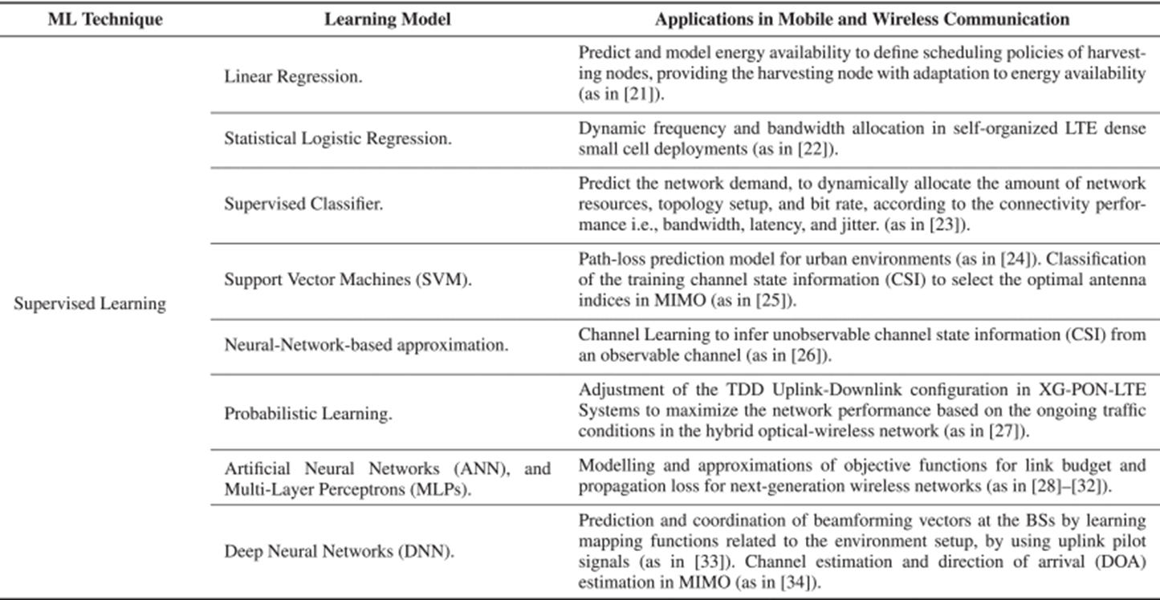

Slide 37
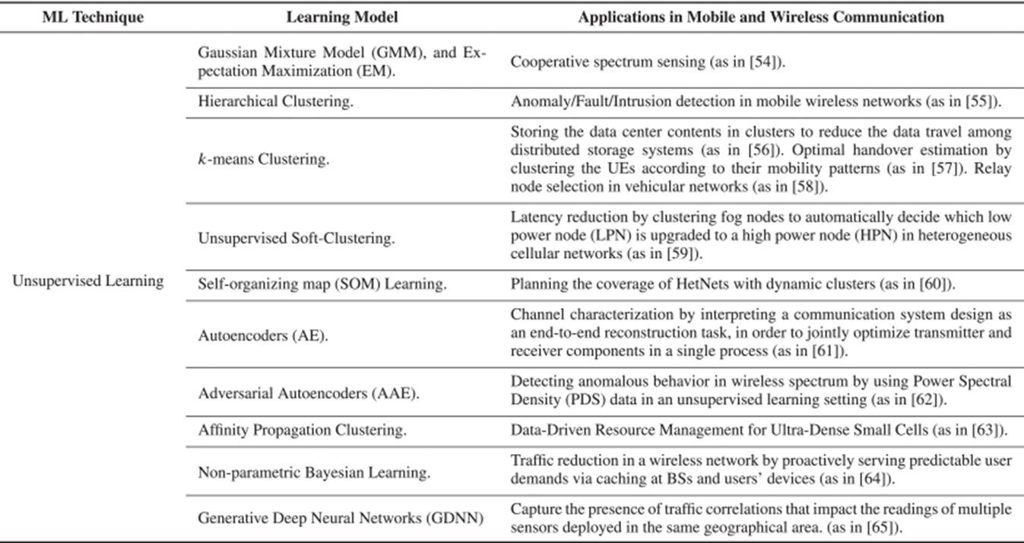

Slide 38
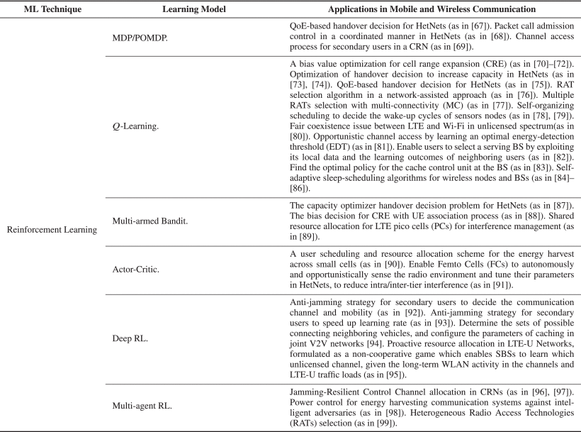

Slide 39
III. POTENTIAL OF MACHINE LEARNING TO SUPPORT 5G REQUIREMENTS
In this section, we look at the road to the next generation network deployment, and explore the link between ML algorithms and 5G requirements [114]. 5G is not an incremental improvement over 4G, but rather the next major evolution of mobile communication with performance improvements of several orders of magnitude over IMT-advanced. The intent of these requirements is to ensure that IMT-2020 guarantees more flexibility, security, and reliability than previous technologies, providing a variety of services and deployment scenarios for a wide range of environments [115], [116].

Slide 40
III. POTENTIAL OF MACHINE LEARNING TO SUPPORT 5G REQUIREMENTS
By agreeing on these requirements, relevant parties (e.g., network operators, manufacturers, regulators, etc.) can work towards developing the same system, where their own particular needs may not be met at the moment. In this section, we have grouped the main 5G requirements into three generic communication services and have studied how ML can assist in reaching their demands. Each service emphasizes a different subset of requirements and applications related to some extent. The three generic services are:

Slide 41
III. POTENTIAL OF MACHINE LEARNING TO SUPPORT 5G REQUIREMENTS
A.ENHANCED MOBILE BROADBAND (eMBB)
Enhancing the current MBB service will enable new applications with higher data rate demands over a uniform coverage area (e.g., ultra-high definition video streaming, and virtual reality) (Fig. 7). The essential requirements to enable eMBB are presented below:

Slide 42
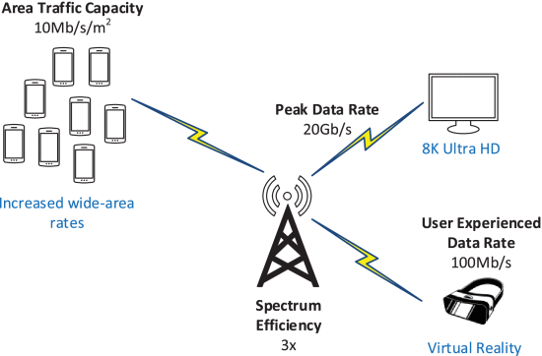
III. POTENTIAL OF MACHINE LEARNING TO SUPPORT 5G REQUIREMENTS
A.ENHANCED MOBILE BROADBAND (eMBB)
Enhancing the current MBB service will enable new applications with higher data rate demands over a uniform coverage area (e.g., ultra-high definition video streaming, and virtual reality) (Fig. 7). The essential requirements to enable eMBB are presented below:

Slide 43
III. POTENTIAL OF MACHINE LEARNING TO SUPPORT 5G REQUIREMENTS
1) PEAK DATA RATE
Peak data rate is planned to increase and support high-demand data-driven use cases. IMT-2020 systems will be required to deliver 20-times higher data rate than the previous technology specification, from 1 Gb/s in 4G to 20 Gb/s in 5G. This is the maximum achievable data rate under ideal error-free conditions assigned to a single mobile station when all of the assignable radio resources for the corresponding link are utilized (excluding radio resources for physical layer synchronization, reference signals, guard bands, etc

Slide 44
III. POTENTIAL OF MACHINE LEARNING TO SUPPORT 5G REQUIREMENTS
Massive or large Multiple-Input Multiple-Output (MIMO) is an essential contribution in the promise to provide an increased spectral efficiency in 5G. MIMO is defined as a system that uses a large number of individually controllable antenna elements to exploit the spatial degrees of freedom of multiplexing messages for several users in the same frequency, or to focus the radiated signal toward intended receivers to minimize intra- and inter-cell interference [118], [119].

Slide 45
III. POTENTIAL OF MACHINE LEARNING TO SUPPORT 5G REQUIREMENTS
Contributions of ML in MIMO technology includes channel estimation and direction of arrival (DOA) estimation by using deep neural networks (DNN) to learn the statistics of the wireless channel and the spatial structures in the angle domain [34]. Another ML contribution in MIMO is the classification of the channel state information (CSI) to select the optimal antenna indices using supervised learning (i.e., k-nearest neighbors (k-NN) [120], and support vector machine (SVM) [25]).

Slide 46
III. POTENTIAL OF MACHINE LEARNING TO SUPPORT 5G REQUIREMENTS
2) USER EXPERIENCED DATA RATE
User experienced data rate is defined as the 5% point of the cumulative distribution function (CDF) of the user throughput over active time (i.e., the number of correctly received bits at MAC Layer 3), measured in a dense urban environment. IMT-2020 intends to brace 10-times higher user experienced data rate compared to 4G LTE, from 10 Mbit/s to 100 Mbit/s. Its strong connection with other requirements such as peak data rate and latency makes it ideal to be used as a 5G performance indicator in real-world environments.

Slide 47
III. POTENTIAL OF MACHINE LEARNING TO SUPPORT 5G REQUIREMENTS
By considering the traffic generated by multiple sources, generative deep neural networks (GDNN) can reveal the presence of correlations that impact the readings of multiple sensors deployed in the same geographical area [65]. For example, a GDNN that is fed with the readings of all the sensors of a building may capture correlations that depend on the traffic generated by the devices, making it possible to discriminate not only between different classes of traffic sources (e.g., random warnings, and periodic sensed data), but even between different streams of the same class (e.g., data with higher priority, and temporal trends),

Slide 48
III. POTENTIAL OF MACHINE LEARNING TO SUPPORT 5G REQUIREMENTS
That kind of rich context information can be further exploited by optimizing the usage of the transmission resources e.g., inferring the type of building (office or residential), and adjusting the propagation models accordingly to maximize the QoE offered to the final user.

Slide 49
III. POTENTIAL OF MACHINE LEARNING TO SUPPORT 5G REQUIREMENTS
3) AREA TRAFFIC CAPACITY
Area traffic capacity refers to the total traffic throughput served per geographic area in Mbit/s/m2 , that is, the number of correctly received bits contained in the service data unit (SDU), over a certain period of time. The target value for area traffic capacity increased from 0.1 Mbits/s/m2 on IMT-advanced, to 10 Mbit/s/m2 in 5G

Slide 50
III. POTENTIAL OF MACHINE LEARNING TO SUPPORT 5G REQUIREMENTS
One of the most promising technologies to increase traffic capacity is the use of multiple input multiple output (MIMO) and coordinated multi-point (CoMP) antenna systems. Multi-antenna systems in eMBB support extreme-data rates in a given area, by improving spectral efficiency and extreme coverage.

Slide 51
III. POTENTIAL OF MACHINE LEARNING TO SUPPORT 5G REQUIREMENTS
B. MASSIVE MACHINE-TYPE COMMUNICATIONS (mMTC) Another key characteristic of 5G communication services is the scalable connectivity demand for the expanding number of wireless network-enabled devices, focusing on the efficient transmission of small payloads over an extended coverage area [131], [132]. Applications such as body-area networks, smart homes, internet of things (IoT), and drone delivery will generate sporadic traffic between a massive number of geographically spread equipments (Fig. 8), requiring mMTC to be able to support new, yet unforeseen use cases.

Slide 52
III. POTENTIAL OF MACHINE LEARNING TO SUPPORT 5G REQUIREMENTS
B. MASSIVE MACHINE-TYPE COMMUNICATIONS (mMTC) Another key characteristic of 5G communication services is the scalable connectivity demand for the expanding number of wireless network-enabled devices, focusing on the efficient transmission of small payloads over an extended coverage area [131], [132]. Applications such as body-area networks, smart homes, internet of things (IoT), and drone delivery will generate sporadic traffic between a massive number of geographically spread equipments (Fig. 8), requiring mMTC to be able to support new, yet unforeseen use cases.

Slide 53
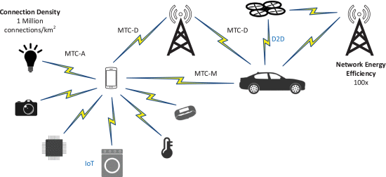
III. POTENTIAL OF MACHINE LEARNING TO SUPPORT 5G REQUIREMENTS

Slide 54
III. POTENTIAL OF MACHINE LEARNING TO SUPPORT 5G REQUIREMENTS
1) CONNECTION DENSITY
An immense challenge for 5G systems is to connect a massive number of devices to the internet, taking IoT, and smart cities/homes/buildings to a higher level, from 100 thousand connections per km2 in 4G to 1 million connections per km2 in 5G. This requirement should be achieved for limited bandwidth and transmission-reception points (TRxPs).

Slide 55
III. POTENTIAL OF MACHINE LEARNING TO SUPPORT 5G REQUIREMENTS
The emergence of IoT has given rise to a significant amount of data, collected from sensors, user devices, and BSs, that must be processed by the next-generation wireless system. The problem of cell association when the density of users increases has been extensively addressed in the past [133], [134], but recently as ML techniques have emerged, Q-learning algorithms have been proposed to enable users to select their serving BS faster by exploiting local data and the learning outcomes of neighboring users, instead of exchanging all the local data among users [82].

Slide 56
III. POTENTIAL OF MACHINE LEARNING TO SUPPORT 5G REQUIREMENTS
Network densification infrastructure (i.e., deploying small femtocells) can easily congest weak backhaul links as well, affecting the QoS of end-users. An ML approach to mitigate this limitation is to fetch popular contents (e.g., video streams) during off-peak hours, storing the data in the SBs’ memory units, and reusing them during peak traffic periods [135], [136]. The caching problem has been formulated as a Markov process with an unknown transition probability and is solved using reinforcement learning to find the optimal caching policy to adapt to the underlying dynamics of 5G [83].

Slide 57
III. POTENTIAL OF MACHINE LEARNING TO SUPPORT 5G REQUIREMENTS
In a similar way, ultra-dense networks (UDN) will result in a decrease in the number of active devices per access node, leading UDN to often work under high-load conditions. Novel multiple-access techniques allow overloading the spectrum by multiplexing users in the power and code domains, resulting in non-orthogonal access. With this approach, gains in user and system throughput of up to 50% can be obtained. Candidate schemes are Non-Orthogonal Multiple Access (NOMA), Sparse Code Multiple Access (SCMA), and Interleave Division Multiple Access (IDMA). These schemes can be combined with open- and closed-loop MIMO schemes [137], [138].

Slide 58
III. POTENTIAL OF MACHINE LEARNING TO SUPPORT 5G REQUIREMENTS
2) NETWORK ENERGY EFFICIENCY
Network energy efficiency is important for eMBB, and it is expected to increase from 1x on 4G, to 100x for IMT-2020. Energy consumption from the devices connected under mMTC applications needs to be considered in the future network design due to the new energy-hungry multimedia applications.

Slide 59
III. POTENTIAL OF MACHINE LEARNING TO SUPPORT 5G REQUIREMENTS
With a proliferation of wireless devices in 5G applications (e.g., mobile phones, wireless sensors, autonomous vehicles, drones, smart logistics, etc.), energy-efficient wireless networking has been a critical and challenging issue addressed by industry and academia, and will remain a hot research area for a long time [132], [139].

Slide 60
III. POTENTIAL OF MACHINE LEARNING TO SUPPORT 5G REQUIREMENTS
Network energy efficiency is the capability of a RAT to minimize the radio access network energy consumption in relation to the traffic capacity provided.The RAT must have the ability to support a high sleep-ratio and a long sleep duration.

Slide 61
III. POTENTIAL OF MACHINE LEARNING TO SUPPORT 5G REQUIREMENTS
It is also desirable that the devices connected to mMTC applications integrate energy harvesting technologies. The concepts of ambient energy harvesting from radio frequency (RF) signals and other renewable energy sources are also essential to extend the lifetime of battery constrained devices. To optimize the harvested energy, researchers have used linear regression and decision trees to derive energy prediction models, allowing them to define scheduling policies and provide the harvesting node with adaptation to energy availability [21].

Slide 62
III. POTENTIAL OF MACHINE LEARNING TO SUPPORT 5G REQUIREMENTS
C. ULTRA-RELIABLE LOW-LATENCY COMMUNICATIONS (URLLC)
Forthcoming network services, e.g., connected healthcare, remote surgery, mission-critical applications, autonomous driving, vehicle-to-vehicle (V2V) communications, highspeed train connectivity, and smart industry applications, will prioritize extreme reliability, low-latency, and mobility, over data rates (Fig. 9). The crucial requirements to enable URLL communications are:

Slide 63
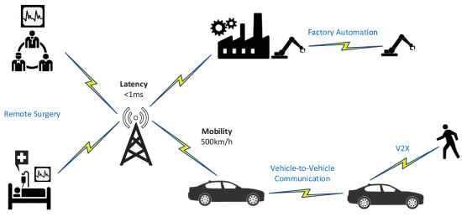
III. POTENTIAL OF MACHINE LEARNING TO SUPPORT 5G REQUIREMENTS

Slide 64
III. POTENTIAL OF MACHINE LEARNING TO SUPPORT 5G REQUIREMENTS
1) LATENCY
Latency is probably one of the most influential performance measures of 5G. A reliable 5G system requires extremely low latency, and even a few milliseconds (ms) can make an enormous difference, making it an extremely important field for 5G researchers and engineers alike. The requirements for IMT-2020 give no room for unbounded delay, from an admissible 10 ms in 4G, to <1 ms in the specification for 5G.

Slide 65
III. POTENTIAL OF MACHINE LEARNING TO SUPPORT 5G REQUIREMENTS
Several authors have indicated that ultimately the success of URLLC will rely on an anticipatory network management, capable of predicting the network needs and reacting accordingly [140], [141]. URLLC will be the key to enable real-time connections between autonomous vehicles, e-health, remote robot operation, augmented & virtual reality (AR/VR), etc. As an example, a self-driving car on the road must recognize other vehicles, pedestrians, bikes, and other objects in realtime, not tomorrow.

Slide 66
III. POTENTIAL OF MACHINE LEARNING TO SUPPORT 5G REQUIREMENTS
Latency increases with distance and congestion of network links, which is why not everything can be stored in remote cloud servers away from the final users. The ideal case would be that the local BS always has the desired content. If it does not, the user will have to download it from a cloud server very far away, increasing the latency proportionally [142], [143

Slide 67
III. POTENTIAL OF MACHINE LEARNING TO SUPPORT 5G REQUIREMENTS
In the other hand, BSs have limited storage size, so they have to learn to predict user needs. ML-based solutions (e.g., Q-learning, deep policy gradient, non-parametric Bayesian learning, etc.) have yielded good results for content popularity prediction and caching [6], [7], [9], [83], [94].

Slide 68
III. POTENTIAL OF MACHINE LEARNING TO SUPPORT 5G REQUIREMENTS
2) MOBILITY
Mobility is described as the maximum mobile station speed at which a defined QoS can be achieved (in km/h). For the high-speed vehicular mobility scenario, it is assumed that the user is moving at the maximum speed of 500 km/h, as opposed to the previous 350 km/h on 4G. To support these highly-mobile use cases, particularly in dense mmWave deployments where the users need to frequently hand-off between BSs, an optimal identification of the beamforming vectors is essential.

Slide 69
III. POTENTIAL OF MACHINE LEARNING TO SUPPORT 5G REQUIREMENTS
ML models can use the uplink pilot signal received at the terminal BSs, and learn the implicit mapping function relating to the environment setup to predict and coordinate beamforming vectors at the BSs [33]. the centralized controller clusters the UEs according to their mobility patterns (i.e., speed information, locations of the UEs, geographic context, as well as past trajectories) using unsupervised learning in order to obtain an optimal handover policy for each UE [57].

Slide 70
III. POTENTIAL OF MACHINE LEARNING TO SUPPORT 5G REQUIREMENTS
Mobility-aware network design also plays an important role in the joint communication between high-mobility networks. Deep Q-learning has been suggested to determine the sets of possible connecting neighboring vehicles, as well as to configure the parameters of caching placement [94].

Slide 71
III. POTENTIAL OF MACHINE LEARNING TO SUPPORT 5G REQUIREMENTS
Additional promising uses of ML to leverage the mobility of wireless networks includes feature extraction or pattern recognition to identify, predict, and mitigate interference in flexible network deployments such as mobile relay nodes or nomadic nodes. Mobile networking is one of the most critical technologies for 5G mobile communications, but fortunately, an anticipatory mobility management through ML is opening a new road towards URLL networking.

Slide 72
III. POTENTIAL OF MACHINE LEARNING TO SUPPORT 5G REQUIREMENTS
Additional promising uses of ML to leverage the mobility of wireless networks includes feature extraction or pattern recognition to identify, predict, and mitigate interference in flexible network deployments such as mobile relay nodes or nomadic nodes. Mobile networking is one of the most critical technologies for 5G mobile communications, but fortunately, an anticipatory mobility management through ML is opening a new road towards URLL networking.

Slide 73
SPECIAL CONSIDERATIONS TO DEPLOY ML ON 5G AND B5G
A. THE CRITICAL ROLE OF DATA
High-quality data is an essential piece in ML applications, and the type of data (i.e., labeled, or unlabeled) is a key factor when deciding which type of learning to use, especially when it comes to deploying applications for 5G use cases.

Slide 74
SPECIAL CONSIDERATIONS TO DEPLOY ML ON 5G AND B5G
In the matter of wireless communications, it is important to notice that generating a dataset from computer simulators is not always the best practice since the ML algorithm will end up learning the rules with which the simulator was programmed, and this will not reflect the un-observable features from the real world (remember that the point is learning from real data). The scarcity of real datasets available for 5G mobile and wireless communications is one of the biggest challenges for researchers and ML practitioners.

Slide 75
SPECIAL CONSIDERATIONS TO DEPLOY ML ON 5G AND B5G
In the matter of wireless communications, it is important to notice that generating a dataset from computer simulators is not always the best practice since the ML algorithm will end up learning the rules with which the simulator was programmed, and this will not reflect the un-observable features from the real world (remember that the point is learning from real data). The scarcity of real datasets available for 5G mobile and wireless communications is one of the biggest challenges for researchers and ML practitioners.

Slide 76
SPECIAL CONSIDERATIONS TO DEPLOY ML ON 5G AND B5G
B. THE NO FREE LUNCH THEOREM
The No Free Lunch Theorem in ML establishes that if we average all possible data-generated distributions, every ML algorithm will have the same performance when inferring unobserved data [173]. Otherwise stated, no ML algorithm is universally better than any other.

Slide 77
SPECIAL CONSIDERATIONS TO DEPLOY ML ON 5G AND B5G
These results hold when we average over all possible data generating distributions in real world applications. This means that the goal of ML is not to seek the absolute best learning algorithm. Instead, we need to understand what kind of distribution is relevant to our specific 5G/B5G application, and which ML algorithm has the best performance on that specific data.

Slide 78
CONCLUSION
We have seen that there is enough promise in the value of ML to dream of and experiment with, a future in which ML can be an inherent element of wireless communications. However, for adopting ML in 5G/B5G, it is needed to consider that ML cannot be applied everywhere, bearing in mind that the costliness, time, latency, and delay introduced from some ML techniques are far from some real-time applications.

Slide 79
CONCLUSION
ML and 5G have a lot of room to improve together as a discipline, and until the major telecommunication industry fully trusts ML, the rate of development in the area will be significantly constrained by the need to be meticulous and not break the current systems. Because ML could add uncertainty and complication to any network, our passion must be tempered by extreme caution.

Slide 80
3 Paradigms of AI in 5G
3.1 AI for SON: Automatic root cause analysis
Self-organizing networks (SONs) establish a new concept of network management which provide intelligence in the operation and maintenance of the network. It has been introduced by 3GPP as a key component of LTE network. In the 5G era, network densification and dynamic resource allocation will result in new problems for coordination, configuration and management of the network, hence bringing increased demand for the improvements of the SON functions. SON modules in mobile networks can be divided into three main categories: self-configuration, self-optimization and self-healing.

Slide 81
3 Paradigms of AI in 5G
The main objectives of SON are to automatically perform network planning, configuration and optimization without human intervention, in order to reduce the overall complexity, Operational Expenditure (OPEX), Capital Expenditure (CAPEX) and man-made faults. Various researches of AI in SON have been summarized in [32–34] which includes AI applied in automatic base station configuration, new cell and spectrum deployment, coverage and capacity optimization, cell outage detection and compensation, etc., using approaches including ANN, ant colony optimization, genetic algorithm, etc..

Slide 82
3 Paradigms of AI in 5G
in [35] as an example for AI in SON. The design of the fault identification system in LTE networks faces two main challenges: (1) A huge number of alarms, KPIs and configuration parameters can be taken as fault indicators in the system. Meanwhile, most of the symptoms of these indicators are not labeled with fault causes, hence are difficult to identify; (2) The system is not automatic and experts are involved to analyze each fault cause. With the huge amount of high-dimensional data, human intervention is not efficient while expensive. Authors of [35] proposes an system in the following steps:

Slide 83
3 Paradigms of AI in 5G
1. Unsupervised SOM training. SOM as shown in Figure 2 is applied for an initial classification of the high-dimensional KPIs. An SOM is a type of unsupervised neural network capable of acquiring knowledge and learning from a set of unlabeled data. It will process high-dimensional data and reducing it to a two-dimensional map of neurons that preserves the topological properties of the input data. Hence, inputs close to each other will be mapped to adjacent neurons. By this unsupervised process, the highdimensional KPIs are mapped into a lower-dimensional map which can classify new KPI data by finding the closest neurons.

Slide 84
3 Paradigms of AI in 5G
2. Unsupervised clustering. After SOM training, all the neurons in the SOM system will be clustered into a certain number of groups using an unsupervised algorithm. Since the SOM neurons are already ordered and the difference between the original inputs can be represented by Euclidean distance between the corresponding neurons, clustering algorithms based on Euclidean distance, e.g. Wards hierarchical method, can be applied to cluster the neurons.

Slide 85
3 Paradigms of AI in 5G
3. Labeling by Experts. After the above two steps, the original high-dimensional data are clustered into several classes. We will finally have the experts to analyze and identify the fault causes of each obtained cluster to have all the clusters labeled.

Slide 86
3 Paradigms of AI in 5G
With the training, clustering and labeling, an automatic system for network diagnosis is constructed by the workflow shown in Figure 4. For a new input of KPIs, it will firstly be mapped to a neuron in SOM. Then by the label of the cluster this neuron belongs to, we can identify the fault and the causes. After obtaining a certain amount of new fault data, we can verify whether the system is right or not and update it by re-training with the above three steps. Simulation results presented in [35] show that the proposed root cause analysis system is highly accurate even though it’s mainly built using unsupervised techniques.

Slide 87
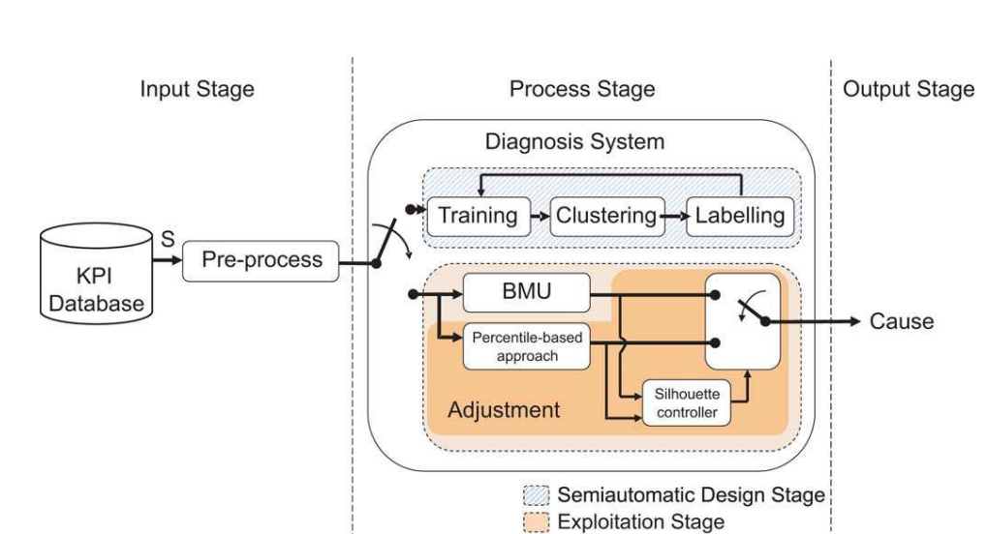
3 Paradigms of AI in 5G

Slide 88
3 Paradigms of AI in 5G
3.2 AI for resource allocation: OFDMA downlink resource allocation
The OFDM resource block (RB) allocation in 5G NR is more complicated and challenging than ever before due to the support for the three aforementioned generic services. In Figure 5, a typical multi-cell, multi-user downlink resource allocation scenario is illustrated. In this system, the intra-cell interference is eliminated since the RB allocated to different users in the same cell is orthogonal to each other.

Slide 89
3 Paradigms of AI in 5G
The system interference mainly depends on the inter-cell interference, which makes the RB allocation for users in neighboring cells important. Suppose the throughput of each user can be evaluated based on signal-tointerference ratio (SIR), the target for the optimization of the RB allocation is the maximization of the total system throughput. This is indeed an NP-hard combinatorial optimization problem with nonlinear constraints. The complexity of the traditional solution is proportional to the factorial of the number of users in coverage, which is computationally prohibitive.

Slide 90
3 Paradigms of AI in 5G
Q-learning can be applied to this problem. Suppose an “Agent” is in charge of the RB allocation, then the possible “Action” of this “Agent”, which is to update the RB for each user, can be selected by the following strategies as illustrated in Figure 5: (1) Within the same cell, allocate free RB with higher SIR to the users; (2) Update the RB allocated to the user with the worst SIR in current cell continuously to achieve better overall system capacity; (3) For a certain RB, pair or cluster the user with worst SIR in the current cell with users with the best SIR from the neighboring cell.

Slide 91
3 Paradigms of AI in 5G
The first two strategies are intuitive. The third one is applied to avoid allocating the same RB to users in neighboring cells that are located close to the boarder, since in such situations the involved users cannot acquire essential SIR to work properly regardless of the transmitting power of the base stations.

Slide 92
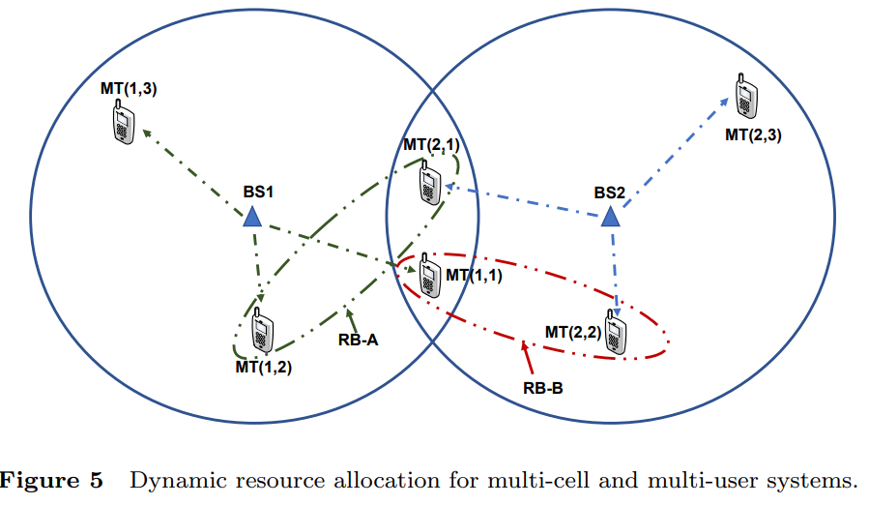
3 Paradigms of AI in 5G

Slide 93
3 Paradigms of AI in 5G
After defining all the possible “Actions”, the “Agent” will evaluate each of them to select the next “Action” to adjust the RB allocation which maximizes the overall capacity of the whole system. The Q function is updated according to the Bellman equation [13] at the same time. We iterate through this process until the Q function converges.

Slide 94
3 Paradigms of AI in 5G
These iterations should also be considered with the optimization of the user power allocation. In [36], a framework based on generalized Nash equilibrium problem (GNEP) is proposed for the optimization of the power control for users from multiple cells that are assigned the same RB. Global quality of service (QoS) constraints are also considered hence Lagrange multipliers are introduced to evaluate the “Actions” and establish the Q function.

Slide 95
3 Paradigms of AI in 5G
3.3 AI for baseband signal processing: Uniform 5G accelerator
The baseband signal processing in 5G consists of a series of signal processing blocks including massive MIMO detection, NOMA detection and decoding for polar codes. The increased number of baseband blocks leads to more hardware area and varied implementation structures.

Slide 96
3 Paradigms of AI in 5G
However, we notice that the belief propagation algorithm based on factor graphs can be applied to all the blocks as proposed in [37–41]. For each specific block, the frameworks are kept unchanged and we only have to adapt the symbol set and constraints of the variables to the certain function. Hence, a uniform accelerator for the baseband can be designed based on the belief propagation algorithms with configurable variables.

Slide 97
3 Paradigms of AI in 5G
However, the performance of belief propagation is limited in some baseband blocks in certain scenarios. Here, AI can be a possible solution to these problems. By improving the belief propagation methods with the AI techniques, an AI-based uniform accelerator can be constructed. The AI-aided belief propagation algorithms can be designed with the following two methods:

Slide 98
3 Paradigms of AI in 5G
DNN-aided belief propagation: (1) Unfold the factor graph of belief propagation by duplicating the iterations to form a DNN; (2) Train the DNN by supervised training. Applications of this method in the baseband include the DNN-based polar codes decoder proposed in [20] and the DNN-aided MMO detector proposed in [42].

Slide 99
3 Paradigms of AI in 5G
Belief propagation-based CNN: (1)Map each node in the factor graph of belief propagation to one pixel in a picture, in which connected nodes should be mapped into neighboring pixels; (2) Train the CNN using the obtained pictures. This method is utilized in the BP-CNN channel decoder proposed in [43].

Slide 100
3 Paradigms of AI in 5G
The neural networks are highly self-adaptive and reliable. By applying DNN and CNN in the baseband, we can achieve performance enhancements as long as a uniform hardware implementation framework. Actually, the core operation for CNN is the convolution, while the core of DNN is the multiplication of the two-dimensional matrices. We notice that the systolic architecture can realize both of the operations.

Slide 101
3 Paradigms of AI in 5G
Figure 6 illustrates a reconfigurable systolic architecture designed for accelerating convolutional neural network [18]. It can be seen that the systolic architecture is regular and scalable, which supports different CNNs and DNNs. This motivates us to explore the possibilities of reusing the same hardware architecture to realize both 5G and DL algorithms

Slide 102
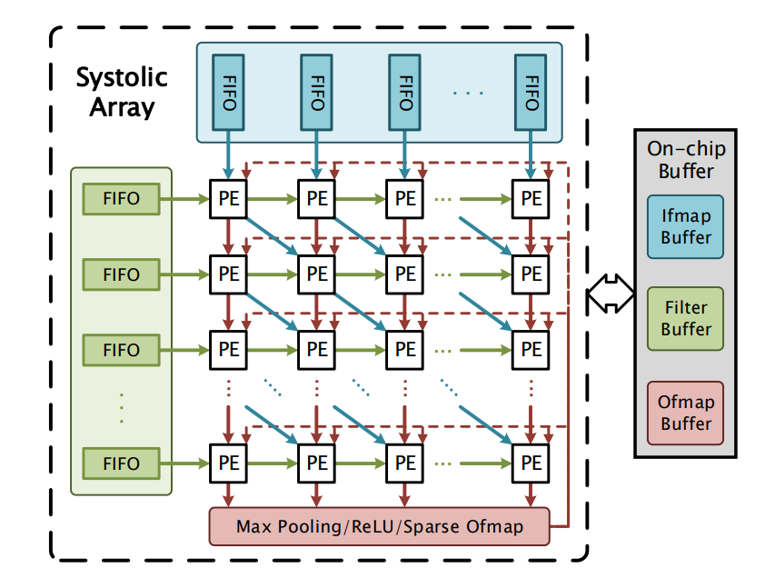
3 Paradigms of AI in 5G
Figure 6 illustrates a reconfigurable systolic architecture designed for accelerating convolutional neural network [18]. It can be seen that the systolic architecture is regular and scalable, which supports different CNNs and DNNs. This motivates us to explore the possibilities of reusing the same hardware architecture to realize both 5G and DL algorithms

Slide 103
3 Paradigms of AI in 5G
The authors of [21] point out that in a system formed with the channel encoder, the channel, the channel equalizer and the decoder (as shown in Figure 7), the equalizer and the decoder in the receiver can be implemented with a CNN and a DNN, respectively. The associated AI accelerator can be jointly realized by two strategies:

Slide 104
3 Paradigms of AI in 5G
(1) The uniform architecture: The overall receiver can be folded into one uniform processor to save the hardware area. This processor firstly works as a CNN-based equalizer with the input signals from the channel. The output of the CNN will be saved at this point. The processor will then function as a DNN-based decoder, for which the saved output from the CNN will serve as the input. The decoding results will be the final output.

Slide 105
3 Paradigms of AI in 5G
(2) The cascade architecture: Two processors will be cascaded directly to construct the receiver, one being the CNN-based equalizer while the other being the DNN-based decoder. This architecture has more hardware consumption, but achieves higher throughput rate.
Overall, the AI-based uniform accelerator is more flexible for the hardware implementation, hence can achieve various system requirements.

Slide 106
3 Paradigms of AI in 5G
3.4 AI for physical layer: DNN-based end-to-end communication
As mentioned above, AI, especially DNN, has been applied to different function blocks in the physical layer, e.g., modulation recognition [44], polar codes decoder [20] and MIMO detection [43]. For the joint optimization of two or more blocks, AI algorithms also achieve success, e.g., the aforementioned joint optimization of channel equalizer and channel decoder proposed in [21]

Slide 107
3 Paradigms of AI in 5G
However, optimizing each of the blocks individually cannot guarantee the optimization for the whole physical layer communication [45]. In the viewpoint of the whole end-to-end communication system, the intuitive connection of different AI modules may bring extra computational cost for both training and online tasks. Hence, a joint optimization method for the end-to-end system is in need.

Slide 108
3 Paradigms of AI in 5G
[46] proposes an autoencoder-based end-to-end system optimization method, in which the communication system is recast as an end-to-end reconstruction optimization problem, and a novel concept, the autoencoder, is introduced to serve as a simplified representation of the system. The autoencoder is a type of ANN.It aims at learning a representation (encoding) for a set of data in an unsupervised manner, which will be capable to reconstruct compressed inputs at the output layer. The transmitter and the receiver are both represented as fully connected DNNs.

Slide 109
3 Paradigms of AI in 5G
A normalization layer is connected to the transmitter to guarantee the energy constraints, whereas a softmax activation layer is placed before the receiver to output soft decisions for the received information. The AWGN channel in between is represented as a simple noise layer with a certain variance. The resulted autoencoder has a structure as shown in Figure 8. This autoencoder is trained based on bit error rate (BER) or block error rate (BLER). After training, it will be able to reconstruct the transmitted signals based on the received signals

Slide 110
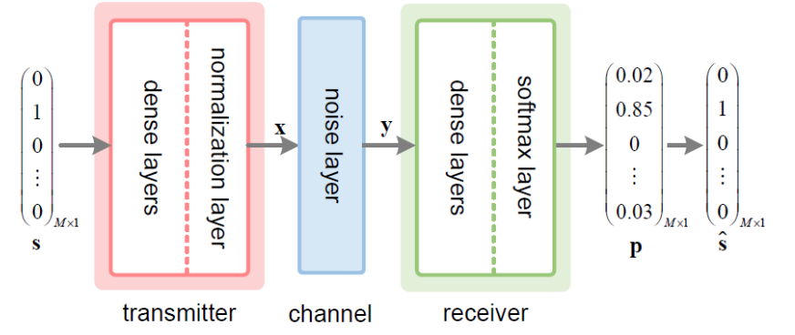
3 Paradigms of AI in 5G

Slide 111
3 Paradigms of AI in 5G
The autoencoder is a novel concept different to all the traditional, conventional methods. DNNs are utilized to represent the whole end-to-end system without considering the specific models in each traditional function block. Hence, in scenarios that is too complicated to model, autoencoder can be a good solution to “learn” these scenarios and optimize the performance. This scheme is extended to a multi-user scenario with interfering channels in [46], and is further extended to MIMO in [47] by adding a module for the channel matrix as shown in Figure 9.

Slide 112
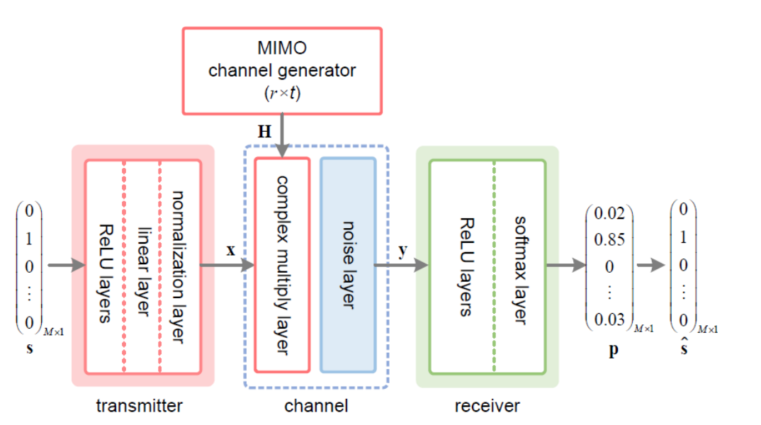
3 Paradigms of AI in 5G
The autoencoder is a novel concept different to all the traditional, conventional methods. DNNs are utilized to represent the whole end-to-end system without considering the specific models in each traditional function block. Hence, in scenarios that is too complicated to model, autoencoder can be a good solution to “learn” these scenarios and optimize the performance. This scheme is extended to a multi-user scenario with interfering channels in [46], and is further extended to MIMO in [47] by adding a module for the channel matrix as shown in Figure 9.

Slide 113
3 Paradigms of AI in 5G
The autoencoder is a novel concept different to all the traditional, conventional methods. DNNs are utilized to represent the whole end-to-end system without considering the specific models in each traditional function block. Hence, in scenarios that is too complicated to model, autoencoder can be a good solution to “learn” these scenarios and optimize the performance. This scheme is extended to a multi-user scenario with interfering channels in [46], and is further extended to MIMO in [47] by adding a module for the channel matrix as shown in Figure 9.

Slide 114
4 Conclusions
5G makes a significant breakthrough in the traditional mobile communication system. While enhancing the service capability of the traditional mobile networks, it further evolves to support the applications of IoT in various fields including business, manufacturing, health care and transportation. Aiming at supporting differentiated applications with a uniform technical framework, 5G is facing enormous challenges. With the revive and the rapid development in recent years, AI is rising to these challenges. It is a potential solution to the problems in the 5G era, which will lead to a revolution in the concepts and capabilities of the communication systems.

Slide 115
4 Conclusions
Many researches have already been done for applying AI in 5G. In this paper, instead of trying to review all the existing literatures, we focus on clarifying the promising research directions with the greatest potential. By further efforts in these research directions, 5G can be anticipated to achieve significantly better performance and more convenient implementations compared to the traditional communication systems. With the inspiring research paradigms introduced in this paper, we are looking forward to the remarkable achievements of AI in 5G in the near future.

Slide 116
References
1 You X H, Pan Z W, Gao X Q, et al. The 5G mobile communication: The development trends and its emerging key techniques. Sci Sin Inform, 2014, 44 (5): 551-563 [. 5G. 2014, 44 (5):551-563]
2 3GPP. RP-170741, Way Forward on the Overall 5G-NR eMBB. Workplan[s]. 2017
3 3GPP. Study on New Radio Access Technology: Radio Access Architecture and Interfaces (Release 14). TR38.801, v14.0[s]. 2017
4 ITU-R. Minimum Requirements Related to Technical Performance for IMT2020 Radio Interface(s). Report ITU-R M.2410-0. 2017
5 3GPP. Release-15: LTE Enhancements and 5G Normative Work. 2018
6 You X H, Wang D M, Sheng B, et al. Cooperative distributed antenna systems for mobile communications. IEEE Wirel Commun, 2010, 17(3): 35
7 Yang W J, Wang M, Zhang J J, et al. Narrowband wireless access for low-power massive Internet of things: A bandwidth perspective. IEEE Wirel Commun, 2017, 24(3): 138-145
8 Whitley D. A genetic algorithm tutorial. Stat Comput, 1994, 4(2): 65-85
9 Schmidhuber J. Deep learning in neural networks: An overview. Neural Netw, 2015, 61: 85-117
10 Yu (You) X H. Can backpropagation error surface not have local minima. IEEE T Neural Networ, 1992, 3(6): 1019-1021

Slide 117
References
11 Yu (You) X H, Chen G A, Cheng S X. Dynamic learning rate optimization of the backpropagation algorithm. IEEET Neural Networ, 1995, 6(3): 669-677
12 Yu (You) X H, Chen G A. Efficient backpropagation learning using optimal learning rate and momentum. Neural Netw, 1997, 10(3): 517-527
13 Kaelbling L P, Littman M L, Moore A W. Reinforcement learning: A survey. J Artif Intell Res, 1996, 4: 237-285
14 Watkins C J C H, Dayan P. Q-learning. Mach Learn, 1992, 8(3-4): 279-292
15 Gatherer A. Machine learning Modems: How ML will change how we specify and design next generation communication systems. IEEE ComSoc News, 2018. https://www.comsoc.org/ctn/machine-learning-modems-how-ml-will-changehow-we-specify-and-design-next-generation
16 Yang C, Xu W H, Zhang Z C, et al. A channel-blind detection for SCMA based on image processing techniques. In: Proceedings of IEEE International Symposium on Circuits and Systems (ISCAS), 2018: 1-5
17 Zhang C, Xu W H. Neural networks: Efficient implementations and applications. In: Proceedings of IEEE International Conference on ASIC (ASICON), 2017: 1029-1032
18 Xu W H, You X H, Zhang C. Efficient deep convolutional neural networks accelerator without multiplication and etraining. In: Proceedings of IEEE International Conference on Acoustics, Speech and Signal Processing (ICASSP),2018: 1-5

Slide 118
References
19 Xu W H, Wang Z F, You X H, et al. Efficient fast convolution architectures for convolutional neural network. In:Proceedings of IEEE International Conference on ASIC (ASICON), 2017: 904-907
20 Xu W H, Wu Z Z, Ueng Y L, et al. Improved polar decoder based on deep learning. In: Proceedings of IEEE International Workshop on Signal Processing Systems (SiPS), 2017:1-6
21 Xu W H, Zhong Z W, Be’ery Y, et al. Joint neural network equalizer and decoder. In: Proceedings of IEEE International Symposium on Wireless Communication Systems (ISWCS), 2018:1-6
22 Xu W H, Be’ery Y, You X H, et al. Polar decoding on sparse graphs with deep learning. In: Proceedings of Asilomar Conference on Signals, Systems, and Computers (Asilomar), 2018:1-6
23 Xu W H, You X H, Zhang C. Using Fermat number transform to accelerate convolutional neural network. In: Proceedings of IEEE International Conference on ASIC (ASICON), 2017: 1033-1036
24 Gao X Q, Jiang B, Li X, et al. Statistical eigenmode transmission over jointly-correlated MIMO channels. IEEE T Inform Theory, 2009,55 (8): 3735-3750
25 Wang D M, Zhang Y, Wei H, et al. An overview of transmission theory and techniques of large-scale antenna systems for 5G wireless communications. Sci China Inform Sci, 2016, 59(8): 081301
26 Gesbert D, Hanly S, Huang H, et al. Multi-cell MIMO cooperative networks: A new look at interference. IEEE J Sel
Area Comm, 2010, 28(9): 1380-1408

Slide 119
References
26 Gesbert D, Hanly S, Huang H, et al. Multi-cell MIMO cooperative networks: A new look at interference. IEEE J Sel Area Comm, 2010, 28(9): 1380-1408
27 Jing S S, Yu A L, Liang X, et al. Uniform belief propagation processor for massive MIMO detection and GF (2n) LDPC decoding. In: Proceedings of IEEE International Conference on ASIC (ASICON), 2017: 961-964
28 Gandhi V S, Maheswaran B. A cross layer design for performance enhancements in LTE-A system. In: Proceedings of IEEE International Conference on Wireless Communications, Signal Processing and Networking (WiSPNET), 2016: 905-909
29 Kuen J, Kong X F, Wang G, et al. DelugeNets: Deep networks with efficient and flexible cross-layer information inflows. In: Proceedings of IEEE International Conference on Computer Vision Workshop (ICCVW), 2017: 958-966
30 Farsad N, Rao M, Goldsmith A. Deep learning for joint source-channel coding of text. arXiv preprint, 2018. https://arxiv.org/abs/1802.06832
31 Xu X W, Ding Y K, Hu S X, et al. Scaling for edge inference of deep neural networks. Nature Electronics, 2018, 1(4):216
32 Wang X F, Li X H, Leung V C M. Artificial intelligence-based techniques for emerging heterogeneous network: State of the arts, opportunities, and challenges. IEEE Access, 2015, 3: 1379-1391

Slide 120
References
33 Klaine P V, Imran M A, Onireti O, et al. A Survey of machine learning techniques applied to self-organizing cellular networks. IEEE Commun Surv Tut, 2017, 19(4): 2392-2431
34 P`erez-Romero J, Sallent O, Ferrs R, et al. Knowledge-based 5G radio access network planning and optimization. In: Proceedings of IEEE International Symposium on Wireless Communication Systems (ISWCS), 2016: 359-365
35 G´omez-Andrades A, Munoz P, Serrano I, et al. Automatic root cause analysis for LTE networks based on unsupervised techniques. IEEE T Veh Technol, 2016, 65(4): 2369-2386
36 Wang J H, Guan W, Huang Y M, et al. Distributed optimization of hierarchical small cell networks: A GNEP framework. IEEE J Sel Area Comm, 2017, 35(2): 249-264
37 Ren Y R, Zhang C, Liu X, et al. Efficient early termination schemes for belief-propagation decoding of polar codes. In: Proceedings of IEEE International Conference on ASIC (ASICON), 2015: 1-4
38 Fossorier M P C, Mihaljevic M, Imai H. Reduced complexity iterative decoding of low-density parity check codes based on belief propagation. IEEE T Commun, 1999, 47(5): 673-680
39 Yang J M, Song W Q, Zhang S Q, et al. Low-complexity belief propagation detection for correlated large-scale MIMO systems. J Signal Process Sys, 2018, 90(4): 585-599

Slide 121
References
39 Yang J M, Song W Q, Zhang S Q, et al. Low-complexity belief propagation detection for correlated large-scale MIMO systems. J Signal Process Sys, 2018, 90(4): 585-599
40 Liu L, Yuen C, Guan Y L, et al. Gaussian message passing iterative detection for MIMO-NOMA systems with massive access. In: Proceedings of IEEE Global Communications Conference (GLOBECOM), 2016: 1-6
41 Yang J M, Zhang C, Zhou H Y, et al. Pipelined belief propagation polar decoders. In: Proceedings of IEEE International Symposium on Circuits and Systems (ISCAS), 2016: 413-416
42 Tan X S, Xu W H, Be’ery Y, et al. Improving massive MIMO belief propagation detector with deep neural network. arXiv preprint, 2018. https://arxiv.org/abs/1804.01002
43 Liang F, Shen C, Wu F. An iterative BP-CNN architecture for channel decoding. IEEE J Sel Top Signa, 2018, 12(1): 144-159
44 Lv X Z, Wei P, Xiao X C. Automatic identification of digital modulation signals using high order cumulants. Electronic Warfare, 2004, 6:1
45 Wang T Q, Wen C K, Wang H Q, et al. Deep learning for wireless physical layer: Opportunities and challenges. China Commun, 2017, 14(11): 92-111
46 O’Shea T, Hoydis J. An introduction to deep learning for the physical layer. IEEE Trans on Cogn Commun Netw, 2017, 3(4): 563-575

