Slide 1
Re-optimizing the embedding of virtual infrastructures
João Soares and Susana Sargento
Notes:
重新優化虛擬基礎設施的嵌入
瑞典人

Slide 2
OUTLINE
Abstract
INTRODUCTION
RELATED WORK
CLOUD NETWORK VIRTUAL-ENABLED INFRASTRUCTURE
MATHEMATICAL FORMULATION
EMBEDDING STRATEGIES
EVALUATION
CONCLUSION AND FUTURE WORK
REFERENCES

Slide 3
Abstract
Today, in the cloud computing context, the network is starting to arise as a true resource itself and not just as a required connectivity add-on.
The ability to define network resources (e.g. routing/switching elements, bandwidth) in this context is still scarce, but there are clear evidences that this is a future reality.
In this article, we consider that cloud infrastructure services will allow the definition of complete infrastructures, to which we refer as Virtual Infrastructures (VIs).
These VIs comprise computing, storage and network resources.
This article specifically tackles the VI embedding problem, which is known to be NP-hard.
Notes:
今天，在雲計算環境中，網絡開始成為一種真正的資源本身，而不僅僅是作為必需的連接附件。
在這種情況下定義網絡資源（例如路由/交換元件、帶寬）的能力仍然很少，但有明確的證據表明這是未來的現實。
在本文中，我們認為雲基礎設施服務將允許定義完整的基礎設施，我們將其稱為虛擬基礎設施 (VI)。
這些 VI 包括計算、存儲和網絡資源。
本文專門解決了眾所周知的 NP-hard 問題 VI 嵌入問題。
Scarce : 稀缺

Slide 4
Abstract
Having in mind this fact, different embedding strategies based on Integer Linear Programming (ILP) formulation are presented.
The problem is addressed by proposing strategies that target load balancing and energy consumption of physical resources along with re Optimization strategies.
A thorough evaluation of the different strategies is performed, studying the VI acceptance ratio, physical infrastructure energy consumption, and the impact of reconfigurations.
Results show that there is a clear tradeoff between improving the VI acceptance ratio and reducing the physical infrastructure usage without allowing re-optimizations.
Notes:
考慮到這一事實，提出了基於整數線性規劃 (ILP) 公式的不同嵌入策略。
通過提出針對物理資源負載平衡和能源消耗的策略以及重新優化的策略來解決該問題。
對不同策略進行了全面評估，研究了 VI 接受率、物理基礎設施能源消耗和重新配置的影響。
結果表明，在不允許重新優化中提高 VI 接受率和減少物理基礎設施使用之間存在明顯的權衡。

Slide 5
INTRODUCTION
The momentum around the Network Functions Virtualization (NFV) [1] concept can be seen as the most recent catalyst to this uprising need for an active role of the network in the cloud.
The Telco sector seems eager to “cloudify” some of its solutions, which have more than just computing requirements: they have very strict requirements in terms of network guarantees.
However, today’s cloud solutions cannot meet the requirements imposed by these systems, mainly in terms of network aspects.
This article addresses the joint embedding of cloud and network resources, a NP-hard problem, through ILP.
[1] ETSI, Network Functions Virtualisation (NFV): Architectural Framework, Technical Report ETSI GS NFV 002 v1.1.1, Oct. 2013.
Notes:
網絡功能虛擬化 (NFV) [1] 概念可以被視為對網絡在雲中發揮積極作用這一需求不斷上升的最新催化劑。
電信部門似乎渴望將其一些解決方案“雲化”，這些解決方案不僅僅是計算要求：它們在網絡保證方面有非常嚴格的要求。
然而，今天的雲解決方案不能滿足這些系統提出的要求，主要是在網絡方面。
本文通過 ILP 解決了雲和網絡資源的聯合嵌入，這是一個 NP hard problem。
Catalyst : 催化劑

Slide 6
INTRODUCTION
We consider the provisioning of computing and network resources through virtualization, enabling the support of VIs.
The VI embedding problem is addressed in a single domain perspective, where a pool of computing and network resources (i.e. server and network nodes) is managed in an integrated way by a single entity.
An example of such entity can be a Cloud Provider DC or a network operator with computing resources spread throughout its network.
We propose different VI embedding strategies that consider load balancing of resources, energy consumption, and the impact of re-optimization processes.
Notes:
我們考慮通過虛擬化來提供計算和網絡資源，從而支持 VI。
VI嵌入問題是在single domain視角下解決的，其中計算和網絡資源池（即服務器和網絡節點）由單個實體以集成方式管理。 (一顆一顆的元件這樣)
此類實體的一個例子可以是雲提供商 DC 或網絡運營商遍布其網絡的計算資源。
我們提出了不同的 VI 嵌入策略，這些策略考慮了資源的負載平衡、能源消耗和重新優化過程的影響。

Slide 7
INTRODUCTION
It is shown that allowing reconfiguration improves the VI acceptance ratio as well as energy consumption, but that can impact running services.
Therefore, our proposed strategy aims to also minimize the costs associated with the reconfiguration process.
We thoroughly explore how enabling VI reconfigurations can benefit the VI embedding problem, without neglecting the impact of the reconfiguration processes.
The following contributions are made:
Notes:
結果表明，允許重新配置可以提高 VI 接受率和能耗，但這會影響正在運行的服務。
因此，我們提出的策略旨在最小化與重新配置過程相關的成本。
我們徹底探索了啟用 VI 重新配置如何有益於 VI 嵌入問題，同時不忽略重新配置過程的影響。
做出了以下貢獻：

Slide 8
I. INTRODUCTION
ILP formulation for the re-optimization of VIs and reconfiguration of resources;
Formulation of the costs associated with re-optimization;
Re-optimization embedding strategy for both loadbalancing, green and dynamic load and green approaches;
Evaluation of the re-optimization approaches with respect to their performance and associated costs.
Notes:
用於重新優化 VI 和重新配置資源的 ILP 公式；
制定與重新優化相關的成本；
負載均衡、綠色和動態負載(這是一個)以及綠色方法的重新優化嵌入策略；
評估重新優化方法的性能和相關成本。

Slide 9
II. RELATED WORK
This section presents works that closely relate to the VI allocation problem.
In [5], we have first addressed the VI embedding problem. Different optimal strategies were proposed.
In this work, we extend the formulation of [5] to enable VI reconfigurations in order to understand its impact in terms of acceptance ratio and energy consumption.
[6] presents a strategy that considers the ability to reconfigure currently mapped Virtual Networks (VNs) when trying to map a new one.
[5] J. Soares, J. Aparicio, S. Sargento, Dynamic strategies for the optimal embedding of virtual infrastructures, submitted to IEEE ICC, June 2017.
[6] P.N. Tran, et.al, Optimal mapping of virtual networks considering reactive reconfiguration, 1st IEEE CloudNet, November 2012
Notes:
RELATED WORK
本節介紹與 VI 分配問題密切相關的工作。
在 [5] 中，我們首先解決了 VI 嵌入問題。 提出了不同的優化策略。
在這篇paper中，我們擴展了 [5] 的公式以啟用 VI 重新配置，以了解其在接受率和能耗方面的影響。
[6] 提出了一種策略，該策略考慮了在嘗試映射新虛擬網絡 (VN) 時重新配置當前已經映射好的虛擬網絡 (VN) 的能力。

Slide 10
II. RELATED WORK
The acceptance ratio of the VNs is evaluated, as well as the impact of the reconfigurations on the running services.
[8] studies the delay minimization in the cloud network through a Mixed ILP (MILP) formulation.
[9] addresses reconfiguration in order to maximize the energy savings, and propose two heuristic approaches benchmarked by MILP approaches.
The trade-off between energy savings and delay minimization was later studied in [10].
[8] B. Kantarci, H. Mouftah, Minimizing the provisioning delay in the cloud network: Benefits, overheads and challenges. IEEE ISCC, 1-4 July 2012.
[9] B. Kantarci, H. Mouftah, Optimal Reconfiguration of the Cloud Network for Maximum Energy Savings. IEEE/ACM CCGrid, 2012.
[10] B. Kantarci, H. Mouftah, Overcoming the energy versus delay trade-off in cloud network reconfiguration, IEEE ISCC, 1-4 July 2012.
Notes:
評估 VN 的接受率，以及重新配置對正在運行的服務的影響。 (他們主要想要做的也是跟這個相關 只是從VN改為VI)
[8] 通過混合 ILP (MILP) 公式研究云網絡中的延遲最小化。
[9] 解決了重新配置以最大限度地節省能源的問題，並提出了兩種以 MILP 方法為基準的啟發式方法。
後來在 [10] 中研究了節能和延遲最小化之間的權衡。

Slide 11
II. RELATED WORK
However, just like in the previous works, the interplay between CPU, memory, storage and network resources is not considered.
In [11] the authors designed a greedy algorithm with the objective to place applications where they will experience minimum network congestion.
[12] has a similar approach but also takes into account the objective of maximizing the VMs fault/failure tolerance.
However there is a considerable amount of work in the VN embedding field, a problem that closely relates to the VI one, that is a good reference point for addressing the VI embedding problem.
[11] M. Mihailescu, et.al, Optimized application placement for network congestion and failure resiliency in cloudsm, IEEE CloudNet, 2015
[12] B. Spinnewyn, et.al, Fault-tolerant application placement in heterogeneous cloud environments, International CNSM, 2015.
Notes:
但是，就像之前的作品一樣，沒有考慮 CPU、內存、存儲和網絡資源之間的相互作用。
在 [11] 中，作者設計了一個貪婪演算法，目的是將應用程序放置在最小網絡擁塞的地方。
[12] 有一個類似的方法，但他多考慮到虛擬機的容錯。
然而，在 VN 嵌入領域有相當多的工作，這個問題與 VI 密切相關，這是解決 VI 嵌入問題的一個很好的參考點。
Congestion : 壅塞

Slide 12
III. CLOUD NETWORK VIRTUAL-ENABLED INFRASTRUCTURE
We consider the concept of cloud network virtual-enabled infrastructure, where cloud and network resources are part of a pool of resources, can be virtualized, and are managed in an integrated way.
Notes:
三、 云網絡虛擬化基礎設施
我們考慮支持云網絡虛擬化基礎設施的概念，其中云和網絡資源是資源池的一部分，可以虛擬化並以集成方式進行管理。

Slide 13
A. Scenario
Two types of nodes are considered, network nodes and server nodes, each with its specific set of associated characteristics.
Network nodes are characterized by the number of CPUs, CPU clock frequency, and amount of memory (Cs, F, and M).
Two types of network nodes are considered: those which have virtualization capabilities and can therefore host virtual network entities; and those that do not have virtualization capabilities, considered network transport elements only.
Server nodes are characterized by the same parameters as network nodes plus storage capabilities (STG).
Notes:
A. 情景
考慮了兩種類型的節點，網絡節點和服務器節點，每一種都有其特定的相關特徵集。
網絡節點的特徵在於 CPU 數量、CPU 時鐘頻率和內存量（Cs、F 和 M）。
考慮了兩種類型的網絡節點：具有虛擬化能力並因此可以託管虛擬網絡實體的網絡節點； 那些沒有虛擬化功能的，只考慮網絡傳輸元素。
服務器節點的特徵在於與網絡節點相同的參數加上存儲能力 (STG)。

Slide 14
A. Scenario
With respect to links, these are characterized by bandwidth capacity (B) and assumed to be bidirectional and with a maximum delay (D).
The infrastructure can host multiple VIs, as it is illustrated in Fig.1.
Notes:
對於鏈結，它們以帶寬容量 (B) 為特徵，並假定為雙向且具有最大延遲 (D)。
基礎設施可以託管多個 VI，如圖 1 所示。

Slide 15
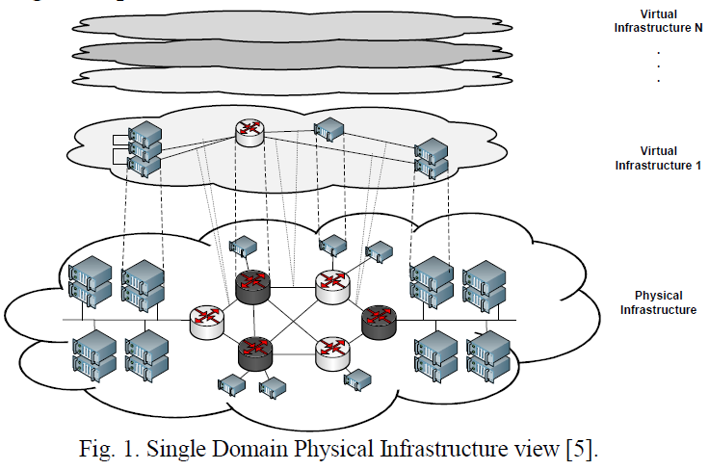

Slide 16
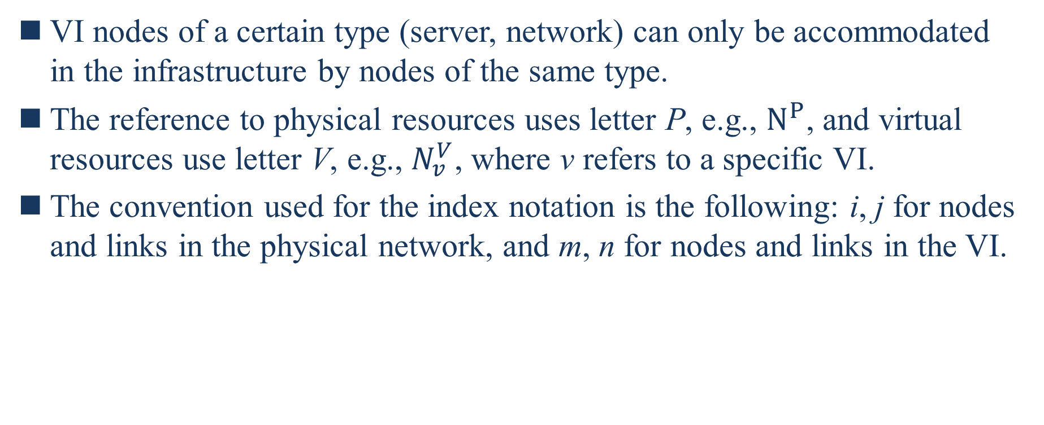
A. Scenario
VI nodes of a certain type (server, network) can only be accommodated in the infrastructure by nodes of the same type.
The reference to physical resources uses letter P, e.g., $N^{P}$, and virtual resources use letter V, e.g., $N_{v}^{V}$, where v refers to a specific VI.
The convention used for the index notation is the following: i, j for nodes and links in the physical network, and m, n for nodes and links in the VI.
Notes:
特定類型（服務器、網絡）的 VI 節點只能由相同類型的節點容納在基礎設施中。
對物理資源的引用使用字母 P，例如 $N^{P}$，虛擬資源使用字母 V，例如，$N_{v}^{V}$，其中 v 指的是特定的 VI。
用於索引符號的約定如下：i、j 表示物理網絡中的節點和鏈接，m、n 表示 VI 中的節點和鏈接。

Slide 17
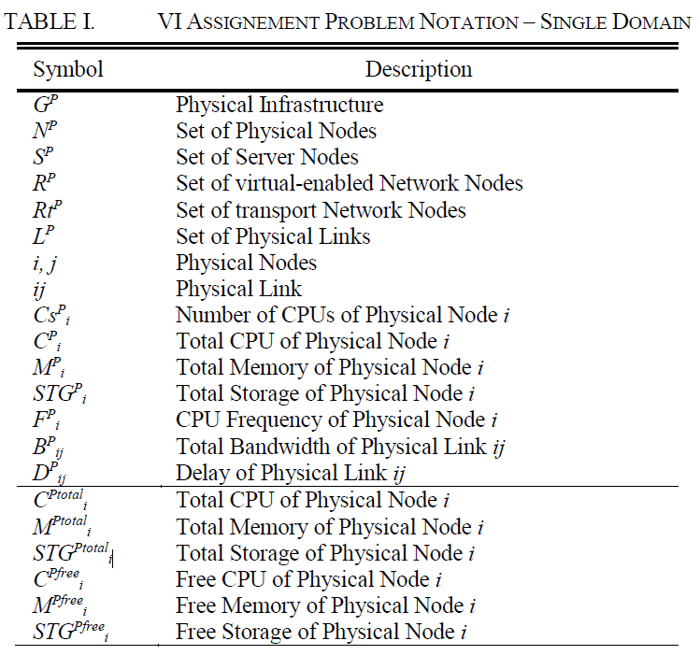
A. Scenario

Slide 18
B. Virtual Embedding Problem
The VI embedding problem is known to be NP-hard.
VIs can be mapped according to multiple objectives, e.g.: occupy the lowest bandwidth possible; balancing the occupation of the physical nodes.
Combining both objectives is not simple as they are not standalone, i.e. the choice of an ideal physical node may not allow the choice of the ideal physical link.
This is considered to be a multiple-objective optimization problem (MOP), where two or more conflicting objectives subject to constraints need to be simultaneously optimized.
Notes:
B. 虛擬嵌入問題
已知 VI 嵌入問題是 NP-hard 問題。
VI 的這些問題可以根據多個目標進行映射，例如：盡可能低的頻寬； 平衡物理節點。
結合這兩個目標並不簡單，因為它們不是獨立的，即選擇一個理想的物理節點可能無法選擇理想的物理鏈接。
這被認為是一個多目標優化問題 (MOP)，其中兩個或多個受約束的衝突目標需要同時優化。

Slide 19
IV. MATHEMATICAL FORMULATION
This section presents the mathematical formulation to solve the VI embedding problem.
Special attention is given to the formulation introduced that allows the VI re-optimization.
Notes:
四、 數學公式
本節介紹解決 VI 嵌入問題的數學公式。
特別注意引入的允許 VI 重新優化的公式。

Slide 20
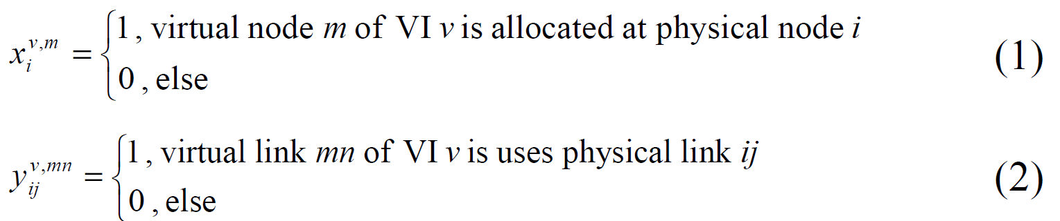
A. Assignment Variables & Generic Constraint
The formulation considers two binary assignment variables, x and y, one for the virtual nodes and another for virtual links as equations (1) and (2) show.
Notes:
A. 賦值變量和通用約束
該公式考慮了兩個變量 x 和 y，一個用於虛擬節點，另一個用於虛擬鏈接，如等式 (1) 和 (2) 所示。

Slide 21
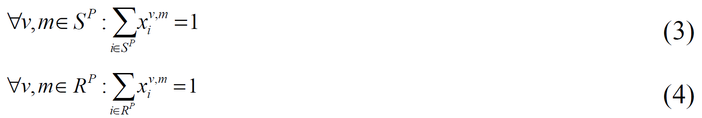
A. Assignment Variables & Generic Constraint
As mentioned in section III, virtual servers are assigned to physical server nodes.
Equation (3) reflects this constraint plus the fact that a virtual node is assigned just to one physical node.
Moreover, equation (4) assures that virtual network nodes are assigned to network nodes with virtual capabilities.
Notes:
如第三部分所述，虛擬服務器被分配給物理服務器節點。
等式 (3) 反映了這一約束以及一個虛擬節點僅分配給一個物理節點的事實。
此外，等式（4）確保將虛擬網絡節點分配給具有虛擬能力的網絡節點。
node m of VI v 只可能配對到一個 Physical node i
SP -> set of Server Nodes
RP -> set of virtual-enabled Network Nodes

Slide 22
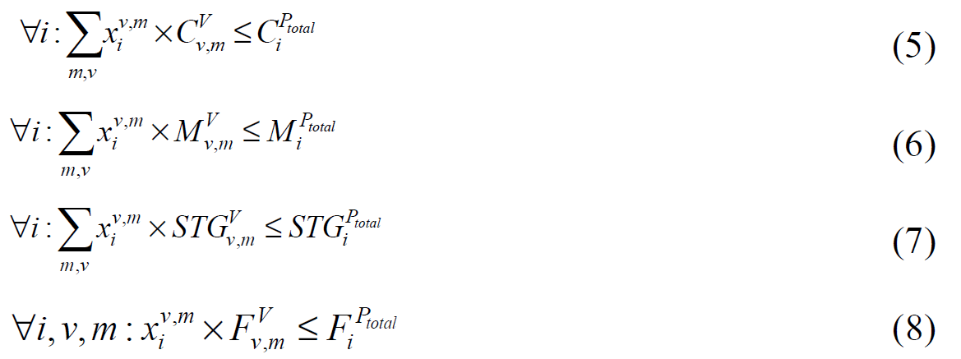
A. Assignment Variables & Generic Constraint
Equations (5), (6) and (7) guarantee that the capacity values of physical nodes are kept within range.
Equation (8) makes sure the physical node selected has at least the same frequency as the virtual node.
Notes:
等式（5）、（6）和（7）保證物理節點的容量值保持在範圍內。
等式（8）確保選擇的物理節點至少與虛擬節點具有相同的頻率。
$C_{i}^{Ptotal}$ = Total CPU of physical Node i
$M_{i}^{Ptotal}$ = Total Memory of physical Node I
${STG}_{i}^{Ptotal}$ = Total storage of physical Node I
$F_{i}^{Ptotal}$ = CPU Frequency of physical Node i

Slide 23
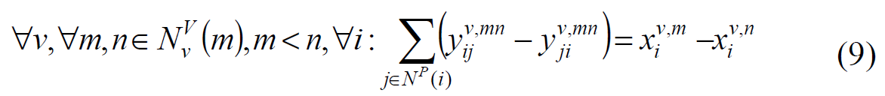
A. Assignment Variables & Generic Constraint
Equation (9) applies the multi-commodity flow constraint [13] with a node-link formulation [14] to simultaneously optimize the mapping of virtual links and nodes.
[13] S. Even, et.al, On the complexity of time table and multi-commodity flow problems, Foundations of Computer Science, 16th Annual Symposium on, (pp. 184-193), 1975.
[14] M. Pioro, D. Medhi. Routing, Flow, and Capacity Design in ommunication and Computer Networks. San Francisco, CA, USA: Morgan Kaufmann Publishers Inc, 2004. 2017 IEEE Symposium on Computers and Communications (ISCC) Authorized
Notes:
等式（9）應用多商品流限制[13]和節點鏈接公式[14]，同時優化虛擬鏈接和節點的映射。
(刪掉)此外，還使用了虛擬鏈路上的直接流的概念。
應該是如果m,n在不同的P node 上的話就會有一條P link mapping

Slide 24
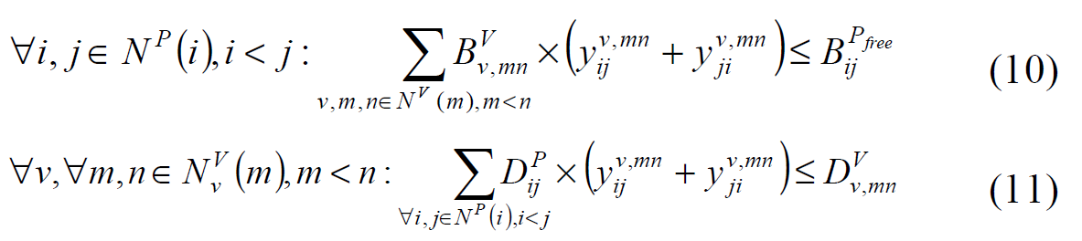
A. Assignment Variables & Generic Constraint
Equation (10) guarantees that each physical link selected has enough bandwidth available to host a virtual link. Finally, equation (11) guarantees that the virtual link delay constraint is met.
Notes:
等式 (10) 保證所選的每個物理鏈結都有足夠的頻寬來承載虛擬鏈結。
最後，等式（11）保證滿足虛擬鏈路延遲約束。
B -> P link ij 的可用頻寬
D -> 虛擬連結的delay會比實體的還要大

Slide 25
B. Formulations
Herein, we specifically focus on the re-optimization formulation.
The remaining formulations that support this article - maximum node and link load formulation, bandwidth consumption, and node and link state formulation - are presented in [5] and summarized here.
The maximum load formulation provides the load consumption of each type of resource (server node, network node and link) that is more loaded among all other resources.
The bandwidth consumption formulation calculates the total bandwidth that a VI consumes.
[5] J. Soares, J. Aparicio, S. Sargento, Dynamic strategies for the optimal embedding of virtual infrastructures, submitted to IEEE ICC, June 2017.
Notes:
B. 公式
在這裡，我們特別關注重新優化公式。
支持本文的其餘公式 - 最大節點和鏈結負載公式、頻寬消耗以及節點和鏈結狀態公式 - 在 [5] 中進行了介紹並在此處進行了總結。
最大負載公式提供了在所有資源中負荷較大的每一類資源（服務器節點、網絡節點和鏈接）的負荷消耗。
帶寬消耗公式計算 VI 消耗的總帶寬。

Slide 26
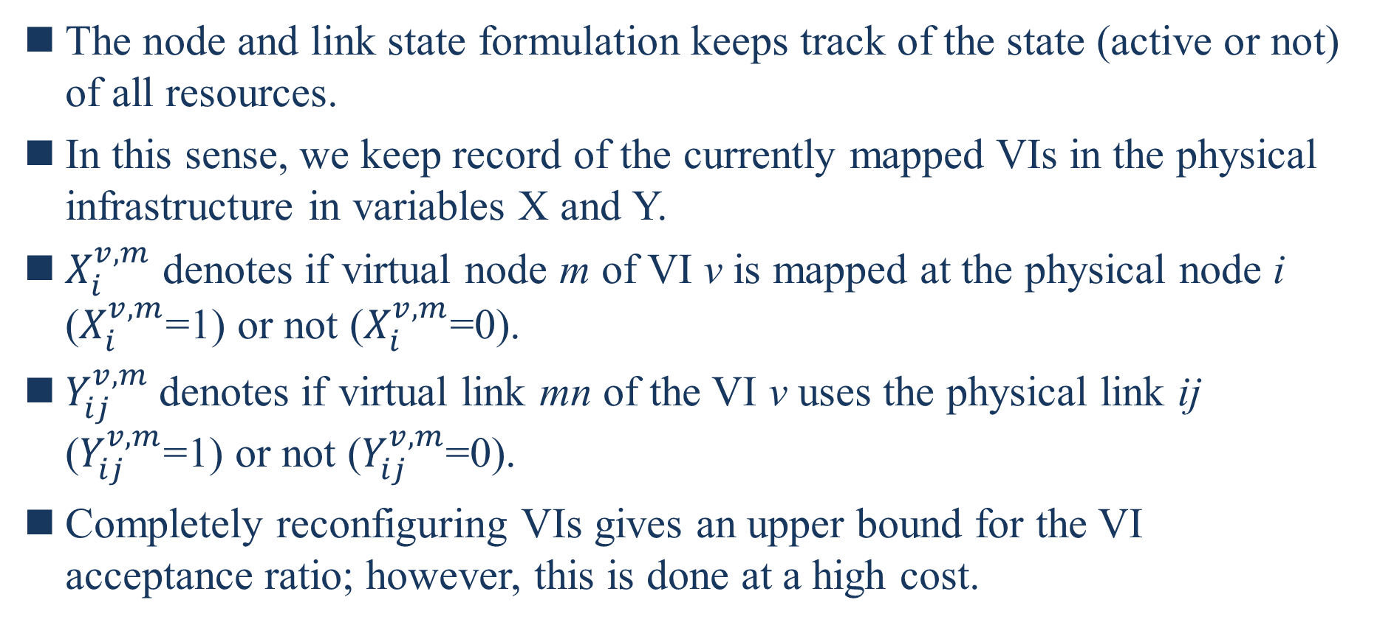
B. Formulations
The node and link state formulation keeps track of the state (active or not) of all resources.
In this sense, we keep record of the currently mapped VIs in the physical infrastructure in variables X and Y.
$X_{i}^{v,m}$ denotes if virtual node m of VI v is mapped at the physical node i ($X_{i}^{v,m}$=1) or not ($X_{i}^{v,m}$=0).
$Y_{ij}^{v,m}$denotes if virtual link mn of the VI v uses the physical link ij ($Y_{ij}^{v,m}$=1) or not ($Y_{ij}^{v,m}$=0).
Completely reconfiguring VIs gives an upper bound for the VI acceptance ratio; however, this is done at a high cost.
Notes:
節點和鏈路狀態公式跟踪所有資源的狀態（活動或非活動）。
從這個意義上說，我們在變量 X 和 Y 中記錄物理基礎設施中當前映射的 VI。
$X_{i}^{v,m}$表示VI v 的虛擬節點m 是否映射到物理節點i ($X_{i}^{v,m}$ =1) 或不映射($X_{i}^{v,m}$ =0)。
$Y_{ij}^{v,m}$表示VI v 的虛擬鏈接mn 是否使用物理鏈接ij ($Y_{ij}^{v,m}$=1) 或不使用($Y_{ij}^{v,m}$=1)。
完全重新配置 VI 給出VI 接受率的上限； 然而，這樣做的成本很高。

Slide 27

B. Formulations
The disruption caused is extremely high, especially when virtual nodes are migrated.
Equation (12) guarantees that VI nodes already embedded must remain in the same physical hosts.
Equation (13) guarantees that virtual links already embedded remain intact.
When equations (12) and (13) are not considered, reconfiguration of nodes and/or links is possible.
Notes:
在遷移虛擬節點時很容易造成中斷
等式（12）保證已經嵌入的 VI 節點必須保留在相同的物理主機中。
等式（13）保證已經嵌入的虛擬鏈接保持完整。
當不考慮等式（12）和（13）時，節點和/或鏈路的重新配置是可能的。

Slide 28
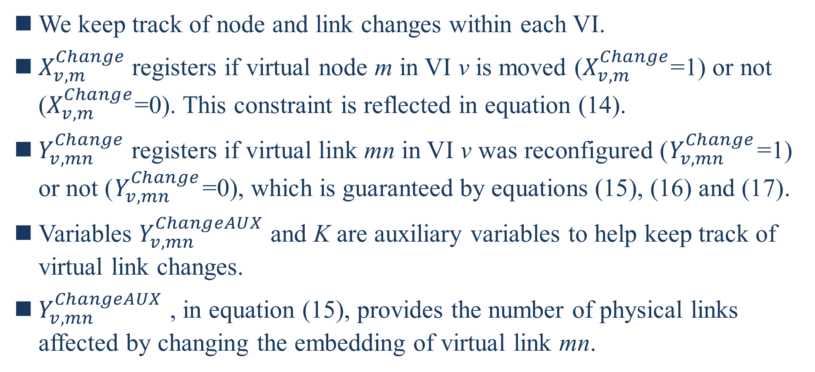
B. Formulations
We keep track of node and link changes within each VI.
$X_{v,m}^{Change}$registers if virtual node m in VI v is moved ($X_{v,m}^{Change}$=1) or not ($X_{v,m}^{Change}$=0). This constraint is reflected in equation (14).
$Y_{v,mn}^{Change}$registers if virtual link mn in VI v was reconfigured ($Y_{v,mn}^{Change}$=1) or not ($Y_{v,mn}^{Change}$=0), which is guaranteed by equations (15), (16) and (17).
Variables $Y_{v,mn}^{ChangeAUX}$ and K are auxiliary variables to help keep track of virtual link changes.
$Y_{v,mn}^{ChangeAUX}$ , in equation (15), provides the number of physical links affected by changing the embedding of virtual link mn.
Notes:
我們跟踪每個 VI 中節點和鏈接的變化。
$X_{v,m}^{Change}$ 如果 VI v 中的虛擬節點 m 是否被移動 ($X_{v,m}^{Change}$=1)，如果沒有($X_{v,m}^{Change}$=0) 。該約束反映在等式（14）中。
$Y_{v,mn}^{Change}$ 如果在VI V虛擬鏈結mn為重新配置（$Y_{v,mn}^{Change}$= 1）或否（$Y_{v,mn}^{Change}$= 0），這是由方程保證 (15)、(16) 和 (17)。
變數 $Y_{v,mn}^{ChangeAUX}$ 和 K 是幫助跟踪虛擬鏈接變化的輔助變數。
$Y_{v,mn}^{ChangeAUX}$，在等式（15）中，提供了改變虛擬鏈接 mn 的嵌入所影響的物理鏈接的數量。

Slide 29
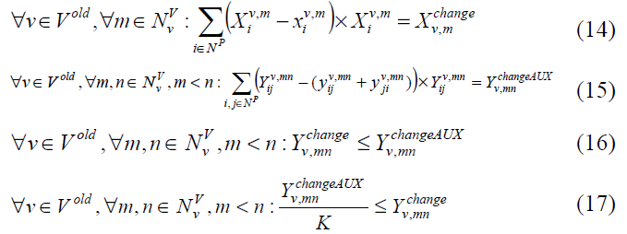

B. Formulations
Equation (16) guarantees that, if $Y_{v,mn}^{ChangeAUX}$=0, then $Y_{v,mn}^{Change}$=0.
In equation (17) variable K is a sufficient large number to ensure that $Y_{v,mn}^{Change}$=1 if $Y_{v,mn}^{ChangeAUX}$ ≥1
Notes:
等式（16）保證，如果$Y_{v,mn}^{ChangeAUX}$=0，那麼$Y_{v,mn}^{Change}$=0
在方程（17）中，變量 K 是一個足夠大的數，以確保 $Y_{v,mn}^{Change}$=1 如果$Y_{v,mn}^{ChangeAUX}≥1$

Slide 30
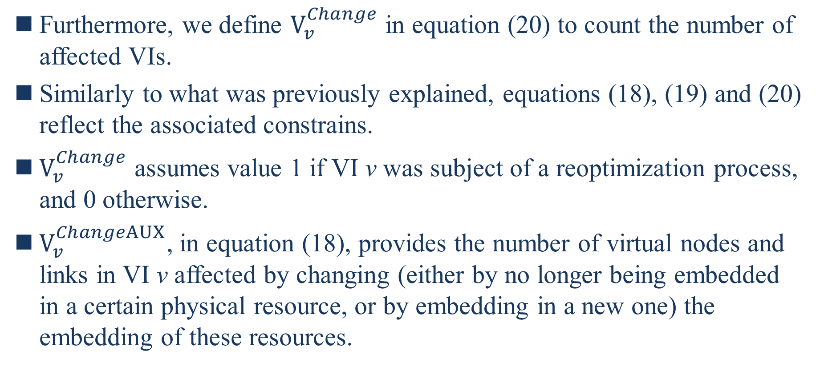
B. Formulations
Furthermore, we define $V_{v}^{Change}$ in equation (20) to count the number of affected VIs.
Similarly to what was previously explained, equations (18), (19) and (20) reflect the associated constrains.
$V_{v}^{Change}$ assumes value 1 if VI v was subject of a reoptimization process, and 0 otherwise.
$V_{v}^{ChangeAUX}$, in equation (18), provides the number of virtual nodes and links in VI v affected by changing (either by no longer being embedded in a certain physical resource, or by embedding in a new one) the embedding of these resources.
Notes:
此外，我們在方程（20）中定義了$V_{v}^{Change}$來計算受影響的 VI 的數量。
與前面解釋的類似，方程 (18)、(19) 和 (20) 反映了相關的約束。
$V_{v}^{Change}$ 如果 VI v 是重新優化過的對象，則值為 1，否則為 0。
$V_{v}^{ChangeAUX}$，在公式（18）中，提供了VI v中受這些資源（要么不再嵌入某個物理資源，要么嵌入一個新的物理資源）的嵌入影響的虛擬節點和鏈接的數量。

Slide 31
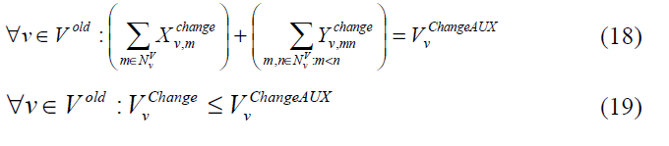


B. Formulations
Equation (19) guarantees that if $V_{v}^{ChangeAUX}$=0, then $V_{v}^{Change}$=0.
Notes:
等式（19）保證如果$V_{v}^{ChangeAUX}$=0, then $V_{v}^{Change}$=0.
$V_{v}^{ChangeAUX}$，在公式（18）中，提供了VI v中受改變（要么不再嵌入某個物理資源，要么嵌入一個新的物理資源）這些資源的嵌入影響的虛擬節點和鏈接的數量。
$X_{v,m}^{Change}$ 如果 VI v 中的虛擬節點 m 是否被移動
$Y_{v,mn}^{Change}$ 如果在VI V虛擬鏈結mn為重新配置

Slide 32
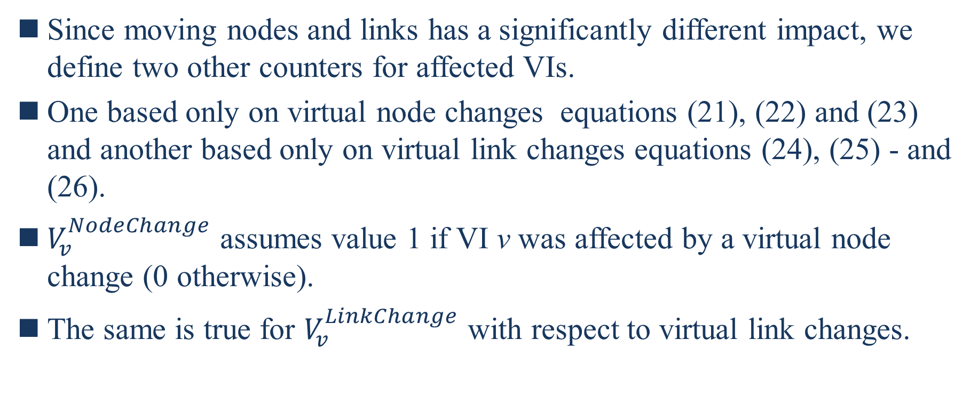
B. Formulations
Since moving nodes and links has a significantly different impact, we define two other counters for affected VIs.
One based only on virtual node changes equations (21), (22) and (23) and another based only on virtual link changes equations (24), (25) - and (26).
$V_{v}^{NodeChange}$ assumes value 1 if VI v was affected by a virtual node change (0 otherwise).
The same is true for $V_{v}^{LinkChange}$ with respect to virtual link changes.
Notes:
由於移動節點和鏈接具有顯著不同的影響，我們為受影響的 VI 定義了另外兩個計數器。
一個僅基於虛擬節點變化方程（21）、（22）和（23），另一個僅基於虛擬鏈路變化方程（24）、（25）-和（26）。
$V_{v}^{NodeChange}$如果 VI v 受到虛擬節點更改的影響，則假定值為 1（否則為 0）。
對於 $V_{v}^{LinkChange}$的虛擬鏈結更改也是如此。

Slide 33
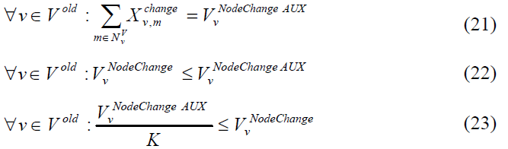
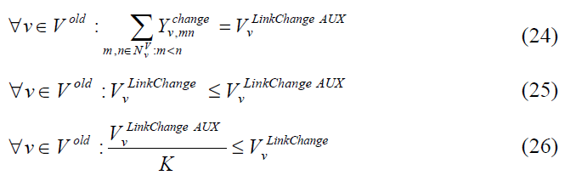

B. Formulations
Variables $V_{v}^{NodeChangeAUX}$ , $V_{v}^{LinkChangeAUX}$ , and K are used for the same purpose as in the cases before - to keep the values of $V_{v}^{NodeChange}$ and $V_{v}^{LinkChange}$ within boundaries (0 or 1).
Notes:
變數$V_{v}^{NodeChangeAUX}$ , $V_{v}^{LinkChangeAUX}$和K用於與之前案例相同的目的 - 保持$V_{v}^{NodeChange}$ and $V_{v}^{LinkChange}$ within boundaries (0 or 1).

Slide 34
V. EMBEDDING STRATEGIES
In this section, we present a set of embedding strategies divide in three main categories: base strategies, dynamic strategies, and reconfiguration strategies.
Notes:
V. 嵌入策略
在本節中，我們提出了一組嵌入策略，分為三個主要類別：基本策略、動態策略和重新配置策略。

Slide 35

A. Base Strategies
These strategies are considered base ones because they will be part of the strategies presented in the following categories.
Load Balancing + Shortest Path - VIE-Opt-LB+SP
This strategy aims to minimize the maximum load of node and link resources by also considering the total bandwidth consumption of a VI.
$S_{load}^{max}$ and $R_{load}^{max}$ refer to the maximum load consumption of server and virtual-enabled network nodes, respectively.
$L_{load}^{max}$ refers to the maximum load consumption of links, and $B_{cons}$ refers to the total amount of bandwidth consumed by a VI.
Notes:
A. 基本策略
這些策略被視為基礎策略，因為它們將成為以下類別中介紹的策略的一部分。
該策略旨在通過還考慮 VI 的總頻寬消耗來最小化節點和鏈路資源的最大負載。
$S_{load}^{max}$ and $R_{load}^{max}$ 分別是指服務器和虛擬網絡節點的最大負載消耗。
$L_{load}^{max}$是指鏈路的最大負載消耗，而$B_{cons}$ 是指VI 消耗的頻寬總量。

Slide 36
A. Base Strategies
Load Balancing + Shortest Path - VIE-Opt-LB+SP
In this case, the weights w1 and w2 have equal values so that there is an equal balance between maximum node load and overall link load (by considering maximum link load and total bandwidth consumed).
Notes:
在這種情況下，權重 w1 和 w2 具有相等的值，因此最大節點負載和總鏈結負載之間存在相等的平衡（通過考慮最大鍊結負載和消耗的總帶寬）。
$S_{load}^{max}$ : 服務器的最大負載消耗。
$R_{load}^{max}$ : 虛擬網絡節點的最大負載消耗。
$L_{load}^{max}$ : 是指鏈路的最大負載消耗
$B_{cons}$ : 是指VI 消耗的頻寬總量。

Slide 37
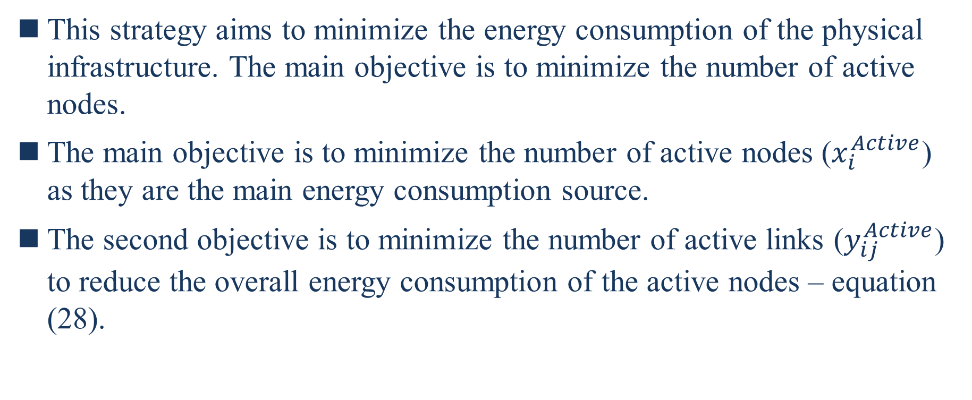
A. Base Strategies
2) Green strategy - VIE-Opt –Green
This strategy aims to minimize the energy consumption of the physical infrastructure. The main objective is to minimize the number of active nodes.
The main objective is to minimize the number of active nodes ($x_{i}^{Active}$) as they are the main energy consumption source.
The second objective is to minimize the number of active links ($y_{ij}^{Active}$) to reduce the overall energy consumption of the active nodes – equation (28).
Notes:
該策略旨在最大限度地減少物理基礎設施的能源消耗。 主要目標是最小化活動節點的數量。
主要目標是盡量減少活動節點（$x_{i}^{Active}$）的數量，因為它們是主要的能源消耗來源。
第二個目標是最小化活動鏈接的數量（$y_{ij}^{Active}$）以減少活動節點的整體能耗——方程（28）。

Slide 38

A. Base Strategies
2) Green strategy - VIE-Opt –Green
In this case, w1 is sufficiently higher than w2 so that the primary objective is to minimize the number of active nodes, and ɛ is a very small value so that another objective can be considered as a tiebreak objective, presented in the equation as Strat.
The objective considered in Strat in the evaluation section is the load balancing with shortest path (VIE-Opt-LB+SP equation (27)).
Notes:
在這種情況下，w1 遠高於 w2，因此主要目標是最小化活動節點的數量，而 ɛ 是一個非常小的值，因此可以將另一個目標視為決勝局目標，在等式中表示為 Strat。
Strat 在評估部分考慮的目標是最短路徑的負載平衡（VIE-Opt-LB+SP 方程（27））。
Tie breaker : 決勝局

Slide 39
A. Base Strategies
2) Green strategy - VIE-Opt –Green
Load balancing the active elements of the infrastructure will ease the future embedding of VIs without having to increase the number of active elements.
Notes:
基礎設施的活動元素的負載平衡將簡化 VI 的未來嵌入，而不必增加活動元素的數量。

Slide 40
B. Dynamic Strategies - Adjusting Weights
This strategy combines different objectives dynamically.
It uses the green strategy (VIE-Opt Green) and the load balancing with shortest path (VIE-Opt-LB+SP).
In equation weights (z1 and z2) are not fixed along time, but change depending on the infrastructure state at the time of each VI arrival.
We consider that if the infrastructure is loaded over a certain limit, the load balancing strategy is applied. If the load is below or equal to the limit, the green strategy is applied.
Notes:
B. 動態策略 - 調整權重
這種策略動態地結合了不同的目標。
它使用綠色策略（VIE-Opt Green）和最短路徑負載均衡（VIE-Opt-LB+SP）。
在等式中，權重（z1 和 z2）不隨時間固定，而是根據每個 VI 基礎設施狀態而變化。
我們認為如果基礎設施負載超過一定限制，則應用負載均衡策略。 如果負載低於或等於限制，則應用綠色策略。

Slide 41
C. Re-optimization Strategies
The strategies defined in this category allow the reconfiguration of already deployed VIs.
We present two types of strategies: those that allow only link re-optimization; and those that allow both link and node re-optimization.
Taking advantage of the strategies presented in the previous subsection, the following strategies are defined:
Notes:
C. 再優化策略
此類別中定義的策略允許重新配置已部署的 VI。
我們提出兩種類型的策略：只允許鏈接重新優化的策略； 以及允許鏈接和節點重新優化的那些。
利用上一小節中介紹的策略，定義了以下策略：

Slide 42
C. Re-optimization Strategies
Load Balancing (Node and Link) + Shortest Path strategy with Link Re-optimization - VIE-LinkReOpt-LB+SP
Load Balancing (Node and Link) + Shortest Path strategy with Node and Link Re-optimization - VIE-ReOpt-LB+SP
Green strategy with Link Re-optimization – VIE-LinkReOpt-LB-R
Green strategy with Node and Link Re-optimization- VIE-ReOpt–Green
Green + Load Balancing with Link Re-optimization – VIE-Link-ReOpt-D-Green-LB
Green + Load Balancing with Node and Link Re optimization - VIE-ReOpt-D-Green-LB
Notes:
紅色地方寫反了
負載均衡（節點和鏈路）+具有鏈結重新優化的最短路徑策略 - VIE-LinkReOpt-LB+SP
負載平衡（節點和鏈路）+ 具有節點和鏈路重新優化的最短路徑策略 - VIE-ReOpt-LB+SP
具有鏈接重新優化的綠色策略 – VIE-LinkReOpt-LB-R
具有節點和鏈路重新優化的綠色策略 - VIE-ReOpt–Green
具有鏈路重新優化的綠色 + 負載平衡 – VIE-Link-ReOpt-D-Green-LB
具有節點和鏈路重新優化的綠色 + 負載平衡 - VIE-ReOpt-D-Green-LB

Slide 43
C. Re-optimization Strategies
Node reconfigurations are the most expensive ones, while link reconfigurations can be easily achieved and, to a certain extent, be neglected when considering the use of technologies like SDN.
With this in mind, we do not penalize link reconfigurations.
However, those that allow also node re-optimization suffer a change, presented in equation (30).
Notes:
節點重配置是最昂貴的，而鏈路重配置很容易實現，並且在考慮使用SDN等技術時在一定程度上被忽略。
考慮到這一點，我們不會考慮那些鏈結重新配置所造成的負面影響。
然而，那些也允許節點重新優化的會發生變化，如等式 (30) 所示。

Slide 44
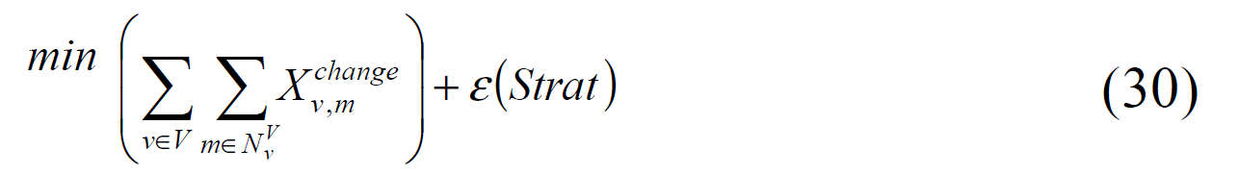
C. Re-optimization Strategies
Due to the cost of node reconfigurations, the objective functions first try to minimize the number of virtual node reconfigurations.
ɛ is a very small value so that Strat is considered as the last objective.
Depending on the strategy used, Strat will assume different forms.
Notes:
由於節點重新配置的成本，目標函數首先嘗試最小化虛擬節點重新配置的數量。
ɛ 是一個非常小的值，因此 Strat 被視為最後一個目標。
根據所使用的策略，Strat 將採用不同的形式。

Slide 45

C. Re-optimization Strategies
For example, in the strategy VIE-ReOpt-LB+SP, Strat will assume the form of equation (29), which leads to the objective function presented in equation (31).
In this case, since both virtual node and link reconfigurations are allowed, equations (12) and (13) are not considered.
In the case of strategy VIE-LinkReOpt-LB+SP, equation (13) is considered to prevent virtual node reconfigurations.
Notes:
例如，在策略 VIE-ReOpt-LB+SP 中，Strat 將採用等式 (29) 的形式，從而得出等式 (31) 中所示的目標函數。
在這種情況下，由於允許虛擬節點和鏈路重新配置，因此不考慮等式（12）和（13）。
在策略 VIE-LinkReOpt-LB+SP 的情況下，考慮等式（13）以防止虛擬節點重新配置。

Slide 46
VI. EVALUATION
Herein we provide a thorough evaluation of the different optimal embedding strategies presented in section V.
To evaluate the performance of the proposed approaches, a Matlab + CPLEX simulator is used.
For each run, the program generates a random physical infrastructure of 20 nodes and a set of requests of VIs (with a number of nodes between 4 and 14).
Both physical infrastructure and the generated VIs have 70% of the nodes as servers.
These values were chosen because, in a cloud computing context, the required computing node capacity is much higher than the network one.
Notes:
六、 評估
在此，我們對第五部分中介紹的不同最佳嵌入策略進行了全面評估。
為了評估所提出方法的性能，使用了 Matlab + CPLEX 模擬器。
對於每次運行，程序生成一個隨機的 20 個節點的物理基礎設施和一組 VI 請求（節點數在 4 到 14 之間）。
物理基礎設施和生成的 VI 都有 70% 的節點作為服務器。
選擇這些值是因為，在雲計算環境中，所需的計算節點容量遠高於網絡節點容量。

Slide 47
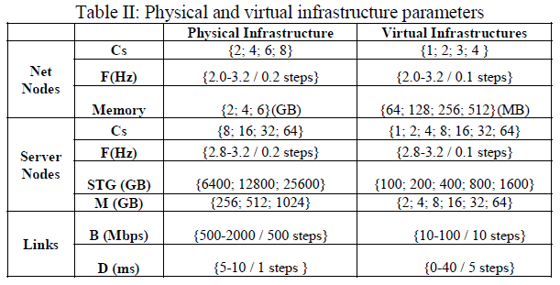
VI. EVALUATION
Details on the nodes and link parameters can be seen in Table II.

Slide 48
VI. EVALUATION
Moreover, the VI request rates (λ) vary between 2 and 5 VIs per time unit (Poisson arrivals), and the average duration of the VIs is 20 time units (exponentially distributed duration).
The weight values used for the optimal strategies are the following: w1 and w2 are 0.5; ɛ is 0.001; z1 and z2 have dynamic values that change depending on the state of the infrastructure.
If the maximum load of any resource (server/network node or link) is below 75%, Opt-Green is applied; otherwise, Opt-LB+SP is applied.
Notes:
此外，VI 請求率 (λ) 在每個時間單位（泊松到達）2 到 5 個 VI 之間變化，並且 VI 的平均持續時間為 20 個時間單位（指數分佈持續時間）。
用於最優策略的權重值如下：w1 和 w2 為 0.5； ɛ 為 0.001； z1 和 z2 具有根據基礎設施狀態而變化的動態值。
如果任何資源（服務器/網絡節點或鏈接）的最大負載低於 75%，則應用 Opt-Green； 否則，應用 Opt-LB+SP
Poisson process是隨機過程的一種
實驗經驗所以選擇75%

Slide 49
VI. EVALUATION
We analyze the VI acceptance ratio as one of the main indicators for the performance of the algorithms.
Moreover, the energy consumption of the physical infrastructure is also analyzed.
Finally, the impact of the re-optimization processes in the VI is carefully evaluated.
All values in the following graphics present a mean of 10 runs (with different substrate) with a confidence interval of 95%.
Notes:
我們將 VI 接受率作為算法性能的主要指標之一進行分析。
此外，還分析了物理基礎設施的能源消耗。
最後，仔細評估了 VI 中重新優化過程的影響。
下圖中的所有值均表示 10 次運行（使用不同底物）的平均值，置信區間為 95%。

Slide 50
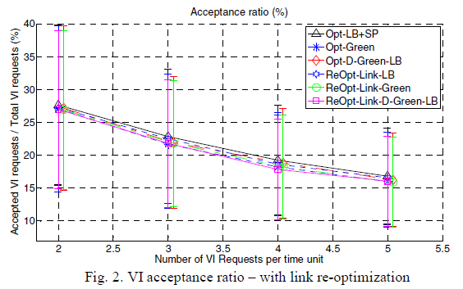
A. Virtual Infrastructure Acceptance Ratio analysis
Fig.2 compares the results of the strategies with and without link re-optimization.
It is clear that the strategies allowing link reconfiguration do not present significant differences.
Notes:
A. 虛擬基礎設施接受率分析
圖 2 比較了有和沒有鏈接重新優化的策略的結果。
很明顯，允許鏈路重新配置的策略沒有顯著差異。
下面為VI requests的數量，左側為接受度，比較低應該是因為是一個ILP的問題，無法快速的解決這個問題，那些Re比較快的原因是因為限制比較少，nodes and links都可以做移動

Slide 51
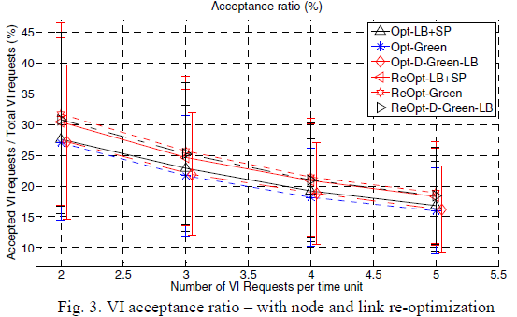
A. Virtual Infrastructure Acceptance Ratio analysis
This happens because these strategies are limited in terms of virtual link mapping alternative solution that make a reconfiguration viable.
On the other hand, the strategies allowing both node and link re-optimization outperform all others – see Fig.3.
The values are, in average, up to 5% higher.
3
1
32%-19%
2
Notes:
發生這種情況是因為這些策略在使重新配置可行的虛擬鏈路映射替代解決方案方面受到限制。
另一方面，允許節點和鏈路重新優化的策略優於所有其他策略——見圖 3。
平均而言，這些值最多高出 5%。
越高越好

Slide 52
A. Virtual Infrastructure Acceptance Ratio analysis
The difference between the three strategies is low (~1%).
This does not happen due to the time constraint set to solve the ILP problem (600 seconds).
In other words, in some cases no solution is found within the defined timeframe.
Notes:
(Fig. 3)(Re….的三種策略) 三種策略之間的差異很小（~1%）。
由於為解決 ILP 問題而設置的時間限制（600 秒），這不會發生。
換句話說，在某些情況下，在定義的時間範圍內找不到解決方案。

Slide 53
B. Physical Infrastructure Energy Consumption
Herein it is analyzed the performance of the different strategies in terms of the physical infrastructure energy consumption.
While in terms of acceptance ratio some strategies present values relatively close, the differences with respect to energy consumption are more pronounced.
The analysis is done considering the cumulative time of active resources, and the results are depicted in Fig. 4 and Fig. 5.
The values are presented in percentage, where 100% means that all resources were active during the entire simulation time.
Notes:
B. 物理基礎設施能源消耗
這里分析了不同策略在物理基礎設施能耗方面的性能。
雖然就接受率而言，一些策略呈現的值相對接近，但在能源消耗方面的差異更為明顯。
分析考慮了活動資源的累積時間，結果如圖 4 和圖 5 所示。
這些值以百分比表示，其中 100% 表示所有資源在整個模擬時間內都處於活動狀態。

Slide 54
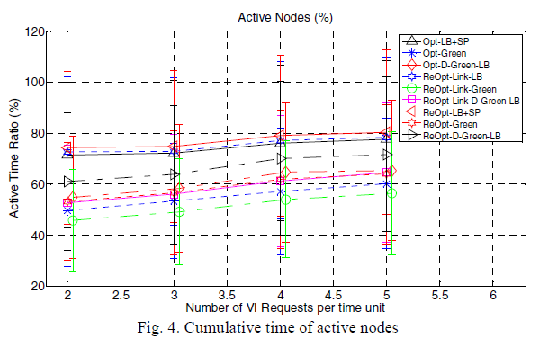
B. Physical Infrastructure Energy Consumption
71%-81%
50%-60%
55%-64%
71%-81%
1
47%-57%
53%-63%
71%-81%
53%-63%
61%-71%
Notes:
所有考慮綠色策略的策略在能源消耗方面都優於其餘策略，即它們有比較低的值。
因為綠色策略就是為了減少耗能

Slide 55
B. Physical Infrastructure Energy Consumption
Not surprisingly, all strategies that consider the green policy outperform the remaining ones in terms of energy consumption, i.e. they present lower values.
Notes:
毫不奇怪，所有考慮綠色政策的策略在能源消耗方面都優於其餘策略，即它們有比較低的值。

Slide 56
B. Physical Infrastructure Energy Consumption
The VIE-ReOpt-Link-Green strategy clearly outperforms the remaining ones (47%-57%).
Although having close values, it is important not to forget that the VIE-ReOpt-Green strategy presents gains up to 5% in terms of acceptance and still manages to present lower values in terms of active nodes.
We highlight here the fact that, among the strategies that consider energy consumption, those that allow only link reoptimization present similar acceptance ratio to those not allowing re-optimization.
However, the former ones do improve the energy consumption indicators.
Notes:
(Fig. 4) VIE-ReOpt-Link-Green 策略明顯優於其餘策略 (47%-57%)。
儘管具有接近的值，但重要的是不要忘記 VIE-ReOpt-Green 策略在接受度方面提供高達 5% 的收益，並且仍然設法在活動節點方面提供較低的值。
我們在此強調的事實是，在考慮能耗的策略中，僅允許鏈路重新優化的策略與不允許重新優化的策略具有相似的接受率。
但是，前者(允許鏈路重新優化的策略)確實提高了能耗指標。

Slide 57
B. Physical Infrastructure Energy Consumption
If the impact of link reconfiguration is low to the point that it can be neglected, these strategies should indeed be considered as better approaches than those performing no reconfiguration.
In terms of active links (Fig.5) the strategies have similar performance.
Notes:
如果鏈路重新配置的影響低到可以忽略的程度，那麼這些策略確實應該被視為比不執行重新配置的策略更好的方法。
就活動鏈接而言（圖 5），這些策略具有相似的性能。

Slide 58
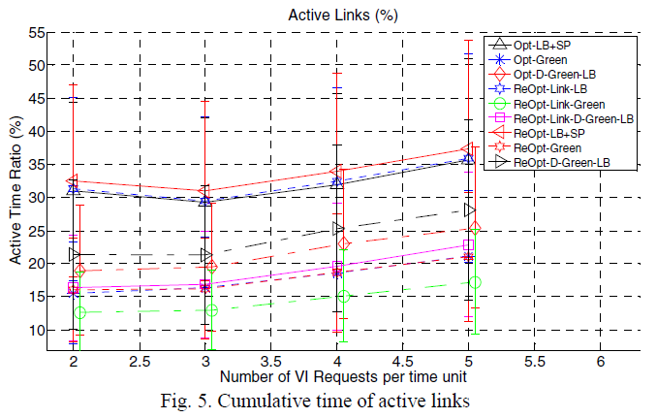
B. Physical Infrastructure Energy Consumption
Green : 12% and 27%.
LB : 29% and 37%.

Slide 59
B. Physical Infrastructure Energy Consumption
The optimal strategies with green approaches perform better, with values of active time between 12% and 27%.
The optimal strategies with load-balancing policies present values between 29% and 37%.
Notes:
(剛剛Fig.5 的數值)
補充的部分 :
請注意，就像接受率指標一樣，接受率指標的值隨著 VI 到達率的增加呈現線性減少。 然而，與接受率相反，這裡它們(active links)隨著 VI 到達率的增加而增加。
這是因為，儘管接受率隨著 VI 到達率的增加而降低，但嵌入物理基礎設施中的 VI 總數增加，這導致基板中的活動資源百分比更高。

Slide 60
C. Re-optimization impact analysis
In this subsection, it is performed an analysis to the different strategies that consider re-optimization of resources.
The analysis is done in different perspectives:
VIs affected by reconfiguration, whether by link or node;
VIs affected by link reconfiguration;
VIs affected by node reconfiguration;
overall number of link reconfigurations;
overall number of migrated nodes.
Notes:
C、重新優化影響分析
在本小節中，對考慮重新優化資源的不同策略進行了分析。
受鏈接還是節點重新配置而影響到的 VI；
受鏈接重新配置影響的 VI；
受節點重新配置影響的 VI；
鏈路重新配置的總數；
遷移節點的總數。

Slide 61
C. Re-optimization impact analysis
Fig. 6 shows the number of VIs affected by reconfigurations (node and/or link).
Notes:
圖 6 顯示了受重新配置（節點和/或鏈接）影響的 VI 數量。

Slide 62
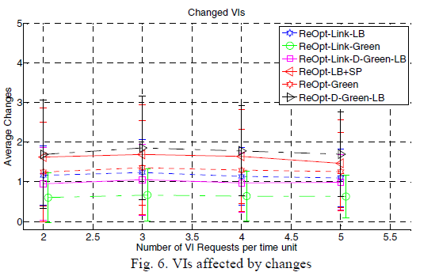
C. Re-optimization impact analysis
1.2
0.6
1
1.6
1.3
1.8
Notes:
越少越好

Slide 63
C. Re-optimization impact analysis
The VIE-ReOpt-D-Green-LB presents the highest value with a mean of 1.8 VIs affected per reoptimization process, followed by the VIE-ReOpt-LB+SP with a mean of 1.6.
The gap between the VIE-ReOpt-Link-Green and the other two strategies that allow only link reconfiguration is due to the fact that the former is a pure green strategy that tends to load active resources (nodes and links), which leads resources to a point of saturation much faster than the load balancing strategy.
Therefore, with a higher probability of saturating nodes, trying to reconfigure virtual links to map a new VI will be in some cases inglorious.
Notes:
(剛剛講過) VIE-ReOpt-D-Green-LB 呈現最高值，每個重新優化過程平均影響 1.8 個 VI，其次是 VIE-ReOpt-LB+SP，平均值為 1.6。
VIE-ReOpt-Link-Green 與僅允許鏈路重配置的其他兩種策略之間的差距是由於前者是一種純綠色策略，傾向於加載活動資源（節點和鏈接），但這導致資源 飽和點比負載平衡策略快得多。
因此，在節點飽和的可能性較高的情況下，嘗試重新配置虛擬鏈接以映射新的 VI 在某些情況下將是不光彩的。
(第二點補充) 這邊最下面應該是說 因為green的策略偏向加載活動資源（節點和鏈接），這導致資源飽和比負載平衡策略快得多，但LB資源點飽和的機率是低很多的，所以LB是一個不錯的策略
Saturating : 飽和
Inglorious : 不光彩的

Slide 64
C. Re-optimization impact analysis
On the other hand, in the load balancing strategy, the probability of nodes reaching a saturation point is much lower than in the former case, which will allow more fruitful reconfigurations of virtual links.
Fig. 7 shows the values related to the overall number of links reconfigured.
Notes:
另一方面，在負載均衡策略中，節點達到飽和點的概率遠低於前一種情況，這將允許更富有成效的虛擬鏈路重新配置。
圖 7 顯示了與重新配置的鏈路總數相關的值。

Slide 65
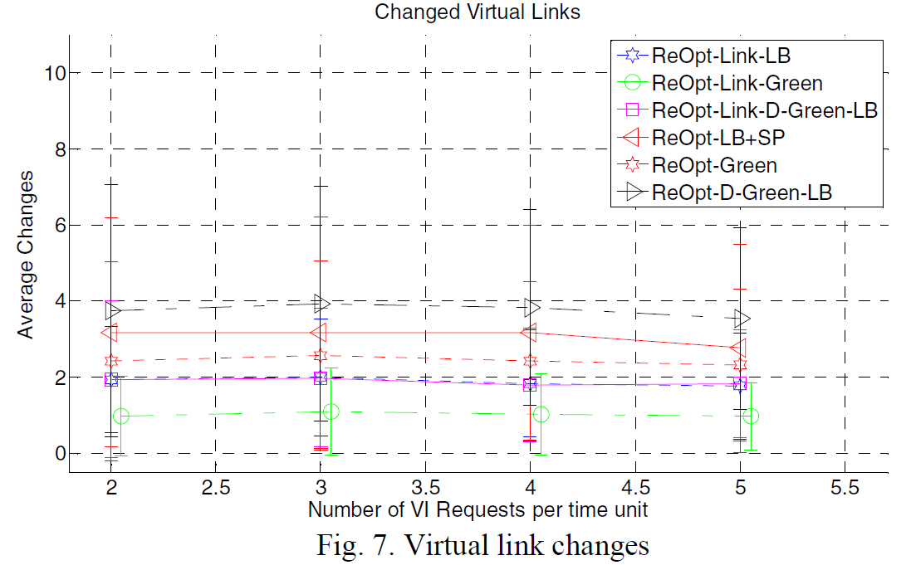
C. Re-optimization impact analysis
1.9
1
1.9
3.1
2.5
3.9

Slide 66
C. Re-optimization impact analysis
The number of VIs affected by the reconfiguration of links is depicted in Fig. 8. Here the ranking remains the same as before.
Notes:
受鏈接重新配置影響的 VI 數量如圖 8 所示。這裡的排名與以前相同

Slide 67
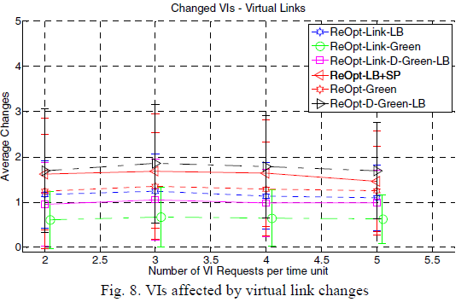
C. Re-optimization impact analysis

Slide 68
C. Re-optimization impact analysis
With respect to the number of nodes reconfigured, the values between the three strategies that allow node reconfiguration are close – see Fig. 9.
The mean values are between 0.5 and 0.6 of virtual nodes that change.
Notes:
關於重新配置的節點數量，允許節點重新配置的三種策略之間的值接近——見圖 9。
平均值介於 0.5 和 0.6 之間的虛擬節點發生變化。

Slide 69
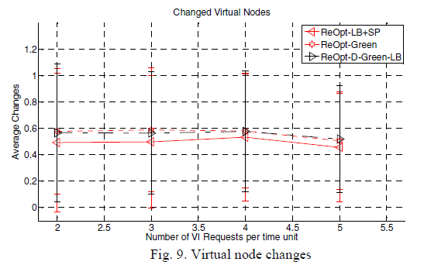
C. Re-optimization impact analysis
Notes:
平均值在 0.5 和 0.6 之間變化的虛擬節點。

Slide 70
C. Re-optimization impact analysis
However, the number of VIs affected by the migration of nodes is only nearly 0.15 as shown in Fig. 10.
Notes:
然而，受節點遷移影響的 VI 數量只有近 0.15，如圖 10 所示。

Slide 71
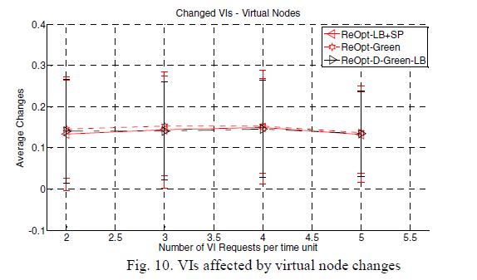
C. Re-optimization impact analysis
Notes:
約莫平均0.15個

Slide 72
C. Re-optimization impact analysis
These results show that the node re-optimization impact can be low.
However, it is considered as future work the characterization of VI nodes in terms of their ability/cost to me migrated.
In this sense, the embedding strategy can better assess which nodes it should first try to migrate.
Notes:
這些結果表明節點重新優化的影響可能很小。
然而，VI 節點在他們遷移時的能力/成本方面的特徵被認為是在未來的工作。
從這個意義上說，嵌入策略可以更好地評估它應該首先嘗試遷移哪些節點。

Slide 73
VII. CONCLUSION AND FUTURE WORK
Optimal formulations and strategies based on ILP to solve the problem were proposed.
An in-depth comparative performance analysis between different strategies was done.
Strategies allowing full re-optimization of resources clearly outperform the remaining ones in terms of acceptance ratio.
However, the adoption of these strategies needs to take into consideration the costs of reconfiguring resources.
The reconfiguration impact values are optimistic.
Notes:
七、 結論和未來的工作
提出了基於 ILP 的優化公式和策略來解決該問題。
對不同策略之間進行了深入的比較性能分析。
允許完全重新優化資源的策略在接受率方面明顯優於其餘策略。
但是，採用這些策略需要考慮重新配置資源的成本。
重新配置影響值是樂觀的。

Slide 74
VII. CONCLUSION AND FUTURE WORK
Furthermore, since each VI and resource can have specific requirements, an evolvement of these strategies could be to classify resources with respect to their ability/cost to be migrated.
This aspect can be especially important in virtual nodes, since they are the ones more difficult to move.
In the cases of strategies allowing only link reoptimization, the values of acceptance ratio remain nearly the same; however, the energy consumption can be improved with green objectives.
These are strategies worth considering, since the cost of reconfiguring links is much lower than of reconfiguring nodes.
Notes:
此外，由於每個 VI 和資源都可能有特定要求，因此這些策略的演變可能是根據要遷移的能力/成本對資源進行分類。
這方面在虛擬節點中尤其重要，因為它們更難移動。
在只允許鏈路重新優化的策略的情況下，接受率的值幾乎保持不變； 但是，可以通過綠色目標來改善能源消耗。
這些都是值得考慮的策略，因為重新配置鏈路的成本遠低於重新配置節點的成本。

Slide 75
REFERENCES
[1] ETSI, Network Functions Virtualisation (NFV): Architectural Framework, Technical Report ETSI GS NFV 002 v1.1.1, Oct. 2013.
[2] N. Yong; et.al, Connectivity as a Service: Outsourcing Enterprise Connectivity over Cloud Computing Environment, Computer and Management, International Conference on, 2011.
[3] W.H. Liao; S.C. Su, A Dynamic VPN Architecture for Private Cloud Computing, IEEE UCC, 2011.
[4] A. Mahimkar, et.al. Bandwidth on demand for inter-data center communication. ACM Workshop on Hot Topics in Networks, 2011.
[5] J. Soares, J. Aparicio, S. Sargento, Dynamic strategies for the optimal embedding of virtual infrastructures, submitted to IEEE ICC, June 2017.

Slide 76
REFERENCES
[6] P.N. Tran, et.al, Optimal mapping of virtual networks considering reactive reconfiguration, 1st IEEE CloudNet, November 2012
[7] I. Houidi, et.al, Virtual network provisioning across multiple networks, Computer Networks, Volume 55, Issue 4, 10 March 2011.
[8] B. Kantarci, H. Mouftah, Minimizing the provisioning delay in the cloud network: Benefits, overheads and challenges. IEEE ISCC, 1-4 July 2012.
[9] B. Kantarci, H. Mouftah, Optimal Reconfiguration of the Cloud
Network for Maximum Energy Savings. IEEE/ACM CCGrid, 2012. [10] B. Kantarci, H. Mouftah, Overcoming the energy versus delay trade-off in cloud network reconfiguration, IEEE ISCC, 1-4 July 2012.
[11] M. Mihailescu, et.al, Optimized application placement for network congestion and failure resiliency in cloudsm, IEEE CloudNet, 2015

Slide 77
REFERENCES
[12] B. Spinnewyn, et.al, Fault-tolerant application placement in heterogeneous cloud environments, International CNSM, 2015.
[13] S. Even, et.al, On the complexity of time table and multi-commodity flow problems, Foundations of Computer Science, 16th Annual Symposium on, (pp. 184-193), 1975.
[14] M. Pioro, D. Medhi. Routing, Flow, and Capacity Design in Communication and Computer Networks. San Francisco, CA, USA: Morgan Kaufmann Publishers Inc, 2004.

