Slide 1
Efficient Virtual Evolved Packet Core Deployment Across Multiple Cloud Domains
Miloud Bagaa, Tarik Taleb, Abdelquoddouss Laghrissi and Adlen Ksentini

Slide 2
Abstract
Many ongoing research activities relevant to 5G mobile systems concern the virtualization of the Evolved Packet Core (EPC) elements aiming for system scalability, elasticity, flexibility, and cost-efficiency.
Virtual Evolved Packet Core (vEPC) will principally rely on some key technologies, such as Network Function Virtualization (NFV), Software Defined Networking (SDN) and Cloud Computing, for enabling the concept of Mobile Carrier Cloud.
Notes:
有許多正在進行的有關於5G行動系統的研究活動包含演進分組核心(EPC)元素的虛擬化，目標是系統可擴展性、彈性、靈活性和成本效益
虛擬演進分組核心將主要依靠一些關鍵技術，如:網路功能虛擬化(NFV)、軟體定義網路(SDN)和雲計算，來實現行動運營商雲的概念

Slide 3
Abstract
The key idea beneath this concept, known also as EPC as a Service (EPCaaS), consists in deploying virtual instances (i.e., Virtual Machines or Containers) of key core network functions (i.e., Virtual Network Functions - VNF), such as the Mobility Management Entity (MME), Serving GateWay (SGW),and Packet Data network gateWay (PGW) over a federated cloud.
In this vein, an efficient VNF placement algorithm is highly needed to sustain the Quality of Service (QoS) while reducing the deployment cost.
Notes:
這個概念下的關鍵思想，也被稱為 EPC即服務(EPCaaS)，包括部署關鍵核心網路功能(即虛擬網路功能-VNF)的虛擬實例(即虛擬機或容器)，如聯合雲上的移動管理實體(MME)、服務網關(SGW)和分組數據網關(PGW)
在這種情況下，一個高效VNF放置演算法是高度需要去維持服務的品質同時減少部署的成本

Slide 4
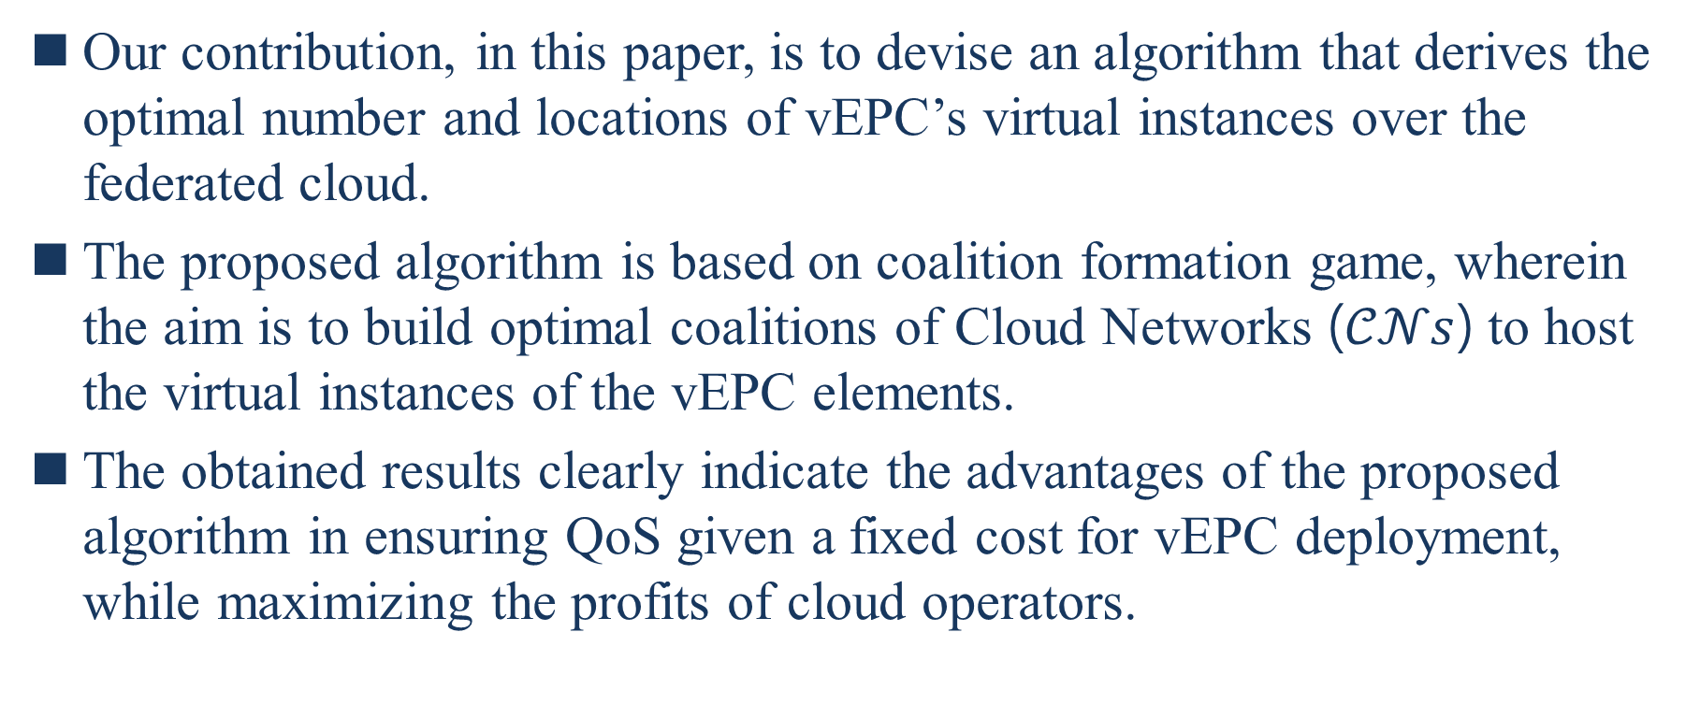
Abstract
Our contribution, in this paper, is to devise an algorithm that derives the optimal number and locations of vEPC’s virtual instances over the federated cloud.
The proposed algorithm is based on coalition formation game, wherein the aim is to build optimal coalitions of Cloud Networks ($𝒞𝒩s$) to host the virtual instances of the vEPC elements.
The obtained results clearly indicate the advantages of the proposed algorithm in ensuring QoS given a fixed cost for vEPC deployment, while maximizing the profits of cloud operators.
Notes:
在本文中，我們的貢獻是設計一種演算法來推導出在聯合雲上vEPC虛擬實例的最佳數量和位置
提出的演算法是根據結盟遊戲，其中目標是建構出雲網路($𝒞𝒩s$)的最佳聯盟來管理EPC元件的虛擬實例
獲得的結果清楚地表明了所提出的算法在給定 vEPC 部署的固定成本的情況下確保 QoS 的優勢，同時最大化雲營運商的利潤
什麼是coalition formation :coalition formation 涉及對一組或多組代理的分析，稱為聯合，這些代理聚集在一起共同決定他們的行動。它與合作博弈和非合作博弈都有關，作為該理論的關鍵概念，聯盟，可以定義為一組代理，協調其成員之間的協議，同時與非成員進行非合作交互。儘管聯盟一旦形成就是合作的，但它的創建可以以非合作的方式進行。從本質上講，人們可以區分聯盟形成理論的兩個主要方面。其中之一涉及團體的形成，即聯盟聯合起來協調其行動的過程。 聯盟形成理論的另一個方面涉及執行群體行動作為適當博弈的均衡。

Slide 5
I.Introduce
NFV represents one of the key enablers of the next generation mobile network systems (5G) [1].
NFV allows running Virtual Network Functions (VNF) as software components on top of a virtualization system (i.e., Virtual Machines – VMs - or Containers) hosted in a cloud; allowing high flexibility and elasticity to deploy network services and functions.
[1] I. Farris, T. Taleb, M. Bagaa, and H. Flinck, “Optimizing Service Replicatio for Mobile Delay-sensitive Applications in 5G Edge Network,” in Proc. IEEE ICC 2017, Paris, France, May 2017.
Notes:
NFV是下一代行動網路系統的關鍵的推動者之一[1]
NFV允許將虛擬網路功能(VNF)作為軟體元件運行在託管在雲中的虛擬化系統(即虛擬機-VMs-或容器)之上;允許高靈活性和彈性來部署網路服務和功能

Slide 6
I.Introduce
Using NFV, different mobile network components will be virtualized and that is spanning the Radio Access Network (RAN) and Evolved Packet Core (EPC) [2]–[4].
[2] T. Taleb, M. Corici, C. Parada, A. Jamakovic, S. Ruffino, G. Karagiannis, and T. Magedanz, “EASE: EPC as a Service to Ease Mobile Core Network,” in IEEE Network Magazine, Vol. 29, No. 2, Mar 2015, pp.78 - 88.
[3] I. Afolabi, A. Ksentini, M. Bagaa, T. Taleb, M. Corici, and A. Nakao, “Towards 5G Network Slicing over Multiple-Domains,” in IEICE Trans. on Communications, Vol. E100.B, No. 11, Nov. 2017, pp. 1992-2006.
[4] I. Afolabi, M. Bagaa, T. Taleb, and H. Flinck, “End-to-End Network Slicing Enabled Through Network Function Virtualization,” in Proc. IEEE CSCN17, Helsinki, Finland, Sep. 2017.
Notes:
使用NFV，不同的移動網路組件將被虛擬化並跨越無線電接入網路(RAN)和演進分組核心(EPC)[2]-[4]

Slide 7
I.Introduce
RAN components will be divided into Base Band Unit (BBU) and Remote Radio Head (RRH), where BBU runs as software and RRH will be kept in the field.
On the other hand, EPC components (i.e., Mobility Management Entity - MME, Home Subscriber Sub-system - HSS, Serving Gateway - SGW, and Packet Data Network Gateway - PGW) will be fully virtualized and hosted in a federated cloud; building the concept of Mobile Carrier Cloud [5].
The virtual instances of these components will then constitute the vEPC.
[5] T. Taleb, “Towards Carrier Cloud: Potential, Challenges & Solutions,” in IEEE Wireless Communications Magazine, Vol. 21, No. 3, Jun 2014, pp. 80-91.
Notes:
RAN元件將分為基帶單元(BBU)和遠程無線電頭(RRH)，其中BBU做為軟體運行和RRH將保留在現場
另一方面，EPC元件(即移動管理實體MME、本地訂閱者子系統HSS、服務網關SGW和分組數據網關PGW)將完全虛擬化並託管在聯合雲中;建構行動運營商雲的概念[5]
這些元件的虛擬實例將構建成vEPC

Slide 8
I.Introduce
Whilst many solutions are currently available for the NFVO [6], such as Open Source Mano (OSM), VIM OpenStack, and VNF Manager JuJu, the optimal number of VM instances and their placement over the federated cloud are still overlooked [18].
In this paper, we aim to fill this gap by proposing a novel solution that addresses both the optimal number of VM instances to instantiate and their placement over a federated cloud to create a vEPC for a specific traffic pattern.
[6] T. Taleb, A. Ksentini, R. Jantii, “Anything as Service for 5G Mobile Systems,” to appear in IEEE Network Magazine.
[18] A. Nakao, P. Du, Y. Kiriha, F. Granelli, A. A. Gebremariam, T. Taleb, and M. Bagaa, “End-to-End Network Slicing for 5G Mobile Networks,” in J. Information Processing, Vol. 25, No. 1, Jan. 2017, pp. 153- 163.
Notes:
雖然NFVO目前有許多解決方案，如開源Mano(OSM)、VIM OpenStack和VNF管理JuJu，VM實例的最佳數量及其在聯盟雲上的位置仍然被忽略[18]
在本文中，我們旨在由提出一個新穎的解決方案來填補這一個空白，該解決方案解決了要實例化的VM實例的最佳數量和其在聯盟雲上的放置，從而為特定流量模式創建vEPC
NFVO : Network Function Virtualization Orchestrator

Slide 9
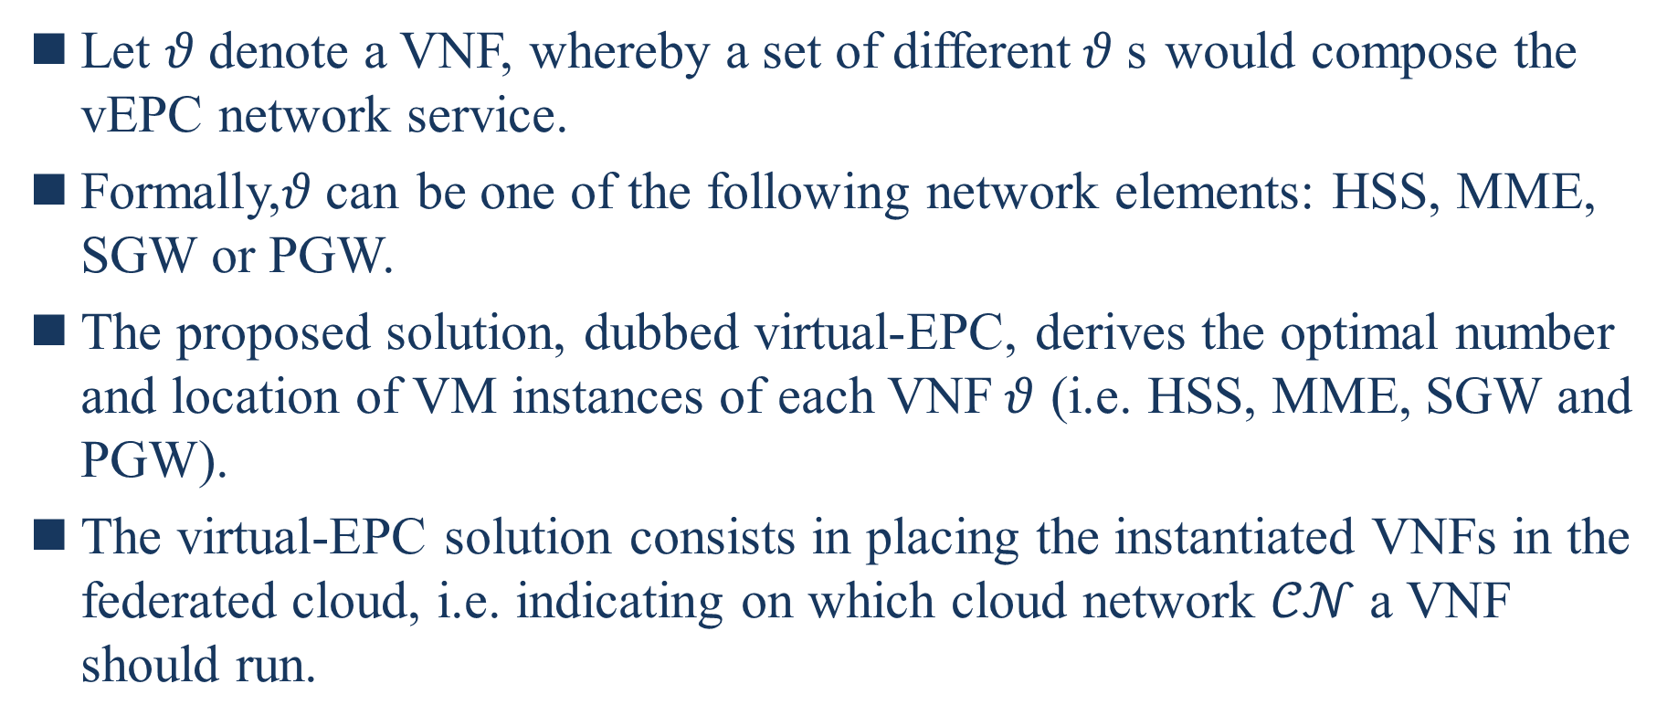
I.Introduce
Let $θ$denote a VNF, whereby a set of different$θ$s would compose the vEPC network service.
Formally,$θ$can be one of the following network elements: HSS, MME, SGW or PGW.
The proposed solution, dubbed virtual-EPC, derives the optimal number and location of VM instances of each VNF$θ$ (i.e. HSS, MME, SGW and PGW).
The virtual-EPC solution consists in placing the instantiated VNFs in the federated cloud, i.e. indicating on which cloud network $𝒞𝒩$ a VNF should run.
Notes:
讓$θ$表示一個VNF，其中一組不同的$θ$將組成vEPC網路服務
從形式上來講，$θ$可以是以下網路元件之一 : HSS、MME、SGW或PGW
提議的解決方案稱為virtual-EPC，可推導出每一個VNF$θ($即HSS、MME、SGW和PGW)的VM實例的最佳數量和位置
virtual-EPC解決方案包括將實例化的VNFs放置在聯盟雲中，即指示一個VNF應在哪個雲網路$𝒞𝒩$運行

Slide 10
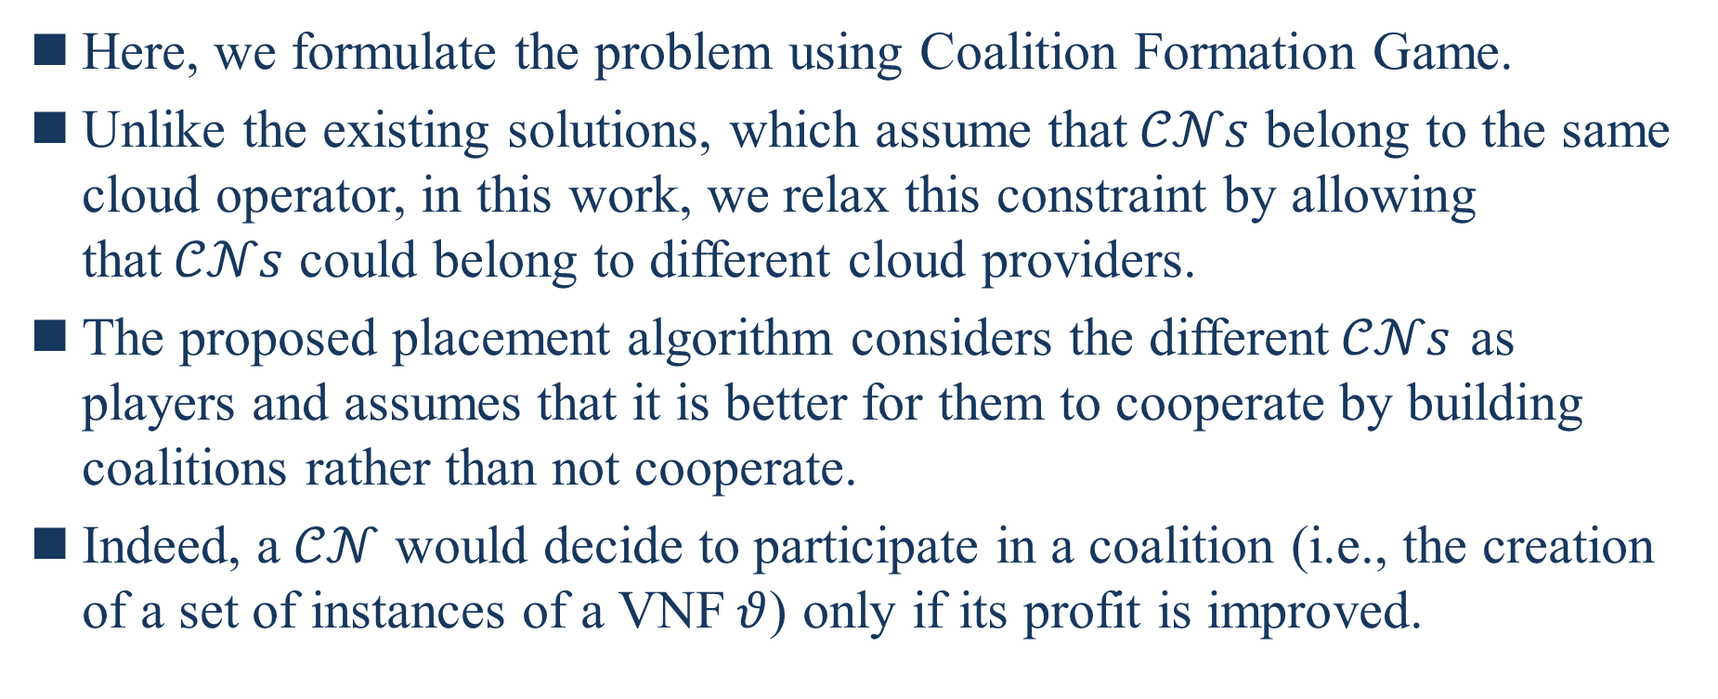
I.Introduce
Here, we formulate the problem using Coalition Formation Game.
Unlike the existing solutions, which assume that$𝒞𝒩s$ belong to the same cloud operator, in this work, we relax this constraint by allowing that$𝒞𝒩s$ could belong to different cloud providers.
The proposed placement algorithm considers the different$𝒞𝒩s$ as players and assumes that it is better for them to cooperate by building coalitions rather than not cooperate.
Indeed, a $𝒞𝒩$ would decide to participate in a coalition (i.e., the creation of a set of instances of a VNF$θ$) only if its profit is improved.
Notes:
這裡，我們使用結盟遊戲來制定問題
與假設$𝒞𝒩s$屬於相同的雲運營商的現有解決方案不同，在這項工作中，我們透過允許$𝒞𝒩s$可以屬於不同的雲運營商來放寬這個限制
提議放置演算法將不同$𝒞𝒩$s視為參與者並假設他們通過建立聯盟來合作而不是不合作更好
事實上，只有當$𝒞𝒩$利潤提升的時候，$𝒞𝒩$才會決定參與聯盟(即創建一組VNF$θ$ 的實例)

Slide 11
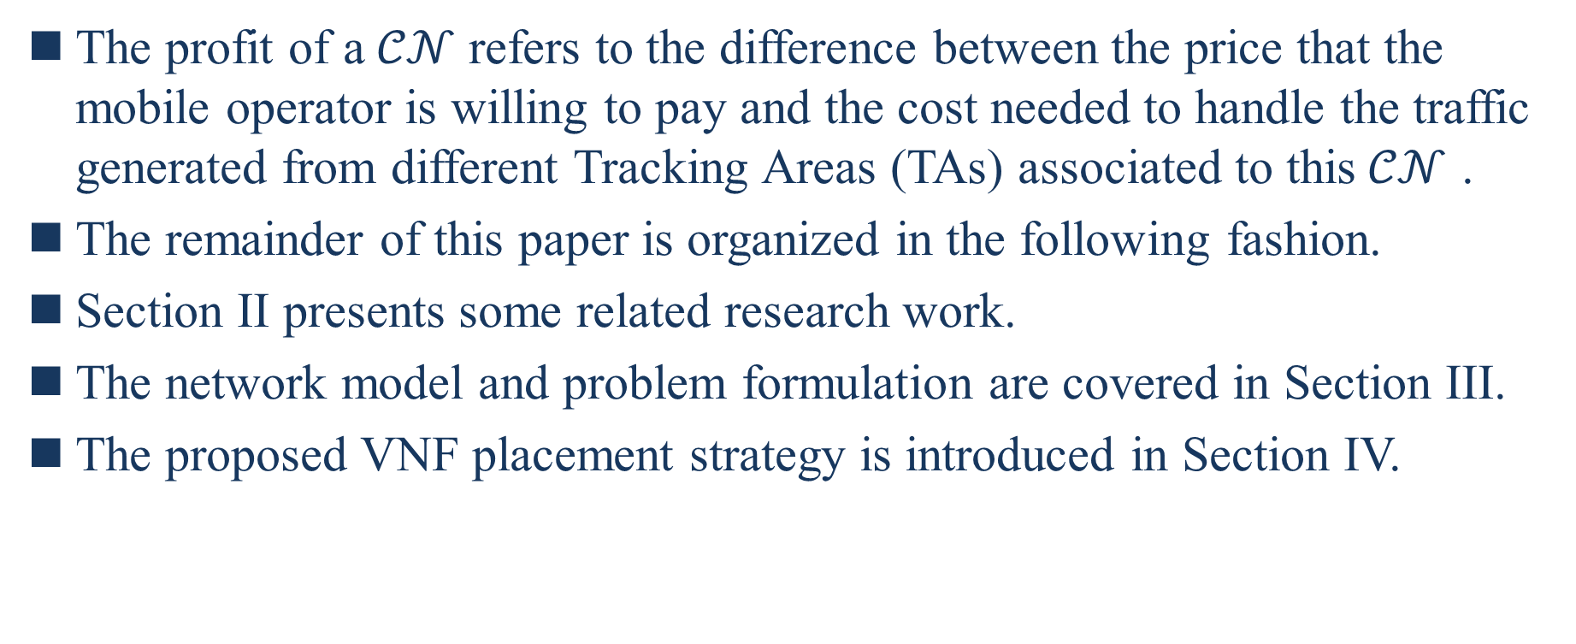
I.Introduce
The profit of a$𝒞𝒩$ refers to the difference between the price that the mobile operator is willing to pay and the cost needed to handle the traffic generated from different Tracking Areas (TAs) associated to this$𝒞𝒩$ .
The remainder of this paper is organized in the following fashion.
Section II presents some related research work.
The network model and problem formulation are covered in Section III.
The proposed VNF placement strategy is introduced in Section IV.
Notes:
$𝒞𝒩$的利潤是指行動運營商願意支付的價錢和處理與該$𝒞𝒩$相關的不同的追蹤區域(TAs)產生的流量所需的成本之間的差額
本文的其餘部分按以下方式組織
第2節是某些相關聯的研究工作
第3節介紹網路模型和問題的表述
第4節介紹建議VNF放置策略

Slide 12
I.Introduce
Section V evaluates the performance of the different optimization solutions envisioned in this paper.
The paper concludes in Section VI.
Notes:
第5節評估本文設想的不同最佳解決方案的性能
第6節是本文結論

Slide 13
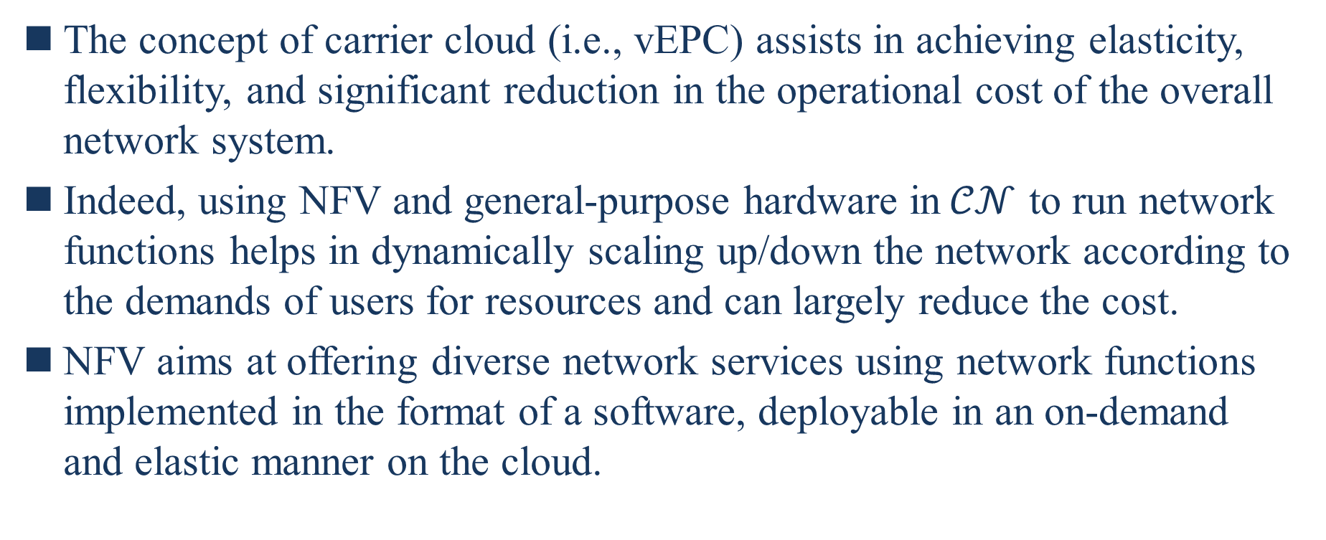
II. Related work
The concept of carrier cloud (i.e., vEPC) assists in achieving elasticity, flexibility, and significant reduction in the operational cost of the overall network system.
Indeed, using NFV and general-purpose hardware in$𝒞𝒩$ to run network functions helps in dynamically scaling up/down the network according to the demands of users for resources and can largely reduce the cost.
NFV aims at offering diverse network services using network functions implemented in the format of a software, deployable in an on-demand and elastic manner on the cloud.
Notes:
運營商雲(即 vEPC)的概念有助於實現彈性、靈活性和顯著地降低在整個網路系統的營運成本
事實上，在$𝒞𝒩$中使用NFV和通用硬體來運行網路功能有助於根據使用者對資源的需求來動態擴大縮小網路並可以大大地減少成本
NFV旨在使用以軟體的形式實作的網路功能提供多樣化的網路服務，可按需求和彈性地部署在雲上

Slide 14
II. Related work
In return of its numerous advantages, vEPC introduces some important challenges, mainly related to the placement of the telco-specific VNFs (i.e. MME, PGW, and SGW) over a federated cloud to ensure an optimal connectivity for users and simultaneously reduce the deployment cost.
More recently, new research work has emerged, proposing algorithms for the placement of vEPC’s VNFs.
In [14], the authors proposed a VNF placement method, particularly for placing mobility-anchor gateways (i.e. SGW) over a federated cloud so that the frequency of SGW relocation occurrences is minimized.
[14] T. Taleb and A. Ksentini, “Gateway Relocation Avoidance Aware Network Function Placement in Carrier Cloud,” in Proc. ACM MSWIM, Barcelona, Spain, Nov 2013, pp. 341-346.
Notes:
作為它眾多優勢的回報，vEPC引入一些重要的挑戰，主要是有關於將電信專用的VNF(即 MME、PGW和SGW)放置在聯盟雲上來確保為使用者提供最佳連線和同時減少部署的成本
最近，新研究已經出現，提出放置vEPC的VNFs的演算法
在[14]中，作者提出一個VNF放置方法，特別是用於將行動錨網關(即SGW)放置在聯盟雲上，以便將SGW重新定位發生的頻率會最小化

Slide 15
II. Related work
The aim of this work was to conduct an efficient planning of Service Areas (SAs) retrieving a trade- off between minimizing the UE handoff between SAs, and minimizing the number of created instances of the virtual SGWs.
In [15], the focus was on the VNF placement and instantiation of another mobile network functionality, namely the data anchoring gateway or PGW.
[15] M. Bagaa, T. Taleb, and A. Ksentini, “Service-Aware Network Function Function Placement for Efficient Traffic Handling in Carrier Cloud,” in Proc. of IEEE WCNC 2014, Istanbul, 2014, pp. 2402-2407.
Notes:
這個工作的目標是對服務區域(SA)進行有效規畫，以在最小化SA之間UE的換手和最小化虛擬SGWs的創建實例數量之間取得折衷
在[15]中，重點是另一個行動網路功能的VNF放置和實例化，即數據錨網關或PGW

Slide 16
II. Related work
The work argued the need for adopting the application type and service requirements as metrics for (i) creating VNF instances of PGWs and (ii) selecting adequate virtual PGWs for UEs receiving specific application types.
The placement of PGW VNFs was modeled through a nonlinear optimization problem whose solution is NP-hard.
Three heuristics were then proposed to deal with this limitation.
Notes:
該工作認為需要採用應用程式類型和服務要求作為( i )創建PGW的VNF實例和( ii )為接收特定應用程式類型的UE選擇足夠的虛擬PGWs的指標
PGW VNFs的放置是通過非線性優化問題建模的，該問題的解決方案是NP-hard
然後提出了三個啟發式算法來處理此限制

Slide 17
II. Related work
In [16], the authors proposed a framework, dubbed softEPC, for flexible and dynamic instantiation of VNFs where most appropriate and as per the actual traffic demand.
The proposed scheme addresses load-aware dynamic placement of SGW/PGW over the underlying transport network topology and as per the traffic demands.
The results show that up to 25% of network resources can be saved with same network topology and service points.
[16] F. Z. Yousef, J. Lessmann, P. Loureiro, and S. Schmid, “SoftEPC Dynamic Instantiation of Mobile Core Network Entities for Efficient Resource Utilization,” in Proc. of IEEE ICC 2013, Budapest, Hungary, 2013, pp. 3602-3606.
Notes:
在[16]中，作者提出一個稱為softEPC的框架，用於在最合適的情況下根據實際流量需求靈活和動態地實例化VNFs
提出的方案解決了SGW/PGW在底層傳輸網絡拓撲上的負載感知動態放置，並根據流量需求
結果表明，在相同的網絡拓撲和服務點情況下，可以節省高達 25% 的網絡資源

Slide 18
II. Related work
Unlike the research works in [7], [8], [11]–[16], which tackle either the optimal number of VNFs or the VNFs placement, our proposed solution jointly addresses both issues.
[7] J. T. Piao and J. Yan, “A network-aware virtual machine placement and migration approach in cloud computing,” in proc. IEEE GCC’10, 2010, pp. 8792.
[8] M. G. Rabbani, R. Pereira Esteves, M. Podlesny, G. Simon, L. Zambenedetti Granville, and R. Boutaba, “On tackling virtual data center embedding problem,” in proc. IFIP/IEEE IM’13, pp. 177 184.
[11] G. Somani, P. Khandelwal, and K. Phatnani, “VUPIC Virtual Machine Usage Based Placement in IaaS Cloud,” in CoRR abs/1212.0085, 2012.
[12] Ray B.K., Khatua S. and Roy S. “Cloud Federation Formation Using Coalitional Game Theory,” in Proc. Springer ICDCIT’15 ACM IWCMC’10, Bhubaneswar, India, Feb 2015.
[13] M. Guazzone, C. Anglano and M. Sereno, “A Game-Theoretic Approach to Coalition Formation in Green Cloud Federations,” in Proc. IEEE ICCG’14, Chicago, IL, 2014. pp. 618-625.
[14] T. Taleb and A. Ksentini, “Gateway Relocation Avoidance-Aware Network Function Placement in Carrier Cloud,” in Proc. ACM MSWIM, Barcelona, Spain, Nov 2013, pp. 341-346.
[15] M. Bagaa, T. Taleb, and A. Ksentini, “Service-Aware Network Function Function Placement for Efficient Traffic Handling in Carrier Cloud,” in Proc. of IEEE WCNC 2014, Istanbul, 2014, pp. 2402-2407.
[16] F. Z. Yousef, J. Lessmann, P. Loureiro, and S. Schmid, “SoftEPC Dynamic Instantiation of Mobile Core Network Entities for Efficient Resource Utilization,” in Proc. of IEEE ICC 2013, Budapest, Hungary, 2013, pp. 3602-3606.
Notes:
與[7]、[8]、[11]-[16]中處理VNF最佳數量或VNF放置的研究工作不同，我們提出的解決方案共同解決了這兩個問題

Slide 19
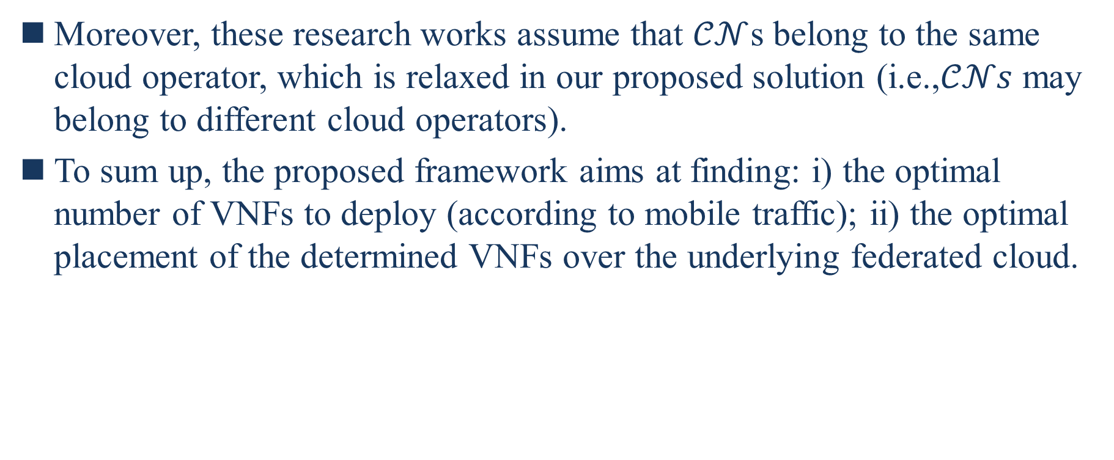
II. Related work
Moreover, these research works assume that $𝒞𝒩$s belong to the same cloud operator, which is relaxed in our proposed solution (i.e.,$𝒞𝒩s$ may belong to different cloud operators).
To sum up, the proposed framework aims at finding: i) the optimal number of VNFs to deploy (according to mobile traffic); ii) the optimal placement of the determined VNFs over the underlying federated cloud.
Notes:
此外，這些研究工作假設CNs屬於相同的雲運營商，這在在我們提出的解決方案中是寬鬆的(即$𝒞𝒩s$有可能屬於不同的雲營運商)
總結一下，提出的框架目標在發現 i)部署VNFs的最佳數量(根據行動流量); ii)確定的VNF在底層聯盟雲上的最佳位置

Slide 20
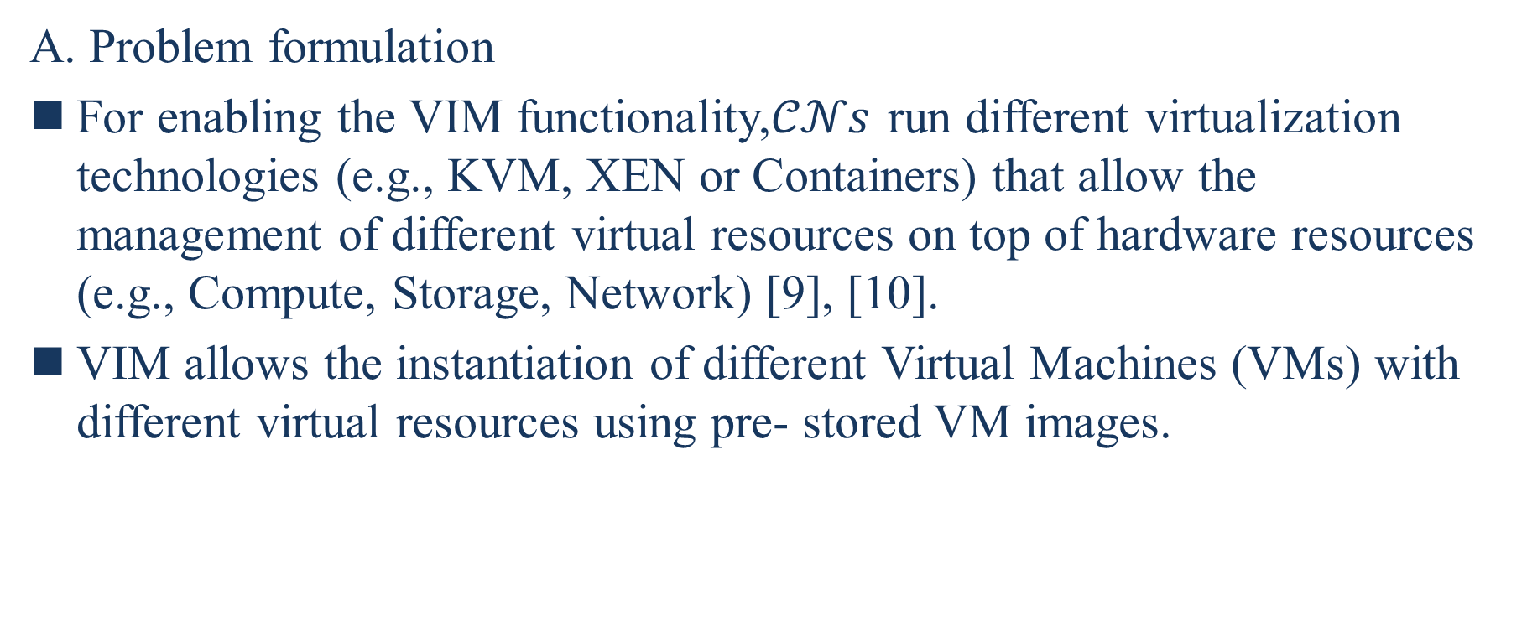
III. PROBLEM FORMULATION AND NETWORK MODEL
A. Problem formulation
For enabling the VIM functionality,$𝒞𝒩s$ run different virtualization technologies (e.g., KVM, XEN or Containers) that allow the management of different virtual resources on top of hardware resources (e.g., Compute, Storage, Network) [9], [10].
VIM allows the instantiation of different Virtual Machines (VMs) with different virtual resources using pre- stored VM images.
[9] I. Farris, J.B. Bernabe, N. Toumi, D. Garcia, T.Taleb, A.F. Skarmet, and B. Sahlin, “Towards Provisioning of SDN/NFV-based Security Enablers for Integrated Protection of IoT Systems,” in Proc. IEEE CSCN17, Helsinki, Finland, Sep. 2017.
[10] A. Laghrissi, T. Taleb, M. Bagaa, and H. Flinck, “Towards Edge Slicing: VNF Placement Algorithms for a Dynamic & Realistic Edge Cloud Environment,” in Proc. IEEE Globecom 2017, Singapore, Dec. 2017.
Notes:
A. 問題表述
用於啟用VIM功能，$𝒞𝒩$s運行不同虛擬化技術(如KVM、XEN或Container)，這將允許在硬體資源(如計算、儲存、網路)上管理不同的虛擬資源[9]、[10]
VIM允許使用預先儲存的VM映像實例化具有不同虛擬資源的不同的虛擬機(VMs)

Slide 21
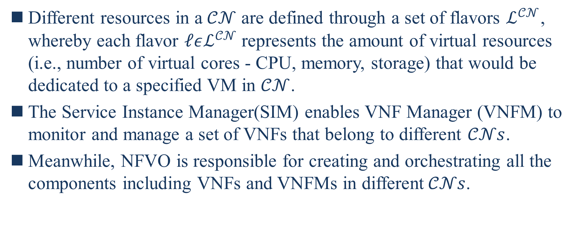
III. PROBLEM FORMULATION AND NETWORK MODEL
Different resources in a$𝒞𝒩$ are defined through a set of flavors $ℒ^{𝒞𝒩}$, whereby each flavor $ℓεℒ^{𝒞𝒩}$represents the amount of virtual resources (i.e., number of virtual cores - CPU, memory, storage) that would be dedicated to a specified VM in $𝒞𝒩$.
The Service Instance Manager(SIM) enables VNF Manager (VNFM) to monitor and manage a set of VNFs that belong to different $𝒞𝒩s$.
Meanwhile, NFVO is responsible for creating and orchestrating all the components including VNFs and VNFMs in different$𝒞𝒩s$.
Notes:
$𝒞𝒩$中不同的資源透過一組風格$ℒ^{𝒞𝒩}$定義，其中每個風格$ℓεℒ^{𝒞𝒩}$表示專用於$𝒞𝒩$中的VM的虛擬資源數量(即虛擬核心的數量-CPU、記憶體、儲存)
服務實例管理(SIM)使得VNF管理器(VNFM)能監控和管理屬於不同$𝒞𝒩$的一組VNF
同時，NFVO是負責創建和編排所有元件包含不同$𝒞𝒩$中的VNFs和VNFMs

Slide 22
III. PROBLEM FORMULATION AND NETWORK MODEL
The descriptions of different components are defined in the Service Instance Descriptor (SID) that defines the Service Instance Graph (SIG), presented through two catalogues: i) VNF Catalogue, and ii) NFV Service Catalogue.
In this work, we consider that the RAN consists of a number of eNodeBs, organized in Tracking Areas (TAs), as per Release 8 of the 3GPP mobile network specifications.
Notes:
不同元件的描述在定義服務實例圖形(SIG)的服務實例描述(SID)中定義，通過兩個目錄呈現：i)VNF目錄和，以及ii)NFV服務目錄
在這項工作中，我們認為RAN由多個eNodeBs組成，根據3GPP行動網路規格的Release 8組織在追蹤區域(TAs)中

Slide 23
III. PROBLEM FORMULATION AND NETWORK MODEL
As per Release 8 of the 3GPP mobile network specifications, S1-MME and S1-U interfaces are changed by the S1-Flex interface that allows each TA to be serviced by multiple MMEs and SGWs within a pool area.
The set of TAs, served by the same MME/SGW node, forms an MME/SGW pool/service area, respectively.
Formally, a MME pool area is defined as a set of TAs where a UE may be served without the need to change the serving MME.
MME pool areas may overlap with each other [20].
[20] A. Kunz, T. Taleb, and S. Schmid, “On Minimizing SGW/MME Relocations in LTE,” in Proc. ACM IWCMC’10, Caen, France, Jun 2010, pp. 960-965.
Notes:
根據3GPP行動網路規格的Release 8，S1-MME和S1-U介面是由S1-Flex介面來更改，允許每個TA由池區域內的多個MMEs和SGWs提供服務
由同一MME/SGW節點服務的TA集合分別形成MME/SGW 池/服務區域
從形式上講，MME池區域被定義為一組TAs，無需更改服務的MME即可提供UE
MME池區域可能和另一個池區域重疊[20]

Slide 24
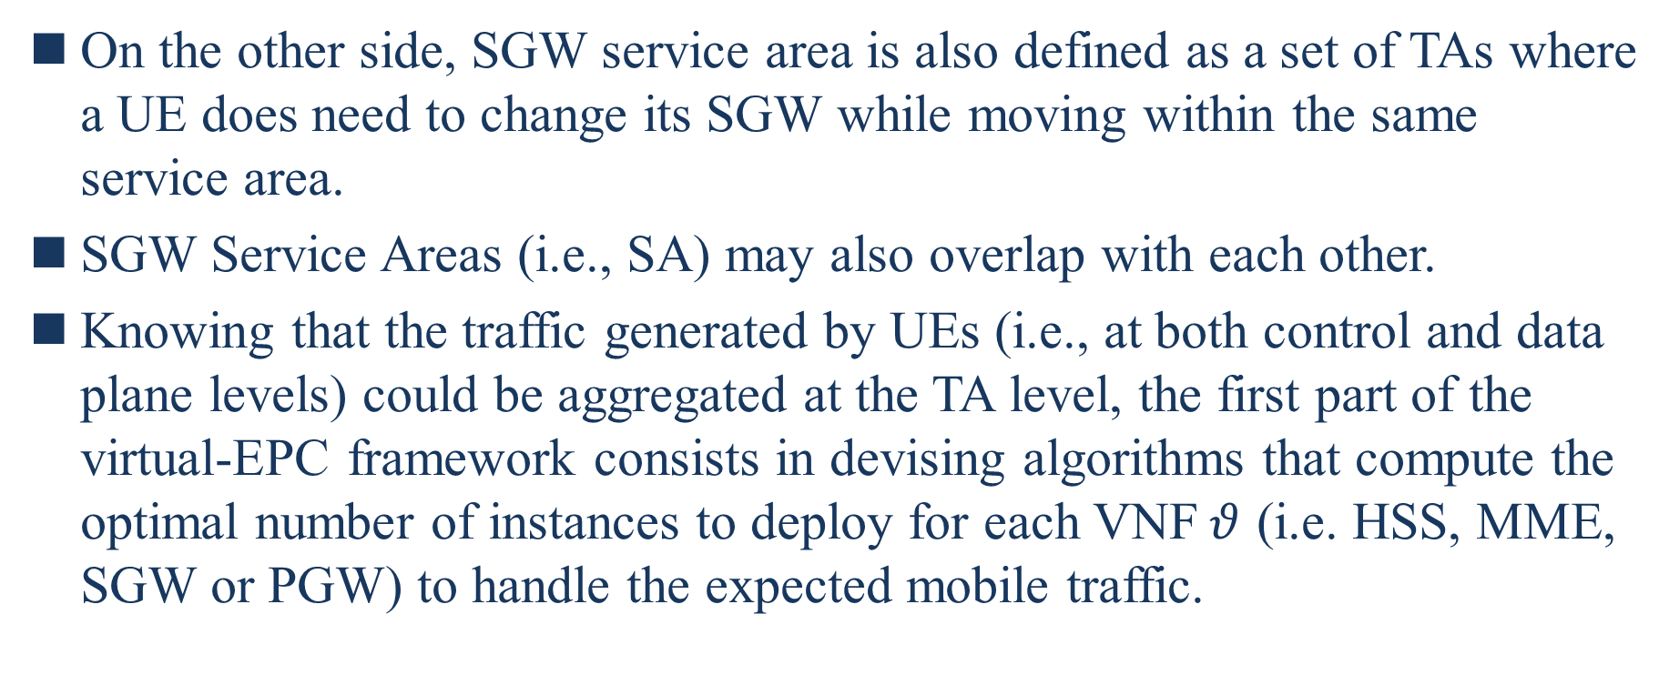
III. PROBLEM FORMULATION AND NETWORK MODEL
On the other side, SGW service area is also defined as a set of TAs where a UE does need to change its SGW while moving within the same service area.
SGW Service Areas (i.e., SA) may also overlap with each other.
Knowing that the traffic generated by UEs (i.e., at both control and data plane levels) could be aggregated at the TA level, the first part of the virtual-EPC framework consists in devising algorithms that compute the optimal number of instances to deploy for each VNF$θ$ (i.e. HSS, MME, SGW or PGW) to handle the expected mobile traffic.
Notes:
另一方面，SGW服務區域也是被定義為一組TA，其中UE在同一服務區域內移動時確實需要更改其SGW
SGW服務區域(即SA)可能也會和其他的SA重疊
知道由UE產生的流量(即在控制和數據面層) 可以在TA層聚集，virtual-EPC框架的第一部分包括設計演算法來計算每個VNF$θ$ (即 HSS、MME、SGW或PGW)用於處理預期行動流量的最佳實例數

Slide 25
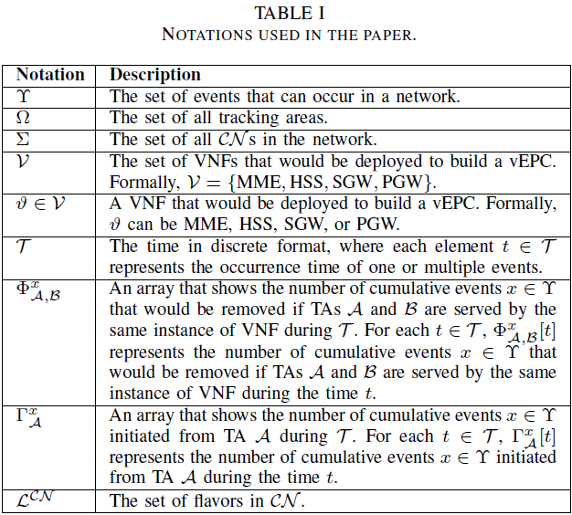
III. PROBLEM FORMULATION AND NETWORK MODEL
Notes:
表一 論文中使用的符號
$Υ$ : 網路中可能發生的一組事件
$Ω$: 所有Tracking Area的集合
$Σ$: 網路中所有$𝒞𝒩$的集合
$𝒱$: 將部署用於建構vEPC的VNF的集合。以形式上講，$𝒱$={MME、HSS、SGW、PGW}
$θ∈𝒱$ : 將部署用於建構vEPC的一個VNF。以形式上講，$θ$可以是MME、HSS、SGW和PGW
$𝒯$: 以離散形式表示的時間，其中每個元素t$∈𝒯$表示一個或多個事件的發生時間
$Φ_{𝒜,ℬ}^{𝓍}$ : 顯示假如在$𝒯$期間的VNF的相同實例為TAs $𝒜和ℬ$提供服務，則將刪除累積事件$𝓍∈Υ$的數目的陣列。對於每個t$∈𝒯$，$Φ_{𝒜,ℬ}^{𝓍}$[t]表示假如在t期間的VNF的相同實例為TAs $𝒜和ℬ$提供服務，則將刪除累積事件$𝓍∈Υ$的數目
$Γ_{𝒜}^{𝓍}$ : 顯示在$𝒯$期間從TAs $𝒜$發起的累積事件$𝓍∈Υ$的數目的陣列。對於每個t$∈𝒯$，$Γ_{𝒜}^{𝓍}$[t]代表在$t$期間從TAs $𝒜$發起的累積事件$𝓍∈Υ$的數目
$ℒ^{𝒞𝒩}$ : $𝒞𝒩$中風格的集合

Slide 26
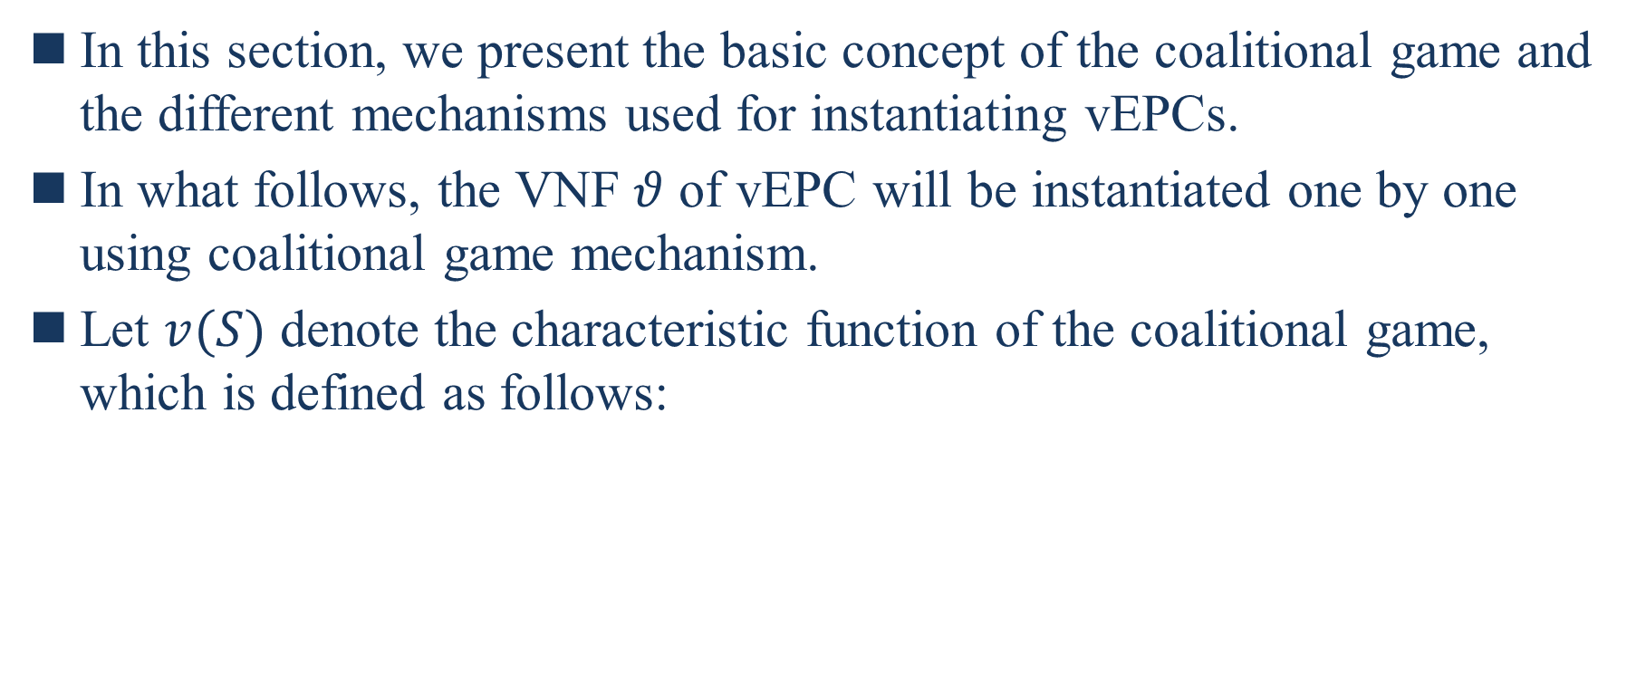
IV. VIRTUAL-EPC MECHANISM
In this section, we present the basic concept of the coalitional game and the different mechanisms used for instantiating vEPCs.
In what follows, the VNF $θ$ of vEPC will be instantiated one by one using coalitional game mechanism.
Let $v(S)$ denote the characteristic function of the coalitional game, which is defined as follows:
Notes:
在本節中，我們介紹聯盟遊戲的基本概念和用於對vEPCs進行實例化的不同的機制
在接下來，vEPC的VNF$θ$ 將使用聯盟遊戲機制一一實例化
讓$𝓋$(S)表示聯盟遊戲的特徵函數，其定義如下:

Slide 27
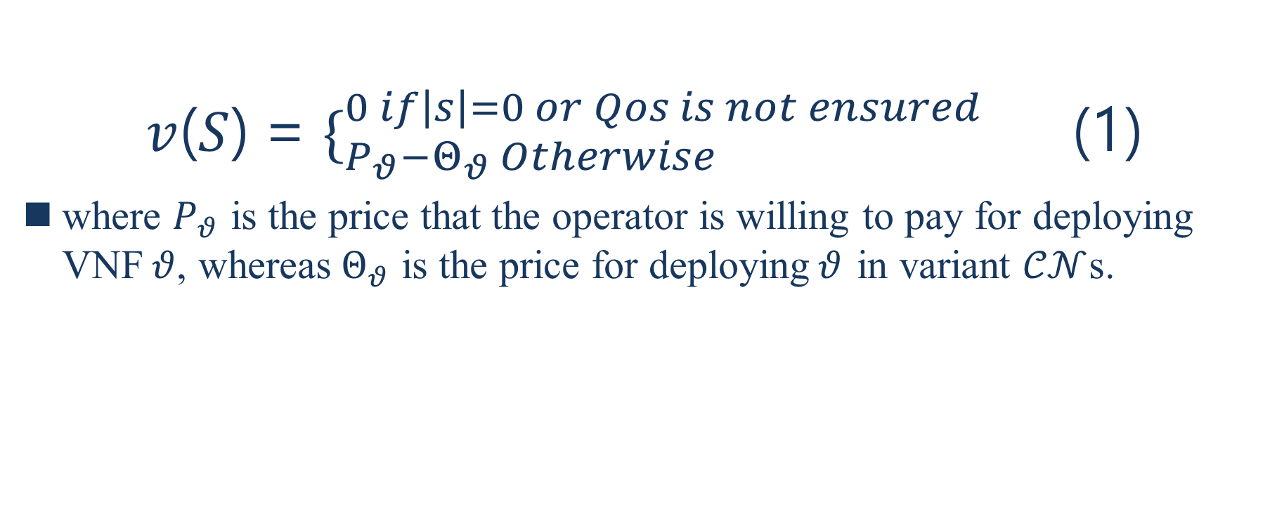
IV. VIRTUAL-EPC MECHANISM
$v$($S$) = $\{_{P_{θ}−Θ_{θ} Otherwise}^{0 if\left|s\right|=0 or Qos is not ensured}$ (1)
where $P_{θ}$ is the price that the operator is willing to pay for deploying VNF$θ$, whereas${ Θ}_{θ}$ is the price for deploying$θ$ in variant $𝒞𝒩$s.
Notes:
其中$P_{θ}$是運營商對於部署VNF $θ$ 願意支付的成本，而$Θ_{θ}$是在變體$𝒞𝒩s$中部署$θ$的成本
聯盟的總利潤，如果聯盟個數=0 或 QoS無法被保證，利潤為0，否則運營商願意支付的成本-變體CN中部署的成本

Slide 28
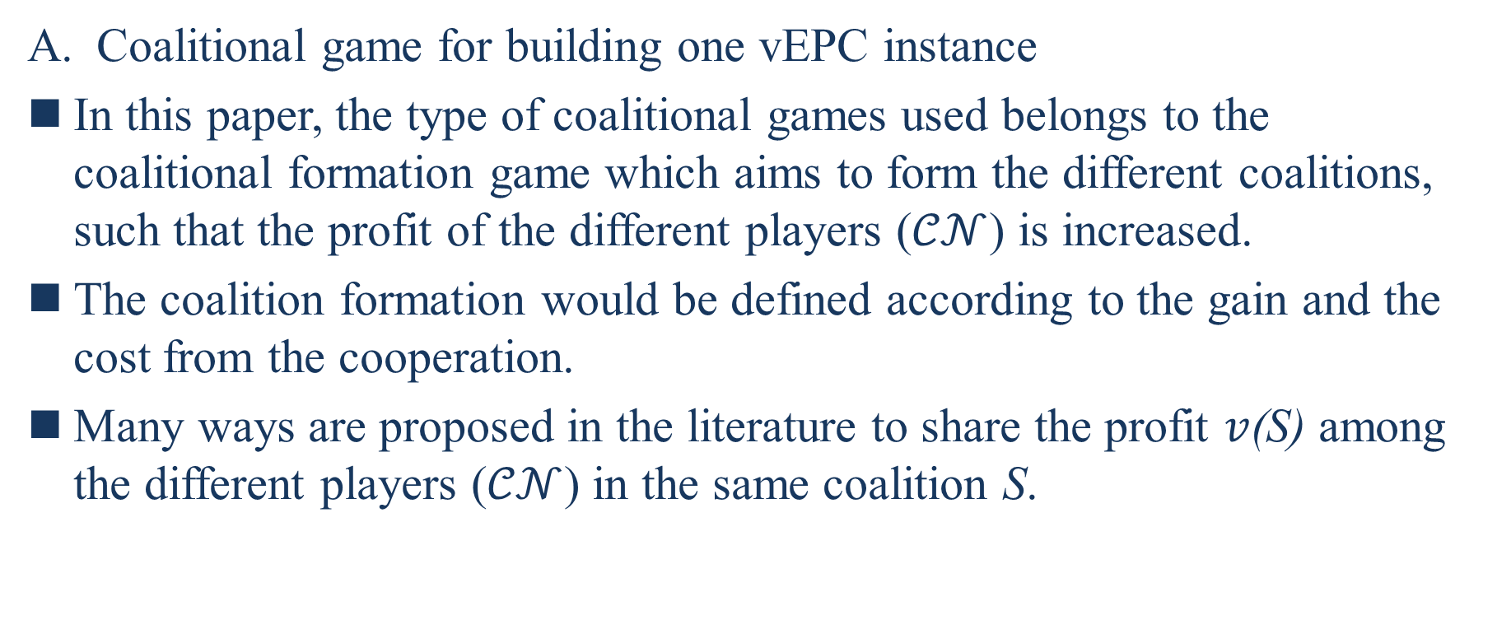
IV. VIRTUAL-EPC MECHANISM
Coalitional game for building one vEPC instance
In this paper, the type of coalitional games used belongs to the coalitional formation game which aims to form the different coalitions, such that the profit of the different players ($𝒞𝒩$) is increased.
The coalition formation would be defined according to the gain and the cost from the cooperation.
Many ways are proposed in the literature to share the profit $v$(S) among the different players ($𝒞𝒩$) in the same coalition S.
Notes:
A. 用於建構一個vEPC實例的聯盟遊戲
在本文中，所使用的聯盟遊戲類型屬於聯盟形式遊戲，旨在形成不同的聯盟，從而增加不同參與者($𝒞𝒩$)的利潤
結盟形式將根據從合作的收益和成本來定義
文獻中提出許多方法來在同一聯盟$S$中的不同參與者$𝒞𝒩$之間分享利潤$𝓋$($S$)

Slide 29
IV. VIRTUAL-EPC MECHANISM
The shapely value [22] is used in the literature to fairly share the profit among the different players.
An easy way to share the profit among different players is the use of an equal-sharing method.
Due to the simplicity of its implementation, this method is widely used in the literature [22].
In this paper, we also use the equal-sharing method to define the payoff of different players in the coalition.
[22] W. Saad, Z. Han, M. Debbah, A. Hjorungnes and T. Basar, “Coalitional game theory for communication networks,” in IEEE Signal Processing Magazine, vol. 26, no. 5, Sep 2009, pp. 77-97.
Notes:
文獻中使用shapely值[22]來公平地在不同參與者之間分享利潤
在不同參與者之間分享利潤的一種簡單方法是使用公平分享方法
因為其實作的簡易性，這個方法在文獻中被廣為使用
在本文中，我們也使用公平分享方法來在聯盟中定義不同參與者的利潤

Slide 30
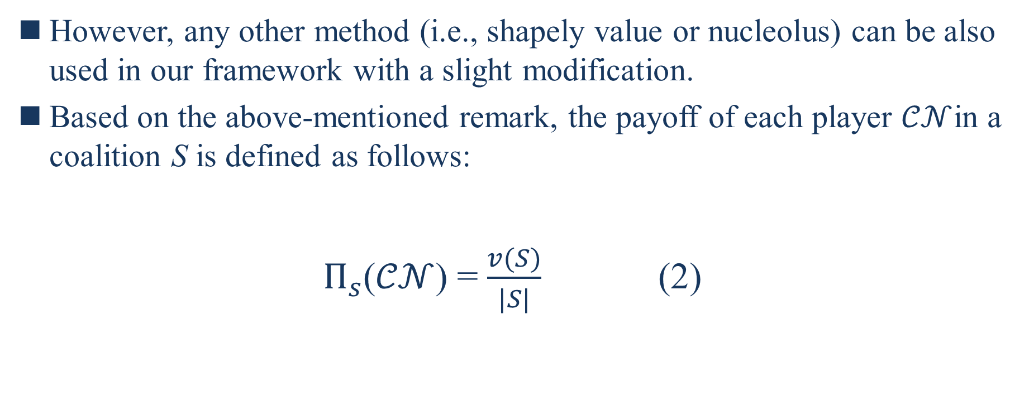
IV. VIRTUAL-EPC MECHANISM
However, any other method (i.e., shapely value or nucleolus) can be also used in our framework with a slight modification.
Based on the above-mentioned remark, the payoff of each player $𝒞𝒩$in a coalition S is defined as follows:
$Π_{s}$($𝒞𝒩$) = $\frac{v(S)}{|S|}$ (2)
Notes:
然而，任何其他方法(即shapely 值或 nucleolus)也可以在我們的框架中，稍作修改
根據上述評論，在聯盟$S$中每一個參與者$𝒞𝒩$的利潤都能被定義為以下:
在聯盟中的每一個CN可以分到的利潤=聯盟的總利潤/聯盟個數

Slide 31
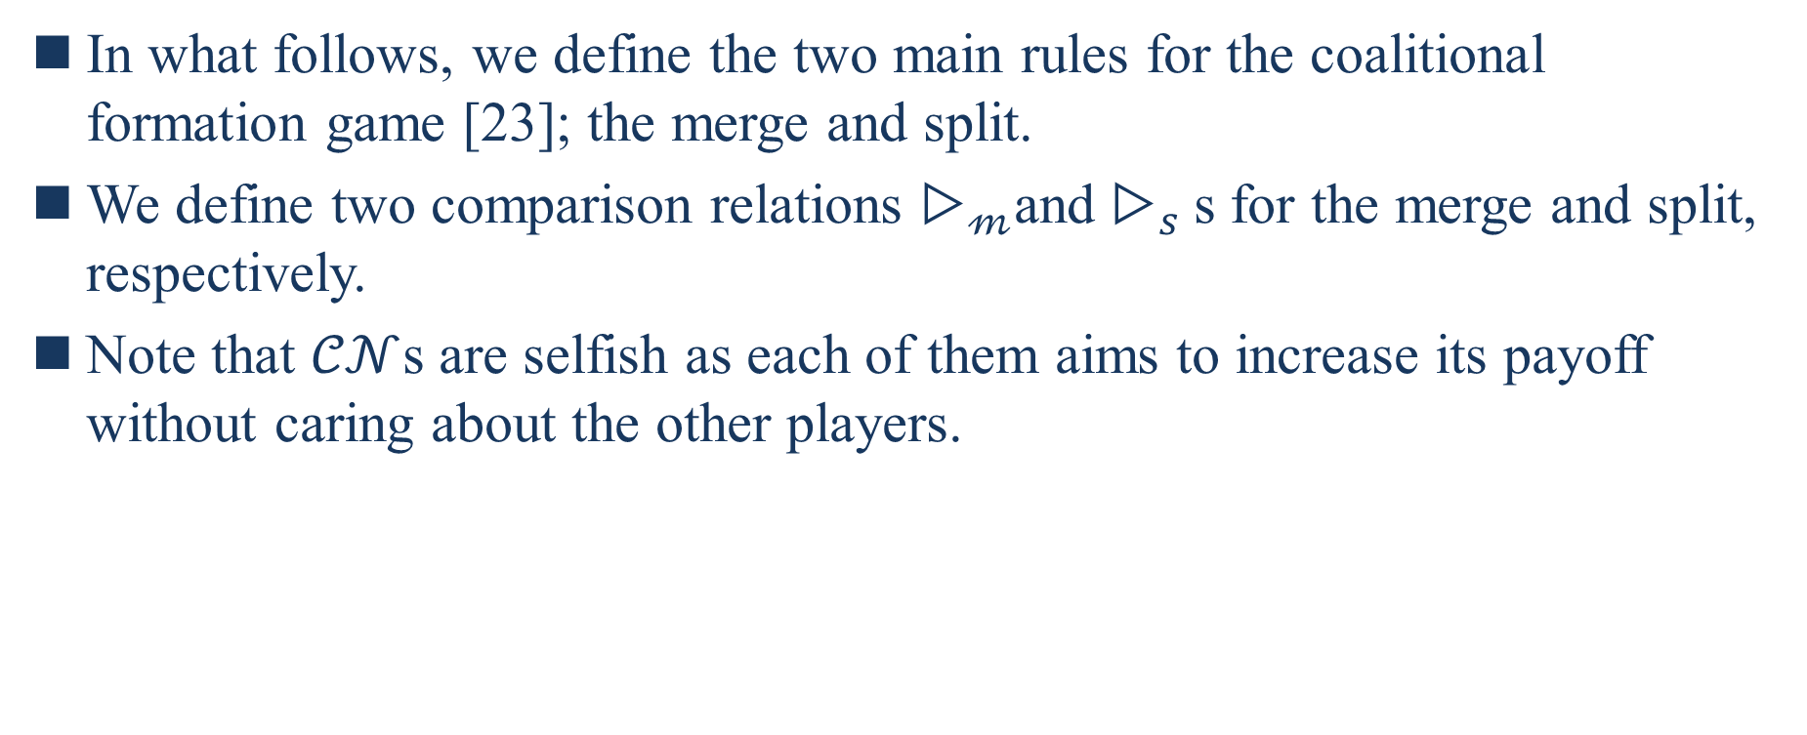
IV. VIRTUAL-EPC MECHANISM
In what follows, we define the two main rules for the coalitional formation game [23]; the merge and split.
We define two comparison relations $▷_{𝓂}$and $▷_{s}$s for the merge and split, respectively.
Note that $𝒞𝒩$s are selfish as each of them aims to increase its payoff without caring about the other players.
[23] Thomas S. Ferguson, “Game Theory, Second Edition”, 2014, Mathematics Department, UCLA, http://www.math.ucla.edu/~tom/Game Theory/ Contents.html.
Notes:
在接下來，我們定義聯盟遊戲的兩個主要規則[23];合併和拆分
我們分別為合併和拆分定義了兩個比較關係$▷$m和$▷$s
請注意，$𝒞𝒩$是自私的，因為它們中的每一個都旨在增加其利潤而不關心其他參與者

Slide 32
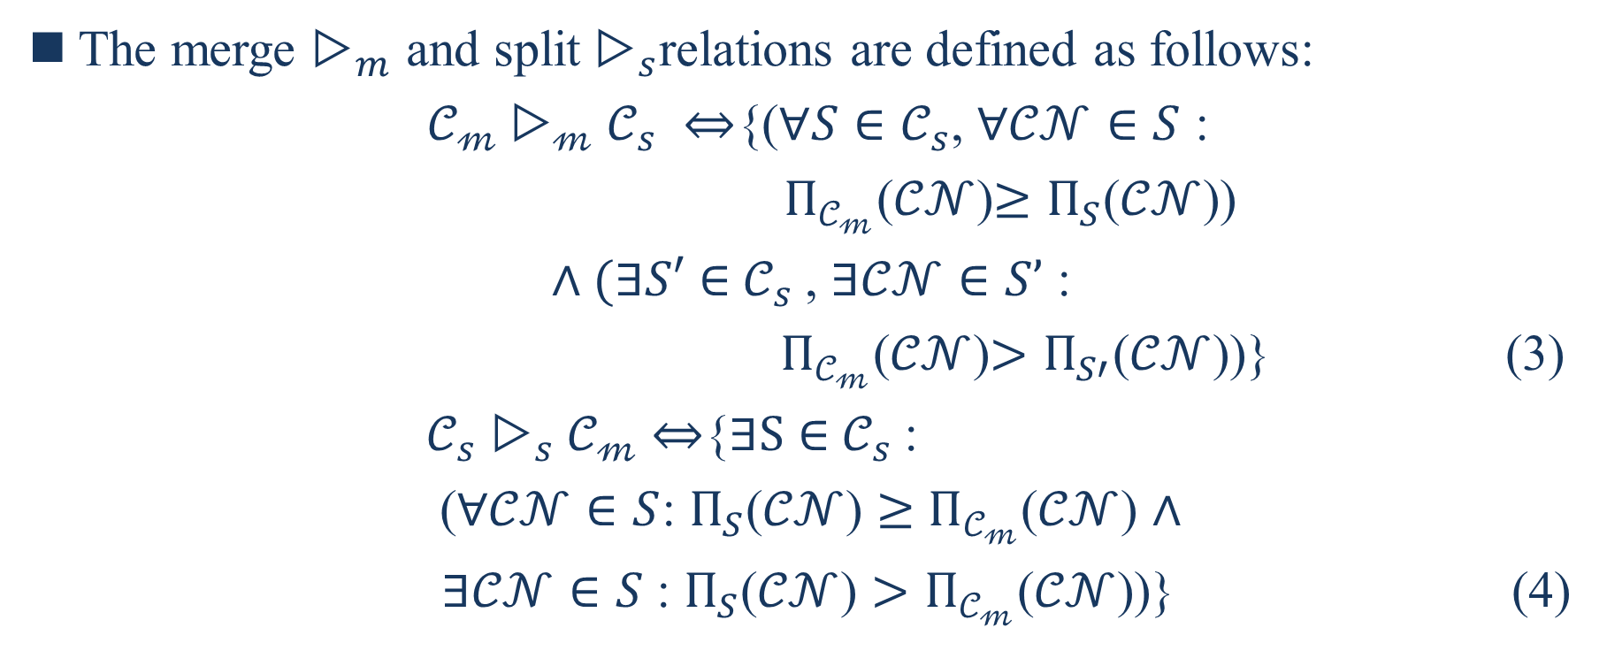
IV. VIRTUAL-EPC MECHANISM
The merge $▷_{m}$ and split $▷_{s}$relations are defined as follows:
$𝒞_{𝓂}▷_{𝓂}𝒞_{s} ⇔${($∀S∈𝒞_{s}$, $∀𝒞𝒩∈S$ :
$Π_{𝒞_{𝓂}}$($𝒞𝒩$)$≥Π_{S}$($𝒞𝒩$))
$∧(∃S′$ $∈$ $𝒞_{s}$, $∃𝒞𝒩∈S’$ :
$Π_{𝒞_{𝓂}}$($𝒞𝒩$)$>Π_{S′}$($𝒞𝒩$))} (3)
$𝒞_{s}$ $▷_{s}𝒞_{𝓂}$ $⇔${$∃S$ $∈$ $𝒞_{s}$:
($∀𝒞𝒩∈S$: $Π_{S}$($𝒞𝒩$) $≥$ $Π_{𝒞_{𝓂}}$($𝒞𝒩$) $∧$
$∃𝒞𝒩∈S$ : $Π_{S}$($𝒞𝒩$) ${>Π}_{𝒞_{𝓂}}$($𝒞𝒩$))} (4)
Notes:
合併$▷_{𝓂}和$拆分 $▷_{s}關係$定義如下
Cm(聯盟m)是Cs(聯盟s)透過合併的方式所產生的聯盟
產生方式如後面 所有聯盟S都屬於Cs，所有CN都屬於S : 合併過的Cm中的每個CN利潤>=沒有合併過的聯盟S中的每個CN利潤且至少存在一個S’屬於Cs，至少存在一個CN屬於S’ : 合併過的Cm中的每個CN的利潤>沒有合併過的聯盟S’中的每個CN利潤
Cs是Cm透過拆分的方式所產生的聯盟
產生的方式如後面 至少存在一個S屬於Cs : 所有的CN都屬於S : 拆分過的S中的每個CN利潤>=沒有拆分過的聯盟Cm的每個CN利潤且至少存在一個CN屬於S，拆分過的S中的每個CN利潤>沒有拆分過的聯盟Cm的每個CN利潤

Slide 33
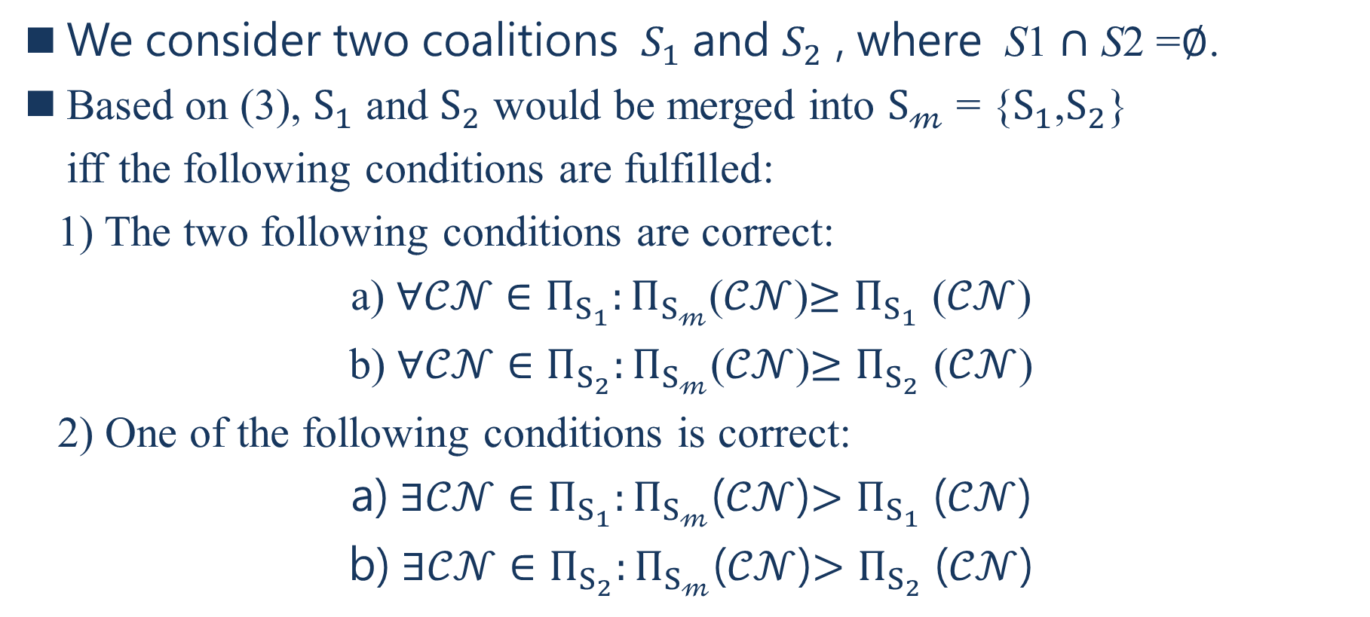
IV. VIRTUAL-EPC MECHANISM
We consider two coalitions $S_{1}$ and $S_{2}$ , where S1 $∩$ S2 =$∅$.
Based on (3), $S_{1}$ and $S_{2}$ would be merged into $S_{𝓂}$ = {$S_{1}$,$S_{2}$}
iff the following conditions are fulfilled:
1) The two following conditions are correct:
a) $∀𝒞𝒩$ $∈Π_{S_{1}}:Π_{S_{𝓂}}$($𝒞𝒩$)$≥Π_{S_{1}}$ ($𝒞𝒩$)
b) $∀𝒞𝒩$ $∈Π_{S_{2}}:Π_{S_{𝓂}}$($𝒞𝒩$)$≥Π_{S_{2}}$ ($𝒞𝒩$)
2) One of the following conditions is correct:
a) $∃𝒞𝒩$ $∈Π_{S_{1}}:Π_{S_{𝓂}}$($𝒞𝒩$)$>Π_{S_{1}}$ ($𝒞𝒩$)
b) $∃𝒞𝒩$ $∈Π_{S_{2}}:Π_{S_{𝓂}}$($𝒞𝒩$)$>Π_{S_{2}}$ ($𝒞𝒩$)
Notes:
我們考慮兩個聯盟$S_{1}$ 和 $S_{2}$，其中S1 $∩$ S2 =$∅$.
根據(3)，$S_{1}$ 和 $S_{2}$將被合併成$S_{𝓂}$ = {$S_{1},S_{2}$}如果滿足下列條件
1) 下列兩個條件是正確的
a)所有的CN都屬於$Π_{S_{1}}$ :合併過的Sm中的每個CN利潤>=沒有合併過的聯盟S1中的每個CN利潤
b)所有的CN都屬於$Π_{S_{2}}$ :合併過的Sm中的每個CN利潤>=沒有合併過的聯盟S2中的每個CN利潤
2) 下列條件其中之一是正確的
a)至少存在一個CN都屬於$Π_{S_{1}}$ :合併過的Sm中的每個CN利潤>沒有合併過的聯盟S1中的每個CN利潤
b)至少存在一個CN都屬於$Π_{S_{2}}$ :合併過的Sm中的每個CN利潤>沒有合併過的聯盟S2中的每個CN利潤

Slide 34
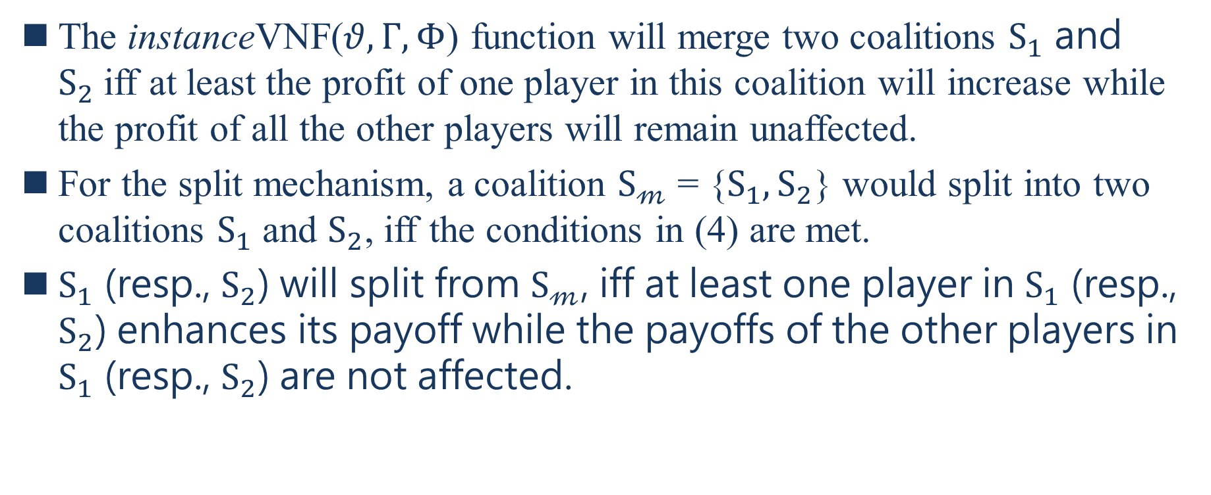
IV. VIRTUAL-EPC MECHANISM
The instanceVNF($θ,Γ,Φ$) function will merge two coalitions $S_{1}$ and $S_{2}$iff at least the profit of one player in this coalition will increase while the profit of all the other players will remain unaffected.
For the split mechanism, a coalition $S_{𝓂}$ = {$S_{1},S_{2}$} would split into two coalitions $S_{1}$ and $S_{2}$, iff the conditions in (4) are met.
$S_{1}$ (resp., $S_{2}$) will split from $S_{𝓂}$, iff at least one player in $S_{1}$ (resp., $S_{2}$) enhances its payoff while the payoffs of the other players in $S_{1}$ (resp., $S_{2}$) are not affected.
Notes:
instanceVNF ($θ,Γ,Φ$)函數將合併兩個聯盟$S_{1}$ 和 $S_{2}$如果該聯盟中至少有一個參與者的利潤增加，而所有的參與者利潤不受影響
對於拆分機制，如果滿足(4)中的條件，聯盟$S_{𝓂}$ = {$S_{1},S_{2}$}將被拆分成兩個聯盟$S_{1}$ and $S_{2}$
$S_{1}$ (分別為$S_{2}$)將從$S_{𝓂}$拆分，如果在$S_{1}$(分別為$S_{2}$)中的至少有一個參與者提高其利潤，而在$S_{1}$ (分別為$S_{2}$)中的其他參與者的利潤不受影響

Slide 35
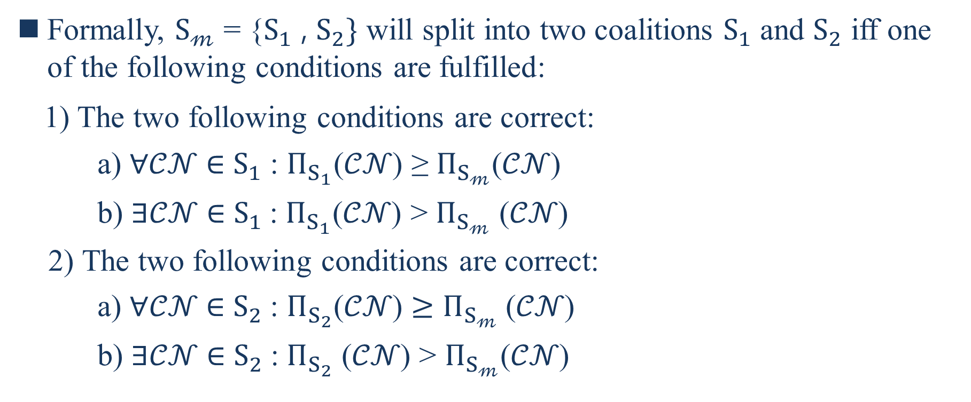
IV. VIRTUAL-EPC MECHANISM
Formally, $S_{𝓂}$ = {$S_{1}$ , $S_{2}\}$ will split into two coalitions $S_{1}$ and $S_{2}$ iff one of the following conditions are fulfilled:
1) The two following conditions are correct:
a) ∀𝒞𝒩 ∈ $S_{1}$ : $Π_{S_{1}}$(𝒞𝒩) ≥ $Π_{S_{𝓂}}$(𝒞𝒩)
b) $∃$𝒞𝒩 ∈ $S_{1}$: $Π_{S_{1}}$(𝒞𝒩) > $Π_{S_{𝓂}}$ (𝒞𝒩)
2) The two following conditions are correct:
a) $∀$𝒞𝒩 ∈ $S_{2}$: $Π_{S_{2}}$(𝒞𝒩) $≥$ $Π_{S_{𝓂}}$ (𝒞𝒩)
b) ∃𝒞𝒩 ∈ $S_{2}$: $Π_{S_{2}}$ (𝒞𝒩) > $Π_{S_{𝓂}}$(𝒞𝒩)
Notes:
以形式上講，$S_{𝓂}$ = {$S_{1},S_{2}$}將拆分成兩個聯盟$S_{1}$ 和 $S_{2}$，如果滿足下列條件之一:
1) 下列兩個條件是正確的
a)所有CN屬於S1:拆分過的S1中的每個CN利潤>=沒有拆分過的聯盟Sm中的每個CN利潤
b)至少存在一個CN屬於S1 : 拆分過的S1中的每個CN利潤>沒有拆分過的聯盟Sm中的每個CN利潤
2) 下列兩個條件是正確的
a)所有CN屬於S2:拆分過的S2中的每個CN利潤>=沒有拆分過的聯盟Sm中的每個CN利潤
b)至少存在一個CN屬於S2 : 拆分過的S2中的每個CN利潤>沒有拆分過的聯盟Sm中的每個CN利潤

Slide 36
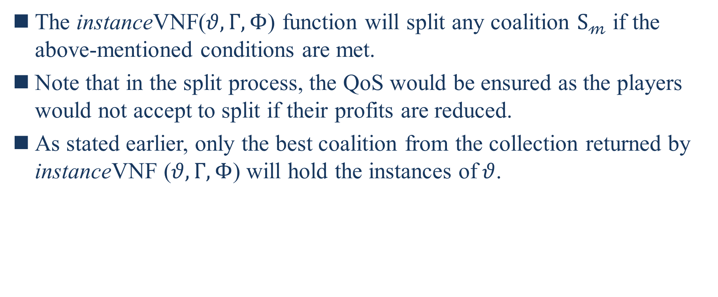
IV. VIRTUAL-EPC MECHANISM
The instanceVNF($θ,Γ,Φ$) function will split any coalition $S_{𝓂}$ if the above-mentioned conditions are met.
Note that in the split process, the QoS would be ensured as the players would not accept to split if their profits are reduced.
As stated earlier, only the best coalition from the collection returned by instanceVNF ($θ,Γ,Φ$) will hold the instances of$θ$.
Notes:
instanceVNF ($θ,Γ,Φ$)函數將拆分任何聯盟$S_{𝓂}$如果滿足上述評論條件
請注意，在拆分過程中，如果他們的利潤減少，參與者將不接受拆分，從而保證QoS
如前所述，只有從instanceVNF ($θ,Γ,Φ$)返回的集合中的最佳聯盟才能保$θ$的實例

Slide 37
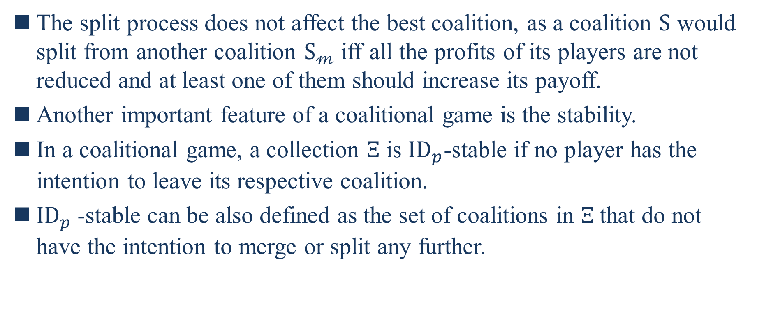
IV. VIRTUAL-EPC MECHANISM
The split process does not affect the best coalition, as a coalition $S$ would split from another coalition $S_{𝓂}$ iff all the profits of its players are not reduced and at least one of them should increase its payoff.
Another important feature of a coalitional game is the stability.
In a coalitional game, a collection $Ξ$ is ${ID}_{p}$-stable if no player has the intention to leave its respective coalition.
${ID}_{p}$-stable can be also defined as the set of coalitions in $Ξ$that do not have the intention to merge or split any further.
Notes:
拆分過程不會影響最佳聯盟，因為聯盟$S$會從另一聯盟$S_{𝓂}$拆分如果其參與者的所有利潤都沒有減少和至少其中一個應該增加其利潤
聯盟遊戲的另一重要特徵是穩定性
在聯盟遊戲中，如果沒有參與者打算離開其各自的聯盟，則集合$Ξ$(Xi)是${ID}_{p}$-stable
${ID}_{p}$-stable也可以定義為$Ξ$中不打算進一步合併或拆分的聯盟集合

Slide 38
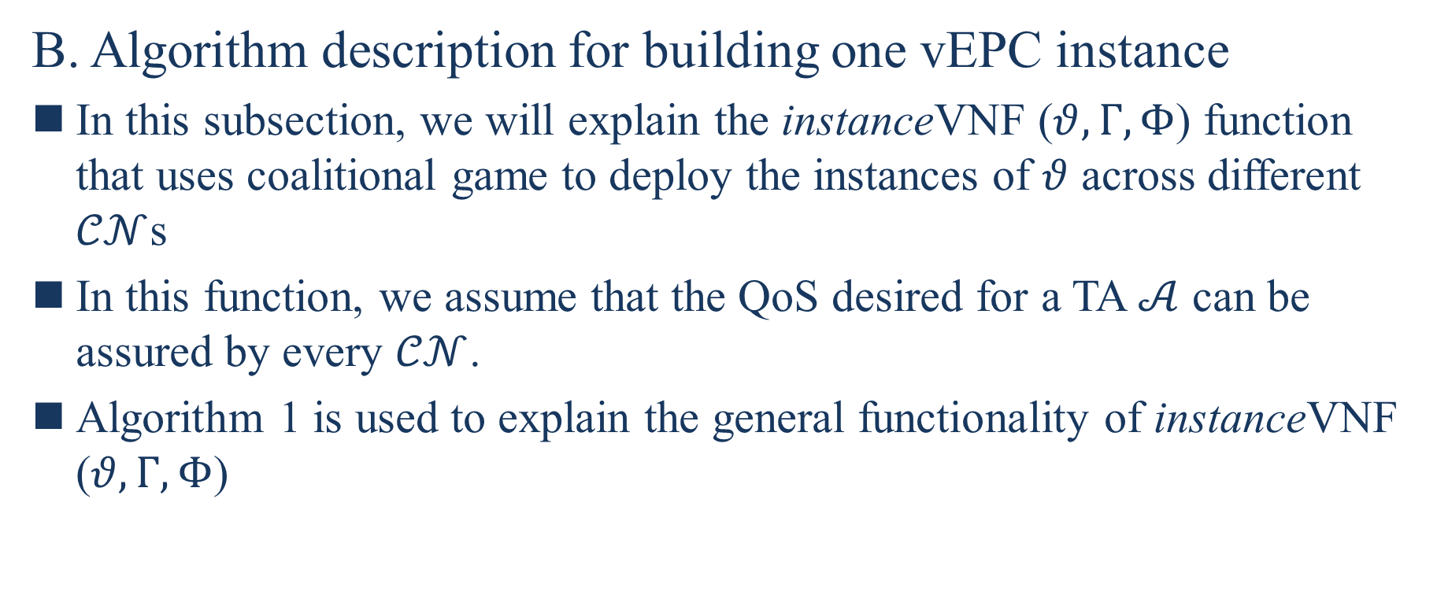
IV. VIRTUAL-EPC MECHANISM
B. Algorithm description for building one vEPC instance
In this subsection, we will explain the instanceVNF ($θ,Γ,Φ$) function that uses coalitional game to deploy the instances of $θ$ across different $𝒞𝒩$s
In this function, we assume that the QoS desired for a TA $𝒜$ can be assured by every $𝒞𝒩$.
Algorithm 1 is used to explain the general functionality of instanceVNF ($θ,Γ,Φ$)
Notes:
B. 構建一個vEPC實例的演算法說明
在本子節中，我們將解釋instanceVNF ($θ,Γ,Φ$)函數，該函數使用聯盟遊戲將$θ$的實例部署到不同的$𝒞𝒩$
在這函數中，我們假設每個$𝒞𝒩$都可以保證TA$𝒜$ 所需的QoS
演算法1用於解釋instanceVNF ($θ,Γ,Φ$)的一般功能

Slide 39
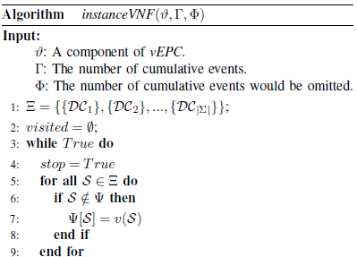
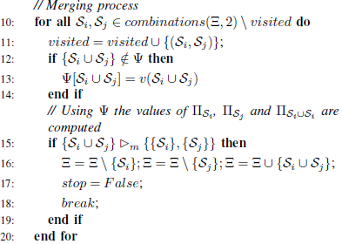
IV. VIRTUAL-EPC MECHANISM
Notes:
$θ$ : vEPC的元件(HSS MME SGW PGW)
$Γ$ : 累積事件的數量
$Φ$ : 將省略累積事件的數量
第4行 將stop變數設定為True
第5-9行 檢查是否有冗餘 其中向量$Ψ$(Psi)儲存$𝓋\left(S\right)$，假如S不屬於$Ψ$代表還沒經過檢查 因此將S放入$Ψ$中，然後將他以V(s)(聯盟的總利潤)的值儲存
第10行對所有Si,Sj屬於這個$Ξ$集合中的任2個的組合，並把這2個S從visited中移除
第12-14行中為防止v(.)計算2次
第15行 進行合併 第16行 集合=把原本的Si從集合中移除 集合=把原本的Sj從集合中移除 集合=將集合聯集新的合併過Si Sj
第17行將stop的變數設為false

Slide 40
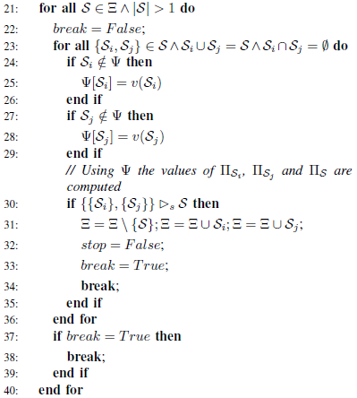

IV. VIRTUAL-EPC MECHANISM
Notes:
第21-40行是拆分得部分 第21行對所有S屬於集合且這個S的個數>1 有可能是2個或以上(Si聯集Sj)
第22行 將break變數設為false
第23行 對所有(Si,Sj)都屬於S且Si聯集Sj=S且Si交集Sj=$∅$
第24-29行跟前面一樣做檢查
第30行 開始進行拆分 將裡面有Si和Sj的S拆分
第31行 將S從原本的集合中移除 將Si聯集(加入)集合 將Sj聯集(加入)集合
第32行 將變數stop設為false
第33行 將變數break設為true
第37行 如果變數break是true那就會離開拆分
第41行 如果變數stop是true那就會離開整個while
最後return 集合 這個集合式IDp-stable的 因為他不會再進行合併或是拆分

Slide 41
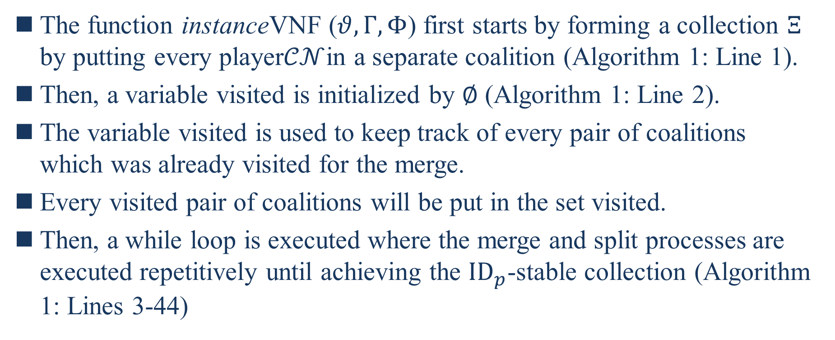
IV. VIRTUAL-EPC MECHANISM
The function instanceVNF ($θ,Γ,Φ$) first starts by forming a collection $Ξ$ by putting every player$𝒞𝒩$in a separate coalition (Algorithm 1: Line 1).
Then, a variable visited is initialized by $∅$ (Algorithm 1: Line 2).
The variable visited is used to keep track of every pair of coalitions which was already visited for the merge.
Every visited pair of coalitions will be put in the set visited.
Then, a while loop is executed where the merge and split processes are executed repetitively until achieving the ${ID}_{p}$-stable collection (Algorithm 1: Lines 3-44)
Notes:
函數instanceVNF ($θ,Γ,Φ$) 首先通過將每個玩家CN放入單獨聯盟中來形成一個集合$Ξ$(演算法1:第1行)
然後，訪問到訪變數由$∅初始化$(演算法1:第2行)
訪問到訪變數用於追蹤已為合併訪問過的每一對聯盟
每一對訪問過的聯盟將被放到訪問集合
然後，執行while迴圈，重複執行合併和拆分過程，直到實現${ID}_{p}$-stable集合(演算法1:第3-44行)

Slide 42
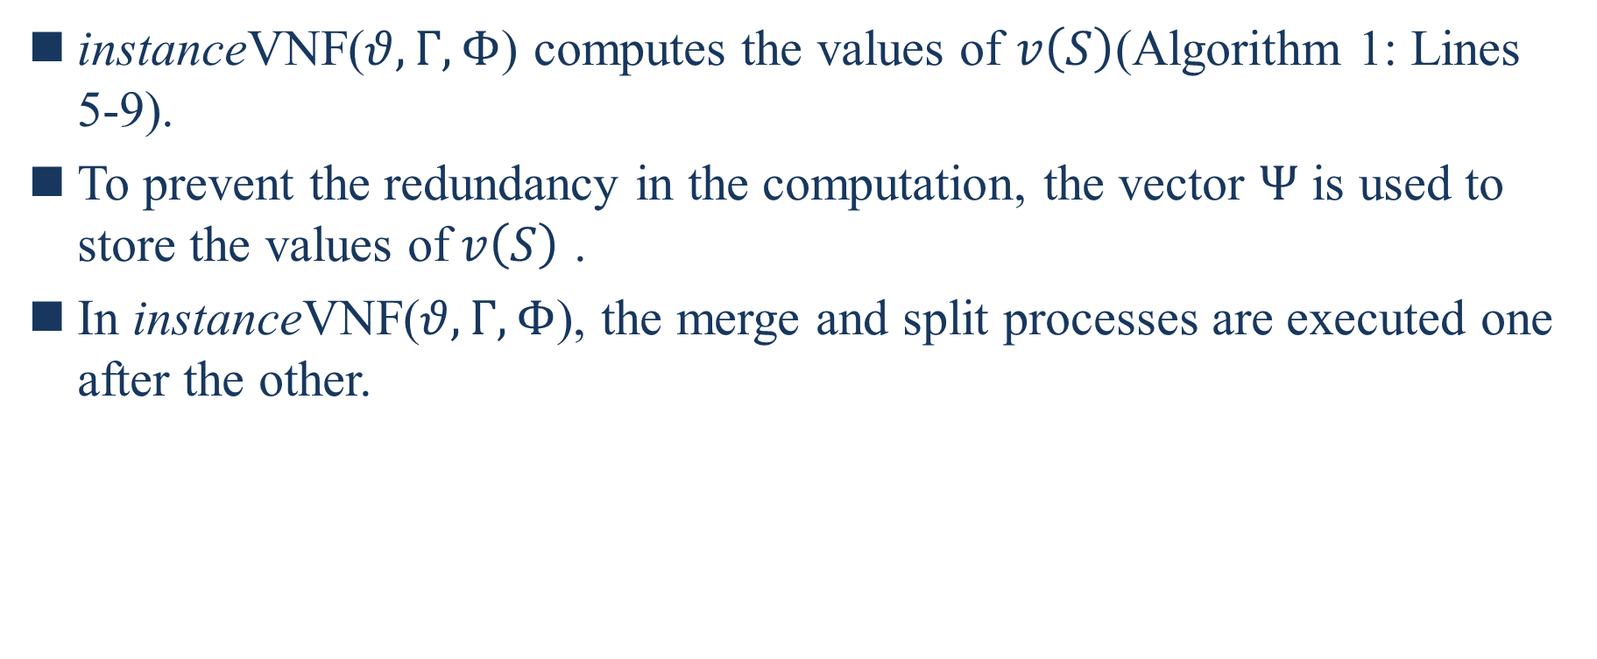
IV. VIRTUAL-EPC MECHANISM
instanceVNF($θ,Γ,Φ$) computes the values of $v\left(S\right)$(Algorithm 1: Lines 5-9).
To prevent the redundancy in the computation, the vector $Ψ$ is used to store the values of$v\left(S\right)$ .
In instanceVNF($θ,Γ,Φ$), the merge and split processes are executed one after the other.
Notes:
instanceVNF($θ,Γ,Φ$) 計算$𝓋\left(S\right)$ 的值(演算法1:第5-9行)
為預防計算中的冗餘，向量$Ψ用於$儲存$𝓋\left(S\right)$ 的值
在instanceVNF($θ,Γ,Φ$) 中，合併和拆分過程一個接一個的執行

Slide 43
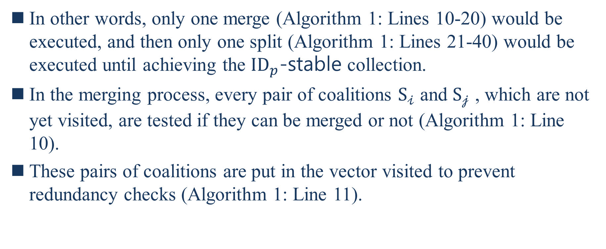
IV. VIRTUAL-EPC MECHANISM
In other words, only one merge (Algorithm 1: Lines 10-20) would be executed, and then only one split (Algorithm 1: Lines 21-40) would be executed until achieving the ${ID}_{p}$-stable collection.
In the merging process, every pair of coalitions $S_{𝒾}$ and $S_{𝒿}$ , which are not yet visited, are tested if they can be merged or not (Algorithm 1: Line 10).
These pairs of coalitions are put in the vector visited to prevent redundancy checks (Algorithm 1: Line 11).
Notes:
換句話說，只有一個合併(演算法1:第10-20行)會被執行，也只有一個拆分(演算法1:第21-40行)會被執行直到實現${ID}_{p}$-stable集合
在合併過程中，每對尚未訪問過的聯盟$S_{𝒾}$和$S_{𝒿}$都經過了是否能夠合併的測試(演算法1:第10行)
這些聯盟對被放在訪問向量來防止冗餘檢查 (演算法1:第11行)

Slide 44
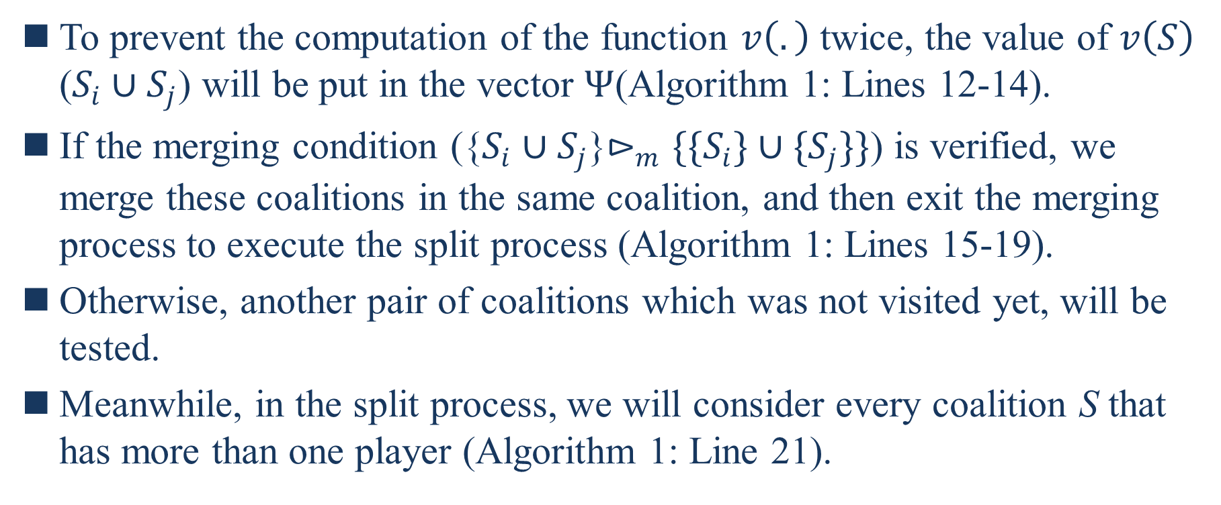
IV. VIRTUAL-EPC MECHANISM
To prevent the computation of the function $v\left(.\right)$ twice, the value of $v\left(S\right)$ ($S_{i}∪S_{j}$) will be put in the vector $Ψ$(Algorithm 1: Lines 12-14).
If the merging condition ({$S_{i}∪S_{j}$}$⊳_{m}\{\{S_{i}\}∪{\{S}_{j}\}\}$) is verified, we merge these coalitions in the same coalition, and then exit the merging process to execute the split process (Algorithm 1: Lines 15-19).
Otherwise, another pair of coalitions which was not visited yet, will be tested.
Meanwhile, in the split process, we will consider every coalition S that has more than one player (Algorithm 1: Line 21).
Notes:
為防止函數v(.)計算2次，v(S)的值($S_{i}∪S_{j}$)將放入向量$Ψ中$(演算法1:第12-14行)
如果合併條件({$S_{i}∪S_{j}$}$⊳_{m}\{\{S_{i}\}∪{\{S}_{j}\}\}$)得到驗證，我們將這些聯盟合併到同一個聯盟中，且離開合併過程去執行拆分過程
否則，另一對未訪問的聯盟將受到測試
同時，在拆分過程中，我們將考慮每個聯盟S擁有多個參與者(演算法1:第21行)

Slide 45
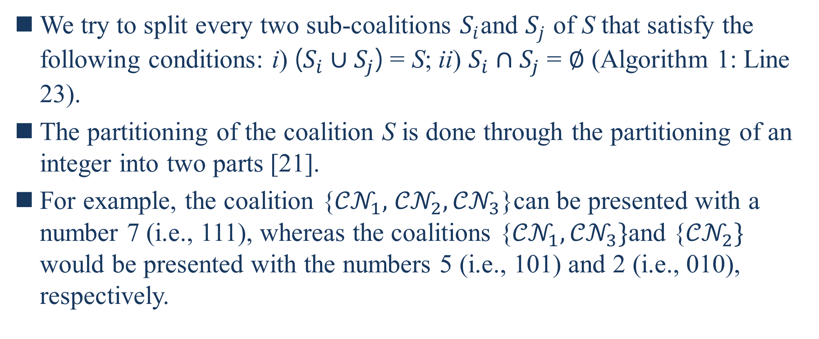
IV. VIRTUAL-EPC MECHANISM
We try to split every two sub-coalitions $S_{i}$and $S_{j}$ of S that satisfy the following conditions: i) ($S_{i}∪S_{j}$) = S; ii) $S_{i}∩S_{j}$ = $∅$ (Algorithm 1: Line 23).
The partitioning of the coalition S is done through the partitioning of an integer into two parts [21].
For example, the coalition {${𝒞𝒩}_{1},$ ${𝒞𝒩}_{2},{𝒞𝒩}_{3}$}can be presented with a number 7 (i.e., 111), whereas the coalitions {${𝒞𝒩}_{1},{𝒞𝒩}_{3}\}$and {${𝒞𝒩}_{2}\}$ would be presented with the numbers 5 (i.e., 101) and 2 (i.e., 010), respectively.
[21] D. Knuth, “The Art of Computer Programming”, Vol. 4, Fascicle 3:“Generating All Combinations and Partitions”, Addison-Wesley Professional,2005.
Notes:
我們試圖將滿足以下條件的i) ($S_{i}∪S_{j}$) = S; ii) $S_{i}∩S_{j}$ = $∅$的2個子聯盟拆分(演算法1:第23行)
聯盟S的劃分是通過將整數分成2部分來完成的[21].
舉個例子，聯盟{${𝒞𝒩}_{1},$ ${𝒞𝒩}_{2},{𝒞𝒩}_{3}$}可以表示為編號7(即111)，而聯盟{${𝒞𝒩}_{1},{𝒞𝒩}_{3}$}和${\{𝒞𝒩}_{2}$}將分別表示編號5和編號2

Slide 46
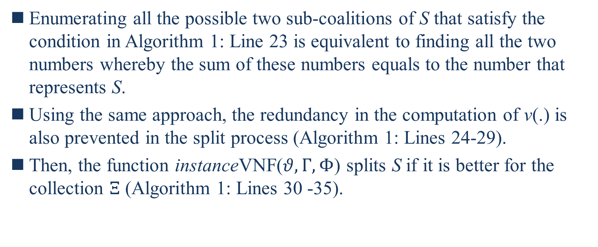
IV. VIRTUAL-EPC MECHANISM
Enumerating all the possible two sub-coalitions of S that satisfy the condition in Algorithm 1: Line 23 is equivalent to finding all the two numbers whereby the sum of these numbers equals to the number that represents S.
Using the same approach, the redundancy in the computation of v(.) is also prevented in the split process (Algorithm 1: Lines 24-29).
Then, the function instanceVNF($θ,Γ,Φ$) splits S if it is better for the collection $Ξ$ (Algorithm 1: Lines 30 -35).
Notes:
枚舉滿足演算法1:第23行的條件的S的所有可能的2個子聯盟等效於找到所有2個數字，其中這些數字的總和等於表示S的數字
使用相同的方法，在拆分過程中也防止了v(.)的計算中的冗餘(演算法1:第24-29行)
然後，函數instanceVNF($θ,Γ,Φ$)拆分S，如果其對集合$Ξ$更好(演算法1:第30-35行)

Slide 47
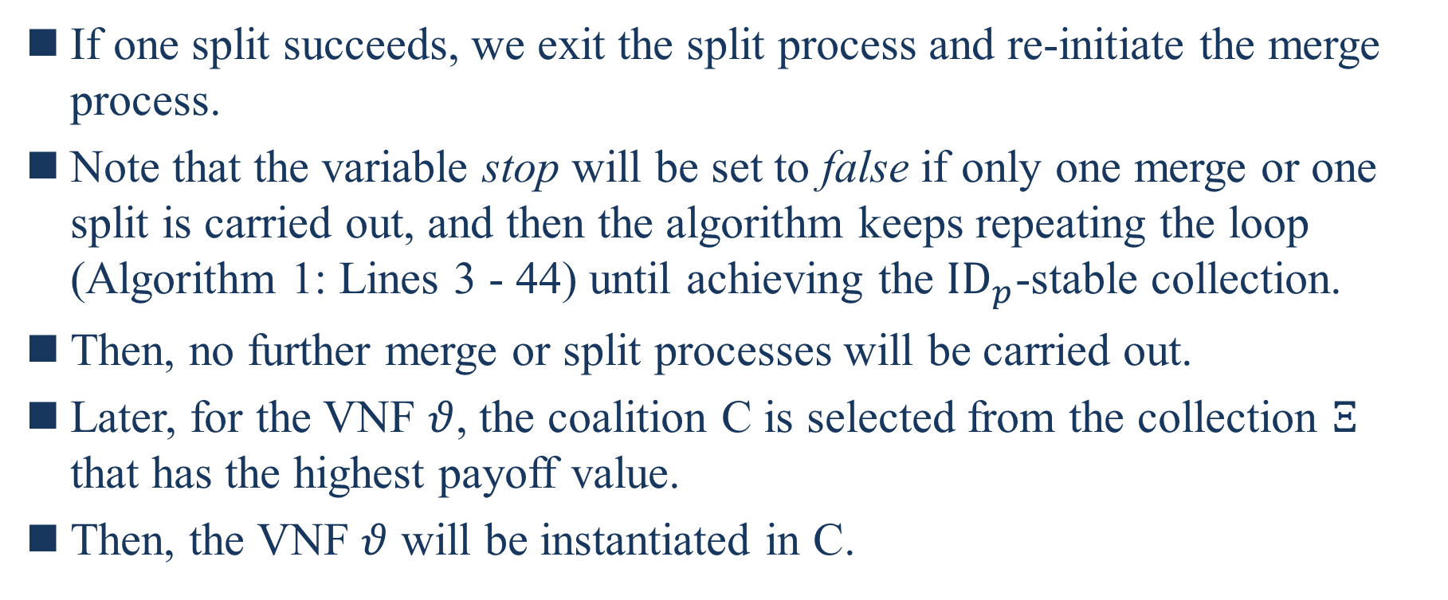
IV. VIRTUAL-EPC MECHANISM
If one split succeeds, we exit the split process and re-initiate the merge process.
Note that the variable stop will be set to false if only one merge or one split is carried out, and then the algorithm keeps repeating the loop (Algorithm 1: Lines 3 - 44) until achieving the ${ID}_{p}$-stable collection.
Then, no further merge or split processes will be carried out.
Later, for the VNF $θ$, the coalition C is selected from the collection $Ξ$ that has the highest payoff value.
Then, the VNF $θ$ will be instantiated in C.
Notes:
如果一個拆分成功，我們退出拆分過程和重新啟動合併過程
注意，如果只進行一次合併或拆分，變數stop將被設定為false，然後演算法不斷重複循環(演算法1:第3-44行)，直到實現${ID}_{p}$-stable 集合
然後，將不再執行進一步合併或拆分流程
之後，對於VNF$θ$，聯盟C是從具有最高利潤值的集合$Ξ$中選擇
然後，VNF$θ$將在C中實例化

Slide 48
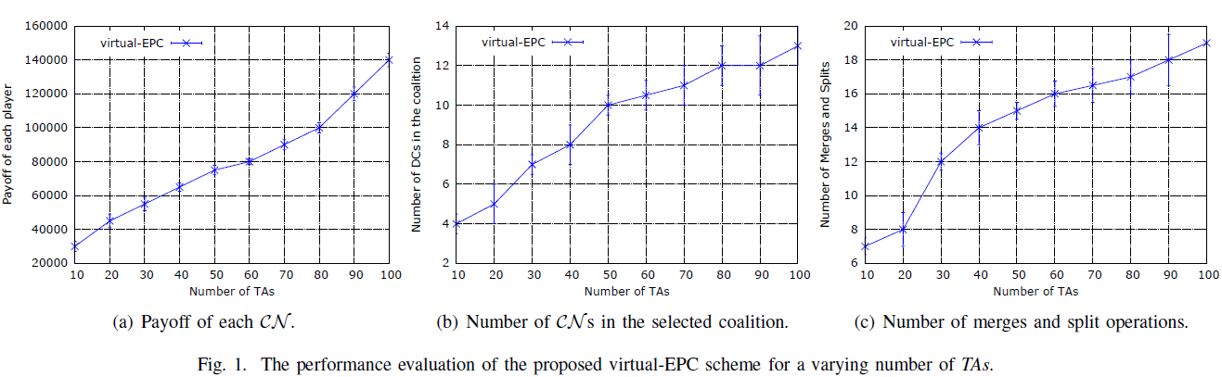
V. SIMULATION RESULTS

Slide 49
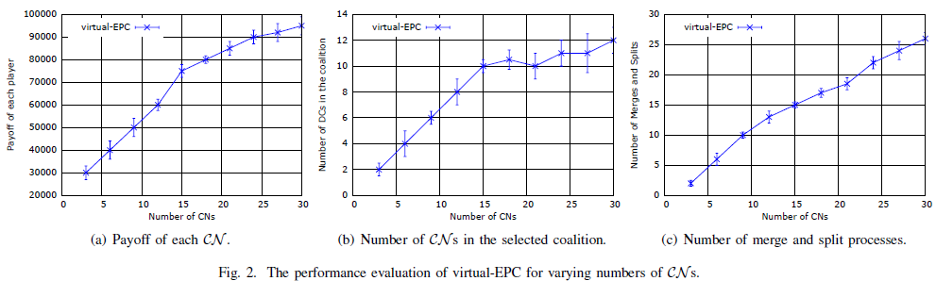
V. SIMULATION RESULTS

Slide 50
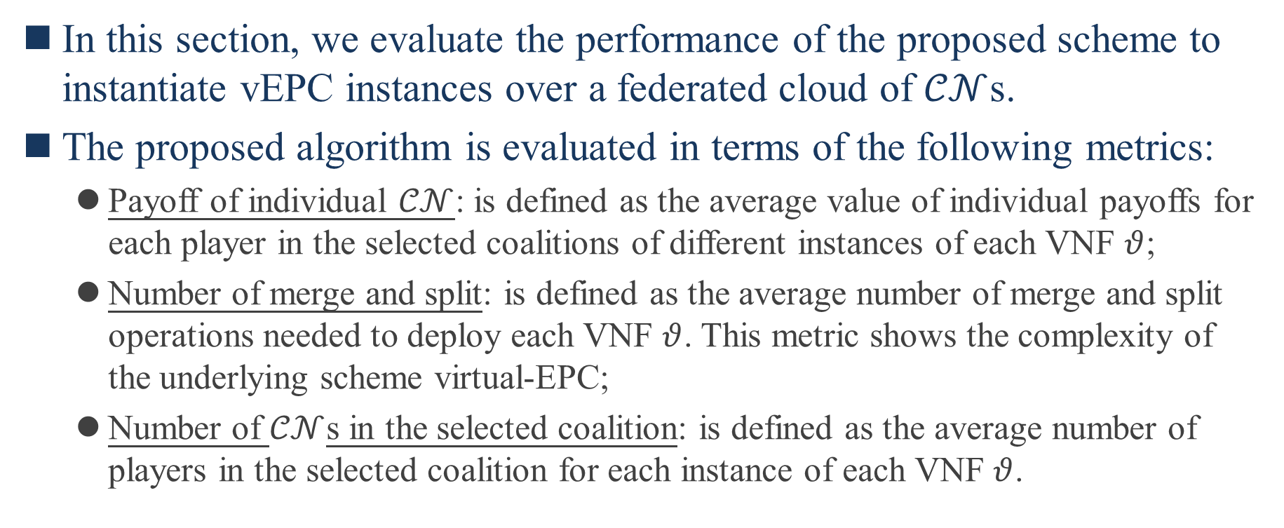
V. SIMULATION RESULTS
In this section, we evaluate the performance of the proposed scheme to instantiate vEPC instances over a federated cloud of $𝒞𝒩$s.
The proposed algorithm is evaluated in terms of the following metrics:
Payoff of individual $𝒞𝒩$: is defined as the average value of individual payoffs for each player in the selected coalitions of different instances of each VNF $θ$;
Number of merge and split: is defined as the average number of merge and split operations needed to deploy each VNF $θ$. This metric shows the complexity of the underlying scheme virtual-EPC;
Number of $𝒞𝒩$s in the selected coalition: is defined as the average number of players in the selected coalition for each instance of each VNF $θ$.
Notes:
在本節中，我們評估了在CN聯合雲上實例化vEPC實例的建議方案的性能
所提出的算法根據以下指標進行評估：
個別$𝒞𝒩的收益$ : 定義為每個VNF$θ$不同實例的選定聯盟中每個參與者的個人收益的平均值
合併和拆分次數 : 定義為部署每個VNF$θ$需要合併和拆分操作的平均次數。該指標顯示了底層方案virtual-EPC的複雜性;
選定聯盟中$𝒞𝒩s$的數量 : 定義為每個VNF$θ$每個實例選定聯盟中的平均參與者數量

Slide 51
V. SIMULATION RESULTS
The algorithms are evaluated using the python programming language and an extended package for graph theory called networkx [24].
We implement the proposed virtual-EPC scheme using IBM ILOG CPLEX version 12:6:1, using the branch-and-bound method to solve the optimization problems.
We used historical data from real-life mobile operator network to evaluate the different solutions; i.e., the different events generated in the network, such as the attach or detach operation of a UE, the executed procedure and the number of generated messages.
[24] Networkx, “http://networkx.lanl.gov”.
Notes:
這些演算法使用 python 編程語言和稱為 networkx 的圖論擴展包進行評估[24]
我們使用IBM ILOG CPLEX版本12:6:1來實作提出的virtual-EPC方案，使用分支界定法(branch-and-bound)來解決優化問題
我們使用來自真實移動營運商網路的歷史數據來評估不同的解決方案;即 網路中產生的不同事件，如一個UE的連結或分離操作、執行程序和產生訊息的數量

Slide 52
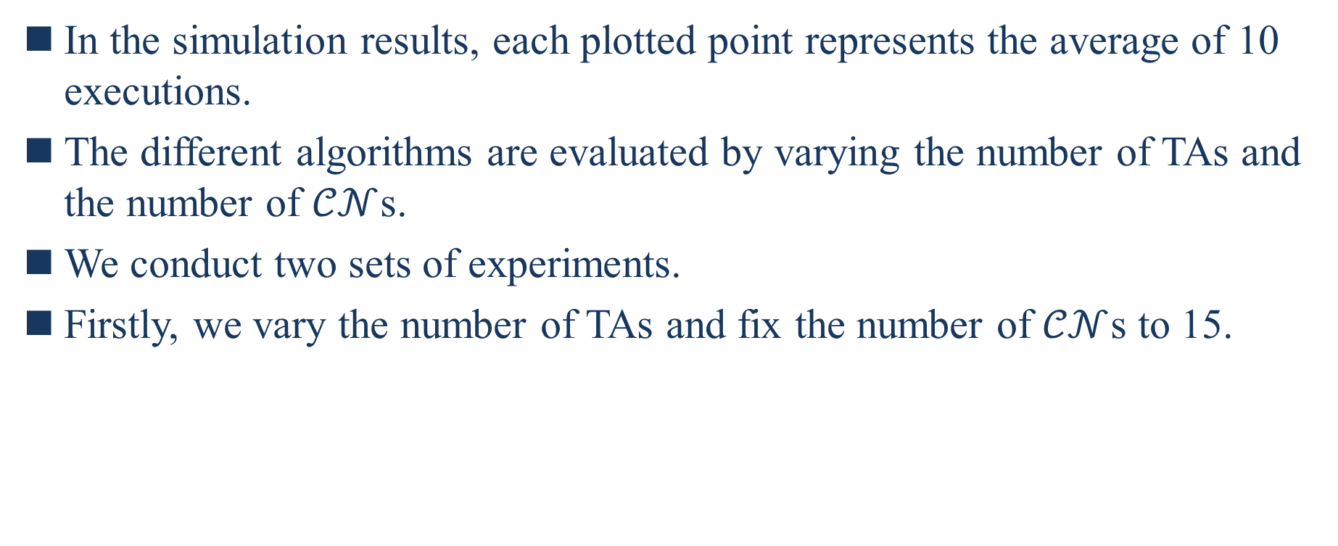
V. SIMULATION RESULTS
In the simulation results, each plotted point represents the average of 10 executions.
The different algorithms are evaluated by varying the number of TAs and the number of $𝒞𝒩$s.
We conduct two sets of experiments.
Firstly, we vary the number of TAs and fix the number of $𝒞𝒩$s to 15.
Notes:
在模擬的結果中，每個繪製點代表10次執行的平均值
通過改變TA數量和CNs數量來評估不同演算法
我們進行兩組實驗
第一，我們改變TA的數量並將CNs的數量固定為15

Slide 53
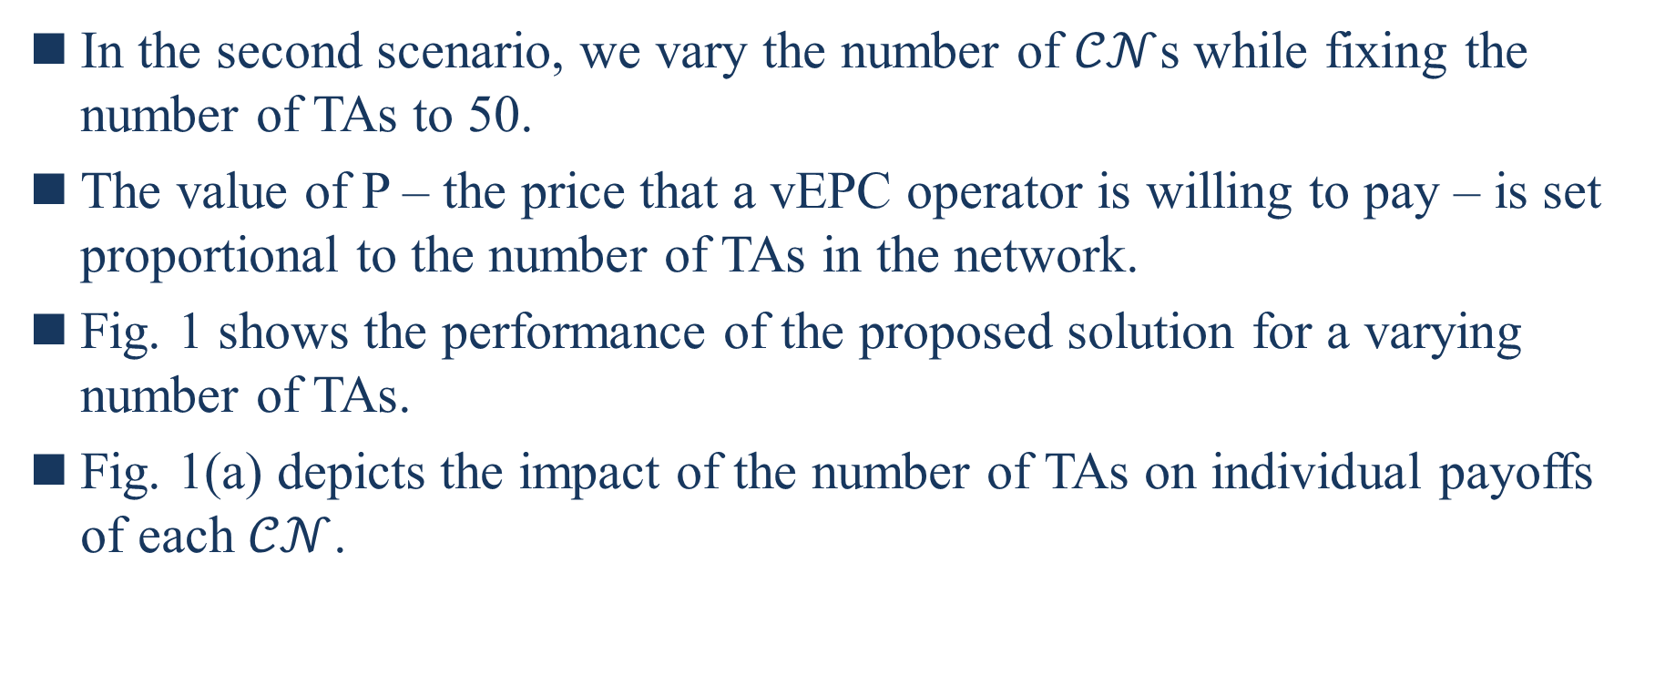
V. SIMULATION RESULTS
In the second scenario, we vary the number of $𝒞𝒩$s while fixing the number of TAs to 50.
The value of P – the price that a vEPC operator is willing to pay – is set proportional to the number of TAs in the network.
Fig. 1 shows the performance of the proposed solution for a varying number of TAs.
Fig. 1(a) depicts the impact of the number of TAs on individual payoffs of each $𝒞𝒩$.
Notes:
第二種情況，我們改變CNs的數量，同時將TA的數量固定為50
P的值-vEPC營運商願意支付的價錢-與網路TA的數量成正比
圖1顯示針對不同TA的數量提出的解決方案的性能
圖1(a)描繪TA數量對每個CN的個人收益上的影響

Slide 54
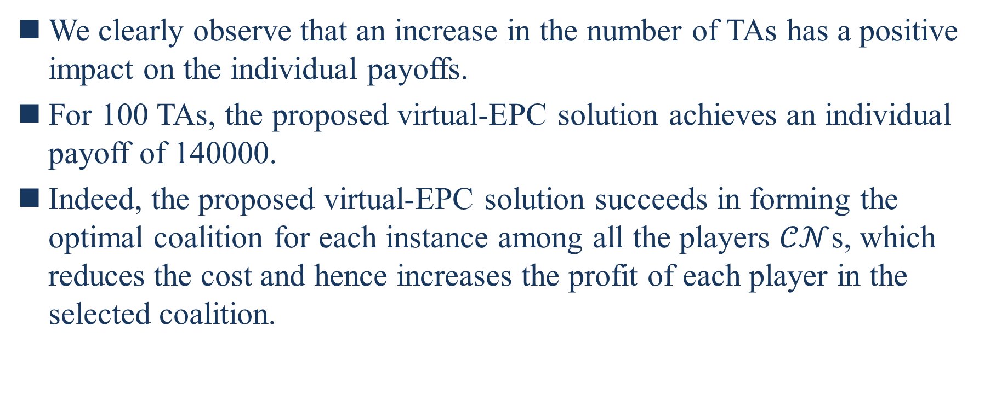
V. SIMULATION RESULTS
We clearly observe that an increase in the number of TAs has a positive impact on the individual payoffs.
For 100 TAs, the proposed virtual-EPC solution achieves an individual payoff of 140000.
Indeed, the proposed virtual-EPC solution succeeds in forming the optimal coalition for each instance among all the players $𝒞𝒩$s, which reduces the cost and hence increases the profit of each player in the selected coalition.
Notes:
我們清楚地觀察到，TA數量的增加對個人收益有正向影響
對於100個TA，提出的virtual-EPC解決方案實現了140000的個人收益
事實上，提出的virtual-EPC解決方案成功地為所有參與者CN之間的每個實例形成了最佳聯盟，這將減少成本從而增加選定聯盟中每個參與者的利潤

Slide 55
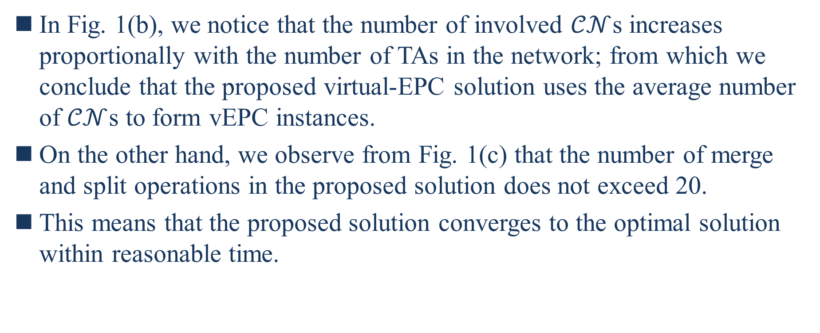
V. SIMULATION RESULTS
In Fig. 1(b), we notice that the number of involved $𝒞𝒩$s increases proportionally with the number of TAs in the network; from which we conclude that the proposed virtual-EPC solution uses the average number of $𝒞𝒩$s to form vEPC instances.
On the other hand, we observe from Fig. 1(c) that the number of merge and split operations in the proposed solution does not exceed 20.
This means that the proposed solution converges to the optimal solution within reasonable time.
Notes:
在圖1(b)中，我們注意到涉及的CN數量和網路中TA的數量成比例增加;從中我們得出結論，提出的virtual-EPC解決方案使用CN平均數量來形成vEPC實例
另一方面，我們從圖1(c)中觀察到，在提出的解決方案中合併和拆分操作的數量不能超過20
這意味著提出的解決方案覆蓋在合理時間內收斂到最佳解決方案

Slide 56
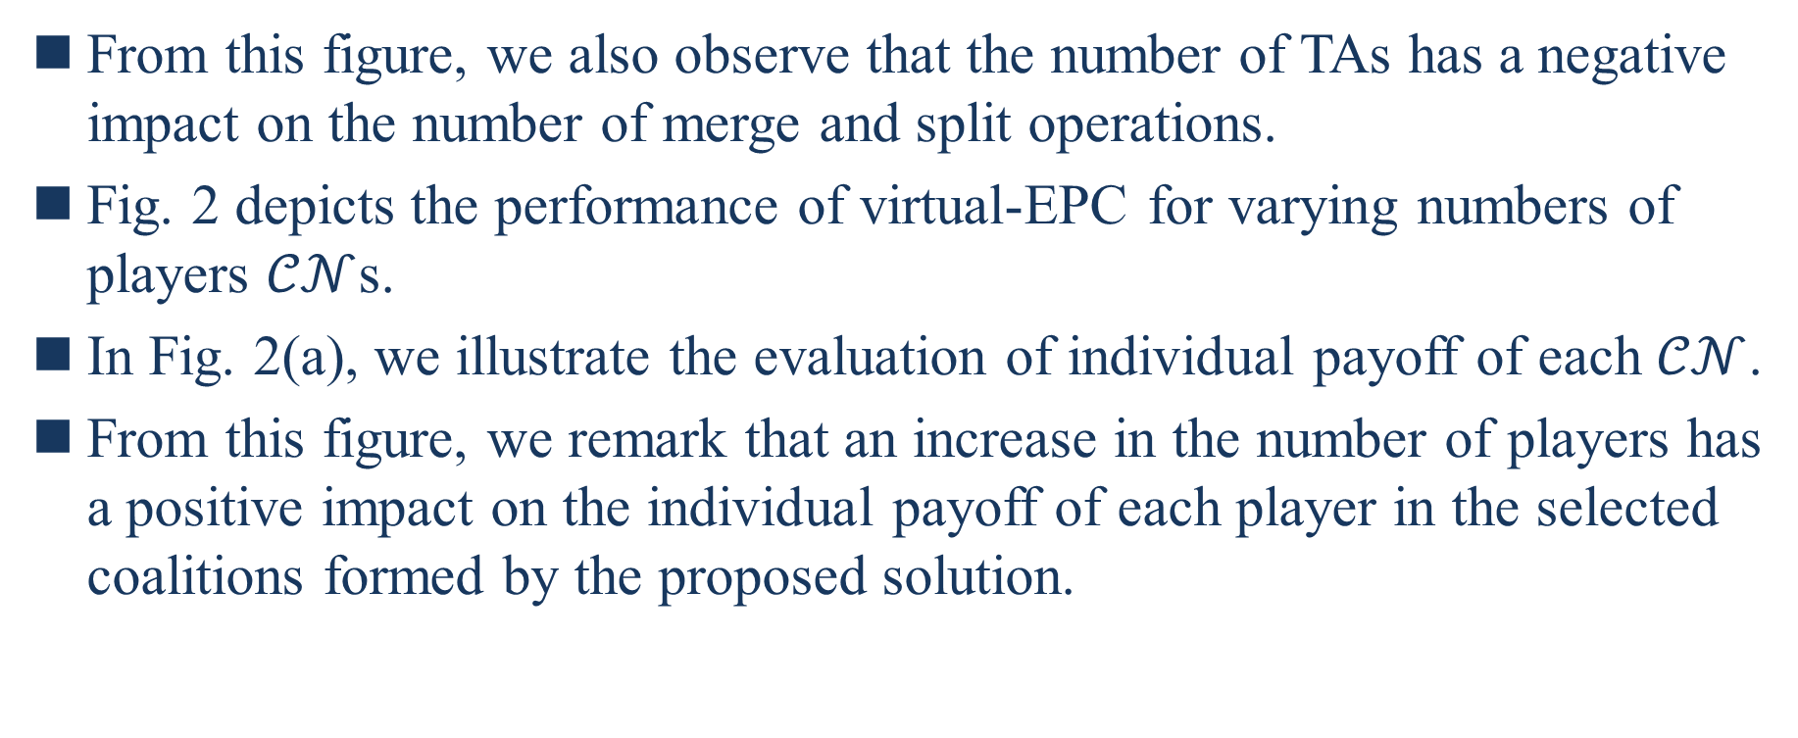
V. SIMULATION RESULTS
From this figure, we also observe that the number of TAs has a negative impact on the number of merge and split operations.
Fig. 2 depicts the performance of virtual-EPC for varying numbers of players $𝒞𝒩$s.
In Fig. 2(a), we illustrate the evaluation of individual payoff of each $𝒞𝒩$.
From this figure, we remark that an increase in the number of players has a positive impact on the individual payoff of each player in the selected coalitions formed by the proposed solution.
Notes:
從該圖，我們可以觀察到TA的數量對於合併和拆分操作的數量是負面影響
圖二描繪對於不同數量的參與者CN的virtual-EPC的性能
圖2(a)中，我們說明了對每個CN的個人收益的評估
從該圖中，我們注意到了參與者數量的增加對於提出的解決方案形成的選定聯盟中每個參與者的利潤產生正面影響

Slide 57
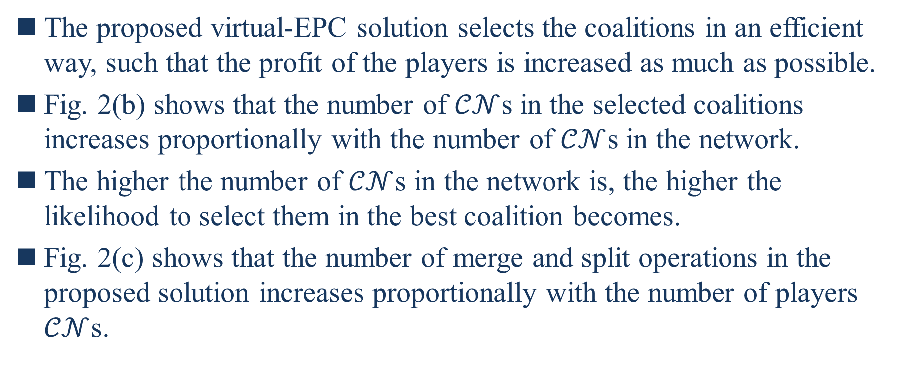
V. SIMULATION RESULTS
The proposed virtual-EPC solution selects the coalitions in an efficient way, such that the profit of the players is increased as much as possible.
Fig. 2(b) shows that the number of $𝒞𝒩$s in the selected coalitions increases proportionally with the number of $𝒞𝒩$s in the network.
The higher the number of $𝒞𝒩$s in the network is, the higher the likelihood to select them in the best coalition becomes.
Fig. 2(c) shows that the number of merge and split operations in the proposed solution increases proportionally with the number of players $𝒞𝒩$s.
Notes:
提出的virtual-EPC解決方案以有效的方法選擇聯盟，從而盡可能增加參與者的利潤
圖2(b)顯示，在選定聯盟中CN的數量與在網路中CN的數量成比例增加
網路中CN的數量愈多，在最佳聯盟中選擇他們的可能性愈大
圖2(c)顯示，在提出解決方案中合併和拆分操作的數量與參與者CN的數量成比例增加

Slide 58
V. SIMULATION RESULTS
An increase in the number of players leads to an increase in the number of possible combinations, which intuitively has a negative impact on the number of merge and split operations.
Finally, we observe from this figure that the number of merge and split operations still does not exceed 25; meaning that the proposed solution would converge to the optimal solution within reasonable time.
Notes:
參與者數量的增加導致可能的組合數量增加，直觀上對合併和拆分操作的數量產生負面影響
最後，我們從圖中觀察到，合併和拆分操作的數量仍然不會超過25;意味著提出的演算法將在合理的時間內收斂到最佳解

Slide 59
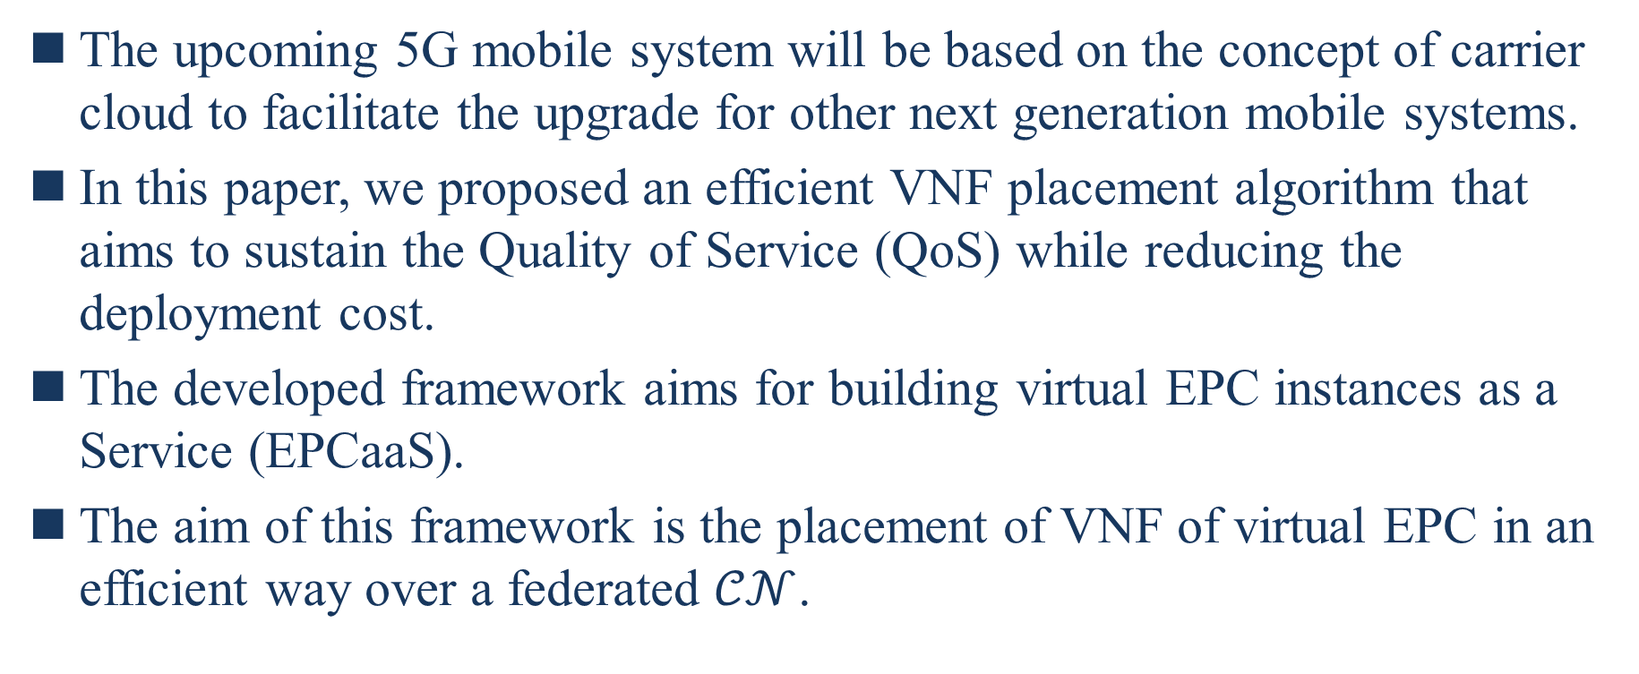
VI. CONCLUSION
The upcoming 5G mobile system will be based on the concept of carrier cloud to facilitate the upgrade for other next generation mobile systems.
In this paper, we proposed an efficient VNF placement algorithm that aims to sustain the Quality of Service (QoS) while reducing the deployment cost.
The developed framework aims for building virtual EPC instances as a Service (EPCaaS).
The aim of this framework is the placement of VNF of virtual EPC in an efficient way over a federated $𝒞𝒩$.
Notes:
即將推出的5G移動系統將基於營運商雲的概念，方便其他下一代移動系統的升級
在本文中，我們提出一個高效的VNF放置演算法，旨在維持QoS，同時減少部署成本
開發的框架旨在構建virtual EPC實例即服務(EPCaaS)
該框架的目標是以有效的方法將virtual EPC的VNF放置在聯邦雲CN上

Slide 60
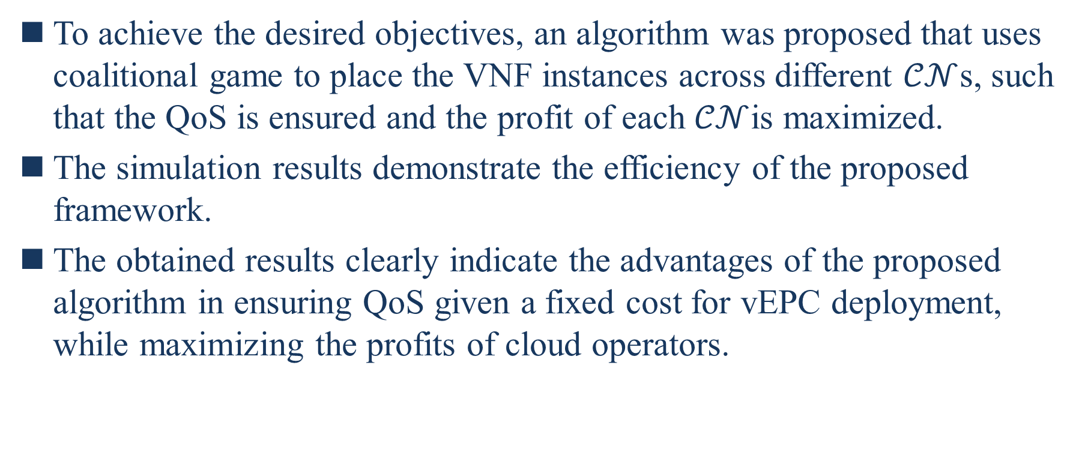
VI. CONCLUSION
To achieve the desired objectives, an algorithm was proposed that uses coalitional game to place the VNF instances across different $𝒞𝒩$s, such that the QoS is ensured and the profit of each $𝒞𝒩$is maximized.
The simulation results demonstrate the efficiency of the proposed framework.
The obtained results clearly indicate the advantages of the proposed algorithm in ensuring QoS given a fixed cost for vEPC deployment, while maximizing the profits of cloud operators.
Notes:
為了實現預期的目標，提出了一種演算法，該演算法使用聯盟博弈將VNF實例放置在不同的CN上，從而確保QoS並最大化每個CN的利潤
模擬的結果證明了提出的框架的效能

