Slide 1
End-to-End Efficient Heuristic Algorithm for 5G Network Slicing
Amal Kammoun, Nabil Tabbane, Gladys Diaz,
Abdulhalim Dandoush and Nadjib Achir
MEDIATRON Laboratory, University of Carthage, Sup’Com, Tunisia
L2TI, Paris 13 University, Sorbonne Paris Cite, France ESME Sudria, France

Slide 2
Abstract
Coupling Software Defined Networking (SDN) and Network Function virtualization (NFV) has proved to be a promising paradigm for flexible resource provisioning in future networks.
Network slicing is a very recent methodology that can be used in this paradigm for accommodating new services with wide different requirements over the same physical network.
Notes:
現在要介紹這篇的摘要
在未來的網路，把軟體定義網路跟網路功能虛擬化結合 已經被證實是對於彈性供應資源的一個有希望的典範
網路切片是一非常個近期的方法，他可以在實體網路容納有著廣泛差異需求的新服務

Slide 3
Abstract
We propose a mathematical formulation of an optimization problem for an end-to-end (E2E) network slices deployment for different 5G-based use-cases.
Each use case such as video streaming, intelligent transport, e-Health and public safety, has its own availability, reliability and delay tolerance requirements.
Notes:
我們提出了一個最佳化問題的數學公式 他是針對 不同基於5G case E2E網路切片部署
例如 像是影音串流、智能傳輸、E健康或是公共安全都有他們對於可用性、可靠度及延遲容忍的需求

Slide 4
Abstract
In view of the fact that the optimization problem is NP-Hard, a low-cost and efficient heuristic algorithm has been proposed.
Last, the efficiency of the proposed algorithm is validated through extensive simulation. Applying our algorithm improves the quality of service (QoS) afforded to the users.
Notes:
這個最佳化的問題是一個NP-hard的問題，所以一個 低成本 及 有效率 的啟發式演算法就被提出了
最後這個演算法的效率在廣泛的模擬下都是有效的， 使用我們的演算法提升我們提供給使用者的服務質量

Slide 5
INTRODUCTION
Nowadays, expertise, people and industries are on top of a digital transformation due to the critical user’s requirements and also to the emergence of new use cases [1].
Those new transformations make the mobile network operators rethink their actual implemented systems and strategies.
[1] ERICSSON WHITE PAPER, 5G SYSTEMS. https://www.ericsson.com/assets/local/publications/white-papers/wp-5g-systems.pdf, Jan. 2017. Accessed: 2017-09-18.
Notes:
現在，很多行業 都因為嚴格的使用者需求 及 新case的急迫性 而做數位的轉型
這些轉型讓 經營行動網路的公司 重新思考他們實際的應用系統跟策略

Slide 6
INTRODUCTION
The major dilemma of the existing technologies is the lack of flexibility, extensibility and also because of the strong coupling between data plane and control plane and also to the vertical implementation of network’s software.
Thus, today’s network architectures are not able to efficiently implement some use cases and to satisfy critical requirements in terms of latency, reliability and availability [2].
[2] N. Omnes, M. Bouillon, G. Fromentoux and O. L. Grand, "A programmable and virtualized network & IT infrastructure for the internet of things: How can NFV & SDN help for facing the upcoming challenges," 2015 18th International Conference on Intelligence in Next Generation Networks, Paris, 2015, pp. 64-69.
Notes:
現在科技的主要困境是缺乏彈性、延伸性、延展性、也同時因為 控制平面和資料平面的強大連結 還有網路軟體的垂直整合
因此，現今網路架構無法有效率的實行一些case也無法滿足延遲、可靠及可用度這三個重要的需求

Slide 7
INTRODUCTION
5G presents promising technologies aiming to meet new challenges that cannot be raised by actual network’s implementations [3].
Unlike previous technologies, such as LTE and UMTS, 5G will not only enhance the network system but will also provide an end-to-end infrastructure that will provision all emergent use cases and will respond to stringent user’s requirement [4].
[3] The European 5G Annual Journal, 2017, [Available online: https://bscw.5g- ppp.eu/pub/bscw.cgi/d204796/Euro%205G%20Annual%2_Journal%202017-web.pdf].
[4] "5G White Paper" February 2015 [online] Available: https://www.ngmn.org/uploads/media/NGMN_5G_White_Paper_V1_0. pdf.
Notes:
5G 提供有前途的技術來致力於面對那些因為實際網路造成的新挑戰
不像之前的的LTE及UMTS這些技術，5G不只增進網路系統，
也同時提供一個 可以供應所有危及案例 和 回應嚴格的使用者需求 的E2E基礎設施
LTE 是給予擁有 GSM/UMTS 網路的運營商最平滑的升級路線，有能力提供 299.6Mbit/s 的下載速率和 75 Mbit/s的上傳速率。目標是簡化和重新設計網路體系結構，使其成為 IP 化網路，這有助於減少3G 轉換中的潛在不良因素
通用行動通訊系統（Universal Mobile Telecommunications System，縮寫：UMTS）是當前最廣泛採用的一種第三代（3G）行動電話技術。。

Slide 8
INTRODUCTION
The vision of the 5G system is to migrate towards a horizontal approach characterized by open software functions that run on logical and virtualized resources.
The key technologies for the 5G vision are the Software-Defined Networking (SDN) [5] and the Network-Function Virtualization (NFV) [6].
[5] D. Kreutz, F. M. V. Ramos, P. E. Veríssimo, C. E. Rothenberg, S. Azodolmolky and S. Uhlig, "Software-Defined Networking: A Comprehensive Survey," in Proceedings of the IEEE, vol. 103, no. 1, pp. 14-76, Jan. 2015.
[6] R. Mijumbi, J. Serrat, J. L. Gorricho, N. Bouten, F. De Turck and R. Boutaba, "Network Function Virtualization: State-of-the-Art and Research Challenges," in IEEE Communications Surveys & Tutorials, vol. 18, no. 1, pp. 236-262, Firstquarter 2016.
Notes:
5G的願景是用水平方法來遷移，
這個方法的特點是運行在邏輯跟虛擬資源的開放軟體功能
5G的關鍵技術是軟體定義網路及網路功能虛擬化

Slide 9
INTRODUCTION
SDN and NFV are complementary and they will together achieve 5G goals and ensure high flexible networks.
SDN separates the control plane from the underlying infrastructure and moves the control logic to a centralized controller.
Notes:
SDN跟NFV是互補的 而且他們能一起實現5G的目標 同時確保高彈性的網路
SDN將控制平面從底層的架構分開 並且把控制邏輯單元交給控制器負責

Slide 10
INTRODUCTION
NFV decouples Network Functions (NFs) from hardware resources to be implemented on virtual machines which are running on top of servers, switches or routers. The controller will then program network’s elements and steer flows through network functions.
Thus, SDN and NFV provide network’s programmability and break vertical software integration.
Notes:
NFV將 網路功能從硬體資源分離，讓他們跑在伺服器、交換機及路由器的虛擬機器上
控制器會安排網路元件跟經過網路功能的flow
因此SDN和NFV能提供網路的可程式化及打破軟體的垂直整合

Slide 11
INTRODUCTION
In order to achieve the highest performance and flexibility for the network, 5G aims to break-down the “one size fits all” approach to move to the “one size per service” approach [7]. After the virtualization and softwarization of the network, the network slices can be implemented [8].
[7] M. R. Sama, X. An, Q. Wei and S. Beker, "Reshaping the mobile core network via function decomposition and network slicing for the 5G Era," 2016 IEEE Wireless Communications and Networking Conference, Doha, 2016, pp. 1-7.
[8] Paul, M., Schallen, S., Betts, M., Hood, D., Shirazipor, M., Lopes, D., Kaippallimalit, J., - Open Network Fundation document "Applying SDN Architecture to 5G Slicing", April 2016; www.opennetworking.org/images/stories/downloads/sdnresources/techn ical-reports/Applying_SDN_Architecture_to_5G_Slicing_TR-526.pdf.
Notes:
為了達到網路的 高性能和高彈性， 5G把 所有服務一種格式 改成一種服務一種格式
在把網路虛擬化及軟體化之後，就能應用網路切片

Slide 12
INTRODUCTION
5G proposes the network slicing technology that provides for each type of service a dedicated network slice [9]. Using this technology, slices will be provision on-demand and each slice will tailor only functions and services that the business model needs.
[9] Vassilaras et al., "The algorithmic aspects of network slicing," in IEEE Communications Magazine, vol. 55, no. 8, pp. 112-119, 2017.
Notes:
5G提出網路切片的技術， 這個技術能提供各種服務一個專門的網路切片
利用此技術 切片可以依照需求來提供，而且每個切片只會專門製作
有該商業模式需要的功能跟服務
專門製作

Slide 13
INTRODUCTION
For the network slicing technology, challenges of the admission control and resources allocation arise.
Our work is related to this context. We are interested in the deployment of E2E network slices for 5G use cases.
For this purpose, we first introduce a 5G use cases classification based on requirements in terms of reliability, availability and latency.
Notes:
對於網路切片技術來說， 提升了 接受控制跟 資源配置的挑戰
我們對於給5Gcase的E2E網路切片部署感興趣
基於此原因，我們首先把5G case依照可靠度、可用度及延遲來做分類

Slide 14
INTRODUCTION
Then, we present our heuristic algorithm which aims to implement the slice on the most convenient resources in order to satisfy the user requests. Target resources have to be chosen according to the requirements of different use cases.
Notes:
接著我們提出 啟發式演算法 他致力於將切片應用在最方便的資源上來滿足使用者需求
我們根據不同case的需求來選擇目標資源

Slide 15
RELATED WORK
Several algorithms for the virtual network resources embedding have been proposed in order to enhance the user’s satisfaction, minimize the network deployment cost, improve resources utilization, etc.
[10] M. Jiang, M. Condoluci and T. Mahmoodi, "Network slicing management & prioritization in 5G mobile systems," European Wireless 2016; 22th European Wireless Conference, Oulu, Finland, 2016, pp. 1-6.
Notes:
很多針對於 虛擬網路資源嵌入的演算法 都被提出來增進 使用者的滿意度及資源使用率等等

Slide 16
RELATED WORK
In [10] authors propose a heuristic algorithm for the admission control mechanism of user’s requests. This algorithm allocates dynamically network resources to each slice while maximizing the slice user’s Quality of Experience based on RAN slice prioritization.
This paper considers only the maximization of the user data rate when the network slice is created. However, for the emergent 5G use cases, additional parameters have to be guaranteed in order to satisfy the user’s requests.
[10] M. Jiang, M. Condoluci and T. Mahmoodi, "Network slicing management & prioritization in 5G mobile systems," European Wireless 2016; 22th European Wireless Conference, Oulu, Finland, 2016, pp. 1-6.
Notes:
在第10個reference中，作者對於 使用者需求的允許控制的機制 提出啟發式演算法
這個演算法在基於無線電信網路切片的優先權 可以動態的分配網路資源給各個切片 同時 滿足將使用者的體驗品質最大化
這篇paper只考慮當網路切片被創造時 使用者最大的傳輸速率
然而對於急迫的5G案例，額外的因素也必須能保證滿足使用者的需求

Slide 17
RELATED WORK
In [11] authors propose a unified approach based on the SDN paradigm that aims to optimize the provisioning of both virtual machines and network bandwidth.
The proposed algorithm minimizes the cost of the over-provisioning of cloud resources when they are requested by the users. This work interests essentially on the optimization of the network bandwidth provisioning without considering other parameters that may impact the QoS like the availability, reliability and E2E latency.
[11] J. Chase, R. Kaewpuang, W. Yonggang and D. Niyato, "Joint virtual machine and bandwidth allocation in software defined network (SDN) and cloud computing environments," 2014 IEEE International Conference on Communications (ICC), Sydney, NSW, 2014, pp. 29692974.
Notes:
在第11個reference 作者提出一個 基於 SDN範例的統一方法 來最佳提供虛擬機器及網路頻寬
這個演算法可以在 使用者要求資源時 把過度供應的雲端資源 成本最小化
他基本上在排除其他可能影響服務質量的因素例如可靠度可用性及延遲之後
最佳化網路頻寬的供應

Slide 18
RELATED WORK
In [12] authors study the problem of the network services decomposition and embedding. They propose two algorithms for the mapping of network service chains to the network infrastructure.
The first proposed algorithm is an Integer Linear Program (ILP) while the second one is a heuristic algorithm. Both algorithms try to minimize the cost of the mapping while considering the requirements of the network service chaining and also the capabilities of the network infrastructure.
[12] Sahel Sahhaf, Wouter Tavernier, Matthias Rost, Stefan Schmid, Didier Colle, Mario Pickavet, Piet Demeester, Network service chaining with optimized network function embedding supporting service decompositions, In Computer Networks, Volume 93, Part 3, 2015, Pages 492-505, ISSN 1389-1286.
Notes:
第12個reference作者對於網路服務的重構及嵌入的問題來研究
他們提出兩個演算法來映射網路服務鍊到網路架構
第一個演算法是一個整數線性規劃
第二個是一個啟發式演算法
兩個演算法都是想要當考慮到網路服務鏈及網路架構容量的需求時，將映射的成本最小化

Slide 19
RELATED WORK
The proposed embedding cost is based on the CPU, memory and storage of physical nodes, the cost of bandwidth in a physical link and the resources utilization rate. In this paper, authors consider only the bandwidth and the delay for the required QoS.
Notes:
這個是基於CPU、記憶體、實體節點的儲存空間 實體連接頻寬及資源使用率的嵌入成本
在此篇paper作者只考慮頻寬及需求服務品質的延遲

Slide 20
RELATED WORK
In [13] authors propose an algorithm for the virtual data center embedding problem which considers several constraints.
The aim of their proposal is to minimize the network resource utilization rate while maximizing the reliability and also the revenue for the infrastructure providers. Regarding the 5G use cases requirements, other QoS indicators need to be considered.
[13] Xuemin Wen, Yanni Han, Bing Yu, X. Chen and Zhen Xu, "Towards reliable virtual data center embedding in software defined networking," MILCOM 2016 - 2016 IEEE Military Communications Conference, Baltimore, MD, 2016, pp. 1059-1064.
Notes:
第13篇paper作者 對於考慮幾個限制下 虛擬資料中心的嵌入問題 提出一個演算法
他們的目標是在最小化網路資源使用率同時能將可靠度和設備提供商的收入最大化

Slide 21
RELATED WORK
In [14] authors propose two heuristic algorithms in order to solve the network slicing problem in the case of simultaneous processing and routing of a set of service requests.
The aim of their work is to optimize the implementation of service function chains according to the link and node capacity constraints. No interest on the user’s QoS requirements was made.
[14] N. Zhang, Y. F. Liu, H. Farmanbar, T. H. Chang, M. Hong and Z. Q. Luo, "Network Slicing for Service-Oriented Networks Under Resource Constraints," in IEEE Journal on Selected Areas in Communications, vol. 35, no. 11, pp. 2512-2521, Nov. 2017.
Notes:
第14篇paper作者提出兩個啟發式演算法 來解決同時處理 及繞送一套服務需求 的網路切片問題
他們希望能根據 鏈結和節點的容量限制 來最佳應用服務功能鏈

Slide 22
RELATED WORK
In summary, virtual networks embedding and resources allocation issues were studied for different contexts and several decision algorithms were proposed.
However, regarding the emerging 5G use cases requirements, the decision of the network resources allocation needs to take into consideration several other constraints which guarantee the offered Quality of Service and Quality of Experience to users.
Notes:
總而言之，虛擬網路嵌入及資源分配被不同文章所討論也被提出幾個不同的演算法
然而關於急迫的5G case需求，網路資源分配的決定 需要考慮能保證服務品質及體驗品質的一些限制

Slide 23
RELATED WORK
In our work, we present an optimization algorithm for the creation of a new slice in a given network according to a user request description.
The purpose of our proposal is to select the best target network resources among available configuration scenarios in order to satisfy the slice requirements. Our proposed algorithm considers the values of the E2E availability, reliability and latency in order to provide the convenient slice to the user’s requests.
Notes:
在此篇 我們提出一個最佳的演算法 來在已知的網路內 根據使用者所描述的需求 來創造一個新的切片
我們希望能在可用的配置情境裡挑選最佳的目標網路資源來滿足切片的需求
我們所提出的演算法考慮E2E可用性、可靠度及延遲的值來提供便利的切片給使用者的需求

Slide 24
STATE OF ART ON THE REQUIREMENTS OF 5G USE CASES
Several industries, research groups and standardization bodies such as Ericsson, NGMN Alliance and 3GPP have been focusing recently on the feasibility of some use cases of the 5G technology [1, 4, 15].
[1] ERICSSON WHITE PAPER, 5G SYSTEMS. https://www.ericsson.com/assets/local/publications/white-papers/wp-5g-systems.pdf, Jan. 2017. Accessed: 2017-09-18.
[4] "5G White Paper" February 2015 [online] Available: https://www.ngmn.org/uploads/media/NGMN_5G_White_Paper_V1_0. pdf.
[15] “3gpp tr 22.891,feasibility study on new services and markets technology enablers, stage 1, rel-14, V14.2.0, 2016-09”
Notes:
許多研究團隊及標準組織像Ericsson、NGMN Alliance及3GPP近期都專注在一些5G技術case的可行性

Slide 25
STATE OF ART ON THE REQUIREMENTS OF 5G USE CASES
They have set the requirements that the 5G network has to achieve for the different use cases. Those use cases were classified according to their requirements into several categories. For instance, the Ericsson’s white paper [1] presents three families for the 5G use cases which are
massive machine type communication (mMTC)
critical communications
enhanced mobile broadband (eMBB).
[1] ERICSSON WHITE PAPER, 5G SYSTEMS. https://www.ericsson.com/assets/local/publications/white-papers/wp-5g-systems.pdf, Jan. 2017. Accessed: 2017-09-18.
Notes:
他們對於5G的需求分成幾個類別
例如Ericsson的白皮書裡提到三個5G案例的分類
第一個是大規模機器通訊
第二個是重要通訊
第三個是增強型行動寬頻

Slide 26
STATE OF ART ON THE REQUIREMENTS OF 5G USE CASES
Reliability
The ability to deliver a service correctly according to its requirement without interruption. Some numerical values of reliability rates for different 5G use cases are presented in the Ericsson white paper [1].
For instance, the 5G network should provide a reliability rate that is equal or higher than 99.999% for the ultra-reliable communication use case. For the use cases which are non-reliability critical such as pervasive video, the reliability rate may be less than 99%.
Notes:
可靠度
是在沒有中斷的情況下，傳送一個正確服務的能力
一些不同5G case的可靠率的數值在白皮書裡有提及到
例如5G網路應該提供一個大於等於百分之99.999的可靠率給超可靠的通訊case
但對於像普遍的影音不需要如此高的可靠度，可靠率就可能低於百分之99

Slide 27
STATE OF ART ON THE REQUIREMENTS OF 5G USE CASES
Availability:
The ability to deliver a service when requested in order to fulfill the required functions.
As the 5G will be used for the public safety and the communication of emergencies, the network has to insure a required level of availability.
Notes:
可用性
當被提出需求的時候能傳送一個服務來滿足需要功能的能力
因為5G會被用在公共安全及危急的通訊，因此必須要確保有一定程度可用性

Slide 28
STATE OF ART ON THE REQUIREMENTS OF 5G USE CASES
Latency:
The latency metric depends on E2E delay and the data plane latency. 5G networks have to insure in general 10 ms E2E latency for the non-latency critical use cases and at most 1 ms for the ultra-low latency use cases [4].
Notes:
延遲
延遲取決於E2E的delay跟資料平面的delay
5G必須確保對於不重視延遲的E2E一般 有10ms的延遲
而對於超低程度的延遲 有1ms的延遲

Slide 29
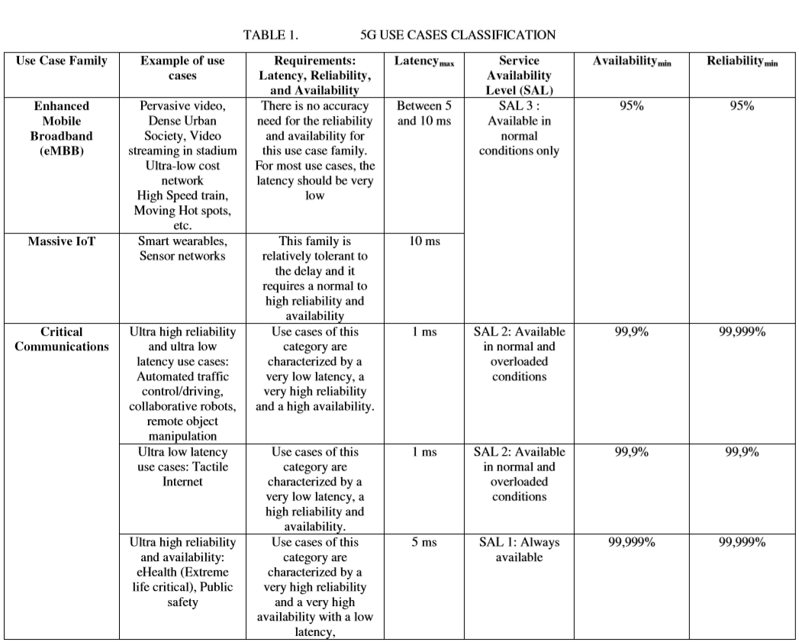
[16] ETSI Industry Specification Group (ISG) NFV. Etsi gs nfv-rel 001 v1.1.1 : Network functions virtualisation (nfv); resiliency requirements, January 2015.
Notes:
從使用端來說，「觸覺互聯網」可用一種新的人機互動介面（HCI）來理解。若要人類覺得自己與某個設備的互動是自然、直覺、即時的（Real time）體驗，則唯有當系統互動的反應時間（傳輸與處理時間）小於或等於人類感官（視覺、聽覺、觸覺）習慣的反應時間時才能達成。

Slide 30
SYSTEM MODEL
A. Network slices deployment process
For the creation of network slices, we consider a network orchestrator that receive user’s demands and according to their requirements it deploys a network slice that responds to their requests. Figure 1 presents the considered network slicing architecture.
Notes:
系統模型
網路切片的部屬過程
對於網路切片的創造
我們考慮 一個接收使用者的要求然後
再根據他們的需求來部屬網路切片 的一個網路編排器

Slide 31
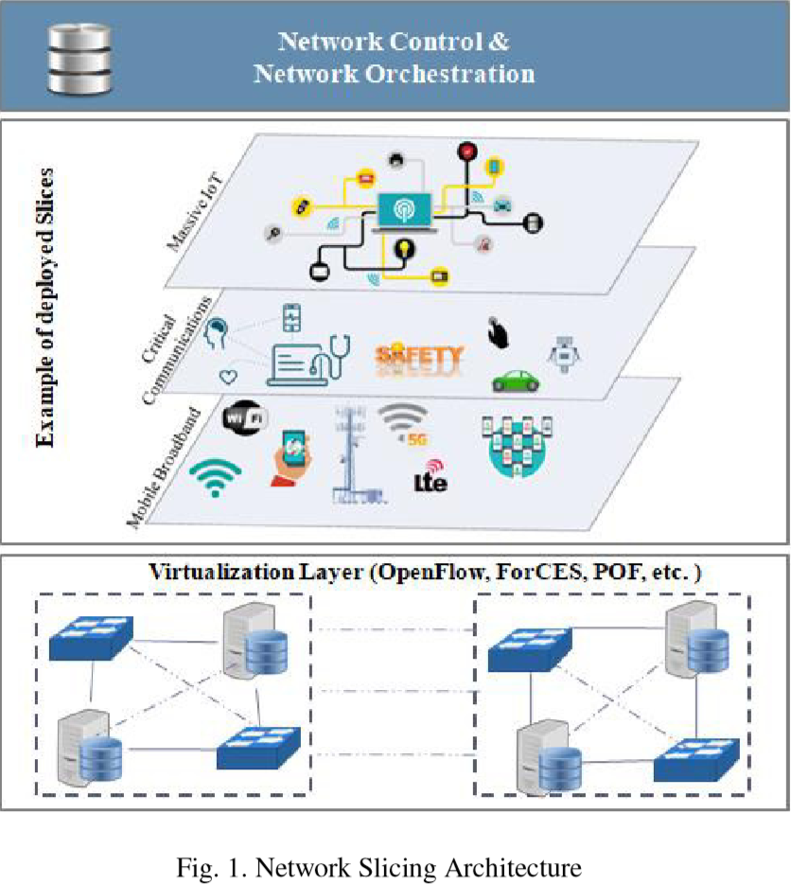
Notes:
虛擬層次Virtualization Layer 介於實體資源與虛擬資源間，負責進行整合

Slide 32
SYSTEM MODEL
A slice is composed of a set of Virtual Network Functions VNFs implemented on top of the virtual infrastructure. This composition of VNFs is adequately configured and chained according to the use case requirements.
Each implemented slice is isolated from the other slices and has a dedicated network proceeding. The use of the network slicing concept allows the network system to provide as many network slices as requested over the same network infrastructure.
Notes:
一個切片是 由一組實行在虛擬架構上的虛擬網路功能組合而成
這個虛擬網路功能的組合根據case的需求適當地配置及鏈結
各個執行的切片跟另一個切片都是獨立的且有專門的網路進行
網路切片的概念允許網路系統在同樣的網路基礎設施上提供跟需求一樣多的網路切片

Slide 33
SYSTEM MODEL
Clearly, the E2E’s performance depends on the performance of all its constituent network resources and applications.
Thus the E2E reliability and availability of the deployed slice depends on the reliability and availability of each constituent functional block.
The combination of several components in the slice deployment is characterized by a serial dependency.
Notes:
很明顯E2E的表現會取決於他網路資源及應用程式 構成 的表現
因此E2E在部署切片的可靠度及可用性會取決於各個構成功能區塊的可靠度及可用性
幾個在切片部署的元件，他們的組合以連續依賴為特點(就是很多VNF互相串連相互依賴VNF可能像是router switch database ,那切片會根據不同的QOS來做 但基本上VNF是相同的)

Slide 34
SYSTEM MODEL
In fact, all the constituent functional blocks need to be available and reliable at the same time in order to have the entire slice available and reliable.
For example, the deployment of a VNF over the NFV Infrastructure (NFVI) is a serial dependency and its reliability and availability depends on the physical hardware, the hypervisor and the software of the VNF itself. In the considered architecture, we define a data base that contains the computed values of the reliability, availability, and latency of each network resource based on its previous behavior.
Notes:
事實上，所有功能區塊的構成需要同時可靠及可用來使整個切片具可靠度及可用性
例如:將虛擬網路功能部署在網路功能虛擬化基礎設施是一個連續依賴且他的可靠度及可行性取決於實體的硬體、 虛擬機管理程序和虛擬網路功能的軟體
在架構中我們定義一個資料庫，它包含了各個網路資源他在先前行為的可靠度、可行性及延遲的數值

Slide 35
Problem Formulation
The virtualized infrastructure (VI) provides an abstraction of the physical network resources layer. It contains N Forwarding Elements (FEs) interconnected according to the VI topology and a set of K servers which are connected to the FEs.
In order to create a slice, an interconnection between virtual network resources is required. Thus, for each slice a set of v Virtual Machines (VM), n nodes and l Links are associated ; Si=<{VMi}, {Ni}, {Linki}>.
Notes:
虛擬的基礎設施提供一個抽象的實體網路資源層
它包含了N個轉送元件 根據VI的拓樸跟一群和FE連接的K個server來做互相串連
為了創造一個切片，需要虛擬網路資源的互相串連
因此對於各個切片的分配式子如下

Slide 36
Problem Formulation
The Slice creation process is characterized as a set of M tasks to be executed with a deadline dthr. A task is defined as the allocation of a network resource to the slice and the implementation of the required Virtual Network Function (VNF). Each task is characterized by its reliability, availability and latency requirements.
Notes:
切片的創造過程是以一組M個要在deadline Dthr內執行的工作為特點
一個工作的定義是網路資源分布到切片以及被需要的虛擬網路資源的執行
各個task已是以可靠度、可用性及延遲的需求為特點

Slide 37

Problem Formulation
We consider a binary variable w(i,j) to indicate if a the network resource NRj is allocated to the slice Slicei or not:
$$W(i,j)\left\{\begin{aligned}1 if the resource NRj is allocated to the Slicei \\ 0 otherwise\end{aligned}\right.$$
Notes:
我們考慮一個二元變數w(i.j)來表示網路資源NRj是否有被分配給切片I

Slide 38
Problem Formulation
We suppose that all the forwarding elements, links and also servers have unlimited computational capacities to implement all the requested slices. In fact, we interest only on the reliability, availability and latency characteristics of those network resources.
Reliability=Rj
NRj Availability=Aj
Latency=Lj
Notes:
我們假設所有繞送元件、鏈結及server有無限制的計算能力來執行所有的切片
事實上我們只關心這些網路資源的可靠度可用性及延遲

Slide 39
Problem Formulation
When a new slice creation request (SCR) is received, the Network Orchestrator has to search for the target resources to allocate for this slice based on its service-level agreement (SLA). In fact, the required SLA of each slice is described based on the following parameters:
Reliability=R_{i}
SCRi Availability=Ai
Latency=Li
Notes:
當一個新的切片創造需求被接收時，網路的編排器就需要依據服務水平協議去找出目標資源來分配給這個切片
事實上各個切片服務水平協議由以下來說明

Slide 40
Problem Formulation
In this work, our goal is the maximization of the availability and reliability for each created slice while considering the requirements of the user’s demand.
Therefore, the following constraints have to be considered:
Notes:
在這篇paper裡，我們的目標是當考慮使用者需求同時將可靠度及可用性達到最大化
因此，以下限制是需要被考慮

Slide 41
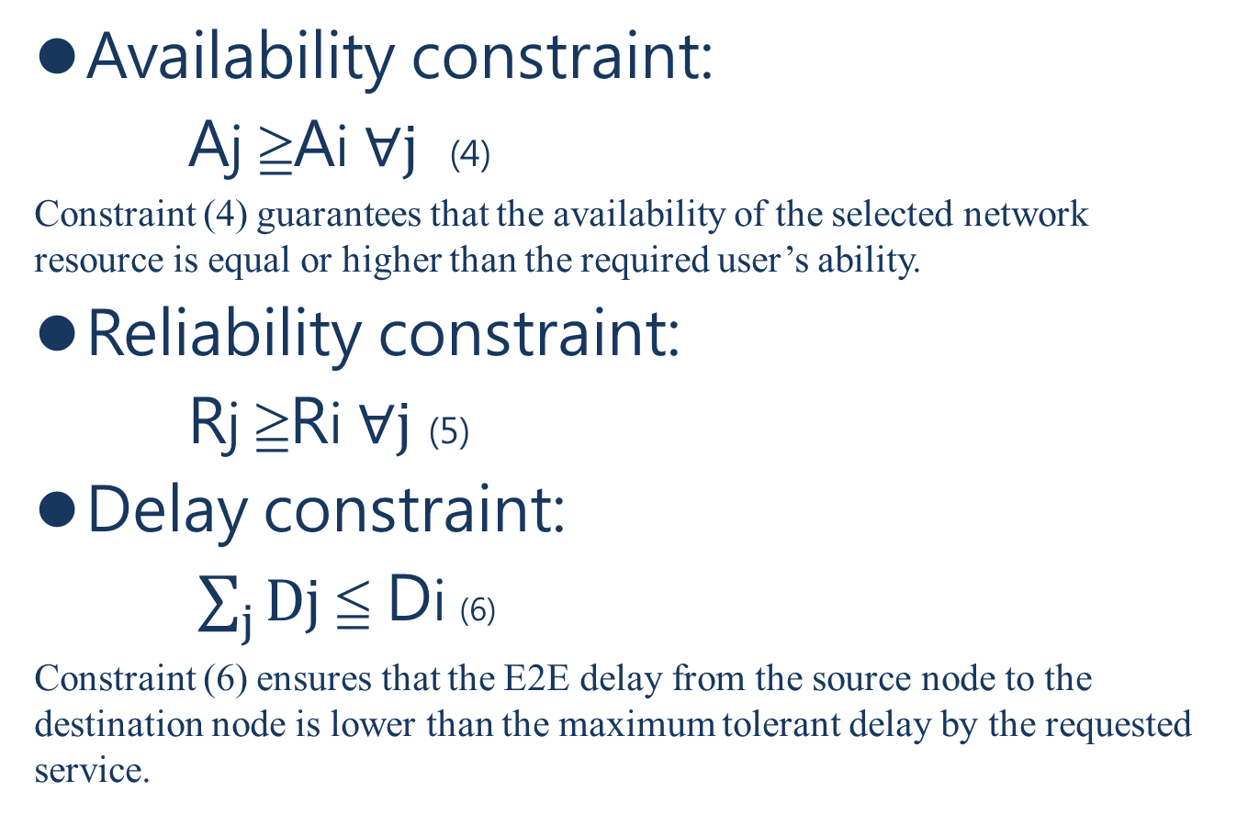
Problem Formulation
Availability constraint:
Aj ≧Ai $∀j$ (4)
Constraint (4) guarantees that the availability of the selected network resource is equal or higher than the required user’s ability.
Reliability constraint:
Rj ≧Ri $∀j$ (5)
Delay constraint:
$\sum_{j}{Dj}$ ≦ Di (6)
Constraint (6) ensures that the E2E delay from the source node to the destination node is lower than the maximum tolerant delay by the requested service.
Notes:
可用性的限制
第4式保證被選中的網路資源他的可用性必須大於等於使用者所需的可行度
可靠度的限制
第5式保證被選中的網路資源他的可靠度必須大於等於使用者所需的可靠度
延遲的限制
第6式保證source node到destination node的延遲必須小於等於被需求資源最大可容忍的延遲

Slide 42
Problem Formulation
Objective function: Our objective is the maximization of the E2E reliability (R) and E2E availability (A) of the deployed slice:
Maximize A+R
This problem is NP-Hard. Therefore, we introduce in the next part a heuristic algorithm which searches for the optimal solution by selecting the most suitable resources for the requested slice in a reasonable time.
Notes:
我們的目標函數式將部署切片的E2E可靠度及E2E可用性最大化
這個問題是NP-hard
因此我們將介紹一個階層式演算法，他會在一個合理的時間，藉由選擇被需求切片所需最適合的資源來找尋最佳解

Slide 43
Proposed Algorithm
In order to determine the target resources for the slice creation, we have opted for the utility theory. In fact, using the utility function, our algorithm computes the score of each candidate network resource while taking into consideration input parameters as well as their weights. Then, the selection will be based on the score of each resource. Our algorithm will select the resources that have the highest utility score.
Notes:
為了決定 給創造切片的目標資源，我們選擇了效用理論
事實上運用了效用功能，我們的演算法在計算各個網路資源候選者分數的同時考慮input 的參數也就是他們的權重
接著會基於各個資源的成績來做選擇
我們的演算法會選最高分的資源

Slide 44
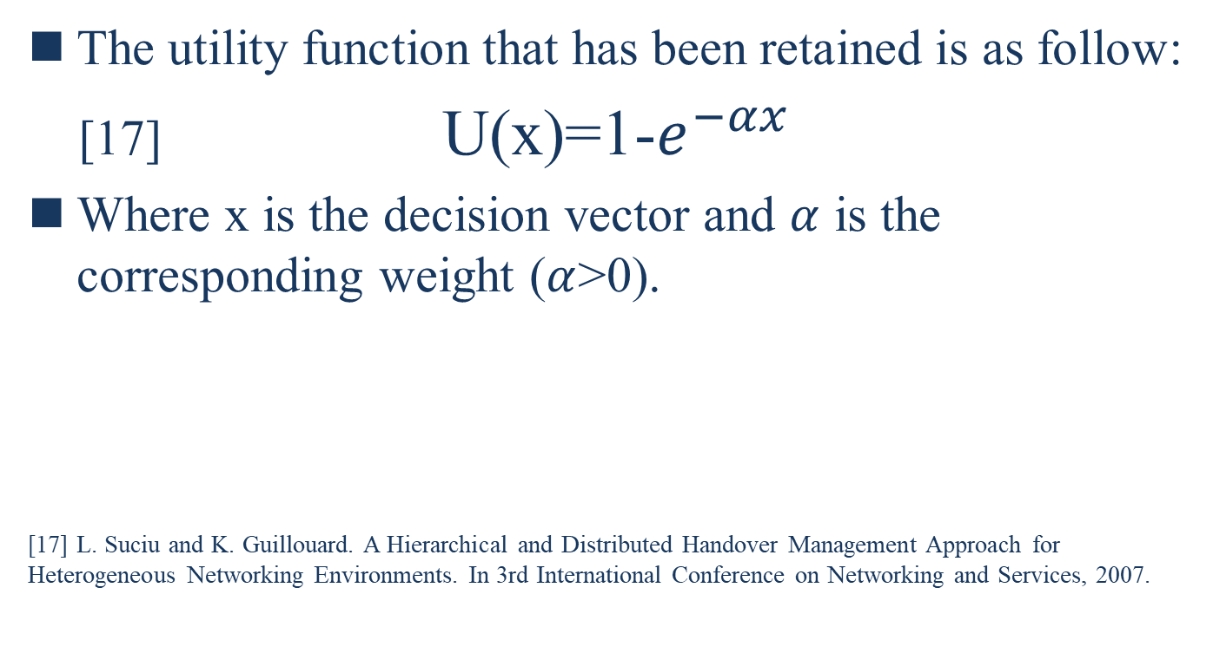
Proposed Algorithm
The utility function that has been retained is as follow:
[17] U(x)=1-$e^{−αx}$
Where x is the decision vector and $α$ is the corresponding weight ($α$>0).
[17] L. Suciu and K. Guillouard. A Hierarchical and Distributed Handover Management Approach for Heterogeneous Networking Environments. In 3rd International Conference on Networking and Services, 2007.
Notes:
效用功能的公式
U(x)=1-$e^{−αx}$
其中X是決定的因子$α$ 是相對應的權重

Slide 45
Proposed Algorithm
In this work, the decision vectors that we implement in the utility function are the network resources availability, reliability and latency. The formula used to compute the score of the network resource NRj while taking into account the requirements of the slice request i is the following:
Notes:
我們在效能功能執行的決定因子是網路功能的可用性、可靠度及延遲
當考慮切片i的需求 公式用來計算網路資源NRj的分數如下

Slide 46
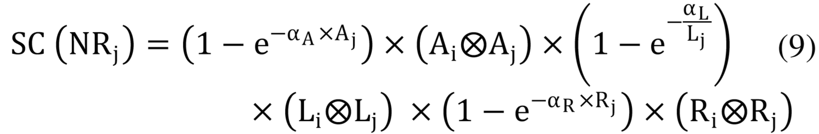
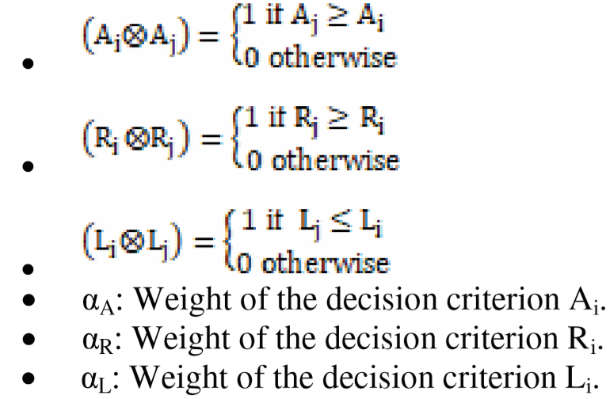
Proposed Algorithm
Where

Slide 47
Proposed Algorithm
This utility function is an increasing function. Therefore, the variation of utility values is proportional to the changes in variable values. Also, it distinguishes between ascending and descending criteria.
For example, the availability and reliability are ascending criteria that has to be maximized to better meet the user satisfaction, while the latency is a descending criterion to minimize.
Notes:
這個效用功能是一個增加的公式
因此效能的數值會因為部分改變的參數數值而改變
他在上升和下降之間會不同
例如:可用性及可靠度是上升的標準，因為他們要最大值才能達到使用者的滿足
然而延遲是一個下降的標準，因為他要盡量小

Slide 48
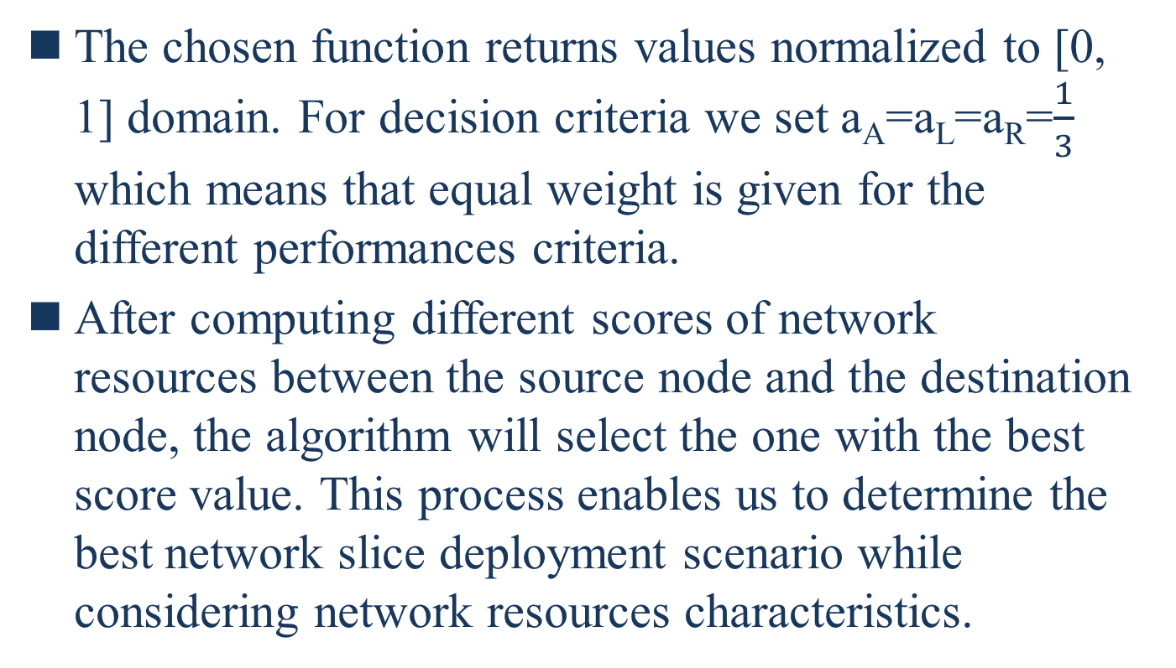
Proposed Algorithm
The chosen function returns values normalized to [0, 1] domain. For decision criteria we set a_{A}=a_{L}=a_{R}=$\frac{1}{3}$ which means that equal weight is given for the different performances criteria.
After computing different scores of network resources between the source node and the destination node, the algorithm will select the one with the best score value. This process enables us to determine the best network slice deployment scenario while considering network resources characteristics.
Notes:
被選定的功能通常都是在0和1之間選擇
對於選擇的標準我們讓每個表現的標準設為相等 都是1/3
在計算來源節點及終端節點網路資源的不同分數後，我們的演算法會選擇最高分的網路資源
這個過程能讓我們決定最好的網路切片部署同時考慮網路資源的特點

Slide 49
Proposed Algorithm
The first proposed algorithm determines at first the list of all possible paths from the source to the destination. In fact, the network control system has a complete view of all the network resources. Therefore, for each requested slice it determines the different implementation scenarios.Algorithm1 determines within a deadline execution d_{thr} the convenient available network slice implementation scenario between the source node and the destination node.
Notes:
我們接下來提出演算法用來找尋滿足使用者需求的切片
第一個提出的演算法決定來源端到終點端的所有路徑並做成一個list
事實上，網路的控制系統掌握所有的網路資源
因此，對於各個要求的切片他能決定不同的執行場景
第一個演算法能在deadline時間dthr時間內，決定起始端到終點端方便可用的網路切片

Slide 50
Proposed Algorithm
This scenario is selected while executing the second proposed algorithm. In fact, the second algorithm computes the score of each selected path and the score of each resource belonging to this path.
When the Algorithm2 finds a path that has a non-null score, this scenario will be retained. In fact, according to the equation (9), a path has a non-null score only if its reliability, availability and latency characteristics correspond to the slice requirements.
Notes:
這個場景被選擇的同時會執行第二個演算法
事實上，第二個演算法計算每個被選擇的路徑以及每個屬於這些路徑上的資源分數
當第二個演算法他找到一個路徑他的分數不等於0時，這個場景就會被保留
根據第9個方程式，這個路徑獲得非0分數的情況下，他的可用性可靠度及延遲必須符合切片的需求

Slide 51
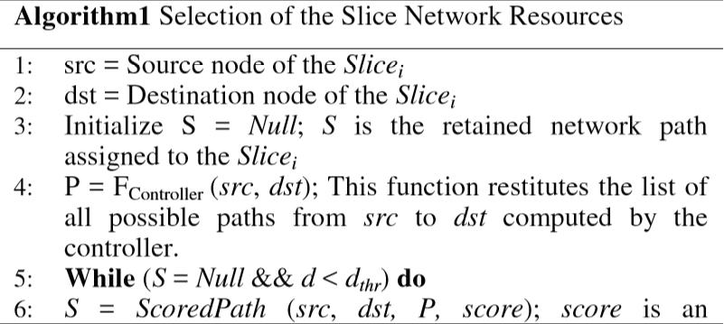
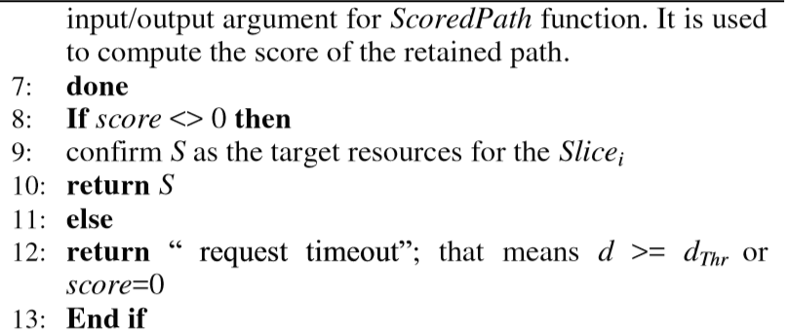
Notes:
Restitute釋放

Slide 52
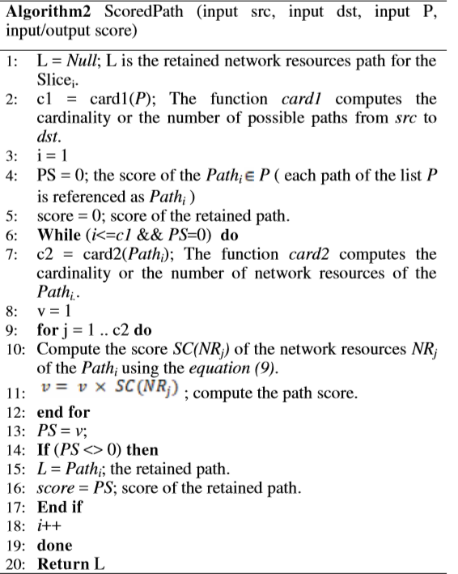
Proposed Algorithm

Slide 53
NUMERICAL RESULTS
We present simulation results of our proposed utility-based algorithm (UBA) compared to the following mono-criterion algorithms:
Delay-based algorithm (DBA): the choice of network resources is based on the delay parameter. The aim of this algorithm is the minimizing of the E2E delay.
Availability-based algorithm (ABA): the slice is embedded on the most available resources.
Reliability-based algorithm (RBA): the selection of the network resources for the requested slice is based on the reliability parameter. The most reliable network resources are selected.
Notes:
接下來，我們呈現我們以效用做為基礎的演算法結果來跟以下單一標準的演算法做比較
第一個是以延遲為基礎的
他選擇網路資源的基礎是基於延遲這項參數，這個演算法是想要達到E2E延遲的最小化
第二個是以可用性為基礎
如果選擇這個演算法，他會將切片嵌入在有最多可用的資源上
第三個是以可靠度為基礎
他選擇網路資源的基礎是基於可靠度這項參數，他會選擇最可靠的網路資源

Slide 54
NUMERICAL RESULTS
We have evaluated our algorithm using MATLAB for the three use cases families presented in Table 1. Two scenarios of real network topologies were considered:
i) the Abilene topology as a small network scenario
ii) the Geant topology as a large network scenario.
Those two topologies are obtained from the Internet Topology Zoo project [18].
The reliability, availability and delay of network resources are generated randomly.
[18] Available at http://www.topology-zoo.org/.
Notes:
我們已經用MATLAB來對我們在fig1分類的三個家族執行我們的演算法
我們考慮兩種實際的網路拓樸
第一種是小的網路場景，以阿比林網路來說明
第二種是大的網路場景，以Geant網路來說明
這兩種拓樸圖都是從拓圖動物園的網路上獲得的
網路資源的可靠度、可用性及延遲是隨機產生的

Slide 55
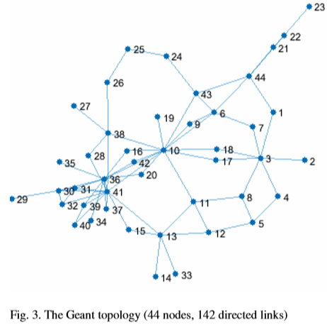
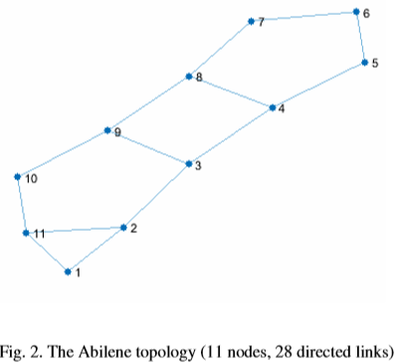
NUMERICAL RESULTS

Slide 56
NUMERICAL RESULTS
Figure 4 presents the score of the slices deployment in the case of the small network scenario. We have evaluated the score for the enhanced mobile broadband, massive IoT and also critical communications use cases which were presented in section III. This score has been evaluated by applying our proposed UBA algorithm as well as the ABA, RBA and DBA algorithms.
Notes:
第4張圖表示這些部署的切片他們套用在阿比林的分數
我們用第三章的三種cases來為增強行動頻寬、大量物聯網及重要通訊來評估分數
這些評估運用了UBA、RBA、ABA以及DBA演算法

Slide 57
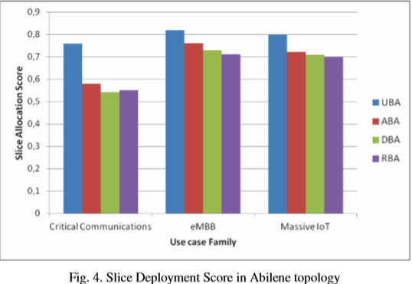
NUMERICAL RESULTS

Slide 58
NUMERICAL RESULTS
Simulation results show that the total score of the slice deployment process for each use case family is enhanced when our algorithm is applied compared to the other considered algorithms. In fact, our algorithm takes into consideration the three network performance criteria (availability, reliability and latency) for the network resources selection while the mono-criterion algorithms consider only one network performance indicator which reduces the score of the deployed slice.
Notes:
模擬出來的分數顯示各個對於不同case部署切片的過程，我們的演算法都優於其他三個
事實上因為我們的演算法綜合考慮了三種表現的標準然而其他三種演算法只考慮讓他們分數減少的單一指標

Slide 59
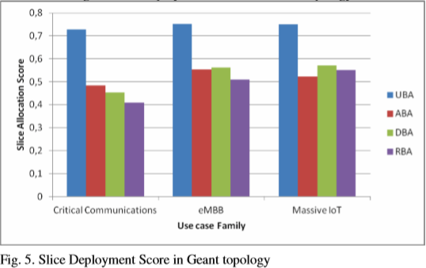
NUMERICAL RESULTS

Slide 60
NUMERICAL RESULTS
Figure 5 presents the E2E score generated by the different algorithms for the large network topology. Similarly to the small network scenario, simulation results show that the score of the slice deployment when our proposed algorithm is applied is higher than the score generated by the other mono-criterion algorithms. Moreover, for the other algorithms, the total slice creation score decreases with the increase of the number of network resources while we maintain a high score when we apply our proposed algorithm.
Notes:
圖五表示E2E在大型網路拓樸產生的分數
跟小型網路相同，我們模擬出來的分數一樣優於其他三種
更多的是，對於其他三種單一標準演算法，他們的切片創造分數在網路資源增加時反而減少
但我們的一直維持高分

Slide 61
NUMERICAL RESULTS
For the two network topologies, the eMBB and the massive IoT use cases families have the highest utility score for all the applied algorithms. In fact, those two families are characterized by a flexible requirements compared to the critical communications use case family which is characterized by stringent requirements. Simulation results demonstrate that the UBA increases the utility of the deployed slices for all the use case families as it selects the network resources based on the three network performance indicators.
Notes:
對於兩種網路拓樸，eMBB跟大型物聯網這兩個家族在所有演算法中都有最高的分數
因為這兩種他們都有彈性的需求 而重要通訊他們的需求則較嚴格
模擬的結果顯示UBA對於所有的分類都增加了他們部署切片的效能因為她選擇切片是基於三種網路指標

Slide 62
NUMERICAL RESULTS
Therefore, our algorithm is efficient even in a large scale network. The selection of the best slice creation scenario among available ones is insured when our proposal is applied. In fact, the three network performance indicators are considered in the UBA algorithm, while for the other algorithms only one indicator is considered and the others are ignored. Thus, our algorithm provides a better QoS for the deployed slices.
Notes:
因此我們的演算法在大規模的網路也是有效率的
我們的演算法能確保在所有可用的切片裡挑選最好的
因此我們的演算法提供對於部署切片提供一個較佳的服務品質

Slide 63
CONCLUSION(1/2)
This paper proposes a utility-based slice deployment algorithm (UBA) that aims to maximize the QoS for the deployed slices while considering the use case requirements as well as the network resources characteristics in terms of availability, reliability and latency. In our scenario, we consider a network control and orchestration module that creates slices according to users’ demands. Our objective is to maximize the slice deployment score by selecting the most convenient network resources.
Notes:
我們的paper提出了一個以效用為基準的切片部署演算法
這個演算法致力於在將部署切片的服務品質最大化的同時考慮每個case的需求跟網路資源的可用性可靠度及延遲
在我們的情境，我們考慮一個根據服務者需求去創造切片的網路控制及編排模組
我們的目標是藉由選擇最方便的網路切片來將部署切片的分數最大化

Slide 64
CONCLUSION(2/2)
Simulation results show that the proposed algorithm is able to select the most convenient network slice deployment scenario while maximizing the total deployment score. As future works, we will consider the management of the deployed slices in order to maintain the required QoS. Furthermore, we will try to better investigate the network performances by handling the interference between the several deployed slices.
Notes:
模擬的結果顯示我們的演算法能同時兼顧選擇最方便的網路資源以及讓總部署成績最大化
在未來我們會為了維持服務品質的需求來考慮部署切片的管理
不只如此我們會嘗試藉由掌控不同部署切片的介面來研究更好的網路的表現

Slide 65
Reference
[1] ERICSSON WHITE PAPER, 5G SYSTEMS. https://www.ericsson.com/assets/local/publications/white-papers/wp-5g-systems.pdf, Jan. 2017. Accessed: 2017-09-18.
[2] N. Omnes, M. Bouillon, G. Fromentoux and O. L. Grand, "A programmable and virtualized network & IT infrastructure for the internet of things: How can NFV & SDN help for facing the upcoming challenges," 2015 18th International Conference on Intelligence in Next Generation Networks, Paris, 2015, pp. 64-69.
[3] The European 5G Annual Journal, 2017, [Available online: https://bscw.5g- ppp.eu/pub/bscw.cgi/d204796/Euro%205G%20Annual%2_Journal%202017-web.pdf].
[4] "5G White Paper" February 2015 [online] Available: https://www.ngmn.org/uploads/media/NGMN_5G_White_Paper_V1_0. pdf.
[5] D. Kreutz,F. M. V. Ramos, P.E.Veríssimo, C. E. Rothenberg, S.Azodolmolky and S.Uhlig, "Software-Defined Networking: A Comprehensive Survey," in Proceedings of the IEEE, vol.103, no.1, pp.14-76, Jan. 2015.
[6] R. Mijumbi, J. Serrat, J. L. Gorricho, N. Bouten, F. De Turck and R. Boutaba, "Network Function Virtualization: State-of-the-Art and Research Challenges," in IEEE Communications Surveys & Tutorials, vol. 18, no. 1, pp. 236-262, Firstquarter 2016.
[7] M. R. Sama, X. An, Q. Wei and S. Beker, "Reshaping the mobile core network via function decomposition and network slicing for the 5G Era," 2016 IEEE Wireless Communications and Networking Conference, Doha, 2016, pp. 1-7.
[8] Paul, M., Schallen, S., Betts, M., Hood, D., Shirazipor, M., Lopes, D., Kaippallimalit, J., - Open Network Fundation document "Applying SDN Architecture to 5G Slicing", April 2016; www.opennetworking.org/images/stories/downloads/sdnresources/techn ical-reports/Applying_SDN_Architecture_to_5G_Slicing_TR-526.pdf.
[9] Vassilaras et al., "The algorithmic aspects of network slicing," in IEEE Communications Magazine, vol. 55, no. 8, pp. 112-119, 2017.

Slide 66
Reference
[10] M.Jiang, M. Condoluci and T. Mahmoodi, "Network slicing management & prioritization in 5G mobile systems," European Wireless 2016; 22th European Wireless Conference, Oulu, Finland, 2016, pp.1-6.
[11] J. Chase, R. Kaewpuang, W. Yonggang and D. Niyato, "Joint virtual machine and bandwidth allocation in software defined network (SDN) and cloud computing environments," 2014 IEEE International Conference on Communications (ICC), Sydney, NSW, 2014, pp. 29692974.
[12] Sahel Sahhaf, Wouter Tavernier, Matthias Rost, Stefan Schmid, Didier Colle, Mario Pickavet, Piet Demeester, Network service chaining with optimized network function embedding supporting service decompositions, In Computer Networks, Volume 93, Part 3, 2015, Pages 492-505, ISSN 1389-1286.
[13] Xuemin Wen, Yanni Han, Bing Yu, X. Chen and Zhen Xu, "Towards reliable virtual data center embedding in software defined networking," MILCOM 2016 - 2016 IEEE Military Communications Conference, Baltimore, MD, 2016, pp. 1059-1064.
[14] N. Zhang, Y. F. Liu, H. Farmanbar, T. H. Chang, M. Hong and Z. Q. Luo, "Network Slicing for Service-Oriented Networks Under Resource Constraints," in IEEE Journal on Selected Areas in Communications, vol. 35, no. 11, pp. 2512-2521, Nov. 2017.
[15] “3GPP tr 22.891,feasibility study on new services and market technology enablers, stage 1, rel-14, V14.2.0, 2016-09”
[16] ETSI Industry Specification Group (ISG) NFV. Etsi gs nfv-rel 001 v1.1.1 : Network functions virtualisation (nfv); resiliency requirements, January 2015.
[17] L. Suciu and K. Guillouard. A Hierarchical and Distributed Handover Management Approach for Heterogeneous Networking Environments. In 3rd International Conference on Networking and Services, 2007.
[18] Available at http://www.topology-zoo.org/.

