Slide 1
A Novel Approach to Optimize Clone Refactoring Activity
Salah Bouktif, Giuliano Antoniol and Ettore Merlo
Markus Neteler
Notes:
一種優化克隆重構活動的新方

Slide 2
ABSTRACT (1/4)
Achieving a high quality and cost-effective tests is a major concern for software buyers and sellers.
we contribute to alleviate the burden by proposing an architecture support for mutation and coverage criteria based testing
Notes:
軟件買家和賣家關注的主要問題是實現高品質和高性價比的測試
我們通過提出對基於變異和覆蓋率標準的測試的架構支持，為減輕負擔作出貢獻。

Slide 3
ABSTRACT (2/4)
This architecture integrates metaheuristics to derivate effective test sets and uses automated tools to speed up testing activities.
In this paper, we describe different components of the testing architecture.
Notes:
這個架構整合了元啟發方法來推動導出有效的測試集，並使用自動化工具來加速測試活動。
在本文中，我們描述了測試架構的不同組成部分。

Slide 4
ABSTRACT (3/4)
We focus on the developed tools performing mutation testing for JAVA code at method-level and the coveragebased testing for C code at function-level.
The integration of metaheuristics in these tools is illustrated by using ant colony and tabu search to derive optimal and pruned test sets.
Notes:
我們專注於在方法級別對 JAVA 代碼執行變異測試的開發工具和在函數級別對 C 代碼執行基於覆蓋的測試。
通過使用蟻群和Tabu搜索得出最優和修剪的測試集，說明了這些工具中元啟發法的整合。

Slide 5
ABSTRACT (4/4)
By using our testing architecture two cases study to carry out tests respectively for JAVA methods and C-functions are presented and discussed.
Notes:
通過使用我們的測試架構，介紹和討論了兩個案例研究，分別對 JAVA 方法和 C 函數進行了測試。

Slide 6
INTRODUCTION (1/15)
As software evolves, very often, documentation is not updated and the source code becomes the only reliable source of information.
People and technologies turnover may also contribute to create poorly-documented and gray code areas, that are essentially no longer known or maintained.
Notes:
隨著軟件的發展，很多時候，文檔並沒有被更新。而源代碼成為唯一可靠的信息來源。
人員和技術的更替也可能導致產生記錄不全和灰色的代碼區，這些代碼區基本上不再為人所知或維護。

Slide 7
INTRODUCTION (2/15)
As a result,software structure, software architecture and, in general, software quality tend to deteriorate.
Often, a system was originally conceived as a single platform application, with a limited number of functionalities and supported devices.
Notes:
因此軟件結構、軟件架構，以及一般來說，軟件質量往往會趨於惡化。
通常情況下一個系統最初被設想為一個單一的平台應用，其功能和支持的設備數量有限。

Slide 8
INTRODUCTION (3/15)
When writing a device driver or porting an existing application to a new processor,developers may decide to copy an entire working subsystem and to modify the code to cope with the new hardware.
This approach increases the chances that programmers’ work will not have any unplanned effect on the original piece of code they have just copied.
Notes:
當編寫設備驅動程序或將現有的應用程序移植到一個新的處理器時，開發人員可能決定複製整個工作子系統並修改代碼以應對新的硬件。
這種方法增加了程序員的工作不會對他們剛剛複制的原始代碼段產生任何意外影響的機會。

Slide 9
INTRODUCTION (4/15)
However, this evolving practice promotes the appearing of duplicated code snippets, also said clones.
GRASS, Geographic Resources Analysis Support System, commonly referred to as GRASS GIS, is a Geographic Information System (GIS) used for data management, image processing, graphics production, spatial modeling, and visualization of many types of data.
Notes:
然而，這種不斷發展的做法促進了重複的代碼片段的出現，也可以說是克隆
GRASS，地理資源分析支持系統，通常被稱為GRASS GIS，是一個地理信息系統（GIS），用於數據管理、圖像處理、圖形製作、空間建模和許多類型數據的可視化。

Slide 10
INTRODUCTION (5/15)
Recently, the GRASS development team started rationalization and redesign actions with the long term goal to improve software structure, modularity and more generally software quality.
As part of this goal several key actions were identified.
Notes:
最近，GRASS開發團隊開始了重整和重新設計的行動，長期目標是改善軟件結構、模塊化和更普遍的軟件質量。
作為這一目標的一部分，確定了幾項關鍵的措施。

Slide 11
INTRODUCTION (6/15)
Old Kernighan and Ritchie (K&R) C code will be replaced by ANSI style code
Code duplication, perceived as poor design, have to be minimized; coupling between functions reduced and function cohesion improved.
Notes:
舊的Kernighan和Ritchie（K&R）C代碼將被ANSI格式的代碼所取代
代碼重複，被認為是糟糕的設計，必須被最小化；減少功能之間的耦合，提高功能的內聚性

Slide 12
INTRODUCTION (7/15)
Old undocumented gray code areas should be revised, possibly, architecture organization improved so that new developers and maintainers could pick up responsibility for that sections of code.
Notes:
舊的無文檔的灰色代碼區域應該被修改，可能的話，架構組織應該被改進，這樣新的開發者和維護者就可以承擔起這部分代碼的責任。

Slide 13
INTRODUCTION (8/15)
For a medium or large software system, quality improvement and clone refactoring are difficult and challenging tasks.
A suitable order of refactoring actions have to be identified,but, refactoring deals with software architectural and design restructuring.
Notes:
對於一個中型或大型的軟件系統來說，質量改進和克隆重構是困難和具有挑戰性的任務。
一個合適的重構行動的順序必須被確定，但是重構涉及到軟件架構和設計的重組。

Slide 14
INTRODUCTION (9/15)
Overall software functionalities must not be affected;effort has to be minimized while quality improvement should be maximized.
This paper proposes to adopt metaheuristic approaches, to schedule quality improvement under constraints and priority
Notes:
軟件的整體功能不能受到影響；必須盡量減少工作量，同時最大限度地提高質量。
本文建議採用元啟發式方法，在約束條件和優先級下安排質量改進。

Slide 15
INTRODUCTION (10/15)
GRASS contains about 8000 functions; out of which there are about 1000 duplicated and 800 old style K&R functions.
Priority should be given to remove duplicate, large, complex, non cohesive K&R functions.
Notes:
GRASS包含了大約8000個函數；其中有大約1000個重複的和800個舊式的K&R函數
應優先考慮消除重複的、大型的、複雜的、不連貫的K&R功能。

Slide 16
INTRODUCTION (11/15)
Certain sub-system, has to be privileged while other code regions have not to be considered in the current phase.
Refactoring actions should be organized into work-packages (WP),so that each WP can be carried out leaving GRASS weekly release in a consistent and fully functional status.
Notes:
某些子系統必須享有特權，而其他代碼區域在當前階段不必考慮。
重構行動應該被組織成工作包（WP），這樣每個工作包都可以在GRASS每週的發布中以一致和完整的功能狀態進行執行。

Slide 17
INTRODUCTION(12/15)
Sub-sets of GRASS functions, including the mentioned about 1000 clones, need to be organized into WPs; any WP, subset of functions, constitutes a solution to our problem.
Notes:
GRASS函數的子集，包括提到的大約1000個克隆，需要組織成WP；任何WP，函數的子集，都構成了我們問題的解決方案。

Slide 18
INTRODUCTION(13/15)
Indeed, the exact solution may not be computational feasible, whereas approximated solutions with low complexity or almost linear complexity may ensure scalability at the price of slightly reducing the result optimality.
Notes:
事實上，精確的解決方案可能在計算上是不可行的，而具有低複雜度或幾乎線性複雜度的近似解決方案可能以略微降低結果的最優性為代價來確保可擴展性。

Slide 19
INTRODUCTION(14/15)
Given the above outlined constraints we re-formulated the quality schedule improvement, under constraint and priority, as an M-dimensional Knapsack problem.
Notes:
考慮到上述約束條件，我們在約束條件和優先權下，將質量進度改進重新表述為M維Knapsack問題。

Slide 20
INTRODUCTION(15/15)
The problem was solved via Genetic Algorithms (GAs) and quality improvement was effectively scheduled by identifying near optimal clone removal actions,set of functions organized into WP.
Notes:
該問題通過基因演算法（GA）來解決，並通過識別接近最優的克隆移除行動來有效地安排質量改進，這套功能被組織成WP。

Slide 21
RELATED WORK
A survey of the application of GAs to solve scheduling problems has been presented by Hart et al. in [16].
A survey of approximated approaches for the bin packing problem is presented in [9].
[16] E. Hart, D. Corne, and P. Ross. The state of the art in evolutionary scheduling. Genetic Programming and
Evolvable Machines, 2004 (to appear).
[9] E. J. Coffman, M. Garey, and D. Johnson. Approximation algorithms for bin-packing. In Algorithm Design for
Computer System Design, 1984.
Notes:
Hart等人在[16]中介紹了關於應用GA解決調度問題的調查。
在[9]中介紹了對裝箱(bin packing)包裝問題的近似方法的調查

Slide 22
RELATED WORK
More recently Falkenauer published a book devoted to the GA and grouping problems [11].
Schema interpretation and bin packing genome encoding described in the book were a source of inspiration, although our problem is slightly different
[11] E. Falkenauer. Genetic Algorithms and Grouping Problems. Wiley-Inter Science, Wiley - NY, 1998.
Notes:
最近Falkenauer出版了一本專門討論GA和分組問題的書[11]。
書中描述的模式解釋和bin packing基因組編碼是靈感的來源，儘管我們的問題略有不同

Slide 23
RELATED WORK
Our problem requires to consider both the work that can be done and, at the same time, the highest possible quality improvement.
Therefore, the order on which WPs are presented to the teams is relevant, whereas bin packing doesn’t impose a packing order to reach an optimum
Notes:
我們的問題要求既要考慮可以完成的工作，同時也要考慮盡可能高的質量改進。
因此，WP被提交給團隊的順序是相關的，而裝箱(bin packing)並不強加一個包裝順序以達到最佳效果。

Slide 24
RELATED WORK
Kirsopp et al. [19] reported a comparison of random search, hill climbing,and forward sequential selection to select the optimal set of project attributes to use in a search–based approach to estimating project effort.
[19] C. Kirsopp, M. Sheppard, and J. Hart. Search heuristics,case-based reasoning and software project effort prediction.In Proceedings of Genetic and Evolutionary Computation Conference. Springer-Verlag, 2002.
Notes:
Kirsopp等人[19]報告了隨機搜尋、爬坡和前向順序選擇的比較，以選擇最佳的項目屬性集，用於基於搜索的方法來估計項目工作。

Slide 25
RELATED WORK
A comparison of approaches (both analytical and evolutionary) for prioritizing software requirements is proposed in [18], while Greer and Ruhe proposed a GA-based approach for planning software releases [15].
[18] J. Karlsson, C. Wohlin, and B. Regnell. An evaluation of methods for priorizing software requirements. Information and Software Technology, 39:939–947, 1998
[15] D. Greer and G. Ruhe. Software release planning: an evolutionary and iterative approach. Information and
Software Technology, 46(4):243–253, 2004.
Notes:
在[18]中提出了一個比較軟件需求優先級的方法（包括分析和進化），而Greer和Ruhe提出了一個基於GA的方法來規劃軟件發布[15]。

Slide 26
RELATED WORK
Clark et al. [8] argued a great potential for the exploitation of metaheuristics within software engineering, particularly, in the areas of test data generation, module clustering and cost/effort prediction
[8] J. A. Clark, J. J. Dolado, M. Harman, R. M. Hierons,B. Jones, M. Lumkin, B. S. Mitchell, S. Mancoridis, K. Rees,M. Roper, and M. J. Shepperd. Formulating softwareengineering as a search problem. IEE Proceedings -
Software, 150(3):161–175, 2003
Notes:
Clark等人[8]認為，在軟件工程中利用元啟發法有很大的潛力，特別是在測試數據生成、模塊聚類和成本/工作量預測等領域。

Slide 27
RELATED WORK
We propose an effort model for clone detection refactoring and we incorporate constraints and priorities into our refactoring problem formulation.
Notes:
我們提出了一個克隆檢測重構的努力模型，我們將約束和優先級納入我們的重構問題表述中。

Slide 28
PROBLEM FORMULATION
Applications based on GAs revealed their effectiveness in finding approximate solutions, when the search space is large or complex, when mathematical analysis or traditional methods are not available, and, in general, when the problem to be solved is NP-complete or NP-hard [13].
[13] M. Garey and D. Johnson. Computers and Intractability: a Guide to the Theory of NP-Completeness. W.H.Freeman,1979
Notes:
基於GA的應用揭示了它們在尋找近似解方面的有效性，當搜索空間很大或很複雜時，當數學分析或傳統方法不可用時，以及一般來說，當要解決的問題是NP完整或NP困難時[13]。

Slide 29
PROBLEM FORMULATION
A GA may be defined as an iterative procedure that searches for the best solution of a given problem among a population, represented by a finite string of symbols, the genome.
Notes:
GA可以被定義為一個迭代程序，在一個由有限的符號串（基因組）代表的群體中尋找一個給定問題的最佳解決方案。

Slide 30
PROBLEM FORMULATION
The termination condition is often based on a maximum number of generations, on a given value of the fitness function or, also, on a maximum number of generations, without fitness improvement.
Notes:
終止條件通常基於最大代數，適應度函數的給定值，或者最大代數沒有適應度改進。

Slide 31
PROBLEM FORMULATION
In this paper we focus on a general problem of how to promote software quality improvement, while performing evolution and maintenance activities.
More precisely, while performing perfective maintenance actions, we would like to select candidate functions to maximize the quality gain under the constraint of a limited amount of available resources i.e., effort.
Notes:
在本文中，我們關注的是如何在進行進化和維護活動的同時促進軟件質量的提高這一普遍問題。
更確切地說，在執行完善的維護行動時，我們希望在有限的可用資源（即努力）的約束下，選擇候選函數來最大化質量收益。

Slide 32
Constrained Knapsack Problem
Let S be a software system and F a set of n problematic functions in S (e.g., set of duplicated functions).
Each function in F is described by a set of metrics (e.g., size, cyclomatic complexity, cohesion, coupling) and a level of priority.
Notes:
設S是一個軟件系統，F是S中n個問題函數的集合（例如，重複函數的集合）。
F中的每個函數都由一組指標（如大小、循環複雜度、內聚力、耦合度）和一個優先級來描述。

Slide 33
Constrained Knapsack Problem
The goal is to find the most valuable subset of functions in F; a subset that when refactored the maximum quality gain is obtained, while it consumes the minimum of resources.
More precisely, the goal is to the maximize the quality improvement, in a given period of time, with an effort not exceeding the maximum amount of available resources.
Notes:
我們的目標是找到F中最有價值的函數子集；這個子集在重構時可以獲得最大的質量收益，同時消耗最少的資源。
更確切地說，目標是在給定的時間內，在不超過最大可用資源的情況下，最大限度地提高質量。

Slide 34
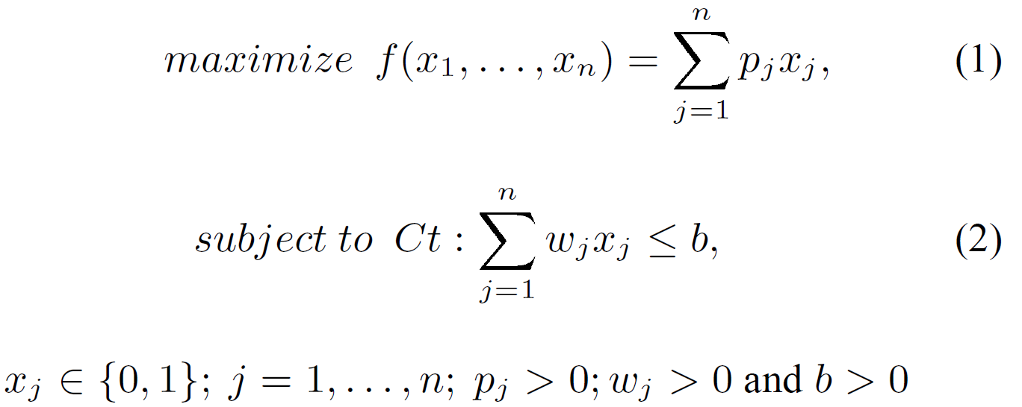
Constrained Knapsack Problem
Given this general goal, our problem can be thought of as a Constrained Knapsack Problem (KP) [25], which can be standardly formulated as follows:
[25] G. R. Raidl. An improved genetic algorithm for the multiconstrained 0–1 knapsack problem. In Proceedings of International Conference on Evolutionary Computation,pages 207–211, 1998.
Notes:
考慮到這個一般的目標，我們的問題可以被認為是一個受限的Knapsack問題（KP）[25]，它可以被標準地表述為：。
在這個公式中，KP項目是有問題的函數（j = 1, ... , n），項目利潤pj是估計的質量增益，當第j個函數被重構時，項目權重wj對應於進行源代碼修改所需的努力。
目标函数f(x1, ... , xn)表示为0-1加权的利润总和；每个变量xj 2 {0, 1}决定第j个函数是否被纳入要重构的函数子集。
這是一個在約束Ct下的最大化問題，稱為 "努力約束"；該約束規定，所需的努力不應超過最大數量Emax。

Slide 35
Constrained Knapsack Problem
Since we are particularly interested in the problem of duplicate code removal, i.e., clone elimination, a second constraint must be considered.
We call it Grouping constraint.
Functions are grouped into clusters according to some distance measures.
Notes:
由於我們對刪除重複代碼的問題特別感興趣，也就是消除克隆，所以必須考慮第二個約束條件。
我們把它稱為分組約束。
函數根據一些距離度量被分組到集群中。

Slide 36
Constrained Knapsack Problem
Each cluster Ck contains functions, i.e., clones cj , with relative distance below a given threshold.
For a threshold value of zero, clusters will contain functions that are exact copies.
Notes:
每個聚類Ck包含相對距離低於給定閾值的函數，即克隆cj
對於閾值為零，集群將包含完全複製的函數。
關於克隆檢測和功能聚類的細節超出了本文的範圍，更多細節可以在[2, 17, 20, 21, 22, 23]中找到。

Slide 37
Constrained Knapsack Problem
The Grouping constraint states that if a clone cj in a cluster Ck belongs to the maximization problem solution, then all the functions in Ck should be in the same solution.
This corresponds to an underlying assumption that refactoring effort is composed by two main parts.
Notes:
分組約束規定，如果集群Ck中的一個克隆cj屬於最大化問題的解決方案，那麼Ck中的所有函數都應該在同一個解決方案中。
這對應於一個基本假設，即重構工作由兩個主要部分組成。

Slide 38
Constrained Knapsack Problem
A first activity is needed to study the system, clones in the cluster, interactions between calling functions and clones, and the overall software architecture.
Once performed this program understanding task, the actual incremental cost to remove a single clone of the same cluster is only a fraction of the overall cost.
Notes:
第一个活动需要研究系统、集群中的克隆、调用函数和克隆之间的相互作用，以及整个软件架构。
一旦執行了這個程序理解任務，刪除同一集群的單個克隆的實際增量成本只是整體成本的一小部分。

Slide 39
Constrained Knapsack Problem
With respect to the quality improvement, we are interested in the modularity of the design, which is often expressed in term of coupling and cohesion measures.
Our strategy tries to select as refactoring candidates, clones with weak cohesion and strong coupling (low modularity).
Notes:
在質量改進方面，我們對設計的模塊化感興趣，這通常是用耦合和內聚措施來表示。
我們的策略試圖選擇具有弱內聚力和強耦合性（低模塊化）的克隆作為重構候選者。

Slide 40
Constrained Knapsack Problem
In other words, since clones with low cohesion and high coupling will be eliminated, the overall quality of S will be improved, because we will improved the quality of F, which are subset of functions composing the system.
While the total cohesion of the selected clones is minimized (or total lack of cohesion maximized), the total coupling of them mustbe maximized.
Notes:
換句話說，由於低內聚力和高耦合度的克隆將被消除，S的整體質量將得到改善，因為我們將改善F的質量，它們是構成系統的功能子集。
雖然所選克隆的總內聚力最小（或總無內聚力最大化），但它們的總耦合度必須最大化。

Slide 41
Constrained Knapsack Problem
In addition to the quality improvement of the system S, we have also to consider, for each function, a level of refactoring priority expressed by expert’ desires.
Expert opinion was modeled by a third objective function to be maximized, which would measure the total priority of problem solution.
Notes:
除了系統S的質量改進之外，我們還必須考慮，對於每個功能，由專家的希望所表達的重構優先級的水平
專家意見由要最大化的第三個目標函數建模，該函數將衡量問題解決方案的總優先級。

Slide 42
Constrained Knapsack Problem
Overall, the above consideration motivate why our Knapsack problem is in reality Multi-constrained (MKP) and Multi-objective (MOKP).
Our tailored problem formulation is the following:
Notes:
總的來說，上述考慮促使我們的Knapsack問題實際上是多約束的（MKP）和多目標的（MOKP）。

Slide 43
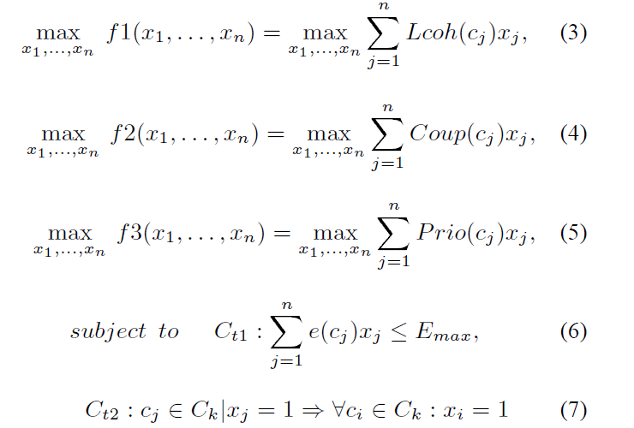
Constrained Knapsack Problem
Notes:
函數Lcoh(cj)是對克隆cj內部缺乏凝聚力的衡量；
Coup(cj)衡量克隆cj與S的其他函數之間的進出耦合；
Prio(cj)是克隆cj的優先重構級別；
e(cj)是重構cj所需的努力，
Emax是重構活動的可用資源提供的最大努力量。

Slide 44
Constrained Knapsack Problem
As a first level of approximation, we distinguish between two types of clones:
Perfect clones: clones which are syntactically and semantically identical; they are pure replicas of the same lines of code, but indentation; and
Near-duplicated clones: clones with some different tokens;they are, for example, code fragments in which a variable has consistently been changed throughout the code.
Notes:
作為第一層次的近似，我們區分了兩種類型的克隆
完美的克隆：在語法和語義上完全相同的克隆；它們是相同代碼行的純粹複製，但縮進；以及
近乎重複的克隆：具有一些不同標記的克隆；例如，它們是代碼片段，其中一個變量在整個代碼中一直被改變。

Slide 45
Constrained Knapsack Problem
The effort required to refactor clones is modeled by the four following components: system understanding, clone modification, called context understanding, and calling context adaptation effort.
Notes:
重構克隆所需的努力由以下四個部分組成：系統理解、克隆修改、調用環境理解和調用環境適應努力。

Slide 46
Clone Refactoring Effort Model
System understanding effort takes into account the time needed to carry out basic program comprehension actions such as locating the clone, studying software architecture, and deciding which clones to eliminate.
Notes:
系統理解的努力考慮到了進行基本的程序理解行動所需的時間，如定位克隆，研究軟件結構，並決定消除哪些克隆。

Slide 47
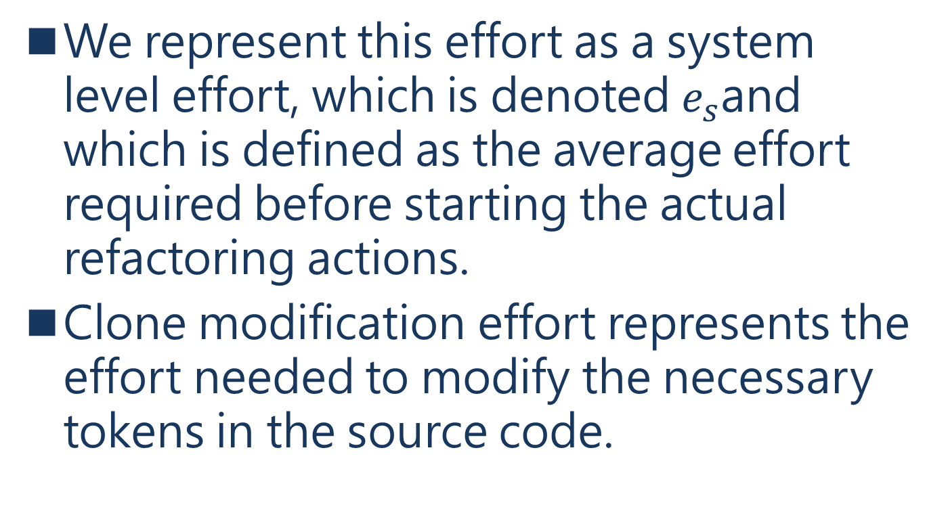
Clone Refactoring Effort Model
We represent this effort as a system level effort, which is denoted $e_{s}$and which is defined as the average effort required before starting the actual refactoring actions.
Clone modification effort represents the effort needed to modify the necessary tokens in the source code.
Notes:
我們將這種努力表示為系統級的努力，用es表示，它被定義為在開始實際重構行動之前所需的平均努力。
克隆修改的努力代表了修改源代碼中必要標記所需的努力。

Slide 48

Clone Refactoring Effort Model
This term is formulated as:
Notes:
e0是对一个通用源代码修改的平均估计工作量，DToken(cj)是cj中需要修改的不同标记的数量。

Slide 49
Clone Refactoring Effort Model
Called context understanding effort expresses the effort required to understand the contexts of the functions called by the clone cj and, possibly, the code of functions that can be reached from the clone via caller-callee relation.
Notes:
被調用的上下文理解工作表示理解被克隆cj調用的函數的上下文所需的努力，可能還有通過調用者-被調用者關係可以從克隆中到達的函數的代碼。

Slide 50
Clone Refactoring Effort Model
It is a function of the size of clone cj (LOC(cj)) and of the size of the reached code RLOC(cj) from cj .
RLOC(cj) is the overall size measured as LOC of the functions reached from the clone via caller-callee relation.
Notes:
它是克隆cj的大小（LOC(cj)）和從cj到達的代碼RLOC(cj)的大小的一個函數。
RLOC(cj) 是通過調用者-被調用者關係從克隆獲得的函數的 LOC 測量的總體大小。
我們假設，理解一行代碼的估計平均努力要比改變一個通用源代碼所需的努力高出μ倍。

Slide 51
Clone Refactoring Effort Model
We assume that the calling context adaptation effort be proportional to the number of functions directly calling the clones cj and that one generic source code change is performed per calling function.
Notes:
我們假設調用上下文適應工作與直接調用克隆體cj的函數數量成正比，並且每個調用函數都要進行一次通用源代碼的修改。

Slide 52

Clone Refactoring Effort Model
This term is formulated as:
where Calling(cj) is the number of calling functions
Notes:
其中Calling(cj)是調用函數的數量

Slide 53
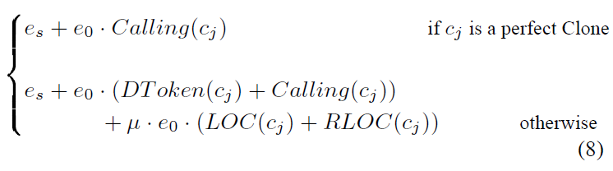
Clone Refactoring Effort Model
Therefore, the overall effort e(cj) required to refactor a clone cj is expressed as:

Slide 54
Clone Refactoring Effort Model
As a general rule, any predictive has to be calibrated, i.e., model parameters have to be adjusted to the given organization, process, domain, and so forth. Clearly, to adapt our model to a particular context or a given organization, three parameters must be estimated: effort es, e0 and the multiplicative coefficient μ.
Notes:
一般來說，任何預測都必須經過校準，也就是說，必須根據特定的組織、過程、領域等調整模型參數。顯然，為了使我們的模型適應特定的環境或特定的組織，必須估計三個參數：努力E、E0和乘法係數μ。

Slide 55
4. A GA SOLUTION TO THE QUALITYIMPROVING PROBLEM
The application of search-based techniques needs a preliminary step in which we define some key ingredients.
In particular, to design a genetic algorithm for any specific problem, the following elements are needed:
Notes:
基於搜索的技術的應用需要一個初步的步驟，在這個步驟中我們要定義一些關鍵的成分
特別是，要為任何特定問題設計遺傳算法，需要以下要素：

Slide 56
4. A GA SOLUTION TO THE QUALITYIMPROVING PROBLEM
a chromosome representation to describe the solutions;
mutation and crossover operators; and
a fitness function to guide the search.
we will describe how we customize the Knapsack problem i.e., chromosome representation, genetic operator implementation, initial population construction as well as fitness function and constraints implementation
Notes:
• 染色體表示法來描述解決方案。
• 突變和交叉運算符；以及
• 一個適應度函式來指導搜索。
我們將描述我們如何定制Knapsack問題，即染色體表示、遺傳算子實現、初始種群構建以及適應度函式和約束條件實現。

Slide 57
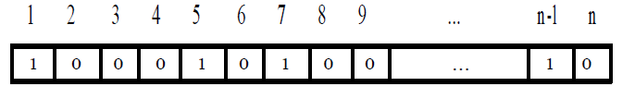
4.1 Clone Knapsack representation
A simple way to encode our Knapsack problem is to represent the inclusion or exclusion of each of the n problematic functions by a bit in a bit string of length n.
Notes:
編碼我們的Knapsack問題的一個簡單方法是用一個長度為n的位串中的一個位來表示n個問題函數的包含或排除。
第j位包含決策變量xj的值。

Slide 58
4.1 Clone Knapsack representation
A chromosome encoding may represent an infeasible solution
An infeasible solution is a solution for which at least one of the problem constraints is violated.
In our case, an infeasible solution is encountered when the total effort needed exceeds the maximum effort or when not all functions of a clone cluster are included in the Knapsack.
Notes:
染色體編碼可能代表一個不可行的解決方案
不可行的解決方案是指至少有一個問題的約束被違反的解決方案。
在我們的案例中，當需要的總努力超過最大努力時，或者當一個克隆集群的所有功能沒有包括在Knapsack中時，會遇到不可行的解決方案。

Slide 59
4.1 Clone Knapsack representation
According to the literature, handling violations can be done in the following ways:
by using a representation that automatically preserves solution feasibility [6];
by applying a penalty method to penalize the fitness of any infeasible solution [14]; and
[6] P. C. Chu and J. E. Beasley. Constraint handling in genetic algorithms: The set partitioning problem. Journal of
Heuristics, 4(4):323–357, June 1998.
[14] D. Goldberg. Genetic Algorithms in Search, Optimization,and Machine Learning. Addison-Wesley, 1989.
Notes:
根據文獻記載，處理違規行為可以通過以下方式進行。
通過使用一種自動保留解決方案可行性的表示方法[6]
通過應用懲罰方法來懲罰任何不可行的解決方案的適用性[14]；以及

Slide 60
4.1 Clone Knapsack representation
by defining a repair operator that transforms infeasible solutions into feasible ones [7].
Clone grouping constraint imposes that if a clone cj belonging to a cluster Ck is selected then, all the functions contained in Ck must be in Knapsack too.
[7] P. C. Chu and J. E. Beasley. A genetic algorithm for the multidimensional knapsack problem. Journal of Heuristics,4(1):63–86, December 1998.
Notes:
通過定義一個修復算子，將不可行的解決方案轉變為可行的解決方案[7]。
克隆分組約束規定，如果一個屬於集群Ck的克隆cj被選中，那麼，Ck中包含的所有函數也必須在Knapsack中。

Slide 61
4.1 Clone Knapsack representation
The easiest way to handle this constraint is to use a different bit string encoding in which a bit will represent the inclusion or exclusion of an entire cluster out of the Nc clusters.
This representation (Nc-bit string) will be used during the search process in particular by the genetic operators
Notes:
處理這種約束的最簡單的方法是使用不同的位串編碼，其中一個位將代表包含或排除Nc個集群中的整個集群。
該表示法（Nc位字符串）將在搜索過程中使用，特別是被遺傳操作符使用

Slide 62
4.1 Clone Knapsack representation
Solutions are then mapped back into the initial representation (n-bit string) via straightforward one-to-one mapping.
With respect to the effort constraint, a Knapsack solution that needs more effort than Emax has to be transformed to lower the needed resources
Notes:
然後通過直接的一對一映射將解決方案映射回初始表示（n位字符串）。
就努力約束而言，需要比Emax更多努力的Knapsack解決方案必須進行轉換，以降低所需資源。

Slide 63
4.2 Crossover and mutation operators
Since the chromosome representation that we adopted for the Knapsack problem is a bit string, several choices are possible to perform the crossover and the mutation.
Notes:
由於我們對Knapsack問題採用的染色體表示法是一個位串，所以在進行交叉和變異時可以有幾種選擇。

Slide 64
4.2 Crossover and mutation operators
We adopted two ways to perform crossover.
The first is the standard crossover with two cut points: two parent chromosomes (P1 and P2) are selected according to their fitness function values.
Notes:
我們採用了兩種方式來進行交叉。
第一種是有兩個切點的標準交叉：根據適應度函數值選擇兩個父染色體（P1和P2）

Slide 65
4.2 Crossover and mutation operators
Two substrings (SS1 and SS2),having the same length and beginning at the same position, are extracted respectively, from P1 and P2.
The crossover operator adopted is the uniform crossover in which two parent chromosomes give birth to a single offspring
Notes:
從P1和P2中分別提取兩個具有相同長度並在相同位置開始的子字符串（SS1和SS2）。
採用的交叉運算符是均勻交叉，其中兩個親代染色體產生一個子代。

Slide 66
4.2 Crossover and mutation operators
Each bit of the offspring is copied from one of the parent.
For each offspring position, a binary random number is generated.
If this number is 0, the jth bit of the offspring is a copy of the jth bit in the first parent.
Notes:
子代的每一個比特都是從父代的一個比特複製過來的。
對於每個後代的位置，都會產生一個二進制隨機數。
如果這個數字是0，那麼子代的第j位就是第一個父代的第j位的拷貝。

Slide 67
4.2 Crossover and mutation operators
If it is equal to 1 the bit is copied from the second parent.
Once the offspring are generated by the standard or the uniform crossover, a mutation operator is applied.
The mutation consists in complementing a small number of bits equivalent in size to roughly 2 or 3% of the string length, by changing them from 0 to 1 and vice versa
Notes:
如果它等於1，該位就會從第二個父本中復制出來。
一旦通過標準交叉或統一交叉產生了後代，就會應用變異操作符。
突變包括補充少量的比特，其大小大約相當於字符串長度的2%或3%，通過將它們從0變為1，反之亦然。

Slide 68
4.3 Repair operator
This operator is mainly needed to ensure feasible solution under the effort constraint.
The offspring generated by the crossover and mutation may violate the effort constraint.
Notes:
這個算子主要是為了確保在努力約束下的可行方案。
由交叉和變異產生的後代可能會違反努力約束。

Slide 69
4.3 Repair operator
In order to make all the offspring feasible, we developed a greedy algorithm inspired by the works of Raidl [25] and of Chu and Beasley [7].
[25] G. R. Raidl. An improved genetic algorithm for the multiconstrained 0–1 knapsack problem. In Proceedings of International Conference on Evolutionary Computation,pages 207–211, 1998.
[7] P. C. Chu and J. E. Beasley. A genetic algorithm for the multidimensional knapsack problem. Journal of Heuristics,
4(1):63–86, December 1998.
Notes:
為了使所有的後代都是可行的，我們開發了一種貪婪的算法，其靈感來自於Raidl[25]和Chu and Beasley[7]的工作。

Slide 70
4.3 Repair operator
Since we are handling only one constraint in this algorithm, a pseudo-utility ratio for a clone cluster Ck is defined as qpk =q(Ck)/e(Ck), where q(Ck) is quality gain associated to Ck and e(Ck) is the effort needed to eliminate the clones in Ck.
We call this ratio quality-price ratio.
Notes:
由於我們在這個算法中只處理一個約束條件，一個克隆集群Ck的偽效用率被定義為qpk=q(Ck)/e(Ck)，其中q(Ck)是與Ck相關的質量增益，e(Ck)是消除Ck中克隆所需的努力。
我們把這個比率稱為質量-價格比率。

Slide 71
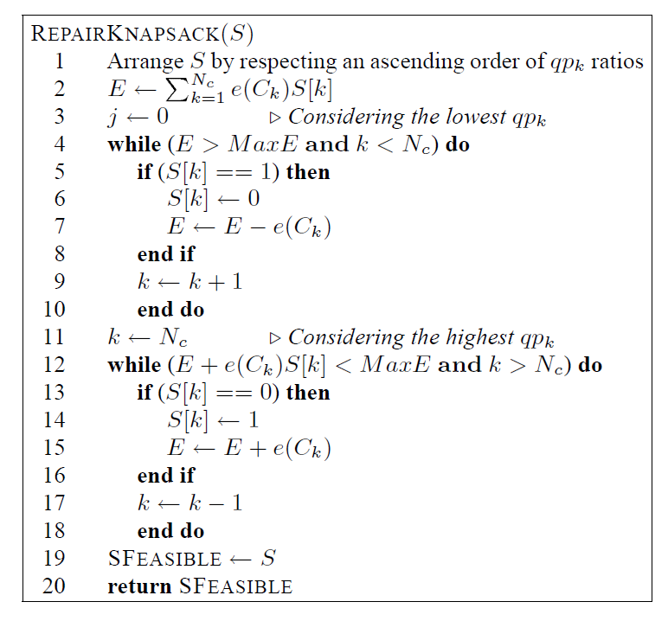
4.3 Repair operator
Notes:
第一步按照qpk的升序檢查決策變量，如果仍然違反可行性，則將其從1變到0。
因此，具有最低质量价格比的变量被首先考虑，相应的克隆群组被从Knapsack中移除。
第二步按照qpk的降序检查决策变量，只要不违反可行性，就把它们从0变到1。
因此，具有最高質量價格比的變量被首先考慮，相應的克隆集群被添加到Knapsack中，同時不違反可行性。

Slide 72
4.4 Initial Population
Two objectives have to be pursued when constructing the initial population: individuals must be diversified and must represent feasible solutions.
Using the bit string representation, the inclusion and the exclusion (decision variable xk) of a randomly selected clone cluster Ck is decided in the following way.
Notes:
在構建初始種群時，必須追求兩個目標：個體必須是多樣化的，必須代表可行的解決方案。
使用位串表示，隨機選擇的克隆集群Ck的包含和排除（決策變量xk）以下列方式決定。

Slide 73
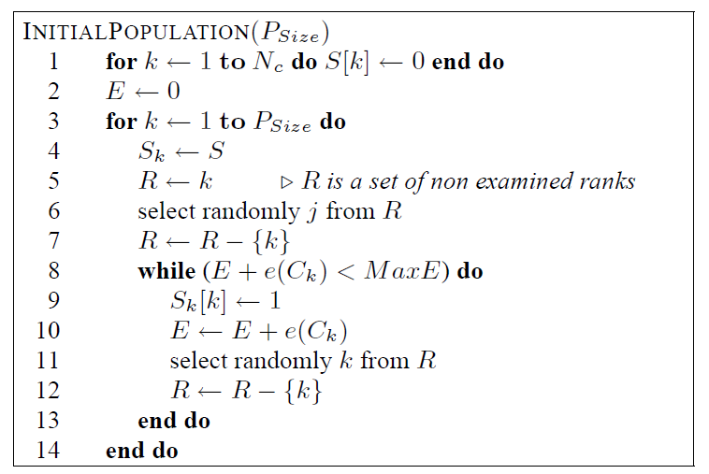
4.4 Initial Population
Notes:
首先，隨機生成一個二進制數字。
如果这个数字等于1，那么所选的克隆集群就被添加到解决方案中，如果这个集群仍然是可行的。
這個過程一直持續到沒有克隆集群可以在不違反Emax的情況下被添加。

Slide 74
4.5 Fitness function and selection methods
In single-objective optimization problems using a GA fitness function and objective function are often identical
However in Multiobjective Optimization Problems (MOP), fitness assignment and consequently the selection operation must take into account multicriteria of optimization.
Notes:
在使用GA的單目標優化問題中，適應度函式和目標函數往往是相同的
然而，在多目標優化問題（MOP）中，適配性分配以及隨之而來的選擇操作必須考慮到優化的多標準。

Slide 75
4.5 Fitness function and selection methods
Basically, three strategies dealing with MOP resolution are reported and used in the literature [27]:Aggregation-based, criterion-based, and Pareto-based strategies.
[27] E. Talbi. M´etaheuristiques pour l’optimisation combinatoire muli-objectif : ´ Etat de l’art. TR 98-757.33, Laboratoire d’Informatique Fondamentale de Lille, Universit´e desSciences et Technologies de Lille, 2001.
Notes:
基本上，文獻[27]中報導和使用了三種處理MOP解決方案的策略：基於聚集的策略、基於標準的策略和基於帕累託的策略。

Slide 76
4.5 Fitness function and selection methods
Aggregation-based strategy central idea is to transform MOP into a single-objective problem.
The different objective functions fi of the problem are combined into a single function F with an affine transformation
Notes:
基於聚集的策略的中心思想是將MOP轉化為一個單目標問題。
問題的不同目標函數fi被合併為一個單一的函數F，並進行仿射轉換

Slide 77
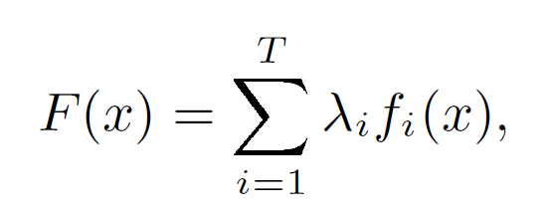

4.5 Fitness function and selection methods
where x is a solution, the weights $λ_{i}∈[0,1]$ and $\sum_{i=1}^{T}{λ_{i=1}=1}$and T is the number ob objectives of the MOP.

Slide 78
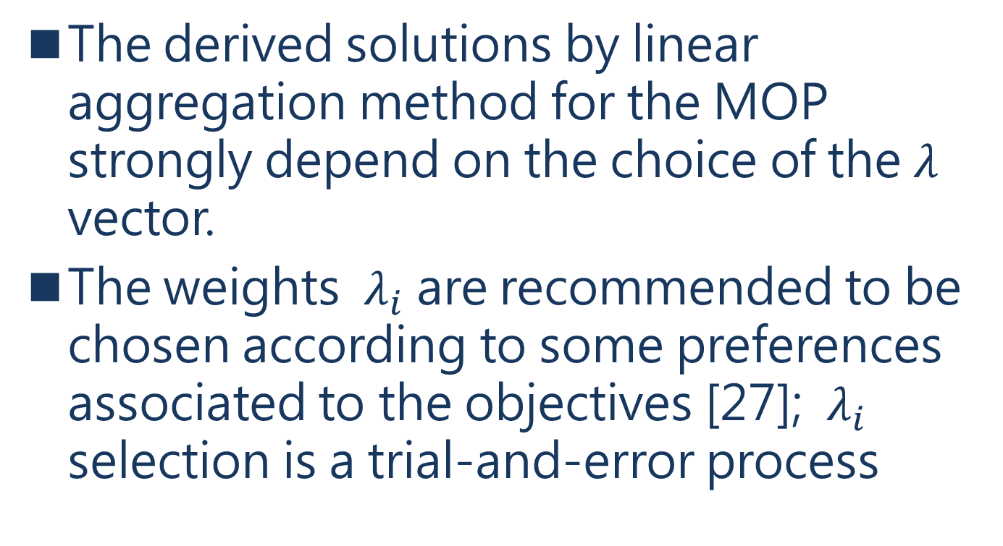
4.5 Fitness function and selection methods
The derived solutions by linear aggregation method for the MOP strongly depend on the choice of the $λ$ vector.
The weights $λ_{i}$ are recommended to be chosen according to some preferences associated to the objectives [27]; $λ_{i}$ selection is a trial-and-error process
Notes:
通過線性聚集法推導出的MOP的解決方案在很大程度上取決於 決於矢量的選擇。
建議根據與目標相關的一些偏好來選擇權重i[27]；i的選擇是一個試錯的過程

Slide 79
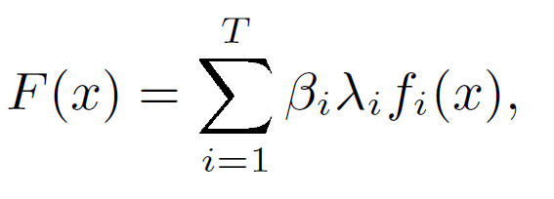
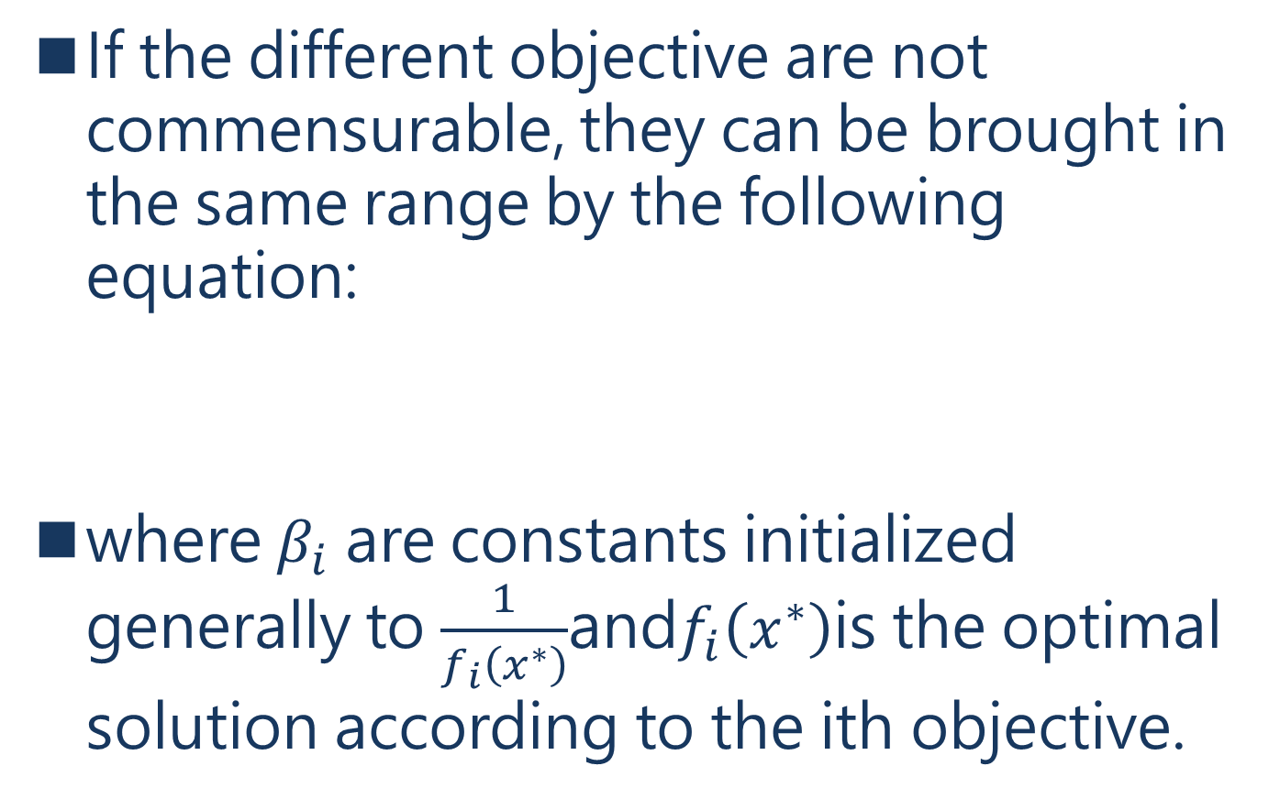
4.5 Fitness function and selection methods
If the different objective are not commensurable, they can be brought in the same range by the following equation:
where $β_{i}$ are constants initialized generally to $\frac{1}{f_{i}\left(x^{∗}\right)}$and$f_{i}\left(x^{∗}\right)$is the optimal solution according to the ith objective.
Notes:
如果不同的目標不能相稱，可以通過以下公式將它們帶入同一範圍。
其中i是常数，一般初始化为1 fi(x )，fi(x )是根据第i个目标的最优解。

Slide 80
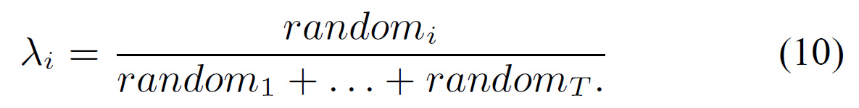

4.5 Fitness function and selection methods
Several blind strategies are used to generate randomly the weights $λ_{i}$ as follows:
Notes:
有幾種盲目的策略被用來隨機生成權重i，如下所示。

Slide 81
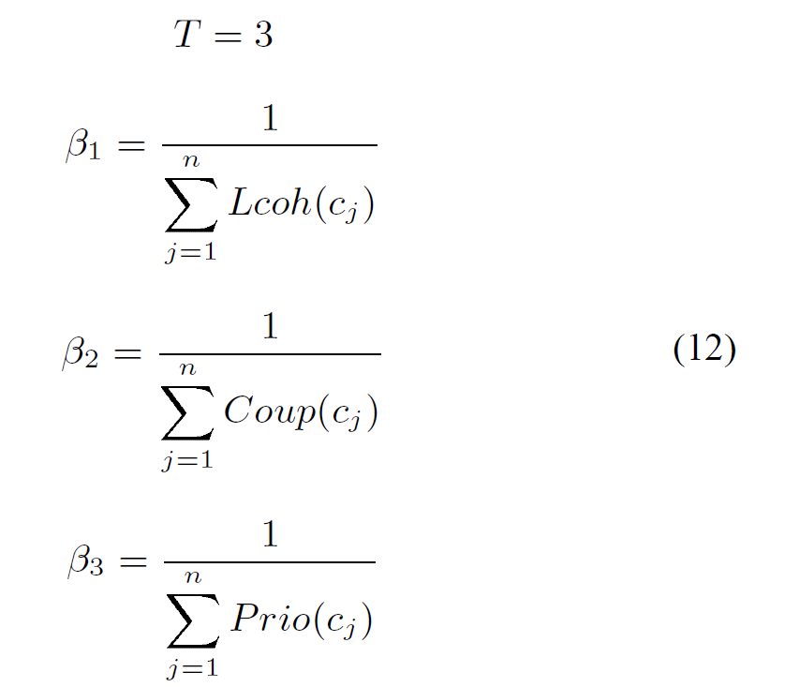
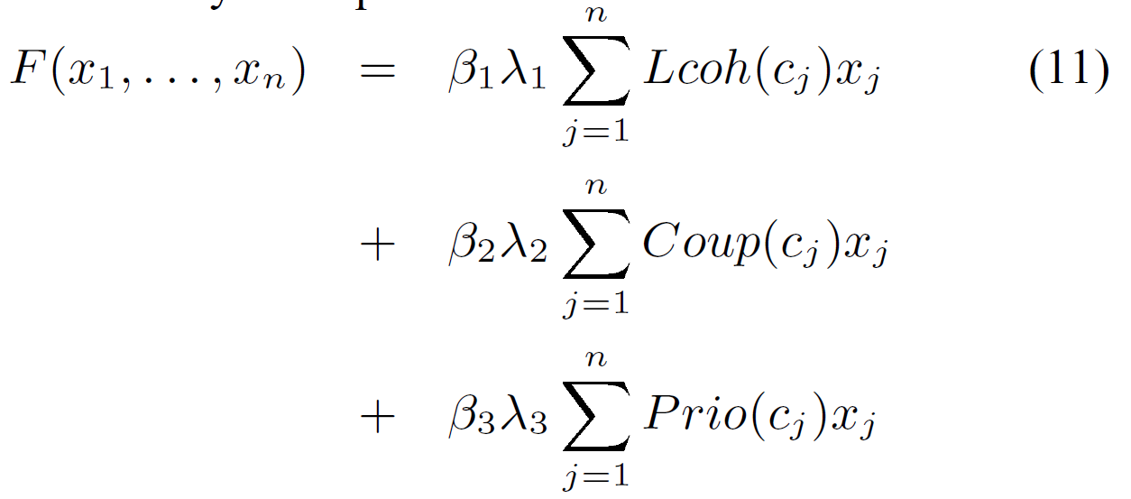
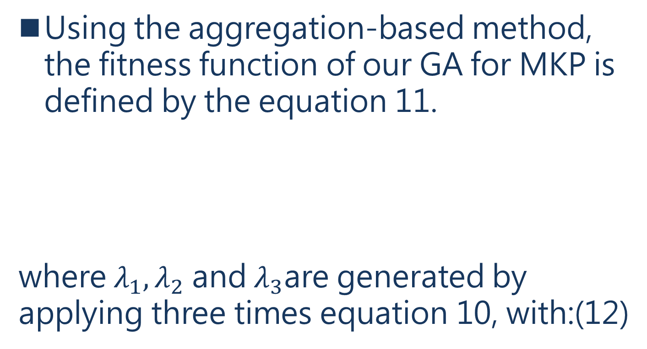
4.5 Fitness function and selection methods
Using the aggregation-based method, the fitness function of our GA for MKP is defined by the equation 11.
where $λ_{1},λ_{2}$ and $λ_{3}$are generated by applying three times equation 10, with:(12)
Notes:
使用基於聚集的方法，我們的GA對MKP的適應度函式由公式11定義。
其中，1、2和3是通過應用三次方程10產生的，有

Slide 82

4.5 Fitness function and selection methods
Here, the denominators take the respective values of the objective functions when $x_{j}= 1∀j = 1, . . . , n.$
Notes:
這裡，當xj=18j=1，......時，分母分別取目標函數的值。 , n.

Slide 83
4.5 Fitness function and selection methods
With the aggregation based method, individual selection is performed via methods like the Roulette Wheel Selection, the Rank Selection, or the Steady-State Selection [12]
[12] E. Falkenauer. Genetic algorithms and grouping problems.John Wiley and Sons, 1998.
Notes:
在基於聚合的方法中，個體選擇是通過輪盤選擇、等級選擇或穩態選擇等方法進行的[12]。
由於沒有特別的理由選擇一種方法，在本文中，通過應用輪盤選擇法進行個體選擇。

Slide 84
4.5 Fitness function and selection methods
The set of selected individuals contains in our case three sub-sets, portions or fractions.
Each sub-set contains the ”fittest” individuals,according to a different objective function.
Notes:
在我們的案例中，被選中的個體集合包含三個子集，即部分或分數。
根據不同的目標函數，每個子集都包含 "最合適 "的個體。

Slide 85
4.5 Fitness function and selection methods
Pareto-based methods are based on computing the fitness values by using Pareto dominance [14].
The idea is to exploit the partial order on the population.
[14] D. Goldberg. Genetic Algorithms in Search, Optimization,and Machine Learning. Addison-Wesley, 1989.
Notes:
基於帕累託的方法是通過使用帕累托優勢來計算適應值[14]。
這個想法是為了利用人口的部分順序。

Slide 86
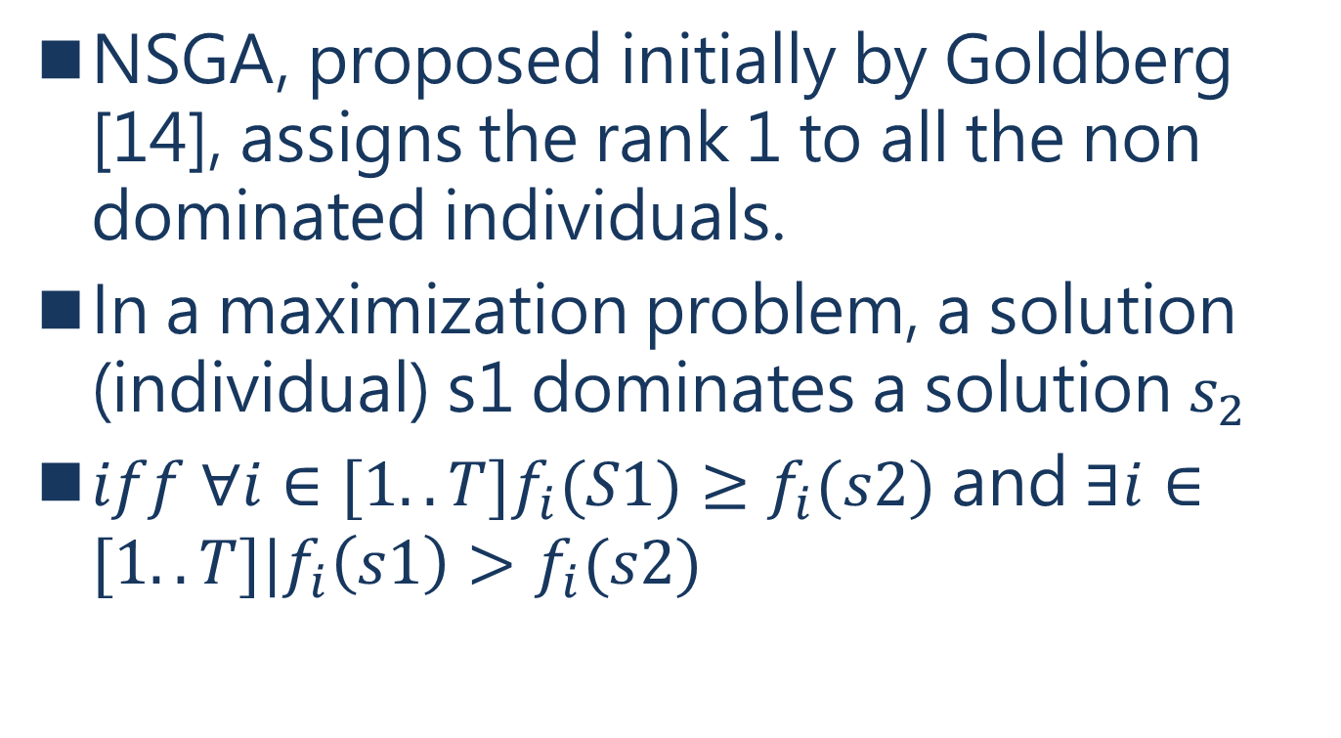
4.5 Fitness function and selection methods
NSGA, proposed initially by Goldberg [14], assigns the rank 1 to all the non dominated individuals.
In a maximization problem, a solution (individual) s1 dominates a solution $s_{2}$
$iff ∀i∈[1..T]f_{i}(S1)≥f_{i}(s2)$ and $∃i∈[1..T]|f_{i}\left(s1\right)>f_{i}(s2)$
Notes:
最初由Goldberg[14]提出的NSGA，將等級1分配給所有非支配性個體。

Slide 87
4.5 Fitness function and selection methods
Then, these individuals are removed from the population; the next new non dominated individuals are identified and the rank 2 is assigned to them.
The process continues until all the population individuals are ranked.
Afterward, the probability of an individual to be selected is computed on basis of its rank.
Notes:
然後，這些個體被從種群中移除；下一個新的非支配個體被識別出來，並將等級2分配給它們。
這個過程一直持續到所有的人口個體都被排列出來。
之後，根據個體的等級來計算其被選中的概率。

Slide 88
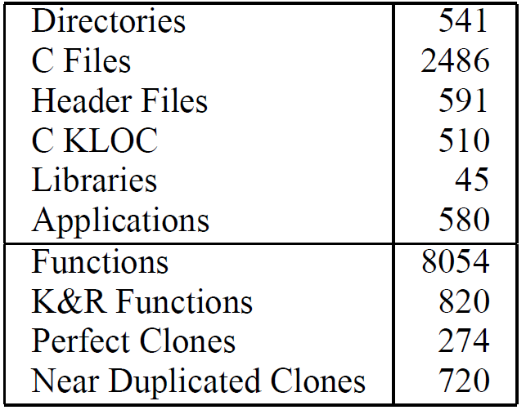
5. CASE STUDY
As mentioned in the introduction, refactoring has been performed to GRASS, which is a large open source GIS.
Notes:
正如在介紹中提到的，對GRASS進行了重構，它是一個大型的開源地理信息系統。
特別是，2005年12月5日的GRASS 6.1-CVS開發快照1被作為案例研究。
其特點總結於表1。

Slide 89
5. CASE STUDY
GRASS modules correspond to applications and represent commands.
Applications are organized by name, based on their functionality group such as map display, general file operations, image processing, raster, vector operations, etc.
Notes:
GRASS模塊對應於應用程序，並代表命令。
應用程序按名稱組織，基於其功能組，如地圖顯示、一般文件操作、圖像處理、光柵、矢量操作等。

Slide 90
5. CASE STUDY
The first letter of a module name refers to a functionality group and is followed by one dot and one or two other dot-separated words, which describe specific tasks.
All GRASS modules are linked with an internal parser. If there are no command-line arguments entered by a user, the parser calls a Tcl/TK based graphical user interface, for an interactive version of a command.
Notes:
模塊名稱的第一個字母指的是一個功能組，後面是一個圓點和一個或兩個其他圓點分隔的詞，描述具體的任務。
所有的GRASS模塊都與一個內部解析器相連接。如果沒有用戶輸入的命令行參數，解析器會調用一個基於Tcl/TK的圖形用戶界面，以獲得一個互動版本的命令。

Slide 91
5. CASE STUDY
Otherwise, it will start the command-line version.
Code parameters and flags are defined within each module.
They are used to ask user to define map names and other options.
Notes:
否則，它將啟動命令行版本。
代碼參數和標誌是在每個模塊內定義的。
它們用於要求用戶定義地圖名稱和其他選項。

Slide 92
5. CASE STUDY
GRASS provides an ANSI C language API with nearly one thousand of GIS functions, which are used by GRASS modules to read and write maps, to compute areas and distances for georeferenced data and to visualize attributes and maps
Details of GRASS programming are covered in [24]
[24] M. Neteler, editor. GRASS 6.1 Programmer’s Manual.Geographic Resources Analysis Support System. ITC-irst,Italy, http://grass.itc.it/devel/, 2005.
Notes:
GRASS提供了一個ANSI C語言的API，其中有近千種GIS函數，GRASS模塊使用這些函數來讀寫地圖，計算地理參考數據的面積和距離，以及可視化屬性和地圖。
關於GRASS編程的細節，見[24]。

Slide 93
5. CASE STUDY
This programming API is organized in about forty libraries, and higher priority was given to eliminate old style K&R functions and to refactor clones
Details on number of function, number of K&R functions and clones are summarized in Table 1.
Notes:
這個編程API被組織在大約40個庫中，更優先考慮的是消除舊式的K&R函數和重構克隆。
表1總結了關於功能數量、K&R功能數量和克隆的詳細信息。

Slide 94
5. CASE STUDY
The process to determine model constants was perceived as crucial to produce a meaningful quality improvement planning.
Moreover, although GRASS quality improvement is priority, the reliable organization of refactoring activity into WPs compatible with the current GRASS development practice was perceived as essential to obtain programmers’ cooperation and support.
Notes:
確定模型常數的過程被認為是產生一個有意義的質量改進規劃的關鍵。
此外，儘管GRASS的質量改進是優先事項，但要獲得程序員的合作和支持，將重構活動可靠地組織到與當前GRASS開發實踐相適應的WP中是至關重要的。

Slide 95
5. CASE STUDY
Perfect clones are a special case of near duplicated clones and they have been the target of model calibration, since the effort to refactor them is lower than that needed to refactor near duplicated clones.
Notes:
完美克隆是近似重複克隆的一個特例，它們一直是模型校準的目標，因為重構它們的努力比重構近似重複克隆的努力要低。

Slide 96
5. CASE STUDY
Model tuning was thus organized into the following sub-steps:
Initial subjective model constant determination;
Qualitative result assessment; and
Preliminary constant recalibration.
Notes:
因此，模型的调整被组织成以下几个子步骤。
最初的主觀模型常數確定。
定性結果評估；以及
初步的常數重新校準。

Slide 97
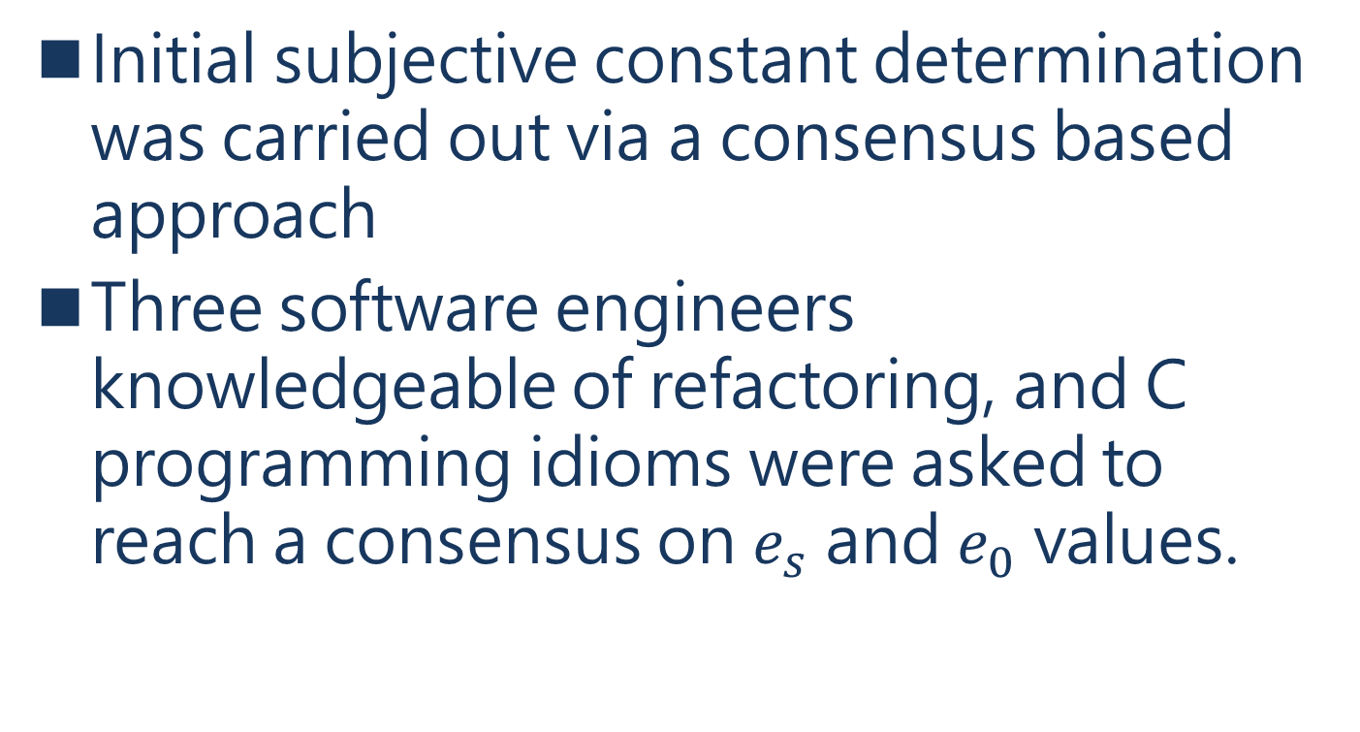
5. CASE STUDY
Initial subjective constant determination was carried out via a consensus based approach
Three software engineers knowledgeable of refactoring, and C programming idioms were asked to reach a consensus on $e_{s}$ and $e_{0}$ values.
Notes:
最初的主觀常數確定是通過一種基於共識的方法進行的
三位熟悉重構和C語言編程習慣的軟件工程師被要求就es和e0值達成共識。

Slide 98
5. CASE STUDY
Once a consensus was reached, a qualitative assessment was done.
This step aimed at verifying that no major error in constant value guessing was made
Values were used in the effort model to produce via GA two sets of ten WPs.
Notes:
一旦達成共識，就進行了定性評估。
這一步的目的是驗證在常量值猜測中沒有出現重大錯誤
这些数值被用于努力模型中，通过GA产生两套10个WP。

Slide 99
5. CASE STUDY
For the first set Emax was fixed at one hour and thus the overall estimated refactoring effort for each WP was of about one hour.
The second set contained, the same number of WPs, but for groups of clones requiring a refactoring activity of about two hours.
Notes:
在第一組中，Emax被固定為一小時，因此每個WP的總體估計重構工作量約為一小時。
第二組包含，同樣數量的WP，但對於克隆組來說，需要約兩個小時的重構活動。

Slide 100
5. CASE STUDY
Two GRASS developers were asked to qualitatively assess the WPs.
More precisely they were asked to judge, in their best knowledge, how long it would have been taken to refactor one randomly chosen WP in each of the two sets.
Notes:
兩名GRASS開發人員被要求對WPs進行定性評估。
更確切地說，他們被要求判斷，根據他們的最佳知識，在兩組中的每一組中隨機選擇一個WP進行重構需要多長時間。

Slide 101
5. CASE STUDY
They were also asked to quantify the average expected ratio of the time requires in the two cases.
GRASS developers were neither aware of the effort model, nor of the imposed different Emax values.
Notes:
他們還被要求量化兩種情況下所需時間的平均預期比率。
GRASS的開發者既不知道努力模式，也不知道強加的不同Emax值。

Slide 102
5. CASE STUDY
Qualitative results substantially confirmed es and e0 initial values.
GRASS developers were asked to provide guidelines to set up GA priority constraints.
Notes:
定性結果大大證實了es和e0的初始值。
GRASS的開發者被要求提供設置GA優先級約束的指南。

Slide 103
5. CASE STUDY
Discussion lead to the decision to separate the problem of K&R code ansification from the more long term quality improvement goal.
Notes:
討論的結果是，決定將K&R代碼匿名化的問題與更長期的質量改進目標分開。

Slide 104
5. CASE STUDY
we developed our own ansification toolkit; information collected while parsing C code on K&R function location is very accurate and it was used to perform precise (including saving comment position) and semantic preserving code transformation.
Notes:
公共領域的分析工具並不能提供準確的代碼轉換。
因此，我們開發了自己的分析工具包；在解析C代碼時收集的關於K&R函數位置的信息非常準確，它被用來進行精確（包括保存註釋位置）和保留語義的代碼轉換。

Slide 105
5. CASE STUDY
The overall time required in the process was of about six hours of an expert in parsing and code transformation and eight hours of an expert GRASS programmer.
Out of the six hours, about five were needed to develop the ansification script.
Notes:
在這個過程中，一個解析和代碼轉換專家需要大約6個小時，一個GRASS程序員需要8個小時。
在這6個小時中，大約有5個小時是用來開發Ansification腳本的。

Slide 106
5. CASE STUDY
Ansification was performed on a per-directory basis; GRASS developer time was needed to semiautomatically verify performed transformations, to recompile the system, perform basic tests, and commit changes in the central CVS repository.
Notes:
Ansification是在每個目錄的基礎上進行的；GRASS開發人員需要時間來半自動地驗證所進行的轉換，重新編譯系統，進行基本測試，並在中央CVS庫中提交更改。

Slide 107
5. CASE STUDY
It is however worth noticing the relation with quality issues: in K&R style function parameter declaration, at function definition, is optional.
Indeed out of the 820 functions about 20 had undeclared parameters; most of these dangerous missing declarations were unknown to developers.
Notes:
然而，值得注意的是與質量問題的關係：在K&R風格中，函數參數聲明，在函數定義中是可選的。
事實上，在820個函數中，約有20個有未聲明的參數；這些危險的缺失聲明中，大多數是開發者不知道的。

Slide 108
5. CASE STUDY
The type of these parameters is assumed by the compiler, however, there is no guarantee on assumptions made by different compilers, thus the simple rebuild of an application with different compiler may lead crashes or, in the worst scenario, to undetected data corruption.
GRASS developers set up priority on a code region perceived as critical.
Notes:
這些參數的類型是由編譯器假設的，然而，不同的編譯器所做的假設是沒有保證的，因此，用不同的編譯器簡單地重建一個應用程序可能導致崩潰，或者在最壞的情況下，導致未被發現的數據損壞。
GRASS開發者在被認為是關鍵的代碼區域上設置了優先權。

Slide 109
5. CASE STUDY
These new priority values together with the selected model parameter values were then used exactly as above to produce two new sets of WPs different in term of involved functions from the previous one.
The same GRASS developers were asked to randomly select one WP and to perform the actual refactoring, while recording effort data.
Notes:
然後，這些新的優先級值和選定的模型參數值被完全用於產生兩套新的WP，在涉及的功能方面與之前的不同。
同樣的GRASS開發人員被要求隨機選擇一個WP並進行實際的重構，同時記錄工作數據。

Slide 110
5. CASE STUDY
As already underlined, effort data for the GRASS case study are needed to ensure that the refactoring effort will be compatible with the GRASS development process and will not interfere with GRASS planned milestones.
Notes:
正如已經強調的那樣，需要GRASS案例研究的工作數據，以確保重構工作與GRASS的開發過程兼容，並且不會干擾GRASS計劃的里程碑。

Slide 111
5. CASE STUDY
Nevertheless, reported data for the two programmers, were about 25 % higher
Two WPs of one hour requires about 75 and 76 minutes respectively; out of this time in both cases about 15 minutes were needed to initially study the task.
Notes:
然而，這兩個程序員的報告數據，大約高出25％。
兩個一小時的工作小組分別需要約75分鐘和76分鐘；在這段時間裡，都需要約15分鐘來初步研究任務。

Slide 112
5. CASE STUDY
Collected data were fed into a recalibration algorithm to update es and e0 estimates.
Effort to refactor near duplicated clones was assumed as being three fold higher than the effort required for perfect clones, i.e. μ value was set to three.
Notes:
收集的數據被輸入到一個重新校準的算法中，以更新es和e0的估計值。
對近似重複的克隆進行重構的努力被假定為比完美克隆所需的努力高三倍，即μ值被設定為三。

Slide 113
5. CASE STUDY
With these estimated values,simulations to schedule and study quality improvement were carried out on a ten weeks temporal horizon.
Notes:
有了這些估計值，在十週的時間範圍內進行了安排和研究質量改進的模擬。

Slide 114
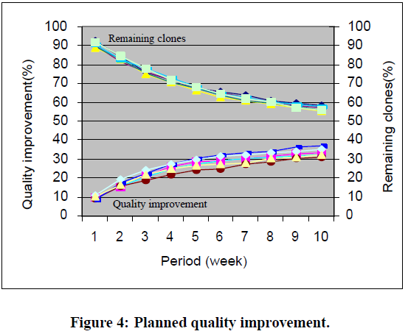
5. CASE STUDY
Figure 4 reports data obtained out of five simulations.
Notes:
數據點相當封閉，因此很難區分一個和另一個。
還請注意 系統中共有274個完美的克隆體。

Slide 115
5. CASE STUDY
Therefore, under the assumption of an available effort corresponding to one GRASS developer working full time on refactoring, i.e., Emax equal to 40 hours, the first month of activity is substantially devoted to removing most of these clones.
Clearly, new data and new empirical evidence are needed to verify our conjecture that μ has an approximate value of three.
Notes:
因此，在假設一個GRASS開發人員全職從事重構工作的情況下，即Emax等於40小時，第一個月的活動主要用於移除大部分的克隆。
顯然，需要新的數據和新的經驗證據來驗證 我們的猜想，即μ有一個近似值為3。

Slide 116
5. CASE STUDY
New data will also help us to better calibrate the model and to quantify model accuracy.
However it pays to be cautious in that only a few data points were available to calibrate the model.
Notes:
新的數據也將幫助我們更好地校準模型和量化模型的準確性。
然而，需要謹慎的是，只有少數數據點可用於校準模型。

Slide 117
6. CONCLUSION
We reported how the problem can be instantiated into an approach to schedule refactoring actions aiming at removing duplicated code under constraints and priorities.
Notes:
我們報告瞭如何將該問題實例化為一種方法，以安排重構行動，目的是在約束和優先級下刪除重複的代碼。

Slide 118
6. CONCLUSION
By working in tight contact with the GRASS development team,we were able to obtain a first tuning of the effort model parameters and, thus, to effectively provide people with WPs, which are sets of functions to be refactored, that maximized quality improvement under imposed constraints.
Notes:
通過與GRASS開發團隊的緊密聯繫，我們能夠獲得對努力模型參數的首次調整，從而有效地為人們提供WP，即一組需要重構的函數，在強加的約束條件下實現質量的最大化。

Slide 119
6. CONCLUSION
WPs were identified via GAs. Presently work is undergoing to apply refactoring actions to the GRASS system
Priority in this early phase was given to eliminate K&R code and large non cohesive exactly duplicated functions.
Notes:
工作方案是通過GAs確定的。目前正在進行的工作是將重構行動應用到GRASS系統中。
在這個早期階段，優先考慮的是消除K&R代碼和大型非內聚的完全重複的功能。

Slide 120
6. CONCLUSION
In the paper,simulation was carried out and reported to better understand the time frame under which clone removal will take place.
Notes:
本文進行了模擬，並報告了模擬結果，以更好地了解清除克隆的時間框架。

Slide 121
6. CONCLUSION
Future work will be devoted to better calibrate constant parameters of the effort model, to incorporate library structure into the quality schedule problem, and to provide a detailed taxonomy of clones so that semi-automatic clone removal will be feasible.
Notes:
未來的工作將致力於更好地校準努力模型的恆定參數，將圖書館結構納入質量計劃問題，並提供詳細的克隆分類學，以便半自動的克隆清除是可行的。

Slide 122
8. REFERENCES (1/5)
[1] G. Antoniol, A. Cimitile, G. A. Di Lucca, and M. Di Penta.Assessing staffing needs for a software maintenance project through queuing simulation. IEEE Transactions on Software Engineering, 30(1):43–58, Jan 2004.
[2] G. Antoniol, U. Villano, E. Merlo, and M. Di Penta. Analyzing cloning evolution in the linux kernel. Information and Software Technology, 44:755–765, October 2002.
[3] B. S. Baker. On finding duplication and near-duplication in large software systems. In Proceedings of IEEE Working Conference on Reverse Engineering, July 1995.
[4] I. D. Baxter, A. Yahin, L. Moura, M. Sant’Anna, and L. Bier. Clone detection using abstract syntax trees. In Proceedings of IEEE International Conference on Software Maintenance, pages 368–377, 1998.
[5] E. Buss, R. D. Mori, W. Gentleman, J. Henshaw, H. Johnson,K. Kontogiannis, E. Merlo, H. Muller, J. M. S. Paul,A. Prakash, M. Stanley, S. Tilley, J. Troster, and K. Wong.Investigating reverse engineeering technologies for the CASprogram understanding project. IBM Systems Journal,33(3):477–500, 1994.

Slide 123
8. REFERENCES (2/5)
[6] P. C. Chu and J. E. Beasley. Constraint handling in genetic algorithms: The set partitioning problem. Journal of Heuristics, 4(4):323–357, June 1998.
[7] P. C. Chu and J. E. Beasley. A genetic algorithm for the multidimensional knapsack problem. Journal of Heuristics, 4(1):63–86, December 1998.
[8] J. A. Clark, J. J. Dolado, M. Harman, R. M. Hierons, B. Jones, M. Lumkin, B. S. Mitchell, S. Mancoridis, K. Rees, M. Roper, and M. J. Shepperd. Formulating software engineering as a search problem. IEE Proceedings -Software, 150(3):161–175, 2003.
[9] E. J. Coffman, M. Garey, and D. Johnson. Approximation algorithms for bin-packing. In Algorithm Design for Computer System Design, 1984.
[10] L. Davis. Job-shop scheduling with genetic algorithms. In International Conference on GAs, pages 136–140. Lawrence Erlbaum, 1985.

Slide 124
8. REFERENCES (3/5)
[11] E. Falkenauer. Genetic Algorithms and Grouping Problems. Wiley-Inter Science, Wiley - NY, 1998.
[12] E. Falkenauer. Genetic algorithms and grouping problems. John Wiley and Sons, 1998.
[13] M. Garey and D. Johnson. Computers and Intractability: a Guide to the Theory of NP-Completeness. W.H. Freeman,1979.
[14] D. Goldberg. Genetic Algorithms in Search, Optimization, and Machine Learning. Addison-Wesley, 1989.
[15] D. Greer and G. Ruhe. Software release planning: an evolutionary and iterative approach. Information and Software Technology, 46(4):243–253, 2004.
[16] E. Hart, D. Corne, and P. Ross. The state of the art in evolutionary scheduling. Genetic Programming and Evolvable Machines, 2004 (to appear).
[17] J. H. Johnson. Identifying redundancy in source code using fingerprints. In CASCON, pages 171–183, October 1993.

Slide 125
8. REFERENCES (4/5)
[18] J. Karlsson, C. Wohlin, and B. Regnell. An evaluation of methods for priorizing software requirements. Information and Software Technology, 39:939–947, 1998.
[19] C. Kirsopp, M. Sheppard, and J. Hart. Search heuristics, case-based reasoning and software project effort prediction.In Proceedings of Genetic and Evolutionary Computation Conference. Springer-Verlag, 2002.
[20] K. Kontogiannis, R. D. Mori, R. Bernstein, M. Galler, and E. Merlo. Pattern matching for clone and concept detection.Journal of Automated Software Engineering, March 1996.
[21] J. Mayrand, C. Leblanc, and E. Merlo. Experiment on the automatic detection of function clones in a software system using metrics. In Proceedings of IEEE International Conference on Software Maintenance, pages 244–253, Monterey CA, Nov 1996.
[22] T. J. McCabe. Reverse engineering reusability redundancy:the connection. American Programmer, 3:8–13, Oct 1990.

Slide 126
8. REFERENCES (5/5)
[23] E. Merlo, G. Antoniol, M. DiPenta, and F. Rollo. Linear complexity object-oriented similarity for clone detection and software evolution analysis. In Proceedings of IEEE International Conference on Software Maintenance, pages 412–416. IEEE Computer Society Press, 2004.
[24] M. Neteler, editor. GRASS 6.1 Programmer’s Manual.Geographic Resources Analysis Support System. ITC-irst,Italy, http://grass.itc.it/devel/, 2005.
[25] G. R. Raidl. An improved genetic algorithm for the multiconstrained 0–1 knapsack problem. In Proceedings of International Conference on Evolutionary Computation, pages 207–211, 1998.
[26] J. D. Schaffer. Multiple objective optimization with vector evaluated genetic algorithms. In Proceedings of International Conference on Genetic Algorithms and Their Applications,pages 193–100, Pittsburgh, PAL, 1985.
[27] E. Talbi. M´etaheuristiques pour l’optimisation combinatoire muli-objectif : ´ Etat de l’art. TR 98-757.33, Laboratoire d’Informatique Fondamentale de Lille, Universit´e des Sciences et Technologies de Lille, 2001.

Slide 127
Mutation testing
Mutation testing (or mutation analysis or program mutation) is used to design new software tests and evaluate the quality of existing software tests.
. Mutation testing involves modifying a program in small ways
Each mutated version is called a mutant and tests detect and reject mutants by causing the behavior of the original version to differ from the mutant.
Notes:
變異測試用於設計新的軟件測試並評估現有軟件測試的質量。
變異測試包括以小方式修改程序。
每個變異版本都稱為變異版本，測試通過使原始版本的行為與變異版本不同來檢測和拒絕變異版本。

Slide 128
coverage criteria testing
To measure what percentage of code has been exercised by a test suite, one or more coverage criteria are used. Coverage criteria are usually defined as rules or requirements, which a test suite needs to satisfy.
Notes:
為了衡量一個測試套件行使了多少百分比的代碼，使用了一個或多個覆蓋率標準。覆蓋率標准通常被定義為規則或要求，測試套件需要滿足這些要求。

Slide 129
Metaheuristic
Metaheuristic is a higher-level procedure or heuristic designed to find, generate, or select a heuristic (partial search algorithm) that may provide a sufficiently good solution to an optimization problem, especially with incomplete or imperfect information or limited computation capacity
Notes:
元啟發算法（英文：metaheuristic）, 又稱 萬能啟發式演算法、萬用啟發式演算法。在計算機科學和數學優化中，元啟發是一種高級的程序或啟發式算法，專門用於搜索、生成或選取一個啟發式結果（局部搜索算法），該結果可以為一個最優化問題提供足夠好的求解，尤其適用於信息不完備或者計算能力受限時的最優化問題。

Slide 130
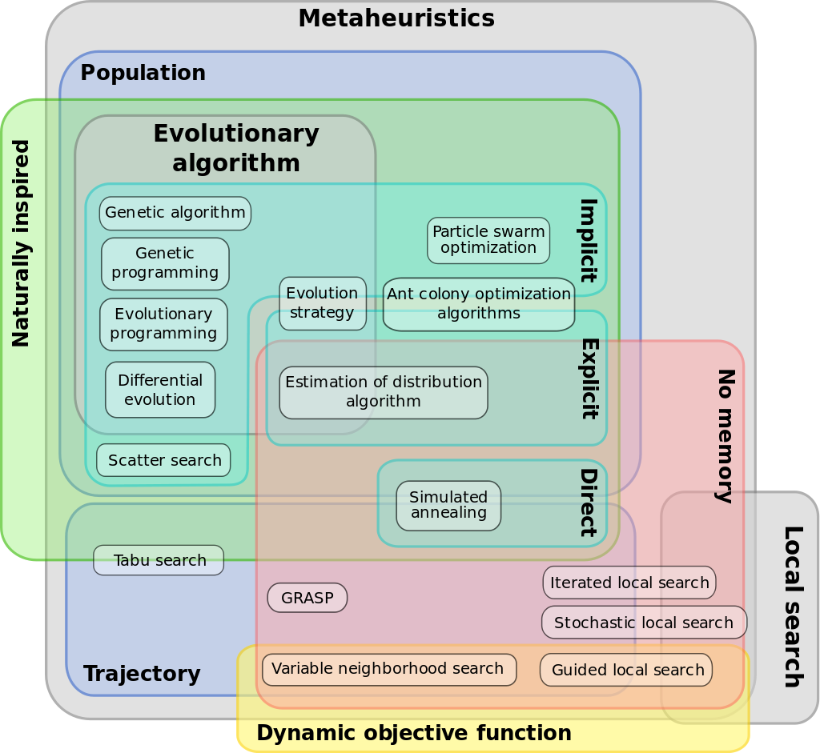
Metaheuristic
Notes:
元啟發式不同分類的尤拉圖

Slide 131
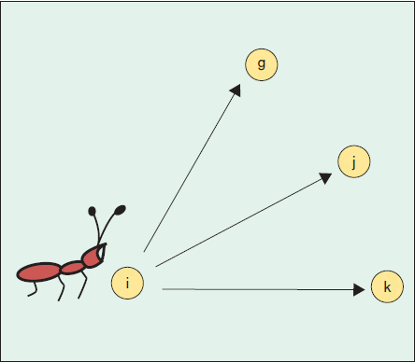
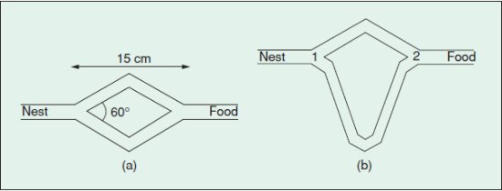
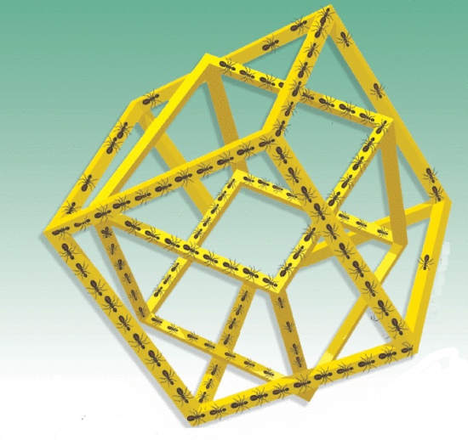
Ant colony search
Ant colony optimization algorithm (ACO) is a probabilistic technique for solving computational problems which can be reduced to finding good paths through graphs.
M. Dorigo, M. Birattari and T. Stutzle, "Ant colony optimization," in IEEE Computational Intelligence Magazine, vol. 1, no. 4, pp. 28-39, Nov. 2006, doi: 10.1109/MCI.2006.329691.
Notes:
蟻群優化算法（ACO）是一種解決計算問題的概率技術，可以簡化為尋找通過圖的良好路徑。

Slide 132
Tabu search
local (neighborhood) searches take a potential solution to a problem and check its immediate neighbors (that is, solutions that are similar except for very few minor details) in the hope of finding an improved solution.
Fred Glover., Laguna M. (1998) Tabu Search. In: Du DZ., Pardalos P.M. (eds) Handbook of Combinatorial Optimization. Springer, Boston, MA.
https://doi.org/10.1007/978-1-4613-0303-9_33
Notes:
局部（鄰域）搜索將一個問題的潛在解決方案拿出來，並檢查其近鄰（即除了極少的小細節外相似的解決方案），希望能找到一個改進的解決方案。
是一個用來跳脫局部最優解的搜索方法。其先創立一個初始化的方案；基於此，算法「移動」到一相鄰的方案。經過許多連續的移動過程，提高解的質量。

Slide 133
Genetic algorithm
a genetic algorithm (GA) is a metaheuristic inspired by the process of natural selection that belongs to the larger class of evolutionary algorithms (EA).
Genetic algorithms are commonly used to generate high-quality solutions to optimization and search problems by relying on biologically inspired operators such as mutation, crossover and selection.
Notes:
遺傳算法（GA）是一種自然選擇過程的元模型算法，屬於自然算法（EA）類別。
遺傳算法通常用於生成合理的優化和搜索問題的解決方案，依靠自己選擇的方法，如變異、補償和補償。

