Slide 1
Optimization of Capacity Allocation Problem in 4G LTE Mobile Networks
Rajalakshmi Krishnamurthi Department of Computer Science, Jaypee Institute of Information Technology, Noida k.rajalakshmi@jiit.ac.in
Mukta Goyal Department of Computer Science, Jaypee Institute of Information Technology, Noida mukta goyal@jiit.ac.in
Notes:
在4G LTE 行動網路容量分配問題的優化
Subest sum problem 解決作為np-complete的LTE回傳容量分配的問題
回傳容量分配:objection function目標函數是優化分配EPC的可用容量
自適應式迭代演算法(AILS algorithm) 解決作為np-hard的LTE回傳容量分配的問題

Slide 2
Abstract
In today's information era, the mobile communication has outperformed as one of the leading technology for information exchange.
It is highly possible, by mobile networks to provide any time and any where communication strategy, which meets the user requirements.
Notes:
在現今的資訊時代，行動通訊已成為領先的訊息交換技術之一。
行動網路極有可能，提供隨時隨地滿足用戶需求的通訊策略。

Slide 3
Abstract
However, the rising demand for multimedia, interactive and high quality of services on mobile network platform has made the existing mobile technologies to be reconsidered and reengineered.
The 4G technology is one such platform that addresses the challenges in conventional mobile communication network.
Notes:
然而，行動網路平台上互動式服務的需求不斷增長，使得現有的行動技術需要重新考慮及設計。
4G 技術就是一種平台，可以解決傳統行動通訊的挑戰。

Slide 4
Abstract
In this regard, 4G Long Term Evolution (4G -LTE) has promised to be effective solution to meet the future challenge of dynamism in all dimension of mobile communication.
This work primarily focuses on reviewing the LTE mobile technology, the various challenges in designing LTE network and the issues in LTE while performing intended operations.
Notes:
在這方面，4G 長期演進 (4G -LTE) ，已確認能夠有效應對未來行動通訊在各層面所面臨的挑戰。
它主要著重於回顧 LTE 行動技術，設計 LTE 網路所面臨的挑戰，以及執行預期操作時， LTE 中的問題。
Dynamism ‘dīnəmizəm’ 有活力的

Slide 5
Abstract
Specifically, in LTE network design, the optimization of capacity allocation in LTE backhaul network is one of the most challenging issues due to high dynamic nature of mobile network communications and components.
Such optimization problems are hard to solve in polynomial time.
Notes:
具體而言，在設計LTE 網路時，由於行動網路通訊和組件的高機動性，LTE 回傳網路中容量分配的優化是最具挑戰性的問題之一。
這樣的優化問題很難在polynomial time中解決。

Slide 6
Abstract
Next, this work addresses the reduction of LTE capacity allocation problem as NP complete using subset sum problem.
Further, adaptive iterative local search algorithm is proposed to solve this problem.
The experimental results exhibited the efficiency of proposed algorithm as 6.7% improvement in computation time in comparison of greedy method.
Notes:
接下來，它使用subset sum problem解決了作為 NP complete 的 LTE 容量分配問題。
進一步地，它提出了自適應迭代局部搜索演算法(adaptive iterative local search algorithm)來解決這個問題。
實驗結果表明，與貪婪演算法相比，該算法的計算時間減少了 6.7%。

Slide 7
INTRODUCTION
The 4G also known as 4th generation technology is the convergence platform for all existing network technologies like 2G, 3G, Wireless Local Area network (WLAN), WiMAX, Wireless Personal Area Network (WPAN), and including wired network systems [1,2].
In addition, 4G is the advancement and integration of existing protocols like GSM, GPRS, EDGE, UMTS, W-CDMA, CDMAone, IMT-2000, WiFi, Zigbee , Bluetooth, etc [3].
Notes:
4G 也稱為第四代技術，是所有現有網路技術的整合平台，
如 2G、3G、無線區域網路(WLAN)、WiMAX(全球互通微波存取)、無線個人網路 (WPAN)以及有線網路系統，在reference [1,2]中提到 。
此外，4G是GSM、GPRS、EDGE、UMTS、W-CDMA、CDMAone、IMT-2000、WiFi、Zigbee、藍牙等現有協定的集大成，在reference [3]中提到 。

Slide 8
INTRODUCTION
The major goal of the 4G technology is to provide end to end best quality of multimedia, interactive services over Internet Protocol.
However, the challenging issue is, any 4G system must provide capabilities defined by ITU (International Telecommunications Union) in IMT (International Mobile Telecommunications) Advanced [4, 5].
Notes:
4G 技術的主要目標是透過互聯網協定的交互式服務，提供端到端最佳質量的多媒體。
然而，具有挑戰性的問題是，任何 4G 系統都必須提供 ITU 在 IMT Advanced 中定義的功能。在ref[4, 5]中有提到 。
ITU (International Telecommunications Union)國際電信聯盟
IMT (International Mobile Telecommunications)國際移動電信

Slide 9
INTRODUCTION
The 4G-LTE network is one such kind of mobile communication network that exhibits potential solution to achieve the goals set by ITU-IMT.
The notable technological advancement in 4G-LTE is that, the removal of redundant circuit switching based data transmission [6, 7].
To recollect, in conventional 2G network, the voice traffic is transmitted through Mobile Switching Centres (MSC) as TDMA frames by base stations.
Notes:
4G-LTE 網路是一種行動通訊網路，它實現了 ITU-IMT 所設定的目標的潛在解決方案。
4G-LTE 顯著的技術進步在於，去除了數據傳輸的冗餘電路交換 。在ref[6, 7]中有提到 。
在傳統的 2G 網路中，語音傳輸是透過MSC作為 TDMA frame 由基站 所傳輸的。
Mobile Switching Centres (MSC) 移動交換中心
TDMA frames(分時多工訊框): 是一種為實現共享傳輸介質或者網路的通訊技術

Slide 10
INTRODUCTION
However, in 4G-LTE all these, voice traffic are converted into data packets at base station and is transmitted as Voice over Internet Protocol (VoIP) through IP backhaul network.
Next major milestone in 4G-LTE network is that, the 4G mobile network is completely in conjunction with Wireless LAN, in oppose to the traditional way of wired LANs [2].
Notes:
然而，在所有 4G-LTE 中，語音傳輸在基站被轉換為數據包，並透過 IP 回傳網路作為VoIP傳輸。
4G-LTE網路的下一個重大里程碑是，4G行動網路完全與無線區域網路結合，並與傳統的有線區域網路的方式相反，在ref[2]中有提到 。
Voice over Internet Protocol (VoIP) : 是一種語音通話技術，經由IP來達成語音通話與多媒體會議，也就是經由網際網路來進行通訊。

Slide 11
INTRODUCTION
This way, the standards are been promoted for the air interfaces of 4G cellular network to integrate with wireless LANs.
This technological evolution has out shown several advantages like support for high definition multimedia applications, enhanced mobility management, uninterrupted services, and diversified access network support through mobile networks.
Notes:
透過這種方式，推動了4G 蜂巢式網路的空中介面與無線局部網路集成的標準。
這種技術演進已經展現出支援高清多媒體應用、增強移動管理、不間斷服務以及透過行動網路支援多樣化接入網路等多項優勢。
4G cellular network(4G 蜂巢式網路)
air interface(空中介面)是一種用於行動裝置傳輸的通信鏈路，透過無線通訊，連結行動電話終端使用者或基地台。
diversified: /dɪˈvɜrsɪfaɪd/多樣化

Slide 12
INTRODUCTION
The basic architecture of LTE mobile network is given below Figure 1.
There are three major components involved namely Evolved Node Base Stations (eNBs), Evolved Pocket Core (EPC) and Network Resource Manager (NRM).
The transmission link between eNBs and EPC are using any of the technologies like microwave, wireless, copper wired and optical links.
Notes:
LTE 行動網路的基本架構如下圖 1 所示。
它主要有三個元件，演進節點基站 (eNBs)、演進封包核心 (EPC) 和網路資源管理 (NRM)。
eNBs 和 EPC 之間的傳輸連結使用的技術，如微波(microwave)、無線(wireless)、銅線(copper wired)和光鏈路(optical links)的技術。

Slide 13
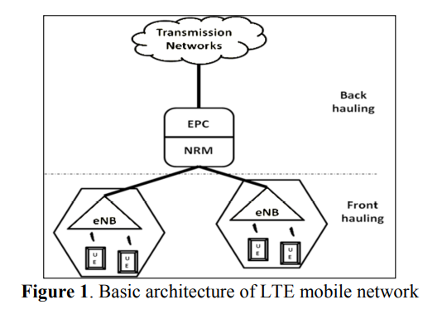
INTRODUCTION
Notes:
LTE 行動網路的基本架構
演進節點基站 (eNBs)、演進封包核心 (EPC) 和網路資源管理 (NRM)
eNBs: 該設備是用於在行動網路中，連接用戶手機和行動電話網絡之間的硬體設備。其功能類似於GSM網絡中的BTS。

Slide 14
INTRODUCTION
The eNBs provide requested frequency by its various user equipments (UE).
Other words, user equipment establish mobile communication through eNBs.
The eNBs are controlled by network resource managers.
The NRM allocate available total capacity to all its associated eNBs.
Notes:
eNBs 提供各種UE請求的頻率。
換句話說，UE透過eNBs建立行動通訊。
NRM 為所有關聯的 eNB 分配可用的總容量。
user equipments (UE)用戶設備
NRM網路資源管理

Slide 15
INTRODUCTION
Each EPC has its own NRMs.
EPC is further connects to IP based 4G transmission networks.
The main role of NRM is to perform network control, sharing available capacity and allocated capacity for dynamic requests from its associated eNBs.
Notes:
每個 EPC 都有自己的 NRMs。
EPC連接到，基於IP的4G transmission networks(傳輸網路)。
NRM 的主要作用是執行網路控制、共享可用容量以及與NRM有關的 eNBs 的動態請求分配容量。

Slide 16
INTRODUCTION
Primarily, this work focuses to analyse various LTE backhaul network complexities.
Further, in real mobile network scenario, these problems are hard optimization problems due to dynamic nature of network components, user mobility, and dynamic requirements of the end users.
Hence, this optimization problem cannot be solved in deterministic way.
Notes:
這項工作主要著重於分析各種 LTE 回傳網路的複雜性。
此外，在實際的行動網路場景中，由於網路組件的動態特性、用戶移動性和最終用戶的動態需求，這些問題都是難以優化的。
因此，這個優化問題不能以確定性的方式解決。

Slide 17
INTRODUCTION
In turn, prospective methods require intelligent ways to find solution for these problems.
As stated in [1], the main objective of such optimization problem is to minimize the CAPEX/OPEX cost involved in LTE backhaul network.
Notes:
反過來說，前瞻性方法需要以智能方法來找到這些問題的解決方案。
從ref [1] 所述，此類優化問題的主要目標是最小化 LTE 回傳網路中涉及的 CAPEX/OPEX 成本。
CAPEX(Capital Expense):資金、固定資產的投入
OPEX(Operating Expense):營運成本

Slide 18
INTRODUCTION
Further, this work focuses on, to show that the optimization problem at LTE backhaul capacity allocation is a NP complete.
Notes:
此外，這項的重點是，表明 LTE 回傳容量分配的優化問題是一個 NP complete的問題。

Slide 19
RELATED WORK
The LTE based mobile communication network has two levels of networking namely front hauling and backhauling.
LTE Front hauling: At the state of art, several existing research literatures mostly address LTE front hauling networks.
LTE front hauling network design targets spectrum allocation between eNBs and user devices [2, 3].
Notes:
基於LTE的行動通訊網路具有兩個級別的組網，即前傳和回傳。
LTE 前傳：在現有技術中，一些現有的研究文獻主要針對 LTE 前傳網路。
LTE 前傳網路設計的目標是在 eNBs 和UE(用戶設備)之間分配頻譜 ，從ref [2, 3]中提到。
Spectrum(頻譜): 訊號由不同頻率的波所組成的，如何分辨訊號的話，可以從頻譜得到

Slide 20
RELATED WORK
The communication link between eNBs and user devices is based on wireless medium.
The objective at front haul network is the optimal frequency spectrum allocation for the user equipment to establish communication with suitable eNBs.
Notes:
eNBs 和UE(用戶設備)之間的通訊連結是透過無線傳輸媒介。
前傳網路的目標是UE(用戶設備)與合適的eNBs在最佳頻譜分配下建立通訊。
Wireless Medium (WM)：無線傳輸媒介，無線區域網路實體層所使用到的傳輸媒介。

Slide 21
RELATED WORK
The objective is further complicated by the signal propagation features of wireless communication along with dynamic nature of user and user requirements.
In [8], discussed the capacity assignment using queuing methods for PON based mobile front haul network.
Notes:
無線通訊的信號傳播特性，以及用戶和用戶需求的動態特性使該目標更加複雜。
在 ref[8] 中，討論了使用排隊方法為基於 PON 的行動前傳網路進行容量分配。

Slide 22
RELATED WORK
LTE backhauling: Next level is, the LTE backhaul network dealing with capacity allocation by EPC for eNBs.
Authors in [9], addressed that the LTE backhaul network problem in two ways namely centralized approach and decentralized approach.
Notes:
LTE backhauling(LTE 回傳)：LTE 回傳網路，透過 EPC 為 eNBs 處理容量分配。
在ref[9]中，作者以兩種方式解決了 LTE 回傳網路問題，集中式方法和分散式方法。

Slide 23
RELATED WORK
The centralized approach for handling base station equipments is very expensive in case of backhauling network because of technical constraints like fixed available data transmission rate and heavy cost on latency.
In case of distributed approach for handling backhaul network, might be cost efficient.
Notes:
在集中式方法中，由於固定可用數據傳輸速率，和，延遲成本高等技術限制，在回傳網路的情況下，處理基站設備非常昂貴。
而在處理回傳網路的分散式方法的情況下，可能具有成本效益。

Slide 24
RELATED WORK
However, the issues like interconnection, integration and management of difference technologies itself difficult to handle.
In addition to this, another critical issue is interference problem between communication subcarriers.
Notes:
然而，不同技術之間的互聯、集成和管理等問題，本身就難以處理。
除此之外，另一個關鍵問題是通訊副載波之間的干擾問題。
副載波（subcarrier）是一種電子通信信號載波，它攜帶在另一載波的上端，兩個信號能夠同時有效傳播。

Slide 25
RELATED WORK
The major hurdle and overstated in LTE backhauling network is available capacity at EPC.
In reality, the available LTE capacity is limited and fixed per macrocell coverage.
In [9], stated that the capacity is independent of number of subscribes per cell site or number of user equipments request connectivity.
Notes:
EPC 的可用容量是 LTE 回傳網路中的主要障礙。
實際上，可用的LTE容量是有限的，而且每個大型基地台的覆蓋範圍都是固定的。
在[9]中，指出容量與每個小區站點的訂閱數量或UE請求連接的數量無關。
Hurdle /ˈhərdl/ 障礙
Overstated 誇大的
macrocell coverage: 一種蜂巢式基站，它通過大型塔和天線，發送和接收無線電信號。

Slide 26
RELATED WORK
The complexity is further increased while more cell sites are added, which would in turn increase the mobile network operational and maintenance costs.
Hence, the mobile service provides are in urge to plan and design cost effective backhaul methodologies.
Notes:
隨著更多小區站點的增加，複雜性也進一步增加，這反過來，又會增加行動網路的運營和維護成本。
因此，行動服務提供商，迫切需要規劃和設計具有成本效益的回傳方法。

Slide 27
RELATED WORK
And the objective is to have optimized and balanced allocation of capacity among eNBs that servers high and dynamic user demand.
Definitely, the LTE backhaul network has to fulfil critical requirement of flexible capacity in this evolving mobile communication network.
Notes:
並且目標是在服務於高動態用戶需求的 eNBs 之間優化和平衡容量分配。
確實，LTE 回傳網路必須滿足這個不斷發展的行動通訊網路，對彈性容量的關鍵要求。

Slide 28
OPTIMIZATION AT LTE BACKHAUL NETWORKING
The objective function targeted is, to optimally assign the available capacity at EPC, and serve the requested capacity of each associated eNBs.
While satisfying the technical constraints that each eNB is associated with only one EPC at any given time.
Further, the total allocated capacity of each eNBs should not exceed the available capacity of EPC.
Notes:
LTE 回傳網路的優化
目標函數是優化分配 EPC 的可用容量，並為每個 eNBs 的請求容量提供服務。
同時滿足在任何給定時間每個 eNB 僅與一個 EPC 有關的技術限制。
此外，每個 eNBs 的總分配容量不應超過 EPC 的可用容量。

Slide 29
OPTIMIZATION AT LTE BACKHAUL NETWORKING
Also, the power allocated for each eNB should not exceed the total power available at EPC.
In literature, this optimization problem is modelled using mathematical program like mixed integer problem for 2G, 3G mobile network [11, 12, 13].
Notes:
此外，分配給每個 eNB 的功率不能超過 EPC 上可用的總功率。
在ref[11, 12, 13]中，這個優化問題是使用數學程序建模的，像是 2G、3G 行動網路的混合整數問題 。

Slide 30
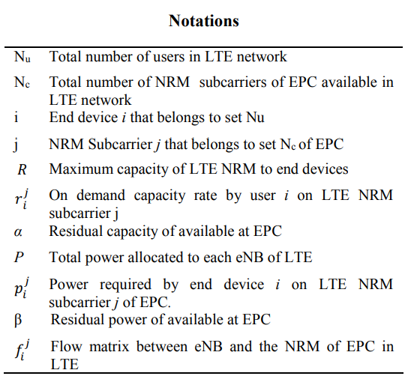
OPTIMIZATION AT LTE BACKHAUL NETWORKING
Notes:
Notations(符號)
$N_{u}$->LTE網路的用戶總數(N是指total number, u是指users)
$N_{c}$->LTE網路中EPC可用的NRM子載波總數(c是指NRM subcarriers)
i->終端設備 i屬於集合$N_{u}$
j->NRM子載波j屬於EPC集合$N_{c}$
R->LTE NRM 到終端設備的最大容量
$r_{i}^{j}$->用戶 i 在 LTE NRM 子載波 j 上的需求容量率(r是指On demand capacity rate需求容量率、i是指user用戶、j是指on LTE NRM subcarrier子載波)
(不是次方，只是一種符號的表示方法)
$α$-> EPC 可用的剩餘容量
P->分配給 LTE 的每個 eNB 的總功率
$p_{i}^{j}$->終端設備 i 在 EPC 的 LTE NRM 子載波 j 上所需的功率(p試指功率、i是指終端設備、j是指on LTE NRM subcarrier子載波)
$β$-> EPC 可用的剩餘功率
$f_{i}^{j}$-> LTE中eNB和EPC的NRM之間的流矩陣(f是指流矩陣、i是指user用戶、j是指on LTE NRM subcarrier子載波)
(與destination flow matrix 類似)

Slide 31
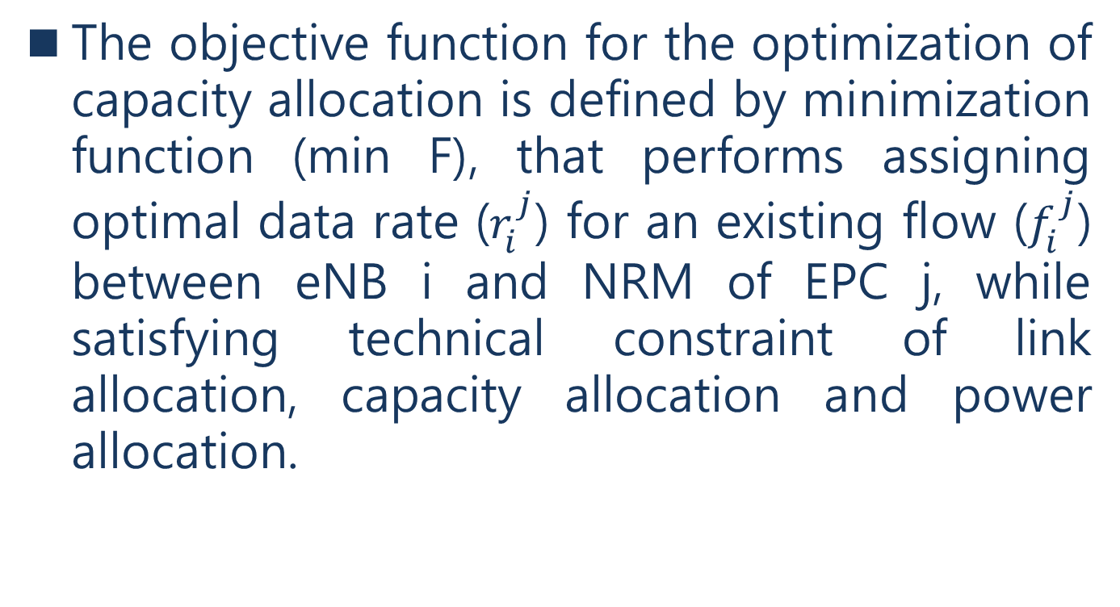
OPTIMIZATION AT LTE BACKHAUL NETWORKING
The objective function for the optimization of capacity allocation is defined by minimization function (min F), that performs assigning optimal data rate ($r_{i}^{j}$) for an existing flow ($f_{i}^{j}$) between eNB i and NRM of EPC j, while satisfying technical constraint of link allocation, capacity allocation and power allocation.
Notes:
容量分配優化的目標函數由最小化函數 (min F) 定義，
該函數為 eNB i 和 EPC j 的 NRM 之間的現有流 ($f_{i}^{j}$)
分配最佳數據速率 ($r_{i}^{j}$)，
同時滿足鏈路分配、容量分配和功率分配的技術約束。

Slide 32
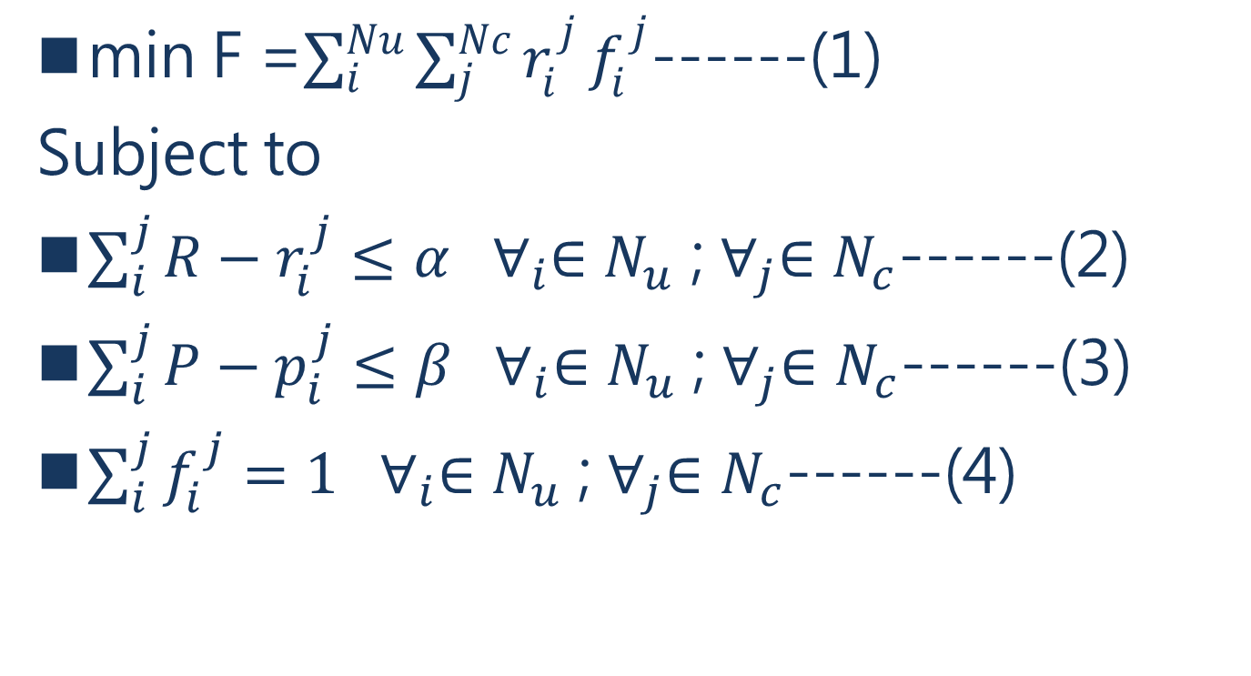
OPTIMIZATION AT LTE BACKHAUL NETWORKING
min F =$\sum_{i}^{Nu}{\sum_{j}^{Nc}{r_{i}^{j}}}f_{i}^{j}$------(1)
Subject to
$\sum_{i}^{j}{R}−r_{i}^{j}≤α ∀_{i}∈N_{u}$ ; $∀_{j}∈N_{c}$------(2)
$\sum_{i}^{j}{P}−p_{i}^{j}≤β ∀_{i}∈N_{u}$ ; $∀_{j}∈N_{c}$------(3)
$\sum_{i}^{j}{f_{i}^{j}}=1 ∀_{i}∈N_{u}$ ; $∀_{j}∈N_{c}$------(4)
Notes:
最小化函數 (min F)
受限於以下3個式子
(2) 任一個i屬於在nu中

Slide 33
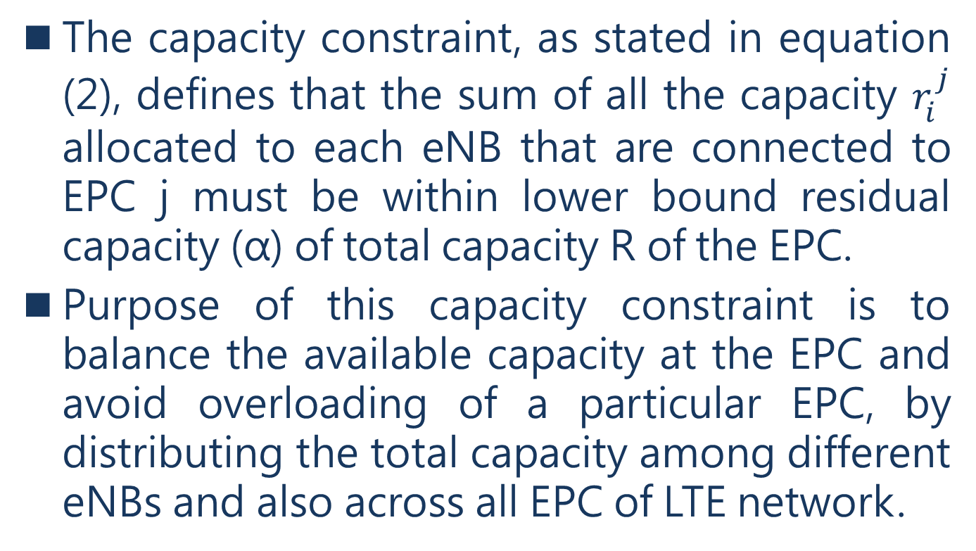
OPTIMIZATION AT LTE BACKHAUL NETWORKING
The capacity constraint, as stated in equation (2), defines that the sum of all the capacity $r_{i}^{j}$ allocated to each eNB that are connected to EPC j must be within lower bound residual capacity (α) of total capacity R of the EPC.
Purpose of this capacity constraint is to balance the available capacity at the EPC and avoid overloading of a particular EPC, by distributing the total capacity among different eNBs and also across all EPC of LTE network.
Notes:
容量分配約束，如等式（2）中所述，
分配給連接到 EPC j 的每個 eNB 的所有容量 $r_{i}^{j}$ 的總和，必須在 EPC 總容量 R 的下限，剩餘容量 (α) 內。
$\sum_{i}^{j}{R}−r_{i}^{j}≤α ∀_{i}∈N_{u}$ ; $∀_{j}∈N_{c}$------(2)
這個目的是透過在不同 eNBs 以及 LTE 網路的所有 EPC 之間，分配總容量來平衡 EPC 的可用容量並避免特定 EPC 過載。

Slide 34
OPTIMIZATION AT LTE BACKHAUL NETWORKING
The power constraint, as given in equation (3), defines that the power allocated to each eNB i is within the lower bound of total power available at ENB j.
The link constraint , as given in equation (4), defines that each eNB i is allocated to only one EPC resource of LTE network.
Notes:
功率約束，在等式 (3) 中，定義了分配給每個 eNB i 的功率在 ENB j 可用總功率的下限內。
$\sum_{i}^{j}{P}−p_{i}^{j}≤β ∀_{i}∈N_{u}$ ; $∀_{j}∈N_{c}$------(3)
鏈路約束，在等式 (4) 中，定義了每個 eNB i 只分配給 LTE 網路的一個 EPC 資源。
$\sum_{i}^{j}{f_{i}^{j}}=1 ∀_{i}∈N_{u}$ ; $∀_{j}∈N_{c}$------(4)

Slide 35
LTE CAPACITY ALLOCATION PROBLEM AND NP COMPLETENESS
We define the problem as set of Evolved Packet Core (EPC) which is having a collection of call capacity requests from various evolved node base stations (eNBs).
Each eNB should be under single EPC at any given time as shown Figure 2 below.
Notes:
我們將問題定義為一組演進封包核心 (EPC)，它收集了來自各種演進節點基站 (eNBs) 的呼叫容量請求。
每個 eNB 應該在任何給定時間處於單個 EPC 下，如下面的圖 2 所示。

Slide 36
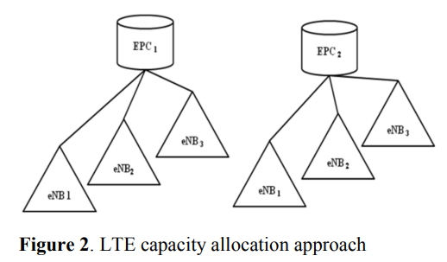
LTE CAPACITY ALLOCATION PROBLEM AND NP COMPLETENESS

Slide 37
LTE CAPACITY ALLOCATION PROBLEM AND NP COMPLETENESS
Problem formulation
For each call capacity request of eNB, we can easily determine the capacity request of each eNB.
This is achieved, by abstracting each call capacity requests simply as an integer – the capacity of the requested eNB.
The load which is exactly the capacity of the requested eNB stations that each EPC can accommodate is NP hard.
Notes:
LTE容量分配問題和NP-complete
Problem formulation
對於 eNB的每個呼叫容量請求，我們可以很容易地確定每個 eNB 的容量請求。
它是透過將每個呼叫容量請求，簡單地抽象為一個請求的 eNB 的容量(一個整數)來實現 。
負載正是請求的 eNBs的容量，而每個可以容納的EPC是 NP hard。

Slide 38
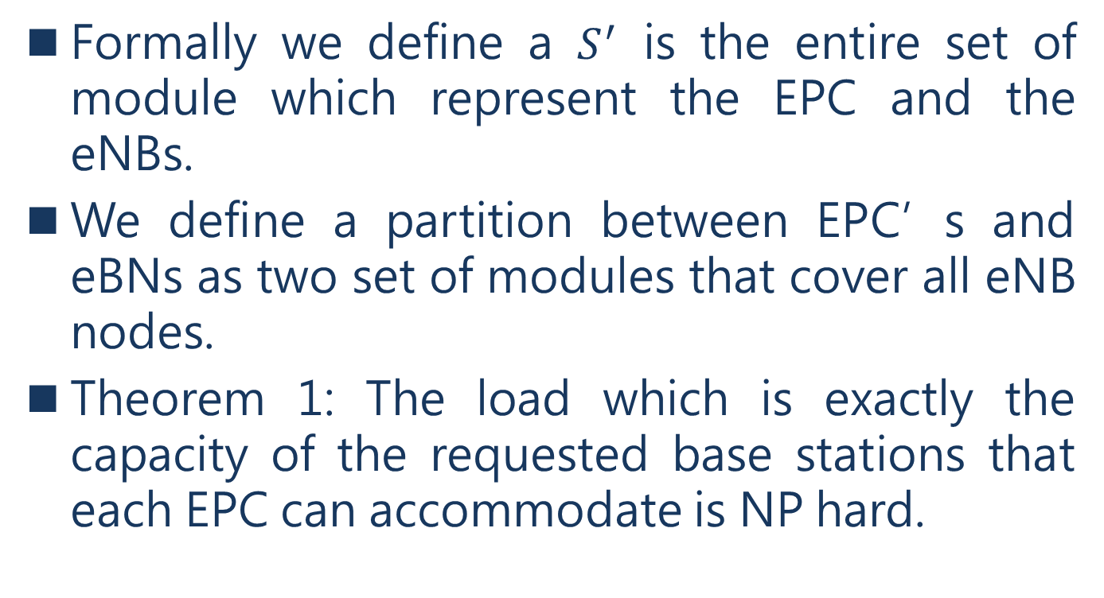
LTE CAPACITY ALLOCATION PROBLEM AND NP COMPLETENESS
Formally we define a $S^{′}$ is the entire set of module which represent the EPC and the eNBs.
We define a partition between EPC’s and eBNs as two set of modules that cover all eNB nodes.
Theorem 1: The load which is exactly the capacity of the requested base stations that each EPC can accommodate is NP hard.
Notes:
我們定義一個 s’ 來代表 EPC 和 eNB 的整個模塊集。
我們將 EPC 和 eBN 之間的劃分，定義為覆蓋所有 eNB 節點的兩組模塊。
定理 1：負載是請求的base stations的容量，而每個可以容納的EPC是 NP hard

Slide 39
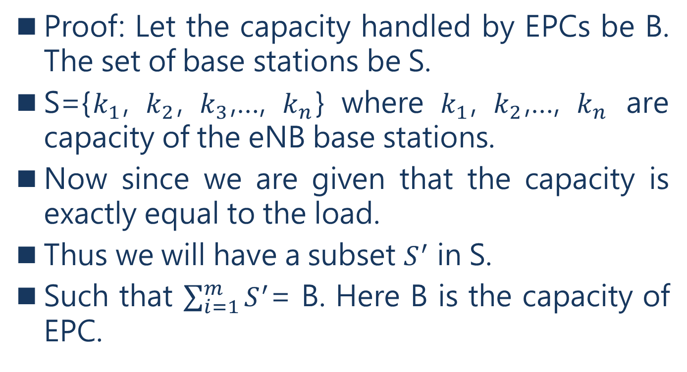
LTE CAPACITY ALLOCATION PROBLEM AND NP COMPLETENESS
Proof: Let the capacity handled by EPCs be B. The set of base stations be S.
S={$k_{1}$, $k_{2}$, $k_{3}$,…, $k_{n}$} where $k_{1}$, $k_{2}$,…, $k_{n}$ are capacity of the eNB base stations.
Now since we are given that the capacity is exactly equal to the load.
Thus we will have a subset $S^{′}$ in S.
Such that $\sum_{i=1}^{m}{S^{′}}$= B. Here B is the capacity of EPC.
Notes:
證明：設EPC處理的容量為B，基站(base station)的集合為S。
S={K₁,K₂,K₃,…,K_{n}} 其中K₁,K₂,…,K_{n} 是 eNB 基站的容量。
既然我們得到容量正好等於負載。
因此，我們將在 S 中有一個子集 S’。
使得 $\sum_{i=1}^{m}{S′}$= B。這裡 B 是 EPC 的容量。

Slide 40
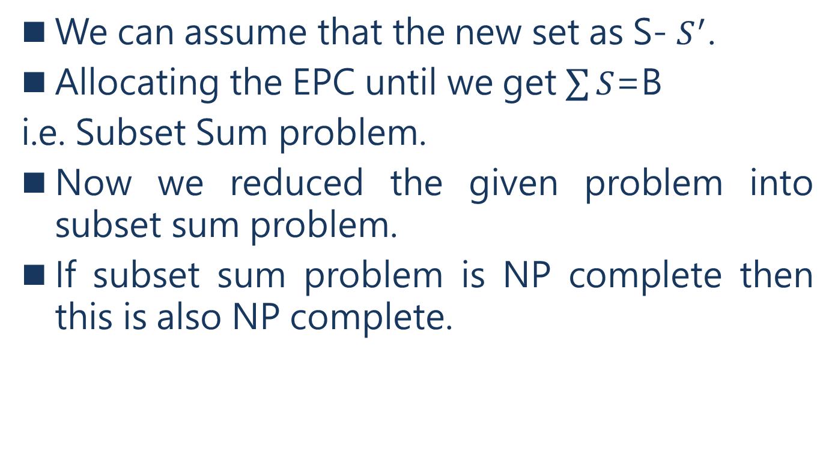
LTE CAPACITY ALLOCATION PROBLEM AND NP COMPLETENESS
We can assume that the new set as S- $S^{′}$.
Allocating the EPC until we get $\sum{S}$=B
i.e. Subset Sum problem.
Now we reduced the given problem into subset sum problem.
If subset sum problem is NP complete then this is also NP complete.
Notes:
我們可以假設新集合為 S – S’ 。
分配 EPC 直到我們得到 $\sum{S}=B$
i.e.(那就是說, that is (to say)) Subset Sum problem(子集和問題)。
現在我們將給定的問題簡化為子集和問題。
如果子集和問題是NP complete，那麼這個定理1也是 NP complete。

Slide 41
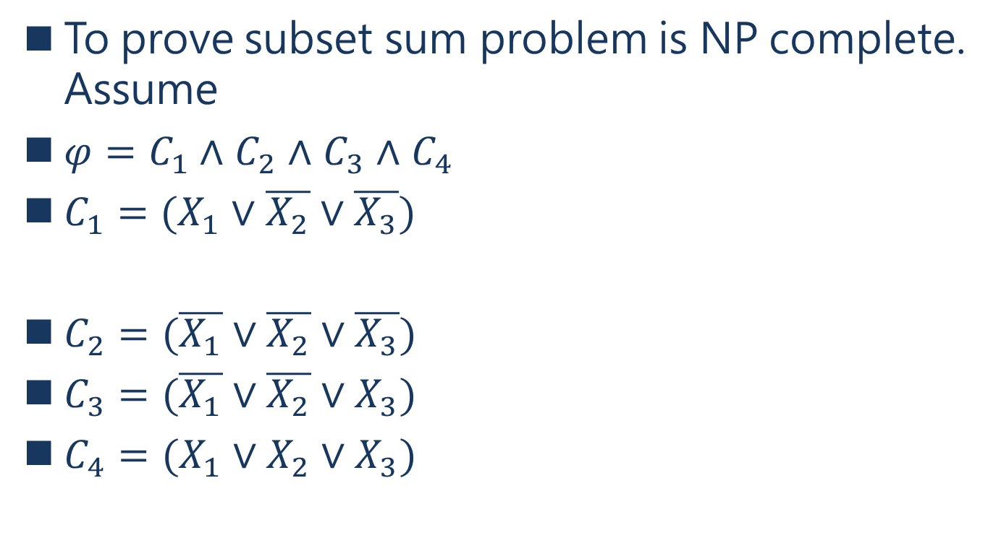
LTE CAPACITY ALLOCATION PROBLEM AND NP COMPLETENESS
To prove subset sum problem is NP complete. Assume
$φ=C_{1}∧$ $C_{2}$ $∧$ $C_{3}$ $∧$ $C_{4}$
$C_{1}=(X_{1}∨\overline{X_{2}}∨\overline{X_{3}})$
$C_{2}=(\overline{X_{1}}∨\overline{X_{2}}∨\overline{X_{3}})$
$C_{3}=(\overline{X_{1}}∨\overline{X_{2}}∨X_{3})$
$C_{4}=(X_{1}∨X_{2}∨X_{3})$
Notes:
為了證明子集和問題是NP complete
假設
$φ=C_{1}∧$ $C_{2}$ $∧$ $C_{3}$ $∧$ $C_{4}$($φ$音=>fi 一整statement)
($∧$=>且and)=true
$C_{1}=(X_{1}∨\overline{X_{2}}∨\overline{X_{3}})$ ($∨$=>或or)$C_{2}=(\overline{X_{1}}∨\overline{X_{2}}∨\overline{X_{3}})C_{3}=(\overline{X_{1}}∨\overline{X_{2}}∨X_{3})C_{4}=(X_{1}∨X_{2}∨X_{3})$
而這個式子就是3SAT

Slide 42
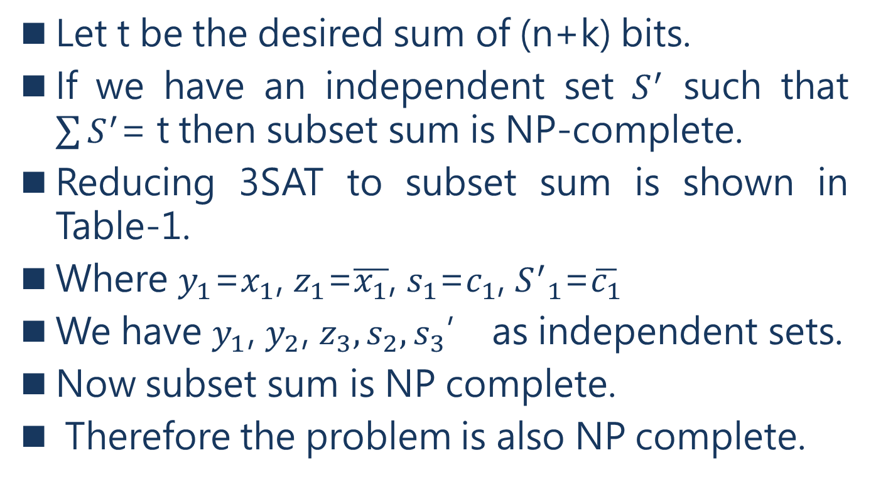
LTE CAPACITY ALLOCATION PROBLEM AND NP COMPLETENESS
Let t be the desired sum of (n+k) bits.
If we have an independent set $S^{′}$ such that $\sum{S^{′}}$= t then subset sum is NP-complete.
Reducing 3SAT to subset sum is shown in Table-1.
Where $y_{1}$=$x_{1}$, $z_{1}$=$\overline{x_{1}}$, $s_{1}$=$c_{1}$, ${S^{′}}_{1}$=$\overline{c_{1}}$
We have $y_{1}$, $y_{2}$, $z_{3},s_{2},s_{3}$’ as independent sets.
Now subset sum is NP complete.
Therefore the problem is also NP complete.
Notes:
令 t 為所需 (n+k) 位元的總和。
如果我們有一個獨立的集合 S' 使得 $\sum{S′}=t$那麼子集和是NP-complete。
將 3SAT (也是一種NP-complete的問題)reduce到子集和，如表 1 所示。
其中 $y_{1}$=$x_{1}$, $z_{1}$=$\overline{x_{1}}$, $s_{1}$=$c_{1}$, S_{1’}=$\overline{c_{1}}$
我們有 $y_{1}$, $y_{2}$, $z_{3},s_{2},s_{3}$’作為獨立的集合。
子集和是 NP-complete。
因此這個問題(定理1)也是NP-complete。

Slide 43
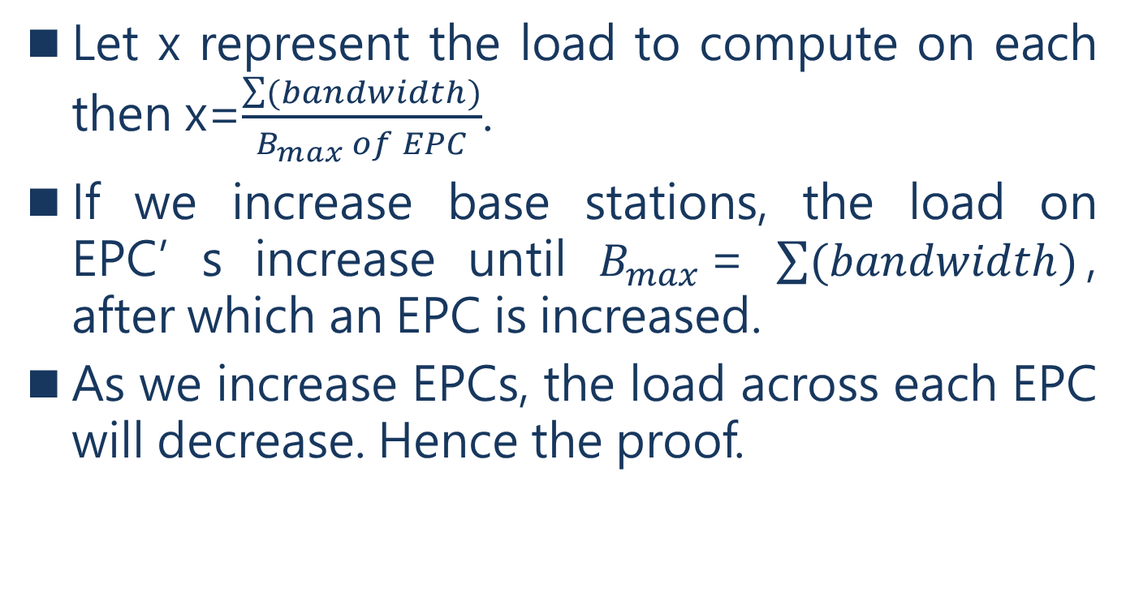
LTE CAPACITY ALLOCATION PROBLEM AND NP COMPLETENESS
Let x represent the load to compute on each then x=$\frac{\sum{(bandwidth)}}{B_{max} of EPC}$.
If we increase base stations, the load on EPC’s increase until $B_{max}$= $\sum{(bandwidth)}$, after which an EPC is increased.
As we increase EPCs, the load across each EPC will decrease. Hence the proof.
Notes:
設 x 表示要計算的負載，則 x=$\frac{\sum{(bandwidth)}}{B_{max} of EPC}$
(B為EPC處理的容量)
如果我們增加基站，EPC 的負載會增加，那麼等到$B_{max}$= $\sum{(bandwidth)}$，$EPC$會被增加。
隨著我們增加 EPC，每個 EPC 的負載將減少。因此證明子集和問題是NP complete。

Slide 44
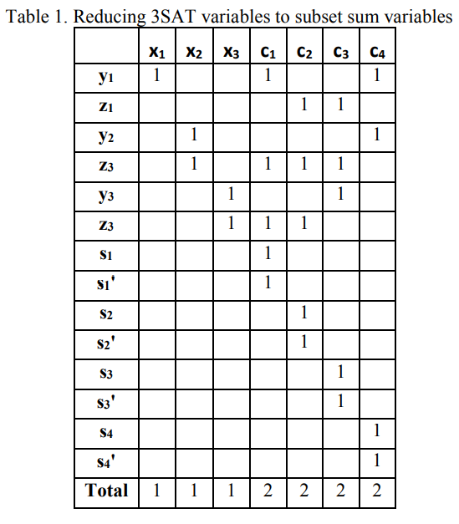
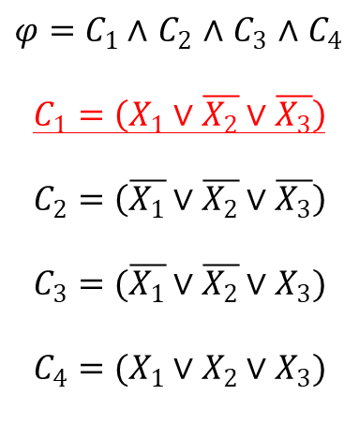
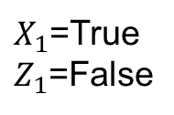


LTE CAPACITY ALLOCATION PROBLEM AND NP COMPLETENESS
$${10}^{6}$$
$${10}^{0}$$
$φ=C_{1}∧$ $C_{2}$ $∧$ $C_{3}$ $∧$ $C_{4}$
$$C_{1}=\left(X_{1}∨\overline{X_{2}}∨\overline{X_{3}}\right)$$
$$C_{2}=\left(\overline{X_{1}}∨\overline{X_{2}}∨\overline{X_{3}}\right)$$
$$C_{3}=(\overline{X_{1}}∨\overline{X_{2}}∨X_{3})$$
$$C_{4}=(X_{1}∨X_{2}∨X_{3})$$
$X_{1}$=True
$Z_{1}$=False
二擇一
1
1
The reduced
subset-sum problem
S={1001001,1000110,100001,….,100,100,10,10,1,1}
t=1112222
Notes:
The reduced subset-sum problem
S={1001001,1000110,100001,….,100,100,10,10,1,1}
t=1112222
是否有組合可以滿足t
If yes->則滿足3 SAT
反之亦然

Slide 45
ADAPTIVE ITERATIVE LOCAL SEARCH ALGORITHM [AILS]
The iterative local search algorithm developed by Thomas Stuzle in 1999, is a meta heuristic algorithm [10].
The techniques involved within ILS algorithm are simple and effective.
In this paper, we used an incremental improvement to this basic ILS using adaptive local search method.
Notes:
Thomas Stuzle 於 1999 年開發的迭代局部搜索算法是一種元啟發式演算法 [10]。
ILS algorithm (迭代局部搜索演算法)中涉及的技術簡單而有效。
在本文中，我們使用自適應局部搜索方法對該基本 ILS 進行了增量改進。
meta heuristic algorithm: 又稱 萬能啟發式演算法。在計算機科學和數學優化中，元啟發是一種高級的程序或啟發式算法，專門用於搜索、生成或選取一個啟發式結果（局部搜索算法），
該結果可以為一個最優化問題提供足夠好的求解，尤其適用於信息不完備或者計算能力受限時的最優化問題。
ILS algorithm(Iterated local search):迭代局部搜索從一個初始解出發，然後搜索解的鄰域，如有更優的解則移動至該解並繼續執行搜索，否則返回當前解。
對於某些計算起來非常複雜的最優化問題，比如各種NP完全問題

Slide 46
ADAPTIVE ITERATIVE LOCAL SEARCH ALGORITHM [AILS]
The other effective operators are namely perturbation, shuffling limit and acceptance criteria.
These method are simple to implement and powerful by converging within less computation item into feasible solution space.
Hence, the adaptive ILS is well suitable to solve the NP hard capacity allocation problem in LTE Network.
Notes:
其他有效的算子是perturbation(打亂、擾動)、shuffling limit(隨機分配)和acceptance criteria(接受標準)。
這些方法透過將較少的計算項收斂到可行解空間中而實現簡單且功能強大的效果。
因此，自適應ILS非常適合解決LTE網路中的NP hard容量分配問題。

Slide 47
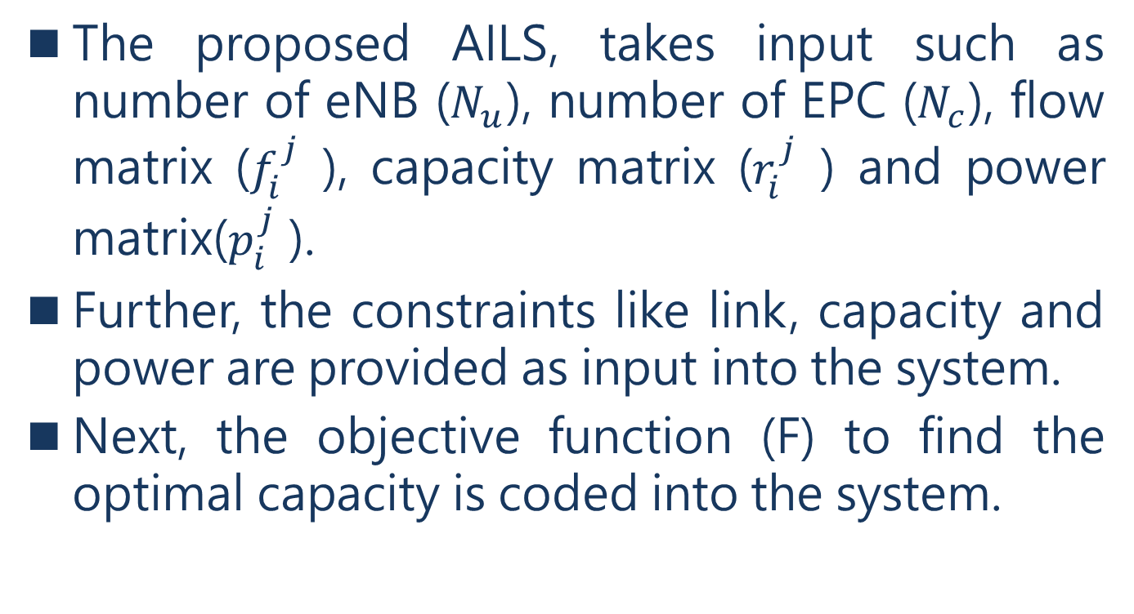
ADAPTIVE ITERATIVE LOCAL SEARCH ALGORITHM [AILS]
The proposed AILS, takes input such as number of eNB ($N_{u}$), number of EPC ($N_{c}$), flow matrix ($f_{i}^{j}$ ), capacity matrix ($r_{i}^{j}$ ) and power matrix($p_{i}^{j}$ ).
Further, the constraints like link, capacity and power are provided as input into the system.
Next, the objective function (F) to find the optimal capacity is coded into the system.
Notes:
在AILS中，需要輸入像是eNB 數量 ($N_{u}$)、EPC 數量 ($N_{c}$)、流矩陣 ($f_{i}^{j}$)、容量矩陣 ($r_{i}^{j}$) 和功率矩陣 ($p_{i}^{j}$) 等參數。
此外，將鏈路、容量和功率等約束條件作為輸入提供給系統。
接下來，將尋找最佳容量的目標函數 (F) 編碼到系統中。

Slide 48
ADAPTIVE ITERATIVE LOCAL SEARCH ALGORITHM [AILS]
The purpose of objective function (F) is produces optimal solution vector, with each eNBs assigned to the feasible EPC, while satisfying all technical constraints.
Notes:
目標函數 (F) 的目的是產生最佳解的向量，將每個 eNB 分配給可行的 EPC，同時滿足所有技術限制。

Slide 49
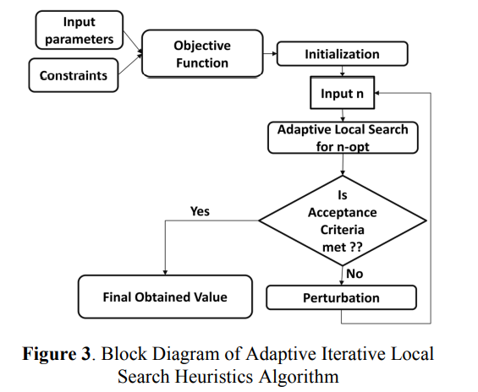
ADAPTIVE ITERATIVE LOCAL SEARCH ALGORITHM [AILS]
shuffling limit
acceptance criteria
perturbation
Notes:
Input parameters: Nu,Nc, $f_{i}^{j}$ ,…
Constraints: link, capacity, power
Objective function: min(F)目標函數=>產生最佳解
Initialization:做ENB到EPC的隨機分配
Adaptive local search for n-opt(自適應式局部搜索法)

Slide 50
ADAPTIVE ITERATIVE LOCAL SEARCH ALGORITHM [AILS]
During initialization phase, the random assignment of eNB to EPC is performed.
During initialization phase, the random assignment of eNB to EPC is performed.
During initialization the objective function is estimated and acts as the upper bound for further feasible solutions within the search space of valid solution.
Notes:
在初始化階段，執行 eNB 到 EPC 的隨機分配。
這種使用隨機性的初始化被提供作為下一步局部搜索方法的輸入。
在初始化期間，目標函數被估計，並作為有效解的搜索空間內進一步可行解的上限。

Slide 51
ADAPTIVE ITERATIVE LOCAL SEARCH ALGORITHM [AILS]
Next, the local search method is added with option for algorithm to choose between different neighbourhood solutions by exchanging values at some random locations within the allocation solution vector.
In [10], details about different opt method for local search namely 2-opt, 3-opt, and 4-opt.
In this work, the user can set the algorithm to choose different local search methods, hence is adaptive.
Notes:
接下來，局部搜索法添加了選項，透過在分配解向量內的一些隨機位置交換值來在不同的鄰域解之間進行選擇。
在 ref[10] 中，詳細介紹了用於局部搜索的不同 opt 方法，即 2-opt、3-opt 和 4-opt。
在這項工作中，用戶可以設置演算法來選擇不同的局部搜索方法，因此是自適應的。

Slide 52
ADAPTIVE ITERATIVE LOCAL SEARCH ALGORITHM [AILS]
These search operation are controlled by two powerful operators namely perturbation and acceptance criteria.
In order to handle the feasible solution get stuck into the local search, perturbation operator is used.
Notes:
這些搜索操作由兩個強大的運算子控制，即擾動和接受標準。
為了處理可行解陷入局部搜索，使用擾動運算子。

Slide 53
ADAPTIVE ITERATIVE LOCAL SEARCH ALGORITHM [AILS]
The perturbation operator performs random shuffling of values in the current solution vector.
Here, the local search is allowed to explore other solution spaces by pushing the local solution to away from current best local minima.
The shuffling limit controls the perturbation process.
The second, operator is acceptance criteria.
Notes:
擾動運算子對當前解向量中的值進行隨機分配。
在這裡，透過將局部解推離當前最佳局部最小值，允許局部搜索，探索其他解空間。
隨機分配控制擾動過程。
第二，運算子是接受標準。

Slide 54
ADAPTIVE ITERATIVE LOCAL SEARCH ALGORITHM [AILS]
The acceptance criteria, always measures whether the current local solution is better than the best known solution so far.
Finally, the algorithm terminates once the iteration limit is reached.
Notes:
接收標準會一直衡量當前的局部解決方案是否優於迄今為止最知名的解決方案。
最後，一旦達到迭代限制，演算法就會終止。

Slide 55
RESULTS AND DISCUSSION
The experiment was conducted on Intel (R) core(TM) i5- 600 CPU at the speed of 3.2GHz, installed random access memory of 8GB, along with 64-bit operating system of x64 processor.
Microsoft Visual C++ was used for programming the proposed iterative local search algorithm to solve capacity allocation in LTE network.
Notes:
實驗在Intel(R) core(TM) i5-600 CPU上進行，主頻為3.2GHz，安裝8GB隨機存取存儲器，x64處理器的64位元的作業系統。
Microsoft Visual C++ 對所提出的迭代局部搜索演算法進行編程，以解決 LTE 網路中的容量分配問題。

Slide 56
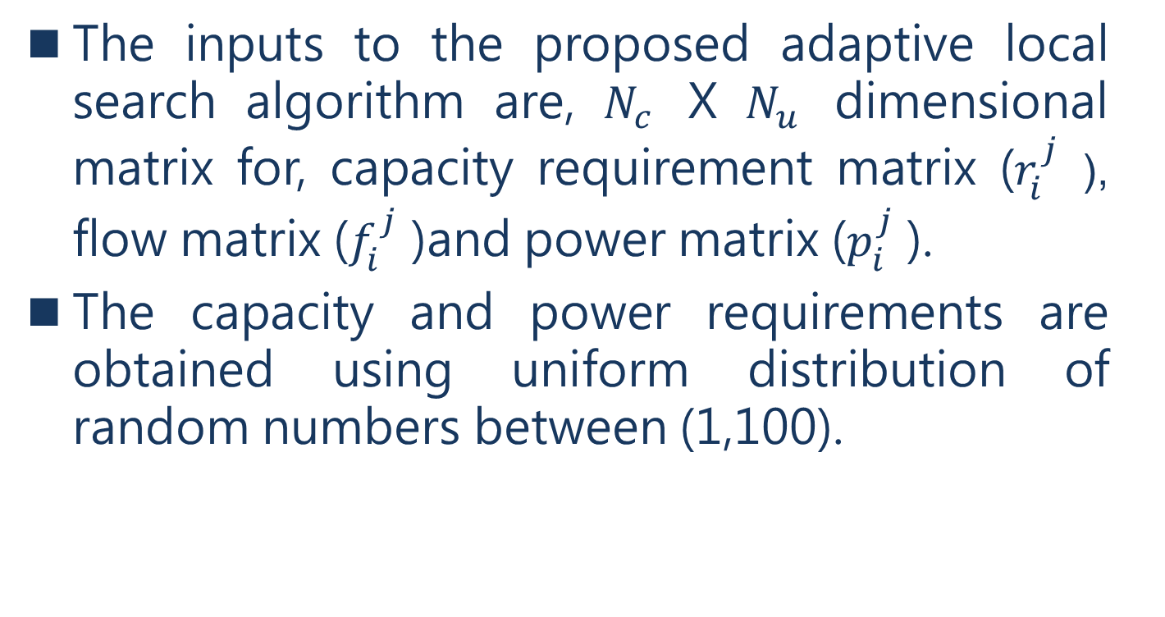
RESULTS AND DISCUSSION
The inputs to the proposed adaptive local search algorithm are, $N_{c}$ X $N_{u}$ dimensional matrix for, capacity requirement matrix ($r_{i}^{j}$ ), flow matrix ($f_{i}^{j}$ )and power matrix ($p_{i}^{j}$ ).
The capacity and power requirements are obtained using uniform distribution of random numbers between (1,100).
Notes:
自適應局部搜索演算法所輸入是 $N_{c}$ X $N_{u}$ ，維矩陣則是容量需求矩陣 ($r_{i}^{j}$)、流矩陣 ($f_{i}^{j}$) 和功率矩陣 ($p_{i}^{j}$)。
容量和功率的需求是使用 (1,100) 之間隨機數的均勻分佈所獲得的。

Slide 57
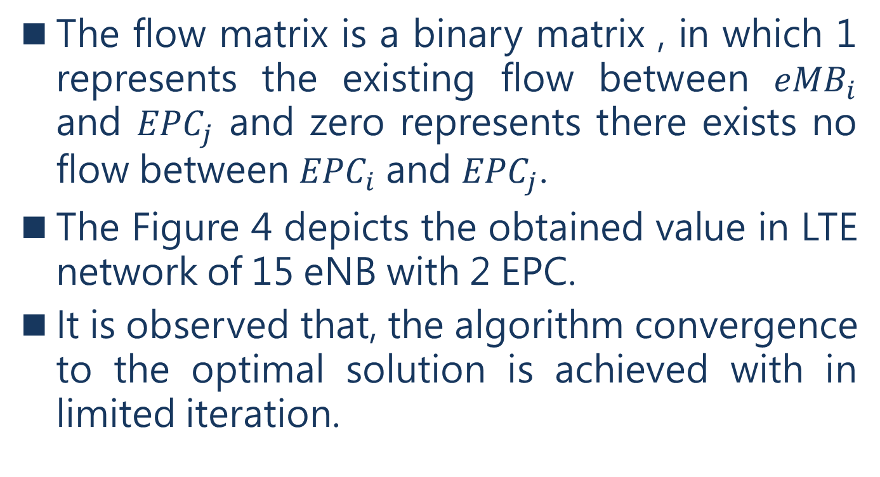
RESULTS AND DISCUSSION
The flow matrix is a binary matrix , in which 1 represents the existing flow between ${eMB}_{i}$ and ${EPC}_{j}$ and zero represents there exists no flow between ${EPC}_{i}$ and ${EPC}_{j}$.
The Figure 4 depicts the obtained value in LTE network of 15 eNB with 2 EPC.
It is observed that, the algorithm convergence to the optimal solution is achieved with in limited iteration.
Notes:
流矩陣是一個二元矩陣，其中1表示${eMB}_{i}$和${EPC}_{j}$之間有存在流，0表示${EPC}_{i}$ 和 ${EPC}_{j}$之間沒有存在流。
圖 4 描述了在 15 個 eNB 和 2 個 EPC 的 LTE 網路中獲得的值。
可以看出，演算法收斂到最佳解是在有限的迭代中實現的。

Slide 58
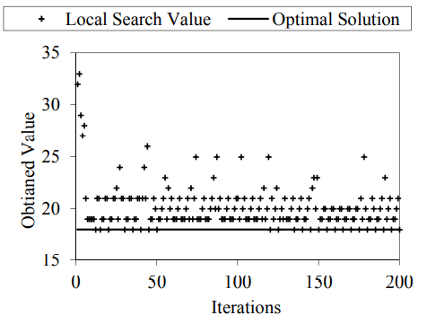
RESULTS AND DISCUSSION
Notes:
Iterations: 迭代次數
Obtianed Value: 獲得的價值

Slide 59
RESULTS AND DISCUSSION
The Table 2 represents the computation time for each of the different local search methods of proposed adaptive iterative local search algorithm.
It is observed that, the algorithm has exhibited very less time in comparison with greedy method of solving the capacity allocation problem.
Notes:
表 2 表示所提出的自適應迭代局部搜索演算法的每種不同局部搜索方法的計算時間。
可以看出，與解決容量分配問題的貪婪方法相比，該演算法表現出的時間非常少。

Slide 60
RESULTS AND DISCUSSION
Improvement of 6.7% is achieved in computation time as shown in Table 2.
Further, the algorithm exhibits there is significant time difference between the different local search executions.
Notes:
如表 2 所示，計算時間減少了 6.7%。
此外，該演算法表現出不同的局部搜索執行之間存在顯著的時間差異。

Slide 61
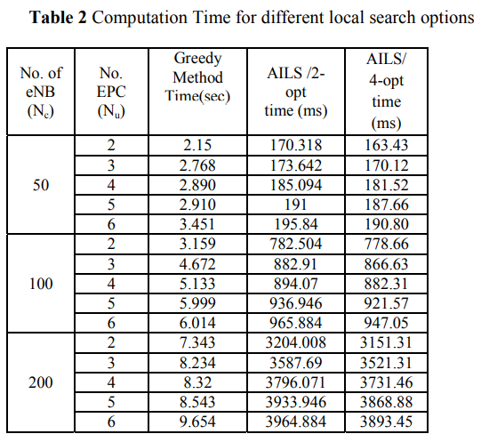
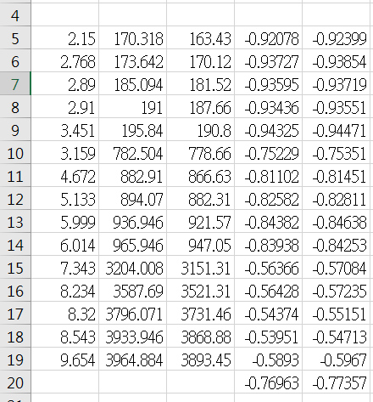
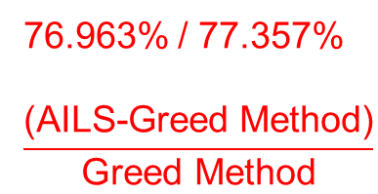
RESULTS AND DISCUSSION
76.963% / 77.357%
$$\frac{\text{(}\text{AILS}\text{−}\text{Greed} \text{Method}\text{)}}{\text{Greed} \text{Method}}$$

Slide 62
CONCLUSION
The 4G-LTE mobile network technology is one of the highly potential advancement to meet the requirements of ITU-IMT proposal.
The 4G- LTE achieves its various requirements by technology enhancement, as well efficient ways to serving dynamic user demands.
Notes:
4G-LTE行動網路技術是滿足ITU-IMT提案要求的極具潛力的進步之一。
4G-LTE 透過技術增強以及滿足動態用戶需求的有效方式來實現其各種要求。

Slide 63
CONCLUSION
However, the achieving the goal has severe hurdles and stringent reality factors like available frequency spectrum, sharing of the available spectrum and allocation of available spectrum optimally among network components.
This work, discusses the LTE technology, network components, the component functionalities, and various challenges.
Notes:
然而，實現該目標具有嚴重的障礙和嚴竣的現實因素，例如可用頻譜、共享可用頻譜以及分配在網路組件之間優化可用頻譜。
這項工作討論了 LTE 技術、網路組件、組件功能和各種挑戰。

Slide 64
CONCLUSION
Specifically, the capacity allocation of LTE backhaul network is NP complete.
In this work, the reduction of capacity allocation at LTE backhaul networking is stated and proved.
Further, the proposed Adaptive Iterative Local Search Algorithm has exhibited improvement of average computation time by approximately 6.7% in comparison to greedy algorithm.
Notes:
具體來說，LTE回傳網路的容量分配是NP complete。
在本文中，闡述並證明了 LTE 回傳網路容量分配的減少。
此外，與貪婪算法相比，在本文提出的自適應迭代局部搜索演算法的平均計算時間減少了大約 6.7%。

Slide 65
REFERENCES
[1] F. Baccelli, N. Bambos and N. Gast, "Distributed Delay-Power Control Algorithms for Capacity Sharing in Wireless Networks," in IEEE/ACM Transactions on Networking, vol. 19, no. 5, pp. 1458-1471, Oct. 2011.
[2] Derrick Wing Kwan Ng, Ernest S. Lo, and Robert Schober, "Energy-Efficient Resource Allocation in MultiCell OFDMA Systems with Limited Backhaul Capacity", IEEE Transactions On Wireless Communications, Vol. 11, No. 10, October 2012.
[3] J. Liu, N. Kato, J. Ma and N. Kadowaki, "Device-toDevice Communication in LTE-Advanced Networks: A Survey," in IEEE Communications Surveys & Tutorials, vol. 17, no. 4, pp. 1923-1940, 2015.
[4] E-UTRA; MAC Protocol Specification. 3GPP TS 36.321.
[5] V. Osa, C. Herranz, J.F. Monserrat, X. Gelabert, “Implementing opportunistic spectrum access in LTEadvanced”, EURASIP Journal of Wireless Communications and Networking, vol. 2012, no.1, pp. 99 - 112, March 2012.
[6] “Mobile Backhaul Equipment, Installed Base and Services Market Outlook,” Infonetics Research, Oct. 2006.
[7] A. Asheralieva, "Prediction based capacity allocation for cognitive LTE network," 2013 IEEE Wireless Communications and Networking Conference (WCNC), Shanghai, 2013, pp. 801-806.
[8] W. Lim, P. Kourtessis, K. Kanonakis, M. Milosavljevic, I. Tomkos and J. M. Senior, "Dynamic Capacity Allocation in Heterogeneous OFDMA-PONs Featuring Intelligent LTE-A Traffic Queuing," in IEEE Journal of Lightwave Technology, vol. 32, no. 10, pp. 1877-1885, May15, 2014.

Slide 66
REFERENCES
[9] H. Raza, "A brief survey of radio access network backhaul evolution: part II," in IEEE Communications Magazine, vol. 51, no. 5, pp. 170-177, May 2013.
[10] Stutzle, Thomas, “Local Search Algorithms for Combinatorial Problems – Analysis, Algorithms and New Applications”, Disseration an der Technischen Universitat Darmstadt, Berlin, 1999.
[11] Rajalakshmi, K., and Hima Bindu, M., “On Costefficient Optimization of UMTS Access Subsystem using Extended Evolutionary Heuristic Algorithm”, International Journal of Mobile Network Design and Innovation, Inderscience Publications, Vol. 4, No. 3 pp. 130 - 137 , 2012.
[12] Rajalakshmi, K. and Krishna Gopal, “Dual Homing based Link Level Failure Recovery in Mobile Access Network”, International Journal of Advanced Science and Technology, SERSC publications,Australia Vol.79, pp.1- 14, June 2015.
[13] K. Rajalakshmi, Prakash Kumar, Hima M. Bindu, “Targeting Cells to switch assignment of Cellular mobile network using heuristic algorithm”, 14th WSEAS international conference on Computers, vol. 1, pp: 75-80, USA, July 23-25, 2010.

Slide 67
Subset Sum Problem
Input有2個
(1)a set of (positive) integers =>S
(2)T(target)
是否有組合可以等於t
<e.g>
S={3, 34, 4, 12, 5, 2}
T=9
Notes:
如果裡面的數字挑選幾個出來，相加等於9 就代表符合這個問題。

Slide 68
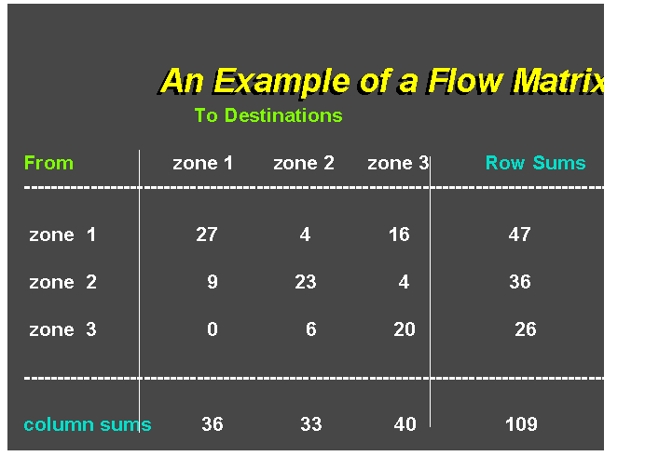
Flow Matrix

