Slide 1
Network Function Virtualization-Aware Orchestrator for Service Function Chaining Placement in the Cloud
Hassan Hawilo, Manar Jammal and Abdallah Shami
IEEE Journal on Selected Areas in Communication
Vol. 37, No. 3, March 2019

Slide 2
Report Outline
Abstract
Introduction
Background & Related Work
Motivation
Problem Formulation
Mathematical Formulation

Slide 3
Report Outline
BACON: NFV-Aware Placement Algorithm
NFV-Aware Placement Simulation
Conclusion

Slide 4
Abstract
主題 : VNF Placement Problem
方法 : MILP 和 Heuristic algorithm
洞見 : 方法更符合 Carrier-Grade 要求
目標 : 兼顧 Availability / Redundancy 等 Constraints 下，最小化 Latency

Slide 5
【補充】VNF Architecture
NFV (Network Function Virtualization) services are consist of one or more VNFs (Virtualized Network Function)
VNF Forwarding Graph ( VNFFG ) shows the overall logical connection between VNFs
also called Service Function Chain (SFC)

Slide 6
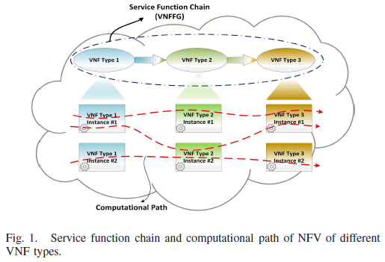
【補充】VNF Forwarding Graph ( VNFFG )

Slide 7
【補充】VNF Architecture
VNFFG shows the dependency relation and some configurating attribute, e.g. delay tolerance, are defined in this phase
When delay tolerance are violated, we called it computational path outage ( service degradation )

Slide 8
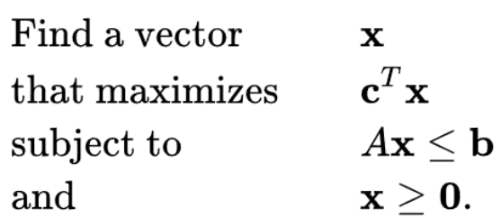
【補充】MILP Model
Linear Programming :
Integer Programming
  all of the (decision) variables are restricted to be integers
  Also refers to Integer Linear Programming

Slide 9
【補充】MILP Model
Mixed Integer Programming
  Some of the decision variables are allowed to be not integer ( a.k.a. linear )
  Also refers to Mixed Integer Linear Programming
總結 : IP (ILP) ⊂ MIP(MILP) ⊂ LP

Slide 10
【補充】Carrier Grade
Well-tested / reliable / redundant
Five main attribute :
  High availability / reliability
  QoS / QoE
  Performance / Efficiency
  Scalability
  Security

Slide 11
1. Introduction
VNF Placements 中待解決的問題 :
  Lower OPEX and CPEX
  On-demand scaling
  Real-time network programmability
  Satisfying carrier-grade requirements
Notes:
Introduction 的東西後面都會說到，所以我這邊就先跳過很多東西

Slide 12
1. Introduction
論文目標 :
  Minimizing the intra-communication delays between VNFs
  Enhancing QoS of the computational paths, to meet the carrier-grade requirements
    QoS : 在此主要 redundancy

Slide 13
2. Background & Related Work
大多前述方法都是假定運行在 private cloud，並且不同的 application ( NFV ) 無法共用 VNF
因此，上述方法都只適用於 small-scale network within a private cloud
實際上，現有許多服務應用都是佈署於 Multi-tenant supported public cloud 上 ( 比如 : AWS、Azure、GCP、etc… )

Slide 14
2. Background & Related Work
大多前述方法假定一個 NFV 功能是由一個 VNF 提供 ( single-tier application )
但實際上許多應用是 Multi-tier application，需要 different types of VNFs work collaboratively ( 形成 SFC )

Slide 15
2. Background & Related Work
既有文獻提出的 VNF Scheduler 仍然無法真正達到 Carrier-grade requirements
Such as performance, fault resilience, high availability, scalability, QoS, VNF components structure, and governments’ geo-restrictions

Slide 16
3. Motivation
ETSI 沒有定標準規範 VNFs’ placement management entity
VNF placement 會直接影響 NFV 的最終表現，比如 Latency
通常由 營運商 (Provider) 提供此 entity
但 Provider 只能保證 VNF 個體於 VM上的表現，難以保證 VNFs 之間的 通訊延遲

Slide 17
Optimal allocation 與各應用的性質/目標/需求密切相關，若由 Tenant 自行管理更有效
Ex : Netflix exploits AWS by deploy and manage their own cloud application

Slide 18
3. Motivation
結論 :
  當我們想達到 Carrier 等級的服務並且 minimize SFC delay，我們會需要一個 Application-aware ( NFV-aware ) VNF Scheduler，針對各個 App 的需求精準找出 optimal allocation

Slide 19
3. Motivation
結論 :
  如果 VNF placement 想達到 Carrier 等級的要求並且 minimize SFC delay，我們會需要一個 Application-aware ( NFV-aware ) Orchestrator，針對各個 App 的需求精準找出 optimal allocation

Slide 20
4. Problem Formulation
Requirements (Problem) of VNF Scheduler
  Balancing traffic between various computational paths, to increase QoS
  # of computational paths are increased by placing redundant VNF instance
  But, adding to much VNF instance can overwhelm the CPEX and OPEX, even violate the delay tolerance

Slide 22
4. Problem Formulation
Objective :
  在不違反 Quality Requirements ( e.g. delay tolerance ) 的前提下，盡量多地配置 Redundant VNF instances，以便增加 computational paths 的數量

Slide 23
4. Problem Formulation
Constraints :
  Capacity ( CPU & Memory )
  Network-Delay
  Availability
    Co-location
    Anti-location
    Redundancy ( as far as possible )
  Dependency

Slide 24
【補充】Functional Group
增加 Computational Path 能帶來什麼好處?
作者提出 Functional Group 的概念來量化計算其好處
Functional Group :
  同一種 VNF type，計算 instance 數
  所有 instances 都要置於同一 Orbital Area ( 軌道區 )

Slide 25
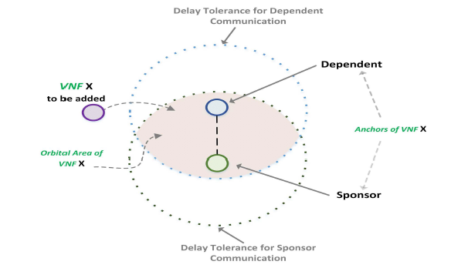
交集區域為 Orbital Area of VNF X，member 可在內自由移動而不違反 Constraints

Slide 26
Functional group members 愈多，代表 Computational paths 愈多，因而 :
  故障時可以轉移流量而不至於使系統失效， 防止單點故障 ( 增加 Availability )
  有閒置資源可以維持原本的用戶需求，使其 察覺不到影響 ( 增加 QoS / Reliability )
  增加 Throughput / Scalability
結論 : 增加 Computational paths 可以有效使系統達成 Carrier-grade requirements

Slide 27
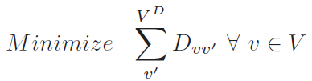

5. Mathematical Formulation
Objective function :

Slide 28

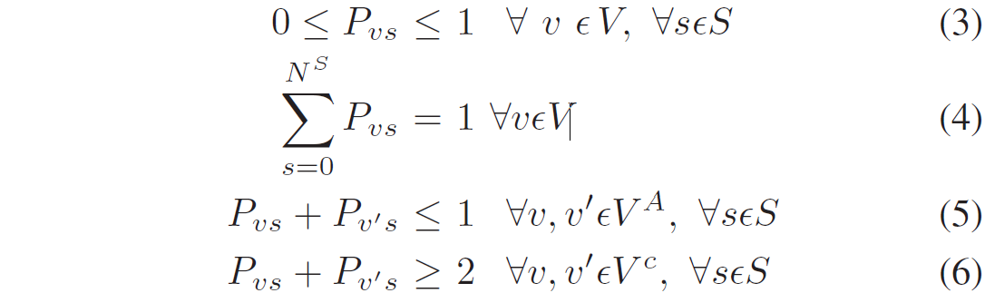

Availability / Dependency Constraints :
Notes:
3. Pvs 要不就是 1，要不就是 0，只會是 binary 不會有其他可能
4. 每個 vnf inst 要放在 server 上，且也只能放在一個 server
5. 有 anti-loaction 限制的 2 個 vnf 不能放在同一 server
6. 有 co-location 限制的 2 個 vnf 不能不放在同一 server 上

Slide 29
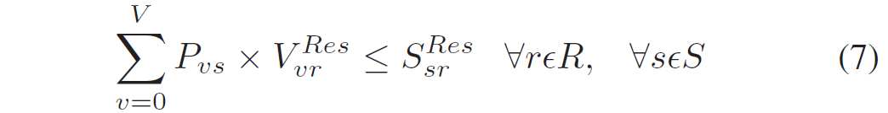
Capacity Constraints :

Slide 30
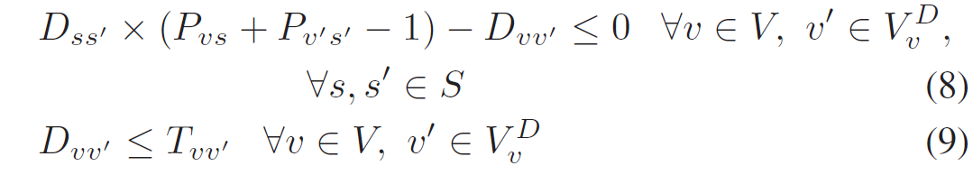
Network Delays Constraints :

Slide 31
【補充】P, NP, NPC, NP-hard
P : 可以在 polynomial time 找出最佳解
NP : 可以在 polynomial time 驗證一組“潛在的解”是否為 “真正的解” ( 是否正確 )
NP-hard : 若有一 Q 為 NP-hard，則所有 NP 問題都可以 reduce 至 Q
NP-Complete : 若有一 Q 為 NP-Complete，則 :
  Q 為 NP
  Q 為 NP-hard

Slide 32
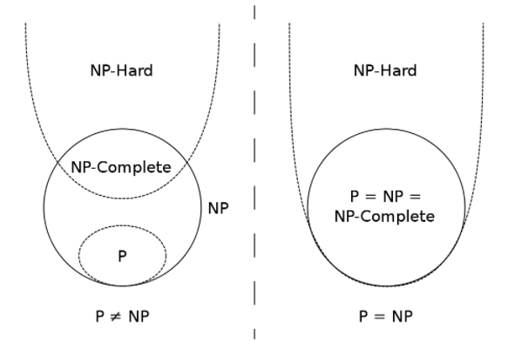
【補充】P, NP, NPC, NP-hard

Slide 33
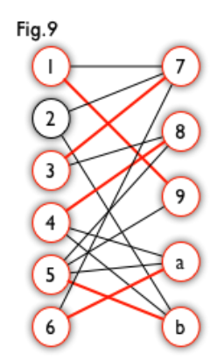
5. Mathematical Formulation
Model Complexity :
  Proving the MILP model is NP-hard by reducing it to a Bipartite Matching problem
  Using the Hopcroft-Karp algorithm, the bipartite maximal matchings are determined in polynomial time to the number of edges and vertices

Slide 34

  The problem can be represented as triplet
    : The set of servers
    : The set of VNFs
    : Objective function to be optimized
  G = (V, S, a) as a bipartite graph
    V : the set of VNF nodes
    S : the set of server nodes
    a : {v, s } that assign VNF v to server s , same as :

Slide 35
  In this special case, the problem is known as a constrained bipartite matching problem.
  Thus, this type of bipartite matching problem that is formulated using linear programming models is categorized as NP-hard problem

Slide 36
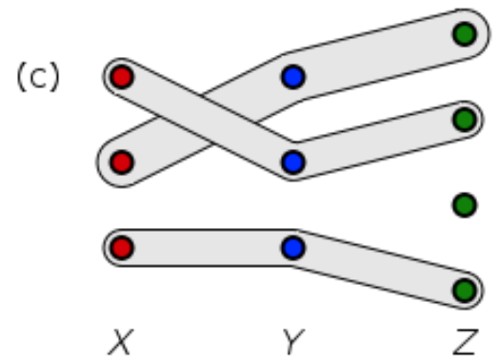
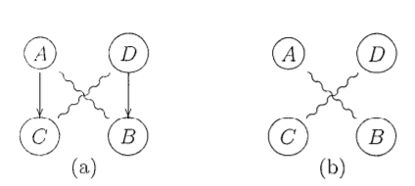
Q : 為何 Bipartite Matching 是 NP-hard ?
  Maximum bipartite matching : P
  3-dimensional (bipartite) matching : NP-hard
  Maximum matching with ordering constraints : NP-Complete
Q : 所以這個 MILP Model 具體如何轉換成 Constrained 3-dimensional bipartite matching?
①
②

Slide 37
6. BACON
MILP 時間複雜度太高，只適用於 small scale DC
因此論文還有提出了啟發式演算法 — Betweenness centrality Algorithm for Component Orchestration of NFV platform ( BACON ) 用於 large scale DC

Slide 38
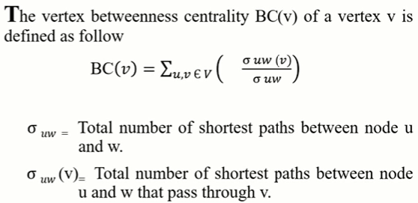
【補充】Betweenness Centrality

Slide 39
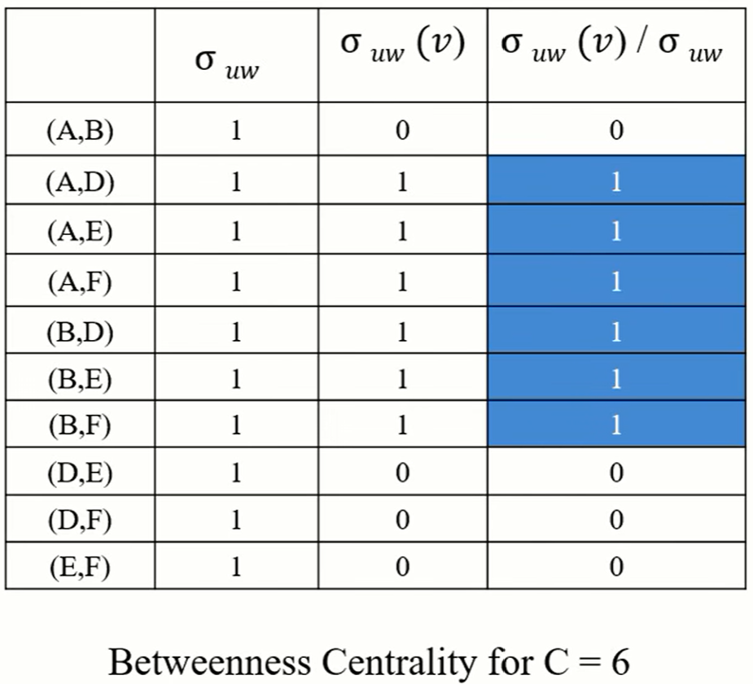
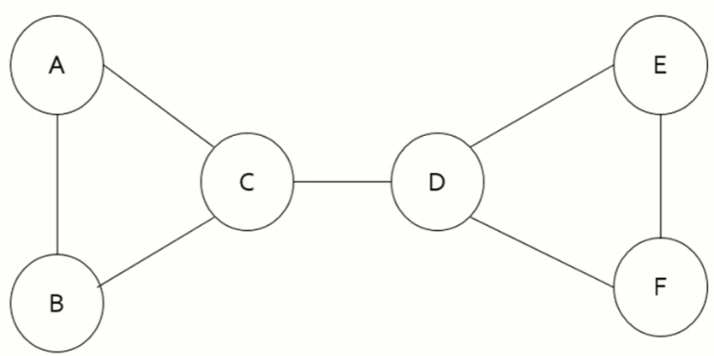
【補充】Betweenness Centrality

Slide 40
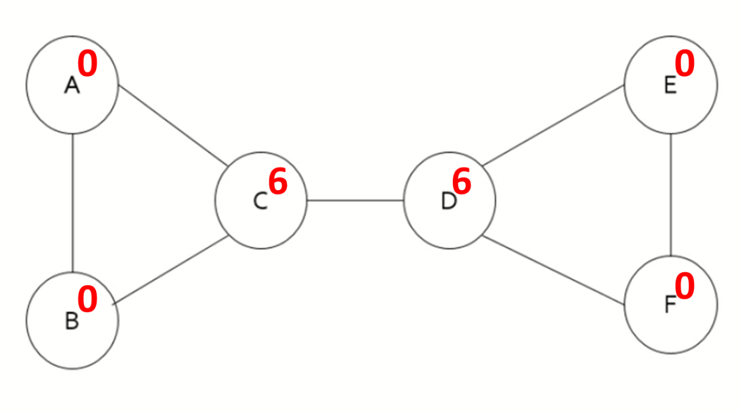
【補充】Betweenness Centrality

Slide 41
6. BACON
將一條 Service Function Chain 分成數個 sub-groups
每個 sub-group 由 3 種不同的 VNF types 組成
如果有湊不齊 3 種的 undercount group，則與其他 sub-group 共用 VNF types

Slide 43
6. BACON
每個 sub-group 有一個 critical attribute，他是基於 3 種 VNF types 的 critical attribute ( delay tolerance ) 計算而出
論文中沒提出 Sub-group 成員挑選策略 ( Brute-force )
Undercount group 只能跟一個 sub-group 共用 ?

Slide 44
6. BACON
After grouping, BACON construct a weighted graph G(V, E, w)
  V : The set of available servers
  E(v, v ’) : The set of logical connection between servers
  w(v, v ’) : The comm. delay between servers
Calculate the BC of the vertices (severs)

Slide 45
G(V, E, w) 示意圖 :
S1
10 ms
S2
0
2
15 ms
5 ms
S3
0
S4
0
10 ms

Slide 46
6. BACON
Critical attribute 最高 ( delay tolerance 最低 ) 的 sub-group 中的 median VNF 會優先放在 BC 最高 ( branch 最多 ) 的 server 上

Slide 47
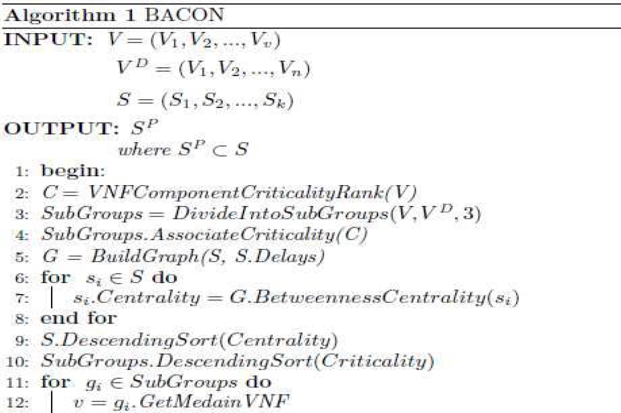
6. BACON

Slide 48
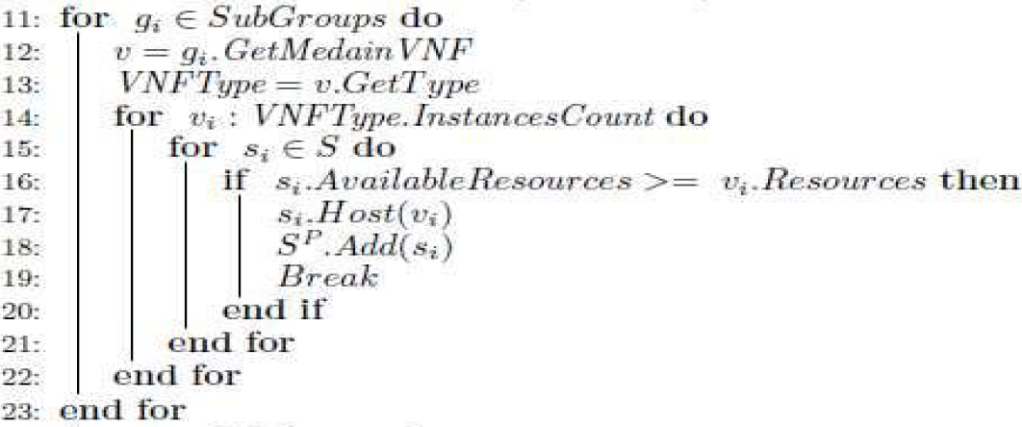
6. BACON

Slide 49
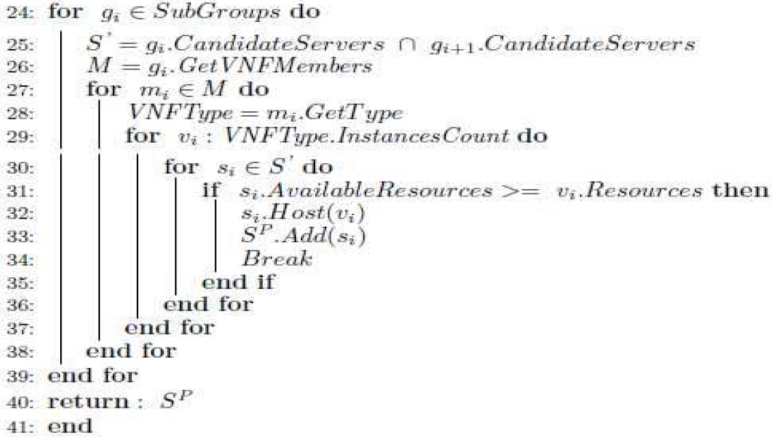
6. BACON

Slide 50
6. BACON
時間複雜度 :
  The highest order of magnitude in BACON is the subroutine that calculates the betweenness centrality of the vertices nodes.
  The worst-case scenario can be calculated by finding all the combinations of the sub-groups while holding the median node then calculating the betweenness centrality of the median nodes.

Slide 51
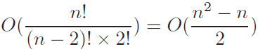


時間複雜度 :
  Iterating n times over the median node
  n = S , representing # of available servers
  , for S = # of available servers

Slide 52
7. Placement Simulation
Simulate 3-tier data center :
  TOR Switches : Connecting servers in the same rack
  Aggregation Switches ( AS ) : Connecting TOR Switches
  Core Switches : Connecting AS and acting as a gateway to external network
  Communication latency between switches are generated randomly and follow a normal distribution for each tier

Slide 53
7. Placement Simulation
實驗分成 small-scale 和 large-scale
  在 large-scale 中沒有 MILP 方案
以 BACON 比較 MILP，以及另外兩個 Greedy Algorithm — NFV-agnostic 和 Greedy-k-NFV
後者是 reliability-aware and delay-constrained heuristic algorithm，由 L. Qu et al 提出於 Sep, 2017 [43]

Slide 54
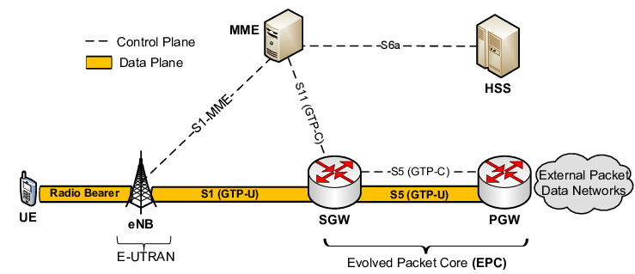
7. Placement Simulation
Using vEPC as the simulation use case
Considering 4 major components :
  MME
  HSS
  SGW
  PGW

Slide 55
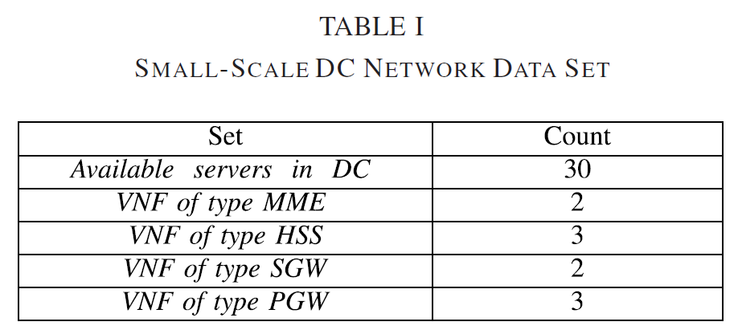
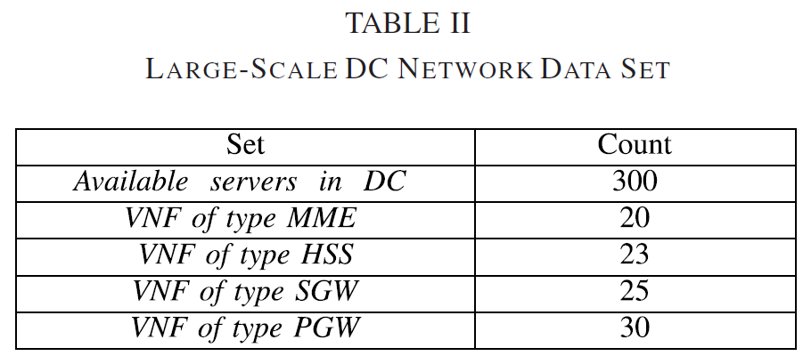
7. Placement Simulation

Slide 56
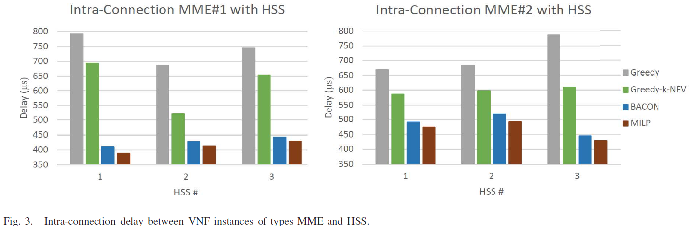
7. Placement Simulation

Slide 57
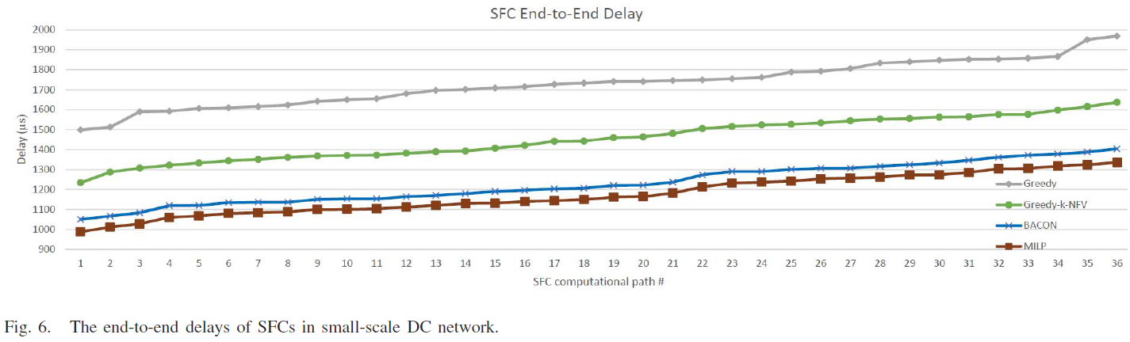
7. Placement Simulation

Slide 58
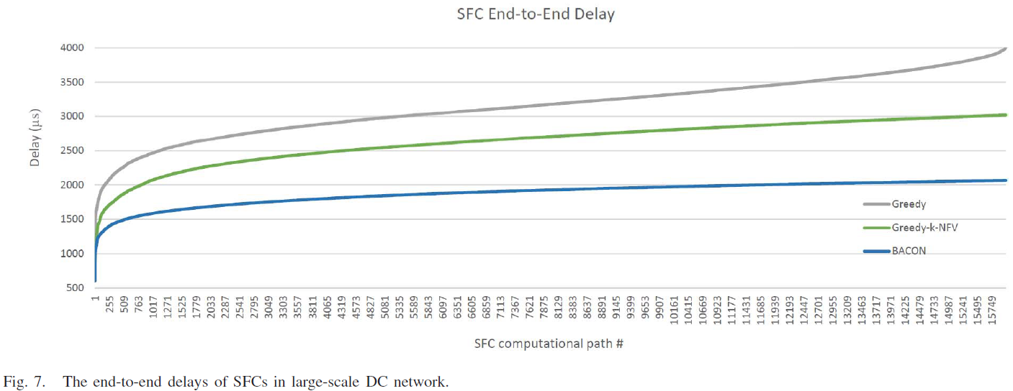
7. Placement Simulation

Slide 59
1. Introduction
貢獻 :
  Propose MILP model & BACON to minimizing latency between VNFCs and enhancing QoS of SFC
  Capture the carrier-grade’s functionality constraints, e.g. availability
  Capture the VNF’s dependencies constraints
  Minimize the end-to-end delay of SFC

Slide 60
心得
Related work 可以當作概略判斷論文品質的依據
實驗設計部分值得參考

Slide 61
心得
花太多時間在單篇論文
  逐行讀懂太耗時
  不能每篇論文精讀，要有略覽和抓重點的策略
見樹不見林，對 VNF Placement Problem 理解還不夠廣泛全面 :
  除了 Delay, Redundancy 還有什麼重要因素?
  Carrier-grade 的其他面向該如何達成?

Slide 62
Q & A

