Slide 1
Traffic Aware Placement of Interdependent
NFV Middleboxes
Wenrui Ma, Oscar Sandoval, Jonathan Beltran, Deng Pan, and Niki Pissinou
School of Computing and Information Sciences, Florida International University, Miami, FL
Department of Computer Science, Univeristy of Virginia, Charlottesville, VA
fwma006, jbelt021, pand, pissinoug@fiu.edu, oks2vd@virginia.edu
IEEE INFOCOM 2017 - IEEE Conference on Computer Communications
Notes:
相互依賴的 NFV middlebox 的流量感知放置
佛羅里達國際大學

Slide 2
OUTLINE
Abstract
INTRODUCTION
RELATED WORKS
PROBLEM STATEMENT
MIDDLEBOX PLACEMENT WITH PREDETERMINED PATHS
MIDDLEBOX PLACEMENT WITHOUT PREDETERMINED PATH
REFERENCES

Slide 3
Abstract
Network function virtualization enables flexible implementation of network functions, or middleboxes, as virtual machines running on standard servers.
However, the flexibility also creates a challenge for efficiently placing such middleboxes, due to the availability of multiple hosting servers, capability of middleboxes to change traffic volumes, and dependency between middleboxes.
In this paper, we address the optimal placement challenge of NFV middleboxes, and propose solutions for middleboxes of different traffic changing effects and with different dependency relations.
Notes:
網絡功能虛擬化可以將網絡功能或middlebox作為在標準服務器上運行的虛擬機靈活實施。
然而，由於多個託管服務器的可用性、middlebox改變流量的能力以及middlebox之間的依賴性，靈活性也為有效放置此類middlebox帶來了挑戰。
在本文中，我們解決了 NFV middlebox的最佳放置挑戰，並針對不同流量變化效果和不同依賴關係的middlebox提出了解決方案。

Slide 4
Abstract
First, we formulate the Traffic Aware Placement of Interdependent Middleboxes problem as a graph optimization problem.
When the flow path is predetermined, we design optimal algorithms to place a non-ordered or totally ordered middlebox set, and propose an efficient heuristic for the general scenario of a partially-ordered middlebox set after proving its NP-hardness.
When the flow path is not predetermined, we show that the problem is NP-hard even for a non-ordered middlebox set, and propose a traffic and space aware routing heuristic.
Notes:
首先，我們將流量感知放置的相互依賴的middlebox問題 (TAPIM) 表述為圖優化問題。
當流路被預先確定時，我們設計了最優算法來放置一個無序或完全有序的middlebox集，並在證明部分有序的middlebox集是一個NP-hardness 問題後，提出一種有效的啟發式方法。
當流路徑未預先確定時，我們表明即使對於無序的middlebox集該問題也是 NP hard的，並提出了一種流量和空間感知路由 (TASAR) 啟發式算法。

Slide 5
I. INTRODUCTION
Network function virtualization (NFV) transforms the implementation of network functions, also called middleboxes, from proprietary hardware appliances to virtual machines (VMs) running on industry standard servers [27].
Leveraging the underlying virtualization technology, VM-based software middleboxes bring many benefits that were not previously available, such as accelerated time-to-market, reduced hardware and operation cost, improved security, and elastic scalability [6].
In an NFV network, each switch may have one or more attached NFV servers with standard hardware that can host VMs of arbitrary network functions [27].
[6] “Network functions virtualisation white paper #3,” https://portal.etsi.org/Portals/0/TBpages/NFV/Docs/NFV White Paper3.pdf.
[27] V. Sekar et al., “Design and implementation of a consolidated middlebox architecture,” in USENIX NSDI, 2012.
Notes:
網絡功能虛擬化 (NFV) 將網絡功能的實現，也稱為middlebox，從專有硬件設備轉換為在行業標準服務器上運行的虛擬機 (VM) [27]。
利用底層虛擬化技術，基於 VM 的軟件middlebox帶來了許多以前無法獲得的好處，例如加快上市時間、降低硬件和運營成本、提高安全性以及彈性可擴展性 [6]。
在 NFV 網絡中，每個交換機可能有一個或多個附加的 NFV 服務器，帶有標準硬體，可以託管任意網絡功能的虛擬機 [27]。

Slide 6
I. INTRODUCTION
It is thus possible to optimize the network performance by carefully selecting the location to place a software middlebox among multiple candidate servers.
Improper placement decisions may cause inefficient flow paths and traffic jam.
Furthermore, the NFV service location challenge is complicated by the traffic changing effects of middleboxes.
Unlike switches and routers that forward traffic without changing its volume, middleboxes may change the traffic volumes of processed flows, and may do it in different ways.
Notes:
因此，可以通過仔細選擇在多個候選服務器之間放置軟件middlebox的位置來優化網絡性能。
不正確的放置決策可能會導致低效的流動路徑和流量擁堵。
此外，NFV 服務定位挑戰因middlebox的流量變化影響而變得複雜。
與轉發流量而不改變其流量的交換機和路由器不同，middlebox可能會改變已處理流的流量，並且可能以不同的方式進行。

Slide 7
I. INTRODUCTION
For example, the Citrix CloudBridge WAN optimizer compresses traffic before sending it to the next hop, and may reduce the traffic volume by up to 80% [4].
On the other hand, the BCH(63,48) encoder, used for satellite communications signaling messages, increases the traffic volume by 31% due to the checksum overhead [21].
We use the following example to illustrate the traffic changing effects of middleboxes.
Consider a network of three nodes v1, v2 and v3, and two links (v1; v2) and (v2; v3). Each node has an attached NFV server (denoted as a circle in Fig. 1), and each server can host a single middlebox.
Notes:
例如，Citrix CloudBridge WAN 優化器會在將流量發送到下一跳之前對其進行壓縮，並且可以將流量減少多達 80% [4]。
另一方面，由於校驗和開銷[21]，用於衛星通信信令消息的BCH(63,48)編碼器使通信量增加了31%。
我們用下面的例子來說明middleboxes的流量變化效果。
考慮一個由三個節點 v1、v2 和 v3 以及兩條鏈路 (v1; v2) 和 (v2; v3) 組成的網絡。 每個節點都有一個附加的 NFV 服務器（在圖 1 中用圓圈表示），每個服務器可以託管一個middlebox。

Slide 8
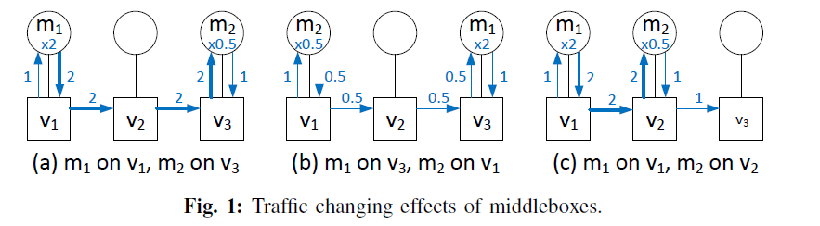
I. INTRODUCTION
If there is a constraint for m1 to be applied before m2, then the placement scheme in Fig. 1(b) would violate the constraint.
Notes:
如果在 m2 之前應用 m1 的約束，那麼圖 1(b) 中的佈局方案將違反約束。

Slide 9
I. INTRODUCTION
In this paper, we study the optimal placement of NFV middleboxes.
Compared with the existing works in Section II, this paper proposes comprehensive solutions that consider different traffic changing effects of middleboxes as well as different types of middlebox dependency relations.
An SDN based prototype is implemented to validate our design.
Our design philosophy is to prevent different elephant flows from sharing the same middlebox to avoid resource contention and congestion, but instead let mice flows utilize the spare processing capacity of already deployed middleboxes.
Notes:
在本文中，我們研究了 NFV middlebox的最佳放置。
與第二節的現有工作相比，本文提出了綜合解決方案，考慮了middlebox的不同流量變化影響以及不同類型的middlebox依賴關係。
實現了基於 SDN 的原型來驗證我們的設計。
我們的設計理念是防止不同的大流量共享同一個middlebox以避免資源爭用和擁塞，而是讓小流量利用已部署的middlebox的空閑處理能力。

Slide 10
I. INTRODUCTION
Elephant flows can be statically determined based on the application types, such as data backup or VM migration, or dynamically detected using existing techniques in the literature [9], [23].
Our main contributions in this paper are summarized as follows.
[9] A. Curtis et al., “Mahout: Low-overhead datacenter traffic management using end-host-based elephant detection,” in IEEE INFOCOM, 2011.
[23] T. Mori et al., “Identifying elephant flows through periodically sampled packets,” in ACM IMC, 2004.
Notes:
大流量可以根據應用程序類型靜態確定，例如數據備份或 VM 遷移，或者使用文獻 [9]、[23] 中的現有技術動態檢測。
我們在本文中的主要貢獻總結如下。

Slide 11
I. INTRODUCTION
We formulate the Traffic Aware Placement of Interdependent Middleboxes (TAPIM) problem, considering in particular a generalized partial order for the middlebox dependency relation, as a graph optimization problem with the objective to load-balance the network.
For topologies with predetermined paths, such as the tree, we design optimal algorithms for the special case when the middlebox set is a non-ordered or totally-ordered one. For the general case when the dependency relation is a partial order, we show that the TAPIM problem is NP-hard by reduction from the Clique problem, and propose an efficient heuristic to convert a partially-ordered set to a totally-ordered one.
Notes:
我們制定了流量感知放置的相互依賴的middlebox (TAPIM) 問題，特別是考慮到middlebox依賴關係的部分順序 ，作為以網絡負載平衡為目標的圖優化問題。
對於具有預定路徑的拓撲，例如樹，我們為middlebox集合是無序或完全有序的特殊情況設計最佳算法。 對於依賴關係是偏序的一般情況，我們通過從 Clique 問題歸約來證明 TAPIM 問題是 NP-hard 問題，並提出一種有效的啟發式方法將部分依賴集轉換為全依賴集。

Slide 12
I. INTRODUCTION
For topologies without predetermined paths, we prove that the TAPIM problem is NP-hard even for a nonordered middlebox set by reduction from the Hamiltonian Cycle problem. Our proposed solution then works in two steps: first finding a path with enough resources to host all the middleboxes, and then placing the middleboxes on the given path.
We have implemented the proposed algorithms in the NS-3 simulator and a SDN based prototype, and present extensive simulation and experiment results to demonstrate the effectiveness of our design.
Notes:
對於沒有預定路徑的拓撲，我們證明了 TAPIM 問題是 NP-hard 問題，即使對於通過從哈密頓循環問題歸約的無序middlebox集也是如此。 然後我們提出的解決方案分兩步工作：首先找到一個擁有足夠資源來承載所有middlebox的路徑，然後將middlebox放在給定的路徑上。
我們已經在 NS-3 模擬器和基於 SDN 的原型中實現了所提出的算法，並提供了大量的模擬和實驗結果來證明我們設計的有效性。

Slide 13
II. RELATED WORKS
Sekar et al. propose an NFV architecture named CoMb [27] that explores consolidation opportunities to reduce network provisioning cost and load skew.
Anderson et al. propose the xOMB [14] architecture for building scalable and extensible middleboxes.
Hwang et al. propose the NetVM [15] network virtualization platform, to dynamically scale, deploy, and reprogram network functions.
[14] J. Anderson et al., “xOMB: extensible open middleboxes with commodity servers,” in ACM/IEEE ANCS, 2012.
[15] J. Hwang et al., “NetVM: high performance and flexible networking using virtualization on commodity platforms,” IEEE Transactions on Network and Service Management, vol. 12, no. 1, pp. 34–47, 2015.
[27] V. Sekar et al., “Design and implementation of a consolidated middlebox architecture,” in USENIX NSDI, 2012.
Notes:
II. RELATED WORKS
塞卡爾[27]等人。 提出了一種名為 CoMb [27] 的 NFV 架構，該架構探索整合機會以降低網絡配置成本和負載偏斜。 (應該是讓各個flow的成本與負載相同，load balance 的概念)
安德森[14]等人。 提出 xOMB [14] 架構來構建可擴展和可延伸的middlebox。
黃等人[15]。 提出 NetVM [15] 網絡虛擬化平台，以動態擴展、部署和重新編程網絡功能。

Slide 14
II. RELATED WORKS
ClickOS [16] is a high-performance and virtualized software middlebox platform, which enables hundreds of concurrent virtual network functions without significant overhead in packet processing.
It has been recognized as a challenge to implement a chain of network functions under certain dependency constraints.
Moens and Turck present an Integer Linear Program (ILP) model named VNF-P [22] for resource allocation of NFV service chains, and evaluate it with a case study simulation.
[16] J. Martins et al., “ClickOS and the art of network function virtualization,” in USENIX NSDI, 2014.
[22] H. Moens and F. De Turck, “VNF-P: A model for efficient placement of virtualized network functions,” in IEEE CNSM, 2014.
Notes:
ClickOS [16] 是一個高性能和虛擬化的middlebox軟體平台，它支持數百個並發的虛擬網絡功能，而沒有顯著的數據包處理開銷。
在某些依賴性約束下實現網絡功能鏈已被認為是一項挑戰。
Moens 和 Turck[22] 提出了一個名為 VNF-P [22] 的整數線性規劃 (ILP) 模型，用於 NFV 服務鏈的資源分配，並通過案例研究模擬對其進行評估。

Slide 15
II. RELATED WORKS
Mehraghdam et al. define a model for formalizing the chaining of network functions using a context-free language [26], and allocate network resources by solving a Mixed Integer Quadratically Constrained Program (MIQCP).
Rami et al. formulate the NFV location problem [24], and propose near optimal approximation algorithms for NFV resource allocation without considering network function dependency.
Li et al. propose the NFV-RT [19] resource provisioning system that uses a linear programming approach to maximize the number of requests for each service chain, and validate the design by simulation and emulation.
[19] Y. Li, L. Phan, and B. T. Loo, “Network functions virtualization with soft real-time guarantees,” in IEEE INFOCOM, 2016.
[24] R. Cohen et al., “Near optimal placement of virtual network functions,” in IEEE INFOCOM, 2015.
[26] S. Mehraghdam et al., “Specifying and placing chains of virtual network functions,” in IEEE Cloud Networking, 2014.
Notes:
梅拉格達姆等人[26]。 使用上下文無關語言(context-free language) [26] 定義用於形式化網絡功能鏈的模型，並通過求解混合整數二次約束程序 (MIQCP) 來分配網絡資源。
拉米等人[24]。 制定 NFV 位置問題 [24]，並在不考慮網絡功能依賴性的情況下為 NFV 資源分配提出近乎最優的近似算法。
李等人[19] 。 提出了 NFV-RT [19] 資源供應系統，該系統使用線性規劃方法來最大化每個服務鏈的請求數量，並通過仿真和仿真驗證設計。

Slide 16
II. RELATED WORKS
The formal model defined in this work differs from the above ones in considering different middlebox traffic changing effects and dependency relations.
Due to its capability of global optimization, SDN is commonly adopted as the control protocol to maneuver traffic in an NFV network.
For example, SIMPLE [28] is an SDN-based policy enforcement layer for efficient middlebox-specific traffic steering.
[28] Z. Qazi et al., “SIMPLE-fying middlebox policy enforcement using SDN,” in ACM SIGCOMM Computer Communication Review, vol. 43, no. 4. ACM, 2013, pp. 27–38.
Notes:
本工作中定義的形式模型與上述模型的不同之處在於考慮了不同的middlebox流量變化影響和依賴關係。
由於其全局優化能力，SDN 通常被用作控制協議來操縱 NFV 網絡中的流量。
例如，SIMPLE [28] 是一個基於 SDN 的策略執行層，用於高效的特定於middlebox的流量控制。

Slide 17
II. RELATED WORKS
To correctly reason and enforce networkwide policies, Fayazbakhsh et al. propose an extended SDN architecture called FlowTags [25], in which middleboxes add packet tags to provide the necessary context for systematic policy enforcement.
To the best of our knowledge, no existing research has focused on the traffic changing effects of middleboxes, except our preliminary work [20], which did not consider dependency relations between middleboxes.
[20] W. Ma et al., “Traffic-aware placement of NFV middleboxes,” in IEEE GLOBECOM, 2015.
[25] S. Fayazbakhsh et al., “Enforcing network-wide policies in the presence of dynamic middlebox actions using flowtags,” in USENIX NSDI, 2014.
Notes:
為了正確推理和執行廣泛的網路策略，Fayazbakhsh[25] 等人。 提出了一種稱為 FlowTags [25] 的擴展 SDN 架構，其中middlebox添加數據包標籤以為系統策略執行提供必要的上下文。
據我們所知，現有的研究都沒有關注middlebox的流量變化影響，除了我們的初步工作 [20]但沒有考慮到middlebox之間的依賴關係。

Slide 18
II. RELATED WORKS
Compared with the extensively studied problem on general VM placement [18], this work addresses not only the VM placement but also flow routing issue, and targets network load balancing instead of resource utilization.
[18] H. Jin et al., “Efficient VM placement with multiple deterministic and stochastic resources in data centers,” in IEEE GLOBECOM, 2012.
Notes:
與廣泛研究的一般 VM 放置問題 [18] 相比，這項工作不僅解決了 VM 放置問題，還解決了流路由問題，並且針對網絡負載平衡而不是資源利用率。

Slide 19
III. PROBLEM STATEMENT
In this section, we formulate the Traffic Aware Placement of Interdependent Middleboxes (TAPIM) problem.
Consider a network represented by a directed graph G = (V, E).
Each node v ∈ V may have one or more attached NFV servers, and its space capacity is denoted as sc[u]≧ 0, i.e., the maximum number of middleboxes to host.
A link (u, v) ∈ E has a bandwidth capacity bc[u, v] ≧ 0, i.e., the amount of available bandwidth.
For easy representation, we define connectivity by connect[u, v] = 1 if bc[u, v] > 0.
Notes:
III. PROBLEM STATEMENT 問題陳述
在本節中，我們制定了相互依賴的Middleboxes流量感知放置 (TAPIM) 問題。
考慮由有向圖 G = (V, E) 表示的網絡。
每個節點 v ∈ V 可能有一個或多個附加的 NFV 服務器，其空間容量表示為 sc[u]≧ 0，即託管的middlebox的最大數量。
link(u, v) ∈ E 具有頻寬容量 bc[u, v] ≧ 0，即可用頻寬量。
為了便於表示，如果 bc[u, v] > 0，我們通過 connect[u, v] = 1 定義連通性。

Slide 20
III. PROBLEM STATEMENT
The existing load of the link is denoted as load[u, v].
For route calculation, each link is assigned a (u, v) ∈ E is assigned a weight, denoted as weight(u, v, l), which is a non-decreasing function of the link load l, i.e., ∀ l ≤ l’, weight(u, v, l) ≤ weight(u, v, l’).
The non decreasing link weight function helps load-balance network traffic when the routing protocol aims to minimizes the path cost, which is defined as the weight sum of all the path links.
An elephant flow f is defined as a 4-tuple (src, dst, t, M), in which src ∈ V is the source node, dst ∈ V is the destination node, t is the initial traffic rate when f arrives at the ingress switch of the network, and M is the set of required middleboxes.
Notes:
Link的現有負載表示為 load[u, v]。
對於路由計算，每條link分配一個(u, v) ∈ E 分配一個權重，記為weight(u, v, l)，它是鏈路負載 l 的非遞減函數，即∀ l ≤ l', weight(u, v, l) ≤ weight(u, v, l’)。
當路由協議旨在最小化路徑成本時，非遞減鏈路權重函數有助於負載平衡網絡流量，路徑成本定義為所有路徑鏈路的權重總和。
大象流 f 被定義為一個四元組 (src, dst, t, M)，其中 src ∈ V 是源節點，dst ∈ V 是目的節點，t 是 f 到達時的初始流量速率 網絡的入口交換機，M 是所需的middlebox的集合。

Slide 21
III. PROBLEM STATEMENT
Each middlebox m ∈ M has an associated traffic changing factor ratio[m] ≥ 0, which is the ratio of the traffic rate of a flow after and before being processed by m.
The dependency relation ← is defined as a strict partial order on M that is
Notes:
每個middlebox m ∈ M 都有一個關聯的流量變化因子 ratio[m] ≥ 0，這是一個流在被 m 處理前後的流量率之比。
依賴關係 ← 被定義為 M 上的嚴格順序，即

Slide 22
III. PROBLEM STATEMENT
Irreflexive: m ←! m,
Transitive: m ← m’ and m’ ← m’’ then m ← m’’, and
Asymmetric: m ← m’ then m’ ←! m.
If m ← m’, we say that the middlebox m’ depends on m, or intuitively m’ should be applied after m.
For easy representation, define depend[m, m’] = 1 if m ← m’, and 0 otherwise.
Notes:
反身：m ←！ M，
傳遞性：m ← m’ 和 m' ← m‘’ 推導成 m ← m‘’
不對稱：m ← m' 然後 m' ←！ m。
如果 m ← m'，我們說middlebox m' 依賴於 m，或者直觀地 m' 應該應用在 m 之後。
為了便於表示，如果 m ← m‘ 定義 depend [m, m'] = 1，否則定義 0。

Slide 23

III. PROBLEM STATEMENT
When the flow f enters the network, a multi-hop path, denoted as route, will be assigned for the flow, which is a decision variable defined as
We define i to start from one, and denote the last hop number as n for convenience.
Note that repeating nodes are allowed on the path to enable more general solutions, i.e., ∃v, i ≠ i’ : route(v, i) = 1 and route(v, i’) = 1.
To avoid performance degradation for TCP flows, a flow is not allowed to be split
among two paths [11].
Notes:
當流 f 進入網絡時，將為該流分配一條多跳路徑(multi-hop path)，記為route()，它是一個決策變量，定義為下方公式
們定義 i 從 1 開始，為方便起見，將最後一跳數表示為 n。
請注意，路徑上允許重複節點以啟用更通用的解決方案，即 ∃v, i ≠ i‘ : route(v, i) = 1 and route(v, i’) = 1。 (path在跑的時候可能走過重複的node v)
為避免 TCP 流的性能下降，不允許拆分流兩條路徑之間[11]。 (flow 不能拆解)

Slide 24
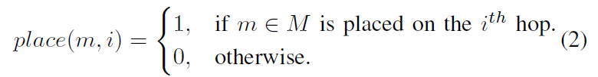
III. PROBLEM STATEMENT
In addition, a placement scheme, denoted as place, will determine the location for each middlebox m ∈ M, which is a decision variable defined as
Notes:
此外，表示為 place 的放置方案將確定每個middlebox m ∈ M 的位置，這是一個定義為的決策變量

Slide 25
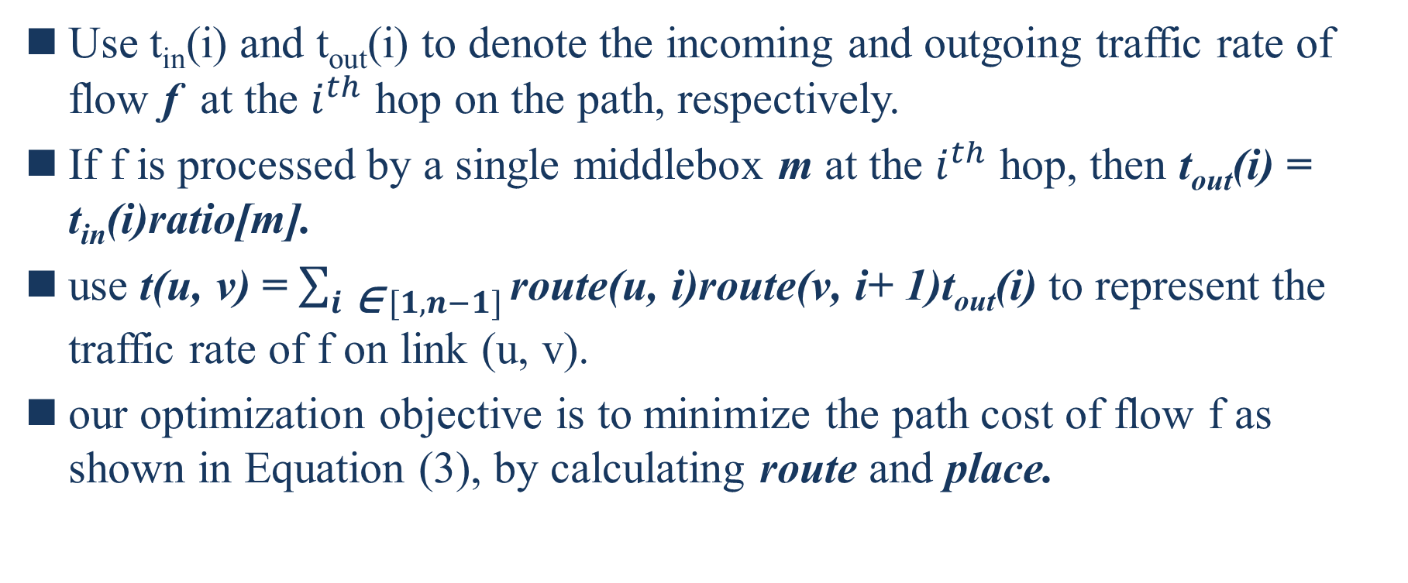
III. PROBLEM STATEMENT
Use t_{in}(i) and t_{out}(i) to denote the incoming and outgoing traffic rate of flow f at the $i^{th}$ hop on the path, respectively.
If f is processed by a single middlebox m at the $i^{th}$ hop, then t_{out}(i) = t_{in}(i)ratio[m].
use t(u, v) = $\sum_{i \text{∈} [1, n−1]}{\text{route}\text{(}\text{u}\text{,} \text{i}\text{)}\text{route}\text{(}\text{v}\text{,} \text{i}\text{+}\text{ 1)}\text{tout}\text{(}\text{i}\text{)}}$ to represent the traffic rate of f on link (u, v).
our optimization objective is to minimize the path cost of flow f as shown in Equation (3), by calculating route and place.
Notes:
使用t_{in}(i) 和 t_{out}(i) 分別表示路徑上 𝑖^{𝑡ℎ} 跳處的流入和流出的流量 f。
如果 f 在 𝑖^{𝑡ℎ} 跳由單個middlebox m 處理，則 t_{out}(i) = t_{in}(i)ratio[m]。
用t(u, v) = $\sum_{i \text{∈} [1, n−1]}{\text{route}\text{(}\text{u}\text{,} \text{i}\text{)}\text{route}\text{(}\text{v}\text{,} \text{i}\text{+}\text{ 1)}\text{tout}\text{(}\text{i}\text{)}}$ 來表示f的流量在link (u, v) 上。
我們的優化目標是通過計算路徑和位置來最小化流 f 的路徑成本，如公式（3）所示。

Slide 26
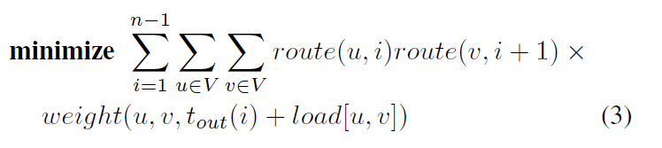
III. PROBLEM STATEMENT
It should be noted that the proposed solutions can easily adapt to other optimization objectives, such as minimizing the maximum link load in the network.
Notes:
應該注意的是，所提出的解決方案可以很容易地適應其他優化目標，例如最小化網絡中的最大鍊路負載。 (最小的weight)

Slide 27
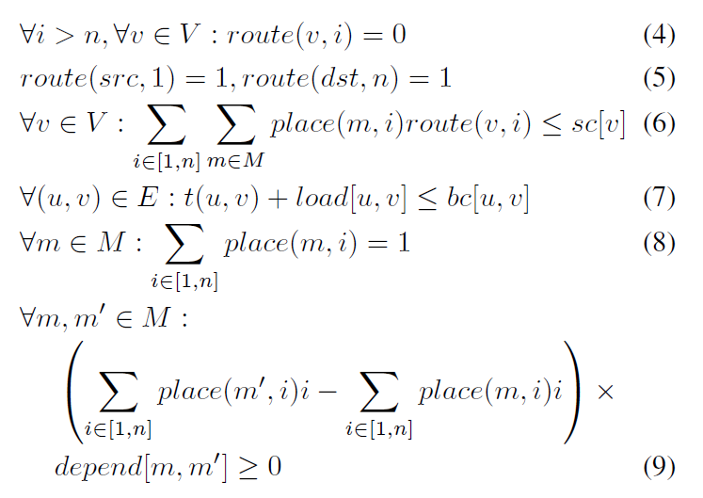
III. PROBLEM STATEMENT
Notes:
等式 (4) 表明第 n 跳是流路徑的最後一跳。
等式 (5) 強制流路徑的第一跳和最後一跳分別為源 src 和目標 dst。
等式（6）表明，對於節點 v，託管的middlebox$\sum_{i E [1, n]}{\sum_{m E M}{place\left(m, i\right)route(v, i)}}$ 的總空間需求不應超過其空間容量 sc[v]。
等式 (7) 表明，對於 link(u, v)，所有流經該鏈路的總負載為 t(u; v)+load[u; v] 不應超過其頻寬容量 bc[u; v]。 ( t 代表流量 f 的traffic rate，load是原先就有的)
等式 (8) 表明middlebox m 應該只會安裝在一個地方。
等式（9）加強了middlebox之間的依賴關係，或者換句話說，如果前者被後者依賴，則 m 必須不遲於 m’ 放置。

Slide 28
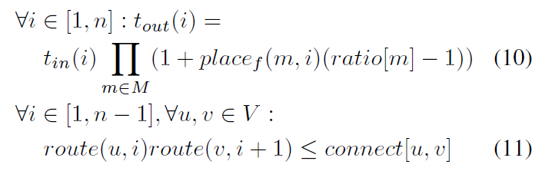
III. PROBLEM STATEMENT
Notes:
等式（10）表明，一跳的流出流量速率，即tout(I)，等於流入速率(tin(i))，乘以所有middlebox的流量變化率ratio[m] m 放置在這一跳，即 $\prod_{m\text{∈} M}{(1+placef(m, i)(ratio\left[m\right]−1))}$。它還確保流量守恆，從某種意義上說，除了middlebox的影響之外，不會在中間節點生成或終止任何流量流量。 (為何不用ratio[m]全部相乘是因為會把沒放置在節點m上的middlebox 的 ratio也計算進去)
等式 (11) 強制流路徑的連續跳躍必須在網絡中連接。

Slide 29
IV. MIDDLEBOX PLACEMENT WITH
PREDETERMINED PATHS
In this section, we propose solutions for the TAPIM problem when the flow path, i.e., route, is predetermined.
For example, in the tree topology, there is a unique path between any pair of leaves. We look at three cases of the problem.
First, for the special case when there is no dependency between any middleboxes, we propose the Non-Ordered Set Placement (NOSP) algorithm that uses the least-first-greatest-last rule.
Next, for the special case when there is a total dependency order on the middlebox set, we propose the dynamic programming based Totally-Ordered Set Placement (TOSP) algorithm.
Notes:
在本節中，我們提出了當流動路徑(route)，是預先確定的情況下，TAPIM問題的解決方案。
例如，在樹形拓撲結構中，任何一對葉子之間都有一條唯一的路徑。我們看一下該問題的三種情況。
首先，對於任何middlebox之間沒有依賴關係的特殊情況，我們提出了使用least-first-greatest-last(小的放前面，大的放尾巴)規則的無序集放置算法(NOSP)。
其次，對於middlebox集存在完全依賴關係的特殊情況，我們提出了基於動態規劃的全序集合放置算法。(TOSP)

Slide 30
IV. MIDDLEBOX PLACEMENT WITH
PREDETERMINED PATHS
Finally, for the general scenario of a partial dependency order on the middlebox set, we prove that it is NP-hard by reduction from the Clique problem, and propose an efficient heuristic to convert a partially-ordered set to a totally-ordered set.
Notes:
最後，對於middlebox集上的部分依賴順序的場景，我們通過從 Clique problem的規依(reduction)證明它是 NP-hard 的，並提出了一種有效的啟發式方法將偏序集轉換為全序集。

Slide 31
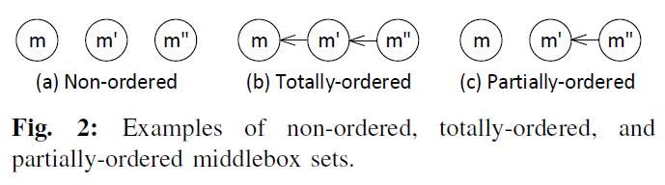
A. Non-Ordered Middlebox Set
We start with the special case that the middlebox set M is a non-ordered set, i.e., ∀m,m’ ∈ M, m ←! m’ and m’ ←! m.
Thus, different middleboxes can be placed in an arbitrary order. An example is shown in Fig. 2(a), where no dependency exists between middleboxes.
We propose the Non-Ordered Set Placement (NOSP) algorithm, and show its optimality.
Notes:
我們從middlebox集合 M 是一個無序集合的特殊情況開始，即 ∀m,m' ∈ M, m ←！ m’和m’←！ m。
因此，可以按任意順序放置不同的middlebox。
圖 2(a) 顯示了一個示例，其中middlebox之間不存在依賴關係。 我們提出了無序集合放置（NOSP）算法，並展示了它的最優性。

Slide 32
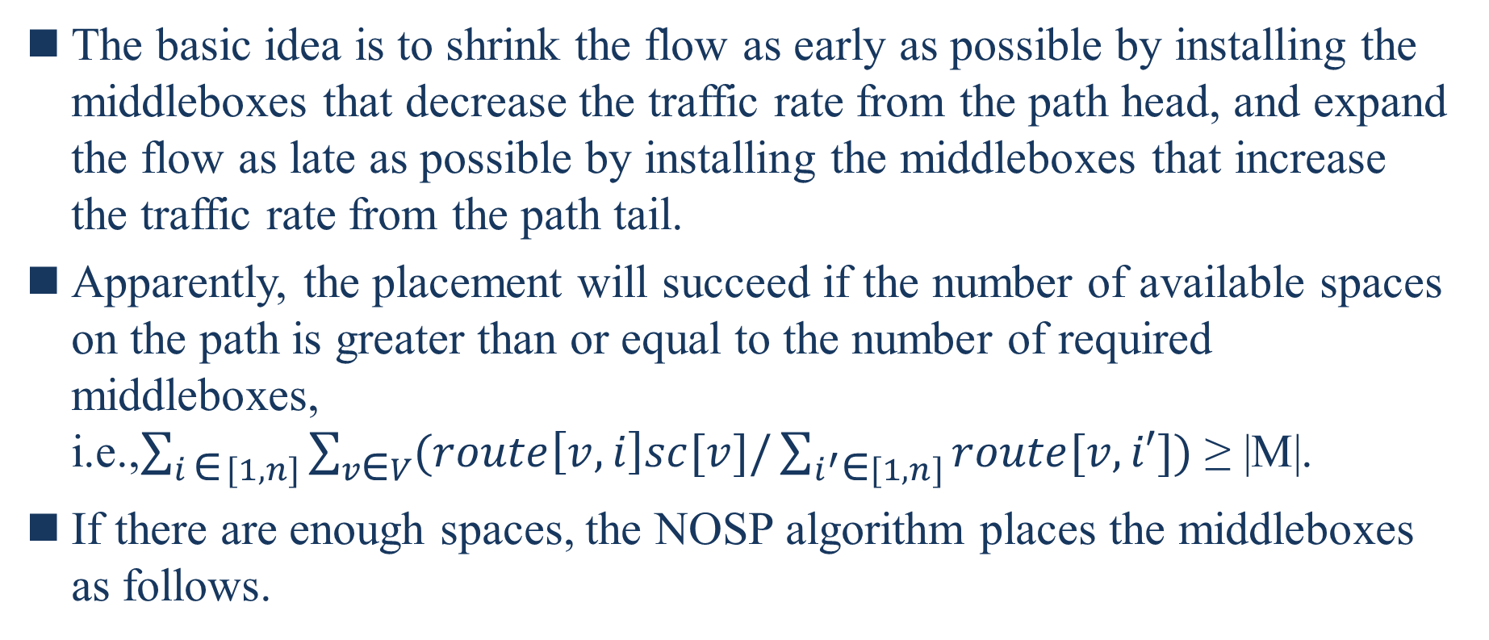
A. Non-Ordered Middlebox Set
The basic idea is to shrink the flow as early as possible by installing the middleboxes that decrease the traffic rate from the path head, and expand the flow as late as possible by installing the middleboxes that increase the traffic rate from the path tail.
Apparently, the placement will succeed if the number of available spaces on the path is greater than or equal to the number of required middleboxes, i.e.,$\sum_{i \text{∈} [1,n]}{\sum_{v\text{∈} V}{(route\left[v, i\right]sc[v]/\sum_{i^{′}\text{∈}[1, n]}{route[v, i′]})}}$ ≥ |M|.
If there are enough spaces, the NOSP algorithm places the middleboxes as follows.
Notes:
其基本思想是通過從路徑頭部安裝降低流量的middlebox來儘早收縮流量，並通過從路徑尾部安裝增加流量的middlebox來盡可能晚地擴大流量。
顯然，如果路徑上可用空間的數量大於或等於所需的middlebox數量，即 i.e.,$\sum_{i \text{∈} [1,n]}{\sum_{v\text{∈} V}{(route\left[v, i\right]sc[v]/\sum_{i^{′}\text{∈}[1, n]}{route[v, i′]})}}$ ≥ |M|. (括弧內相除是因為可能一個node v上有多個hop，但如果直接route[v, i]sc[v] 會重複計算相同點v的空間)
如果有足夠的空間，NOSP 算法會按如下方式放置middlebox。

Slide 33
A. Non-Ordered Middlebox Set
Sort all the middleboxes m ∈ M based on their traffic changing ratios ratio[m].
Place the middleboxes m with ratio[m] < 1 from the path head in an increasing order of their traffic changing ratios. When a node has no more space, continue with the succeeding node on the path.
Place the middleboxes m with ratio[m] ≥ 1 from the path end in an decreasing order. When a node has no more space, continue with the proceeding node.
Notes:
根據流量變化率 ratio[m] 對所有middlebox m ∈ M 進行排序。
將middlebox m 與 ratio[m] < 1 從路徑頭按其流量變化率的遞增順序放置。
當一個節點沒有更多空間時，繼續處理路徑上的後續節點。 從路徑末端以降序放置 ratio[m] ≥ 1 的middlebox m。 當一個節點沒有更多空間時，繼續處理前一個節點。

Slide 34
A. Non-Ordered Middlebox Set
As can be seen, NOSP processes each middlebox in M only once after sorting, and therefore its time complexity is O( |M| log |M|) , i.e., the time complexity to sort M.
Theorem 1. The Non-Ordered Set Placement algorithm achieves the minimum path cost. The proof is omitted due to space limitations.
Notes:
可以看出，NOSP在排序後只對M中的每個middlebox進行一次處理，因此其時間複雜度為O( |M| log |M|) ，即對M進行排序的時間複雜度。
定理 1. 無序集合放置算法實現了最小路徑成本。 限於篇幅，證明省略。

Slide 35

B. Totally-Ordered Middlebox Set
Next, we solve the other special case of TAPIM when the middlebox set is a totally-ordered set, i.e., ∀m,m’ ∈ M, either m ← m’ or m’ ← m, or in other words the middleboxes form a dependency chain.
An example is shown in Fig. 2(b), in which m must be placed before m’, and m’ before m’’.
Although the placement order of the middleboxes has been determined, it is still necessary to determine the optimal placement location for each middlebox, because there may be an excessive number of available spaces on the flow path.
Notes:
接下來，我們解決 TAPIM 的另一個特殊情況，當middlebox集合是全序集時，即 ∀m,m' ∈ M，或者 m ← m' 或 m' ← m，或者換句話說middlebox形成一個 依賴鏈。
示例如圖 2(b) 所示，其中 m 必須放在 m' 之前，並且 m' 在 m'' 之前。
儘管middlebox的放置順序已經確定，但仍然需要確定每個middlebox的最佳放置位置，因為流路上可能存在過多的可用空間。

Slide 36
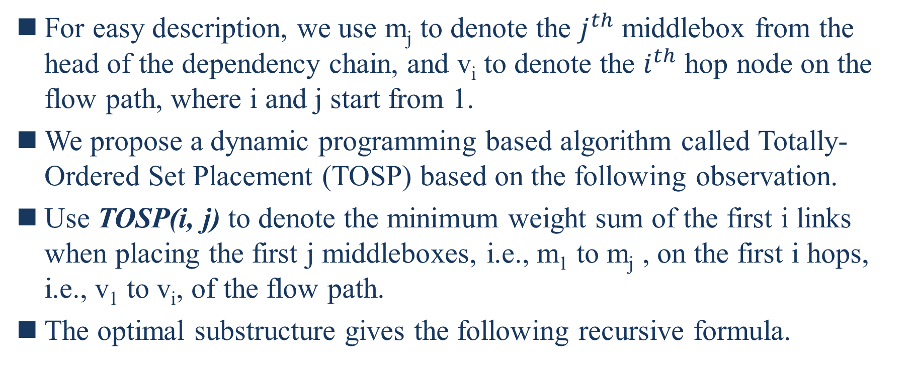
B. Totally-Ordered Middlebox Set
For easy description, we use m_{j} to denote the $j^{th}$ middlebox from the head of the dependency chain, and v_{i} to denote the $i^{th}$ hop node on the flow path, where i and j start from 1.
We propose a dynamic programming based algorithm called Totally-Ordered Set Placement (TOSP) based on the following observation.
Use TOSP(i, j) to denote the minimum weight sum of the first i links when placing the first j middleboxes, i.e., m₁ to m_{j} , on the first i hops, i.e., v₁ to v_{i}, of the flow path.
The optimal substructure gives the following recursive formula.
Notes:
為了便於描述，我們用m_{j}表示依賴鏈頭部的𝑗^{𝑡ℎ}middlebox，v_{i}表示流路徑上的𝑖^{𝑡ℎ}跳節點，其中i和j從1開始。
基於以下觀察，我們提出了一種基於動態規劃的算法，稱為全序集合放置 (TOSP)。
使用 TOSP(i, j) 表示將前 j 個middlebox（即 m₁ 到 m_{j} ）放置在流路徑的前 i 跳（即 v₁ 到 v_{i}）上時前 i 個鏈接的最小權重和。
最優子結構給出以下遞歸公式。

Slide 37
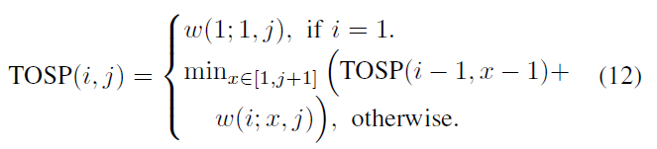
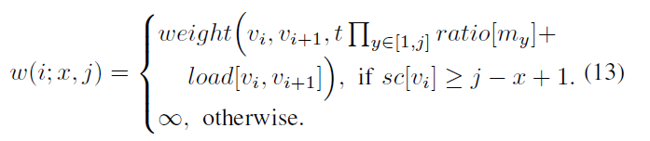
B. Totally-Ordered Middlebox Set
where w(i, x, j) is the weight of link (v_{i}, v_{i+1}) when placing middleboxes m_{x} to m_{j} on node v_{i}, i.e.,
Notes:
其中 w(i, x, j) 是在節點 v_{i} 上放置middlebox m_{x} 到 m_{j} 時鏈接 (v_{i}, _{vi+1}) 的權重，即，
Weight (v_{i}, v_{i+1}, -----) ---- : 算出對link(vi, vi+1) 的負載(權重) 盡量小，把v_{i}前面的load 都相加起來算出weight

Slide 38
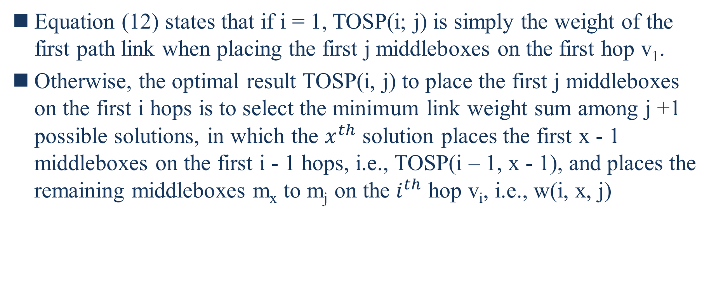
B. Totally-Ordered Middlebox Set
Equation (12) states that if i = 1, TOSP(i; j) is simply the weight of the first path link when placing the first j middleboxes on the first hop v₁.
Otherwise, the optimal result TOSP(i, j) to place the first j middleboxes on the first i hops is to select the minimum link weight sum among j +1 possible solutions, in which the $x^{th}$ solution places the first x - 1 middleboxes on the first i - 1 hops, i.e., TOSP(i – 1, x - 1), and places the remaining middleboxes m_{x} to m_{j} on the $i^{th}$ hop v_{i}, i.e., w(i, x, j)
Notes:
等式（12）表明，如果 i = 1，則 TOSP(i; j) 只是將前 j 個middlebox放置在第一跳 v1 上時第一個路徑鏈路的權重。
否則，在前 i 跳上放置前 j 個middlebox的最佳結果 TOSP(i, j) 是在 j +1 個可能的解決方案中選擇最小的鏈路權重和，其中𝑥^{𝑡ℎ} 解決方案將第一個 x - 1 在前 i - 1 跳上放置middlebox，即 TOSP(i - 1, x - 1)，並將剩餘的middlebox m_{x} 到 m_{j} 放在𝑖^{𝑡ℎ} hop v_{i} +上，即 w(i, x, j)

Slide 39
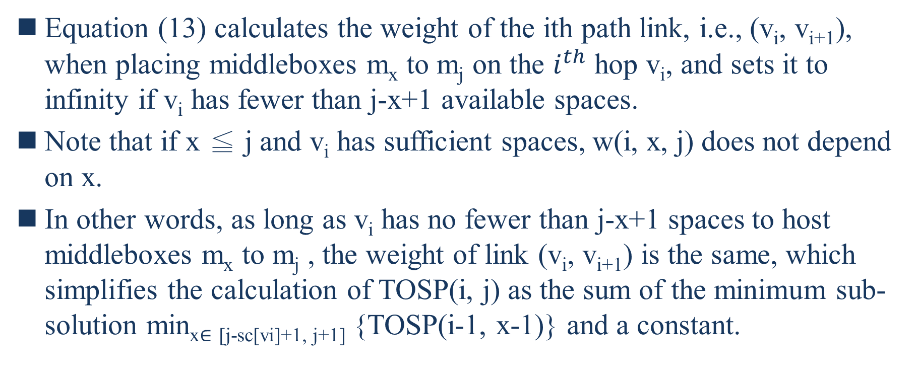
B. Totally-Ordered Middlebox Set
Equation (13) calculates the weight of the ith path link, i.e., (v_{i}, v_{i+1}), when placing middleboxes m_{x} to m_{j} on the $i^{th}$ hop v_{i}, and sets it to infinity if v_{i} has fewer than j-x+1 available spaces.
Note that if x ≦ j and v_{i} has sufficient spaces, w(i, x, j) does not depend on x.
In other words, as long as v_{i} has no fewer than j-x+1 spaces to host middleboxes m_{x} to m_{j} , the weight of link (v_{i}, v_{i+1}) is the same, which simplifies the calculation of TOSP(i, j) as the sum of the minimum sub-solution min_{x∈ [j-sc[vi]+1, j+1]} {TOSP(i-1, x-1)} and a constant.
Notes:
等式(13)計算第i個路徑鏈路的權重，即(v_{i},v_{i+1})，當在𝑖^{𝑡ℎ}跳v_{i}上放置m_{x}到m_{j}的middlebox時，如果v_{i}的可用空間少於j-x+1，則將其設置為無窮大。
請注意，如果 x ≦ j 且 v_{i} 有足夠的空間，則 w(i, x, j) 不依賴於 x。
換句話說，只要 v_{i} 有不少於 j-x+1 個空間來託管middlebox m_{x} 到 m_{j} ，則鏈接 (v_{i}, v_{i+1}) 的權重是相同的，這簡化了 TOSP(i, j ) 作為最小子解 min_{x∈ [j-sc[vi]+1, j+1]} {TOSP(i-1, x-1)} 和一個常數的和。

Slide 40
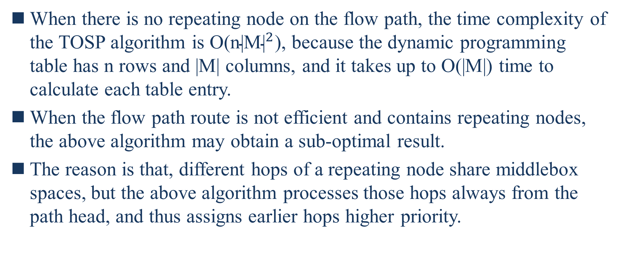
B. Totally-Ordered Middlebox Set
When there is no repeating node on the flow path, the time complexity of the TOSP algorithm is O(${\text{n}\text{|}\text{M}\text{|}}^{2}$), because the dynamic programming table has n rows and |M| columns, and it takes up to O(|M|) time to calculate each table entry.
When the flow path route is not efficient and contains repeating nodes, the above algorithm may obtain a sub-optimal result.
The reason is that, different hops of a repeating node share middlebox spaces, but the above algorithm processes those hops always from the path head, and thus assigns earlier hops higher priority.
Notes:
當流動路徑上沒有重複節點時，TOSP算法的時間複雜度為O(n|M|²)，因為動態規劃表有n行和 |M| 列，計算每個表條目最多需要 O(|M|) 時間。
當流路路徑效率不高且包含重複節點時，上述算法可能會得到次優結果。
原因是，重複節點的不同跳共享middlebox空間，但上述算法總是從路徑頭開始處理這些跳，從而為較早的跳分配更高的優先級。

Slide 41
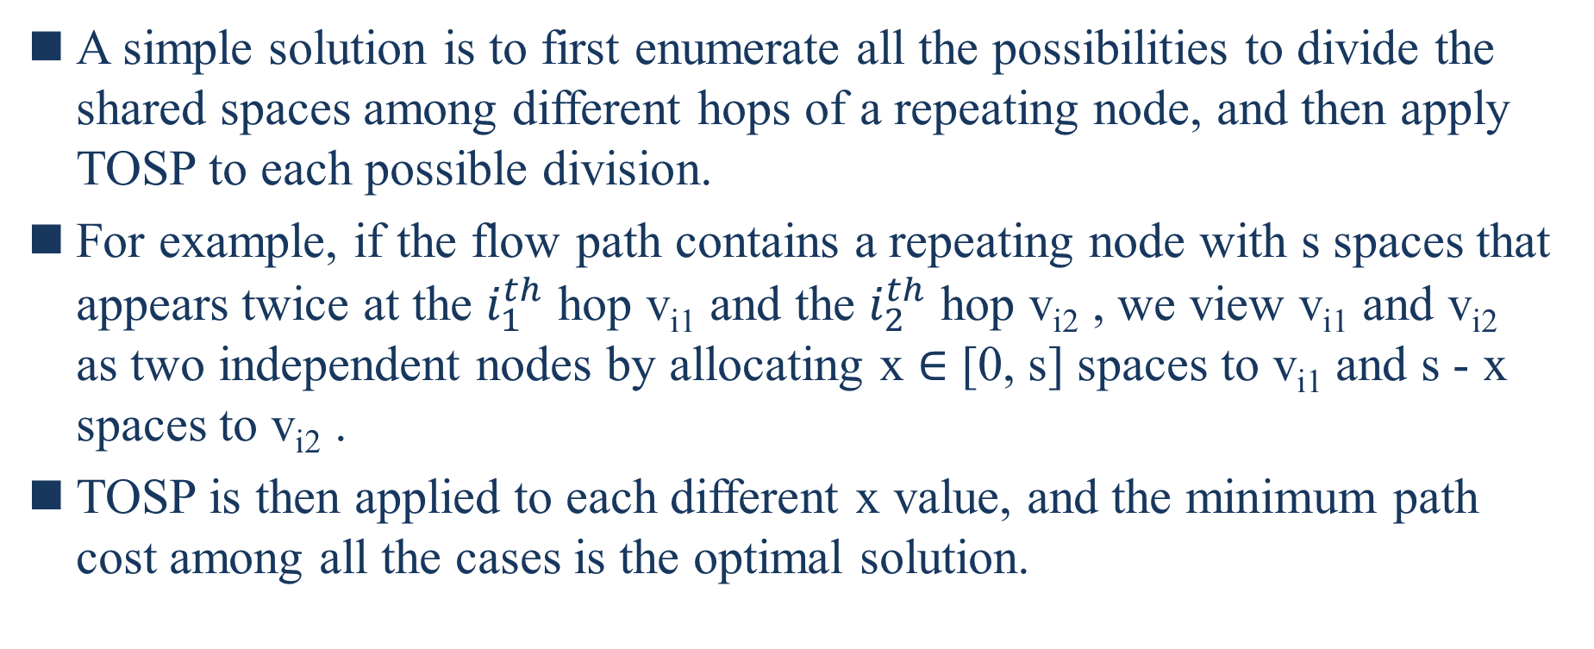
B. Totally-Ordered Middlebox Set
A simple solution is to first enumerate all the possibilities to divide the shared spaces among different hops of a repeating node, and then apply TOSP to each possible division.
For example, if the flow path contains a repeating node with s spaces that appears twice at the $i_{1}^{th}$ hop v_{i1} and the $i_{2}^{th}$ hop v_{i2} , we view v_{i1} and v_{i2} as two independent nodes by allocating x ∈ [0, s] spaces to v_{i1} and s - x spaces to v_{i2} .
TOSP is then applied to each different x value, and the minimum path cost among all the cases is the optimal solution.
Notes:
一個簡單的解決方案是首先列舉在重複節點的不同跳之間劃分共享空間的所有可能性，然後將TOSP應用於每個可能的劃分。
例如，如果流路徑包含一個具有 s 個空格的重複節點，該節點在 𝑖₁^{𝑡ℎ} 跳 v_{i1} 和 𝑖₂^{𝑡ℎ} 跳 v_{i2} 處出現兩次，我們通過分配 x ∈ [0, s] 將 x 的空間分配給 v_{i1} ，v_{i2}則獲得s-x個空間。(有點像是把V_{i1}、V_{i2}當成兩個不在同個節點上的hop空間拆為 x 、 s-x)
然後將 TOSP 應用於每個不同的 x 值，所有情況中的最小路徑成本是最優解。

Slide 42
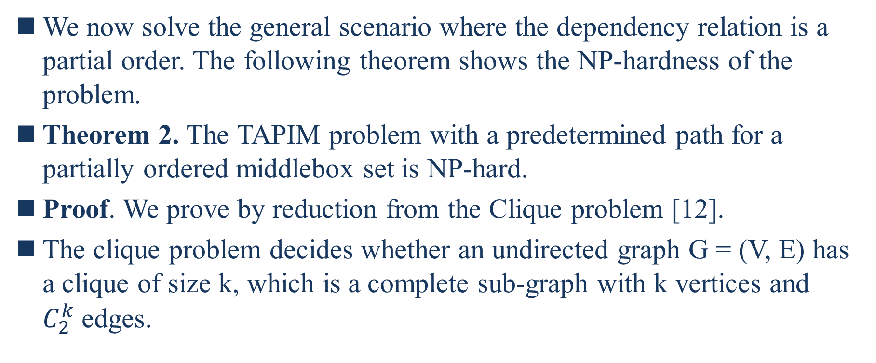
C. Partially-Ordered Middlebox Set
We now solve the general scenario where the dependency relation is a partial order. The following theorem shows the NP-hardness of the problem.
Theorem 2. The TAPIM problem with a predetermined path for a partially ordered middlebox set is NP-hard.
Proof. We prove by reduction from the Clique problem [12].
The clique problem decides whether an undirected graph G = (V, E) has a clique of size k, which is a complete sub-graph with k vertices and $C_{2}^{k}$edges.
Notes:
我們現在解決依賴關係是偏序的一般情況。 以下定理顯示了問題的 NP hard難度。
定理 2. 對於部分有序的middlebox集合，具有預定路徑的 TAPIM 問題是 NP-hard 問題。
證明。 我們通過從 Clique 問題 [12] 的簡化來證明。
團問題決定了一個無向圖 G = (V, E) 是否有一個大小為 k 的團，這是一個具有 k 個頂點和 𝐶^{k}₂ 邊的完整子圖。

Slide 43
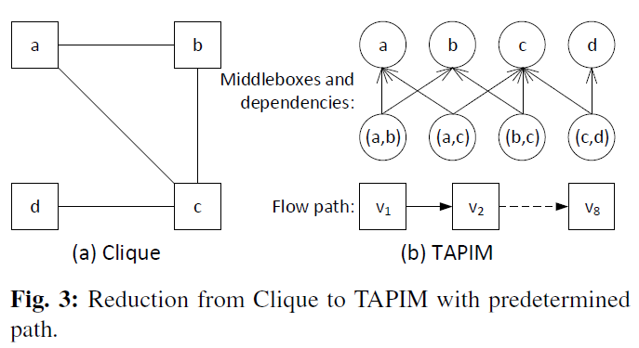
C. Partially-Ordered Middlebox Set
For example, the graph in Fig. 3(a) has a clique of size 3: ({a, b, c}, {(a, b), (b, c), (b, c)}).

Slide 44
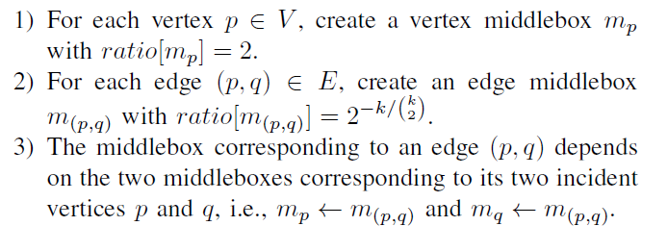
C. Partially-Ordered Middlebox Set
Notes:
對於每個頂點 p ∈ V ，創建一個頂點middlebox m_{p} ，ratio[m_{p}] = 2。
對於每個邊 (e, q) ∈ E ，創建一個邊middlebox m_{(p, q)}，ratio[m_{(p, q)}] = 2 $−k/\left({k \atop 2}\right)$。
一條邊(p, q)對應的middlebox依賴於它的兩個入射頂點p和q對應的兩個middlebox，

Slide 45
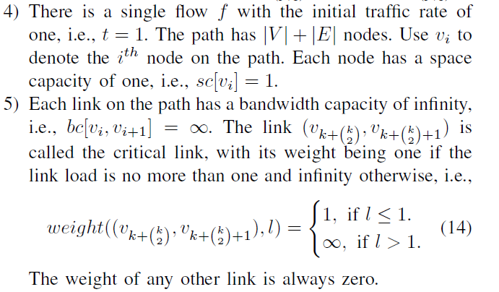
C. Partially-Ordered Middlebox Set
Notes:
有一個初始流量速率為 1 的流 f，即 t = 1。路徑有 |V|+|E| 節點。 使用 v_{i} 表示路徑上的第 i 個節點。 每個節點的空間容量為 1，即 sc[vi] = 1。
路徑上的每條鏈路都有無窮大的頻寬容量， 即，bc[vi; vi+1] = ∞。Link(-----) 稱為關鍵鏈路，如果鏈路負載不超過 1，則其權重為 1，否則為無窮大，即，

Slide 46

C. Partially-Ordered Middlebox Set

Slide 47
C. Partially-Ordered Middlebox Set
Next, it can be shown that if the graph G = (V, E) has a clique of size k, then the constructed TAPIM instance has a minimum path weight of one, and vice versa.
The proof detail is omitted due to space limitations.
After proving the NP-hardness, our solution to place a partially-ordered middelbox set is to first convert it to a totally-ordered middlebox set and then apply TOSP.
Following the least-first-greatest-last rule in NOSP, the objective of the conversion algorithm is to arrange the middleboxes in the resulting total order chain in the increasing order of their traffic changing ratios.
Notes:
接下來，可以證明如果圖 G = (V, E) 有一個大小為 k 的團，那麼構造的 TAPIM 實例的最小路徑權重為 1，反之亦然。
限於篇幅，證明細節略去。
在證明了 NP-hardness 之後，我們放置偏序 middelbox 集的解決方案是首先將其轉換為全序 middlebox 集，然後應用 TOSP。
遵循 NOSP 中”最小先最大最後”的規則，轉換算法的目標是按照流量變化率的遞增順序排列生成的總訂單鏈中的middlebox。

Slide 48
C. Partially-Ordered Middlebox Set
The intuitive solution is thus to iteratively find the middleboxes without dependence, remove among them the one with the least traffic changing ratio, and add it to the end of the total order chain.
For example, given four middleboxes with the following traffic changing ratios and dependencies: 1.4 ← 1.5 and 1.6 ← 0.1, the conversion result will be the following total order chain: 1.4 ← 1.5 ← 1.6 ← 0.1.
To increase the solution search space, we also add lookahead information by searching further beyond just the middleboxes without dependence.
Define a self-dependent middlebox tree of size k to be a tree of k middleboxes that are rooted from a single middlebox and depend on only the middleboxes in the tree.
Notes:
因此，直觀的解決方案是迭代地找到沒有依賴關係的middlebox，從中刪除流量變化率最小的一個，並將其添加到總訂單鏈的末尾。
例如，給定具有以下流量變化率和依賴關係的四個middlebox：1.4 ← 1.5 和 1.6 ← 0.1，轉換結果將是以下總訂單鏈：1.4 ← 1.5 ← 1.6 ← 0.1。
為了增加解決方案的搜索空間，我們還通過在不依賴的middlebox之外進一步搜索來添加前瞻信息。
定義一個大小為 k 的自依賴 middlebox 樹裡面有 k 個 middlebox ，這些 middlebox 以單個 middlebox 為根，並且僅依賴於樹中的 middlebox。

Slide 49
C. Partially-Ordered Middlebox Set
In each iteration, the algorithm first finds all the middleboxes with no dependence.
Using each of such middleboxes as the root, the algorithm calculates the selfdepedent tree of size up to k that has the minimum traffic changing ratio.
Among all the calculated trees with different root middleboxes, the algorithm selects the one with the minimum traffic changing ratio, removes its root middlebox, and adds the middlebox to the total order chain.
Notes:
方法如下 :
在每次迭代中，算法首先找到所有沒有依賴關係的middlebox。
使用每個這樣的middlebox作為根，該算法計算具有最小流量變化率的大小為 k 的自依賴樹。
在計算出的所有具有不同根middlebox的樹中，算法選擇流量變化率最小的那棵，去除其根middlebox，並將middlebox加入到總訂單鏈中。

Slide 50
C. Partially-Ordered Middlebox Set
For the above example, the first iteration generates two trees of size up to 2: 1.4 of size 1 with 1.4 being the root, and 1.6 ← 0.1 of size 2 with 1.6 being the root.
Since the traffic changing ratio of the latter 0.16 is less than that of the former 1.4, the root of the latter will be removed.
The resulting total order chain after the algorithm converges is thus: 1.6 ← 0.1 ← 1.4 ← 1.5.
When the lookahead parameter k = 1 or 2, the time complexity of the conversion algorithm is O(|M|log|M|)), because there are up to |M| iterations, and the time complexity to select the middelebox with the minimum traffic changing ratio is O(log |M|) using a heap.
Notes:
對於上面的示例，第一次迭代生成兩個大小最大為 2 的樹：大小為 1 的 1.4 以 1.4 為根，1.6 ← 0.1 大小為 2，以 1.6 為根。(1.4的大小為一是因為他會迭代看k=1跟k=2的情況怎樣會是ratio(tree)最小的情況，k=1就是只考慮1.4 ; k=2就是考慮1.4←1.5，k=2會造成整體樹比k=1還要大，所以1.4的大小就只會是1，對1.5來說他就是最後在考慮的東西)
算法收斂後得到的全序鍊是這樣的：1.6 ← 0.1 ← 1.4 ← 1.5。
由於後者0.16的流量變化比小於前者的1.4，所以將去除後者的根。
當lookahead參數k=1或2時，轉換算法的時間複雜度為O(|M|log|M|))，因為最多有|M| 迭代，並且使用heap選擇具有最小流量變化率的 middelebox 的時間複雜度為 O(log |M|)。

Slide 51
V. MIDDLEBOX PLACEMENT WITHOUT
PREDETERMINED PATH
In this section, we solve the TAPIM problem when the flow path, i.e., route, is not predetermined.
We then propose a two-step solution by first finding a flow path with sufficient spaces and then applying the algorithms in Section IV to place middleboxes on the given path.
Notes:
在本節中，我們解決了未預先確定流動路徑（即路線）時的 TAPIM 問題。
然後，我們提出了一個兩步解決方案，首先找到具有足夠空間的流動路徑，然後應用第 IV 節中的算法將middlebox放置在給定的路徑上。

Slide 52
A. NP-Hardness
Theorem 3. Without a predetermined flow path, the TAPIM problem is NP-hard even for a non-ordered middlebox set.
Proof. The proof is by reduction from the Hamiltonian Cycle problem, which determines for a directed graph G = (V;E) whether there exists a simple cycle that contains each vertex in V .
For a Hamiltonian Cycle instance with a graph G = (V, E), a TAPIM instance with a graph G’ = (V’, E’) can be constructed in polynomial time as follows:
Notes:
定理 3. 如果沒有預先確定的流路，即使對於無序的middlebox集，TAPIM 問題也是 NP-hard 問題。
證明。 證明是通過漢米爾頓環問題的歸依來證明的，該問題確定有向圖 G = (V;E) 是否存在包含 V 中每個頂點的簡單循環。
對於具有圖 G = (V, E) 的漢米爾頓環實例，可以在多項式時間內構造具有圖 G' = (V', E') 的 TAPIM 實例，如下所示：
(找到具有足夠空間的最小成本路徑是 NPhard 的)

Slide 53
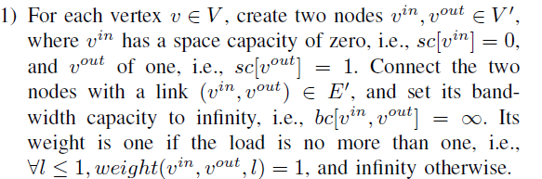
A. NP-Hardness
Notes:
1. 對於每個頂點 v ∈ V，創建兩個節點 v_{in}； v_{out} ∈ V‘ ，其中 v_{in} 的空間容量為零，即 sc[v_{in}] = 0，而 v_{out} 為 1，即 sc[v_{out}] = 1。將兩個節點 (vin; vout) ∈ E‘是連通的，並將其頻寬容量設為無窮大，即 bc[v_{in}; v_{out}] = ∞。 如果負載不超過 1，則其權重為 1，即 ∀l ≤ 1 ; weight(v_{in}; v_{out}; l) = 1，否則為無窮大。

Slide 54
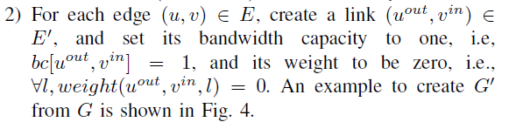
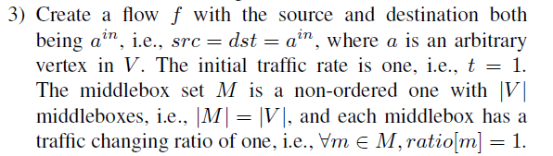
A. NP-Hardness
Notes:
對於每條邊 (u, v) ∈ E，創建一個link (u_{out}, v_{in}) ∈ E‘，並將其頻寬容量設置為 1，即 bc[u_{out}, v_{in}] = 1，並且其權重為零，即 ∀l ; weight(u_{out}, v_{in}; l) = 0。從 G 創建 G' 的示例如圖 4 所示。
創建一個流 f，起始點和目標點都是 a^{in}，即 src = dst = a^{in}，其中 a 是 V 中的任意頂點。 初始流量速率為 1，即 t = 1。middlebox集合 M 是一個無序集合，其中 |V| middlebox，即 |M| = |V|，每個middlebox的流量變化率為1，即∀m ∈ M； ratio[m] = 1

Slide 55
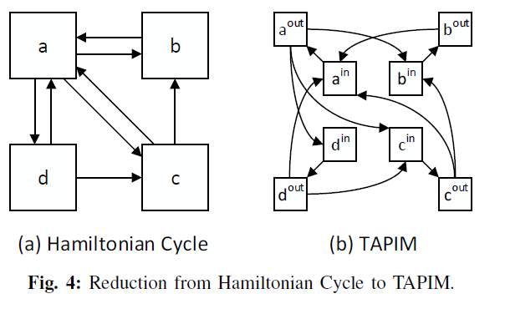
A. NP-Hardness
Notes:
對於每個頂點 v ∈ V，創建兩個節點 v_{in}； v_{out} ∈ V‘ ，其中 v_{in} 的空間容量為零，即 sc[v_{in}] = 0，而 v_{out} 為 1，即 sc[v_{out}] = 1。將兩個節點 (vin; vout) ∈ E‘是連通的，並將其頻寬容量設為無窮大，即 bc[v_{in}; v_{out}] = ∞。 如果負載不超過 1，則其權重為 1，即 ∀l ≤ 1 ; weight(v_{in}; v_{out}; l) = 1，否則為無窮大。
對於每條邊 (u, v) ∈ E，創建一個link (u_{out}, v_{in}) ∈ E‘，並將其頻寬容量設置為 1，即 bc[u_{out}, v_{in}] = 1，並且其權重為零，即 ∀l ; weight(u_{out}, v_{in}; l) = 0。從 G 創建 G' 的示例如圖 4 所示。
創建一個流 f，起始點和目標點都是 a^{in}，即 src = dst = a^{in}，其中 a 是 V 中的任意頂點。 初始流量速率為 1，即 t = 1。middlebox集合 M 是一個無序集合，其中 |V| middlebox，即 |M| = |V|，每個middlebox的流量變化率為1，即∀m ∈ M； ratio[m] = 1

Slide 56
A. NP-Hardness
Next, it can be shown that if G has a Hamiltonian cycle, then the TAPIM instance with G’ and f has a minimum path cost of |V|, and vice versa. The proof detail is omitted due to space limitations.
Notes:
接下來，可以證明，如果 G 具有漢米爾頓環，則具有 G' 和 f 的 TAPIM 實例的最小路徑成本為 |V|，反之亦然。 限於篇幅，證明細節略去。

Slide 57
B. Traffic and Space Aware Routing
Our solution to TAPIM without a predetermined path works in two steps by first finding a viable path for the flow and then applying the algorithms in Section IV to place the middleboxes on the determined path.
From the proof of Theorem 3, it can be seen that it is NPhard to find the minimum cost path with sufficient spaces, and thus we propose the Traffic And Space Aware Routing (TASAR) heuristic.
The basic idea is to originate from the source, iteratively route to a nearby node with spaces until sufficient spaces have been accumulated, and finally go to the destination.
Notes:
我們對沒有預定路徑的 TAPIM 的解決方案分兩個步驟工作，首先為流找到可行的路徑，然後應用第四部分中的算法將middlebox放置在確定的路徑上。
從定理 3 的證明可以看出，找到具有足夠空間的最小成本路徑是 NPhard 的，因此我們提出了流量和空間感知路由（TASAR）啟發式算法。
基本思想是從源頭出發，迭代路由到附近有空間的節點，直到積累了足夠的空間，最後到達目的地。

Slide 58
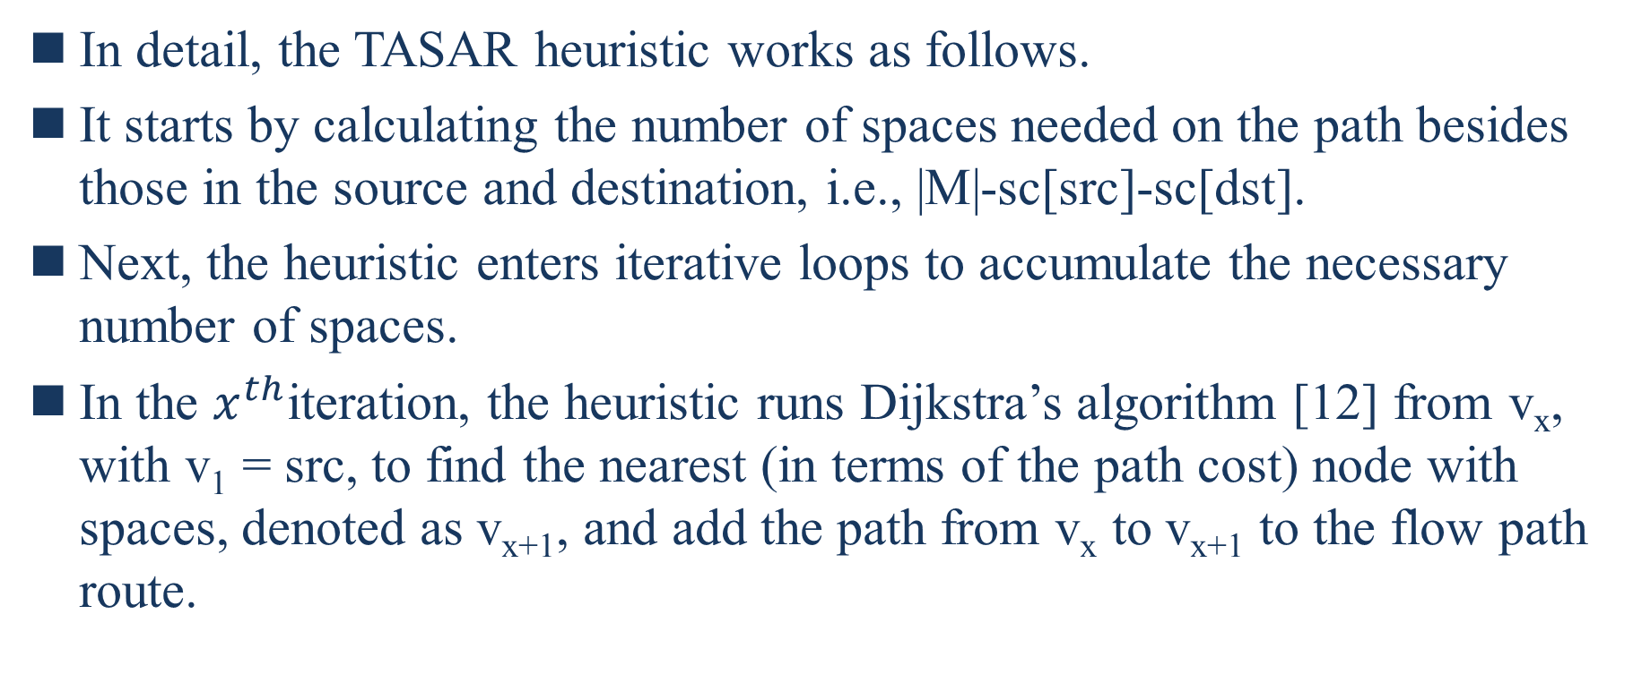
B. Traffic and Space Aware Routing
In detail, the TASAR heuristic works as follows.
It starts by calculating the number of spaces needed on the path besides those in the source and destination, i.e., |M|-sc[src]-sc[dst].
Next, the heuristic enters iterative loops to accumulate the necessary number of spaces.
In the $x^{th}$iteration, the heuristic runs Dijkstra’s algorithm [12] from v_{x}, with v₁ = src, to find the nearest (in terms of the path cost) node with spaces, denoted as v_{x+1}, and add the path from v_{x} to v_{x+1} to the flow path route.
Notes:
詳細地說，TASAR 啟發式的工作原理如下。
首先計算路徑上除了sourc和destination中的空間之外所需的空間數，即 |M|-sc[src]-sc[dst]。
接下來，啟發式進入迭代循環以累積必要數量的空格。
在𝑥^{𝑡ℎ}迭代中，啟發式從 v_{x} 運行 Dijkstra (戴克斯特拉)算法 [12]，其中 v₁ = src，以找到最近的（就路徑成本而言）有空格的節點，表示為 v_{x+1}，並添加來自 v_{x} 的路徑 到 v_{x+1} 到流路路由。

Slide 59
VI. EXPERIMENT AND SIMULATION RESULTS
In this section, we present extensive simulation and experiment results to show the effectiveness of our design.
Notes:
在本節中，我們展示了大量的模擬和實驗結果，以展示我們設計的有效性。

Slide 60
A. Simulation Results
We have implemented the proposed algorithms in the NS-3 simulator, and used the following performance metrics for benchmark comparisons.
End-to-end delay: The end-to-end delay is the interval to transmit a packet from its source to destination.
Packet loss ratio: The packet loss ratio is the percentage of packets lost with respect to packets sent.
To reflect the burstiness of realistic traffic, we adopt the on-off traffic model.
When a flow f is in the on state, its initial traffic rate t is the product of a baseline rate and a random number between 0.5 to 1.5; when in the off state, its traffic rate is zero.
Notes:
我們已經在 NS-3 模擬器中實現了所提出的算法，並使用以下性能指標進行基準比較。
端到端延遲：端到端延遲是將數據包從其源傳輸到目的地的時間間隔。
丟包率：丟包率是丟失的數據包相對於發送的數據包的百分比。
為了反映現實流量的突發性，我們採用了開關流量模型。
當流f處於開啟狀態時，其初始流量t為基準流量與0.5到1.5之間的隨機數的乘積； 當處於關閉狀態時，其流量率為零。

Slide 61
A. Simulation Results
A flow is in each of the two states for 50% of the time.
There are two candidate middlebox sets with different traffic changing ratios and dependency relations, and each flow will randomly choose one of them.
Each link in the network has a bandwidth capacity of 100 Mbps and a propagation delay of 2 μs.
We use the Cisco EIGRP link weight function [2] by setting only K2 to one. Every simulation run lasts five minutes, and the presented result is the average of four simulation runs.
[2] “Cisco EIGRP,” http://www.cisco.com/c/en/us/support/docs/ip/enhanced-interior-gateway-routing-protocol-eigrp/16406-eigrp-toc.html.
Notes:
流在 50% 的時間內處於兩種狀態中的每一種。
有兩個不同流量變化率和依賴關係的候選middlebox集合，每個流將隨機選擇其中一個。
網絡中每條鏈路的帶寬容量為 100 Mbps，傳播延遲為 2 μs。
我們通過僅將 K2 設置為 1 來使用 Cisco EIGRP 鏈路權重函數 [2]。 每次模擬運行持續五分鐘，顯示的結果是四次模擬運行的平均值。

Slide 62
A. Simulation Results
Cisco EIGRP link weight function = 256*((K1*Scaled Bw) + (K2*Scaled Bw)/(256 – Load) + (K3*Scaled Delay)*(K5/(Reliability + K4)))

Slide 63
1) Placing Non-Ordered Set with Predetermined
For the NOSP algorithm to place a non-ordered middlebox set on a redetermined path, since there are no existing solutions for the studied problem, we designed the following three benchmark algorithms.
Same as NOSP, all the benchmark algorithms sort the middleboxes based on their traffic changing ratios before placing them.
First-fit continuously places the sorted middleboxes in the increasing order from the head of the flow path.
Last-fit continuously places the sorted middleboxex in the decreasing order from the tail of the flow path.
Random-fit randomly places the sorted middleboxes on random nodes on the path that have spaces.
Notes:
沒有比較的對象所以自己建立幾個
對於 NOSP 算法在重新確定的路徑上放置一個無序的middlebox集，由於所研究的問題沒有現有的解決方案，我們設計了以下三個基準算法。
與 NOSP 相同，所有基準算法在放置middlebox之前都會根據它們的流量變化率對middlebox進行排序。
First-fit 從流路的頭部開始按遞增的順序連續放置已排序的middlebox。
Last-fit 從流路徑的尾部開始按降序連續放置已排序的 middleboxex。
Random-fit 將排序後的middlebox隨機放置在路徑上有空格的隨機節點上。

Slide 64
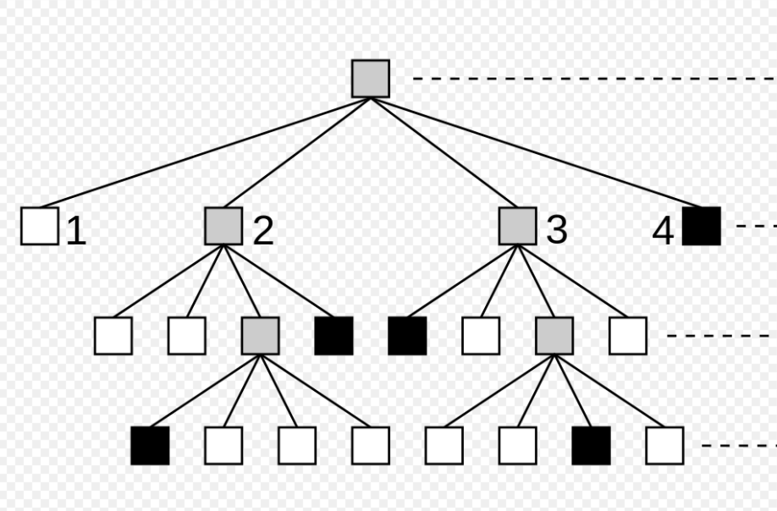
1) Placing Non-Ordered Set with Predetermined
We pick the tree topology, since it is a popular choice among institutional networks, and there is only a single path between any pair of nodes.
We set up a four-layer quad-tree with 21 switches and 64 hosts.
Each switch has 13 spaces to ensure sufficient spaces for all flows.
Notes:
我們選擇樹形拓撲，因為它是機構網絡中的流行選擇，並且任何一對節點之間只有一條路徑。
我們建立了一個帶有 21 個交換機和 64 個主機的四層四叉樹。
每個交換機有 13 個空間，以確保所有流都有足夠的空間。

Slide 65
1) Placing Non-Ordered Set with Predetermined
The two candidate sets of middleboxes are: {0.7, 0.8, 1.1, 1.2} and {0.8, 0.9, 1.1, 1.3}.
The baseline traffic rate of each flow ranges from 0.625 to 6.25 Mbps with a stride of 0.625 Mbps.
Fig. 5(a) shows the average end-to-end delays of the four algorithms.
Notes:
中間框的兩個候選集是：{0.7, 0.8, 1.1, 1.2} 和 {0.8, 0.9, 1.1, 1.3}。
每個流的流量範圍為 0.625 到 6.25 Mbps，步長為 0.625 Mbps。
圖 5(a) 顯示了四種算法的平均端到端延遲。

Slide 66
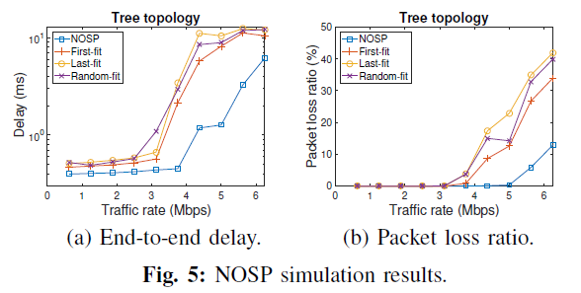
1) Placing Non-Ordered Set with Predetermined
1
1
2
2
4
4
3
3
0.7 x 0.8 x 1.1 x 1.2 = 0.74
0.8 x 0.9 x 1.1 x 1.3 = 1.03
Notes:
我們可以看到 NOSP 由於其最佳的middlebox放置方案而始終達到最短的延遲。
我們可以觀察到類似的趨勢，即 NOSP 始終實現最低的丟包率。
當流量較小時，所有算法的丟包率均為零。
First-fit 比較好是因為剛好數據平均小於1，如果換數據，First-fit可能會比較爛

Slide 67
1) Placing Non-Ordered Set with Predetermined
We can see that NOSP consistently achieves the shortest delay due to its optimal middlebox placement scheme.
We can observe a similar trend that NOSP always achieves the lowest packet loss ratio.
When the flow traffic rate is small, all the algorithms have zero packet loss ratios.
Notes:
我們可以看到 NOSP 由於其最佳的middlebox放置方案而始終達到最短的延遲。
我們可以觀察到類似的趨勢，即 NOSP 始終實現最低的丟包率。
當流量較小時，所有算法的丟包率均為零。

Slide 68
2) Placing Totally-Ordered Set with Predetermined Path
Next, we evaluate the TOSP algorithm to place a totally ordered set with similar benchmark algorithms as above, in which First-fit, Last-fit, and Random-fit place the middleboxes following the given total order chain from the path head, tail, and randomly, respectively.
The traffic changing ratios and dependency chains of the two candidate sets of middleboxes are: {0.8 ← 1.1 ← 0.7 ← 1.2} and {1.2 ← 0.7 ← 1.1 ← 0.8}.
Other simulation settings are the same as above.
Notes:
接下來，我們評估 TOSP 算法以放置具有與上述相似的基準算法的完全有序集，其中 First-fit、Last-fit 和 Random-fit 從路徑頭、尾、 和隨機，分別。
兩組候選middlebox的流量變化率和依賴鍊為：{0.8 ← 1.1 ← 0.7 ← 1.2}和{1.2 ← 0.7 ← 1.1 ← 0.8}。
其他模擬設置同上。

Slide 69
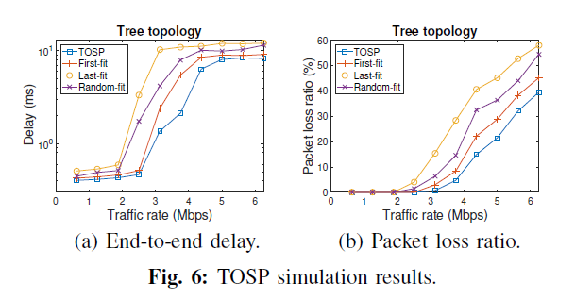
2) Placing Totally-Ordered Set with Predetermined Path
1
1
2
2
4
4
3
3
Notes:
如圖 6(a) 所示，TOSP 實現了最短的端到端延遲，因為它基於動態規劃的最佳middlebox放置方案。
與上麵類似，其他三種算法的延遲按First-fit、Random-fit、Last-fit的順序增加。
圖 6(b) 中的丟包率結果是一致的，並且 TOSP 始終優於其他人。

Slide 70
2) Placing Totally-Ordered Set with Predetermined Path
As shown in Fig. 6(a), TOSP achieves the shortest end-toend delay because of its dynamic programming based optimal middlebox placement scheme.
Similar as above, the delays of the other three algorithms increase in the sequence of First-fit, Random-fit, and Last-fit.
The packet loss ratio results in Fig. 6(b) are consistent, and TOSP consistently outperforms others.
Notes:
如圖 6(a) 所示，TOSP 實現了最短的端到端延遲，因為它基於動態規劃的最佳middlebox放置方案。
與上麵類似，其他三種算法的延遲按First-fit、Random-fit、Last-fit的順序增加。
圖 6(b) 中的丟包率結果是一致的，並且 TOSP 始終優於其他人。

Slide 71
3) Placing Partially-Ordered Set with Predetermined Path
To evaluate the placement of partially-ordered middlebox sets on predetermined paths, we use the proposed heuristic to convert the partially-ordered sets to fully-ordered sets, and then apply TOSP.
We adjust the lookahead parameter k from one to two and compare their performances.
The traffic changing ratios and the dependencies of the two candidate sets of middleboxes are: {1.1 ← 0.8, 1.2 ← 0.7} and {1.1 ← 1.2, 1.3 ← 0.7}.
Note that different total order chains will be generated when using the two different lookahead values.
Notes:
為了評估部分有序的middlebox集合在預定路徑上的放置，我們使用建議的啟發式將部分有序的集合轉換為完全有序的集合，然後應用 TOSP。
我們將前瞻參數 k 從 1 調整為 2 並比較它們的性能。
兩個中間框候選集的流量變化率和依賴關係為：{1.1 ← 0.8, 1.2 ← 0.7}和{1.1 ← 1.2, 1.3 ← 0.7}。
請注意，使用兩個不同的前瞻值時將生成不同的總訂單鏈。

Slide 72
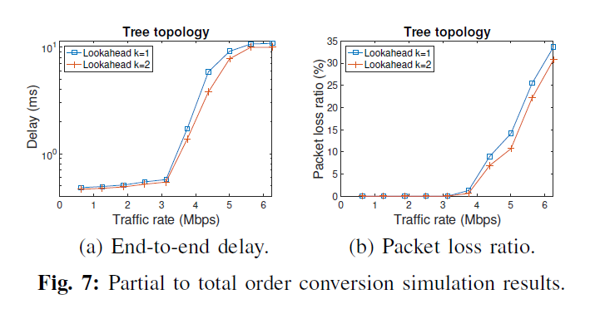
3) Placing Partially-Ordered Set with Predetermined Path
2
2
1
1
Notes:
圖 7(a) 比較了兩個不同超前值的端到端延遲。 我們可以看到，2 的超前值通過更深入地搜索解決方案空間實現了更短的延遲。
類似地，圖 7(b) 表明，2 的超前值實現了較低的平均丟包率。

Slide 73
3) Placing Partially-Ordered Set with Predetermined Path
Fig. 7(a) compares the end-to-end delays of the two different lookahead values. We can see that the lookahead value of two achieves shorter delays with a deeper search into the solution space.
Similarly, Fig.7(b) shows that the lookahead value of two achieves a lower average packet loss ratio.
Notes:
圖 7(a) 比較了兩個不同超前值的端到端延遲。 我們可以看到，2 的超前值通過更深入地搜索解決方案空間實現了更短的延遲。
類似地，圖 7(b) 表明，2 的超前值實現了較低的平均丟包率。

Slide 74
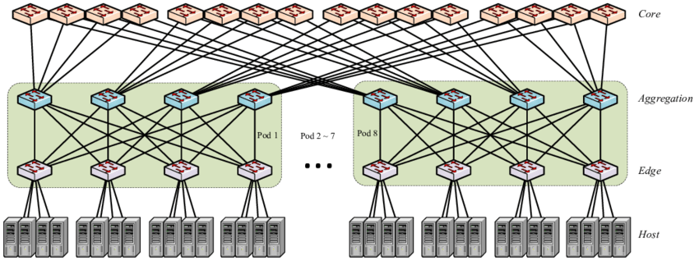
4) Placing Middleboxes without Predetermined Path
Finally, we evaluate the Traffic And Space Aware Routing (TASAR) heuristic by comparing it with a hop count based and ECMP (i.e., load-balancing) enabled shortest path routing algorithm.
For the multi-path topology, we choose an 8- pod fat tree with 80 switches and 128 hosts.
Notes:
最後，我們通過將其與 ”基於跳數(Hop count)和 ECMP（即負載平衡）的最短路徑路由算法” 進行比較來評估 “流量和空間感知路由 (TASAR)” 啟發式算法。
對於多路徑拓撲，我們選擇具有 80 個交換機和 128 個主機的 8-pod fat tree。

Slide 75
4) Placing Middleboxes without Predetermined Path
The two sets of candidate middleboxes after conversion are:{1.2 ← 0.7 ← 1.1 ← 0.8} and {1.3 ← 0.7 ← 1.1 ← 1.2}.
We first compare the routing success ratios of the two algorithms.
We adjust the number of spaces per switch from 6 to 8, and measure the percentage of flows that can successfully find paths with sufficient middlebox spaces.
Notes:
轉換後的兩組候選中間框為：{1.2 ← 0.7 ← 1.1 ← 0.8} 和{1.3 ← 0.7 ← 1.1 ← 1.2}。
我們首先比較兩種算法的路由成功率。
我們將每個交換機的空間數從 6 調整到 8，並測量可以成功找到具有足夠middlebox空間的路徑的流的百分比。

Slide 76
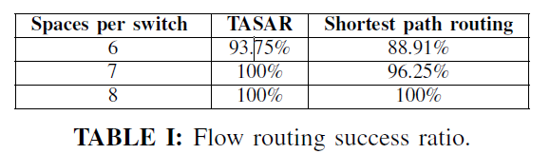
4) Placing Middleboxes without Predetermined Path
As shown in Table I, when the space number per switch is 6, the routing success ratio of TASAR is 5% higher than that of shortest path routing.
Notes:
如表一所示，當每個交換機的空間數為6時，TASAR的路由成功率比最短路徑路由高5%。

Slide 77
4) Placing Middleboxes without Predetermined Path
Next, we fix the space number per switch to 8, and compare the end-to-end delays and packet loss ratios of the two algorithms.
Notes:
接下來，我們將每個交換機的空間數固定為8，並比較兩種算法的端到端延遲和丟包率。

Slide 78
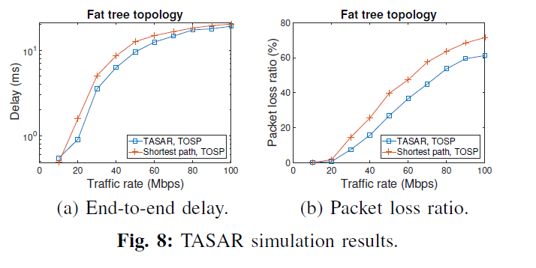
4) Placing Middleboxes without Predetermined Path
As shown in Fig. 8(a), when the baseline flow rate is 10 Mbps, TASAR has a slight longer delay, because its paths are not as short as those generated by shortest path routing.
Notes:
如圖 8（a）所示，當基線流速為 10 Mbps 時，TASAR 的延遲稍長，因為它的路徑不如最短路徑路由生成的路徑短。然而，一旦流量增加超過 10 Mbps，TASAR 始終提供更短的延遲。
圖 8（b）還表明 TASAR 始終如一地實現了較低的丟包率。

Slide 79
B. Experiment Results with Prototype
We have implemented an SDN based prototype using the open-source SDN controller Floodlight and emulation platform Mininet, and developed a middlebox emulator using the libpcap library [8].
We validate our design by comparing TOSP with TASAR routing and TOSP with shortest path routing.
We pick the Abilene backbone topology [1], as shown in Fig. 9. Each node has a space capacity of three, and each link has a bandwidth capacity of 10 Mbps.
[8] “TCPDUMP/LIBPCAP public repository,” http://www.tcpdump.org/.
Notes:
TASAR : Traffic And Space Aware Routing
我們已經使用開源 SDN 控制器 Floodlight 和仿真平台 Mininet 實現了基於 SDN 的原型，並使用 libpcap 庫開發了一個middlebox仿真器 [8]。
我們通過比較 “TOSP 與 TASAR 路由” 和 ” TOSP 與最短路徑路由” 來驗證我們的設計。
我們選擇 Abilene 主幹拓撲結構 [1]，如圖 9 所示。每個節點的空間容量為 3，每個鏈路的帶寬容量為 10 Mbps。

Slide 80
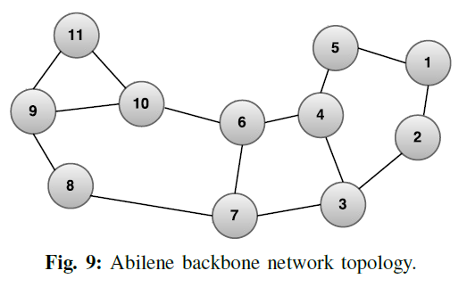
B. Experiment Results with Prototype

Slide 81
B. Experiment Results with Prototype
Four flows are generated: two from node 1 to 8, and two from 11 to 2.
The initial traffic rate of each flow ranges from 1 to 10 Mbps with a stride of 1 Mbps.
Each flow needs four middleboxes with the following traffic changing ratios and total order chain after conversion: {1.2 ← 0.7 ← 1.1 ← 0.8}.
Notes:
生成了四個流：兩個從節點 1 到 8，兩個從節點 11 到 2。
每個流的初始流量速率範圍為 1 到 10 Mbps，步長為 1 Mbps。
每個流需要四個middlebox，轉換後的流量變化率和總訂單鏈如下：{1.2 ← 0.7 ← 1.1 ← 0.8}。

Slide 82
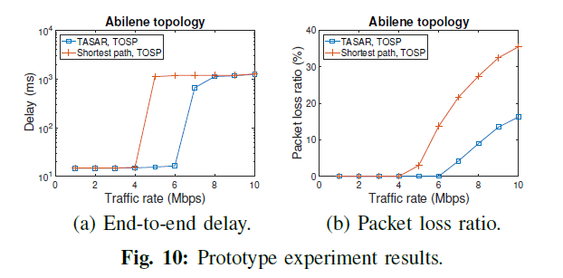
B. Experiment Results with Prototype
Notes:
從圖 10(a) 中可以看出，實驗數據與仿真結果一致，TASAR 實現了比最短路徑路由更短的端到端延遲。
此外，圖 10(b) 顯示前者實現了低得多的丟包率。

Slide 83
VII. CONCLUSIONS
In this paper, we have studied the optimal placement of NFV middleboxes by considering different middlebox traffic changing effects and dependency relations.
We first formulate the Traffic Aware Placement of Interdependent Middleboxes problem as a graph optimization problem with the objective to load-balance the network.
Next, we solve the problem when the flow path is predetermined, and propose optimal algorithms for a non-ordered or totallyordered middlebox set.
Notes:
在本文中，我們通過考慮不同的middlebox流量變化影響和依賴關係研究了 NFV middlebox的最佳放置。
我們首先將 Interdependent Middleboxes 的流量感知放置問題表述為一個圖優化問題，其目標是對網絡進行負載平衡。
接下來，我們解決了流路徑預定時的問題，並針對無序或完全有序的middlebox集提出了最優算法。

Slide 84
VII. CONCLUSIONS
For the general scenario of a partiallyordered middlebox set, we show that the problem is NPhard by reduction from the Clique problem, and propose an efficient heuristic to convert a partially-ordered set to a totally-ordered one.
Extensive simulation and experiment results are presented to show the effectiveness of our design.
Notes:
對於偏序middlebox集的一般場景，我們通過從 Clique 問題歸約來證明該問題是 NPhard，並提出了一種有效的啟發式方法將偏序集轉換為全序集。
大量的模擬和實驗結果顯示了我們設計的有效性。

Slide 85
REFERENCES
[1] “Abilene backbone,” http://abilene.internet2.edu.
[2] “Cisco EIGRP,” http://www.cisco.com/c/en/us/support/docs/ip/enhanced-interior-gateway-routing-protocol-eigrp/16406-eigrp-toc.html.
[3] “Cisco: NAT order of operation,” http://www.cisco.com/c/en/us/support/docs/ip/network-address-translation-nat/6209-5.html.
[4] “Citrix CloudBridge,” https://www.citrix.com/content/dam/citrix/en us/documents/products-solutions/cloudbridge-technical-overview.pdf.
[5] “Microsoft TechNet: VPNs and firewalls,” https://technet.microsoft.com/en-us/library/cc958037.aspx.
[6] “Network functions virtualisation white paper #3,” https://portal.etsi.org/Portals/0/TBpages/NFV/Docs/NFV White Paper3.pdf.
[7] “OSPF: frequently asked questions,” http://www.cisco.com/c/en/us/support/docs/ip/open-shortest-path-first-ospf/9237-9.html.
[8] “TCPDUMP/LIBPCAP public repository,” http://www.tcpdump.org/.
[9] A. Curtis et al., “Mahout: Low-overhead datacenter traffic management using end-host-based elephant detection,” in IEEE INFOCOM, 2011.
[10] A. Singh et al., “Server-storage virtualization: integration and load balancing in data centers,” in ACM/IEEE Supercomputing, 2008.

Slide 86
REFERENCES
[11] B. Heller et al., “Elastictree: saving energy in data center networks,” in USENIX NSDI, 2010.
[12] T. H. Cormen, C. E. Leiserson, R. L. Rivest, and C. Stein, Introduction to Algorithms, 3rd ed. MIT Press, 2009.
[13] W. Ding et al., “OpenSCaaS: an open service chain as a service platform toward the integration of SDN and NFV,” IEEE Network, vol. 29, no. 3, pp. 30–35, 2015.
[14] J. Anderson et al., “xOMB: extensible open middleboxes with commodity servers,” in ACM/IEEE ANCS, 2012.
[15] J. Hwang et al., “NetVM: high performance and flexible networking using virtualization on commodity platforms,” IEEE Transactions on
Network and Service Management, vol. 12, no. 1, pp. 34–47, 2015.
[16] J. Martins et al., “ClickOS and the art of network function virtualization,” in USENIX NSDI, 2014.
[17] J. Matias et al., “Toward an SDN-enabled NFV architecture,” IEEE Communications Magazine, vol. 53, no. 4, pp. 187–193, 2015.
[18] H. Jin et al., “Efficient VM placement with multiple deterministic and stochastic resources in data centers,” in IEEE GLOBECOM, 2012.
[19] Y. Li, L. Phan, and B. T. Loo, “Network functions virtualization with soft real-time guarantees,” in IEEE INFOCOM, 2016.
[20] W. Ma et al., “Traffic-aware placement of NFV middleboxes,” in IEEE GLOBECOM, 2015.
[21] M. J. Miller, B. Vucetic, and L. Berry, Satellite communications: mobile and fixed services. Springer Science & Business Media, 1993.

Slide 87
REFERENCES
[22] H. Moens and F. De Turck, “VNF-P: A model for efficient placement of virtualized network functions,” in IEEE CNSM, 2014.
[23] T. Mori et al., “Identifying elephant flows through periodically sampled packets,” in ACM IMC, 2004.
[24] R. Cohen et al., “Near optimal placement of virtual network functions,” in IEEE INFOCOM, 2015.
[25] S. Fayazbakhsh et al., “Enforcing network-wide policies in the presence of dynamic middlebox actions using flowtags,” in USENIX NSDI, 2014.
[26] S. Mehraghdam et al., “Specifying and placing chains of virtual network functions,” in IEEE Cloud Networking, 2014.
[27] V. Sekar et al., “Design and implementation of a consolidated middlebox architecture,” in USENIX NSDI, 2012.
[28] Z. Qazi et al., “SIMPLE-fying middlebox policy enforcement using SDN,” in ACM SIGCOMM Computer Communication Review, vol. 43, no. 4. ACM, 2013, pp. 27–38.

