Slide 1
Optimizing Service Placement for Microservice Architecture in Clouds
Yang Hu 1,2, Cees de Laat 1 and Zhiming Zhao 1,*
Notes:
優化雲中微服務的服務放置
1 Informatics Institute, Faculty of Science, University of Amsterdam, 1098 XH Amsterdam, The Netherlands;
y.hu@uva.nl (Y.H.); delaat@uva.nl (C.d.L.)
2 School of Computer Science, National University of Defense Technology, Changsha 410073, China
* Correspondence: z.zhao@uva.nl

Slide 2
Abstract
As microservice architecture is becoming more popular than ever, developers intend to transform traditional monolithic applications into service-based applications (composed by a number of services).
To deploy a service-based application in clouds, besides the resource demands of each service, the traffic demands between collaborative services are crucial for the overall performance.
Poor handling of the traffic demands can result in severe performance degradation, such as high response time and jitter.
Notes:
隨著微服務變成流行，開發人員試圖將傳統的單體應用程式轉變為基於服務的應用程序(由數個服務所組成)
在雲中部署基於服務的應用程序，除了每個服務的資源需求外，協同服務間的流量需求對整體效能也是至關重要的
流量需求的不當處理可能導致服務的效能下降，例如回應時間過長和抖動

Slide 3
Abstract
However, current cluster schedulers fail to place services at the best possible machine, since they only consider the resource constraints but ignore the traffic demands between services.
To address this problem, we propose a new approach to optimize the placement of service-based applications in clouds.
The approach first partitions the application into several parts while keeping overall traffic between different parts to a minimum and then carefully packs the different parts into machines with respect to their resource demands and traffic demands.
Notes:
然而，現有的集群排程器無法將服務放置在盡可能好的機器上，因為他們只有考慮資源限制而忽略服務間的流量需求
為解決這個問題，我們提出一個新的方法來優化基於服務的應用程式在雲中的放置
該方法首先將應用程式劃分成幾個部分，同時將不同部分間的總流量保持在最低限度，然後根據他們的資源需求和流量需求小心地將不同的部分封裝至機器中

Slide 4
Abstract
We implement a prototype scheduler and evaluate it with extensive experiments on testbed clusters.
The results show that our approach outperforms existing container cluster schedulers and representative heuristics, leading to much less overall inter-machine traffic.
Notes:
我們實作一個原型排程器，並通過在測試台集群上的大量實驗來對其評估
結果顯示我們提出的方法優於現有的容器排程器和具有代表性的啟發式算法，使得整體機器間流量較少得多

Slide 5
1. Introduction
Microservice architecture is a new trend rising fast for application development, as it enhances flexibility to incorporate different technologies, it reduces complexity by using lightweight and modular services, and it improves overall scalability and resilience of the system.
In the definition , the microservice architectural style is an approach to develop a single application as a suite of small services, each running in its own process and communicating with lightweight mechanisms (e.g., HTTP resource API).
Notes:
微服務架構是應用開發快速興起的新趨勢，因為其增強融合不同技術的靈活性，通過使用輕量級和模塊化的服務降低了複雜度，提高了系統的整體可擴展性和彈性
在定義中，微服務的架構風格是一種將單一應用程序開發為一組小服務的方法，每個小服務都會運行在其自己的進程中並與輕量級機制(例如 HTTP資源API)進行通信

Slide 6
1. Introduction
Due to the advantages of microservices architecture, many developers intend to transform traditional monolithic applications into service-based applications.
For instance, an online shopping application could be basically divided into product service, cart service, and order service, which can greatly improve the productivity, agility, and resilience of the application.
Notes:
因為微服務架構的優點，許多開發人員有意將傳統單體應用程序轉換為基於服務的應用程序
例如，一個線上購物應用程序基本上可以分為產品服務、購物車服務和訂單服務，這可以大大地提高應用程序的生產力、敏捷性和彈性

Slide 7
1. Introduction
However, it also brings challenges. When deploying a service-based application in clouds, the scheduler has to carefully schedule each service, which may have diverse resource demands, on distributed compute clusters.
Furthermore, the network communication between different services needs to be handled well, as the communication conditions significantly influence the quality of service (e.g., the response time of a service).
Ensuring the desired performance of service-based applications, especially the network performance between the involved services, becomes increasingly important.
Notes:
然而，它也帶來了挑戰。在雲中部署基於服務的應用程序時，排程器必須在分佈式計算集群上仔細地安排每個可能具有不同資源需求的服務
此外，需要處理好不同服務間網路通信，因為通信條件顯著地影響服務品質(例如:服務的回應時間)
確保基於服務的應用程序的預期性能，尤其是所涉及的服務之間的網路性能，變得愈來愈重要

Slide 8
1. Introduction
In general, service-based applications involve numerous distributed and complex services which usually require more computing resources beyond single machine capability.
Therefore, a cluster of networked machines or cloud computing platforms (e.g., Amazon EC2, Microsoft Azure, or Google Cloud Platform) are generally leveraged to run service-based applications.
More importantly, containers are emerging as the disruptive technology for effectively encapsulating runtime contexts of software components and services, which significantly improves portability and efficiency of deploying applications in clouds.
Notes:
一般來說，基於服務的應用程序涉及眾多分佈式和複雜的服務，這些服務通常需要比單個機器能力更多的計算資源
因此，通常利用聯網機器或雲計算平台的集群(如Amazon EC2、Microsoft Azure或Google Cloud Platform)來運行基於服務的應用程序
更重要的是，容器正在成為有效封裝軟體元件和服務運行時的上下文，這顯著地提高了在雲中部署應用程序的可移植性和效率

Slide 9
1. Introduction
When deploying a service-based application in clouds, several essential aspects have to be taken into account.
First, services involved in the application often have diverse resource demands, such as CPU, memory and disk.
The underlying machine has to ensure sufficient resources to run each service and at the same time provide cohesive functionalities.
Efficient resource allocation to each service is difficult, while it becomes more challenging when the cluster consists of heterogeneous machines.
Notes:
在雲中部署基於服務的應用程序時，必須考慮幾個基本方面
首先，應用程序中涉及的服務通常具有不同的資源需求，如CPU、記憶體和磁盤
底層機器必須確保充足的資源來運行每個服務，同時提供內聚力
為每個服務有效分配資源是困難的，而當集群由異構機器組成時，它變得更具挑戰性

Slide 10
1. Introduction
Second, services involved in the application often have traffic demands among them due to data communication, which require meticulous treatment.
Poor handling of the traffic demands can result in severe performance degradation, as the response time of a service is directly affected by its traffic situation.
Considering the traffic demands, an intuitive solution is to place the services that have large traffic demands among them on the same machine, which can achieve intra-machine communication and reduce inter-machine traffic.
Notes:
其次，應用程序中涉及的服務之間通常由於數據通信而存在流量需求，需要仔細處理
流量需求的不當處理可能導致服務的效能下降，因為服務的回應時間直接受其流量狀況的影響
考慮到流量需求，一個直觀的解決方案是將流量需求大的服務放在同一台機器上，這樣可以實現機器內通信，減少機器間的流量

Slide 11
1. Introduction
However, such services cannot all be co-located on one machine due to limited resource capacities.
Hence, placement of service-based applications is quite complicated in clouds.
In order to achieve a desired performance of a service-based application, cluster schedulers have to carefully place each service of the application with respect to the resource demands and traffic demands.
Notes:
然而，由於資源容量有限，這些服務不能全部位於同一台機器上
因此，在雲中放置基於服務的應用程序是相當複雜的
為了實現基於服務的應用程序的理想效能，集群排程器必須根據資源需求和流量需求仔細放置應用程序的每個服務

Slide 12
1. Introduction
Recent cluster scheduling methods mainly focus on the cluster resource efficiency or job completion time of batch workloads [1–3].
1.Hu, Y.; Wang, J.; Zhou, H.; Martin, P.; Taal, A.; de Laat, C.; Zhao, Z. Deadline-Aware Deployment for Time Critical Applications in Clouds. In Proceedings of the European Conference on Parallel Processing, Santiago de Compostela, Spain, 28 August–1 September 2017; Springer: New York, NY, USA, 2017; pp. 345–357.
2.Koulouzis, S.; Martin, P.; Zhou, H.; Hu, Y.; Wang, J.; Carval, T.; Grenier, B.; Heikkinen, J.; de Laat, C.; Zhao, Z.
Time-critical data management in clouds: Challenges and a Dynamic Real-Time Infrastructure Planner
(DRIP) solution. Concurr. Comput. Pract. Exp. 2019, e5269. [CrossRef]
3. Hu, Y.; Zhou, H.; de Laat, C.; Zhao, Z. Ecsched: Efficient container scheduling on heterogeneous clusters.
In Proceedings of the European Conference on Parallel Processing, Turin, Italy, 27–31 August 2018; Springer:
New York, NY, USA, 2018; pp. 365–377.
Notes:
最近的集群排程方法主要著關注批量工作負載的集群資源效率或工作完成時間[1-3]

Slide 13
1. Introduction
For instance, Tetris [4], a multi-resource cluster scheduler, adapts heuristics for the multi-dimensional bin packing problem to efficiently pack tasks on multi-resource cluster.
Firmament [5], a centralized cluster scheduler, can make high-quality placement decisions on large-scale clusters via a min-cost max-flow optimization.
4.Grandl, R.; Ananthanarayanan, G.; Kandula, S.; Rao, S.; Akella, A. Multi-resource packing for cluster schedulers. ACM SIGCOMM Comput. Commun. Rev. 2015, 44, 455–466. [CrossRef]
5.Gog, I.; Schwarzkopf, M.; Gleave, A.;Watson, R.N.; Hand, S. Firmament: Fast, centralized cluster scheduling
at scale. In Proceedings of the 12th USENIX Symposium on Operating Systems Design and Implementation
(OSDI 16), Savannah, GA, USA, 2–4 November 2016; pp. 99–115.
Notes:
例如，Tetris，是一種多資源的集群排程器，它採用啟發式演算法解決多維裝箱問題，以在多資源集群上有效地打包任務
Firmament[5]是一個集中式的集群排程器，可以通過最小成本最大流量優化在大規模集群上做出高質量的放置決策

Slide 14
1. Introduction
Unfortunately, these solutions would face difficulties for handling service-based applications, as they ignore the traffic demands when making placement decisions.
Some other research works [6,7] concentrate on composite Software as a service (SaaS) placement problem, which try to minimize the total execution time for composite SaaS.
6.Yusoh, Z.I.M.; Tang, M. A penalty-based genetic algorithm for the composite SaaS placement problem in the cloud. In Proceedings of the IEEE Congress on Evolutionary Computation, Barcelona, Spain, 18–23 July 2010; pp. 1–8.
7. Hajji, M.A.; Mezni, H. A composite particle swarm optimization approach for the composite saas placement in cloud environment. Soft Comput. 2018, 22, 4025–4045. [CrossRef]
Notes:
不幸的是，這些解決方案在處理基於服務的應用程序時將面臨困難，因為當做出放置決策時他們忽略了流量需求
其它一些研究工作[6,7]集中在複合軟體即服務(SaaS)放置問題上，試圖最小化複合SaaS的總執行時間

Slide 15
1. Introduction
However, they only focus on a set of predefined service components for the application placement.
For traffic-aware scheduling, relevant research solutions [8,9] are proposed to handle virtual machine (VM) placement problem, which aims to optimize network resource usage over the cluster.
However, these solutions rely on a certain network topology, while most of existing cluster schedulers are agnostic to network topology.
8.Meng, X.; Pappas, V.; Zhang, L. Improving the scalability of data center networks with traffic-aware virtual machine placement. In Proceedings of the 2010 IEEE INFOCOM, San Diego, CA, USA, 15–19 March 2010; pp. 1–9.
9. Wang, M.; Meng, X.; Zhang, L. Consolidating virtual machines with dynamic bandwidth demand in data centers. Infocom 2011, 201, 71–75.
Notes:
然而，他們只關注一組用於應用程序放置的預定義服務元件
對於流量感知排程，提出了相關的研究解決方案[8,9]來處理虛擬機器(VM)放置問題，旨在優化集群上的網路資源使用
然而，這些解決方案依賴一定的網路拓撲，而大多數現有的集群排程器對網路拓撲都是不可知的

Slide 16
1. Introduction
In particular, it is hard to get the network topology information when deploying a service-based application on a virtual infrastructure.
In this paper, we propose a new approach to optimizing the placement of service-based applications in clouds.
The objective is to minimize the inter-machine traffic while satisfying multi-resource demands for service-based applications.
Our approach involves two key steps: (1) The requested application is partitioned into several parts while keeping overall traffic between different parts to a minimum. (2) The parts in the partition are packed into machines with multi-resource constraints.
Notes:
特別是在虛擬基礎設施上部署基於服務的應用程序時，很難獲得網路拓撲資訊
在本文中，我們提出一種優化基於服務的應用程序在雲中的放置的新方法
目標是在滿足基於服務的應用程序的多個資源需求的同時最小化機器間的流量
我們的方法涉及兩個關鍵步驟:(1)將請求的應用程序劃分為多個部分，同時將不同部分之間的總流量保持在最低限度(2)分區中的零件被打包到具有多資源限制的機器中

Slide 17
1. Introduction
Typically, the partition can be abstracted as a minimum k-cut problem; the packing can be abstracted as a multi-dimensional bin packing problem. However, both are NP-hard problems [10,11].
To address these problems, we first propose two partition algorithms: Binary Partition and K Partition, which are based on a well designed randomized contraction algorithm [12], for finding a high quality application partition.
10. Goldschmidt, O.; Hochbaum, D.S. Polynomial algorithm for the k-cut problem. In Proceedings of the 1988 29th Annual Symposium on Foundations of Computer Science, White Plains, NY, USA, 24–26 October 1988; pp. 444–451.
11. Woeginger, G.J. There is no asymptotic PTAS for two-dimensional vector packing. Inf. Process. Lett. 1997, 64, 293–297. [CrossRef]
12. Karger, D.R. Global Min-cuts in RNC, and Other Ramifications of a Simple Min-Cut Algorithm. SODA 1993, 93, 21–30.
Notes:
通常，分區可以抽象為最小k-cut問題;裝箱可以抽象為多維裝箱問題。然而，兩者都是NP-hard問題[10,11]
為解決這些問題，我們首先提出兩種分區演算法:二元分區和K分區，它們基於精心設計的隨機收縮演算法[12]，用於尋找高質量的應用程序分區

Slide 18
1. Introduction
Then, we propose a packing algorithm, which adopts an effective packing heuristic with traffic awareness, for efficiently packing each part of an application partition into machines.
Finally, we combine the partition and packing algorithm with a resource demand threshold to find an appropriate placement solution.
We implement a prototype scheduler based on our proposed algorithms and evaluate it on testbed clusters.
The results show that our scheduler outperforms existing container cluster schedulers and representative heuristics, leading to much less overall inter-machine traffic.
Notes:
接著，我們提出一種打包演算法，該算法採用具有流量感知的有效打包啟發式算法，將應用程序分區的每個部份有效地打包到機器中
最後，我們將區分和打包算法與資源需求臨界值結合，以找到合適的放置解決方案
我們基於我們提出演算法實作了一個原型排程器，並在測試台集群上對其進行評估
結果顯示我們的排程器勝過現有的容器集群排程器和代表性啟發式演算法，從而大大減少整體機器間流量

Slide 19
2. Problem Formulation
In this section, we formulate the placement problem of service-based application, and introduce the objective of this work.
The notation used in the work is presented in Table 1.
Notes:
在本節中，我們制訂基於服務的應用程序的放置問題，並引入這個研究的目標
研究中使用的符號如Table 1所示

Slide 20
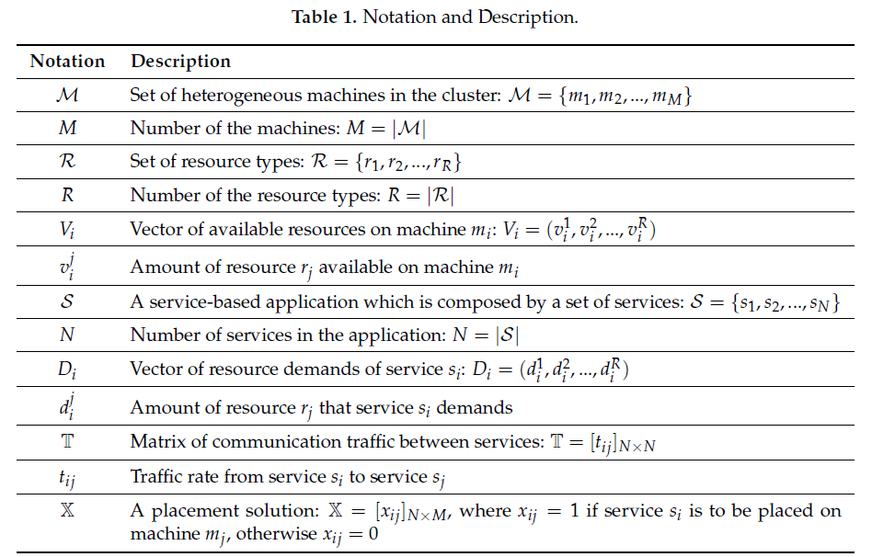
2. Problem Formulation
Notes:
$ℳ$: 集群中的異構機器集合 : $ℳ$=$\{m_{1},m_{2},…,m_{M}\}$ M : 機器的數量 : M=$\left|ℳ\right|$
$ℛ$ : 資源類型集合 : $ℛ$=$\left\{r_{1},r_{2},…,r_{R}\right\}$ R : 資源類型的數量 : R=$\left|ℛ\right|$
$V_{i}$ : 機器$m_{i}$上可用資源的向量 : $V_{i}$=$\left(v_{i}^{1},v_{i}^{2},…,v_{i}^{R}\right)$ $v_{i}^{j}$ : 機器$m_{i}$上可用的資源量$r_{j}$
$S$ : 由一組服務組成的基於服務的應用程序 : $S$=$\left\{s_{1},s_{2},…,s_{N}\right\}$ N : 應用程序中服務的數量 : N =$\left|S\right|$
$D_{i}$ : 服務$s_{i}$的資源需求向量 : $D_{i}$=$\left\{d_{i}^{1},d_{i}^{2},…,d_{i}^{R}\right\}$ $d_{i}^{j}$ : 服務$s_{i}$需要的資源量$r_{j}$
$𝕋$ : 服務間通信流量矩陣 :$𝕋$=${\left[t_{ij}\right]}_{N×N}$ $t_{ij}$ : 從服務$s_{i}$到服務$s_{j}$的流量速率
$𝕏$ : 放置解決方案 :$𝕏$=${\left[x_{ij}\right]}_{N×M}$，其中如果服務$s_{i}$被放置在機器$m_{j}$上，則$x_{ij}$=1，否則$x_{ij}$=0

Slide 21
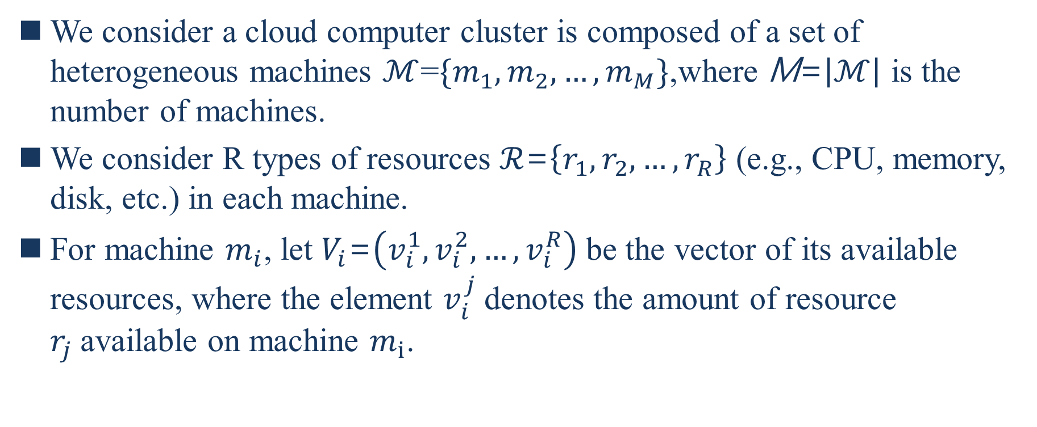
2. Problem Formulation
We consider a cloud computer cluster is composed of a set of heterogeneous machines $ℳ$=$\{m_{1},m_{2},…,m_{M}\}$,where M=$\left|ℳ\right|$ is the number of machines.
We consider R types of resources $ℛ$=$\left\{r_{1},r_{2},…,r_{R}\right\}$ (e.g., CPU, memory, disk, etc.) in each machine.
For machine $m_{i}$, let $V_{i}$=$\left(v_{i}^{1},v_{i}^{2},…,v_{i}^{R}\right)$ be the vector of its available resources, where the element $v_{i}^{j}$denotes the amount of resource $r_{j}$available on machine $m_{i}$.
Notes:
我們認為一個雲計算機集群是由一組異構的機器$ℳ$=$\{m_{1},m_{2},…,m_{M}\}$組成，其中M=$\left|ℳ\right|$是機器的數量
我們考慮每台機器中的R種資源$ℛ$=$\left\{r_{1},r_{2},…,r_{R}\right\}$(例如，CPU、記憶體、磁碟等)
對於機器$m_{i}$，另$V_{i}$=$\left(v_{i}^{1},v_{i}^{2},…,v_{i}^{R}\right)為$其可用資源向量，其中元素$v_{i}^{j}$表示機器$m_{i}$上可用的資源量$r_{j}$

Slide 22
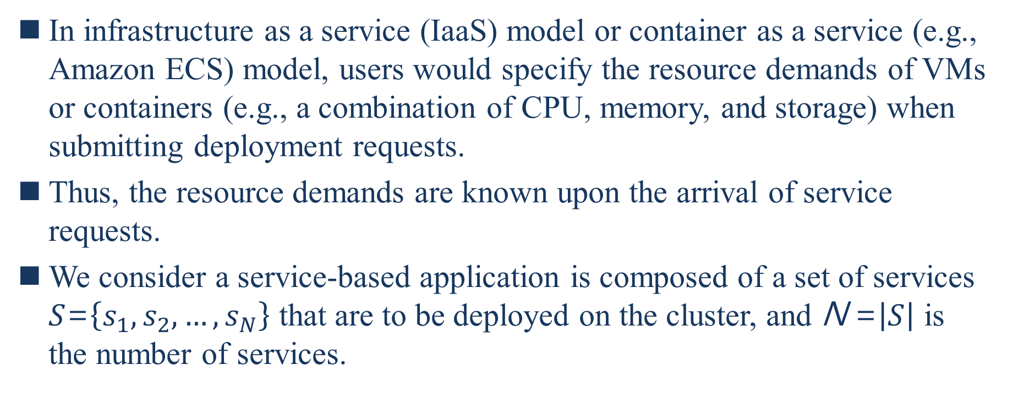
2. Problem Formulation
In infrastructure as a service (IaaS) model or container as a service (e.g., Amazon ECS) model, users would specify the resource demands of VMs or containers (e.g., a combination of CPU, memory, and storage) when submitting deployment requests.
Thus, the resource demands are known upon the arrival of service requests.
We consider a service-based application is composed of a set of services $S$=$\left\{s_{1},s_{2},…,s_{N}\right\}$ that are to be deployed on the cluster, and N =$\left|S\right|$ is the number of services.
Notes:
在基礎設施即服務(IaaS)模型或容器即服務(例如，Amazon ECS)模型中，用戶在提交部署請求時會指定VM或容器(例如，CPU、記憶體、儲存的組合)的資源需求
因此，在服務請求到達時就知道資源需求
我們認為一個基於服務的應用程序是由一組要部署在集群上的服務$S$=$\left\{s_{1},s_{2},…,s_{N}\right\}$組成，並且N =$\left|S\right|$是服務的數量

Slide 23
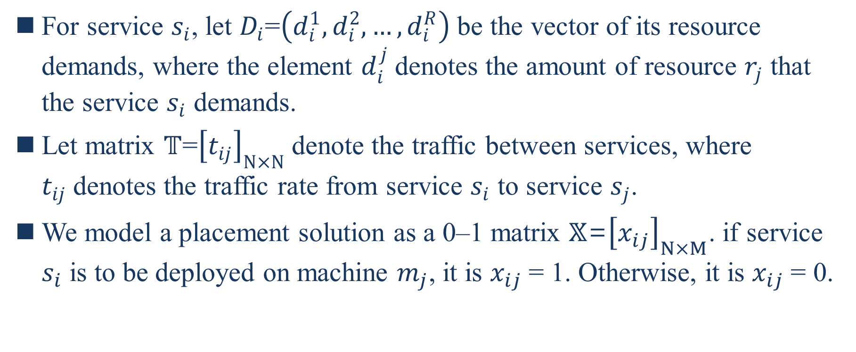
2.1. Model Description
For service $s_{i}$, let $D_{i}$=$\left(d_{i}^{1},d_{i}^{2},…,d_{i}^{R}\right)$ be the vector of its resource demands, where the element $d_{i}^{j}$denotes the amount of resource $r_{j}$ that the service $s_{i}$ demands.
Let matrix $𝕋$=${\left[t_{ij}\right]}_{N×N}$denote the traffic between services, where $t_{ij}$denotes the traffic rate from service $s_{i}$ to service $s_{j}$.
We model a placement solution as a 0–1 matrix $𝕏$=${\left[x_{ij}\right]}_{N×M}$. if service $s_{i}$ is to be deployed on machine $m_{j}$, it is $x_{ij}$= 1. Otherwise, it is $x_{ij}$= 0.
Notes:
對於服務$s_{i}$，令$D_{i}$=$\left(d_{i}^{1},d_{i}^{2},…,d_{i}^{R}\right)為$其資源需求向量，其中元素$d_{i}^{j}$表示服務$s_{i}$需求的資源$r_{j}$數量
讓矩陣$𝕋$=${\left[t_{ij}\right]}_{N×N}$表示服務間的流量，其中$t_{ij}$表示從服務$s_{i}到$服務$s_{j}$的流量率
我們將放置解決方案建模為0-1矩陣$𝕏$=${\left[x_{ij}\right]}_{N×M}$，如果服務$s_{i}要$部署在機器$m_{j}$上，則$x_{ij}$=1，否則$x_{ij}$=0

Slide 24
2.2. Objective
To achieve a desired performance of service-based applications, a scheduler should not only consider the multi-resource demands of services but also the traffic situation between services.
As services, especially data-intensive services, often need to transfer data frequently, the network performance would directly influence the overall performance.
Considering the network dynamics, the placement of different services of an application is crucial for maintaining the overall performance, particularly when unexpected network latency or congestion occurs in the cluster.
Notes:
為了實現基於服務的應用程序的理想效能，排程器不僅要考慮服務的多資源需求，還要考慮服務間的流量情況
由於服務，尤其是數據密集型服務，通常頻繁地需要傳輸數據，網路效能將直接影響到整體效能
考慮到網路動態，應用程序的不同服務的放置對於維持整體效能是至關重要的，尤其是在集群中發生意外的網路延遲或壅塞時

Slide 25
2.2. Objective
Given the traffic situation, the most intuitive solution is to place the services that have high traffic rate among them on the same machine so that the co-located services can leverage the loopback interface to get a high network performance without consuming actual network resources of the cluster.
However, such services cannot all be co-located on one machine due to limited resource capacities.
Notes:
考慮到流量情況，最直觀的方法是將它們之間有高流量率的服務放在同一台機器上，這樣co-located服務就可以利用loopback介面獲得更高的網路效能，而不會消耗集群的真實網路資源
然而，因為資源容量有限，這些服務無法全部co-located在一台機器上

Slide 26
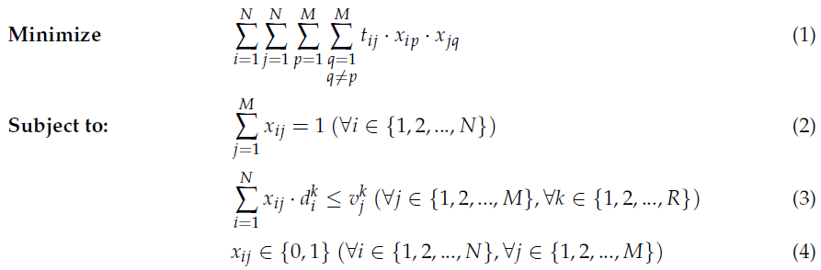
2.2. Objective
Thus, with the resource constraints, we try to find a placement solution to minimize the overall traffic between services that are placed on different machines (inter-machine traffic) while satisfying multi-resource demands of services, so that the objective of this work can be formulated as:
Notes:
因此，在資源限制的情況下，我們試圖找到一個放置解決方案，以最小化放置於不同機器上的服務間的總流量(機器間的流量)，同時滿足服務的多資源需求，從而使這項工作的目標可以被制定為:

Slide 27
2.2. Objective
Equation (2) guarantees that each service is placed on a machine.
Equation (3) guarantees that resource demands on a machine do not exceed its resource capacities.
Equation (1) expresses the goal of this work.
Notes:
等式2保證每個服務都被放在機器上
等式3保證在機器上的資源需求不超過其資源容量
等式1表示這項工作的目標

Slide 28
3. Minimum K-Cut Problem
As a service-based application typically cannot be placed on one machine, an effective partition of the set of services involved in the application is necessary during the deployment.
After partition, each subset of the services should be able to be packed into a machine, which means the machine has sufficient resources to run all the services in the subset.
Considering the traffic rate between different services, the quality of the partition is crucial for the application performance.
Notes:
由於基於服務的應用程序通常無法被放在一台機器上，因此在部署過程中需要對應用程序中涉及的服務集進行有效分區
分區後，服務的每個子集應該能打包到一台機器中，這意味著機器具有充足的資源來運行在子集中的所有服務
考慮到不同服務間的流量率，分區的質量對於應用程序的效能至關重要

Slide 29
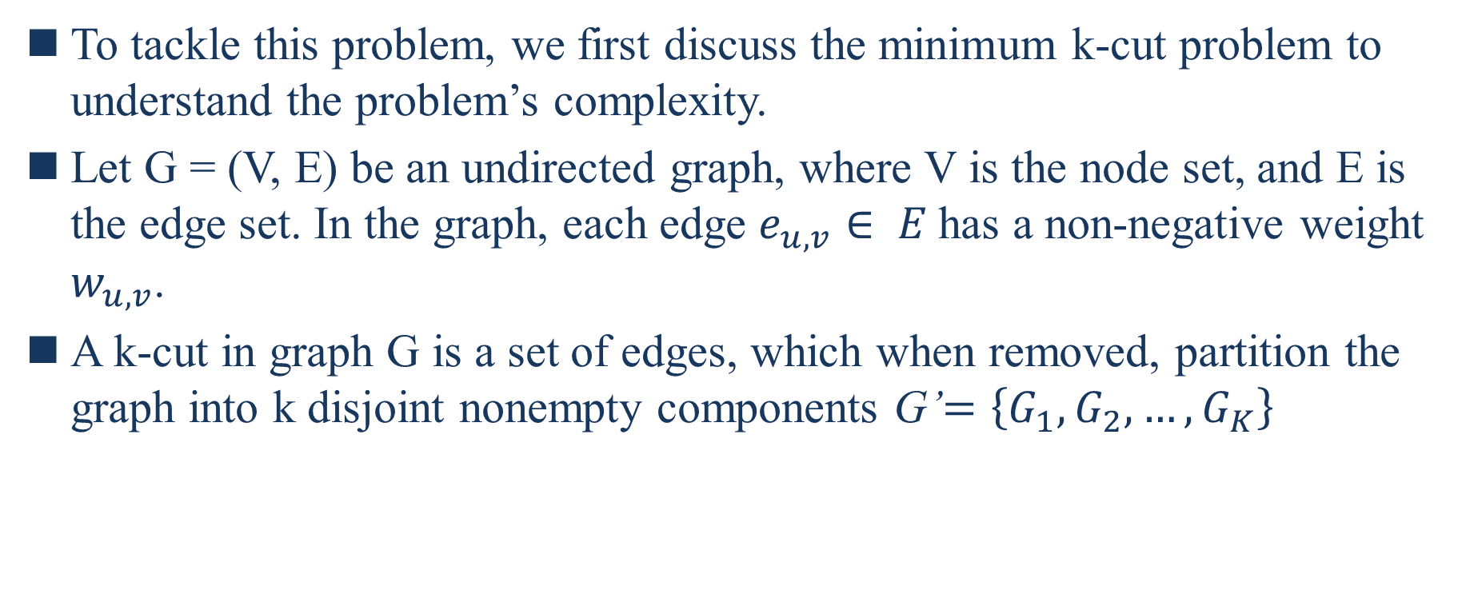
3. Minimum K-Cut Problem
To tackle this problem, we first discuss the minimum k-cut problem to understand the problem’s complexity.
Let G = (V, E) be an undirected graph, where V is the node set, and E is the edge set. In the graph, each edge $e_{u,v}∈ E$has a non-negative weight $w_{u,v}$.
A k-cut in graph G is a set of edges, which when removed, partition the graph into k disjoint nonempty components G’$=\left\{G_{1},G_{2},…,G_{K}\right\}$
Notes:
為了處理這個問題，我們首先討論Minimum K-Cut Problem以了解問題的複雜度
設G = (V, E)是一個無方向性的圖形，其中V是節點集合，和E是邊集合。圖形中，每一個邊$e_{u,v}∈ E都是$非負權重
圖中的k-cut是邊的集合，當刪除邊時，將圖劃分為k個不相交的非空分量G’$=\left\{G_{1},G_{2},…,G_{K}\right\}$

Slide 30
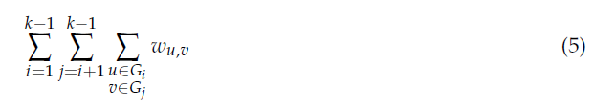
3. Minimum K-Cut Problem
The minimum k-cut problem is to find a k-cut of minimum total weight of edges whose two ends are in different components, which can be computed as:
A minimum cut is a simply minimum k-cut when k = 2.
Notes:
minimum k-cut problem是找到一個兩端在不同分量的邊的最小總權重的k-cut，可計算為
當k=2時，最小切割是簡單的最小k-cut

Slide 31
3. Minimum K-Cut Problem
Figure 1 shows an example of a minimum cut of a graph.
There are 2 cuts shown in the figure, and the dash line is a minimum cut of the graph, as the total weight of edges cut by the dash line is the minimum of all cuts.
Given a service-based application, we can represent it as a graph, where the nodes represent services and the weights of edges represent the traffic rate.
Notes:
圖1顯示了圖形的最小切割的示例
在圖上顯示2個切割，虛線是圖形的最小切割，因為虛線切割的邊總權重是所有切割的最小值
給定一個基於服務的應用程序，我們可以將其表示為一個圖形，其中節點表示服務和邊的權重表示流量率

Slide 32
3. Minimum K-Cut Problem
Specifically, the traffic rate from service 𝑠_𝑖 to service 𝑠_𝑗 and the rate from service 𝑠_𝑗 to service 𝑠_𝑖 are represented as two edges respectively in the graph.
Hence, finding a minimum k-cut of the graph is equivalent to partitioning the application into k parts while keeping overall traffic between different parts to a minimum.
However, for arbitrary k, the minimum k-cut problem is NP-hard [10].
10. Goldschmidt, O.; Hochbaum, D.S. Polynomial algorithm for the k-cut problem. In Proceedings of the 1988 29th Annual Symposium on Foundations of Computer Science, White Plains, NY, USA, 24–26 October 1988; pp. 444–451.
Notes:
具體來說，從服務$s_{i}$到服務$s_{j}$的流量率和從服務$s_{j}$到服務$s_{i}$的流量率在圖中分別表示為兩條邊
因此，找出圖形的最小k-cut等效於將應用程序劃分為k個部分，同時將不同部分間的總流量保持在最低限度
然而，對於任意k來說，minimum k-cut problem是NP-hard[10]

Slide 33
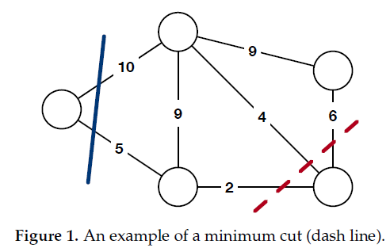
3. Minimum K-Cut Problem
Notes:
因此，找出圖形的最小k-cut等效於將應用程序劃分為k個部分，同時將不同部分間的總流量保持在最低限度
然而，對於任意k來說，minimum k-cut problem是NP-hard[10]
與開發確定性演算法不同，Karger的演算法[12]提供一個有效的隨機方法來找到圖形的最小切割

Slide 34
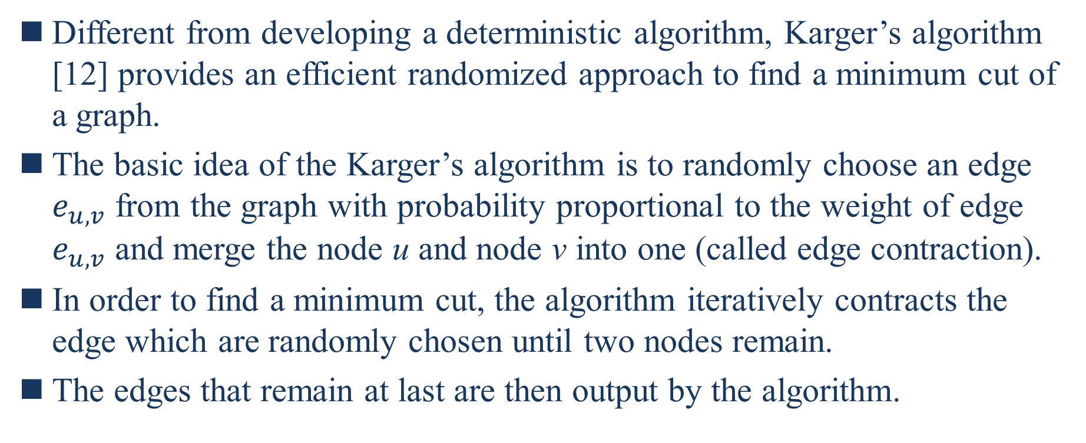
3. Minimum K-Cut Problem
Different from developing a deterministic algorithm, Karger’s algorithm [12] provides an efficient randomized approach to find a minimum cut of a graph.
The basic idea of the Karger’s algorithm is to randomly choose an edge $e_{u,v}$ from the graph with probability proportional to the weight of edge $e_{u,v}$ and merge the node u and node v into one (called edge contraction).
In order to find a minimum cut, the algorithm iteratively contracts the edge which are randomly chosen until two nodes remain.
The edges that remain at last are then output by the algorithm.
12. Karger, D.R. Global Min-cuts in RNC, and Other Ramifications of a Simple Min-Cut Algorithm. SODA 1993, 93, 21–30.
Notes:
與開發確定性演算法不同，Karger的演算法[12]提供一個有效的隨機方法來找到圖形的最小切割
Karger的演算法的基本想法是從圖中隨機選擇一條邊$e_{u,v}$，概率與邊的權重成正比，將節點u和節點v合併為一條邊(成為邊收縮)
為了找出最小切割，演算法迭代地收縮隨機選擇的邊，直到剩下兩個節點
最後剩下的邊由演算法輸出

Slide 35
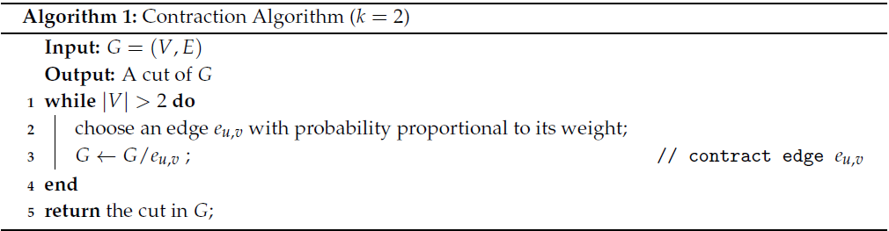
3. Minimum K-Cut Problem
The pseudocode is shown in Algorithm 1.
Notes:
虛擬碼如演算法1

Slide 36
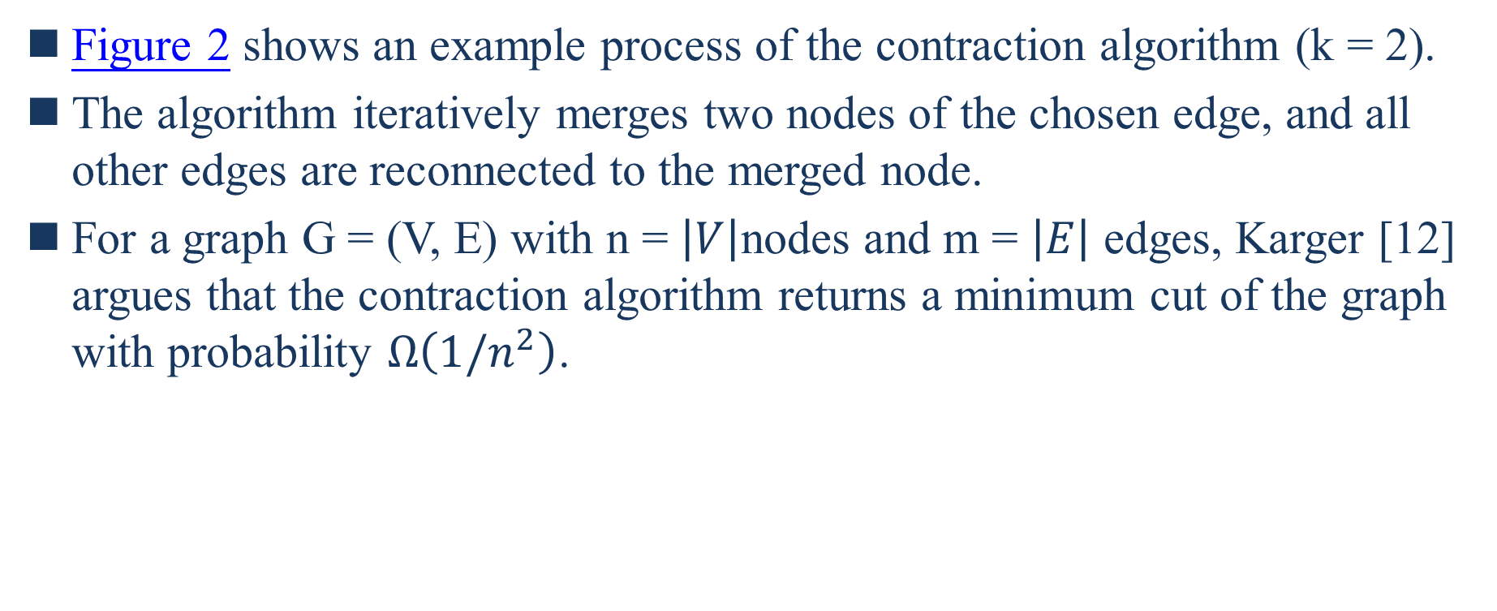
3. Minimum K-Cut Problem
Figure 2 shows an example process of the contraction algorithm (k = 2).
The algorithm iteratively merges two nodes of the chosen edge, and all other edges are reconnected to the merged node.
For a graph G = (V, E) with n = $\left|V\right|$nodes and m = $\left|E\right|$ edges, Karger [12] argues that the contraction algorithm returns a minimum cut of the graph with probability $Ω\left(1/n^{2}\right)$.
12. Karger, D.R. Global Min-cuts in RNC, and Other Ramifications of a Simple Min-Cut Algorithm. SODA 1993, 93, 21–30.
Notes:
圖2顯示了收縮演算法(k=2)的示例過程
演算法迭代合併所選擇的邊的兩個節點，所有其他邊重新連結到合併的節點
對於圖G=(V,E)且n=$\left|V\right|節點$和m=$\left|E\right|$邊，Karger[12]認為收縮演算法以概率$Ω\left(1/n^{2}\right)$回傳圖的最小切割

Slide 37
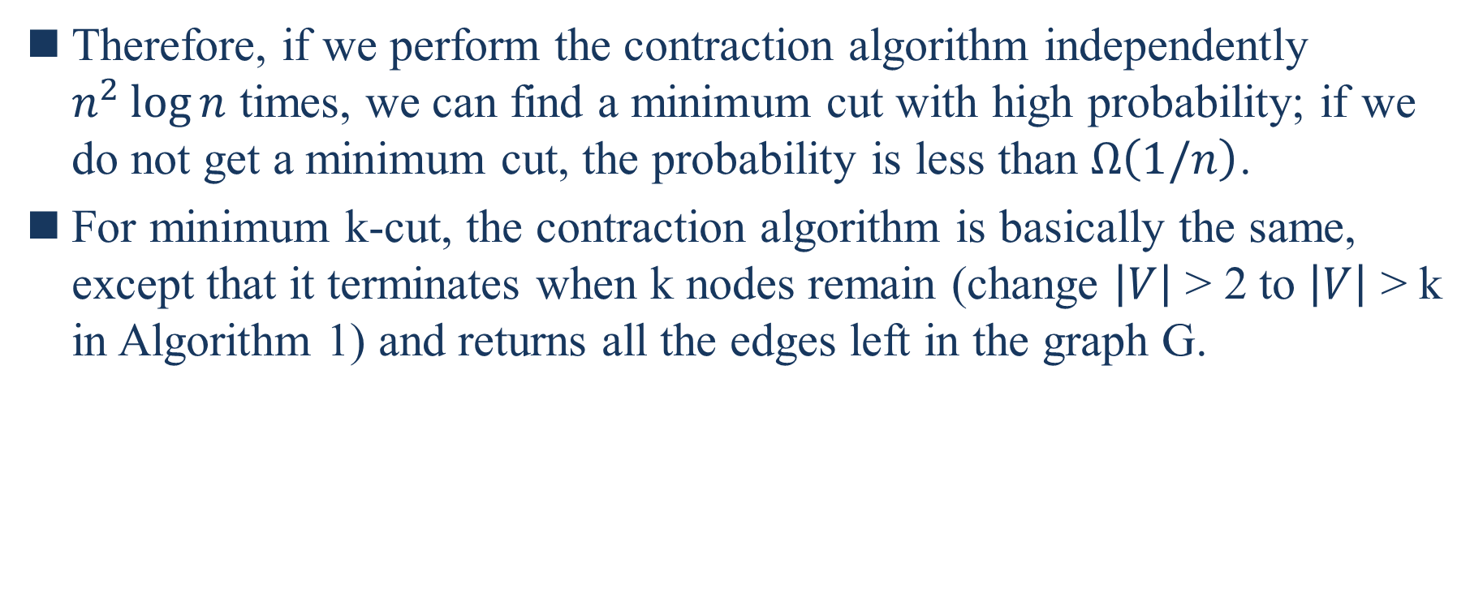
3. Minimum K-Cut Problem
Therefore, if we perform the contraction algorithm independently $n^{2}\log{n}$ times, we can find a minimum cut with high probability; if we do not get a minimum cut, the probability is less than $Ω\left(1/n\right)$.
For minimum k-cut, the contraction algorithm is basically the same, except that it terminates when k nodes remain (change $\left|V\right|$ > 2 to $\left|V\right|$ > k in Algorithm 1) and returns all the edges left in the graph G.
Notes:
因此，如果我們單獨執行收縮演算法$n^{2}\log{n}$次，我們可以找到一個具有高機率的最小切割;如果我們無法獲得一個最小切割，則機率小於$Ω\left(1/n\right)$
對於最小k-cut，收縮演算法基本相同，只是在k個節點剩餘時終止(在演算法1中將$\left|V\right|$ > 2改為$\left|V\right|$ > k)並回傳圖G中剩下的所有邊

Slide 38
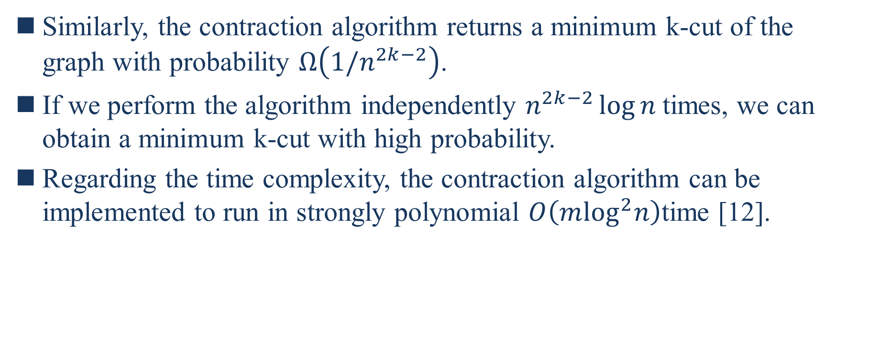
3. Minimum K-Cut Problem
Similarly, the contraction algorithm returns a minimum k-cut of the graph with probability $Ω\left(1/n^{2k−2}\right)$.
If we perform the algorithm independently $n^{2k−2}\log{n}$times, we can obtain a minimum k-cut with high probability.
Regarding the time complexity, the contraction algorithm can be implemented to run in strongly polynomial $O\left(m\log^{2}n\right)$time [12].
12. Karger, D.R. Global Min-cuts in RNC, and Other Ramifications of a Simple Min-Cut Algorithm. SODA 1993, 93, 21–30.
Notes:
相同地，收縮演算法以概率$Ω\left(1/n^{2k−2}\right)$回傳圖的最小k-cut
如果我們單獨執行演算法$n^{2k−2}\log{n}$次，我們可以獲得一個具有高概率的最小k-cut
關於時間複雜度，收縮演算法可以實現在strongly polynomial $O\left(m\log^{2}n\right)$time內運行

Slide 39
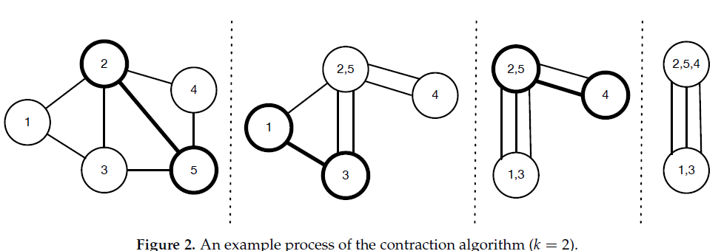
3. Minimum K-Cut Problem

Slide 40
4. Placement Algorithm
In this section, we describe the algorithms we proposed in this work. The goal of our algorithms is to find a placement solution to minimize inter-machine traffic while satisfying multi-resource demands.
The key design of our approach includes: (1) application partition based on contraction algorithms, (2) heuristic packing with traffic awareness, and (3) placement finding with threshold adjustment.
Notes:
在本節中，我們將描述我們在這項工作中提出的演算法。我們的演算法的目標是找出一個放置解決方案，在滿足多資源需求的同時最小化機器間的流量
我們方法的關鍵設計包括:(1)基於收縮演算法的應用程序劃分(2)具有流量感知的啟發式打包，以及(3)具有臨界值調整的位置查找

Slide 41

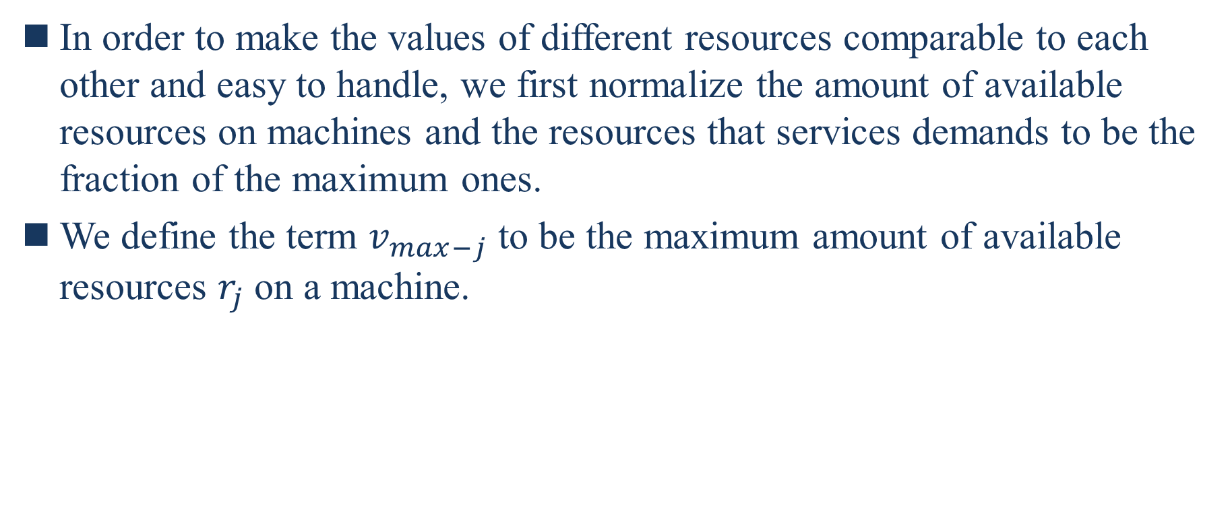
4.1. Application Partition
In order to make the values of different resources comparable to each other and easy to handle, we first normalize the amount of available resources on machines and the resources that services demands to be the fraction of the maximum ones.
We define the term $v_{max−j}$ to be the maximum amount of available resources $r_{j}$ on a machine.
Notes:
為了使不同資源的值相互可比且易於處理，我們首先將機器上的可用資源量和服務所需的資源量標準化為最大資源量的分數
我們定義術語$v_{max−j}是$機器上可用資源的最大數量$r_{j}$

Slide 42
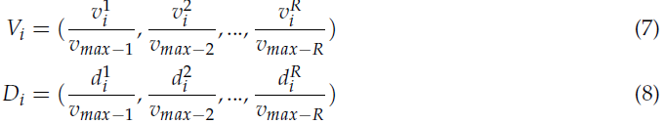

4.1. Application Partition
Then the vector $V_{i}$ of available resources on machine $m_{i}$ and the vector $D_{i}$ of resource demands of service $s_{i}$ are normalized as:
Notes:
接著在機器$m_{i}$上可用資源的向量$V_{i}$和服務$s_{i}$資源需求的向量$D_{i}$被標準化為

Slide 43
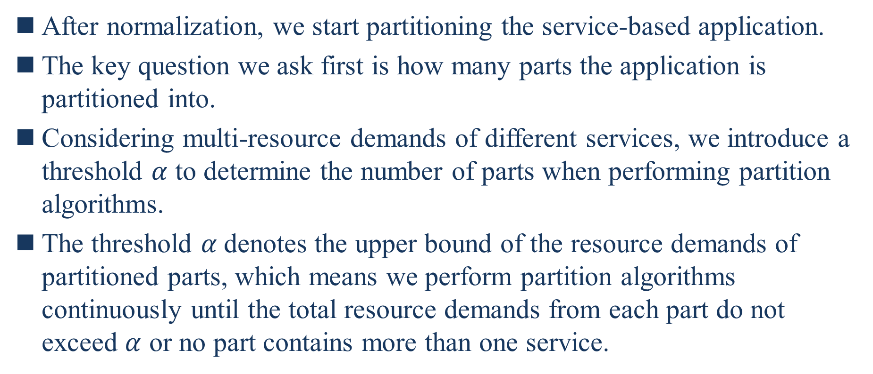
4.1. Application Partition
After normalization, we start partitioning the service-based application.
The key question we ask first is how many parts the application is partitioned into.
Considering multi-resource demands of different services, we introduce a threshold $α$ to determine the number of parts when performing partition algorithms.
The threshold $α$denotes the upper bound of the resource demands of partitioned parts, which means we perform partition algorithms continuously until the total resource demands from each part do not exceed $α$ or no part contains more than one service.
Notes:
標準化後，我們開始劃分基於服務的應用程序
我們首先要問的關鍵問題是應用程序分為多少部分
考慮不同服務的多資源需求，我們在執行分區演算法時引入了一個臨界值$α$ 來決定部分的數量
臨界值$α$表示分區部分的資源需求的上限，這意味著我們連續執行分區演算法直到每個部份的總資源需求無法超過$α$或沒有部份包含多個服務

Slide 44
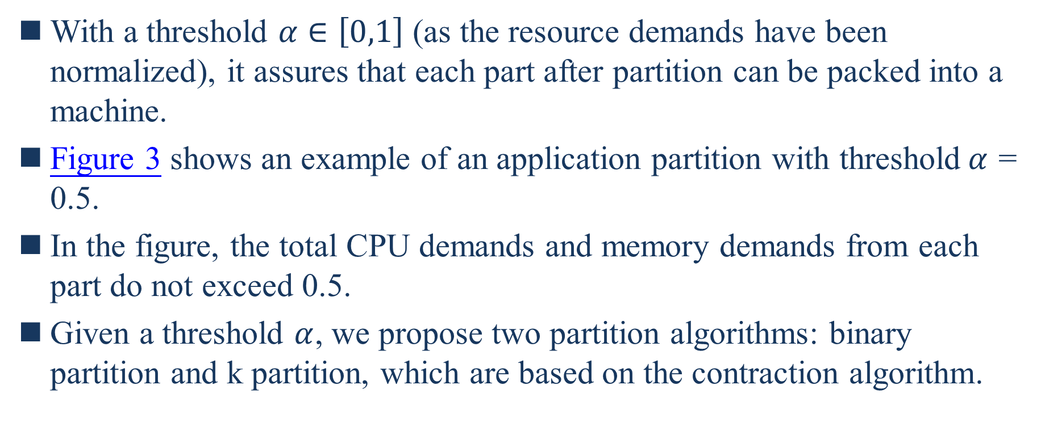
4.1. Application Partition
With a threshold $α∈\left[0,1\right]$ (as the resource demands have been normalized), it assures that each part after partition can be packed into a machine.
Figure 3 shows an example of an application partition with threshold$α$ = 0.5.
In the figure, the total CPU demands and memory demands from each part do not exceed 0.5.
Given a threshold $α$, we propose two partition algorithms: binary partition and k partition, which are based on the contraction algorithm.
Notes:
使用臨界值$α∈\left[0,1\right]$(因為資源需求已經標準化)，它確保分區後每個部份都可以打包到機器中
圖3顯示了臨界值$α$ = 0.5的應用程序分區示例
圖中，各部份的總CPU需求和記憶體需求不超過0.5
給定一個臨界值$α$，我們提出兩個分區演算法 : 二元分區和k分區，該算法都是基於收縮演算法

Slide 45
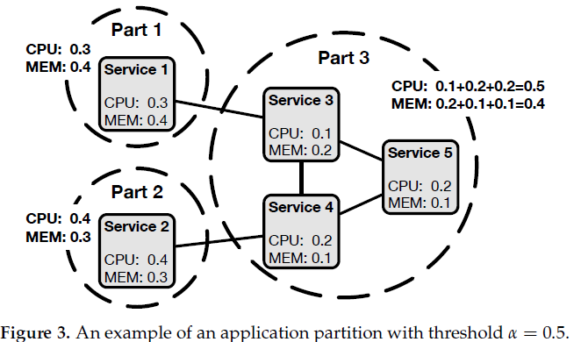
4.1. Application Partition

Slide 46
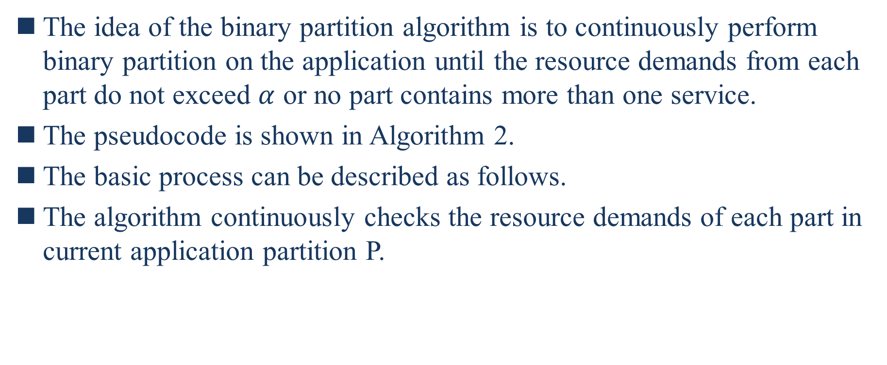
4.1.1. Binary Partition
The idea of the binary partition algorithm is to continuously perform binary partition on the application until the resource demands from each part do not exceed $α$ or no part contains more than one service.
The pseudocode is shown in Algorithm 2.
The basic process can be described as follows.
The algorithm continuously checks the resource demands of each part in current application partition P.
Notes:
二元分區演算法的想法是在應用程序上連續執行二元分區直到每個部份的資源需求不超過$α$或沒有部份包含多個服務
虛擬碼如演算法2
基本過程可以描述如下
該演算法不斷檢查當前應用程序分區P中每個部份的資源需求

Slide 47
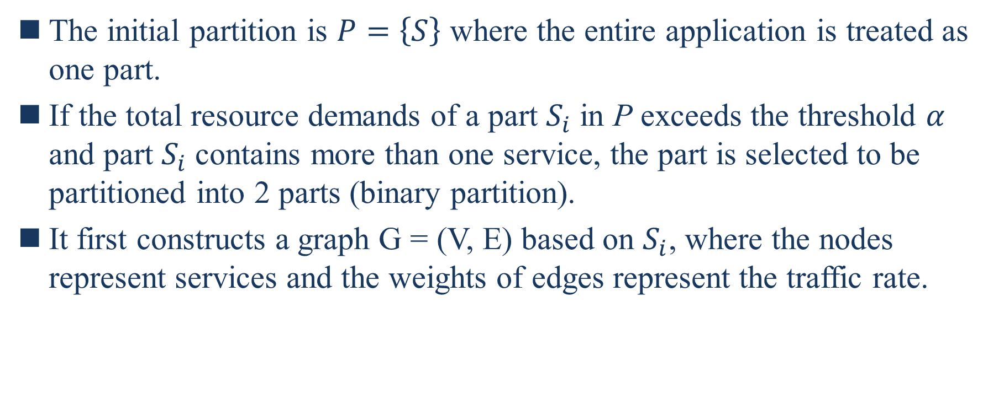
4.1.1. Binary Partition
The initial partition is $P=\left\{S\right\}$ where the entire application is treated as one part.
If the total resource demands of a part $S_{i}$ in P exceeds the threshold $α$ and part $S_{i}$ contains more than one service, the part is selected to be partitioned into 2 parts (binary partition).
It first constructs a graph G = (V, E) based on $S_{i}$, where the nodes represent services and the weights of edges represent the traffic rate.
Notes:
初始分區是$P=\left\{S\right\}$，其中整個應用程序被視為一個部分
假如P中的一個部分$S_{i}$的總資源需求超過臨界值$α$和部分$S_{i}$包含超過一個服務，該部分被選中要劃分為2個部分(二元分區)
它首先根據$S_{i}$建構一個圖G = (V, E)，其中節點代表服務和邊的權重代表流量率

Slide 48
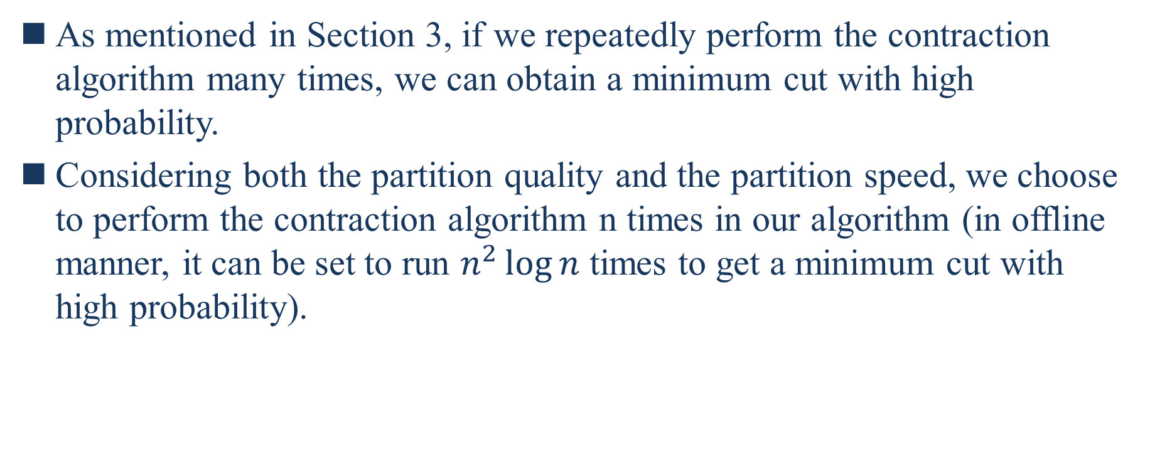
4.1.1. Binary Partition
As mentioned in Section 3, if we repeatedly perform the contraction algorithm many times, we can obtain a minimum cut with high probability.
Considering both the partition quality and the partition speed, we choose to perform the contraction algorithm n times in our algorithm (in offline manner, it can be set to run $n^{2}\log{n}$ times to get a minimum cut with high probability).
Notes:
如章節3所述，如果我們重複執行收縮演算法多次，我們可以獲得高概率的最小切割
考慮分區質量和分區速度，我們選擇在我們的演算法中執行收縮演算法n次(離線方式，可以設置運行$n^{2}\log{n}次$以獲得高概率的最小切割)

Slide 49
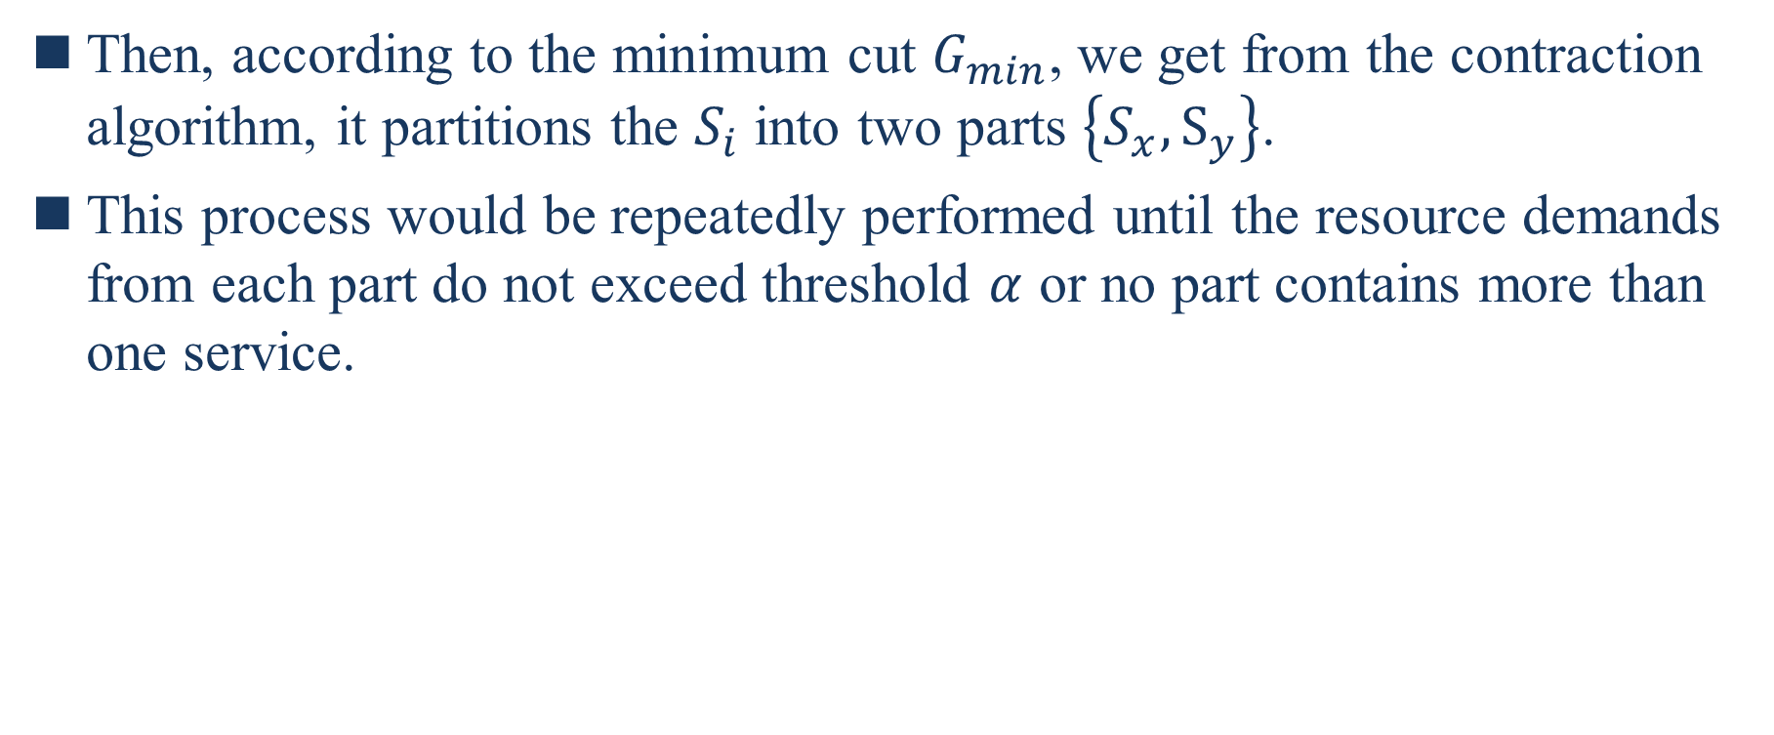
4.1.1. Binary Partition
Then, according to the minimum cut $G_{min}$, we get from the contraction algorithm, it partitions the $S_{i}$ into two parts $\left\{S_{x},S_{y}\right\}$.
This process would be repeatedly performed until the resource demands from each part do not exceed threshold $α$ or no part contains more than one service.
Notes:
接著，根據最小切割$G_{min}$，我們從收縮演算法中得到，它將$S_{i}$分成兩個部分$\left\{S_{x},S_{y}\right\}$
這個過程將重複執行直到每個部份的資源需求不超過臨界值$α$或沒有部份包含超過一個服務

Slide 50
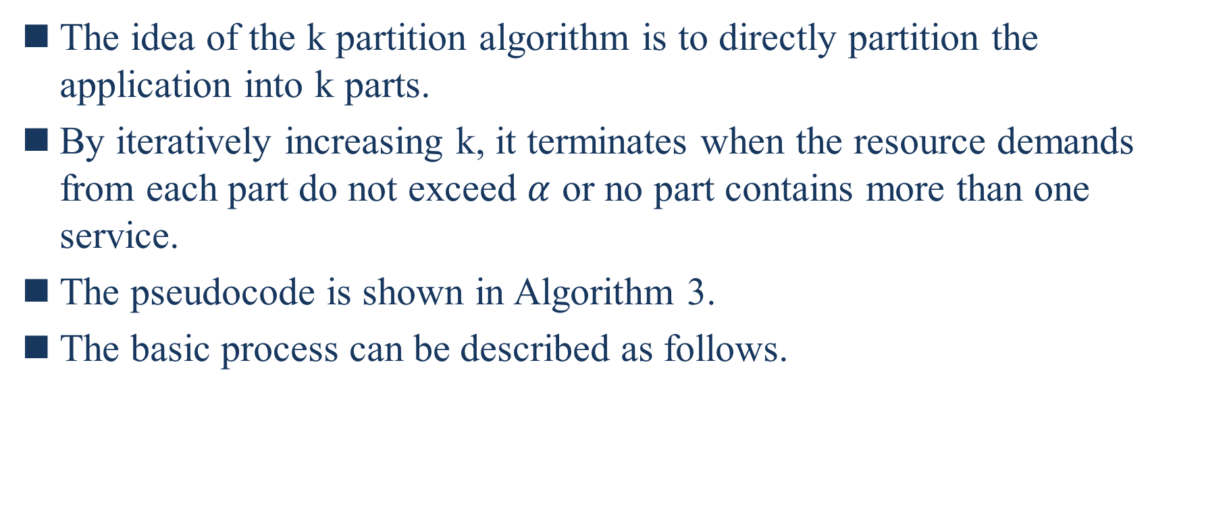
4.1.2. K Partition
The idea of the k partition algorithm is to directly partition the application into k parts.
By iteratively increasing k, it terminates when the resource demands from each part do not exceed $α$ or no part contains more than one service.
The pseudocode is shown in Algorithm 3.
The basic process can be described as follows.
Notes:
K分區演算法的想法是直接將應用程序劃分為K個部分
透過迭代增加K，當每個部份不超過$α$或沒有部分包含超過一個服務時，它終止
虛擬碼如演算法3所示
基本過程可描述為下

Slide 51
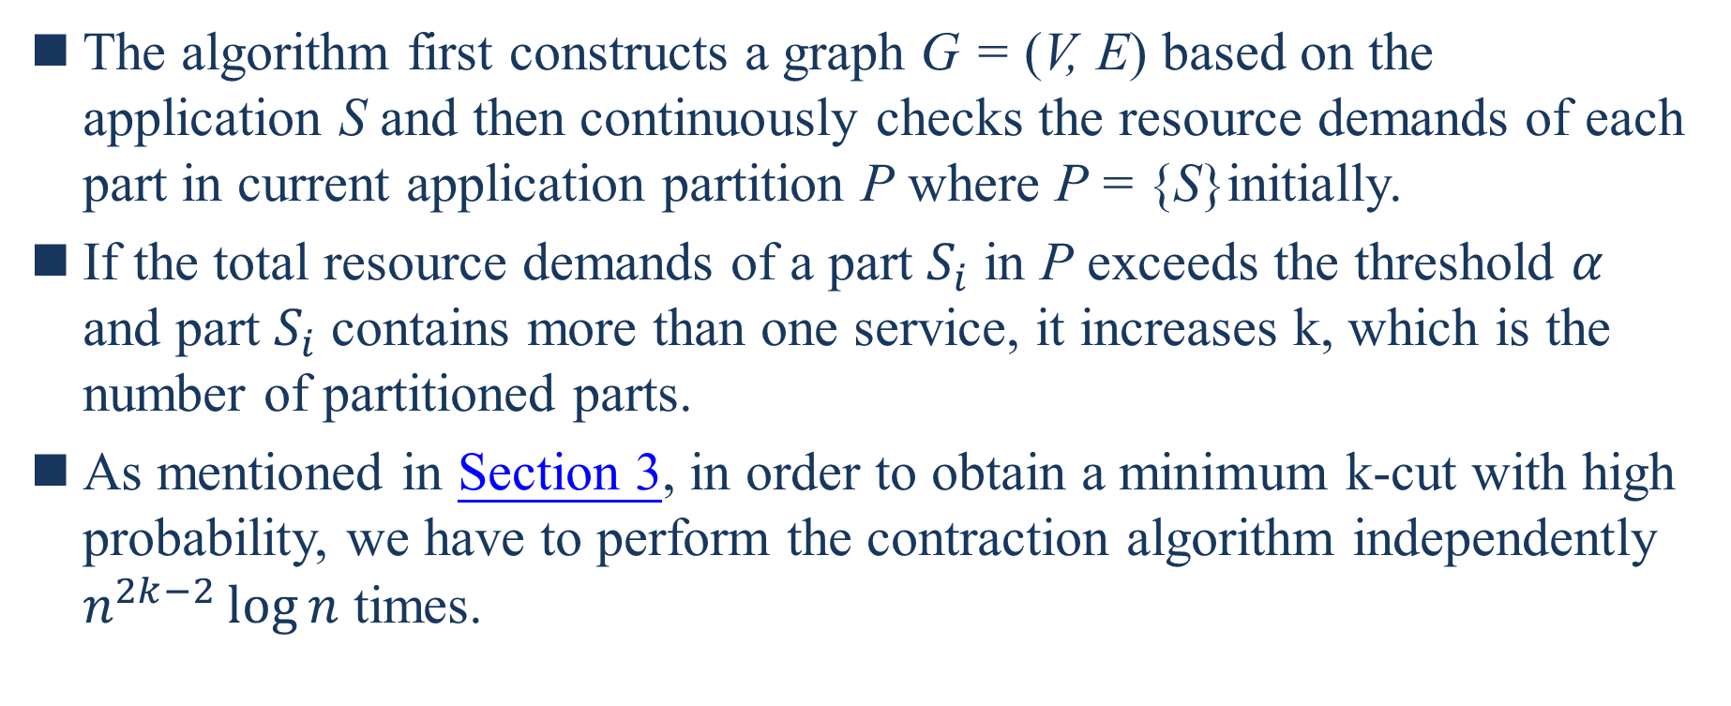
4.1.2. K Partition
The algorithm first constructs a graph G = (V, E) based on the application S and then continuously checks the resource demands of each part in current application partition P where P = {S}initially.
If the total resource demands of a part $S_{i}$ in P exceeds the threshold $α$ and part $S_{i}$ contains more than one service, it increases k, which is the number of partitioned parts.
As mentioned in Section 3, in order to obtain a minimum k-cut with high probability, we have to perform the contraction algorithm independently $n^{2k−2}\log{n}$ times.
Notes:
該演算法首先根據應用程序S構建一個圖G = (V, E)，然後連續檢查現在的應用程序分區P中每個部份的資源需求，其中P = {S}最初
假如P中部分$S_{i}$的總資源需求超過臨界值$α$且部分$S_{i}$包含多個服務，則增加k，即分區的數量
如第3節所述，為了以高概率獲得最小k-cut，我們必須獨立執行收縮演算法$n^{2k−2}\log{n}$次

Slide 52
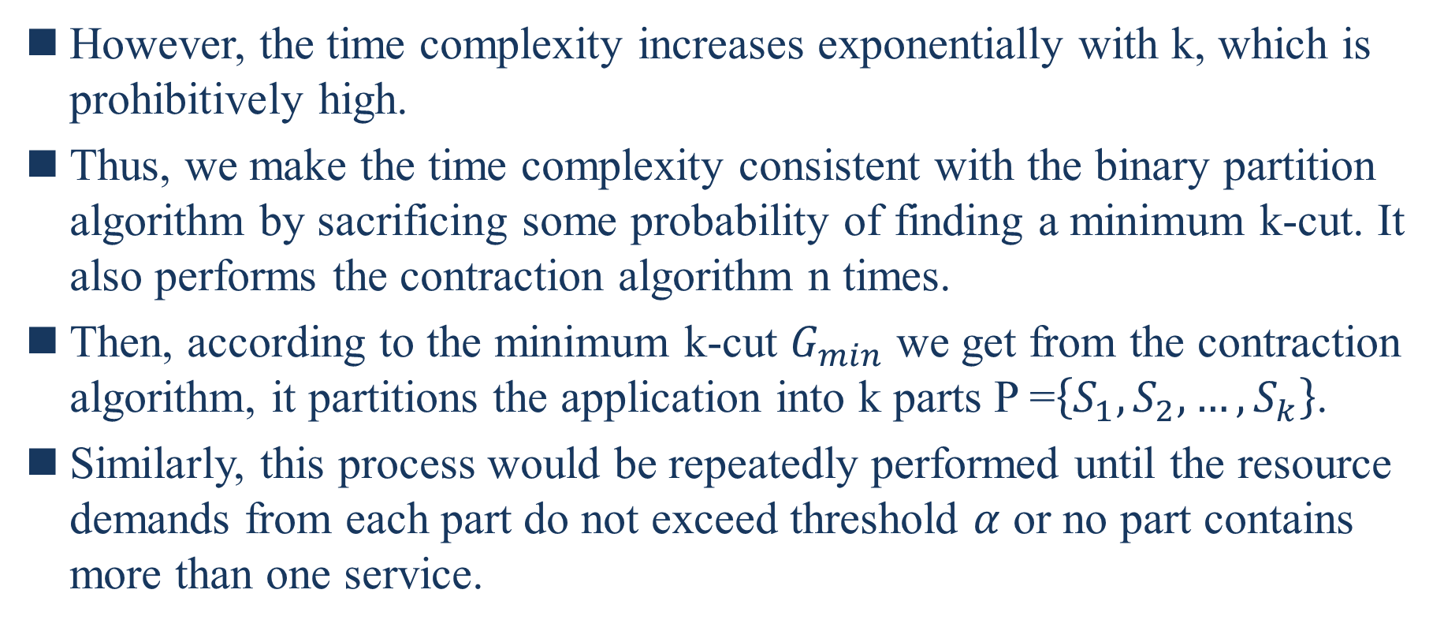
4.1.2. K Partition
However, the time complexity increases exponentially with k, which is prohibitively high.
Thus, we make the time complexity consistent with the binary partition algorithm by sacrificing some probability of finding a minimum k-cut. It also performs the contraction algorithm n times.
Then, according to the minimum k-cut $G_{min}$ we get from the contraction algorithm, it partitions the application into k parts P =$\left\{S_{1},S_{2},…,S_{k}\right\}$.
Similarly, this process would be repeatedly performed until the resource demands from each part do not exceed threshold $α$ or no part contains more than one service.
Notes:
然而，時間複雜度隨著k呈指數增長，這是非常高的
因此，我們通過犧牲一些找到最小k-cut的概率來使時間複雜度和二元分割演算法一致。它還執行收縮演算法n次
然後，根據我們從收縮演算法中得到的最小k-cut${ G}_{min}$，它將應用程序劃分成k個部分P =$\left\{S_{1},S_{2},…,S_{k}\right\}$
相同地，這個過程將重複執行直到每個部份的資源需求不超過臨界值$α$ 或沒有部分包含多個服務

Slide 53
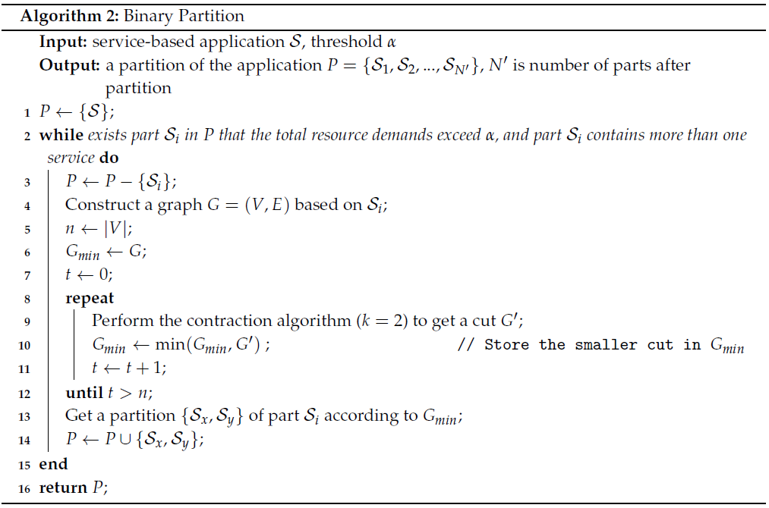
4. Placement Algorithm

Slide 54
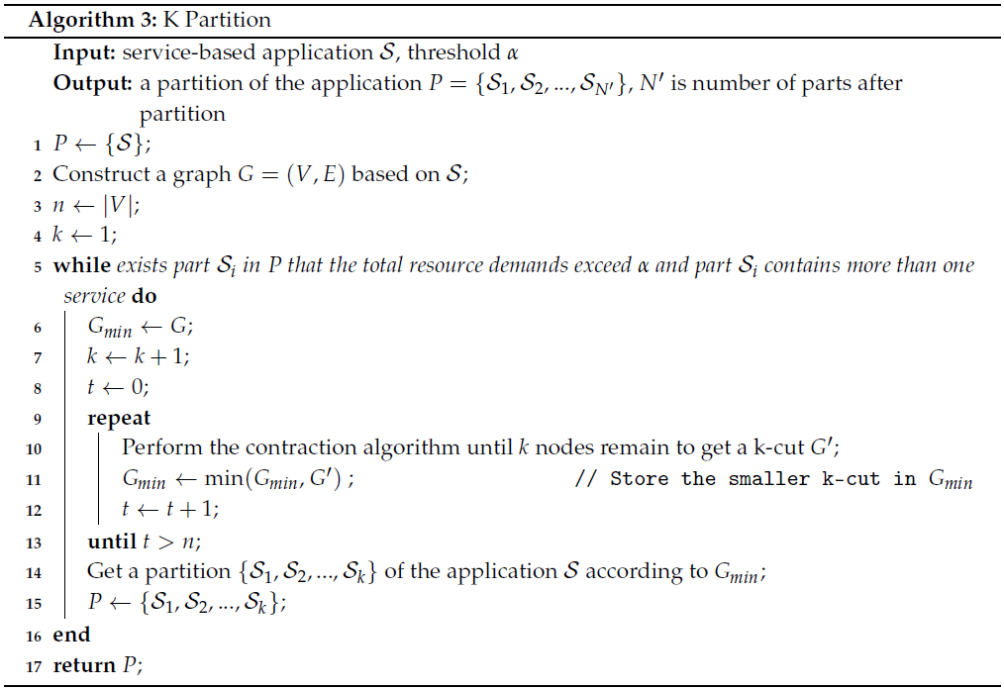
4. Placement Algorithm

Slide 55
4.2. Heuristic Packing
Given a partition of the application, the algorithm here is to pack each part into the heterogeneous machines.
Without considering the traffic rate, the problem can be formulated as a classical multi-dimensional bin packing problem, which is known to be NP-hard [11].
When there are a large amount of services involved in the application, it is infeasible to find the optimal solution in polynomial time.
11. Woeginger, G.J. There is no asymptotic PTAS for two-dimensional vector packing. Inf. Process. Lett. 1997,64, 293–297. [CrossRef]
Notes:
給定應用程式的一個分區，這裡的演算法是將每個部分都打包到異構機器中
不考慮流量率，問題可以表述為一個經典的多維裝箱問題，已知為NP-hard[11]
當應用程序涉及大量服務時，在多項式時間內要找到最佳解是不可行的

Slide 56
4.2. Heuristic Packing
Considering the time complexity and packing quality, we adopt two greedy heuristics in our packing algorithm: Traffic Awareness and Most-Loaded Heuristic. The algorithm is shown in Algorithm 4.
Notes:
考慮到時間複雜度和打包質量，我們在我們的演算法中採取兩個貪然啟發式算法:流量感知和最大負載啟發式算法。該算法如演算法4所示

Slide 57
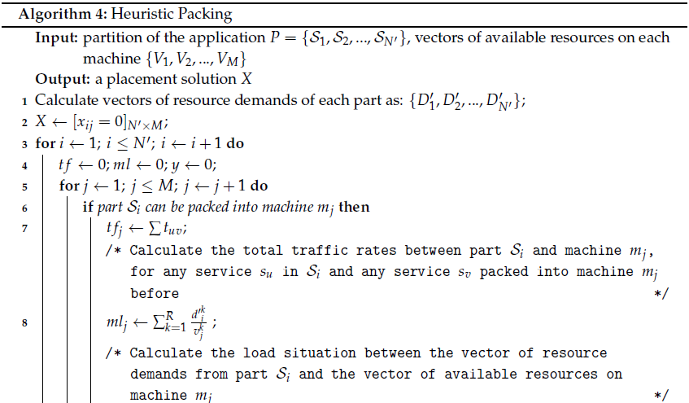
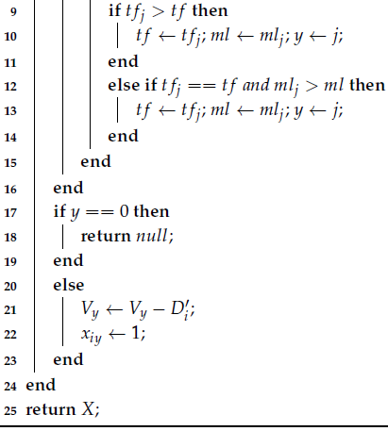
4.2. Heuristic Packing

Slide 58
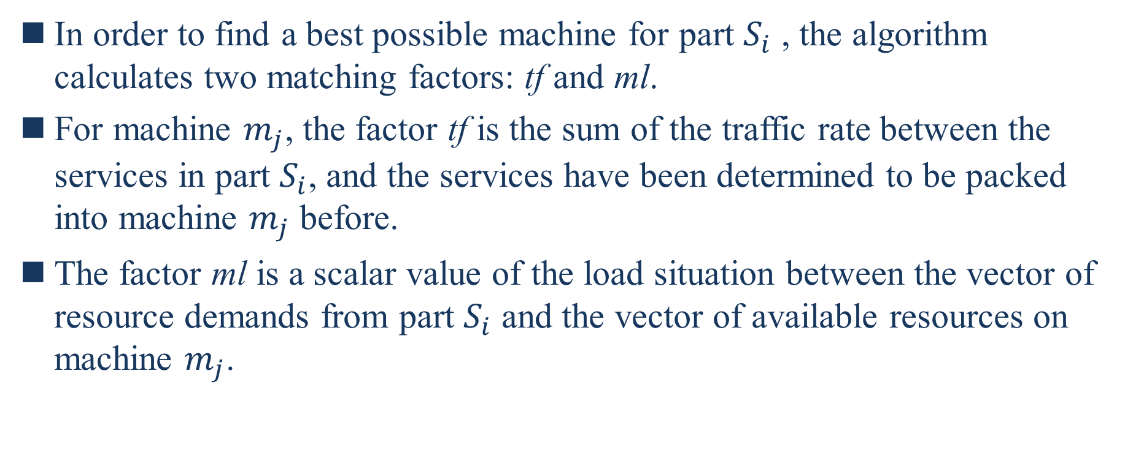
4.2. Heuristic Packing
In order to find a best possible machine for part $S_{i}$ , the algorithm calculates two matching factors: tf and ml.
For machine $m_{j}$, the factor tf is the sum of the traffic rate between the services in part $S_{i}$, and the services have been determined to be packed into machine $m_{j}$ before.
The factor ml is a scalar value of the load situation between the vector of resource demands from part $S_{i}$ and the vector of available resources on machine $m_{j}$.
Notes:
為了找到零件$S_{i}$的最佳可能機器，演算法計算兩個匹配因子:tf 和ml
對於機器$m_{j}$，因子tf是$S_{i}$部分服務之間的流量速率總和，並且之前已經確定要打包到機器$m_{j}中$的服務
因子ml是部分$S_{i}資源需求$的向量和機器$m_{j}$上的可用資源的向量之間負載情況的純量值

Slide 59
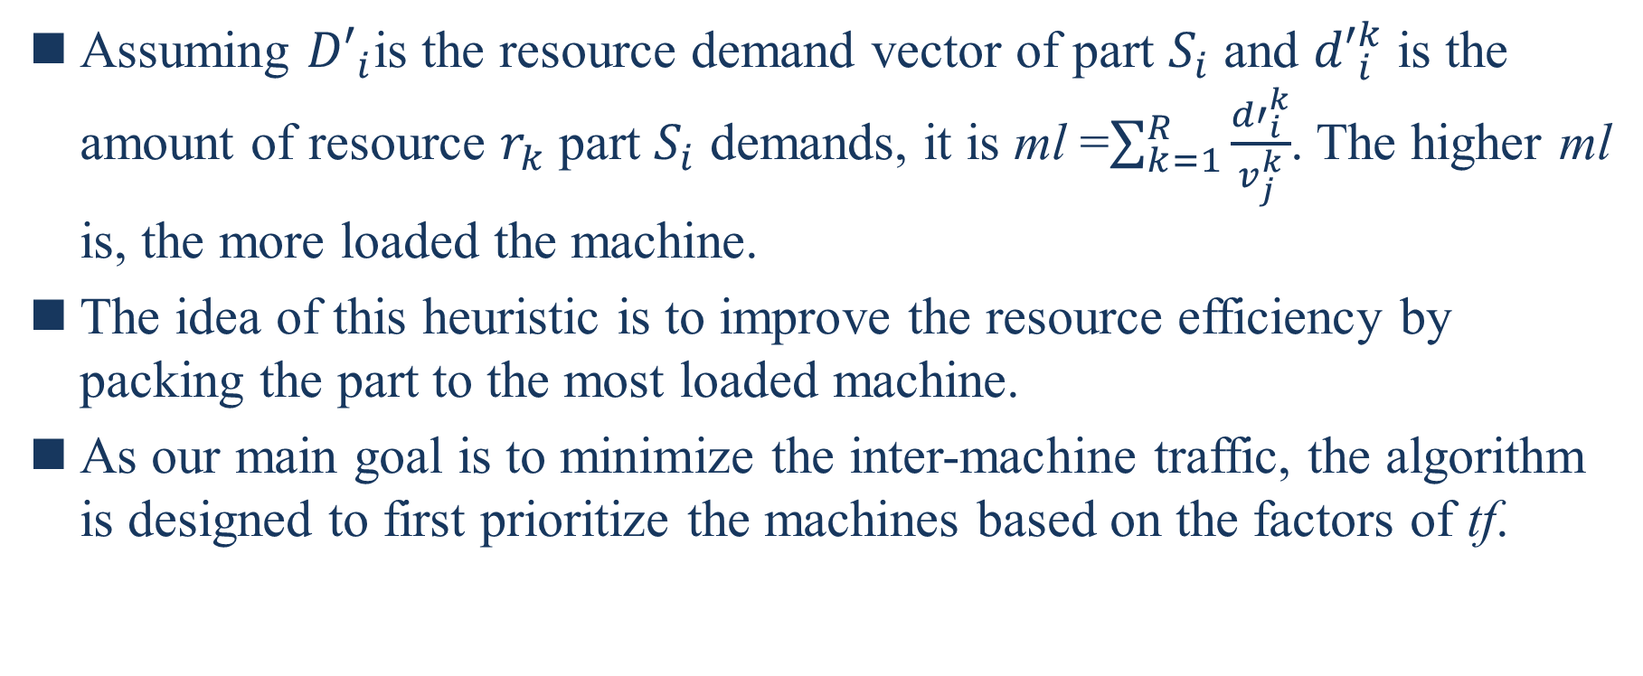
4.2. Heuristic Packing
Assuming ${D′}_{i}$is the resource demand vector of part $S_{i}$ and ${d′}_{i}^{k}$ is the amount of resource $r_{k}$ part $S_{i}$ demands, it is ml =$\sum_{k=1}^{R}{\frac{{d′}_{i}^{k}}{v_{j}^{k}}}$. The higher ml is, the more loaded the machine.
The idea of this heuristic is to improve the resource efficiency by packing the part to the most loaded machine.
As our main goal is to minimize the inter-machine traffic, the algorithm is designed to first prioritize the machines based on the factors of tf.
Notes:
假設${D′}_{i}為$部分$S_{i}$的資源需求向量，${d′}_{i}^{k}為$部分$S_{i}$資源需求量，即ml =$\sum_{k=1}^{R}{\frac{{d′}_{i}^{k}}{v_{j}^{k}}}$。ml愈高，機器裝載的愈多
該啟發式算法的想法是通過將零件打包部分到負載最大的機器來提升資源效率
因為我們的主要目標是最小化機器間的流量，因此該演算法首先根據tf的因素對機器優先順序排序

Slide 60
4.2. Heuristic Packing
If the factors of tf are the same, it then prioritizes the machines based on the factors of ml.
Consequently, if all parts in the partition can be packed into machines, the algorithm returns the placement solution.
Otherwise, it returns null.
Notes:
如果tf因子是相同的，接著會根據ml因子來對機器優先順序排序
因此，如果在分區中所有的零件都可以打包到機器中，則該演算法回傳放置解決方案
否則，它回傳null

Slide 61
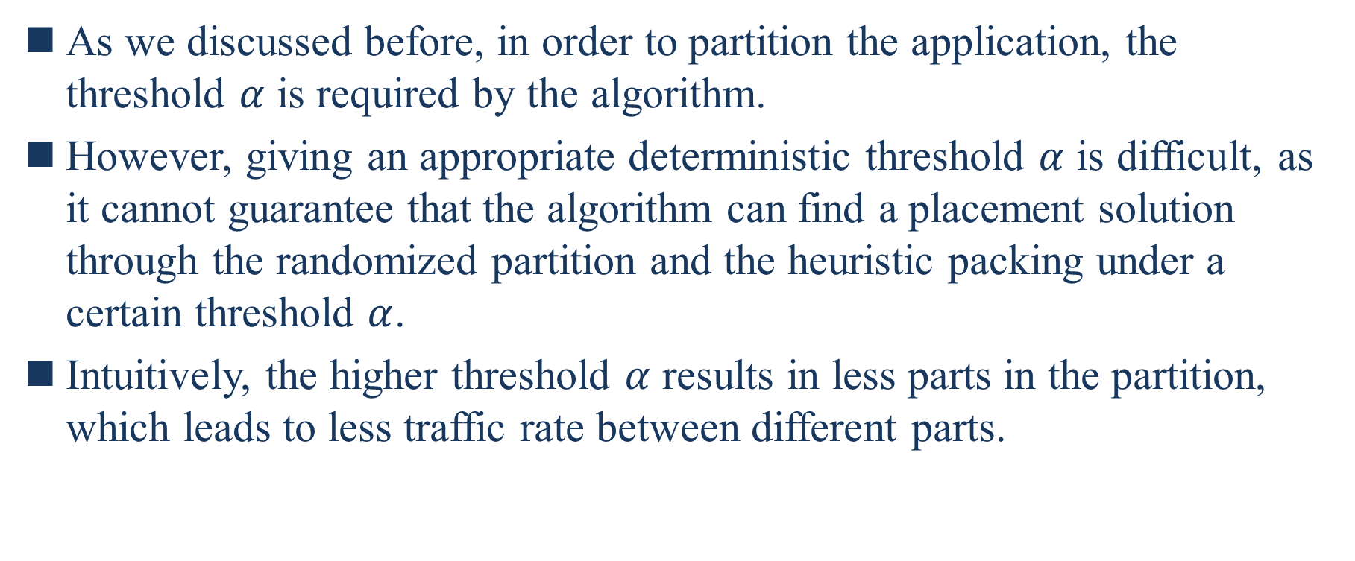
4.3. Placement Finding
As we discussed before, in order to partition the application, the threshold $α$ is required by the algorithm.
However, giving an appropriate deterministic threshold $α$ is difficult, as it cannot guarantee that the algorithm can find a placement solution through the randomized partition and the heuristic packing under a certain threshold $α$.
Intuitively, the higher threshold $α$ results in less parts in the partition, which leads to less traffic rate between different parts.
Notes:
正如我們先前討論的，為了對應用程序分區，演算法需要臨界值$α$
然而，給出一個合適的確定性臨界值是困難的，因為無法保證演算法在一定的臨界值$α$下可以通過隨機分區和啟發式打包找到放置解決方案
直觀上，較高的臨界值$α$導致分區中的部份較小，從而導致不同部分之間的流量率較低

Slide 62
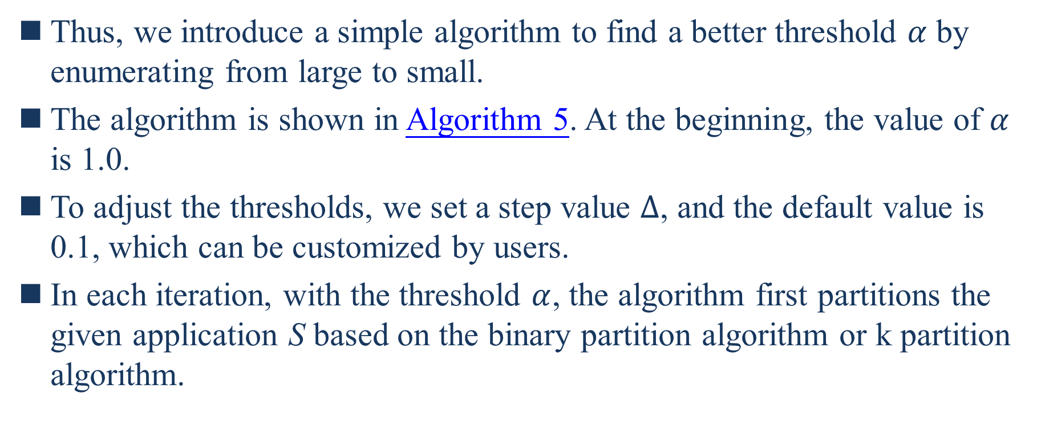
4.3. Placement Finding
Thus, we introduce a simple algorithm to find a better threshold $α$ by enumerating from large to small.
The algorithm is shown in Algorithm 5. At the beginning, the value of $α$ is 1.0.
To adjust the thresholds, we set a step value $∆$, and the default value is 0.1, which can be customized by users.
In each iteration, with the threshold $α$, the algorithm first partitions the given application S based on the binary partition algorithm or k partition algorithm.
Notes:
因此，我們引入了一種簡單的演算法，通過從大到小枚舉來找到更好的臨界值$α$
該算法如演算法5所示。在一開始時，$α$的值為1.0
為了調整臨界值，我們設置了一個步長值$∆$，默認值為0.1，用戶可以自己定義
每次迭代中，使用臨界值$α$，演算法首先根據二元分區演算法或K分區演算法對給定的應用程序S進行分區

Slide 63
4.3. Placement Finding
Note that the algorithm records the latest partition results to avoid multiple repeated partition.
It then tries to pack all parts in the partition into machines based on the heuristic packing algorithm to find a placement solution for the application.
Notes:
注意演算法紀錄的是最新的分區結果，避免多次重覆分區
然後它會嘗試根據啟發式打包演算法將分區中的所有零件打包到機器中，以找到應用程序的放置解決方案

Slide 64
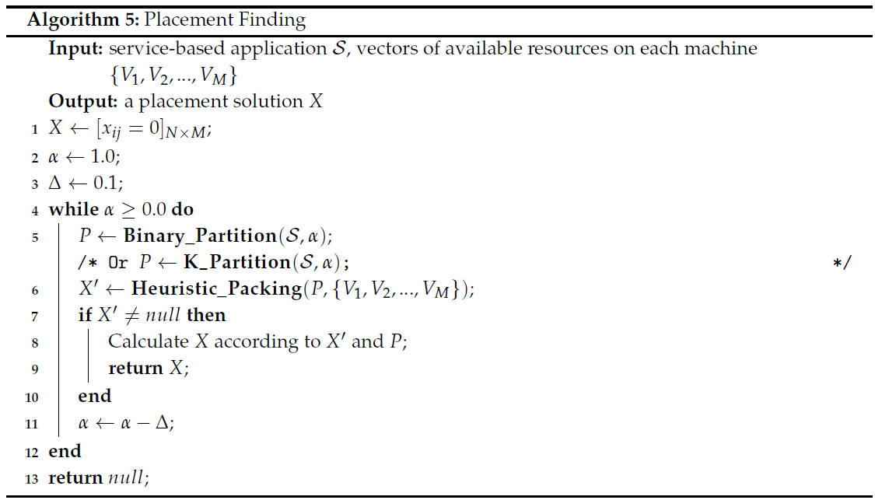
4.3. Placement Finding

Slide 65
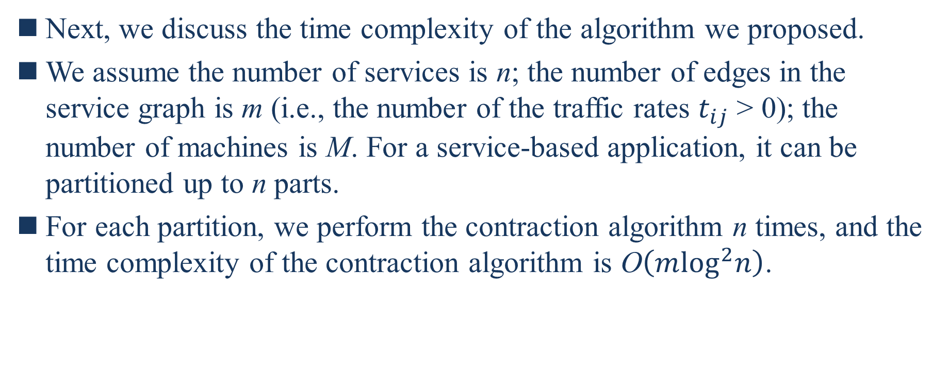
4.3. Placement Finding
Next, we discuss the time complexity of the algorithm we proposed.
We assume the number of services is n; the number of edges in the service graph is m (i.e., the number of the traffic rates $t_{ij}$ > 0); the number of machines is M. For a service-based application, it can be partitioned up to n parts.
For each partition, we perform the contraction algorithm n times, and the time complexity of the contraction algorithm is O$\left(m\log^{2}n\right)$.
Notes:
接著，我們討論我們提出的演算法的時間複雜度
我們假設服務的數量為n;服務圖中的邊的數量為m(即流量率$t_{ij}$的量>0);機器的數量為M。對於基於服務的應用程序，它最多可以劃分為n個部分
對於每個分區，我們執行收縮演算法n次，收縮演算法的時間複雜度是O$\left(m\log^{2}n\right)$

Slide 66
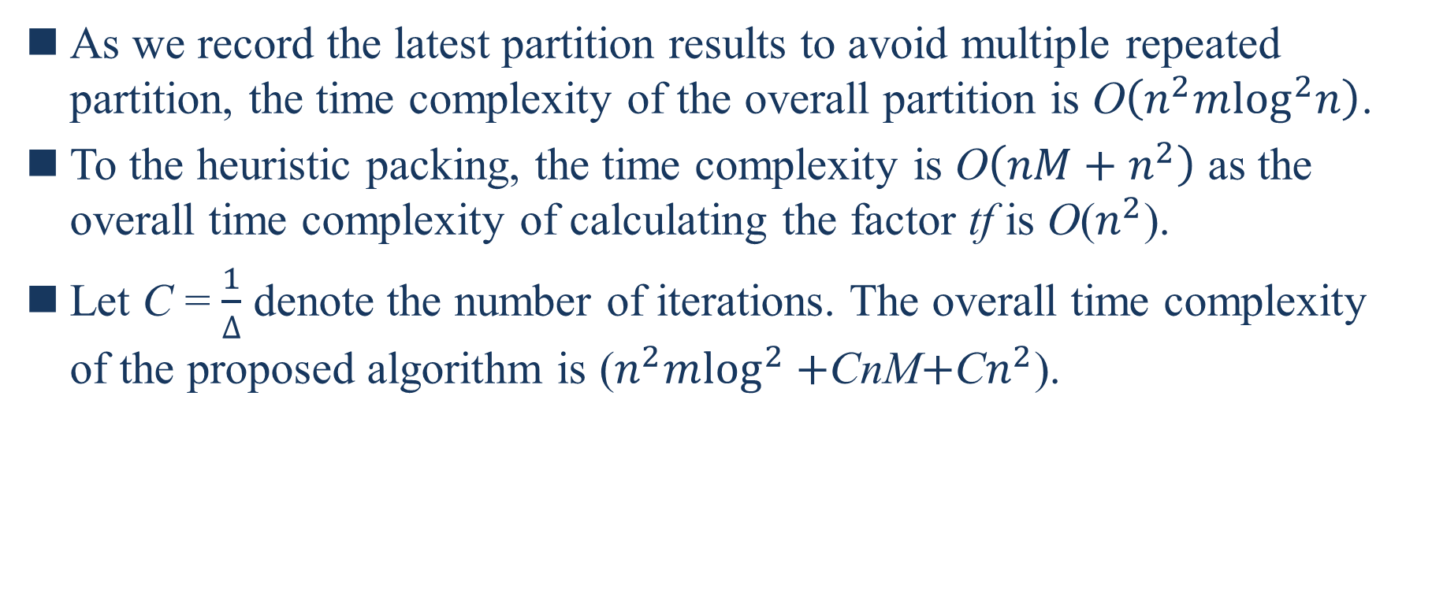
4.3. Placement Finding
As we record the latest partition results to avoid multiple repeated partition, the time complexity of the overall partition is O$\left(n^{2}m\log^{2}n\right)$.
To the heuristic packing, the time complexity is O$\left(nM+n^{2}\right)$ as the overall time complexity of calculating the factor tf is O($n^{2}$).
Let C = $\frac{1}{∆}$ denote the number of iterations. The overall time complexity of the proposed algorithm is ($n^{2}m\log^{2}+$CnM$+$C$n^{2}$).
Notes:
因為我們紀錄的是最新的分區結果，避免多次重覆分區，整體分區的時間複雜度是O$\left(n^{2}m\log^{2}n\right)$
對於啟發式打包，時間複雜度是O$\left(nM+n^{2}\right)$，因為計算因子tf的整體時間複雜度是O($n^{2}$)
讓C = $\frac{1}{∆}$表示迭代的量。提出的演算法整體時間複雜度為($n^{2}m\log^{2}+$CnM$+$C$n^{2}$)

Slide 67
5. Evaluation
We implement a prototype scheduler using python, which is based on our proposed algorithms, for deploying service-based applications on container clusters.
In the experiments, we evaluate our scheduler in testbed clusters of ExoGENI [13] experimental environment.
13. Baldin, I.; Chase, J.; Xin, Y.; Mandal, A.; Ruth, P.; Castillo, C.; Orlikowski, V.; Heermann, C.; Mills, J. Exogeni:
A multi-domain infrastructure-as-a-service testbed. In The GENI Book; Springer: New York, NY, USA, 2016;
pp. 279–315.
Notes:
我們使用python實現了一個原型排程器，它基於我們提出的演算法，用於在容器集群上部署基於服務的應用程序
在實驗中，我們在ExoGENI [13] 實驗環境的測試台集群中評估我們的排程器

Slide 68
5.1. Experimental Methodology
Cluster. We create two different testbed clusters in ExoGENI for experiments.
For the first cluster, we use 30 homogeneous VMs with 2 CPU cores and 6 GB RAM.
Considering the heterogeneity, we use 10 VMs with 2 CPU cores and 6 GB RAM and 10 VMs with 4 CPU cores and 12 GB RAM for the second cluster.
The homogeneous cluster has 30 VMs, and the heterogeneous cluster has 20 VMs, but the total resource capacity is the same.
Notes:
集群。我們在ExoGENI中建立兩個不同的測試台集群進行實驗
對於第一個集群，我們使用30個具有2個CPU內核和6 GB RAM的同構VM
考慮到異構性，我們使用10個具有2個CPU內核和6 GB RAM的VM和10個具有4個內核和12 GB RAM作為第二個集群
同構集群有30個VM，異構集群有20個VM，但總資源量是相同的

Slide 69
5.1. Experimental Methodology
Workloads. In order to evaluate the proposed algorithms in different scenarios, we use synthetic applications in the experiments.
Considering the scale of the testbed cluster, we yield service-based applications which are composed by 64, 96, and 128 services.
For the size of 64, the CPU demand of each service is uniformly picked at random from [30,100] where 100 represents 1 CPU core, and the memory demand is picked at random from [100,300] where 100 represents 1 GB RAM.
Notes:
工作負載。為了在不同的場景中評估提出的演算法，我們在實驗中使用了合成應用程序
考慮到測試台集群的規模，我們產生了由64、96和128個服務所組成的基於服務的應用程序
對於64的大小，每個服務的CPU需求是從[30,100]隨機統一選取的，其中100代表1個CPU內核，記憶體需求從[100,300]隨機選取的，其中100代表1 GB RAM

Slide 70
5.1. Experimental Methodology
For the size of 96, the CPU demand is picked at random from [20,67], and the memory demand is picked at random from [67,200].
For the size of 128, the CPU demand is picked at random from [15,50], and the memory demand is picked at random from [50,150].
According to these ranges, the total resource demands of different application sizes are roughly the same.
For each application size, we generate 10,000 instances for testing.
Notes:
對於96的大小，CPU的需求從[20,67]隨機選取，記憶體需求從[67,200]隨機選取
對於128的大小，CPU的需求從[15,50]隨機選取，記憶體需求從[50,150]隨機選取
根據這些範圍，不同應用程序大小的總資源需求大致相同
對於每個應用程序大小，我們生成10000個實例進行測試

Slide 71
5.1. Experimental Methodology
As the work [14] shows that the log-normal distribution produces the best fit to the data center traffic, we choose to generate the traffic demands between services with the probability 0.05 (ensure that application graph is connected), and the traffic rate follows a log-normal distribution (mean = 5 Mbps, standard deviation = 1 Mbps).
Implementation. We implement all proposed algorithms in our prototype scheduler, where the contraction algorithm is based on the parallel implementation [12].
12. Karger, D.R. Global Min-cuts in RNC, and Other Ramifications of a Simple Min-Cut Algorithm. SODA 1993, 93, 21–30.
14. Benson, T.; Anand, A.; Akella, A.; Zhang, M. Understanding data center traffic characteristics. In Proceedings of the 1st ACM Workshop on Research on Enterprise Networking, Barcelona, Spain, 21 August 2009; ACM: New York, NY, USA, 2009; pp. 65–72.
Notes:
由於工作[14]表明對數常態分布最適合數據中心流量，我們選擇以0.05的機率生成服務之間的流量需求(確保應用程序圖是連通的)，流量率遵循對數常態分布(mean=5Mbps，標準差=1Mbps)
執行。我們在原形排程器中實作所有提出的演算法，其中收縮演算法是根據並行實作[12]

Slide 72
5.1. Experimental Methodology
As we proposed two algorithms for application partition, there are two kinds of configuration.
BP-HP is based on binary partition (BP) and heuristic packing (HP).
KP-HP is based on k partition (KP) and heuristic packing.
Notes:
由於我們提出的兩種應用分區演算法，所以有兩種配置
BP-HP是根據二元分區和啟發式打包
KP-HP是根據K分區和啟發式打包

Slide 73
5.1. Experimental Methodology
Baselines. As we mentioned above, many research efforts have been devoted to the composite Software as a service (SaaS) placement problem [6,15].
However, they target at the placement for a certain set of predefined service components.
6. Yusoh, Z.I.M.; Tang, M. A penalty-based genetic algorithm for the composite SaaS placement problem in the cloud. In Proceedings of the IEEE Congress on Evolutionary Computation, Barcelona, Spain, 18–23 July 2010;
pp. 1–8.
15. Huang, K.C.; Shen, B.J. Service deployment strategies for efficient execution of composite SaaS applications
on cloud platform. J. Syst. Softw. 2015, 107, 127–141. [CrossRef]
Notes:
基線。正如我們上面提到的，許多研究都致力於複合軟體即服務(SaaS)放置問題[6,15]
然而，它們的目標是放置特定的預定義服務元件集

Slide 74
5.1. Experimental Methodology
More importantly, these metaheuristic based approaches often take minutes or even hours, particularly for large-scale clusters, to generate a placement solution, which would face difficulties for an online response.
Another research work focuses on traffic-aware VM placement problem [16,17].
However, these solutions rely on a certain network topology, while our approach is agnostic to network topology.
16. Alicherry, M.; Lakshman, T. Network aware resource allocation in distributed clouds. In Proceedings of the
2012 IEEE INFOCOM, Orlando, FL, USA, 25–30 March 2012; pp. 963–971.
17. Kliazovich, D.; Bouvry, P.; Khan, S.U. DENS: Data center energy-efficient network-aware scheduling. Clust.
Comput. 2013, 16, 65–75. [CrossRef]
Notes:
更重要的是，這些基於元啟發式的方法通常需要幾分鐘或甚至幾小時，特別是對於大規模的集群，才能生成放置解決方案，這將面臨在線回應的難題
另一項研究工作側重於流量感知VM放置問題[16,17]
然而，這些解決方案依賴特定的網路拓撲，而我們的方法與網路拓撲無關

Slide 75
5.1. Experimental Methodology
Thus, we choose to compare our scheduler with the following schemes:
Kubernetes Scheduler (KS): the default scheduler in Kubernetes [18] container cluster tends to distribute containers evenly across the cluster to balance the overall cluster resource usage. Specifically, we add a soft affinity (i.e., pod affinity in Kubernetes) to the services that have traffic between them, as the scheduler would try to place the services which have affinity between them on the same machine.
18. Hightower, K.; Burns, B.; Beda, J. Kubernetes: Up and Running: Dive into the Future of Infrastructure; O’Reilly
Media, Inc.: Champaign, IL, USA, 2017.
Notes:
因此，我們選擇將我們的排程器與以下方案進行比較
Kubernetes排程器(KS): Kubernetes [18]容器集群中的默認排程器傾向於在集群中均勻分布容器，以平衡整個集群資源的使用
。具體來說，我們為它們之間有流量的服務添加一個軟關聯(即Kubernetes中的pod關聯)，因為排程器會嘗試將它們之間具有關聯的服務放在同一台的機器上

Slide 76
5.1. Experimental Methodology
First-Fit Decreasing (FFD): it is a simple and commonly adopted algorithm for the multi-dimensional bin packing problem [19]. FFD operates by first sorting the services in decreasing order according to a certain resource demand and then packs each service into the first machine with sufficient resources.
Best-Fit Decreasing (BFD): it places a service in the fullest machine that still has enough capacity. BFD operates by first sorting the machines in decreasing order according to a certain resource capacity and then packs each service into the first machine with sufficient resources.
19. Ajiro, Y.; Tanaka, A. Improving packing algorithms for server consolidation. In Proceedings of the International CMG Conference, San Diego, CA, USA, 2–7 December 2007; Volume 253.
Notes:
First-Fit Decreasing (FFD): 它是一種用於多維裝箱問題的簡單和普遍採用的演算法[19]。FFD的工作原理是先將服務按照一定的資源需求降序排列，然後打包每個服務到第一台具有足夠的資源機器
Best-Fit Decreasing (BFD): 它將服務放置在仍然具有足夠能量的最完整的機器中。BFD的工作原理是先將機器按照一定的資源容量降序排列，然後將每個服務打包到第一台資源充足的機器中

Slide 77
5.1. Experimental Methodology
Multi-resource Packer (PACK): the idea of this heuristic [4] is that it schedules the services in increasing order of alignment between resource demands of services and resource availability of machines (i.e., dot product between the vector of resource demands and the vector of available resources).
Random (RAND): it randomly picks a service in the application and then packs it into the first machine with sufficient resources.
4. Grandl, R.; Ananthanarayanan, G.; Kandula, S.; Rao, S.; Akella, A. Multi-resource packing for cluster
schedulers. ACM SIGCOMM Comput. Commun. Rev. 2015, 44, 455–466. [CrossRef]
Notes:
多資源打包器 : 這些啟發式[4]的想法是，它按照服務的資源需求和機器的資源可用性之間以遞增順序來排程服務(即資源需求向量和可用資源向量之間的內積
隨機(RAND) : 它在應用程序中隨機選擇，然後將其打包到第一個資源充足的機器中

Slide 78
5.2. Comparison with Baselines
Figure 4 shows the successful placement ratio of different schemes over two clusters.
The successful placement of an application is that the algorithm can find a placement solution to place all the involved services, so the ratio is the number of successfully placed applications to the number of all requested applications.
We observe that RAND performs worst, as it has no heuristic to pack the services.
Notes:
圖4顯示了不同方案在兩個集群上的成功放置率
應用程序的成功放置是演算法可以找出放置所有相關服務的放置解決方案，所以比率是成功放置應用程序的數量佔所有請求的應用程序的數量
我們觀察RAND的表現最差，因為它沒有打包服務的啟發式算法

Slide 79
5.2. Comparison with Baselines
FFD and BFD perform better than KS and PACK because KS mainly focuses on balancing the resource utilization over the cluster, and PACK focuses on the alignment between resource demands and resource availability.
FFD and BFD have been demonstrated as effective algorithms for multi-dimensional bin packing problems [20].
BP-HP performs comparably to KP-HP, and they both slightly outperform other schemes in this evaluation.
20. Stillwell, M.; Schanzenbach, D.; Vivien, F.; Casanova, H. Resource allocation algorithms for virtualized
service hosting platforms. J. Parallel Distrib. Comput. 2010, 70, 962–974. [CrossRef]
Notes:
FFD和BFD比KS和PACK表現更好，因為KS主要側重於平衡集群上的資源使用率，而PACK側重於資源需求和資源可用性之間的一致性
FFD和BFD已被證明是多維裝箱問題的有效算法[20]
BP-HP的性能和KP-HP相當，在本次評估中，它們都略優於其他方案

Slide 80
5.2. Comparison with Baselines
This is mainly because the iterative partition and packing with different thresholds improve the probability of finding a placement solution.
Moreover, the packing algorithm can pack services tightly due to the most-loaded heuristic.
The results of the homogeneous cluster also show that the successful placement ratio increases when the number of services increases.
Notes:
這主要是因為不同臨界值的迭代分區和打包提升找出放置解決方案的概率
此外，打包演算法可以由加載最多的啟發是算法而將服務緊密打包
同構集群的結果也表明，成功放置率隨著服務數量的新增而新增

Slide 81
5.2. Comparison with Baselines
As the total resource demands of the applications in different sizes (different number of services) are roughly the same, the less number of services results in larger resource demands of each individual service, which easily causes the resource fragmentation problem in the placement.
Compared to the homogeneous cluster, the successful placement ratio is much higher in the heterogeneous cluster.
As the machines have larger resource capacity in the heterogeneous cluster, it is easier to pack services constrained by multiple resources.
Notes:
由於不同規模(不同服務數量)的應用程序的總資源需求大致相同，服務數量愈少，每個單獨的服務的資源需求就愈大，容易造成放置中的資源碎片問題
與同構集群比較，異構集群的成功放置率要高得多。
由於機器在異構集群中有更大的資源容量，因此更容易打包受多種資源約束的服務

Slide 82
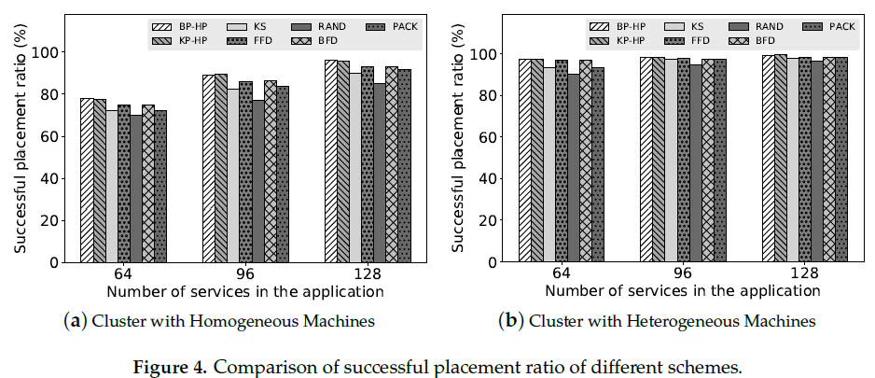
5.2. Comparison with Baselines

Slide 83
5.2. Comparison with Baselines
In the evaluation, we only compare the applications whose all services are placed on the cluster by different algorithms.
Figure 5 shows the average co-located traffic ratio of different schemes, and the error bars represent the maximum and minimum ratio.
The co-located traffic is the traffic between the services that are placed on the same machine, so the ratio is the amount of co-located traffic to the amount of all traffic.
For minimizing inter-machine traffic, the higher the co-located traffic ratio is, the better the placement solution is.
Notes:
在該評估中，我們只比較所有服務通過不同演算法放在集群上的應用程序
圖5顯示了不同方案的平均co-located流量比率，誤差線代表最大和最小比率
co-located流量是放在同一台機器上的服務之間的流量，所以這個比率是co-located流量佔所有流量的比例
為了盡量減小機器間的流量，co-located流量越高，放置方案就越好

Slide 84
5.2. Comparison with Baselines
To be specific, we present the co-located traffic ratio in Table 2. We observe that BP-HP and KP-HP significantly outperform the baselines.
For the cluster with homogeneous machines, BP-HP improves average co-located traffic ratio by 24.8% to 38.1%; KP-HP improves the ratio by 22% to 35.3%.
For the cluster with heterogeneous machines, BP-HP improves average co-located traffic ratio by 24.7% to 39.6%; KP-HP improves the ratio by 23.4% to 38.3%.
Notes:
具體來說，我們在表2中展示co-located流量比率。我們觀察BP-HP和KP-HP明顯優於基線
對於同構機器的集群，BP-HP將平均co-located流量比率提高了24.8%到38.1%;KP-HP將比率提高了22%到35.3%
對於異構機器的集群，BP-HP將平均co-located流量比率提高了24.7%到39.6%;KP-HP將比率提高了23.4%到38.3%

Slide 85
5.2. Comparison with Baselines
FFD, BFD, PACK, and RAND perform poorly as they only focus on packing the services, without considering the traffic rate.
As we set the affinity to the services that have traffic between them in KS, KS tries to put the affinity services on the same machine. However, KS ignores the concrete traffic rate when making placement decisions.
Regarding BP-HP and KP-HP, we find that BP-HP performs slightly better and more stable than KP-HP, but KP-HP may find a better solution in some cases (according to the error bars).
Notes:
FFD、BFD、PACK和RAND表現不佳，因為他們只側重於打包服務，而沒有考慮流量速率
當我們在KS中為它們之間有流量的服務設置關聯時，KS嘗試將關聯服務放在同一台機器上。然而，KS在做出放置決策時會忽略具體的流量速率
關於BP-HP和KP-HP，我們發現BP-HP比KP-HP效能稍好且更穩定，但KP-HP在某些情況下可能會找出更好的解決方案(根據誤差線)

Slide 86
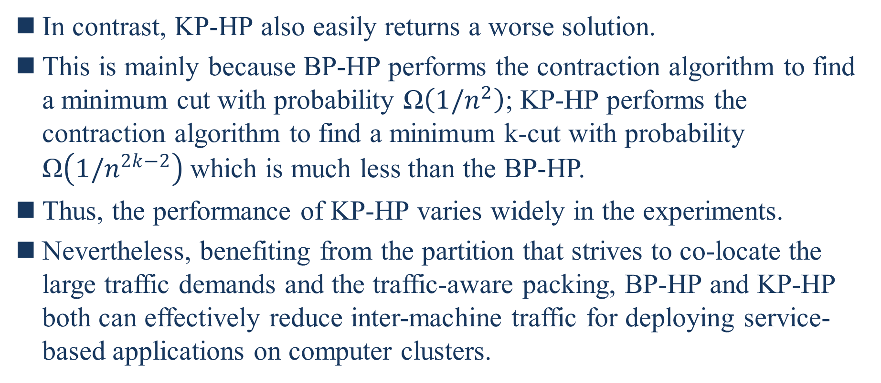
5.2. Comparison with Baselines
In contrast, KP-HP also easily returns a worse solution.
This is mainly because BP-HP performs the contraction algorithm to find a minimum cut with probability Ω$\left(1/n^{2}\right)$; KP-HP performs the contraction algorithm to find a minimum k-cut with probability Ω$\left(1/n^{2k−2}\right)$which is much less than the BP-HP.
Thus, the performance of KP-HP varies widely in the experiments.
Nevertheless, benefiting from the partition that strives to co-locate the large traffic demands and the traffic-aware packing, BP-HP and KP-HP both can effectively reduce inter-machine traffic for deploying service-based applications on computer clusters.
Notes:
相比之下，KP-HP也很容易回傳一個更差的解決方案
這主要是因為BP-HP執行收縮演算法以找到概率為Ω$\left(1/n^{2}\right)$的最小切割;KP-HP執行收縮演算法以找到概率為Ω$\left(1/n^{2k−2}\right)$的最小切割，該概率遠小於BP-HP
因此KP-HP的效能在實驗中差異很大
儘管如此，BP-HP和KP-HP都受益於力爭將大流量需求co-locate分區和流量感知打包，BP-HP和KP-HP都可以有效減少在電腦集群上部署基於服務的應用程序機器間流量

Slide 87
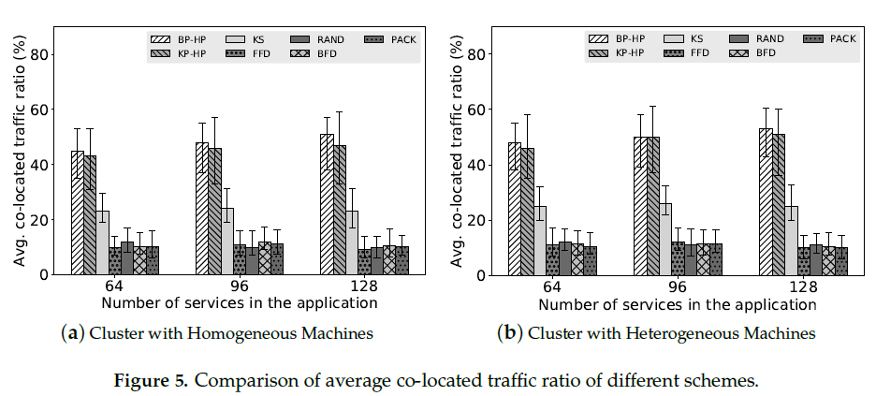
5.2. Comparison with Baselines

Slide 88
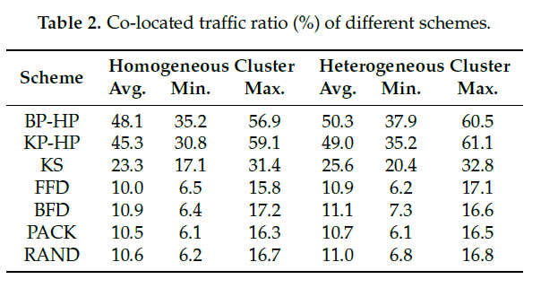
5.2. Comparison with Baselines

Slide 89

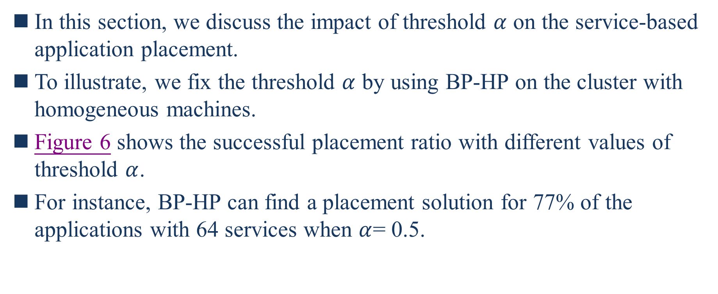
5.3. Impact of Threshold $α$
In this section, we discuss the impact of threshold $α$ on the service-based application placement.
To illustrate, we fix the threshold $α$ by using BP-HP on the cluster with homogeneous machines.
Figure 6 shows the successful placement ratio with different values of threshold $α$.
For instance, BP-HP can find a placement solution for 77% of the applications with 64 services when $α$= 0.5.
Notes:
在本節中，我們將討論臨界值$α$對於基於服務的應用程序放置的影響
為了說明一點，我們通過在具有同構機器的集群上使用BP-HP來固定臨界值$α$
圖6顯示不同臨界值$α$的成功放置比率
舉個例子，當$α$=0.5時，BP-HP可以為77%的具有64個服務的應用程序找到放置解決方案

Slide 90

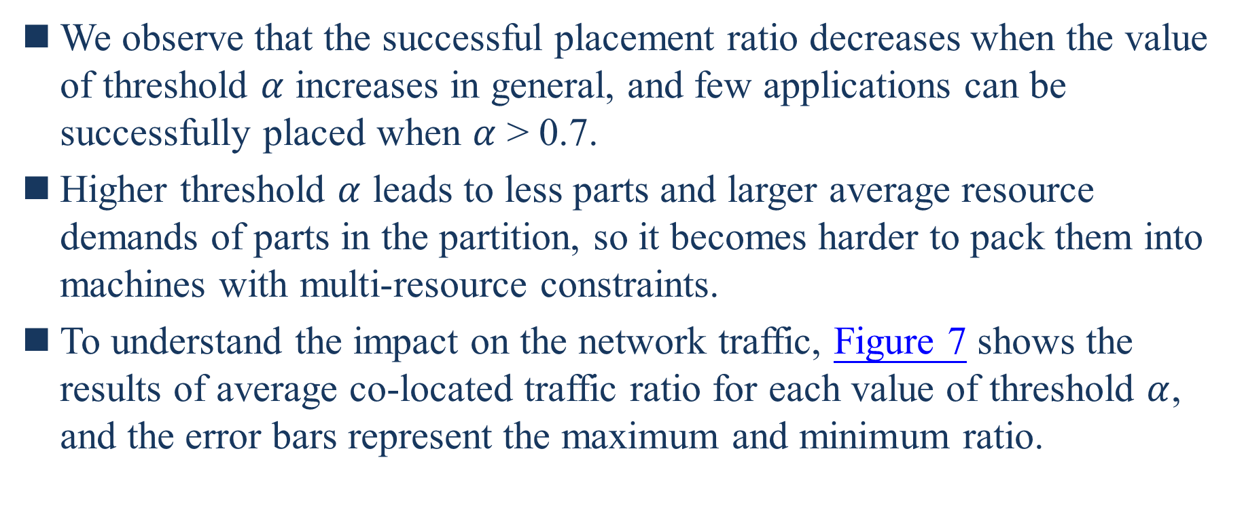
5.3. Impact of Threshold $α$
We observe that the successful placement ratio decreases when the value of threshold $α$ increases in general, and few applications can be successfully placed when $α$ > 0.7.
Higher threshold $α$ leads to less parts and larger average resource demands of parts in the partition, so it becomes harder to pack them into machines with multi-resource constraints.
To understand the impact on the network traffic, Figure 7 shows the results of average co-located traffic ratio for each value of threshold $α$, and the error bars represent the maximum and minimum ratio.
Notes:
我們觀察到，一般隨著臨界值$α$的增加，成功放置率會降低，當$α$ > 0.7時，很少有應用程序可以成功放置
較高的臨界值$α$導致在分區數量較少，而零件的平均資源需求較大，所以將它們打包到多資源約束的機器中變得更加困難
為了了解對網路流量的影響，圖7顯示了每個臨界值$α$的平均co-located流量比率的結果，誤差線表示最大和最小比率

Slide 91
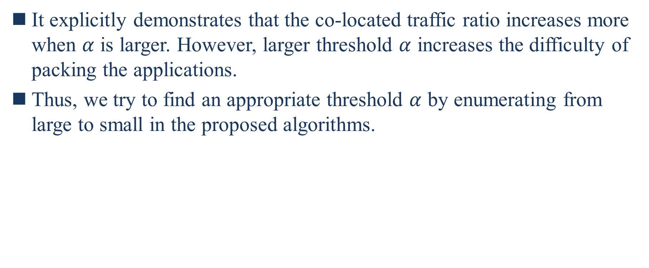
5.3. Impact of Threshold $α$
It explicitly demonstrates that the co-located traffic ratio increases more when $α$ is larger. However, larger threshold $α$ increases the difficulty of packing the applications.
Thus, we try to find an appropriate threshold $α$ by enumerating from large to small in the proposed algorithms.
Notes:
它明確證明隨著$α$較大co-located流量比率增加更多。然而較大的臨界值$α$增加了打包應用程序的難度
因此，我們嘗試通過在提出的演算法中從大到小枚舉來找出合適的臨界值$α$

Slide 92
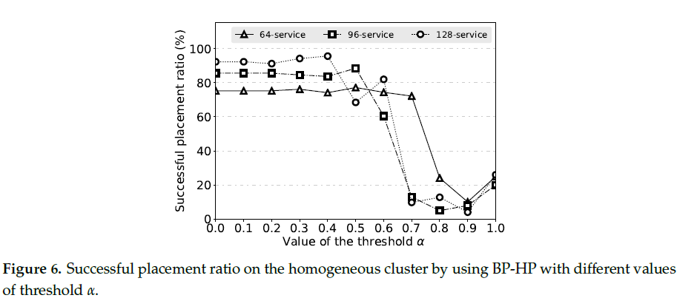
5.3. Impact of Threshold $α$

Slide 93
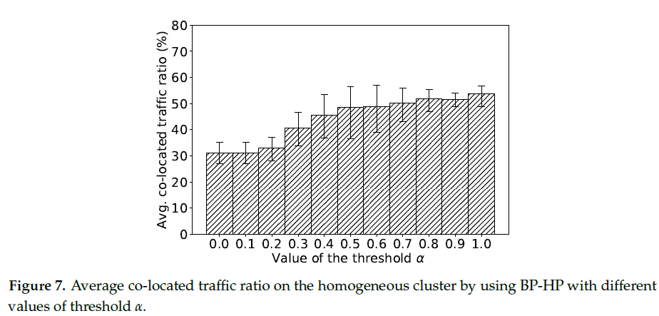
5.3. Impact of Threshold $α$

Slide 94
5.4. Overhead Evaluation
In this section, we evaluate the overhead by measuring the algorithm runtime and compare it with KS and RAND.
In order to fairly compare the algorithm runtime, we also implement the scheduling algorithm of KS in Python, which is the same with other schemes.
We conduct this experiment on a dedicated server with Intel Xeon E5-2630 2.4 GHz CPU and 64 GB memory.
Notes:
在本節中，我們通過測量演算法運行時間並將其與KS和RAND進行比較來評估開銷
為了公平比較演算法運行時間，我們也用Python實作了KS的排程器演算法，和其他方案相同
我們在配備Intel Xeon E5-2630 2.4 GHz CPU and 64 GB 記憶體的專用server上進行此實驗

Slide 95
5.4. Overhead Evaluation
Figure 8 shows the results of the average algorithm runtime of different schemes for the heterogeneous cluster (the homogeneous cluster is similar), and the error bars represent the maximum and minimum algorithm runtime.
RAND incurs little overhead, as it is a very simple algorithm.
Compared with RAND, KS is a bit complex, as KS has multiple predicated policies and priorities policies to filter and score machines, such as handling the affinity between services.
Notes:
圖8顯示異構集群不同方案的平均演算法運行時間的結果(同構集群類似)，誤差線代表最大和最小運行時間
RAND產生的成本很小，因為它是一個非常簡單的演算法
與RAND相比，KS有點複雜，因為KS有多個預測策略和優先權策略來過濾和評分機器，例如處理服務之間的關聯性

Slide 96
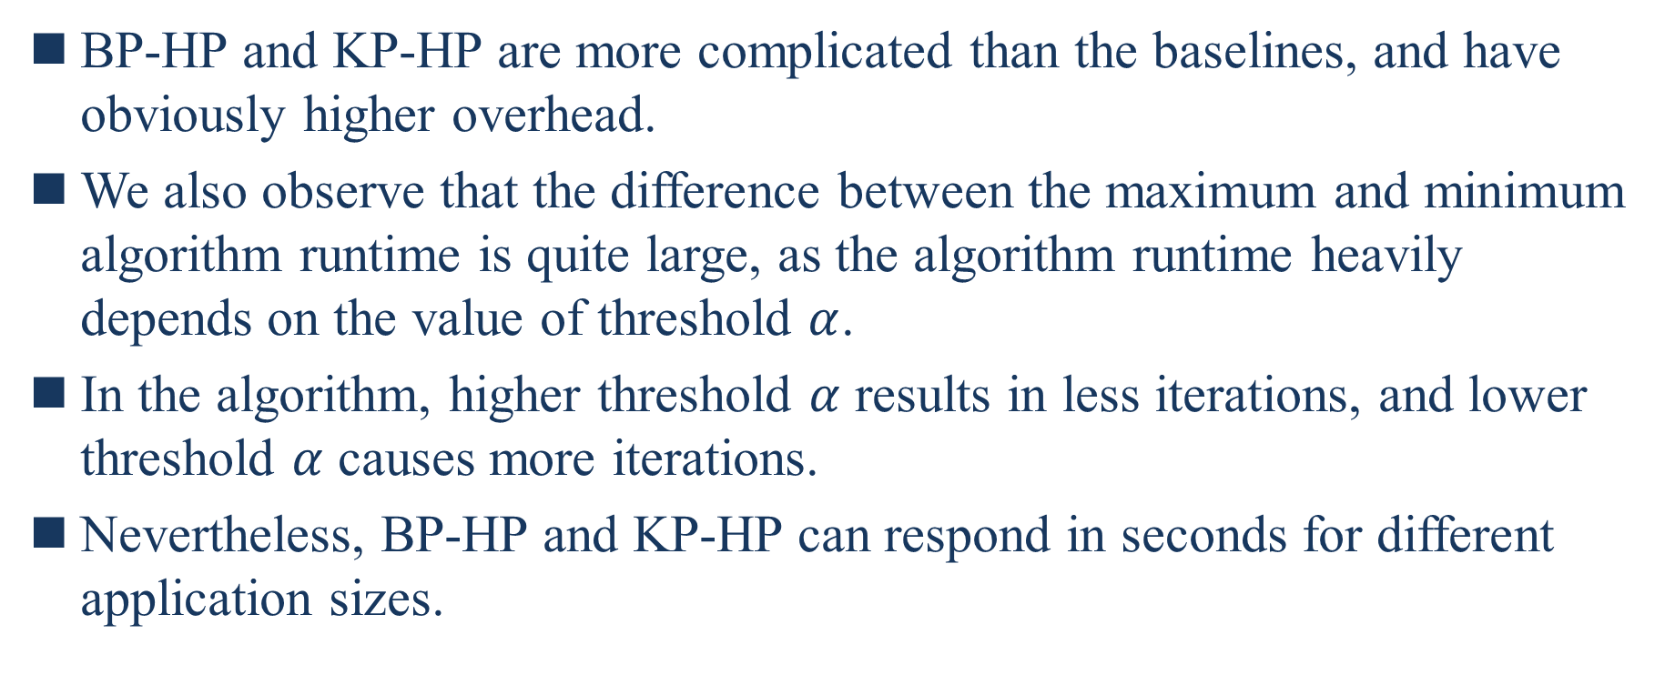
5.4. Overhead Evaluation
BP-HP and KP-HP are more complicated than the baselines, and have obviously higher overhead.
We also observe that the difference between the maximum and minimum algorithm runtime is quite large, as the algorithm runtime heavily depends on the value of threshold $α$.
In the algorithm, higher threshold $α$ results in less iterations, and lower threshold $α$ causes more iterations.
Nevertheless, BP-HP and KP-HP can respond in seconds for different application sizes.
Notes:
BP-HP和KP-HP比基線更複雜，並且明顯成本較高
我們還觀察到最大和最小演算法運行時間之間的差異非常大，因為演算法運行時間在很大程度上取決於臨界值$α$的值
在演算法中，較高臨界值$α$導致較少的跌代，而較小臨界值$α導致$較多的跌代
儘管如此，BP-HP和KP-HP可以在幾秒內回應不同的應用程序大小

Slide 97
5.4. Overhead Evaluation
Especially, for the application with less than 100 services, BP-HP and KP-HP can respond in sub-second time, which is acceptable for online scheduling.
Moreover, the most time consuming part of the proposed algorithms is application partition, which means there would be no big difference of the algorithm runtime for large-scale clusters with the same number of services.
We believe that the proposed algorithms can also effectively handle the placement problem on large-scale clusters.
Notes:
特別是，少於100服務的應用程序，BP-HP和KP-HP可以在亞秒時間回應，在線排程器是可以接受的
此外，提出的演算法的最耗時的部分是應用程序分區，這意味著對於具有相同服務數量的大規模集群，演算法運行時間不會有很大的差異
我們相信提出的演算法也可以有效處理大規模集群的放置問題

Slide 98
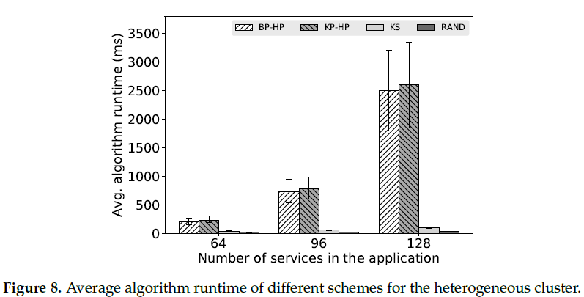
5.4. Overhead Evaluation

Slide 99
6. RelatedWork
As the microservice architecture is emerging as a primary architectural style choice in the service oriented software industry [21], many research efforts have been devoted to the analysis and modeling of microservice architecture [22–24].
21. Thönes, J. Microservices. IEEE Softw. 2015, 32, 116. [CrossRef]
22. Cerny, T.; Donahoo, M.J.; Trnka, M. Contextual understanding of microservice architecture: Current and
future directions. ACM SIGAPP Appl. Comput. Rev. 2018, 17, 29–45. [CrossRef]
23. Hasselbring,W.; Steinacker, G. Microservice architectures for scalability, agility and reliability in e-commerce.
In Proceedings of the 2017 IEEE International Conference on Software ArchitectureWorkshops (ICSAW),
Gothenburg, Sweden, 5–7 April 2017; pp. 243–246.
24. Dragoni, N.; Giallorenzo, S.; Lafuente, A.L.; Mazzara, M.; Montesi, F.; Mustafin, R.; Safina, L. Microservices:
Yesterday, today, and tomorrow. In Present and Ulterior Software Engineering; Springer: New York, NY, USA,
2017; pp. 195–216.
Notes:
隨著微服務架構逐漸成為面向服務軟體行業的主要架構風格選擇[21]，許多研究都致力於微服務架構的分析和建模[22-24]

Slide 100
6. RelatedWork
Leitner et al. [25] proposed a graph-based cost model for deploying microservice-based applications on a public cloud.
Balalaie et al. [26] presented their experience and lessons on migrating a monolithic software architecture to microservices.
25. Leitner, P.; Cito, J.; Stöckli, E. Modelling and managing deployment costs of microservice-based cloud
applications. In Proceedings of the 9th International Conference on Utility and Cloud Computing, Shanghai,
China, 6–9 December 2016; ACM: New York, NY, USA, 2016; pp. 165–174.
26. Balalaie, A.; Heydarnoori, A.; Jamshidi, P. Migrating to cloud-native architectures using microservices: An
experience report. In Proceedings of the European Conference on Service-Oriented and Cloud Computing,
Taormina, Italy, 15–17 September 2015; Springer: New York, NY, USA, 2015; pp. 201–215.
Notes:
Leitner等人[25]提出基於圖形的成本模型，用於在公共雲上部署基於微服務的應用程序
Balalaie等人[26]介紹他們將單體軟體架構遷移到微服務的經驗和教訓

Slide 101
6. RelatedWork
Amaral et al. [27] evaluated the performance of microservices architectures using containers. However, the performance of service placement schemes received little attention in these works.
Software as a Service (SaaS) is one of the most important services offered by cloud providers, and many works have been proposed for optimizing composite SaaS placement in cloud environments [15].
15. Huang, K.C.; Shen, B.J. Service deployment strategies for efficient execution of composite SaaS applications
on cloud platform. J. Syst. Softw. 2015, 107, 127–141. [CrossRef]
27. Amaral, M.; Polo, J.; Carrera, D.; Mohomed, I.; Unuvar, M.; Steinder, M. Performance evaluation of microservices architectures using containers. In Proceedings of the 2015 IEEE 14th International Symposium on Network Computing and Applications, Cambridge, MA, USA, 28–30 September 2015; pp. 27–34.
Notes:
Amaral等人[27]使用容器評估微服務架構的性能。然而服務放置方案的性能在這些工作中很少受到關注
軟體即服務(SaaS)是雲提供者提供的最重要的服務之一，並且已經提出了許多工作來優化雲環境中的複合SaaS放置[15]

Slide 102
6. RelatedWork
Yusoh et al. [6] propose a genetic algorithm for the composite SaaS placement problem, which considers both the placement of the software components of a SaaS and the placement of data of the SaaS. It tries to minimize the total execution time of a composite SaaS.
Hajji et al. [7] adopt a new variation of PSO called Particle Swarm Optimization with Composite Particle (PSO-CP) to solve the composite SaaS placement problem. It considers not only the total execution time of the composite SaaS but also the performance of the underlying machines.
6. Yusoh, Z.I.M.; Tang, M. A penalty-based genetic algorithm for the composite SaaS placement problem in the
cloud. In Proceedings of the IEEE Congress on Evolutionary Computation, Barcelona, Spain, 18–23 July
2010; pp. 1–8.
7. Hajji, M.A.; Mezni, H. A composite particle swarm optimization approach for the composite saas
placement in cloud environment. Soft Comput. 2018, 22, 4025–4045. [CrossRef]
Notes:
Yusoh等人針對複合SaaS放置問題提出了一個基因演算法，該算法考慮SaaS的軟體元件的放置和SaaS數據的放置。它嘗試最小化複合SaaS的總執行時間
Hajji等人採用PSO的一種新變體，稱為具有複合粒子的粒子群優化(PSO-CP)來解決複合SaaS放置問題。它不只考慮複合SaaS的總執行時間，也考慮底層機器的效能

Slide 103
6. RelatedWork
Unfortunately, they target at the placement for a certain set of predefined service components, which has limitations to handle a large number of different services. In addition, plenty of research has been proposed to optimize service placement in edge and fog computing [28,29].
28. Wu, Z.; Lu, Z.; Hung, P.C.; Huang, S.C.; Tong, Y.; Wang, Z. QaMeC: A QoS-driven IoVs application
optimizing deployment scheme in multimedia edge clouds. Future Gener. Comput. Syst. 2019, 92, 17–28.
[CrossRef]
29. Chen, X.; Tang, S.; Lu, Z.; Wu, J.; Duan, Y.; Huang, S.C.; Tang, Q. iDiSC: A New Approach to
IoT-Data-Intensive Service Components Deployment in Edge-Cloud-Hybrid System. IEEE Access 2019,
7, 59172–59184. [CrossRef]
Notes:
不幸的是，它們的目標在放置一組特定的預定義服務元件，這對於處理大量不同的服務具有侷限性。此外，已經提出了大量研究來優化邊緣計算和霧計算中的服務放置[28,29]

Slide 104
6. RelatedWork
Mennan et al. [30] proposed a service placement heuristic to maximize the bandwidth allocation when deploying community networks micro-clouds. It uses the information of network bandwidth and node availability to optimize service placement.
Different from it, we consider the constraints of multiple resources rather than just network bandwidth to minimize the inter-machine traffic while satisfying multi-resource demands of service-based applications.
30. Selimi, M.; Cerdà-Alabern, L.; Freitag, F.; Veiga, L.; Sathiaseelan, A.; Crowcroft, J. A lightweight service
placement approach for community network micro-clouds. J. Grid Comput. 2019, 17, 169–189. [CrossRef]
Notes:
Mennan等人提出一種服務放置啟發式算法，以在部署社區網路微雲時最大化頻寬分配。它使用網路頻寬和節點的可用性的資訊來優化服務放置
與此不同的是，我們考慮多種資源的約束，而不僅僅是網路頻寬，以最小化機器間的流量，同時滿足基於服務的應用程序的多資源需求

Slide 105
6. RelatedWork
Carlos et al. [31] presented a decentralized algorithm for the placement problem to optimize the distance between the clients and the most requested services in fog computing.
They assume there are unlimited resources in cloud computing and try to minimize the hop count by placing the most popular services as closer to the users as possible.
In contrast, our work focuses on the overall network usage of the cloud underlying cluster, which is modeled as a set of heterogeneous machines.
31. Guerrero, C.; Lera, I.; Juiz, C. A lightweight decentralized service placement policy for performance
optimization in fog computing. J. Ambient Intell. Humaniz. Comput. 2019, 10, 2435–2452. [CrossRef]
Notes:
Carlos等人提出一種用於放置問題的分散演算法，以優化霧計算中用戶和請求最多的服務之間的距離
他們假設雲計算中有無限的資源，並且嘗試通過將最熱門的服務盡可能靠近用戶來盡量減少跳數
相比之下，我們的工作側重於雲底層集群的整體網路使用率，該集群被建模成一組異構機器

Slide 106
6. RelatedWork
In recent years, a number of research works have been proposed in the area of VM placement with traffic awareness for cloud data centers [16,17].
Meng et al. [8] analyze the impact of data center network architectures and traffic patterns and propose a heuristic approach to reduce the aggregate traffic when placing VM into the data center.
8. Meng, X.; Pappas, V.; Zhang, L. Improving the scalability of data center networks with traffic-aware virtual machine placement. In Proceedings of the 2010 IEEE INFOCOM, San Diego, CA, USA, 15–19 March 2010; pp. 1–9.
16. Alicherry, M.; Lakshman, T. Network aware resource allocation in distributed clouds. In Proceedings of the 2012 IEEE INFOCOM, Orlando, FL, USA, 25–30 March 2012; pp. 963–971.
17. Kliazovich, D.; Bouvry, P.; Khan, S.U. DENS: Data center energy-efficient network-aware scheduling. Clust.
Comput. 2013, 16, 65–75. [CrossRef]
Notes:
近年來，在雲數據中心具有流量感知的VM放置領域提出許多研究工作[16,17]
Meng等人[8]分析數據中心架構和流量模式的影響，並提出一種啟發式方式來減少將VM放置到數據中心時的聚合流量

Slide 107
6. RelatedWork
Wang et al. [9] formulate the VM placement problem with dynamic bandwidth demands as a stochastic bin packing problem and propose an online packing algorithm to minimize the number of machines required.
However, they only focus on optimizing the network traffic in the data center, without considering the highly diverse resources requirements of the virtual machines.
9. Wang, M.; Meng, X.; Zhang, L. Consolidating virtual machines with dynamic bandwidth demand in data centers. Infocom 2011, 201, 71–75.
Notes:
Wang等人[9]將具有動態頻寬需求的VM放置問題表述為一個隨機裝箱問題，並提出一種在線打包演算法來最小化請求的機器數量
然而，他們只側重於優化數據中心的網路流量，而沒有考慮虛擬機器的高度多樣化的資源需求

Slide 108
6. RelatedWork
Biran et al. [32] proposed a placement scheme to satisfy the traffic demands of the VMs while meeting the CPU and memory requirements.
Dong et al. [33] introduced a placement solution to improve network resource utilization in addition to meeting multiple resource constraints.
They both rely on a certain network topology to make placement decisions.
32. Biran, O.; Corradi, A.; Fanelli, M.; Foschini, L.; Nus, A.; Raz, D.; Silvera, E. A stable network-aware vm placement for cloud systems. In Proceedings of the 2012 12th IEEE/ACM International Symposium on Cluster, Cloud and Grid Computing (ccgrid), Ottawa, ON, Canada, 13–16 May 2012; pp. 498–506.
33. Dong, J.; Jin, X.;Wang, H.; Li, Y.; Zhang, P.; Cheng, S. Energy-saving virtual machine placement in cloud
data centers. In Proceedings of the 2013 13th IEEE/ACM International Symposium on Cluster, Cloud, and
Grid Computing, Delft, The Netherlands, 13–16 May 2013; pp. 618–624.
Notes:
Biran等人[32]提出一種放置方案，以滿足VM的流量需求，同時滿足CPU和記憶體的需求
Dong等人[33]介紹一種放置解決方案，以提高網路資源使用率，此外滿足多資源約束
他們都仰賴一個特定的網路拓撲來做出放置決策

Slide 109
6. RelatedWork
Besides, many research efforts have been devoted to the scheduling and partitioning on heterogeneous systems [34,35].
Different from them, our work is agnostic to the underlying network topology, which aims to minimize the overall inter-machine traffic on the cluster.
34. Brandolese, C.; Fornaciari,W.; Pomante, L.; Salice, F.; Sciuto, D. Affinity-driven system design exploration
for heterogeneous multiprocessor SoC. IEEE Trans. Comput. 2006, 55, 508–519. [CrossRef]
35. Hu, Y.; Zhou, H.; de Laat, C.; Zhao, Z. Concurrent container scheduling on heterogeneous clusters with
multi-resource constraints. Future Gener. Comput. Syst. 2020, 102, 562–573. [CrossRef]
Notes:
此外，許多研究都致力於在異構系統上的排程和劃分[34,35]
與它們不同的是，我們的工作與底層網路拓撲無關，旨在最小化集群上整體機器間流量

Slide 110
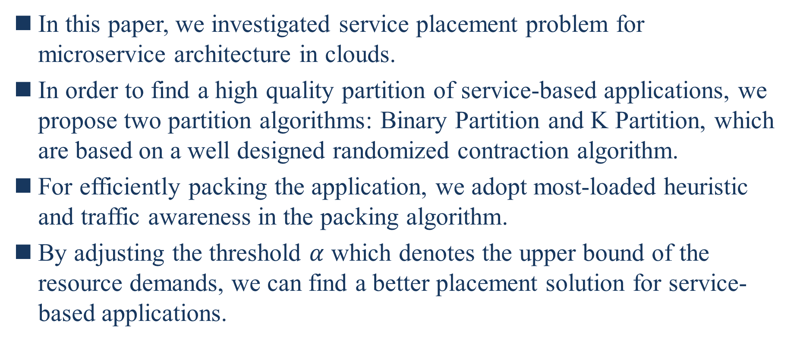
7. Conclusions
In this paper, we investigated service placement problem for microservice architecture in clouds.
In order to find a high quality partition of service-based applications, we propose two partition algorithms: Binary Partition and K Partition, which are based on a well designed randomized contraction algorithm.
For efficiently packing the application, we adopt most-loaded heuristic and traffic awareness in the packing algorithm.
By adjusting the threshold $α$ which denotes the upper bound of the resource demands, we can find a better placement solution for service-based applications.
Notes:
在本文中，我們研究了雲中微服務的服務放置問題
為了找出基於服務的應用程序的高質量分區，我們提出兩種分區演算法Binary Partition 和 K Partition，它們基於一種設計良好的隨機收縮演算法
為了有效地打包應用程序，我們在打包演算法中採用負載最大啟發式和流量感知
通過調整表示資源需求上限的臨界值$α$，我們可以為基於服務的應用程序找到更好的放置解決方案

Slide 111
7. Conclusions
We implement a prototype scheduler based on our proposed algorithms and evaluate it on testbed clusters.
In the evaluation, we show that our algorithms can improve the ratio of successfully placing applications on the cluster while significantly increasing the ratio of co-located traffic (i.e., reducing the inter-machine traffic).
In the overhead evaluation, the results show that our algorithms incur some overhead but in an acceptable time.
Notes:
我們基於我們提出的演算法實作一個原型排程器，並在測試台集群上對其進行評估
在評估中，我們表明我們的演算法可以提高成功將應用程序放置在集群上的比率，同時顯著增加co-located流量的比率(即減少機器間的流量)
在成本評估中，結果表明我們的演算法會產生一些成本，但在可接受的時間內

Slide 112
7. Conclusions
We believe that the proposed algorithms are practical for realistic use cases.
In the future, we will investigate problem-specific optimizations to improve our implementation and consider resource dynamics in the placement to adapt more sophisticated situations.
Notes:
我們相信提出的演算法對實際使用例子是實用的
在未來，我們將研究針對特定問題的優化以改進我們實作，並考慮放置中資源動態以適應更複雜的狀況

Slide 113
co-located
將VM放進單一區域內可以減少實例間的距離，從另一方面來看就是將它們彼此緊密地結合在一起，不過當使用量增加時，單一區域可能無法負載大量的需求，從而導致網路延遲，使得服務的效能降低。

Slide 114
loopback
環回是一種特殊的虛擬網絡介面，計算機使用它與自身進行通信。它主要用於診斷和故障排除，以及連接到本地機器上運行的服務器。

Slide 115
fog computing
霧計算的兩個特點
霧計算是雲計算的延伸
霧計算更接近終端用戶
霧計算的優勢
霧計算能提供超低延遲
霧計算所採用的架構更接近網絡邊緣，因此，存取速度就能非常之快。

