Slide 1
(2016) SEGUE : quality of service aware edge cloud service migration
Wuyang Zhang, Yi Hu, Yanyong Zhang, Dipankar Raychaudhuri
2016 IEEE 8th International Conference on Cloud Computing Technology and Science

Slide 2
Outline
Introduction to Service Migration Problem
Introduction to Markov Decision Process (MDP)
(2014) A Markov decision process-based service migration procedure for follow me cloud
(2016) SEGUE : quality of service aware edge cloud service migration
Notes:
為何需要介紹 (2014)? 因為我的主要收穫是得知「Service migration 問題可以有不同的問題定義、不同的追求目標，因而導致不同的 MDP formulation」，因此除了論文本體還需要一個比較對象

Slide 3
Introduction to Service Migration Problem

Slide 4
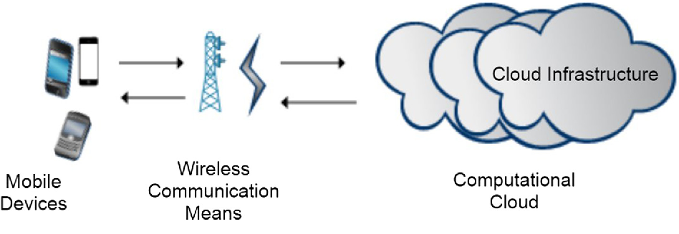

Computation Offloading in MCC
Popular topic in Mobile Cloud Computing (MCC)
Cooperate mobile device with cloud server to handle resource-intensive tasks
Drawback : High network latency, not suitable for real-time application, e.g. AR/VR, Autonomous Vehicle
Task
Task
Notes:
圖片來源 : https://www.semanticscholar.org/paper/Mobile-cloud-computing-for-computation-offloading%3A-Akherfi-Gerndt/14d917690ad36e0e0eb335e8231da440ef586c95

Slide 5
Computation Offloading in MEC
Mobile Edge Computing (MEC)
Cloud servers are placed in close proximity(接近) to users, e.g. placed together with Base Station (BS)
Benefit : Reduce network latency

Slide 6
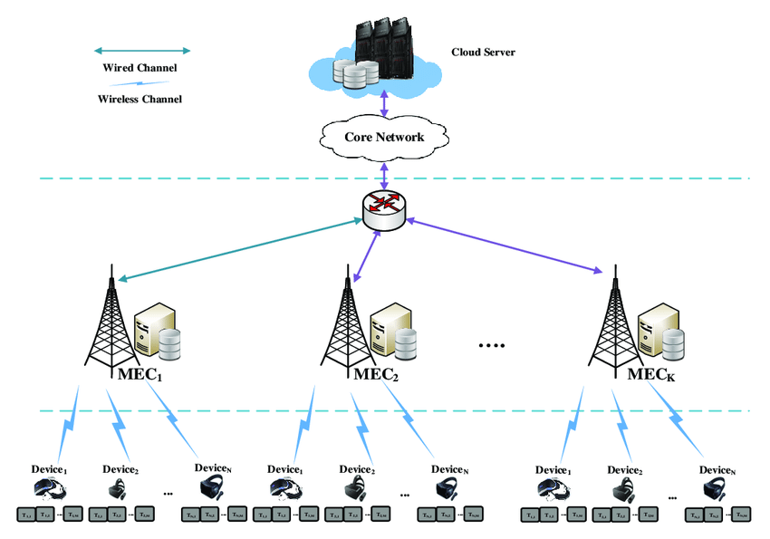


Service Migration Problem
Mobility problem : When user move away from originating Base Station
Solution : Multi-hopping communication
Task

Slide 7
Service Migration Problem
Hopping Problem : Latency increase as hopping count increase
Solution : Migrating tasks to follow user movement
Task
Task
7
Notes:
Never migrate 不夠好，會抵消 MEC 優勢
Always migrate 也不夠好，因為遷移必定會有 service down time。甚至，如果多個用戶頻繁遷移，會導致網路壅塞，down time 更嚴重

Slide 8
Service Migration Problem
Research directions in Service Migration Problem :
Migration policy : Where to migrate & When to migrate ?
  Two baseline methods : never migrate & always migrate
  Tradeoff between QoS improvement and migration cost
Live migration : How to migrate ?
  Minimizing service interruption during migration

Slide 9
Service Migration Problem
Research directions in Service Migration Problem :
Migration policy : Where to migrate & When to migrate ?
  Two baseline methods : never migrate & always migrate
  Tradeoff between QoS improvement and migration cost
Live migration : How to migrate ?
  Minimizing service interruption during migration
Notes:
我的研究，以及下面介紹的兩篇，都是在研究 Where & When to migrate，而不是研究 live migration

Slide 10
Introduction to Markov Decision Process

Slide 11
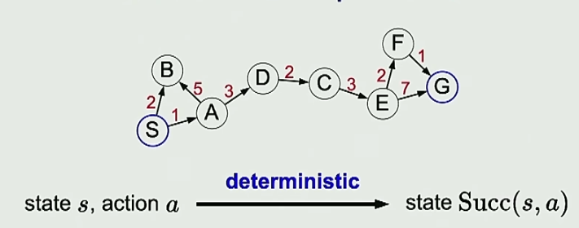
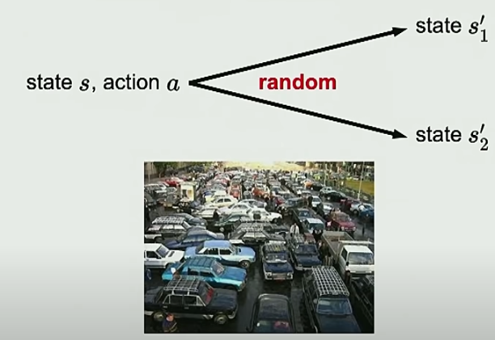
Deterministic Process vs. Stochastic Process
Deterministic (確定性的) process :
Stochastic (隨機的) process :
Notes:
Deterministic : 該怎麼走我們可以自己決定，所以可以找出最短路徑

Slide 12
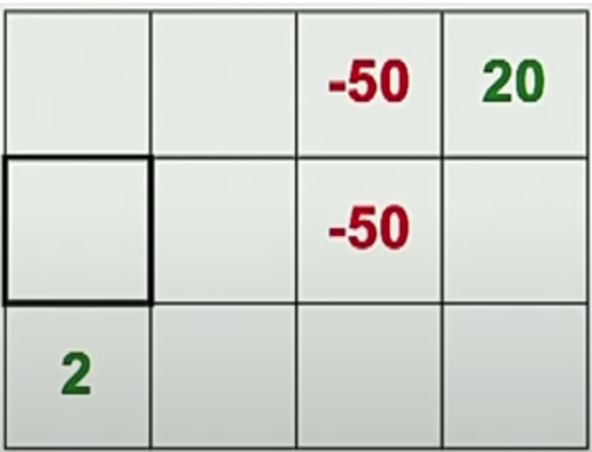
Volcano Crossing Problem
Notes:
以下，以 volcano crossing 做舉例，說明 deter. 和 random process 之間的差別
Deter. Process Problem : 你該怎麼走，才能讓你的收益最大化?
Random Process Problem : 當失足機率 XX，是否值得我冒著風險跑過去釣魚?具體的期望收穫值是多少?

Slide 13
Example 1 : Volcano Crossing Problem
If this is deterministic process :
Notes:
Deter. Process Problem : 你該怎麼走，才能讓你的收益最大化?
Random Process Problem : 當失足機率 XX，是否值得我冒著風險跑過去釣魚?具體的期望收穫值是多少?

Slide 14
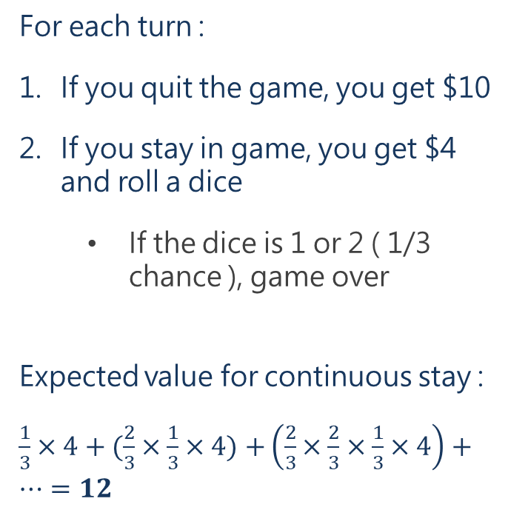
Example 2 : Dice Game
For each turn :
If you quit the game, you get $10
If you stay in game, you get $4 and roll a dice
  If the dice is 1 or 2 ( 1/3 chance ), game over
Expected value for continuous stay :
$\frac{1}{3}×4+(\frac{2}{3}×\frac{1}{3}×4)$ $+\left(\frac{2}{3}×\frac{2}{3}×\frac{1}{3}×4\right)+…=12$
Notes:
接下來，介紹另一個範例 dice game，說明如何把這樣一個 random process 問題轉換成 MDP model 來描述
Problem : 怎麼選擇，才能讓我的利益最大化
這是一個 random process，因為 stay 的結果不一定
Stay 的 expect value => 最佳策略或許是 …

Slide 15
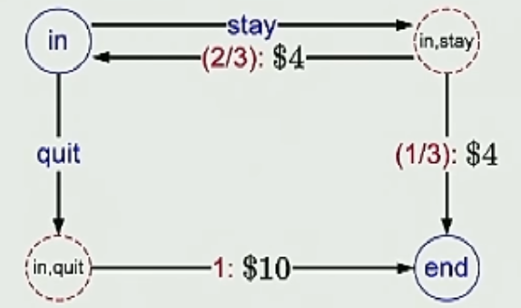
Example 2 : Dice Game
For each turn :
If you quit the game, you get $10
If you stay in game, you get $4 and roll a dice
  If the dice is 1 or 2 ( 1/3 chance ), game over
Expected value for continuous stay :
$\frac{1}{3}×4+(\frac{2}{3}×\frac{1}{3}×4)$ $+\left(\frac{2}{3}×\frac{2}{3}×\frac{1}{3}×4\right)+…=12$
⇒

Slide 16
MDP Formulation of Dice Game
State = {in , end}
Action = {stay, quit}
Notes:
State : 可以選擇 Action 執行，但注意每個 State 能執行哪些 Action 很可能是不一樣的
Chance node : 當你在 state s 選擇了 action a，注意他的 out degree 機率加起來為 1，因為即便結果不固定，但當你採取行動後他總會帶你到某個結果

Slide 17
Transition Probability T(s, a, s’) :
  T(in, stay, end) = 1/3 ; T(in, stay, in) = 2/3 ; T(in, quit, end) = 1
Reward Function R(s, a, s’) :
  R(in, stay, in) = 4 ; R(in, quite, end) = 10
Notes:
T : 我在 s 選擇動作 a，因而前往 s’ 的機率
R : 我們定義每個 state transition 都會獲得一些獎勵
這兩個參數是很關鍵的，我們後續就是會評估 : 動作可能帶來的結果，以及這些結果帶給我的多大好處，決定要不要採取這樣的動作

Slide 18
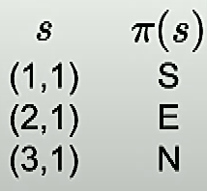
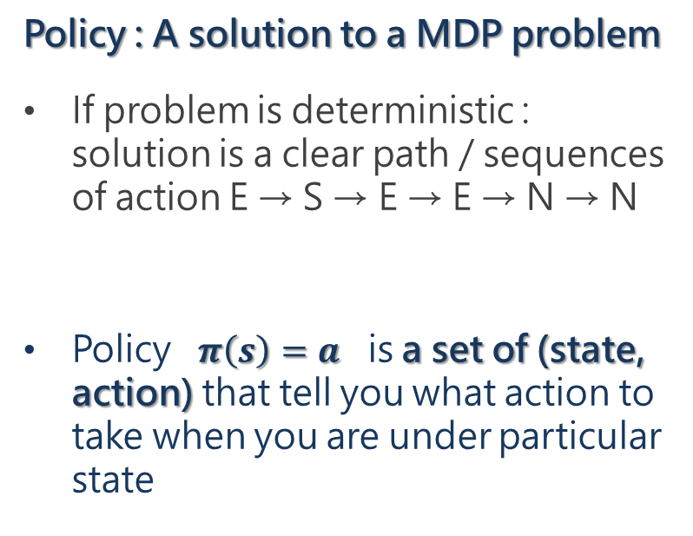
Policy
Policy : A solution to a MDP problem
  If problem is deterministic : solution is a clear path / sequences of action E → S → E → E → N → N
Policy $π\left(s\right)=a$ is a set of (state, action) that tell you what action to take when you are under particular state
Policy :
…
Notes:
在說明 policy 的概念之前，我們先來看，如果要在 deterministic process 中找到 solution，該怎麼做? 比如我想從 S -> G 該怎麼做?
如果是 deterministic，就好像導航我們可以給出一條明確的路徑 (path)，或者說，一系列的動作「你就一直向右走就對了」，告訴使用者「照著這條路走就會到了」
但如果是 random process，這種 solution 形式就不適合，因為它可能 S->B，無法走到 A，所以第一步就卡關了
因此，如果是 random process，在每一個可能的狀態，我都要給他一種指示
Policy is a function

Slide 19
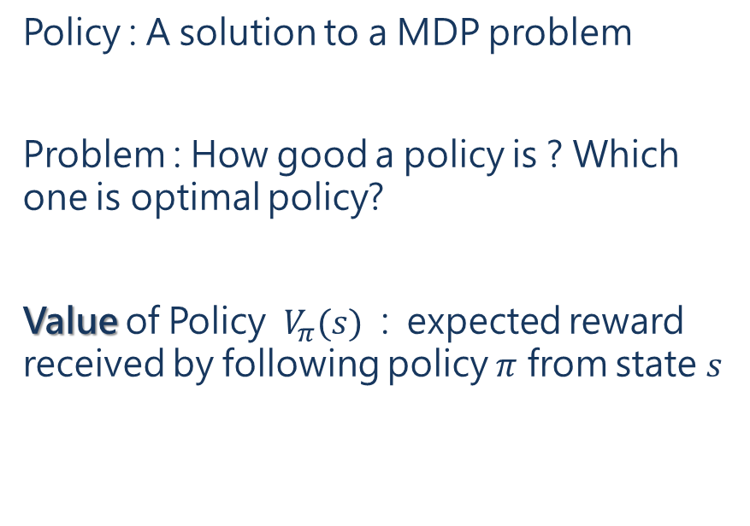
Value of Policy
Policy : A solution to a MDP problem
Problem : How good a policy is ? Which one is optimal policy?
Value of Policy $V_{π}(s)$ : expected reward received by following policy $π$ from state $s$
Notes:
在說明 policy 的概念之前，我們先來看，如果要在 deterministic process 中找到 solution，該怎麼做? 比如我想從 S -> G 該怎麼做?
如果是 deterministic，就好像導航我們可以給出一條明確的路徑 (path)，或者說，一系列的動作「你就一直向右走就對了」，告訴使用者「照著這條路走就會到了」
但如果是 random process，這種 solution 形式就不適合，因為它可能 S->B，無法走到 A，所以第一步就卡關了
因此，如果是 random process，在每一個可能的狀態，我都要給他一種指示
Policy is a function

Slide 20
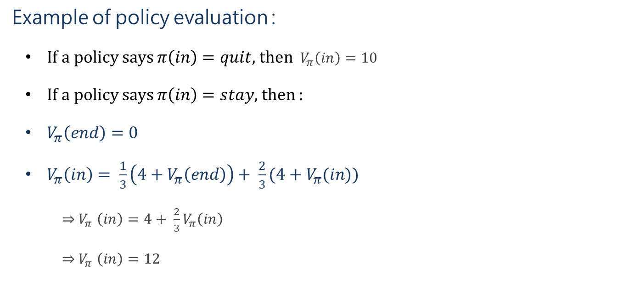
Value of Policy
Example of policy evaluation :
  If a policy says $π\left(in\right)=quit$, then ${ V}_{π}\left(in\right)=10$
If a policy says $π\left(in\right)=stay$, then :
$V_{π}\left(end\right)=0$
$V_{π}\left(in\right)= \frac{1}{3}\left(4+V_{π}\left(end\right)\right)+ \frac{2}{3}(4+V_{π}(in))$
  ${\text{⇒} V}_{π}\left(in\right)=4+ \frac{2}{3}V_{π}\left(in\right)$
  ${\text{⇒} V}_{π}\left(in\right)=12$
Notes:
我們會說 1/3*4 + 2/3* 4 是 immediate reward
通常 value 不會只相依於自己 V(in) = 4 + 2/3 V(in)，而是 V(s1) = V(s2) + V(s3) + …，V(s2), V(s3) 亦同，通常不會是單純移項就能解決

Slide 21
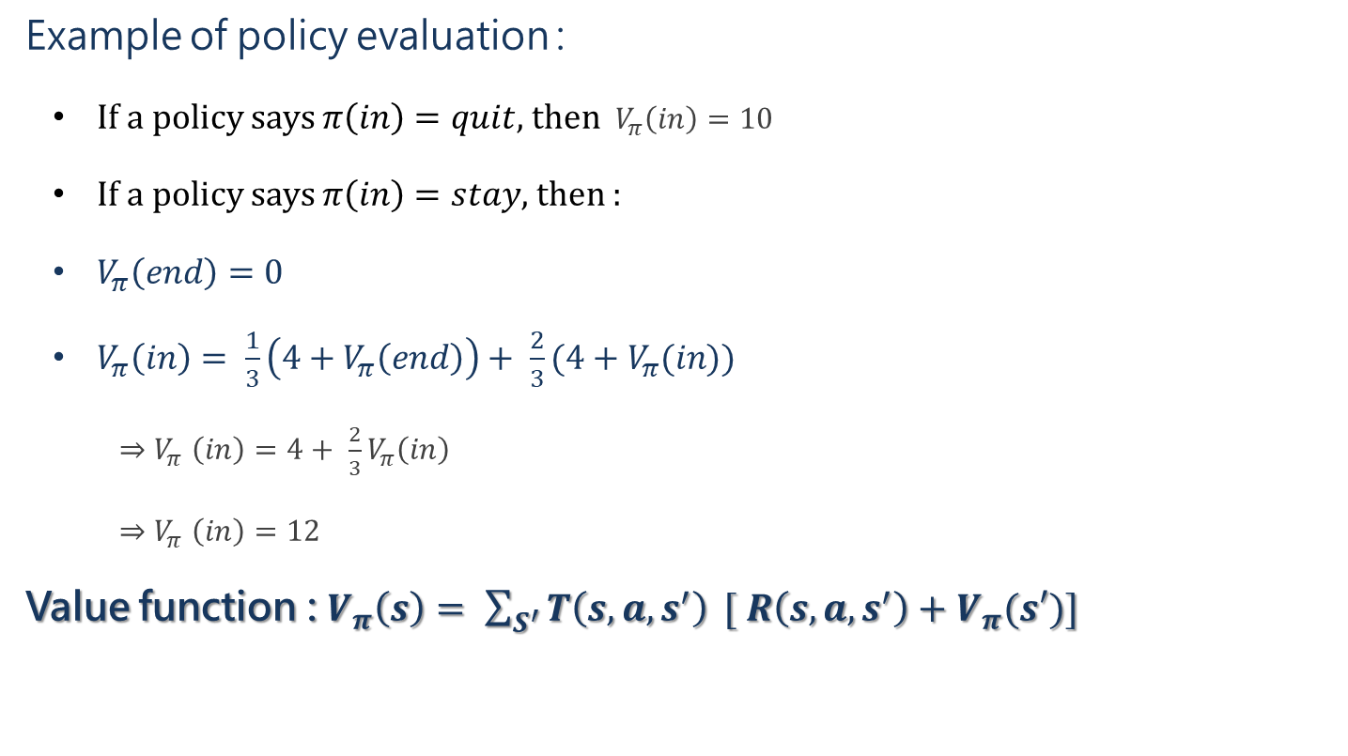
Value of Policy
Example of policy evaluation :
  If a policy says $π\left(in\right)=quit$, then ${ V}_{π}\left(in\right)=10$
If a policy says $π\left(in\right)=stay$, then :
$V_{π}\left(end\right)=0$
$V_{π}\left(in\right)= \frac{1}{3}\left(4+V_{π}\left(end\right)\right)+ \frac{2}{3}(4+V_{π}(in))$
  ${\text{⇒} V}_{π}\left(in\right)=4+ \frac{2}{3}V_{π}\left(in\right)$
  ${\text{⇒} V}_{π}\left(in\right)=12$
Value function : $V_{π}\left(s\right)= \sum_{S^{′}}^{ }{T\left(s, a, s^{′}\right)} [ R\left(s, a, s^{′}\right)+V_{π}(s′)]$
Immediate Reward
Expected Value
Notes:
在 value function 的計算上，因為 T 和 R 是我們早就定義好的，所以很好算，問題在於 expected value，也就是說，你有可能要算 value of state 1，就需要先知道 value of state 2 ; 想知道 value of state 2 就得先知道 value of state 3

Slide 22
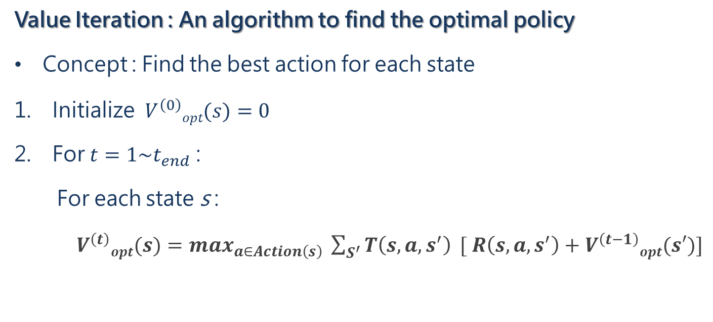
Algorithm to Solve MDP
Value Iteration : An algorithm to find the optimal policy
Concept : Find the best action for each state
Initialize $V^{\left(0\right)}opt(s)=0$
For $t=1\sim t_{end}$ :
For each state s :
  $V^{\left(t\right)}opt(s)=\max_{a∈Action\left(s\right)} \sum_{S^{′}}^{ }{T\left(s, a, s^{′}\right)} [ R\left(s, a, s^{′}\right)+V^{\left(t−1\right)}opt(s′)]$
Value function

Slide 23
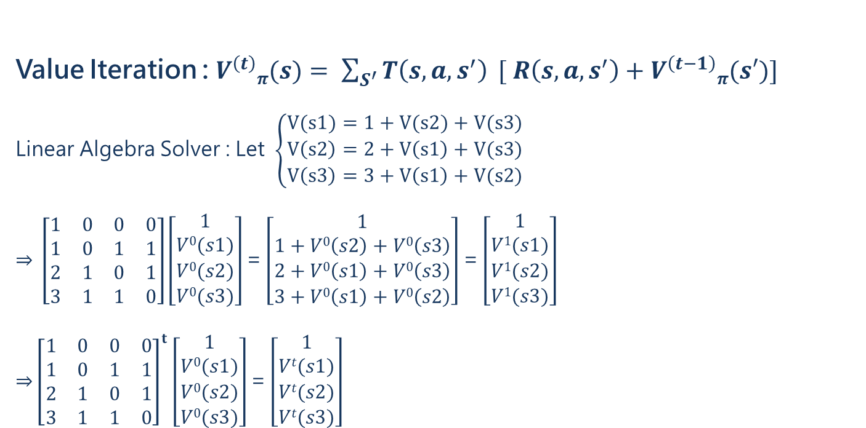
Value Iteration
Value Iteration : $V^{\left(t\right)}π(s)= \sum_{S^{′}}^{ }{T\left(s, a, s^{′}\right)} [ R\left(s, a, s^{′}\right)+V^{\left(t−1\right)}π(s′)]$
Linear Algebra Solver : Let $\left\{\begin{aligned}V(s1)=1+V(s2)+V(s3) \\ V\left(s2\right)=2+V\left(s1\right)+V(s3) \\ V\left(s3\right)=3+V\left(s1\right)+V(s2)\end{aligned}\right.$
$\text{⇒} \left[\begin{matrix}1 & 0 & 0 & 0 \\ 1 & 0 & 1 & 1 \\ 2 & 1 & 0 & 1 \\ 3 & 1 & 1 & 0\end{matrix}\right]\left[\begin{matrix}1 \\ V0(s1) \\ V0(s2) \\ V0(s3)\end{matrix}\right]$ = $\left[\begin{matrix}1 \\ 1+V0\left(s2\right)+V0\left(s3\right) \\ 2+V0\left(s1\right)+V0\left(s3\right) \\ 3+V0\left(s1\right)+V0\left(s2\right)\end{matrix}\right]$ = $\left[\begin{matrix}1 \\ V1(s1) \\ V1(s2) \\ V1(s3)\end{matrix}\right]$
${\text{⇒}\left[\begin{matrix}1 & 0 & 0 & 0 \\ 1 & 0 & 1 & 1 \\ 2 & 1 & 0 & 1 \\ 3 & 1 & 1 & 0\end{matrix}\right]}^{t}\left[\begin{matrix}1 \\ V0(s1) \\ V0(s2) \\ V0(s3)\end{matrix}\right]$ = $\left[\begin{matrix}1 \\ Vt(s1) \\ Vt(s2) \\ Vt(s3)\end{matrix}\right]$
Notes:
這邊是簡化數值，不然照理講應是寫 V(s1) = 1 + 1/2V(s2) + ½V(s3) ，讓機率加起來為 1，但這樣矩陣寫起來太麻煩
總之，經過 Value Iteration 之後，我們就能夠知道在每個 state 上執行什麼 action 會是最好的選擇

Slide 24
Recap 1 : MDP Formulation
For each turn :
If you quit the game, you get $10
If you stay in game, you get $4 and roll a dice
  If the dice is 1 or 2 ( 1/3 chance ), game over
⇒
Notes:
Recap : 針對結果有機率性的 random process 的問題，我們可以用 MDP model 來描述他

Slide 25
Recap 2 : MDP Component
State = {in , end}
Action = {stay, quit}
Transition Probability T(s, a, s’)
Reward Function R(s, a, s’)
Notes:
Recap : MDP 主要由 4 個東西組成

Slide 26
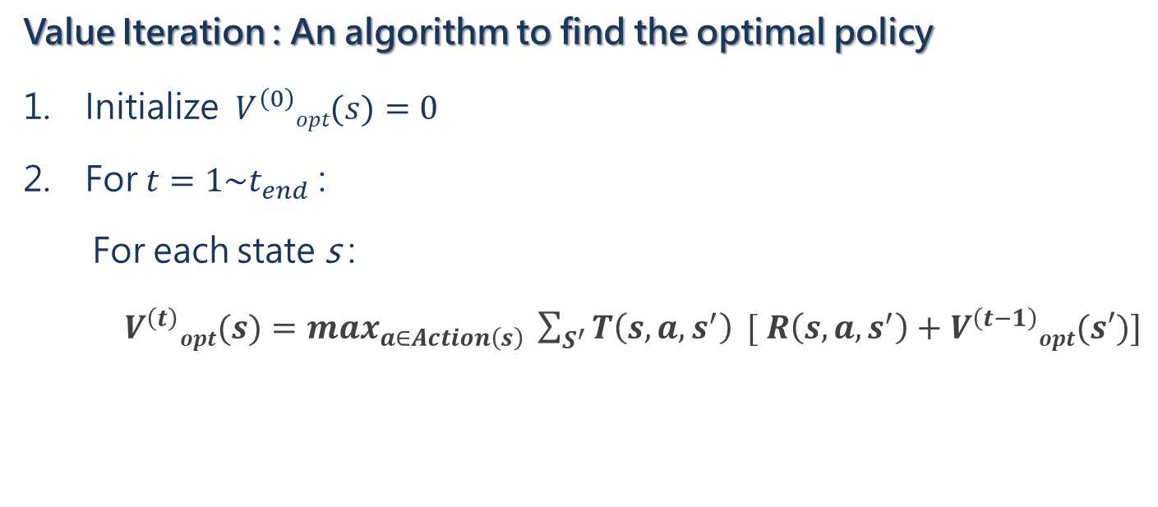
Recap 3 : Algorithm to Solve MDP
Value Iteration : An algorithm to find the optimal policy
Initialize $V^{\left(0\right)}opt(s)=0$
For $t=1\sim t_{end}$ :
For each state s :
  $V^{\left(t\right)}opt(s)=\max_{a∈Action\left(s\right)} \sum_{S^{′}}^{ }{T\left(s, a, s^{′}\right)} [ R\left(s, a, s^{′}\right)+V^{\left(t−1\right)}opt(s′)]$
Value function

Slide 27
(2014) A Markov decision process-based service migration procedure for follow me cloud
Adlen Ksentini, Tarik Taleb, Min Chen
IEEE ICC 2014 - Communication QoS, Reliability and Modeling Symposium

Slide 28
Introduction
This paper try to answer Where to migrate & When to migrate ?
Two baseline methods : never migrate & always migrate
Tradeoff between QoS improvement and migration cost
This paper modeling Service Migration Problem as Markov Decision Process (MDP) to solve it

Slide 29


Introduction
Why formulate Service Migration Problem as MDP model ?
User mobility is a stochastic process
MDP solution takes long-term reward into consideration
  Contrast to myopic (短視近利) solution
  Myopic means only migrate when immediate reward > cost
Task
Task
29
29

Slide 30


Problem Formulation
Assuming :
1-demensional mobility model
Each serving area (SA) has 1 base station (BS) and 1 edge server (ES)
Uniform random walk : p to move away from serving DC ; 1-p to move closer to serving DC
User sojourn(逗留) time follows an exponential distribution with mean 1/μ
1-p
p
Notes:
1D 是為了簡化等一下的 MDP 模型，不然要把 2D 轉換成 MDP 也沒什麼問題

Slide 31
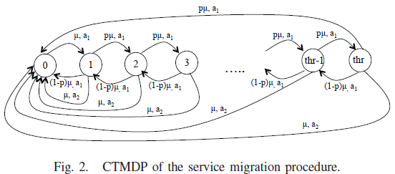
MDP Formulation
State : distance between user and serving ES
Action : a1 for not migrate, a2 for migrate
Notes:
在每個 state 都要回答「你要不要 migrate」，以此回答 when to migrate ; 他預設要 migrate 就是回到原點，以此默認回答 where to migrate
他的 state 只從 0 ~ thr，因為他設計成「如果距離超過 thr 就會強制執行 migration」
P, 1-p，但是與一般 MDP 不一樣，他在每個 SA 逗留的時間是不固定的，即便平均 20 換一次 SA，也不是說固定 20st、40st 會發生一次移動事件
該怎麼辦呢，首先就是假設他是 exp. dist.，然後我們把時間切得更細，比如 1 分鐘，那代表每分鐘發生移動的機率是 1/20，也就是有 1-u 的機率是不改變狀態的
對比上面的 MDP，這裡沒畫出 chance node，且目前沒有標示 r(s, a, s’)，這是在論文後面會說明的

Slide 32
MDP Formulation
T(s, a, s’) : pμ to move forward, (1-p)μ to move backward, 1-μ to stay in same state
R(s, a, s’) : described later
Notes:
根據定義，當發生使用者的移動事件，離開原區域，則會有 p 機率前移、1-p 機率往後移，只要知道 p 並以 MDP algorithm 計算，我們就能判斷是否 migrate 會更好。 但為什麼會有一個 mu 呢? 這是因為所謂的移動事件發生的間隔不一定，比如 : 他可能在 1 待了 10 分、在 2 待了 30 分鐘
對比下，像剛才介紹的 dice game 是屬於回合制的遊戲，他就是每回合都可以選擇一個動作 {stay/quit}，並且每回合觸發一次 state transition 將我們帶向下一個 state
換句話說，基本的 dice game 是一個回合制的遊戲，但在 Service migration 卻是一個即時制遊戲，那麼 MDP model 又該怎麼描述一個即時制的問題?
他在這個裡的做法就是把 MDP 事件的更新頻率縮短，比如他先假設用戶平均每 20 分鐘移動一次，那他就一分鐘觸發一次 state transition，因此 mu = 1/20，相對的，代表他有 19/20 的機率會待在原位
2.

Slide 33
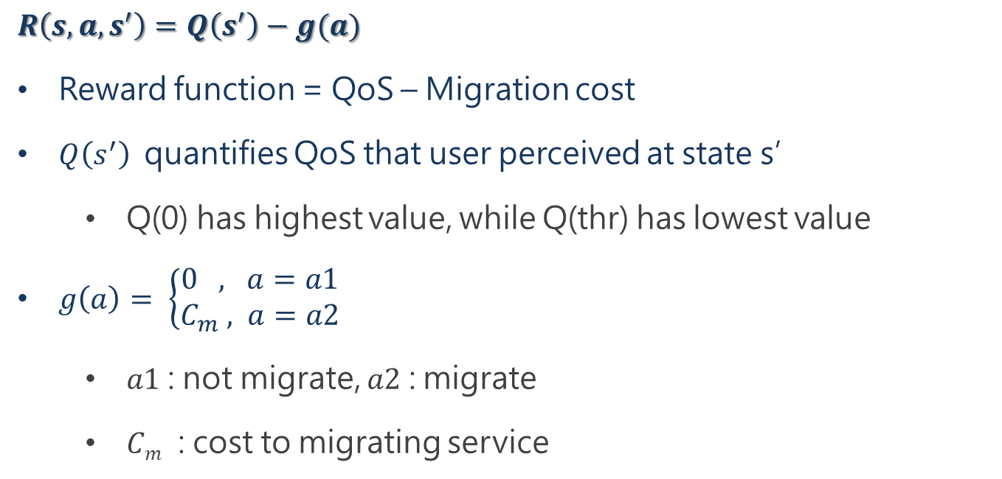
MDP Formulation
$R\left(s, a, s^{′}\right)=Q\left(s^{′}\right)−g(a)$
Reward function = QoS – Migration cost
$Q\left(s^{′}\right)$ quantifies QoS that user perceived at state s’
  Q(0) has highest value, while Q(thr) has lowest value
$g\left(a\right)= \left\{\begin{aligned}0 , a=a1 \\ C_{m} , a=a2\end{aligned}\right.$
  $a1$ : not migrate, $a2$ : migrate
  $Cm$ : cost to migrating service
Notes:
他只給了這樣一個空洞的定義，但是，Q(s) 和 Cm 的實際內涵到底是什麼? 在論文裡面沒說
當然，我們能猜測 : QoS 就是取決於通訊延遲、Cm 取決於 (1) 資料傳輸量 (2) service interrupt time

Slide 34
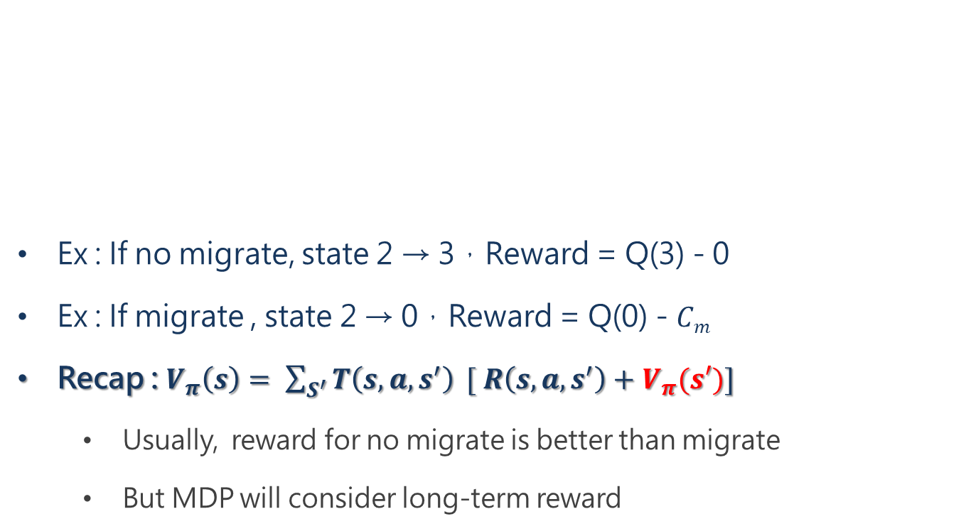
Ex : If no migrate, state 2 → 3，Reward = Q(3) - 0
Ex : If migrate , state 2 → 0，Reward = Q(0) - $Cm$
Recap : $V_{π}\left(s\right)= \sum_{S^{′}}^{ }{T\left(s, a, s^{′}\right)} [ R\left(s, a, s^{′}\right)+V_{π}(s′)]$
  Usually, reward for no migrate is better than migrate
  But MDP will consider long-term reward

Slide 35
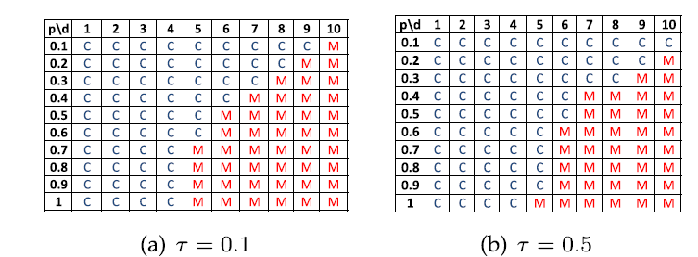

Numerical Result
$R\left(s, a, s^{′}\right)=Q\left(s^{′}\right)−Cm$
Let $τ$ represent the ratio between migration cost and maximum quality $Q(0)$
  $τ$ = 0.1 means $C_{m}=\frac{1}{10}Q(0)$
Notes:
這實驗是要展現 Transition 和 Reward function 對於遷移時機 (When) 的影響
但其實，我認為這個實驗設計相當潦草，主要就是這個 Reward function 的兩個部分都沒有交代清楚
Migration cost 被蒙混過去
QoS 沒有交代計算公式，不知道他的下降斜率多快。比如 Q(0) 和 Q(1) 之間差距多少? 100 對 90? 還是 100 對 99?
也就是說，這個實驗他其實沒交代清楚
在這實驗影響顯示了 p 和 $τ$ 兩個關鍵參數對 migration decision 的影響，但這實際情境下的關鍵參數不只這兩個
【疑問】只有說 Cm = 0.1Q(0)，但沒說 Q(1~10) 是 Q(0) 的幾分之幾。 比如如果我 Q(1) = 0.1Q(0), Q(2) = 0.01Q(0)，下降很快，那我應該會更傾向 migrate
【答】應該是跟 latency 成正相關，也就是和 distance / # of hopping 成正相關，不過不知道它具體數字

Slide 36

Recap : 1-D Mobility Model
1-p
p

Slide 37
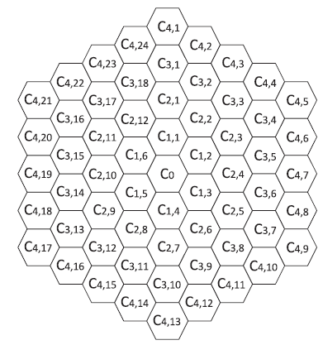
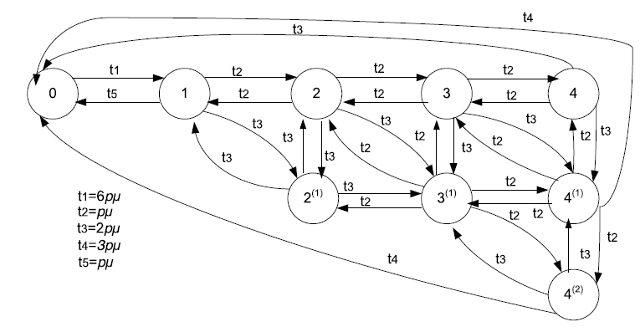
Extend to 2-D Mobility Model
(2016)Follow-me cloud : When cloud services follow mobile users

Slide 38
(2016) SEGUE : quality of service aware edge cloud service migration
Wuyang Zhang, Yi Hu, Yanyong Zhang, Dipankar Raychaudhuri
2016 IEEE 8th International Conference on Cloud Computing Technology and Science

Slide 39
Drawback of previous paper
Where to migrate
  Fails to consider both dynamic network and server conditions
  Servers e.g. C_{1,1~6} shouldn’t be simplified as one MDP state
  Only least hop migration destination

Slide 40
Improvement in this paper
Where to migrate
  MDP state is not distance-based ( increase state space )
  Not only least-hop migration ( increase action space )
  Keep track of network bandwidth and server workload
X :

Slide 41
Drawback of previous paper
When to migrate
  Update of Transition & Reward function is essential
  But the paper did not specify the MDP recalculate interval

Slide 42
Improvement in this paper
When to migrate
  Instead of MDP, it use QoS prediction to answer the timing
  Migrate when predicted QoS < threshold
  When decided to migrate, MDP recalculate to find optimal migrate destination (recalculation is event-triggered)
X :

Slide 43
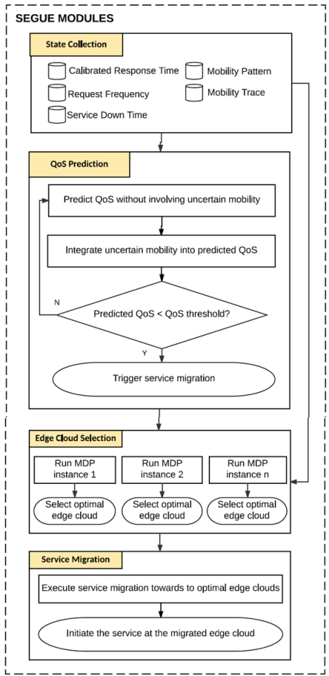
Ch.2 System Overview
SEGUE system is composed of 4 modules :
State Collection
  Collect data for other modules
QoS Prediction
  Answering when to migrate
Edge Cloud Selection
  Answering where to migrate
Service Migration
  Executing migration

Slide 44
3.1 State Collection Module
Collect info for the rest of modules
Calibrated Response Time can reflect network & server state
Calibrated Response Time is calculated by hybrid method of server push and client proxy probe [12]
[12] : (1998) A novel server selection technique for improving the response time of a replicated service

Slide 45
3.1 State Collection Module
Server push :
Estimating response time by monitoring server workload
Edge Server
SEGUE
(Client)
Reporting response time to SEGUE when server workload shift exceeds threshold
Drawback : The estimation is less accurate, for it did not reflect the impact of network bandwidth
Benefit : Event-triggered ( lightweight )

Slide 46
3.1 State Collection Module
Client Proxy Probe :
Measuring time before sending query and after receiving response ( ≈ Pinging )
1.
Base Station
Edge Server
2.
SEGUE periodically sending probing requests to all edge servers
Drawback : Significant overhead if performed frequently
Benefit : The estimation is almost as accurate as real performance
Notes:
類似 Pinging，因為做法是 Measuring time before sending query and after receiving response
【疑問】為何 client probe (= ping) 可以反映 server loading? Server load 10% 和 Server load 90% 的回應時間真的會不一樣嗎?

Slide 47
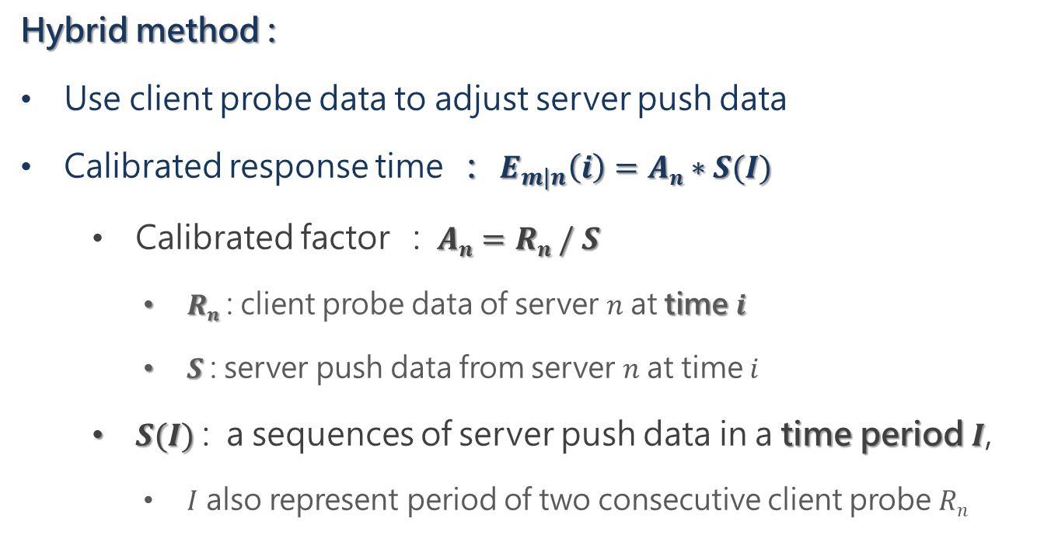
3.1 State Collection Module
Hybrid method :
Use client probe data to adjust server push data
Calibrated response time : $E_{m|n}\left(i\right)=An∗S(I)$
  Calibrated factor : $An=Rn / S$
    $Rn$ : client probe data of server $n$ at time $i$
    $S$ : server push data from server $n$ at time $i$
  $S(I)$ : a sequences of server push data in a time period $I$,
    $I$ also represent period of two consecutive client probe $Rn$
Notes:
Ex :
如果 server push S 推測 response time 為 100 ms，但實際 client probe 推測為 150ms，代表被 server push 忽略的 network state 可能會提供額外 50% 的延遲加成
因此，如果在 time i 之前的最近一段時間 I 裡，server push 傳來三筆資料，分別推測 92, 95, 98，那我們就知道實際的 response time 延遲可能會更接近 92*1.5 = 138，以此類推…

Slide 48
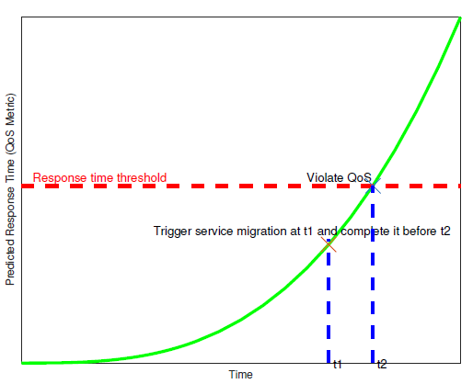
3.2 QoS Prediction Module
Answering When to migrate by QoS prediction
[14] propose a Subset ARIMA model to predict future QoS from history of calibrated QoS ( response time )
Assuming 1-D mobility
[14] : (1999) Application of subset autoregressive integrated moving average model for short-term freeway traffic volume forecasting

Slide 49
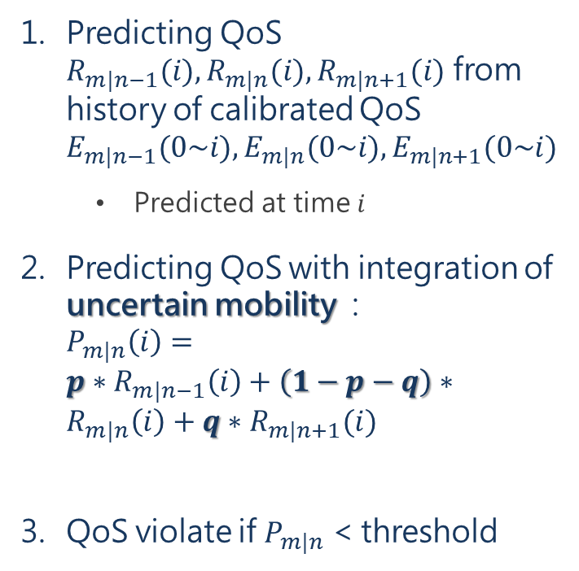
3.2 QoS Prediction Module
Predicting QoS $R_{m|n−1}(i), R_{m|n}(i), R_{m|n+1}(i)$ from history of calibrated QoS $E_{m|n−1}(0\sim i), E_{m|n}(0\sim i), E_{m|n+1}(0\sim i)$
  Predicted at time $i$
Predicting QoS with integration of uncertain mobility : $P_{m|n}\left(i\right)=p∗R_{m|n−1}\left(i\right)+\left(1−p−q\right)∗R_{m|n}\left(i\right)+q∗R_{m|n+1}(i)$
QoS violate if $P_{m|n}$ < threshold
Notes:
這頁的內容很難說，我可能會跳過。因為得先了解他的 MDP model 之後，才知道為何需要考量 n-1, n, n+1 三個 state

Slide 50
3.3 Edge Cloud Selection Module
Answering Where to migrate by solving MDP
Next to discuss :
  Problem formulation
  MDP formulation
  Reward function

Slide 51

3.3.1 Problem Formulation
Assuming 1D mobility
Assuming n geographical region (BS area) and m edge servers
n = 7
m = 3
p
1-p-q
q

Slide 52
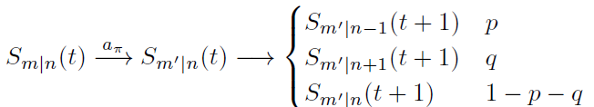



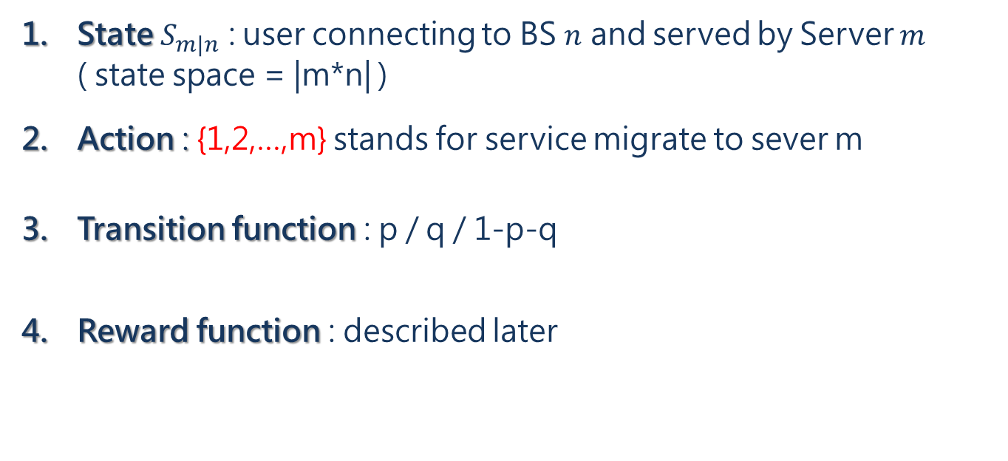
3.3.2 MDP Formulation
State $S_{m|n}$ : user connecting to BS $n$ and served by Server $m$ ( state space = |m*n| )
Action : {1,2,…,m} stands for service migrate to sever m
Transition function : p / q / 1-p-q
Reward function : described later
n = 7
m = 3
p
1-p-q
q

Slide 53
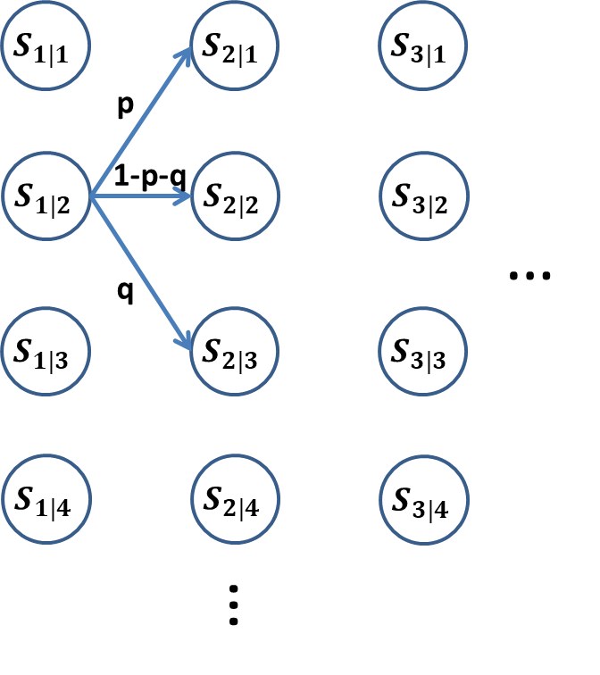

3.3.2 MDP Formulation
When state = $S_{1|2}$, evaluating value for action = 2

Slide 54
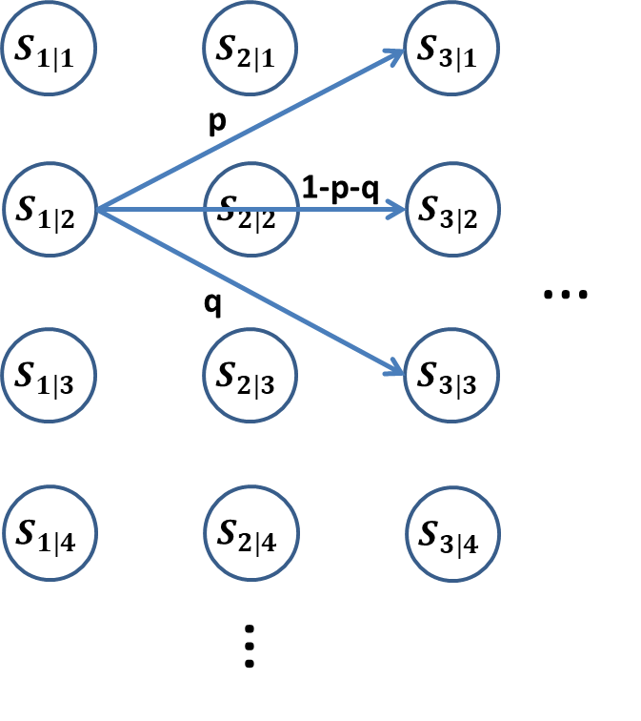

3.3.2 MDP Formulation
When state = $S_{1|2}$, evaluating value for action = 3

Slide 55
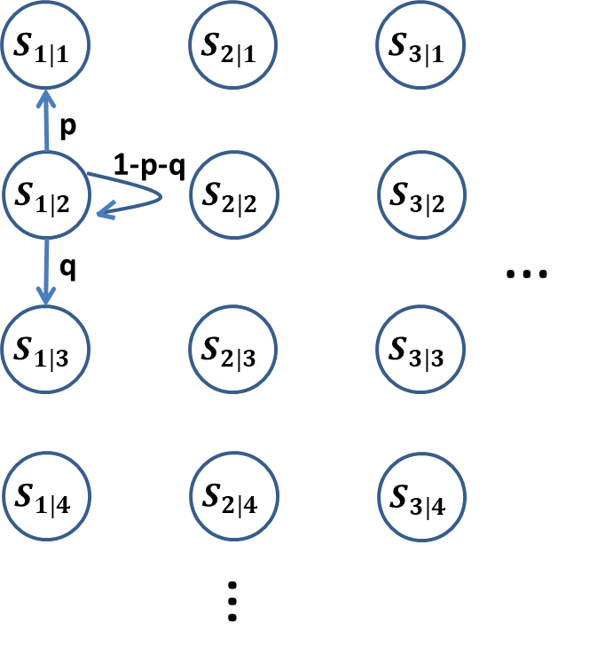

3.3.2 MDP Formulation
When state = $S_{1|2}$, evaluating value for action = 1

Slide 56
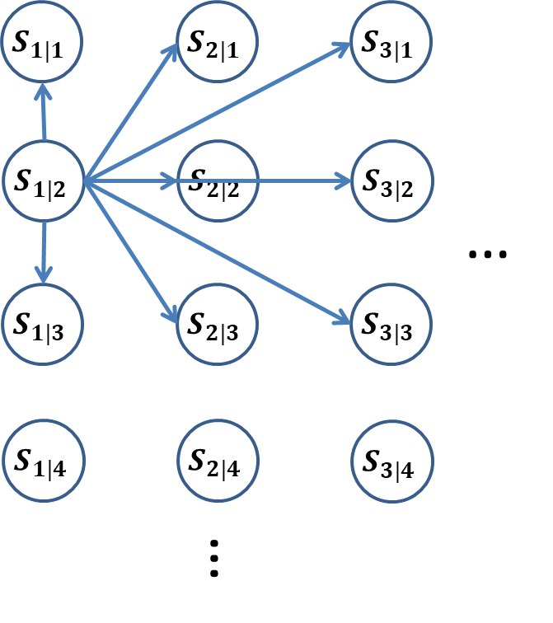

3.3.2 MDP Formulation
When state = $S_{1|2}$, evaluating values for all actions

Slide 57
補充 – Compare to pervious MDP model
Notes:
對比之前的 MDP model，可以更明顯看到此 MDP model 有的致命的缺點 : 解題的複雜度會隨著 m,n 的規模有爆炸性的增長，稱為 state space explosion
State (點) 會無止盡增長
Action (線) 選擇變多了
所以，我認為這個 MDP 雖然能夠更精準的表達這個系統的狀態，找出更好的解答，但他的這種做法反而更加不實用

Slide 58
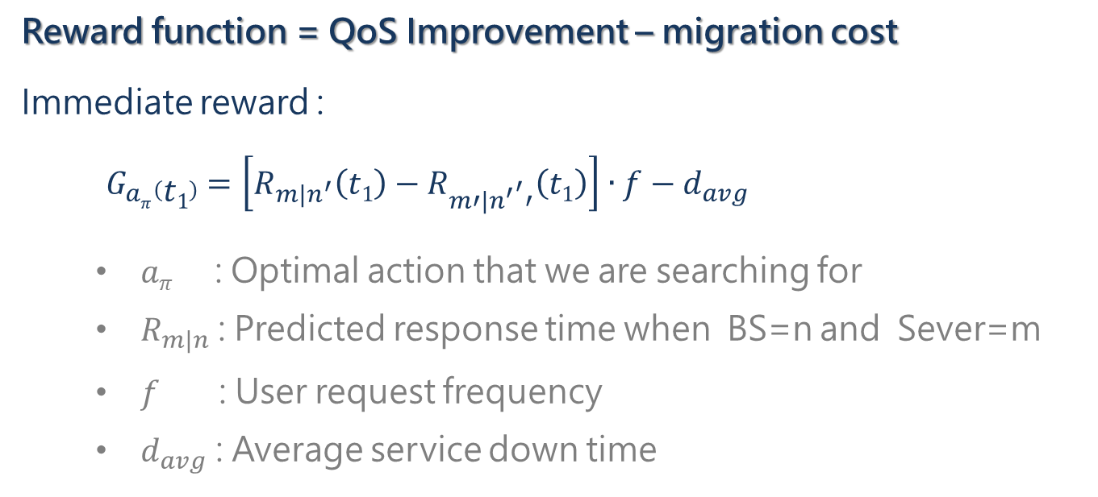
3.3.3 Reward Function
Reward function = QoS Improvement – migration cost
Immediate reward :
$G_{aπ}\left(t1\right)=\left[R_{m|n^{′}}\left(t1\right)−R_{m′|{n^{′}}^{′}′}\left(t1\right)\right]∙f−d_{avg}$
  $aπ$ : Optimal action that we are searching for
  $R_{m|n}$ : Predicted response time when BS=n and Sever=m
  $f$ : User request frequency
  $d_{avg}$ : Average service down time

Slide 59
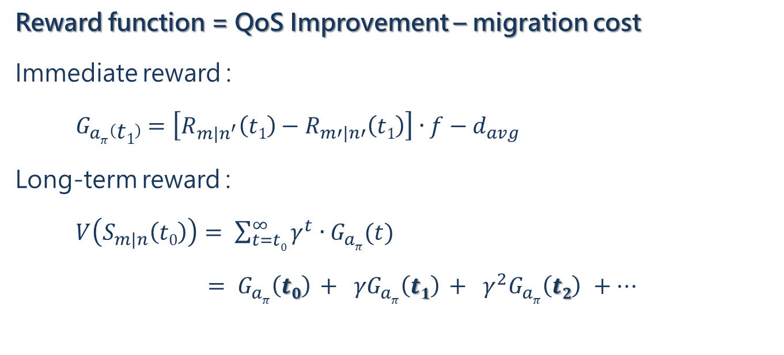
3.3.3 Reward Function
Reward function = QoS Improvement – migration cost
Immediate reward :
$G_{aπ}\left(t1\right)=\left[R_{m|n^{′}}\left(t1\right)−R_{m′|n′}\left(t1\right)\right]∙f−d_{avg}$
Long-term reward :
$V\left(S_{m|n}\left(t0\right)\right)= \sum_{t=t0}^{∞}{γ^{t}∙G_{aπ}(t)}$
$= G_{aπ}\left(t0\right) + γG_{aπ}\left(t1\right) + γ^{2}G_{aπ}\left(t2\right) +…$

Slide 60
3.4 Service Migration Module
Related to Live Migration Problem (How to migrate)
Not answered in this paper

Slide 61
Ch.4 Performance Evaluation
Experiment Set Up :
Implemented on Open-Access Research Testbed for Next-Generation Wireless Network (ORBIT)
Real case simulation based on 320 taxis’ track in Rome
Assuming :
  30 edge servers with identical capability
  30 geographical regions
  1D mobility

Slide 62
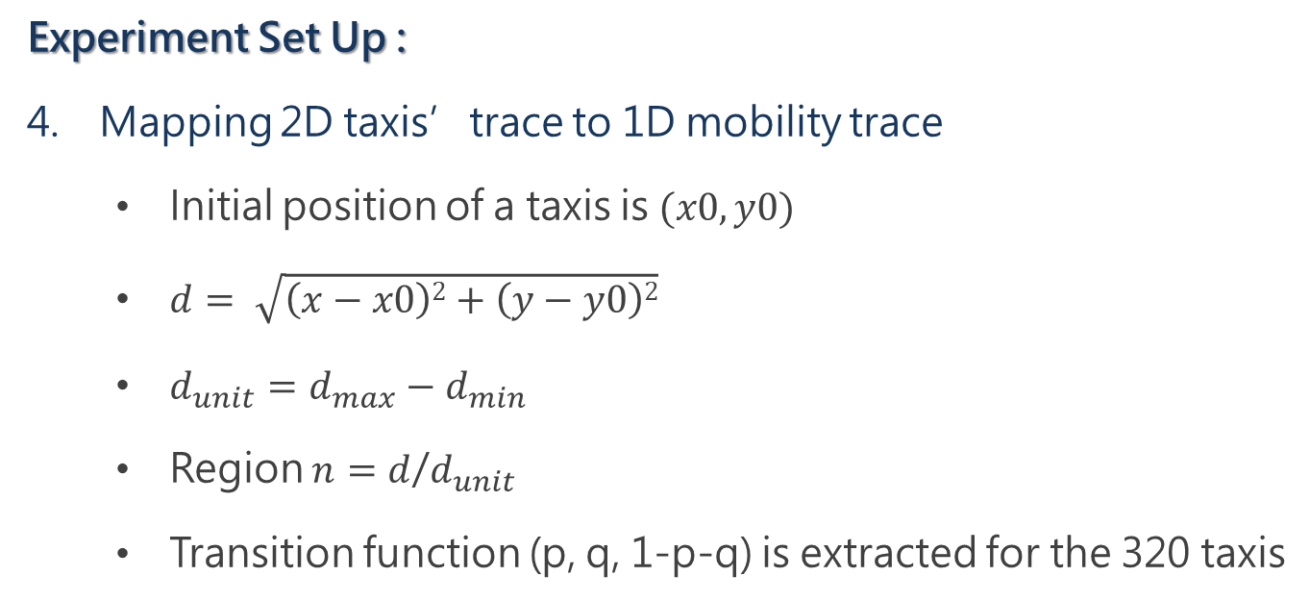
Ch.4 Performance Evaluation
Experiment Set Up :
Mapping 2D taxis’trace to 1D mobility trace
  Initial position of a taxis is $(x0, y0)$
  $d= \sqrt{\left(x−x0\right)2+\left(y−y0\right)2}$
  $d_{unit}=d_{max}−d_{min}$
  Region $n=d$/$d_{unit}$
  Transition function (p, q, 1-p-q) is extracted for the 320 taxis
Notes:
(x,y) 是計程車每個位置位置，(x0,y0) 是計程車在資料中的起點位置
把整份資料集該計程車移動到的最遠距離和最近距離分別設為 dmax 和 dmin
所以每台計程車一定都會出現在 第一區 和 最後一區 至少一次，並且在這條線之間來回跑動

Slide 63
Ch.4 Performance Evaluation
Experiment Set Up :
Parameters Configuration :
  QoS threshold = 200 ms
  Service downtime = 2 sec.
  Request frequency = 300 requests per 2 min.

Slide 64
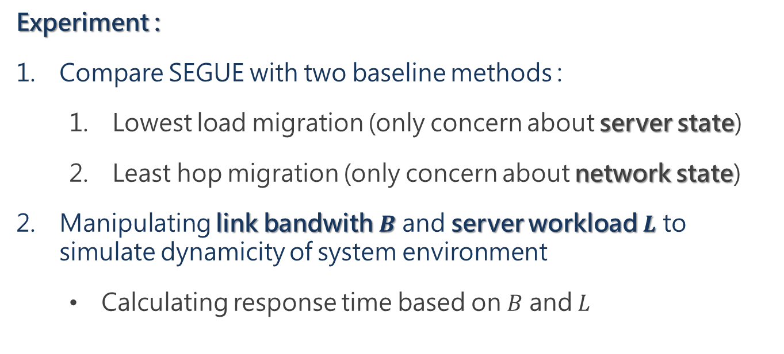
Ch.4 Performance Evaluation
Experiment :
Compare SEGUE with two baseline methods :
  Lowest load migration (only concern about server state)
  Least hop migration (only concern about network state)
Manipulating link bandwith $B$ and server workload $L$ to simulate dynamicity of system environment
  Calculating response time based on $B$ and $L$
Notes:
沒交代從 B 和 L 逆推 response time 的公式

Slide 65
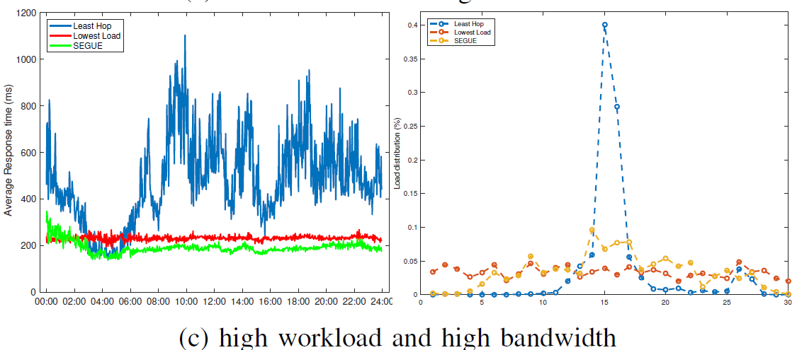
Ch.4 Performance Evaluation
Experimental Result :
When server workload is bottleneck, QoS for lowest load (239.37ms) is better than least hop (481.40ms)

Slide 66
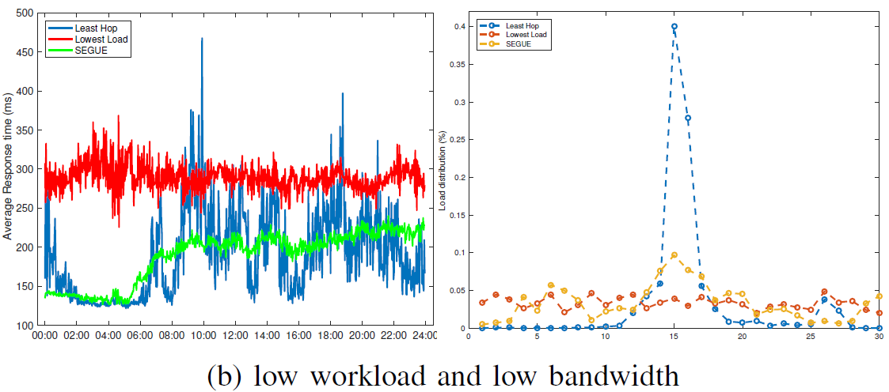
Ch.4 Performance Evaluation
Experimental Result :
When network bandwidth is bottleneck, QoS for least hop (190.71ms) is better than lowest load (289.71ms)

Slide 67
Lesson Learned from this paper
Even for same service migration topic, MDP formulation can vary significantly
To answer “Where to migrate” problem, there are two factor to be consider : server loading & (backhaul) network bandwidth
Although MDP can eliminate the need to predict the user mobility, there is still a need to predict the change of system environment

Slide 68
Drawback of this paper
MDP state space explosion
  For geographical regions n and servers m, state space = |m*n|
  Distanced-based MDP can limit state space by distance < threshold, but the same doesn’t apply to SEGUE
  Hard to apply to real case scenarios
v.s

Slide 69
Drawback of this paper
MDP state space explosion
Assuming 1D mobility
  Assumption inherited from the QoS prediction method
  Transition function : (p, q, 1-p-q)
  Can not apply to real case scenarios (6 directions)

Slide 70
Q & A

Slide 71
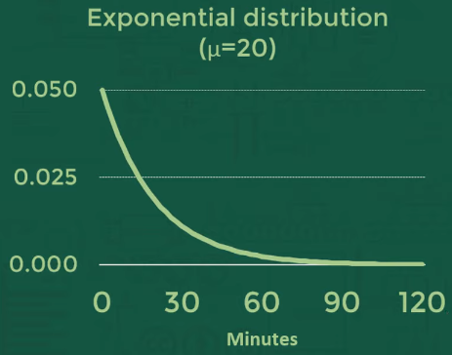

Exponential Distribution
Times per single event occur
  20 minutes for next customer arrival , $μ=20$
Events per unit of time
  $\frac{1}{20}$ customers visit shop per minute , λ = $\frac{1}{20}$
Notes:
比如擲骰子，每次骰出 6 的機率都會是一樣的 1/6，不會因為你前一百次沒骰出 6 ，下一次骰出 6 的機率就翻倍

Slide 72
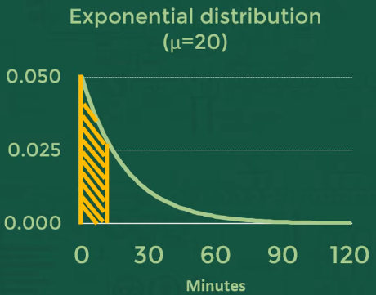
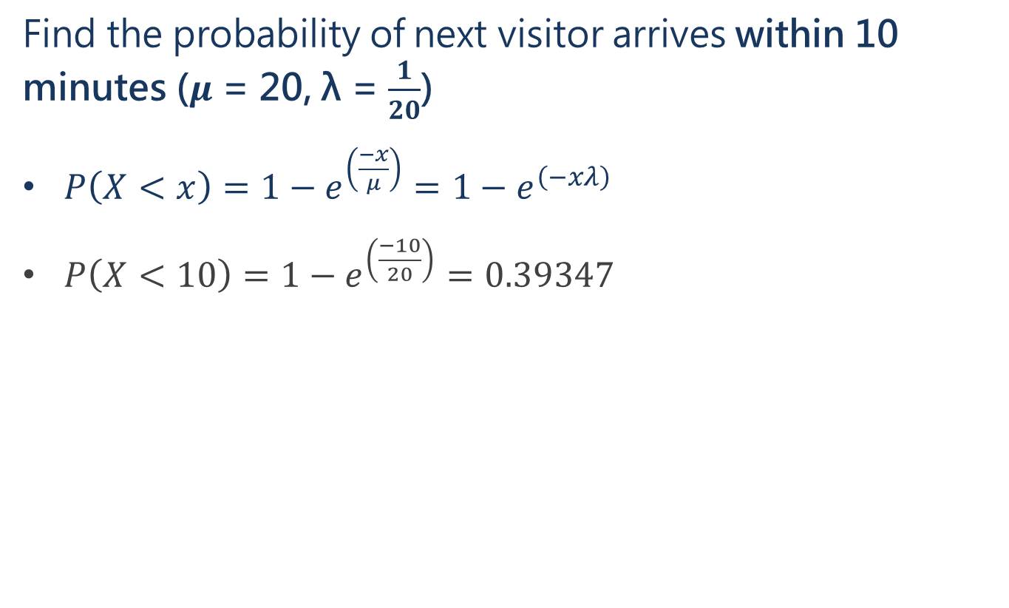
Exponential Distribution
Find the probability of next visitor arrives within 10 minutes ($μ$ = 20, λ = $\frac{1}{20}$)
$P\left(X<x\right)=1−e^{\left(\frac{−x}{μ}\right)}=1−e^{\left(−xλ\right)}$
  $P\left(X<10\right)=1−e^{\left(\frac{−10}{20}\right)}=0.39347$

Slide 73


Exponential Distribution
Why is it called “exponential” ?
Requirement :
  Event must occur in constant rate
  Event must be independent from each other
Example :
  Rolling a dice, the probability to get 6 is $\frac{1}{6}$
  If the first 100 roll didn’t get you any 6, then the probability to get 6 in 101st roll is $\frac{1}{6}$
Notes:
Rolling a dice, the probability to get 6
If the first 100 try didn’t get any 6, then the probability to get 6 in 101st try

Slide 74
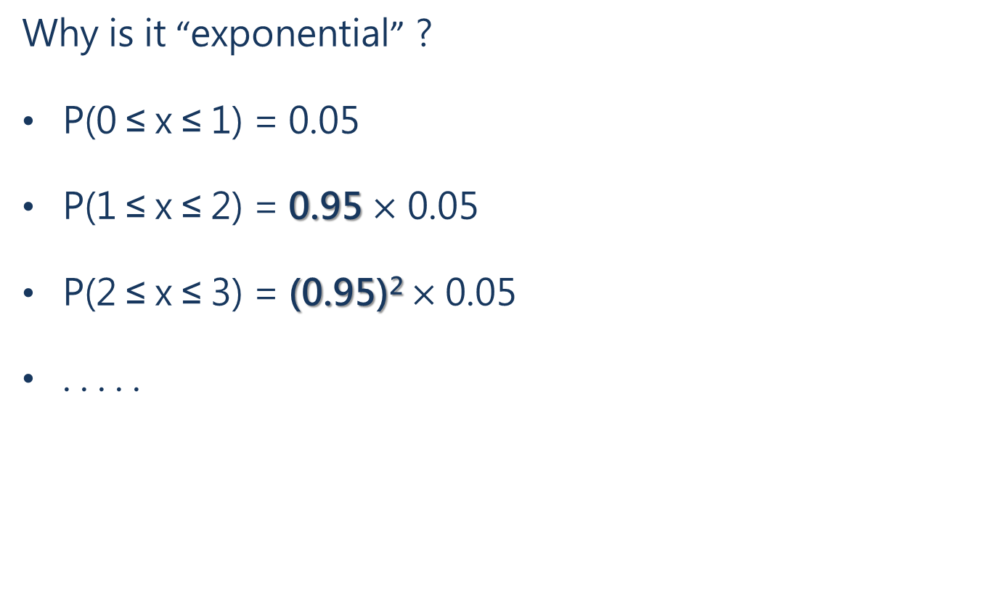
Exponential Distribution
Why is it “exponential” ?
P(0 ≤ x ≤ 1) = 0.05
P(1 ≤ x ≤ 2) = 0.95 $×$ 0.05
P(2 ≤ x ≤ 3) = (0.95)² $×$0.05
. . . . .
Notes:
事件機率一樣，但是進入事件的前提條件會愈來愈嚴苛

