Slide 1
Machine learning-driven service function chain placement and scaling in MEC-enabled 5G networks
Tejas Subramanya a , ∗, Davit Harutyunyan a , Roberto Riggio
(2020) Computer Networks

Slide 2
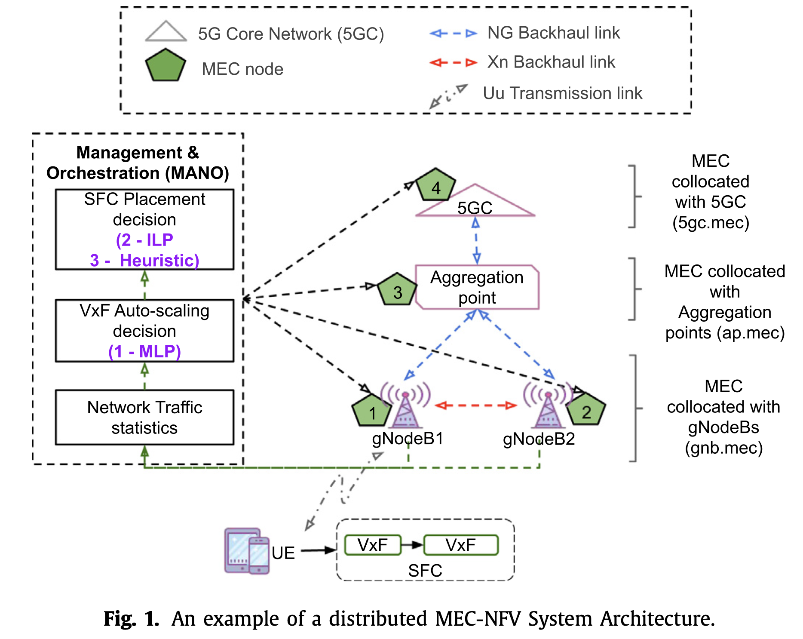
Introduction
How to associate UEs, place their SFCs, and allocate sufficient VxF instances and resources to make sure that the UEs SFC requirements are satisfied while the network resources are used efficiently?
Towards this end, auto-scaling of VxFs, in addition to UEs association and their SFC placement, is thought to be an essential requirement for successful management and orchestration (MANO) of resources and services in 5G networks.
Notes:
本篇論文作者想要解決兩個問題：
第一個是Auto-scaling 的問題，當需要As的時候要擴展到多少個能保有最佳資源使用效率? 作者使用MLP解決這個問題
第二個是UE到UE，E2E之間的SFC要如何部屬，作者使用了ILP與Heuristic Algorism 來解決這個問題。

Slide 3
Outline
Introduction
MLP Auto-scaling
  Input X and Output Y
  Types of Y
  MLP Models
  Result
SFC placement
  Problem description
  Delay model
  Problem formulation
  ILP
  Heuristic algorism
  Evaluation
Conclusions

Slide 4
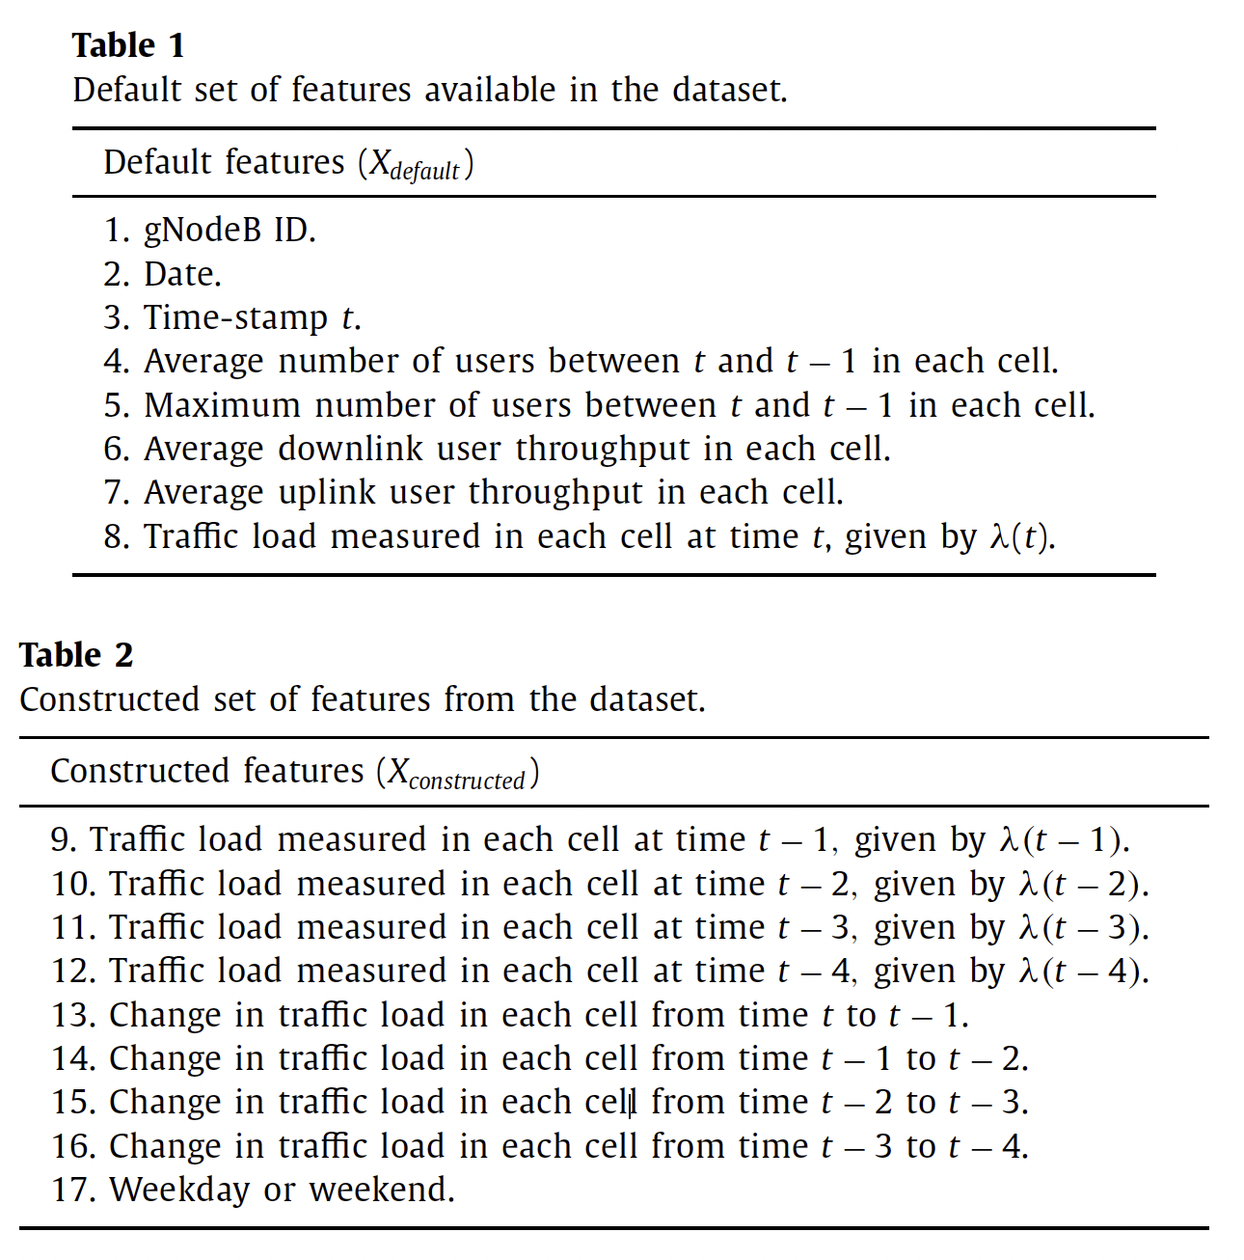
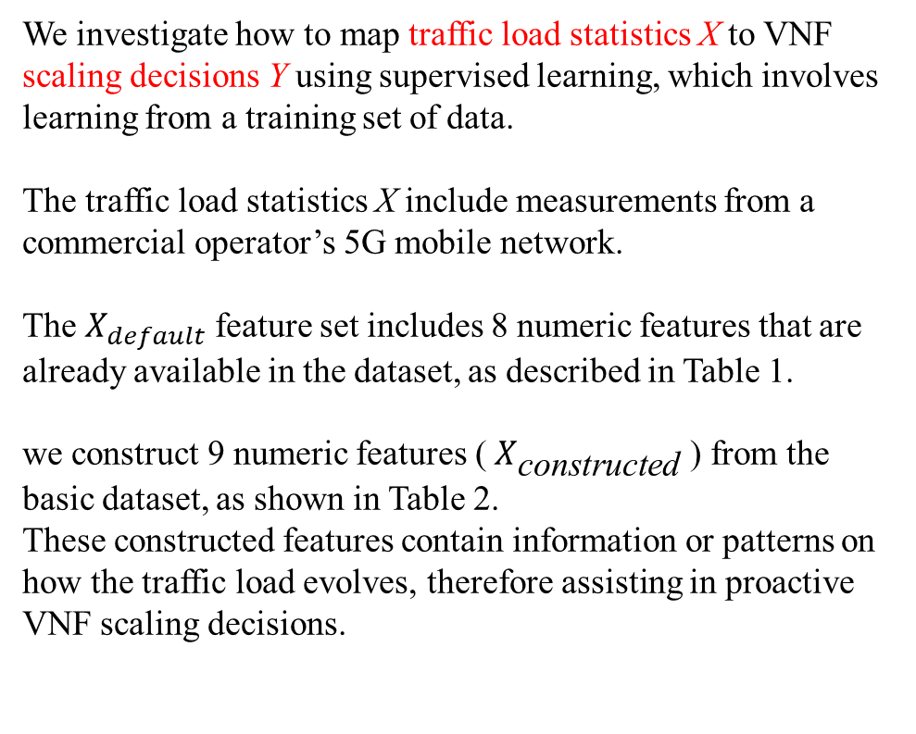
MLP Auto-scaling
We investigate how to map traffic load statistics X to VNF scaling decisions Y using supervised learning, which involves learning from a training set of data.
The traffic load statistics X include measurements from a commercial operator’s 5G mobile network.
The $X_{default}$ feature set includes 8 numeric features that are already available in the dataset, as described in Table 1.
we construct 9 numeric features ( $X_{\text{constructed}}$ ) from the basic dataset, as shown in Table 2.
These constructed features contain information or patterns on how the traffic load evolves, therefore assisting in proactive VNF scaling decisions.
Notes:
作者使用 Traffic load statistics 作為 ML的input X ，然後產生出來的 output Y 就是 VNF scaling decisions。
網路流量分析資料來源是使用真實營運商的data
右邊Xdefalut是收集到的原始資料(1~8)，下面Xconstruct(9~17)是根據原始資料，加上時間序後產生出的資料，目的是要帶入隨著時間的改變，過去的網路流量是如何改變，如此一來就可以幫助模型學習得更好。

Slide 5
Input X
Feature subset selection:
Recursive Feature Elimination (RFE):
RFE is a greedy optimization technique that strives to find the best-performing feature subset.
Principal Component Analysis (PCA) :
A statistical method to find correlated features and their impact on classification and regression
After ranking, features 8, 9, 10, 11, and 12 are ranked highest, which implies that measured loads closer to the scaling decision time are the crucial features. Features 2, 17, and 3 are ranked 2nd, 3rd, and 4th, respectively.
we use only 12 features (eliminating 1, 4, 5, 6, and 7 from Table 1 ) that provide the best results for our MLP models.
Notes:
作者使用兩個演算法，目的在求出哪些features(input x) 對於模型學習有較好的幫助
一個是 RFE，他是一個greedy演算法，致力於找出best-performance的feature
一個是PCA，一個統計的方法找出相關feature與feature對於classification與regression學習的影響
經過作者實驗，Features 8, 9, 10, 11, 12分數最高，表示具有時間序列性質的feature對於模型學習有較大的幫助，其次2~4名的feature分別是2, 17, 3
作者接下來只會使用12個feature，也就是拋棄掉1, 4, 5, 6, 7這五個feature做模型學習。

Slide 6
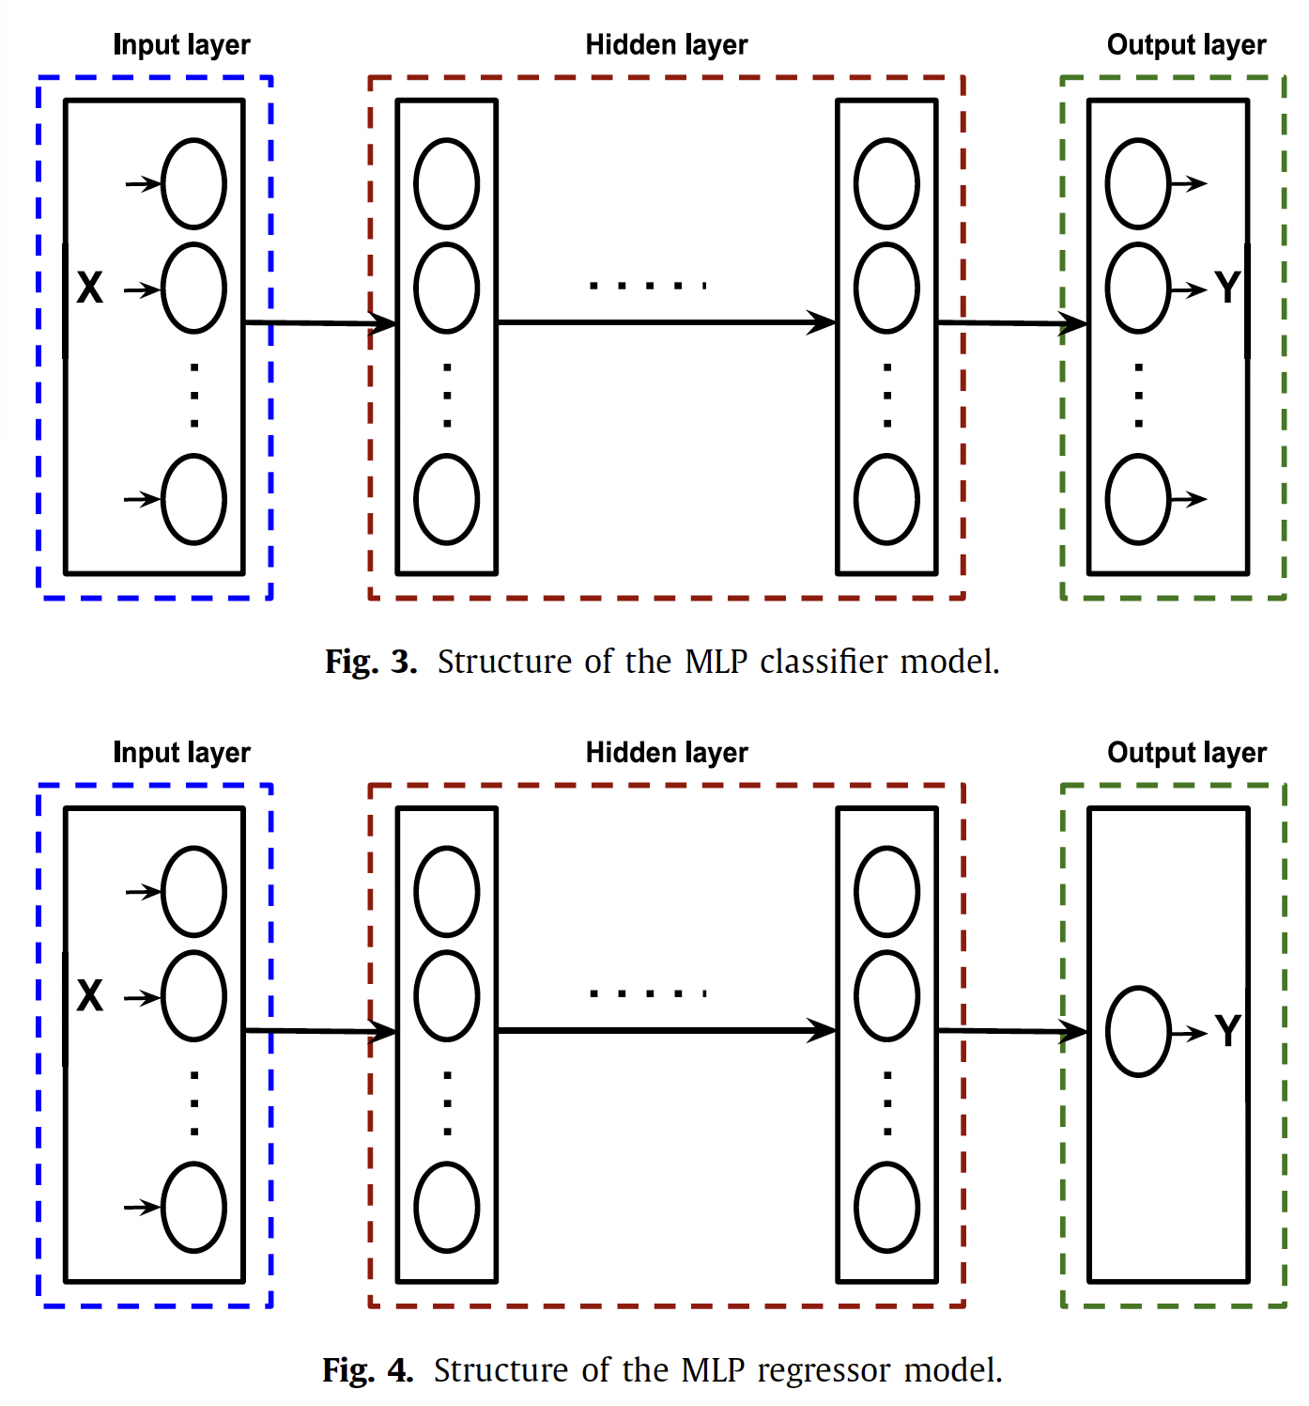
Output Y
MLP Classifier
The output is a vector containing the probabilities that sample x ∈ X belongs to each class.
The final result is the class with the highest probability.
MLP Regressor
The output is a real-valued quantity predicted based on the input sample x ∈ X
QoS favored classifier/regressor (Q-classifier/Q-regressor)
Cost favored classifier/regressor (C-classifier/C-regressor).
Notes:
介紹完X，現在介紹output Y
這裡output Y就是常見的 classifier與regressor
Classifier意思是在模型的最後一層，會有多個細胞，不同細胞代表不同的Y值，作者使用softmax產生出每個y的可能機率，而最高機率的y就會是最佳答案。
Regressor則是在模型最後一層只有一個細胞，這個細胞會產生的output為一個數值，表示需要部屬幾個NF
作者額外設計兩種目標，QoS優先與Cost優先(續下頁)

Slide 7
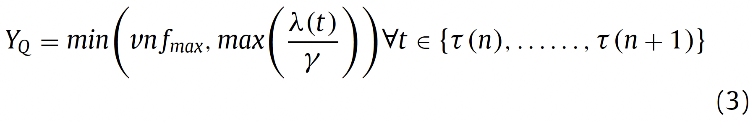
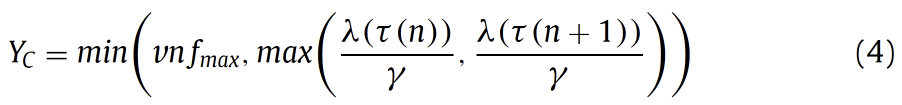
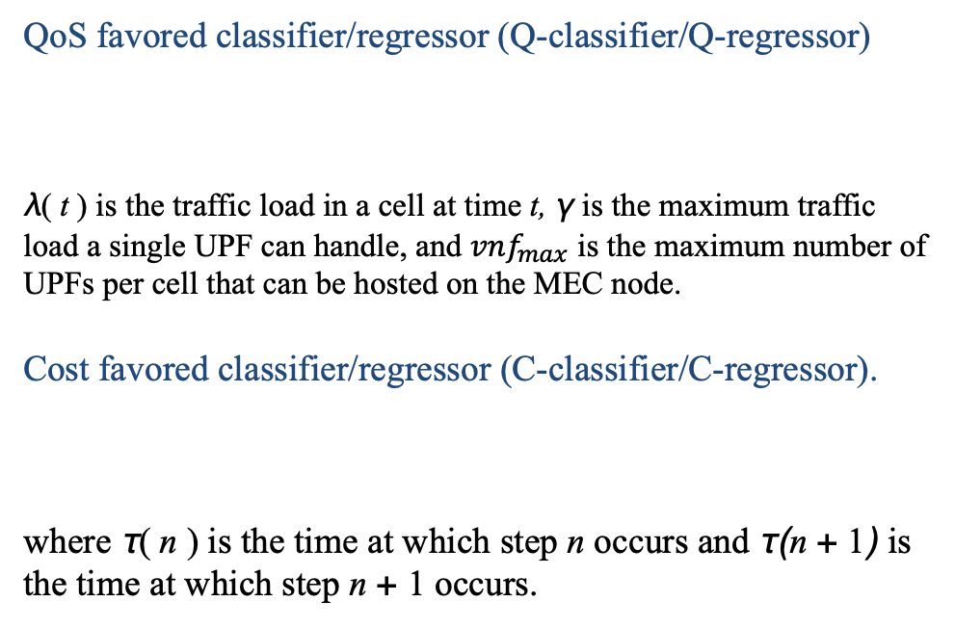
Output Y
QoS favored classifier/regressor (Q-classifier/Q-regressor)
λ( t ) is the traffic load in a cell at time t, γ is the maximum traffic load a single UPF can handle, and ${vnf}_{max}$ is the maximum number of UPFs per cell that can be hosted on the MEC node.
Cost favored classifier/regressor (C-classifier/C-regressor).
where τ( n ) is the time at which step n occurs and τ(n + 1) is the time at which step n + 1 occurs.
Notes:
QoS優先的公式，將所有時間納入考慮，並取min
CoS的公式，只把n與n+1的資料納入考慮。

Slide 8
MLP Models
Finding the parameters of a neural-network model means searching for the best hyper-parameters of the MLP that can make the best predictions on the input
We applied grid search and baby-sitting as search strategies.
Our search space for finding optimal hyperparameters for MLP models are as follows:
• Hidden layers: 1 to 5.
• Nodes in each hidden layer: 12 to 30 in intervals of 3.
• Optimizer: Adam, SGD, RMSprop.
• Learning rate: 0.1, 0.01, 0.001.
• Batch size: 100 to 500 in intervals of 100.
• Number of epochs: 100 to 500 in intervals of 100.
Notes:
深度學習的模型中，每個perceptron的值是由模型自己去學習的，而實驗就是要測試使用哪一些的超參數可以使模型的學習效果最好。
作者這邊列出了這些他會做調整的超參數，使用 grid search 和 baby-sitting 來找出最佳超參數組合

Slide 9
MLP Models
The structure includes
One input layer with 12 nodes (i.e., one for each input feature),
three hidden layers with 12, 24, and 12 nodes, respectively, and
an output layer with 10 nodes for the MLP classifier (i.e., one for each output class) and
1 node for MLP regressor.
The regularization parameter used is 0.01,
The optimizer is based on a stochastic gradient approach with a constant learning rate of 0.001,
The batch size is fixed to 100, and
the number of epochs equals 300.
We use a rule-of-thumb decomposition conforming to 60%/20%/20% between the training, validation and test datasets, respectively.
Notes:
詳細設定

Slide 10
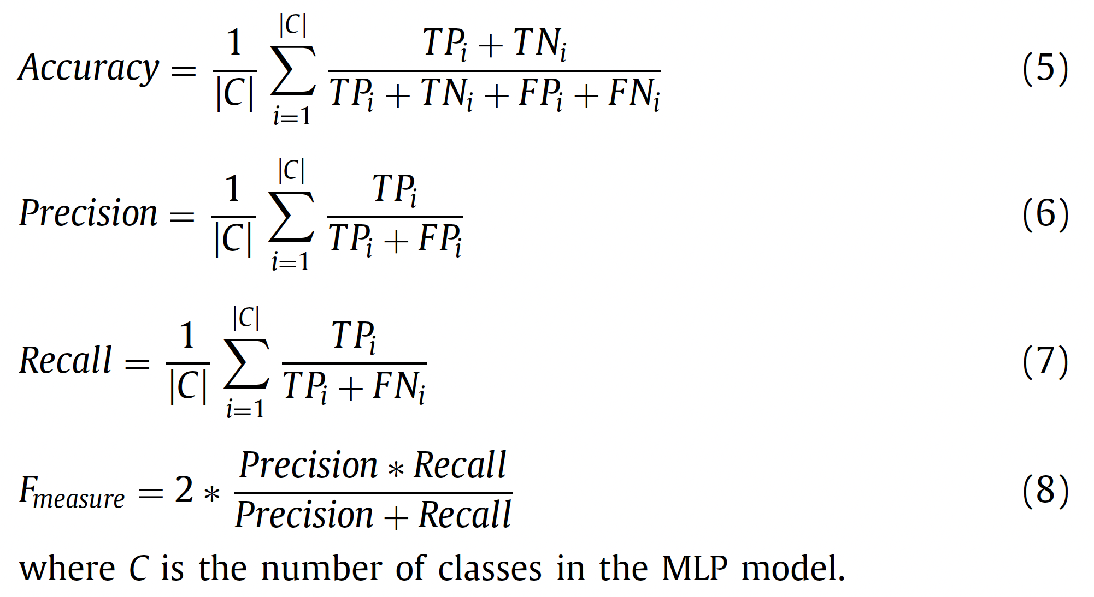
MLP Auto-scaling
MLP Classifier :
  True Positive (TP)
  True Negative (TN)
  False Positive (FP)
  False Negative (FN)
Recall is a measure that calculates how many of the actual positives are captured in our model by labeling it as positive. It is a good measure to determine when the cost of FN is high.
F-measure is the weighted average of precision and recall, and it is used when there is an uneven class distribution.
Notes:
超參數設定完，丟X進去讓模型學習完，產生出Y之後就可以開始做分析
Classifier使用四個指標：TP, TN, FP, FN
Accuracy 衡量了模型在整體測試數據集上的預測正確性。
Precision 準確率：衡量了模型在所有被預測為正例的樣本中，實際正例的比例。
Recall 也稱為召回率，它衡量了在所有實際正例中，模型成功預測為正例的比例。較高的 Recall 表示模型在檢測正例方面表現較好，較低的 Recall 則表示模型可能錯過了許多實際正例。
F-measure（F值）是精確度（Precision）和召回率（Recall）的加權平均。在某些分類問題中，不同類別的樣本數量可能差距很大，這個指標的主要目的是綜合考慮模型的精確性和覆蓋性，特別是在存在類別不平衡的情況下。

Slide 11
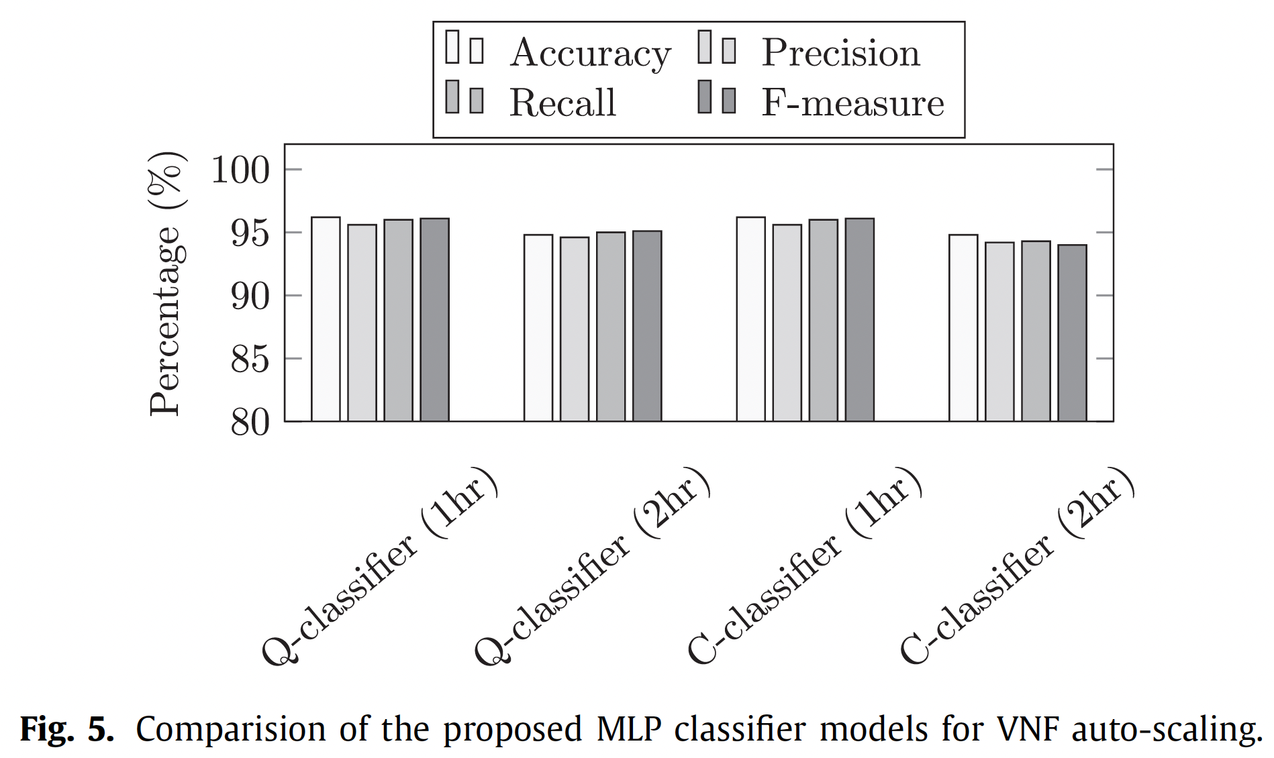
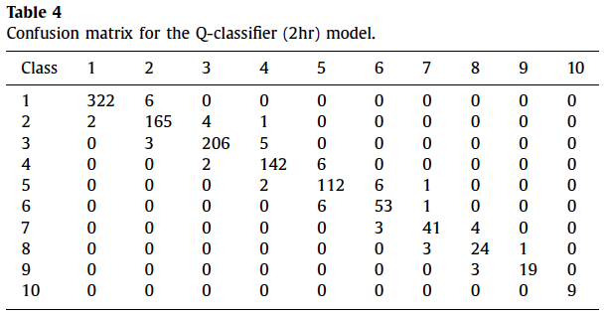
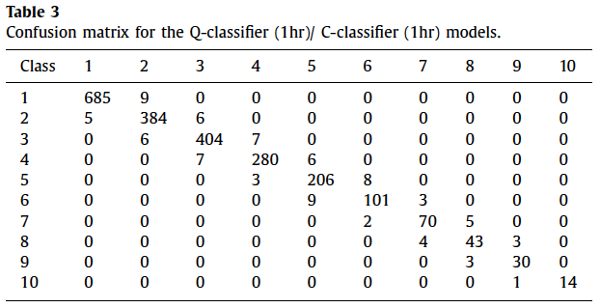
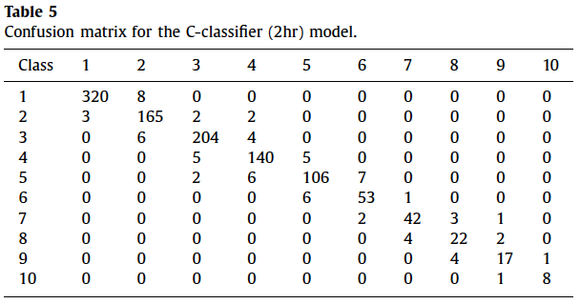
MLP Auto-scaling
Notes:
四個指標的分數、混淆矩陣

Slide 12
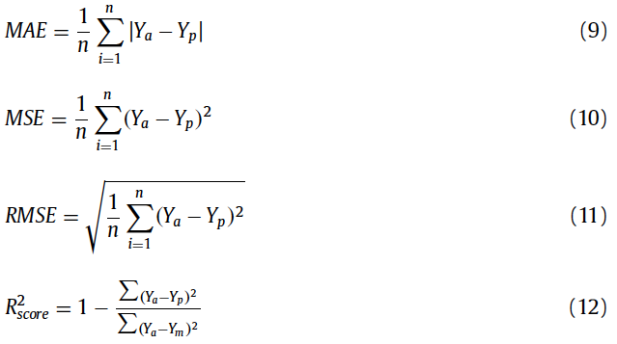
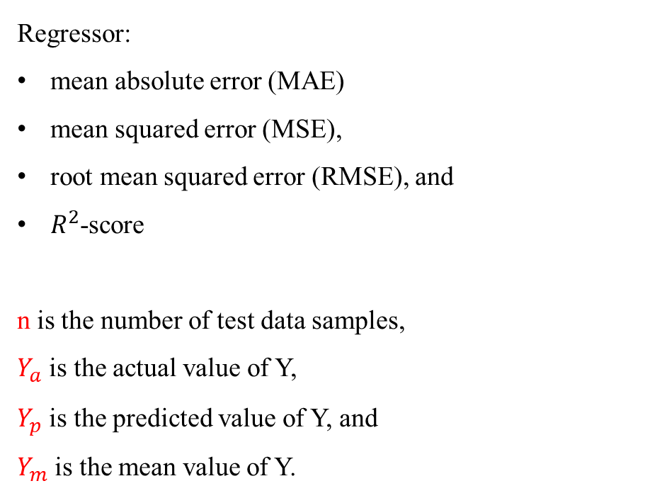
MLP Models
Regressor:
mean absolute error (MAE)
mean squared error (MSE),
root mean squared error (RMSE), and
$R^{2}$-score
n is the number of test data samples,
$Y_{a}$ is the actual value of Y,
$Y_{p}$ is the predicted value of Y, and
$Y_{m}$ is the mean value of Y.
Notes:
R square
1~0，1表示模型的預測與實際數據之間的差距很小，相似度高
0表是模型無效，不適用於這個數據集

Slide 13
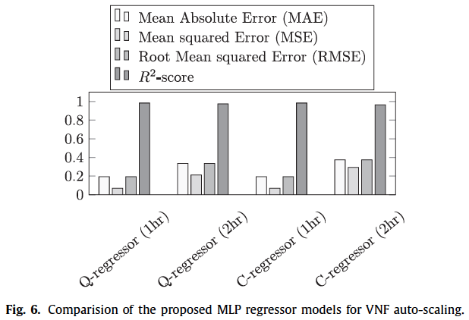
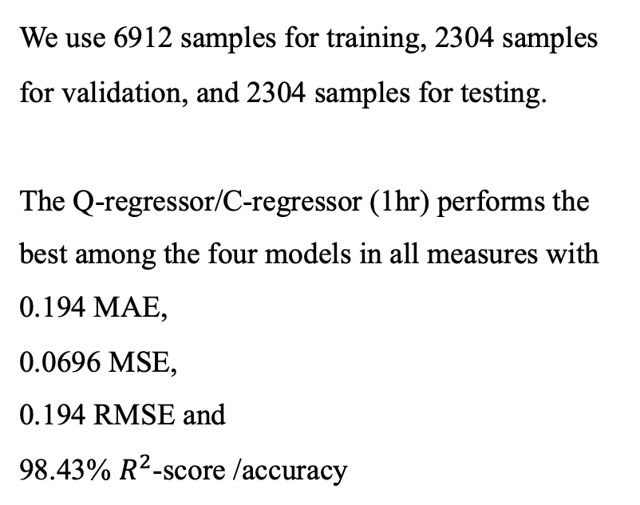
MLP Models
We use 6912 samples for training, 2304 samples for validation, and 2304 samples for testing.
The Q-regressor/C-regressor (1hr) performs the best among the four models in all measures with
0.194 MAE,
0.0696 MSE,
0.194 RMSE and
98.43% $R^{2}$-score /accuracy

Slide 14
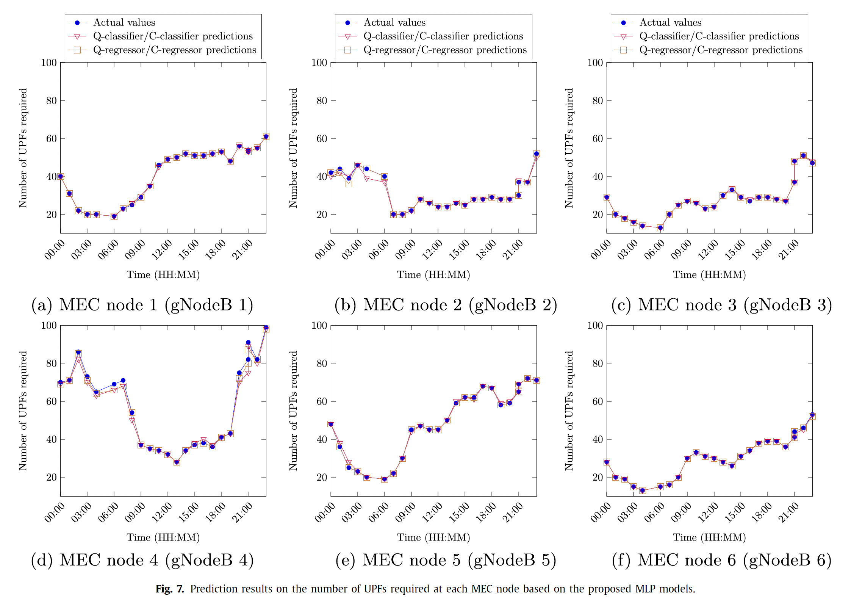
MLP Auto-scaling

Slide 15
Outline
Introduction
MLP Auto-scaling
  Input X and Output Y
  Types of Y
  MLP Models
  Result
SFC placement
  Problem description
  Delay model
  Problem formulation
  ILP
  Heuristic algorism
  Evaluation
Conclusions

Slide 16
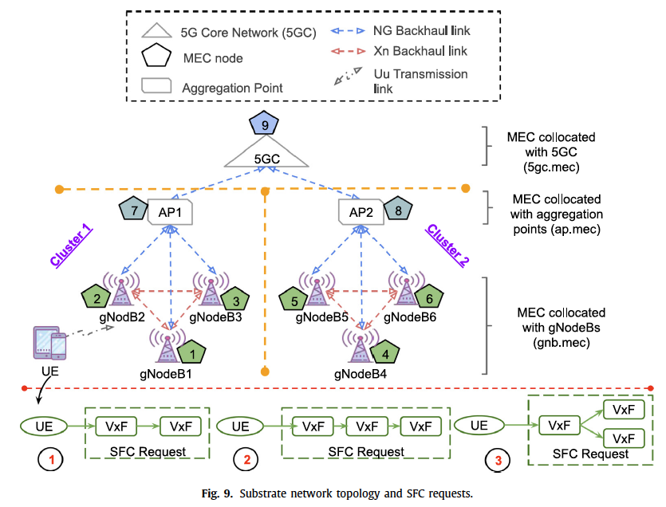
Latency-optimal SFC placement problem
Each element in our network topology is equipped with a resource-constrained (e.g., CPU) MEC node that is capable of hosting SFCs composed of one or several VxFs (e.g., VMs, containers)
Given: a small 5G mobile network with gNodeBs, aggregation points, 5GC, and MEC nodes, the scheduling capabilities of gNodeBs
Find: ’where’ to allocate resources to VxFs and ’which’ network paths to use.
Objective: minimize average end-to-end latency for UEs to access their SFCs in the mobile network.
Notes:
考慮一個5G網路架構，有6個基地台，3個基地台會連接到1的Aggregation point，兩個AP會連線到5G Core，這些點都是MEC node 可以部署的地方，並且每一個點都有資源限制，例如gNodeB可以使用的硬體資源最少，其次是AP，最後是Core Network。根據他們不同的硬體資源，可以部署的VxFs數量也不同。
給：具有gNodeBs，聚合點，5GC和MEC節點的小型5G移動網路，gNodeB的調度能力
找：哪裡分配資源給VxF及使用哪一條network paths
目標：最小化平均E2E延遲

Slide 17
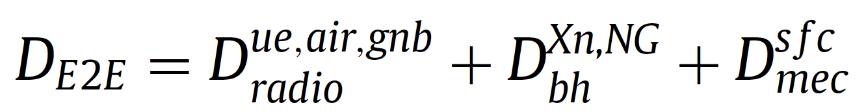
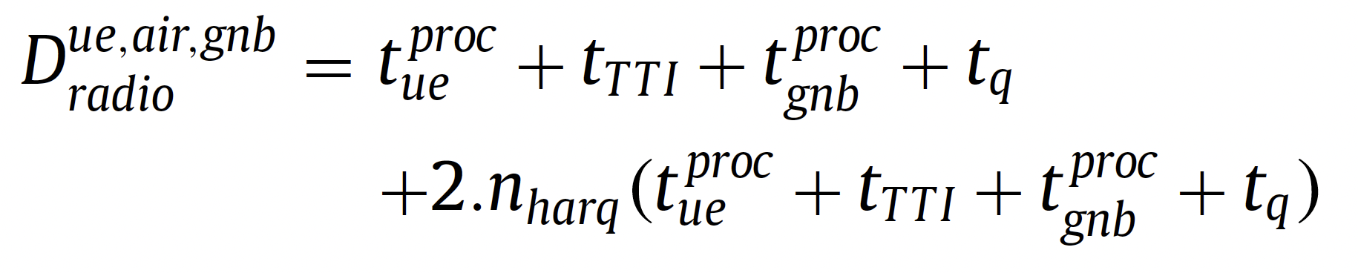
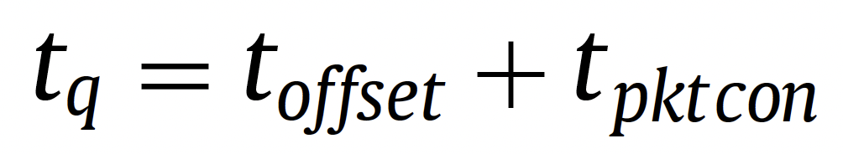
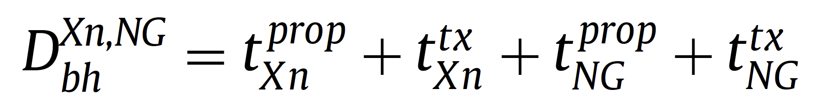
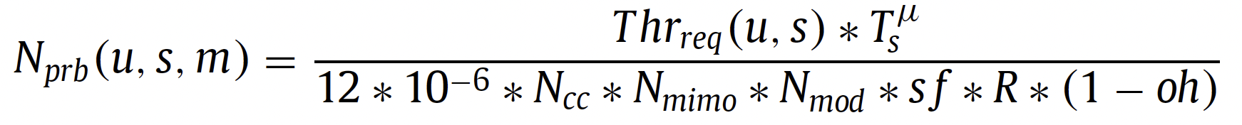
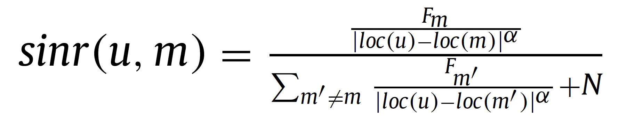
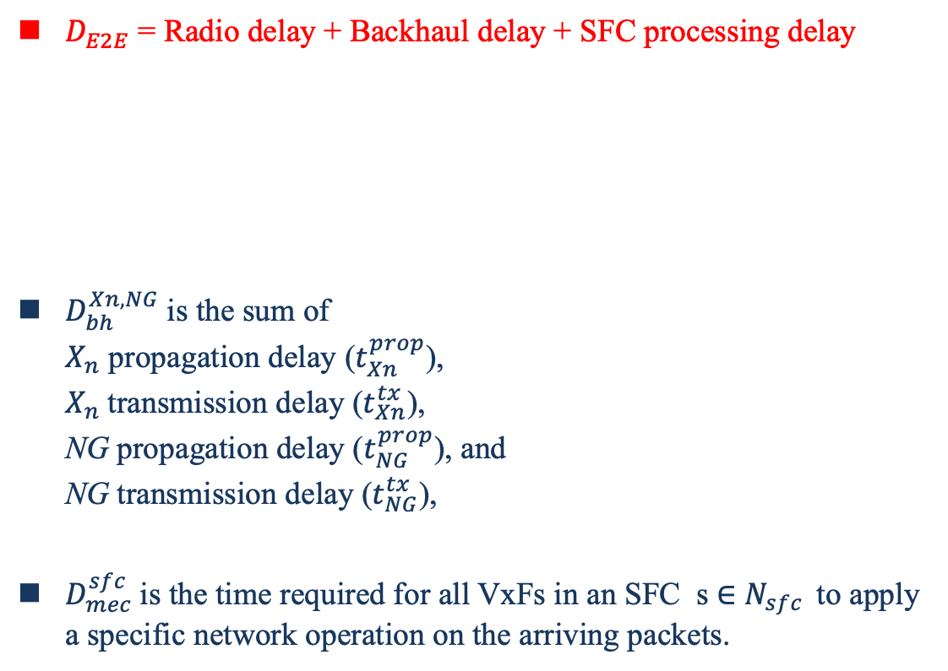
Delay Model
$D_{E2E}$ = Radio delay + Backhaul delay + SFC processing delay
$D_{bh}^{Xn, NG}$is the sum of
$X_{n}$ propagation delay ($t_{Xn}^{prop}$),
$X_{n}$transmission delay ($t_{Xn}^{tx}$),
NG propagation delay ($t_{NG}^{prop}$), and
NG transmission delay ($t_{NG}^{tx}$),
$D_{mec}^{sfc}$is the time required for all VxFs in an SFC s ∈ $N_{sfc }$ to apply a specific network operation on the arriving packets.

Slide 18
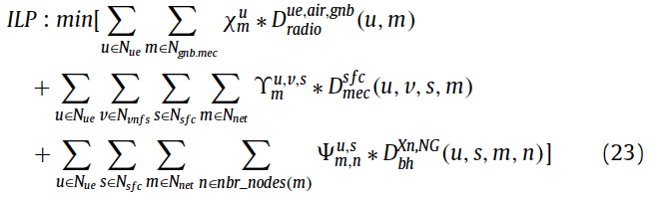
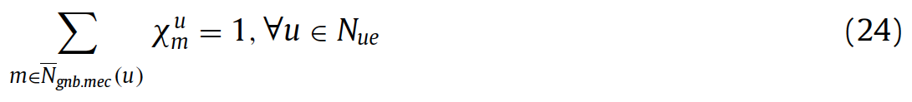
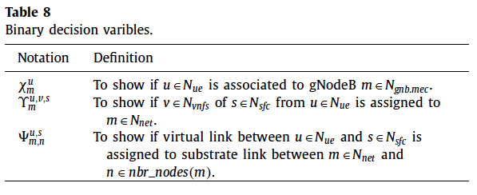
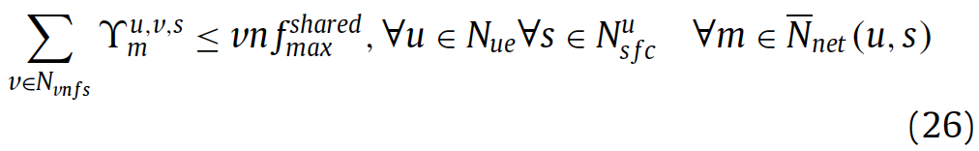

  Problem formulation
Constraint (24) ensures that each UE is associated to only one gNodeB from its candidate set.
Constraint (25) guarantees that each VxF of SFC requested from each UE is hosted by only one substrate MEC node from its candidate set.
Constraint (26) guarantees that each VxF is at most shared by ${vnf}_{max}^{shared}$ number of UEs.
Notes:
24 確保每個UE只連接一個gnb
25 確保來自每個UE所需的SFC中，每個VxF僅由其中一個MEC節點托管。
26 確保每個VxF的 UE shared 數量小於vnf shared max這個數值

Slide 19
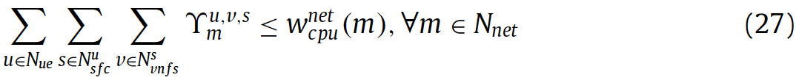
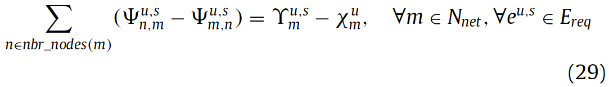
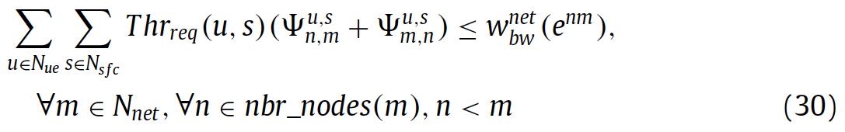

Problem formulation
Constraint (27) ensures that the amount of CPU resources allocated to VxFs of SFCs adheres to the available CPU capabilities on the substrate node.
Constraint (28) makes sure that in each time slot, gNodeBs can associate UEs only if they have enough PRBs to meet the data rate demand of the requested SFC by the UE.
Flow constraint (29) enforces for each virtual link between UE u ∈ $N_{ue}$ and its SFC s ∈ $N_{sfc}$ there exists a continuous path established between the gNodeB to which the UE is associated and the MEC node hosting the VxFs of SFC s .
Constraint (30) makes sure that virtual links are mapped onto the backhaul substrate links in the mobile network, if and only if it has enough bandwidth capacity to meet the link demand of virtual links.
Notes:
27 確保分配給SFC的VxF的CPU資源量符合真實可用的CPU能力。
28 確保在每個time slot中，gNodeB僅在具有足夠的PRB（物理資源塊）滿足UE對所需SFC的數據速率需求時才連接UE。
29強制每條virtual link（從UE到MEC node）存在一條連續的路徑
30 確保只有在移動網絡的背部鏈路有足夠的頻寬容量來滿足虛擬鏈路的鏈路需求時，才將虛擬鏈路映射到背部底層鏈路。
30 確保只有當 backhaul 網路中有足夠的頻寬容量提供給 virtual link 時，才會將virtual link map 到 backhaul substrate links。

Slide 20
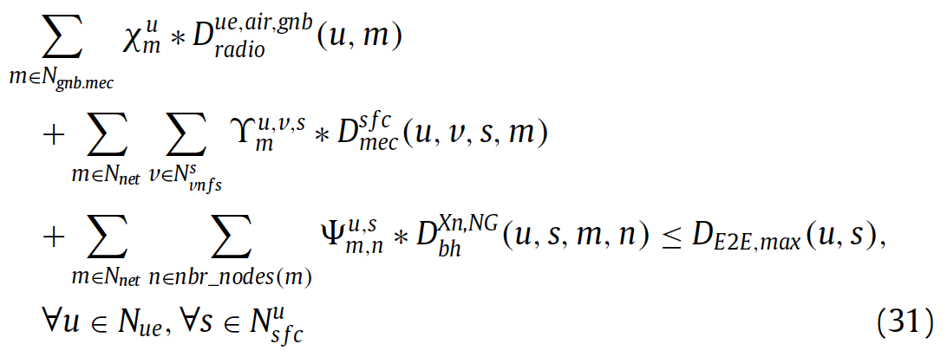
Problem formulation
Constraint (31) ensures that the end-to-end latency from the UEs to its associated SFCs does not exceed the maximum acceptable latency as requested by the UEs.
Notes:
31 確保從UE到其關聯的SFC的端到端延遲不超過UE所要求的最大可接受延遲。

Slide 21
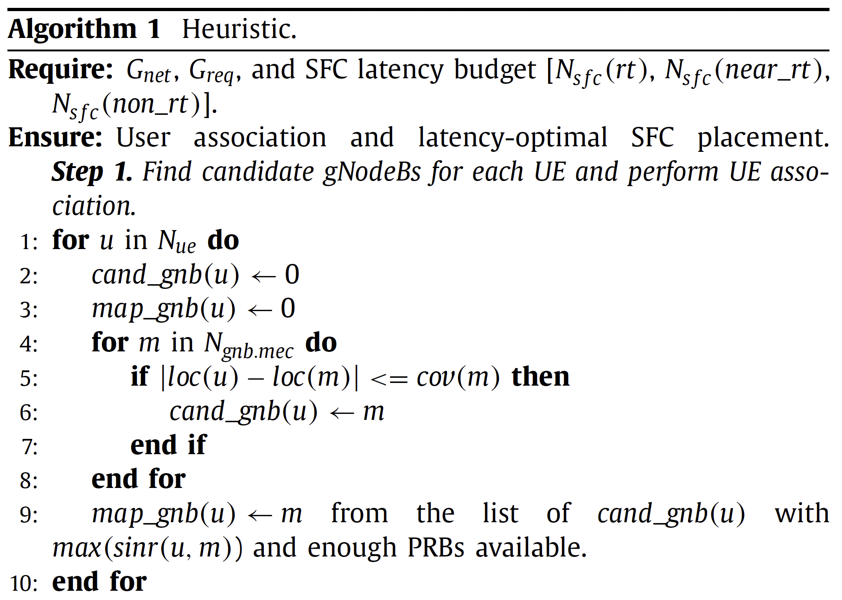
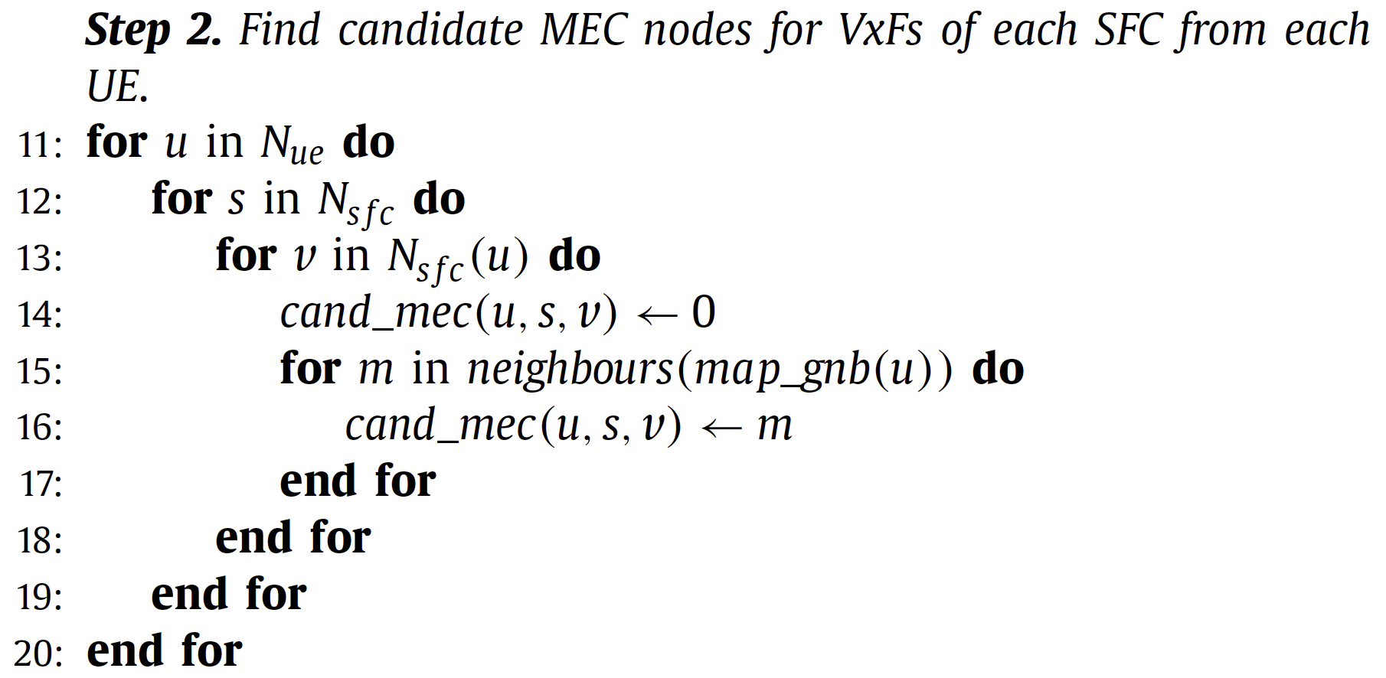
    Heuristic algorism
Notes:
第一步找出該演算法遍歷所有的UE，考慮UE的位置、gNodeB的位置以及gNodeB的覆蓋範圍，以確定一組候選gNodeBs，然後為每個UE創建一個候選gNodeB的列表cand_gnb(u)。接下來，從cand_gnb(u)中選擇訊號品質最佳（即SINR最高）且具有足夠PRB（物理資源塊）來托管UE的gNodeB，並將每個UE映射到該gNodeB。
第二步 該演算法為從所有UE收到的每個SFC請求的每個VxF找到候選MEC節點，這僅僅是與UE的主機gNodeB相同位置的MEC節點（從步驟1中確定）以及通過背部鏈路直接或間接連接到UE的主機gNodeB的所有其他MEC節點的聯集。然後，為每個來自所有UE的SFC的每個VxF創建一個cand_mec(u, s, v)的列表。

Slide 22
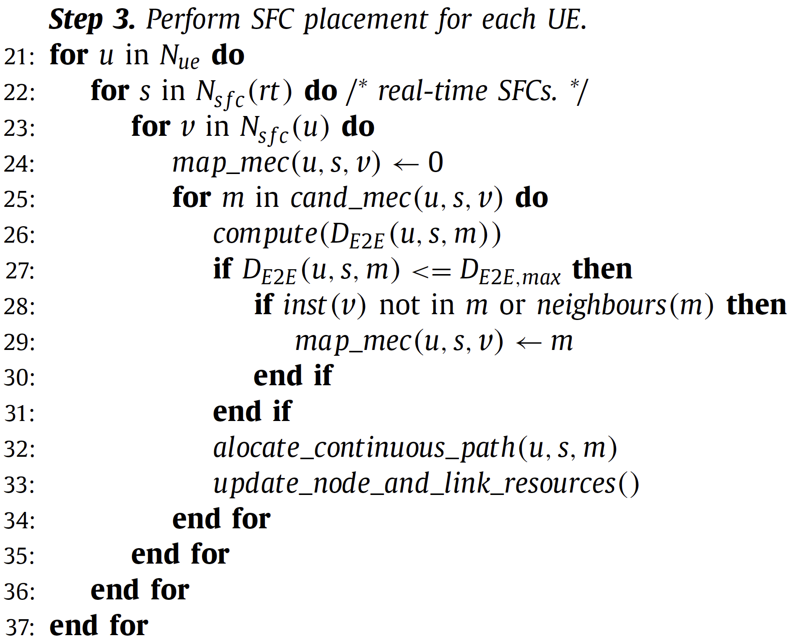
    Heuristic algorism
Notes:
第三步 該演算法開始根據每個SFC的即時延遲需求，使用cand_mec(u, s)將所有SFC請求的所有VxF進行映射，從gnb.mec節點開始。一旦它們耗盡計算資源，該演算法轉向ap.mec節點，最後轉向5gc.mec節點，前提是計算得到的端到端延遲（D E2E(u, s, m)）小於該SFC的最大可接受端到端延遲（D E2E,max）。此外，如果VxF的一個實例已經映射到候選MEC節點，UE將共享此VxF以實現其SFC，而不是實例化新的VxF。然後，啟發式演算法使用最短路徑演算法將UE和SFC之間的virtual link映射到gNodeB和MEC節點之間的backhaul link。在每次映射後，節點和連結的計算資源都會更新。同樣的過程對於具有接近實時和非實時延遲需求的其他SFC請求也會重複，直到所有SFC請求都被映射。

Slide 23
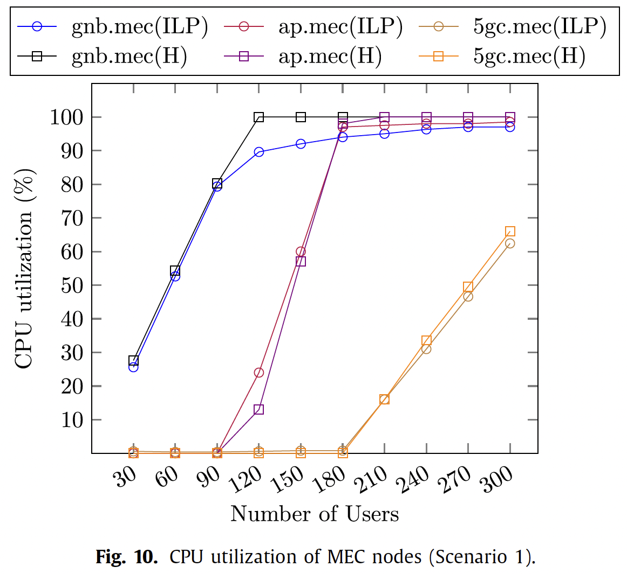
  Evaluation
Our simulations are carried out for two scenarios. In the first scenario, we consider that SFC requests arrive in batches of 30 UEs (equally divided among real-time, near-real-time, and non-real- time) with each batch corresponding to 1 timeslot. We consider 10 batches of SFC requests corresponding to 300 UEs
In the second scenario, we consider that SFC requests arrive according to the predicted number of UPF instances from our MLP neural-network model.
The performance of ILP is compared with our heuristic algorithm in both scenarios
Notes:
作者採用了兩種實驗方式
第一種是連續的10個bathes，每一次增加30個UE，最後達到300個UE。
第二個情境是用前面機器學習根據真實情況預測的結果當作UE數量，來模擬真實情況

Slide 24
Evaluation
Only after gnb.mec nodes are depleted with their CPU resources (after 90 UEs), the ILP starts moving VxFs with near-real-time and non-real-time latency requirements initially placed in gnb.mec nodes to ap.mec nodes and starts placing new SFCs with real-time latency requirements on gnb.mec nodes
heuristic algorithm follows a similar pattern to that of ILP, but instead of placing non-real-time VxFs that are shared by UEs associated to cluster 1 and cluster 2 on 5gc.mec nodes, those VxFs are initially placed on gnb.mec nodes, then on ap.mec nodes and finally on 5gc.mec nodes
Notes:
右圖橫坐標是UE數量，縱座標是CPU使用率
可以看到ILP及啟發式演算法都是優先將VNF部署在gnb、接著是AP，最後是5gc。所以可以看到gnb的cpu使用率最早開始提升，當提升到90%左右開始會往mec部署，最後是5gc
ILP跟H的不同之處，在於當gnb的cpu使用率高後，ILP會將non-real-time latency requirements部署到mec上，將real time的vnf優先部署在gnb
啟發式跟ILP相似，但是不會將non-real-time搬移到ap，而是依序將vnf部署到gnb, ap, 5gc

Slide 25
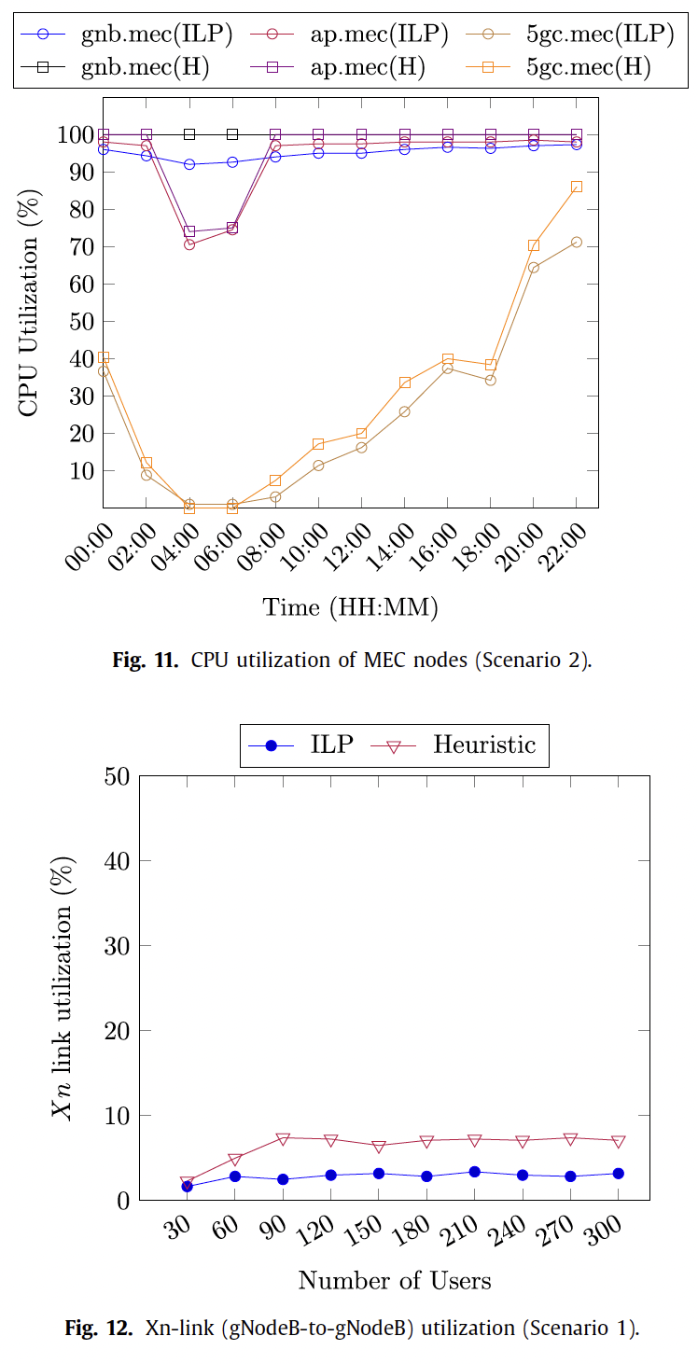
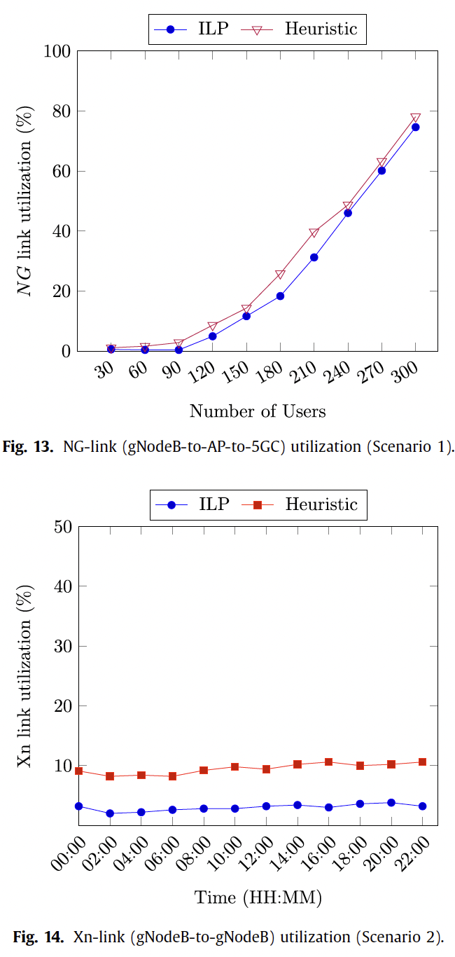
Evaluation

Slide 26
Outline
Introduction
MLP Auto-scaling
  Input X and Output Y
  Types of Y
  MLP Models
  Result
SFC placement
  Problem description
  Delay model
  Problem formulation
  ILP
  Heuristic algorism
  Evaluation
Conclusions

Slide 27
Conclusions
we proposed two neural-network based MLP models (i.e., a classifier and a regressor)
we solve a joint UE association and SFC placement problem aiming to minimize the overall user-to-sfc end-to-end latency.
We have seen that the ILP improves QoS of all UEs by
  initially placing their SFCs in MEC nodes closer to gNodeBs (gnb.mec) and thereby reducing NG backhaul link usage.
  Once the gnb.mec node CPU resources are depleted, near-real-time and non-real-time SFCs are moved/ placed in MEC nodes closer to aggregation points and 5GC which results in increased usage of Xn and NG backhaul links.
Our results show that the average end-to-end latency reduces significantly when SFCs are placed at the MEC nodes according to their latency and data rate demands.
Notes:
作者提出了classifier 和 regressor兩種MLP模型
並且解決了低延遲E2E的SFC placement 問題
ILP透過兩種方式提升QoS，首先一開始將SFC部署在gnb上，減少NG backhaul 的延遲。接著當gnb的使用率耗盡後，就會根據real time 或 non real time來部署VxFs
結果顯示當部署SFC時考慮他們的延遲與data rate需求，可使平均E2E延遲有顯著的減少

