Slide 1
Proactive and Intelligent Monitoring and Orchestration of Cloud-Native IP Multimedia Subsystem
RASEL CHOWDHURY , CHAMSEDDINE TALHI , HAKIMA OULD-SLIMANE ,
AND AZZAM MOURAD 3,4 (Senior Member, IEEE) IEEE Open Journal of the Communications Society

Slide 2
Outline
Introduction
Background
Literature review
Architecture
Multi-Objective Optimization For Scalablity
Implementation
Experimentation
Conclusion

Slide 3
Introduction
As LTE and VoLTE are becoming the norm,the telecom industries must meet the challenges faced by 5G and beyond.
The main target of evolution to 5G is to meet the main use cases: enhanced mobile broadband, massive ultra reliable communication, and low latency in communication.
Currently, there are around 8.4 billion mobile users and they generate an enormous amount of data, which is around 25 exabytes [1].
[1] (Ericsson, Stockholm, Sweden). Ericsson Mobility Report Q4 2018. (2019). Accessed: Jan. 10, 2022.
Notes:
最近，電信行業經歷了快速的演進。隨著 LTE 和 VoLTE 成為標準，電信行業必須應對 5G 及更高版本所面臨的挑戰。5G 演進的主要目標是滿足主要用例：增強型移動寬帶、大規模超可靠通信和通信低延遲。目前，全球約有 84 億移動用戶，他們產生了龐大的數據，約為 25 艾字節[1]。在 6 年的時間內，移動數據使用量呈指數增長。電信行業正朝著雲端解決方案邁進，以應對日益增長的流量。此外，雲端提供了更短的部署新服務時間、更低的運營成本（OpEx）和更好的客戶體驗（QoE），符合 5G 和 6G 的要求。根據 [2] 和 [3]，積極和智能的監控和編排將在管理在異質雲基礎設施中運行的電信服務方面發揮重要作用。

Slide 4
Introduction
The telecom industries are moving towards cloud solutions in order to cope with the increasing number of traffic.
The cloud provides a shorter time to deploy new services, a lower operational cost (OpEx) and a better customer experience (QoE), according to the requirements of 5G and 6G
Cloudifying the telecom solution means that the components need to be transformed from the proprietary hardware-based solutions into Cloud-Native applications.
Notes:
最近，電信行業經歷了快速的演進。隨著 LTE 和 VoLTE 成為標準，電信行業必須應對 5G 及更高版本所面臨的挑戰。5G 演進的主要目標是滿足主要用例：增強型移動寬帶、大規模超可靠通信和通信低延遲。目前，全球約有 84 億移動用戶，他們產生了龐大的數據，約為 25 艾字節[1]。在 6 年的時間內，移動數據使用量呈指數增長。電信行業正朝著雲端解決方案邁進，以應對日益增長的流量。此外，雲端提供了更短的部署新服務時間、更低的運營成本（OpEx）和更好的客戶體驗（QoE），符合 5G 和 6G 的要求。根據 [2] 和 [3]，積極和智能的監控和編排將在管理在異質雲基礎設施中運行的電信服務方面發揮重要作用。
將電信解決方案雲端化意味著將組件從基於專有硬體的解決方案轉換為雲原生應用

Slide 5
Introduction
The Cloud-Native approach provides： 1. resilience 2. operating system abstraction 3. collaborations 4. continuous delivery 5. independent and automated scalability
IBM projected that automation will be the next phase for the cloud environment and the optimized industry [2].
[2] (IBM Technol. Corp., Armonk, NY, USA). Cloud in 2020: The Year of Edge, Automation and Industry-Specific Clouds. (2019).
Notes:
雲原生方法提供了彈性、操作系統抽象、協作、持續交付、獨立和自動擴展能力。IBM 預計自動化將是雲環境和優化行業的下一階段[2]

Slide 6
Introduction
Still these Orchestration platform have some limitations. The authors [3] explained that there are many limitations to orchestration operations. Some of the limitations are as follows: 1. There are no or limited validated performance model for orchestration which are required to maintain a certain level of service. 2. Orchestration metrics are not standardized to determine the performance of the containerized application. 3. There are few standards or policies for different orchestration operations using the metrics of the application and system. 4. The policies available are very simple for orchestration operations. For example, threshold-based scalability, round-robin for load balancing, etc.
[3] E. Casalicchio, Container Orchestration: A Survey. Cham, Switzerland, Springer, 2019.
Notes:
然而，這些編排平台仍然存在一些限制。作者們[14]解釋了編排操作存在許多限制。以下是一些限制：
沒有或有限的經過驗證的績效模型可用於維護一定水平的服務。
編排指標未標準化，無法確定容器化應用程序的性能。
對於使用應用程序和系統指標的不同編排操作，幾乎沒有標準或政策。
可用的政策對於編排操作非常簡單。例如，基於閾值的擴展性、輪詢的負載平衡等。

Slide 7
Introduction
The orchestrator has an important role in the cloud native deployment, as it is responsible for the microservice management decisions.
Docker Swarm： 1. Faster in terms of deployment time. 2. It does not provide automatic scaling. 3. It does not have built-in monitoring mechanisms that are provided through a third-party application. 4. Allows for simple TLS for security and access control-related work.
Notes:
Docker Swarm 在部署時間方面更快，但它不提供自動擴展功能。它沒有內建的監控機制，需要通過第三方應用程序提供。Docker Swarm 允許使用簡單的 TLS 來進行安全性和訪問控制相關的工作。

Slide 8
Introduction
Kubernetes： 1. Allows for high availability, fault tolerance, and self-healing, and also provides automatic scaling and can replace faulty pods. 2. Has a basic built-in monitoring system and supports integration with third-party monitoring tools. 3. Has support for various security schemes, such as RBAC, TLS/SSL, Secret management, etc. 4. The main disadvantage of Kubernetes is that the installation process is complex and requires separate CLI tools.
Notes:
Kubernetes 允許高可用性、容錯容忍和自癒，並提供自動擴展，必要時可以替換故障的 pod。Kubernetes 具有基本的內建監控系統，並支持與第三方監控工具的集成。Kubernetes 支持各種安全方案，例如 RBAC、TLS/SSL、密鑰管理等。Kubernetes 的主要缺點是安裝過程複雜，需要單獨的 CLI 工具。

Slide 9
Introduction
Main contributions：
New monitoring and orchestration architecture for cloud native systems for Kubernetes cluster, which can perform operations by monitoring Pod, Node and Application.
Formulation of the horizontal scalability problem as multi-variant support vector regression using different kernels for resource prediction.
Resource prediction algorithms for the application specifically for SIP servers in order to achieve scalability operation.
Realistic cloud-native SIP application as a use-case to test and evaluate the monitoring and orchestration architecture.
Notes:
• 雲原生系統的新監控和編排架構，針對 Kubernetes 集群，可通過監控 Pod、Node 和應用程式執行操作；
• 將水平擴展問題制定為多變量支持向量回歸，使用不同的內核進行資源預測；
• 針對應用特定於 SIP 伺服器的資源預測算法，以實現可擴展性操作；
• 將實際的雲原生 SIP 應用程式作為使用案例，用於測試和評估監控和編排架構。

Slide 10
Outline
Introduction
Background
Literature review
Architecture
Multi-Objective Optimization For Scalablity
Implementation
Experimentation
Conclusion

Slide 11
IP Multimedia Subsystem(IMS)
IMS is standardized by 3GPP and is used to provide different services like Image Share, IMS Security, Multimedia telephony, OMA Instant Messaging and Presence Service, Peer-to-peer video sharing, Push-to-talk, Real-time text, Session Initialization Protocol (SIP) extensions for the IP Multimedia Subsystem, Text over IP, Video Share, Voice call continuity, Presence, etc. for users.
Notes:
IMS由3GPP標準化，用於為用戶提供不同的服務，例如圖像共享、IMS安全、多媒體電話、OMA即時消息和狀態服務、點對點視頻共享、即時文本、IP多媒體子系統的會話初始化協議（SIP）擴展、IP文本、視頻共享、語音通話連續性、狀態等。

Slide 12
SIP
SIP is a signalling transport protocol, which is one of the core functionalities of cloud-native IMS.
SIP is used for signalling and controlling communication sessions for different services like instant messaging, voice of LTE, events notification, Internet conferencing, instant messaging,etc.
Notes:
SIP（Session Initialization Protocol）[18] 是一種信令傳輸協議，是雲原生IMS的核心功能之一。SIP用於不同服務的信令和控制通信會話，例如即時消息、LTE語音、事件通知、互聯網會議、即時消息等。SIP協議利用代理SIP伺服器來端對端地連接遠程SIP用戶和系統。此外，SIP已被用於在網絡運營商之間建立服務質量（QoS）以及不同的互聯網架構

Slide 13
Microservices
Microservices are software development techniques that make an application a collection of loosely coupled independent services.
In this architecture, the services are made into fine-grained modules and the protocols that are used to communicate are usually lightweight.
Microservices allow faster delivery, improved scalability, and greater autonomy for development and software maintenance.
Notes:
微服務是一種軟體開發技術，將應用程序製作為一系列鬆散耦合的獨立服務 在這種架構中，服務被製作成細粒度模塊，用於通信的協議通常是輕量級的
微服務允許更快的交付、改進的可擴展性，以及更大的開發和軟件維護自主性

Slide 14
Monitoring Microservices
Monitoring the microservices running in containers is necessary, as containers are buried under the physical host, which is invisible to traditional monitoring architecture.
Monitoring the containers will allow different orchestration decisions, like diagnosing performance of the container, failure detection, malicious activities, network performance, etc.
Notes:
監控運行在容器中的微服務是必要的，因為容器被埋藏在物理主機下，傳統的監控架構無法看到它們。
監控容器將允許不同的編排決策，例如診斷容器的性能、檢測故障、恶意活動、網絡性能等。

Slide 15
Monitoring Microservices
There are lots of metrics available to monitor a container ecosystem; some of the most important metrics and their importance for orchestration are as follows: 1. Relative metrics: measure values based on data collected from the virtual file system, such as the utilization of the CPU / memory of the container. 2. Absolute metrics: measure the cumulative activity of the overall system, such as the CPU/Memory consumption of the physical machine. 3. Application metrics: measure the performance and activity of the application, such as the latency of the processes, the number of requests it is processing, etc.
Notes:
監控容器生態系統有許多可用的指標；以下是一些最重要的指標及其對編排的重要性：
相對指標基於從虛擬文件系統收集的數據來衡量值，例如容器的CPU/內存利用率。通常使用工具如docker stats或cAdvisor收集這些數據。
絕對指標衡量整個系統的累計活動，例如物理機器的CPU/內存消耗。使用mpstat、top等工具收集這些數據。
應用程序指標衡量應用程序的性能和活動，例如進程的延遲、它處理的請求數量等。如果應用程序通過自定義工具暴露了這些指標，則收集這些指標。

Slide 16
Orchestration
Orchestration allows the cloud and application providers to define how to select, deploy, monitor, and dynamically control the configuration of multi-container packaged applications [4]. According to [4], the different types of microservice orchestration are: 1. Resource limit control: allows to reserve a specific amount of resources like CPU and memory for a container. 2. Scheduling: defines the policy used to place the amount of container on nodes at a given time instance. 3. Load Balancing: distributes the loads/tasks among multiple container instances.
[4] E. Casalicchio, Container Orchestration: A Survey. Cham, Switzerland, Springer, 2019.
Notes:
編排允許雲和應用程序提供者定義如何選擇、部署、監控和動態控制多容器打包應用程序的配置。根據[14]，不同類型的微服務編排包括：
資源限制控制允許為容器保留特定量的資源，如CPU和內存；
調度定義了在給定時間點將容器放置在節點上的策略；
負載平衡在多個容器實例之間分配負載/任務；
健康檢查驗證容器是否能夠回應請求；
容錯容忍以副本控制和/或高可用性控制器的形式實現；
自動擴展允許根據某些條件自動添加或刪除容器或資源。

Slide 17
Orchestration
4. Health checking: checking verifies if the container is capable of answering requests. 5. Fault tolerance: is implemented as replica control and/or high availability controller. 6. Auto-scaling: allows to automatically add or remove container or resources based on some conditions.
Notes:
編排允許雲和應用程序提供者定義如何選擇、部署、監控和動態控制多容器打包應用程序的配置。根據[14]，不同類型的微服務編排包括：
資源限制控制允許為容器保留特定量的資源，如CPU和內存；
調度定義了在給定時間點將容器放置在節點上的策略；
負載平衡在多個容器實例之間分配負載/任務；
健康檢查驗證容器是否能夠回應請求；
容錯容忍以副本控制和/或高可用性控制器的形式實現；
自動擴展允許根據某些條件自動添加或刪除容器或資源。

Slide 18
Orchestration
There are two main types of scalability, which are as follows: 1. Vertical scalability: increases or decreases the computing resources, such a CPU, memory, etc. Vertical elasticity is also known as resource resizing. The vertical elasticity is limited to the host machine capacity as it cannot provision more resources when all the host machine resources are already allocated to different containers.
Notes:
有兩種主要類型的可擴展性，如下所示：
垂直擴展性：增加或減少計算資源，如 CPU、內存等。垂直彈性也被稱為資源調整大小。垂直彈性受主機機器容量限制，因為當所有主機機器資源已分配給不同的容器時，它無法提供更多資源。
水平擴展性：增加或刪除與應用程序相關聯的計算資源的實例。水平彈性也被稱為資源的複製。水平擴展性的一個缺點是它需要應用程序更多的支持，以便將其分解為實例。水平擴展性的另一個缺點是，開始另一個實例需要一些時間，以及在縮小規模時需要冷卻時間。

Slide 19
Orchestration
2. Horizontal scalability: adds or removes instances of computing resources associated with an application. Horizontal elasticity is also known as replication of resources. One disadvantage of horizontal scalability is that it requires more support from the application to be decomposed into instances. Another disadvantage of horizontal scalability is that it requires some time to start another instance, as well as a period of cooling when scaling down.
Notes:
有兩種主要類型的可擴展性，如下所示：
垂直擴展性：增加或減少計算資源，如 CPU、內存等。垂直彈性也被稱為資源調整大小。垂直彈性受主機機器容量限制，因為當所有主機機器資源已分配給不同的容器時，它無法提供更多資源。
水平擴展性：增加或刪除與應用程序相關聯的計算資源的實例。水平彈性也被稱為資源的複製。水平擴展性的一個缺點是它需要應用程序更多的支持，以便將其分解為實例。水平擴展性的另一個缺點是，開始另一個實例需要一些時間，以及在縮小規模時需要冷卻時間。

Slide 20
K8S Horizontal Pod Auto-Scaling(KHPA)
The state of the Art Kubernetes Auto-Scaling is the KHPA Algorithm [5], a relative performance measured using threshold.
The algorithm inputs the relative utilization and the number of active pods and outputs the number of pods needed to be deployed.
Relative performance measures are adapted by all container orchestration frameworks. But relative usage measures underestimate the required capacity, so it is not capable of determining the most appropriate resources required by the service level objectives.
[5] Kubernetes. Horizontal Pod Autoscaler. (2022).
Notes:
KHPA 算法是當前 Kubernetes 自動擴展的最先進算法[5]，其採用閾值來衡量相對性能。
該算法的輸入包括相對利用率和活動 pod 的數量，並輸出需要部署的 pod 數量。
相對性能衡量方法被所有容器編排框架所採用。但是相對使用量的衡量方法低估了所需的容量，因此無法確定滿足服務水準目標所需的最合適資源。

Slide 21
Outline
Introduction
Background
Literature review
Architecture
Multi-Objective Optimization For Scalablity
Implementation
Experimentation
Conclusion

Slide 22
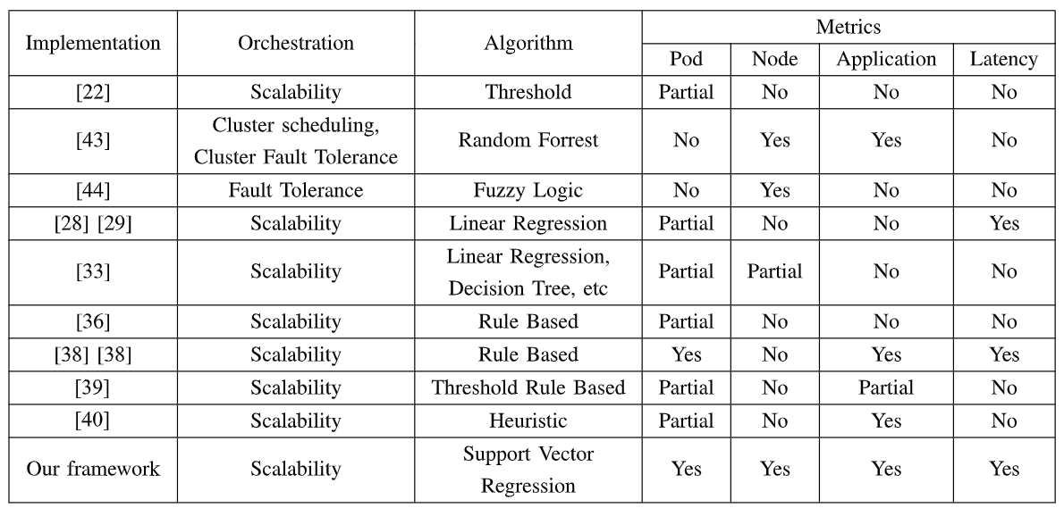
Literature review

Slide 23
Outline
Introduction
Background
Literature review
Architecture
Multi-Objective Optimization For Scalablity
Implementation
Experimentation
Conclusion

Slide 24
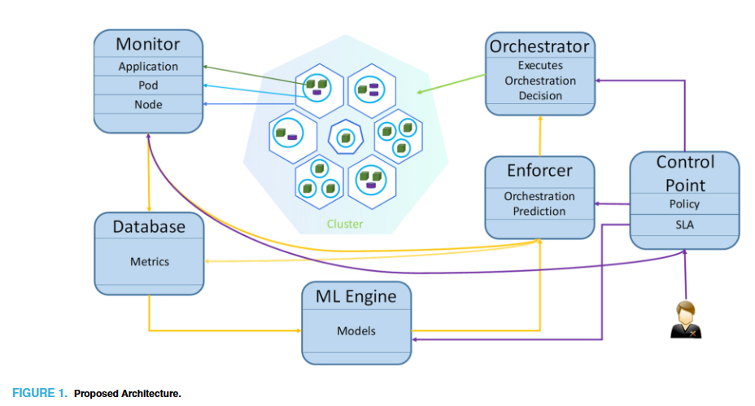
Architecture
a high-level design of the Cloud-Native IMS automation which is based on the MAPE-K architecture [6]
The Monitor collects metrics of pods along with application metrics, as well as metrics of the node where the pod is running, then transmits the values to the database for future use and to the Enforcer.
[6] Y. Brun et al., “Engineering self-adaptive systems through feedback loops,” in Software Engineering for Self-Adaptive Systems. Berlin, Germany, Springer, 2009, pp. 48–70.
Notes:
Monitor收集 Pod 的指標以及應用程序的指標，還有 Pod 運行的節點的指標，然後將這些值傳遞到數據庫以供將來使用，並傳遞給Enforcer。

Slide 25
Architecture
a high-level design of the Cloud-Native IMS automation which is based on the MAPE-K architecture [6]
ML-Engine creates different models for orchestration based on the data stored in the Database and sends the models to the Enforcer.
[6] Y. Brun et al., “Engineering self-adaptive systems through feedback loops,” in Software Engineering for Self-Adaptive Systems. Berlin, Germany, Springer, 2009, pp. 48–70.
Notes:
ML-Engine基於存儲在數據庫中的數據創建不同的編排模型，並將這些模型發送給Enforcer。

Slide 26
Architecture
a high-level design of the Cloud-Native IMS automation which is based on the MAPE-K architecture [6]
Enforcer takes the orchestration decisions based on the current metrics provided by the Monitor using the models received by the ML Engine and forwards the decision to the Orchestrator.
[6] Y. Brun et al., “Engineering self-adaptive systems through feedback loops,” in Software Engineering for Self-Adaptive Systems. Berlin, Germany, Springer, 2009, pp. 48–70.
Notes:
Enforcer根據Monitor提供的當前指標使用 ML ML Engine接收的模型做出編排決策，然後將決策發送給Orchestrator。

Slide 27
Architecture
a high-level design of the Cloud-Native IMS automation which is based on the MAPE-K architecture [6]
Based on the orchestration decision of the Enforcer, Orchestrator performs the operation in the cluster.
[6] Y. Brun et al., “Engineering self-adaptive systems through feedback loops,” in Software Engineering for Self-Adaptive Systems. Berlin, Germany, Springer, 2009, pp. 48–70.
Notes:
根據Enforcer的編排決策，Orchestrator在集群中執行操作。

Slide 28
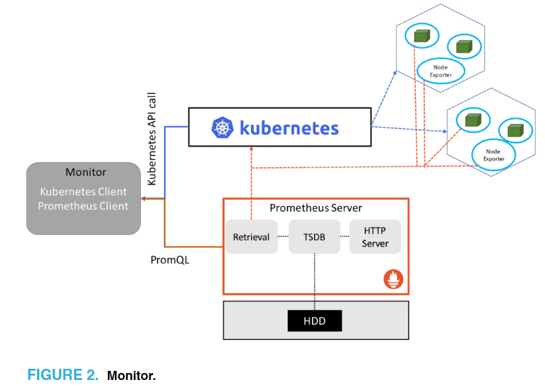
Architecture
Monitor queries the Kubernetes cluster using the Kubernetes API to get the information regarding the clusters, like the list of nodes, pods, deployments, namespaces, etc.
Notes:
Monitor 使用 Kubernetes API 查詢 Kubernetes 集群，以獲取關於集群的信息，例如節點、Pod、部署、命名空間等的列表。

Slide 29
Architecture
Then, the Monitor selects a specific deployment and queries the cluster using the Prometheus API to find the metrics of the system.
Notes:
然後，Monitor 選擇特定的部署並使用 Prometheus API 查詢集群以查找系統的指標

Slide 30
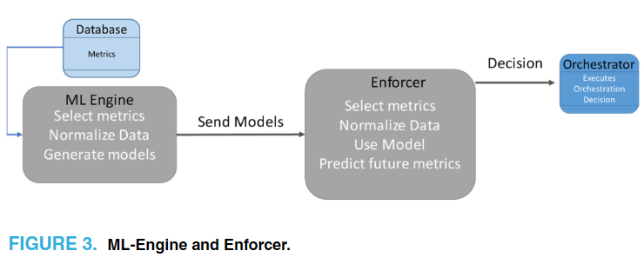
Architecture
In our system there are two
types of Model for the same operations. One of them generates models for long-term decisions and later one for the pro-active decisions.
Notes:
在我們的系統中，對於同一操作有兩種類型的模型。其中一種是為長期決策生成模型，另一種是為主動式決策生成模型。

Slide 31
Architecture
Long-term models use time-
based historical data to generate models for orchestration operations. However, short-term models are generated using metrics from all the collection points for making proactive orchestration decisions.
Notes:
長期模型使用基於時間的歷史數據生成編排操作模型。然而，短期模型使用來自所有收集點的指標來生成主動式編排決策。

Slide 32
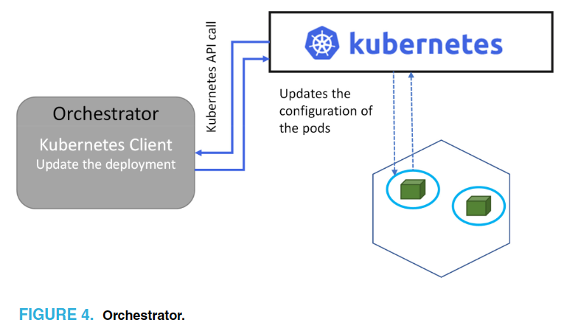
Architecture
The Orchestrator enforces the orchestration decisions on the Kubernetes cluster
Notes:
Orchestrator在Kubernetes集群上執行編排決策。

Slide 33
Architecture
Control Point：
Control Point is an interface for the application administrator to assign SLA policies to microservices. This module is the only way for the administrator to access the system to intervene and update the policies.
Notes:
Control Point是一個界面，用於應用程序管理員將SLA策略分配給微服務。該模塊是管理員訪問系統並干預並更新策略的唯一途徑。

Slide 34
Architecture
Database：
The Database is required for storing the data generated by the system in the time series database. Whenever the Monitor sends the aggregated metrics from the system, the database stores the data using a time-series schema.
Notes:
Orchestrator在Kubernetes集群上執行編排決策。

Slide 35
Outline
Introduction
Background
Literature review
Architecture
Multi-Objective Optimization For Scalablity
Implementation
Experimentation
Conclusion

Slide 36
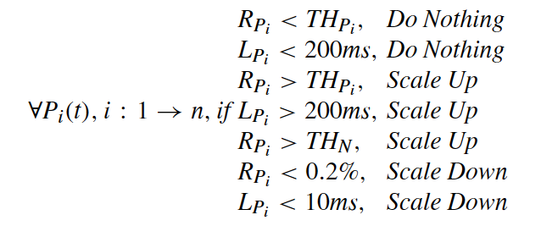
Problem Definition
To perform horizontal scalability, we need to formulate the resource consumption of each pod independently as the pod will be having different workloads based on the number of SIP requests it is processing. Based on the workload and resource consumption of a pod at time t, the pod might need to create a replication or remove it. As an example, the conditions below show simple scalability actions based on the resources of the pod at time t.
Pod resources
Application latency
Notes:
要進行水平擴展，我們需要獨立地制定每個 Pod 的資源消耗情況，因為每個 Pod 將根據其處理的 SIP 請求數量而具有不同的工作負載。根據 Pod 在時間 t 的工作負載和資源消耗情況，可能需要創建或移除一個複本。以下是根據 Pod 在時間 t 的資源情況而制定的簡單擴展操作條件的示例：

Slide 37
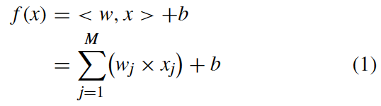
Problem Definition
In order to predict resource utilization at a given time t, Multivariant Support Vector Regression (SVR) is one of the suitable solutions. The goal of SVR is to calculate a function that is capable of minimizing the overestimation and underestimation of data based on the ε insensitive loss function, penalizing predictions that are farther from the desired output. The target function can be formulated according to [7] as
[7] A. J. Smola and B. Schölkopf, “A tutorial on support vector regression,” Statist. Comput., vol. 14, no. 3, pp. 199–222, 2004.
Notes:
為了在給定時間 t 預測資源利用率，多變量支援向量回歸（SVR）是一個合適的解決方案之一。SVR 的目標是計算一個能夠最小化基於 ε 不敏感損失函數的過度估計和低估計的函數，懲罰距離期望輸出更遠的預測。目標函數可以根據以下公式制定：

Slide 38
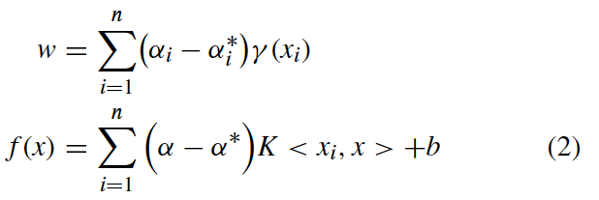
Problem Definition
where x is the input variable and w is the weight. Using optimization and applying slack variables and Lagrange multipliers equation as shown in [7] and [8], equation (1) can be re-written as
[7] A. J. Smola and B. Schölkopf, “A tutorial on support vector regression,” Statist. Comput., vol. 14, no. 3, pp. 199–222, 2004.
[8] M. Awad and R. Khanna, Support Vector Regression. Berkeley, CA, USA: Apress, 2015, pp. 67–80.
Notes:
其中，x 是輸入變數，w 是權重。利用最適化和應用松弛變量和拉格朗日乘子方程，可以將方程式（1）重新寫為：

Slide 39
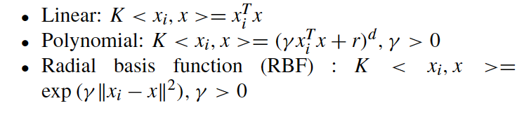
Problem Definition
where K < xi, x >= φ(xi)φ(x) is called the kernel functions.The kernel functions used in this research for formulation of our cost functions are
Notes:
其中 K < xi, x >= φ(xi)φ(x) 稱為核函數。本研究中用於制定成本函數的核函數是

Slide 40
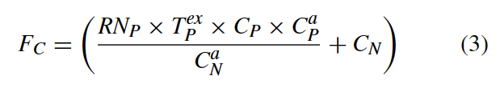
Problem Definition
F_C is the CPU resource required to run the application at time t for processing the workload. It is equal to the number of SIP requests processed along with the utilization of other resources. By doing so, we maximize the CPU utilization of each pod.
Notes:
FC 是在時間 t 運行應用程式所需的 CPU 資源，用於處理工作負載。它等於處理的 SIP 請求數量加上其他資源的利用率。透過這樣做，我們最大化了每個 Pod 的 CPU 利用率。

Slide 41

Problem Definition
F_M is the memory required for running the application and processing the workload based on the number of sip requests, as well as other dependent resource utilizations.
Notes:
FM 是根據 SIP 請求的數量以及其他相關資源利用率，用於運行應用程式並處理工作負載所需的記憶體。

Slide 42

Problem Definition
F_L calculates the application latency based on the application workload it is processing along with other resource consumption that affects the application latency.
Notes:
FL 是根據應用程式處理的工作負載以及影響應用程式延遲的其他資源消耗來計算應用程式的延遲。

Slide 43
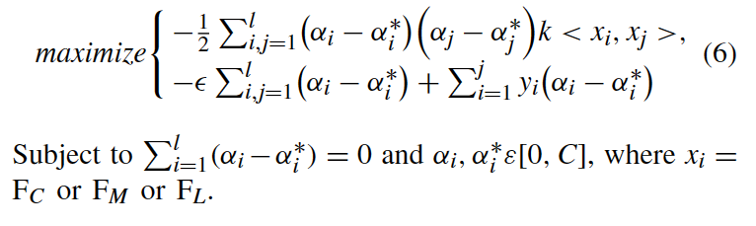
Problem Definition
Based on [7], [8] our objective function is
[7] A. J. Smola and B. Schölkopf, “A tutorial on support vector regression,” Statist. Comput., vol. 14, no. 3, pp. 199–222, 2004.
[8] M. Awad and R. Khanna, Support Vector Regression. Berkeley, CA, USA: Apress, 2015, pp. 67–80.
Notes:
FL 是根據應用程式處理的工作負載以及影響應用程式延遲的其他資源消耗來計算應用程式的延遲。

Slide 44
Problem Definition
PREDICTION ALGORITHM
The Algorithm 1 is the prediction algorithm which is designed based on the definitions of the problem and the objective function. The algorithm requires the current resource metrics of a pod, then evaluates the equation (2) with functions (3), (4), and (5) using different kernel functions to predict the future resources required. After the prediction of the resources is done, it makes the decision for
the pod to scale up or down or to keep it the same.
[7] A. J. Smola and B. Schölkopf, “A tutorial on support vector regression,” Statist. Comput., vol. 14, no. 3, pp. 199–222, 2004.
[8] M. Awad and R. Khanna, Support Vector Regression. Berkeley, CA, USA: Apress, 2015, pp. 67–80.
Notes:
Algorithm 1 是基於問題的定義和目標函數設計的預測算法。該算法需要一個 pod 的當前資源指標，然後使用不同的核函數計算方程式 (2) 中的函數 (3)、(4) 和 (5)，來預測未來所需的資源。預測資源完成後，它會決定是否對該 pod 進行擴展、縮減或保持不變。

Slide 45
Outline
Introduction
Background
Literature review
Architecture
Multi-Objective Optimization For Scalablity
Implementation
Experimentation
Conclusion

Slide 46
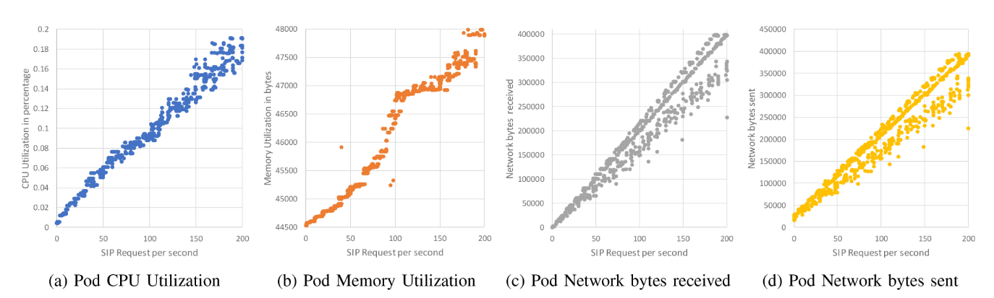
Implementation

Slide 47
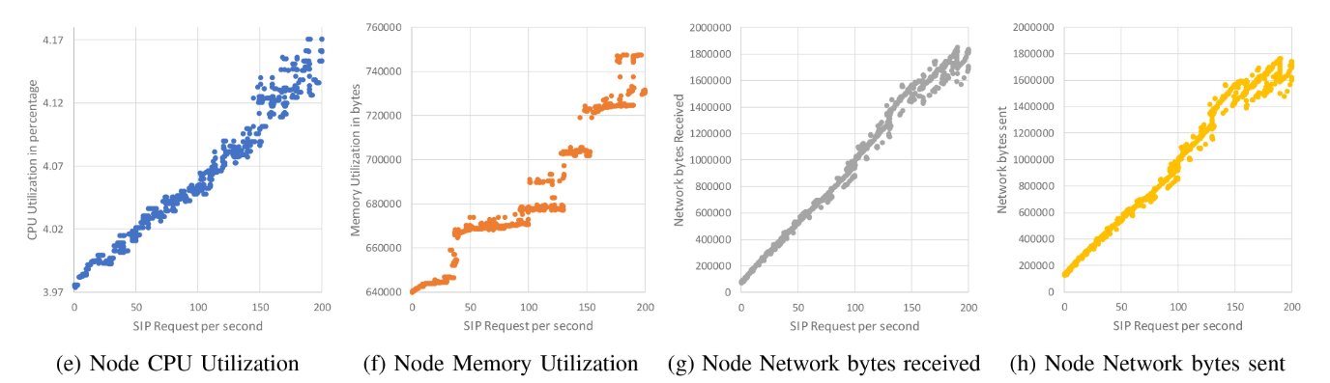
Implementation

Slide 48
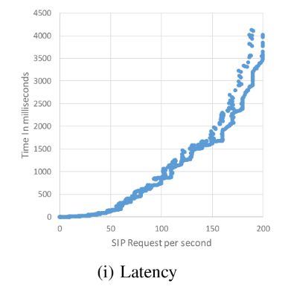
Implementation

Slide 49
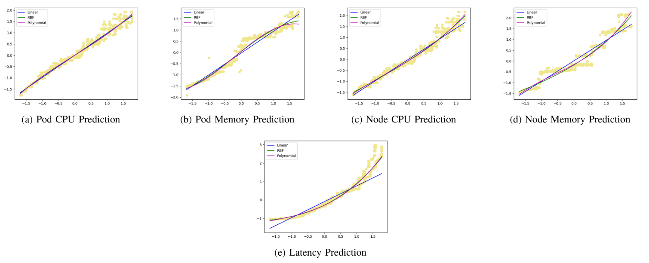
Implementation

Slide 50
Implementation
We have tested the model with three different SVR algorithms： linear SVR, Polynomial SVR and Radial Basis Function (RBF) kernel.
To select the best algorithm to predict resource consumption, we tested the system with the remaining 30% of the dataset. The R2 score of the algorithms for predicting CPU, memory, and latency is presented in Table 2. From the results of Table 2, it is clear that 1. For Pod CPU, RBF SVR is the best among them; 2. For Pod Memory, RBF SVR is the most suitable; 3. For Node CPU, RBF SVR has the highest R2 score; 4. For Node Memory, polynomial SVR is the best; 5. For latency, polynomial SVR shows the best R2 score.
Notes:
為了選擇最佳的算法來預測資源消耗，我們使用剩餘的 30% 數據集對系統進行了測試。表2顯示了用於預測 CPU、記憶體和延遲的算法的 R2 分數。從表2的結果來看，可以得出以下結論：
對於 Pod 的 CPU，RBF SVR 是最好的選擇；
對於 Pod 的記憶體，RBF SVR 是最合適的；
對於 Node 的 CPU，RBF SVR 有最高的 R2 分數；
對於 Node 的記憶體，多項式 SVR 是最好的選擇；
對於延遲，多項式 SVR 展示了最佳的 R2 分數。

Slide 51
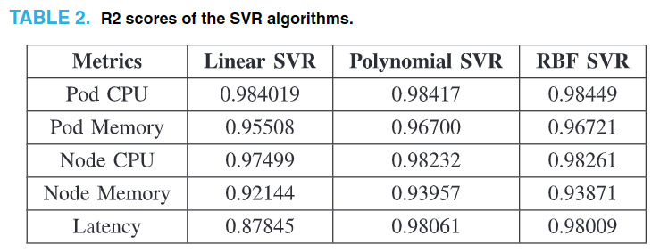
Implementation

Slide 52
Outline
Introduction
Background
Literature review
Architecture
Multi-Objective Optimization For Scalablity
Implementation
Experimentation
Conclusion

Slide 53
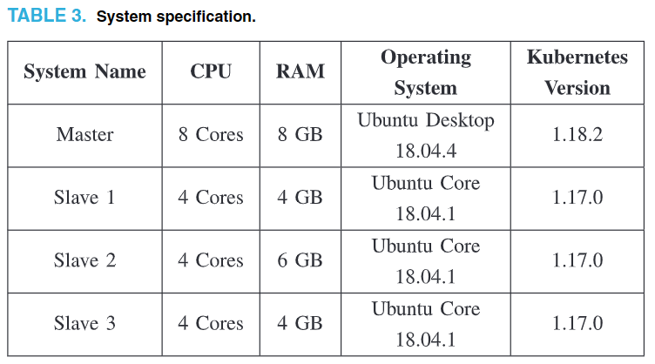
Experimentation
Notes:
為了選擇最佳的算法來預測資源消耗，我們使用剩餘的 30% 數據集對系統進行了測試。表2顯示了用於預測 CPU、記憶體和延遲的算法的 R2 分數。從表2的結果來看，可以得出以下結論：
對於 Pod 的 CPU，RBF SVR 是最好的選擇；
對於 Pod 的記憶體，RBF SVR 是最合適的；
對於 Node 的 CPU，RBF SVR 有最高的 R2 分數；
對於 Node 的記憶體，多項式 SVR 是最好的選擇；
對於延遲，多項式 SVR 展示了最佳的 R2 分數。

Slide 54
Experimentation
To simulate SIP traffic, we have used a SIP traffic generator called SIPp [9], which is a free Open Source test tool for the SIP protocol. The tool allows for different scenarios such as the number of SIP requests per second, duration of the SIP request, simultaneous concurrent SIP requests, etc. This tool is used to simulate real IMS traffic to test and validate the monitoring part of the research.
[9] SIPp. “Open source SIP traffic generator.” 2022. .
Notes:
為了模擬 SIP 流量，我們使用了一個名為 SIPp [54] 的 SIP 流量生成器，這是一個免費的開源 SIP 協議測試工具。該工具允許不同的情景，比如每秒 SIP 請求的數量、SIP 請求的持續時間、同時並行的 SIP 請求等。這個工具用於模擬真實的 IMS 流量，以測試和驗證研究的監控部分。

Slide 55
Performance of framework
We ran the system for two hours and collected twenty five different types of metrics running the SIPp traffic generator from 1 SIP request to 200 SIP requests per second in real time at an interval of 2 seconds. The SIP requests are gradually increased over a period of 120 minutes, so that there are multiple numbers of instances for the same number of requests.
Notes:
我們運行系統兩個小時，以 2 秒的間隔實時運行 SIPp 流量生成器，從每秒 1 個 SIP 請求到每秒 200 個 SIP 請求，並收集了二十五種不同類型的指標。SIP 請求逐漸增加，持續了 120 分鐘，這樣同時存在多個相同數量的實例來處理相同數量的請求。

Slide 56
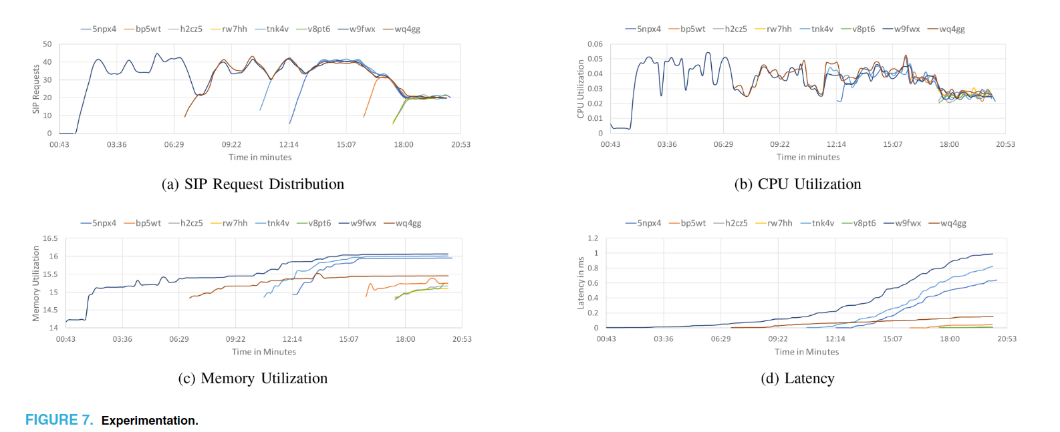
Performance of framework
Figure 7 shows the reaction of the system when the SIP requests are increased or decreased over a 20-minute period and the number of replicas created by the system. Over the period of time, seven total replicas were created by the system and the deploying replicas takes around 4.4 seconds
Notes:
圖 7 顯示了當 SIP 請求在 20 分鐘內增加或減少時系統的反應以及系統創建的副本數量。在這段時間內，系統總共創建了七個副本，部署副本大約需要 4.4 秒。此外，流量均勻分配給副本，這是由 Kubernetes 原生流量負載平衡器提供的。

Slide 57
Test scenarios
We tested the framework using two scenarios; The first scenario has regular SIP traffic, while the second scenario has abnormal traffic behavior.
We have compared our implementation with the native kubernetes horizontal pod autoscaling algorithm to show the difference between the two implementations and as well as the benefit of using our framework for performing autoscaling.
Notes:
我們使用了兩個情境來測試這個框架；第一個情境具有常規的 SIP 流量，而第二個情境則具有異常的流量行為。我們將我們的實現與原生的 Kubernetes 水平 Pod 自動縮放算法進行了比較，以顯示這兩種實現之間的差異，以及使用我們的框架進行自動縮放的好處。

Slide 58
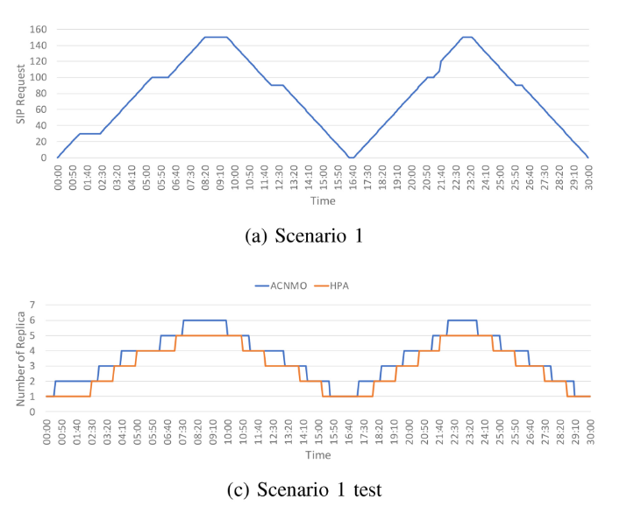
Test scenarios
SCENARIO 1:
Notes:
我們使用了兩個情境來測試這個框架；第一個情境具有常規的 SIP 流量，而第二個情境則具有異常的流量行為。我們將我們的實現與原生的 Kubernetes 水平 Pod 自動縮放算法進行了比較，以顯示這兩種實現之間的差異，以及使用我們的框架進行自動縮放的好處。

Slide 59
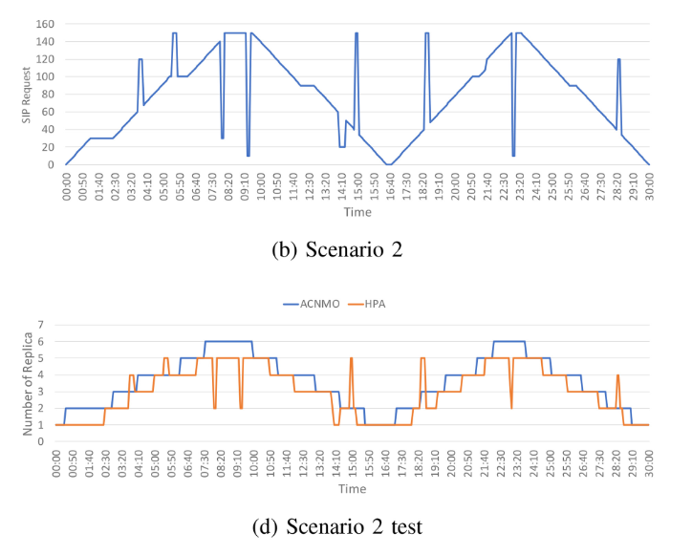
Test scenarios
SCENARIO 2:
Notes:
我們使用了兩個情境來測試這個框架；第一個情境具有常規的 SIP 流量，而第二個情境則具有異常的流量行為。我們將我們的實現與原生的 Kubernetes 水平 Pod 自動縮放算法進行了比較，以顯示這兩種實現之間的差異，以及使用我們的框架進行自動縮放的好處。

Slide 60
Test scenarios
In summary, both systems perform well when the traffic is gradually increasing and decreasing, but our framework is able to predict the future resource consumption and to make the decision to scale up before replica reaches the threshold. When the system has spikes and sinks of traffic load, KHPA does not maintain system stability, which will eventually add latency to the system. Our framework is able to foresee the spikes and sinks of the traffic and can maintain system stability, which eventually will have less latency to the system.
Notes:
總的來說，當流量逐漸增加和減少時，兩個系統都表現良好，但我們的框架能夠預測未來的資源消耗並在副本達到閾值之前進行伸縮的決策。當系統出現流量負載的高峰和低谷時，KHPA 不能保持系統穩定，最終會導致系統延遲增加。我們的框架能夠預見流量的高峰和低谷，並能夠保持系統的穩定，最終對系統的延遲會更小。

Slide 61
Outline
Introduction
Background
Literature review
Architecture
Multi-Objective Optimization For Scalablity
Implementation
Experimentation
Conclusion

Slide 62
Conclusion
We proposed an architectural framework for automated orchestration for Cloud-Native applications.
We implemented the proposed architecture in the Kubernetes cluster that runs the vIMS as well as a simple machine learning algorithm to predict future resource.
We evaluated our implementation with Kubernetes native horizontal pod autoscaler and have shown that our framework is able to perform better than Kubernetes native autoscaler.
For future work, we are planning to add more orchestration operations, such as anomaly detection, load balancing, etc., using neural networks and deep learning
Notes:
提出了一個用於雲原生應用自動編排的架構框架 運行 vIMS 的 Kubernetes 集群中實現了所提出的架構，並使用了一個簡單的機器學習算法來預測未來的資源利用情況。
我們通過與 Kubernetes 原生水平 Pod 自動伸縮器進行比較評估了我們的實現，並且展示了我們的框架能夠優於 Kubernetes 原生自動伸縮器
對於未來的工作，我們計劃使用神經網絡和深度學習添加更多的編排操作，例如異常檢測、負載平衡等

