Slide 1
Efficient Network Slicing with SDN and Heuristic Algorithm for Low Latency Services in 5G/B5G Networks
Robert Botez , Andres-Gabriel Pasca, Alin-Tudor Sferle, Iustin-Alexandru Ivanciu and Virgil Dobrota
(2022) Science and Technology of Sensors
IF: 3.9

Slide 2
ABSTRACT
This paper presents a novel approach for network slicing in 5G backhaul networks, targeting services with low or very low latency requirements. We propose a modified A* algorithm that incorporates network quality of service parameters into a composite metric. The algorithm’s efficiency outperforms that of Dijkstra’s algorithm using a precalculated heuristic function and a real-time monitoring strategy for congestion management. We integrate the algorithm into an SDN module called a path computation element, which computes the optimal path for the network slices.
Notes:
本文提出了一種新的方法，用於在5G背景網絡中進行網絡切片，以達到具有低或非常低延遲要求。
透過一種修改後的A*演算法，將網絡QoS參數納入到一個綜合指標中。
通過使用預先計算的heuristic function和用於congestion management的即時監控策略，該算法的效率優於Dijkstra算法。
我們將該算法整合到SND的path computation element 的module中，該module計算網絡切片的最優路徑。
實驗結果顯示，與Dijkstra算法相比，所提出的算法在處理時間方面顯著提高，特別是在複雜的拓撲中。
該算法成功地根據需要即時調整路徑，以滿足低延遲要求，防止封包延遲超出設定的threshold

Slide 3
1. INTRODUCTION
The global network slicing market is forecast to grow rapidly in the coming years, due to the increasing demand for the capabilities that 5G networks offer.
The concept of network slicing was proposed and introduced in order to deliver the specific traffic requirements for different services defined in 5G networks: enhanced mobile broadband (eMBB), ultra-reliable and lowlatency communications (URLLC) and massive machine type communications (mMTC).
Network slicing can be achieved through software-defined networking (SDN) and network function virtualization (NFV) technologies, which allow network operators to dynamically allocate resources and configure network functions for each slice.
Notes:
由於對5G網絡提供的功能需求不斷增加，所以全球network slicing市場預計在未來幾年將迅速增長
網絡切片的概念是為了滿足5G網絡中定義的不同服務的特定流量需求而提出和引入的：
增強型移動寬帶（eMBB）、超可靠低延遲通信（URLLC）和大規模機器型通信（mMTC）
網絡切片可以通過軟件定義網絡（SDN）和網絡功能虛擬化（NFV）技術來實現，這使得網絡運營商可以為每個切片動態分配資源並配置網絡功能。
eMBB是Enhanced Mobile Broadband的縮寫，意指增強型行動寬頻。
它是5G的主要應用場景之一，旨在提供更快的網絡速度和更高的帶寬，
以支持高清視頻串流、虛擬實境、遠程醫療等高帶寬需求的應用。
eMBB使用5G技術，包括更高的頻譜效率和更低的延遲，以實現更好的用戶體驗和更廣泛的應用場景。
URLLC是Ultra-Reliable Low Latency Communication的縮寫，意指超高可靠低延遲通信。在5G和物聯網領域中，URLLC是一種重要的應用場景，其主要目標是實現極低的通信延遲和極高的通信可靠性。這種通信技術適用於需要即時、可靠且低延遲的應用，如工業自動化、智能交通系統和醫療保健。URLLC使用5G技術的特性，如極低的端到端延遲、高可靠性和穩定的連接，以確保對於關鍵應用場景的支持和服務。
mMTC代表大量機器型通信（Massive Machine Type Communication），是5G和物聯網領域中的一種重要應用場景。它旨在支持大規模設備之間的高密度通信，包括嵌入式感測器、智能設備和其他物聯網設備。mMTC主要特點是支持大量設備同時連接到網絡，並能夠有效地管理和處理它們之間的通信。這種通信技術對於智能城市、智能家居和工業物聯網等場景具有重要意義，能夠實現設備之間的互聯互通，促進數據的收集和分析，從而提高效率和便利性。

Slide 4
Network function virtualization (NFV) is the process of moving network functions from proprietary hardware to a virtualized environment [7]. NFV offers benefits such as portability, orchestration, scalability, and cost reduction, which are particularly relevant for 5G networks [8].
MANO platforms, developed based on the ETSI framework, aim to reduce OPEX and enhance VNF deployment with features like scalability and lifecycle management.
Software-defined networking (SDN) has seen increased demand, particularly with the emergence of 5G networks. The tight coupling of network architecture before 5G made it unsuitable for SDN. However, as the need for scalable and customizable services grew, the network architecture evolved to accommodate SDN and NFV technologies.
Notes:
網絡功能虛擬化（NFV）是將網絡功能從專用硬體移到虛擬化環境的過程[7]。
NFV帶來了諸如portability、orchestration、scalability和cost reduction等好處，對於5G網絡尤為重要[8]。
基於ETSI框架開發的MANO平台旨在降低OPEX並通過scalability和lifecycle management等功能增強VNF部署。
Operational Expenditure 的縮寫，意為運營支出
軟件定義網絡（SDN）的需求在5G網絡的出現增加了。在5G之前，網絡架構的緊密耦合使得它不適合於SDN。
然而，隨著對可擴展和可定制服務需求的增加，網絡架構發展以容納SDN和NFV技術。

Slide 5
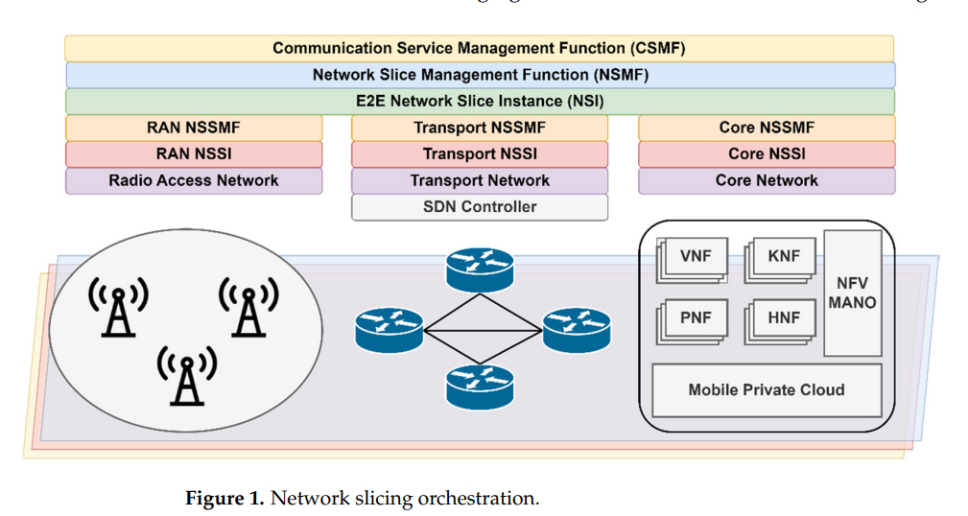
Notes:
在網絡切片管理架構中，客戶（或用戶）可以通過通信服務管理功能（CSMF）向網絡切片管理功能（NSMF）發出請求，以滿足特定的服務需求。NSMF負責根據客戶的需求創建、修改或釋放網絡切片實例（NSI），並在需要時將其分配給客戶。
為了滿足客戶的需求，NSMF可能需要創建或修改多個網絡切片子實例（NSSI），這些NSSI可能在網絡的不同部分（如接入、傳輸、核心等）中運行。NSSI由網絡切片子網管理功能（NSSMF）負責管理和編排。
因此，NSMF負責處理從CSMF收到的客戶需求，並在需要時與NSSMF合作以創建、修改或釋放相應的NSSI和NSI，從而實現客戶的服務要求。

Slide 6
1.2. Motivation and Contribution
Motivation
-The need for efficient network slicing in 5G backhaul networks, especially for low
or very low latency services.
-The challenges in achieving ultra-reliable low-latency communication (URLLC) due
to stochastic delays in upper networking layers.
-While transmission delay is only a small fraction of the end-to-end delay, addressing
these bottlenecks is crucial for realizing URLLC services effectively [22].
Notes:
-因為低或超低延遲服務的需求，所以有效率的network slicing在5G backhaul網路的需求增加
-因為上層網路的隨機延遲讓達成URLLC很有挑戰性
-雖然傳輸延遲在佔整體end-to-end delay一小部分，但但解決這些bottleneck對於有效實現URLLC服務至關重要。

Slide 7
Contribution
-Introduction of a novel algorithm based on A* heuristic search for network slicing
in 5G backhaul networks.
-Integration of algorithm and strategy into an SDN module, known as the Path
Computation Element, within the RYU controller.
-Efficient computation of optimal paths based on the composite metric and real-time
monitoring of network conditions.
-Comparison with Dijkstra’s algorithm shows higher efficiency, especially for
complex topologies.
Notes:
-引用了一種基於A*啟發式搜索的新型算法，用於5Gbackhaul network
-算法和策略整合到RYU控制器中的SDN module中，稱為路徑計算元素
-在複雜拓撲中，與Dijkstra算法的比較，效率更高。
-

Slide 8
2. RELATED WORK
In ref. [24], a cloud-based SDN and NFV testbed for end-to-end network slicing in 4G/5G networks is introduced. This solution leverages advanced SDN and NFV technologies to create a flexible and programmable network infrastructure that can be customized and optimized.
Another solution for network slicing in 5G is presented in ref. [25] and implemented using the Open Network Automation Platform (ONAP). This open-source platform allows for automating network service delivery, management, and orchestration.
On the other hand, ref. [26] describes a method for integrating blockchain technology into 5G and beyond 5G (B5G) networks for efficient monitoring and management of resource use and sharing.
Notes:
-在參考文獻[24]中，介紹了一個基於雲的SDN和NFV測試平台，用於4G/5G網絡的端到端網絡切片。該解決方案利用先進的SDN和NFV技術來創建一個靈活且可編程的網絡基礎設施，可以進行定制和優化。
-另一種用於5G網絡切片的解決方案在參考文獻[25]中介紹，並利用開放式網絡自動化平台（ONAP）實現。這個開源平台允許自動化網絡服務交付、管理和編排。所提出的解決方案包括幾個組件，包括一個5G網絡切片模板、切片管理功能和切片編排功能。作者們詳細描述了使用ONAP進行端到端網絡切片管理過程，並展示了該機制在各種使用案例中的有效性。
-另一方面，參考文獻[26]描述了一種將區塊鏈技術整合到5G及B5G（B5G）網絡中，以實現有效的資源使用和共享監控管理的方法。提出的區塊鏈啟用的網絡切片模型（BENS）以複雜的方式處理頻譜資源的分配。該文章討論了5G頻譜共享的架構、動態頻譜共享以及頻譜共享的學習策略。結果表明，與其他分散和集中式學習方法相比，BENS在能源效率性能、傳輸成功率和收斂速度方面均表現更好。
B5G 是指「Beyond 5G」，即「超越 5G」。它指的是在 5G 技術之後的下一代無線通信技術。B5G 技術將進一步推動無線通信領域的發展，提供更高的速度、更低的延遲以及更大的連接性，以滿足未來數據需求的不斷增長。

Slide 9
In ref. [27], a management and orchestration (MANO) framework that automates end-to-end network slicing and integrates core network (CN) and transport network (TN) slices is described.
Another implementation of a 5G mobile core network slicing based on the NFV MANO architecture is presented in ref. [28]. The authors used open-source tools such as OpenStack Tacker and NCTU free5GC to create 5G core network slicing based on the network service descriptor (NSD).
In another study, ref. [29], the authors aimed to create an open source 5G network slicing architecture that can be deployed automatically. The proposed architecture utilized OpenStack, Tacker, free5GC, and UERANSIM for various functions such as virtualization, slicing environment deployment, core network management, and simulation of UE and gNB, respectively
Notes:
-參考文獻[27]介紹了一個管理和管控（MANO）框架，該框架自動化了端到端的網絡切片並集成了核心網絡（CN）和傳輸網絡（TN）切片
-參考文獻[28]介紹了基於NFV MANO架構的另一種5G移動核心網絡切片的實作。作者使用了OpenStack Tacker和NCTU free5GC等開源工具來基於網絡服務描述符（NSD）創建5G核心網絡切片。
-參考文獻[29] 的作者旨在創建一個可以自動部署的開源 5G 網絡切片架構。所提出的架構利用 OpenStack、Tacker、free5GC 和 UERANSIM 等工具，分別用於虛擬化、切片環境部署、核心網絡管理以及模擬 UE 和 gNB 等功能。實驗結果顯示所提出的架構是可行的，並且為每個切片保證了服務品質。
OpenStack 是一個開源的雲端計算平台，用於構建和管理私有雲和公有雲的基礎設施。它提供了一系列模組和服務，包括虛擬機器管理、網絡管理、存儲管理等，使用戶可以快速構建和管理彈性、可擴展的雲端基礎設施。OpenStack 可以自動化部署和管理雲端資源，簡化了雲端運營和管理的工作。

Slide 10
3. Proposed System Architecture
This paper is an extension of our previous work in ref. [13] and aims to develop a novel algorithm for enabling network slicing for different types of services in 5G backhaul networks.
We used the deployed 5G CN based on free5GC [43,44].
To implement the RAN we set up two virtual machines, each for a different network slice, with Ubuntu 20.04 operating system having 1 vCPU, 1 GB of RAM, and 10 GB of storage.
The communication between RAN and CN was achieved using a secondary CNI, Multus [45] , for the CN components to attach multiple network interfaces to Kubernetes pods, thus facilitating the communication between gNB and N2 or N3 interfaces.
Notes:
本篇是他們之前在ref[13]中做法的延伸，目的在為5G backhaul networks 開發一種新穎的network slicing算法。
使用free5gc當core network，用虛擬機當RAN
RAN跟CN之間的溝通透過Multus CNI(container network interface)，達成N2，N3介面

Slide 11
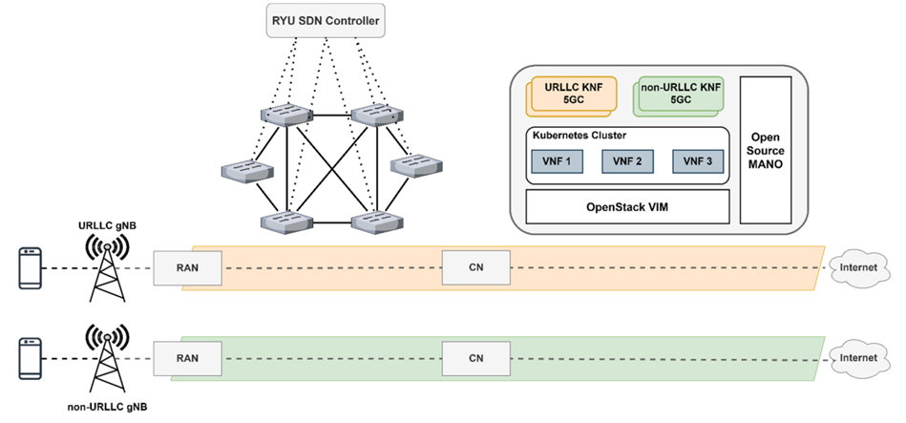
On these virtual machines, we installed UERANSIM [46] to emulate the UE and gNB.
we created the backhaul network by using multiple virtual switches running as Open vSwitch [47], which were connected to the RYU SDN controller [48].
Notes:
RYU controller會及時監控確保要求的latency, ATR及packet loss低於設定的threshold
用RYU SDN controller來連結多台虛擬交換機以實作backhaul network

Slide 12
3.1 Backhaul Network Slicing
In 5G, backhaul refers to the segment of the network which carries the data traffic from RAN to the core network; it typically consists of switching and routers.
Conventional routing protocols can be broadly categorized into two main types: distance vector and link state.
However, conventional routing protocols primarily respond to link failures rather than congestion.
Therefore, SDN is essential for facilitating rapid network adaptation in the event of congestion or link failure, especially for critical services.
Notes:
Distance vector依賴迭代式的更新模式，例如基於hop的routing information protocol.
每個節點會維護一個distance vector，通常會記錄到其他節點的hop數，當收到鄰居發送的distance vector更新時，他也會跟著更新。
Link-state使用一個同步的的topology information and shortest path algorithms.
但傳統的routing protocol著重於link failure而非congestion
比起傳統路由，SDN有更好的收斂時間尤其是在topology規模增加時

Slide 13
Taking these considerations into account, obtaining the right path in the backhaul networks must be done with an algorithm that responds quickly to congestion and provides necessary requirements in terms of ATR, latency, or packet loss. One of these is the modified Dijkstra’s algorithm presented in ref. [50].
However, there’s other methods can be employed to enhance the computation for the shortest path, especially for congestion scenarios in critical services in 5G networks.
Notes:
經過以上的考量，在backhaul網路中，我們需要一個可以對congestion做出快速反應並滿足ATR、延遲、Packet loss的演算法
Ref. [50]有提到一個 修改過的Dijkstra’s algorithm
不過，在網路壅塞時，有另外的演算法可以用來增強計算最短路徑。

Slide 14
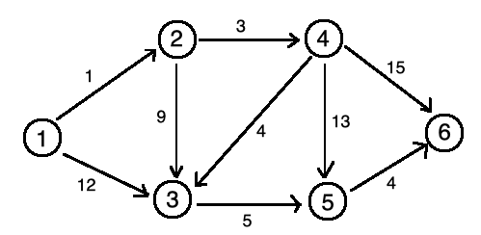
Dijkstra’s algorithm
Let us quickly review the algorithm.
 | 1 | 2 | 3 | 4 | 5 | 6
1 | 0 | 1 | 12 | ∞ | ∞ | ∞
2
3
4
5
0
1
10
4
∞
∞
0
1
8
4
17
19
,2
,4
,3
,5
S：[1 ]
0
1
8
4
13
19
0
1
8
4
13
19
Notes:
Table內第一行是iteration次數，低一列是node的名字
如果到不了的node距離會先設為無限
S是一個 list放visited過的node
每次會挑選權重最小的點開始
最後的結果代表從起始點到每個點的最短路徑

Slide 15
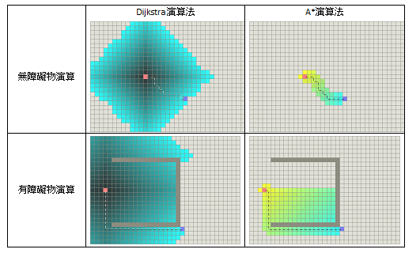
A* Algorithm
A heuristic algorithm that finds the shortest path between two nodes in a graph.
A* can be considered as an extension of Dijkstra’s algorithm which uses the heuristic component to estimate the cost of the remaining path from a node to a destination, allowing us to prune the search space and find the path much faster.
Source : https://tedsieblog.wordpress.com/2016/07/08/a-star-algorithm-introduction/
Notes:
A*演算法是一個可以計算點到點最短路徑的演算法
A*可以被視為Dijkstra的延伸，他用啟發式的演算法來預測剩下路徑的cost，讓我們可以裁減掉不必要的path來提高效率

Slide 16
At each step, the algorithm evaluates the nodes based on their total estimated cost, which is the sum of the actual cost from the start node g(v) and the heuristic estimate of the cost to reach the goal node h(v).
F(v) = g(v) + h(v)
By considering both the actual cost and the heuristic estimate, the A* algorithm intelligently explores the graph, focusing its search on the most promising paths.
Notes:
在每個步驟中 A*演算法會計算出一個起點到目前node的真實cost g(v)
及目前node到目標node的heuristic cost h(v)
透過這樣的方法，我們可以專注於較有希望path

Slide 17
3.2. Modified A* Algorithm
We propose a modified version of A* by considering multiple factors such as ATR, delay, and packet loss for enabling network slicing in the backhaul network.
Notes:
本篇提出一個 修改過的A*演算法，考慮ATR, delay and packet loss以實現backhaul network的network slicing

Slide 18

The algorithm initializes necessary data structures and variables.
It Maintains a priority queue called the heap.
It keeps track of visited nodes, maintains the g_scores (8) for each node, (representing the cost of reaching that node from the start), and tracks minimum ATR and cumulative packet loss (PL) values as shown in (5) and (7).
Notes:
g_score

Slide 19
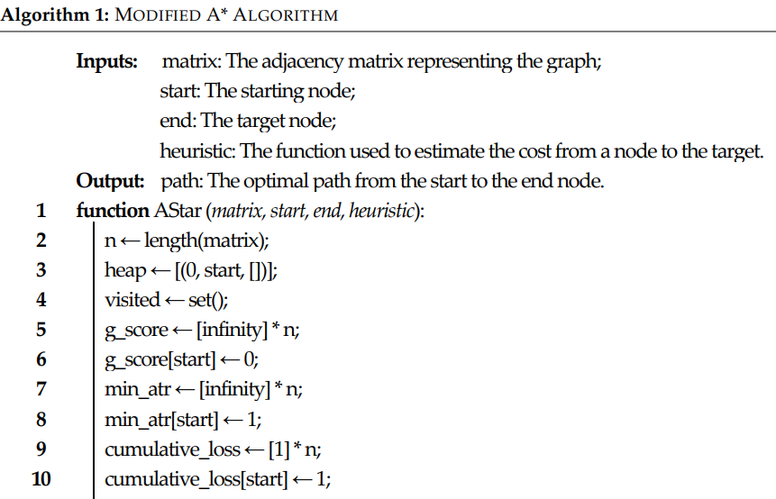
heap: it stores tuples.
visited : an empty set at first.
g_score : represent the cost

Slide 20
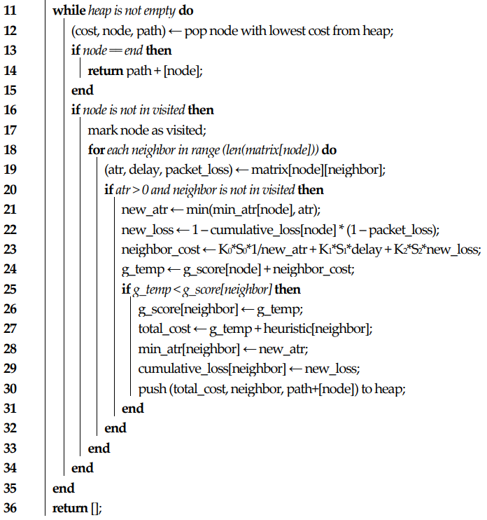
The main loop iterates until the heap is empty
temp. parameters
If the g_temp is lower than g_score[neighbor], then we update the cost, and push the node to the heap.
This algorithm ends when we find the optimal path or
exhausts all possible nodes to explore.
Notes:
K0 S0 那些是甚麼?

Slide 21
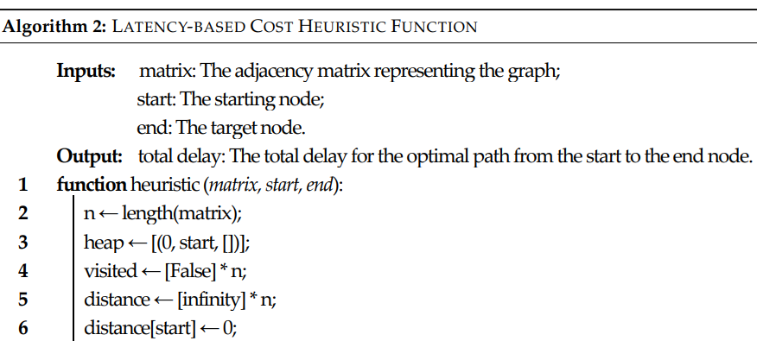

Slide 22
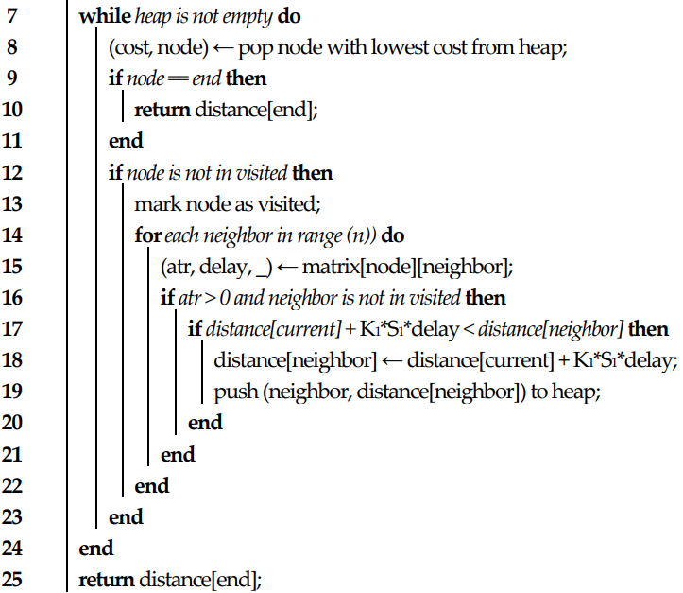

Slide 23
3.3. Efficient Path Computation Module for
Dynamic Network Slicing in SDN
The previous algorithms were integrated into an SDN backhaul network. In order to be used, we implemented extra modules as applications for the chosen SDN controller which is RYU.
First, we needed a topology discovery module to determine the network devices in the topology: hosts, switches, and links. The module encompasses two primary components:
- Switch and link discovery: The code utilizes the RYU controller’s event-driven architecture to
capture the EventSwitchEnter event. With get_switch and get_link from the controller’s built-in
functions, we can obtain the data of links and switches. The data will be stored in a nested dictionary.
- Regarding host discovery, the module responds to the EventHostAdd event triggered when a new
host is detected in the network. It captures information about the host. This information is stored in a
dictionary structure for future reference.
Notes:
先前提到的算法已經整合到SDN的backhaul network中。
為了要可以使用，本篇實作了另一個 module應用在SDN RYU controller
首先要有一個 拓樸發現module來找hosts, switches, and links，包含兩大部分
Switch and link discovery
host discovery
EventSwitchEnter : 表示有新的switch加入了網路拓樸中

Slide 24
Next, we implemented a network performance metrics module to measure the network metrics based on the discovered topology. We measured three features for each link: ATR, OWD, and packet loss.
The last component is the path computation module which integrates the algorithm discussed in the previous subsection. When we load the application into the SDN controller, it starts by initializing the default optimal path for the priority service (e.g., URLLC) and calculates the best K optimal paths using Yen’s algorithm [56].
In our case, the only peculiarity when we applied Yen’s algorithm was that we employed the algorithm previously shown in Algorithm 2 to calculate the shortest distance between two nodes.
Notes:
-再來我們使用三個性能指標來量測發現的拓樸
-最後一個組件是路徑計算模組，它整合了前面討論的算法。當我們將應用程式加載到 SDN 控制器中時，它首先初始化了優先服務（例如 URLLC）的預設最佳路徑，並使用 Yen 算法計算出最佳的 K 條路徑。
Yen’s algorithm可以找出多個node到goal node的shortest path，所以會產生出K條paths, 然後本篇再把這K條path 聯集成 set H

Slide 25
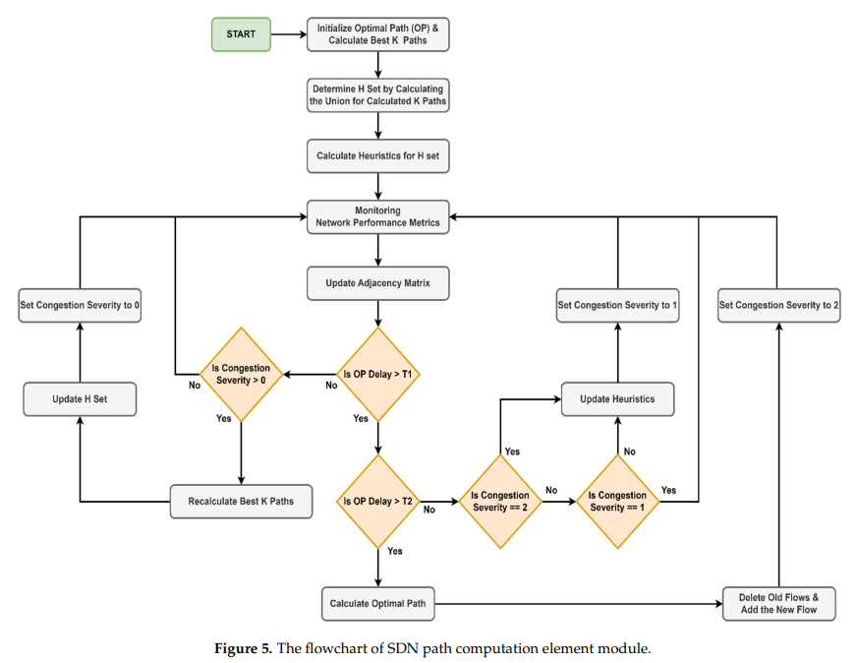

Slide 26
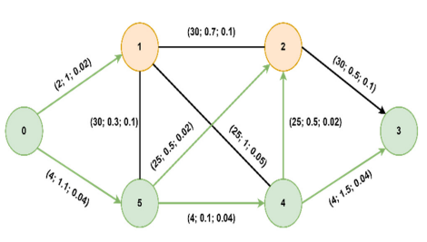
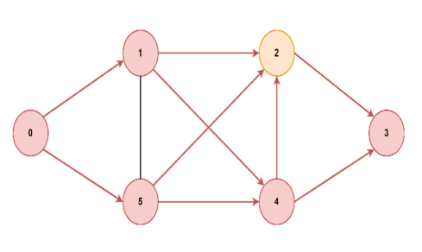
4. Experimental Results
We compared the execution times between the proposed algorithm and Dijkstra for the topology presented in Figure 7. Then, we assessed the consistency of the algorithm on different graphs by varying both the number of nodes and the topology.
The optimal path found from starting node 0 to goal node 3 is [0, 5, 4, 3], for both algorithms, but A* will prioritize the paths with lower delays, thus reaching the optimal solution faster.
Notes:
本篇論文比較了多種情況，在不同節點數及不同網路拓蹼都有測試
在figure 7中 最佳路徑是0,5,4,3 在兩種演算法都一樣，不過A*會優先尋找更低延遲的節點，因此可以更快的找到OPT solution

Slide 27
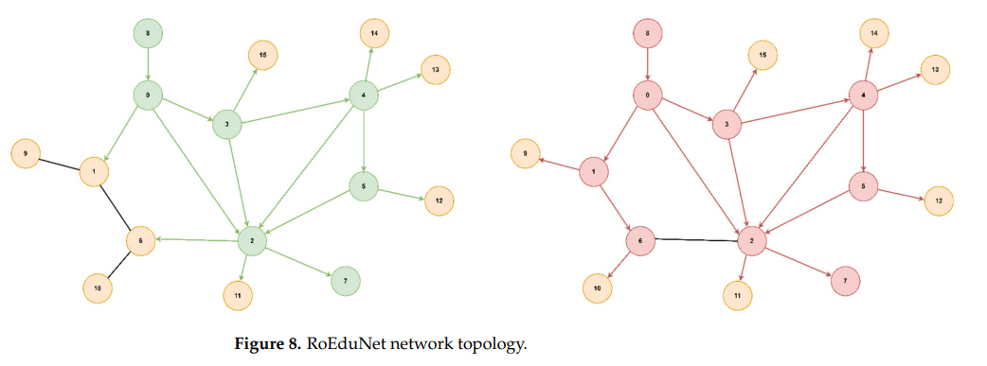

Slide 28
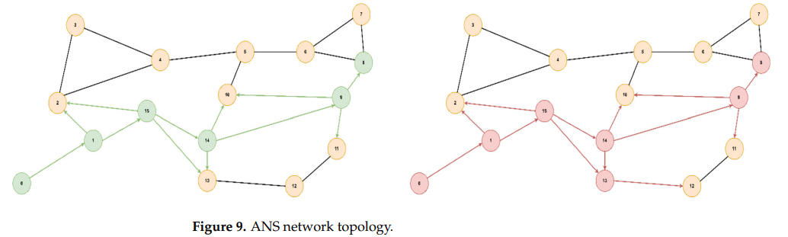

Slide 29
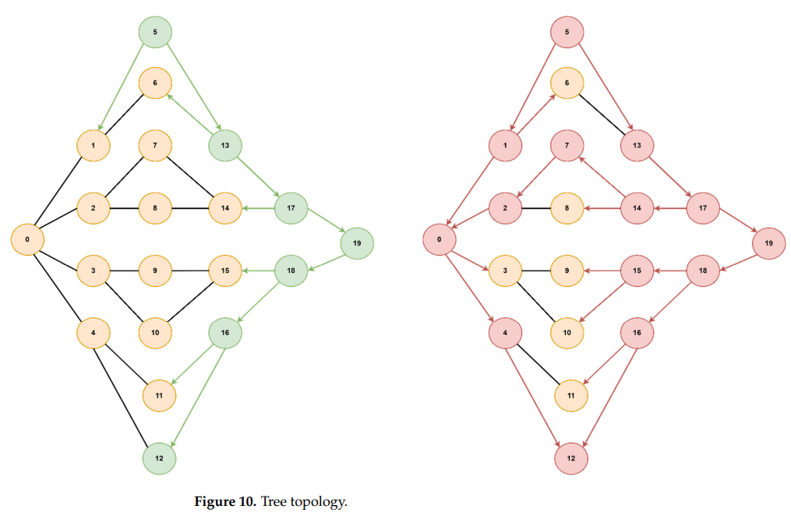

Slide 30
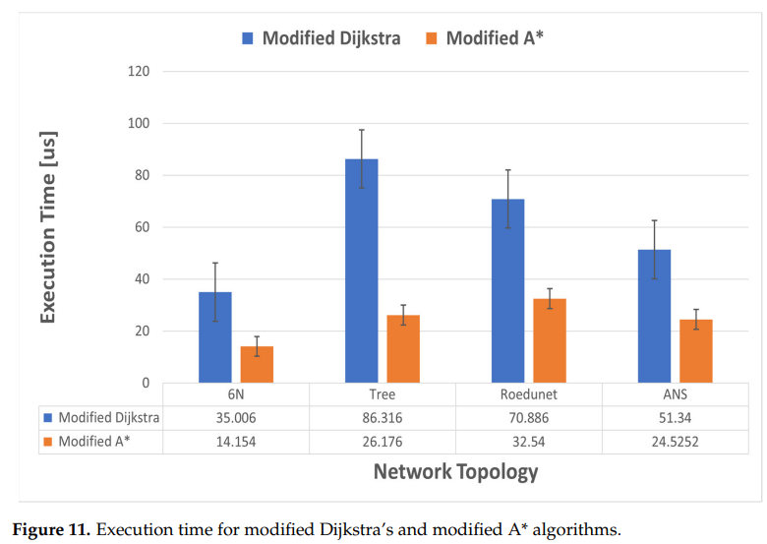
Next, we compared the execution time between the modified A* algorithm and the modified Dijkstra’s algorithm for the four topologies presented previously.
Environment: Ubuntu 20, 16 GB RAM, 4 cores, and 60 GB of storage.
Language: Python
Notes:
接下來，用上面的圖來比較modified A* algorithm and the modified Dijkstra’s algorithm的執行時間
可以看出modified A* algorithm明顯快於modified Dijkstra’s algorithm, 在tree topology上有最明顯的差距，modified A* algorithm約是modified Dijkstra’s algorithm的執行時間的 30%

Slide 31
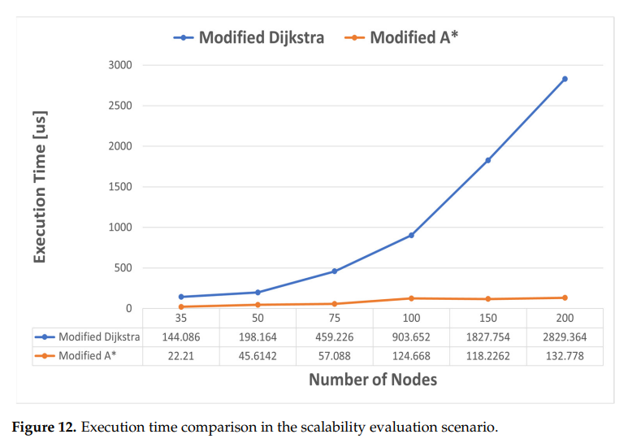
Then, we measured again the execution time for six different values of the number of nodes: 35, 50, 75, 100, 150, and 200 nodes by calculating the average values over 60 different tests.
Notes:
可以看出，修改後的Dijkstra算法的平均執行時間在大約150個節點之前呈現大約指數增長。
A*則沒有明確的模式，但在100個節點後，它在120-130微秒左右的值上穩定下來。

Slide 32
5. Discussion and Conclusions
In this paper, which is an extension of our previous work presented in ref. [13], we have proposed a novel algorithm based on SDN for network slicing in 5G backhaul networks, intended especially for services that have low or very low latency requirements.
We then moved on to the development of a new algorithm based on A* heuristic search, which takes into account several network QoS parameters and includes them in a composite metric.
The efficiency of the algorithm comes with a compromise because the heuristic function must be precalculated. To tackle this disadvantage, we proposed a strategy that involves real-time monitoring, constant and/or event-based updating of the heuristic function, and recalculation of the optimal path only in case of congestion.
Notes:
在這篇論文中，我們延續了我們在參考文獻[13]中提出的先前工作，提出了一個基於SDN的新算法，用於5G回程網絡中的網絡切片，尤其是針對具有低或非常低延遲要求的服務。
然後，我們開始開發一個基於A*啟發式搜索的新算法，該算法考慮了幾個網絡QoS參數並將它們納入了一個綜合度量標準中。
該算法的效率是有代價的，因為啟發式函數必須事先計算。為了解決這個缺點，我們提出了一種策略，該策略涉及實時監控，持續和/或事件觸發的啟發式函數更新，並且僅在出現擁塞時重新計算最佳路徑。

Slide 33
The proposed algorithm worked efficiently on the implemented testbed, immediately changing the path of the URLLC service with low delay requirements, without allowing the packets sent by the UE to exceed the established path delay threshold of 20ms. Moreover, after the congestion passed, the path of the URLLC slice was again adjusted to minimize the delay.
In future work, we will consider the implementation of a module based on artificial intelligence techniques for predicting congestion to assist the implemented module in making the optimal decision. Another possible solution is to take into account the effect of uncertainty on QoS/QoE by applying an intuitionistic fuzzy approach as presented in ref. [61]. Also, we want to expand the algorithm by approaching a strategy based on the D* algorithm, so the recalculation of the optimal path will be performed only for subsets of the graph rather than on the entire path.
Notes:
提出的算法在實現的測試環境中運行效率很高，能夠立即更改具有低延遲要求的URLLC服務的路徑，而不允許UE發送的數據包超過建立的路徑延遲閾值20ms。此外，在擁塞情況解除後，URLLC切片的路徑再次進行調整，以最小化延遲。
在未來的工作中，我們將考慮實現一個基於人工智慧技術的模塊，用於預測擁塞，以協助實現的模塊做出最優決策。另一種可能的解決方案是考慮不確定性對QoS/QoE的影響，採用類似於引用[61]中提出的直觀模糊方法。此外，我們希望通過採用基於D*算法的策略來擴展算法，因此將僅針對圖的子集進行最優路徑的重新計算，而不是整個路徑。

