Slide 1
An Extended SDN Architecture for Video‑on‑Demand Caching
Wei‑Kuo Chiang · Tsung‑Ying Li
Accepted: 1 April 2024 / Published online: 13 April 2024
SCI, IF=3.8/2022 Resurchify
An Extended SDN Architecture for Video-on-Demand Caching

Slide 2
目錄
Introduction
System Entities
System Flow
Performance Analysis
Conclusions

Slide 3
Introduction
Video on Demand growth: rising bandwidth and QoE demands
Problems: network congestion; high latency; inefficient bandwidth use
Extended SDN Cache service architecture (ESC)
OpenCache
C-flow
An Extended SDN architecture
User Behavior of VoD Service

Slide 4
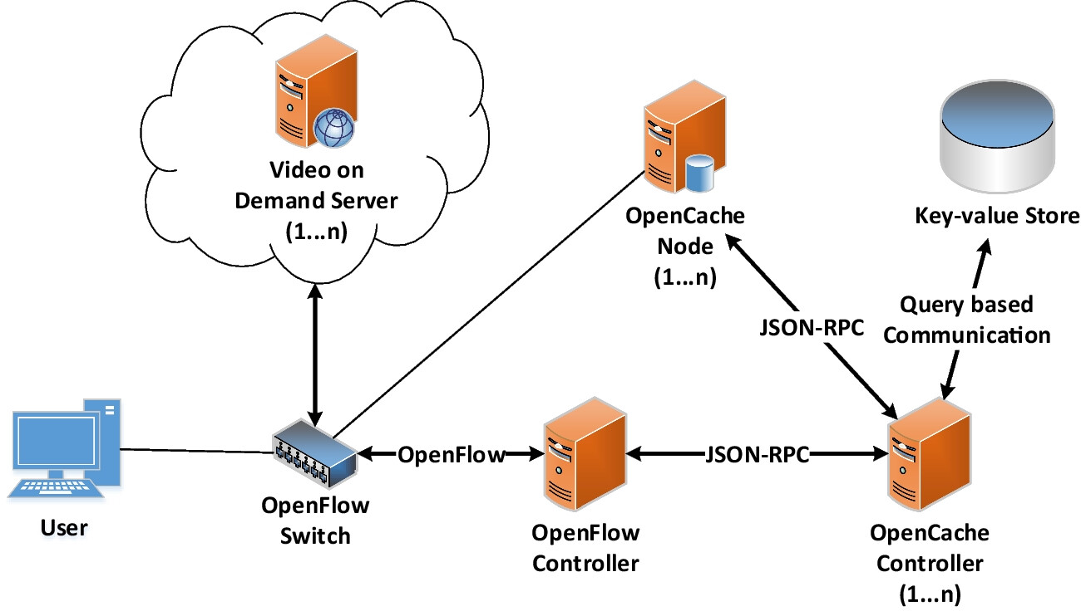
Introduction
OpenCache

Slide 5
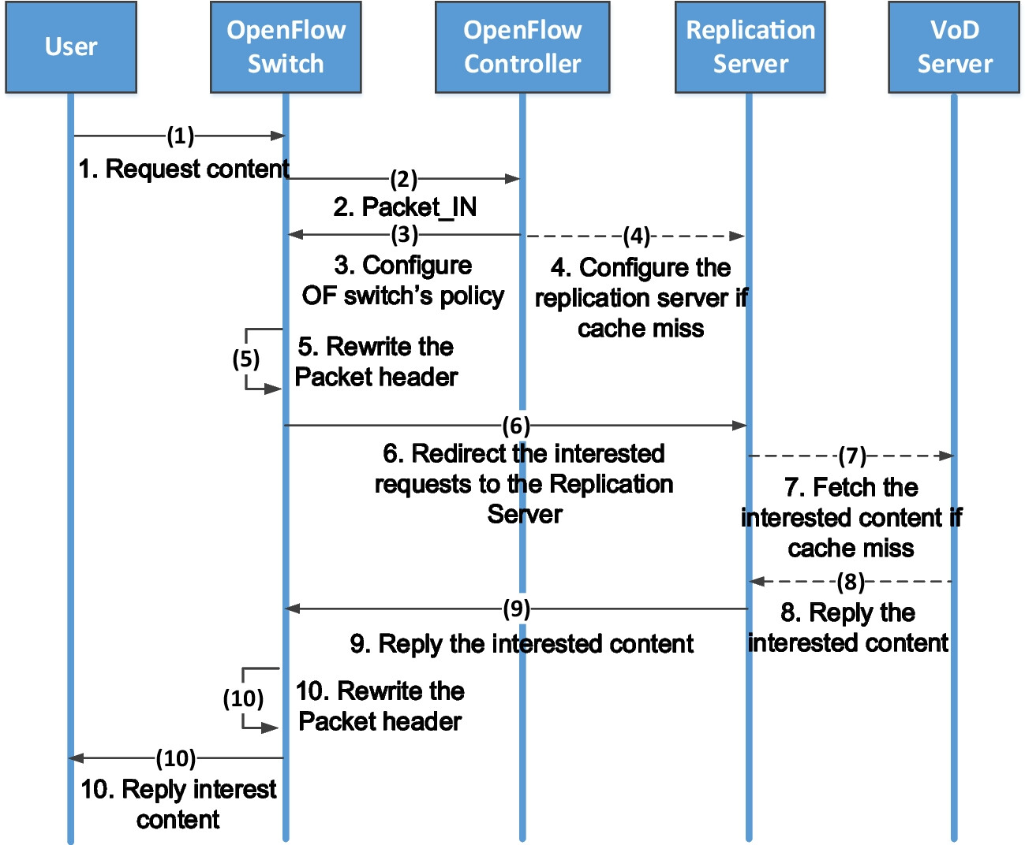
Introduction
C-Flow

Slide 6
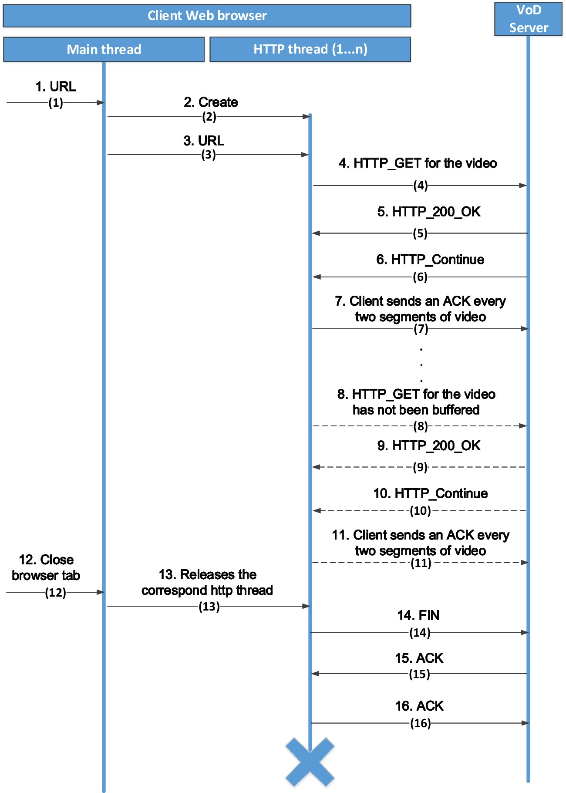
Introduction
User Behavior of VoD Service

Slide 7
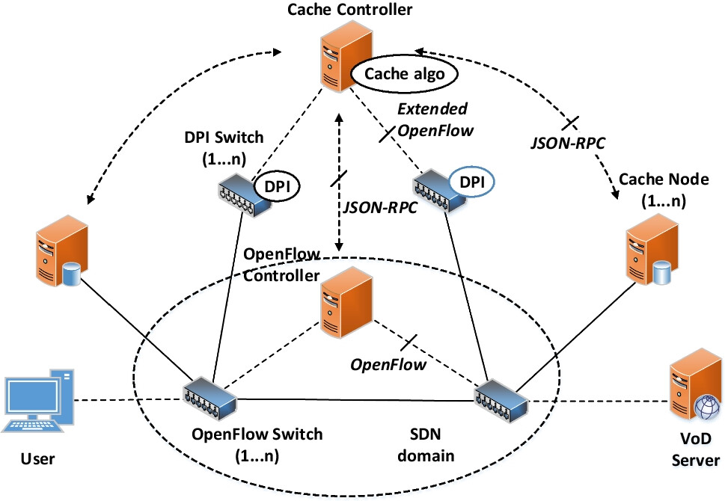
System Entities
Cache Node (CN) CN is the cache node in charge of caching the requested content.

Slide 8
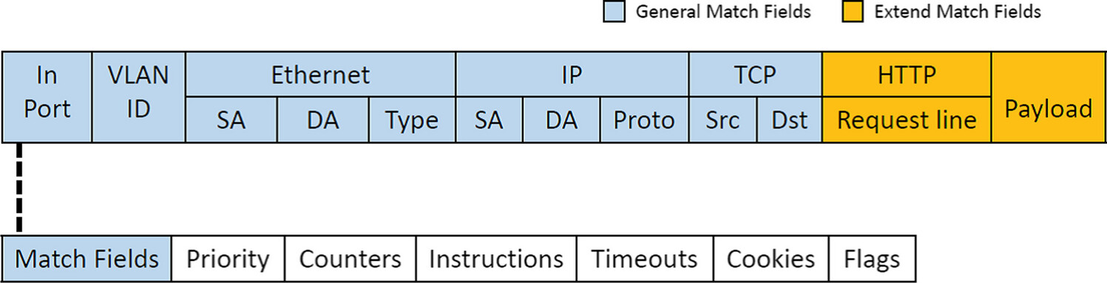
System Entities
DPI (deep packet inspection) switch It can inspect the packet header and the payload information in the packets.

Slide 9
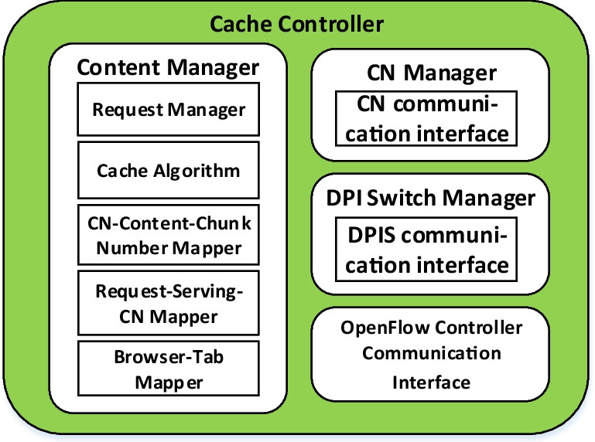
System Entities
Cache Controller (CC) A Cache Controller (CC) is an extended SDN controller that controls the DPI switch and CN.

Slide 10
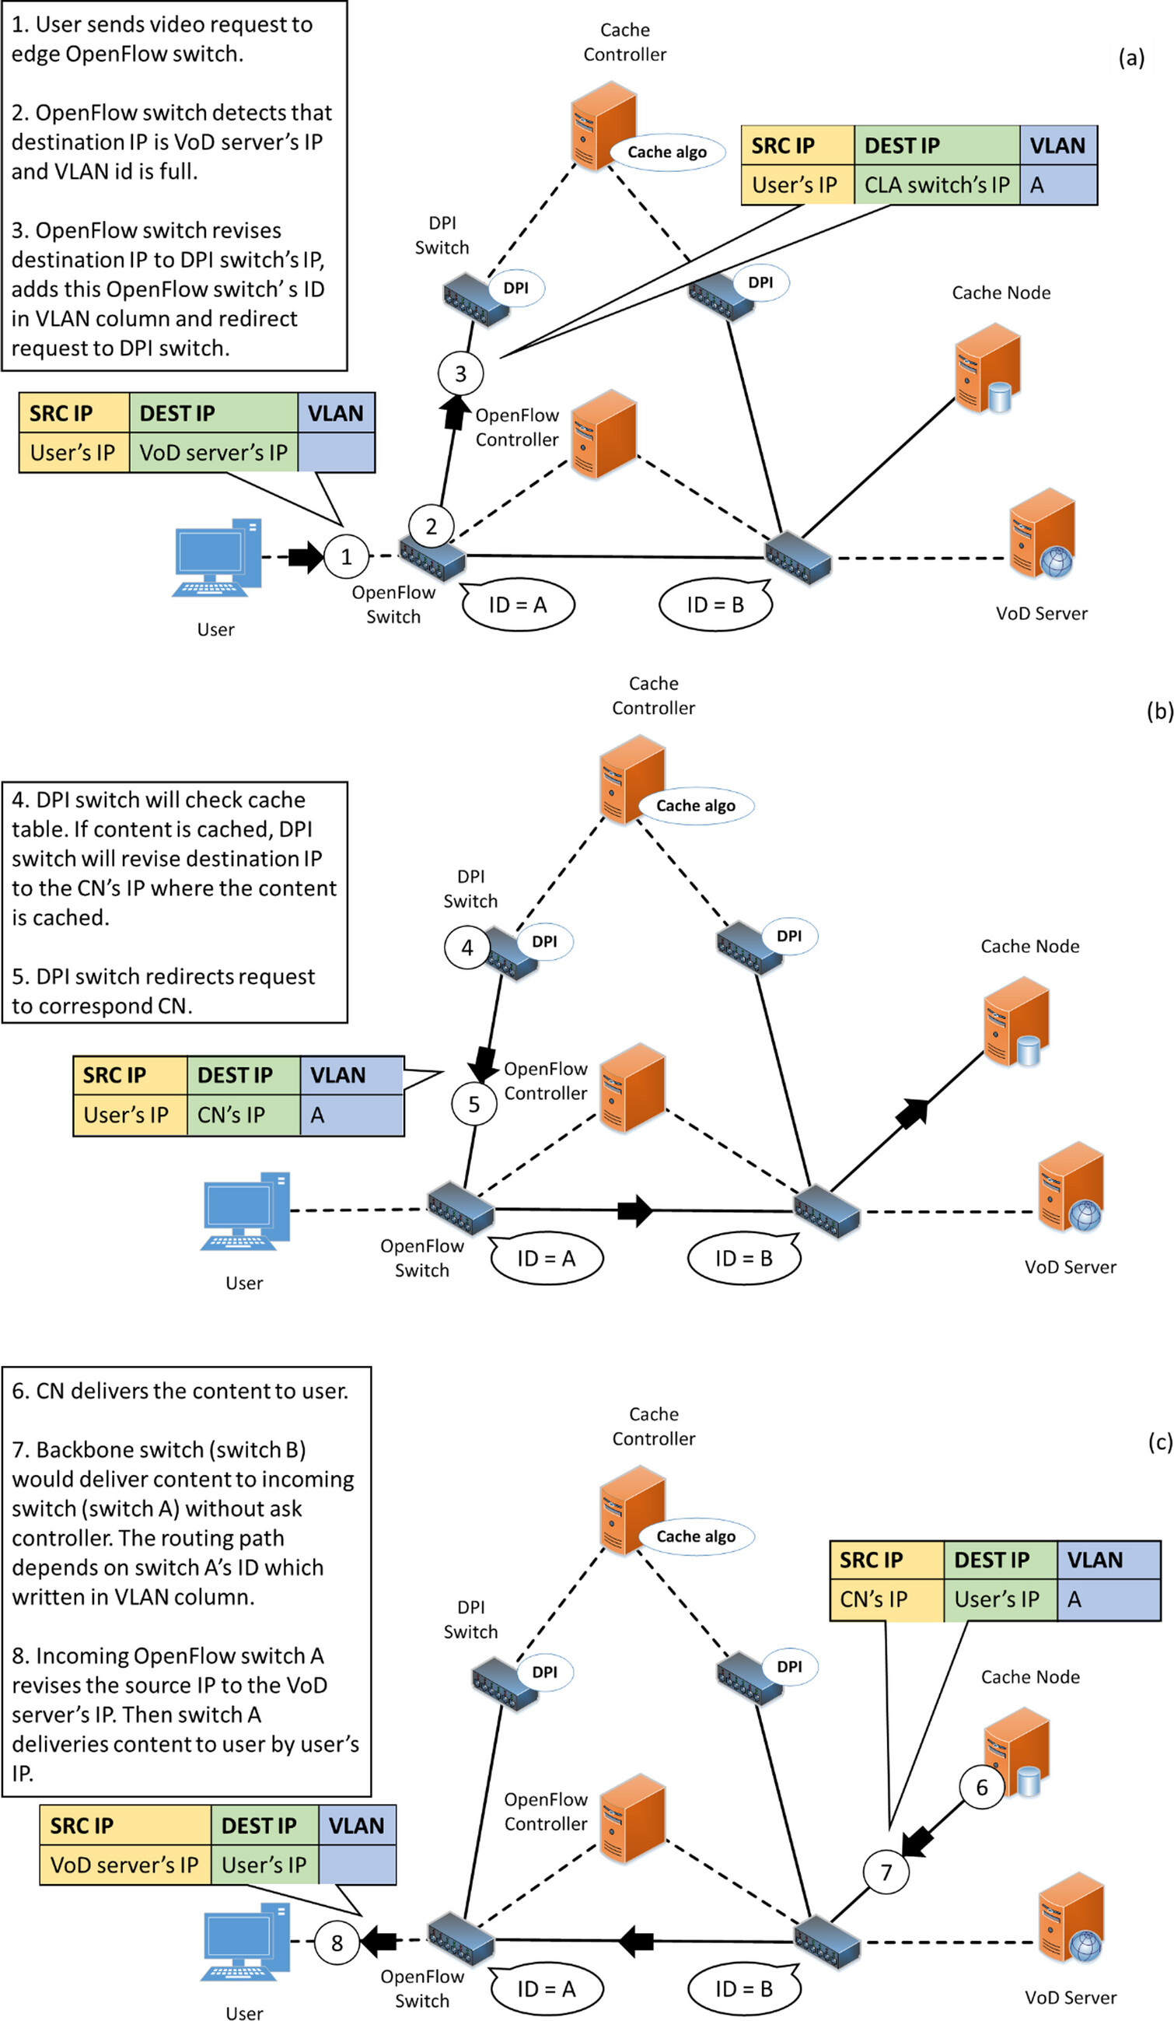
System Flow

Slide 11
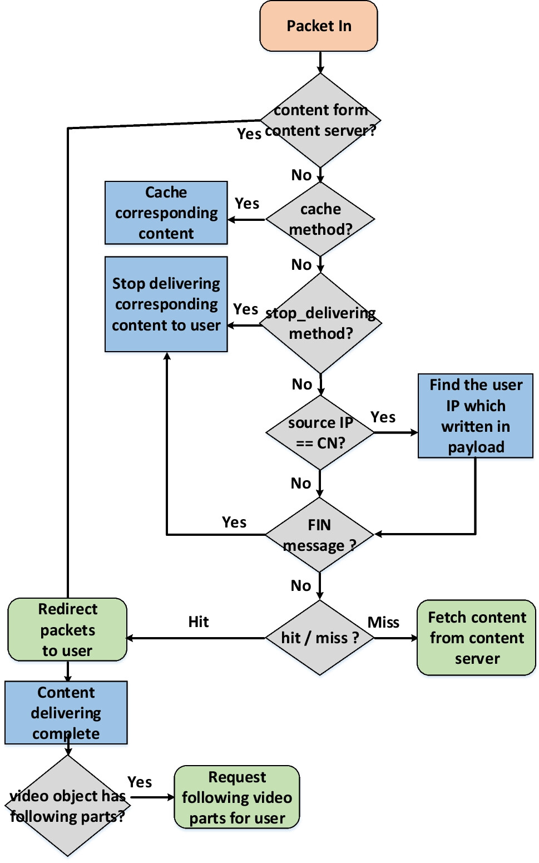
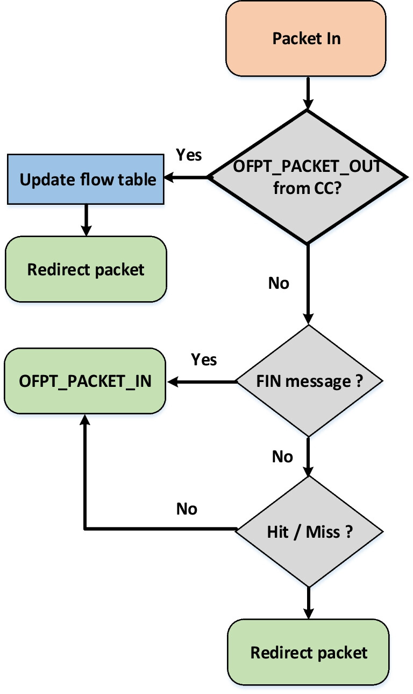

Slide 12
System Flow

Slide 13
System Flow

Slide 14
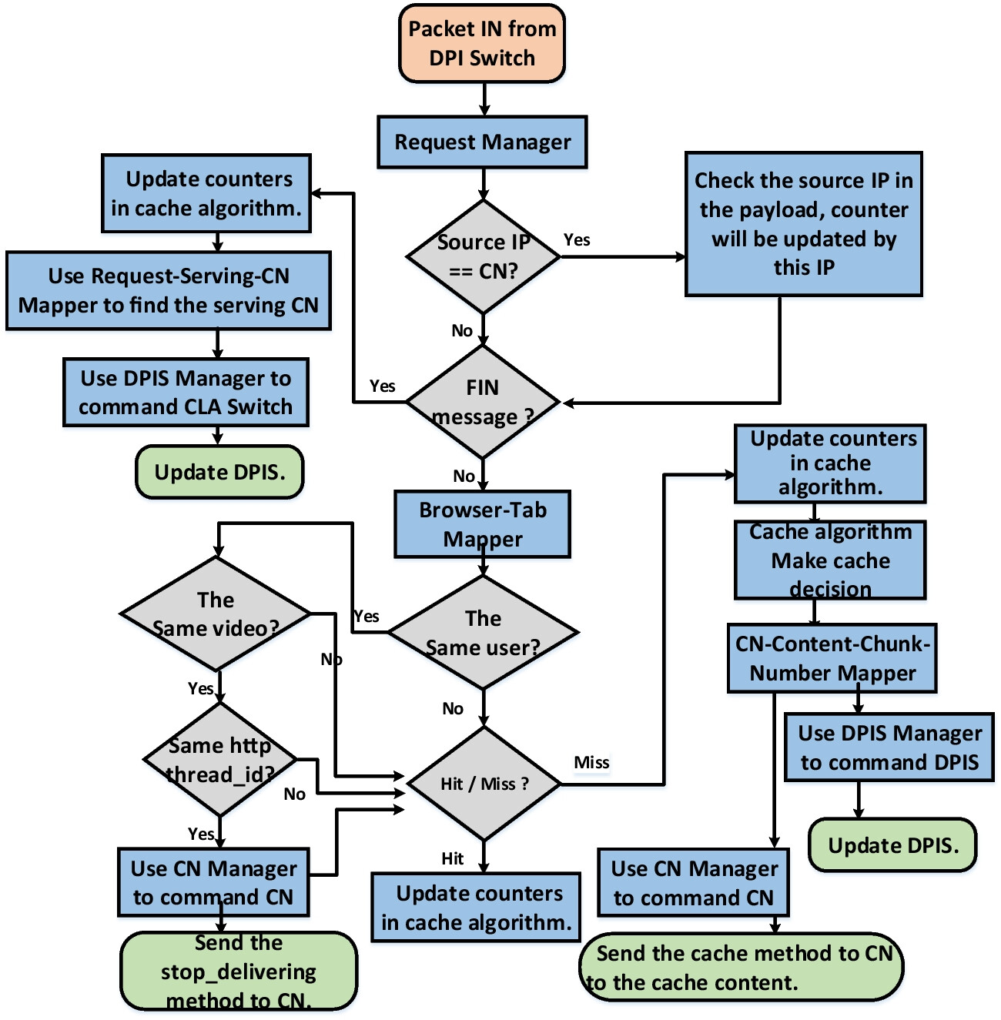

Slide 15
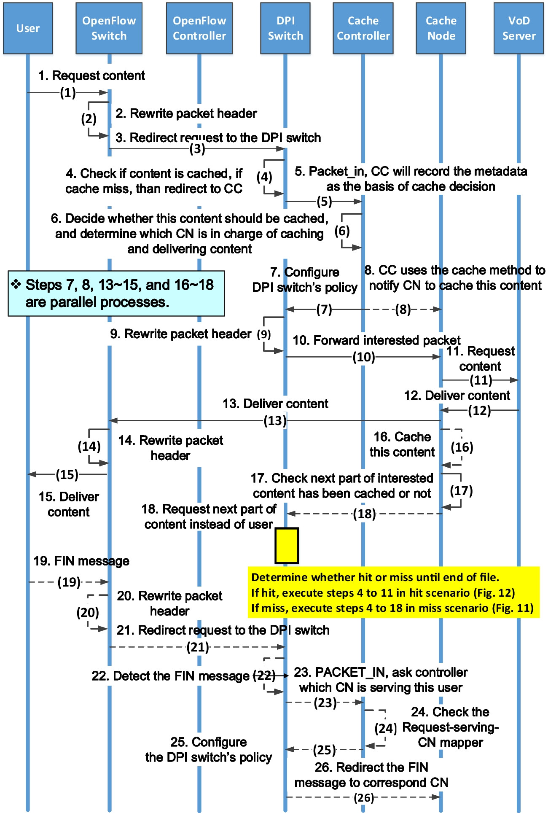
Steps 9-10: The DPI switch uses OFPAT_SET_NW_DST action to rewrite the destination IP address of the interested request to the IP address of the VoD server, uses OFPAT_SET_NW_SRC action to rewrite the source IP address of the interested request into the IP address of the corresponding CN, and then forwards the interested request to the CN.

Slide 17
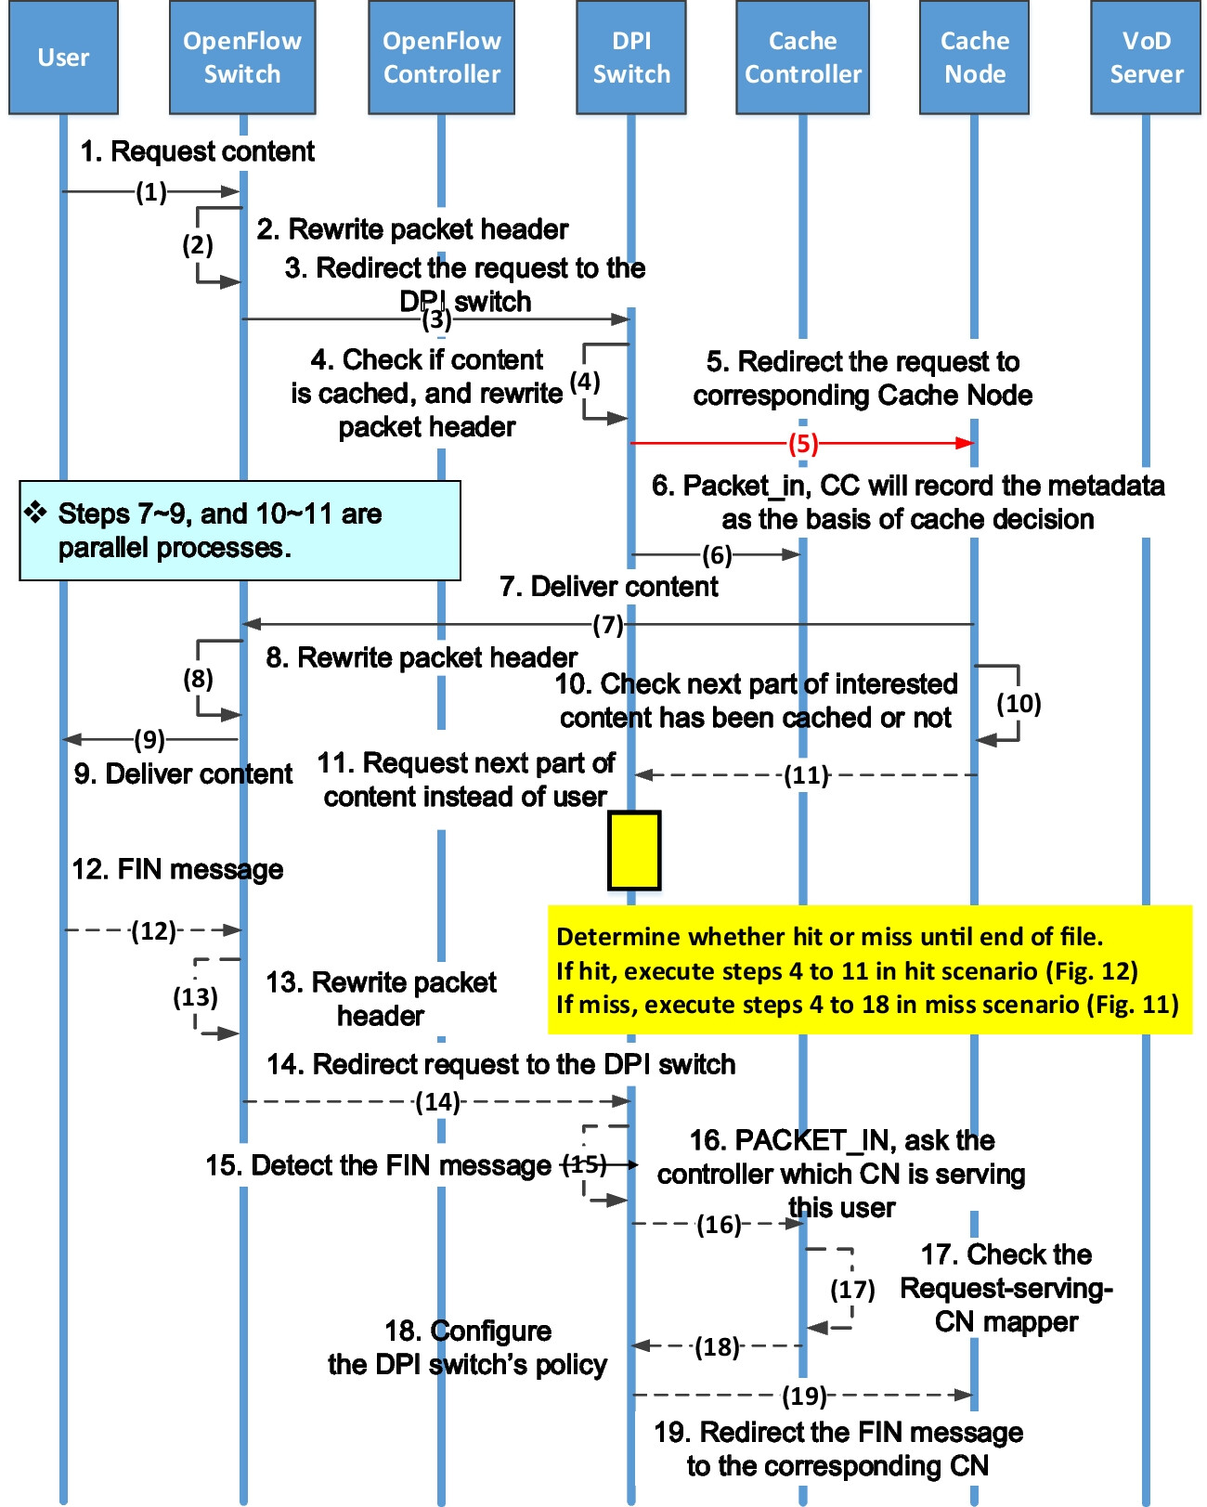

Slide 19

System Flow
CN
VoD server

Slide 20
System Flow
CN
VoD server

Slide 21
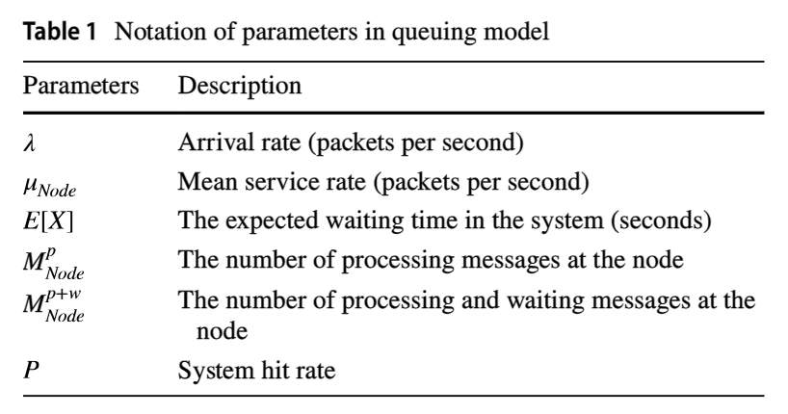
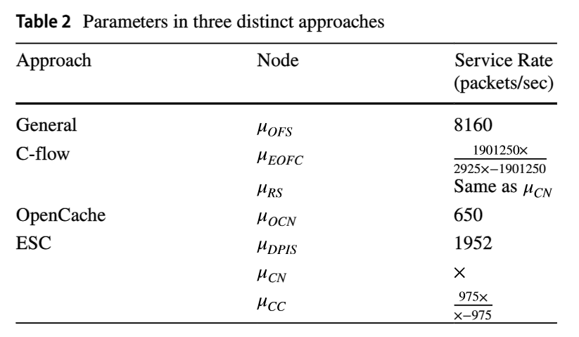
Performance Analysis

Slide 22
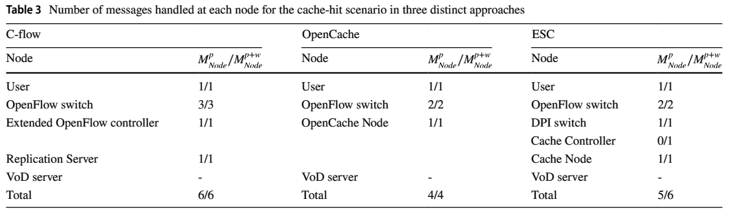
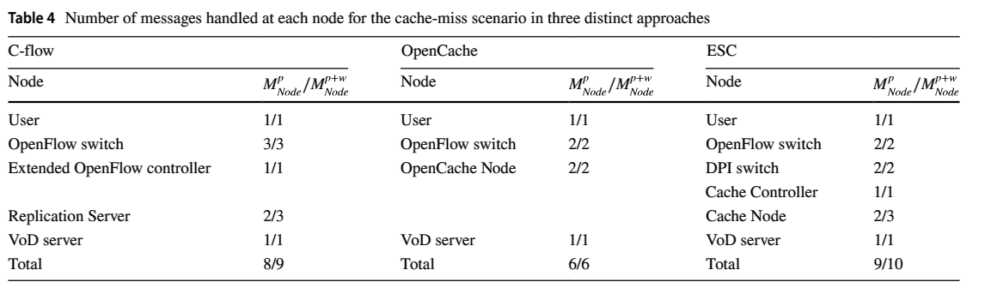
Performance Analysis

Slide 23
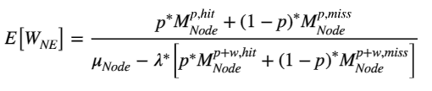
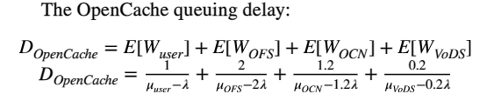
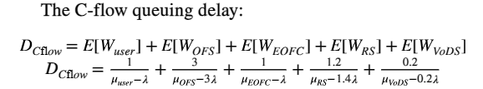
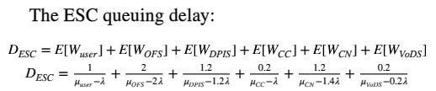
Performance Analysis

Slide 24
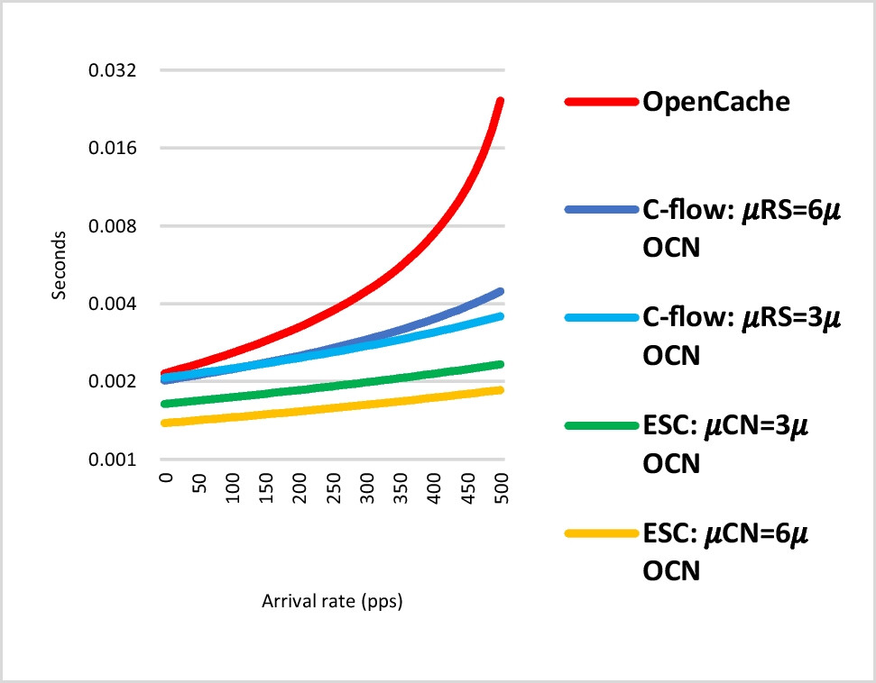
Performance Analysis
The average queuing delay of the three distinct approaches

Slide 25
Conclusions
a DPI switch to assist the incoming traffic inspection of the cache controller.
The cache controller in ESC makes the cache decision, which avoids caching the same content in different cache nodes.
Using OpenFlow-based packet replies, the system reduces the frequency of switch-to-controller routing queries.
In the comparison, the ESC queuing delay is better than OpenCache and C-flow.

