Slide 1
心得分享
Grow and prune Compact, fast, and accurate LSTMs.
(2020, March 1). IEEE Journals & Magazine | IEEE Xplore. https://ieeexplore.ieee.org/document/8907435
IEEE Transactions on Computers IF 3.8

Slide 2
Grow and prune Compact, fast, and accurate LSTMs.
摘要:
為解決執行時間長與容易overfitting的問題。
提出hidden-layer LSTM(H-LSTM)。
利用加入隱藏層與grow-and-prune(GP)解決問題。
並使用dataset驗證H-LSTM能有效加速與提高正確率。

Slide 3
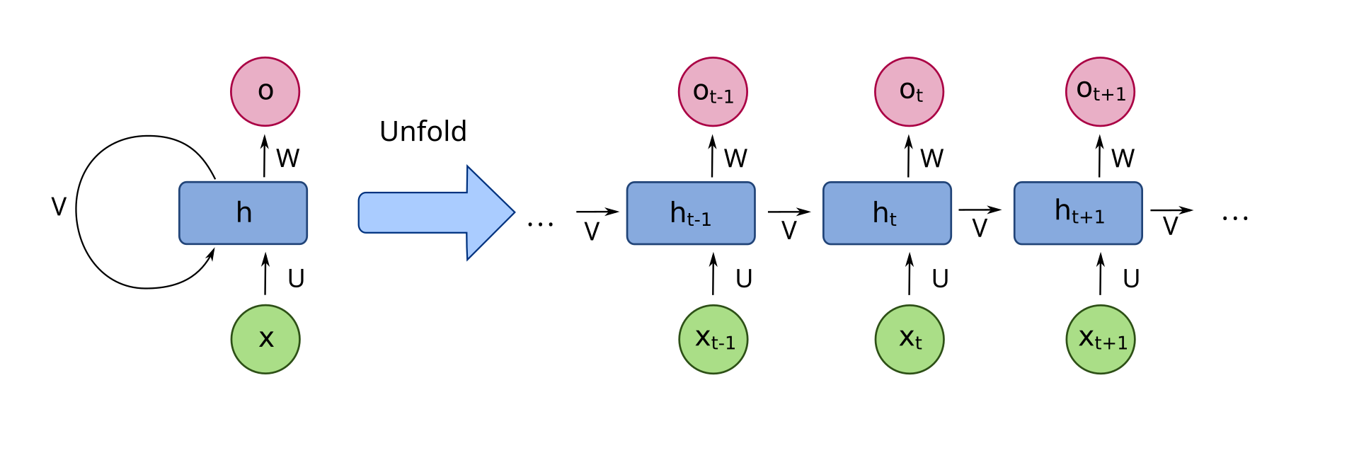
Grow and prune Compact, fast, and accurate LSTMs.
LSTM為解決RNN無法長期記憶的問題而被提出，雖問題能有效改善，但隨著需求提高，LSTM所需的計算成本與延遲也隨之成長，所以這篇論文中提出了hidden-layer LSTM(H-LSTM)。

Slide 4
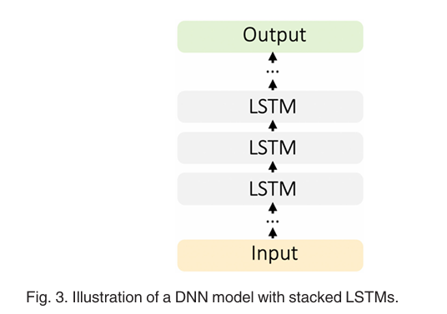
Grow and prune Compact, fast, and accurate LSTMs.
在傳統的LSTM架構下，如果想要更準確的結果，會嘗試疊加多層的LSTM cell
但會產生相應的問題
容易overfitting。
增加大量的計算成本與延遲。

Slide 5
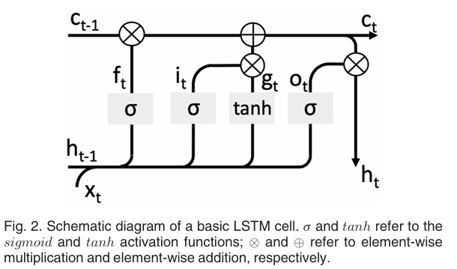
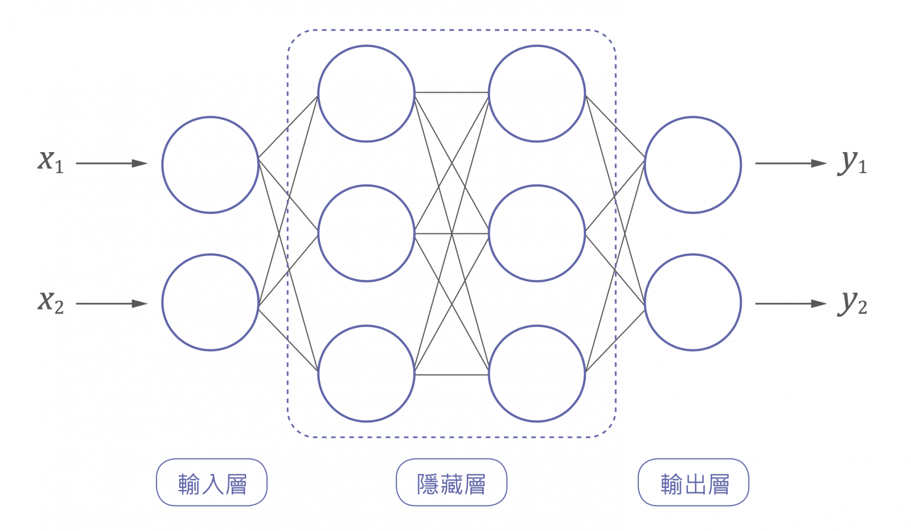
Grow and prune Compact, fast, and accurate LSTMs.
H-LSTM:
改變LSTM的架構。
加入由ReLU組成的隱藏層，將原本單層的結構改成DNN。

Slide 6
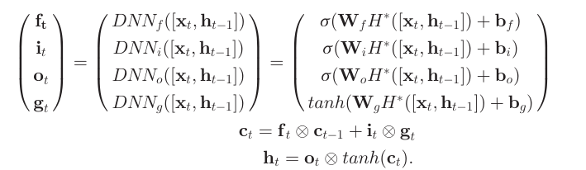
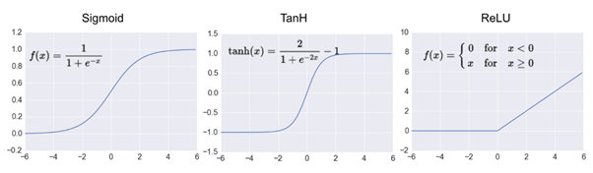
Grow and prune Compact, fast, and accurate LSTMs.
H-LSTM:
將單層的activation function前增加多層ReLU

Slide 7
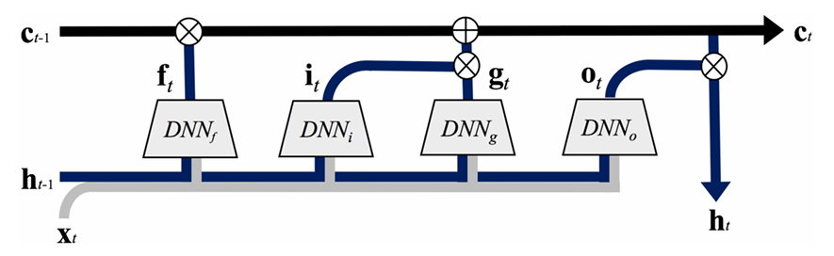
Grow and prune Compact, fast, and accurate LSTMs.
H-LSTM:
轉換後，因為解決外部堆疊，降低overfitting的可能性，但仍存在大量計算。

Slide 8
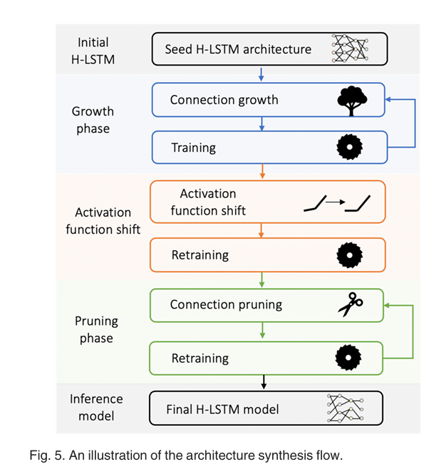
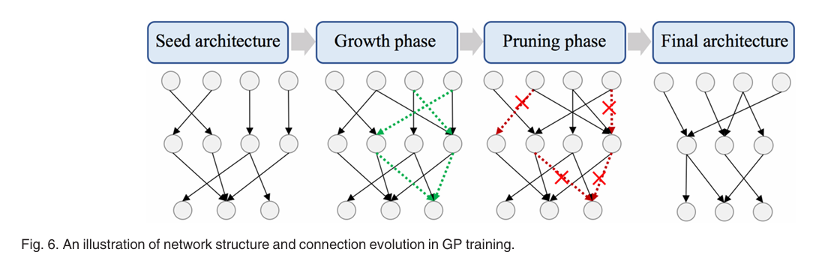
Grow and prune Compact, fast, and accurate LSTMs.
H-LSTM:
Grow-and-Prune Training(GP, 剪枝)
利用關閉不用的神經元達到減少計算量

Slide 9
Grow and prune Compact, fast, and accurate LSTMs.
H-LSTM:
Initial : 設定50%的種子模型

Slide 10
Grow and prune Compact, fast, and accurate LSTMs.
H-LSTM:
Growth : 從結果的Loss function回推「啟動這個神經元」對Loss值的影響。
如果在整體的前15%，則啟動神經元。

Slide 11
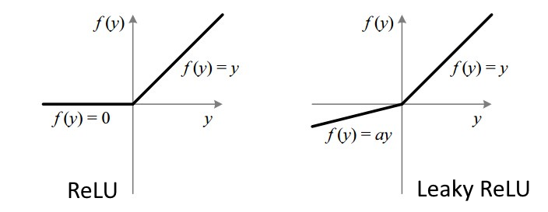
Grow and prune Compact, fast, and accurate LSTMs.
GP成長的過程避免發生神經元因為輸出為零，
導致無法更新的問題，所以使用LeakyReLU

Slide 12
Grow and prune Compact, fast, and accurate LSTMs.
H-LSTM:
Pruning : 重新計算所有啟動的神經元，如果對Loss值的影響在整體的20%後，關閉此神經元。

Slide 13
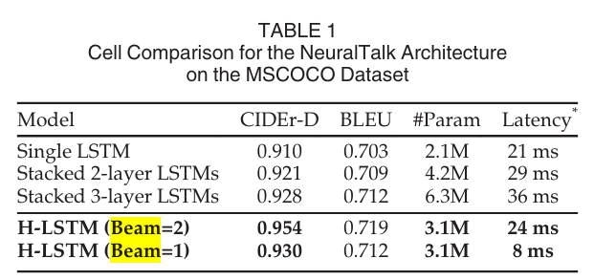
Grow and prune Compact, fast, and accurate LSTMs.
H-LSTM:
分別使用在NeuralTalk與DeepSpeech2上做評分
NeuralTalk:圖片轉文字
DeepSpeech2:語音辨識
Beam參數設定做選擇時要保留幾步的候選路徑

Slide 14
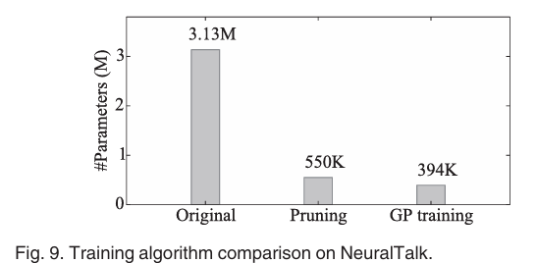
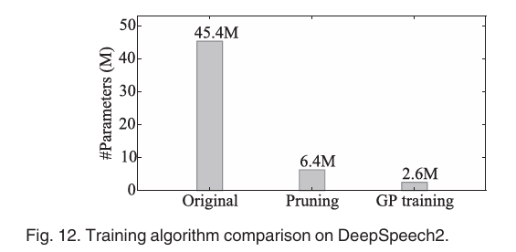
Grow and prune Compact, fast, and accurate LSTMs.
H-LSTM:
實際代入dataset運行，在相同評分下所需要的神經元數量。

Slide 15
Grow and prune Compact, fast, and accurate LSTMs.
Conclusion :
改變過去堆疊LSTM的方法。
成功實作GP，證明模型架構也可以透過學習生成。
對overfitting、計算成本、計算延遲與正確率都有所提升。

