Slide 1
心得分享
Niu, S., Liu, Y., Liao, K., Zhang, B., & Zou, G. (2025). Dynamic edge-caching through content popularity and crowd prediction for short video services. Scientific Reports, 15(1), 42147. https://doi.org/10.1038/s41598-025-26079-w
Scientific Reports IF 3.9

Slide 2
Dynamic edge-caching through content popularity and crowd prediction for short video services.
摘要:
為解決日漸興起的短影音需求。
將流量的週期與空間分佈的特性加入考量。
以達到增加hit rate與降低資源浪費。

Slide 3
Dynamic edge-caching through content popularity and crowd prediction for short video services.
研究動機與背景:
短影音具有高更新率、生命週期短的特性， 相較長影音，無法以連續播放內容的特性提高hit rate。
過去方法大多在快取決策時，忽略邊緣節點的位置與流量時間週期， 導致無人使用的節點頻繁更新快取內容。
=>本篇論文提出DECC (Dynamic Edge-caching through Content Popularity and Crowd Prediction)

Slide 4
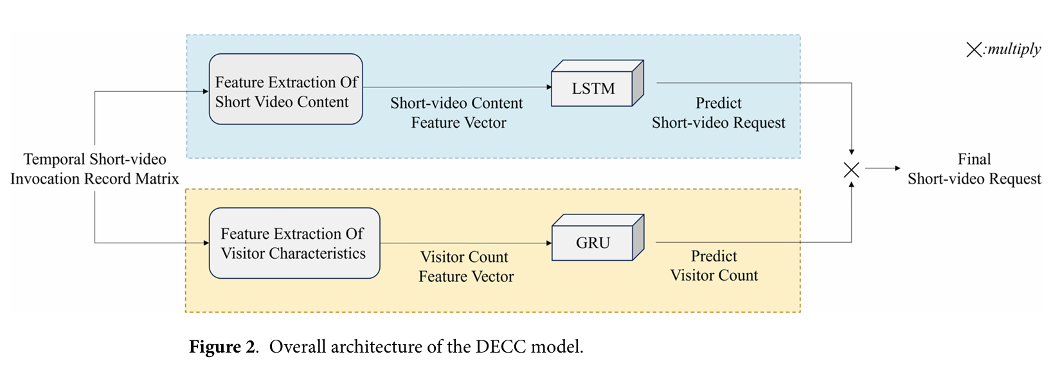
Dynamic edge-caching through content popularity and crowd prediction for short video services.
DECC (Dynamic Edge-caching through Content Popularity and Crowd Prediction)
核心概念:
根據影片內容做短影音的存取機率預測。
根據節點的流量預測使用的用戶數量。

Slide 5
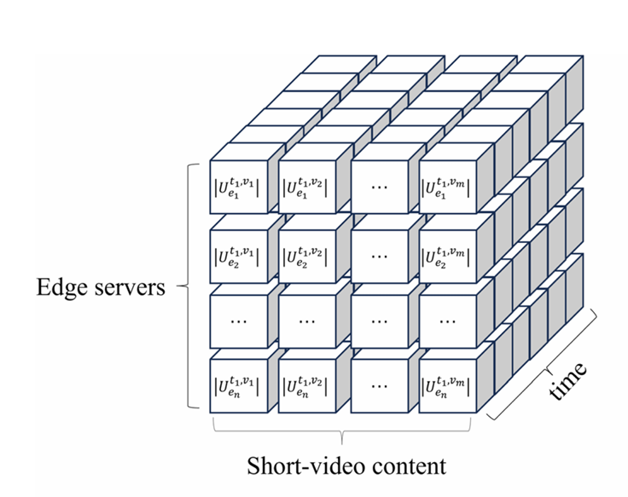
Dynamic edge-caching through content popularity and crowd prediction for short video services.
DECC (Dynamic Edge-caching through Content Popularity and Crowd Prediction)
先根據邊緣節點、短影音的內容和時間建立三維的資料，
後續會根據這三個資訊做內容預測與節點的流量預測。

Slide 6
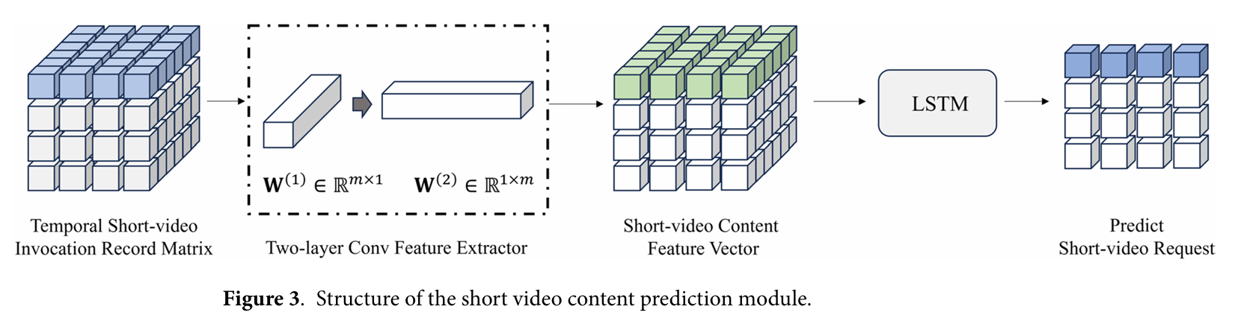
Dynamic edge-caching through content popularity and crowd prediction for short video services.
DECC (Dynamic Edge-caching through Content Popularity and Crowd Prediction)
內容熱度預測 (Content Path)
會對時間與影片被點擊數做兩次的conv捲積，會將特徵提取後，輸入LSTM預測未來被請求的影片。

Slide 7
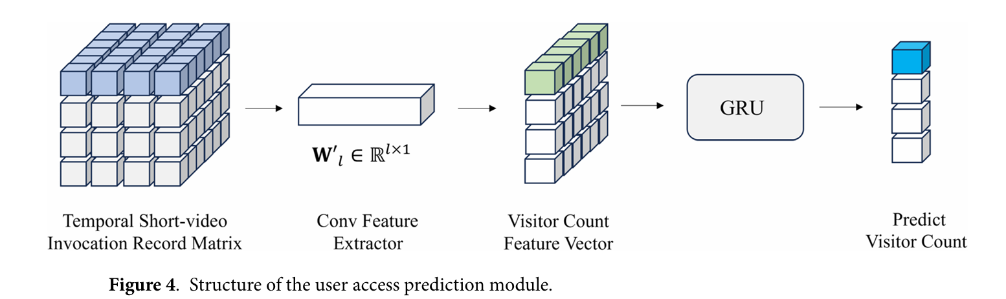
Dynamic edge-caching through content popularity and crowd prediction for short video services.
DECC (Dynamic Edge-caching through Content Popularity and Crowd Prediction)
用戶人群預測 (Crowd Path)
對節點的流量預測。
GRU則是為了應對邊緣運算，是將LSTM簡化後的深度學習演算法。

Slide 8
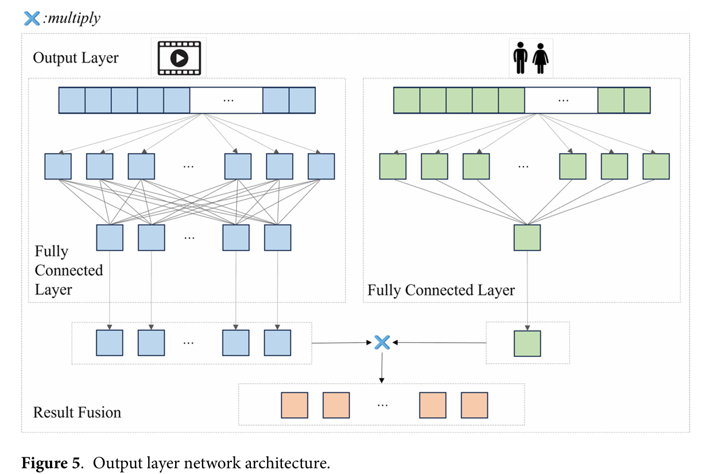
Dynamic edge-caching through content popularity and crowd prediction for short video services.
DECC (Dynamic Edge-caching through Content Popularity and Crowd Prediction)
將兩條路徑綜合考量， 最後決定要被快取的內容。

Slide 9
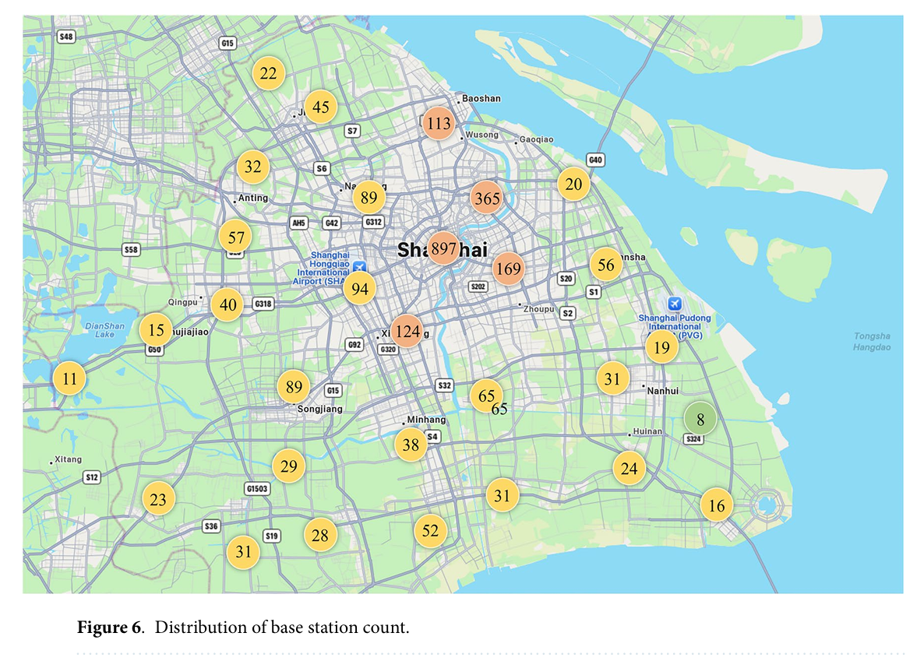
Dynamic edge-caching through content popularity and crowd prediction for short video services.
DECC (Dynamic Edge-caching through Content Popularity and Crowd Prediction)
實驗數據來源:
上海電信的真實數據。
抖音平台的請求紀錄。

Slide 10
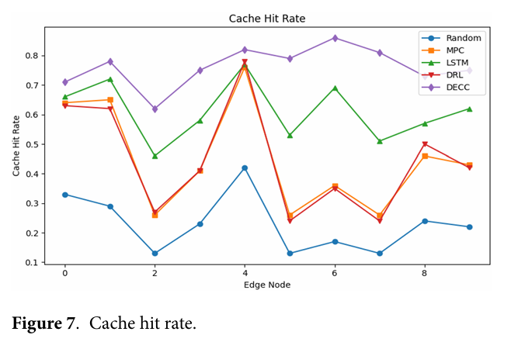
Dynamic edge-caching through content popularity and crowd prediction for short video services.
DECC (Dynamic Edge-caching through Content Popularity and Crowd Prediction)
實驗結果:
Notes:
MPC計算被請求次數最多的
• Random: Randomly selects content for caching without considering user demand or content popularity.
• MPC: Caches the most popular content based on computed content popularity statistics.
• LSTM: Predicts cached content using a Long Short-Term Memory (LSTM) network trained on historical request records from edge servers.
• DRL: Employs a Deep Reinforcement Learning-based agent to optimize caching decisions through tri al-and-error interactions with the environment, aiming to maximize cumulative reward related to cache effi ciency and latency reduction.
• DECC (Ours): The proposed method-a hybrid caching approach that jointly models content popularity and user access prediction through Conv1D-LSTM and GRU integration, achieving adaptive and cost-efficient caching optimization.

Slide 11
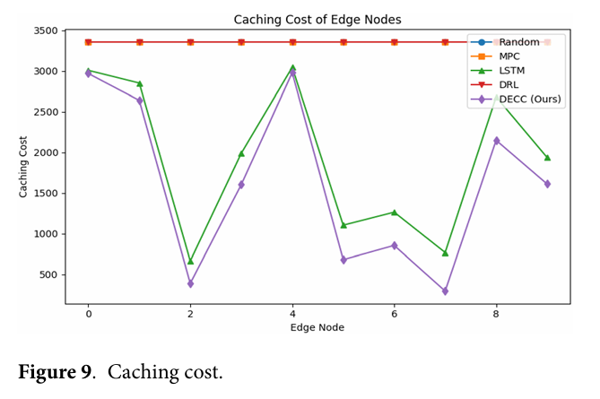
Dynamic edge-caching through content popularity and crowd prediction for short video services.
DECC (Dynamic Edge-caching through Content Popularity and Crowd Prediction)
實驗結果:

Slide 12
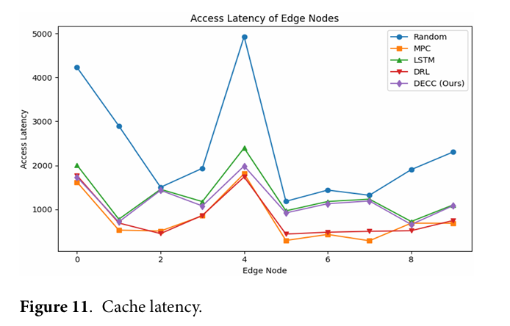
Dynamic edge-caching through content popularity and crowd prediction for short video services.
DECC (Dynamic Edge-caching through Content Popularity and Crowd Prediction)
實驗結果:

Slide 13
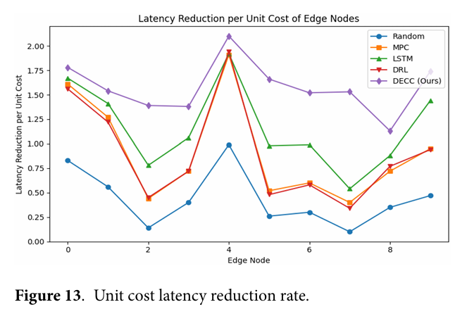
Dynamic edge-caching through content popularity and crowd prediction for short video services.
DECC (Dynamic Edge-caching through Content Popularity and Crowd Prediction)
實驗結果:

Slide 14
Dynamic edge-caching through content popularity and crowd prediction for short video services.
DECC (Dynamic Edge-caching through Content Popularity and Crowd Prediction)
結論:
效能比較皆有提升。
考量邊緣節點的計算能力，利用捲積提取特徵，減少後續的計算量。
數據集本身難以取得。

Slide 15
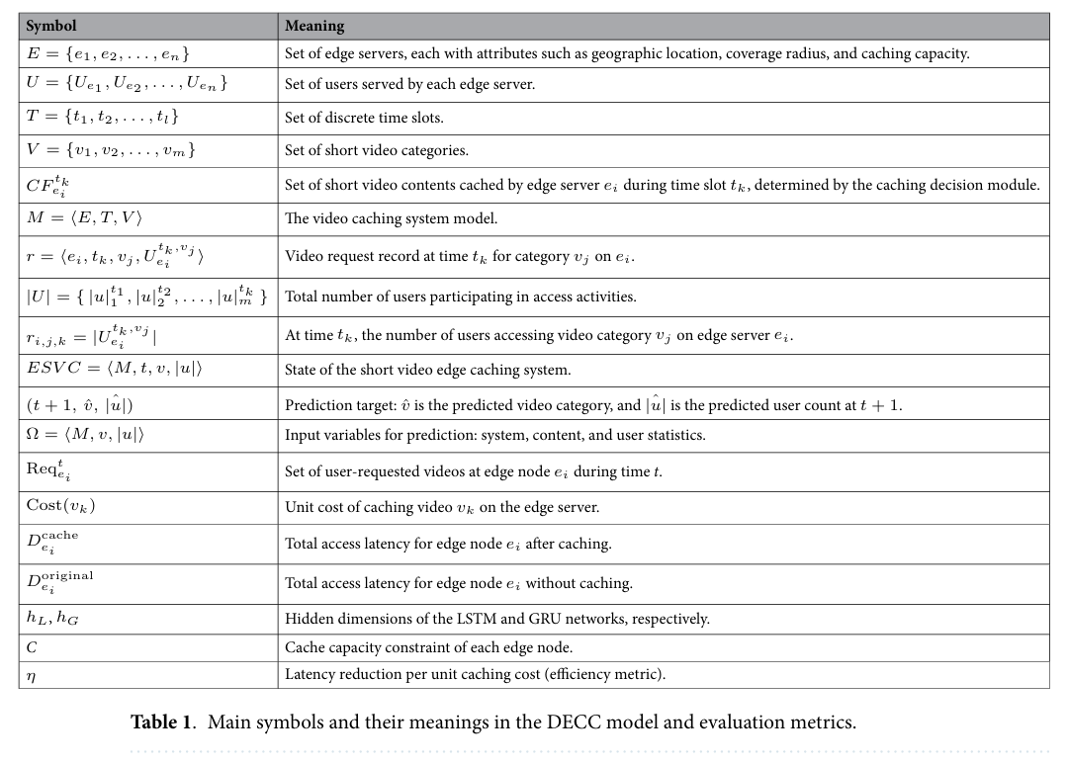
Dynamic edge-caching through content popularity and crowd prediction for short video services.

