Slide 1
Technology pillars in the architecture of future 5G mobile networks: NFV,MEC and SDN
B. Blanco, J.O. Fajardo, I. Giannoulakis, E. Kafetzakis, S. Peng, J. Pérez-Romero, I. Trajkovska, P.S. Khodashenas, L. Goratti, M. Paolino, E. Sfakianakis, F. Liberal, G. Xilouris
Computer Standards & Interfaces 54 (2017) 216–228
Impact Factor:2.441

Slide 2
OUTLINE
ABSTRACT
Introduction
Identification of SDOs and main stakeholders
Identification of use case categories, scenarios, vertical sectors and requirements
5G technology trends and design principles
Convergence of NFV, MEC and SDN in 5G systems
Conclusions
References

Slide 3
ABSTRACT
This paper surveys recent documentation from the main stakeholders to pick out the use cases, scenarios and emerging vertical sectors that will be enabled by 5G technologies, and to identify future high-level service requirements.
Then, based on the identified requirements, the paper overviews the main 5G technology trends and design principles to address them.
In particular, the paper emphasizes the role played by three main technologies, namely SDN, NFV and MEC.

Slide 4
Introduction
5G will create an ecosystem for technical and business innovation involving vertical markets such as automotive, energy or healthcare and will enable competitive advantages for industry.
5G must face up to new demands such as growing traffic volume and service complexity, higher quality of user experience, increasing number and heterogeneity of devices and better affordability by further cost reduction.

Slide 5
Introduction
5G will leverage Software Defined Networking (SDN), Network Function Virtualization (NFV) and Mobile Edge Computing (MEC) principles for scalable and flexible network management to deal with short-service life-cycles.
This paper analyzes current standardization situation of 5G and the role SDN/NFV/MEC play in order to address the challenges the new generation of mobile networks must face.

Slide 6
Identification of SDOs and main stakeholders
Standardization bodies
  ITU: The International Telecommunications Union is working on the definition of the framework and overall objectives of the future 5G systems, denoted as IMT-2020 systems in ITU terminology.
  3GPP:
    The 3rd Generation Partnership Project is planning to split the 5G work into three phases or releases.
    Technical Specification Group (TSG) Radio Access Network (RAN) is working on the scenarios and requirements for next generation access technologies (Release 14).
    TSG SA (Service and System Aspects), specifies the service
    requirements and the overall architecture of the 3GPP system.

Slide 7
Identification of SDOs and main stakeholders
Standardization bodies
  ETSI:
    European Telecommunication Standards Institute has defined several Industry Specification Groups (ISG) to develop standards in fields such as SDN, NFV and autonomic network management.
    NFV ISG is developing an open and interoperable NFV ecosystem to leverage rapid service innovation for network operators and service suppliers.

Slide 8
Identification of SDOs and main stakeholders
Standardization bodies
  ETSI:
    MEC (Multi-access Edge Computing, former Mobile Edge Computing) ISG provides a new value chain offering application developers and content providers cloud-computing capabilities and an IT service environment at the edge of the mobile network, within the Radio Access Network (RAN) and in close proximity to mobile subscribers.
    NGP (Next Generation Protocols) ISG is working on the identification of the requirements for next generation protocols and network architectures, from all interested user and industry groups.

Slide 9
Identification of SDOs and main stakeholders
Standardization bodies
  IEEE: The Institute of Electrical and Electronics Engineers has just started the standardization work on future 5G systems. Among others, it has launched pre-standardization Research Group on Cloud-based Mobile Core to analyze SDN/NFV concepts applied to 5G.
  ONF: Open Networking Foundation is a user-driven organization dedicated to the promotion and adoption of SDN through open standards development.

Slide 10
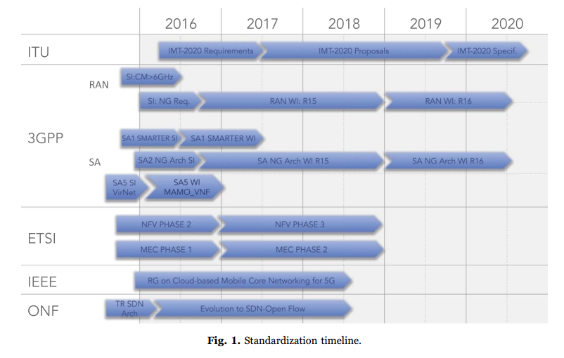
Identification of SDOs and main stakeholders

Slide 11
Identification of SDOs and main stakeholders
Regional initiatives
  FP-7 (Europe): The RAS (Radio Access and Spectrum) is a cluster activity that comprises the research effort on radio access and spectrum in the area of future networks of the Seventh Framework Programme of the EU.
  5G-PPP (Europe): 5G Public Private Partnership Program has been initiated by the EU Commission and industry manufacturers, telecommunications operators, service providers, SMEs and researchers.

Slide 12
Identification of SDOs and main stakeholders
Regional initiatives
  5G Forum (Korea): 5G Forum is leading the development of key candidate next-generation communications technologies in Korea.
  5G Promotion Group (China): IMT2020 (5G) Promotion Group is working in the analysis of the main technical scenarios, challenges, and key enabling technologies for 5G.
  5GMF (Japan): The Fifth Generation Mobile Communications Promotion Group was created to conduct research and development concerning the 5G Mobile Communications Systems and research and study pertaining to standardization thereof.

Slide 13
Identification of SDOs and main stakeholders
Regional initiatives
  5G America's: 5G Americas is an industry trade organization composed of leading telecommunications service providers and manufacturers.
Industry alliances
  NGMN: Next Generation Mobile Networks alliance has developed the requirements for 5G mobile broadband technologies.
  SCF: Small Cell Forum is aimed to drive the wide-scale adoption of small cells and to influence and deliver technical inputs that inform and enhance the standards process.

Slide 14
Identification of use case categories, scenarios, vertical sectors and requirements
This section identifies a collection of use cases expected for 5G that will probably be the driver for the technology.
Then, these use cases are classified into four main scenarios and also are assorted according to envisioned vertical sectors.
This identification of prospective use cases, scenarios and vertical sectors is useful to clarify and organize system requirements of the services that will be deployed and scaled on demand in an agile and cost efficient manner.

Slide 15
Identification of use case categories, scenarios, vertical sectors and requirements
Use cases
  5G will allow to cover use cases ranging from applications with very low bandwidth requirements to use cases with a very high demand on data rate and latency.
  5G technologies are also envisioned to promote emerging use cases like machine-to-machine communications, augmented/virtual/assisted reality or eHealth, which are focusing significative attention, as well as promising fields such as industrial control.

Slide 16
Identification of use case categories, scenarios, vertical sectors and requirements
Use cases
  Unlike previous mobile networking systems that offered ’one size fits all’ solutions, 5G is expected to be able to simultaneously provide optimized support for different configurations through various means.
  The mobile network must be able to dynamically control and allocate network resources to provide flexibly adjustable capacity based on the variation in demand.

Slide 17
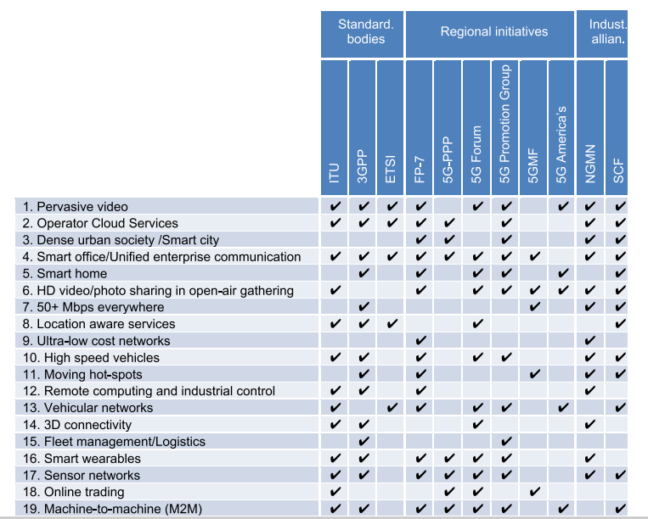
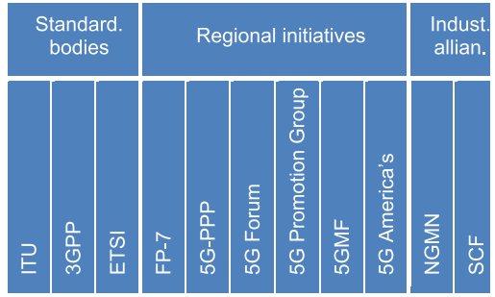
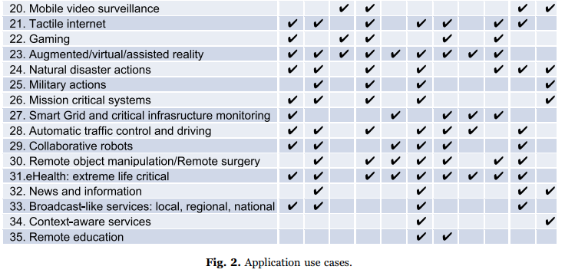
Identification of use case categories, scenarios, vertical sectors and requirements

Slide 18
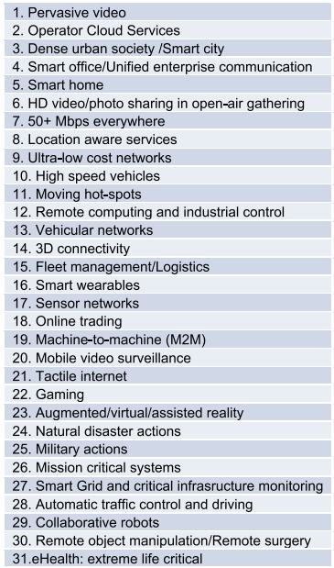
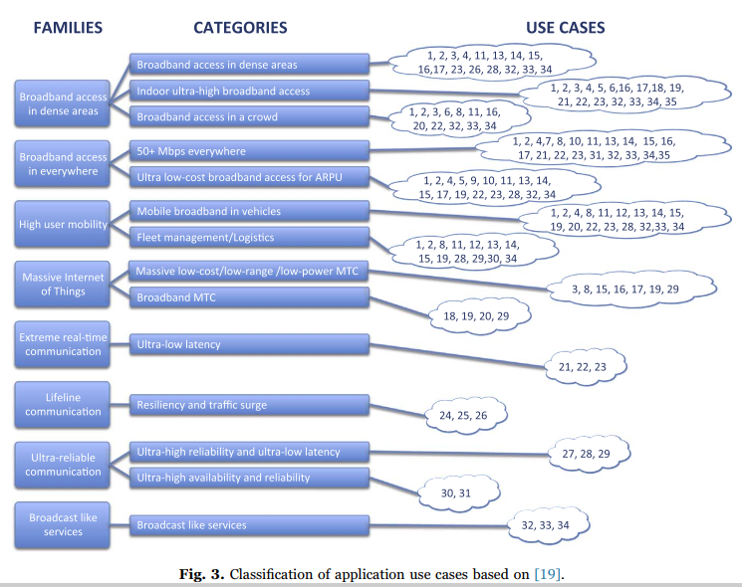

Identification of use case categories, scenarios, vertical sectors and requirements
[19] NGMN, 5G White Paper, 2015.

Slide 19
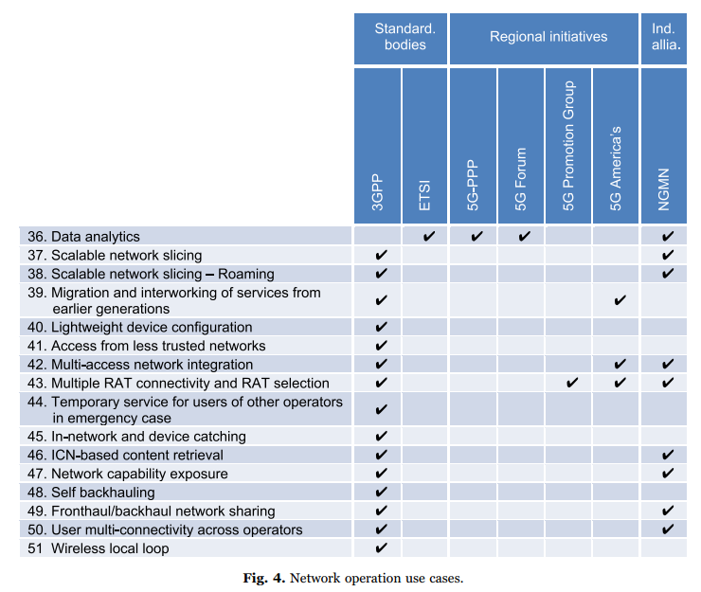
Identification of use case categories, scenarios, vertical sectors and requirements

Slide 20
Identification of use case categories, scenarios, vertical sectors and requirements
Scenarios and vertical sectors
  The capabilities needed to serve all those use cases are tightly coupled with the characteristics of the environment and thus, the identification of the scenarios becomes relevant in order to demarcate the constraints.
  Four main usage scenarios:
    Residential
    Enterprise
    Urban
    Rural and remote

Slide 21
Identification of use case categories, scenarios, vertical sectors and requirements
Scenarios and vertical sectors
  5G network infrastructure is envisaged as a key enabler to make society and economy more efficient and to increase global competitiveness, providing new value chains and business models.
  The most relevant vertical sectors at the moment are:
    Manufacturing
    Automotive
    eHealth
    Energy
    Media & Entertainment

Slide 22
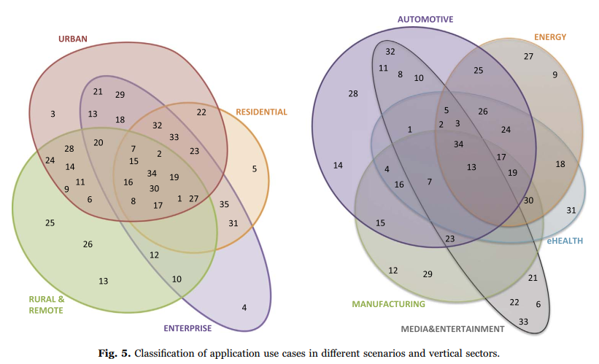
Identification of use case categories, scenarios, vertical sectors and requirements

Slide 23
Identification of use case categories, scenarios, vertical sectors and requirements
Requirements
  Different usage scenarios along with the current and future trends will result in a great diversity/variety of requirements.
  One of the main challenges of 5G is to support such variety of use cases in a flexible, reliable and cost-effective way.

Slide 24
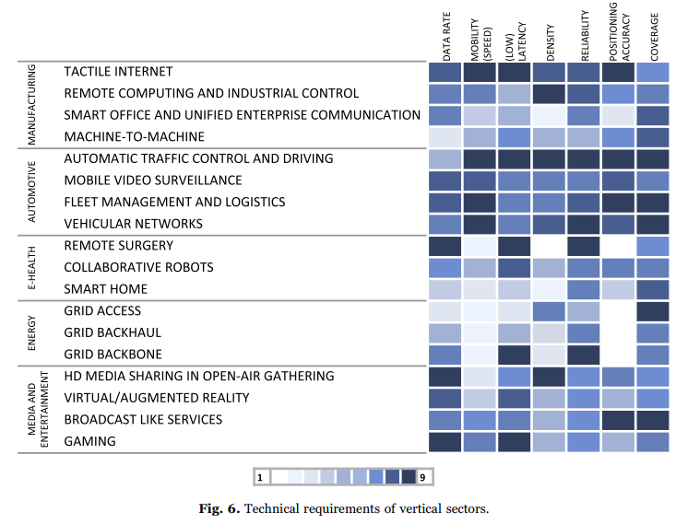
Identification of use case categories, scenarios, vertical sectors and requirements

Slide 25
5G technology trends and design principles
Technology trends
  ITU identifies the following technology trends in its overall vision of future 5G systems:
    Technologies to enhance the radio interface
    Network technologies such as NFV, SDN and C-RAN
    Technologies to provide mobile broadband communications
    Technologies to leverage massive machine-type communications
    Technologies to establish ultra-reliable and low latency communications
    Technologies to improve network energy efficiency
    Advanced mobile terminal technologies
    Technologies to enhance privacy and security
    Technologies enabling higher data rates

Slide 26
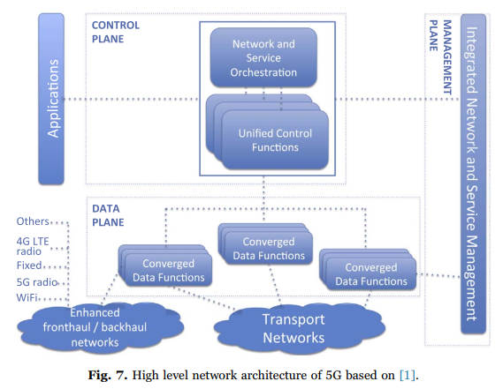
5G technology trends and design principles
High level architecture
[1] ITU-R, Recommendation ITU-R M.2083-0. IMT Vision: Framework and Overall Objectives of the Future Development of IMT for 2020 and Beyond, 2015.

Slide 27
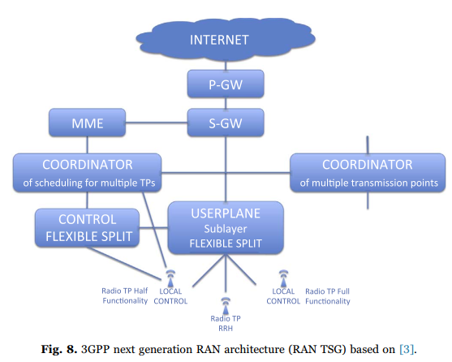
5G technology trends and design principles
[3] 3GPP, TR 38.913: Study on Scenarios and Requirements for next Generation Access Technologies, 2016.

Slide 28
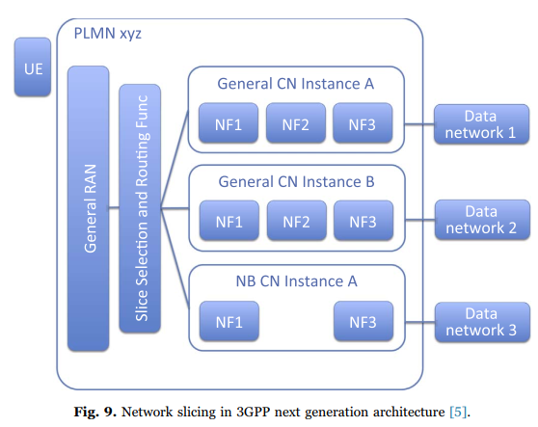
5G technology trends and design principles
[5] 3GPP, TR 23.799: Study on Architecture for next Generation System, 2016.

Slide 29
5G technology trends and design principles
Network virtualization
  The NFV concept envisages the implementation of Network Functions (NFs) as software-only entities that run over the NFV Infrastructure (NFVI).
  Three main working domains can be identified:
    Virtual Network Function (VNF)
    NFV Infrastructure (NFVI)
    NFV Management and Orchestration (NFV MANO)

Slide 30
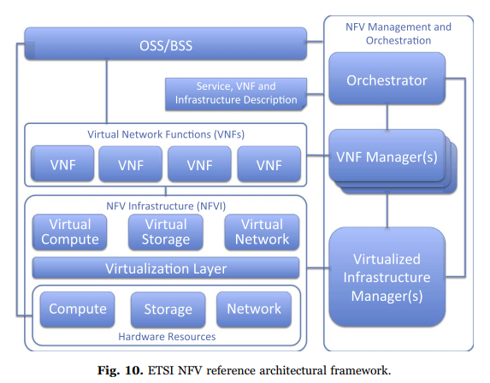
5G technology trends and design principles

Slide 31
5G technology trends and design principles
Integration of NFV into mobile networks management systems
  The work in [6] presents the management concept, architecture and requirements for mobile networks with virtualized network functions.
  The management architecture was designed for mobile networks composed of both physical and virtualized network elements.
[6] 3GPP, TR 28.500: Management Concept, Architecture and Requirements for Mobile Networks That Include Virtualized Network Functions, 2016.

Slide 32
5G technology trends and design principles
Integration of NFV into mobile networks management systems
  The Small Cell Forum (SCF) carried out several studies analyzing the introduction of virtualization technologies in small cell networks.
  Considering different layers of the user/control plane protocol stacks, the study follows a top-down approach, in which gradually more layers are virtualized by moving them from the remote to the central small cell.

Slide 33
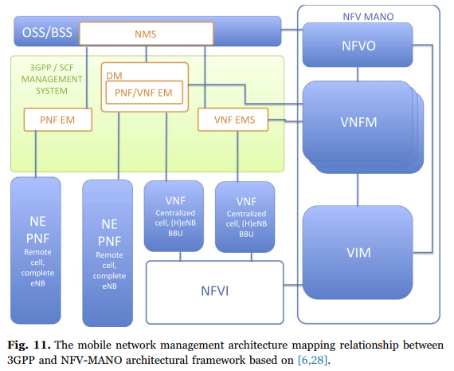
5G technology trends and design principles
[6] 3GPP, TR 28.500: Management Concept, Architecture and Requirements for Mobile Networks That Include Virtualized Network Functions, 2016.
[28] Small Cell Forum, SCF 106: Virtualization for Small Cells: Overview, 2015.

Slide 34
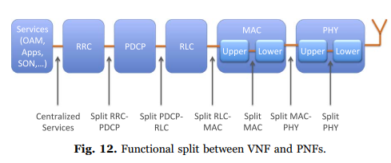
5G technology trends and design principles

Slide 35
5G technology trends and design principles
Mobile Edge Computing (MEC)
  It follows the current trends towards cloud-based architectures operating in an IT environment but with the peculiarity of being located at the edge of the mobile network, within the RAN and in close proximity of the mobile subscribers.
  The mobile subscriber's experience can be significantly improved through more efficient network and service operations, enhanced service quality, minimized data transit costs and reduced network congestion.

Slide 36
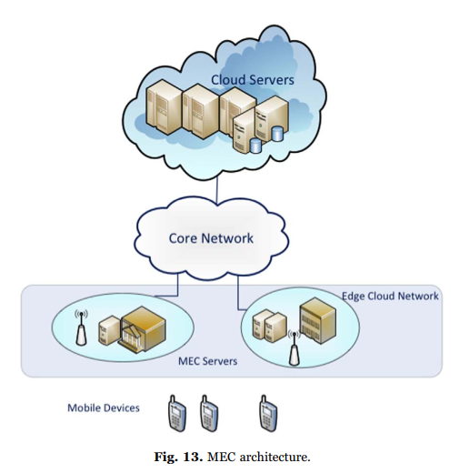
5G technology trends and design principles

Slide 37
5G technology trends and design principles
Software Defined Networks (SDN)
  SDN proposes to separate the control and data planes, enabling centralized control of all the data flows and data paths in the network domain.
  As a result, the data plane of network nodes is less complex, which implements fast forwarding mechanisms leading to enhanced data plane performance.

Slide 38
5G technology trends and design principles
Software Defined Networks (SDN)
  There is a dual perspective of the entity SDN controller, represented through the role of SDN-server - as an element that offers services to clients, and the SDN-client - an element that can request service invocation from other services, including the SDN-server.

Slide 39
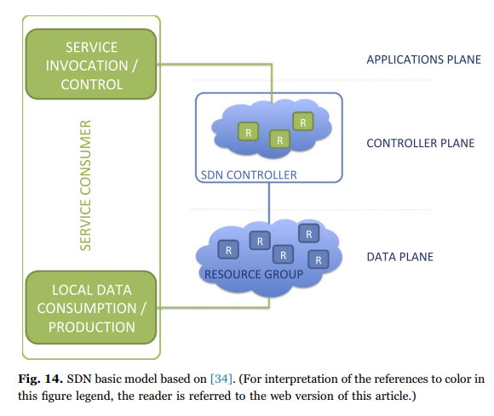
5G technology trends and design principles
[34] ONF, TR-521: SDN Architecture 1.1, 2014.

Slide 40
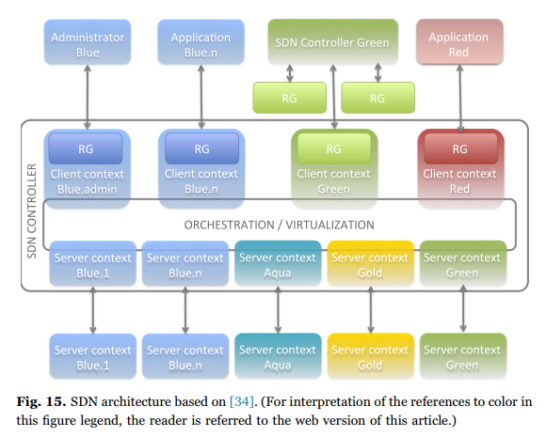
5G technology trends and design principles
[34] ONF, TR-521: SDN Architecture 1.1, 2014.

Slide 41
Convergence of NFV, MEC and SDN in 5G systems
SDN has been considered as a technology to improve the flexibility and simplicity on delivering the network service (NS).
The ultimate goal is to build up a system in which NFV technology focuses on the creation, configuration and management of VNFs used in the NS instances.
Furthermore, SDN helps VNFs interconnection and NS organization.
The main integration approach is to include the SDN controller in the Virtualized Infrastructure Manager (VIM) and let the NVF Orchestrator (NFVO) to orchestrate/manage the SDN operation.

Slide 42
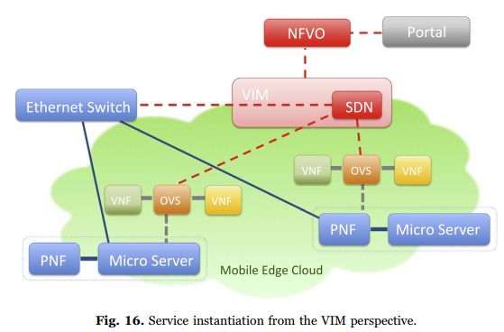
Convergence of NFV, MEC and SDN in 5G systems

Slide 43
Conclusions
This paper showed several use cases, scenarios and emerging vertical sectors foreseen to have a role in the 5G ecosystem.
Driven by service requirements and innovative technological trends applied to the mobile network, the 5G communication system will be capable of accommodating multiple radio access technologies, meet end-to-end user requirements and provide compelling solutions for flexible network deployment and timely network operations.

Slide 44
心得分享
5G網路會針對不同的使用情境進行最佳化，所以需要能夠動態控制和配置網路資源，以提供更具彈性的能力，此時就需要有SDN、NFV和MEC的技術支援。
SDN可以透過軟體來集中管理控制網路，並讓router可以專注於傳遞封包，加速forward的效率。
NFV將網路功能虛擬化，不需要再用專有硬體來進行網路功能，
並且更容易配置需要的資源，提供更有彈性的服務。
MEC將資料傳到就近的邊緣端Server進行分析、運算，不需要再透過核心網路到雲端Server，可以大幅降低傳輸時間。

Slide 45
References
[1] ITU-R, Recommendation ITU-R M.2083-0. IMT Vision: Framework and Overall Objectives of the Future Development of IMT for 2020 and Beyond, 2015.
[2] ITU-T, FG IMT 2020: Report on Standards Gap Analysis, 2015.
[3] 3GPP, TR 38.913: Study on Scenarios and Requirements for next Generation Access Technologies, 2016.
[4] 3GPP, TR22.891: Feasibility Study on New Services and Market Enablers, 2016.
[5] 3GPP, TR 23.799: Study on Architecture for next Generation System, 2016.
[6] 3GPP, TR 28.500: Management Concept, Architecture and Requirements for Mobile Networks That Include Virtualized Network Functions, 2016.
[7] 3GPP, TR 32.842: Study on Network Management of Virtualized Networks, 2015.
[8] Openmano open source project, 〈http://github.com/nfvlabs/openmano〉, 2016 (accessed 10.10.16).
[9] ETSI, ETSI GS MEC 002: Technical Requirements, 2016.
[10] OpenFlow Standard Communications Interface. 〈http://www.opennetworking.org/ sdn-resources/openflow〉, 2016 (accessed 10.10.16).
[11] ONF, Software-Defined Networking: The New Norm for Networks. 〈http://www. opennetworking.org/images/stories/downloads/sdn-resources/white-papers/wpsdn-newnorm.pdf〉, 2012 (accessed 10.10.16).
[12] RAS Cluster, White Paper on 5G Radio Network Architecture, 2014.
[13] 5G-PPP, 5G Vision: the Next Generation of Communication Networks and Services, 2015.
[14] 5G-Forum, 5G Vision, Requirements, and Enabling Technologies, 2015.
[15] IMT-2020 Promotion Group, White paper on 5G Concepts, 2015.

Slide 46
[16] 5G Promotion Group, White Paper on 5G Network Technology Architecture, 2015.
[17] 5GMF, White Paper on Network Technology Concept for 5G, 2015.
[18] 5G Americas, 5G Technology Evolution Recommendations, 2015.
[19] NGMN, 5G White Paper, 2015.
[20] Small Cell Forum, SCF 046: Small Cell Services White Paper, 2014.
[21] SESAME Project, Deliverable D.2.1: System Use Cases and Requirements. 〈http:// www.sesame-h2020-5g-ppp.eu/Deliverables.aspx〉, 2016 (accessed 10.10.16).
[22] Small Cell Forum, SCF 101: Home Overview, 2014.
[23] Small Cell Forum, SCF 102: Enterprise Overview, 2014.
[24] Small Cell Forum, SCF 104: Urban Small Cells Overview, 2014.
[25] Small Cell Forum, SCF 105: Rural and Remote Overview, 2015.
[26] P. Chemouil, G. Pavlou, R. Boutaba, A. Galis, Foreword, in: Proceedings of IEEE Conference on Network Softwarization (NetSoft), London, U.K., 2015.
[27] NGMN, Description of Network Slicing Concept, 2015.
[28] Small Cell Forum, SCF 106: Virtualization for Small Cells: Overview, 2015.
[29] Small Cell Forum, SCF 160: Small Cells Services in Rural and Remote Environments, 2015.
[30] Small Cell Forum, SCF 159: Small Cell Virtualization: Functional Splits and Use Cases, 2015.

Slide 47
[31] Small Cell Forum, SCF 161: Small Cells Services in Rural and Remote Environments, 2015.
[32] ETSI, ETSI GS NFV-MAN 001: Network Function Virtualisation (NFV): Management and Orchestration, 2014.
[33] ONF, TR-502: SDN Architecture 1.0, 2014.
[34] ONF, TR-521: SDN Architecture 1.1, 2014.
[35] J. Matias, J. Garay, N. Toledo, J. Unzilla, E. Jacob, Toward an sdn-enabled nfv architecture, IEEE Commun. Mag. 33 (4) (2015) 187–193.
[36] T. Wood, K.K. Ramakrishnan, J. Hwang, G. Liu, W. Zhang, Toward a softwarebased network: integrating software defined networking and network function virtualization, IEEE Netw. 29 (3) (2015) 36–41.
[37] A. Hakiri, P. Berthou, Leveraging sdn for the 5g networks: Trends, prospects and challenges, J. Mob. Wirel. Commun.
[38] S. Sun, M. Kadoch, L. Gong, B. Rong, Integrating network function virtualization with sdr and sdn for 4g 5g networks, IEEE Netw. 29 (3) (2015) 54–59.
[39] C. Prodhon, C. Prons, A survey of recent research on location-routing problems, Eur. J. Oper. Res. 238 (1) (2014) 1–17.
[40] A. Fischer, J.F. Botero, M.T. Beck, H. de Meer, X. Hesselbach, Virtual network embedding: a survey, IEEE Commun. Surveys Tutor. 15 (4) (2013) 1888–1906.
[41] R. Trivisonno, R. Guerzoni, I. Vaishnavi, D. Soldani, Sdn-based 5g mobile networks: architecture, functions, procedures and backward compatibility, Trans. Emerg. Telecommun. Technol. 26 (1) (2015) 82–92.

