Slide 1
A Microservices-based Approach for VNF-as-a-Service
The case of IMS-as-a-Service Architecture
Amina Boubendir,
Emmanuel Bertin,
Noemie Simoni

Slide 2
OUTLINE
ABSTRACT
INTRODUCTION
RELATED WORK
A MICRO-SERVICE APPROACH FOR VNF-AS-A-SERVICE
IMS-AS-A-SERVICE USE CASE A MICROSERVICE-BASED
IMS ARCHITECTURE
IMPLEMENTATION AND EVALUATION RESULTS
CONCLUSIONS

Slide 3
ABSTRACT
We present in this paper an approach for designing VNF-as-a-Service.
With this approach, we define design requirements for the service architecture and the service logic of VNFs.
We consider IMS as a case of study to illustrate the proposed approach.
We have developed and implemented IMS-as-a-Service with respect to the proposed requirements.
We consider a service scenario where we focus on authentication and authorization procedures.

Slide 4
INTRODUCTION
Within an ever-changing telecommunication ecosystem and with the evolution towards 5G systems, flexibility in delivering services is a must for Telcos.
Network services are expected to be designed in a user-centric approach.
Indeed, simply virtualizing existing network functions may make them cheaper to implement but will not reduce network complexity or eliminate the monolithic nature of network services and architectures.
We propose a microservices-based approach for the design of VNFs based on Atomicity, Statelessness and LooseCoupling requirements.

Slide 5
RELATED WORK
1) A Cloud Infrastructure for IMS:
  The work presented in [13] proposes a cloud infrastructure for the IMS core network functions that run IMS entities on cloud-based VMs.
  However, this means keeping the stateful and highly coupled architecture of IMS functional entities.
  This does not allow horizontal scalability.
[13] F. Lu, H. Pan, X. Lei, X. Liao, and H. Jin, “A virtualization-based cloud infrastructure for ims core network,” in Cloud Computing Technology and Science, 2013 IEEE 5th International Conference on, vol. 1, pp. 25– 32, IEEE, 2013.

Slide 6
RELATED WORK
2) Virtualized IMS:
  Virtualized-IMS architecture [14], like in [13], has implemented each legacy IMS entity as software on a single VM keeping the same interfaces between entities.
  However, the reproduction of the same functional service logic of IMS stateful architecture limits the scalability.
[14] G. Carella, M. Corici, P. Crosta, P. Comi, T. M. Bohnert, A. A. Corici, D. Vingarzan, and T. Magedanz, “Cloudified ip multimedia subsystem for network function virtualization (nfv)-based architectures,” in Computers and Communication, 2014 IEEE Symposium on, vol. Workshops, pp. 1–6, June 2014.

Slide 7
RELATED WORK
3) Split IMS:
  The Split-IMS proposes a general architecture where IMS entities are split into multiple NFWorkers to be deployed on top of multiple VMs or containers.
  It also moves the state that these NFWorkers maintain to an external functional entity called Shared-Memory to make them stateless.
  However, even though it considers state separation and functional split, it does not propose a fine-grained decomposed architecture describing roles for NFWorkers.

Slide 8
RELATED WORK
4) Merge IMS:
  The Merge-IMS deploys the four main IMS entities (P-CSCF, S- CSCF, I-CSCF, and HSS) into one IMS-VM.
  Scaling is possible by instantiating a new IMS-VM with all entities.
  Thus, scaling is difficult due to the monolithic and stateful nature of IMS-VM.

Slide 9
A MICRO-SERVICE APPROACH
FOR VNF-AS-A-SERVICE
The microservice architectural model is an approach to develop a single application as a set of elementary services.
This copes with our objective of decomposing Telco network functions into sub-entities with finer granularity levels to eliminate their monolithic nature.
We propose the following microservice-based approach for an efficient decomposition.

Slide 10
A MICRO-SERVICE APPROACH
FOR VNF-AS-A-SERVICE
1) Separation of State:
  The first step in reconsidering the granularity levels of a network service or architecture is to consider separating the service logic of functional entities and the handled data or state.
  A service is stateless if it processes each request as an independent transaction without any relationship with previous ones.
  Information handling and state management should be delegated to an external data base.
  With stateless entities the logic of a service can scale easily by instantiating new stateless entities.

Slide 11
A MICRO-SERVICE APPROACH
FOR VNF-AS-A-SERVICE
2) Functional Decomposition:
  The next step is to consider the granularity level of functional entities by decomposing the logic into elementary atomic services.
  It is important to list all the functions that an entity is responsible of and extract them to create new ones.
  The new functional entities should perform one and only one service.

Slide 12
A MICRO-SERVICE APPROACH
FOR VNF-AS-A-SERVICE
3) Functional Independence:
  The last step consists in defining the new service processes while verifying that services are functionally independent or loosely coupled.
  For services composed of a set of elementary services, there should be reduced functional dependencies among interacting service components.
  These requirements are a must for building agile and scalable distributes services.

Slide 13
IMS-AS-A-SERVICE USE CASE
A MICROSERVICE-BASED IMS ARCHITECTURE
We present our proposition of IMS-as-a-Service architecture using the proposed VNF-as-a-Service design approach.
We formalize the functional blocks using Service Functional Component (SFC) UML category where each SFC is a micro-service.
The data that these functional blocks handle is formalized as Service Functional Data (SFD).

Slide 14
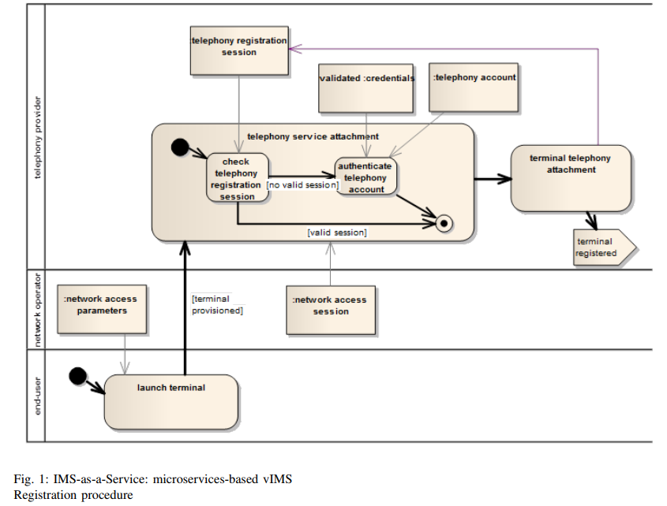

Slide 15
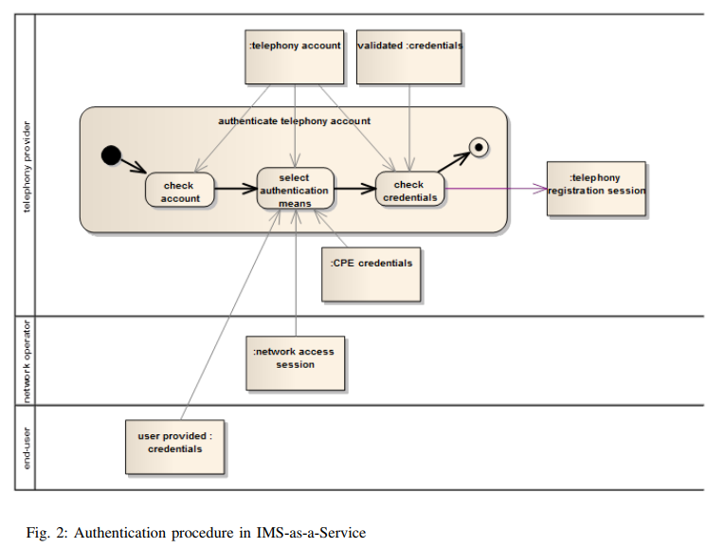

Slide 16
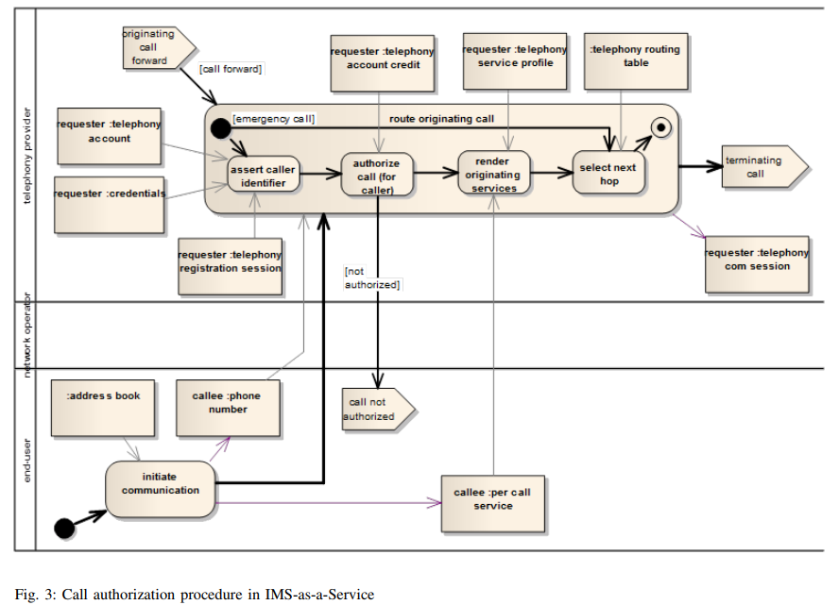

Slide 17
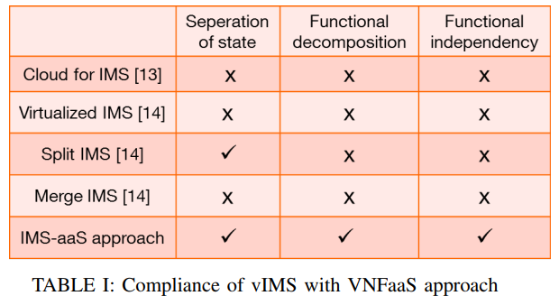
IMS-AS-A-SERVICE USE CASE
A MICROSERVICE-BASED IMS ARCHITECTURE
We summarize in Table I below, the compliance of existing vIMS architectures with our VNFaaS approach.
[13] F. Lu, H. Pan, X. Lei, X. Liao, and H. Jin, “A virtualization-based cloud infrastructure for ims core network,” in Cloud Computing Technology and Science, 2013 IEEE 5th International Conference on, vol. 1, pp. 25– 32, IEEE, 2013.
[14] G. Carella, M. Corici, P. Crosta, P. Comi, T. M. Bohnert, A. A. Corici, D. Vingarzan, and T. Magedanz, “Cloudified ip multimedia subsystem for network function virtualization (nfv)-based architectures,” in Computers and Communication, 2014 IEEE Symposium on, vol. Workshops, pp. 1–6, June 2014.

Slide 18
IMPLEMENTATION AND
EVALUATION RESULTS
We have developed the proposed microservices by analyzing open source OpenIMS solution.
We have then developed the new microservices functional entities using VerCors , a design platform for the modeling, specification, verification and validation of the software architecture of services.
the services are then instantiated and executed using GCM/Proactive which ensures the life-cycle management of microservices (SFCs).

Slide 19
IMPLEMENTATION AND
EVALUATION RESULTS
In order to evaluate the proposed IMS-aaS microservices, we have performed the scenario of Figure 3 which involves the process of Figure 2.
As the developed services are stateless, we have developed an external entity called Frontal to handle state.
The call generator acts as end users. It sends SIP requests towards the Frontal external (stateful) entity.
Frontal converts the SIP into Java RMI(Remote Method Invocation) and relays them to the first SFC of the process.

Slide 20
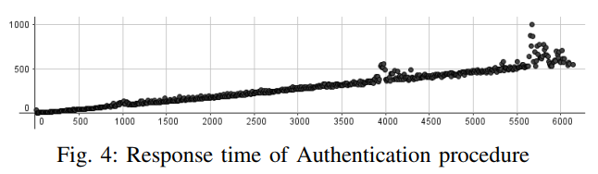
IMPLEMENTATION AND
EVALUATION RESULTS

Slide 21
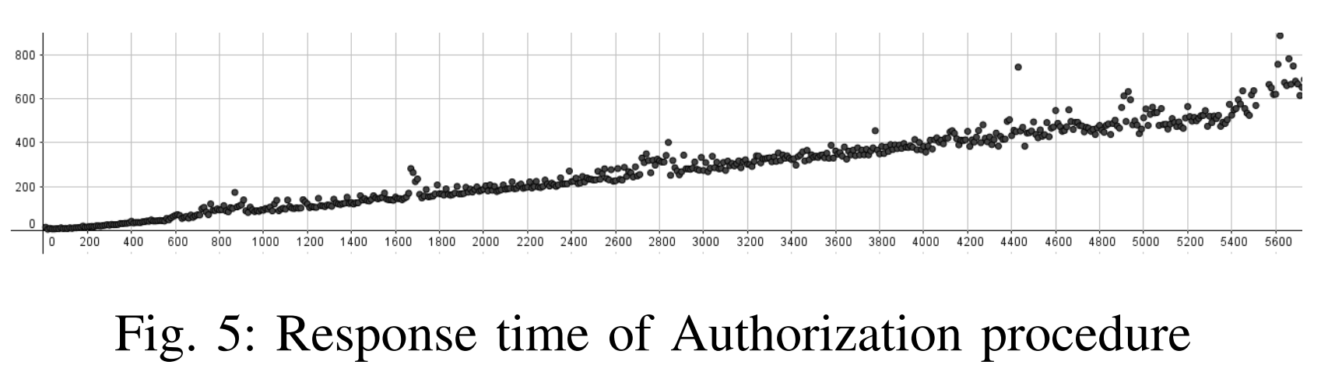
IMPLEMENTATION AND
EVALUATION RESULTS

Slide 22
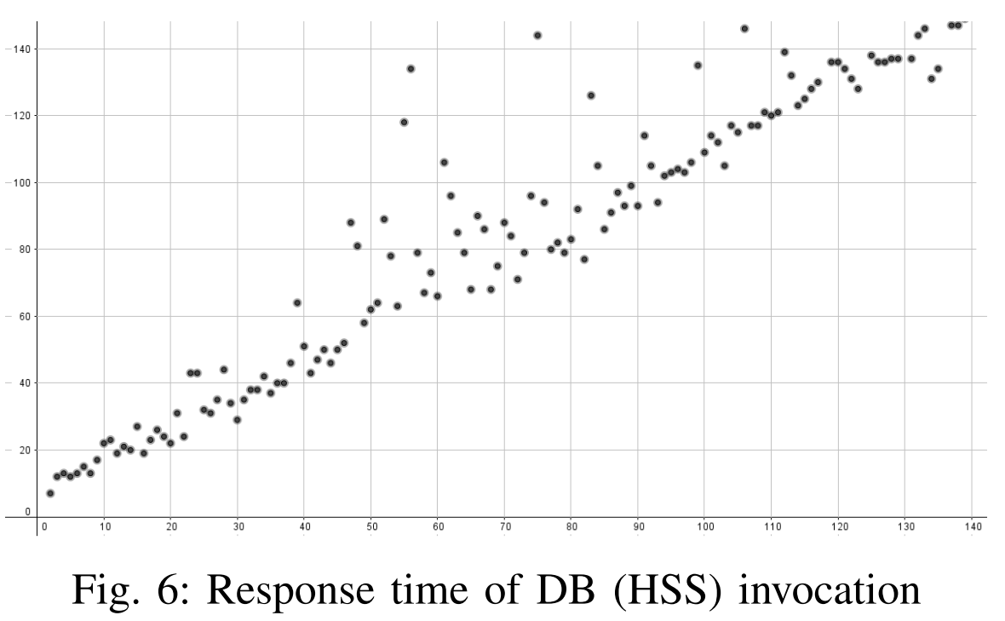
IMPLEMENTATION AND
EVALUATION RESULTS

Slide 23
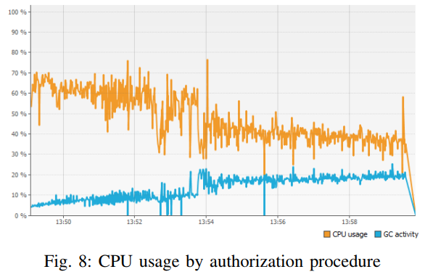
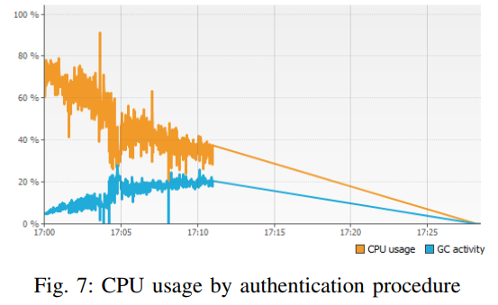
IMPLEMENTATION AND
EVALUATION RESULTS

Slide 24
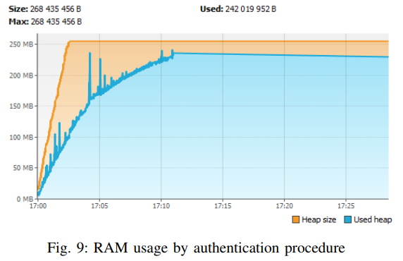
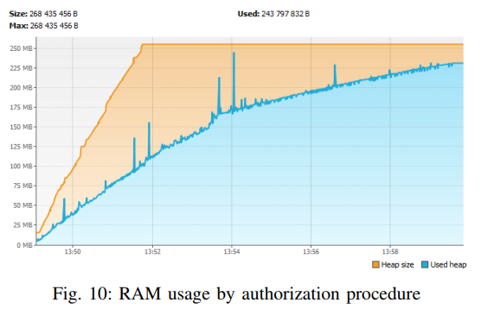
IMPLEMENTATION AND
EVALUATION RESULTS

Slide 25
IMPLEMENTATION AND
EVALUATION RESULTS
Regarding resource consumption, comparing to evaluation results from Split-IMS [14] which also considers stateless network functions, our evaluation results present better resource efficiency results on CPU usage and on memory usage.
[14] G. Carella, M. Corici, P. Crosta, P. Comi, T. M. Bohnert, A. A. Corici, D. Vingarzan, and T. Magedanz, “Cloudified ip multimedia subsystem for network function virtualization (nfv)-based architectures,” in Computers and Communication, 2014 IEEE Symposium on, vol. Workshops, pp. 1–6, June 2014.

Slide 26
CONCLUSION
We have presented in this paper a microservice-based approach for the design of VNFs as services.
The use of microservices software pattern for VNFs is motivated by a move towards more flexible service delivery and more agile network management operations.
We have shown the compliance of our approach with the design requirements of microservices and the advantages on QoS parameters such as availability through the measurement of response time, and the resource consumption efficiency comparing to existing approaches.

Slide 27
REFERENCES
[1] B. Han, V. Gopalakrishnan, L. Ji, and S. Lee, “Network function virtualization: Challenges and opportunities for innovations,” Communications Magazine, IEEE, vol. 53, pp. 90–97, Feb 2015.
[2] ETSI NFV ISG, Network Functions Virtualisation (NFV); Architectural Framework. Group Specification, Dec 2014.
[3] A. V. V. Q. Duan, Y. Yan, “A survey on service-oriented network virtualization toward convergence of networking and cloud computing,” IEEE Transactions on Network and Service Management, vol. 9, pp. 373–392, dec 2012.
[4] “Microservices. a definition of this new architectural term. http://martinfowler.com/articles/microservices.html,” 2016.
[5] D. Namiot and M. Sneps-Sneppe, “On micro-services architecture,”International Journal of Open Information Technologies, vol. 2, no. 9, 2014
[6] D. Malavalli and S. Sathappan, “Scalable microservice based architecture for enabling dmtf profiles,” in Network and Service Management (CNSM), 2015 11th International Conference on, pp. 428–432, Nov 2015.
[7] M. Villamizar, O. Garcs, H. Castro, M. Verano, L. Salamanca, R. Casallas, and S. Gil, “Evaluating the monolithic and the microservice architecture pattern to deploy web applications in the cloud,” in Computing Colombian Conference (10CCC), 2015 10th, pp. 583–590, Sept 2015.
[8] D. Jaramillo, D. V. Nguyen, and R. Smart, “Leveraging microservices architecture by using docker technology,” in SoutheastCon 2016, pp. 1– 5, March 2016.
[9] 3GPP, “Ip multimedia subsystem (ims), stage 2, 3gpp is 23.228, vol. 12,”2015.
[10] F. Gouveia, S. Wahle, N. Blum, and T. Magedanz, “Cloud computing and epc / ims integration: New value-added services on demand,” in Proceedings of the 5th International ICST Mobile Multimedia Communications Conference, Mobimedia ’09, pp. 51:1–51:5, 2009

Slide 28
[11] R. Glitho, “Cloudifying the 3gpp ip multimedia subsystem: Why and how?,” in New Technologies, Mobility and Security, 2014 6th International Conference on, pp. 1–5, March 2014.
[12] M. Abu-Lebdeh, J. Sahoo, R. Glitho, and C. W. Tchouati, “Cloudifying the 3gpp ip multimedia subsystem for 4g and beyond: A survey,” IEEE Communications Magazine, vol. 54, pp. 91–97, January 2016.
[13] F. Lu, H. Pan, X. Lei, X. Liao, and H. Jin, “A virtualization-based cloud infrastructure for ims core network,” in Cloud Computing Technology and Science, 2013 IEEE 5th International Conference on, vol. 1, pp. 25– 32, IEEE, 2013.
[14] G. Carella, M. Corici, P. Crosta, P. Comi, T. M. Bohnert, A. A. Corici, D. Vingarzan, and T. Magedanz, “Cloudified ip multimedia subsystem for network function virtualization (nfv)-based architectures,” in Computers and Communication, 2014 IEEE Symposium on, vol. Workshops, pp. 1–6, June 2014.
[15] M. Kablan, B. Caldwell, R. Han, H. Jamjoom, and E. Keller, “Stateless network functions,” in Proceedings of the 2015 ACM SIGCOMM Workshop on Hot Topics in Middleboxes and Network Function Virtualization, HotMiddlebox ’15, (New York, NY, USA), pp. 49–54, ACM, 2015.
[16] T. Yang, X. Wen, Y. Sun, Z. Zhao, and Y. Wang, “A new architecture of hss based on cloud computing,” in Communication Technology (ICCT), 2011 IEEE 13th International Conference on, pp. 526–530, Sept 2011.
[17] Fraunhofer, “Fokus openimscore, www.openimscore.org,” tech. rep.
[18] “Verification of models for distributed communicating componants. https://team.inria.fr/scale/software/vercors/vcev4-download/.”
[19] “Proactive parallel suite. http://proactive.inria.fr/.”
[20] “Session initiation protocol. http://www.rfc-base.org/txt/rfc-3261.txt,”tech. rep.
[21] StarTrinity, “Sip tester, call generator and simulator. http://startrinity.com/voip/siptester/siptester.aspx,” 2016.

