Slide 1
Experimental and Analytical Analysis of a Virtualized Network Function
Mousa Ryad Al Naser
Supervisor: Yuming Jiang, Besmir Tola
Master’s thesis in Communication Technology
June 2019
Notes:
虚拟化网络功能的实验与(分析事物的結果)分析
碩士論文畢業於通信技術系

Slide 2
OUTLINE
Abstract
Introduction
Background and Related Works
Methodology
Results and Discussion
Conclusion and Future Work
References
Notes:
摘要
介紹 背景與相關工作 方法 結果與討論 結論和未來工作

Slide 3
Abstract
NFV decouples software from hardware which means that the implementation of both hardware and software is no longer dependent on each other.
The deployed VNFs share a common standard infrastructure, and they can be modified and managed without the need of modifying the physical infrastructure.
Notes:
NFV将软件与硬件分离，这意味着硬件和软件的实现不再相互依赖。
部署的vnf共享一个通用的标准基础设施，它们可以在不需要修改物理基础设施的情况下进行修改和管理。

Slide 4
We study the performance of an open-source widely referenced VNF prototype, namely ClearWater.
The system will be deployed on top of two widely used virtualization technologies: Linux based container (Docker), and VMs.
The project aims to investigate the influence of different system features in terms of response time, and resource utilization.
We consider two well-known methods to derive the analytical model: M/M/1, M/G/1, and G/G/1. The experimental results will form the basis to eventually refine and validate the analytic model.
Notes:
我們研究了廣泛引用的VNF原型（即ClearWater）的性能。
該系統將部署在兩種廣泛使用的虛擬化技術之上：基於Linux的container（Docker）和VM。
該項目旨在根據響應時間和資源利用率，研究不同系統功能（如資源分配，到達率和處理實例數）對系統性能的影響。
我們考慮兩種眾所周知的方法來導出分析模型：M / M / 1 , M / G / 1和G / G / 1。實驗結果將為進一步完善和驗證分析模型奠定基礎。

Slide 5
Introduction
The increasing number of mobile and broadband subscriptions makes it essential to adapt a new technology which aims to overcome the limitations of legacy networks with respect to scalability, cost, resources management, and complexity of the network infrastructure.
In sake of improving the network performance, some of the dominant service providers among the world, who extensively use NFs like Network Address Translation (NAT) or Firewall, in cooperation with European Telecommunications Standards Institute (ETSI), introduced the concept of NFV for the first time in October 2012.
Notes:
移動和寬帶訂戶的數量不斷增加，因此必須採用一種新技術，旨在克服傳統網絡 關於(respect to) 可伸縮性，成本，資源管理和網絡基礎結構複雜性方面的局限性。
为了提高网络性能，世界上一些主要的服务提供商在2012年10月与欧洲电信标准协会（ETSI）合作，首次引入了NFV的概念，它们广泛使用NFs类的网络地址转换（NAT）或防火墙。

Slide 6
NFV has changed the approach of deploying network functions to be virtualized instead of using specific property hardware and software.
Separating software from hardware improves sharing of the resources and makes deploying of new services much faster.
NFV is expected to significantly reduce costs related to network operation, and increase providers' profit.
The high-level architecture of NFV framework, as defined by ETSI, is shown in Figure 1.1. It consists of four main components: NFV infrastructure (NFVI), VNFs, Operations and Business Support System (OSS/BSS), and NFV Management and Orchestration (MANO).
Notes:
NFV已经改变了将网络功能部署为虚拟化的方法，而不是使用特定属性的硬件和软件。
将软件与硬件分离可以改善资源共享，并使新服务的部署速度更快。
NFV有望显著降低网络运营成本，增加运营商利润。
由ETSI定义的NFV框架的高级架构如图1.1。它由四个主要组件组成：NFV基础设施（NFVI）、VNFs、操作和业务支持系统（OSS/BSS）和NFV管理和编排（MANO）。

Slide 7
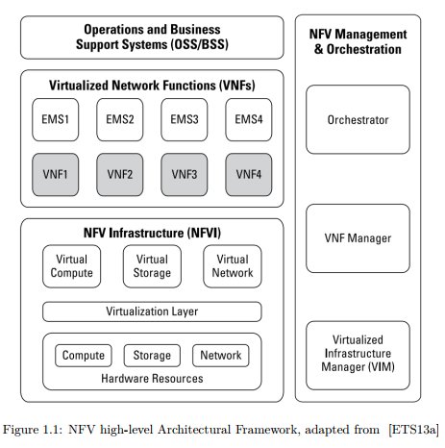
Notes:
首先，NFVI是包含標準硬體和虛擬資源的層，它構成NFV環境的基礎。NFVI本身由三部分組成：
1. 硬體資源：包括計算硬體（如伺服器）、存儲硬體（如網路連接存儲（NAS））和網路硬體（如交換機）。
2. 虛擬化層：抽象硬體資源，將軟體與硬體分離，使軟體能夠獨立於硬體運行。
3. 虛擬化資源：包括VNF所利用的虛擬 計算，存儲和網絡資源。
VNF部分代表 各種NF的軟件實現。 可以將多個VNF組合在一起以實現更專業的功能，稱為服務功能鏈（SFC），旨在提高可擴展性和網絡敏捷性。
元素管理系統（EMS）對網絡元素進行管理。 它有助於對故障和性能信息採取措施，並處理網元的安全性方面。
NFV MANO功能块由以下部分组成：
1. 虚拟基础设施管理器（Virtualized Infrastructure Manager，VIM）：用於管理和監視具有可用資源的VNF的連接。
2. VNF管理器（VNFM）：负责VNF生命周期。它初始化、更新、缩放和终止VNF实例。
3. NFV Orchestrator（NFVO）：负责网络服务生命周期。
OSS/BSS执行计费、故障、元素、配置和操作管理。

Slide 8
NFVI itself consists of three parts:
Hardware resources: consist of computing hardware such as servers, storage hardware such as Network-Attached Storage (NAS), and network hardware such as switches.
Virtualization layer: abstracts hardware resources and detaches software from hardware which enables software to be run independently from hardware.
Virtualized resources: includes virtual computing, storage, and network resources which are exploited by the VNFs.
Notes:
首先，NFVI是包含標準硬體和虛擬資源的層，它構成NFV環境的基礎。NFVI本身由三部分組成：
1. 硬體資源：包括計算硬體（如伺服器）、存儲硬體（如網路連接存儲（NAS））和網路硬體（如交換機）。
2. 虛擬化層：抽象硬體資源，將軟體與硬體分離，使軟體能夠獨立於硬體運行。
3. 虛擬化資源：包括VNF所利用的虛擬 計算，存儲和網絡資源。

Slide 9
The VNF part represents the software implementation of various NFs.
It is possible to combine several VNFs together in order to achieve more specialized function, known as Service Function Chaining (SFC), aiming at increasing scalability and network agility.
An Element Management System (EMS) performs management for network elements. It assists to take action on fault and performance information, and it handles the security aspects of the network element.
Notes:
VNF部分代表 各種NF的軟件實現。 可以將多個VNF組合在一起以實現更專業的功能，稱為服務功能鏈（SFC），旨在提高可擴展性和網絡敏捷性。
元素管理系統（EMS）對網絡元素進行管理。 它有助於對故障和性能信息採取措施，並處理網元的安全性方面。

Slide 10
the NFV MANO functional block consists of the following parts:
Virtualized Infrastructure Manager (VIM): is used to manage and monitor the connections of VNFs with the available resources.
VNF Manager (VNFM): is in charge of the VNF lifecycle. It initializes, updates, scales, and terminates VNF instances.
NFV Orchestrator (NFVO): is responsible for the network services lifecycle.
the OSS/BSS performs billing, fault, element, configuration, and operations management.
Notes:
NFV MANO功能块由以下部分组成：
1. 虚拟基础设施管理器（Virtualized Infrastructure Manager，VIM）：用於管理和監視具有可用資源的VNF的連接。
2. VNF管理器（VNFM）：负责VNF生命周期。它初始化、更新、缩放和终止VNF实例。
3. NFV Orchestrator（NFVO）：负责网络服务生命周期。
OSS/BSS执行计费、故障、元素、配置和操作管理。

Slide 11
In this project, we study an NFV-enabled service by assessing the performance of an open source and widely referenced VNF which implements a virtualized IMS (vIMS), namely Clearwater.
ClearWater has several typical deployment options using virtualization technologies like VM and Linux-based Docker containers.
Notes:
在這個項目中，我們研究了已啟用NFV的服務”通過評估開放源代碼的性能並得到廣泛引用“的VNF實現了虛擬化的IMS(clearwater)。
ClearWater有幾個典型的使用虛擬化技術的部署選項，比如VM和Linux-based的Docker containers

Slide 12
The aim of this project is to analyze the performance of such a VNF when it is deployed on the two different options aiming at investigating the following research questions:
Which of the both approaches acts better in terms of average registration delay?
How they are compared to each other and how resource allocation and scaling impact the delay?
How the performance of ClearWater elements is influenced when varying the arrival rate?
Notes:
本项目的目的是分析这种VNF部署在两个不同选项上时的性能，旨在调查以下研究问题：
–在平均注册延迟方面，这两种方法哪种效果更好？
–它们是如何相互比较的，资源分配和扩展如何影响延迟？
–当到达率变化时，清水元件的性能如何受到影响？

Slide 13
This project is structured from two main parts.
The first part is to set up the experimental environment, and conduct the experimental measurements.
The second part consists of deriving an analytical model based on queuing network theory and validating it based on the experimental results.
We would rather focus on the average registration delay, influence of the resource allocation, different arrival rates, and several deployment options.
Notes:
这个项目由两个主要部分组成
第一部分是搭建实验环境，进行实验测量。
第二部分包括推導 基於排隊網絡理論 的分析模型且根據實驗結果對其進行驗證。
我们更愿意关注平均注册延迟、资源分配的影响、不同的到达率和几个部署选项。

Slide 14
Background
On the core of the IMS architecture there is the SIP signalling protocol.
SIP can operate on top of TCP or UDP, and it supports the following features when establishing and terminating multimedia sessions:
User location: regardless of their locations and devices, users can connect to the network using the same identifier.
User availability: determine the willingness of the recipient to engage in communications.
User capabilities: parameters to be utilized during a session.
Session setup and management.
Notes:
IMS体系结构的核心是SIP信令协议。
SIP可以在传输控制协议（TCP）或用户数据报协议（UDP）之上运行，在建立和终止多媒体会话时支持以下功能：
1. 用户位置：无论其位置和设备如何，用户都可以使用相同的标识符(identifier)连接到网络。
2. 用户可用性：确定接收者参与通信的意愿。
3. 用户功能：会话期间要使用的参数。
4. 会话设置和管理。

Slide 15
SIP is a request-response protocol which means when a SIP endpoint received a request from a certain node, it sends back a response to the initiator.
All the SIP responses have a response code and message. In total, there are six different types of response codes that start from 100 up to 600.
Notes:
SIP是一种请求-响应协议，它意味着当SIP端点接收到来自某个节点的请求时，它会将响应发回给发起方。
所有SIP响应都有响应代码和消息。总共有六种不同类型的响应代码，从100到600。

Slide 16
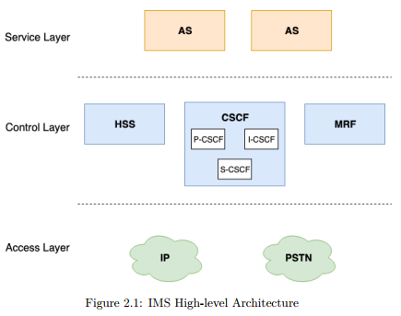
Notes:
通常，IMS由三个主要层组成：
1. 接入网络层：提供与外部网络的连接。它包含IP路由器和公共交换电话网（PSTN）交换机。
2. 控制层：负责呼叫建立、管理、终止的控制。它由四个不同的部分组成：家庭用户服务器（HSS）、呼叫会话控制功能（CSCF）和媒体资源功能（MRF）。
3. 服务层：由承载和执行服务的多个应用服务器（ASs）组成。

Slide 17
In order to understand how ClearWater operates and provides services, it is essential to realize the traditional IMS architecture shown in Figure 2.1. Generally, IMS consists of three main layers:
Access network layer: provides connectivity to external networks. It contains IP routers and Public switched telephone network (PSTN) switches.
Control layer: in charge of controlling calls establishment, management, and termination. It consists of four different parts: Home Subscriber Server (HSS), Call Session Control Functions (CSCF), and Media Resource Functions (MRF).
Notes:
为了理解ClearWater是如何操作和提供服务的，必须实现图2.1所示的传统IMS架构。通常，IMS由三个主要层组成：
1. 接入网络层：提供与外部网络的连接。它包含IP路由器和公共交换电话网（PSTN）交换机。
2. 控制层：负责calls建立、管理、终止的控制。它由四个不同的部分组成：家庭用户服务器（HSS）、呼叫会话控制功能（CSCF）和媒体资源功能（MRF）。
3. 服务层：由承载和执行服务的多个应用服务器（ASs）组成。

Slide 18
Service layer: consists of multiple Application Servers (ASs) which host and execute services.
Notes:
3. 服务层：由承载和执行服务的多个应用服务器（ASs）组成。

Slide 19
CSCF of traditional IMS has three main types: P-CSCF, I-CSCF, and S-CSCF.
In this project, We use an open source vIMS, namely ClearWater.
n case of ClearWater, Sprout element is equivalent to functionality of both I-CSCF and S-CSCF. P-CSCF function is implemented in Bono.
Notes:
传统IMS的CSCF主要有三种类型：代理呼叫会话控制功能（P-CSCF）、询问呼叫会话控制功能（I-CSCF）和服务呼叫会话控制功能（S-CSCF）。
在这个项目中，我们使用一个开源的vIMS，即ClearWater。
對於ClearWater，sprot相当于I-CSCF和S-CSCF的功能。P-CSCF function在Bono中实现。

Slide 20
Related Works
In [BCC+15], the authors deployed chains of NFVs on a single server where the virtualization environment was container and VM.
They measured both latency and throughput for packets of various sizes and concluded that container provides performance close to VM, utilize less resources, and has better latency.
In this project, we consider to both Docker container and VM since they provide different values of latency.
Notes:
在[BCC+15]中，作者在虚拟化环境是container和VM的单个服务器上部署了nfv链。
他们测量了不同大小数据包的延迟和吞吐量，得出结论：container提供接近VM的性能，利用更少的资源，并且具有更好的延迟。
在这个项目中，我们考虑Docker container和虚拟机，因为它们提供不同的延迟值。

Slide 21
Research [CW18] was performed to explore performance of an altered IMS architecture.
They mainly measured user registration success rate and call flow success rate for the new IMS, original ClearWater with only one Sprout, and ClearWater with two Sprout elements.
The registration success rate for ClearWater with a single Sprout node rapidly declines. The registration success rates of the others deployment gradually decline at 2500 test run.
They concluded that the new IMS has the best performance for user registration and call flow.
Notes:
研究[CW18]是为了探索改变后的IMS体系结构的性能。
他们主要测量了新IMS的用户注册成功率和呼叫流成功率，只有一个spreat的原始ClearWater和两个spreat元素的ClearWater。
具有單個Sprout節點的ClearWater的註冊成功率迅速下降。另一種部署的註冊成功率在2500次測試運行中逐漸下降。
他們得出結論，新的IMS在用戶註冊和呼叫流程方面具有最佳性能。

Slide 22
With regard to analytical modelling of NFV, queuing network analyzer theory was applied to derive a mathematical model of VNF in order to estimate the system response time [PAR+17].
Each node was considered as G/G/m queue. They modeled the signaling procedure of Mobility Management Entity (MME) following a threetiered architecture. It was assumed that each element serves the packets following a First Come First Served (FCFS) scheduling scheme.
On the contrary to our model which will be validated based on the experimental results, the final model was validated by simulation.
Notes:
对于NFV的分析建模，应用排队网络分析器理论导出VNF的数学模型，以估计系统响应时间[PAR + 17 ]。
(作者没有对到达时间或服务时间做任何假设。)每个节点被认为是G/G/m队列。他们按照三层体系结构对MME的signaling procedure进行了建模。假设每个元素按照先到先服务（FCFS）调度方案来服务分组。
与我们将根据实验结果进行验证的模型相反，最后的模型通过仿真进行了验证。

Slide 23
Another related work is [SSJ19] where the authors compared tow popular approaches of deploying VNFs: monolithic and microservice.
The comparison of performance included a mathematical analysis and experimental measurements.
SNORT, which is an open source Intrusion Detection System (IDS), was used to conduct the experimental measurements. Monoliths and microservices of SNORT were deployed on Docker containers.
With regard to the analytical model, they considered M/M/1 to derive the analytical model.
Notes:
另一项相关的工作是[SSJ19]，作者比较了两种流行的部署VNFs的方法：monolithic(單體式)和microservice(微服務)。
SNORT是一个开源的入侵检测系统（IDS），被用来进行实验测量。SNORT被透過單體式和微服務兩種方法部署在Docker containers上。

Slide 24
It was concluded that scaling up monolithic VNFs has a better performance rather than decomposition using the microservice approach.
This work differs from ours in the nature and complexity of the studied VNFs.
Notes:
結論是，增加單體式的VNF具有更好的性能，而不是使用微服務方法進行分解。
這項工作與我們的不同之處在於所研究的VNF的性質和復雜性。

Slide 25
In [MG10], the authors analyzed the registration delay for tow different systems:3G and WiMax.
They also performed an analytical analysis by using M/M/1 and G/G/1.
They concluded that WiMax networks provides better delay compared to 3G.
Several papers [Mun08][NTN13] have justified that M/M/1 is a valid method to mathematically describe the IMSs processes.
Notes:
在[MG10]中，作者分析了两种不同系统的注册延迟：3G和WiMax。
他们还使用M/M/1和G/G/1进行了分析。
他们的结论是WiMax网络提供了比3G更好的延迟。
一些文献[Mun08][NTN13]证明了M/M/1是数学描述IMSs过程的有效方法。

Slide 26
In this project, we study and analyze the user registration process of ClearWater in two different virtualization technologies (Docker and VM) and investigate the influence of different system features like resource allocation, service request arrival rates, and number of processing elements on the overall system performance.
the project includes deriving an analytical model using classical queuing theory where both the arrival and service processes can be either Markovian or general processes.
Notes:
在本项目中，我们研究和分析了两种不同虚拟化技术（Docker和VM）中ClearWater的用户注册过程，并研究了资源分配、服务请求到达率和处理元素数量等不同系统特性对系统整体性能的影响。
该项目还包括利用经典排队理论推导一个分析模型，其中到达和服务过程可以是马尔可夫过程或一般过程。

Slide 27
Methodology
This chapter introduces the methodology applied for evaluation and analysis of the Clearwater IMS network function for the different virtualization technologies and resource configurations.
It also presents the approach of deriving an analytical model which is suitable for characterizing and describing performance-wise the system architecture.
Notes:
本章介绍了针对不同的虚拟化技术和资源配置对Clearwater IMS网络功能进行评估和分析的方法。
它還介紹了導出分析模型的方法，該方法適用於表徵和描述性能方面的系統體系結構。

Slide 28
The overall process consists of two main parts.
The first part is to set up the experimental environment and conduct the necessary measurements when performing various tuning of the resource allocations, the incoming traffic load, and other related testbed specifications.
The aim is to analysis the user registration process of ClearWater which will be deployed on top of Docker containers and VMs.
Notes:
第一部分是建立实验环境，并在执行(资源分配、传入流量负载和其他相关测试台规范)的各种调整时 所进行必要的测量。
目的是分析ClearWater的用户注册过程，ClearWater将部署在Docker containers和VMs之上。

Slide 29
The second part is to derive an analytic model based on queuing network theory as a reference method.
Through the experimental results we investigate the suitability of the queuing models by comparing the experimental measurements with the expected performance results given by each assumed queue model.
Notes:
第二部分是以排队网络理论为参考，推导出一个分析模型。
通過實驗結果研究了排隊模型的適用性，我們通過將實驗測量結果與每個假定隊列模型給出的預期性能結果進行比較。

Slide 30
ClearWater
A widely adopted and referenced ETSI-compliant vIMS is developed by the Clearwater project [Neta].
ClearWater is an open-source NFV based IMS which enables IMS and its associated services to be deployed in a cloud environment.
Similar to typical IMS, ClearWater utilizes SIP signaling for voice, video, and messaging services.
Notes:
Clearwater項目[Neta]開發了一種被廣泛採用和引用的符合ETSI規定的vIMS。
ClearWater是一个基于NFV的开源IMS，它使IMS及其相关服务能够部署在云环境中。
与典型的IMS类似，ClearWater将SIP信令用于语音、视频和消息传递服务。

Slide 31
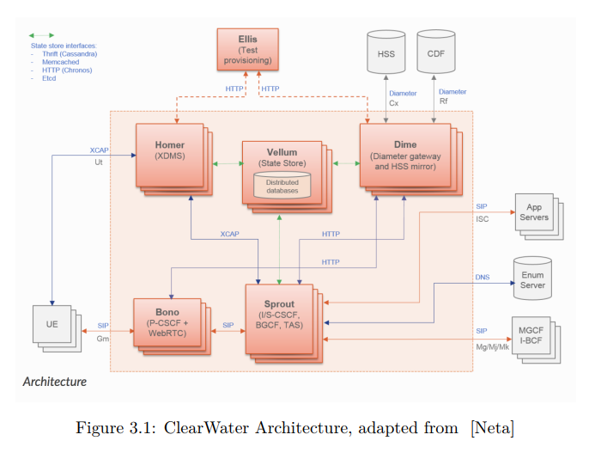
Notes:
圖3.1顯示了ClearWater的體系結構，包括以下部分：
1. sprout：充當SIP路由器和註冊器，執行用戶身份驗證，並為另一個名為Vellum的節點提供介面，以保存註冊資料。
由於可以跨sprout集群執行負載平衡，因此不使用訂戶和特定sprout節點之間的長時間關聯。
sprout提供了與Homer和HSS的介面，以檢索使用者資訊和服務設定檔。sprout執行典型IMS的I-CSCF和S-CSCF的功能。
2. Bono：使用者為了獲得認證並到達其他系統節點而接觸的邊緣點。它充當SIP代理，為SIP提供機密性和完整性。Bono相當於IMS的P-CSCF。
3. Dime：由以下元件組成：
a） Homestead：提供一個Sprout介面，用於交換身份驗證憑據和訂閱戶設定檔資訊。
b） Homestead Prov：方便提供在Vellum的Cassandra上的訂戶。
c） Ralf(拉爾夫)：負責帳單服務。
4. Homer：是一個XML文檔管理伺服器（XDMS），用於存儲系統中每個訂閱者的服務設置文檔。
5. Vellum：用於將所有long lived狀態存儲在clearwater中。它由Cassandra(卡桑德拉)、Chronos 和Astaire 組成：
a） Cassandra：Homestead使用它來保存使用者資訊，如身份驗證憑證和設定檔資訊。
b） Chronos(克洛诺斯)：由ClearWater開發，提供計時服務。Sprout和Ralf都利用Chronos啟動計時器。

Slide 32
Figure 3.1 shows the architecture of ClearWater which consists of the following parts:
Sprout: acts as a SIP router and registrar, performs user authentication, and it supplies interface to another node called Vellum in order to save registration data. Since it is possible to perform load balancing across the Sprout cluster, a long time association between a subscriber and specific Sprout node is not used. Sprout provides interface to Homer and HSS to retrieve user information and service profile. Sprout performs the functionality of both I-CSCF and S-CSCF of typical IMS.
Notes:
圖3.1顯示了ClearWater的體系結構，包括以下部分：
1. sprout：充當SIP路由器和註冊器，執行用戶身份驗證，並為另一個名為Vellum的節點提供介面，以保存註冊資料。
由於可以跨sprout集群執行負載平衡，因此不使用訂戶和特定sprout節點之間的長時間關聯。
sprout提供了與Homer和HSS的介面，以檢索使用者資訊和服務設定檔。sprout執行典型IMS的I-CSCF和S-CSCF的功能。

Slide 33
Bono: the edge point that users contact in order to get authenticated and reach other system's nodes. It acts as a SIP proxy and provides confidentiality and integrity for SIP. Bono is equivalent to the P-CSCF of IMS.
Dime: consists of the following components:
Homestead: provides an interface to Sprout to exchange the authentication credentials and subscriber profile information.
Homestead Prov: facilitate provisioning of subscribers in Cassandra on Vellum.
Ralf: is responsible for the billing service.
Notes:
2. Bono：使用者為了獲得認證並到達其他系統節點而接觸的邊緣點。它充當SIP代理，為SIP提供機密性和完整性。Bono相當於IMS的P-CSCF。
3. Dime：由以下元件組成：
a） Homestead：提供一個Sprout介面，用於交換身份驗證憑據和訂戶設定檔資訊。
b） Homestead Prov：方便提供在Vellum的Cassandra上的訂戶。
c） Ralf(拉爾夫)：負責帳單服務。

Slide 34
Homer: is a XML Document Management Server (XDMS) used to store service settings documents for each subscriber in the system.
Vellum: is used to store all long lived state in ClearWater. It consists of Cassandra, Chronos, and Astaire:
Cassandra: is used by Homestead to save user information like authentication credentials and profile information.
Chronos: developed by ClearWater to provide timing service. Both Sprout and Ralf make use of Chronos to initiate timers to be run.
Notes:
4. Homer：是一個XML文檔管理伺服器（XDMS），用於存儲系統中每個訂閱者的服務設置文檔。
5. Vellum：用於將所有long lived狀態存儲在clearwater中。它由Cassandra(卡桑德拉)、Chronos 和Astaire 組成：
a） Cassandra：Homestead使用它來保存使用者資訊，如身份驗證憑證和設定檔資訊。
b） Chronos：由ClearWater開發，提供計時服務。Sprout和Ralf都利用Chronos啟動計時器。

Slide 35
ClearWater is horizontally scalable which allows to createmultiple instances of each node if needed.
In this project, we consider scaling up of the Sprout component and analyze how this will influence the performance with regard to the registration phase and resource utilization.
Notes:
ClearWater是水平可伸缩的，允许在需要时创建每个节点的多个实例。
在这个项目中，我们考虑扩展Sprout组件，并分析这将如何影响注册阶段和资源利用方面的性能。

Slide 36
VM and Docker container
ClearWater has several deployment options.
They rely on two common virtualization technologies, hypervisor-based VMs and Linux containers.
We considered both Docker container and VM, and deployed the ClearWater software stack on our own hardware infrastructure.
Notes:
ClearWater有几个部署选项。
它们依赖于两种常见的虚拟化技术：基于hypervisor的vm和Linux containers。
我们考虑了Docker containers和VM，并在我们自己的硬件基础设施上部署了ClearWater software stack。

Slide 37
A VM is a virtualized environment which enables the users to emulate several operating systems and applications on one physical machine. Each of the VMs, exploits virtualized resources which are mapped with physical ones through the Hypervisor.
Docker containers are an open source software which enables a code and all its dependencies to be executed quickly. It is a lightweight virtualized environment which has some promising features like low memory-foot print and booting times compared to VMs (few seconds to initialize).
Notes:
VM是一个虚拟化环境，它允许用户在一台物理机器上模拟多个操作系统和应用程序。每个vm都利用虚拟化资源，这些资源通过Hypervisor与物理资源进行映射。
Docker containers是一个开放源码软件，它使代码及其所有依赖项能够快速执行。它是一个轻量级的虚拟化环境，与VMs相比，它有一些很有前途的特性，比如低内存的脚印和启动时间（初始化几秒钟）。

Slide 38
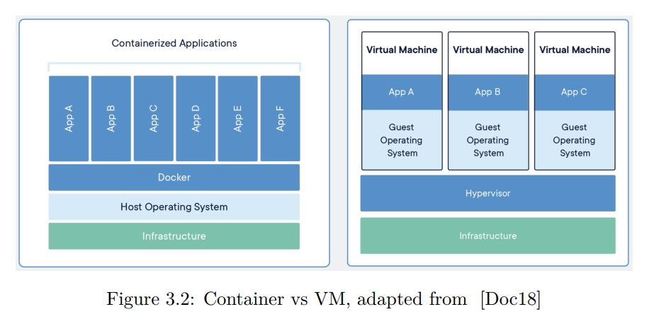
Notes:
图3.2显示了基于Linux的容器和虚拟机之间的主要区别。
在基于虚拟机的虚拟化方面，每个虚拟机都需要自己的操作系统，这需要更多的专用资源，并且可能会极大地影响部署的虚拟机的引导过程。基于containers的虚拟化与基于hypervisor的虚拟化在同一主机上运行多个容器方面类似，但这些containers共享一个统一的操作系统，从而降低了存储利用率，从而获得了更低的内存占用率，与标准vm相比，具有更快的启动时间，从而提高了时间效率。简言之，基于Linux的容器是更高效的轻量级虚拟化环境，使它们非常适合于云计算等动态架构[Doc18]。
在资源分配方面，每个虚拟机都有一个专用的资源量，这意味着在根据每个虚拟机上的工作负载管理可用资源时没有灵活性。与vm不同，Docker容器允许动态资源共享，其中根据每个容器上的工作负载分配给容器的资源。

Slide 39
SIPp
SIPp [sip] is a free source SIP traffic generator with built-in default scenario files developed by Intel Corporation in accordance with the IMS/Next Generation Networks (NGN) Performance Benchmark specification.
Notes:
SIPp[sip]是一个自由源sip流量生成器，具有由Intel公司根据IMS/Next Generation Networks（NGN）性能基准规范开发的內置默認方案文件。

Slide 40
Wireshark
Wireshark is a traffic capture and network analyzer.
Before sending Register requests, we started Wireshark on the physical machine listening to either VM or Docker container interface. The captured traffic was analyzed afterwards to estimate the actual service time of each involved component during the registration process.
Notes:
Wireshark是一个流量捕获和网络分析器。
在发送注册请求之前，我们在物理机器上启动了Wireshark，监听VM或Docker container接口。隨後對捕獲的流量進行分析，以估計註冊過程中每個涉及組件的實際服務時間。

Slide 41
CPU and RAM Monitoring Tools
The following parameters were observed during the experimental work:
Total average delay of succeeded requests.
Average CPU usage.
Average RAM usage.
Those information assist to characterize the main aspects of the system.
Capacity of the system.
Resources consumption.
Notes:
在实验过程中观察到以下参数：
1. 成功请求的总平均延迟。 2. 平均CPU使用率。 3. 平均RAM使用量。
这些信息有助于描述系统的主要方面：
1. 系统容量。 2. 资源消耗。

Slide 42
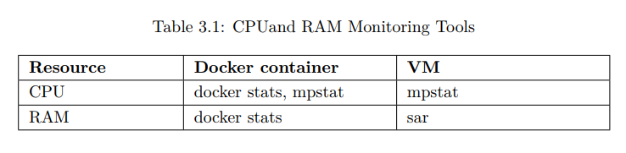
There are plenty of available tools which can be utilized to monitor the CPU and RAM usage.
The tools utilized within this project are presented in Table 3.1.
Notes:
有很多可用的工具可以用来监视CPU和RAM的使用情况。本项目中使用的工具见表3.1。
sar将显示与RAM状态相关的信息
mpstat将显示某个处理核心数（分配给组件的特定核心数）的CPU报告（每秒钟一次）。
Docker stats是一个内置的命令，用于Docker容器。默认情况下，它每秒钟显示一次有关CPU和RAM状态的信息。

Slide 43
ClearWater's User Registration Flow
it is to have a closer look at messages being created and exchanessentialged among the involved nodes of ClearWater during the user registration process.
Figure 3.3 shows the exchanged SIP dialogue in order to successfully register new clients.
Notes:
在用户注册过程中，有必要仔细观察ClearWater的相关节点之间正在创建和交换的消息。
图3.3显示了为了成功注册新客户机而交换的SIP对话。

Slide 44
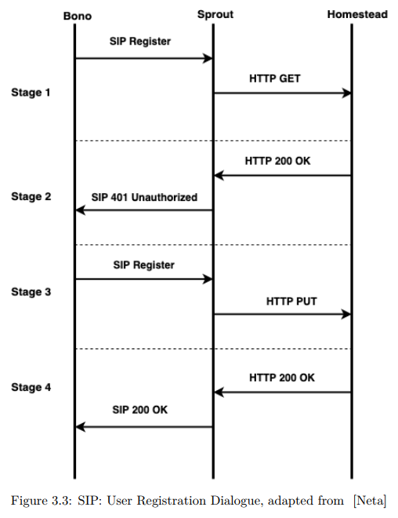
Notes:
1. Bono从SIP终端接收到SIP register 。注册请求将转发给Sprout。
2. sprut向Homestead发送HTTP GET消息以检索身份验证凭据。
3. 由于我们没有任何外部HSS，homestad将负责计算认证向量（AV）并生成所需的认证参数。
4. HTTP 200被转发回Sprout并附带身份验证参数。
5. Sprouts向Bono发送SIP 401未经授权的消息，要求用户提供其安全参数并计算质询响应。
6. 由于SIP终端具有密钥，因此它可以对网络进行身份验证，计算所需的响应，并用计算出的值再次向IMS系统发送SIP寄存器。
7. 消息将遵循与前两个阶段相同的过程，只是Homestead将检查用户响应是否等于Homestead在第一阶段计算的响应。如果这两个值相等，那么将对用户进行身份验证，并通过Bono将200ok消息转发回订户。

Slide 45
In sake of facilitating the mapping of the SIP dialogue to a queuing network, the call flow was divided into four stages. The SIP dialogue consists of the following messages:
Bono received SIP register from SIP terminal. The register request will be forwarded to Sprout.
Sprout sends HTTP GET message to Homestead in order to retrieve authentication credentials.
Since we do not have any external HSS, Homestead will be in charge of calculating the Authentication Vector (AV) and generating the required authentication parameters.
Notes:
为了方便SIP对话到排队网络的映射，将呼叫流分为四个阶段。SIP对话由以下消息组成：
1. Bono从SIP终端接收到SIP register 。注册请求将转发给Sprout。
2. sprut向Homestead发送HTTP GET消息以检索身份验证凭据。
3. 由于我们没有任何外部HSS，homestead将负责计算认证向量（AV）并生成所需的认证参数。

Slide 46
HTTP 200 is forwarded back to Sprout accompanied with authentication parameters.
Sprouts sends SIP 401 unauthorized message to Bono asking the user to provide his security parameters and calculate the challenge response.
Since the SIP terminal has the secret key, it can then authenticate the network, calculate the required response, and send again a SIP register to the IMS system with the calculated values.
Notes:
4. HTTP 200被转发回Sprout并附带身份验证参数。
5. Sprouts向Bono发送SIP 401未经授权的消息，要求用户提供其安全参数并计算质询响应。
6. 由于SIP终端具有密钥，因此它可以对网络进行身份验证，计算所需的响应，并用计算出的值再次向IMS系统发送SIP寄存器。

Slide 47
The messages will follow the same procedure as the first two stages except that Homestead will check if the user response is equal to the one that was calculated by Homestead in the first stage. If the two values are equal, then the user will be authenticated and 200 OK message will be forwarded back to the subscriber through Bono.
Notes:
7. 消息将遵循与前两个阶段相同的过程，只是Homestead将检查用户响应是否等于Homestead在第一阶段计算的响应。如果这两个值相等，那么将对用户进行身份验证，并通过Bono将200ok消息转发回订户。

Slide 48
Testbed Specifications
In order to perform the experimental test, we use two physical machines with capabilities illustrated in Table 3.2.
The first machine was dedicated to deploy the Docker container environment while the other one was used to host the VMs environment.
Notes:
試驗台規格
为了进行实验测试，我们使用了两台物理机器，其性能如表3.2所示。
第一台机器专用于部署Docker容器环境，而另一台则用于托管VMs环境。

Slide 49
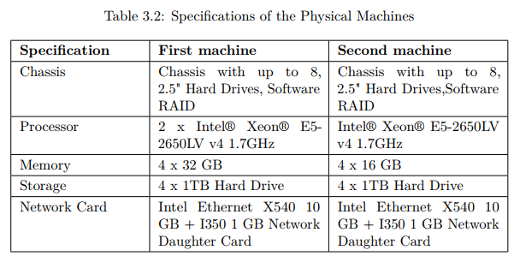
Notes:
第一台機器在處理能力和內存容量方面具有更高的功能，但是當為服務組件分配物理資源時，我們為每個VM和容器分配了相同的數量，以確保兩次部署之間的計算能力保持一致 。

Slide 50
ClearWater on Docker container
The entire process of deploying ClearWater on Docker containers can be found on [cle].
Algorithm 3.2 shows the commands needed in order to install ClearWater system.
Table 3.3 shows the deployed containers and the resources assigned to each of them.
A useful tool, called Weave Scope [Wea], can be used with Docker to provide a real-time interactive view including all deployed containers, connectivity between them, and resources usage.
Notes:
在Docker容器上部署ClearWater的整个过程可以在[cle]上找到
算法3.2显示了安装清水系统所需的命令。
表3.3显示了部署的容器和分配给每个容器的资源。
一个叫做Weave Scope[Wea]的有用工具可以与Docker一起使用，提供一个实时的交互视图，包括所有部署的容器、它们之间的连接和资源使用情况。

Slide 51
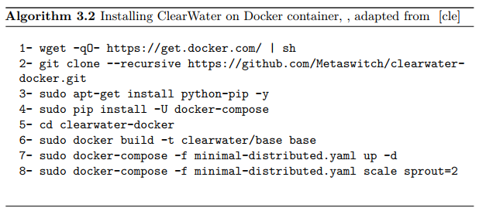
Notes:
前四个命令是在Ubuntu上安装Docker和Docker的compose(就是用來管理 Docker Container 的文件檔)。第六个命令是建立ClearWater的基础映像檔(一個唯讀的模板)，而第七个命令是建立所有其他映像檔并启动ClearWater系统。需要缩放时使用的最后一个命令。它会将Sprout实例的数量增加到两个。

Slide 52
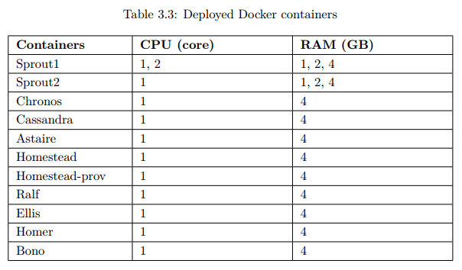
Notes:
所有的容器，除了Sprout被分配了不同的CPU核和RAM值外，都有一个处理核和4gb的RAM。

Slide 53
Each Docker container has shared and local configuration files.
The shared configuration file must be the same on all existed containers within ClearWater deployment. It contains the necessary parameters for ClearWater to operate properly.
The shared configurations includes settings like the domain name, names of the deployment nodes, and the port numbers used to communicate among the different containers.
The local configuration file contains information regarding the private and public IP addresses, and the hostname.
Notes:
每个Docker容器都有共享和本地配置文件。
在ClearWater部署中的所有现有容器上，共享配置文件必须相同。它包含ClearWater正常运行所需的参数。
共享配置包括域名、部署节点的名称以及用于在不同容器之间通信的端口号等设置。
本地配置文件包含有关专用和公用IP地址以及主机名的信息。

Slide 54
Once ClearWater is successfully installed on Docker, the shared and local configurations files will be created by default and there is no need to add or modify them to bring ClearWater working.
Notes:
一旦ClearWater在Docker上成功安装，默认情况下将创建共享和本地配置文件，无需添加或修改它们即可使ClearWater正常工作。

Slide 55
ClearWater on VM
To be able to implement ClearWater through VM, a virtualization player such as VMware workstation is required. Once the VMware player was installed, we started with creating seven different VMs running Ubuntu 14.04 - 64bit server edition.
After creating the VMs, we had to grant them an access to Clearwater Debian repository.
Notes:
为了能够通过VM实现ClearWater，需要一个虚拟化播放器，比如VMware工作站。
一旦安装了VMware播放器，我们就开始创建七个运行Ubuntu 14.04-64位服务器版本的不同vm。
创建VMs之后，我们必须授予它们访问Clearwater Debian存储库的权限。

Slide 56
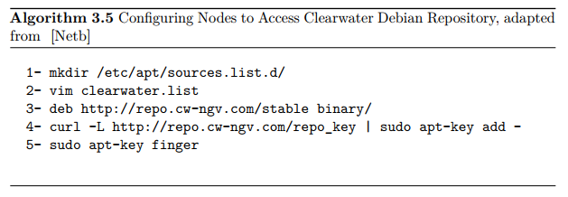
Notes:
首先，我们创建了一个目录，其中包含使用名为vim的文本编辑器创建的clearwater.list文件。
该文件包含算法3.5的第三行，这是ClearWater Debian服务器的链接。
创建文件后，我们通过执行第四个命令导入Clearwater的签名密钥。
最后的命令是检查密钥指纹的正确性。

Slide 57
Second, creating the per-node configuration as it was done in 3.4. The next step, is to determine the role of each VM: Sprout1, Sprout2, Vellum, Dime, Ellis, Homer, and Bono.
Table 3.4 shows the amount of resources assigned to each VM.
Notes:
其次，按照3.4中的步驟創建每個節點的配置。 下一步是確定每個VM的角色：Sprout1，Sprout2，Vellum，Dime，Ellis，Homer和Bono。
表3.4顯示分配給每個VM的資源量。

Slide 58
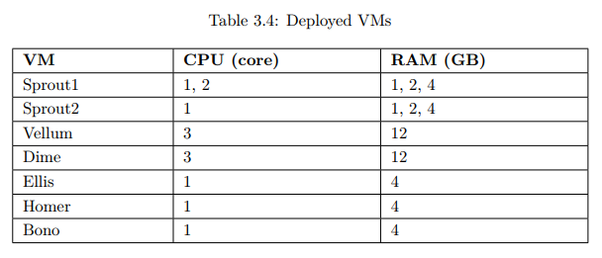
Notes:
Dime和Vellum都有三个专用的处理核心和12gb的RAM，以便使它们与Docker实现的设置相等。在Docker环境中，Dime被分为三个独立的容器：Homestead、Homestead Prov和Ralf。分配给Dime节点的总资源是三个核心和12gb的RAM。与Dime类似，Vellum有三个独立的容器：Cassandra、Chronos和Astaire。

Slide 59
In contrast to Docker environment, we had to create the shared configuration file on each VM.
All VMs were equipped with the same shared configuration file as Docker containers 3.3.
After creating the shared and local configuration files on each VM, ClearWater is ready to perform the experimental measurement.
Notes:
与Docker环境不同，我们必须在每个虚拟机上创建共享配置文件。
所有虚拟机都配备了与Docker containers 3.3相同的共享配置文件。
在每个VM上创建共享和本地配置文件后，ClearWater准备好执行实验测量。

Slide 60
SIPp: Preparation and Installation
We chose to install SIPp on the Bono node to reduce the number of exchanged messages during the registration process.
The SIPp tool was used to produce a large amount of SIP traffic against the ClearWater deployment in order to observe how the system will perform under certain circumstances, and to monitor relevant performance metrics.
Notes:
我们选择在Bono节点上安装SIPp来减少注册过程中交换的消息数量。
SIPp工具被用来产生大量针对ClearWater部署的SIP流量，以便观察系统在特定情况下的性能，并监视相关的性能度量。

Slide 61
Experimental Test Settings
In this project, we focused on how the allocated resources to Sprout will affect the initial user registration's performance.
Furthermore, we considered scaling up the Sprout in order to investigate how that would impact the system metrics.
Table 3.5 shows the combinations of the experimental test.
Notes:
在这个项目中，我们主要关注分配给Sprout的资源如何影响初始用户注册的性能。
此外，我们考虑扩大Sprout，以研究这将如何影响系统度量(對一個系統、元件或流程所具有的某個既定的屬性給予一個量化程度的測量)。
表3.5顯示了實驗測試的組合

Slide 62
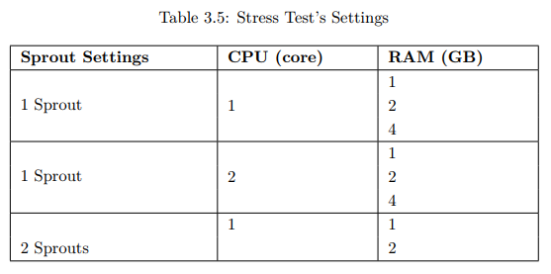
Notes:
使用一个处理核心的一个Sprout节点进行测试，并分配不同的RAM值。
其次，在将RAM从1改为4gb的同时，将处理核改为2个。
最后，我们增加了Sprout实例来研究扩展过程对用户注册的平均延迟和资源利用率的影响。

Slide 63
We started the test from 20 Registers per second and then increased it by a fixed step (30) until 200 Registers per second. The last two values are 250 and 300 Registers per second.
The different values aimed to produce an extensive analysis of the system behaviour under different circumstances.
The test was run fifty times for each single value of the arrival rate in order to produce more precise results by taking the average of the all fifty times' outputs.
Notes:
我们从每秒20个寄存器开始测试，然后按固定的步骤（30）增加到每秒200个寄存器。
不同的值旨在對不同情況下的系統行為進行廣泛的分析。
为了得到更精确的结果，对每一个到达率值进行50次测试，取所有50次输出的平均值。

Slide 64
Analytical Model and Analysis
Queuing network theory is an approach to model systems as a network of queues where each queue represents a service center.
In order to map ClearWater's components to the queuing network, we need to identify the involved nodes in the user registration process.
The registration process starts with a SIP register sent from Bono to Sprout, and ends with SIP 200 OK sent back to Bono.
Notes:
排队网络理论是一种将系统建模为队列网络的方法，其中每个队列代表一个服务中心。
为了将ClearWater的组件映射到排队网络，我们需要识别用户注册过程中涉及的节点。
注册过程开始于从Bono发送到Sprout的SIP寄存器，结束于发送回Bono的SIP 200 OK。

Slide 65
Before introducing the methods we considered to derive the analytical model, it is essential to introduce briefly Kendall's notation which is used to describe the queuing system. The following notation A/B/C/D refers to:
A: is the arrival distribution (M for Poisson, and G for general).
B: is the service time distribution (M for negative exponential distribution, and G for general distribution).
C: refers to the number of servers
D: maximum number of customers in the queue.
Notes:
在介绍我们所考虑的导出分析模型的方法之前，有必要简要介绍用于描述排队系统的Kendall符号。下列符号A/B/C/D指：
1. A： 是到达分布（M表示Poisson，G表示一般）。
2. B： 是服务时间分布（M表示负指数分布，G表示一般分布）。
3. C： 指服务器的数量
4. D： 队列中的最大客户数。
針對一個Queueing的系統，其中有許多的參數和特性，為了要有個簡單且明確的表示方法。這邊使用由Kendall提出的表示法：「Kendall notation」 這表示法是由一連串的「/」區分不同的特性，表示法如下： A/B/X/Y/Z
其中個別代表的意思是： A：Arrival Pattern，Request到達系統的分布特性
B：Service Pattern，Request離開系統的分布特性
X：Number of parallel server，單一系統同時有幾個Server進行服務
Y：System Capacity，系統內Buffer的大小
Z：Queueing discipline，系統處理Request的方式
其中A和B可以有下列幾個類型：
Exponential Distribution (M)
Deterministic (D)
General Distribution (G)
Erlang type k (k=1,2,...) (Ek)
Mixture of k expoenetials (Hk)
Phase type (PH)
而X和Y則是給予數字，代表該系統的Buffer大小和可處理之Service數，
Z的部分則有：
FCFS：first come, first served，先到先處理
LCFS：last come, first served，後到先處理
RSS：random selection for service，隨機取Buffer內的處理
PR：priority，依優先權處理
GD：general discipline
一般來說，系統大多是取前面的A/B/X做描述，這時候後面的Y和Z各自代表「系統內的Buffer Size無限大」和「採用FCFS處理」。

Slide 66
We assume that each different network service entity, involved in the IMS signaling, is modeled through an M/M/1 queue.
Therefore, the resulting network is a queuing network of M/M/1 tandem queues, and in case the input process is Poisson, the departure process is also Poisson and independent of the input process [Zuk13].
As a result, the total average waiting time or delay in the queuing network, consisting of queues in tandem, is the sum of the expected waiting times at each queue.
However, we assume a different approach on validating the suitability of the assumed model.
Notes:
我们假设IMS信令中涉及的每个不同的网络服务实体通过M/M/1队列建模。
因此，得到的网络是M/M/1串联队列的排队网络，在输入过程为Poisson的情况下，離開过程也是Poisson的，并且与输入过程无关[Zuk13]。
因此，排队网络中由队列串联组成的总平均等待时间或延迟是每个队列的预期等待时间之和。
然而，我们假设了一种不同的方法来验证假设模型的适用性。

Slide 67
First, during the experimental measurement, we specified the arrival process distribution to follow a Poisson process with exponential inter-arrival times of the user's Registration requests.
This was achieved by setting a 'pause' process between each Registration request in the XML SIPp scenario. Through the GNU Scientific Library (GSL) package, we were able to set a specific distribution for the interarrival times.
For each measurement, the 'pause' follows an exponential distribution with a mean value equal to the specific arrival rates under consideration.
Notes:
首先，在实验测量过程中，我们指定到达过程分布遵循Poisson过程，用户注册请求的到达时间为指数。
这是通过在XML SIPp场景中的每个注册请求之间设置一个“pause”进程来实现的。
通过GNU科学图书馆（GSL）包，我们能够为到达时间设置一个特定的分布。
对于每个测量，“暂停”遵循指数分布，平均值等于考虑中的特定到达率。

Slide 68
Secondly, we assume that the service process of each queue may have either negative exponential distribution or a general distribution.
Therefore we consider two methods to derive the analytical model: M/M/1 and M/G/1.
For both approaches, it is required to identify the service time since the actual service time for each of Bono, Sprout, and Homestead is unknown.
In order to estimate the service time of each node, one packet was sent to ensure that the node is empty and the packet will be processed instantly upon reaching the node.
The entire process was captured and analyzed by a network analyzer tool.
Notes:
其次，我们假设每个队列的服务过程可能具有负指数分布或一般分布。
因此，我们考虑两种方法来推导分析模型：M/M/1和M/G/1。
对于这两种方法，都需要确定服务时间，因为每个Bono、Sprout和Homestead的实际服务时间都是未知的。
为了估计每个节点的服务时间，发送一个数据包以确保节点为空，数据包到达节点后将立即被处理。
整个过程被一个网络分析工具捕获和分析。

Slide 69
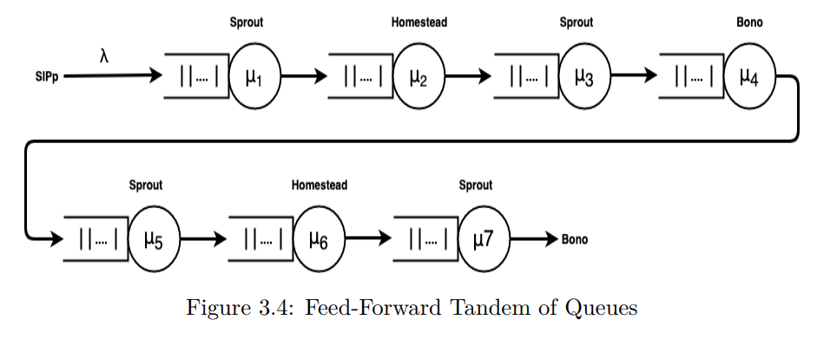
Notes:
我们总共有七个不同的服务时间，如图3.4所示。服务时间是(某个节点处理并将数据发送到下一个节点)所需的时间。
如上所述，这些服务时间值是使用Wireshark網絡分析儀捕獲的。

Slide 70
In total, we have seven different service times as shown in Figure 3.4.
The service time is the time needed for a certain node to process and send the data out to the next node.
As stated above, those service times values were captured using Wireshark network analyzer.
Notes:
我们总共有七个不同的服务时间，如图3.4所示。
服务时间是(某个节点处理并将数据发送到下一个节点)所需的时间。
如上所述，这些服务时间值是使用Wireshark網絡分析儀捕獲的。

Slide 71
for sake of simplicity, we chose to analyse and validate the analytical model for the case when Sprout has one processing core and two GB of RAM for each of Docker container and VM.
Tables 3.6 and 3.7 show the numerical values for the average service times of Docker containers and VMs.
Notes:
为了简单起见，我们选择了当Sprout的Docker container和VM各有一个处理核心和两个GB的RAM时，对分析模型进行分析和验证。
表3.6和3.7显示了Docker containers和虚拟机平均服务时间的数值。

Slide 72
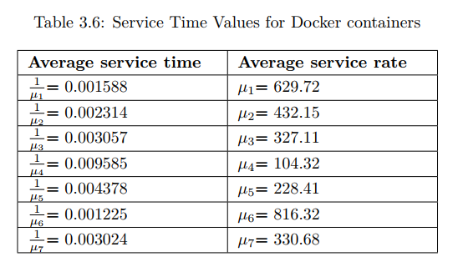
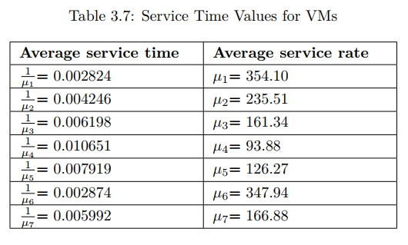

Slide 73
M/M/1
Consider an IMS based network with K identical servers with no loss due to buffer overflows. By applying M/M/1, it was assumed that:
Each node has an infinite capacity
Arrival process from outside is a discrete time process which follows a Poisson distribution with arrival intensity λ.
The service time is a negative exponential distribution with parameter µ.
Notes:
考虑一个基于IMS的网络，它有K个相同的服务器，不会因为缓冲区溢出而丢失。通过应用M/M/1，假设：
每个节点都有无限的容量。
来自外部的到达过程是一个离散的时间过程，該過程遵循具有到達強度λ的Poisson分佈。
服务时间是带参数的负指数分布 µ。

Slide 74
All messages related to the registration process have to traverse through the queues shown in Figure 3.4 sequentially.
In particular, the Burke's theorem states that in an M/M/1 system where the arrival process is Poisson with arrival rate , at equilibrium, the departure process is still Poisson with the same parameter.
Therefore, the arrival process of the second queue will still be a Poisson process with arrival rate equal to and so on for the rest of queues in the tandem network.
The overall registration time is the sum of the response time for the all queues.
Notes:
与注册过程相关的所有消息都必须按顺序遍历图3.4所示的队列。
特别地，Burke定理指出，在M/M/1系统中，到达过程是到达率为Poisson的，在平衡状态下，离开过程仍然是具有相同参数的Poisson。
因此，对于串联网络中的其他队列，第二个队列的到达过程仍然是到达率等于等的泊松过程。
总注册时间是所有队列的响应时间之和。

Slide 75
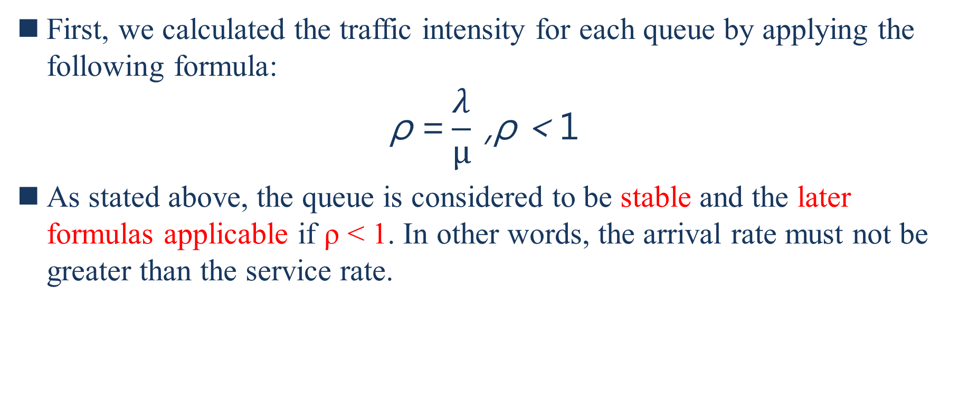
First, we calculated the traffic intensity for each queue by applying the following formula:
$$\text{ρ} \text{=}\frac{λ}{µ} \text{,}\text{ρ}\text{ < }\text{1}$$
As stated above, the queue is considered to be stable and the later formulas applicable if ρ < 1. In other words, the arrival rate must not be greater than the service rate.
Notes:
首先，我们应用以下公式计算每个队列的traffic强度：$\text{ρ} \text{=}\frac{λ}{µ} \text{,}\text{ρ}\text{ < }\text{1}$
如上所述，如果ρ<1，則隊列被認為是穩定的，並且後面的公式適用。換句話說，到達速率不得大於服務速率。

Slide 76
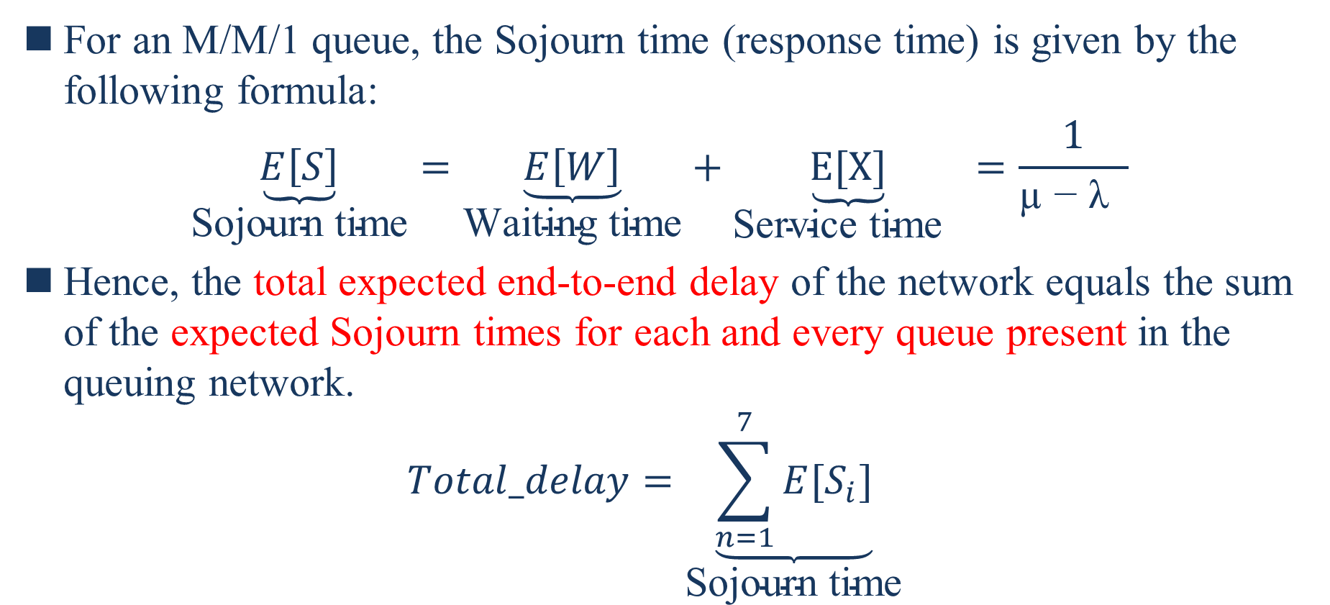
For an M/M/1 queue, the Sojourn time (response time) is given by the following formula:
$$\underset{\text{Sojourn} \text{time}}{\underbrace{E\left[S\right]}}=\underset{\text{Waiting} \text{time}}{\underbrace{E\left[W\right]}}+\underset{\text{Service} \text{time} }{\underbrace{E[X]}}=\frac{1}{\text{µ − }\text{λ} }$$
Hence, the total expected end-to-end delay of the network equals the sum of the expected Sojourn times for each and every queue present in the queuing network.
$$Total_delay=\underset{\text{Sojourn} \text{time}}{\underbrace{\sum_{n=1}^{7}{E[S_{i}]}}}$$
Notes:
對於M / M / 1隊列，通過以下公式給出停留時間（響應時間）：
因此，网络的总预期端到端延迟等于排队网络中每个队列的预期逗留时间之和：

Slide 77
M/G/1 and G/G/1
Consider an IMS based network with K identical servers. It is assumed that the servers experience no loss due to buffer overflows.
The arrival process from outside is assumed to follow a Poisson distribution. When a M/G/1 queuing system is assumed, the service time distribution can be any general distribution like Geometric, Weibull, Gamma, Lognormal, etc.
Notes:
考虑一个具有K个相同服务器的基于IMS的网络。假设服务器不会因缓冲区溢出而丢失。
假设来自外部的到达过程服从Poisson(泊松)分布。当假定M/G/1排队系统时，服务时间分布可以是几何分布、Weibull分布、Gamma分布、对数正态分布等任何一般分布

Slide 78
In case of M/G/1, we can apply M/G/1 to the first queue where the arrival distribution was predefined within the XML scenario to follow a Poisson process. However, its output is basically no more Poisson.
Even though the next queue might have the same arrival rate or inter-arrival time as the first queue, but the other characteristics (e.g. variance) of the input to the next queue is unknown.
Therefore, M/G/1 is a valid method to be applied for the first queue analysis, but not the other queues in the tandem network.
Thus, starting from the second queue in the tandem 3.4, the queues are considered to be G/G/1.
Notes:
在M/G/1的情况下，我们可以将M/G/1应用于第一个队列，其中到达分布是在XML场景中预定义的，以遵循Poisson过程。然而，它的输出基本上不再是泊松。
即使下一个队列可能与第一个队列具有相同的到达率或到达间隔时间，但是下一个队列的输入的其他特征（例如方差）是未知的。
因此，M/G/1是第一个队列分析的有效方法，而不是串联网络中的其他队列。
因此，从串联3.4中的第二个队列开始，队列被认为是G/G/1。

Slide 79
The total end-to-end delay average delay is the sum of each queue in the tandem.
Similarly to the M/M/1 case, all the messages during the connection setup have to traverse through the tandem of queues sequentially.
As mentioned above, the expected Sojourn time is the sum of the expected service and waiting time.
Notes:
总端到端延迟平均延迟是串联中每个队列的总和。
与M/M/1类似，连接设置过程中的所有消息都必须按顺序遍历队列序列。
如上所述，预期逗留时间是预期服务和等待时间的总和。

Slide 80
The expected service time for each queue is known as it was captured from the Wireshark tool.
Regarding the waiting time, we make use of two different formulas to calculate the waiting time for all the queues within the tandem.
Notes:
每个队列的预期服务时间称为从Wireshark工具捕获的时间。
关于等待时间，我们使用两个不同的公式来计算串联中所有队列的等待时间。

Slide 81
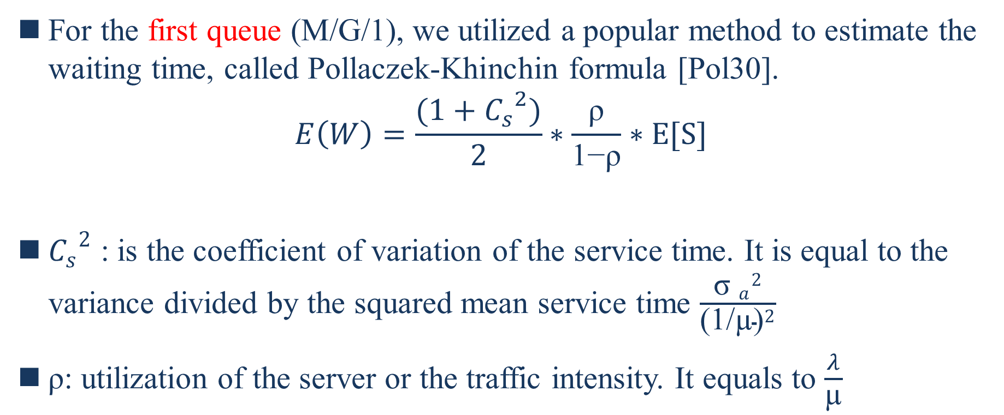
For the first queue (M/G/1), we utilized a popular method to estimate the waiting time, called Pollaczek-Khinchin formula [Pol30].
$$E\left(W\right)=\frac{(1+{C_{s}}^{2})}{2}∗\frac{\text{ρ}}{\text{1−}\text{ρ}}∗E[S]$$
${C_{s}}^{2}$ : is the coefficient of variation of the service time. It is equal to the variance divided by the squared mean service time $\frac{{{\text{σ} }_{a}}^{2}}{{\text{(1/µ)}}^{2}}$
ρ: utilization of the server or the traffic intensity. It equals to $\frac{λ}{\text{µ}}$
Notes:
对于第一个队列（M/G/1），我们使用了一种流行的方法来估计等待时间，称为Pollaczek Khinchin公式[Pol30]。
${C_{s}}^{2}$是服務時間的變化係數。
ρ:服務器的利用率或流量強度。

Slide 82
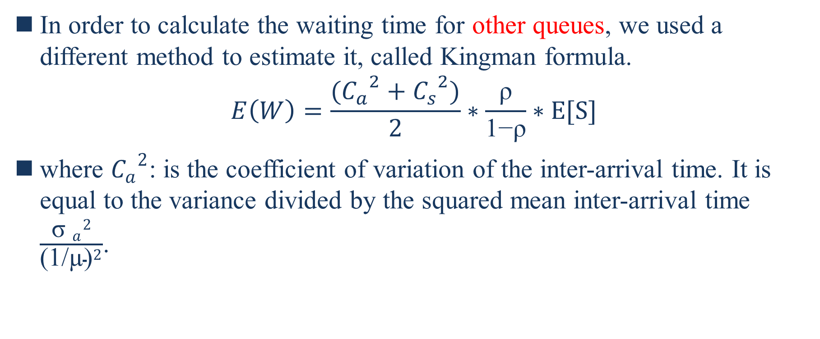
In order to calculate the waiting time for other queues, we used a different method to estimate it, called Kingman formula.
$$E\left(W\right)=\frac{({C_{a}}^{2}+{C_{s}}^{2})}{2}∗\frac{\text{ρ}}{\text{1−}\text{ρ}}∗E[S]$$
where ${C_{a}}^{2}$: is the coefficient of variation of the inter-arrival time. It is equal to the variance divided by the squared mean inter-arrival time $\frac{{{\text{σ} }_{a}}^{2}}{{\text{(1/µ)}}^{2}}$.
Notes:
为了计算其他队列的等待时间，我们使用了一种不同的方法来估计它，称为Kingman公式。
其中${C_{a}}^{2}$：是到達間隔時間的變化係數。 它等於方差除以平均到達間隔時間的平方$\frac{{{\text{σ} }_{a}}^{2}}{{\text{(1/µ)}}^{2}}$。

Slide 83
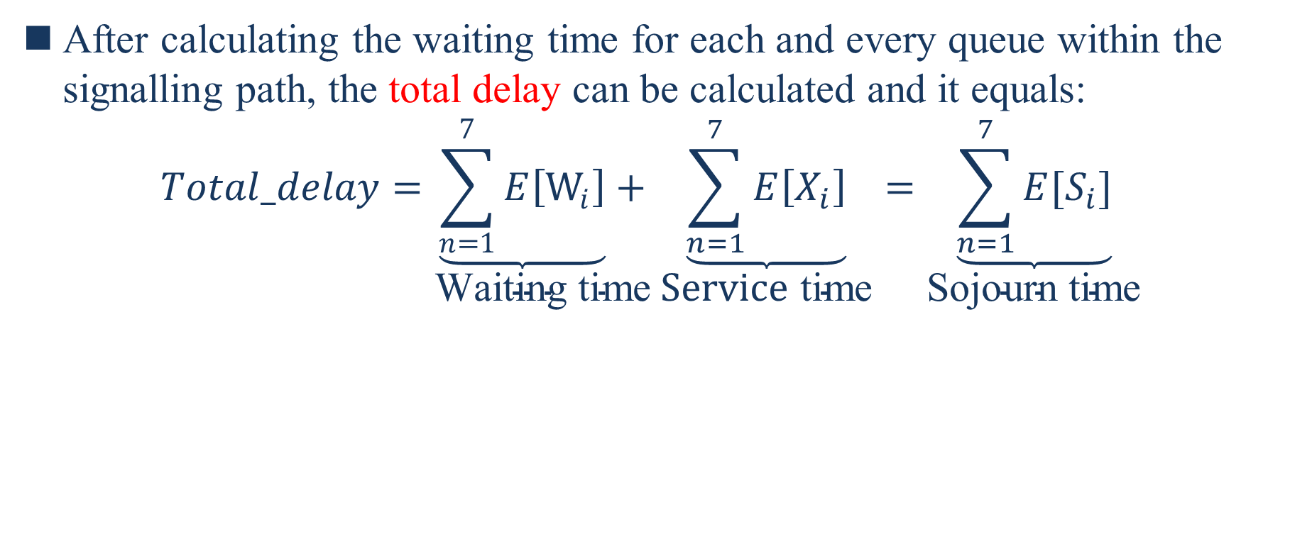
After calculating the waiting time for each and every queue within the signalling path, the total delay can be calculated and it equals:
$$Total_delay=\underset{\text{W}\text{aiting} \text{time}}{\underbrace{\sum_{n=1}^{7}{E\left[W_{i}\right]}}+}\underset{\text{Service} \text{time}}{\underbrace{\sum_{n=1}^{7}{E\left[X_{i}\right]}}}=\underset{\text{Sojourn} \text{time}}{\underbrace{\sum_{n=1}^{7}{E[S_{i}]}}}$$
Notes:
在计算信令路径中每个队列的等待时间之后，可以计算总延迟，它等于：

Slide 84
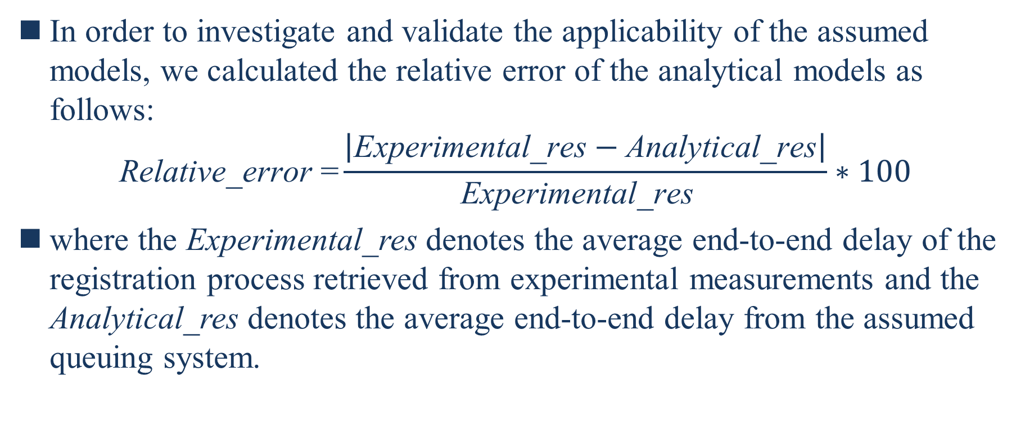
In order to investigate and validate the applicability of the assumed models, we calculated the relative error of the analytical models as follows:
$$\text{Relative}\text{_}\text{error}\text{ =}\frac{\left|\text{Experimental}\text{_}\text{res}−\text{Analytical}\text{_}\text{res}\right|}{\text{Experimental}\text{_}\text{res} }∗100$$
where the Experimental_res denotes the average end-to-end delay of the registration process retrieved from experimental measurements and the Analytical_res denotes the average end-to-end delay from the assumed queuing system.
Notes:
为了研究和验证假设模型的适用性，我们计算了分析模型的相对误差如下：
其中Experimental_res表示從實驗測量中檢索到的註冊過程的平均端到端延遲，而Analytical_res表示從假定排隊系統得到的平均端到端延遲。

Slide 85
Results and Discussion
All the introduced delay results represent the average delay for fifty different measurements.
A single measurement consists in capturing the average system delay of performing the registration of 2000 subscribers for a specific registration rate, i.e., 20, 50 Reg/sec etc.
Notes:
所有引入的延迟结果表示50个不同测量的平均延迟。
单次测量包括捕获在特定注册率（即20、50 Reg/sec等）下执行2000个订户的注册的平均系统延迟。

Slide 86
Average Registration Delay
The X axis represents several values of arrival rates for different values of RAM allocated to the Sprout component.
The Y axis is the average system time of 2000 registrations measured in ms.
We observed that the trends in the average registration delay witness a significant increment when increasing the arrival rate across several environment settings with different constraints.
Notes:
X轴表示分配给Sprout组件的不同RAM值的到达率的多个值
Y轴是2000次注册的平均系统时间，单位为ms。
我们观察到，在不同的约束条件下，当到达率增加时，平均注册延迟的趋势显著增加。

Slide 87
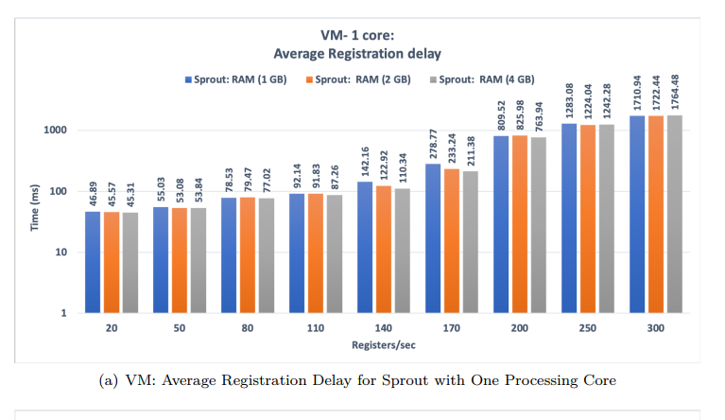
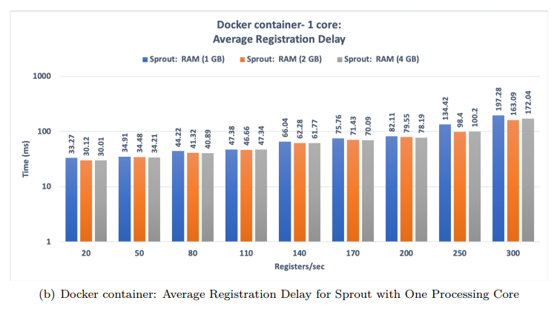
Notes:
对于内核上专用于Sprout 4.1（a）的VMs，平均注册延迟从大约46ms开始，到最后达到1700ms以上。这是由于缺乏处理能力。
我们在这里观察到，当具有固定的注册率时，RAM的数量对性能的影响几乎可以忽略不计。因此，就系统延迟而言，分配少量RAM不会产生明显的增益。
另一方面，分配给Sprout 4.1（b）的On-processing核心的Docker容器的平均延迟大约从33毫秒到200毫秒不等。
很明显，Docker容器每秒可以处理更多请求，平均延迟比虚拟机更好。

Slide 88
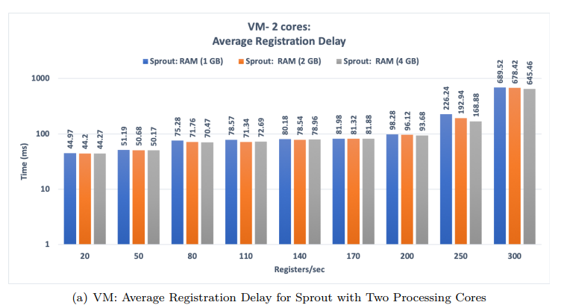

Notes:
将两个处理核心专用于VMs使平均延迟下降到小于700ms，如图4.2（a）所示。当到达率大于110时，具有更大处理能力的效果尤其明显。
对DockerContainer4.2（b）应用相同的设置比平均延迟稍有提高，但与VMs相比仍然没有那么多。到达率最大值处的平均延迟达到约125ms。确实，分配更多的处理功率将改善系统的性能，但这与不断增加的成本相结合。

Slide 89
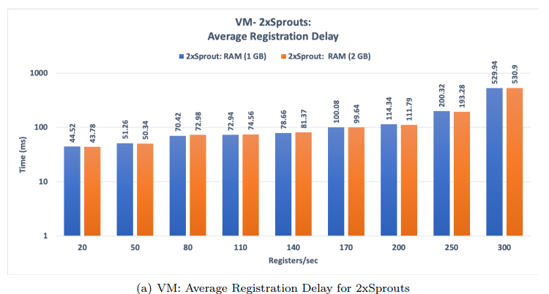
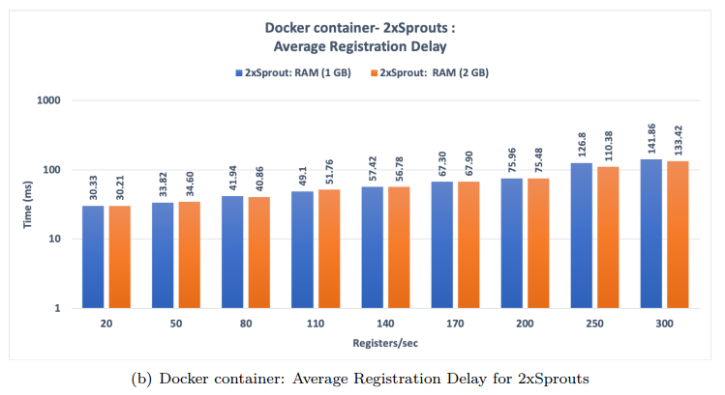

Slide 90
Having two separated instances of Sprout had almost the same impact on the average delay as having two dedicated cores assigned for Sprout.
We measured the average delay when each of the Sprout instances has one GB of RAM, and then two GB of RAM.
In case of VMs, the delay starts from around 45 ms and goes up to 530 ms at 300 registers per second. Whereas, Docker containers have a maximum delay of 142 ms when it is most loaded.
To conclude, scaling up Sprout has a performance close to that provided by two processing cores, but it is advantageous when high availability and fault tolerance are desired.
Notes:
拥有两个Sprout实例对平均延迟的影响几乎与拥有两个分配给Sprout的专用内核的影响相同。
我们测量了当每个Sprout实例都有1 GB的RAM，然后是2 GB的RAM时的平均延迟。对于VMs，延迟从大约45ms开始，以每秒300个寄存器的速度增加到530ms。然而，Docker容器在最大负载时的最大延迟为142ms。
综上所述，扩展sprot的性能接近于两个处理核所提供的性能，但是当需要高可用性和容错性时，它是有利的。

Slide 91
To summarize, Docker containers provide better average delay through all the environment's settings compared to VMs.
Notes:
总而言之，Docker容器在整个环境的设置中提供了比虚拟机更好的平均延迟。
这在一定程度上是意料之中的，因为hypervisor虚拟化在来宾操作系统之间包含了一个附加层以及物理硬件资源，即hypervisor本身。
由于存在内存开销，Docker容器的服务时间较短，这意味着它们每秒可以处理更多的流量。

Slide 92
Average CPU Utilization
All the figures showing the CPU utilization of Sprout have a similar upward trends.
The Y axis indicates the percent CPU utilization.
The X axis represents the arrival rate values.
Notes:
所有显示spreat的CPU利用率的数据都有类似的上升趋势。
Y轴表示CPU利用率的百分比。X轴表示到达率值。

Slide 93
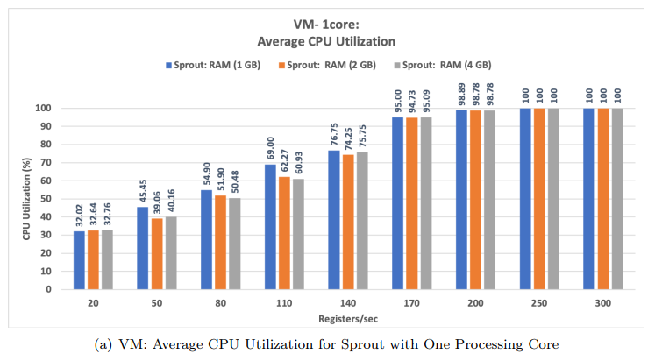
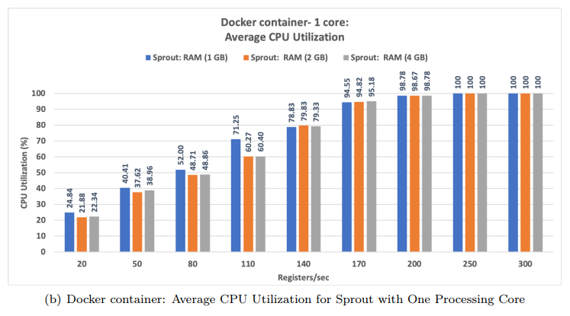
Notes:
从图4.4中，我们观察到Docker容器和虚拟机在配备一个处理核心时提供了几乎相似的CPU利用率。
当到达率接近时，Docker容器和虚拟机都达到饱和状态。

Slide 94
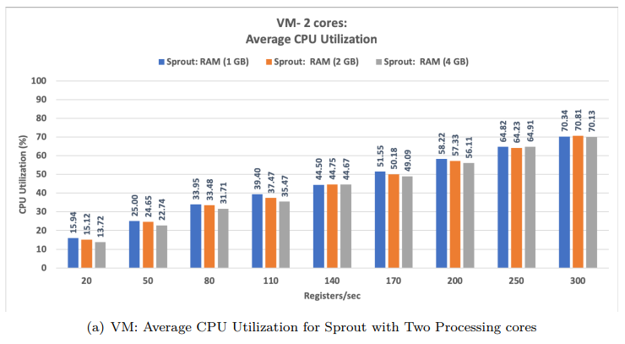
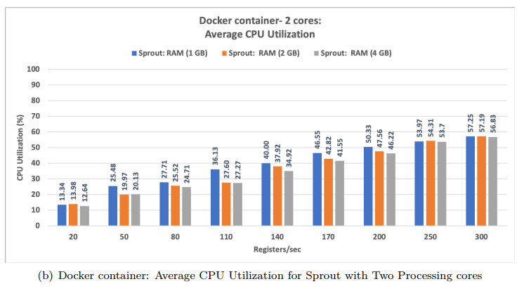
Notes:
增加Sprout的处理核心数量可以显著提高Docker容器和vm的CPU利用率。
对于vm，当它主要是加载时，CPU消耗减少到71%左右，如图4.5（a）所示。
對於Docker容器，它們見證了CPU利用率4.5（b）的大幅下降，並且當它們實際上處於最密集的流量之下時，它們的消耗為57％。
圖4.5是比較Docker容器和VM的CPU消耗的好例子。 顯然，在不同的RAM和到達率設置下，Docker容器可提供最少的CPU使用率。

Slide 95
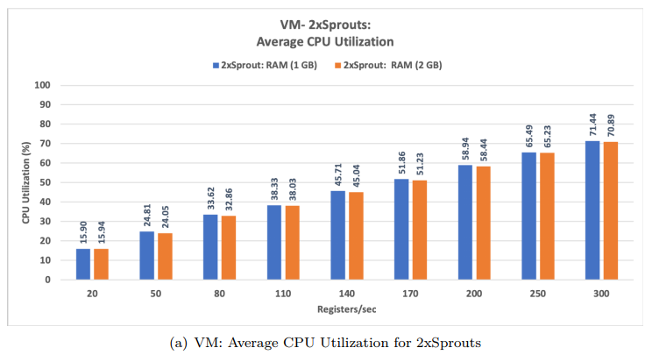
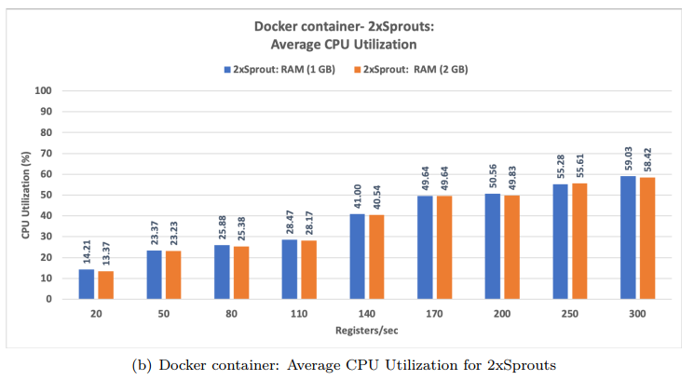
Notes:
最后一个环境设置（有两个sprot实例）输出的CPU消耗量略高于sprot有两个专用内核时提供的CPU消耗量，如图4.6所示。
VM的CPU消耗從16％左右開始，然後以最大到達率值大幅增加到71％。 在不同的環境設置下，儘管Docker容器的CPU使用率在14％到60％之間波動。
再次，圖4.6顯示，在CPU消耗方面，Docker容器優於VM，因為在每個環境設置中都擊敗了VM。

Slide 96
Average RAM Utilization
With regard to the RAM utilization, we considered one environment setting where Sprout has one processing core.
VMs provides less memory consumption as the RAM utilization did not exceed 50% of the total available RAM.
In terms of Docker containers, Sprout consumes the entire available RAM when it is equipped with one GB of RAM.
Notes:
关于RAM的使用率，我们考虑了Sprout有一个处理核心的环境设置。
VMs提供更少的内存消耗，因为RAM利用率不超过总可用RAM的50%。
在Docker容器方面，Sprout在配备1 GB RAM时会消耗整个可用RAM。

Slide 97
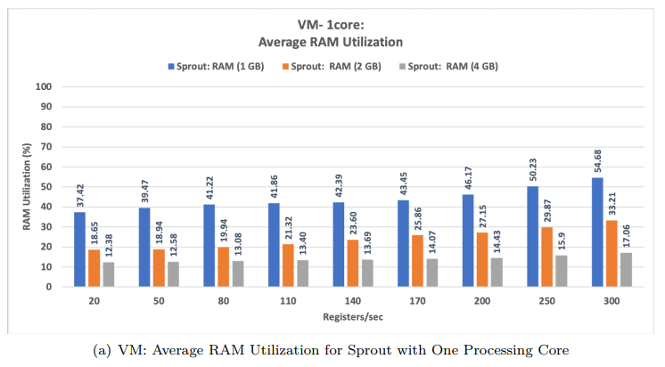
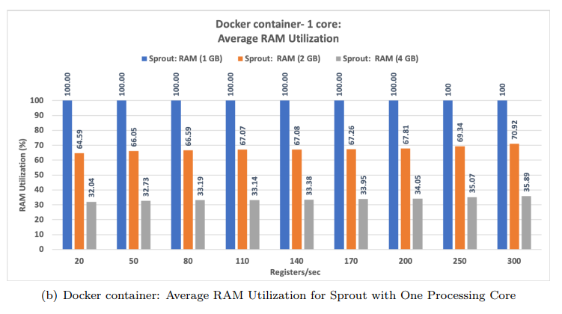
Notes:
VMs提供更少的内存消耗，因为RAM利用率不超过总可用RAM的50%。
在Docker容器方面，Sprout在配备1 GB RAM时会消耗整个可用RAM。

Slide 98
CPU needs to access the RAM memory whenever it has to write or read to or from the RAM.
Having no available RAM will reflect negatively on the speed of writing and reading operations which might result in a greater delay during the registration process.
Notes:
CPU需要访问RAM内存，无论何时它必须写入或读取RAM。
没有可用的RAM将对写入和读取操作的速度产生负面影响，这可能导致注册过程中出现更大的延迟。

Slide 99
This section introduces the analytical results of M/M/1 and M/G/1 & G/G/1 for VMs and Docker containers.
The relative error, which shows how much the experimental result differs from the analytical result, is confined to 25%.
Notes:
本节介绍VMs和Docker容器的M/M/1和M/G/1&G/G/1分析结果。
实验结果与分析结果的相对误差控制在25%以内。

Slide 100
VMs
Figure 4.8 shows the relative error between the experimental and analytical results for M/M/1 and M/G/1.
We have three values of the arrival rate fulfill the stability condition where ρ < 1. M/M/1 seems to provide appropriate results until 50 Reg/sec.
On the contrary, M/G/1& G/G/1 outputs a better relative error starting from 5.19 % when the arrival rate is 20 Registers per second, and ends at 8.39 % at the maximum value of arrival rate. The relative error of M/G/1 & G/G/1 over the all values of arrival rates did not exceed 10 %.
Notes:
图4.8显示了M/M/1和M/G/1的实验和分析结果之间的相对误差。
我们有三个到达率值满足稳定性条件，其中ρ<1。M/M/1似乎可以提供适当的结果，直到50 Reg/sec。
相反，M/G/1&G/G/1在到达速率为每秒20个寄存器时，从5.19%开始输出更好的相对误差，在到达速率的最大值处以8.39%结束。M/G/1&G/G/1的相对误差不超过10%。

Slide 101
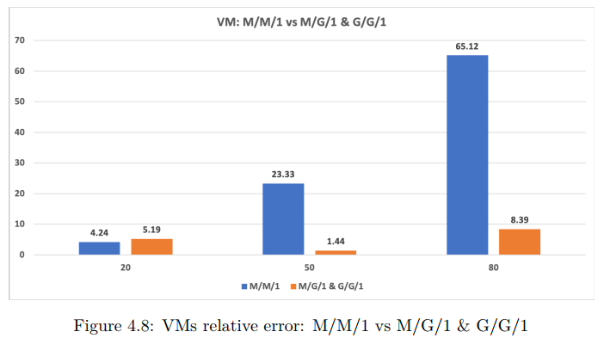

Slide 102
Therefore, M/G/1 & G/G/1 is a valid method to model the subscriber registration process of ClearWater deployed on VMs, and it provides a minimal relative error.
M/M/1 might be used if the queue utilization is around half.
Notes:
因此，M/G/1&G/G/1是对部署在VMs上的ClearWater的用户注册过程进行建模的有效方法，它提供了最小的相对误差。
如果队列利用率约为一半，则可以使用M/M/1。

Slide 103
Docker containers
Figure 4.9 shows the relative error between the experimental and analytical results for M/M/1 and M/G/1 & G/G/1.
With regard to M/M/1, the relative error starts from around 5.53% and ends at 49.78%. Therefore, M/M/1 outputs adequate results until 50 Registers per second.
The M/G/1 combined with G/G/1 relative error starts from 11.83 %, and it fluctuates reaching a 0.29 % at the end.
Notes:
图4.9显示了M/M/1和M/G/1&G/G/1的实验结果和分析结果之间的相对误差。
对于M/M/1，相对误差从5.53%左右开始，到49.78%结束。
M/G/1与G/G/1组合的相對誤差從11.83％開始，並最終波動至0.29％。

Slide 104
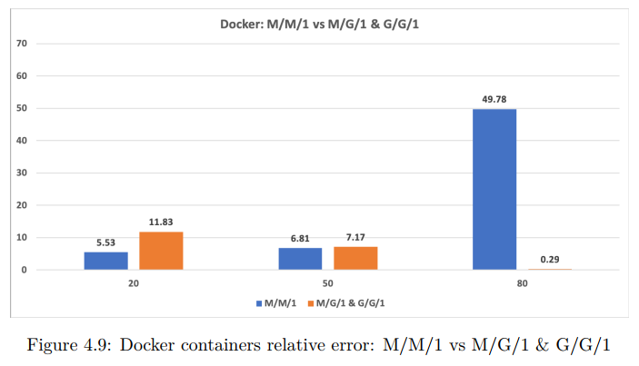

Slide 105
Hence, M/G/1 & G/G/1 is a sufficient method to model the studied process when ClearWater is deployed on top of Docker containers.
Notes:
因此，當將ClearWater部署在Docker容器之上時，M / G / 1和G / G / 1是一種適當對研究過程進行建模的方法。

Slide 106
Service Time Distribution Fitting for M/G/1 & G/G/1
As stated previously, the service time measurement was done for a sample size of one hundred times.
Then, the average for each service time was calculated. We used Matlab to define the service time distribution for each component in the signaling path: Bono, Sprout, and Homestead.
Distribution fitting is a process that aims to select a statistical distribution that best fits a set of data.
Notes:
如前所述，服務時間的測量是針對一百次樣本量進行的。然後，計算每個服務時間的平均值。
我們使用Matlab為信令路徑中的每個組件（Bono，Sprout和Homestead）定義服務時間分配。
分佈擬合是旨在選擇最適合一組數據的統計分佈的過程。

Slide 107
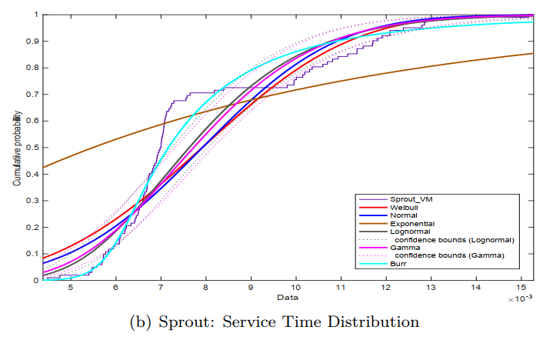
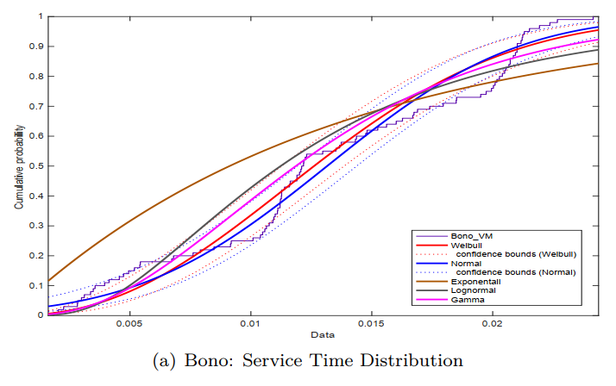
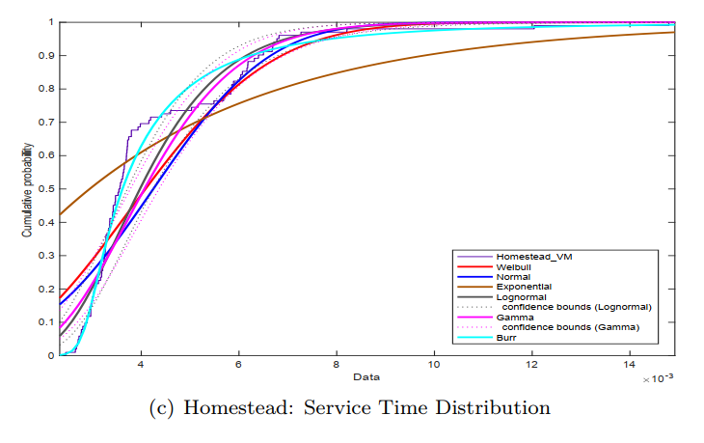
Notes:
圖4.10和4.11顯示了實驗數據的實際服務時間累積分佈以及置信區間為95％的各種分佈。
出於說明目的，我們在最適合數據的分佈上添加了置信區間界限。
如圖所示，我們選擇將經驗分佈擬合為最流行的統計分佈：Weibull，Normal (正態)，Log-normal (對數正態)，Gamma (伽瑪)和 Exponential(指數)。

Slide 108
However, through a closer investigation, we noticed that for most of fittings, the Burr Type XII distribution outperforms the other distributions.
The Burr type XII distribution is a three-parameter family of distributions on the positive real line. It is a very ’flexible’ distribution that can fit a wide range of empirical data. Different values of its parameters cover a broad set of skewness and kurtosis.
Notes:
但是，通過更深入的調查，我們發現對於大多數fittings，Burr Type XII分佈優於其他分佈。
Burr XII分佈是正實線上的三參數分佈族。這是一個非常“靈活”的分佈，可以適應廣泛的經驗數據。其參數的不同值涵蓋了廣泛的偏度和峰度。

Slide 109
In addition, the plotting of the cumulative distributions gives an estimation of the model correctness but in cases where more than one distribution may reasonably fit the data, a visual model selection may not be sufficient.
To this end, we made use of the well-known Akaike Information Criterion (AIC) estimator.
It is an estimator of the relative quality of statistical distribution for a set of data values. The distribution with the smallest AIC value is the preferred model.
Notes:
另外，累積分佈圖可以估算出模型的正確性，但是在一個以上的分佈可能合理地擬合數據的情況下，視覺模型的選擇可能不夠。
为此，我们使用了著名的Akaike信息准则（AIC）估计量。
它是一组数据值的统计分布相对质量的估计量。AIC值最小的分布是最优模型。

Slide 110
Due to the fact that our sample sets of the service distributions are limited to 100 values, we make use of the revised version of AIC, i.e., AIC-corrected.
This is to avoid any over/under-fitting due to a small set of sample values.
Notes:
由于我们的服务分布样本集被限制为100个值，所以我们使用了AIC的修订版，即AIC修正版。
这是为了避免由于一组小样本值而导致的任何过度/不足拟合。

Slide 111
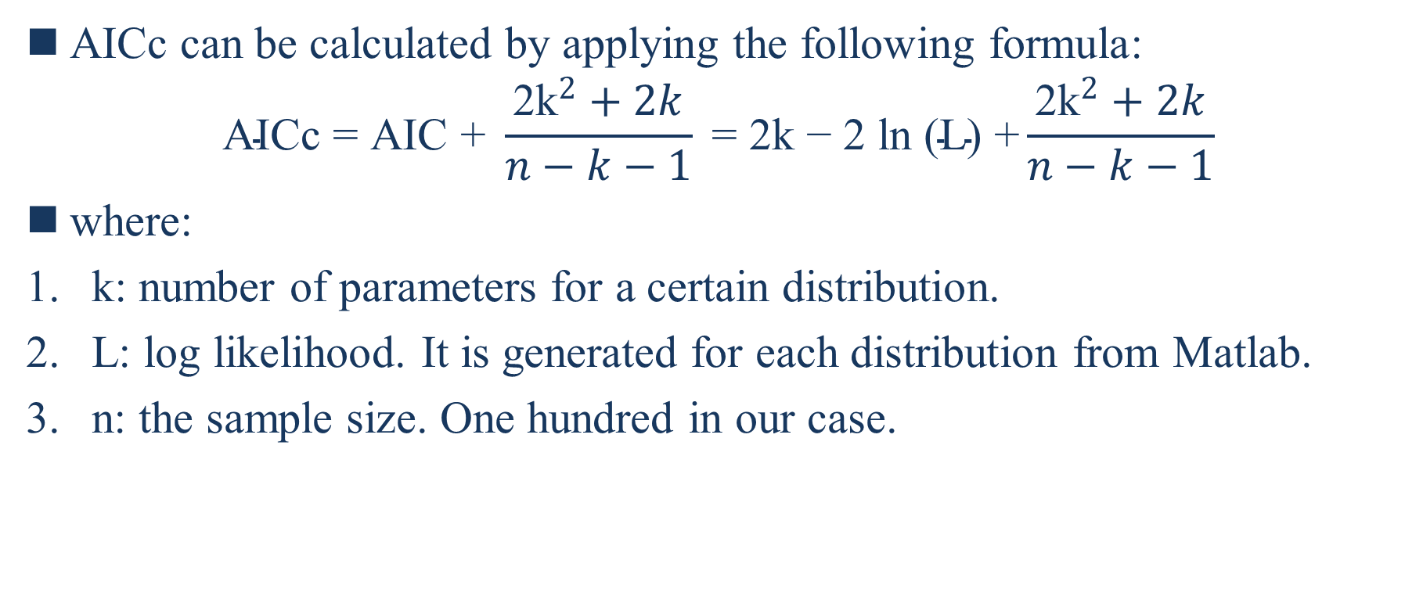
AICc can be calculated by applying the following formula:
$$\text{AICc}\text{ = }\text{AIC}\text{ + }\frac{{\text{2}\text{k}}^{2}+2k}{n−k−1}\text{ = 2}\text{k}\text{ − 2 }\text{ln}\text{ (}\text{L}\text{) +}\frac{{\text{2}\text{k}}^{2}+2k}{n−k−1}$$
where:
k: number of parameters for a certain distribution.
L: log likelihood. It is generated for each distribution from Matlab.
n: the sample size. One hundred in our case.
Notes:
AICc可通过应用以下公式计算：
1. k：一個固定分佈的參數數量。 2. L：對數似然。 它是從Matlab為每個發行版生成的。 3. n：樣本量。 在我們的情況下是一百。

Slide 112
Matlab has a bunch of commands to quickly calculate the AICc, or it can be done by writing a simple code in any programming language.
After calculating the AICc, the selected distributions for each of VMs and Docker components are shown in Table 4.1.
Notes:
Matlab有很多命令可以快速计算AICc，也可以用任何编程语言编写一个简单的代码来完成。
计算AICc后，VMs和Docker组件的选定分布如表4.1所示。

Slide 113
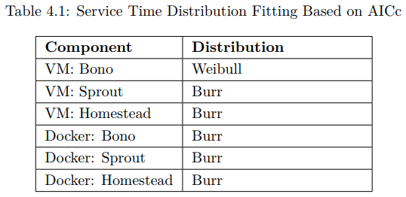

Slide 114
Inter-Arrival Time Distribution Fitting for M/G/1 & G/G/1
The input of the next queue is no more Poisson, and we chose to apply G/G/1 to analyze other queues in the tandem network. Each queue was considered as a single G/G/1 queue.
Similar to the service time distribution fitting above, we performed a distribution fitting for the inter-arrival times of the queues in the tandem.
Figures 4.12, 6.1, 4.13, and 6.2 show the distribution fitting of the experimental data to the most popular statistical distributions: Weibull, Normal, Exponential, Lognormal, and Gamma. A confidence interval bounds of 95% was added distributions that most fits the data.
Notes:
下一个队列的输入不再是Poisson，我们选择用G/G/1来分析串联网络中的其他队列。每个队列被视为一个G/G/1队列。
与上面的服务时间分布拟合类似，我们对串联队列的到达间隔时间进行了分布拟合。
图4.12、6.1、4.13和6.2显示了实验数据与最流行的统计分布的分布拟合：威布尔分布、正态分布、指数分布、对数正态分布和伽马分布。
信賴區間为95%的边界被添加到最适合数据的分布中。

Slide 115
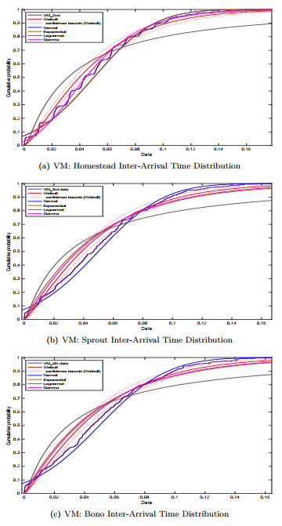
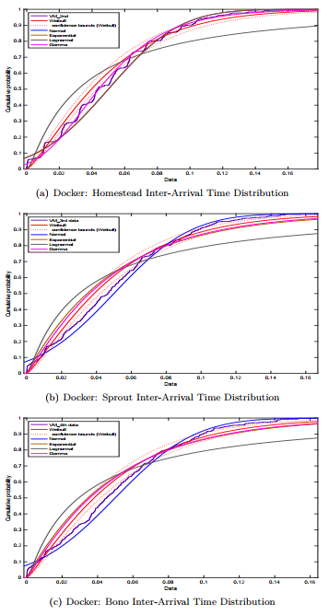

Slide 116
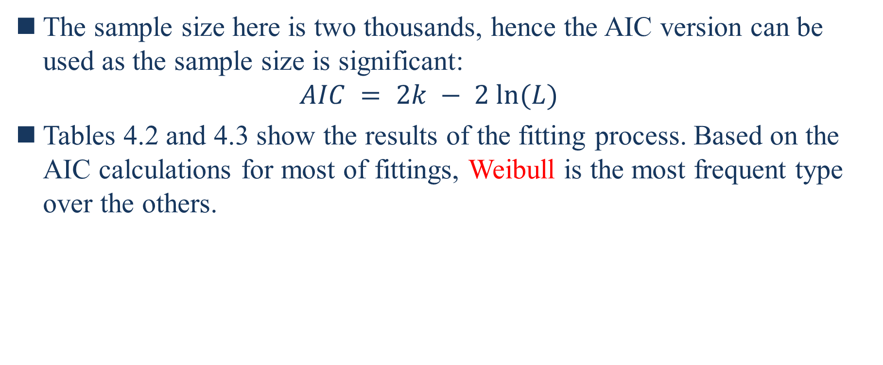
The sample size here is two thousands, hence the AIC version can be used as the sample size is significant: $AIC = 2k − 2 ln(L)$
Tables 4.2 and 4.3 show the results of the fitting process. Based on the AIC calculations for most of fittings, Weibull is the most frequent type over the others.
Notes:
这里的样本量是2000，因此可以使用AIC版本，因为样本量很重要：
表4.2和4.3显示了拟合过程的结果。根据大多数fitting的AIC计算，Weibull(歪bo)是最常见的类型。

Slide 117
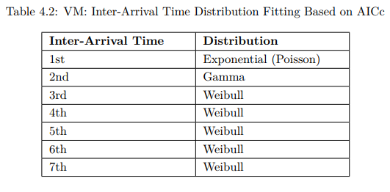
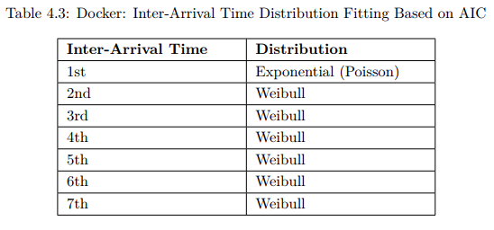

Slide 118
Conclusion and Future Work
In this project, we experimentally and analytically studied the performance of the initial subscriber registration process for a virtualized IMS, called ClearWater. We considered two popular virtualization technologies to deploy ClearWater: VM and Docker containers.
According to the experimental analysis, Docker containers produced lower average delay, and consumed less processing power.
For this specific use case, VMs utilized less memory compared to Docker containers. A lack of adequate RAM can result in slowing down CPU or disabling operations from execution.
Notes:
在这个项目中，我们实验和分析地研究了虚拟化IMS（称为ClearWater）的初始订户注册过程的性能。我们考虑了两种流行的虚拟化技术来部署ClearWater：VM和Docker容器。
根据实验分析，Docker容器产生的平均延迟较低，消耗的处理能力较小。
对于这个特定的用例，VMs比Docker容器占用更少的内存。缺乏足够的RAM会导致CPU速度减慢或使操作无法执行。

Slide 119
In addition, the project discussed the impact of varying the CPU power, RAM capacity, arrival rate, and scaling up on the system performance.
Regarding the analytical analysis, two different queuing models were considered: M/M/1 and M/G/1 combined with G/G/1.
M/M/1 is simple to use and it has a direct formula to find the approximation for the average delay in each queue. However, the M/M/1 queuing model did not provide adequate results when the queue utilization factor (ρ) is around 0.6.
Notes:
此外，该项目还讨论了改变CPU功率、RAM容量、到达率和扩展对系统性能的影响。
在分析方面，考虑了两种不同的排队模型：M/M/1和M/G/1与G/G/1的组合。
M/M/1算法使用简单，并且有一个直接的公式来计算每个队列中平均延迟的近似值。然而，当队列利用率（ρ）在0.6左右时，M/M/1排队模型并没有提供足够的结果。

Slide 120
On the contrary, assuming general distributions for the service process, i.e., M/G/1 & G/G/1, which requires definite first and second moments, outputs better results compared to M/M/1 as the relative error did not exceed 12 % for any single value of the arrival rates that meets the stability condition.
Therefore, M/G/1 & G/G/1 is the recommended method to model the user registration process of ClearWater as the relative error is minimal.
Notes:
相反，假设服务过程的一般分布，即M/G/1&G/G/1，需要确定的第一和第二时刻，与M/M/1相比输出更好的结果，因为满足稳定条件的到达率的任何单个值的相对误差不超过12%。
因此，在相对误差最小的情况下，M/G/1&G/G/1是建立ClearWater用户注册过程模型的推荐方法。

Slide 121
The project is open for many future works where other attributes can be studied or another queuing model can be used.
One suggestion here is to study the call flow parameters such as end-to-end delay, resource consumption, and successful and failure rates.
Notes:
该项目是开放的许多未来的工作，其他属性可以研究或其他排队模型可以使用。
这里的一个建议是研究呼叫流参数，如端到端延迟、资源消耗、成功率和失败率。

Slide 122
References
[BBY15] Chaithanya Bandi, Dimitris Bertsimas, and Nataly Youssef. Robust queueing theory. Operations Research, 63(3):676–700, 2015.
[BCC+15] Roberto Bonafiglia, Ivano Cerrato, Francesco Ciaccia, Mario Nemirovsky, and Fulvio Risso. Assessing the performance of virtualization technologies for nfv: A preliminary benchmarking. 2015 Fourth European Workshop on Software Defined Networks, 2015.
[cle] Clearwater docker. https://github.com/Metaswitch/clearwater-docker.
[CW18] Wei-Kuo Chiang and Juin-Wei Wen. Design and experiment of nfv-based virtualized ip multimedia subsystem. 2018.
[Doc18] Docker. What is a container. https://www.docker.com/resources/what-container, 2018.

Slide 123
[ETS13a] ETSI. Network functions virtualisation (nfv); architectural framework. https://www.etsi.org/deliver/etsi_gs/NFV/001_099/002/01.01.01_60/gs_NFV002v010101p.pdf, October 2013.
[ETS13b] ETSI. Nfv white paper. https://portal.etsi.org/nfv/nfv_white_paper2.pdf, October 2013.
[ETS13c] GSNFV ETSI. Network functions virtualisation (nfv); use cases. V1, 1:2013–10, 2013.
[FCP06] Hanane Fathi, Shyam S Chakraborty, and Ramjee Prasad. Optimization of sip session setup delay for voip in 3g wireless networks. IEEE Transactions on Mobile Computing, 5(9):1121–1132, 2006.

Slide 124
[Jej18] Fredrik Jejdling. Ericsson mobility report. https://www.ericsson.com/assets/local/mobilityreport/documents/2018/ericssonmobility-report-november-2018.pdf, November 2018.
[Kin61] J. F. C. Kingman. The single server queue in heavy traffic. Mathematical Proceedings of the Cambridge Philosophical Society, 57(4):902–904, 1961.
[MG10] A. Munir and A. Gordon-Ross. Sip-based ims signaling analysis for wimax-3g interworking architectures. IEEE Transactions on Mobile Computing, 9(5):733–750, May 2010.
[Mun08] A. Munir. Analysis of sip-based ims session establishment signaling for wimax-3g networks. In Fourth International Conference on Networking and Services (icns 2008), pages 282–287, March 2008.

Slide 125
[NC13] Network Functions Virtualisation NFV and Use Cases. Etsi gs nfv 001 v1. 1.1 (2013-10). 2013.
[Neta] Metaswitch Networks. Clearwater. http://www.projectclearwater.org/.
[Netb] Metaswitch Networks. Clearwater. https://clearwater.readthedocs.io/en/stable/.
[NSV17] Priyanka Naik, Dilip Kumar Shaw, and Mythili Vutukuru. Nfvperf: Online performance monitoring and bottleneck detection for nfv. 2017.
[NTN13] L. Nagy, J. Tombal, and V. Novotny. Proposal of a queueing model for simulation of advanced telecommunication services over ims architecture. In 2013 36th International Conference on Telecommunications and Signal Processing (TSP), pages 326–330, July 2013.

Slide 126
[PAR+17] Jonathan Prados-Garzon, Pablo Ameigeiras, Juan J. Ramos-Muñoz, Pilar AndresMaldonado, and Juan M. López-Soler. Analytical modeling for virtualized network functions. CoRR, 2017.
[Pol30] Felix Pollaczek. Über eine aufgabe der wahrscheinlichkeitstheorie. i. Mathematische Zeitschrift, 32(1):64–100, Dec 1930.
[Rep] Market Research Reports. Global network function virtualization market 2016-2020.
[sip] Sipp. http://sipp.sourceforge.net/.
[SSFS17] Amit Sheoran, Puneet Sharma, Sonia Fahmy, and Vinay Saxena. Contain-ed: An nfv micro-service system for containing e2e latency. 2017.

Slide 127
[SSJ19] Besmir Tola Sachin Sharma, Navdeep Uniyal and Yuming Jiang. On monolithic and microservice deployment of network functions. Accepted in IEEE Netsoft 2019, 2019.
[Sys] GNU Operating System. Gsl - gnu scientific library. https://www.gnu.org/software/gsl/.
[ubu] Ubuntu releases. http://releases.ubuntu.com/trusty/.
[WBBD05] Wei Wu, Nilanjan Banerjee, Kalyan Basu, and Sajal K Das. Sip-based vertical handoff between wwans and wlans. IEEE Wireless Communications, 12(3):66–72, 2005.
[Wea] Weaveworks. Weave scope. https://www.weave.works/docs/scope/latest/installing/.

Slide 128
[Zuk13] Moshe Zukerman. Introduction to queueing theory and stochastic teletraffic models. arXiv preprint arXiv:1307.2968, 2013

